Slide 1
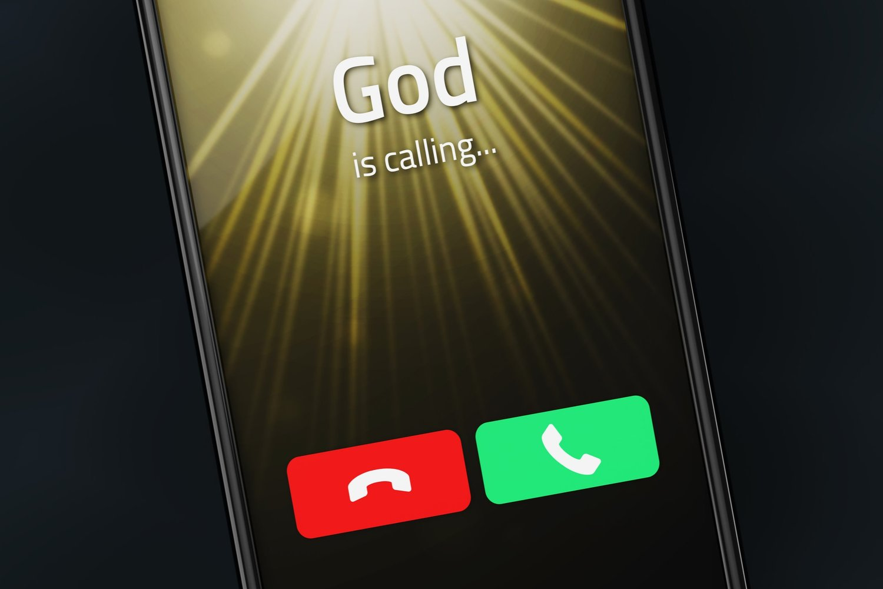
When God Calls
Exodus 3–4
Dr. Rick Griffith • Jordan Evangelical Theological Seminary • BibleStudyDownloads.org

Slide 2
God
is calling...
Dr. Rick Griffith • Jordan Evangelical Theological Seminary • BibleStudyDownloads.org
Notes:
We are all used to ignoring spam calls, but what if God calls us?

Slide 3
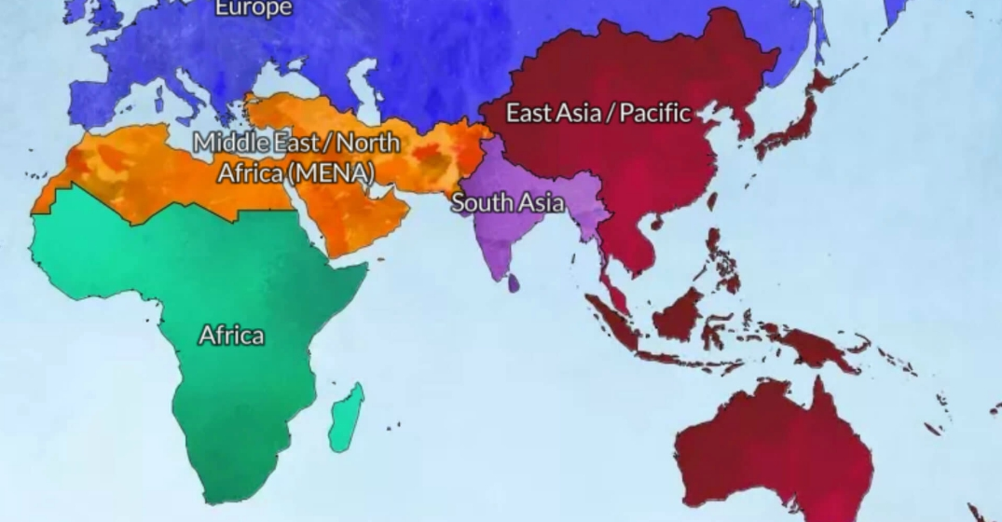
God led us from Asia to MENA in 2021
Jordan
Singapore
Notes:
Susan and I recently addressed this issue when God called us to leave Singapore, where we had served 30 years to switch from the Chinese to the Arab world, based in Jordan.

Slide 4
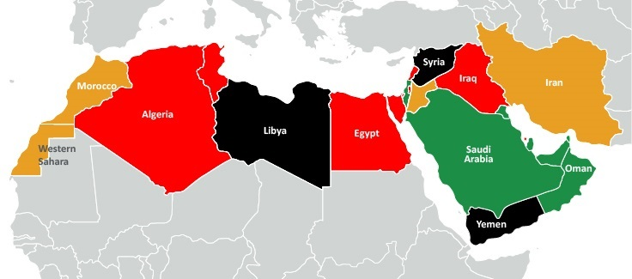
My Students from 11 Nations
Spain
Syria
Morocco
Israel
Iraq
Jordan
Egypt
Dubai
Sudan
Eritrea
Chad
Notes:
Isaiah: Rami (Bible prof in Amman), Jackson (ST prof in Sudan), Jonathan (pastor in Chad), Habil (Hebrew prof? from Sudan in Amman), Amir (Sudanese translator in Amman), Nassef (Egypt), Ayoub (planting church and Bible college as lawyer in Casa Blanca, Morocco), Basem (Egypt), Nassar (Ramallah), Ramzi (Iraq), Dibora (Eritrea)
OT3: Osama (Jordan), Fadi (Syrian trained in Jordan at JETS but translating from Sweden while writing dissertation on Russian theologian for seminary in Belgium), Sara (English teacher in Jordan), Nagat (Egyptian Cru in Spain), Randa (CFO boarding school in Jordan), Jacklin (Jordanian reaching Syrian refugees), Adeeb (Egyptian international church in Dubai), Dani (Arabic apologist in Jordan)
Where serving:
1 Chad—Jonathan
1 Morocco—Ayoub
1 Spain—Nagat
1 Syria—Fadi
1 Dubai—Adeeb
2 Egypt—Nassef, Basem
3 Sudan—Jackson, Habil, Amir
6 Jordan—Rami, Osama, Sara, Randa, Jacklin, Dani
16

Slide 5

God is calling believers today to obey him.
Do you want to follow God’s calling for your life?
Notes:
God is calling believers today to obey him. If he has called you to serve him, raise your hand.
• Do you want to follow God’s calling for your life?
How many of us want to obey the Lord?
Raise your hand again if that includes you.
Good. Willingness is the first step.

Slide 6

How can you follow God’s calling?
Notes:
Now the question is how to obey.

Slide 7
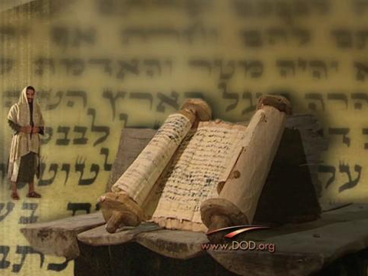
Background to Exodus 3–4
Notes:
Exodus 1–2 shows how God prepared the scene to call his servant Moses in Exodus 3–4.

Slide 8
Slides on
Exodus 1

Slide 9
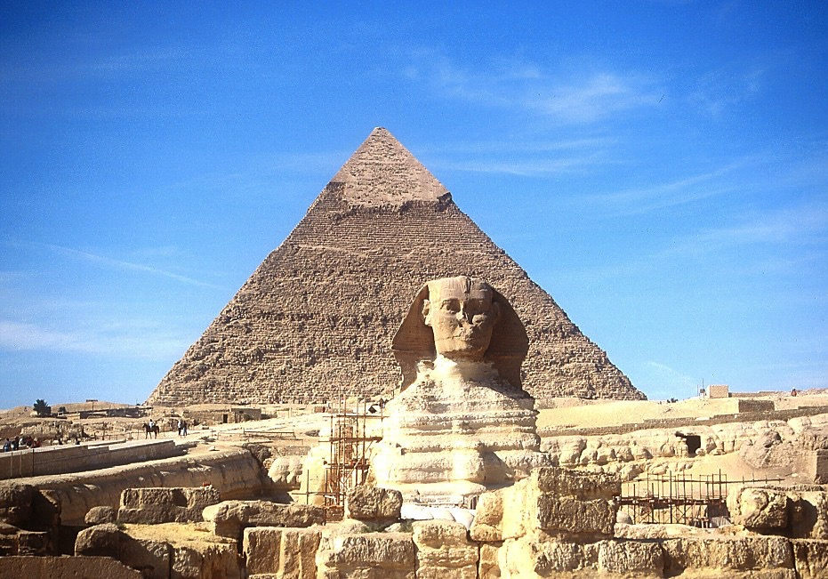
The Sphinx and the Great Pyramid
7
Handbook pg. 24-25
57
Notes:
The Sphinx and the Great Pyramid still visible today remind us of Egypt’s great power.

Slide 10
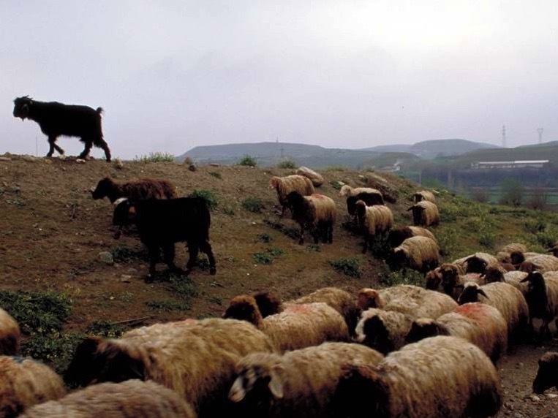
Egyptians Despised Israelites for being Shepherds
Notes:
Egyptians despised the Israelites for being shepherds.

Slide 11
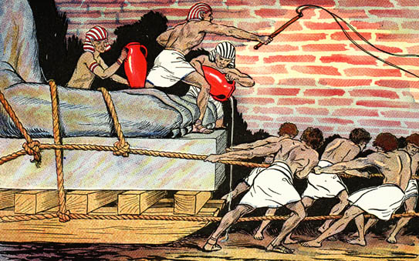
Egyptians Ruthlessly Oppressed Israel

Slide 12
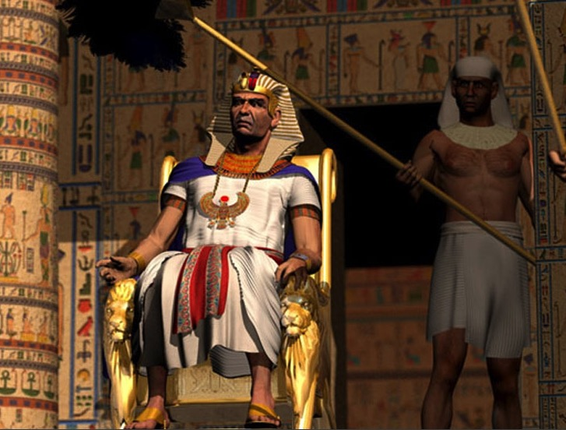
"Ultimate" Power
Notes:
Pharaoh was viewed as the ultimate power.

Slide 13
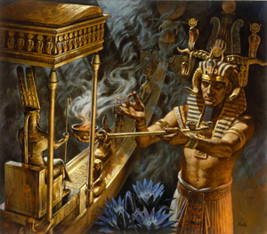
Who has greater power –
Pharaoh or Yahweh?
Notes:
This raised the question of who had the greater power—Pharaoh or Yahweh, the Lord of the Hebrews.

Slide 14
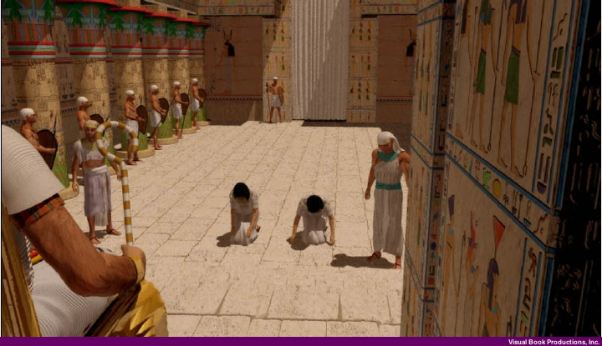
Hebrew Midwives appear before Pharaoh (Exodus 1:15-22)
Notes:
Pharaoh even abused his power by commanding the Hebrew midwives to kill the baby Hebrew boys.

Slide 15
Slides on
Exodus 2

Slide 16
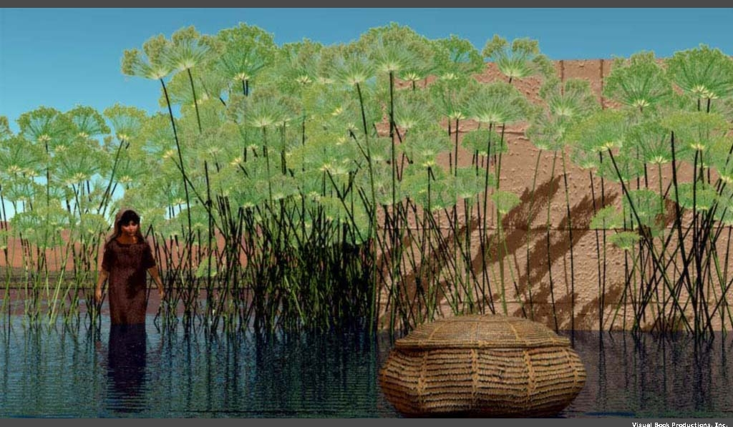
Moses was "thrown into the Nile" (Exod. 1:22)
Notes:
So the mother of Moses “obeyed” Pharaoh’s command and gently tossed Moses into the Nile!

Slide 17

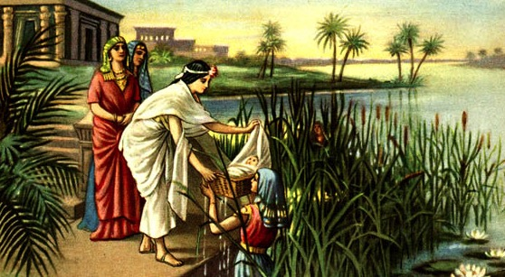
Moses sounds like the Hebrew for draw out (2:10)
Queen Hatshepsut
Notes:
But God worked amazingly so Pharaoh’s own daughter found the baby Moses.

Slide 18
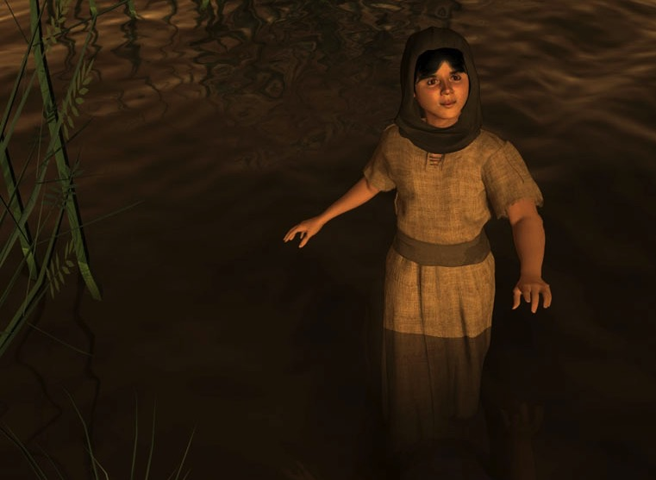
Miriam (Exod. 2:4)
Notes:
God even used Miriam—the older sister of Moses—to pay the mother of Moses to nurse him!

Slide 19
Acts 7:20-21 (NIV)
"At that time Moses was born, and he was no ordinary child. For three months he was cared for in his father's house. When he was placed outside, Pharaoh's daughter took him and brought him up as her own son."
Notes:
Acts 7 notes that Pharaoh’s daughter raised Moses as if he were her own son!

Slide 20

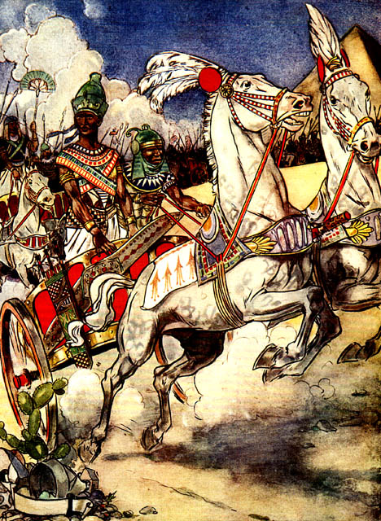
Moses Flees
Thutmose III
Notes:
But Moses grows up and takes matters into his own hands and Pharaoh seeks to kill him, so Moses flees.

Slide 21
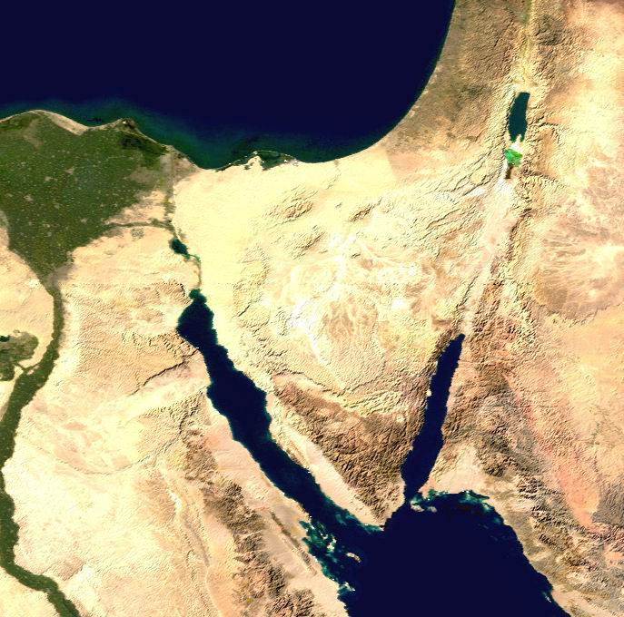
Location of Midian
Canaan
Goshen
Nile River
Mt. Sinai
Egypt
Midian
Notes:
In Exodus 3, we find Moses far away in Midian, traveling to Mount Sinai with his sheep.

Slide 22
How can you follow God’s calling?
How can Moses follow God’s calling?
Notes:
• How can you follow God's calling?

Slide 23
Our role
God's role
Notes:
Today, in Exodus 3–4, we will first see God’s role
• and then our role regarding God’s call on our lives.
We will summarize Exodus 3–4 in two principles relating to (1) God’s calling and (2) our response.

Slide 24
Slides on
Exodus 3
Notes:
(How does the LORD convince us to respond to Him? It starts when…)

Slide 25
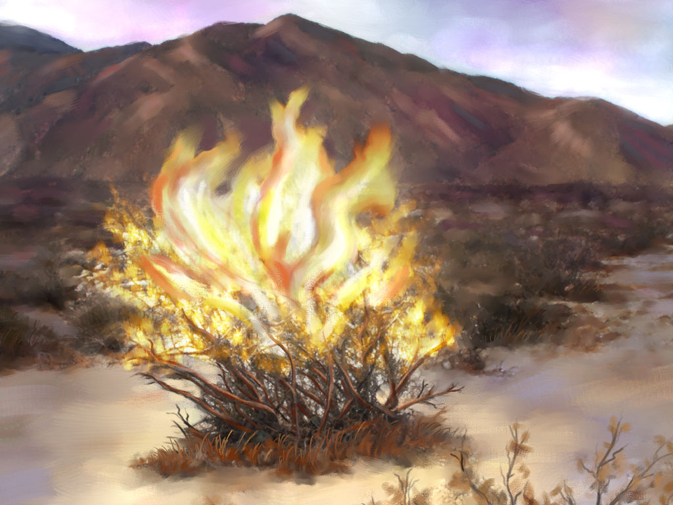
God calls His servant
(Exodus 3)
Notes:
[The Lord tells us to do the impossible to show us our inadequacy and need.]

Slide 26
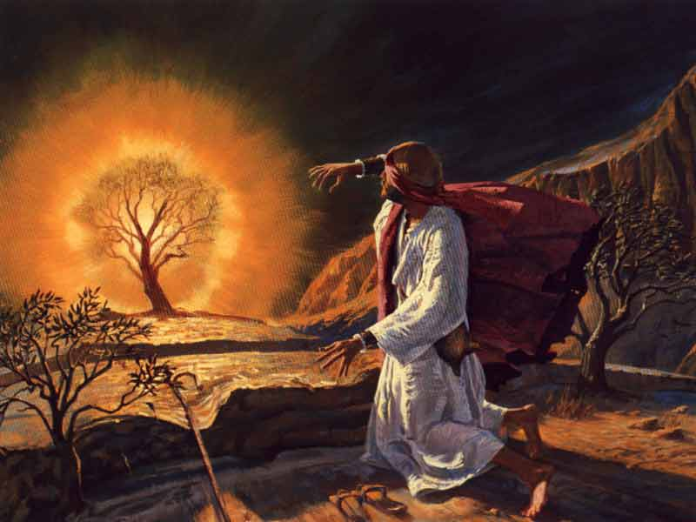
The Burning Bush
(Exod. 3:1–4:17)
Notes:
God called Moses to lead all Israel out of Egypt (3:1-10).

Slide 27
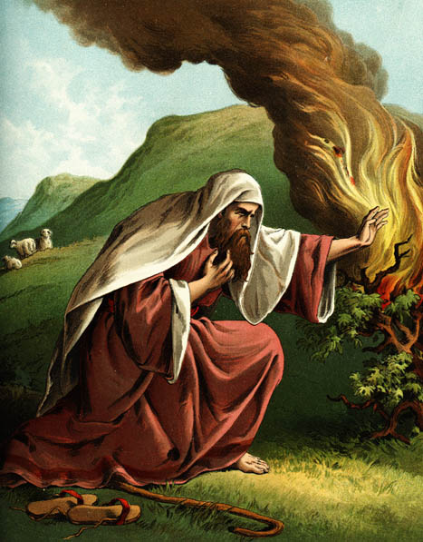
EXCUSES
1. Who am I (3:11)?
Notes:
Moses gave excuses instead of obeying God’s call (3:11–4:17).
• 1. "Who am I?"
This is not a relevant question, but Moses asked it.
God could have focused on Moses, "You are my chosen servant with the perfect balance of 40 years in Egypt and 40 in the wilderness."
But God answered, “I will be with you. And this is your sign that I am the one who has sent you: When you have brought the people out of Egypt, you will worship God at this very mountain” (3:12).

Slide 28
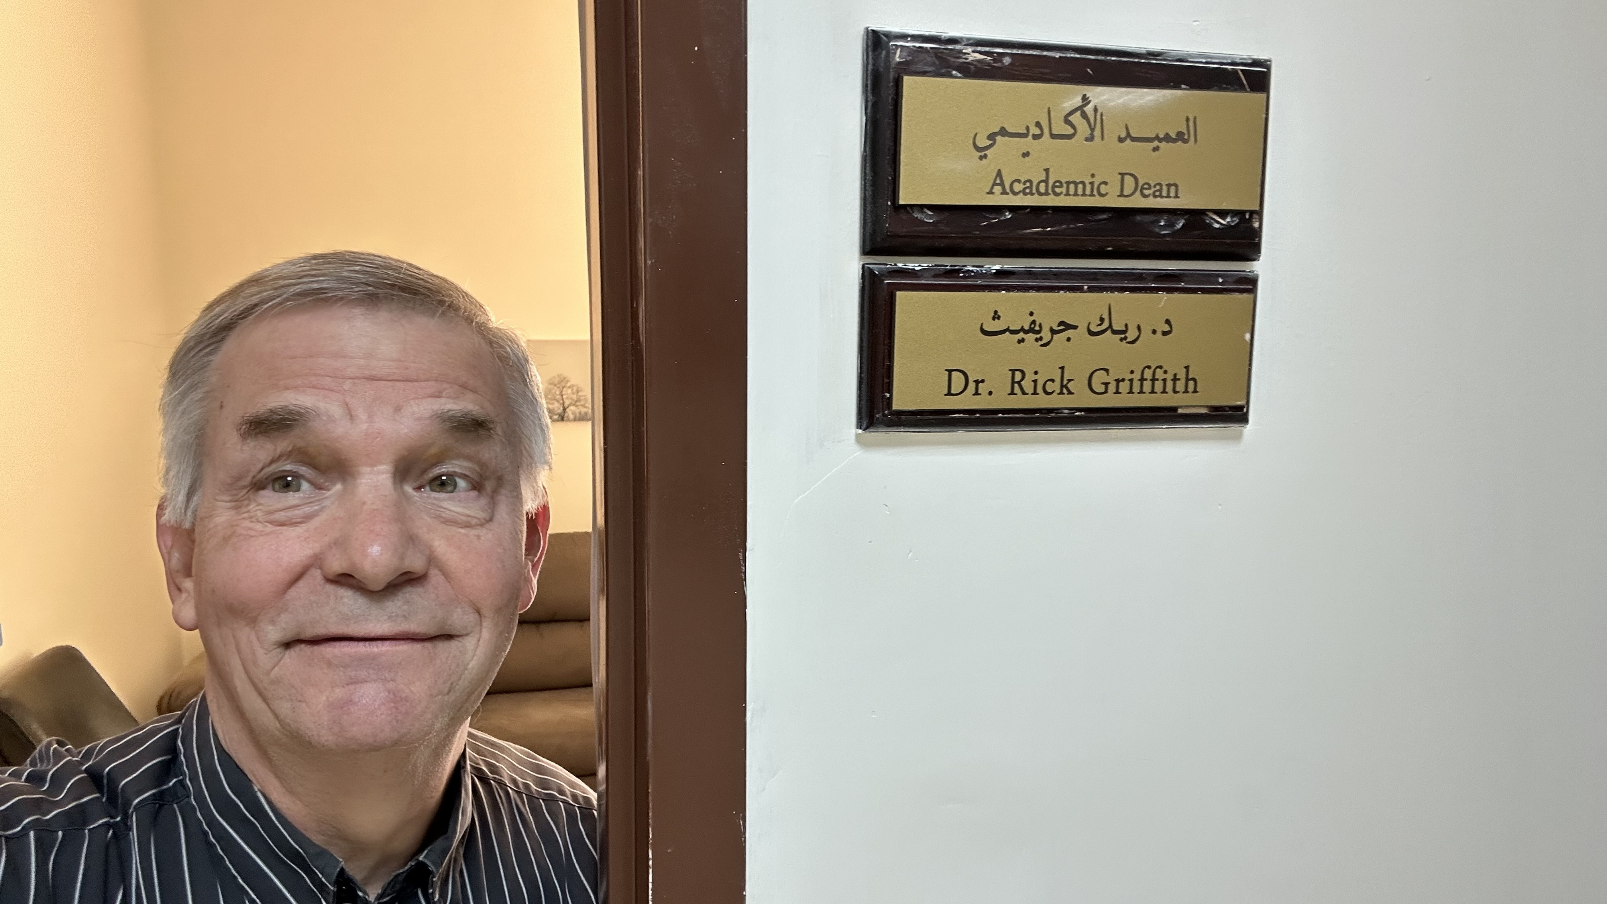
Rick is Now Academic Dean
Notes:
Lately, I've been thinking a lot about God's call, because after we went to Jordan and served for three years, God called me to be the Academic Dean of our seminary. Like Moses, I said, "Who am I to lead these people?"

Slide 29
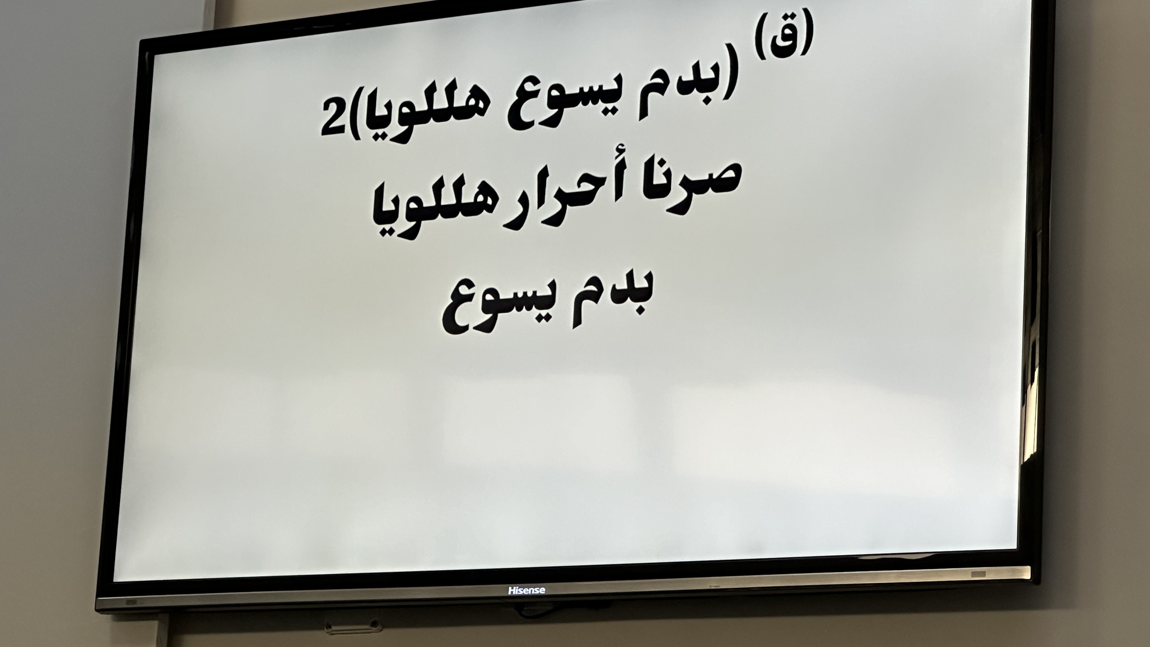
Song in Chapel
Notes:
All the students know Arabic.
All the staff know Arabic.
All the faculty know Arabic.
But I can't even read what we sing in chapel.

Slide 30
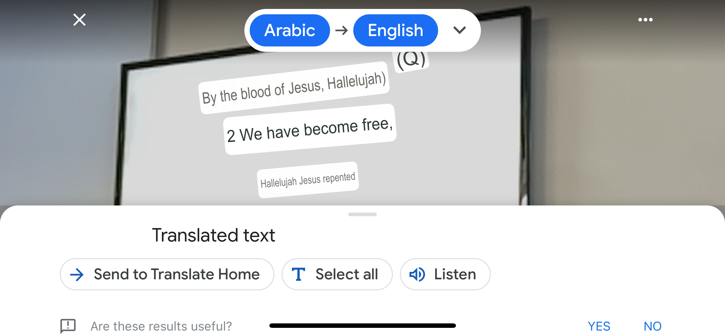
Song in Chapel
Notes:
But God said, "Have you ever heard of Google Translate"? So I use my iPhone in chapel and now see that the song reads, "By the blood of Jesus, Hallelujah. We have become free."
Then it says, "Hallelujah, Jesus repented," so the app still needs some work—and so do I.

Slide 31
EXCUSES
1. Who am I (3:11)?
2. Who are You (3:13)?
"God replied to Moses, 'I Am Who
I Am. Say this to the people of Israel:
I Am has sent me to you'"
(Exodus 3:14 NLT).
Notes:
God didn't accept this excuse of who Moses was.
• 2. So Moses then questioned who God was!
But this wasn't any better an excuse.
• "God replied to Moses, 'I Am Who
I Am. Say this to the people of Israel:
I Am has sent me to you'"
(Exodus 3:14 NLT).

Slide 32
EXCUSES
1. Who am I (3:11)?
2. Who are You (3:13)?
3. What if I fail (4:1)?
Notes:
3. "What if they do not believe me?" is essentially, "What if I fail?"

Slide 33

God Doesn't Call the Qualified
He Qualifies the Called

Slide 34
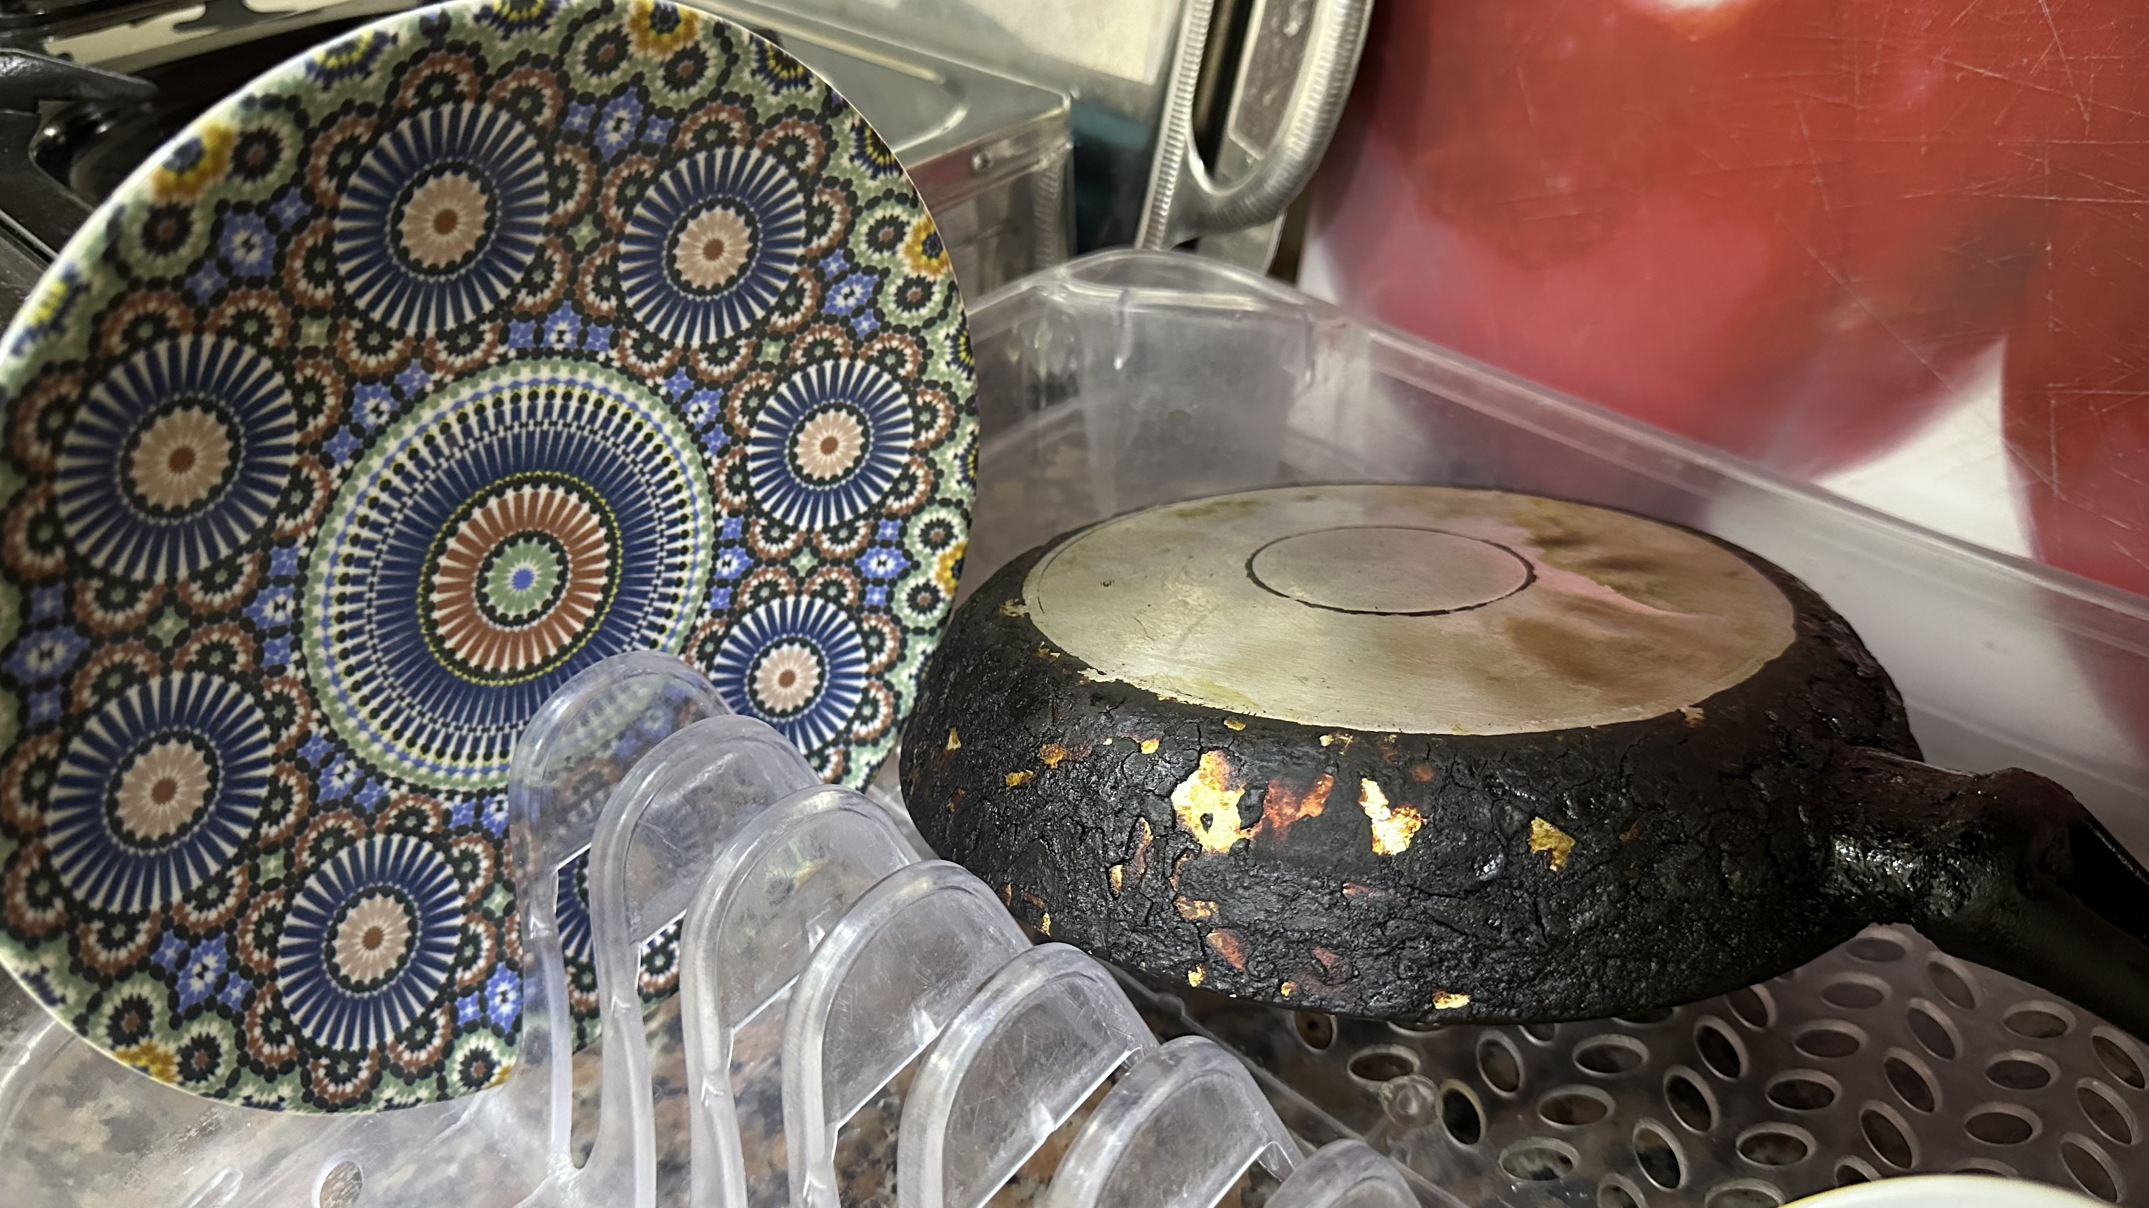
Standards Can Differ
Notes:
I thought of this when I washed my dish at school before we left for the summer. Next to it was a pan that supposedly was clean, but not by my standards! Yet I didn't have to worry about failure to live like the Arabs.

Slide 35
EXCUSES
1. Who am I (3:11)?
2. Who are You (3:13)?
3. What if I fail (4:1)?
4. I'm not gifted (4:10)
Notes:
Ex. 4:10 But Moses pleaded with the LORD, “O Lord, I’m not very good with words. I never have been, and I’m not now, even though you have spoken to me. I get tongue-tied, and my words get tangled.”
This is like saying, “But God, I need a translator!”

Slide 36
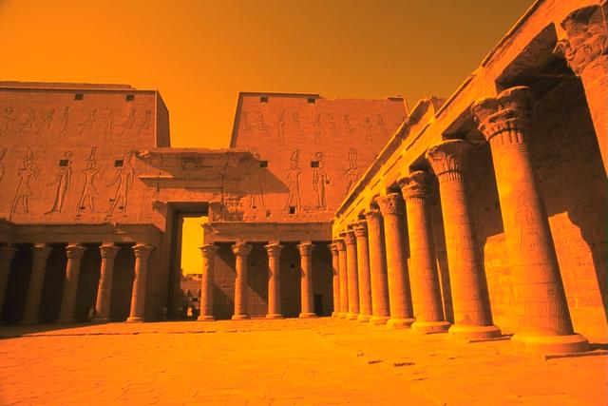
Acts 7:22 (NIV)
"Moses was educated in all the wisdom of the Egyptians and was powerful in speech and action."
Notes:
His self-perception was poor, but Stephen in Acts 7 notes, “Moses was educated in all the wisdom of the Egyptians and was powerful in speech and action."

Slide 37
EXCUSES
1. Who am I (3:11)?
2. Who are You (3:13)?
3. What if I fail (4:1)?
4. I'm not gifted (4:10)
5. I don't want to get involved (4:13)
Notes:
Ex. 4:13 But Moses again pleaded, “Lord, please! Send anyone else.”
This is like saying, “Here am I, Lord! But please, send Aaron!”

Slide 38
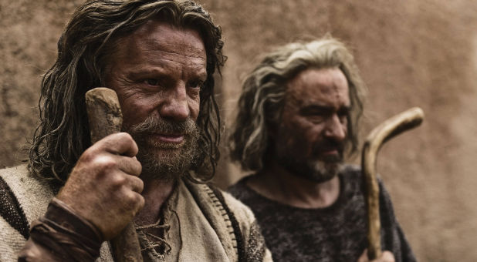
The conversation between Moses and God ended only after Aaron's appointment as ministry partner
(Exod. 4:13-17)
Notes:
In fact, Aaron was already traveling from Egypt to Midian to see Moses.

Slide 39
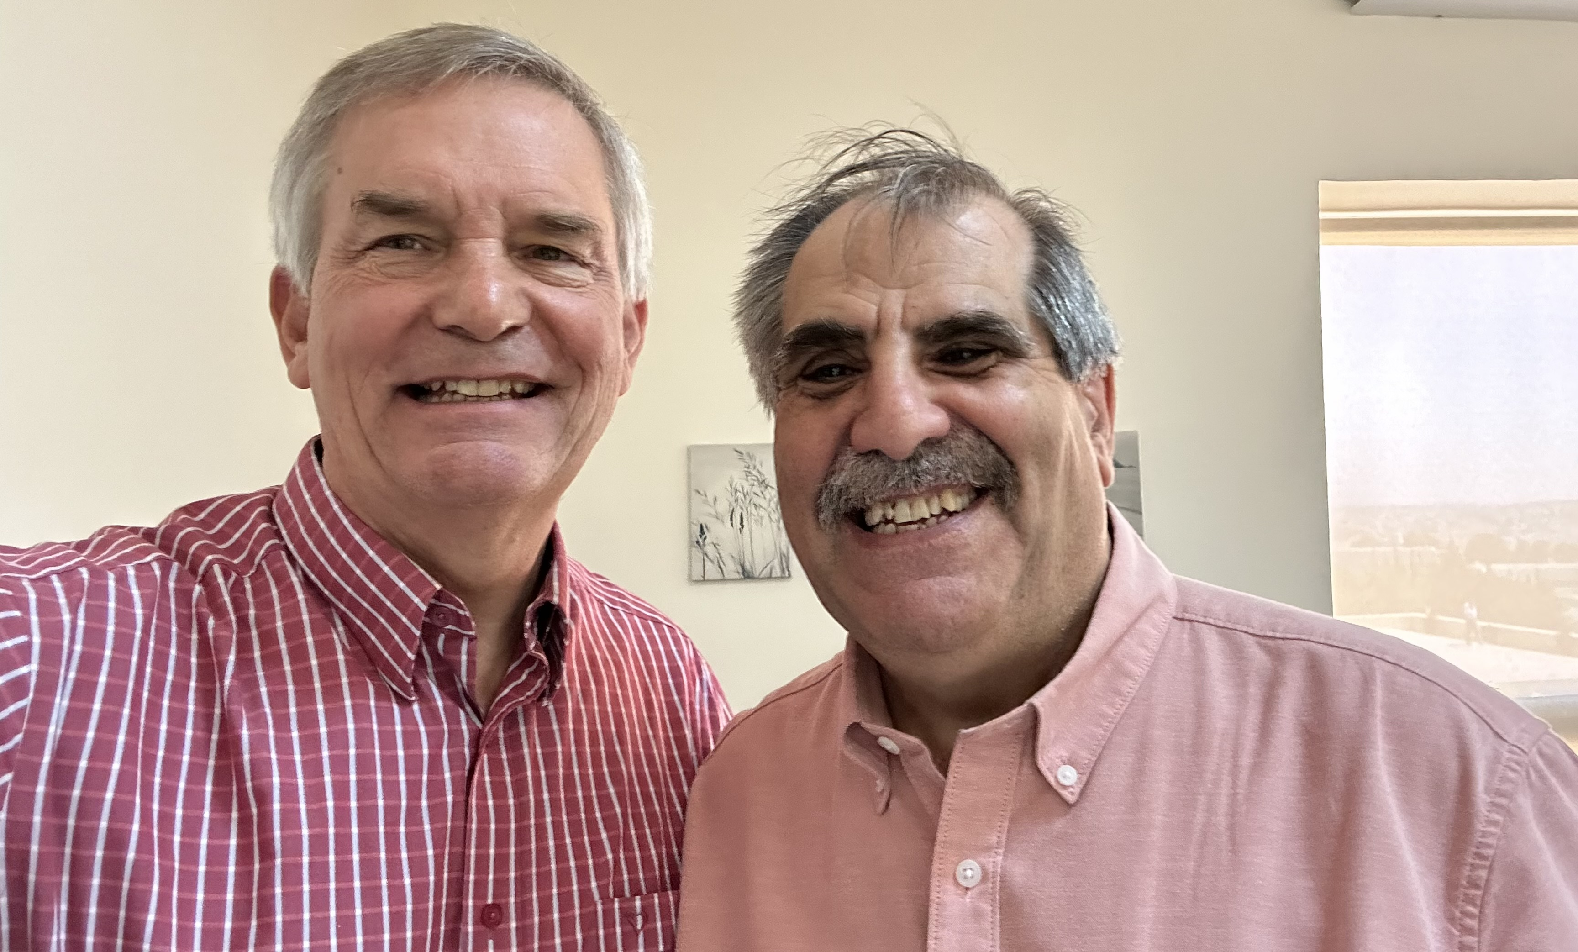
Pastor George Translates
Notes:
So God has gone ahead of me to provide Pastor George as my translator for my classes. And would you believe that my various translators have already provided over 122,000 PPT slides and 6000 pages of notes in Arabic?

Slide 40
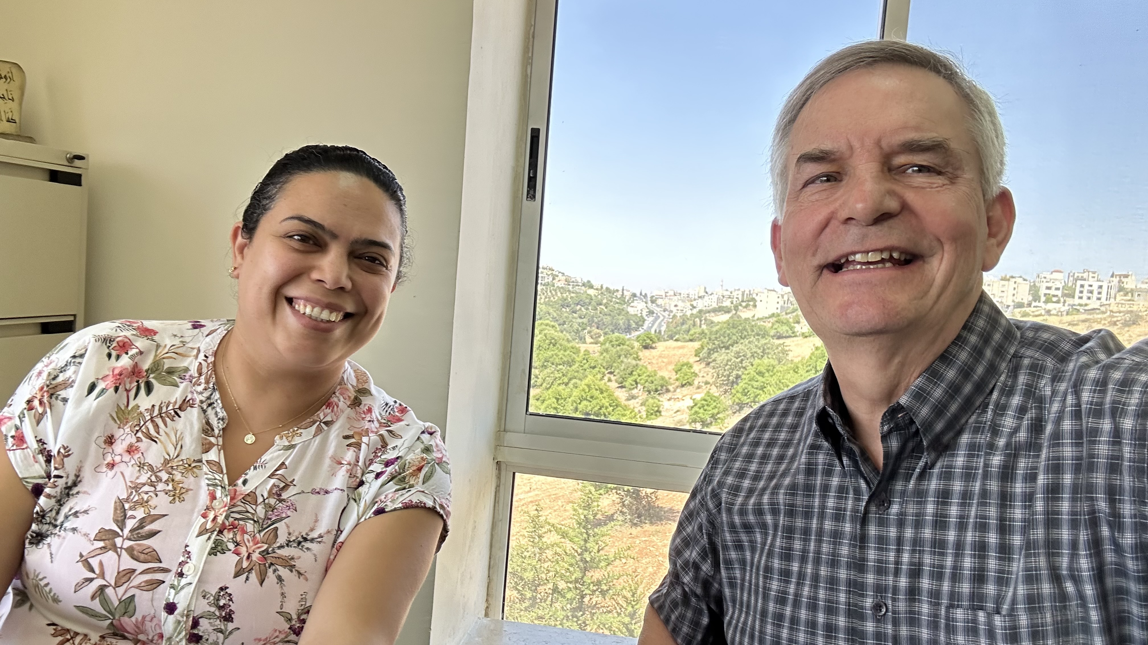
Planning Courses with Caroline

Slide 41
God calls His servant
(Exodus 3)
Notes:
[The Lord tells us to do the impossible to show us our inadequacy and need.]

Slide 42
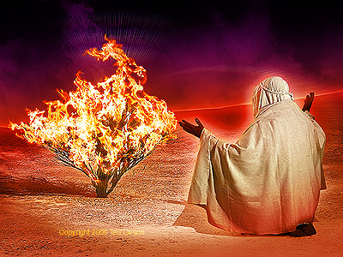
We present ourselves as God's instrument
(Exodus 4:18-31)
Notes:
[Offer yourself to God as an inadequate vessel trusting in God’s sufficiency.]
Moses finally obeyed God’s call by returning to Egypt (4:18-31).

Slide 43
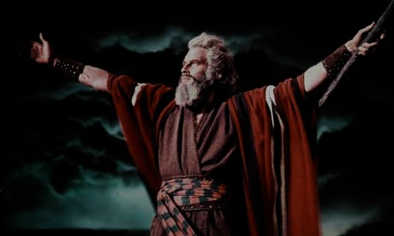
Moses' Life
Period
Reference
Dates
Location
40 years Prince
Exod. 2:1-10
1525-1485 BC
Egypt
(Academic)
40 years Shepherd
Exod. 2:11-25
1485-1445 BC
Midian
(Field Ed.)
40 years Leader
Exod. 3:1– Deut. 34:8
1445-1405 BC
Midian Egypt Wilderness
Notes:
Moses’ life had three distinct periods that helped him see God’s sufficiency.
• To lead Israel, God gifted Moses with a typical lifespan in his era to understand palace life, undoubtedly including speaking Egyptian.
• Yet that would not prepare him to lead two million Israelites in the desert, so God gave Moses another typical lifespan leading sheep in the wilderness.
• God promised that Moses would return to Mount Sinai, so he invested his final 40-year period to lead people wandering in the desert, which was far more complex than leading sheep.
Moses spent the perfect balance of 40 years in the palace and 40 years in the desert, beginning at age 80 when he began his life's most arduous calling.

Slide 44
How can you follow God’s calling?
Notes:
• How can you follow God's calling?

Slide 45
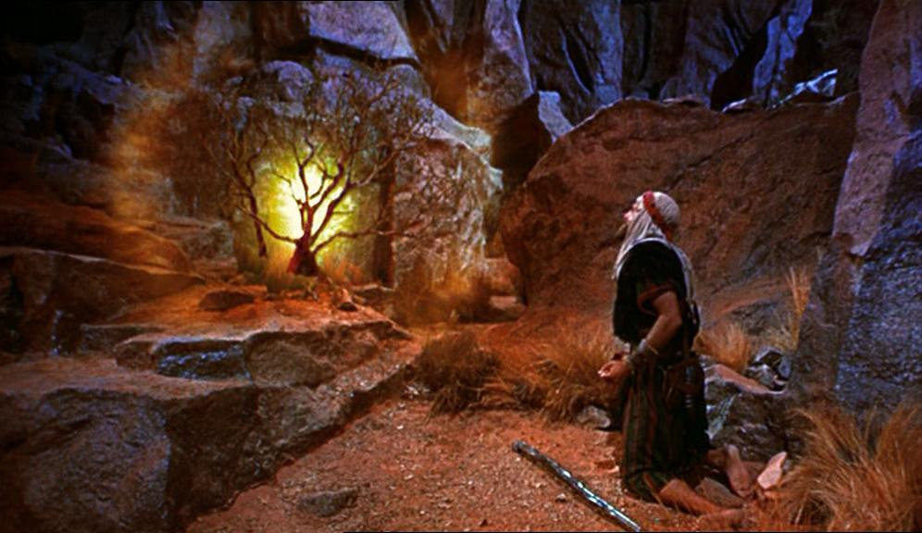
    Admit your inadequacy to know God’s sufficiency.
Main Idea
Notes:
God's servant who understands his own inadequacy will show God's sufficiency
(Exodus 3–4 restated).

Slide 46
Our role
God's role
Notes:
Today, in Exodus 3–4, we will first see God’s role
• and then our role regarding God’s call on our lives.
We will summarize Exodus 3–4 in two principles relating to (1) God’s calling and (2) our response.

Slide 47
God calls His servant
(Exodus 3)
Notes:
[The Lord tells us to do the impossible to show us our inadequacy and need.]

Slide 48
We present ourselves as God's instrument
(Exodus 4:18-31)
Notes:
[Offer yourself to God as an inadequate vessel trusting in God’s sufficiency.]
Moses finally obeyed God’s call by returning to Egypt (4:18-31).

Slide 49
God's Sufficiency Over My Inadequacy
High school witness
High school Bible teacher
Music evangelist in the Philippines
Student at Dallas Seminary
Pastor during seminary
Professor at Singapore Bible College
School planter in Singapore
Church planter in Singapore
Professor at JETS
Academic Dean at JETS
Notes:
Witness at Hayward High School—but my parents opposed it.
Teacher in Barnabas Brothers—but I knew only one more week of the Bible than them.
Music evangelist in Crossroads—but I had never preached before.
Student at DTS—but it took me much more time to learn than it did others.
Pastor at Grace Fellowship—but the people were 75% divorced with many issues.
Professor at Singapore Bible College—but I never fit the academic mold as an author.
School planter at ICS—but I had never had a child in primary school before.
Church planter at CIC—but I had too little time and no idea how to start a church.
Professor at JETS—but I started teaching five days after arrival and have little capacity to learn Arabic.
Academic Dean at JETS—but I am closest to retirement and know Arabic the least of anyone at JETS.

Slide 50
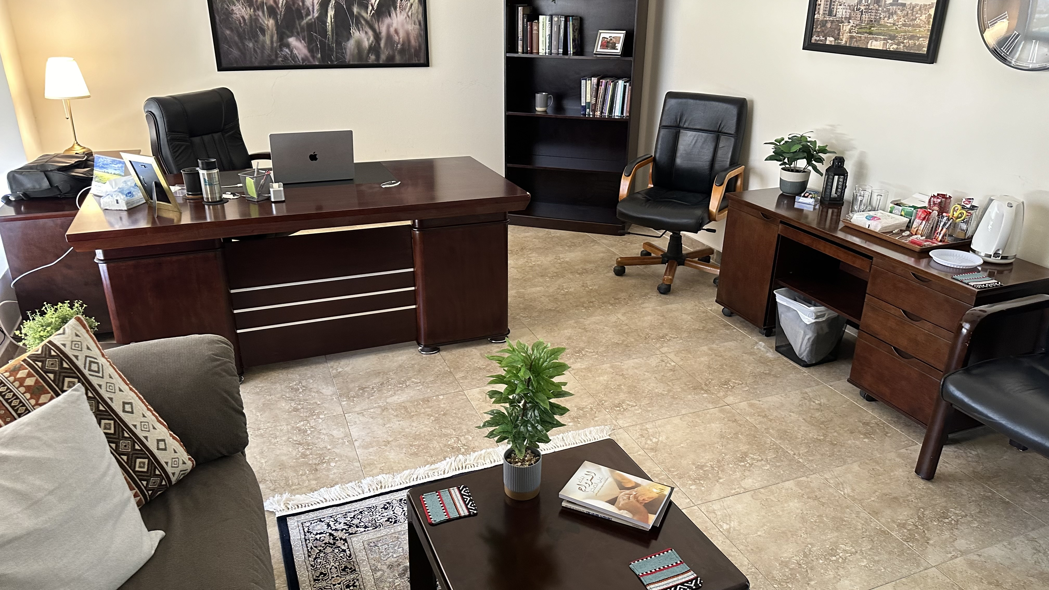
Rick is Now Academic Dean

Slide 51
Rick is Now Academic Dean

Slide 52
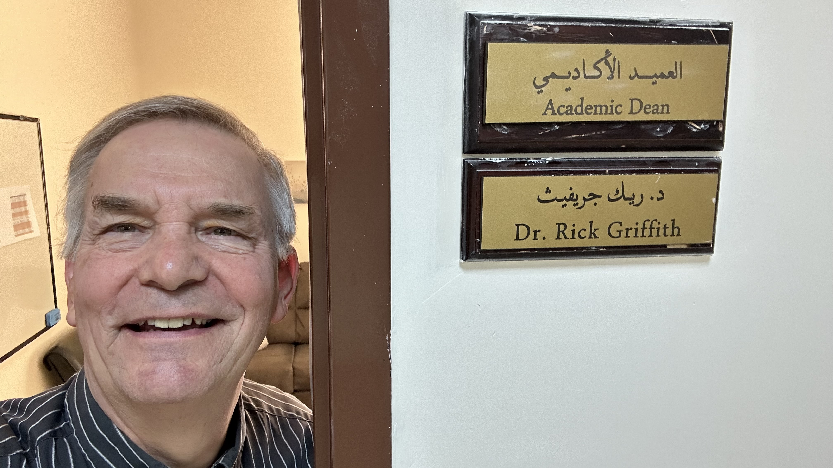
Rick is Now Academic Dean

Slide 53

Jordan Evangelical Theological Seminary (JETS)
Notes:
Degrees range from bachelor's to doctoral levels. But it is another faith venture for me to start up an English degree program.

Slide 54
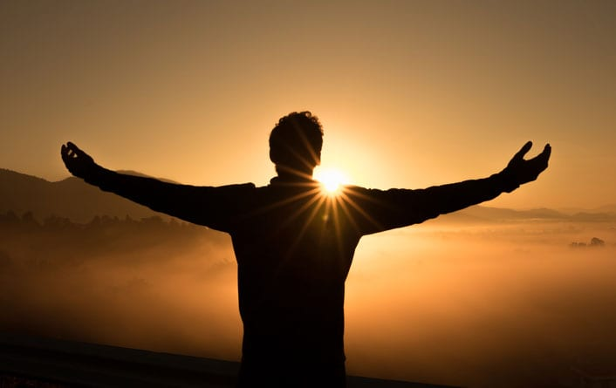
How is God calling you?
What is he telling you to do that shows your inadequacy and his sufficiency?
Will you tell him YES?
Notes:
What ministry is new to you that God is leading you to do, where you are tempted to give excuses?
Will you focus on what God can do instead of what you can accomplish?

Slide 55
EXCUSES
1. Who am I (3:11)?
2. Who are You (3:13)?
3. What if I fail (4:1)?
4. I'm not gifted (4:10)
5. I don't want to get involved (4:13)
Notes:
Ex. 4:13 But Moses again pleaded, “Lord, please! Send anyone else.”
This is like saying, “Here am I, Lord! But please, send Aaron!”

Slide 56
Black

Slide 57
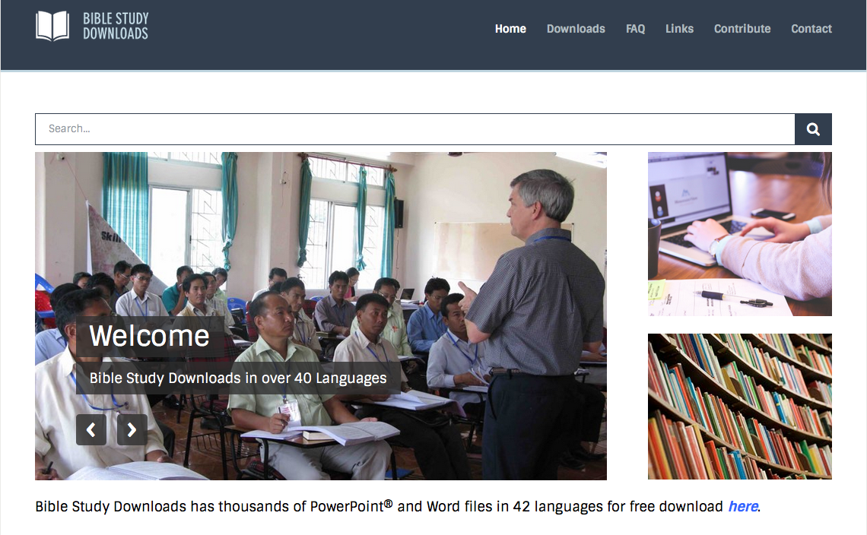

OT Preaching link at BibleStudyDownloads.org
Get this presentation and script for free!

