Slide 1
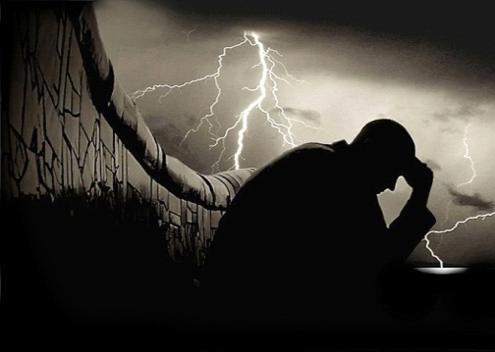
EXODUS 17:8-16
How to Defeat Satan
Dr Scott Wooddell Eastridge Park Christian Church, Mesquite, Texas Uploaded by Dr. Rick Griffith • Jordan Evangelical Theological Seminary Files in many languages for free download at BibleStudyDownloads.org

Slide 2
EXODUS 17:8-16
What tactics can we employ to defeat Satan and his demon army?

Slide 3
1. VICTORY DEMANDS WE KNOW OUR ENEMY
“Remember what the Amalekites did to you along the way when you came out of Egypt. When you were weary and worn out, they met you on your journey and cut off all who were lagging behind; they had no fear of God.” (Deuteronomy 25:17-18)

Slide 4
2. VICTORY DEMANDS WE KNOW OUR WEAPONS
The Sword of Joshua – Scripture
The Staff of Moses - Prayer
“Moses said to Joshua, ‘Choose some of our men and go out to fight the Amalekites. Tomorrow I will stand on top of the hill with the staff of God in my hands’”

Slide 5
TAKE HOME TRUTH
TRUTH
We ensure victory when we hold up Scripture in one hand and Prayer in the other.

Slide 6
Black

Slide 7
OT Preaching link at BibleStudyDownloads.org
Get this presentation for free!
Notes:
OT Preaching (op)

