Slide 1
EXODUS 13:17-22
Coping with Life's Unexpected
Dr Scott Wooddell • Eastridge Park Christian Church, Mesquite, Texas Uploaded by Dr. Rick Griffith • Jordan Evangelical Theological Seminary Files in many languages for free download at BibleStudyDownloads.org

Slide 2
EXODUS 13:17-22
How do we cope with the unexpected twists and turns in life?

Slide 3
1. THE LORD SOMETIMES LEADS US ON A ZIG-ZAG PATH.
“When Pharaoh let the people go, God did not lead them on the road through the Philistine country, though that was shorter…So God led the people around by the desert road toward the Red Sea.” (Exodus 13:17a & 18)

Slide 4
2. THE LORD LEADS US ON A ZIG-ZAG PATH TO STRENGTHEN OUR FAITH
“…for God said, “If they face war, they might change their minds and return to Egypt.” (Exodus 13:17b)
The Lord teaches us to trust Him.
The Lord teaches us we are no longer in bondage.
The Lord teaches us spiritual warfare.

Slide 5
3. THE LORD ENCOURAGES US AS WE FOLLOW HIM ON THE ZIG-ZAG PATH.
God will send us reminders of His good intentions (Exodus 13:19).
God will reveal His guiding presence (Exodus 13:21).

Slide 6
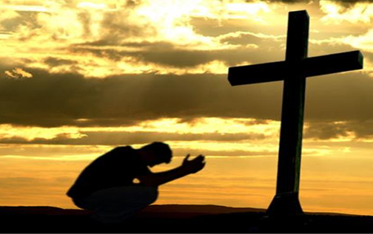
TAKE HOME TRUTH
When life takes an unexpected turn, we trust in our all-knowing God.

Slide 7
Black

Slide 8
OT Preaching link at BibleStudyDownloads.org
Get this presentation for free!
Notes:
OT Preaching (op)

