Slide 1
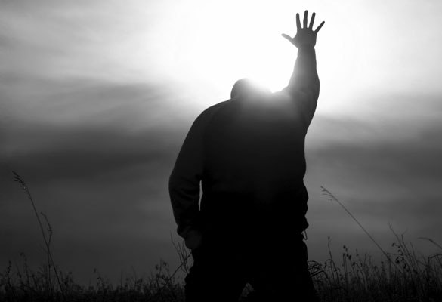
Be Committed
Esther
Dr. Rick Griffith • Crossroads International Church Singapore
CICFamily.com • BibleStudyDownloads.org

Slide 2

The church typically has a serious lack of commitment.
Why is that so?
Notes:
Why do you think? Tell your neighbor next to you.

Slide 3
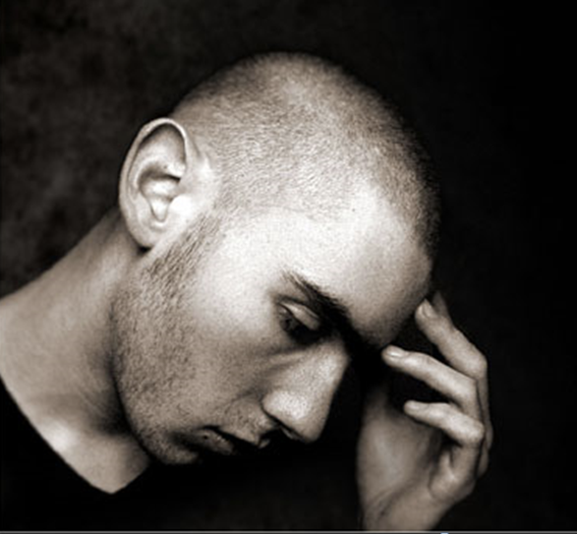
How committed are you to God’s work?
Notes:
If you were accused of being devoted to Jesus, would there be enough evidence to convict you in a court of law?

Slide 4
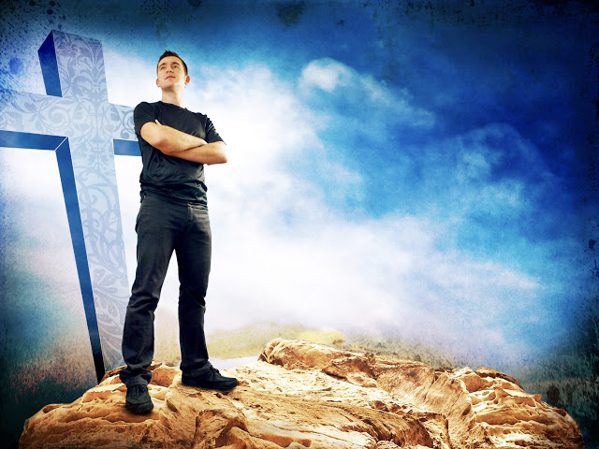
Why should you be committed to God?
Notes:
What reasons can you give to be dedicated, loyal and devoted to the Lord?

Slide 5

Background to Esther
NEVER GIVE UP
Notes:
Today in the book of Esther we will see that apathy can be cured.

Slide 6


The Postexilic Era
295
296
560
The Postexilic Era
Temple work
Prophets:
Haggai
Zechariah
Malachi
605
586
539
536
520
516
483-473
444-425
Others:
Zerubbabel
Esther
Ezra
Nehemiah
Persian Kings:
Cyrus
Darius
Xerxes
Artaxerxes
Notes:
The temple was rebuilt some 50 years before Esther—and Nehemiah would live some 50 years afterwards.

Slide 7
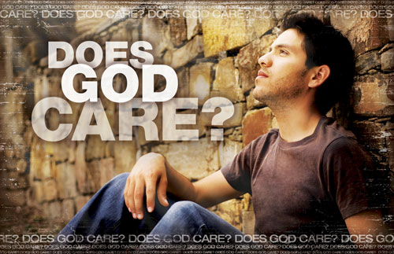
Does God Care About Those Left Behind?
Most of the Jews never returned to the land of Israel even in the Post-Exilic Period
Notes:
Why didn’t they return? What would happen to them? How would God shake them out of their lethargy?

Slide 8

The Persian Empire
Map of the Persian Empire
317
Barry J. Beitzel, Moody Atlas of Bible Lands, 150-51
Susa
The Persian Empire in the 5th century BC
extended "from India and Ethiopia" (Esther 1:1)
The boundaries of the empire that Cyrus II initiated
and Darius I consolidated stretched from Greece to India
Notes:
The Jews needed to renew their commitment to God based on his commitment to them over the ages. Yet they also needed to see God working in their lives right then as they lived outside the land of Israel.
Cyrus ruled over an absolutely ENORMOUS kingdom that eventually stretched from Greece in the west and India in the east. From his capital at Susa he had control over 127 provinces! God moved his heart to initiate a return to the land not only for the Jews but for other conquered peoples—as long as they would pray for the welfare of the king and his sons.

Slide 9
Correlation with Ezra
289
Restoring the Temple and People
Temple
Book of Esther (58 YEAR GAP)
People
Zerubbabel
Ezra
Ezra 1–6
Ezra 7–10
50,000 Return
5,000 Return
Survival
Revival
Working
Worshipping
538-516 BC (22 Years)
458-457 BC (1 Year)
External Opposition: Samaritans
Internal Opposition: Intermarriage
Return
1–2
Rebuilding
3–6
Return
7–8
Restoration
9–10
Decree
1
Returnees
2
Begins
3
Opposed
4:1–6:12
Ends
6:13-22
Qualifications
& Provisions
7
Returnees
& Protection
8
Inter- marriage
& Lament
9
Divorces
Carried Out
10

Slide 10

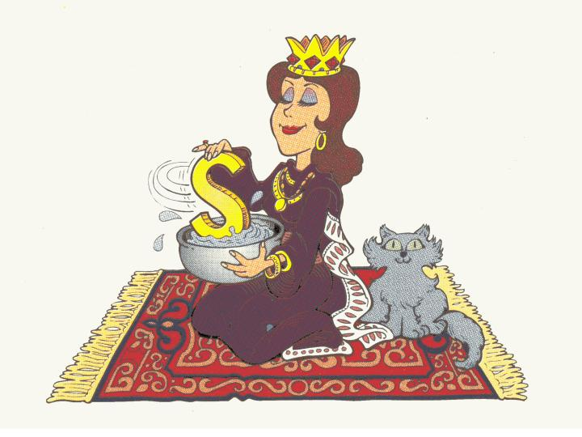
Queen of Persia
Esther:
Walk Through The Bible ©1989

Slide 11
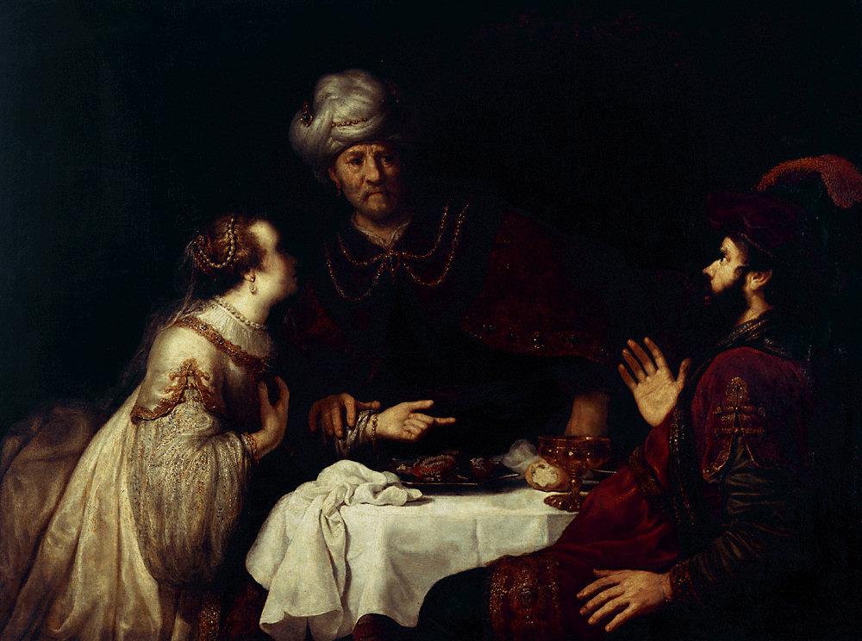
Esther Book Chart
308
Extermination Plot Foiled
Plot Planned
Plot Foiled
Chapters 1–4
Chapters 5–10
Threat
Triumph
Providence Prepared
Providence Enacted
Persecution
Preservation
Grave Danger
Great Deliverance
Feasts of Ahasuerus
Feasts of Esther & Purim
Esther Exalted
1:1–2:18
Haman Plots
2:19–4:17
Mordecai over
Haman
5:1–8:2
Jews over Enemies
8:3–9:32
Mordecai over Persia
10
Persia
10 Years (483-473 BC)

Slide 12
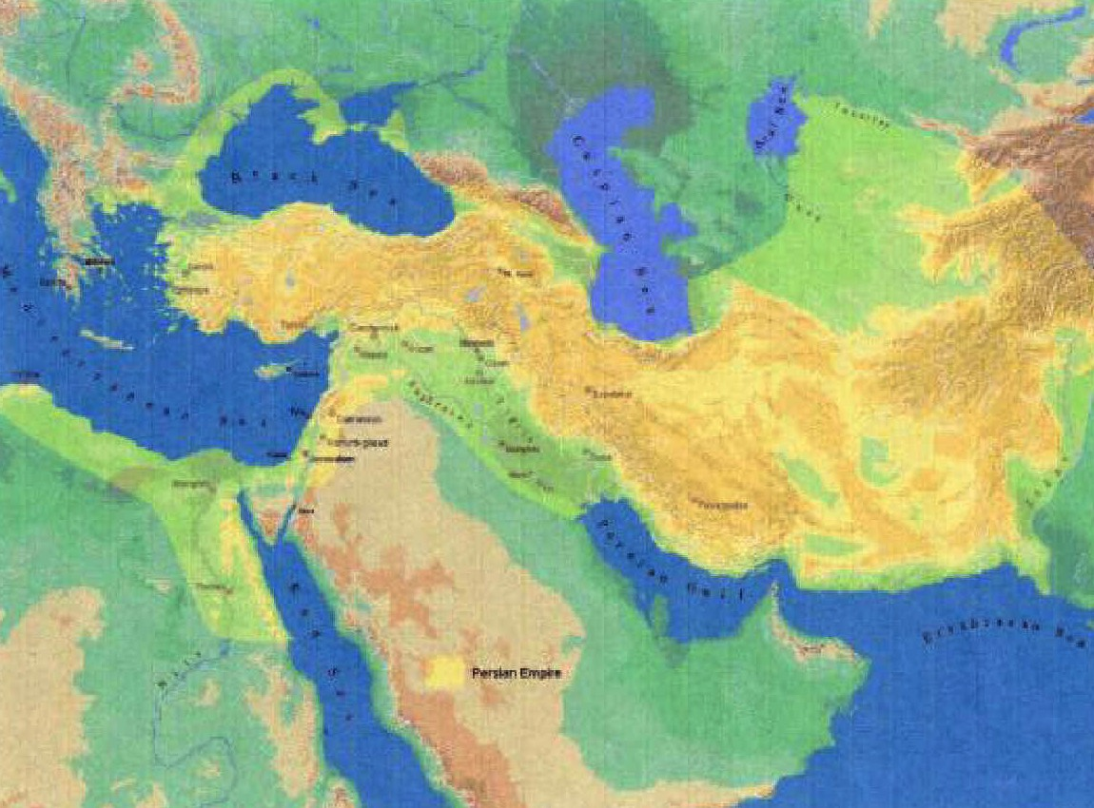
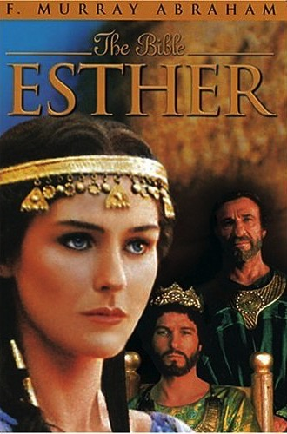
Key Word
308
Providence

Slide 13
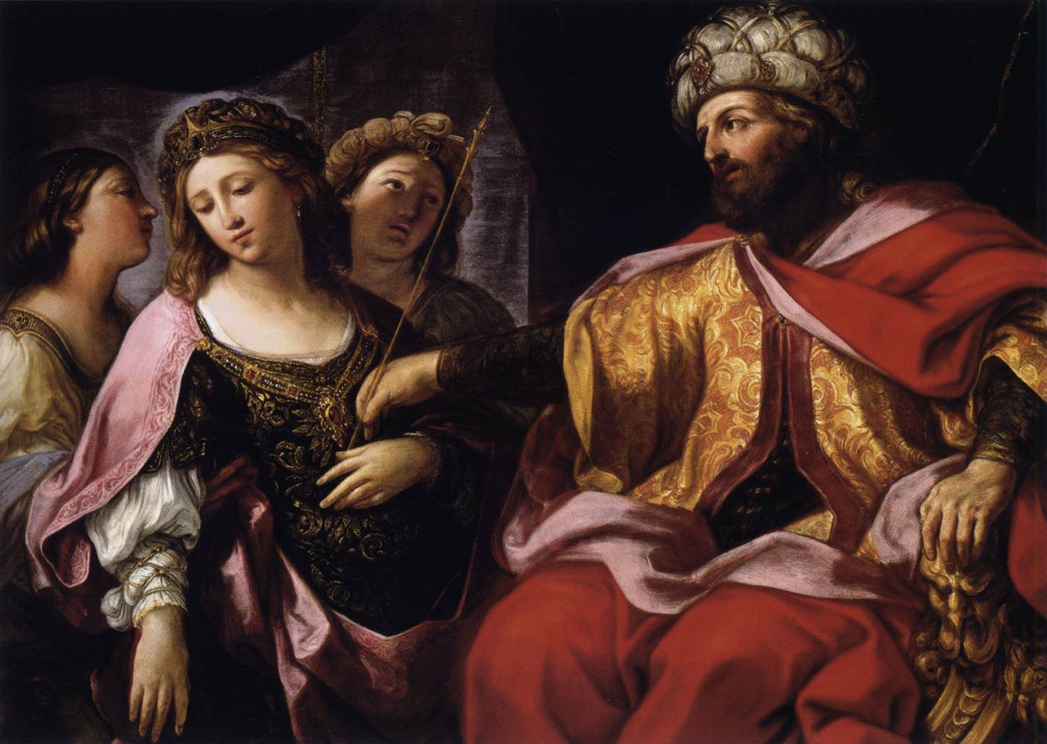
Key Verse
308
(Mordecai to Esther)
"For if you remain silent at this time, relief & deliverance for the Jews will arise from another place, but you & your father's family will perish. And who knows but that you have come to royal position for such a time as this?"
(Esther 4:14).

Slide 14
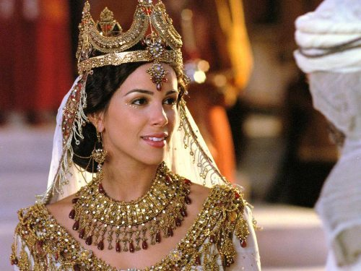
"…for such a time as this"

Slide 15
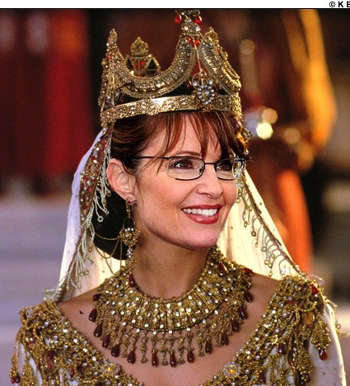
"…for such a time as this"

Slide 16
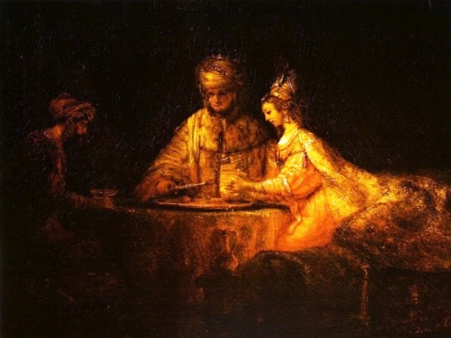
Summary Statement
308
An extermination of the Jewish nation plotted by Haman reverts upon his own head through God's providence through Mordecai & Esther to encourage postexilic Israel of God's continued commitment to the Abrahamic Covenant.

Slide 17
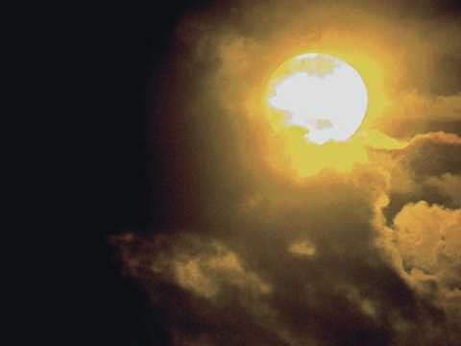
Synthesis
311
Extermination plot foiled
1–4 Plot planned—threat
5–10 Plot foiled—triumph

Slide 18
Why should you be committed to God?
2 REASONS
Notes:
What reasons can you give to be dedicated, loyal and devoted to the Lord?

Slide 19
God’s work faces threats (Esther 1–4).
Why be committed to God?
Notes:
Satan is always trying to push down whatever the Lord does.
God commands our wholehearted devotion as we face many obstacles while God fulfills his plan.

Slide 20
Slides on
Esther 1
Notes:
Threat: God strategically placed Mordecai and Esther to thwart Haman's plot to exterminate the Jews to fulfill the Abrahamic Covenant (Esther 1–4).

Slide 21
The Persian Empire
Map of the Persian Empire
317
Barry J. Beitzel, Moody Atlas of Bible Lands, 150-51
Susa
The Persian Empire in the 5th century BC
extended "from India and Ethiopia" (Esther 1:1)
The boundaries of the empire that Cyrus II initiated
and Darius I consolidated stretched from Greece to India
Notes:
Cyrus ruled over an absolutely ENORMOUS kingdom that eventually stretched from Greece in the west and India in the east. From his capital at Susa he had control over 127 provinces! God moved his heart to initiate a return to the land not only for the Jews but for other conquered peoples—as long as they would pray for the welfare of the king and his sons.
But God is bigger than Persia! Esther replaced the deposed Queen Vashti as God's intervention to save his people from annihilation as a nation (1:1–2:18).

Slide 22
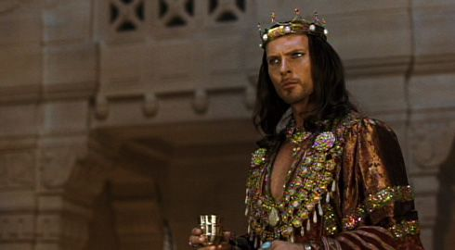
King Xerxe's Unreasonable Command to Queen Vashti
Notes:
The account begins with a very frustrated King Xerxes, or Ahasuerus.

Slide 23
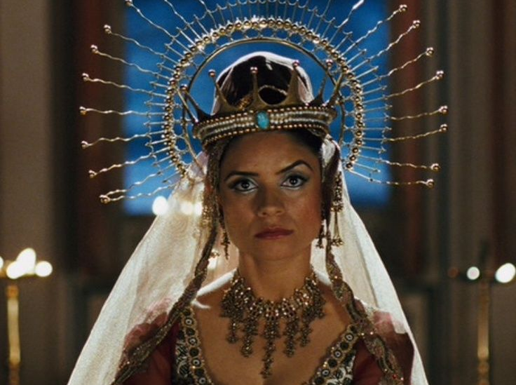
Vashti Upset
Notes:
Xerxes (Heb. Ahasuerus in the book) divorced his disobedient Queen Vashti, unaware of God’s plan for Esther to replace Vashti to preserve the Jews (Esther 1; 483 BC; 1:3).

Slide 24
Rise of Esther
  Confusion 1–2
Vashti
483
479
Mordecai's rise
Banquets
Notes:
God actually uses the confusion of the first two chapters to bring about his plan. Sound familiar?

Slide 25
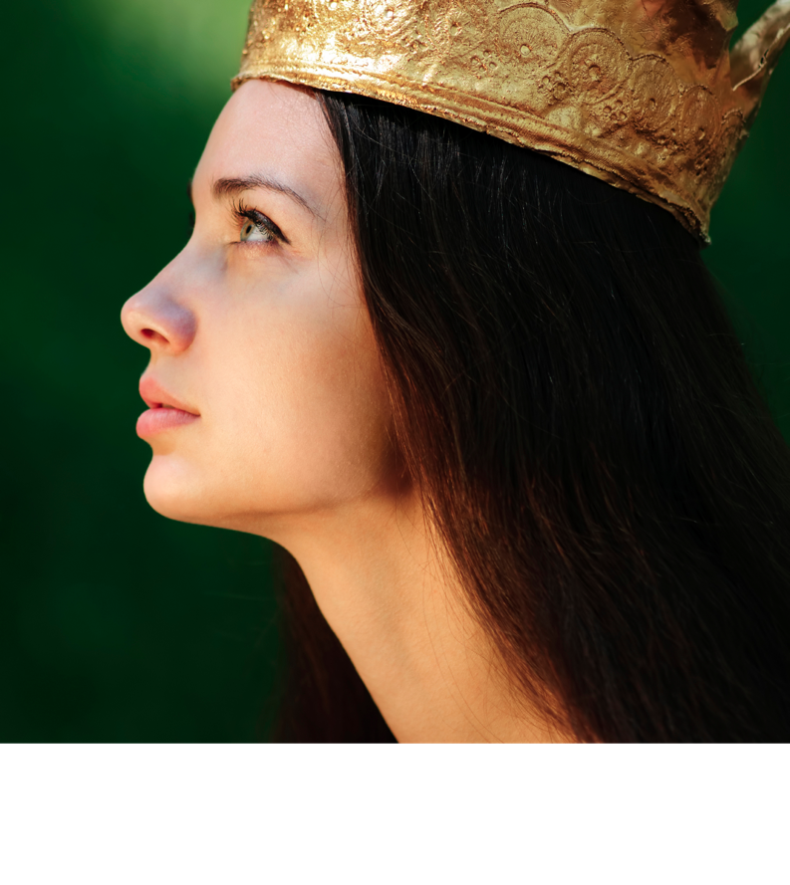
Outline
311-312
I. (Chs. 1–4) Haman's plot to exterminate the Jewish people becomes known to Mordecai and Esther, whom God has strategically placed, to inform Israel that apart from God it could not exist as a nation.
Notes:
Haman’s plot to kill the Jews came just after Mordecai foiled a plot to murder the king to show God protecting Jews via Esther to uphold the Abrahamic Covenant (2:19–4:17).

Slide 26
Slides on
Esther 2
Notes:
Xerxes married Esther to replace Vashti after a divinely designed beauty contest where God controlled Xerxes' taste in women to avert a disaster for the Jews (2:1-18; 479 BC).

Slide 27
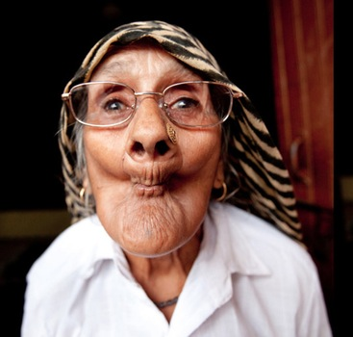
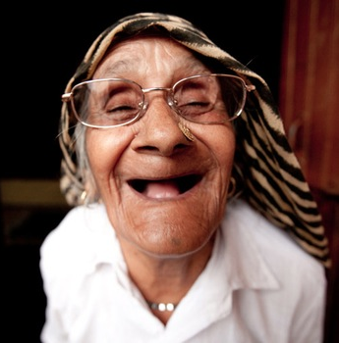
The Beauty Contest
Notes:
Actually God uses a beauty contest for his plan.
• So all the beauties are gathered.
• And they were happy about that!

Slide 28
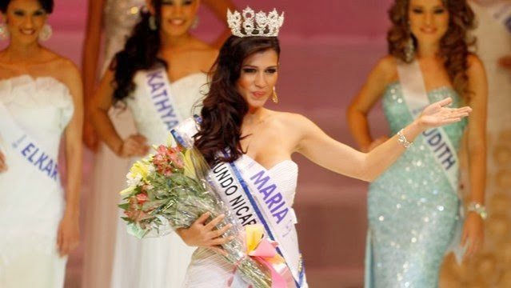
The Beauty Contest
Notes:
OK, maybe they looked better than that…

Slide 29
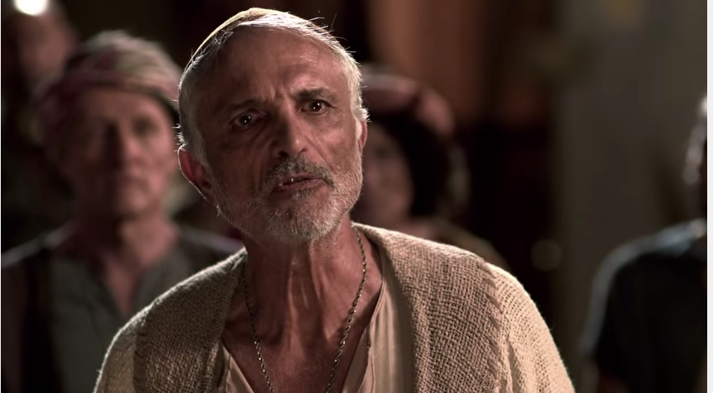
Mordecai the Jew
(Esther 2:5)
Notes:
"At that time there was a Jewish man in the fortress of Susa whose name was Mordecai son of Jair. He was from the tribe of Benjamin and was a descendant of Kish and Shimei. ⁶ His family had been among those who, with King Jehoiachin of Judah, had been exiled from Jerusalem to Babylon by King Nebuchadnezzar" (2:5-6 NLT).

Slide 30
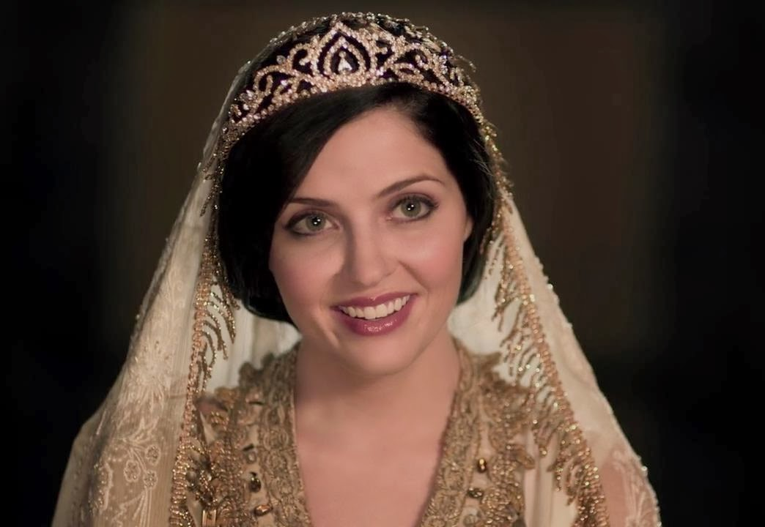
Mordecai's Young Cousin Esther (2:7)
Notes:
"This man had a very beautiful and lovely young cousin, Hadassah, who was also called Esther. When her father and mother died, Mordecai adopted her into his family and raised her as his own daughter" (2:7 NLT).

Slide 31
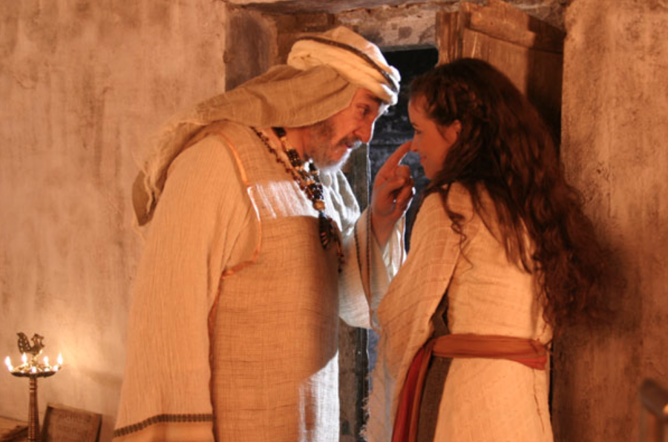
Mordecai Counsels Esther
Notes:
"Esther had not told anyone of her nationality and family background, because Mordecai had directed her not to do so" (2:10 NLT).

Slide 32
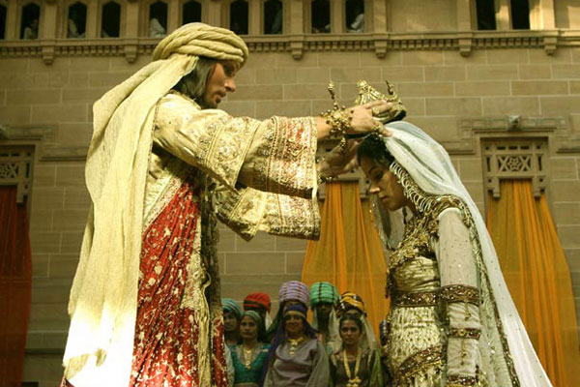
Did Esther act honorably?
Notes:
"Esther kept her Jewish nationality a secret (cf. v. 20), not telling Hegai, her maids, or anyone else because Mordecai had told her not to. From this and other statements in the book it is clear the author was making the point that God protected and used Esther and Mordecai in spite of the fact that they were not living according to the Law commanded by God to the people of Israel. By Law Esther was not to marry a pagan (Deut. 7:1-4) or have sexual relations with a man who was not her husband (Ex. 20:14), and yet this was the purpose of her being included in the harem. Esther could be contrasted with Daniel who refused to eat the things from the king’s table (Dan. 1:5) because the food would include items considered unclean by the Jewish Law. Apparently Esther had no qualms about the food she ate (Es. 2:9). She certainly did not set herself apart as Daniel had done" (John A. Martin, "Esther," in The Bible Knowledge Commentary, 1:704).

Slide 33
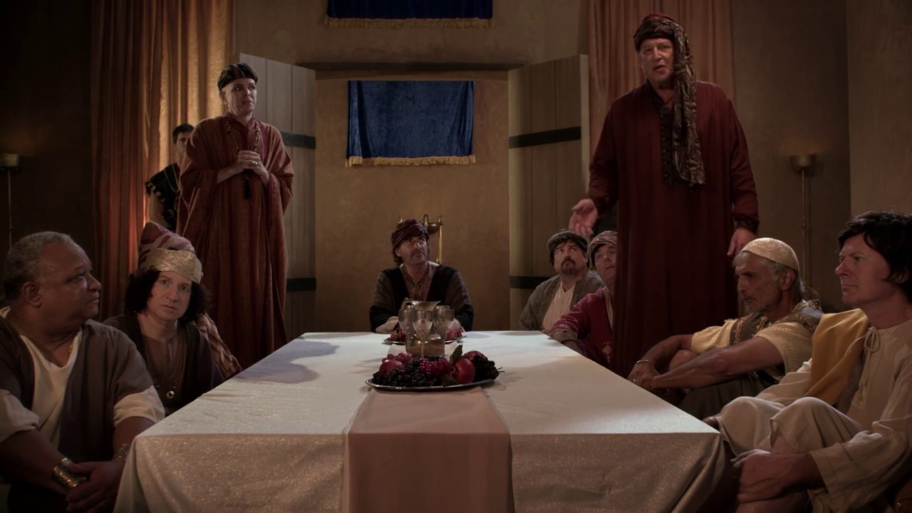
All the King's Men
Notes:
Haman’s plot to kill the Jews came just after Mordecai foiled a plot to murder the king to show God protecting Jews via Esther to uphold the Abrahamic Covenant (2:19–4:17).

Slide 34
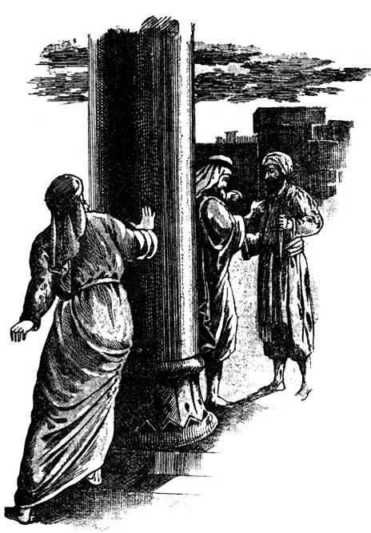
Eavesdropping
Esther
  Confusion 1–2
Vashti
483
479
Mordecai's rise
Banquets
Notes:
God informed Mordecai of a secret assassination plot that saved Xerxes' life as God’s design to later exalt Mordecai to benefit his people (2:19-23).

Slide 35
Slides on
Esther 3
Notes:
Haman’s anger at Mordecai refusing to honor him convinced Xerxes to kill all Jews from Egypt to India eleven months later for God protect them instead (Esther 3).

Slide 36
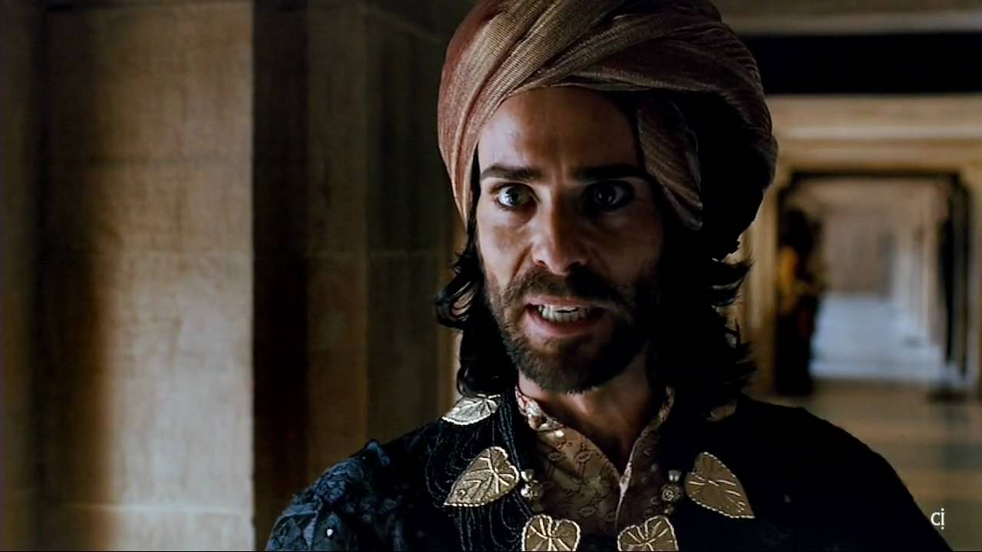
Haman the Agagite
(Esther 3:1-2)
Notes:
"Some time later King Xerxes promoted Haman son of Hammedatha the Agagite over all the other nobles, making him the most powerful official in the empire. ² All the king’s officials would bow down before Haman to show him respect whenever he passed by, for so the king had commanded. But Mordecai refused to bow down or show him respect" (3:1-2 NLT).
"Because Haman was an Agagite, some have supposed that he was descended from Agag, king of the Amalekites (1 Sam. 15:8). However, it seems unlikely that a high-ranking Persian official would be related to a west Semite who lived 600 years earlier. Archeologists have uncovered an inscription which indicates that Agag was also the name of a province in the Persian Empire. This probably explains why Haman was called an Agagite" (John A. Martin, "Esther," Bible Knowledge Commentary, 1:705).

Slide 37
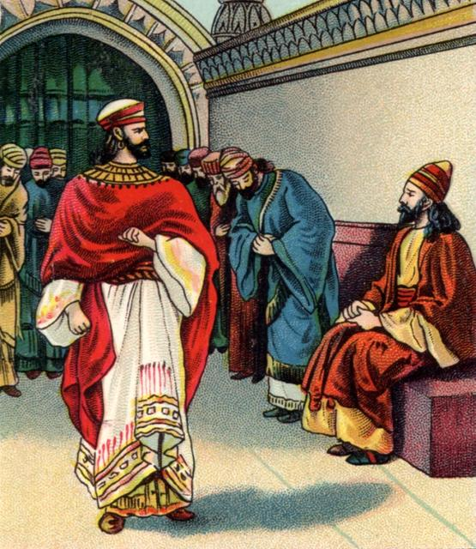
No Respect (3:1-2)
Esther
Grave
Danger
  Conspiracy 3–4
  Confusion 1–2
Haman's rise & fall
Vashti
483
479
Mordecai's rise
Banquets
Fasting
Notes:
Haman was so stuck on himself that when Mordecai refused to stand in his presence, Haman decided to kill not only him, but ALL Jews throughout the 127 provinces of the empire! Talk a chip on his shoulder!

Slide 38
Slides on
Esther 4
Notes:
Mordecai convinced Esther to risk her life for the Jews by showing that God crowned her for this role even if she failed since he would still uphold the Abrahamic Covenant (Esther 4).

Slide 39
Key Verse
308
(Mordecai to Esther)
"For if you remain silent at this time, relief & deliverance for the Jews will arise from another place, but you & your father's family will perish. And who knows but that you have come to royal position for such a time as this?"
(Esther 4:14).

Slide 40
Why should you be committed to God?
Notes:
What reasons can you give to be dedicated, loyal and devoted to the Lord?

Slide 41
God’s work faces threats (Esther 1–4).
Why be committed to God?
Notes:
Satan is always trying to push down whatever the Lord does.
God commands our wholehearted devotion as we face many obstacles while God fulfills his plan.

Slide 42
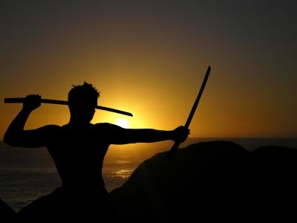
We are secure in our relationship with God—but that doesn’t mean there are no attacks!

Slide 43

We are at war.
Notes:
We are at war. The sad reality is that many of us do not realize it—so we are not committed to God as a result.

Slide 44

Crossroads
Notes:
Each of us is at a crossroads—thus our church is Crossroads International Church.
Like the Jews in the story of Esther, right now we are attacked at home, at work, and a number of other arenas.
We are challenges whether we will take God’s road at the crossroads. Too often our problem is not that we don’t know which road is God’s road. Our issue is having the courage and commitment to do it.
Why should we be committed to God?

Slide 45
God’s work faces threats (Esther 1–4).
Why be committed to God?
God’s work will triumph (Esther 5–10).
Notes:
Satan is always trying to push down whatever the Lord does.
But the Lord will eventually be the victor.
It’s easier to be committed to God’s plan when we know that it will ultimately succeed.

Slide 46
Outline
311-312
I. (Chs. 1–4) Haman's plot to exterminate the Jewish people becomes known to Mordecai and Esther, whom God has strategically placed, to inform Israel that apart from God it could not exist as a nation.
II. (Chs. 5–10) Haman's extermination plot reverts upon his own head through God's providential workings in Mordecai and Esther to encourage postexilic Israel of God's continued commitment to the Abrahamic Covenant.
Notes:
Triumph: God reverted Haman's massacre plot on his own head via Mordecai and Esther to fulfill the Abrahamic Covenant (Esther 5–10).

Slide 47
Slides on
Esther 5
Notes:
Mordecai overcame Haman as proof of God's faithfulness when we fear him (5:1–8:2).

Slide 48
Courage 5–7
Esther
Grave
Danger
  Conspiracy 3–4
  Confusion 1–2
  Courage 5–7
Haman's rise & fall
Vashti
483
479
Mordecai's rise
Banquets
Banquets
Fasting
Notes:
True, God is for us—but that doesn't mean it doesn't take courage on our part!

Slide 49
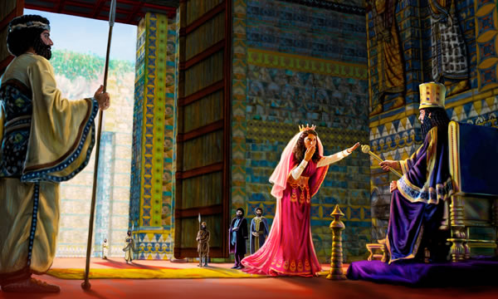
Esther Risked Her Life for the Jews (5:2)
Notes:
Esther had not been summonded by the king for over a month, and to come into his presence without an invitation was actually risking her very life.

Slide 50
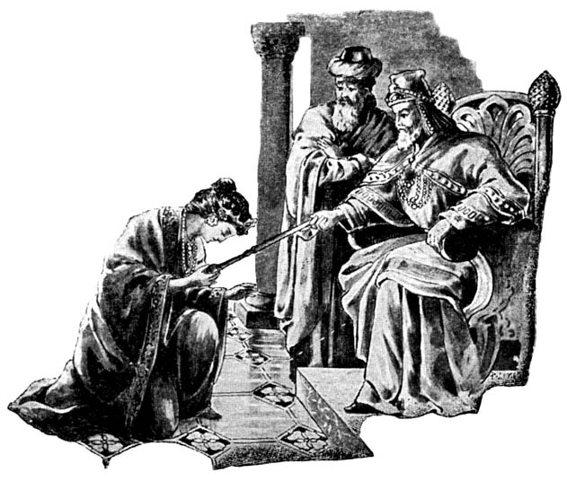
Esther 5:1-8
Notes:
I think it is telling here that a woman is set as an example of courage. Too often it is the ladies who model courage before us men, even though God's plan is for the men to be the spiritual leaders.

Slide 51
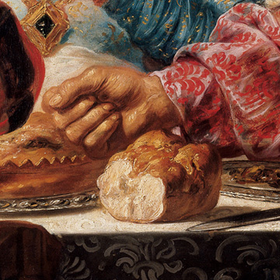
Esther invited Haman and the king to eat (5:4)
Notes:
The king enthusiastically and curiously accepted Esther's boldness, yet Esther only invited him to a banquet to put him in the proper mood to grant her request (5:1-8).

Slide 52
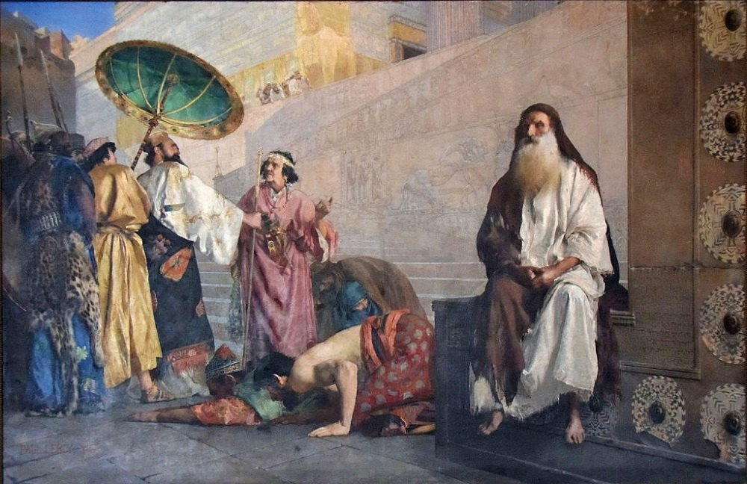
Esther 5:9-14
Notes:
Yet, when Haman leaves after the meal, Mordecai refused to stand for Haman which motivated Haman to impale Mordecai.
So Haman arrogantly plotted to murder Mordecai on a 75-foot gallows as God's provision for his own death to protect the Jews (5:9-14).

Slide 53

"a sharpened pole… seventy-five feet tall”
(5:14 NLT)
"a gallows built… seventy-five feet tall”
(5:14 NIV, NAU)
Notes:
"Haman’s wife, Zeresh, and all his friends were no better than he was. They suggested that Haman have a gallows built that would be 75 feet high and that he have Mordecai hanged on it before the banquet so he would have nothing bothering him when he went to the feast. The gallows probably was an impaling stake, a common method of execution in the ancient world (cf. comments on 2:23). The purpose in suggesting such a tall stake was so it would be a lesson to all who saw it. The person on the stake would be visible from all directions, since he would be higher than all the trees. This spectacle would solemnly emphasize that Haman was in control (cf. 3:1) and that no one should try to stand in his way.
Haman undoubtedly felt that with Mordecai gone there would be no organized opposition from the Jewish camp. He would be freed from his enemy forever. Here the tension in the Haman-Mordecai conflict reached its peak. From this point on it was relieved little by little through circumstances that had already been set in motion. As the events unfold, the reader is reminded of seemingly insignificant or forgotten events that the skillful narrator had previously mentioned but had not highlighted. God was sovereignly at work behind even such a hateful act as building a gallows (cf. Acts 2:23; 4:27-28)" (John A. Martin, "Esther," Bible Knowledge Commentary, 1:708).

Slide 54
Slides on
Esther 6
Notes:
Haman honored Mordecai and returned home humiliated (Esther 6).

Slide 55
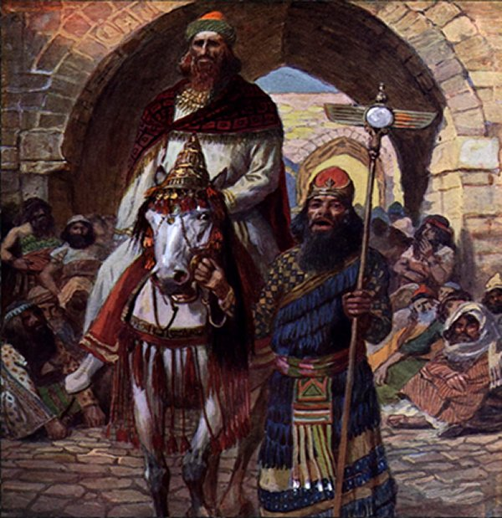
Esther 6
Notes:
I can just hear Haman pronounce under his voice, "This is what the king does for the one he wants to honor" and then Morcedai says, "Hey, say it a little louder!"

Slide 56
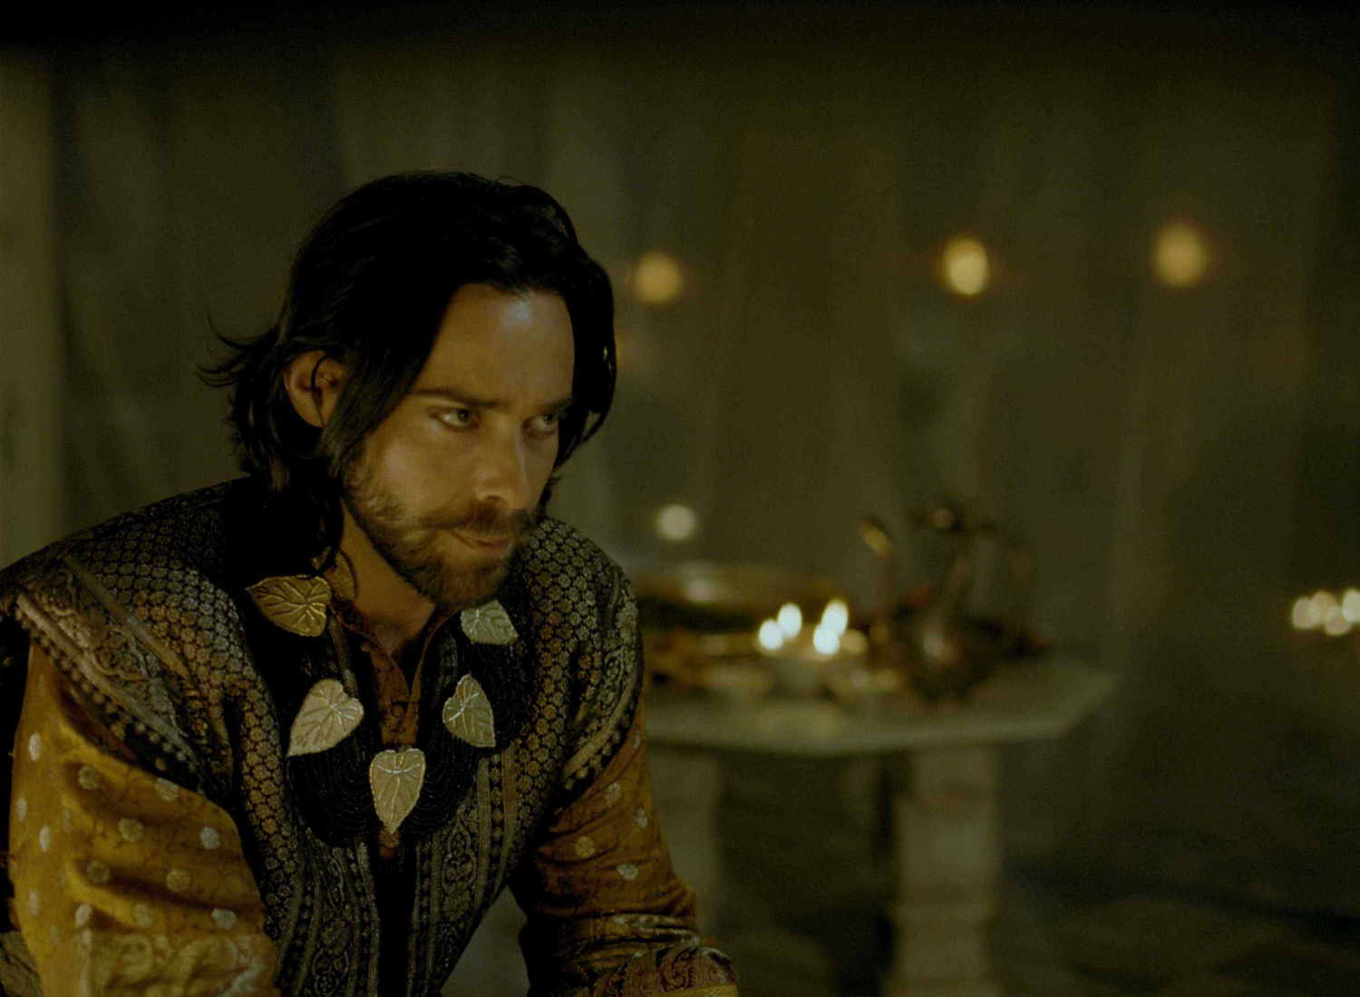
"Afterward Mordecai returned to the palace gate, but Haman hurried home dejected and completely humiliated”
(6:12 NLT)

Slide 57
Slides on
Esther 7
Notes:
Haman died on the gallows prepared for Mordecai as evidence that God protects those who fear him and punishes those who oppose him and his people (Esther 7).

Slide 58

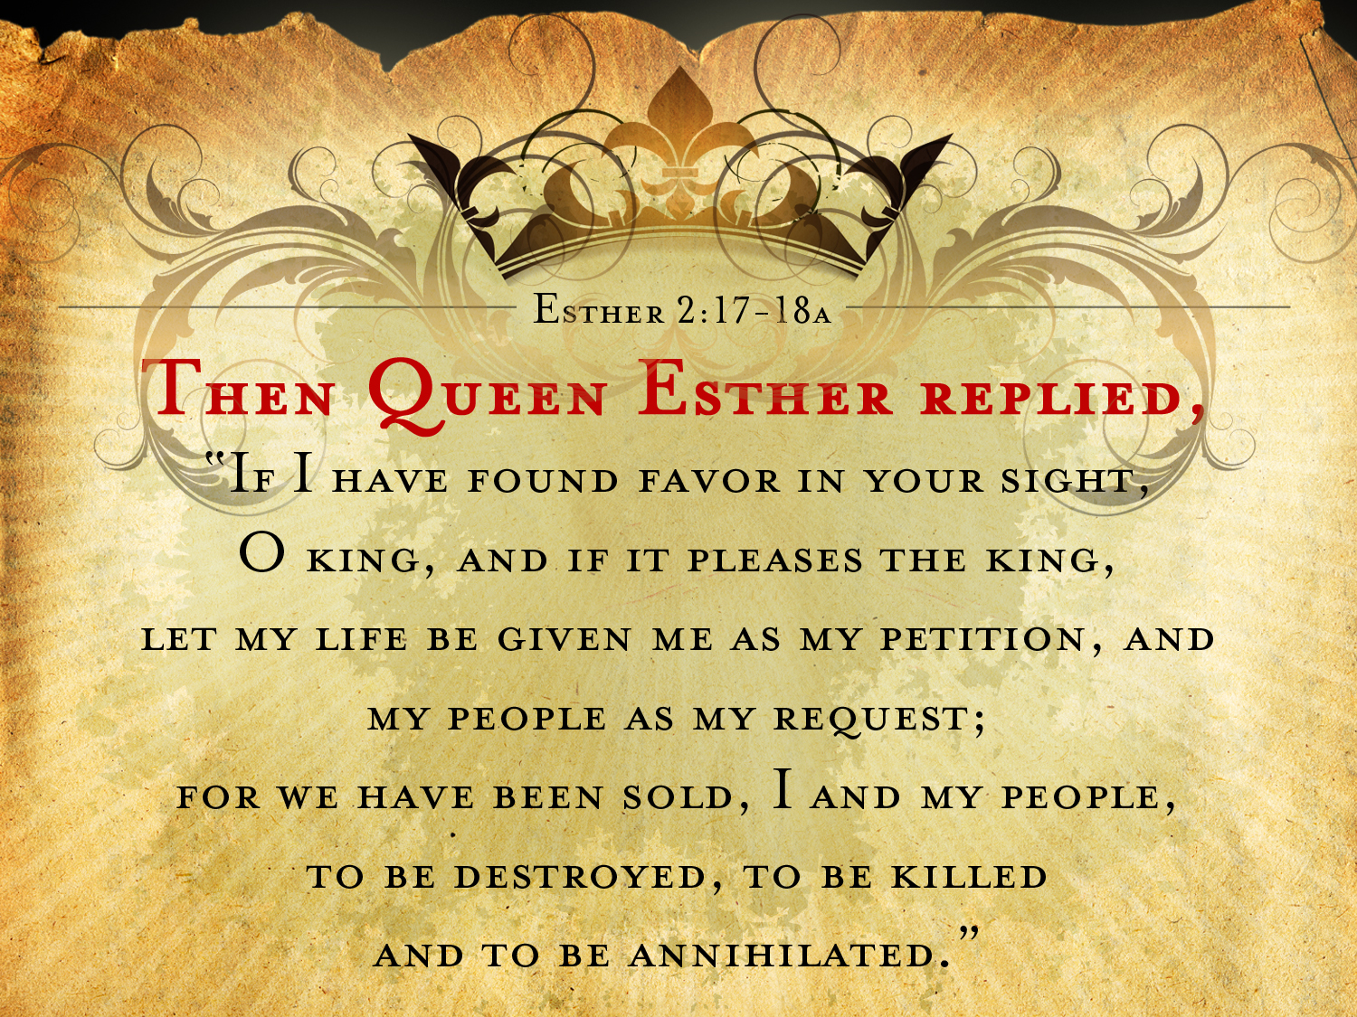
ESTHER 7:3-4a NIV
Then Queen Esther answered,
"If I have found favor with you, O king, and if it pleases your majesty, grant me my life—this is my petition. And spare my people—this is my request. ⁴For I and my people have been sold for destruction and slaughter and annihilation."

Slide 59
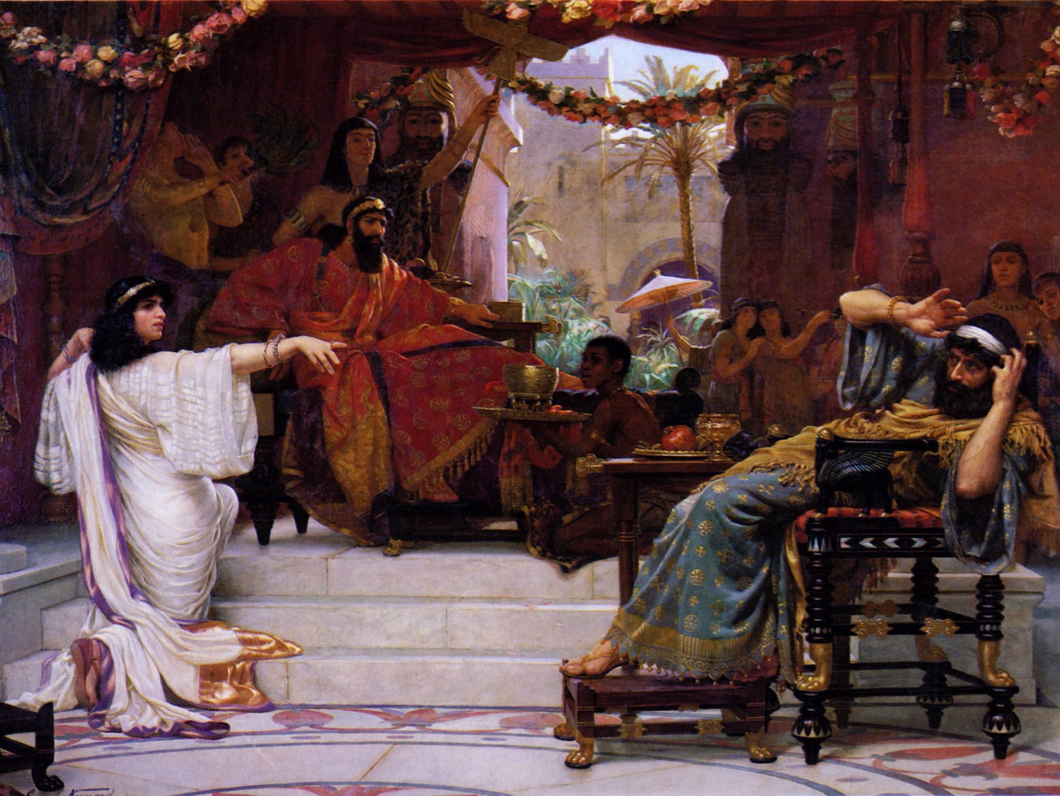
"The adversary is this vile Haman” (7:6)

Slide 60
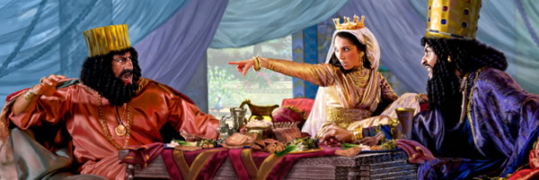
"That vile Haman…” (7:6)

Slide 61
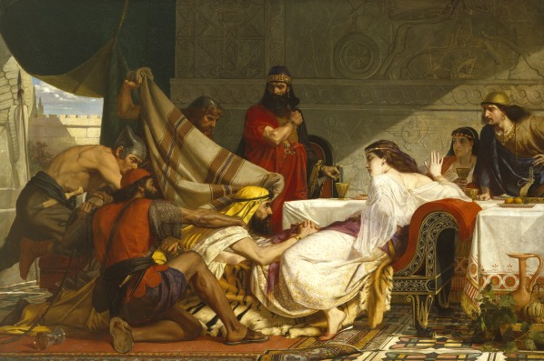
Esther 7:8
Notes:
"In despair he fell on the couch where Queen Esther was reclining, just as the king was returning from the palace garden. The king exclaimed, “Will he even assault the queen right here in the palace, before my very eyes?” And as soon as the king spoke, his attendants covered Haman’s face, signaling his doom" (7:8 NLT).

Slide 62
"a sharpened pole… seventy-five feet tall”
(5:14 NLT)
"a gallows built… seventy-five feet tall”
(5:14 NIV, NAU)
Notes:
"Haman’s wife, Zeresh, and all his friends were no better than he was. They suggested that Haman have a gallows built that would be 75 feet high and that he have Mordecai hanged on it before the banquet so he would have nothing bothering him when he went to the feast. The gallows probably was an impaling stake, a common method of execution in the ancient world (cf. comments on 2:23). The purpose in suggesting such a tall stake was so it would be a lesson to all who saw it. The person on the stake would be visible from all directions, since he would be higher than all the trees. This spectacle would solemnly emphasize that Haman was in control (cf. 3:1) and that no one should try to stand in his way.
Haman undoubtedly felt that with Mordecai gone there would be no organized opposition from the Jewish camp. He would be freed from his enemy forever. Here the tension in the Haman-Mordecai conflict reached its peak. From this point on it was relieved little by little through circumstances that had already been set in motion. As the events unfold, the reader is reminded of seemingly insignificant or forgotten events that the skillful narrator had previously mentioned but had not highlighted. God was sovereignly at work behind even such a hateful act as building a gallows (cf. Acts 2:23; 4:27-28)" (John A. Martin, "Esther," Bible Knowledge Commentary, 1:708).

Slide 63
Slides on
Esther 8
Notes:
Mordecai was elevated to Haman's position and appointed over Haman's estate to show that those who plot evil will only prosper the righteous (8:1-2).

Slide 64
V-Day
Esther
Grave
Danger
Great Deliverance
  Conspiracy 3–4
  Vindication 8
  Confusion 1–2
  Courage 5–7
Haman's rise & fall
Jews' protection
Vashti
483
479
Mordecai's rise
473
Banquets
Feasting
Banquets
Fasting

Slide 65
Slides on
Esther 9
Notes:
Israel triumphed over its enemies and began to annually celebrate the Feast of Purim as evidence of God's faithfulness to the Abrahamic Covenant (8:3–9:32).

Slide 66
V-Day
Esther
Grave
Danger
Great Deliverance
  Conspiracy 3–4
  Vindication 8
  Confusion 1–2
  Courage 5–7
  Victory 9–10
Haman's rise & fall
Jews' protection
Vashti
483
479
Mordecai's rise
473
Banquets
Feasting
Banquets
Fasting
Notes:
God delivered the Jews in a massive slaughter of their enemies authorized by a counter-decree for their self-defense to show God upholding the Abrahamic Covenant (8:3–9:16).

Slide 67
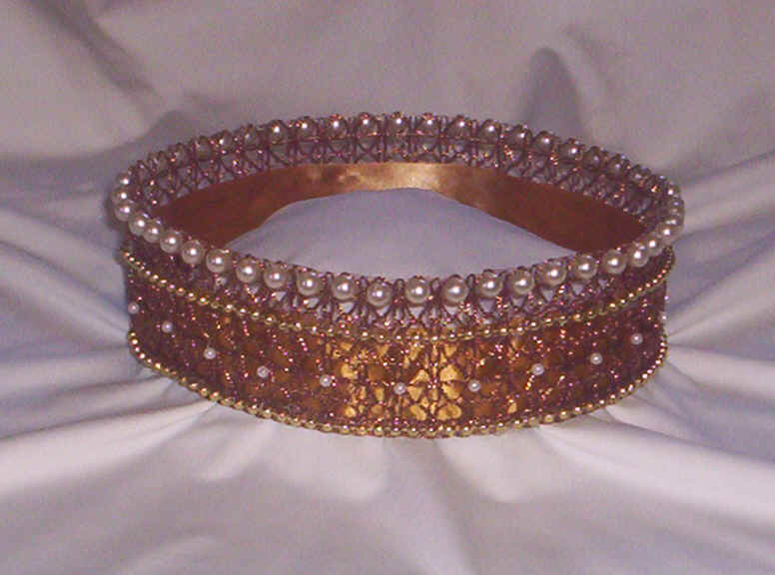
Purim
"Purim is a minor holiday of the Jewish calendar based upon the account in the book of Esther. The holiday is preceded by the Fast of Esther, commemorating the period of assembly and fasting before the deliverance. On Purim, according to Talmudic practice, the Megillah (Scroll of Esther) is read in the synagogue, charity is distributed, gifts of food are exchanged, and a festive meal is eaten."
"Purim," in Harper's Bible Dictionary
Notes:
Xerxes allowed Esther and Mordecai’s counter-decree for Jews to defend themselves and God caused many Gentiles to become proselytes (8:3-17).

Slide 68
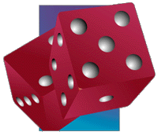
Proverbs 16:33 (NIV)
    "The lot is cast into the lap,
    but its every decision is from the LORD."
Notes:
The Jews slaughtered at least 75,810 enemies in two days with help from royal officials to show God's faithfulness to the Abrahamic Covenant (9:1-16; Feb-Mar 473 BC).
Mordecai and Esther authorized the Feast of Purim (plural for pur, the lot thrown by Haman) to annually celebrate God’s victory over the enemies of the Jews (9:17-32).

Slide 69
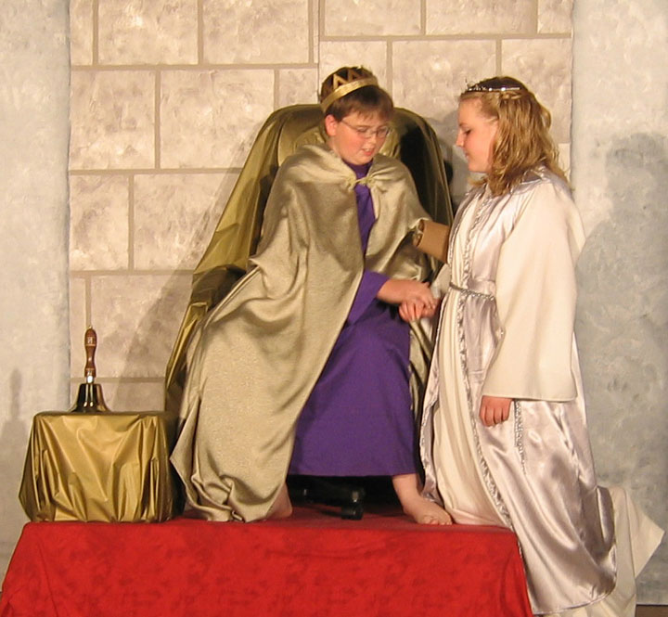
The story lives on in Jewish plays each year…
Notes:
Purim is celebrated annually by Jews where boys play the part of Mordecai and girls Esther.

Slide 70
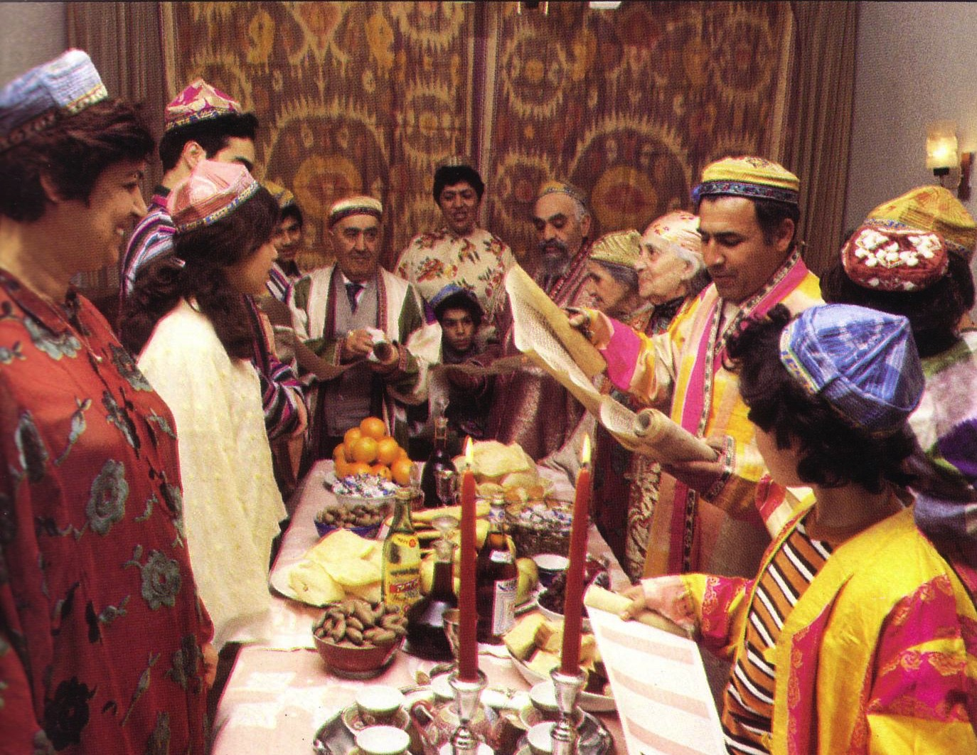
Purim: Lots of Victory
Notes:
It is a festive time!

Slide 71
Slides on
Esther 10
Notes:
The LORD exalted Mordecai to second only to Xerxes due to his selfless concern for the Jews, which shows God's blessing on those who seek the welfare of others (Esther 10).

Slide 72
We are secure in our relationship with God—but that doesn’t mean there are no attacks!

Slide 73
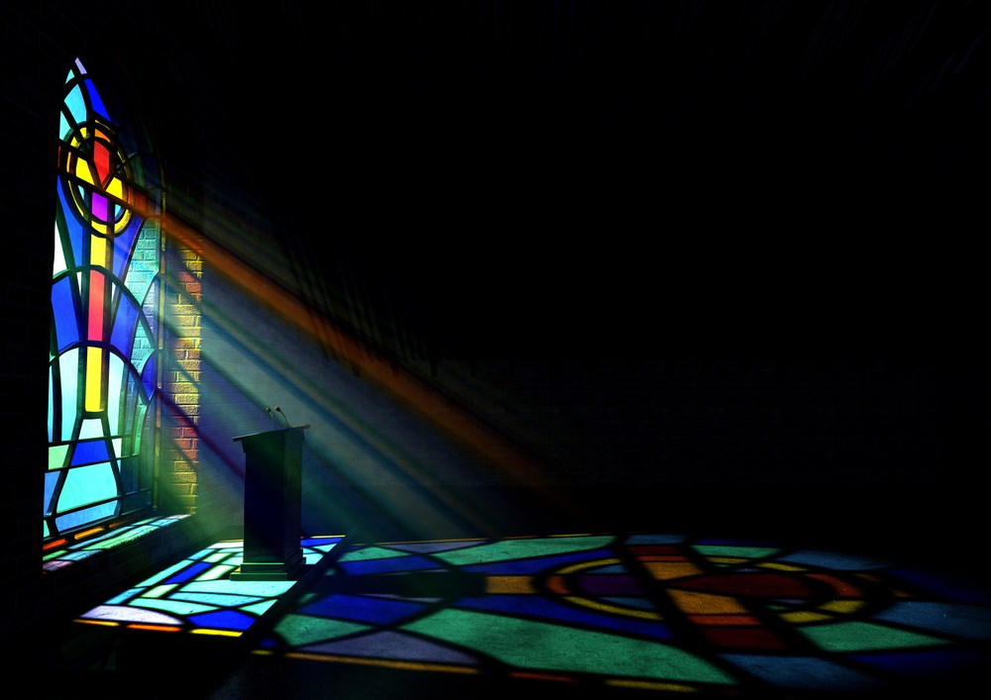
We also have a future victory because God’s plan will not be thwarted.

Slide 74
Key Verse
308
(Mordecai to Esther)
"For if you remain silent at this time, relief & deliverance for the Jews will arise from another place, but you & your father's family will perish. And who knows but that you have come to royal position for such a time as this?"
(Esther 4:14).
Notes:
The key verse reminds us that, even if we have poor judgment and are not committed to God’s plan, “relief for the Jews will arise from another place” (Esther 4:14).

Slide 75
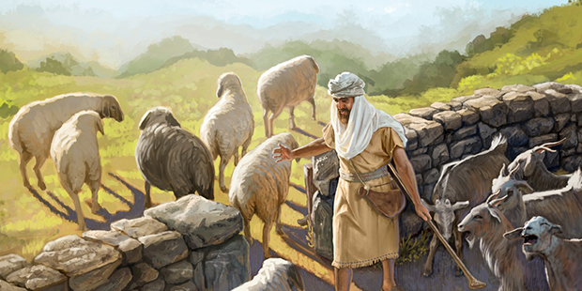
You can't thwart God’s sovereign plan. But you can be part of it.
Notes:
It is the same with us! You cannot thwart God’s sovereign plan! He is the king and will accomplish it with or without you. The real question is whether you will have that blessing to be reigning with him.

Slide 76
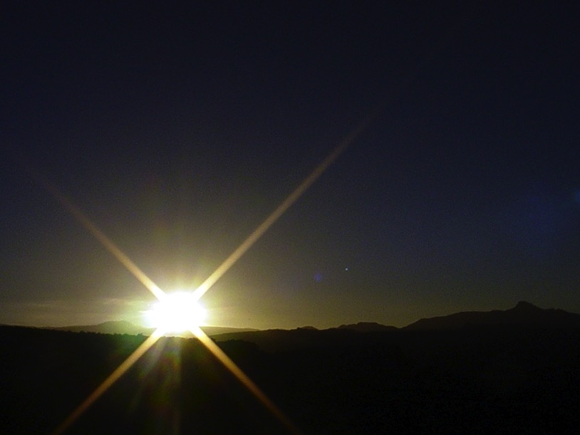


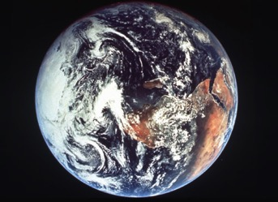
The Bible's Chiasm
446
Repeated Patterns in Reverse Order
Christ's Redemption
Christ's Rule
Man's Rule Lost at
Fall
Man's
Rule Restored at Millennium
Creation
New Creation
Notes:
Creation in Genesis 1–2 is repeated In the Restored, New Creation in Rev 21–22
Man was created to rule over the fish, birds, and land animals (Gen. 1:28) but he gave over his rule over to the god of this world, Satan (2 Cor. 4:4)
However, this rule is restored during the 1000-year reign of the saints (Rev. 20:4-6)
But Christ is the central Person of history: both as Lamb (Redeemer) and as Lion (Ruler of all creation in the line of David)

Slide 77

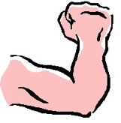
Revelation 20:4-6 Diagrammed
424
^{4b}and they came to life and reigned with Christ for a thousand years.
^{4a}Then I saw thrones, and they sat on them, and judgment was given to them. And I saw the souls of those who had been beheaded because of their testimony of Jesus and because of the word of God, and those who had not worshiped the beast or his image, and had not received the mark on their forehead and on their hand…
1000 years
^{5b}This is the first resurrection. ^{6a}Blessed and holy is the one who has a part in the first resurrection; over these the second death has no power…
^{6b}but they will be priests of God and of Christ and will reign with Him for a thousand years.
^{5a}The rest of the dead did not come to life until the thousand years were completed.
Notes:
Believers will reign with Christ for 1000 years!

Slide 78
Why should you be committed to God?
Notes:
What reasons can you give to be dedicated, loyal and devoted to the Lord?

Slide 79
God’s work faces threats (Esther 1–4).
Why be committed to God?
God’s work will triumph (Esther 5–10).
MAIN IDEA:
Despite Satan’s threats,
God will triumph
Notes:
Satan is always trying to push down whatever the Lord does.
But the Lord will eventually be the victor.
It’s easier to be committed to God’s plan when we know that it will ultimately succeed.

Slide 80

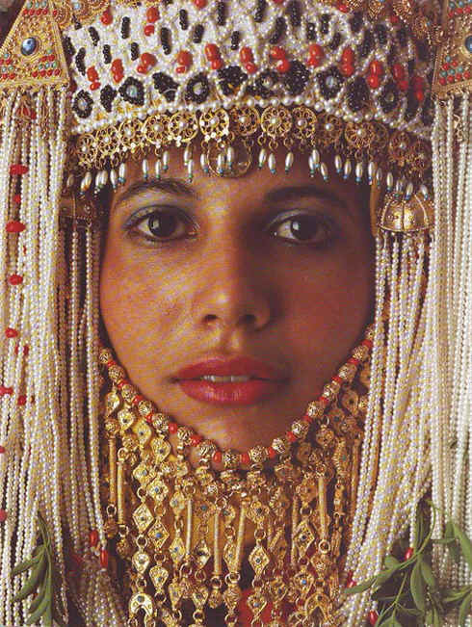
WHAT TO DO?
308
Use your
providentially
placed position
to help
God's people
Notes:
Where are you feeling crushed as if on the losing team? Plans at work, home, your future, your whatever…
You are not on the losing team! Be committed to God because you are actually on the winning side!
• Use your providentially placed position to help God's people. How? What advantages do you have that others do not? Language? Relationships? Money?

Slide 81
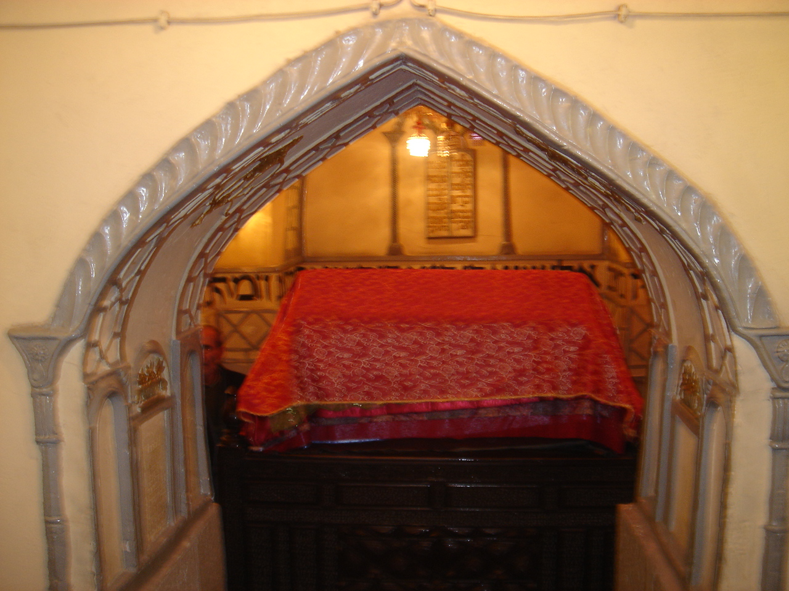
Esther's Tomb in Iran Today
Notes:
Just as one can visit Esther’s tomb in Iran today, who knows but that your courage could long be remembered in God’s service.

Slide 82
Black

Slide 83


OT Preaching link at BibleStudyDownloads.org
Get this presentation and script for free!

