Slide 1
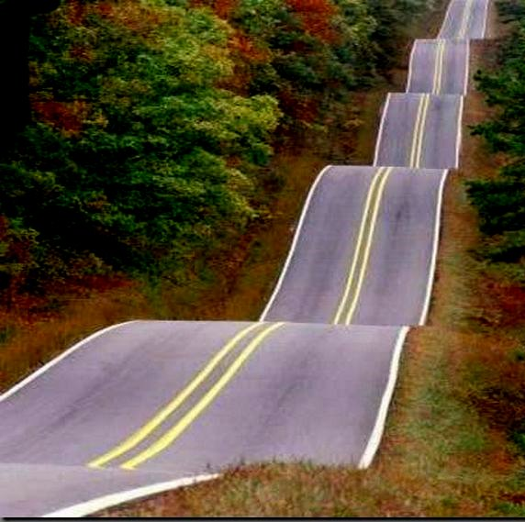
Wisdom in the Ups & Downs
Ecclesiastes 6:10–7:14
Dr. Rick Griffith • Crossroads International Church Singapore
CICFamily.com • BibleStudyDownloads.org

Slide 2
If you could, would you like to know what would happen in the next year of your life?
Yes? Or No?
Why?

Slide 3
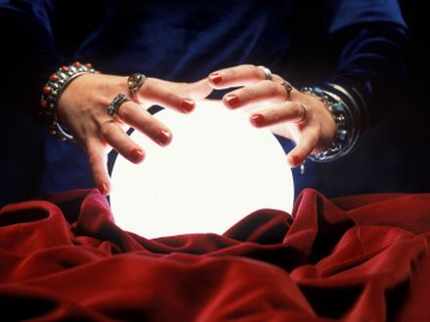
Do you think that knowing your future would make you more secure, more peaceful, and more joyful?
Notes:
That future will include some pleasant things—the joy you will experience, maybe a pay raise, or reconciled relationship—but you won’t experience that right now.
That future also will include some tough times—perhaps grief, maybe some difficult relationships, sickness, or heartache—and if you knew right now that these difficulties were coming, I suspect you might live more anxiously today.
Isn’t living in ignorance better? We tend to think that knowledge brings blessing, so we try to increase our knowledge. However, there is a rest that comes from not knowing not the details of our future, but knowing that we can trust God with our lives.

Slide 4
Why should we trust in God's plan for our lives?

Slide 5
Ecclesiastes Overview
403

Slide 6
Work
Notes:
The emphasis in the book up to this point has been to speak a lot about work.

Slide 7
Materialism
Notes:
Solomon has told us that a life pursuit of only work, projects, and money is futile. He has warned of being a workaholic and materialist.

Slide 8
Wisdom
Notes:
So why is this latter part of the book on wisdom in the Bible?
Some might think, “I agree. Life is more important than just work. What really makes life worthwhile is wisdom!” So now the topic shifts to addressing wisdom itself—but it will surprise you!

Slide 9
Our Study in Ecclesiastes
Work & Wisdom Don't Last

Slide 10
Emphases of 6:10–11:6
"do(es) not or cannot know"
"do(es) not or cannot discover"
"it is good"
"X is better than Y"
"what God has done"
what the future holds
fear God
please Him
Notes:
"This section is characterized the repetition of the phrases 'do(es) not/cannot know' (6:12; 9:1, 12: 10:14; 11:2, 6) and 'do(es) not/cannot discover' (7:14, 24,28; 8:17). As many commentators note, this section is characterized by many imperatives, recommendations, and commendations (e.g., "it is good," 7:18; or "X is better than Y"; 7:2,5; 9:16,19). This second half of the book thus contains much practical advice on how to live. However, this advice is given in the light of constant reminders of man's ignorance of the providence of God (i.e., "What God has done," 7:13; cf. 8:17) and what the future holds (e.g., 9:1; 10:14; 11:2). This advice is intended to encourage people to fear God (7:18; 8:12; 12:13) and lead lives that please Him (7:26; cf. 2:26)" (Glenn, BKC, 1:991)

Slide 11
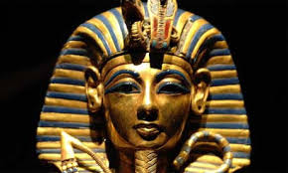
Heroes
Today:
Sports & Actors
Ancient Near East: Wisdom
Notes:
Today we idolize people who can put a ball through a net better than others, or can run faster or lift more weight, or whatever sport it might be. We also idolize people who make a living pretending to be someone else. That’s called being an actor or actress.
However, the Ancient Near East had a prominent emphasis on wisdom. Each society prided itself on its “aged sages”—men of wisdom who declared and wrote literature that helped people with life’s thorny issues. Ecclesiastes is a prime example of such wisdom, and…

Slide 12
Why should we trust in God's plan for our lives?
2 reasons (Eccl. 6:10–7:14)
Notes:
Today's text gives two reasons we should trust in God’s plan for our lives.

Slide 13
I. God has planned all events and won't change them (6:10-12).
Notes:
You can try to change many things in your life, but God ultimately decides.

Slide 14
"Everything has already been decided. It was known long ago what each person would be. So there's no use arguing with God about your destiny. The more words you speak, the less they mean. So what good are they?" (6:10-11 NLT).
Notes:
God won’t change His plan despite our arguing with Him (6:10-11).

Slide 15
A Lie of Our Age…

Slide 16
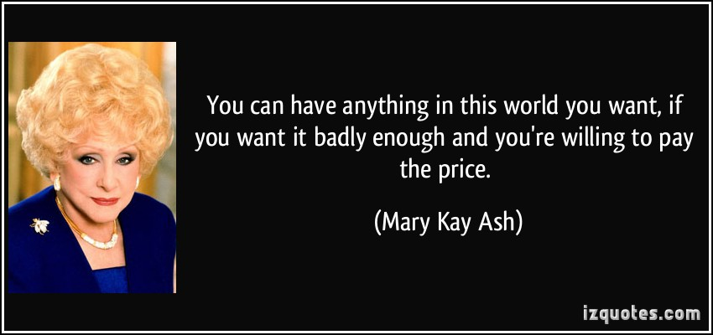
"You can have anything in this world you want, if you want it badly enough and you're willing to pay the price" — Mary Kay Ash

Slide 17
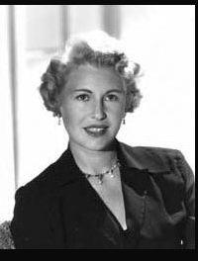
"You can have anything you want if you want it desperately enough. You must want it with an exuberance that erupts through the skin and joins the energy that created the world." —Sheila Graham

Slide 18
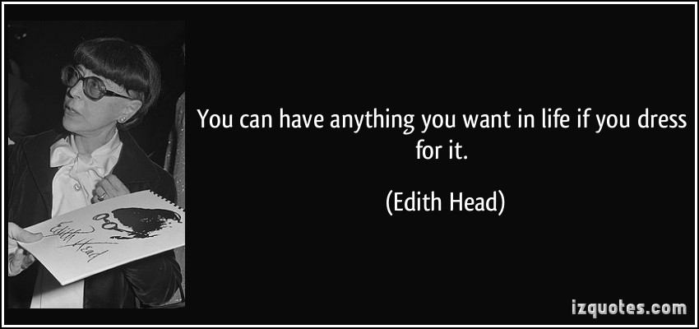
"You can have anything you want in life if you dress for it" —Edith Head

Slide 19
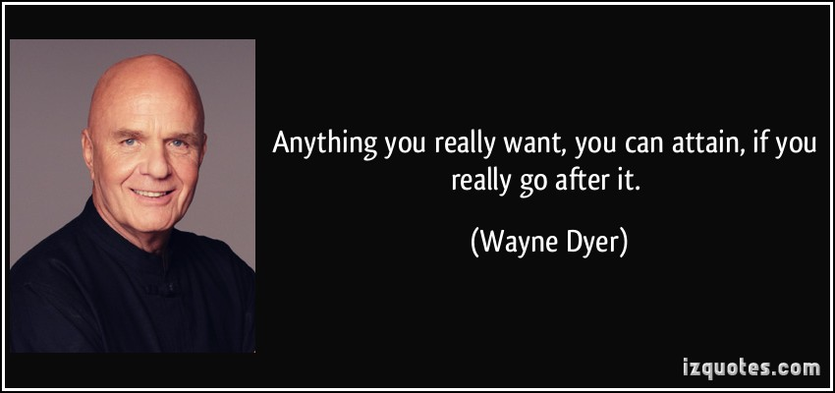
"Anything you really want, you can attain, if you really go after it." — Wayne Dyer

Slide 20
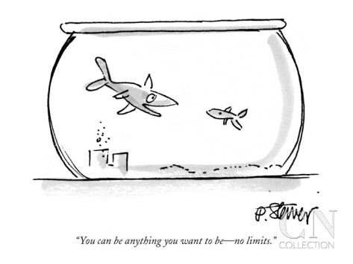
"You can be anything you want to be—no limits"
Notes:
Really? So this fish can breathe air?

Slide 21
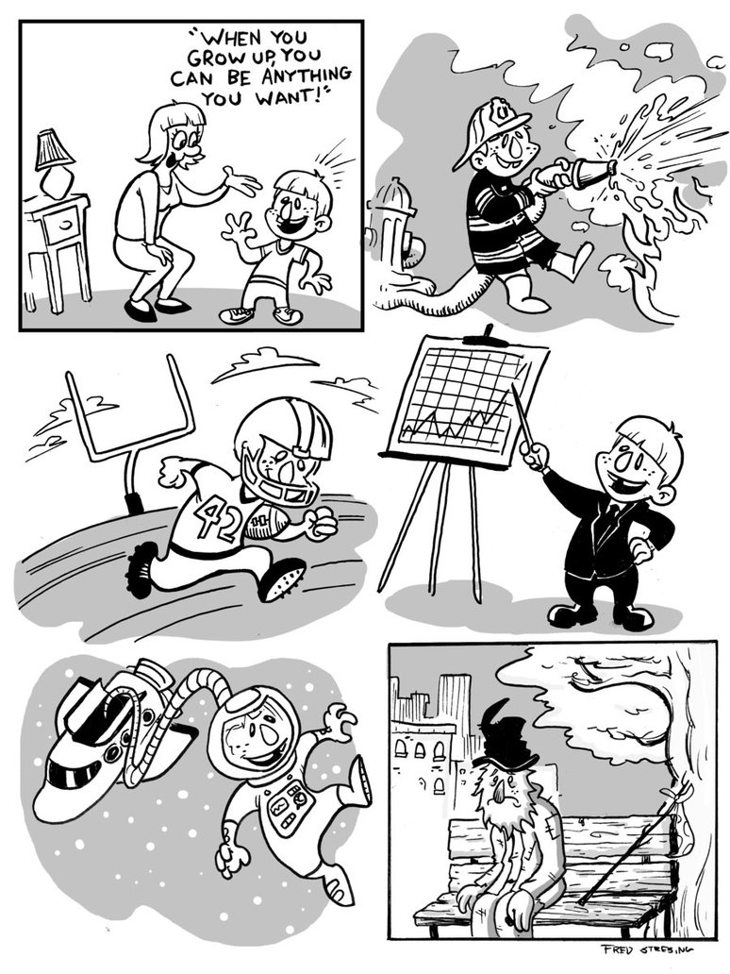
"When you grow up, you can be anything you want!"
Notes:
“You can be whatever you want!” Really? Then why aren’t we all happy? Don’t all people want to be happy?
“Be what you want to be!” Really? Can I be the best shot-putter in the world? I don’t think so! God hasn’t given me the muscle mass.

Slide 22
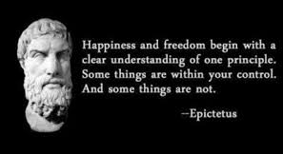
None of us really believes that we can control our lives.
"Happiness and freedom begin with a clear understanding of one principle. Some things are within your control. And some things are not."
—Epictetus

Slide 23
"In the few days of our meaningless lives, who knows how our days can best be spent? Our lives are like a shadow. Who can tell what will happen on this earth after we are gone?" (6:12 NLT).
Notes:
We are fleeting and ignorant of the future (6:12).

Slide 24
None of knows the future—and it's a good thing!
Notes:
None of knows the future—and it’s a good thing!
If we knew the difficulties ahead, then we would live dreading the future.
If we knew the blessings ahead, I doubt we would enjoy life now.

Slide 25
Why should we trust in God's plan for our lives?

Slide 26
I. God has planned all events and won't change them (6:10-12).
Notes:
So why trust God? Solomon has said we should trust him because he has planned all events and won’t change them. Now he gives a second reason to trust God’s plans for our lives…

Slide 27
II. We don't know why easy and tough times come our way (7:1-14).
Notes:
Trust God, even though you can’t explain why "good times roll" and "not-so-good times roll."

Slide 28
The wise gain wisdom from adversity (7:1-10).

Slide 29
"A good reputation is more valuable than costly perfume" (7:1a NLT).
Notes:
The wise know that character is better than outward characteristics (7:1a).
Wow, I better be careful here since two of our key members are managers with Chanel! Of course, I think that Valentin and Jieun would agree that…
Having a good reputation is more important than just smelling nice.

Slide 30
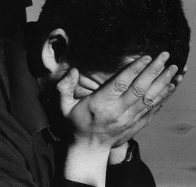
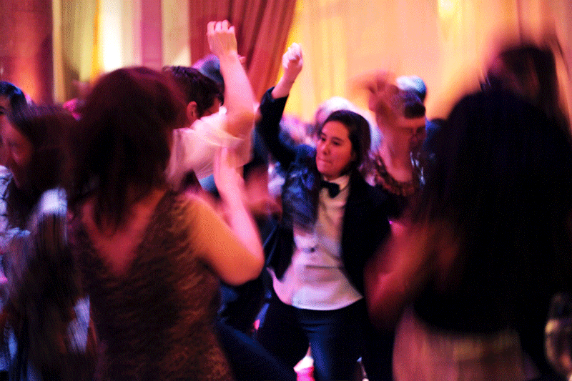
"And the day you die is better than the day you are born. ²Better to spend your time at funerals than at parties. After all, everyone dies—so the living should take this to heart" (7:1b-2 NLT)
Notes:
Attending a funeral is better than gorging at a feast because this reminder of one's own end prompts him to soberness and wisdom (7:2; cf. Ps. 90:12)

Slide 31
"Sorrow is better than laughter, for sadness has a refining influence on us. ⁴A wise person thinks a lot about death, while a fool thinks only about having a good time" (7:3-4 NLT).
Notes:
The wise reflect upon the brevity of their lives (7:1b-4).

Slide 32
Help children deal with death.
Notes:
I don’t have many regrets in raising my three sons, but one is that I wish I took them out of school to go to funerals.

Slide 33
The wise listen to rebuke (7:5-6)

Slide 34
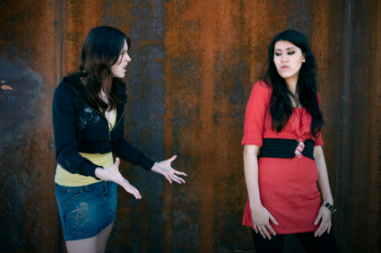
"Better to be criticized by a wise person than to be praised by a fool" (7:5 NLT).

Slide 35
Listen to your parents
Notes:
Having parents issues? Check this guide for teens to understanding their parents
January 21, 2014InspiredA guide for teens to understanding their parents (MUST READ)
by Sharon Nton Ntan
Parents – there's no escaping them! You live with them, eat with them, you sleep in the same house with them. You've observed firsthand what they are like and no doubt have come to the conclusion: parents are "strange and different". They don't talk like you talk. "How in the world do I get along with these people ?!" you ask.
Getting along with your parents is a very real task you have to face as a teenager. It's a part of your life, and it has a great impact and bearing on the rest of your life.. How you act and react when you are with your family will determine how you relate to other people in the future.
You may really have your life together when you're with your friends, but when you get home, it's crazy. It's a hair-tearing, plate-throwing, name-calling experience. It's a mess! And it's not right because home ought to be where all your training begins and counts.
So what can you do? The answers are as listed and explained below.
1. Listen to your parents Many people say there is a generation gap in the world today. There is no generation gap – there is a communication gap. The first step to getting along with your parents is to close up that communication gap. This is appropriate, because you should carry on a lot of conversations with your parents. If you don't, you miss a great privilege.
Listening to your parents is as easy as closing them out. Do you ever turn off the switch? Your parents start talking and click! You shut them off. What would happen if you had a friend who turned the switch off when you were telling them something important? Exactly! As you train yourself to listen to your parents, you train yourself to listen to others. If you love someone, you are willing to listen to what they have to say. Not listening expresses the opposite. It tells the people talking to you that you think they should shut up or you think their words or thoughts are worthless. Listen to your parents if you want them to listen to you. Do not interrupt them when they are speaking.

Slide 36
"An open rebuke is better than hidden love!" (Prov. 27:5 NLT).

Slide 37
"…Be quick to listen, slow to speak…" (James 1:19 NLT).

Slide 38
"A fool's laughter is quickly gone, like thorns crackling in a fire. This also is meaningless" (7:6 NLT).

Slide 39
The wise submit to both prosperous and adverse circumstances (7:7-10).
If there are no ups and downs in your life it means you are dead.

Slide 40
Life is a roller coaster

Slide 41
"For oppression makes a wise man mad, and a bribe corrupts the heart" (7:7 NAU)
An oppressive situation can tempt one to anger and greed.
Notes:
The NLT renders “oppression” as “extortion” here, which is too narrow a meaning. “Oppression (the normal meaning of this word rather than extortion; cf. 4:1; 5:8) might turn him into a fool” (BKC).

Slide 42
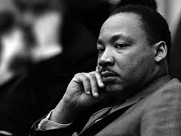
"Injustice anywhere is a threat to justice everywhere" —Martin Luther King

Slide 43
This is the most dangerous animal in the world. It is responsible for MILLIONS of deaths every year. By its side, a great white shark swims peacefully

Slide 44
"…a bribe corrupts the heart" (7b)
Notes:
This is why we must avoid bribes. Our hearts can become very corrupt from bribes!
A Philippine policeman once stopped our truck with a harp on the roof for supposedly violating a top load permit law. So we showed him our top load permit. He told us, “That is not valid. You can pay me the fine now or wait three hours in line down at the police station and pay it there.” We looked closely at his badge to get his police identity number. Then he covered it and said, “I let you by just this one time!”

Slide 45
"Finishing is better than starting.
Patience is better than pride" (7:8 NLT).

Slide 46
"Control your temper, for anger labels you a fool" (7:9 NLT).

Slide 47
"Don't long for 'the good old days.' This is not wise" (7:10 NLT).

Slide 48
The wise benefit from prosperity (7:11-12).

Slide 49
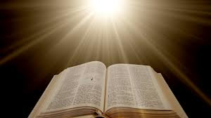
"Wisdom is even better when you have money. Both are a benefit as you go through life. ¹²Wisdom and money can get you almost anything, but only wisdom can save your life" (7:11-12 NLT).
Notes:
Wisdom plus prosperity is good (7:11).
Wisdom and prosperity both provide protection (7:12a).
Wisdom is superior to prosperity since generally a wise man lives longer than does a [rich] fool (7:12b; cf. 7:17; Prov. 13:14).
Prov. 13:14 The instruction of the wise is like a life-giving fountain;
those who accept it avoid the snares of death.

Slide 50
The wise rest in God's plan for prosperity and adversity (7:13-14).

Slide 51
"Accept the way God does things, for who can straighten what he has made crooked?" (7:13 NLT).
Notes:
Although people find fault with God's ways they can't change them (7:13).

Slide 52
Remember that nothing is certain in this life" (7:14 NLT).
"Enjoy prosperity while you can, but when hard times strike, realize that both come from God.
Notes:
Rejoice in prosperity (7:14a).
Recognize God's sovereignty in adversity (7:14b).
God made prosperity and adversity so our ignorance of the future will cause us to trust God (7:14c).

Slide 53
Why should we trust in God's plan for our lives?
2 reasons

Slide 54
God's plan is unchanging and you are ignorant of it.
The Main Idea of 6:10–7:14
Why trust in God's plan?
Notes:
Trust the Lord’s will even though you can’t figure it out (MI restated)!

Slide 55
I. God has planned all events and won't change them (6:10-12).
Notes:
Trust God’s wise plan because his plan is already set!

Slide 56
II. We don't know why easy and tough times come our way (7:1-14).
Notes:
Trust God’s wise plan because you don’t know your future—whether the good times or the bad times in life.

Slide 57
Rest in your future.
Notes:
God has planned the future, so wisdom finds refuge in trusting in plan.
Wise people rest about their future marriage partner.
Wise people rest about their future ministry.
Wise people rest about their children’s future.

Slide 58
Since God is author of both the good times and the bad times, wisdom trusts that God has purposes beyond human understanding.
Notes:
Rest in Your Future Trials and Good Times: Since God is author of both the good times and the bad times, wisdom trusts that God has purposes beyond human understanding.
The wise person learns what God wanted from trials.
The wise person sees that the present good times also come from God.

Slide 59
How is God telling you to rest in your ignorance of your future?

Slide 60
Black

Slide 61
OT Preaching link at BibleStudyDownloads.org
Get this presentation and script for free!

