Slide 1
Humble-Hearted Sanity
Ecclesiastes 11:7–12:14
Matthew Lyle at Crossroads International Church Singapore • CICFamily.com Uploaded by Dr. Rick Griffith • Jordan Evangelical Theological Seminary Files in many languages for free download at BibleStudyDownloads.org

Slide 2


Slide 3


A Watched Pot Never Boils
心急吃不了热豆腐
A hurried heart
can't eat hot tofu

Slide 4
Where are you going?
To get a haircut

Slide 5
Shouldn’t you have thought about that before the sermon?

Slide 6
I didn’t need a haircut before the sermon!

Slide 7



Slide 8
O Lord my God
when I in awesome wonder
Consider all
the works Thy hand hath made
I see the stars
I hear the mighty thunder
Thy pow'r throughout
the universe displayed
Creation – Genesis 1

Slide 9
When through the woods
and forest glades I wander
And hear the birds
sing sweetly in the trees
When I look down
from lofty mountain grandeur
And hear the brook
and feel the gentle breeze
Creation & Romans 1:20
Romans 1:20

Slide 10
Romans 1:20
For ever since the world was created, people have seen the earth and sky. Through everything God made, they can clearly see his invisible qualities—his eternal power and divine nature. So they have no excuse for not knowing God.

Slide 11
Evidence of God
Injustice in the world
Solomon’s Dilemma

Slide 12
And when I think
that God His Son not sparing
Sent Him to die
I scarce can take it in
That on the Cross
my burden gladly bearing
He bled and died
to take away my sin
God’s Answer

Slide 13
Gen 12 ³ I will bless those who bless you, and him who dishonors you I will curse, and in you all the families of the earth shall be blessed.”
Gen 22 ¹⁸ and in your offspring shall all the nations of the earth be blessed, because you have obeyed my voice.”
God’s Answer

Slide 14
When Christ shall come
with shout of acclamation
And take me home
what joy shall fill my heart
Then shall I bow
in humble adoration
And there proclaim
my God how great Thou art
a call to stand in awe and worship before the Creator!
Our Response

Slide 15
¹³ The end of the matter; all has been heard. Fear God and keep his commandments, for this is the whole duty of man. ¹⁴ For God will bring every deed into judgment, with every secret thing, whether good or evil.
Eccl 12:13-15 (ESV)
Solomon’s
Response
a call to stand in awe and worship before the Creator!

Slide 16
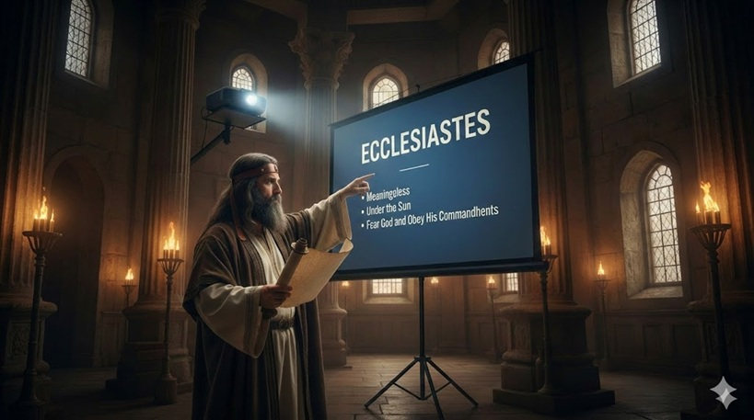
Eccl 1:1-11 11 verses Author
Eccl 1:12-12:7 204 verses Solomon
Eccl 12:8-14 7 verses Author

Slide 17
Without God, Life Stinks!
Ecclesiastes
Section 1: Futility of living in a Frustrating World
(Teacher's Search for meaning of life)
Eccl 1-2 Genius Level Depression
Eccl 3:1-5:1 Time Marches, Justice Crawls
Eccl 5:1-6:9 Full Hands, Empty Lives
Section 2: Faithful Living in a Frustrating World
(Teacher’s Advice)
Eccl 6:10-8:17 When Wisdom Comes Up Short
Eccl 9:1-11:6 Death Levels All, But Life Still Calls
Eccl 11:7–12:14 Humble-Hearted Sanity

Slide 18
Without God, Life Stinks!
Ecclesiastes
Section 1: Futility of living in a Frustrating World
(Teacher's Search for meaning of life)
Ch 1 ¹ These are the words of the Teacher, King David’s son, who ruled in Jerusalem. ² “Everything is meaningless,” says the Teacher, “completely meaningless!”
Section 2: Faithful Living in a Frustrating World
(Teacher’s Advice)
Ch 12 ¹³ That’s the whole story. Here now is my final conclusion: Fear God and obey his commands, for this is everyone’s duty. ¹⁴ God will judge us for everything we do, including every secret thing, whether good or bad.

Slide 19
I look around
and see the world’s affliction,
Life's not made fair
it seems like chasing wind
I hear your word,
your faithful wisdom calling
To fear my God,
obey and choose his joy.
Sing to tune of “How Great Thou Art”
Ecclesiastes in Song

Slide 20
Humble-Hearted Sanity
Ecclesiastes 11:7–12:14

Slide 21

Humble Hearted Sanity is Found in Fearing God, not Following the World

Slide 22
1. Rejoice and Remember (11:7–12:7)
Solomon’s summary / epilogue
2. The Bottom Line (12:8-14)
Author’s summary / epilogue)
Humble-Hearted Sanity
Ecclesiastes 11:7–12:14

Slide 23
1. Rejoice and Remember (11:7-12:7)
Solomon’s summary / epilogue
A. Life Is Sweet (11:7-8a, 9a)
B. Dark Days Are Certain (11:8b
C. Joy has Boundaries (11:9b:10)
D. Remember Before It’s Gone (12:1-7)
2. The Bottom Line (12:8-14)
Author’s summary / epilogue)
Humble-Hearted Sanity
Ecclesiastes 11:7–12:14

Slide 24
⁷ Light is sweet; how pleasant to see a new day dawning.
⁸ When people live to be very old, let them rejoice in every day of life. But let them also remember there will be many dark days. Everything still to come is meaningless.
⁹ Young people, it’s wonderful to be young! Enjoy every minute of it. Do everything you want to do; take it all in. But remember that you must give an account to God for everything you do. ¹⁰ So refuse to worry, and keep your body healthy. But remember that youth, with a whole life before you, is meaningless.
Rejoice
Eccl 12:7-10

Slide 25
⁷ Light is sweet; how pleasant to see a new day dawning. ⁸ When people live to be very old, let them rejoice in every day of life. … ⁹ Young people, it’s wonderful to be young! Enjoy every minute of it. Do everything you want to do; take it all in.
2:24-25
3:12-13
3:22
5:18-19
8:15
9:7-9
11:7-8a
Enjoy Life!
Life Is Sweet
Eccl 12:7-8a,9a

Slide 26
2:24-25
3:12-13
3:22
5:18-19
8:15
9:7-9
11:7-8a
statement
affirmation
RECOMMENDATION
COMMAND
EXECUTIVE SUMMARY
Enjoy Life!

Slide 27
⁷ Light is sweet; how pleasant to see a new day dawning. ⁸ When people live to be very old, let them rejoice in every day of life. But let them also remember there will be many dark days. Everything still to come is meaningless.
Dark Days Are Certain
Eccl 12:8b

Slide 28
⁹ Young people, it’s wonderful to be young! Enjoy every minute of it. Do everything you want to do; take it all in. But remember that you must give an account to God for everything you do. ¹⁰ So refuse to worry, and keep your body healthy. But remember that youth, with a whole life before you, is meaningless.
Joy has Boundaries
Eccl 12:9-10

Slide 29
Ch 12 ¹ Don’t let the excitement of youth cause you to forget your Creator. Honor him in your youth before you grow old and say, “Life is not pleasant anymore.”
² Remember him before the light of the sun, moon, and stars is dim to your old eyes, and rain clouds continually darken your sky. ³ Remember him before your legs—the guards of your house—start to tremble; and before your shoulders—the strong men—stoop. Remember him before your teeth—your few remaining servants—stop grinding; and before your eyes—the women looking through the windows—see dimly. ⁴ Remember him before the door to life’s opportunities is closed and the sound of work fades. Now you rise at the first chirping of the birds, but then all their sounds will grow faint. ⁵ Remember him before you become fearful of falling and worry about danger in the streets; before your hair turns white like an almond tree in bloom, and you drag along without energy like a dying grasshopper, and the caperberry no longer inspires sexual desire. Remember him before you near the grave, your everlasting home, when the mourners will weep at your funeral.
⁶ Yes, remember your Creator now while you are young, before the silver cord of life snaps and the golden bowl is broken. Don’t wait until the water jar is smashed at the spring and the pulley is broken at the well. ⁷ For then the dust will return to the earth, and the spirit will return to God who gave it.
Remember Before It’s Gone
Eccl 12:1-7

Slide 30
Without God, Life Stinks!
Ecclesiastes
Section 1: Futility of living in a Frustrating World
(Teacher's Search for meaning of life)
Ch 1 ¹ These are the words of the Teacher, King David’s son, who ruled in Jerusalem. ² “Everything is meaningless,” says the Teacher, “completely meaningless!” (NLT)
Section 2: Faithful Living in a Frustrating World
(Teacher’s Advice)
Ch 12 ¹³ That’s the whole story. Here now is my final conclusion: Fear God and obey his commands, for this is everyone’s duty. ¹⁴ God will judge us for everything we do, including every secret thing, whether good or bad. (NLT)

Slide 31
Ch 1 ¹ These are the words of the Teacher, King David’s son, who ruled in Jerusalem. ² “Everything is meaningless,” says the Teacher, “completely meaningless!” (NLT)
Ch 12 ¹³ That’s the whole story. Here now is my final conclusion: Fear God and obey his commands, for this is everyone’s duty. ¹⁴ God will judge us for everything we do, including every secret thing, whether good or bad. (NLT)
Author’s Summary

Slide 32
Ch 1 ¹ These are the words of the Teacher, King David’s son, who ruled in Jerusalem. ² “Everything is meaningless,” says the Teacher, “completely meaningless!” (NLT)
Ch 1 ¹² I, the Teacher, was king of Israel, and I lived in Jerusalem. …. ¹⁴ I observed everything going on under the sun, and really, it is all meaningless—like chasing the wind. (NLT)
Ch 12 ¹³ That’s the whole story. Here now is my final conclusion: Fear God and obey his commands, for this is everyone’s duty. ¹⁴ God will judge us for everything we do, including every secret thing, whether good or bad. (NLT)
Ch 12 ¹ Don’t let the excitement of youth cause you to forget your Creator. Honor him in your youth before you grow old and say, “Life is not pleasant anymore.” (NLT)
Author’s Summary
Solomon’s Summary

Slide 33
Ch 1 ¹ These are the words of the Teacher, King David’s son, who ruled in Jerusalem. ² “Everything is meaningless,” says the Teacher, “completely meaningless!” (NLT)
Ch 1 ¹² I, the Teacher, was king of Israel, and I lived in Jerusalem. …. ¹⁴ I observed everything going on under the sun, and really, it is all meaningless—like chasing the wind.
Ch 12 ¹³ That’s the whole story. Here now is my final conclusion: Fear God and obey his commands, for this is everyone’s duty. ¹⁴ God will judge us for everything we do, including every secret thing, whether good or bad. (NLT)
Ch 12 ¹ Remember also your Creator in the days of your youth, before the evil days come and the years draw near of which you will say, “I have no pleasure in them”;
(ESV)
Author’s Summary
Solomon’s Summary

Slide 34
² Remember him before the light of the sun, moon, and stars is dim to your old eyes, and rain clouds continually darken your sky. ³ Remember him before your legs—the guards of your house—start to tremble; and before your shoulders—the strong men—stoop. Remember him before your teeth—your few remaining servants—stop grinding; and before your eyes—the women looking through the windows—see dimly. ⁴ Remember him before the door to life’s opportunities is closed and the sound of work fades. Now you rise at the first chirping of the birds, but then all their sounds will grow faint.
Remember Before It’s Gone
Eccl 12:2-4

Slide 35
⁵ Remember him before you become fearful of falling and worry about danger in the streets; before your hair turns white like an almond tree in bloom, and you drag along without energy like a dying grasshopper, and the caperberry no longer inspires sexual desire. Remember him before you near the grave, your everlasting home, when the mourners will weep at your funeral.
Remember Before It’s Gone
Eccl 12:5

Slide 36
⁶ Yes, remember your Creator now while you are young, before the silver cord of life snaps and the golden bowl is broken. Don’t wait until the water jar is smashed at the spring and the pulley is broken at the well. ⁷ For then the dust will return to the earth, and the spirit will return to God who gave it.
Remember Before It’s Gone
Eccl 12:6-7

Slide 37
1. Rejoice and Remember (11:7-12:7)
Solomon’s summary / epilogue
A. Life Is Sweet (11:7-8a, 9a)
B. Dark Days Are Certain (11:8b
C. Joy has Boundaries (11:9b:10)
D. Remember Before It’s Gone (12:1-7)
2. The Bottom Line (12:8-14)
Author’s summary / epilogue)
Humble-Hearted Sanity
Ecclesiastes 11:7–12:14

Slide 38
1. Rejoice and Remember (11:7–12:7)
Solomon’s summary / epilogue
2. The Bottom Line (12:8-14)
Author’s summary / epilogue)
A. Nothing New — Still Vapor (8)
B. A Trusted Voice (9-10)
C. Words That Wound and Wake (11)
D. Limits to Learning (12)
E. The Whole Duty /Wise conclusion (13-14)
Humble-Hearted Sanity
Ecclesiastes 11:7–12:14

Slide 39
⁸ “Everything is meaningless,” says the Teacher, “completely meaningless.”
⁹ Keep this in mind: The Teacher was considered wise, and he taught the people everything he knew. He listened carefully to many proverbs, studying and classifying them. ¹⁰ The Teacher sought to find just the right words to express truths clearly.
¹¹ The words of the wise are like cattle prods—painful but helpful. Their collected sayings are like a nail-studded stick with which a shepherd drives the sheep.
¹² But, my child, let me give you some further advice: Be careful, for writing books is endless, and much study wears you out.
¹³ That’s the whole story. Here now is my final conclusion: Fear God and obey his commands, for this is everyone’s duty. ¹⁴ God will judge us for everything we do, including every secret thing, whether good or bad.
The Bottom Line
Eccl 12:8-14

Slide 40
⁸ “Everything is meaningless,” says the Teacher, “completely meaningless.”
Nothing New — Still Vapor
Eccl 12:8

Slide 41
⁸ “Everything is meaningless,” says the Teacher, “completely meaningless.”
⁹ Keep this in mind: The Teacher was considered wise, and he taught the people everything he knew. He listened carefully to many proverbs, studying and classifying them. ¹⁰ The Teacher sought to find just the right words to express truths clearly.
A Trusted Voice
Eccl 12:9-10

Slide 42
⁸ “Everything is meaningless,” says the Teacher, “completely meaningless.”
⁹ Keep this in mind: The Teacher was considered wise, and he taught the people everything he knew. He listened carefully to many proverbs, studying and classifying them. ¹⁰ The Teacher sought to find just the right words to express truths clearly.
¹¹ The words of the wise are like cattle prods—painful but helpful. Their collected sayings are like a nail-studded stick with which a shepherd drives the sheep.
Words That Wound and Wake
Eccl 12:11

Slide 43
¹² But, my child, let me give you some further advice: Be careful, for writing books is endless, and much study wears you out.
Limits to Learning
Eccl 12:12

Slide 44
¹² But, my child, let me give you some further advice: Be careful, for writing books is endless, and much study wears you out.
¹³ That’s the whole story. Here now is my final conclusion: Fear God and obey his commands, for this is everyone’s duty. ¹⁴ God will judge us for everything we do, including every secret thing, whether good or bad.
The Whole Duty / Wise conclusion
Eccl 12:13-14

Slide 45
Ch 3 ¹⁷ I said to myself, “In due season God will judge everyone, both good and bad, for all their deeds.”
Ch 11 ⁹ Young people, it’s wonderful to be young! Enjoy every minute of it. Do everything you want to do; take it all in. But remember that you must give an account to God for everything you do.

Slide 46
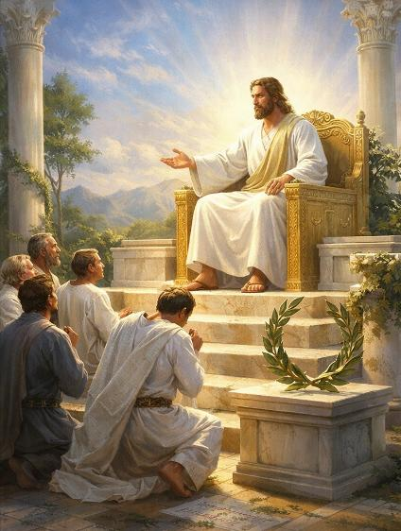
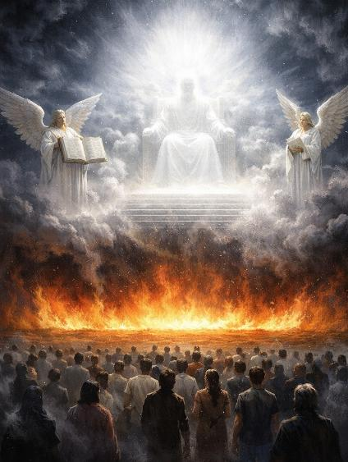
Bema Seat (Judgment Seat of Christ)
2 Cor 5:10, Rom 14:10
Believers only (Christians)
Post-Rapture (often believed to be in Heaven) To evaluate works and rewards
Crowns and rewards (or loss of reward)
Great White Throne Judgment
Rev 20:11-15
Unbelievers of all ages
After the Millennial Reign of Christ
To determine eternal condemnation
Separation from God in the Lake of Fire

Slide 47
Humble Hearted Sanity is Found in Fearing God, not Following the World

Slide 48
from Remember our Creator to Remember our Redeemer

Slide 49
Small Group Discussion
Solomon warns us not to let excitement make us forget. In our modern life, what are the specific excitements or distractions that most often make us forget we have a Creator?
What does it actually look like to Remember or Honor God in the middle of a busy, unpredictable life now, rather than waiting for the dark days of old age to arrive?

Slide 50
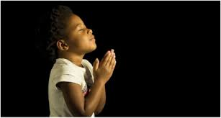
LET US PRAY….

Slide 51
Black

Slide 52


OT Preaching link at BibleStudyDownloads.org
Get this presentation and handout for free!
Notes:
OT Preaching (op)

