Slide 1
Genius-Level Depression
Ecclesiastes 1–2
Matthew Lyle
at Crossroads International Church Singapore • CICFamily.com
Uploaded by Dr. Rick Griffith • Jordan Evangelical Theological Seminary
Files in many languages for free download at BibleStudyDownloads.org

Slide 2
Biggest
Smallest
Strongest
T
Fastest
Brightest
Hottest
allest
Richest
LOUDEST
Greatest
Most
Best

Slide 3
World’s
Tallest
Building

Slide 4
WORLD’S TALLEST BUILINGS
    Skyscraper Center
    by Council of Vertical Urbanism
Name | Country | Height | Floors
Burj Khalifa | Dubai | 828 m | 163
Merdeka 118 | Malaysia | 679 m | 118
Shanghai Tower | China | 632 m | 128
Makkah Royal Clock Tower | Saudi Arabia | 601 m | 120
Ping An Finance Center | China | 599 m | 115
Lotte World Tower | South Korea | 555 m | 123

Slide 5
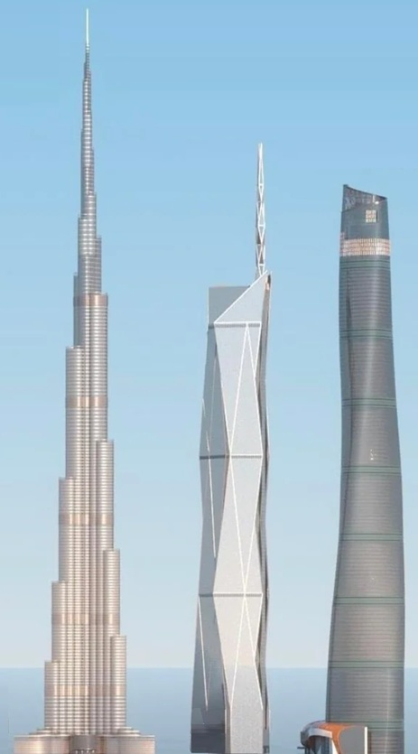

Slide 6
Asia-pacific vs world
    Skyscraper Center
    by Council of Vertical Urbanism
As of 2025 | Top 10 | Top 50
Asia-Pacific | 7 | 40
World | 3 | 10

Slide 7

Asia-pacific vs world
    Skyscraper Center
    by Council of Vertical Urbanism
Under Construction | Top 10 | Top 50
Asia-Pacific | 0 | ~15
World | 10 | ~35

Slide 8
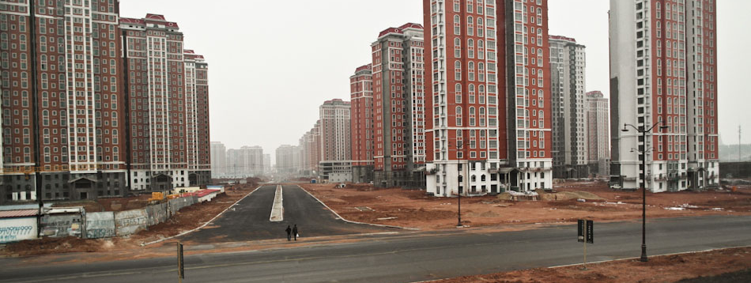
vanity
This Photo (https://dfc-economiahistoria.blogspot.com/2012/) by Unknown Author is licensed under CC BY-NC-ND (https://creativecommons.org/licenses/by-nc-nd/3.0/)

Slide 9
Genius-Level Depression
Ecclesiastes 1-2

Slide 10
Without God,
Life Stinks!
Ecclesiastes
Section 1: Futility of living in a Frustrating World
(Teacher's Search for meaning of life)
Section 2: Faithful Living in a Frustrating World (Teacher’s Advice)

Slide 11

BibleProject

Slide 12
Genius-Level Depression
1. The Problem Stated: Life on Repeat (1:1-11)
(Author’s summary / prologue)
2. Brilliant Mind, Bleak Results (1:12-18)
(Solomon’s speaking)
3. I Tried Everything. It Didn’t Work (2:1-23)
(Solomon’s Searching)
4. A Crack in the Darkness (2:24-26)
(Solomon’s Summary)
Ecclesiastes 1-2

Slide 13

Ch 1 ¹The words of the Preacher, the son of David, king in Jerusalem
The Teacher Identified
Eccl 1:1 (ESV)

Slide 14
Ch 1 ¹The words of the Preacher, the son of David, king in Jerusalem
² Vanity of vanities, says the preacher,
vanity of vanities! All is vanity.
The Shocking Thesis
Eccl 1:2 (ESV)

Slide 15
הֶבֶל heḇel
Literal
vapor
breath
mist
Figurative
meaningless
futile
vanity

Slide 16

Vanity of vanities

Slide 17
¹ These are the words of the Teacher, King David’s son, who ruled in Jerusalem.
² “Everything is meaningless,” says the Teacher, “completely meaningless!”
The Shocking Thesis
Eccl 1:2 (NLT)

Slide 18
³ What do people get for all their hard work under the sun? ⁴ Generations come and generations go, but the earth never changes. ⁵ The sun rises and the sun sets, then hurries around to rise again. ⁶ The wind blows south, and then turns north. Around and around it goes, blowing in circles. ⁷ Rivers run into the sea, but the sea is never full. Then the water returns again to the rivers and flows out again to the sea.
The Wearisome Evidence
Eccl 1:3-7 (NLT)

Slide 19
⁸ Everything is wearisome beyond description. No matter how much we see, we are never satisfied. No matter how much we hear, we are not content.
⁹ History merely repeats itself. It has all been done before. Nothing under the sun is truly new. ¹⁰ Sometimes people say, “Here is something new!” But actually it is old; nothing is ever truly new. ¹¹ We don’t remember what happened in the past, and in future generations, no one will remember what we are doing now.
The Sobering Conclusion
Eccl 1:8-11 (NLT)

Slide 20
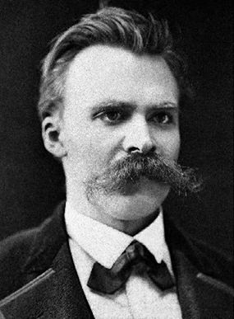
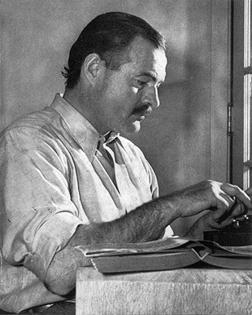
Nothing new under the sun
Nietzsche
Hemingway
Notes:
By Friedrich Hermann Hartmann - https://s-media-cache-ak0.pinimg.com/originals/04/10/0b/04100baec90c105729b47f33c371476b.jpg, Public Domain, https://commons.wikimedia.org/w/index.php?curid=95970

Slide 21
Genius-Level Depression
1. The Problem Stated: Life on Repeat (1:1-11)
(Author’s summary / prologue)
    The Teacher Identified (1)
    The Shocking Thesis (2)
    The Wearisome Evidence (3-7)
    The Sobering Conclusion (8-11)
Ecclesiastes 1-2

Slide 22
Genius-Level Depression
1. The Problem Stated: Life on Repeat (1:1-11)
(Author’s summary / prologue)
2. Brilliant Mind, Bleak Results (1:12-18)
(Solomon’s speaking)
Ecclesiastes 1-2

Slide 23
¹² I, the Teacher, was king of Israel, and I lived in Jerusalem.
¹⁶ I said to myself, “Look, I am wiser than any of the kings who ruled in Jerusalem before me. I have greater wisdom and knowledge than any of them.”
The King Reintroduced
Eccl 1:12,16 (NLT)

Slide 24
¹³ I devoted myself to search for understanding and to explore by wisdom everything being done under heaven.
¹⁷ So I set out to learn everything from wisdom to madness and folly.
The Frustrating Task
Eccl 1:13a,17a (NLT)

Slide 25
¹³ … I soon discovered that God has dealt a tragic existence to the human race. ¹⁴ I observed everything going on under the sun, and really, it is all meaningless—like chasing the wind.
¹⁷ … But I learned firsthand that pursuing all this is like chasing the wind.
By the sweat of your face
you shall eat bread,
till you return to the ground,
for out of it you were taken;
for you are dust,
and to dust you shall return.
Gen 3:19 (ESV)
The Bitter Discoveries
Eccl 1:13b-14,17b (NLT)

Slide 26
¹⁵ What is wrong cannot be made right.
What is missing cannot be recovered.
¹⁸ The greater my wisdom, the greater my grief.
To increase knowledge only increases sorrow.
The Painful Conclusion
Eccl 1:15,18 (NLT)

Slide 27
Genius-Level Depression
1. The Problem Stated: Life on Repeat (1:1-11)
(Author’s summary / prologue)
2. Brilliant Mind, Bleak Results (1:12-18)
(Solomon’s speaking)
    The King Reintroduced (12, 16)
    The Frustrating Task (13a, 17a)
    The Bitter Discoveries (13b-14, 17b)
    The Painful Conclusion (15,18)
Ecclesiastes 1-2

Slide 28
Genius-Level Depression
1. The Problem Stated: Life on Repeat (1:1-11)
(Author’s summary / prologue)
2. Brilliant Mind, Bleak Results (1:12-18)
(Solomon’s speaking)
3. I Tried Everything. It Didn’t Work (2:1-23)
(Solomon’s Searching)
Ecclesiastes 1-2

Slide 29
Ch 2 ¹ I said to myself, “Come on, let’s try pleasure. Let’s look for the ‘good things’ in life.” But I found that this, too, was meaningless. ² So I said, “Laughter is silly. What good does it do to seek pleasure?” ³ After much thought, I decided to cheer myself with wine. And while still seeking wisdom, I clutched at foolishness. In this way, I tried to experience the only happiness most people find during their brief life in this world.
Pleasure through Leisure
Eccl 2:1-3 (NLT)

Slide 30
⁴ I also tried to find meaning by building huge homes for myself and by planting beautiful vineyards. ⁵ I made gardens and parks, filling them with all kinds of fruit trees. ⁶ I built reservoirs to collect the water to irrigate my many flourishing groves.
Pleasure through Achievement
Eccl 2:4-6 (NLT)

Slide 31
⁷ I bought slaves, both men and women, and others were born into my household. I also owned large herds and flocks, more than any of the kings who had lived in Jerusalem before me. ⁸ I collected great sums of silver and gold, the treasure of many kings and provinces. I hired wonderful singers, both men and women, and had many beautiful concubines. I had everything a man could desire!
Pleasure through Abundance
Eccl 2:7-8 (NLT)

Slide 32
⁹ So I became greater than all who had lived in Jerusalem before me, and my wisdom never failed me. ¹⁰ Anything I wanted, I would take. I denied myself no pleasure. I even found great pleasure in hard work, a reward for all my labors. ¹¹ But as I looked at everything I had worked so hard to accomplish, it was all so meaningless—like chasing the wind. There was nothing really worthwhile anywhere.
Verdict on Pleasure
Eccl 2:9-11 (NLT)

Slide 33
Genius-Level Depression
3. I Tried Everything. It Didn’t Work (2:1-23)
(Solomon’s Searching)
  Pleasure: Promised More Than It Delivered (1-11)
    Pleasure through Leisure (1-3)
    Pleasure through Achievements (4-6)
    Pleasure through Abundance (7-8)
    Verdict on Pleasure (9-11)
Ecclesiastes 1-2

Slide 34
Genius-Level Depression
3. I Tried Everything. It Didn’t Work (2:1-23)
(Solomon’s Searching)
  Pleasure: Promised More Than It Delivered (1-11)
  Wisdom: Knew More but Gained Nothing (12-17)
Ecclesiastes 1-2

Slide 35
¹² So I decided to compare wisdom with foolishness and madness (for who can do this better than I, the king?). ¹³ I thought, “Wisdom is better than foolishness, just as light is better than darkness. ¹⁴ For the wise can see where they are going, but fools walk in the dark.”
Wisdom’s Advantage
Eccl 2:12-14a (NLT)

Slide 36
¹⁴ . . Yet I saw that the wise and the foolish share the same fate. ¹⁵ Both will die. So I said to myself, “Since I will end up the same as the fool, what’s the value of all my wisdom? This is all so meaningless!” ¹⁶ For the wise and the foolish both die. The wise will not be remembered any longer than the fool. In the days to come, both will be forgotten.
Wisdom’s Limit
Eccl 2:14b-16 (NLT)

Slide 37
¹⁷ So I came to hate life because everything done here under the sun is so troubling. Everything is meaningless—like chasing the wind.
Wisdom’s Verdict
Eccl 2:17 (NLT)

Slide 38
Genius-Level Depression
3. I Tried Everything. It Didn’t Work (2:1-23)
(Solomon’s Searching)
  Pleasure: Promised More Than It Delivered (1-11)
  Wisdom: Knew More but Gained Nothing (12-17)
    Wisdom’s Advantage (12-14a)
    Wisdom’s Limit (14b-16)
    Wisdom’s Verdict (17)
Ecclesiastes 1-2

Slide 39
Genius-Level Depression
3. I Tried Everything. It Didn’t Work (2:1-23)
(Solomon’s Searching)
  Pleasure: Promised More Than It Delivered (1-11)
  Wisdom: Knew More but Gained Nothing (12-17)
  Work: Built Much but Left Nothing (18-23)
Ecclesiastes 1-2

Slide 40
^{18a} I came to hate all my hard work here on earth,
^{21a} Some people work wisely with knowledge and skill,
Work’s Implied Gains
Eccl 2:18a, 21a (NLT)

Slide 41
^{18b} …for I must leave to others everything I have earned. ^{19a} And who can tell whether my successors will be wise or foolish? Yet they will control everything I have gained by my skill and hard work under the sun
^{21b} … then must leave the fruit of their efforts to someone who hasn’t worked for it.
Work’s Uncertain Legacy
Eccl 2:18b-19a, 21b (NLT)

Slide 42
^{19b} … How meaningless!
^{21c} … This, too, is meaningless, a great tragedy. ²² So what do people get in this life for all their hard work and anxiety?
Work’s Bitter Verdict
Eccl 2:19b, 21c-22 (NLT)

Slide 43
²⁰ So I gave up in despair, questioning the value of all my hard work in this world.
²³ Their days of labor are filled with pain and grief; even at night their minds cannot rest. It is all meaningless.
Work’s Relentless Pain
Eccl 2:20,23 (NLT)

Slide 44
Genius-Level Depression
3. I Tried Everything. It Didn’t Work (2:1-23)
(Solomon’s Searching)
  Pleasure: Promised More Than It Delivered (1-11)
  Wisdom: Knew More but Gained Nothing (12-17)
  Work: Built Much but Left Nothing (18-23)
    Work’s Implied Gains (18a, 21a)
    Work’s Uncertain Legacy (18b–19, 21b)
    Work’s Bitter Verdict (19b, 21c–22)
    Work’s Relentless Pain (20, 23)
Ecclesiastes 1-2

Slide 45
Genius-Level Depression
1. The Problem Stated: Life on Repeat (1:1-11)
(Author’s summary / prologue)
2. Brilliant Mind, Bleak Results (1:12-18)
(Solomon’s speaking)
3. I Tried Everything. It Didn’t Work (2:1-23)
  (Solomon’s Searching)
    Leisure fails because it cannot satisfy desire
    Wisdom fails because it cannot defeat death
    Work fails because it cannot secure legacy
Ecclesiastes 1-2

Slide 46
Genius-Level Depression
1. The Problem Stated: Life on Repeat (1:1-11)
(Author’s summary / prologue)
2. Brilliant Mind, Bleak Results (1:12-18)
(Solomon’s speaking)
3. I Tried Everything. It Didn’t Work (2:1-23)
(Solomon’s Searching)
4. A Crack in the Darkness (2:24-26)
(Solomon’s Summary)
Ecclesiastes 1-2

Slide 47
²⁴ So I decided there is nothing better than to enjoy food and drink and to find satisfaction in work. Then I realized that these pleasures are from the hand of God. ²⁵ For who can eat or enjoy anything apart from him?
Enjoyment Is God’s Gift
Eccl 2:24-25 (NLT)

Slide 48
²⁶ God gives wisdom, knowledge, and joy to those who please him. But if a sinner becomes wealthy, God takes the wealth away and gives it to those who please him. This, too, is meaningless—like chasing the wind.
God Gives… and God Redirects
Eccl 2:26 (NLT)

Slide 49
Same diagnosis, deeper hope
¹⁸ For I consider that the sufferings of this present time are not worth comparing with the glory that is to be revealed to us. ¹⁹ For the creation waits with eager longing for the revealing of the sons of God. ²⁰ For the creation was subjected to futility, not willingly, but because of him who subjected it, in hope ²¹ that the creation itself will be set free from its bondage to corruption and obtain the freedom of the glory of the children of God. Rom 8:18-22 (ESV)

Slide 50
⁴ But when the fullness of time had come, God sent forth his Son, born of woman, born under the law Gal 4:4 (ESV)
Notes:
Image source: Microsoft 365 content library

Slide 51

This Christmas…
stop asking creation to save you.
receive life as God’s gift.
live with hope while you wait.
Notes:
Image source: Microsoft 365 content library

Slide 52
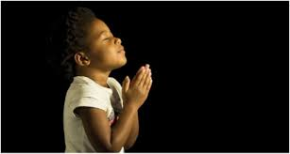
LET US PRAY….

Slide 53
Black

Slide 54


OT Preaching link at BibleStudyDownloads.org
Get this presentation and script for free!
Notes:
OT Preaching (op)

