Slide 1
Dan Bridges at Amman International Church, Jordan Uploaded by Dr. Rick Griffith • Jordan Evangelical Theological Seminary Files in many languages for free download at BibleStudyDownloads.org

Slide 3
Deuteronomy 6:
Loving God

Slide 4
Sobering Statistic…
About 2/3 of teens who grew up in Christian homes are leaving the faith

Slide 5
Sobering Statistic…
Why do you think this is?

Slide 6
What about You???

Slide 7
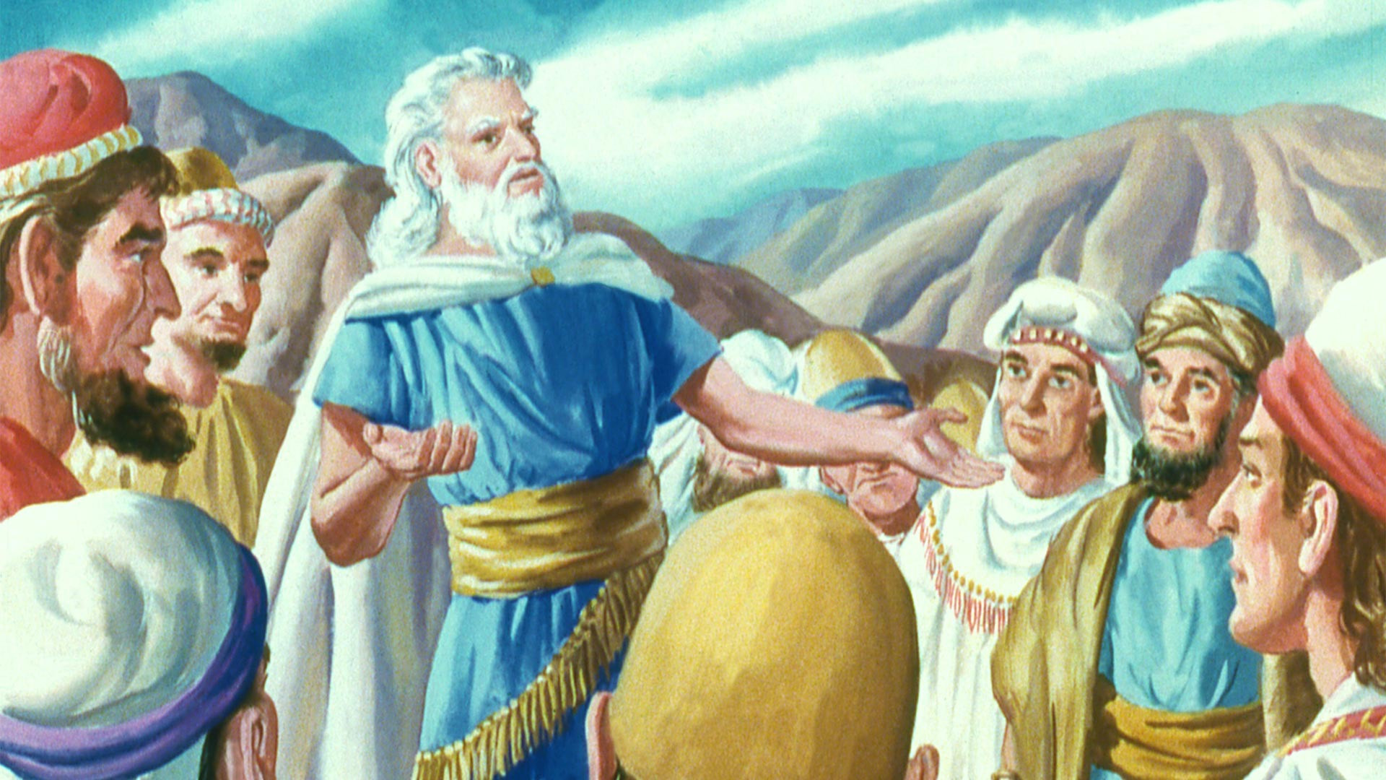
If you don’t want to become a statistic, then Deuteronomy is for you!

Slide 8
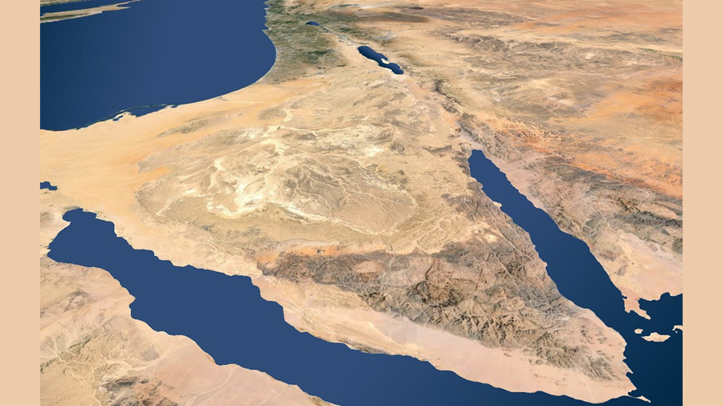
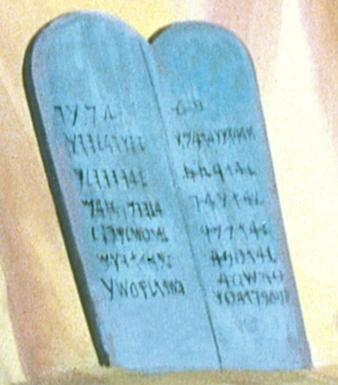
Context of Deuteronomy
The Past 40 Years
Finally Ready!
12 Spies
The Exodus
40 Years of Wandering
Mount Sinai
10 Commandments

Slide 9
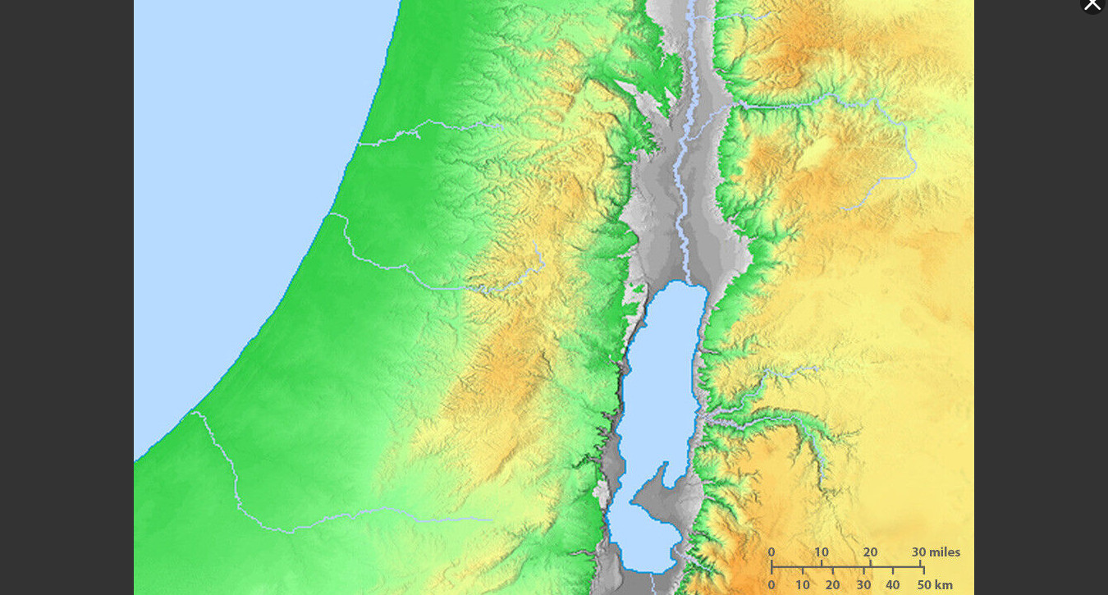
Amman
Plains
Of Moab
Jericho
Context of Deuteronomy
The Location

Slide 10
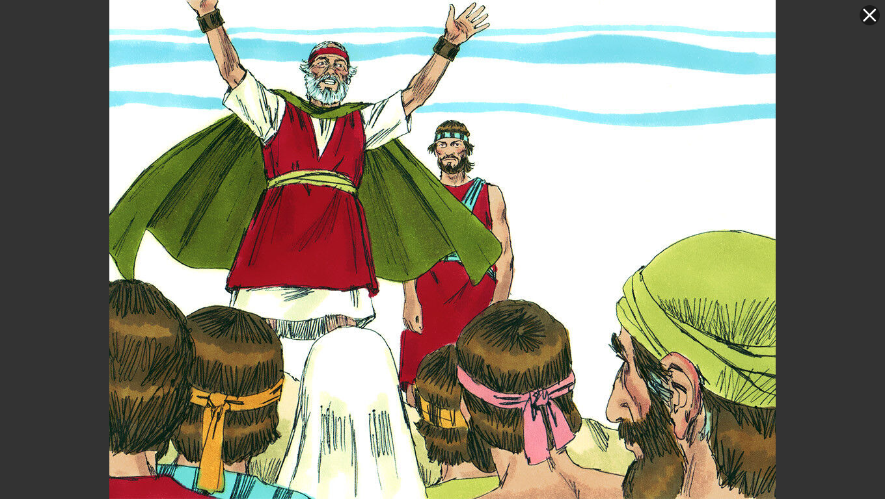
Context of Deuteronomy
Preparing to Enter the Land

Slide 11
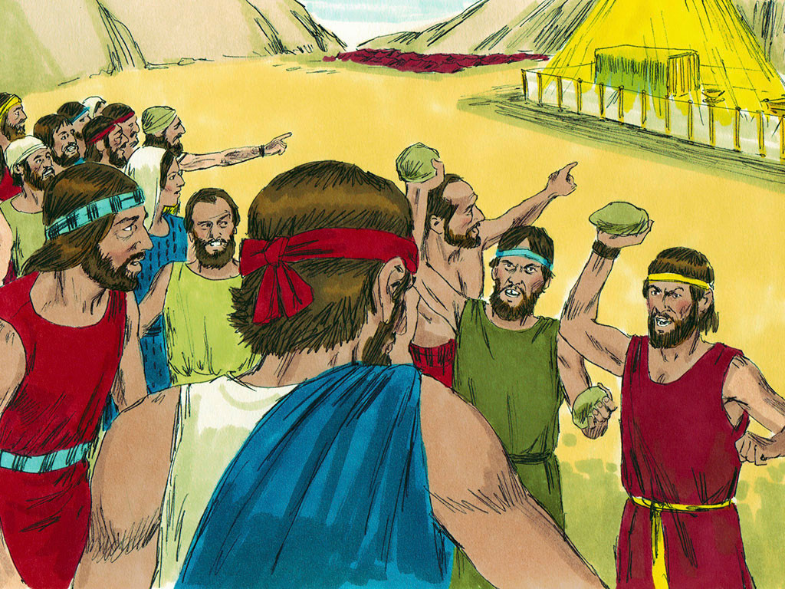
The Big Question…
The Israelites are about to enter the land…
But has anything changed?
What will enable them to succeed when
their parents had failed???

Slide 12
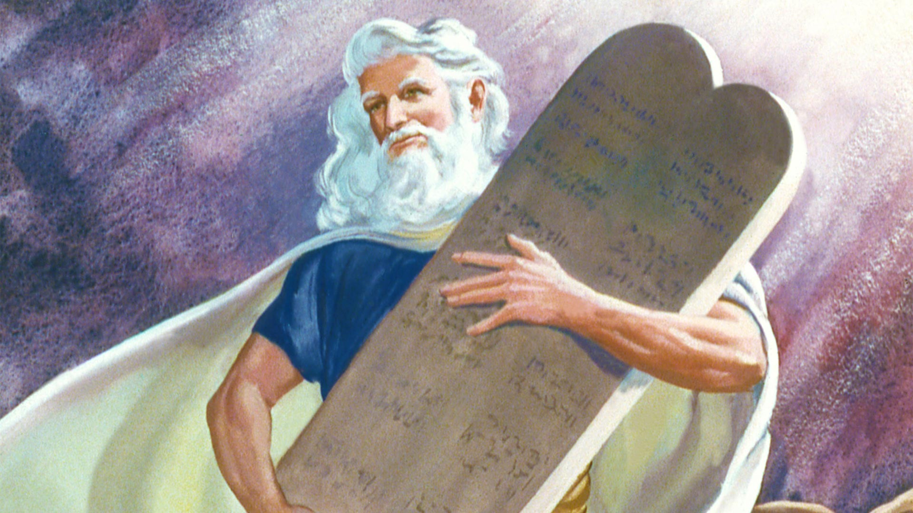
¹ These are the commands, decrees and laws the Lord your God directed me to teach you to observe in the land that you are crossing the Jordan to possess, ² so that you, your children and their children after them may fear the Lord your God as long as you live by keeping all his decrees and commands that I give you, and so that you may enjoy long life.
Deuteronomy 6:1-2
Let’s break the cycle!
But How???

Slide 13
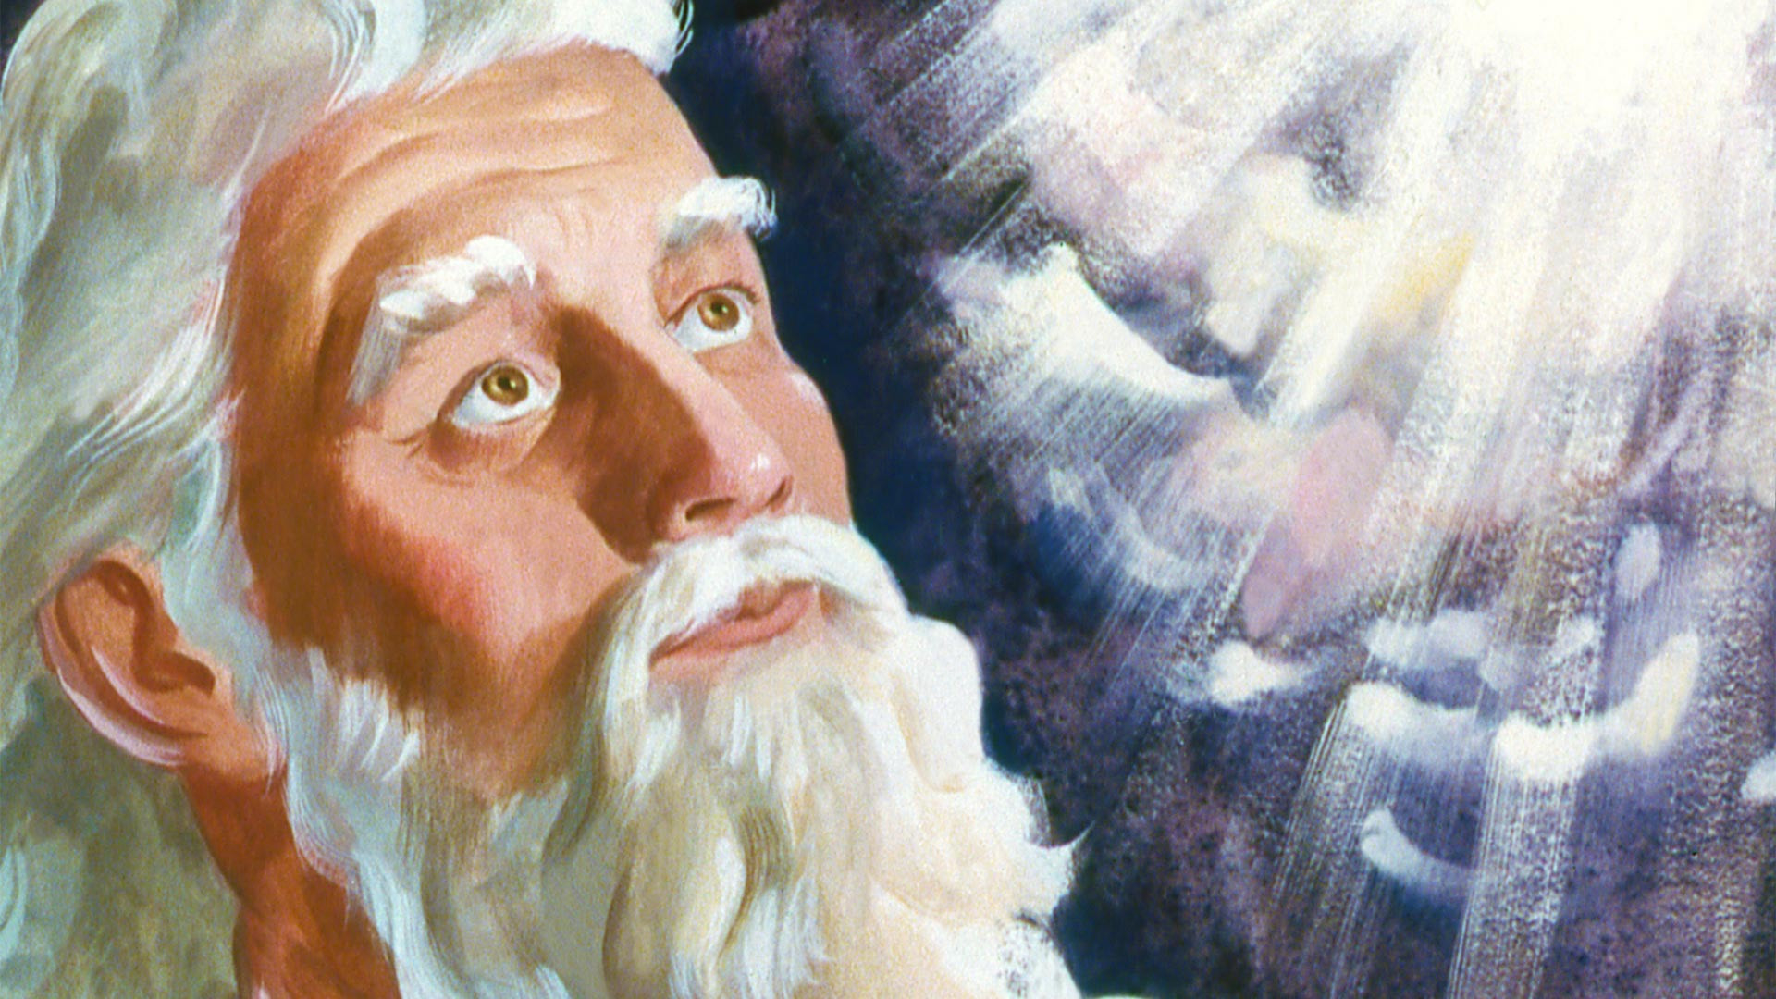
⁴ Hear, O Israel: The Lord our God, the Lord is one. ⁵ Love the Lord your God with all your heart and with all your soul and with all your strength.
Deuteronomy 6:4-5

Slide 14
How does God measure our love for him???
The same as we measure it with each other – by our actions!

Slide 15
“What you really are is what you love the most…”
Timothy Keller
But what good is that when not a single boy at school will even look at you?”
True Story:
Depressed Teen Girl
Christian
Can count up God’s blessings in her life
Said: “I know Jesus loves me, saved me and will one day take me to heaven…

Slide 16
Assessment:
What do we Love???
You want to be a part of the popular crowd…
But they are cutting others down.

Slide 17
Assessment:
What do we Love???
Guys…
A girl you like starts flirting with you…
But she doesn’t seem very serious about God.

Slide 18
Assessment:
What do we Love???
Girls…
A guy likes you and makes you feel really special…
but you’re not sure about his faith

Slide 19
Assessment:
What do we Love???
You love video games …
But your parents tell you they are becoming too important to you.

Slide 20
Assessment:
What do we Love???
Working as a camp counselor …
A summer job where you can make lots of money!

Slide 21
How do we
Grow in our Love for God?
⁶ These commandments that I give you today are to be on your hearts.
Deuteronomy 6:6
But How???

Slide 22
Talk about God’s Laws
⁶ These commandments that I give you today are to be on your hearts. ⁷ Impress them on your children. Talk about them when you
and when you , when you
and when you .
Deuteronomy 6:6-7
sit at home
walk along the road
lie
down
get up

Slide 23
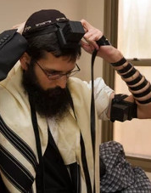
Tie them as Symbols…
⁸ Tie them as symbols on your hands and bind them on your foreheads. ⁹ Write them on the doorframes of your houses and on your gates.
Deuteronomy 6:8-9
Is this really the goal???

Slide 24
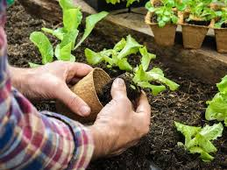
Tie them as Symbols…
How does loving God apply to what I’m doing right now?
…on your hands
…on your foreheads
…on the doorposts of your houses
…on your gates
Whatever we’re doing, whatever we’re thinking, wherever we are, how can we love God now???
⁸ Tie them as symbols on your hands and bind them on your foreheads. ⁹ Write them on the doorframes of your houses and on your gates.
Deuteronomy 6:8-9
How does loving God apply to what I’m thinking about right now?

Slide 25
What about You???
What will your walk with God be like in 10 years?

Slide 26
“What you really are is what you love the most.”
Long-term spiritual growth is not about changing our behavior.
It’s about changing what we love.

Slide 27
How do we Change What we Love?
By getting God’s Word into our hearts, which happens when we
Talk about God’s Word with others
Apply God’s Word to all situations in life

Slide 28
Small Group Time…

Slide 29
Small Group Time…
Ice Breakers:
Have you ever been in a situation where a coach, teacher or parent has given final instructions just before starting something important? What sort of things did they include in those instructions?
Main Discussion:
Describe the setting for Deuteronomy (After 40 years in the wilderness, the new generation is getting ready to enter the promised land. Moses is giving his final instructions to them.)
Read together Deuteronomy 6:1-9. Then have someone (or several people) summarize what you read.
What is similar between us as teens and the people of Israel in Deuteronomy? (Answer: We are both a new generation and we need to think about our future spiritual well-being.)
We often think of love as a feeling. Is that what Moses is talking about when he says to “love God with all your heart, soul and strength”? How do we decide when others love us? (Answer: Though feelings may be involved, we know we are loved by actions of others toward us. That’s what this verse is referring to.)
Why did Moses start this section by talking about loving God rather than jumping straight into the rules? (Answer: What we love overpowers what we know when it comes to making decisions about life. Our actions follow our love – not our knowledge. Learning to LOVE God is the only path to long-term obedience and spiritual well-being.)
Think about the story of the girl to whom the attention of boys was more real than God’s love to her. How would that affect her decisions when it came to love and boys? How do you think she could change?
Why do you think Moses exhorted the people to talk about God’s laws rather than just thinking about them?
What are some things we can do to help grow in our love for God? (Ideas: Talking in everyday life about his Word with others, Brainstorm right now in the group some daily situations where we can think about how his Word applies.)

Slide 30
Black

Slide 31
OT Preaching link at BibleStudyDownloads.org
Get this presentation and script for free!
Notes:
OT Preaching (op)

