Slide 1
The Secret Things of God
Deuteronomy 29:29
Dr. Rick Griffith • Jordan Evangelical Theological Seminary BibleStudyDownloads.org

Slide 2
What would you like to know?
Notes:
In our world’s explosion of knowledge, we still don’t know many things.
We don’t know why God chose such a tiny nation like Singapore for his great plans.
We don’t know what will happen to our ministries of family and mentoring.
We all have questions that remain. So what would you like to know?
Why is it that some of the wealthiest people you know are often the most ungodly?
Why do some women who don’t want a child easily get pregnant but you long for a child in your barrenness?
Why can’t you seem to hear from God on that key question that you have?

Slide 3
How should you deal with your ignorance of God’s ways?
Notes:
What should you do since you do not really know why God does what he does?

Slide 4
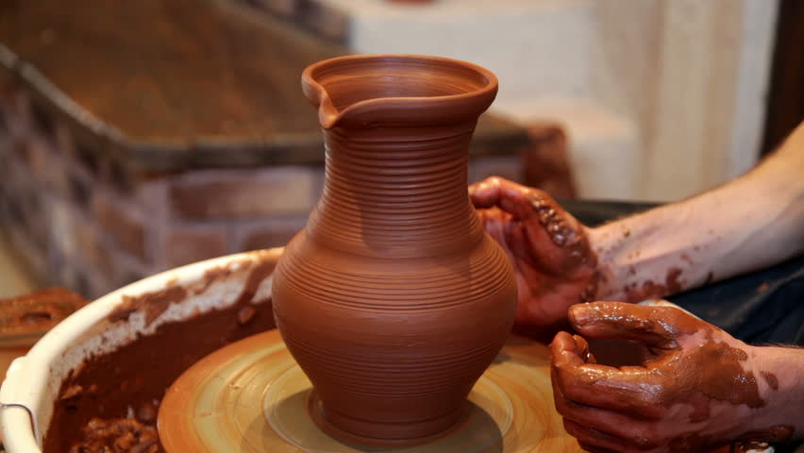
The Context of Deuteronomy
Notes:
Israel was poised to enter Canaan but still needed to know much about God even after Moses recorded all five books of the Pentateuch. They still needed forming.

Slide 5
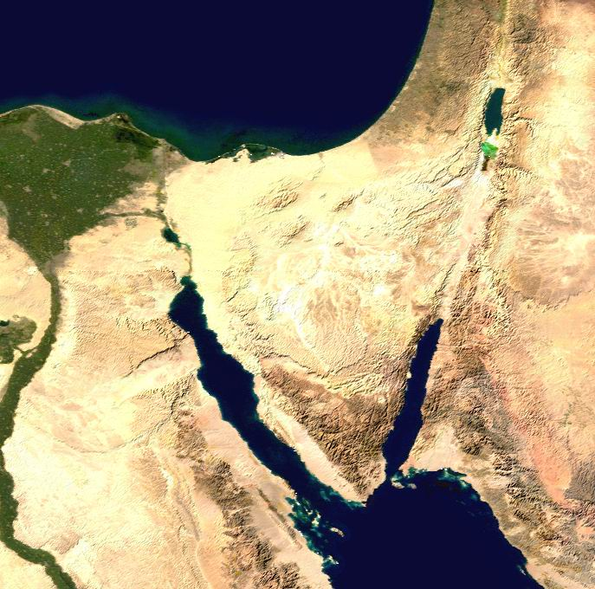
Moses at Moab
Moab
"These are the words that Moses spoke to all the people of Israel while they were in the wilderness east of the Jordan River. They were camped in the Jordan Valley near Suph, between Paran on one side and Tophel, Laban, Hazeroth, and Di-zahab on the other" (Deut 1:1 NLT).
Kadesh- barnea
Mt. Hor
Mt. Sinai
Notes:
Our text is given at the end of 40 years of wilderness wandering. In Deuteronomy Moses, the covenant mediator, speaks to Israel's new generation opposite the Jordan (1:1).
Imagine traveling your whole life in the desert—even being born amidst the dirt, dry plants, and scorpions—and the nicest thing you’ve ever seen is an interesting rock formation!
Finally your parents have been fully disciplined by God for failing to trust them to bring then into a rich, lush land.
Your parents are buried along the way as a testimony to God’s word of judgment that they wouldn’t come into Israel’s inheritance.

Slide 6
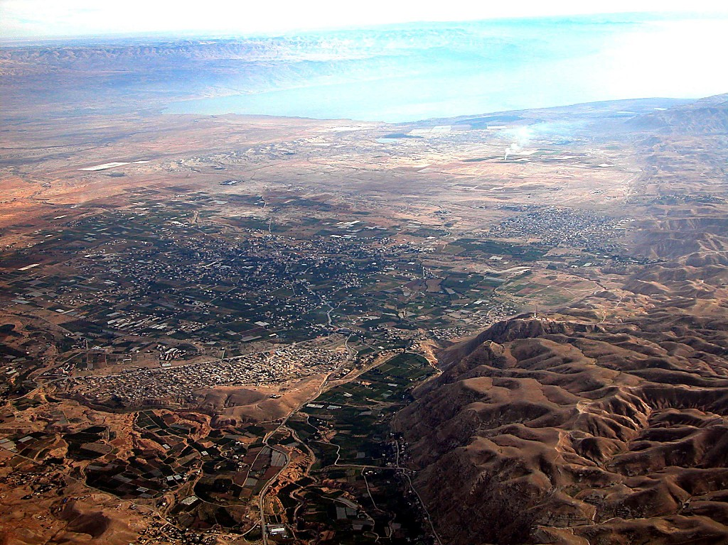
Crossing to Jericho
DEAD SEA
JORDAN RIVER
MODERN JERICHO
JOSHUA
Jericho/Ai
ANCIENT JERICHO
From Jericho...
Looking East Across the Jordan River
Handbook pg. 26-29
42
Notes:
They are poised to cross over into Jericho. But this means that huge giants await them?

Slide 7
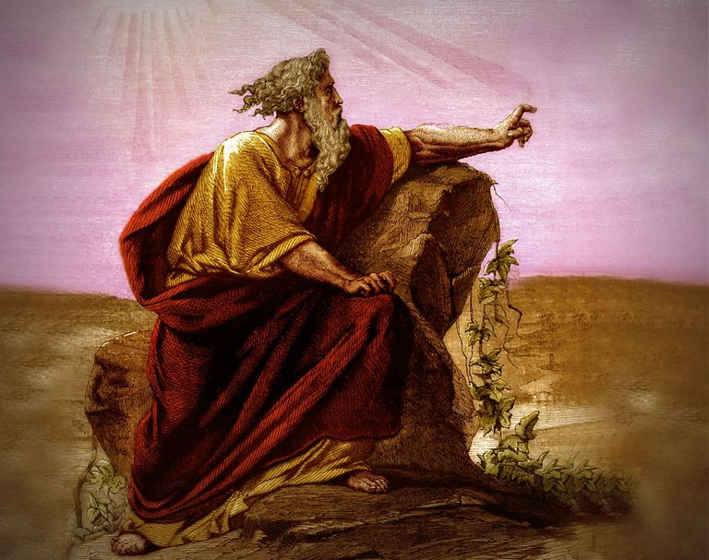
Deuteronomy
Renewal of the Mosaic Covenant
Renewal of the Mosaic Covenant
Notes:
So Moses commits to prepare them. What would he say?
He gives five sermons in Deuteronomy, and today we will look at only one verse in the last sermon.

Slide 8
How should you deal with your ignorance of God’s ways?
—3 keys…
Notes:
Today we will see three keys in Deuteronomy 29:29 on how to deal with what we can know and not know.
How should you deal with your ignorance of God’s ways? Here is the first thing to do…

Slide 9
1. Don’t worry about God not telling you everything you want to know (Deut 29:29a).
Notes:
The LORD isn’t obligated to answer all your questions—so deal with it.

Slide 10
Deuteronomy 29:29 NIV
"The secret things belong to the LORD our God, but the things revealed belong to us and to our children forever, that we may follow all the words of this law."
"The Lord our God has secrets known to no one. We are not accountable for them, but we and our children are accountable forever for all that he has revealed to us, so that we may obey all the terms of these instructions" (NLT).
Notes:
NLT: “The Lord our God has secrets known to no one. We are not accountable for them, but we and our children are accountable forever for all that he has revealed to us, so that we may obey all the terms of these instructions."
SECRET THINGS:
Why godless people live so long with so much money (Pss. 37, 73)
Why hundreds of millions of mothers kill their own children in the womb which totally defies their maternal instincts
Why the ones most calling for tolerance are the least tolerant
Why God would cause his son to suffer so much on our behalf
Why I would be the only boy from a broken home in my school growing up
Why God allowed me to come to know him when so many others never do or do so later in life
Why I have so many privileges to serve him throughout Asia in 35 countries when others never get to leave the USA

Slide 11
We planned to stay in Singapore until age 70 teaching Bible and theology…
Notes:
My goal has been to teach Bible and theology until age 70—which is 7 more years as I am now 63 years old.
But the College recently decided to shift me to teach only preaching rather than my master degree specialty of theology and my PhD area in Bible Exposition.
So we have been praying whether to try to stay 7 more years in Singapore without teaching Bible and theology.
Singapore law also seeks to retire expatriates in their 60s so more Singaporeans can take these positions.

Slide 12
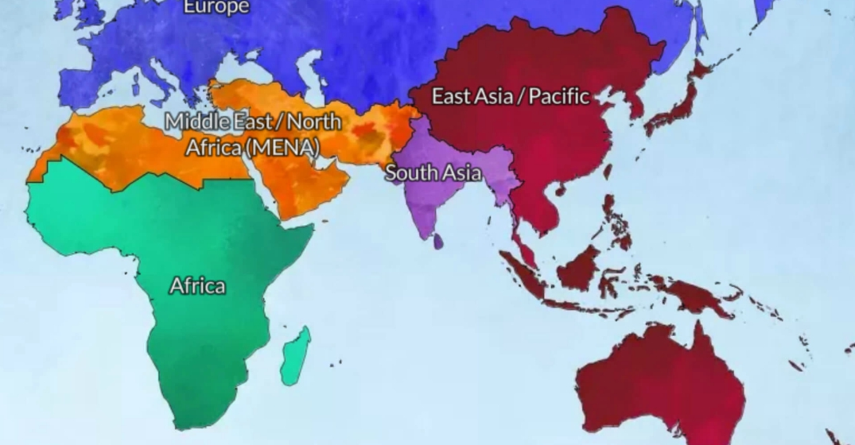
God is leading us from Asia to MENA
Jordan
Singapore

Slide 13
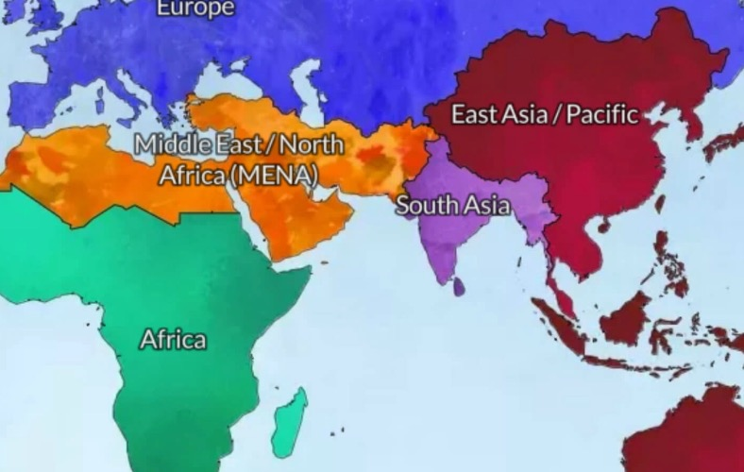
From East to West
Spain
? years
Eastern Empire
30 years
MENA
? years
East Asia
30 years

Slide 14
Please get our latest prayer card
Front
Back

Slide 15
Jordan Evangelical Theological Seminary (JETS)

Slide 16
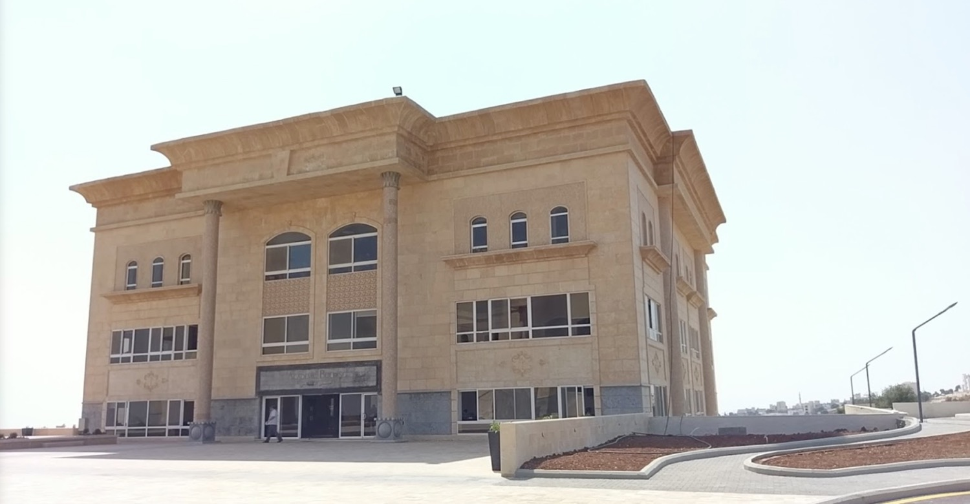
Jordan Evangelical Theological Seminary (JETS)
Notes:
to teach Bible and theology through translation into Arabic.

Slide 17
Dr. Imad Shehadeh Founder and President of JETS Video by Dallas Theological Seminary
Notes:
In 1990, I graduated with the president and founder, Dr Imad Shehadeh

Slide 18
Jordan Evangelical Theological Seminary (JETS)
Notes:
The school has its 30th anniversary this year.

Slide 19
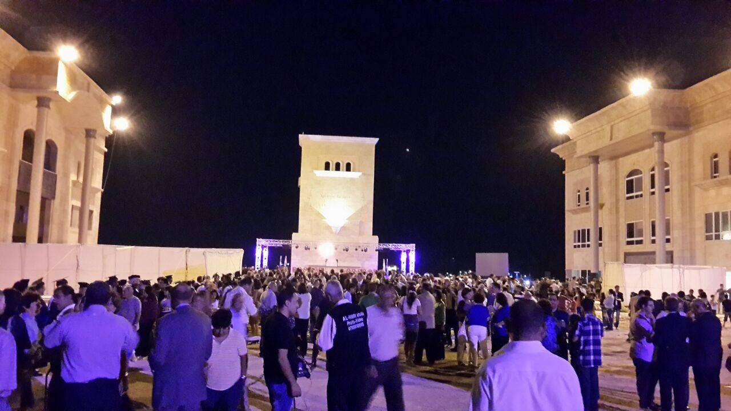
JETS (bachelor to doctoral)
Whitman Academy
(K-12)

Slide 20
Faculty
25 Faculty
25 Doctorates
15 Faculty
4 Doctorates

Slide 21
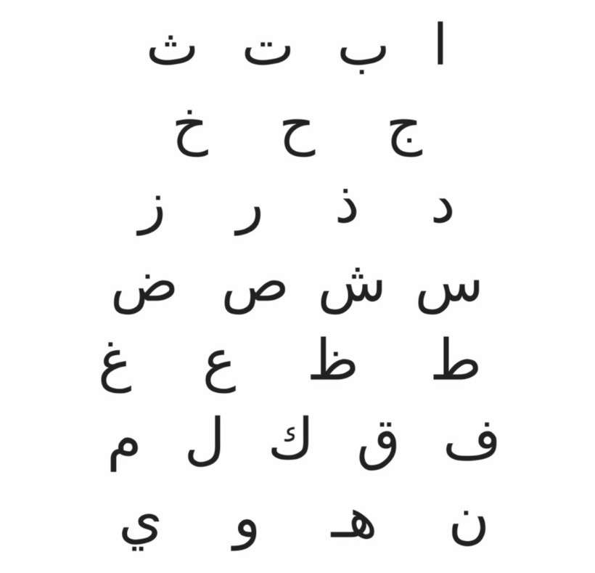
Arabic
Dr. Rick Griffith
Notes:
I will need to be translated into Arabic—but I did learn this Arabic. Do you know what it says?
• Here is the translation—my name!

Slide 22
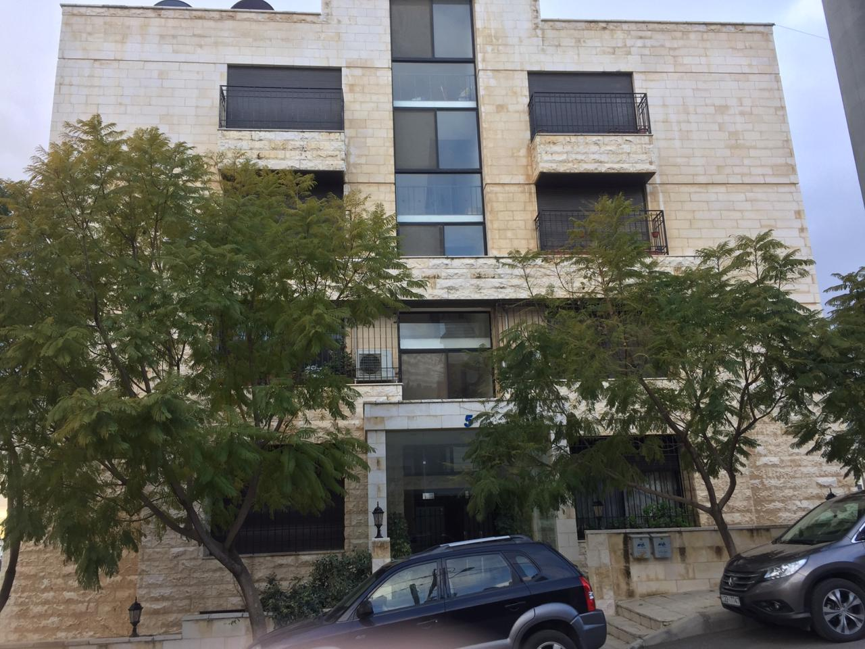
Our Jordan Apartment

Slide 23
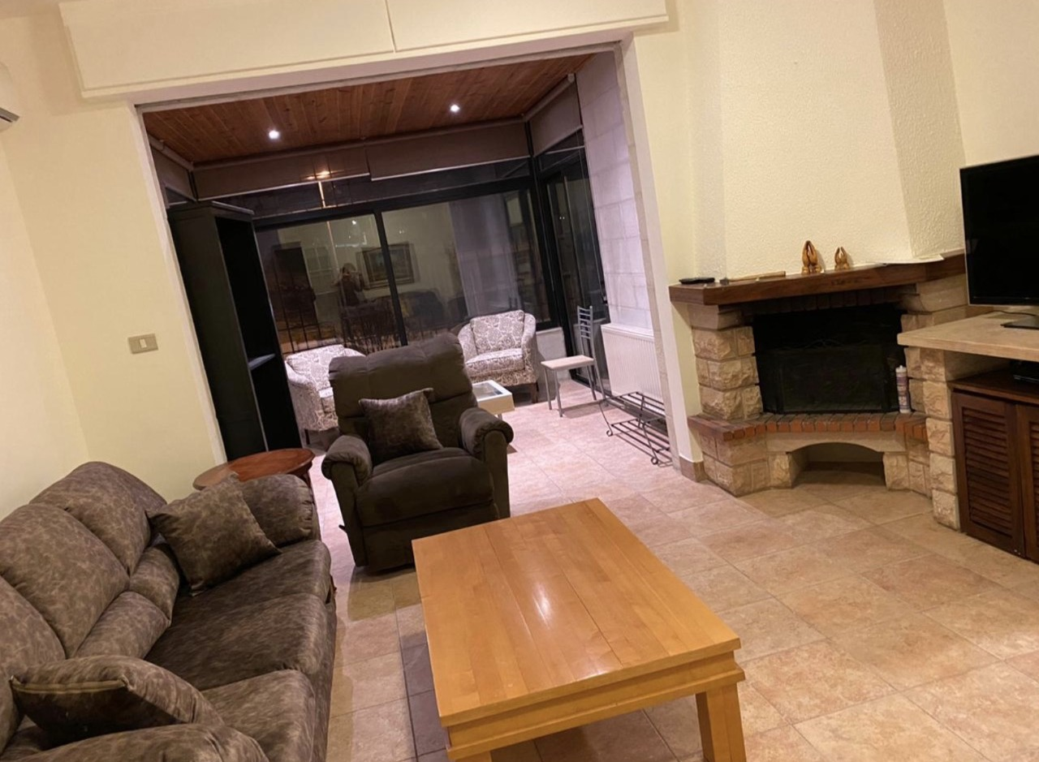
Our Jordan Apartment

Slide 24
Our Jordan Apartment

Slide 25
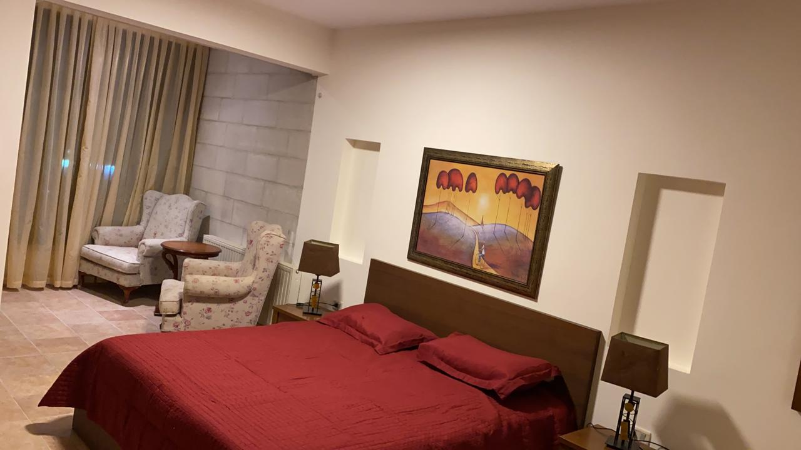
Our Jordan Apartment

Slide 26
June 9 left Singapore June-August USA family & church visits August 17 fly to Jordan August 23 begin at JETS
Notes:
So we will be leaving Singapore on June 8, have a few weeks in the USA with churches and family, and join JETS in August

Slide 27
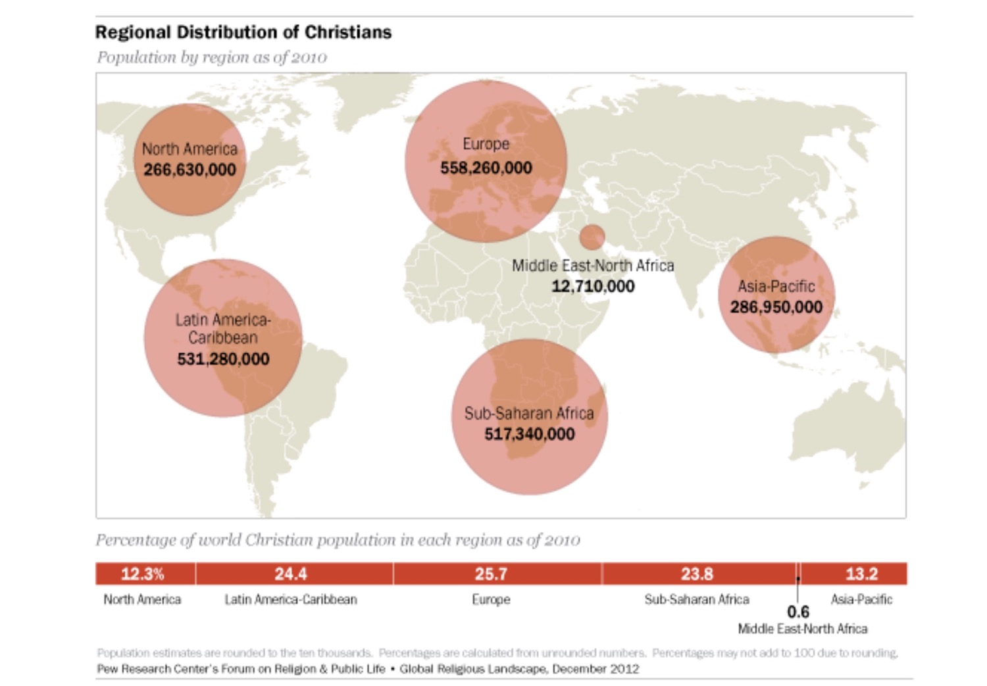
Jordan Evangelical Theological Seminary (JETS)
Notes:
This map depicts the number of people on each continent who claim to be Christians. What sticks out to me is that MEAN is far behind the other regions, even though it is where Christianity began.

Slide 28
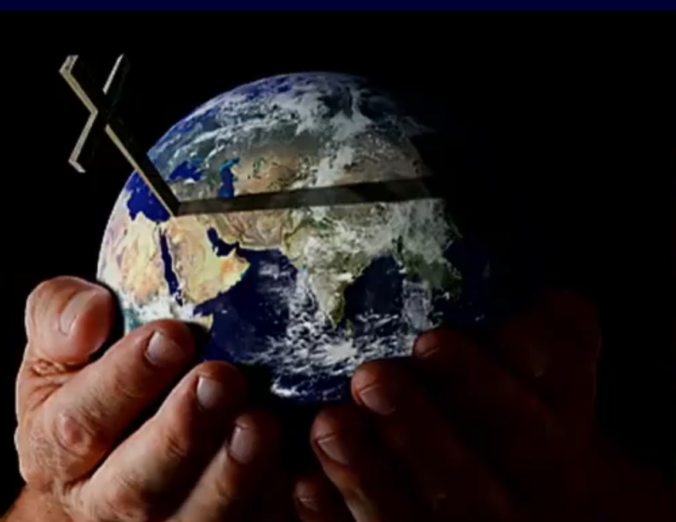
Jordan Evangelical Theological Seminary (JETS)
Notes:
So now God has opened the door to serve at JETS that has students from 21 MENA nations (Middle East & North Africa). I am convinced that the best years for CIC are ahead!

Slide 29
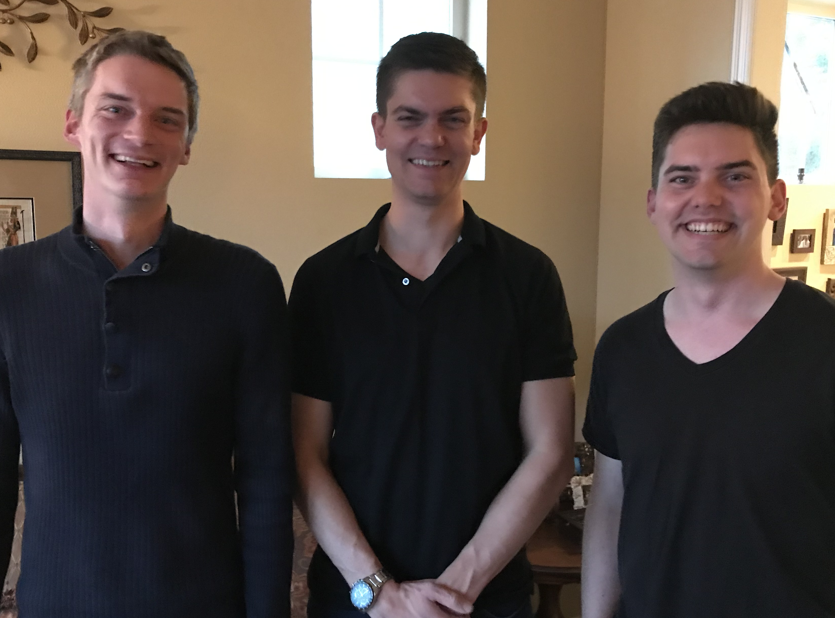
Our Three Sons

Slide 30
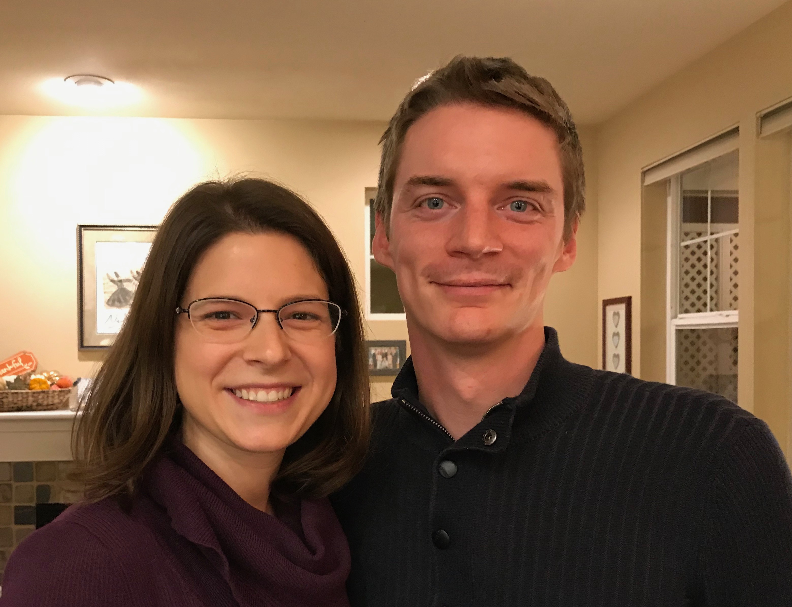
Kurt & Cara own an HR consulting business in Harstine
Notes:
Kurt and his wife Cara are in Seattle

Slide 31
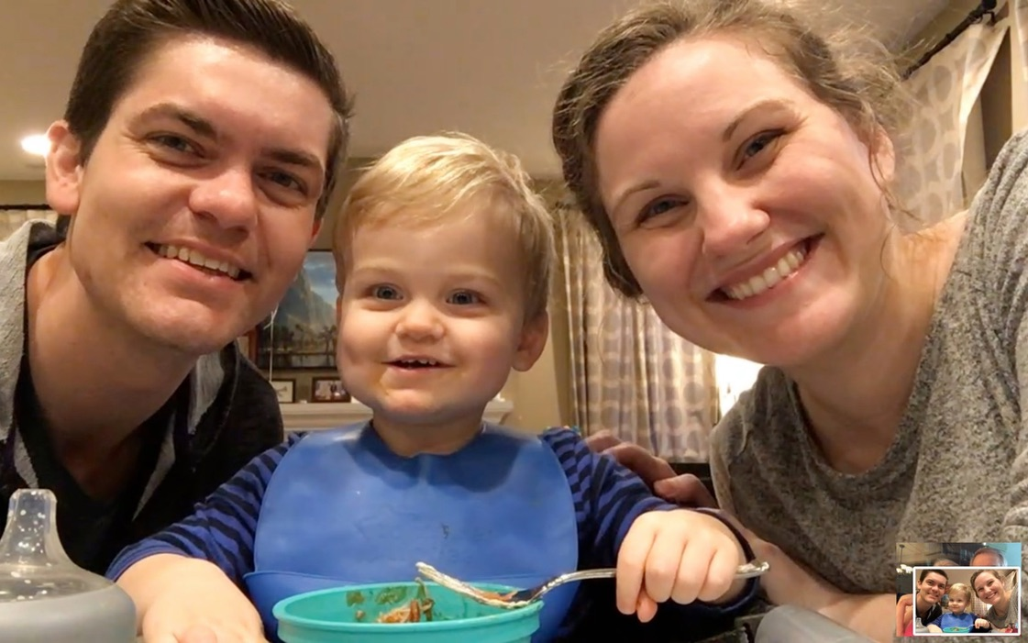
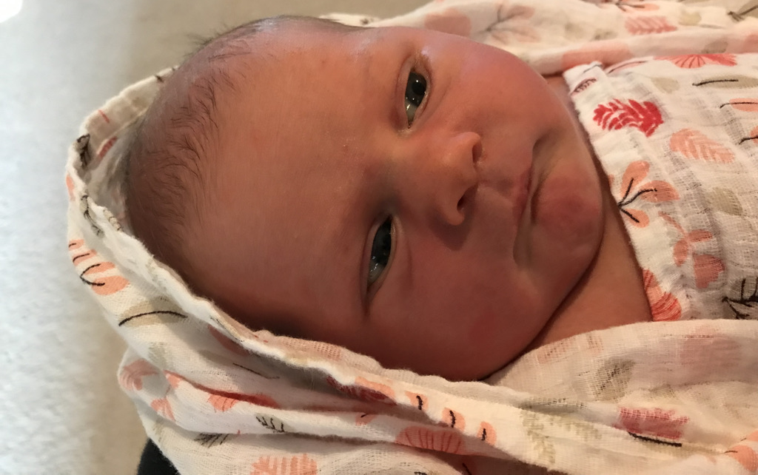
Stephen, Katie, & Jesse in Gig Harbor
Norah born July 31
Notes:
Our granddaughter joined the family on 31 July 2021 but why would God take us now? I don’t know.

Slide 32
How should you deal with your ignorance of God’s ways?
Notes:
So how should you deal with your ignorance of God’s ways? Be willing to stay ignorant! God has secrets and he’s not telling. So what should you do instead of striving for answers to everything?

Slide 33
1. Don’t worry about God not telling you everything you want to know (29a).
Notes:
Be willing to stay ignorant! God has secrets and he’s not telling. So what should you do instead of striving for answers to everything?

Slide 34
2. Instead, seek to know what God does tell you (29b).
Notes:
The LORD speaks—though he doesn’t say all we want to know. So listen to him.

Slide 35
Deuteronomy 29:29 NIV
"The secret things belong to the LORD our God, but the things revealed belong to us and to our children forever, that we may follow all the words of this law."
"The Lord our God has secrets known to no one. We are not accountable for them, but we and our children are accountable forever for all that he has revealed to us, so that we may obey all the terms of these instructions" (NLT).
Notes:
NLT: “The Lord our God has secrets known to no one. We are not accountable for them, but we and our children are accountable forever for all that he has revealed to us, so that we may obey all the terms of these instructions."
THINGS REVEALED:
God gave us a Bible of 1100 chapters that is so long that we never will learn it well in one lifetime
We have everything in Scripture that we need to know for life and godliness (2 Pet 1:3 NLT: "By his divine power, God has given us everything we need for living a godly life.")
This is why I have committed my life to help people understand what God has revealed in this precious Book!

Slide 36
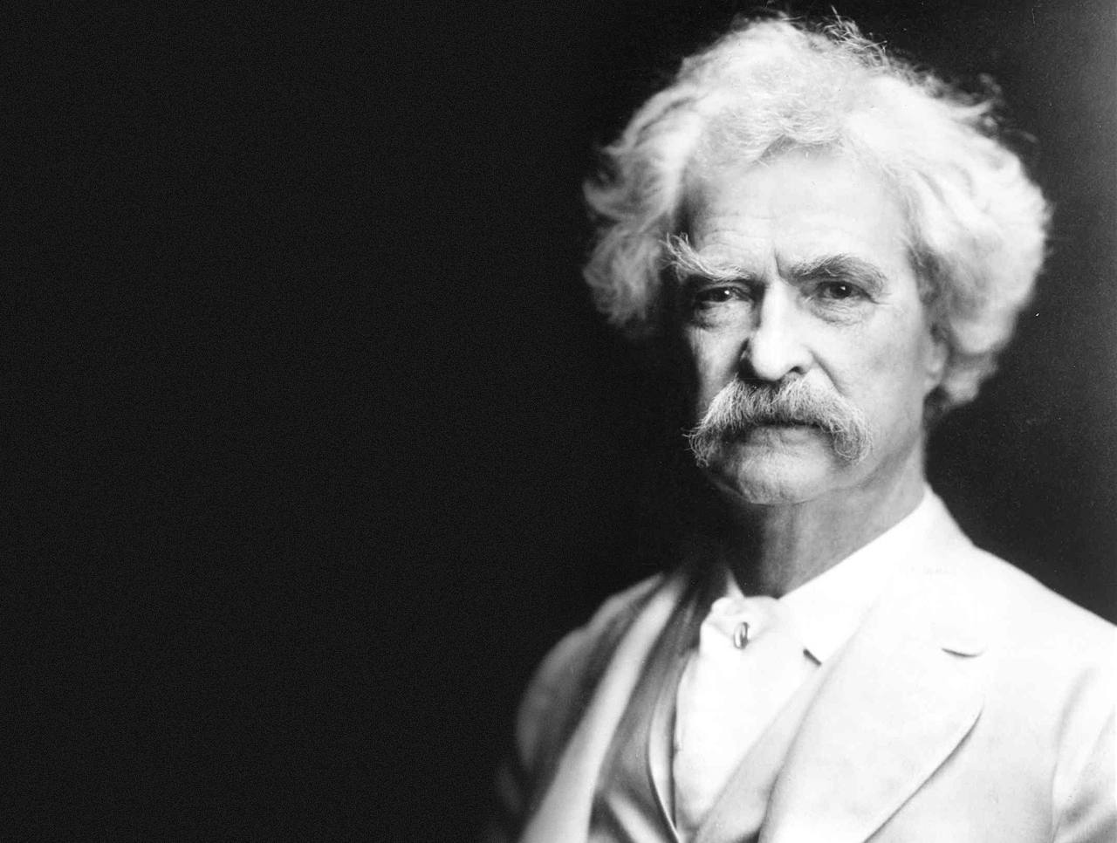
— Mark Twain —
'It ain't the parts of the Bible that I can't understand that bother me, it's the parts that I do understand.'

Slide 37
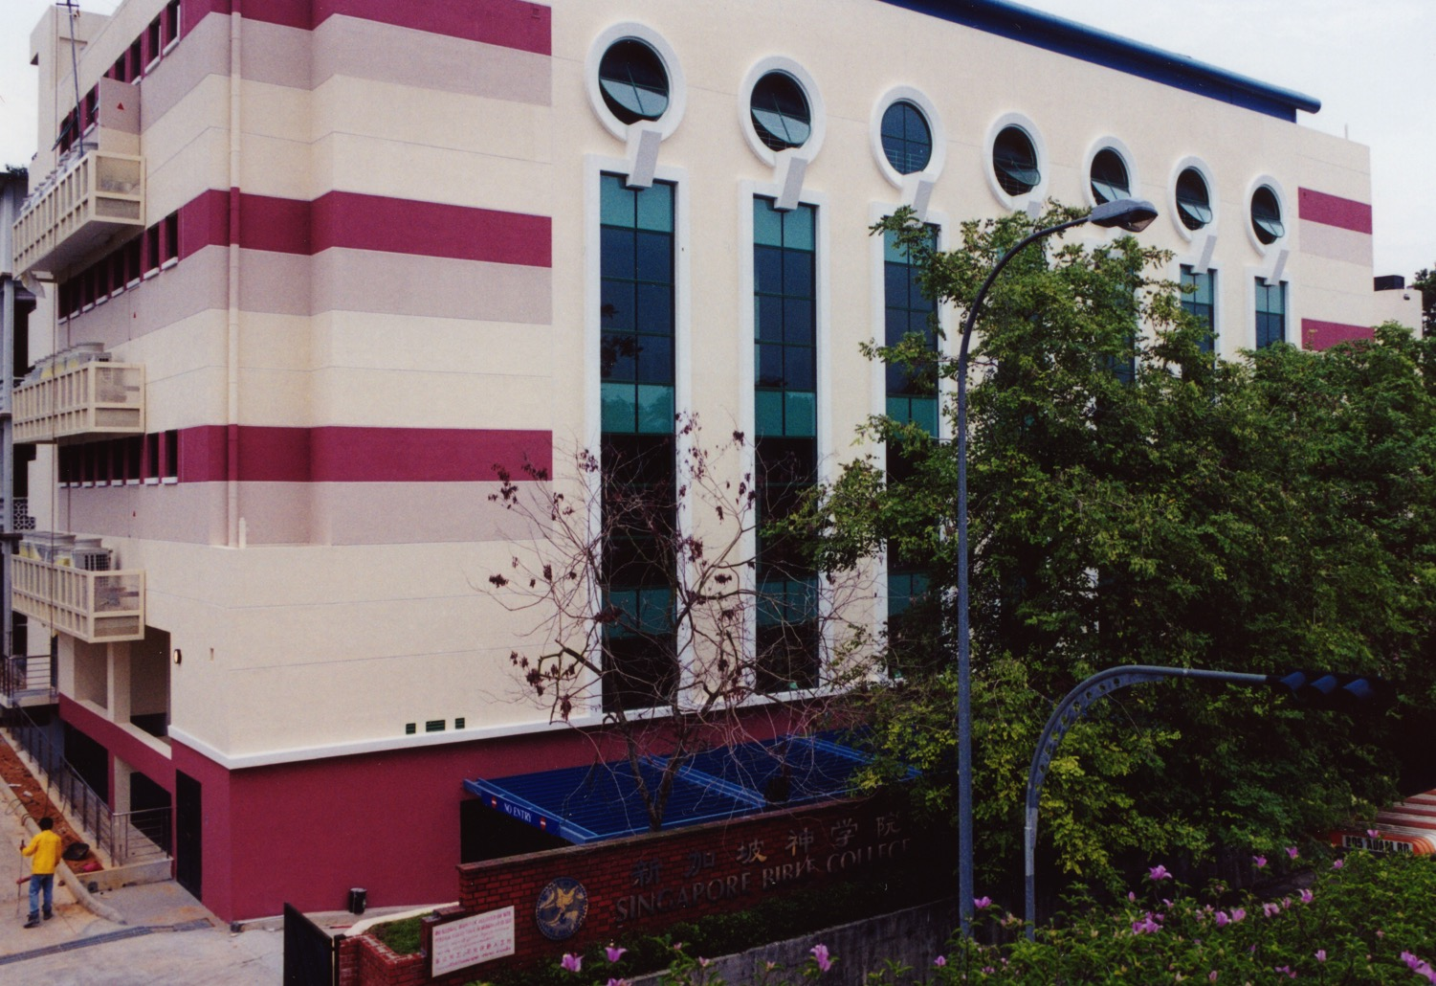
SINGAPORE BIBLE COLLEGE
9
Notes:
I've served as a seminary professor with 30 other faculty at Singapore's largest training school: Singapore Bible College

Slide 38
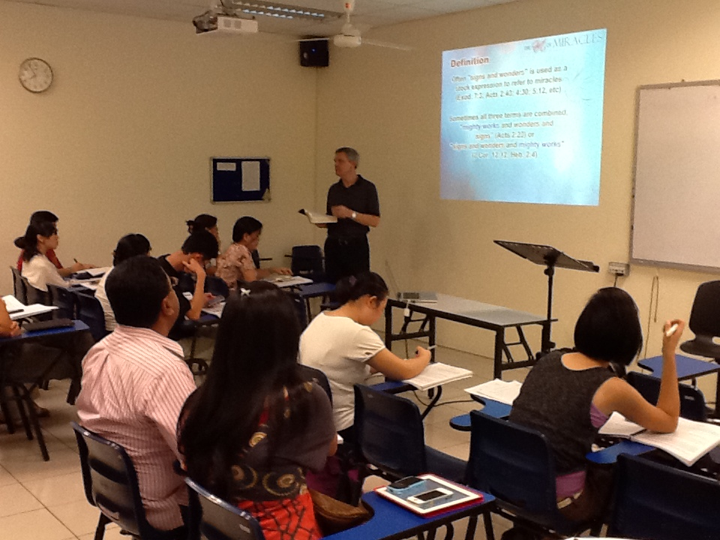
Singapore Bible College Students
9
Notes:
Most of these students are first-generation Christians eager to share the gospel with their own people!

Slide 39
SBC Courses I Teach
(English • Indonesian • Chinese)
Survey • The Bible…Basically
OT NT Bible Study
Backgrounds • Research & Writing
OT NT Geography
Theology • Creation • Jesus
Church • Spirit • Salvation • Future
Preaching
Homiletics 1 Homiletics 2
Notes:
I get to teach these leaders every book of the Bible in survey courses, plus backgrounds to both the OT and NT, three areas of theology, and how to preach.

Slide 40
Developing Leadership Through Mentoring & Coaching (Ron Horton)

Slide 41
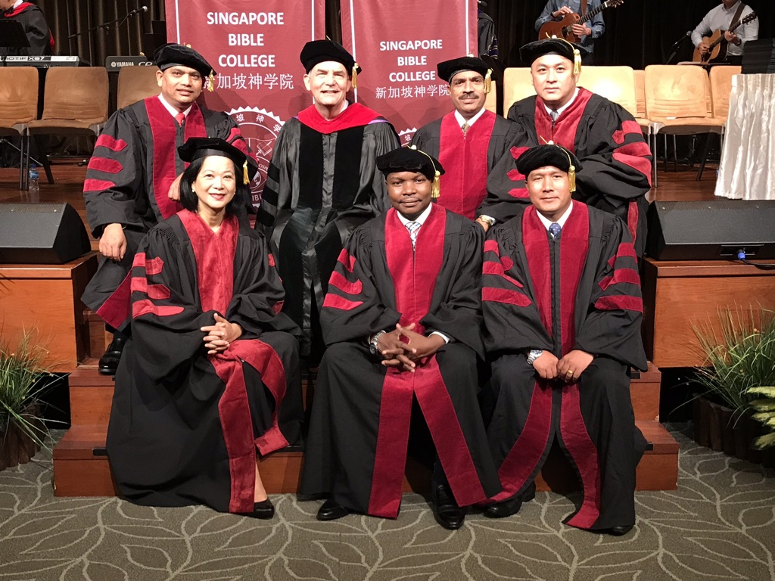
I directed the SBC Doctor of Ministry studies (DMin) from 2012-2021
Notes:
I also directed the doctoral program at SBC that trains seminary professors and pastors throughout Asia in English and Chinese. Generally each year about 4 of them received their Doctor of Ministry degree.

Slide 42
Assignment File System

Slide 43
TBB

Slide 44
TBB Vision

Slide 45
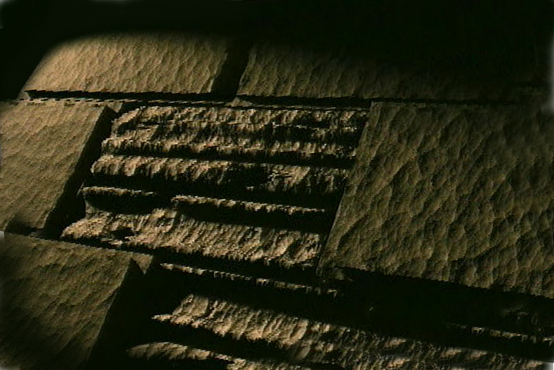
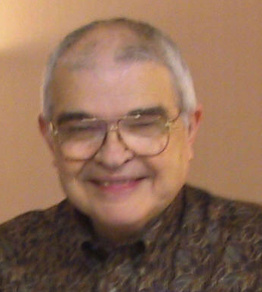
Dr John Fryman
Dr. John Fryman
Author of The Bible…Basically 10-Hour Seminar Fort Worth, Texas
www.biblebasically.org
©2004 TBBMI
8.0.01.
04

Slide 46
English

Slide 47
Burmese
Lai S iangtho…Abulpi
A Presentation of The Bible…Basically Ministries International Inc. Fort Worth, Texas
www.biblebasically.com
©2004 TBBMI
8.0.01.
04

Slide 48
French
LA BIBLE…
EN BASE
Une Présentation du Ministère Internationale de La Bible… En Base Inc. Fort Worth, Texas
www.biblebasically.com
©2006 TBBMI
8.0.01.
04
©2004 TBBMI
9.6.01.

Slide 49
Japanese
バイブル ベイシックミニストリーズ
インスティチュート
A Presentation of The Bible…Basically Ministries International Inc. Fort Worth, Texas
www.biblebasically.com
©2004 TBBMI
8.0.01.
04
Notes:
Japanese title slide

Slide 50
Khmer (Cambodian)
mUldæanRKwH>>>
énRBHKm<IIr
karbgðaj[sÁal;nUvRBHKm<Ir>>> EdlCamUldæanRKw³ kñúg B½n§kic©shKmnGnþrCati GayGinsIu.
Fort Worth, Texas
www.biblebasically.com
©2004 TBBMI
8.0.01.
04

Slide 51
Korean
성경은 … 기본적으로
A Presentation of The Bible…Basically Ministries International Inc. Fort Worth, Texas
www.biblebasically.com
7.5.01.
©2003 TBBMI
04

Slide 52
Malay
Alkitab… Dasar
Presentasi dari The Bible…Basically Ministries International Inc. Fort Worth, Texas
www.biblebasically.com
©2004 TBBMI
8.0.01.
04

Slide 53
Mao (India)
Bible…
Amolo Leino
Bible…Ngashankakhuina Ministries International Inc. pashina semkashok Fort Worth, Texas
www.biblebasically.com
©2004 TBBMI
8.0.01.
04

Slide 54
Malayalam (India)
Æß èÌÌßZ çÌØßAÜß
¥ÕÄøßMßAáKÄí Æß èÌÌßZ çÌØßAÜß… ÎßÈßØíd¿àØí §aVÈÞ×ÃW çËÞVGíÕVJí, æ¿µíØÞØí
©2004 TBBMI
8.0.01.
04

Slide 55
Mongolian
Библи… Үндсэндээ
A Presentation of The Bible…Basically Ministries International Inc. Fort Worth, Texas
www.biblebasically.com
©2004 TBBMI
8.0.01.
04

Slide 56
Nepali
afOan======
cfwf/e[\t
A Presentation of The Bible…Basically Ministries International Inc. Fort Worth, Texas
www.biblebasically.com
8.0.01.
©2004 TBBMI
04

Slide 57
Swahili (Kenya)
biblia kwa ujumla
A Presentation of The Bible…Basically Ministries International Inc. Fort Worth, Texas
www.biblebasically.com
8.0.01.
©2003 TBBMI
04

Slide 58
Tagalog (Philippines)
Ang Biblia . . . Pinasimple
A Presentation of The Bible…Basically Ministries International Inc. Fort Worth, Texas
www.biblebasically.com
©2004 TBBMI
8.0.01.
04
Notes:
PLEASE PUT THE TITLE AND SUBTITLES INTO YOUR NATIONAL LANGUAGE AND LEAVE THE WEBSITE UNCHANGED

Slide 59
Tangkhul (India)
Bible…
Ngashankakhui
Bible…Ngashankakhuina Ministries International Inc. pashina semkashok Fort Worth, Texas
www.biblebasically.com
©2004 TBBMI
8.0.01.
04

Slide 60
Tamil (Sri Lanka/India)
jpUkiwapd;… mbg;gil
A Presentation of The Bible…Basically Ministries International Inc. Fort Worth, Texas
www.biblebasically.com
©2004 TBBMI
8.0.01.
04

Slide 61
Vietnamese
Kinh thánh… Cơ bản là
A Presentation of The Bible…Basically Ministries International Inc. Fort Worth, Texas
www.biblebasically.com
©2004 TBBMI
8.0.01.
04

Slide 62
Bahasa Indonesia
Presentasi dari The Bible…Basically Ministries International Inc. Fort Worth, Texas
www.biblebasically.com
7.5.01.
©2003 TBBMI
04

Slide 63
Chinese (Mandarin)
圣经...
基要
国际基本事工呈献…圣经纵览系列. 福特沃得, 德州
www.biblebasically.com
8.0.01.
©2003 TBBMI
04

Slide 64
PowerPoint (945 slides) Student Workbook (100 pages) Teacher Script (400 pages)
TBB Materials
Completed in English • Chinese • Hindi • Indonesian • Korean • Malay • Mongolian • Russian • Spanish
A Presentation of The Bible…Basically Ministries International Inc. Fort Worth, Texas
©2004 TBBMI
8.0.01.
04

Slide 65
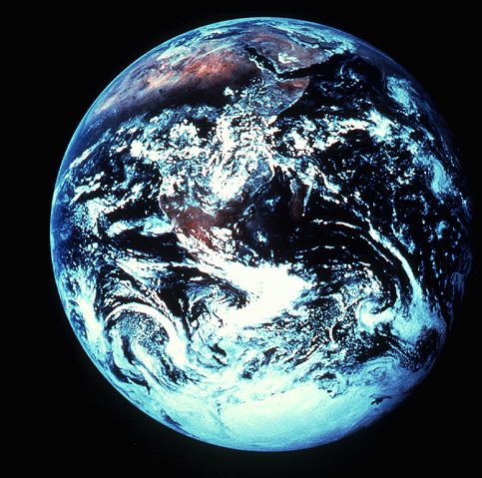
"in the beginning"
Gen. 1:1
An Introduction to Genesis

Slide 66
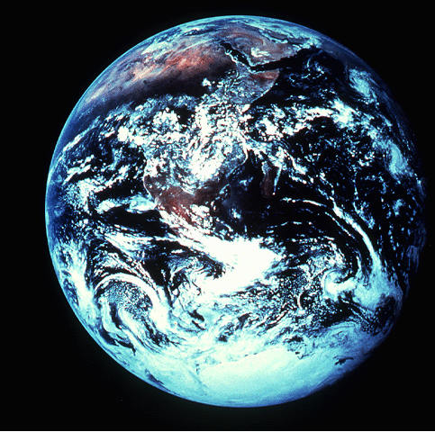
"pada mulanya"
Gen. 1:1
Pengenalan kitab Kejadian

Slide 67
"起初"
Gen. 1:1
创世记导论

Slide 68
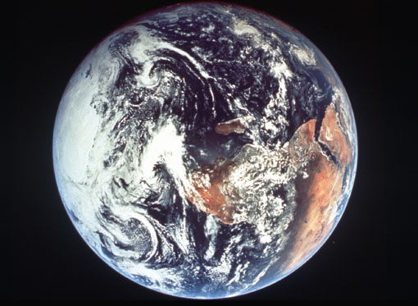
Days of Creation
33
Void
Formless
Forming
Filling
Day 4: Sun, moon & stars arranged
Day 1: Light
Day 2: Water & air separated
Day 5: Fish & fowl
Day 3: Land & sea separated
Day 6: Animals & man
Genesis 1:3-31

Slide 69
Days of Creation in Bahasa Indonesian
Hari-hari penciptaan
64
Kosong
Tidak berbentuk
Dibentuk
Diisi
Hari 4: Matahari, bulan & bintang diatur
Hari 1: Terang
Hari 2: Air & udara dipisahkan
Hari 5: Ikan & unggas
Hari 3: Darat & laut dipisahkan
Hari 6: Binatang & manusia
Kejadian 1:3-31

Slide 70
六天的创造
空虚
64
充满
混沌
形成
第四天: 太阳，月亮与众星摆列在天
第一天: 光
第二天:
水与空气分开
第五天: 鱼与雀鸟
第三天:
旱地与海分开
第六天: 动物与人
创世记 1:3-31

Slide 71
BibleStudyDownloads.org
Get 200,000 PPT slides for free!
Notes:
Student translation since 2003 with 600 translators has resulted in Bible teaching and study materials—mostly PowerPoint—in 49 languages! All a teacher needs to do is to click on a file and it downloads for free to teach any book of the Bible and many other subjects.

Slide 72
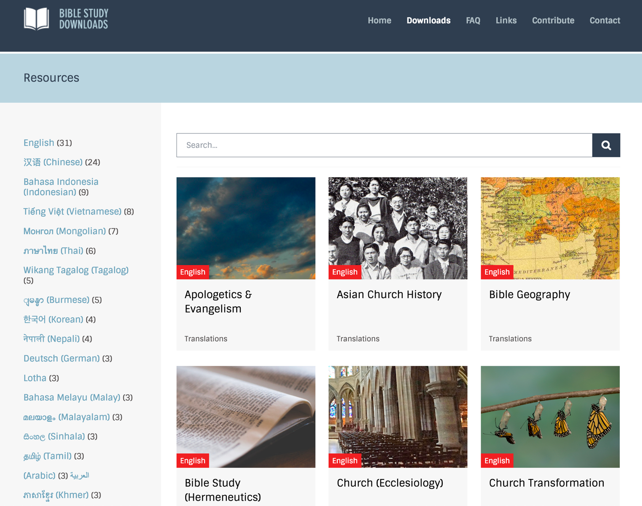
BibleStudyDownloads.org
7
Notes:
This has resulted in Bible teaching and study materials—mostly PowerPoint—in 42 languages! All a teacher needs to do is to click on a file and it downloads for free to teach any book of the Bible and many other subjects.

Slide 73
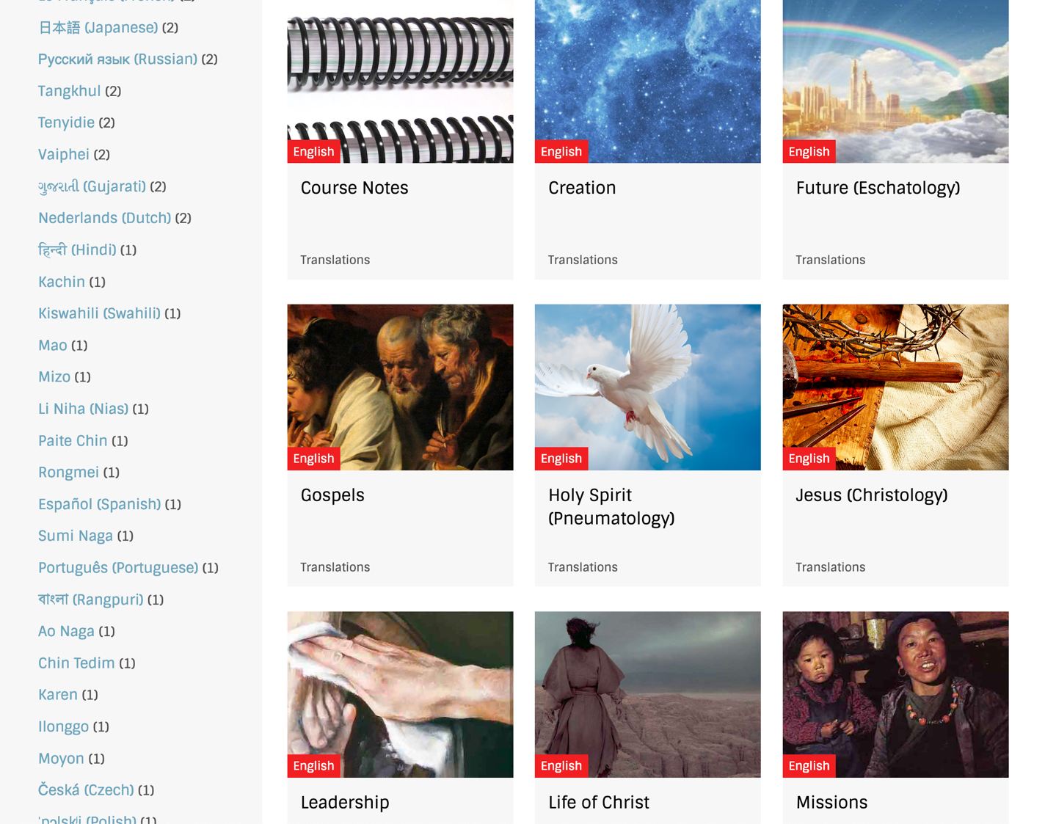
BibleStudyDownloads.org
7
Notes:
This has resulted in Bible teaching and study materials—mostly PowerPoint—in 42 languages! All a teacher needs to do is to click on a file and it downloads for free to teach any book of the Bible and many other subjects.

Slide 74
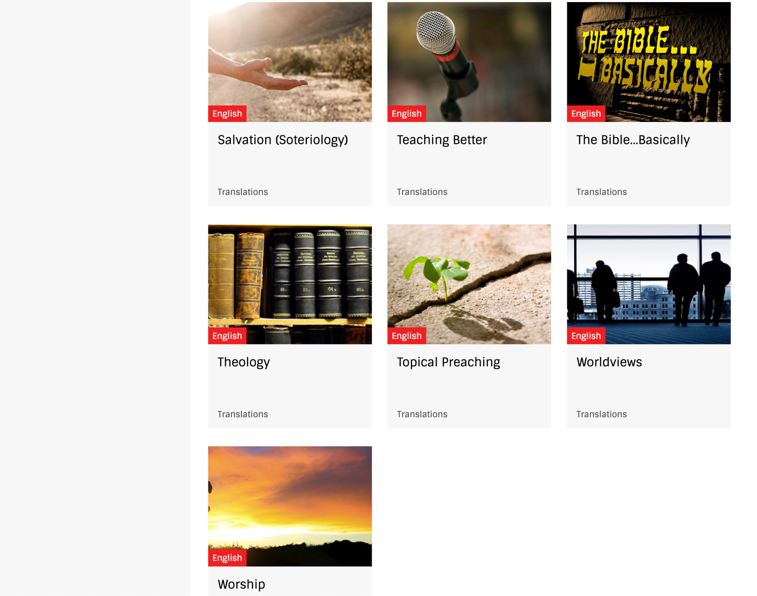
BibleStudyDownloads.org
7
Notes:
This has resulted in Bible teaching and study materials—mostly PowerPoint—in 42 languages! All a teacher needs to do is to click on a file and it downloads for free to teach any book of the Bible and many other subjects.

Slide 75
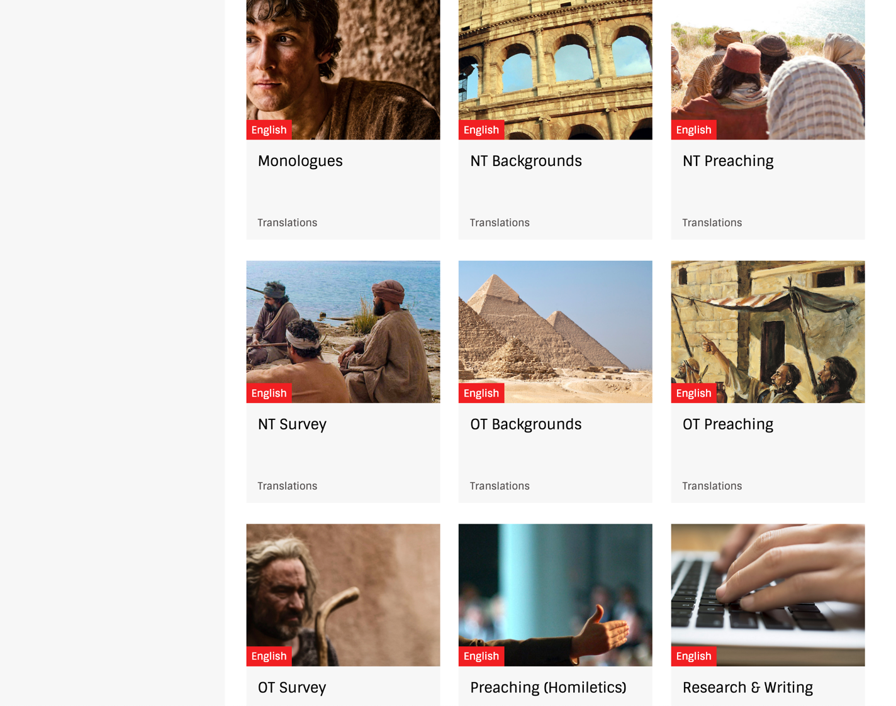
BibleStudyDownloads.org
7
Notes:
This has resulted in Bible teaching and study materials—mostly PowerPoint—in 42 languages! All a teacher needs to do is to click on a file and it downloads for free to teach any book of the Bible and many other subjects.

Slide 76
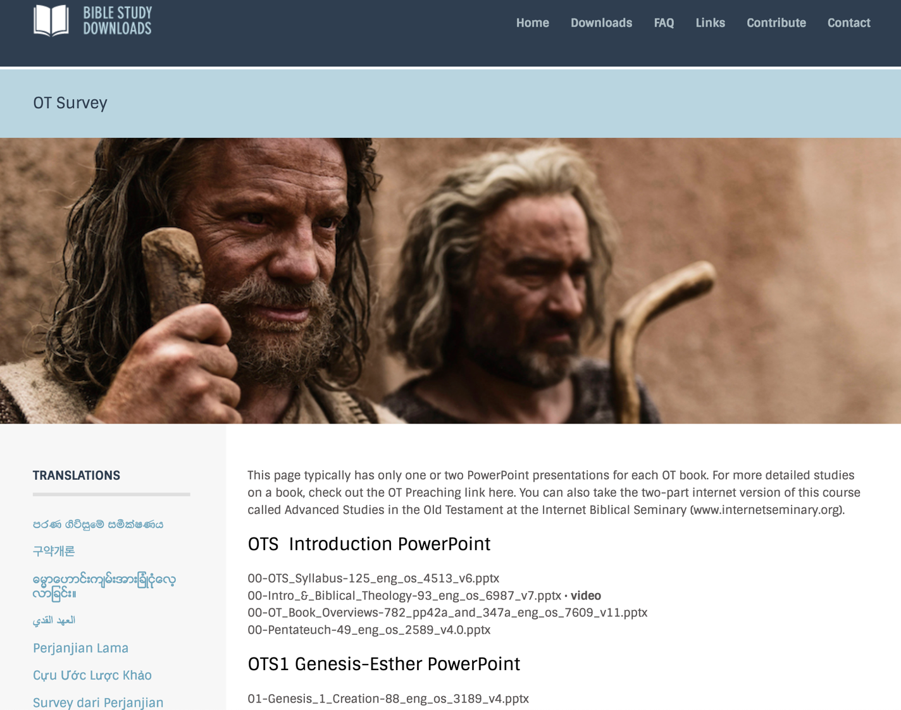
BibleStudyDownloads.org
7
English
Notes:
This has resulted in Bible teaching and study materials—mostly PowerPoint—in 49 languages! All a teacher needs to do is to click on a file and it downloads for free to teach any book of the Bible and many other subjects.

Slide 77
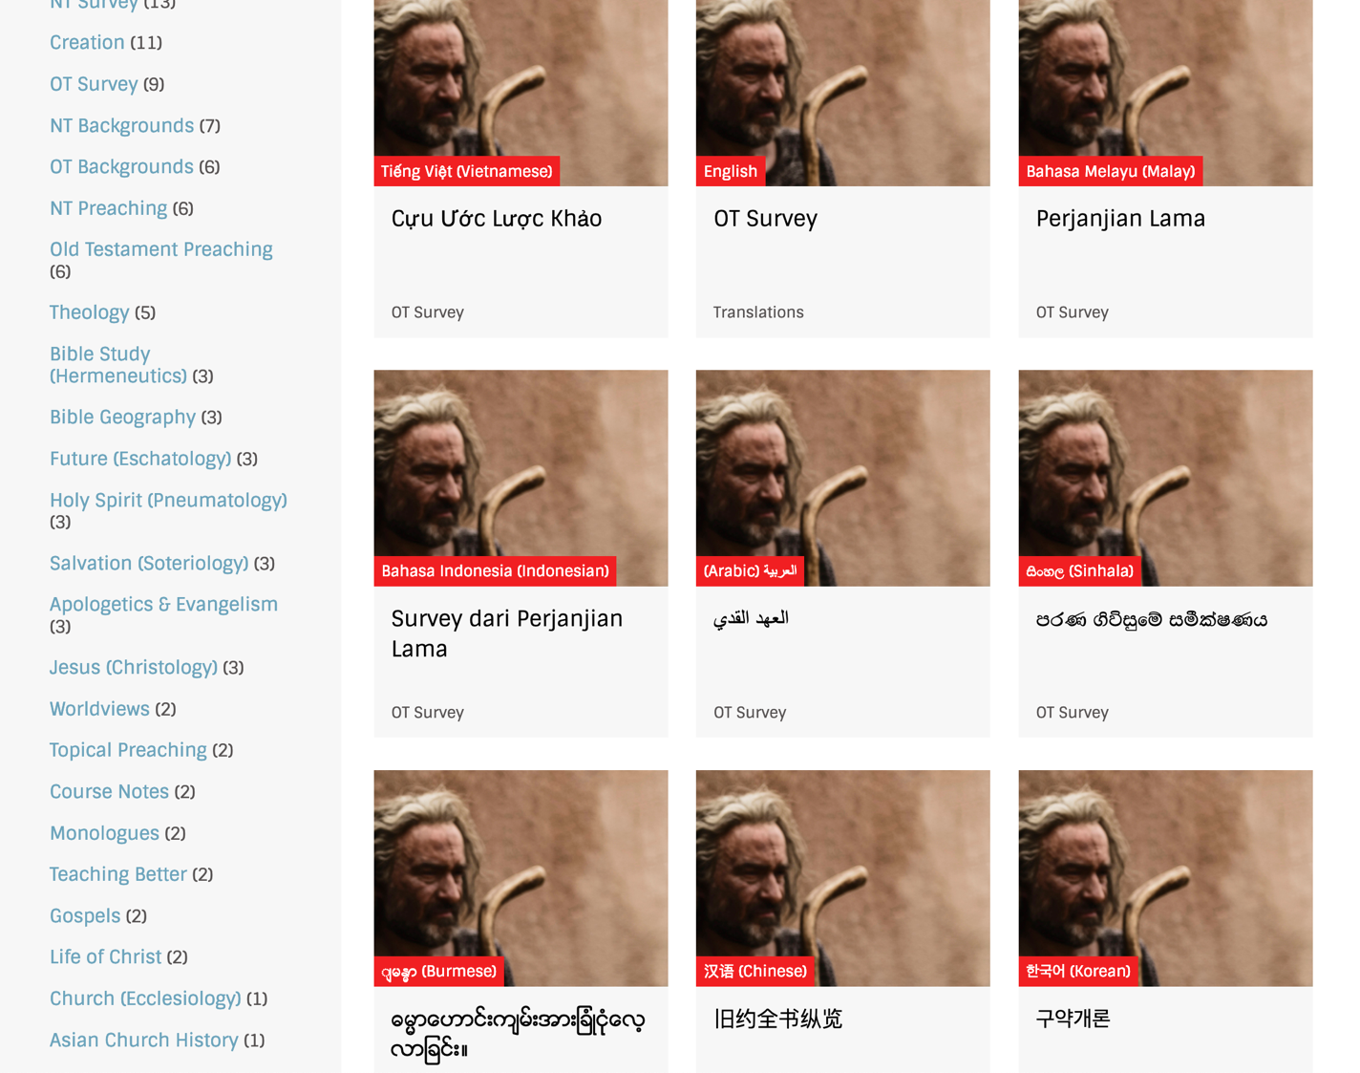
BibleStudyDownloads.org
7
Notes:
This has resulted in Bible teaching and study materials—mostly PowerPoint—in 42 languages! All a teacher needs to do is to click on a file and it downloads for free to teach any book of the Bible and many other subjects.

Slide 78
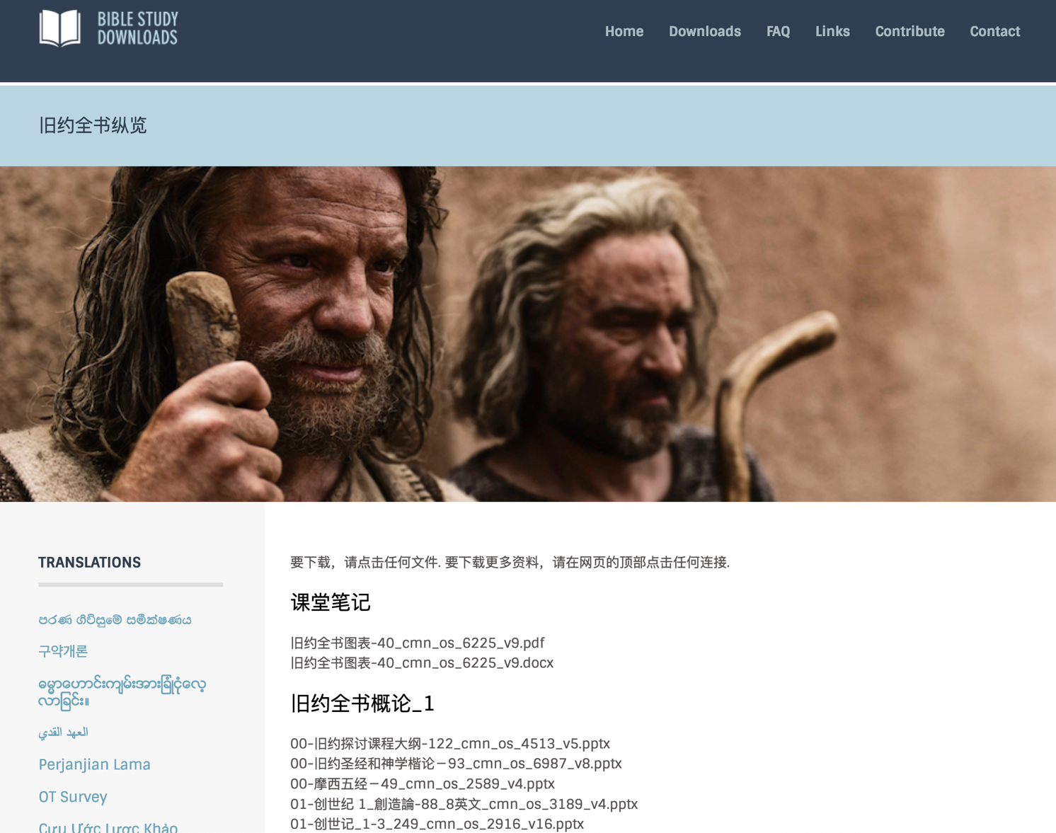
Chinese
7
Notes:
This has resulted in Bible teaching and study materials—mostly PowerPoint—in 42 languages! All a teacher needs to do is to click on a file and it downloads for free to teach any book of the Bible and many other subjects.

Slide 79
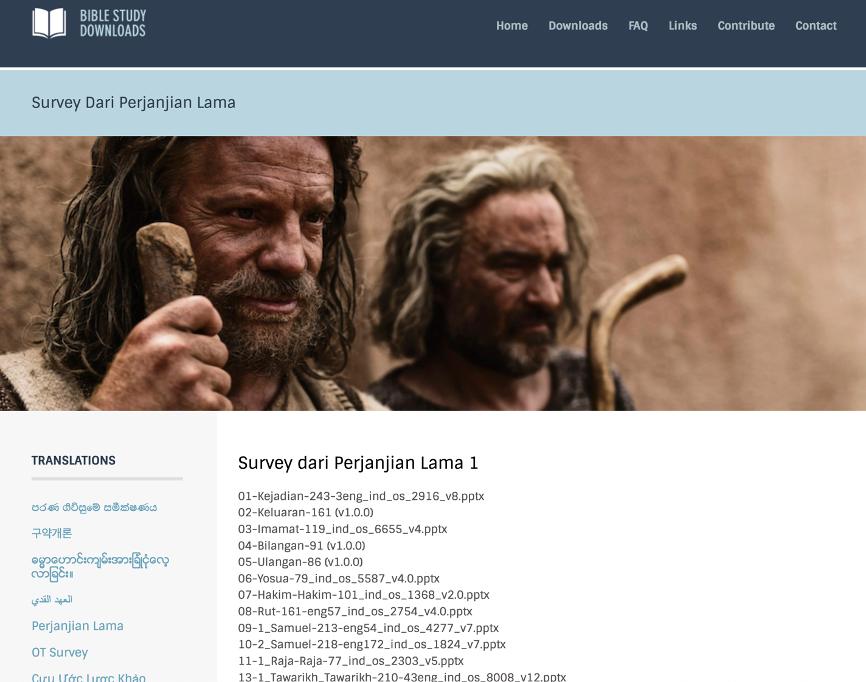
Indonesian
7
Notes:
This has resulted in Bible teaching and study materials—mostly PowerPoint—in 42 languages! All a teacher needs to do is to click on a file and it downloads for free to teach any book of the Bible and many other subjects.

Slide 80
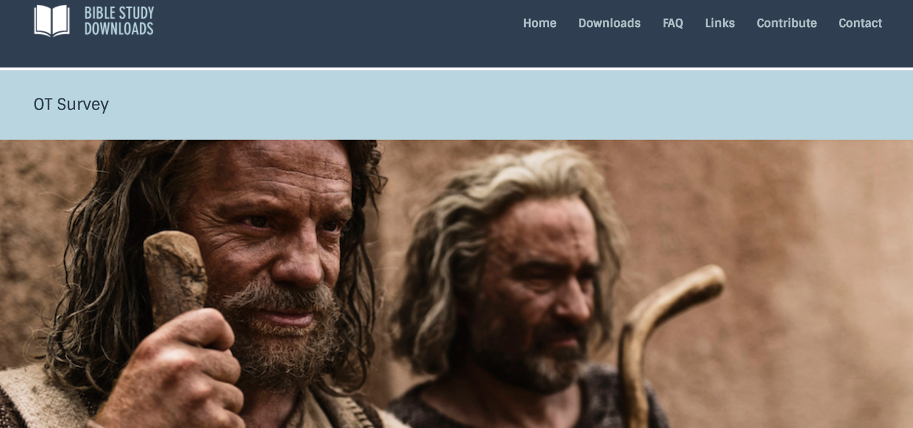
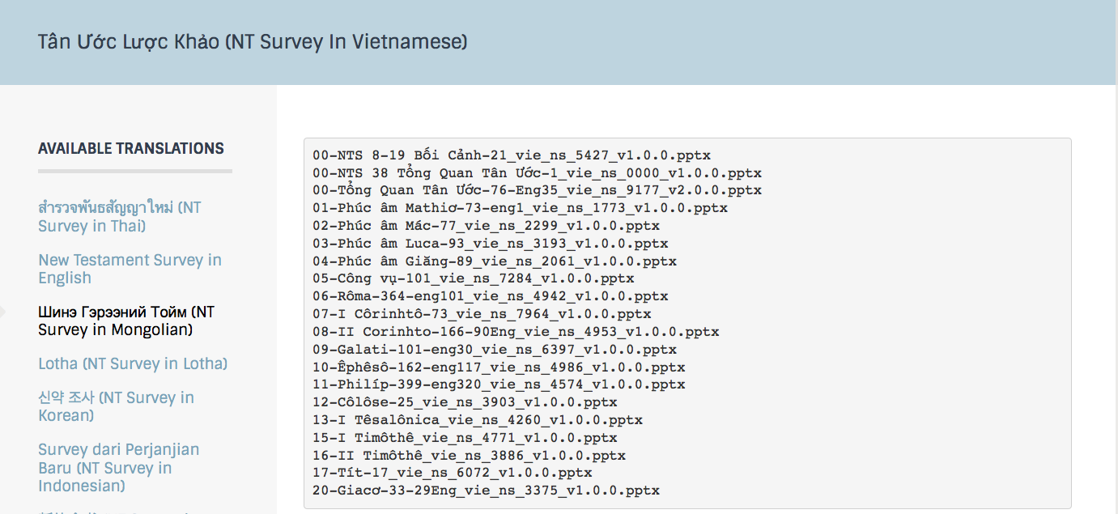
Vietnamese
7
Notes:
This has resulted in Bible teaching and study materials—mostly PowerPoint—in 49 languages! All a teacher needs to do is to click on a file and it downloads for free to teach any book of the Bible and many other subjects.

Slide 81
How should you deal with your ignorance of God’s ways?
Notes:
How should you deal with your ignorance of God’s ways?

Slide 82
1. Don’t worry about God not telling you everything you want to know (29a).
Notes:
We have seen that we need to know what God wants us to know.

Slide 83
2. Instead, seek to know what God does tell you (29b).
Notes:
But why? It is so you can…

Slide 84
3. Obey what you do know (29c).
Notes:
Put into practice your limited knowledge.

Slide 85
Deuteronomy 29:29 NIV
"The secret things belong to the LORD our God, but the things revealed belong to us and to our children forever, that we may follow all the words of this law."
"The Lord our God has secrets known to no one. We are not accountable for them, but we and our children are accountable forever for all that he has revealed to us, so that we may obey all the terms of these instructions" (NLT).
Notes:
NLT: “The Lord our God has secrets known to no one. We are not accountable for them, but we and our children are accountable forever for all that he has revealed to us, so that we may obey all the terms of these instructions."
WHY REVEALED:
God does not want us to be smarter sinners but trusting saints despite the fact that he will not reveal some secrets to us.
In the book of Job, God never did tell Job the reason for his suffering. He only expected Job to continue to trust and obey him.

Slide 86
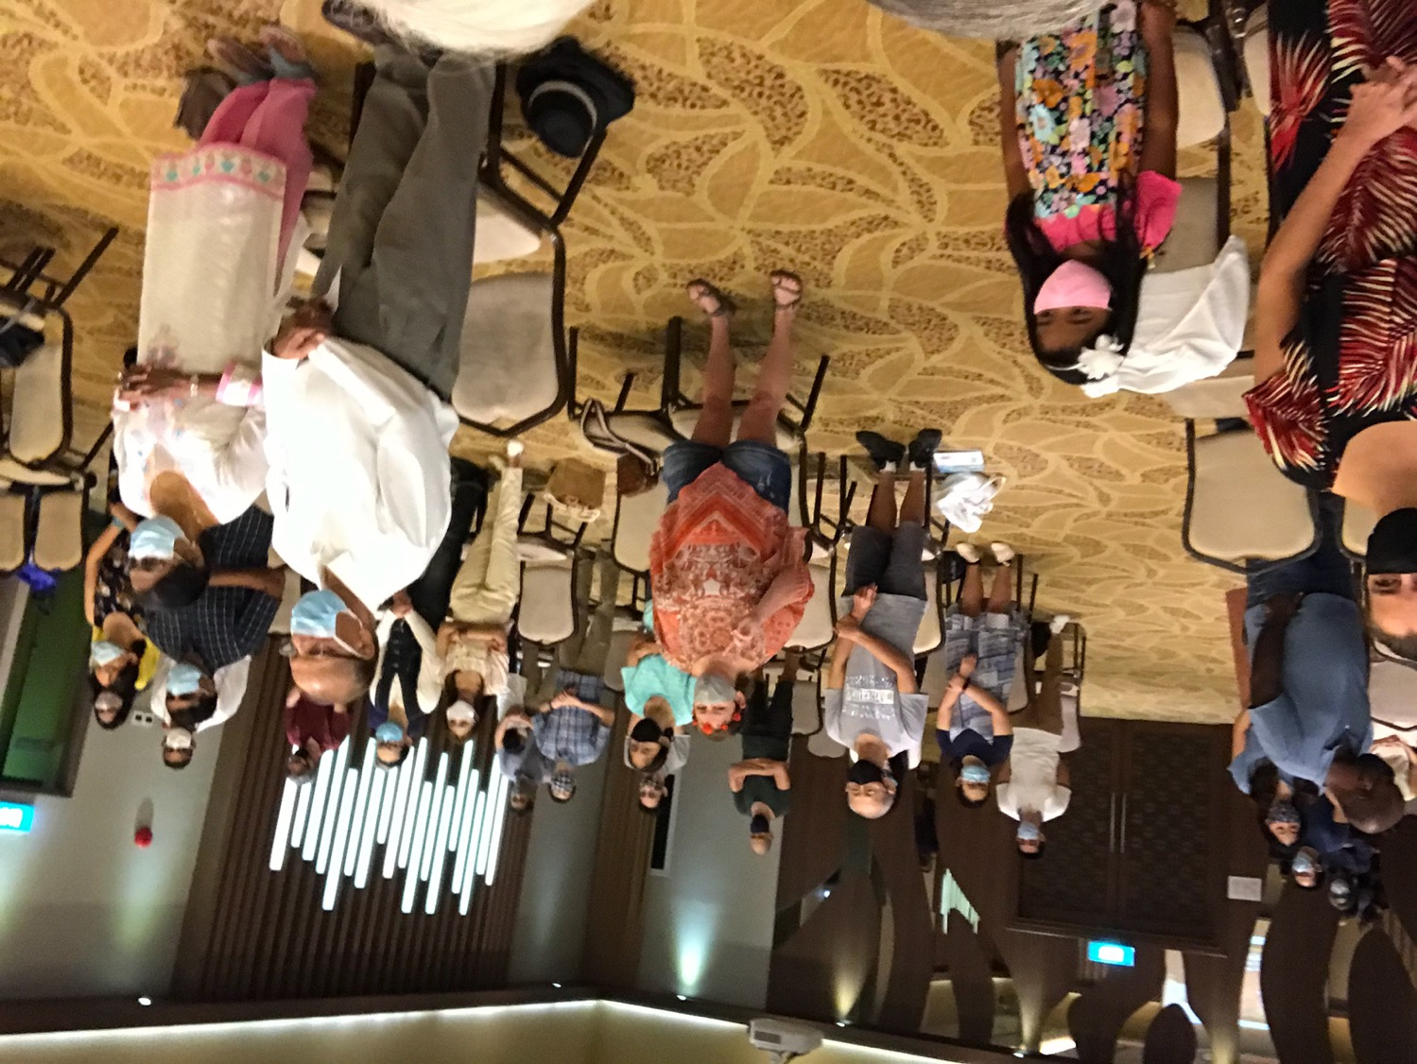
Our People
9
June 2021
90 people from 16 nations

Slide 87
Crossroads People • June 2021
UK
UNITED KINGDOM
RUSSIA
NETHERLANDS
MONGOLIA
ITALY
FRANCE
KOREA
HONG KONG
LEBANON
EGYPT
JAPAN
CHINA
GERMANY
NEPAL
TAIWAN
CANADA
MYANMAR
INDIA
USA
THAILAND
ETHIOPIA
MALAYSIA
ZIMBABWE
SOUTH AFRICA
PHILIPPINES
SINGAPORE
INDONESIA
CIC
AUSTRALIA
NEW ZEALAND
KENYA
Notes:
We actually have about 20% Indian at CIC, thanks to St. Thomas, who overcame his initial reluctance to witness for Jesus in India.
Our June 2021 church of 90 people stem from 16 different countries around the world: Australia (David & Fiona), China (Jian Yih), Egypt (Tamara), France (Valentin), Korea (Grace Kim), India (Cynthia), Indonesia (Rena), Kenya (Jacqueline Ngare), Myanmar (Jonathan), Nepal (Joshua Limbu), Netherlands (Toes), Singapore (Albina), South Africa (Melody Hertenberger), Taiwan (Maple), Thailand (Mae), UK (James & Gabi), USA (Jim & Jacqui).
This does not include people who have recently attended only once:
Nor does it include missionaries living back in their countries but still are members of CIC: Budmaa (Mongolia), Singpu (Myanmar)
Previous: Canada (Gloria Lee), Ethiopia (Lele), Malaysia (Aston, Naomi), Netherlands (Dies & Desiree), Philippines (Micah), South Africa (Melody),

Slide 88
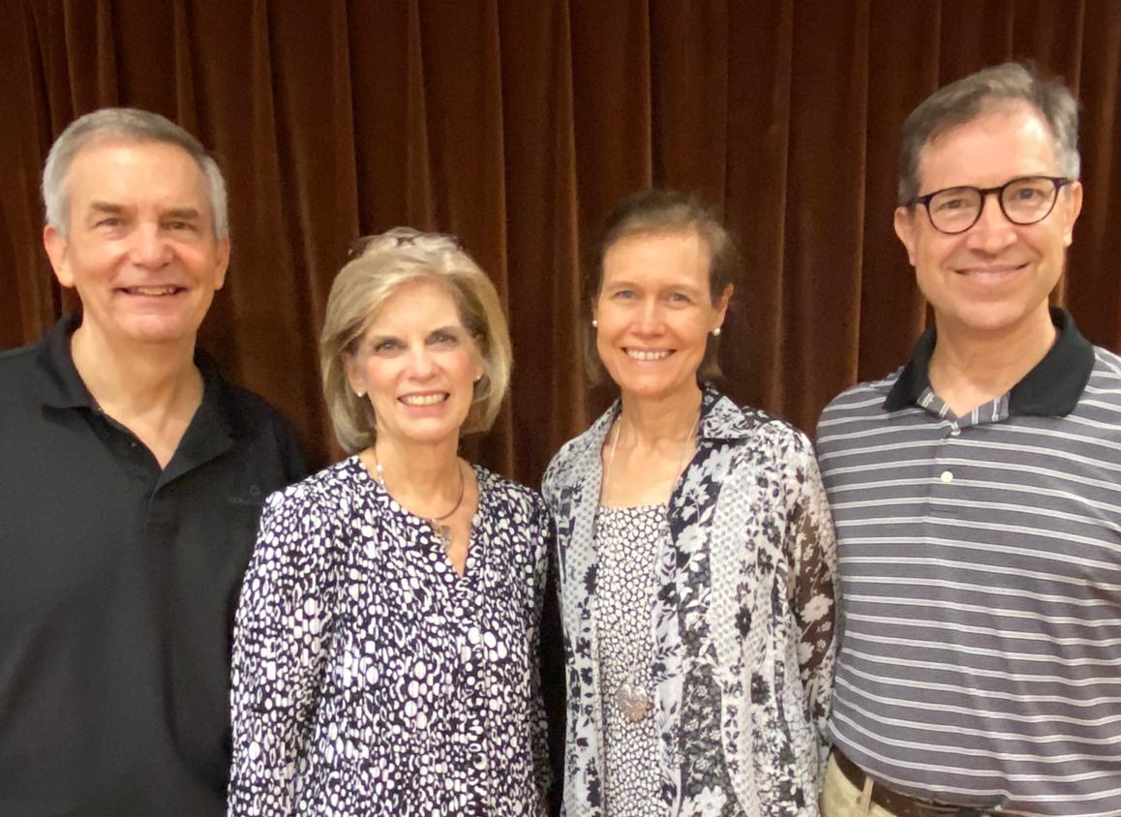
Rick & Susan 2006-2021
Jim & Jacqui
2019-2021
Notes:
We are passing the baton to the Harmelings, who have been with us nearly two years now.

Slide 89
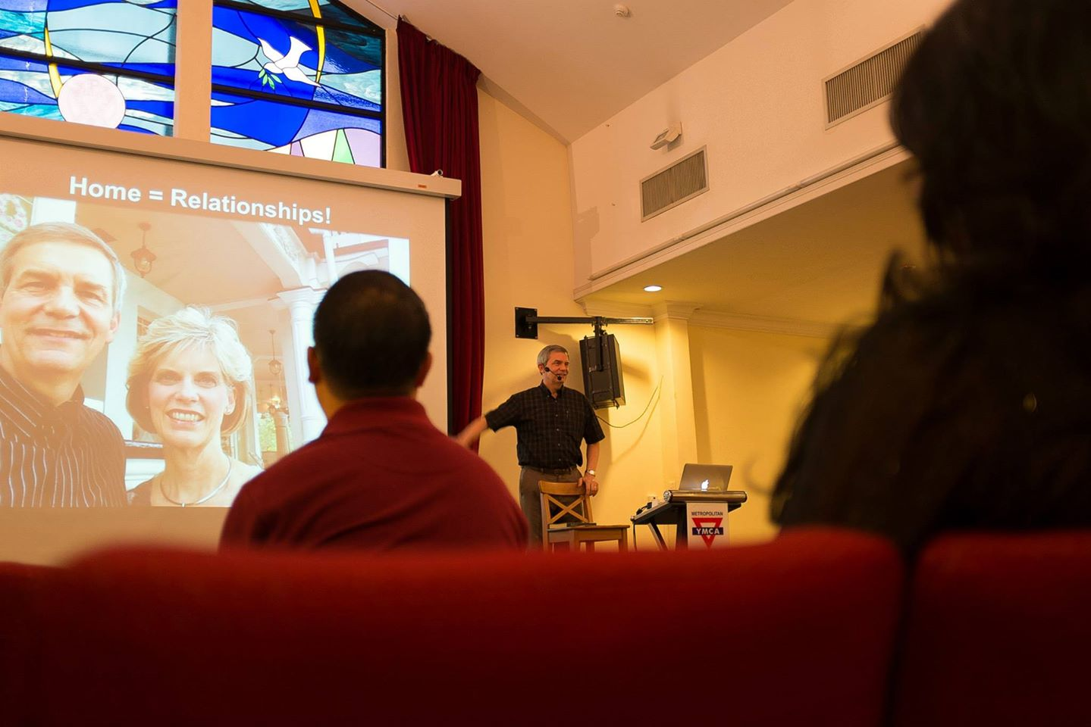
Our People
9
Preaching through Scripture
Notes:
Being a pastor gives me the privilege to teach God’s Word on weekends too!

Slide 90
Let's Study Through Scripture
The Bible: Book by Book
Notes:
I have been preaching through the entire Bible, book by book.

Slide 91
BE FAITHFUL
Genesis
Dr. Rick Griffith, Crossroads International Church Singapore
CICFamily.com • BibleStudyDownloads.org
Notes:
Since we are human beings and not “human doings,” each sermon starts with the word “Be...” So the overview of Genesis is “Be Faithful”…

Slide 92
Be Triumphant
Revelation
Dr. Rick Griffith • Crossroads International Church Singapore
BibleStudyDownloads.org
Notes:
…and so on all the way to Revelation entitled “Be Triumphant.”

Slide 93
How should you deal with your ignorance of God’s ways?
Notes:
How should you deal with your ignorance of God’s ways?

Slide 94
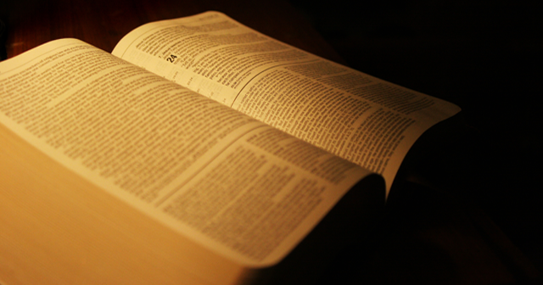
Main Idea
Obey what God says instead of worrying about what he will never tell you.

Slide 95
Deuteronomy 29:29 NIV
"The secret things belong to the LORD our God, but the things revealed belong to us and to our children forever, that we may follow all the words of this law."
Notes:
How can you better follow all the words of this law?
Stop worrying about how much you know since God isn’t telling many things.
Be more concerned with who you are becoming.
But are you doing what he asks of you? James 4:17 says, “To him who knows what is right to do and does not do it, to him it is sin.”

Slide 96
Black

Slide 97
OT Preaching link at BibleStudyDownloads.org
Get this presentation and script for free!

