Slide 1
Rectifying Wrongs
Deuteronomy 21
Dr. Rick Griffith • Preached at The People's Bible Church, Singapore
BibleStudyDownloads.org

Slide 2
Injustice.
Notes:
Last week a friend felt I had treated her unfairly. She said that she got fairer treatment from non-Christians! I had to rectify this wrong by asking her forgiveness where I “ate humble pie.”
This got me thinking if this is true for us as believers: Do we believers treat people less fairly than unbelievers do?
God is fair to us, so we should be fair to others.

Slide 3
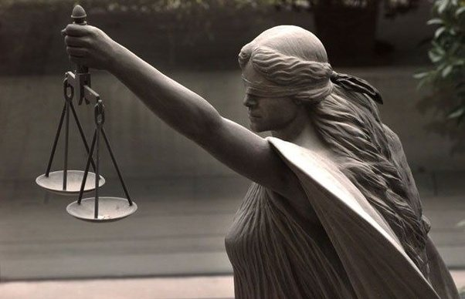
Lady Justice
Notes:
But are we? Do we value people?
"Since the 15th century, Lady Justice has often been depicted wearing a blindfold. The blindfold represents objectivity, in that justice is or should be meted out objectively, without fear or favor, regardless of money, wealth, power, or identity; blind justice and impartiality.
All over the world, you can see statues of Lady Justice brandishing a sword, holding a scale and wearing a blindfold. They are posted in front of Court buildings and their message is clear; Justice will prevail."
______
"The Trouble with Justice"
May 5, 2015 by Lise LaSalle
The Jury System or When Lady Justice Became Lady Luck
http://thetroublewithjustice.com/2015/05/05/the-jury-system-or-when-lady-justice-becomes-lady-luck/

Slide 4
Injustice.
Notes:
Would those who know you say you are just and fair?

Slide 5
Main Idea:
Treat people fairly by rectifying wrongs.
Notes:
Treat people fairly by rectifying wrongs. That is the key idea in today’s passage.
Correct offences. Handle others justly by undoing inequalities you may have done to them—or when you are tempted to be unfair to them. Value human lives. The title of this message is simply “Rectify Wrongs.”
But what does rectifying wrongs look like? How should we correct offences—or better yet, not do injustices to start with?

Slide 6
What does rectifying wrongs look like?
Notes:
But what does rectifying wrongs look like? How should we correct offences—or better yet, not do injustices to start with?

Slide 7
Background to Today's Text
Notes:
Israel needed to know how to treat people fairly.

Slide 8
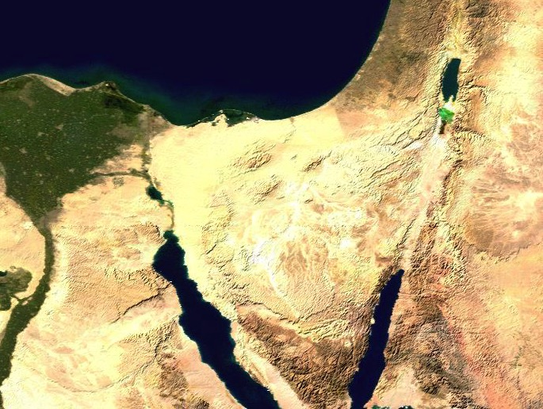
Wilderness Wanderings
Injustice
Moab
Egypt
Kadesh- barnea
Injustice
Mt. Sinai
Notes:
Israel had been treated unjustly for 400 years in Egypt. That was when they were the underdogs. They were slaves and the Egyptians were their overlords. As a result, they experienced generations of injustice.
• However, now the tables were about to turn. They would soon conquer Canaan and become the people of power.

Slide 9
Topography of Israel
http://www.studylight.org/se/maps/browse.cgi?st=51&pn=11
Notes:
As Israelites looked towards becoming the ones with more potential to injustice, they needed God’s instructions. Otherwise, they would repeat the same wrongs of the Egyptians. How could Israel prevent such inequalities?

Slide 10
What does rectifying wrongs look like?
5 ways
Notes:
Today we’ll see five examples how we must treat people fairly by rectifying wrongs. Sadly, more than half of these examples were in families, where injustice often is most evident!

Slide 11
What does rectifying wrongs look like?
Deuteronomy 21
Notes:
Deuteronomy 21 gives us these five situations and what to do in them.

Slide 12
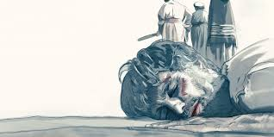
1. Murder must be treated seriously (Deut 21:1-9).
What does rectifying wrongs look like?
Notes:
Human life is valuable so we should investigate every homicide.
Israel’s unsolved murders required leaders to kill a heifer nearby (1-9).
Murdering an innocent man polluted the land (1).
The way to turn God’s wrath away from the people was for the leaders to publicly declare their innocence (2-9).

Slide 13
“Breaking the heifer’s neck symbolized that the crime deserved capital punishment, and the washing of the elders’ hands over the heifer symbolized their innocence in the matter. This ritual demonstrated how extremely valuable God considers life. For even though no murderer was found, the land and the people both incurred the guilt of shedding innocent blood. The animal sacrifice, accompanied by the petition of the elders, made atonement, that is, turned the wrath of God away from the people” (Jack Deere, “Deuteronomy,” in BKC, 1:300).

Slide 14
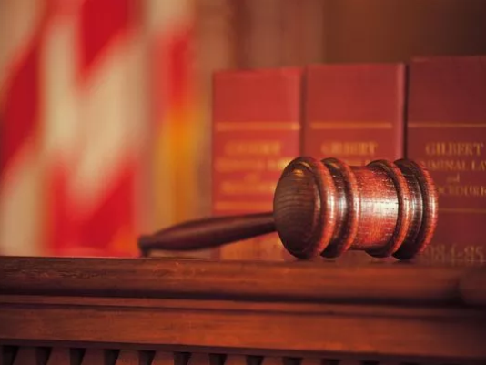
We must value human life publicly.
Notes:
All societies have laws to value human life.
We should go beyond these laws, though, such as protecting the life of the unborn even if the country’s laws do not do so.
Some Christians fed their maids with the food scraped off their children’s plates!
Employers in JB got perturbed when employees accidentally cut off their fingers.

Slide 15
2. Women must be highly valued (Deut 21:10-14).
What does rectifying wrongs look like?
Notes:
Ladies should never be abused simply since they’re weaker physically.

Slide 16
A Question
How could Israelites take a captive woman (21:11)? Weren’t all the Canaanites supposed to be slain?
Notes:
Captives were not to be taken for battles in Canaan (cf. 7:1, 3-4).
Therefore, this passage must apply to war outside Israel (cf. 20:15).

Slide 17
Deuteronomy 7:1-4
"When the LORD your God brings you into the land you are entering to possess and drives out before you many nations – the Hittites, Girgashites, Amorites, Canaanites, Perizzites, Hivites, and Jebusites, seven nations larger and stronger than you – and when the LORD your God has delivered them over to you and you have defeated them, then you must destroy them totally."

Slide 18
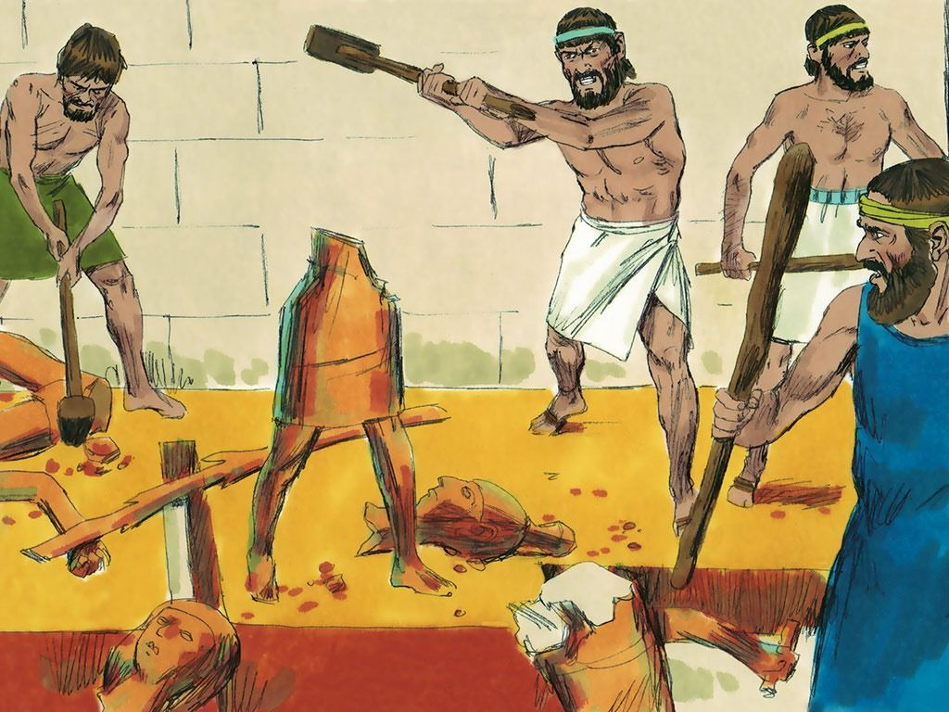
Destroying Pagan Images

Slide 19
Deuteronomy 7:1-4
"Make no treaty with them, and show them no mercy. Do not intermarry with them. Do not give your daughters to their sons or take their daughters for your sons, for they will turn your sons away from following me to serve other gods, and the LORD's anger will burn against you and will quickly destroy you."

Slide 20
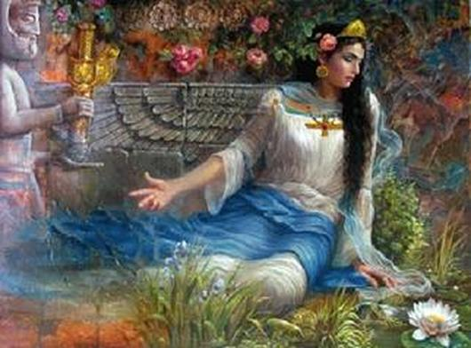
Why did a soldier have to wait a whole month before taking the captive women as his wife (13)?
Notes:
“The full month allowed the captive woman a proper amount of time for mourning and it also gave the prospective husband opportunity to reflect on his initial decision to take her as his wife. For with a shaved head she would be less attractive” (Deere, 1:300).

Slide 21
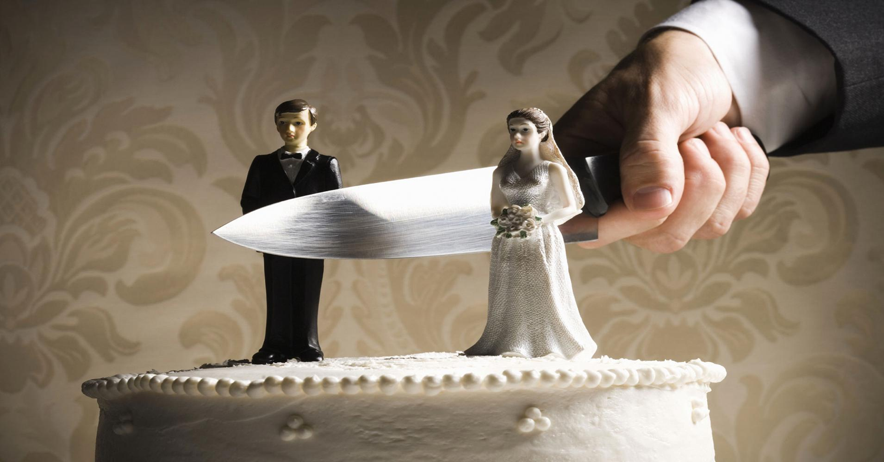
We must honor women and marriage today.
Notes:
Wherever Christianity has gone, the rights of women have increased.
Jesus himself was the best example of one who cared for women—he touched them when they were diseased, he cared for his own mother while suffering on the cross, and he died for all women!

Slide 22
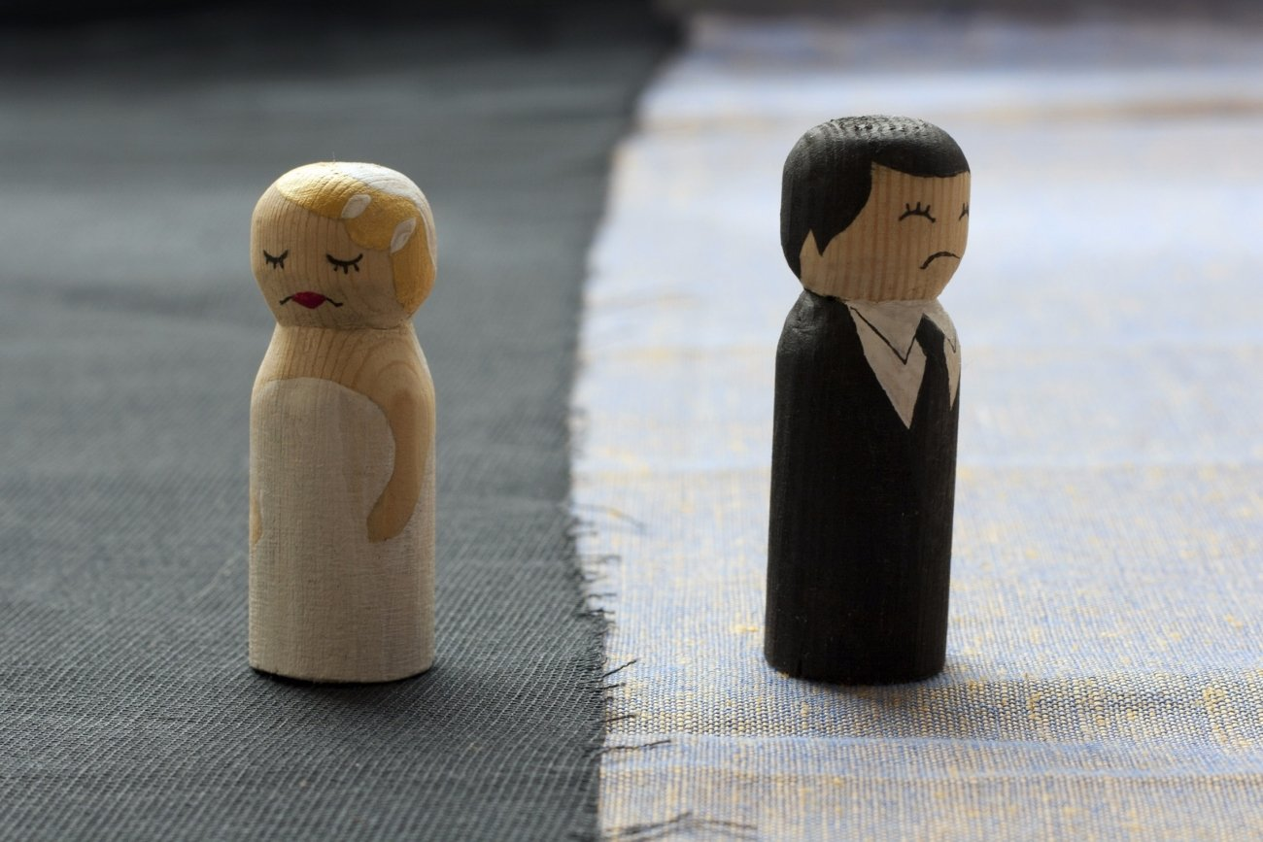
3. Wives must have financial security (Deut 21:15-17).
What does rectifying wrongs look like?

Slide 23
Firstborn Double Inheritance
Notes:
Why must there be a double share given to the firstborn son (15-17)?
It doesn’t say that he had to do this, but this was the practice then as it is today.
The point is that, when the rights of the firstborn were practiced, they must be done without favoritism.

Slide 24
We must financially care for every wife.
Notes:
This is why we have laws that require men to care for their wife, even if they divorce her.
God is dishonored especially in the church when people do not care for their own relatives (1 Tim. 5:8).

Slide 25
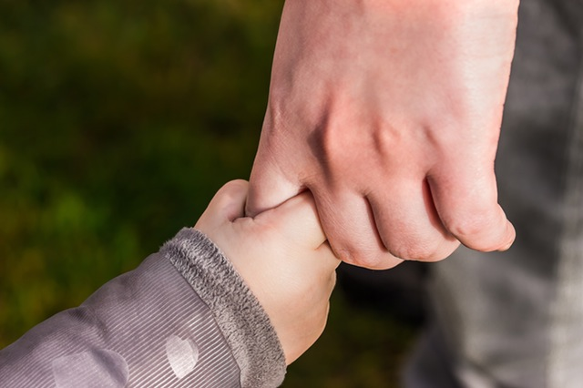
4. Relatives must follow the same laws as others (Deut 21:18-21).
What does rectifying wrongs look like?
Notes:
You can’t change the law just because the guilty one is related to you.

Slide 26
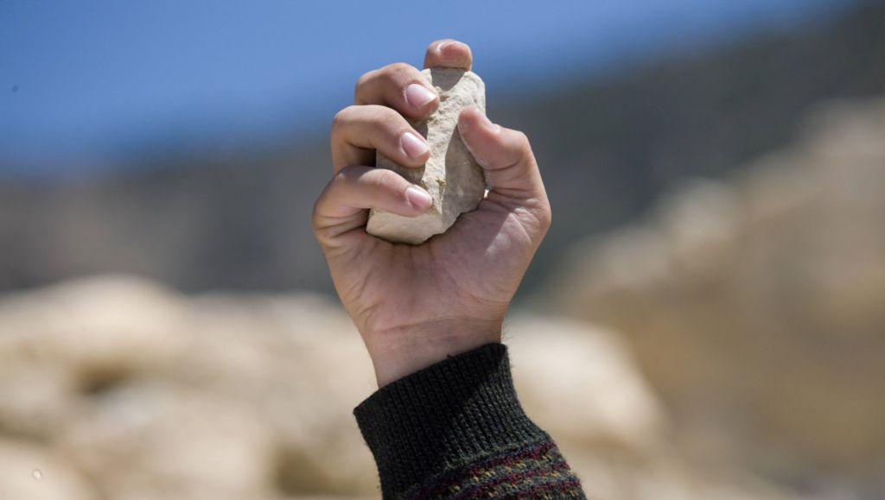
Why such a severe penalty for a rebellious son (21)?
Notes:
“An extreme violation of the fifth commandment, ‘Honor your father and your mother’ (5:16), was to be punished by death. In view here was not an occasional lapse into disobedience but a persistent rebellion against one’s father and mother even after the parents had warned their son of the consequences of his rebellious actions. The son was ultimately rebelling against the Lord’s authority and therefore attacking the foundations of the covenant community. The legislation here was not cruel nor did it give parents a right to abuse their children” (Deere, 1:301).

Slide 27
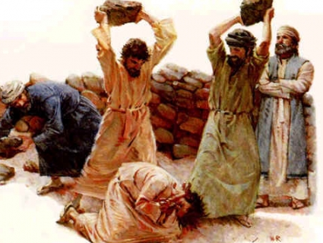
Never Happened

Slide 28
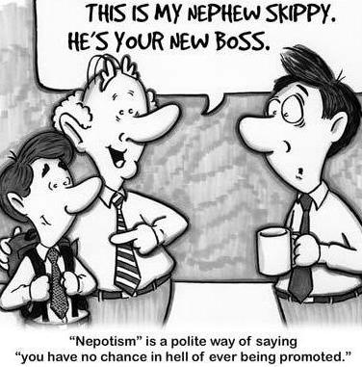
Nephew
This is my nephew, Skippy. He's your new boss.
Notes:
“This was more than a family concern, for it involved the peace and reputation of the community. The solidarity of the people of Israel was an important element in their civil, social, and religious life, for the sin of a single person, family, city, or tribe could affect the whole nation (see Deut. 13; Josh. 7:1–15). This is also true of the church, for as members of one spiritual body (1 Cor. 12), we belong to one another and we affect one another (1 Cor. 5)” (Wiersbe, 171).

Slide 29
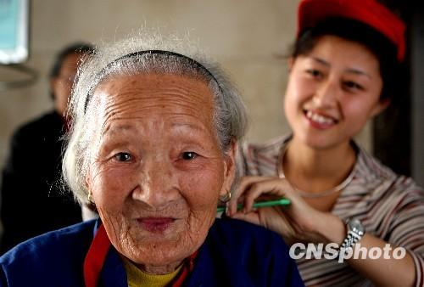
2013 China Law says visit old relatives or pay a fine
Notes:
China has passed a new law that says people must visit their older relatives. This means older parents or grandparents can sue their kids and grandkids for not visiting them. The new law will start on July 1, 2013. It is part of a new campaign called the Protection of the Rights and Interests of the Elderly. China says it is so the country's aging population is not left alone. There have been many stories recently in China's newspapers of old people dying alone because their children do not visit them. More than half of China's elderly live alone. Even though the law says children have to visit their older relatives "often," it does not say how often "often" is. It also does not say how much the fine is for not visiting often. China is becoming an aging society because of its one child per family policy. In 1978, the Chinese government told all couples they could have only one child. Some families could have two or more, such as those living in the countryside, ethnic minorities, or people who had twins. The Xinhua news agency said that at the end of 2011, almost 14 per cent of China's population was over 60 years old. That's more than 184 million people. This number is increasing because of China's rapid economic development. More and more young people are leaving the countryside to work in China's cities. Their parents are left alone and have to look after themselves. There are very few homes for the aged in the countryside.
_____
English Channel
2013-01-07 07:50:00
http://tx.english-ch.com/teacher/jocelyn/others/law-says-visit-old-relatives-or-pay-a-fine/
Accessed 5 Aug 2017

Slide 30
Favoritism Divides
Notes:
“This was more than a family concern, for it involved the peace and reputation of the community. The solidarity of the people of Israel was an important element in their civil, social, and religious life, for the sin of a single person, family, city, or tribe could affect the whole nation (see Deut. 13; Josh. 7:1–15). This is also true of the church, for as members of one spiritual body (1 Cor. 12), we belong to one another and we affect one another (1 Cor. 5)” (Wiersbe, 171).
Favoritism divides the church in many ways.
Don't allow divisive people come to church. Sometimes schizophrenics or others can disrupt a church to the degree that the church must prevent them from coming and dividing the body.
One leadership principle that I have had to learn repeatedly is not to show such grace to one person that others suffer as a result. I have hired principals or even brought on pastors or elders with the sincere belief that they can learn the ropes, but then lost a bunch of people over my attempt to show grace!

Slide 31
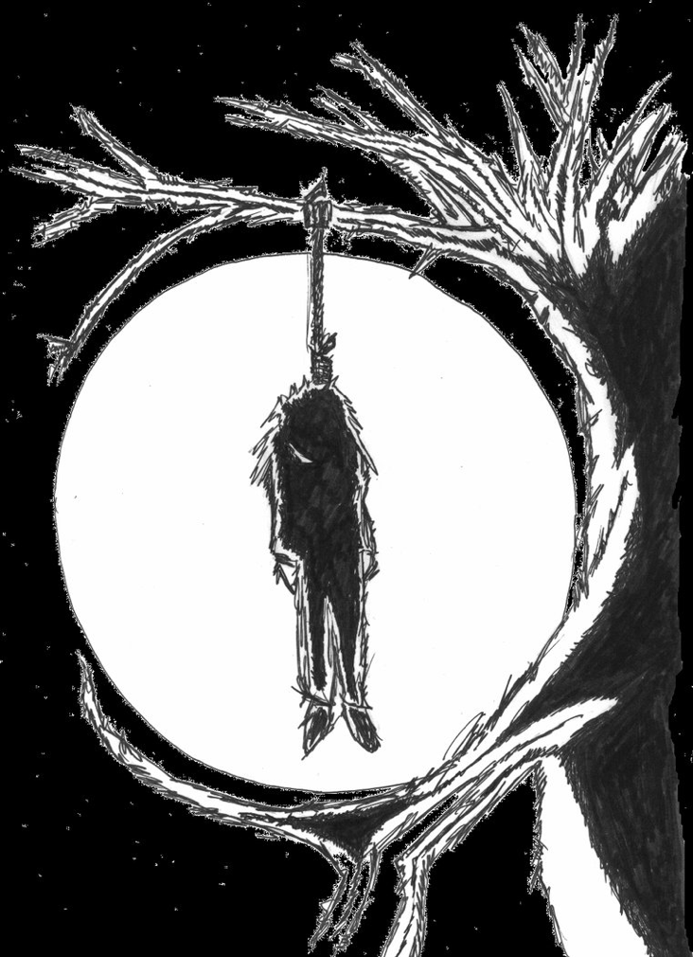
5. Corpses of the condemned also deserve respect (Deut 21:22-23).
What does rectifying wrongs look like?
Notes:
The body is sacred, no matter what kind of life the person lived.
Israel had to respect an executed man’s corpse by burying it before dark (22-23).
People could be tempted to mistreat the body of one executed by hanging it overnight where it could be eaten by animals (22).
Instead, the body had to be treated respectfully with a decent burial on the day of execution so God would not curse the land (23).
Why was it wrong to leave a body hung on a tree overnight (23)?
“Hanging a criminal on a tree was not for the purpose of putting him to death. Rather, after he was executed for a capital offense ... his body was hanged on a tree as a warning to all who saw it not to commit the same offense. The criminal was under God’s curse not because his body was hung on a tree but because he had broken God’s Law by committing a crime worthy of death. Therefore his body was not to be left on the tree overnight. This text was used by the Apostle Paul (Gal. 3:13) to support the doctrine of Christ’s penal substitutionary death for sinners. Christ’s being under God’s curse (cf. comments on Mark 15:34) enabled Him to redeem ‘us from the curse of the Law’” (Deere, 1:301).

Slide 32
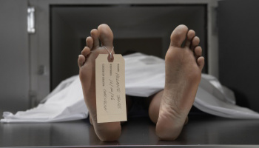
We must show respect in death as well as in life.
Notes:
“Since a dead body was unclean, it was taken down at sundown so as not to decay further and defile the land. Also, the Lord didn’t want executed criminals to get too much attention lest they become heroes” (Wiersbe, 175).
I think this helps us also appreciate the death of Christ: “This rather gruesome symbolic act reminded the people that God cursed people who committed capital crimes. In Galatians 3:13, Paul applied this truth to our Lord’s death on the cross: ‘Christ has redeemed us from the curse of the law, having become a curse for us (for it is written, “Cursed is everyone who hangs on a tree”)’ (NKJV). Those who trust Christ cannot be condemned by the law (Gal. 3:10) because Christ bore that curse for them” (Wiersbe, 175-76).

Slide 33
Main Idea:
Treat people fairly by rectifying wrongs.
Notes:
We must show respect in death as well as in life.

Slide 34
Where do you have power to abuse or show fairness?
Are you just with your relatives?
Do you treat your employees with equity?
Would your students accuse you of bias?
What wrong do you need to correct?
Notes:
This is OT law, but doesn’t the principle of rectifying wrongs show up in our lives today?

Slide 35
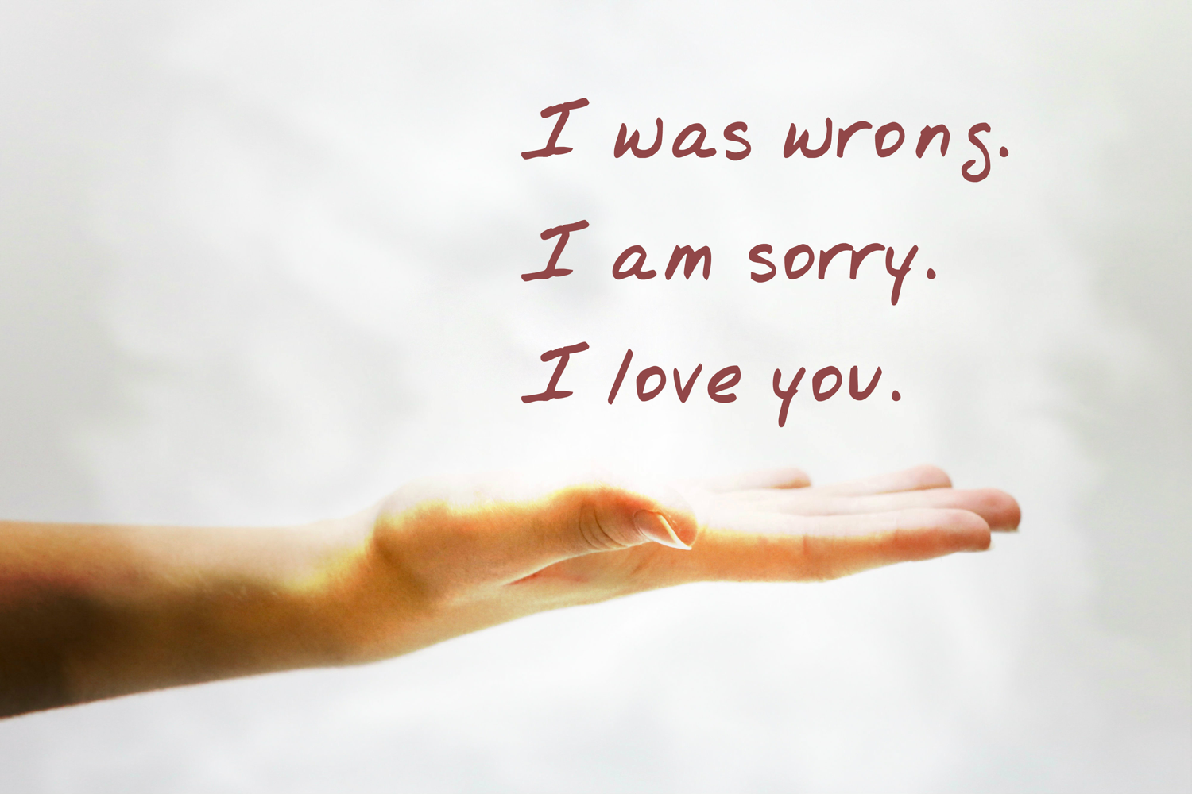
Injustice
Notes:
How can you rectify a wrong you have done to others?
Do you need to ask forgiveness—and with whom?
What policy or practice must you change?
Men, do the women in your life feel valuable?
But do you unfairly show nepotism?

Slide 36
Black

Slide 37
OT Preaching link at BibleStudyDownloads.org
Get this presentation and script for free!

