Slide 1
To look forward to
Part 6:
What Are the Signs?
Preached by Matt Lyle at Crossroads International Church Singapore • CICFamily.com Uploaded by Dr. Rick Griffith • Singapore Bible College Files in many languages for free download at BibleStudyDownloads.org

Slide 2
To look forward to
Part 6:
What Are the Signs?
Fixing our sight on God’s revelation of the future

Slide 3
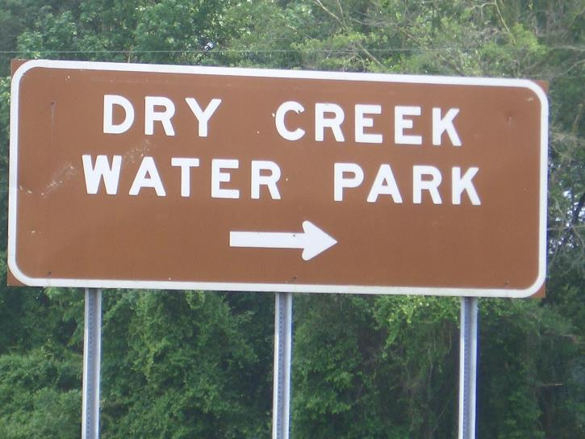
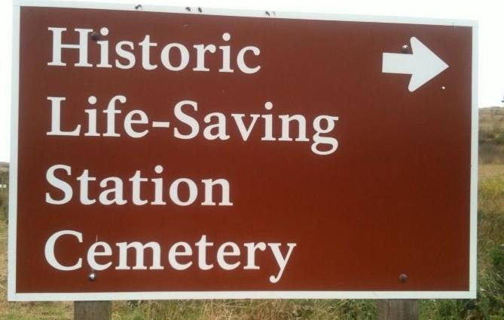
Signs: Where to go

Slide 4
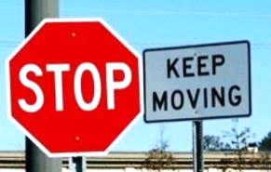
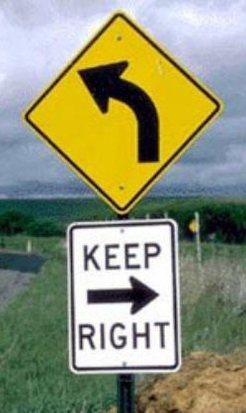
Signs: What to do

Slide 5
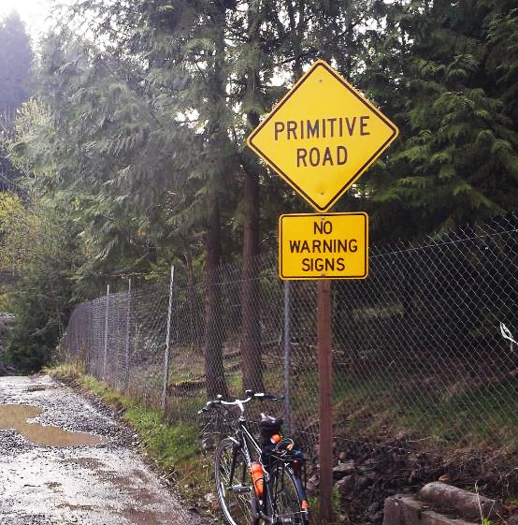
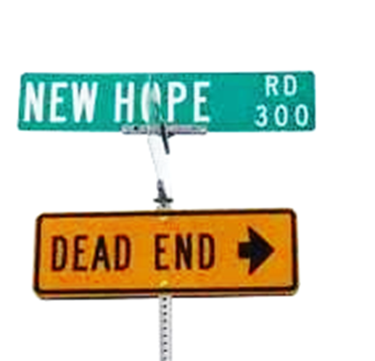
Signs: What to expect

Slide 6
Signs: Are Not Always Clear
Signs of the Return Christ

Slide 7
www.CICFamily.com

Slide 8
Rejoice! Evil is Defeated (vs. 1-5)
The King Reigns and His Bride is Ready (vs. 6-10)
Behold! He comes (vs. 11-21)
Thy Kingdom Come (vs. 1-6)

Slide 9
Messianic Prophecies / Signs
1st Coming
2nd Coming
Olivet Discourse
Daniel’s 70 Weeks Prophecy
Looking Ahead

Slide 10
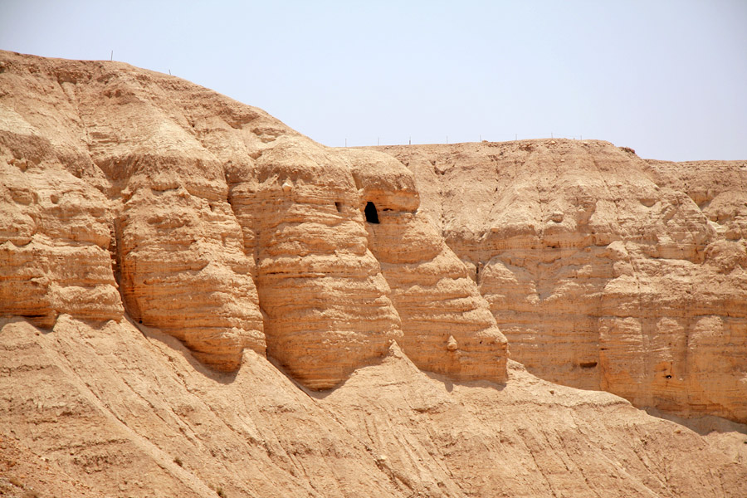
Dead Sea Scrolls

Slide 11
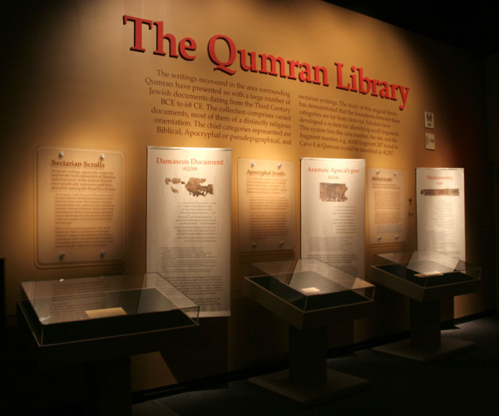
Scroll 4Q175
The Testimonia

Slide 12
Deuteronomy 5:28-29 & 18:18-19 (ESV)
¹⁸ I will raise up for them a prophet like you
Numbers 24:15-17 (ESV)
a star shall come out of Jacob,
and a scepter shall rise out of Israel;
Deuteronomy 33:8-11 (ESV)
⁸ And of Levi he said, . . .
Joshua 6:26 (ESV)
At the cost of his firstborn shall he lay its foundation .

Slide 13
The first two quotations refer to the raising up of a prophet like Moses. The third quotation refers to a royal Messiah, the fourth to a priestly Messiah. The quotation from Joshua is connected to the coming of a time of great disaster, brought on by those dedicated to evil.
Marilyn J. Lundberg

Slide 14
Fulfilled Messianic Prophecies
Born of a woman Genesis 3:15
“I will put enmity between you and the woman,
and between your offspring and her offspring;
he shall bruise your head,
and you shall bruise his heel.”

Slide 15
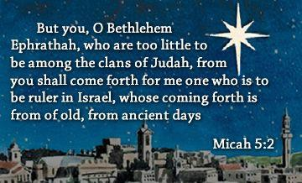
Fulfilled Messianic Prophecies
1 Born of a woman Genesis 3:15
2 Born in Bethlehem Micah 5:2

Slide 16
Footnote
Mic 5:2

Slide 17
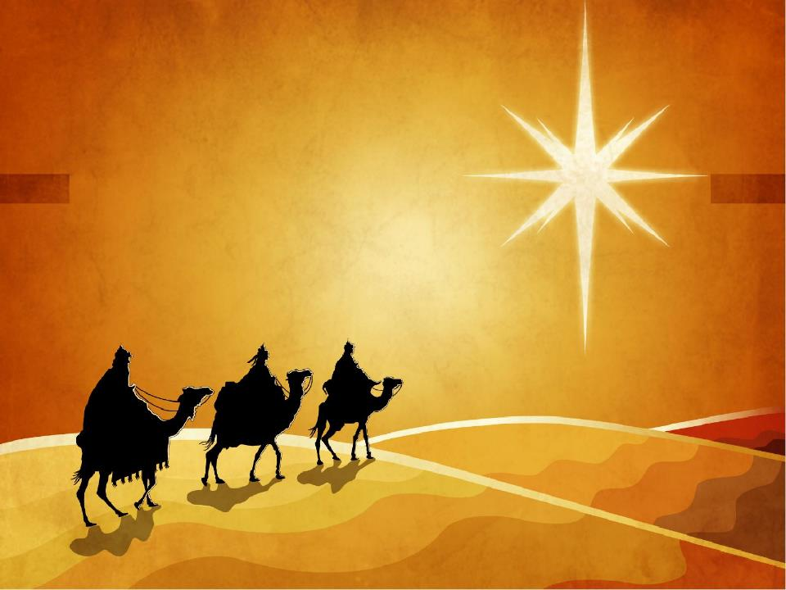
Micah 5:2 (ESV)
But you, O Bethlehem Ephrathah,
who are too little to be among the clans of Judah,
from you shall come forth for me
one who is to be ruler in Israel,
whose coming forth is from of old,
from ancient days.
Footnote
Mic 5:2

Slide 18
Fulfilled Messianic Prophecies
1 Born of a woman Genesis 3:15
2 Born in Bethlehem Micah 5:2
3 Born of a virgin Isaiah 7:14
4 Come from the line of Abraham Genesis 12:3, 22:18
5 Be a descendant of Isaac Genesis 17:19, 21:12
6 Be a descendant of Jacob Numbers 24:17
7 Come from the tribe of Judah Genesis 49:10
8 Heir to King David's throne 2 Samuel 7:12-13
9 Be called Immanuel Isaiah 7:14
10 Spend a season in Egypt Hosea 11:1
11 Massacre of children Jeremiah 31:15
12 Messenger prepare way Isaiah 40:3-5

Slide 19
Fulfilled Messianic Prophecies
13 Rejected by own people Psalm 69:8, Isaiah 53:3
14 Called a Nazarene Isaiah 11:1
15 Speak in parables Psalm 78:2-4
16 Heal the brokenhearted Isaiah 61:1-2
17 Would be betrayed Psalm 41:9, Zech 11:12-13
18 Money buy a potter's field Zechariah 11:12-13
19 Falsely accused Psalm 35:11
20 Silent before his accusers Isaiah 53:7
21 Spat upon and struck Isaiah 50:6
22 Hated without cause Psalm 35:19, 69:4
23 Be crucified with criminals Isaiah 53:12
24 Given vinegar to drink Psalm 69:21

Slide 20
Fulfilled Messianic Prophecies
25 Hands and feet pierced Psalm 22:16, Zech 12:10
26 Mocked and ridiculed Psalm 22:7-8
27 Soldiers gamble for garments Psalm 22:18
28 Bones would not be broken Ex 12:46, Psalm 34:20
29 Forsaken by God Psalm 22:1
30 Pray for his enemies Psalm 109:4
31 Soldiers would pierce side Zechariah 12:10
32 Buried with the rich Isaiah 53:9
33 Resurrect from the dead Psalm 16:10, 49:15
34 Ascend to heaven Psalm 24:7-10
35 Seated at God's right hand Psalm 68:18
36 Be a sacrifice for sin Isaiah 53:5-12

Slide 21
Fulfilled Messianic Prophecies
Micah 5:2 Born in Bethlehem
Micah 4:3 No more war
Unfulfilled
Messianic Prophecies

Slide 22
Fulfilled and Unfulfilled Messianic Prophecies
New Heavens & New Earth
Christ’s
Second
Coming to
Reign in
Millennium
Christ’s
First
Coming
to Suffer
Exile & Return
Prophet's Own Time
Adapted significantly from Salem Kirban, Charts on Revelation (1979), 49

Slide 23
Fulfilled and Unfulfilled Messianic Prophecies
New Heavens & New Earth
Christ’s
Second
Coming to
Reign in
Millennium
Christ’s
First
Coming
to Suffer
Exile & Return
Reading the Old Testament
Adapted significantly from Salem Kirban, Charts on Revelation (1979), 49

Slide 24
Looking for the Messiah
Looking for the Messiah’s Return

Slide 25
The Olivet Discourse
3 Questions (Matt 24:3)
Tell us, when will (temple be destroyed)?
What will be the sign of your coming?
and of the end of the age?
Answers
Luke 21:20-24
Matt 24:15-44
Matt 24:4-14

Slide 26
Matt 24:4-14 Signs of the end of the age
⁴ And Jesus answered them, “See that no one leads you astray. ⁵ For many will come in my name, saying, ‘I am the Christ,’ and they will lead many astray. ⁶ And you will hear of wars and rumors of wars. See that you are not alarmed, for this must take place, but the end is not yet. ⁷ For nation will rise against nation, and kingdom against kingdom, and there will be famines and earthquakes in various places. ⁸ All these are but the beginning of the birth pains.
⁹ “Then they will deliver you up to tribulation and put you to death, and you will be hated by all nations for my name's sake. ¹⁰ And then many will fall away and betray one another and hate one another. ¹¹ And many false prophets will arise and lead many astray. ¹² And because lawlessness will be increased, the love of many will grow cold. ¹³ But the one who endures to the end will be saved. ¹⁴ And this gospel of the kingdom will be proclaimed throughout the whole world as a testimony to all nations, and then the end will come.

Slide 27
Matt 24:4-14 Signs of the end of the age
⁴ And Jesus answered them, “See that no one leads you astray. ⁵ For many will come in my name, saying, ‘I am the Christ,’ and they will lead many astray. ⁶ And you will hear of wars and rumors of wars. See that you are not alarmed, for this must take place, but the end is not yet. ⁷ For nation will rise against nation, and kingdom against kingdom, and there will be famines and earthquakes in various places. ⁸ All these are but the beginning of the birth pains.
⁹ “Then they will deliver you up to tribulation and put you to death, and you will be hated by all nations for my name's sake. ¹⁰ And then many will fall away and betray one another and hate one another. ¹¹ And many false prophets will arise and lead many astray. ¹² And because lawlessness will be increased, the love of many will grow cold. ¹³ But the one who endures to the end will be saved. ¹⁴ And this gospel of the kingdom will be proclaimed throughout the whole world as a testimony to all nations, and then the end will come.

Slide 28
Matt 24:4-14 Signs of the end of the age
⁴ And Jesus answered them, “See that no one leads you astray. ⁵ For many will come in my name, saying, ‘I am the Christ,’ and they will lead many astray. ⁶ And you will hear of wars and rumors of wars. See that you are not alarmed, for this must take place, but the end is not yet. ⁷ For nation will rise against nation, and kingdom against kingdom, and there will be famines and earthquakes in various places. ⁸ All these are but the beginning of the birth pains.
⁹ “Then they will deliver you up to tribulation and put you to death, and you will be hated by all nations for my name's sake. ¹⁰ And then many will fall away and betray one another and hate one another. ¹¹ And many false prophets will arise and lead many astray. ¹² And because lawlessness will be increased, the love of many will grow cold. ¹³ But the one who endures to the end will be saved. ¹⁴ And this gospel of the kingdom will be proclaimed throughout the whole world as a testimony to all nations, and then the end will come.
False Prophets

Slide 29
Matt 24:4-14 Signs of the end of the age
⁴ And Jesus answered them, “See that no one leads you astray. ⁵ For many will come in my name, saying, ‘I am the Christ,’ and they will lead many astray. ⁶ And you will hear of wars and rumors of wars. See that you are not alarmed, for this must take place, but the end is not yet. ⁷ For nation will rise against nation, and kingdom against kingdom, and there will be famines and earthquakes in various places. ⁸ All these are but the beginning of the birth pains.
⁹ “Then they will deliver you up to tribulation and put you to death, and you will be hated by all nations for my name's sake. ¹⁰ And then many will fall away and betray one another and hate one another. ¹¹ And many false prophets will arise and lead many astray. ¹² And because lawlessness will be increased, the love of many will grow cold. ¹³ But the one who endures to the end will be saved. ¹⁴ And this gospel of the kingdom will be proclaimed throughout the whole world as a testimony to all nations, and then the end will come.
False Prophets
War among nations

Slide 30
Matt 24:4-14 Signs of the end of the age
⁴ And Jesus answered them, “See that no one leads you astray. ⁵ For many will come in my name, saying, ‘I am the Christ,’ and they will lead many astray. ⁶ And you will hear of wars and rumors of wars. See that you are not alarmed, for this must take place, but the end is not yet. ⁷ For nation will rise against nation, and kingdom against kingdom, and there will be famines and earthquakes in various places. ⁸ All these are but the beginning of the birth pains.
⁹ “Then they will deliver you up to tribulation and put you to death, and you will be hated by all nations for my name's sake. ¹⁰ And then many will fall away and betray one another and hate one another. ¹¹ And many false prophets will arise and lead many astray. ¹² And because lawlessness will be increased, the love of many will grow cold. ¹³ But the one who endures to the end will be saved. ¹⁴ And this gospel of the kingdom will be proclaimed throughout the whole world as a testimony to all nations, and then the end will come.
False Prophets
War among nations
Famines / Earthquakes
Luke 21:11 Pestilences

Slide 31
Matt 24:4-14 Signs of the end of the age
⁴ And Jesus answered them, “See that no one leads you astray. ⁵ For many will come in my name, saying, ‘I am the Christ,’ and they will lead many astray. ⁶ And you will hear of wars and rumors of wars. See that you are not alarmed, for this must take place, but the end is not yet. ⁷ For nation will rise against nation, and kingdom against kingdom, and there will be famines and earthquakes in various places. ⁸ All these are but the beginning of the birth pains.
⁹ “Then they will deliver you up to tribulation and put you to death, and you will be hated by all nations for my name's sake. ¹⁰ And then many will fall away and betray one another and hate one another. ¹¹ And many false prophets will arise and lead many astray. ¹² And because lawlessness will be increased, the love of many will grow cold. ¹³ But the one who endures to the end will be saved. ¹⁴ And this gospel of the kingdom will be proclaimed throughout the whole world as a testimony to all nations, and then the end will come.
False Prophets
War among nations
Famines / Earthquakes
Persecution
Luke 21:11 Pestilences

Slide 32
Matt 24:4-14 Signs of the end of the age
⁴ And Jesus answered them, “See that no one leads you astray. ⁵ For many will come in my name, saying, ‘I am the Christ,’ and they will lead many astray. ⁶ And you will hear of wars and rumors of wars. See that you are not alarmed, for this must take place, but the end is not yet. ⁷ For nation will rise against nation, and kingdom against kingdom, and there will be famines and earthquakes in various places. ⁸ All these are but the beginning of the birth pains.
⁹ “Then they will deliver you up to tribulation and put you to death, and you will be hated by all nations for my name's sake. ¹⁰ And then many will fall away and betray one another and hate one another. ¹¹ And many false prophets will arise and lead many astray. ¹² And because lawlessness will be increased, the love of many will grow cold. ¹³ But the one who endures to the end will be saved. ¹⁴ And this gospel of the kingdom will be proclaimed throughout the whole world as a testimony to all nations, and then the end will come.
False Prophets
War among nations
Famines / Earthquakes
Persecution
Apostasy
Luke 21:11 Pestilences

Slide 33
Matt 24:4-14 Signs of the end of the age
⁴ And Jesus answered them, “See that no one leads you astray. ⁵ For many will come in my name, saying, ‘I am the Christ,’ and they will lead many astray. ⁶ And you will hear of wars and rumors of wars. See that you are not alarmed, for this must take place, but the end is not yet. ⁷ For nation will rise against nation, and kingdom against kingdom, and there will be famines and earthquakes in various places. ⁸ All these are but the beginning of the birth pains.
⁹ “Then they will deliver you up to tribulation and put you to death, and you will be hated by all nations for my name's sake. ¹⁰ And then many will fall away and betray one another and hate one another. ¹¹ And many false prophets will arise and lead many astray. ¹² And because lawlessness will be increased, the love of many will grow cold. ¹³ But the one who endures to the end will be saved. ¹⁴ And this gospel of the kingdom will be proclaimed throughout the whole world as a testimony to all nations, and then the end will come.
False Prophets
War among nations
Famines / Earthquakes
Persecution
Apostasy
Cold Hearts
Luke 21:11 Pestilences

Slide 34
Matt 24:15-44 Signs of Messiah’s Return
²⁷ For as the lightning comes from the east and shines as far as the west, so will be the coming of the Son of Man.
³⁰ Then will appear in heaven the sign of the Son of Man, and then all the tribes of the earth will mourn, and they will see the Son of Man coming on the clouds of heaven with power and great glory.

Slide 35
Matt 24:15-44 Signs of Messiah’s Return
²⁷ For as the lightning comes from the east and shines as far as the west, so will be the coming of the Son of Man
³⁰ Then will appear in heaven the sign of the Son of Man, and then all the tribes of the earth will mourn, and they will see the Son of Man coming on the clouds of heaven with power and great glory.

Slide 36
Matt 24:15-44 Signs of Messiah’s Return
¹⁵ “So when you see the abomination of desolation spoken of by the prophet Daniel, standing in the holy place (let the reader understand), ¹⁶ then let those who are in Judea flee to the mountains.

Slide 37
Dan: 9:24-27 70 Weeks Prophecy
²⁴ “Seventy weeks are decreed about your people and your holy city,
to finish the transgression,
to put an end to sin,
and to atone for iniquity,
to bring in everlasting righteousness,
to seal both vision and prophet,
and to anoint a most holy place.
Tribulation
Millennium
70
x 7
490
Seventy weeks = 490 Years

Slide 38
Dan: 9:24-27 70 Weeks Prophecy
²⁵ Know therefore and understand that from the going out of the word to restore and build Jerusalem to the coming of an anointed one, a prince, there shall be seven weeks and sixty-two weeks. It shall be built again with squares and moat, but in a troubled time.
Jewish Calendar = 360 days/yr
483 x 360 = 173,880 days
444 BC: Artaxerxes decree #2
444 BC + 173,880 days = AD 33
62
+ 7
69
69
x 7
483

Slide 39
Dan: 9:24-27 70 Weeks Prophecy
²⁶ And after the sixty-two weeks, an anointed one shall be cut off and shall have nothing.
444 BC
AD 33
6 Dec 2020
69 weeks
(483 yrs)

Slide 40
Dan: 9:24-27 70 Weeks Prophecy
²⁶ And after the sixty-two weeks, an anointed one shall be cut off and shall have nothing. And the people of the prince who is to come shall destroy the city and the sanctuary.
444 BC
AD 33
AD 70
6 Dec 2020
69 weeks
(483 yrs)
Jerusalem Sacked

Slide 41
Dan: 9:24-27 70 Weeks Prophecy
the prince who is to come . . .
Its end shall come with a flood, and to the end there shall be war. Desolations are decreed. ²⁷ And he shall make a strong covenant with many for one week,
Tribulation
444 BC
AD 33
AD 70
6 Dec 2020
69 weeks
(483 yrs)
1 week
(7 years)

Slide 42
Dan: 9:24-27 70 Weeks Prophecy
Its end shall come with a flood, and to the end there shall be war. Desolations are decreed. ²⁷ And he shall make a strong covenant with many for one week, and for half of the week he shall put an end to sacrifice and offering. And on the wing of abominations shall come one who makes desolate, until the decreed end is poured out on the desolator.”
Tribulation
444 BC
AD 33
AD 70
6 Dec 2020
62 weeks
(483 yrs)
1 week
(7 years)

Slide 43
Dan: 9:24-27 70 Weeks Prophecy
Its end shall come with a flood, and to the end there shall be war. Desolations are decreed. ²⁷ And he shall make a strong covenant with many for one week, and for half of the week he shall put an end to sacrifice and offering. And on the wing of abominations shall come one who makes desolate, until the decreed end is poured out on the desolator.”
½ week
(3 ½ years)
444 BC
AD 33
AD 70
6 Dec 2020
62 weeks
(483 yrs)
1 week
(7 years)

Slide 44
Dan: 9:24-27 70 Weeks Prophecy
Its end shall come with a flood, and to the end there shall be war. Desolations are decreed. ²⁷ And he shall make a strong covenant with many for one week, and for half of the week he shall put an end to sacrifice and offering. And on the wing of abominations shall come one who makes desolate, until the decreed end is poured out on the desolator.”
½ week
(3 ½ years)
444 BC
AD 33
AD 70
6 Dec 2020
62 weeks
(483 yrs)
1 week
(7 years)

Slide 45
Matt 24:15-44 Signs of Messiah’s Return
¹⁵ “So when you see the abomination of desolation spoken of by the prophet Daniel, standing in the holy place (let the reader understand), ¹⁶ then let those who are in Judea flee to the mountains.

Slide 46
Matt 24:15-44 Signs of Messiah’s Return
Matt 24
²¹ For then there will be great tribulation, such as has not been from the beginning of the world until now, no, and never will be.
Rev 6
³ war and slaughter
⁷ Famine and pestilence
¹² great earthquake.

Slide 47
Matt 24:15-44 Signs of Messiah’s Return
Matt 24
²⁹ “Immediately after the tribulation of those days the sun will be darkened, and the moon will not give its light, and the stars will fall from heaven, and the powers of the heavens will be shaken.
Rev 6
¹² . . . sun became black as sackcloth, the full moon became like blood, ¹³ and the stars of the sky fell to the earth

Slide 48
Who will see these signs?
Dan 9:24 Your people and your holy city
Matt 24:5 People looking for a Messiah
Matt 24:15 People practicing temple
sacrifice
Matt 24:20 People who follow the Sabbath
Nation of Israel

Slide 49
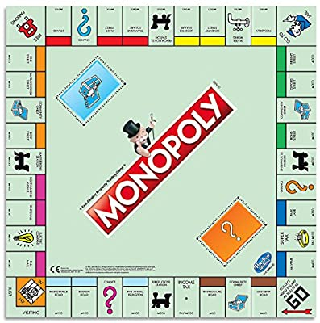
Chance
ADVANCE TO
GO
?
COLLECT $200

Slide 50
?

Slide 51
Christ
ADVANCE TO
MILLENNIUM
Tribulation
444 BC
33 AD
70 AD
6 Dec 2020
Millennium
62 weeks
(483 yrs)
COLLECT CROWN
1 week
(7 years)

Slide 52
Advance to Millennial Kingdom
Matthew 3:1-2 In those days John the Baptist came to the Judean wilderness and began preaching. His message was, 2 “Repent of your sins and turn to God, for the Kingdom of Heaven is near.”
Matthew 4:17 From that time on Jesus began to preach, “Repent, for the Kingdom of Heaven has come near.”
Acts 2:38 Peter replied, “Each of you must repent of your sins and turn to God.”

Slide 53
Black

Slide 54
Old Testament Preaching link at BibleStudyDownloads.org
Get this presentation for free!
Notes:
The Bible…Basically (bb)

