Slide 1
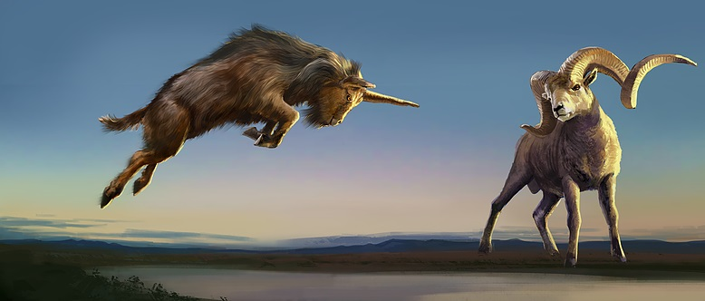
Daniel’s Second Vision: The Ram & Goat
Daniel 8
Dr. Jim Harmeling at Crossroads International Church Singapore • CICFamily.com Uploaded by Dr. Rick Griffith • Jordan Evangelical Theological Seminary Files in many languages for free download at BibleStudyDownloads.org

Slide 2
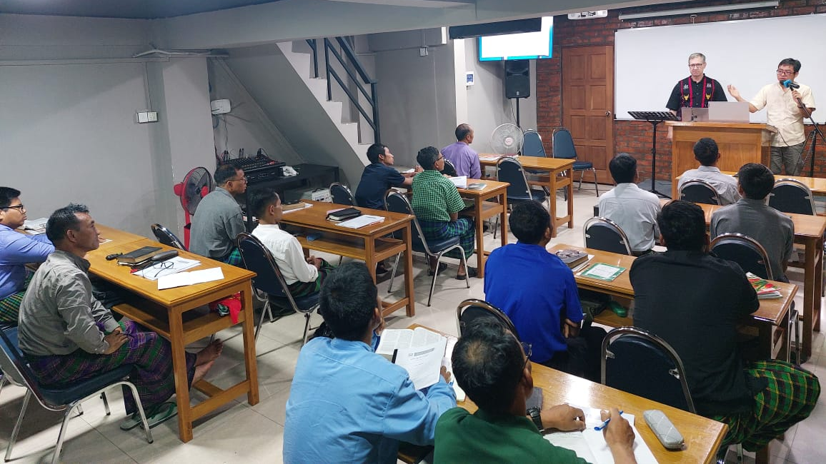

Slide 3
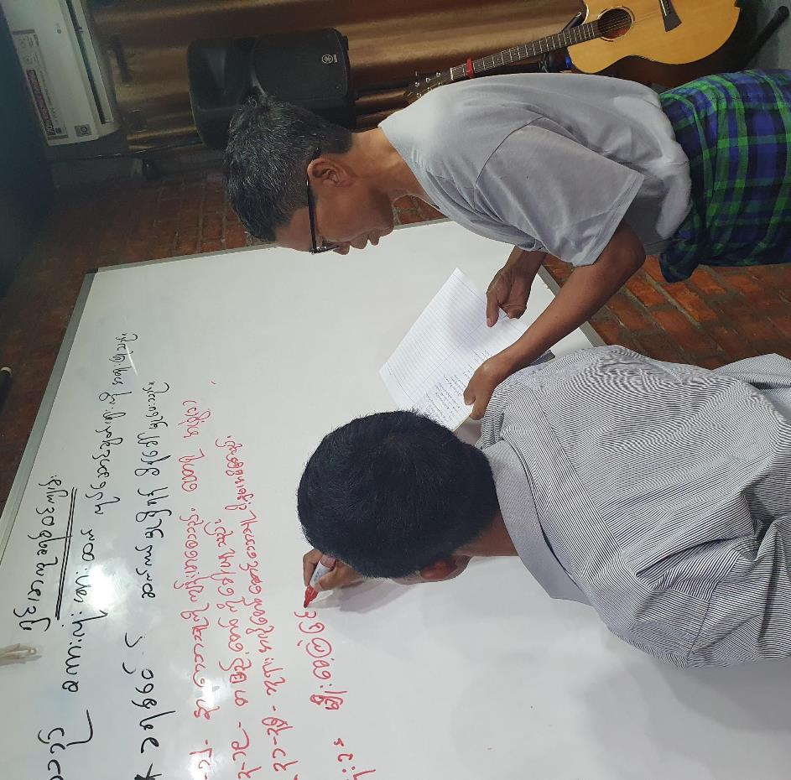
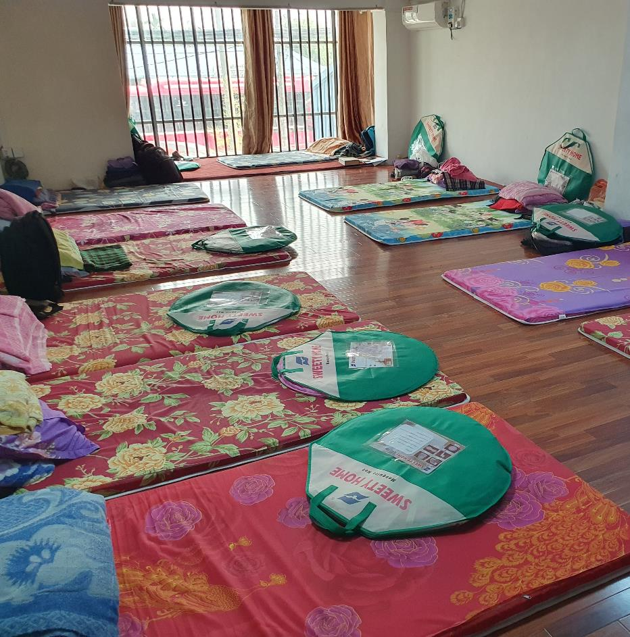

Slide 6
Daniel’s Second Vision: The Ram & Goat
Daniel 8

Slide 7
The Vision at Night (8:1-14)

Slide 8
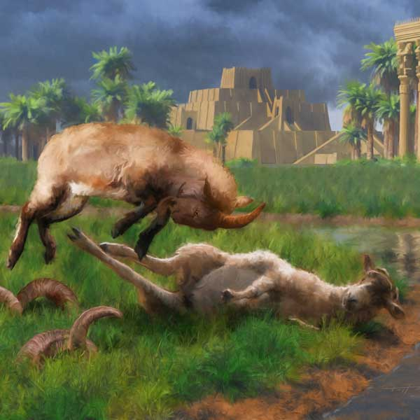
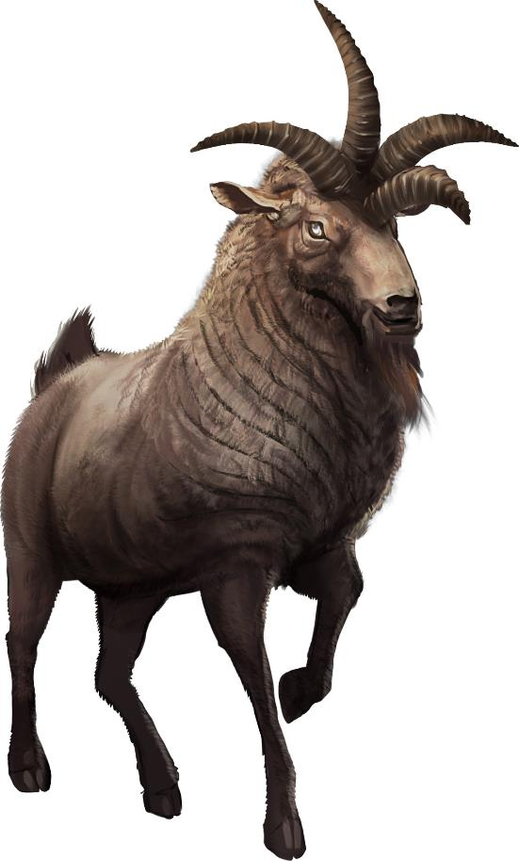

Slide 9
The Meaning of the Vision: The Power of the Little Horn (8:15-27)
big horn = Alexander the Great
2 horns = Kings of Media & Persia (larger horn)
Greece
Medo-Persia

Slide 10
4 horns = Alexander’s succeeding commanders:
Seleucus (east), Cassander (west),
Ptolemy (south),
Lysimachus (north)
New little horn = Antiochus IV (“Epiphanes”)

Slide 11
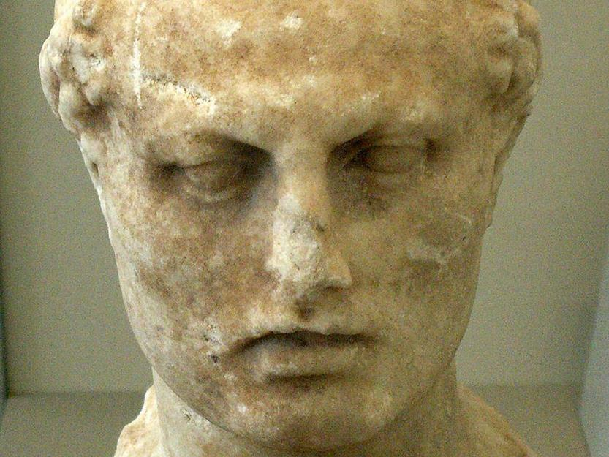
Host = Israel
Prince of the host = God
2,300 mornings & evenings = 6+ years
Judas “Maccabeus”
Parusim = separatists
Hanukkah

Slide 12
Matthew 24:15-16
¹⁵ “So when you see the abomination of desolation spoken of by the prophet Daniel, standing in the holy place (let the reader understand), ¹⁶ then let those who are in Judea flee to the mountains.

Slide 13
Culprit Action Outcome
Pharaoh of Egypt Destroy Israel Victory feast: Passover
Haman of Persia Destroy Israel Victory feast: Purim
Antiochus of Greece Destroy Israel Victory feast: Hanukkah
Antichrist Destroy Israel Wedding feast

Slide 14
Black

Slide 15
OT Preaching link at BibleStudyDownloads.org
Get this presentation for free!
Notes:
OT Preaching (op)

