Slide 1
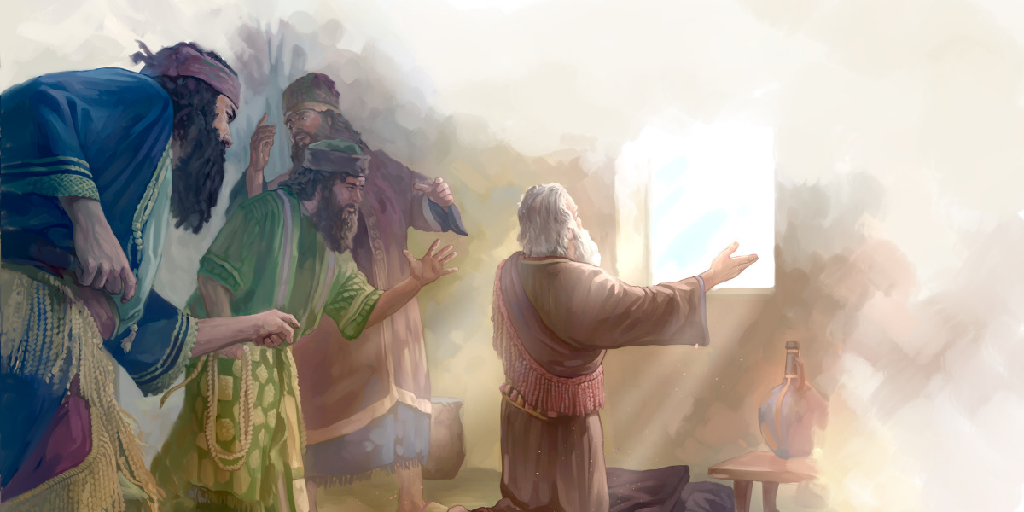
Daniel 6 – Trust in a Den of Despair
Preached by Manik Corea at Crossroads International Church Singapore • CICFamily.com Uploaded by Dr. Rick Griffith • Jordan Evangelical Theological Seminary Files in many languages for free download at BibleStudyDownloads.org

Slide 3
God has a Man – God has a Plan.
The Book of Daniel So far….
Daniel 1 – I Won’t Compromise A Little
Daniel 2 – God is in Control of the Future
Daniel 3 – I Stand on God’s Word
Daniel 4 – Learning the Truth About the Most
High God
Daniel 5 – Walk Humbly Before God

Slide 4
Daniel 6 – Trust in a Den of Despair

Slide 5
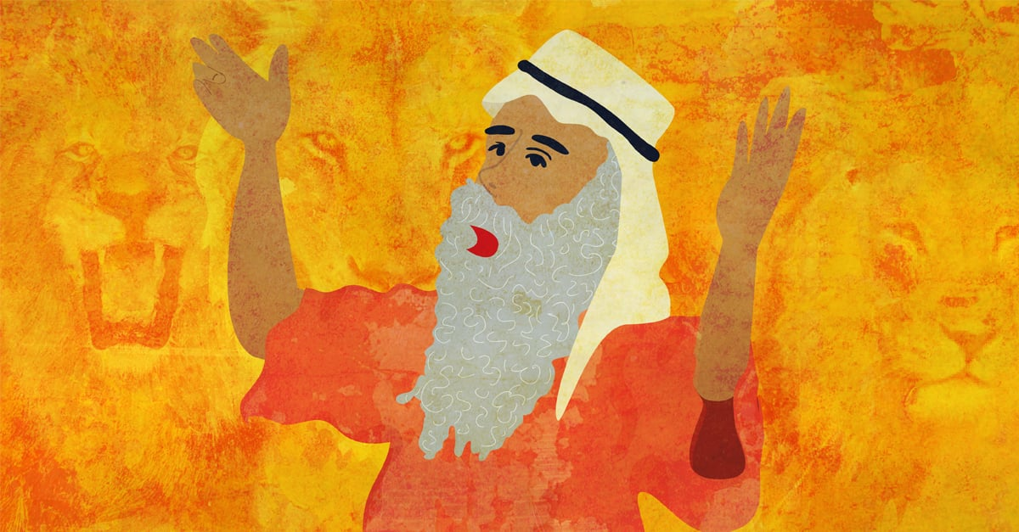
God has a Man – God has a Plan.
Part 1: Dan 6:1-5 – The Setting
Vs 1 – Darius the Mede is real!
Vs 1-2 – Daniel appointed to leadership.
Vs 3 – “an excellent spirit was in (Daniel)”
Vs 4 – Others were jealous but Daniel was faultless.
We are likewise to live as blameless before the world.

Slide 6
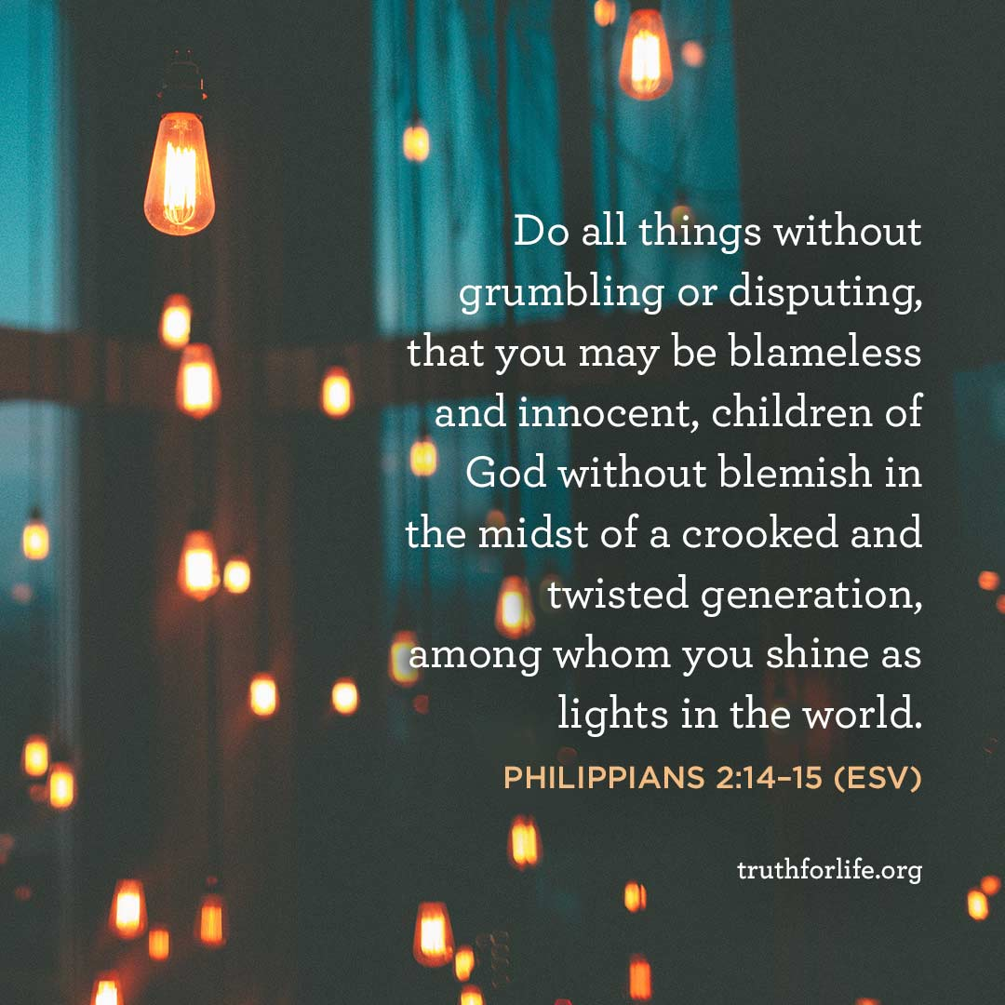

Slide 7
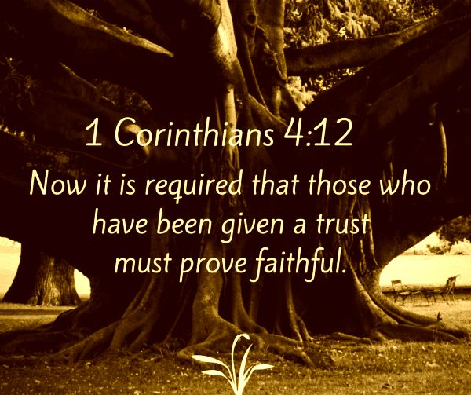

Slide 8
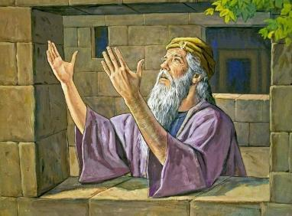
God has a Man – God has a Plan.
Part 2: Dan 6:6-15 – The Trap
Vs 6 – High officials and satraps joined
together against Daniel
Vs 10 – “When Daniel knew….he got down on his knees.... and prayed.”

Slide 9
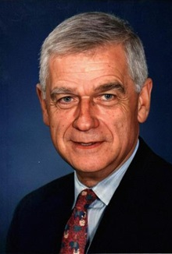
Senator Mark Hatfield, US politician
A daily relationship with God in prayer helps us not to confuse our will with His will. Any person in public life who thinks he can "go it alone" is tragically mistaken. No one has enough love, enough concern, enough humility, enough strength, enough courage. In an individual's friendship with God, there comes each day the humility of having fallen short, the joy of being forgiven, and the strength of being renewed.

Slide 10
God has a Man – God has a Plan.
Part 2: Dan 6:6-15 – The Trap
Vs 6 – High officials and satraps joined
together against Daniel.
Vs 10 – “When Daniel knew….he prayed.”
- ”windows opened towards Jerusalem (see 1 Kings 8:46-52).
- ”…gave thanks before his God, as he had done so previously.” (see Phil 4:6).

Slide 11
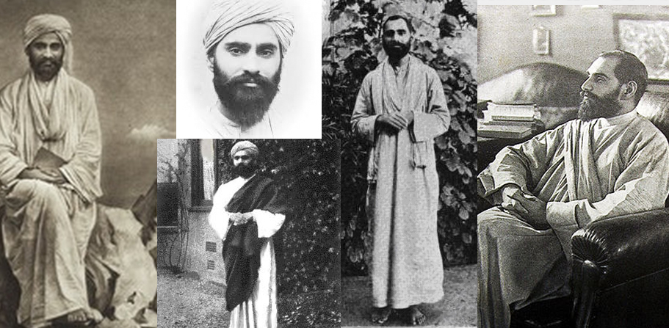
Sadhu Sundar Singh

Slide 12
God has a Man – God has a Plan.
Part 2: Dan 6:6-15 – The Trap
Vs 11 – “Making petition and plea before
his God.”
Vs 13 – Daniel is accused as a foreigner.
Vs 14 – Irony of the king not being able to save Daniel. Only God can.

Slide 13
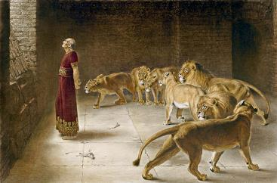
God has a Man – God has a Plan.
Part 3: Dan 6:16-18 – The Den
Vs 16 – The king tells Daniel that he hopes his God, whom he serves continually, will deliver him.
Vs 17 – Stone laid across the den and sealed. Daniel was assumed to be as good as dead.

Slide 14
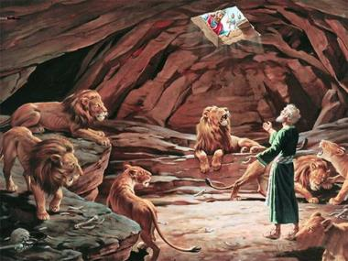
God has a Man – God has a Plan.
Part 4: Dan 6:19-24 – The Deliverance
Vs 19 – At the break of day, the king rushes to see if Daniel survived.
Vs 22 – “My God sent his angel and shut the lions’ mouth.”
Vs 23 – Daniel was not harmed ”because he trusted in his God.”

Slide 16
God has a Man – God has a Plan.
Take-aways
Develop holy habits for the day of trouble.

Slide 17
God has a Man – God has a Plan.
Take-aways
Develop holy habits for the day of trouble.
Make prayer your first response to every trial and trouble.
Trust God even when things go south!

Slide 18
Black

Slide 19
OT Preaching link at BibleStudyDownloads.org
Get this presentation and handout for free!
Notes:
OT Preaching (op)

