Slide 1
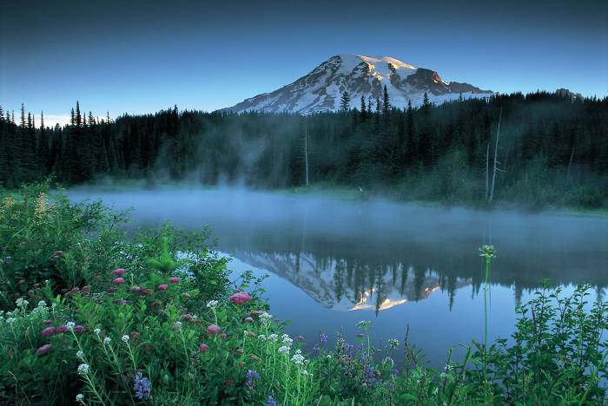
Are You Dying to Pray?
Daniel 6
Preached by Dr. Lewis Winkler at Crossroads International Church Singapore • CICFamily.com Uploaded by Dr. Rick Griffith • Singapore Bible College Files in many languages for free download at BibleStudyDownloads.org

Slide 2
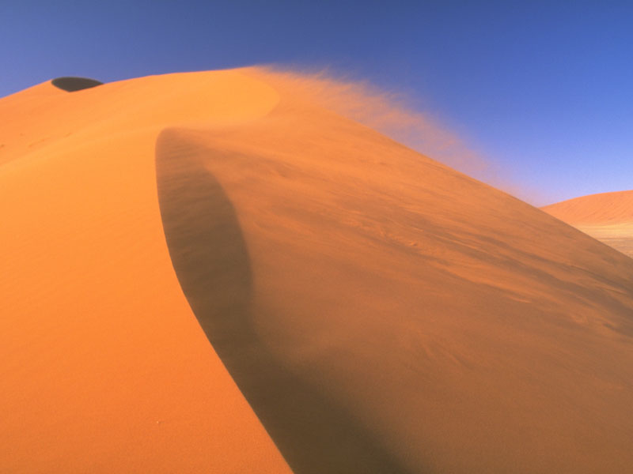
The Reputation:
His Recollection: Daniel 1
Forcibly Taken from His Family
Forced to Take New Name
Forced to Learn a Foreign Culture and Language
Forced to Serve a Godless King and a Pagan Empire

Slide 3
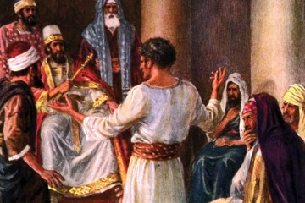
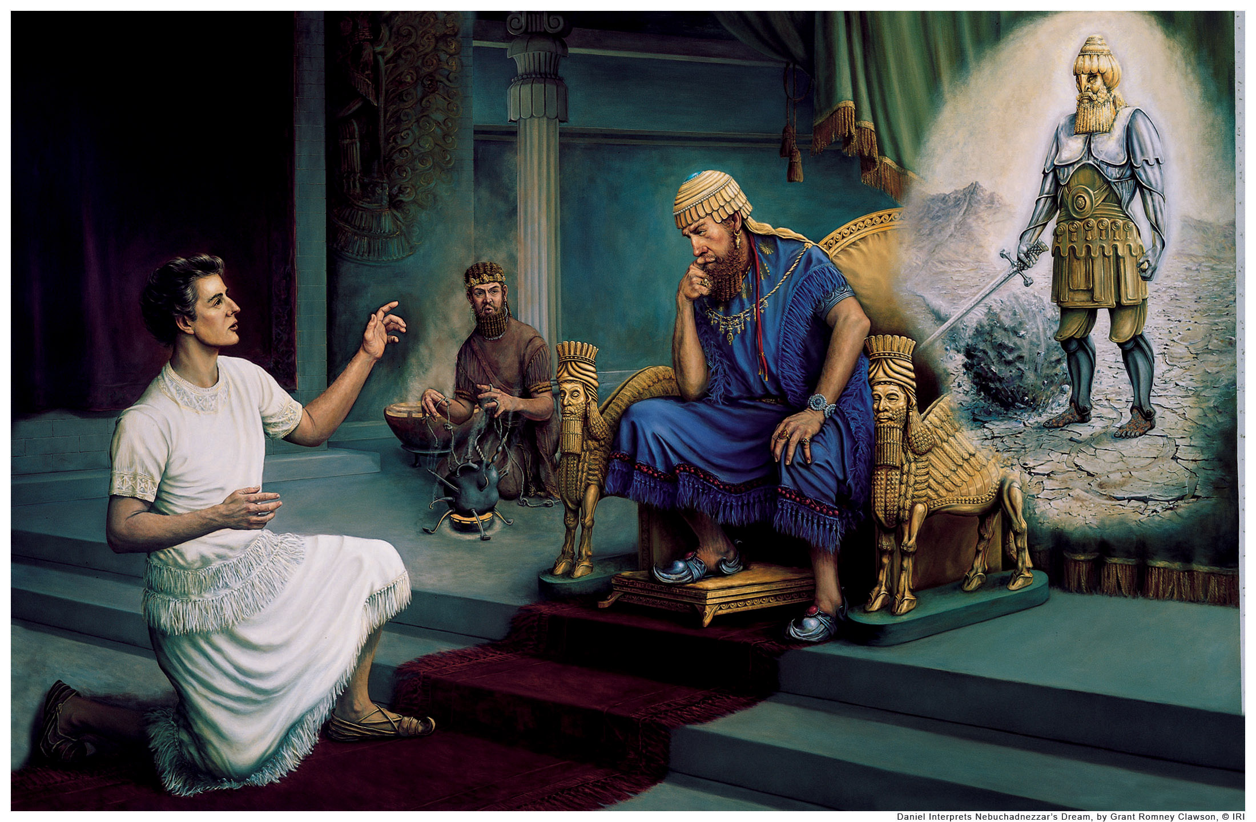
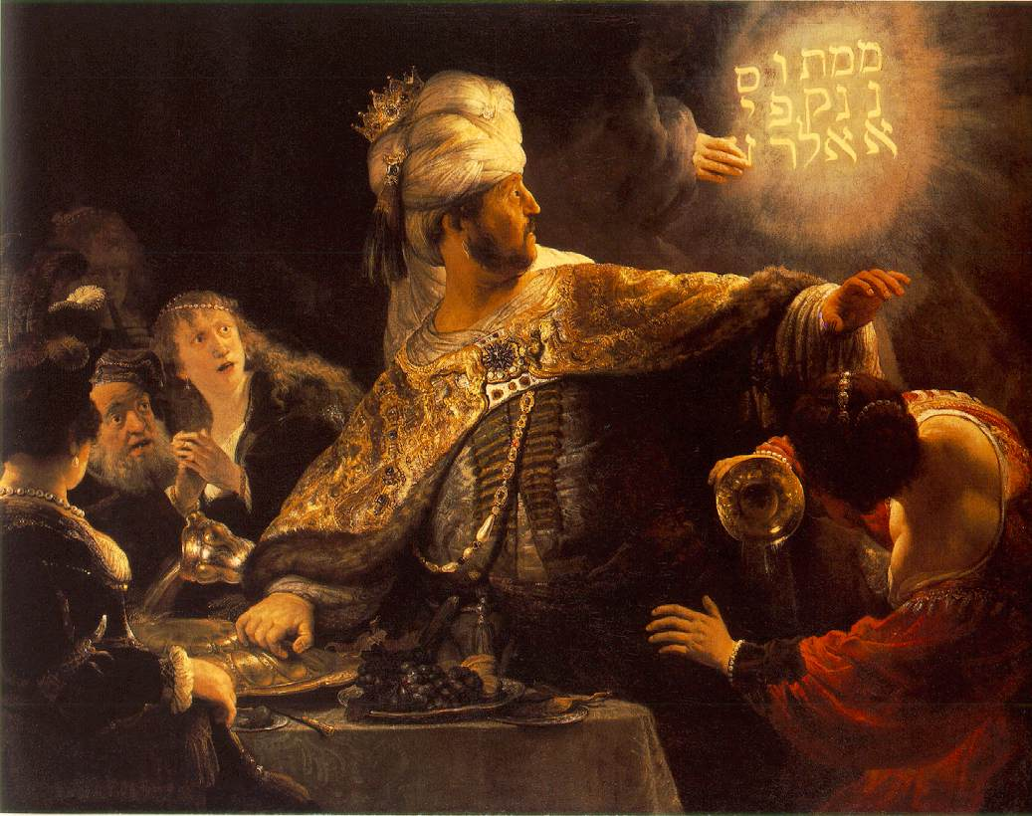
The Reputation:
His Record: Daniel 1-2; 4-5
A Person of Integrity
An Interpreter of Dreams
A Prophet of God
A Highly Respected Leader

Slide 4
The Reputation:
Daniel 6:1-5
His Rule: Daniel 6:1-3
His Rivals: Daniel 6:4-5

Slide 5
“Bloodthirsty men hate a man of integrity and seek to kill the upright.”
—Proverbs 29:10

Slide 6
A Personal Investigation
What if the government was investigating your own life?
Would they find any lack of integrity?
Would your impeccable integrity be the only thing that gets you into trouble?

Slide 7
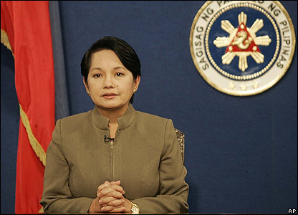
Gloria Arroyo

Slide 8
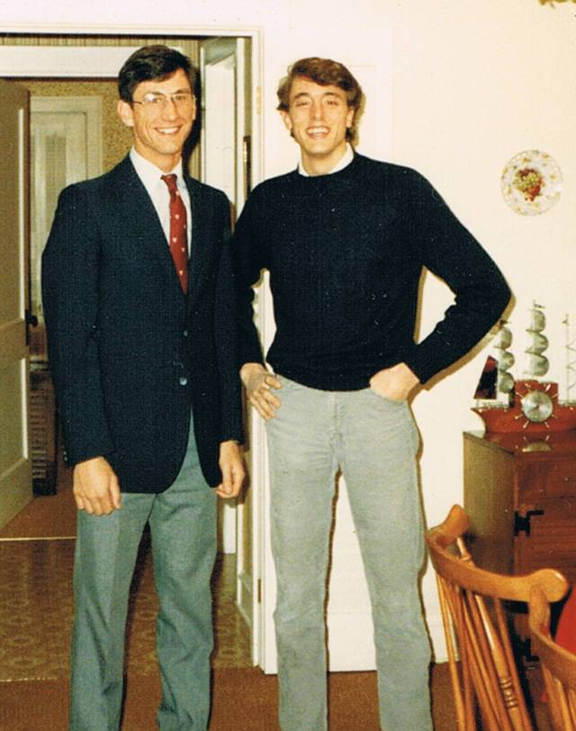
Timothy C. Phillips

Slide 9
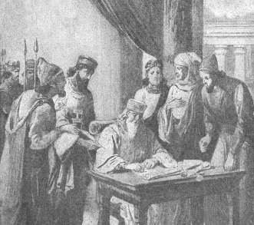
The Ruse:
Daniel 6:6-11
The Regulation: Daniel 6:6-9

Slide 10
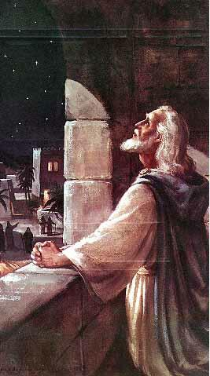
The Ruse:
Daniel 6:6-11
The Response:
Daniel 6:10-11

Slide 11
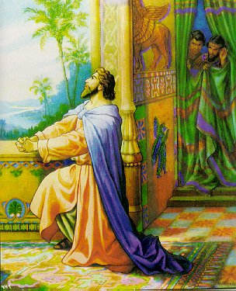
The Results:
Daniel 6:12-19
The Capture: Daniel 6:12-15

Slide 12
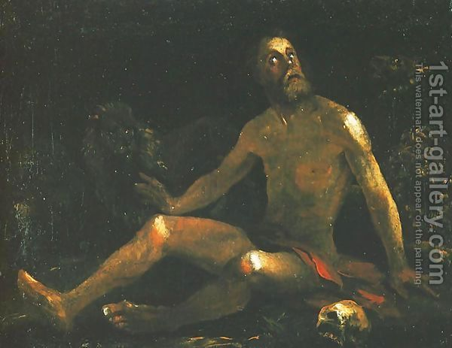
The Results:
Daniel 6:12-19
The Consequence: Daniel 6:16-19

Slide 13
Daniel’s Dramatic Irony
The Crisis didn’t produce prayer in Daniel’s life.
Instead, Daniel’s life of prayer produced the crisis!
Daniel would rather die than not pray.

Slide 14
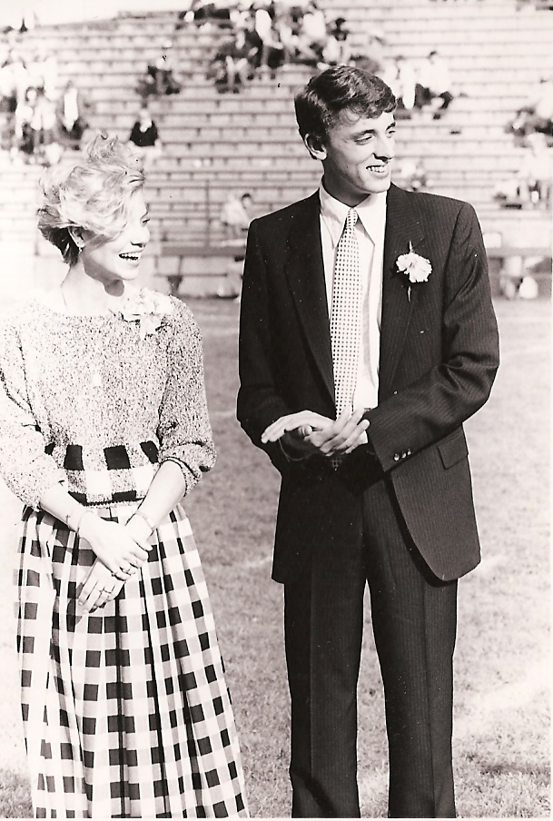
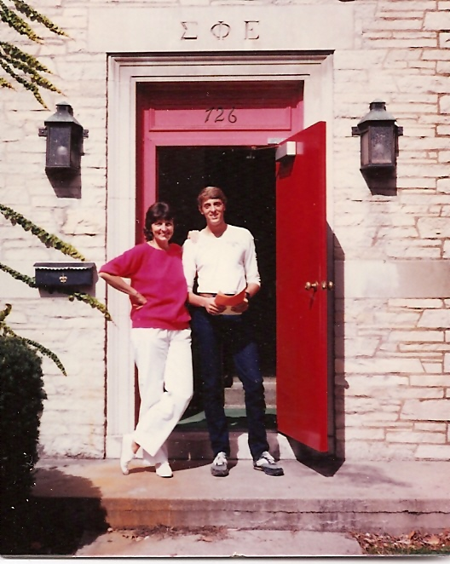
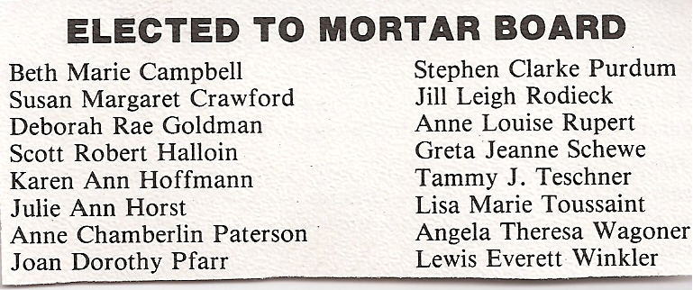
My Own Story:
Coleman Hall Student President
Residence Hall Hiring Committee
Inter-fraternity Council President
Homecoming Court

Slide 15
“Therefore, since Christ suffered . . . arm yourselves also with the same attitude . . . . As a result, he does not live the rest of his earthly life for evil human desires, but rather for the will of God. For you have spent enough time in the past doing what pagans choose to do . . . . They think it strange that you do not plunge with them into the same flood of dissipation, and they heap abuse on you. But they will have to give account to him who is ready to judge the living and the dead.”
—1 Peter 4:1-5

Slide 16
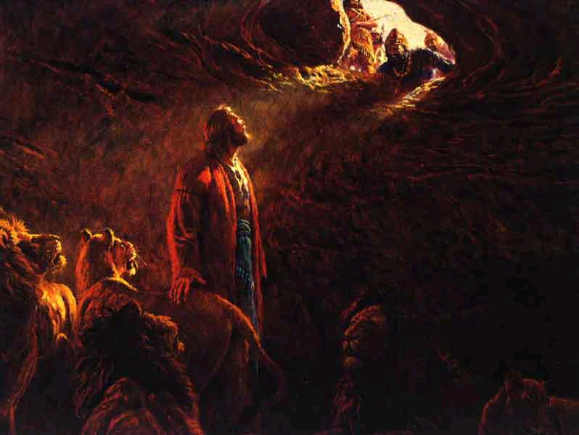
The Rescue:
Daniel 6:20-23

Slide 17
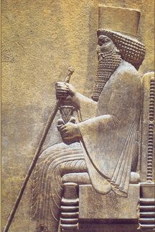
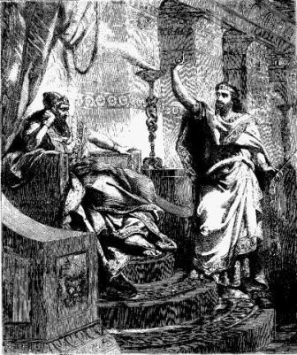
The Revival:
Daniel 6:24-27
The Wrath: Daniel 6:24
The Writing: Daniel 6:25-26a
The Reverence: Daniel 6:26b-27

Slide 18
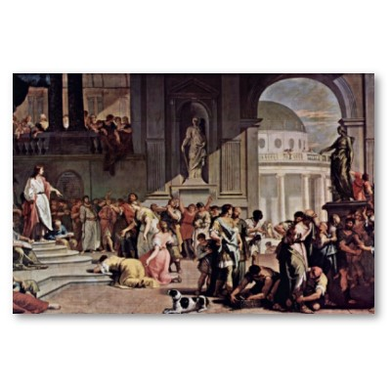
The Reversal:
Daniel 6:28

Slide 19
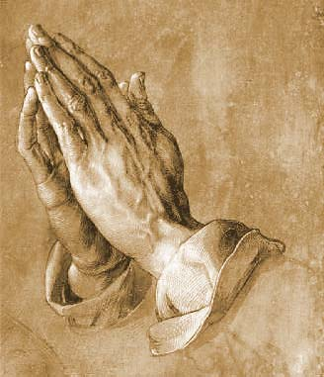
The Relevance:
Set aside regular times for prayer.
Set aside special times for prayer.

Slide 20
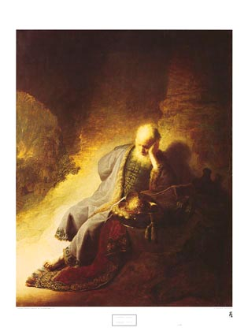
Jerry’s Story

Slide 21
Jerry’s Story
“Yet this I call to mind and therefore I have hope. Because of the Lord’s great love we are not consumed, for his compassions never fail. They are new every morning. Great is your faithfulness.”
—Lamentations 3:21-23

Slide 22
The steadfast love of the Lord never ceases
His mercies never come to an end
They are new every morning
New every morning
Great is Thy faithfulness, O Lord
Great is They faithfulness

Slide 23
Black

Slide 24
Old Testament Preaching link at BibleStudyDownloads.org
Get this presentation for free!
Notes:
The Bible…Basically (bb)

