Slide 1
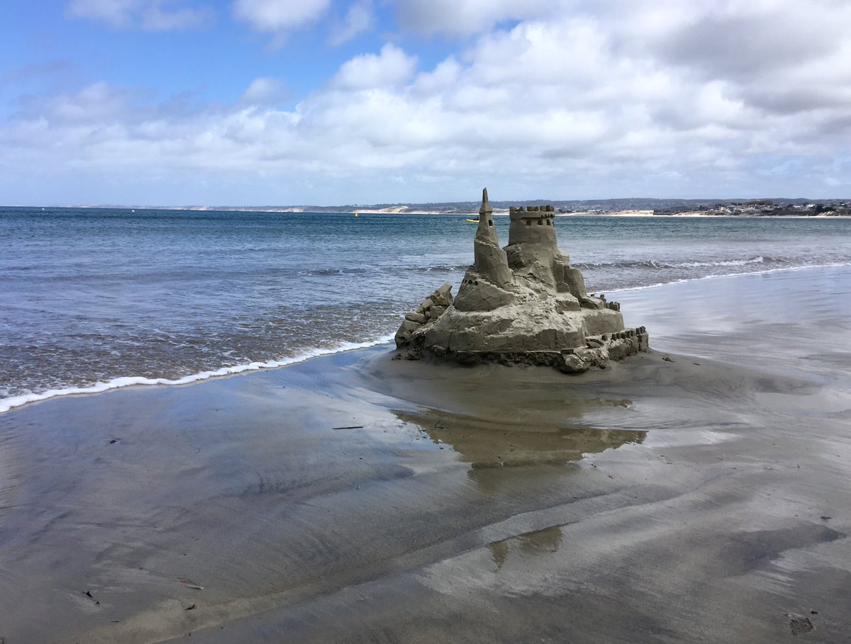
Daniel’s Third Vision Part 2
Sandcastles
Daniel 11–12
Dr. Jim Harmeling at Crossroads International Church Singapore • CICFamily.com Uploaded by Dr. Rick Griffith • Jordan Evangelical Theological Seminary Files in many languages for free download at BibleStudyDownloads.org

Slide 3
Daniel’s Third Vision Part 2
Sandcastles
Daniel 11–12

Slide 4
A Word from the Director: Yahweh Sabaoth (11:1)

Slide 5
Episode 1
Swoosh (11:2-4)

Slide 6
These 3 Kings . . . Plus 1 More
Cambyses
Pseudo-Smerdis
Darius I
Xerxes
Battle of Marathon
Battle of Thermopylae
Alexander the Great

Slide 7
Alexander the Great
Cassander
Seleucus
Lysimachus
Ptolemy

Slide 8
Huge Persia
Smaller Greece
4 divisions of Greece
2 main divisions of 4 divisions of Greece
1 person of Greece
1 future person like person of Greece

Slide 9
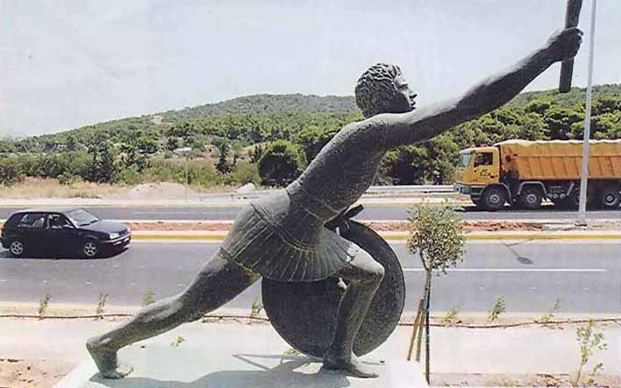
We have conquered!
Nike

Slide 10
Written & Directed by
Yahweh Sabaoth

Slide 11
Episode 2
Beware of the Spurned Wife (11:5-6)

Slide 12
SOUTH
Ptolemy 1
(Ptony 1)
Prince
Seleucus
NORTH
Antiochus 1
(Ty 1)

Slide 13
Peace Treaty
Berenice
SOUTH
Ptony 2
NORTH
Ty 2
Laodice

Slide 14
X
Peace Treaty
X
Berenice
X
NORTH
Ty 2
Laodice

Slide 15
NORTH
Seleucus II
(Selly 2)
Laodice

Slide 16
Written & Directed by
Yahweh Sabaoth

Slide 17
Episode 3
That was my sister . . . and my stuff! (11:5-6)

Slide 18
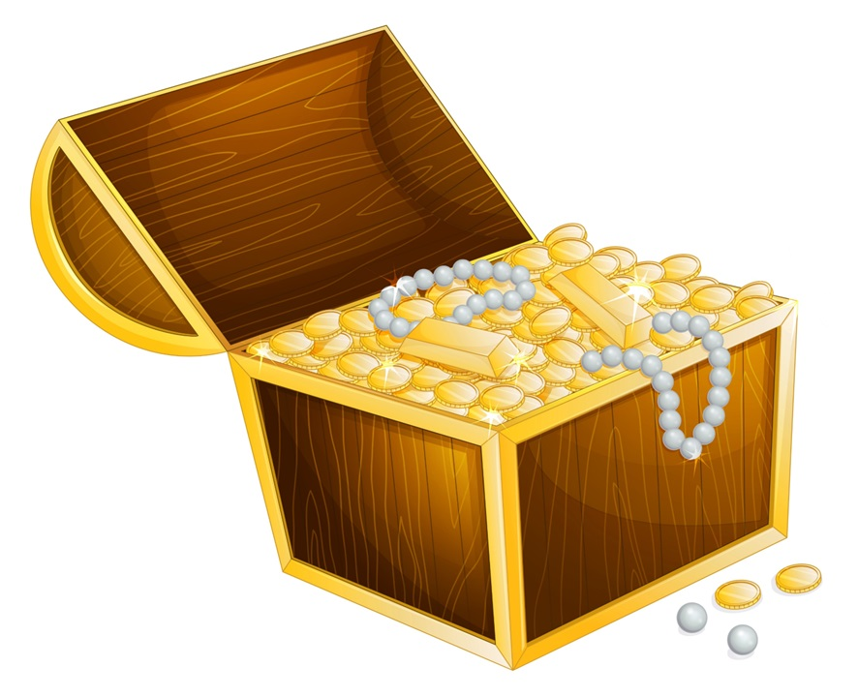
SOUTH
Ptony 3
NORTH
Selly 2
X
Laodice

Slide 19
Written & Directed by
Yahweh Sabaoth

Slide 20
Episode 4
The Overreach
(11:10-20)

Slide 21
SOUTH
Ptony 4
NORTH
Ty 3

Slide 22
Peace Treaty
Cleopatra
X
SOUTH
Ptony 5
NORTH
Ty 3
ROME

Slide 23
X
SOUTH
Ptony 5
NORTH
Selly 4
ROME

Slide 24
Written & Directed by
Yahweh Sabaoth

Slide 25
Episode 5
The “Contemptible Person” (11:20-35)

Slide 26
"Peace" Treaty
SOUTH
Ptony 6
NORTH
Ty 4
ROME
Jerusalem
Notes:
ORTH

Slide 27
Written & Directed by
Yahweh Sabaoth

Slide 28
Black

Slide 29
OT Preaching link at BibleStudyDownloads.org
Get this presentation for free!
Notes:
OT Preaching (op)

