Slide 1

Be Confident
Daniel
Dr. Rick Griffith • Crossroads International Church Singapore
CICFamily.com • BibleStudyDownloads.org

Slide 2

Need Confidence?
Notes:
Most of struggle with confidence. One writer notes,
“Confidence means feeling sure of yourself and your abilities — not in an arrogant way, but in a realistic, secure way. Confidence isn't about feeling superior to others. It's a quiet inner knowledge that you're capable. Confident people feel secure rather than insecure.” https://kidshealth.org/en/teens/confidence.html
• Based on this, we are often told, "Believe in yourself"! Do you see the irony of the red letters here? If you believe in yourself, then you can “be you.”

Slide 3
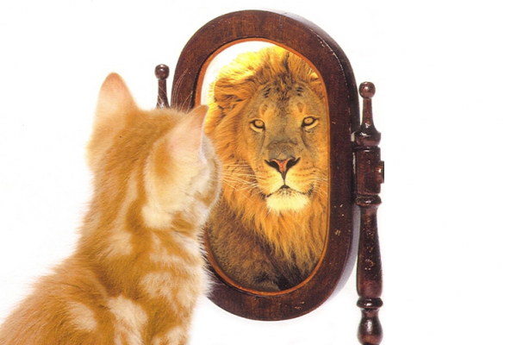
Release that lion in you!?
Notes:
Hey kitty, just release that lion hiding inside you!
Well, do you find that this strategy works?
I think we all know that self-confidence can be self-defeating! It is only as good as your abilities are or you think your abilities are.
So what do you do instead?

Slide 4

What do you need to know to be truly confident?
Notes:
The answer, of course, is that Daniel placed his confidence not in himself but in God. In his book we will see three truths that will help us, like Daniel, be confident that God is working.

Slide 5

The Babylonian Kingdom
50
Westward Expansion
Nineveh
Carchemish
Mediterranean
Sea
Syria
Babylon
Israel
Judah
605 BC
Persian
Gulf
Egypt
Notes:
Daniel served the very confident superpower, Babylon, that had conquered its way across the Ancient Near East.

Slide 6
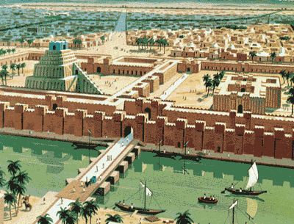





The Context
The City of Babylon
Was there ever a city greater than Babylon?
Notes:
Why the Exile?

Slide 7
Jerusalem's Fall
Jerusalem's Fall
232
342
560
Key Dates
627
Jeremiah
605
Daniel
597
Ezekiel
586
538
Zephaniah
Joel
630
Lamentations
Habakkuk
590
606
Notes:
God judged the idolatry of his people—but not without warning! Of the 17 prophetical writings, 13 were BEFORE the exile! He sent several prophets just before Jerusalem fell, including three whose ministries continued through the destruction of Judah and Jerusalem. Even in exile, God spoke to the exiles through Daniel and Ezekiel, as well as Jeremiah who sent them letters (see Jer 29). But the people stubbornly continued in idolatry, and, like a good parent who makes good on the warnings before disobedience, God sent his punishment. But he also promised a 70-year limit to this discipline, followed by a restoration to their land. God has the perfect balance of loving discipline.

Slide 8
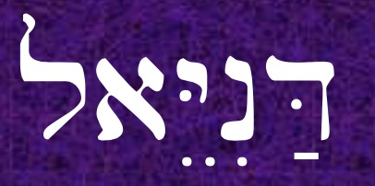
Title, Key Word, Key Verse
DANIEL =
533
(MEANS LITERALLY "EL [GOD] IS MY JUDGE")
KEY WORD: SOVEREIGNTY
KEY VERSE: 2:20-21a
Daniel said, "Let the name of God be blessed forever and ever, for wisdom and power belong to Him. ²¹It is He who changes the times and the epochs; He removes kings and establishes kings."
Notes:
The message of Daniel’s prophecy is actually in his name!

Slide 9
What do you need to know to be truly confident?
Three truths...
Notes:
What do you need to know to be truly confident?
Today we will see that Daniel placed his confidence not in himself but in God.
• In his book we will see three truths that will help us, like Daniel, be confident that God is working.

Slide 10

I. God rules over you
(Dan 1).
Notes:
You can be confident when you know that…
The LORD controls what happens to you as an individual.

Slide 11
Slides on
Daniel 1

Slide 12
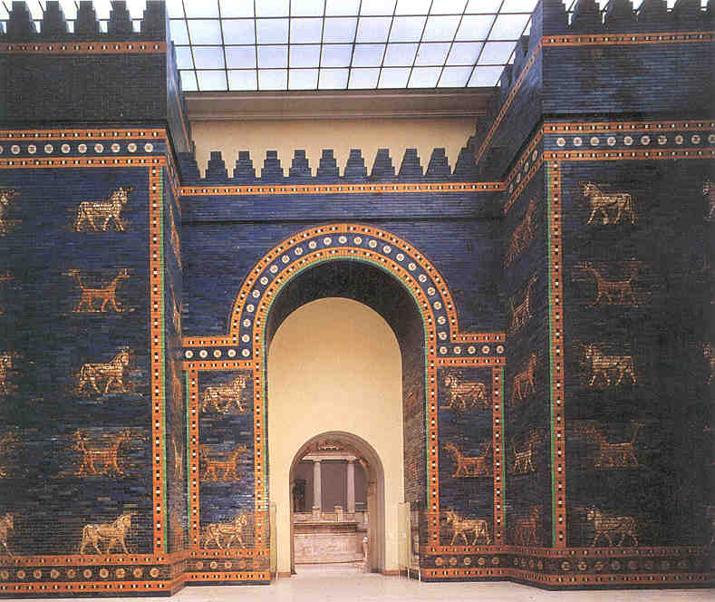
The Point of Daniel 1
544a
The exiles could confidently trust God’s sovereignty shown in rewarding Daniel’s godliness in Babylon despite deportation (Dan 1).
Daniel was the model exile.
Notes:
The idea is, “So you think you cannot live a godly life in your situation? Hey, just look at Daniel!”

Slide 13
Outline of Daniel
532
UNIVERSAL SOVEREIGNTY IN TIMES OF THE GENTILES
Sovereignty over Daniel |  |  | Sovereignty over Gentiles |  |  |  |  |  | Sovereignty over Jews
Chapter 1 |  |  | Chapters 2–7 |  |  |  |  |  | Chapters 8–12
Narrative |  |  | Visions in Narrative |  |  |  |  |  | Vision
Hebrew |  |  | Aramaic |  |  |  |  |  | Hebrew
Gentile Names for God |  |  | Gentile Names for God |  |  |  |  |  | Jewish Names for God
Third person ("Daniel") |  |  | Third person ("Daniel") |  |  |  |  |  | First person ("I")
Daniel's Example |  |  | Daniel Interprets King's Dreams |  |  |  |  |  | Angel Interprets Daniel's Dreams
The Man Daniel |  |  | Images |  | Kings |  |  |  | Israel's Future
Exile 1:1-7 | Food 1:8-16 | Exalted 1:17-21 | Varied 2 Promoted | Gold 3 Furnace | Neb. 4 Exile | Bel. 5 Party | Dar. 6 Lions | All 7 Beasts | Medo- Persia To Greece 8 | Return to Seventy "7s" 9 | Intertest-ament Period to Tribulation 10-12
Babylon
605-536 BC

Slide 14
The Babylonian Kingdom
50
Westward Expansion
Nineveh
Carchemish
Mediterranean
Sea
Syria
Babylon
Israel
Judah
605 BC
Persian
Gulf
Egypt
Notes:
Daniel served the very confident superpower, Babylon, that had conquered its way across the Ancient Near East.

Slide 15
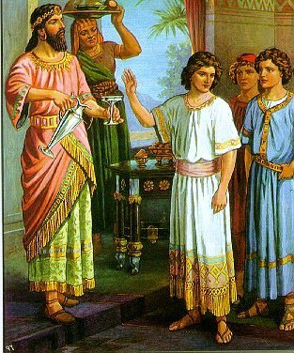
Handsome Men in M.Div. Studies at the University of Babylon
Notes:
At the first deportation to Babylon (605 BC), Daniel and three friends were captured and groomed to minister in Babylon (1:1-7).

Slide 16
Names of Daniel & His Friends
544a
Hebrew
Babylonian
Daniel
"God [El] is my judge"
Belteshazzar
"Bel, protect his life!"
Hananiah
"The LORD is gracious"
Shadrach
"Command of Aku (moon god)"
Mishael
"Who is what God is?"
Meshach
"Who is what Aku is?"
Azariah
"The LORD helps"
(or "Whom the LORD helps")
Abednego
"Servant of Nego"
(or Nebo, i.e., the god Nabu)

Slide 17
Hard to remember their names?
Shad's shack
My shack
And a bungalow

Slide 18
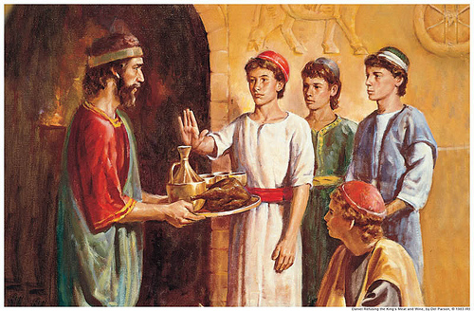
Daniel says "no" to defiled food
Notes:
Daniel and his friends were faithful to God’s law even while in captivity as an encouragement to other exiles to remain true to God (1:8-16).

Slide 19
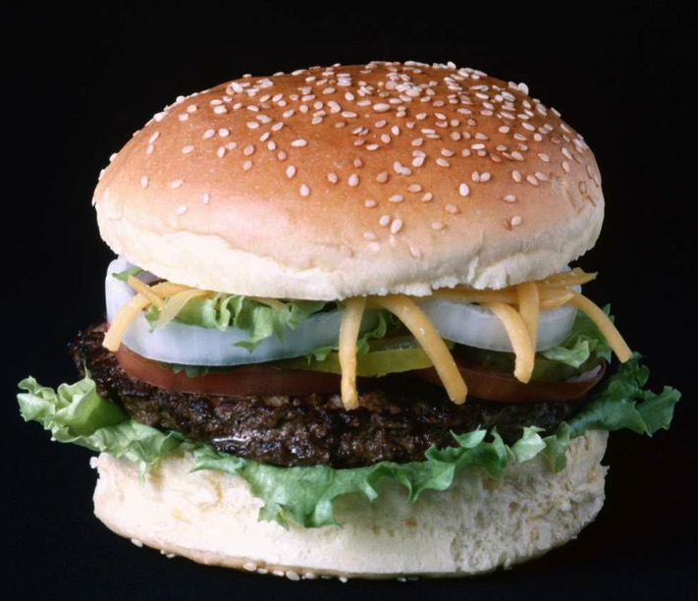
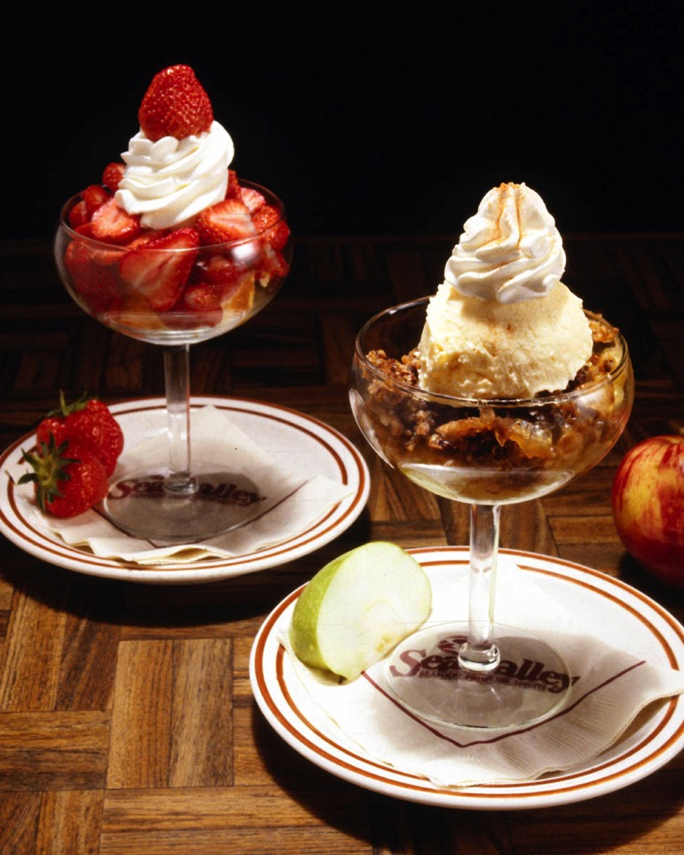
The King's Choice Food?
Notes:
We don’t know what food they were offered but it may have been prohibited in the Lev 11 food laws.

Slide 20
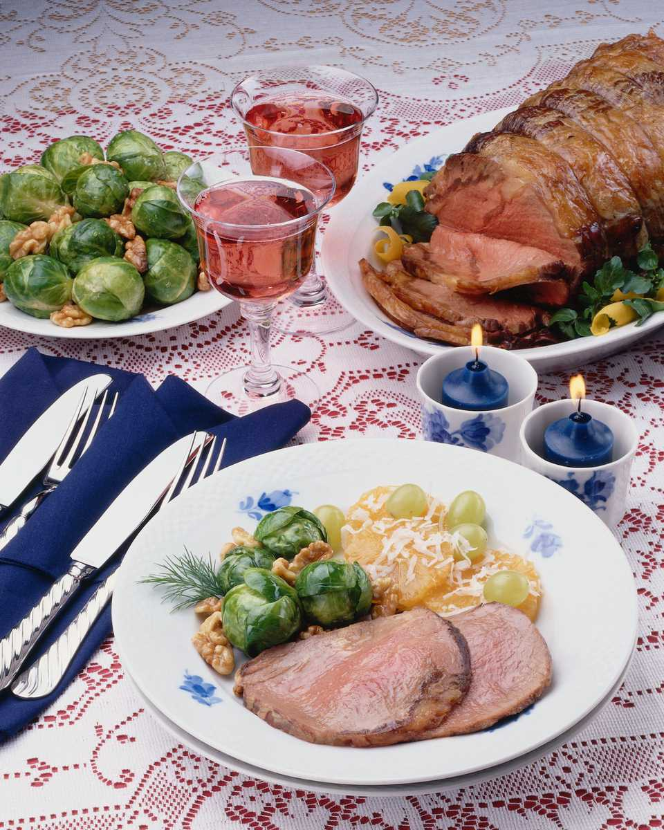
Add Brussels sprouts…
The King's Choice Food?
Notes:
It certainly must have been delicious food that other Jewish captives ate.

Slide 21
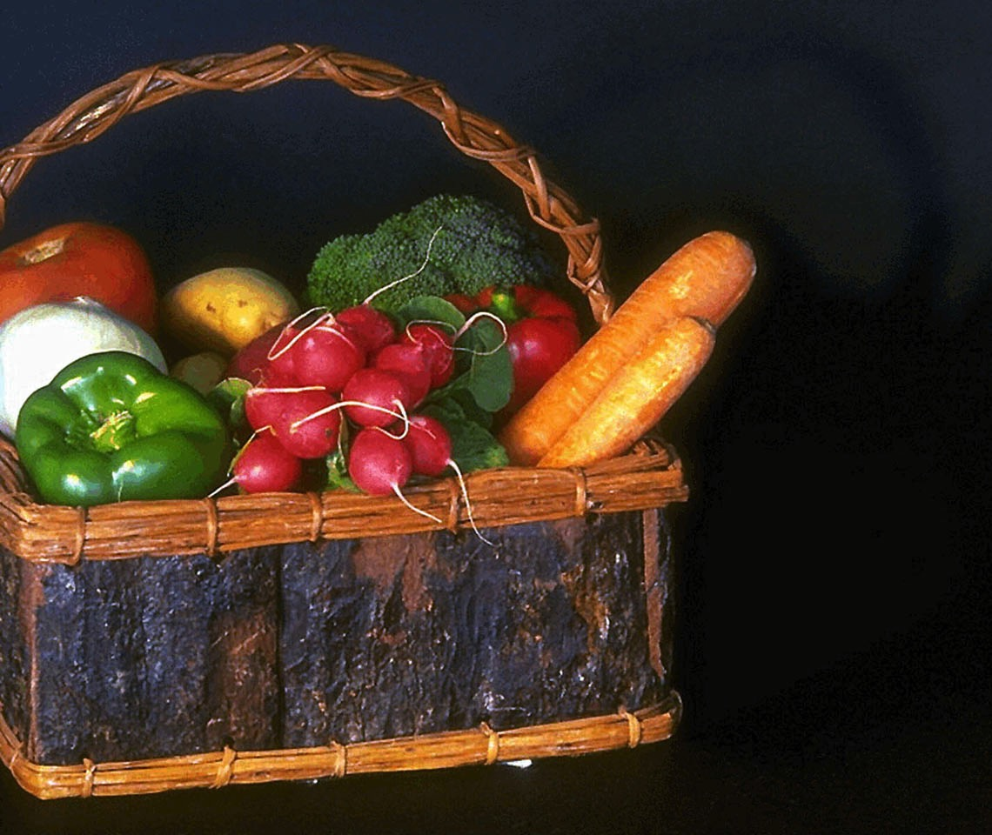
Daniel's Food of Choice
Notes:
But Daniel and his friends respectfully asked for only vegetables and water for 10 days. God miraculously intervened and they looked better and did better in the school.

Slide 22
Daniel's Diet
DANIEL'S DIET: The 10-Day Detox & Weight Loss Plan
Notes:
Some think the point here is to detox your body with Daniel’s diet.

Slide 23

Are our Christian teenagers TODAY doing better or worse than Daniel at holding to godly convictions?
Notes:
But the real point is to see if we influence others more than they influence us.

Slide 24
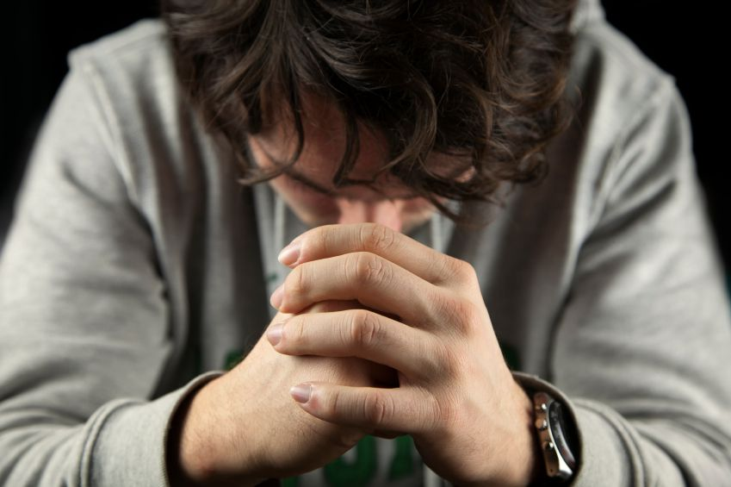
Applying Daniel 1
544a
Be confident in your pagan setting that God can help you not violate your godly convictions.
You also can be a model exile.
Notes:
We lose confidence when we lose sight that God has our lives under his control.
God can even take our own exile and use it for his purposes. I was pushed out of my first church as pastor and went across town to survive. That church Susan and I went to that first Sunday after my resignation has become our main supporting church since we became missionaries in 1990!
• The book of Daniel reminds us to be confident in God like Daniel and his three friends. You also can be a model exile.

Slide 25
What do you need to know to be truly confident?
Notes:
The answer, of course, is that Daniel placed his confidence not in himself but in God. In his book we will see three truths that will help us, like Daniel, be confident that God is working.

Slide 26
I. God rules over you
(Dan 1).
Notes:
You can be confident when you know that…
The LORD controls what happens to you as an individual.

Slide 27
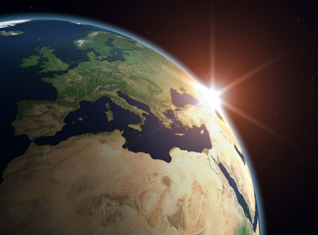
II. God rules over all nations (Dan 2–7).
Notes:
The LORD controls what happens to the peoples of the world.

Slide 28
Slides on
Daniel 2

Slide 29
The Point of Daniel 2–7
544a
The exiles could confidently trust God’s sovereignty over the nations seen in Daniel's devotion and prophecy of "the times of the Gentiles" (Dan 2–7).
Daniel saw world history
—in advance!

Slide 30
Chapter 2
Daniel
Prophetic 2–12
Hebrew
Gentiles 2–7
Aramaic
Interpreter
Personal 1
Statue 2
605-536 B.C.
Notes:
Nebuchadnezzar recognized God's sovereignty in his dream of the destruction of a statue revealed by Daniel (Dan 2).

Slide 31
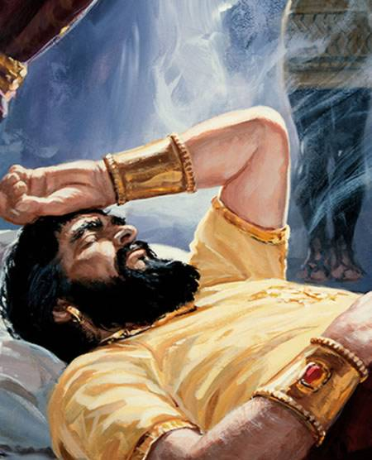
Dreaming of an Image
Notes:
In 604 BC Nebuchadnezzar had a dream that his wise men could not discern as they did not know God (2:1-13).

Slide 32
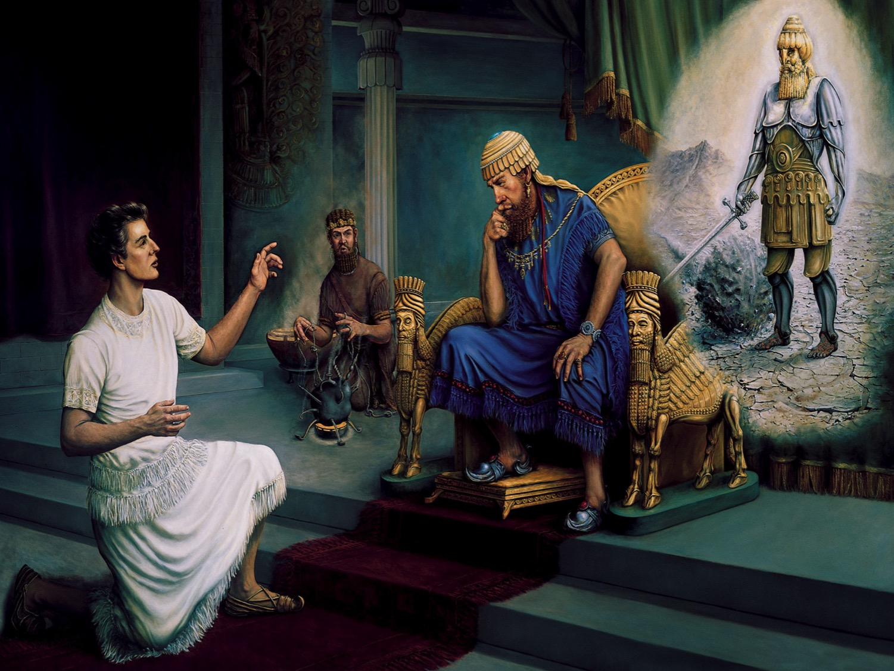
Daniel's Reputation
Daniel 1-2, 4-5
A Person of Integrity
An Interpreter of Dreams
A Prophet of God
A Highly Respected Leader
Notes:
But Daniel revealed and interpreted the dream of the destruction of a multi-material image to show God's sovereignty (2:14-45).

Slide 33
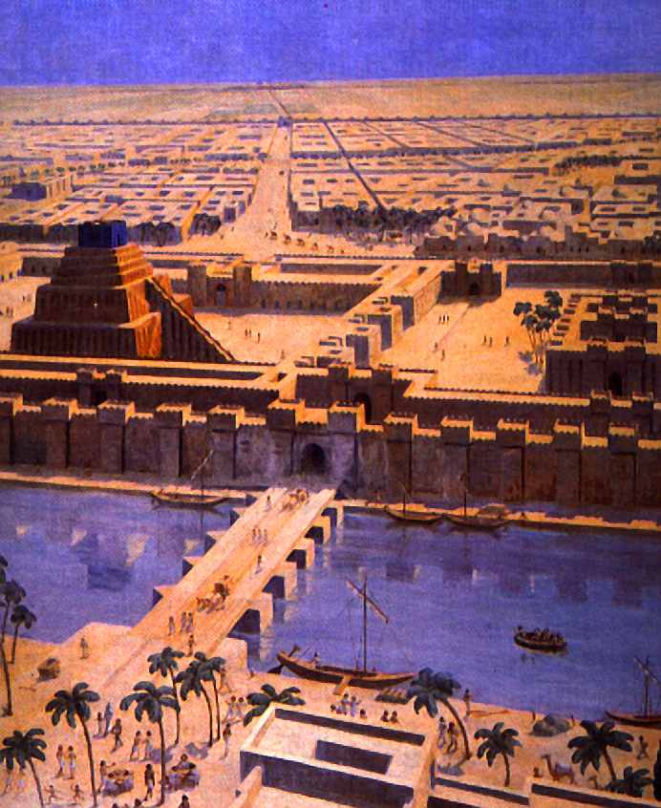
Babylon
Notes:
The dream rightfully gave Babylon prominence. How?

Slide 34
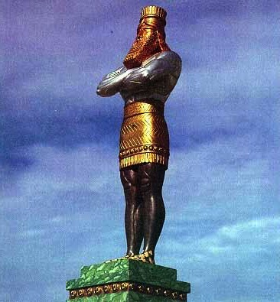
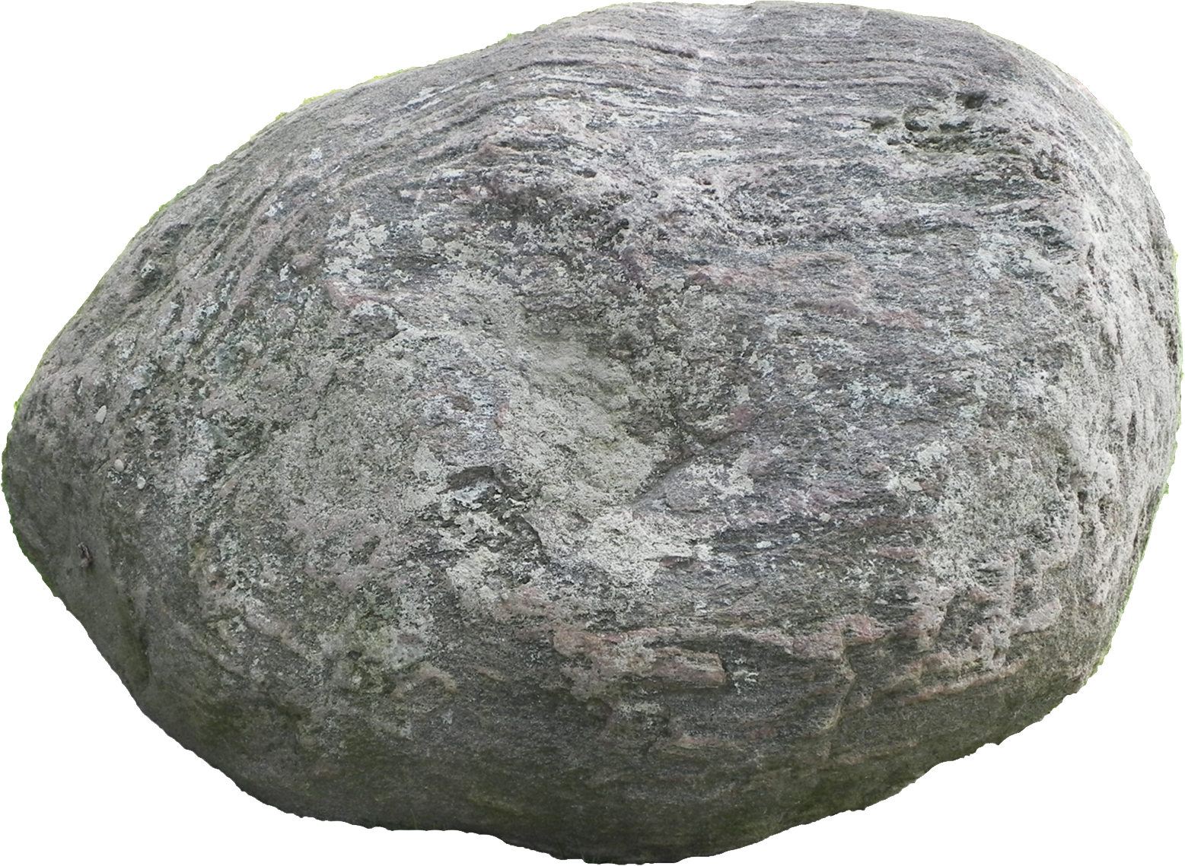
The Image of Daniel 2
Gold
Babylon
Silver
Persia
Bronze
Greece
Iron
Rome
Iron & Clay
Antichrist
Stone
Kingdom
Notes:
While Babylon was depicted by gold, even Babylon would fall to Christ’s kingdom!

Slide 35
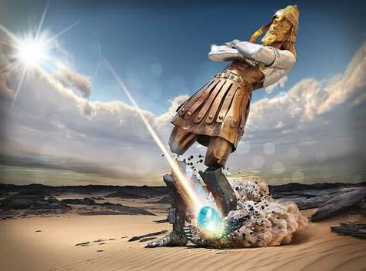
Note that ALL of the kingdoms will fall at the same time!
Notes:
The dream tells us that each of these kingdoms still survives in some form: Babylon mystery religion in the Catholic Church; Persian administration; Greek influence in democracy, philosophy, language, arts, and sports; and Roman influence in Romance languages, the government republic and the power of warfare.

Slide 36
Slides on
Daniel 3

Slide 37
Chapter 3
Daniel
Prophetic 2–12
Hebrew
Gentiles 2–7
Aramaic
Interpreter
Personal 1
Statue 2
Idol 3
605-536 B.C.
God rules the world
Notes:
Nebuchadnezzar admitted God's sovereignty after he saved Daniel's friends from fire for not worshipping a gold statue (Dan 3).

Slide 38
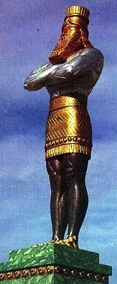
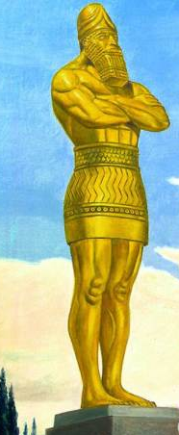
Statues can become a bad habit
Daniel 2
Many materials
Daniel 3
All Gold at
9 x 90 feet!
Notes:
Nebuchadnezzar erected a gold image in self-worship that was worshiped by all the peoples of Babylon (3:1-7).

Slide 39
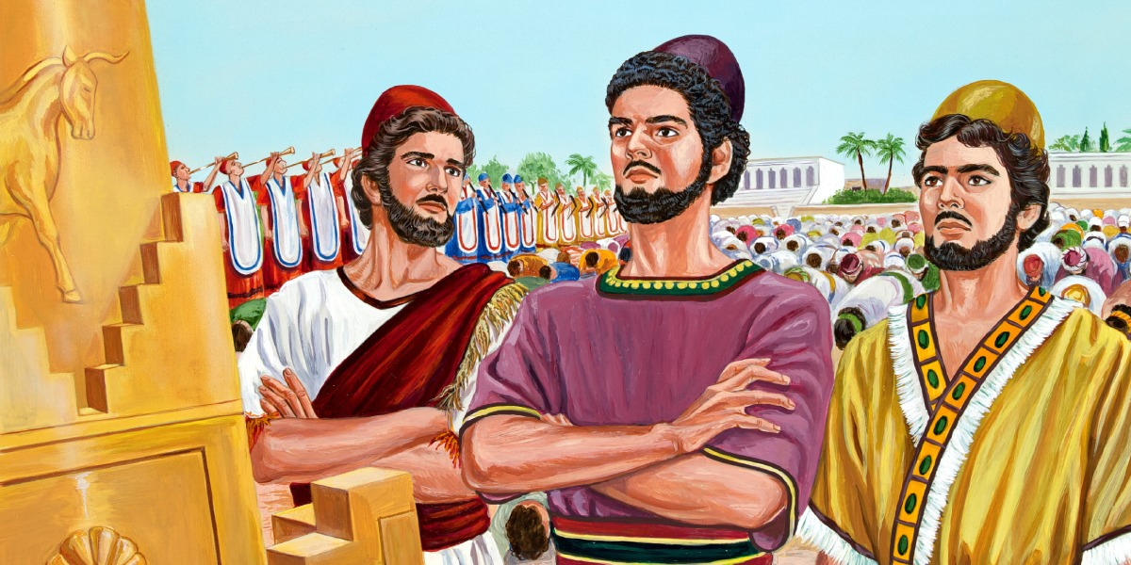
Hananiah, Mishael, Azariah
(Shadrach, Meshach and Abednego)
Notes:
Shadrach, Meshach and Abednego refuse to worship the image to show Israel and Babylon loyalty to the true God (3:8-23).

Slide 40
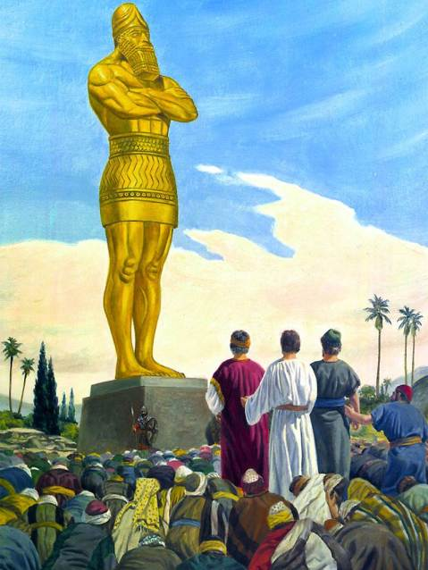
Standing Alone

Slide 41
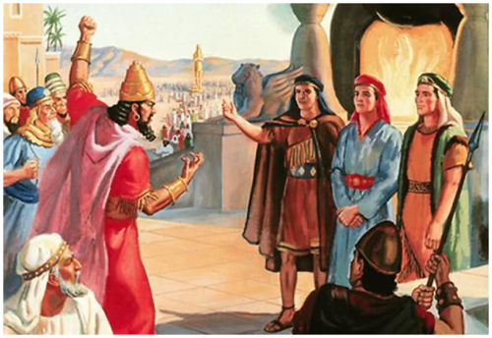
The Edict (Daniel 3)

Slide 42
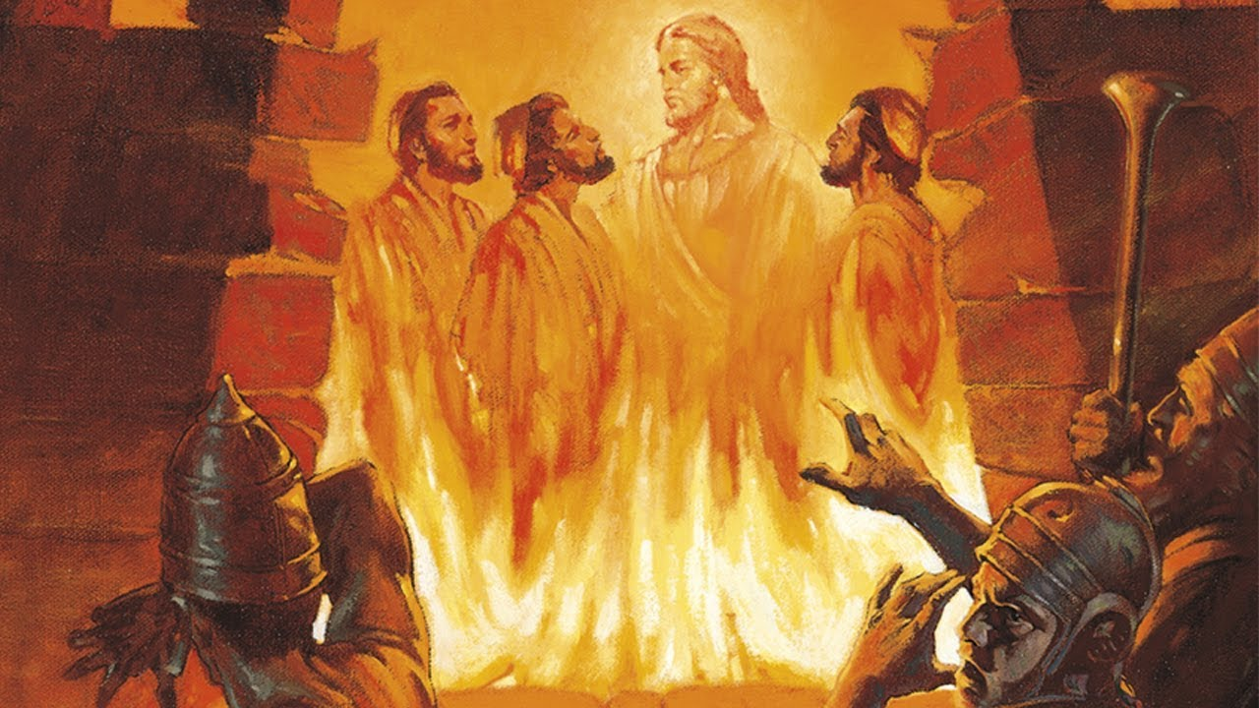
The Fiery Furnace

Slide 43
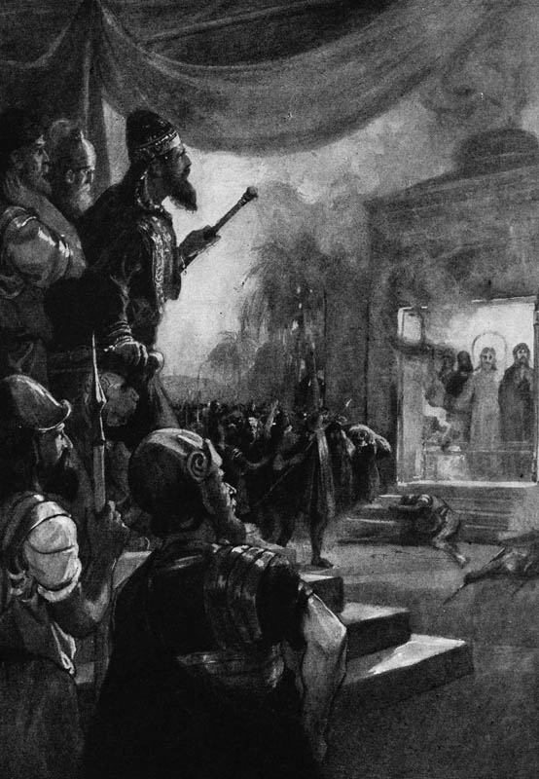
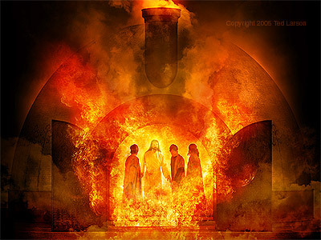
"I see four men..."

Slide 44
Slides on
Daniel 4

Slide 45
Chapter 4
Daniel
Prophetic 2–12
Hebrew
Gentiles 2–7
Aramaic
Interpreter
Personal 1
Statue 2
Idol 3
Tree 4
605-536 B.C.
Judgment
God rules the world
Notes:
Nebuchadnezzar again recognized God's sovereignty over Babylon and all nations, but this time based on his own experience (Dan 4).

Slide 46
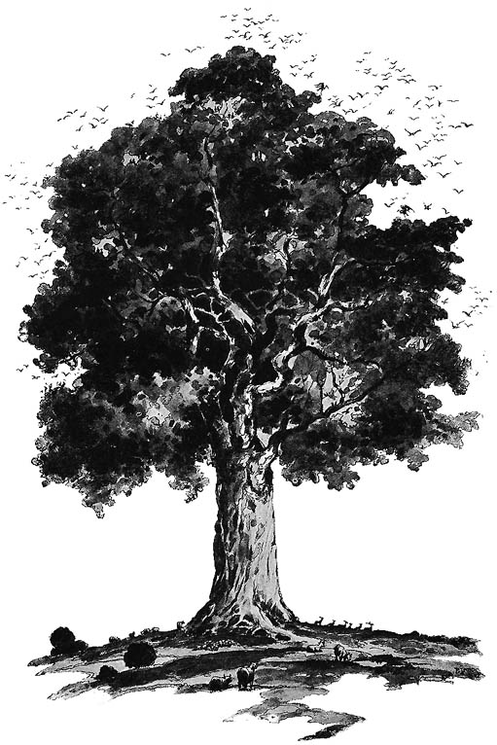
The Tree of Daniel 4
Notes:
Nebuchadnezzar made the proclamations about God in chapters 2-3 but he didn't really take them to heart personally. His arrogance of being a majestic tree was tempered by Daniel's prophecy that he would be cut down, but that could be avoided if he humbled himself. Fat chance of that!

Slide 47
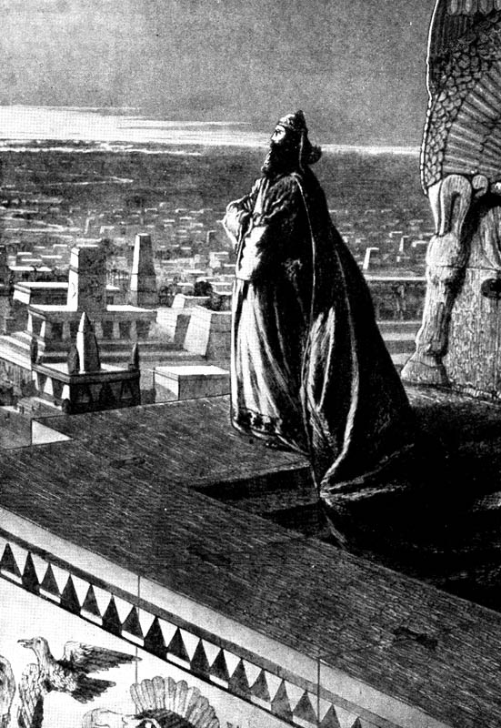
Nebuchadnezzar Exalts Himself (4:30)
"As he looked out across the city, he said, 'Look at this great city of Babylon! By my own mighty power, I have built this beautiful city as my royal residence to display my majestic splendor.'"
Notes:
Had he really built Babylon? No, it was being built for almost 2000 years since the time of Nimrod in Genesis 10!
He uttered too many "I" and "my" statements and not a single statement about God's blessing.

Slide 48
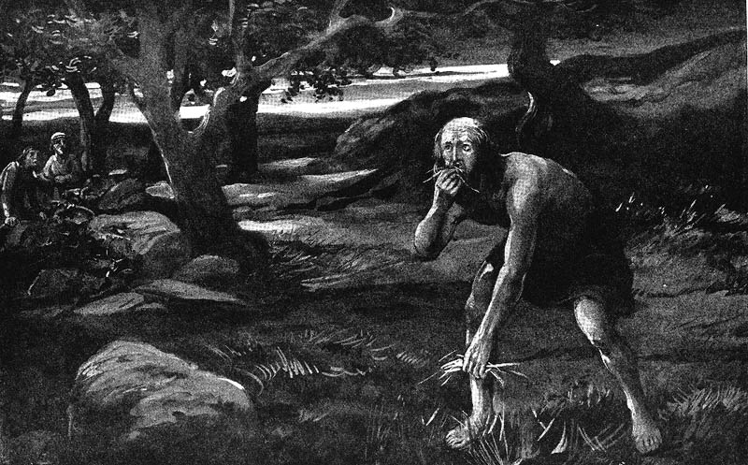
Involuntary Vegetarianism
Notes:
The result was involuntary vegetarianism. Daniel chose vegetarianism in chapter 1, but God gave the king no choice in the matter!

Slide 49
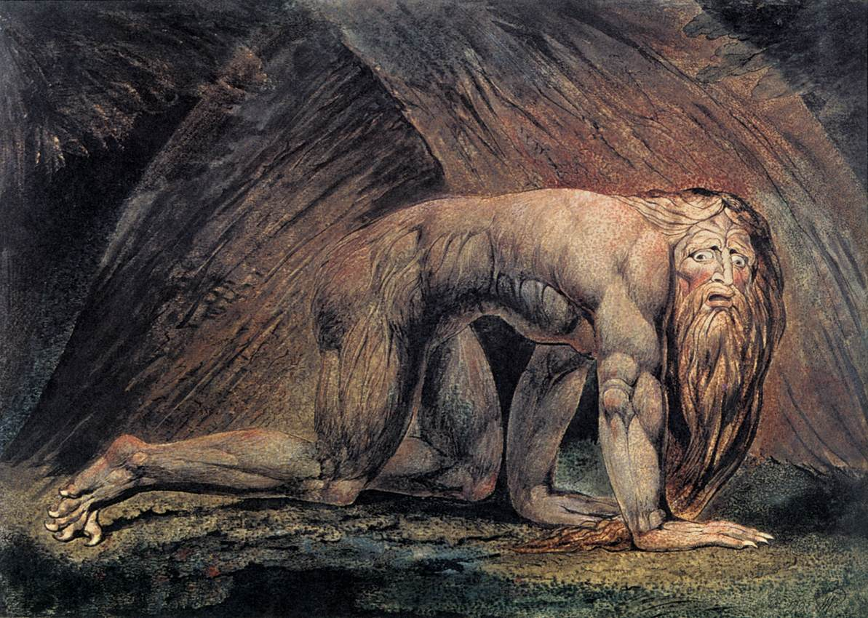
He lived as an animal
Famous Painting "Nebuchadnezzar" by William Blake
Notes:
His hair grew and nails were not trimmed for seven years. Likewise, my wife calls me Nebuchadnezzar when my nails get too long.

Slide 50
Neo-Babylonian Kings
342
1
Neriglissar
560-556 (4 yrs.)
Nabopolassar
625-605 (20 yrs.)
Conquered Nineveh
4
5
Labashi-Marduk
556 (9 months)
2
Nebuchadnezzar
605-562 (43 yrs.)
Conquered Judah
6
Nabonidus
556-539
(17 yrs.)
Tema
3
Self-Imposed Exile
Evil-Merodach
562-560 (2 yrs.)
Released Jehoiakim
(2 Kings 25:27)
7
Belshazzar
553-539
(14 yrs.)
First Dynasty in white
Others in yellow
Notes:
The point here is that, after Nabopolassar, kings came and went but Daniel remained throughout! He lasted even beyond Belshazzar into the Persian era once Cyrus conquered Babylon.
____________
Source: Matthias Henze, The Madness of King Nebuchadnezzar: The ancient Near Eastern Origins and Early History of Interpretation of Daniel 4, Supplements to the Journal for the study of Judaism, vol. 61 (Leiden, The Netherlands: Brill), 57.

Slide 51
Chiasm in Daniel 2–7
536
outline
1 NARRATIVE
1:1-7 Exile
1:8-16 Food
1:17-21 Exaltation
2–7 VISIONS IN NARRATIVE
2 Kingdom: "Image" of history destroyed
3 Deliverance from fiery furnace
4 Nebuchadnezzar humbled
5 Belshazzar humbled
6 Deliverance from lion's den
7 Kingdom: "Beasts" of history destroyed
Chiasm

Slide 52
Slides on
Daniel 5

Slide 53
Chapter 5
Daniel
Prophetic 2–12
Hebrew
Gentiles 2–7
Israel 8–12
Aramaic
Hebrew
Interpreter
Inquirer
Statue 2
Idol 3
Tree 4
Hand 5
Personal 1
605-536 B.C.
Judgment
Consolation
God rules the world
Notes:
Belshazzar’s denial of God's sovereignty led to death while Daniel was honored to show God is pleased with those who follow him (Dan 5).

Slide 54

Belshazzar Humbled
Rembrandt
Notes:
In 539 BC Belshazzar denied God's sovereignty at a huge party by praising false gods while drinking from the temple goblets (5:1-4).
God hid his judgment due to Belshazzar’s pride in an unreadable wall inscription that the wise men could not decipher (5:5-9).
God helped Daniel interpret the inscription as his judgment on Belshazzar’s pride and wisdom for the humble (5:10-28).

Slide 55


BABYLON FELL in 539 BC
510a
Persians entered under the water gates!
Daniel 5
(Belshazzar's Feast)
Notes:
"Babylon was being besieged by the Persian army, led by Ugbaru, governor of Gutium, while Belshazzar, inside the city, was giving a great banquet for 1,000 of his nobles. Belshazzar's name means "Bel (another name for the god Marduk) has protected the king." Perhaps the banquet was given to show Belshazzar's contempt for the Persians and to allay his people's fears. Archeologists have excavated a large hall in Babylon 55 feet wide and 165 feet long that had plastered walls. Such a room would have been sufficient to house a gathering of this size. Belshazzar considered his city secure from assault because of its massive walls. Within the city were supplies that would sustain it for 20 years. Therefore the king felt he had little cause for concern."
Dwight Pentecost, “Daniel,” eds. John F. Walvoord, Roy B. Zuck and Dallas Theological Seminary, The Bible Knowledge Commentary : An Exposition of the Scriptures (Wheaton, IL: Victor Books, 1983-1985), 1:1344.

Slide 56
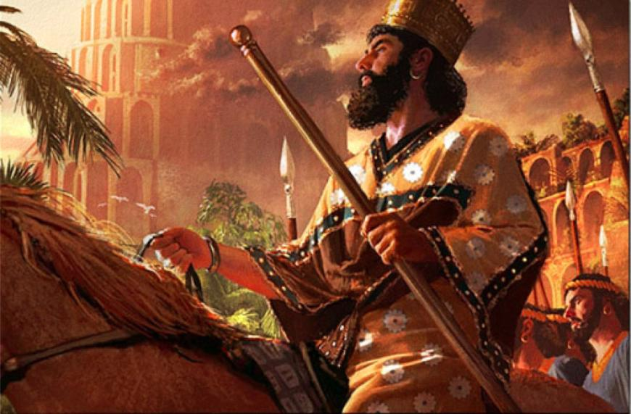
Cyrus Conquers Babylon
539 BC
Notes:
Daniel was promoted to Babylon’s third position to show God's pleasure with those who accept his sovereignty (5:29).
Belshazzar lost his kingdom that night to Darius the Mede [in the reign of Cyrus the Persian, 6:28] for denying God's rule (5:30).

Slide 57
Slides on
Daniel 6

Slide 58
Chapter 6
Daniel
Prophetic 2–12
Hebrew
Gentiles 2–7
Aramaic
Interpreter
Statue 2
Idol 3
Tree 4
Hand 5
Lions 6
Personal 1
605-536 B.C.
Judgment
God rules the world
Notes:
Darius admitted God's rule after seeing Daniel delivered from the lion's den for refusing to petition any god or man except Darius (Dan 6).

Slide 59
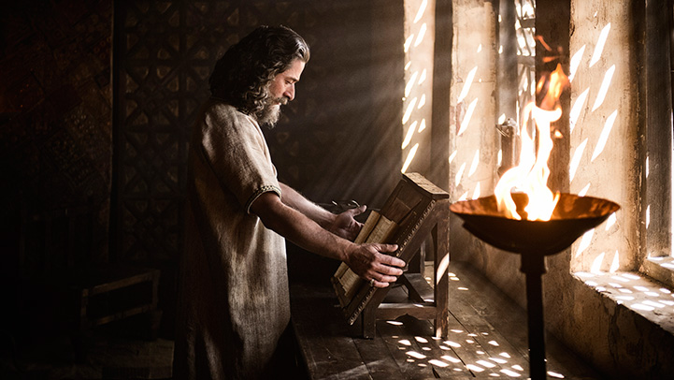
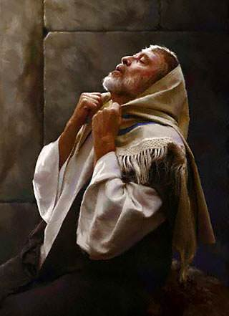
Daniel prayed with windows open to Jerusalem
Notes:
When you act in accord with God’s will, you need not fear the results. This doesn’t mean that you parade your righteousness or you always spout off your beliefs. Daniel was known for his integrity and commitment to keep the Jewish food laws—but he also did not want to be known as one who prayed to pagan deities to save his head.

Slide 60
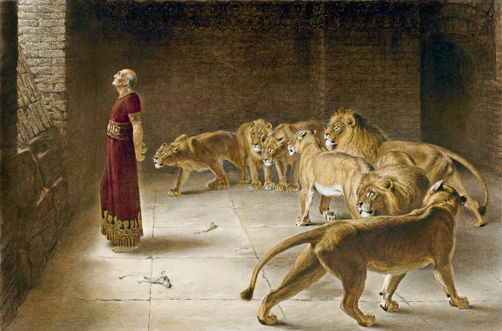
Hungry lions (but not for Daniel)
Notes:
Daniel got a good’s night’s sleep with all the warm lions. But the king tossed and turned all night without rest on his comfortable bed!

Slide 61
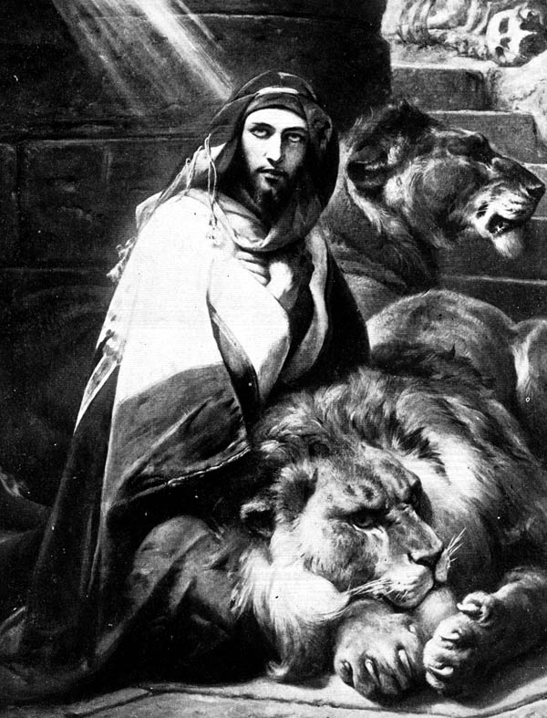
Darius Humbled
Darius the Mede conquered Belshazzar (grandson of Nebuchadnezzar). Darius also acknowledged God's sovereignty:
"I make a decree that in all the dominion of my kingdom men are to fear and tremble before the God of Daniel; For He is the living God and enduring forever, and His kingdom is one which will not be destroyed and His dominion [will be] forever. He delivers and rescues and performs signs and wonders in heaven and on earth, who has [also] delivered Daniel from the power of the lions."
Daniel 6:26-27

Slide 62
Slides on
Daniel 7

Slide 63
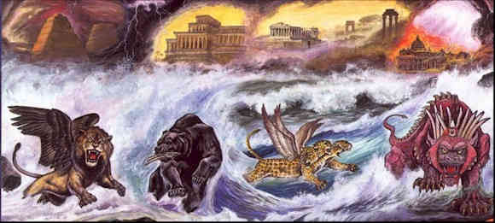
Four Beasts of Daniel 7

Slide 64
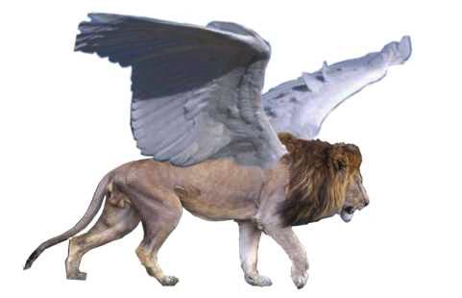
Beast 1: Winged Lion (Babylon)

Slide 65
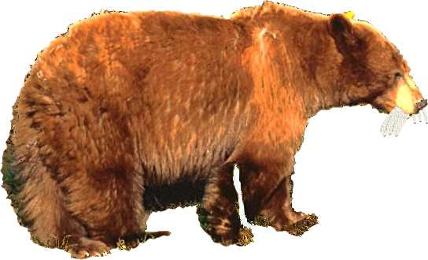
Beast 2: Bear (Medo-Persia)

Slide 66
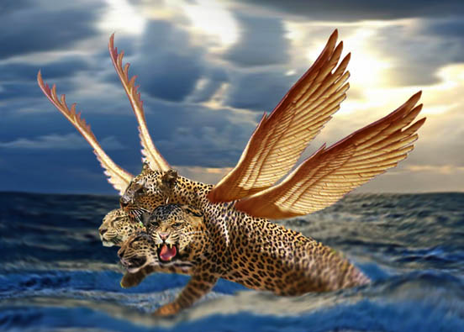
Beast 3: Leopard (Greece)

Slide 67
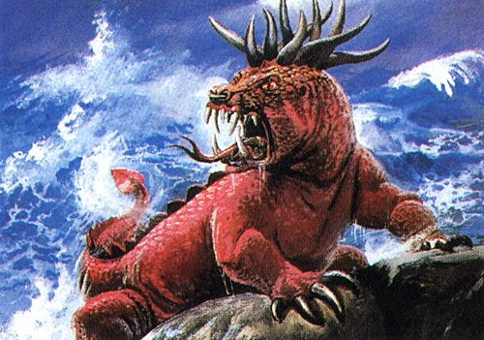
Beast 4: Terrifying (Rome)
Daniel 7:7

Slide 68
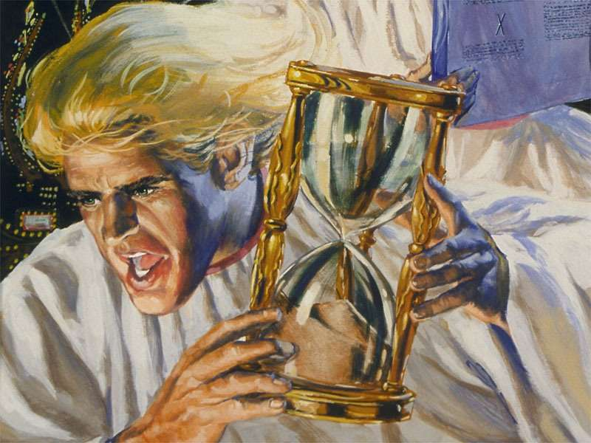
Little Horn on Beast 4 (Antichrist)
Daniel 7:8

Slide 69
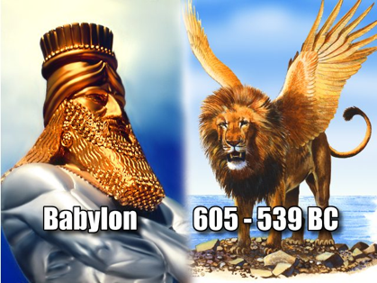
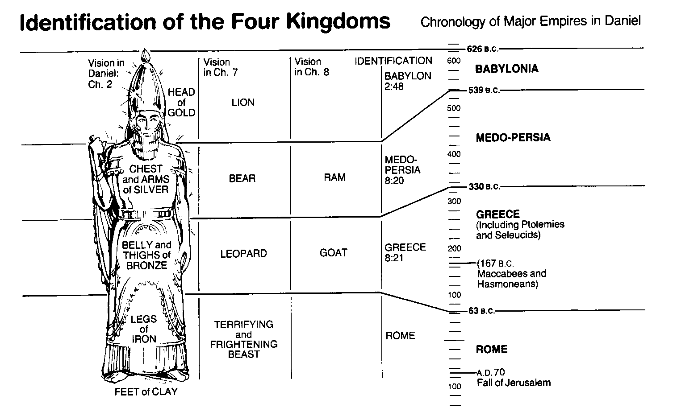
World Empires in Daniel
545
Bible Visual Resource Book, 133

Slide 70
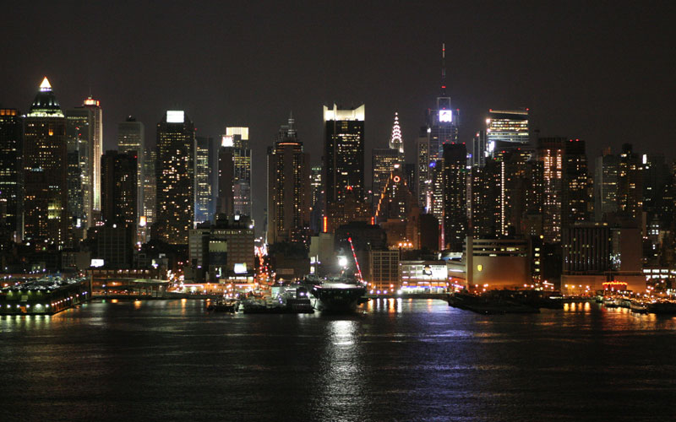
Applying Daniel 2–7
544a
Be confident that God still rules over all nations today.
Notes:
We lose confidence when we lose sight that God has the nations under his control.
The book of Daniel reminds us to be confident in God like Daniel and his three friends.
Rely on Daniel’s interpretation of kings’ dreams.
God has his nations under control of who he wants to use and when.

Slide 71
What do you need to know to be truly confident?
Notes:
The answer, of course, is that Daniel placed his confidence not in himself but in God. In his book we will see three truths that will help us, like Daniel, be confident that God is working.

Slide 72
I. God rules over you
(Dan 1).
Notes:
You can be confident when you know that…
The LORD controls what happens to you as an individual.

Slide 73
II. God rules over all nations (Dan 2–7).
Notes:
The LORD controls what happens to the peoples of the world.

Slide 74
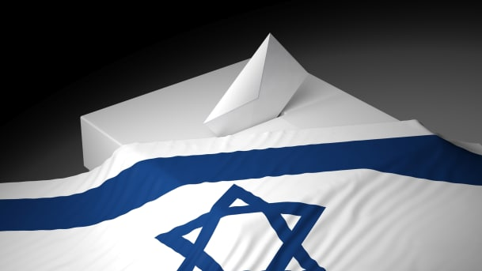
III. God rules over Israel’s future (Dan 8–12).
Notes:
The LORD controls the prophetic fulfillments for his people in the days ahead.

Slide 75
The Point of Daniel 8–12
544a
The exiles could confidently trust God’s sovereignty over Israel in "the times of the Gentiles" by being faithful to his covenant (Dan 8–12).
Daniel saw Jewish history
—in advance!
Notes:
Daniel prophesied that many in history will oppose Israel but not prevail.

Slide 76
Slides on
Daniel 8
Notes:
The animal vision of Alexander the Great over the Medo-Persian Empire and Antiochus IV defiling the temple foretell the same by Antichrist (Dan 8).

Slide 77

Daniel 8
Can God know the future almost 300 years in advance?
Well, of course He can!

Slide 78
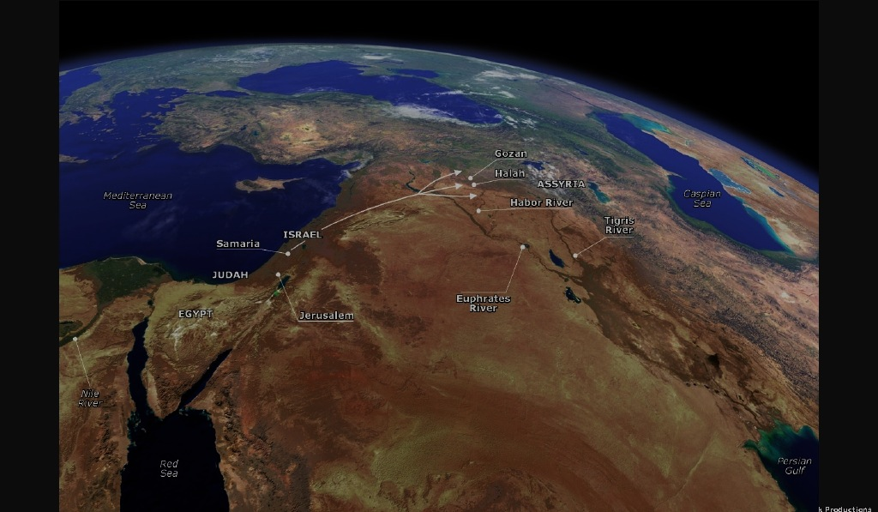
Flow of Daniel 8
539
Chapter 8
vv. 3-4 The powerful ram with two horns (Persia)
5-7 A goat defeats a ram (Alex over Persians)
8 Horn replaced by four horns (Alex's generals)
9-12 The small horn (Antiochus IV Epiphanes)
        His Career
        His Defeat
        His Fury
        His death (cf. v. 25)
13-14 The Maccabees and Hanukkah (167-164 BC)
15-27 The interpretation

Slide 79
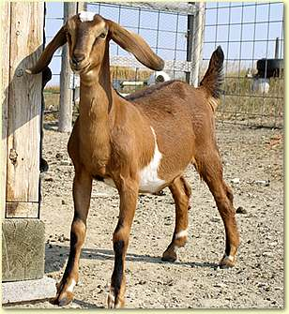
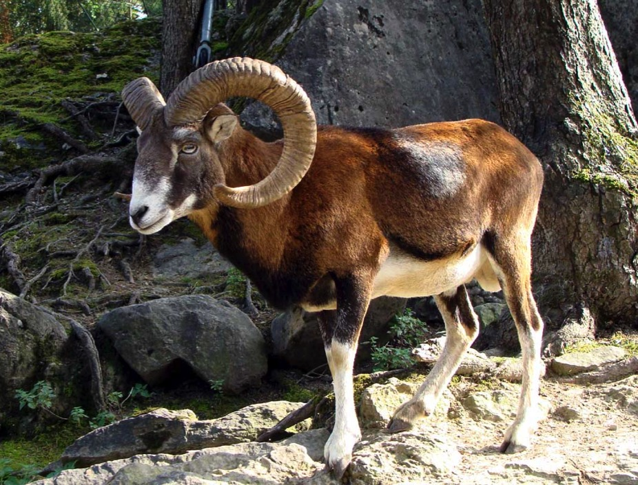
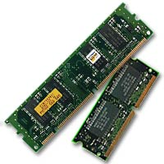
Which is stronger & faster?
557
Goat?
Ram?

Slide 80
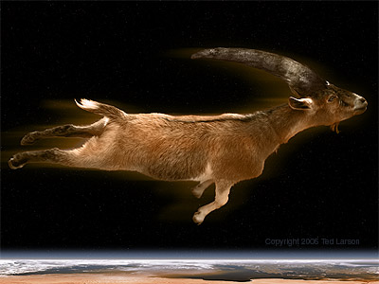
A goat never touching the ground (Dan. 8:5)?
557

Slide 81

Goat Beats Ram (Dan. 8:7)?
557

Slide 82

Alexander Made Headlines…
539

Slide 83





The Ram and Goat (Dan. 8)
557
Notes:
Daniel sees a vision of a goat defeating a ram but being replaced by four horns with one gaining power and desecrating the temple (8:1-14).

Slide 84

Alexander's Conquests
557
Notes:
The goat (Alexander the Great) over the ram (Medo-Persia) will lead to the Seleucid Antiochus IV desecrating the temple like Antichrist (8:15-26; cf. 9:27).

Slide 85



His Downfall
Due to Pride:
Desire for worship
Wine
Women
Song

Slide 86



After Alexander…
557
Greek Empire
Cassander
Lysimacus
Ptolemy
Seleucus
"And the he-goat is the king of Greece; and the great horn between his eyes is the first king. As for the horn that was broken, in place of which four others arose, four kingdoms shall arise from his nation but not with his power" (Daniel 8:21-22 RSV)
Notes:
God amazingly predicted Greek history 300 years in advance.

Slide 87
Slides on
Daniel 9

Slide 88
Chapter 9
Daniel
Prophetic 2–12
Hebrew
Gentiles 2–7
Israel 8–12
Aramaic
Hebrew
Interpreter
Beasts 7
Horns 8
Prayer 9
Statue 2
Idol 3
Tree 4
Hand 5
Lions 6
Inquirer
Personal 1
605-536 B.C.
Judgment
Consolation
God rules the world
Notes:
Daniel confessed Israel's sin before the 70 "sevens" vision where God revealed that the full restoration would need Messiah to come twice (Dan 9).

Slide 89
Two 70-Year Exiles
560
Two 70-Year Exiles
People Exile
605
586
539
536
516
Temple Exile
"This entire land will become a desolate wasteland. Israel and her neighboring lands will serve the king of Babylon for seventy years. ¹²Then, after the seventy years of captivity are over, I will punish the king of Babylon and his people for their sins," says the Lord. I will make the country of the Babylonians a wasteland forever"
(Jer. 25:11-12).
Notes:
In 539 BC under the rule of Darius, Daniel read Jeremiah 25:11-12 that limited the exile to 70 years (605-536 BC), or only three years away (9:1-2).

Slide 90

Chapter 9 Outline
539
Daniel's prayer: How long? (9:1-19)
Notes:
The nearness of restoration compelled Daniel to confess God’s just judgment of Israel's sins and ask God to restore Jerusalem’s temple (9:3-19).

Slide 91
Before the Curtain Closes (9:24 NLT)
540
“A period of seventy sets of seven has been decreed for your people and your holy city
to finish their rebellion,
to put an end to their sin,
to atone for their guilt,
to bring in everlasting righteousness,
to confirm the prophetic vision, and
to anoint the Most Holy Place."
Tribulation
Millennium
These were NOT fulfilled in the first century––so the 70 weeks must have a future fulfillment
Notes:
Gabriel brought to Daniel the 70 "sevens" vision where God revealed that the full restoration would need Messiah to come twice (9:20-27).

Slide 92

70 "Weeks" in Daniel 9:25-27
551
Decree
Anointed One
69 sevens = 483 years
7 sevens + 62 sevens
1 seven
= 7 years
"Know and understand this: From the issuing of the decree to restore and rebuild Jerusalem until the Anointed One, the ruler, comes, there will be seven 'sevens,' and sixty-two 'sevens.' It will be rebuilt with streets and a trench, but in times of trouble. ²⁶After the sixty-two 'sevens,' the Anointed One will be cut off and will have nothing. The people of the ruler who will come will destroy the city and the sanctuary. The end will come like a flood: War will continue until the end, and desolations have been decreed" (Dan. 9:25-26 NIV).
Notes:
Gabriel brought to Daniel the 70 "sevens" vision where God revealed that the full restoration would need Messiah to come twice (9:20-27).

Slide 93

Triumphal Entry: "Anointed One comes"
Zech. 9:9
Dan. 9:25
30 March AD 33
Notes:
Gabriel told Daniel that the Messiah would come 173,880 days after the decree of Artaxerxes. This works out to be on 30 March AD 33 when Jesus came into Jerusalem to present himself as Israel’s king— the most specific fulfillment of Bible prophecy in the Bible!

Slide 94


Chronology of the 70th "Week"
556
Adapted from J. Dwight Pentecost, Dallas Theological Seminary, 1988
Middle of the Week
Sign of
Son of Man
Matt. 24:30
Christ's Return Complete
3½ YEARS
1290 DAYS
Dan. 12:11
30 DAYS
30 DAYS
1260 DAYS
45 DAYS
Rev. 12:6
Dan. 12:12
3½ YEARS
3½ YEARS
Election
of Beast
Rev. 17:13
Covenant Made
Dan. 9:27a
Covenant Broken
Dan. 9:27b
The Great Tribulation
2nd ADVENT
The Tribulation
"He will confirm a covenant with many for one 'seven.' In the middle of the 'seven' he will put an end to sacrifice and offering. And on a wing [of the temple] he will set up an abomination that causes desolation, until the end that is decreed is poured out on him" (Daniel 9:27 NIV).

Slide 95

Events of the 70th "Week"
556
2018 09 23 John Haller's Prophecy Update
"Surveillance Society” (https://www.youtube.com/watch?v=GE35KQWKCWw)
"He will confirm a covenant with many for one 'seven.' In the middle of the 'seven' he will put an end to sacrifice and offering. And on a wing [of the temple] he will set up an abomination that causes desolation, until the end that is decreed is poured out on him" (Daniel 9:27 NIV).

Slide 96

Antichrist will make a 7-year treaty with Israel
This will likely enable the rebuilding of the Jerusalem temple
Artwork by Sunny Chandra
Notes:
The 70th week of Daniel 9:27 is believed by nearly all scholars to depict a seven-year period. Since this “ruler to come” will set up a desecration in the temple and this event is still future, it must mean that the present temple rebuilding preparations in Jerusalem right now will be successful in building the temple on its original spot.

Slide 97

Antichrist will make a 7-year treaty with Israel
This will likely enable the rebuilding of the Jerusalem temple
Artwork by Sunny Chandra
Notes:
The traditional spot for the temple is the exact spot where the Dome of the Rock was constructed by Muslims in the late AD 690s. But will this be easily demolished by one who the world will accept as a peaceful negotiator? That seems unlikely.

Slide 98

Antichrist will make a 7-year treaty with Israel
This will likely enable the rebuilding of the Jerusalem temple
Artwork by Sunny Chandra
Notes:
Some propose that this deceitful ruler will negotiate a deal to have the temple built right next to the Dome. Rabbis like Asher Kaufman have proposed the northern site as the original site of Solomon’s temple, partly because it gives a straight shot towards the Eastern Gate.

Slide 99

Antichrist will make a 7-year treaty with Israel
This will likely enable the rebuilding of the Jerusalem temple
Artwork by Sunny Chandra
Notes:
Building these adjacent would certainly be the result of a master negotiator!

Slide 100

Antichrist will make a 7-year treaty with Israel
This will likely enable the rebuilding of the Jerusalem temple
Artwork by Sunny Chandra
Notes:
Perhaps such a feat would underscore the unity of all religions—a major tenant of the one-world religion that will lead to global worship of the Antichrist as the messianic figure at the focus of that one-world government.

Slide 101
Slides on
Daniel 10

Slide 102

Angels

Slide 103

Gabriel? (Daniel 10:4-12)
Notes:
https://whatshotn.wordpress.com/tag/pray/

Slide 104

Michael (Daniel 10:13b)
Notes:
https://whatshotn.wordpress.com/tag/pray/

Slide 105

The Prince of Persia (Daniel 10:13a)
Notes:
https://whatshotn.wordpress.com/tag/pray/

Slide 106

Daniel 10
541
Daniel's prayer and fasting for 21 days (10:1-13a)
Victory Over Satan’s opposition to Israel's restoration (10:13b-20)
  Persia, Samaritans (book of Ezra)
  Haman (book of Esther)
  Greeks, Romans, Arabs, Hitler, UN, etc.
The certainty of the prophecies = God prevails (10:21)

Slide 107
Slides on
Daniel 11

Slide 108

Daniel 11 Prophecies

Slide 109

Chapter 11
542
Previews intertestamental & end times history
Intertestamental History––11:1-35 has over 100 prophecies of the Persian and Greek Empires from Alexander the Great to Antiochus IV fighting over the land of Israel
End Times History––11:36-45 prophesies the Antichrist's final assault on Israel

Slide 110

Daniel 11:40
543
Israel's enemies will invade her land

Slide 111

Daniel 11:40-45
543
Even ships in the Mediterranean will join the battle

Slide 112


East Meets West (Dan. 11:44)
543

Slide 113

Christ will defeat Antichrist (Dan. 11:45)

Slide 114
Slides on
Daniel 12
Notes:
Israel's future will see Antichrist’s self-deification and military power end at Christ’s Second Coming to show God's rule over all nations (11:36–12:3).

Slide 115

Daniel 12:7
Notes:
These prophecies will bless Israel in the Tribulation and reveal judgment for unbelievers to encourage Israel with God's rule (12:4-14).

Slide 116
Daniel 12
543
The revelation given to Daniel is sealed up for the end time
The great tribulation (Dan. 12:1; cf. Matt. 24:21)
"After which" => the resurrection
Endure to the end to be blessed (Matt. 24:14)
When Daniel asked for the time of these events, the reply was:
  The time, times, half a time (Dan. 7:25; 12:7; Rev. 11:2; 13:5; 12:6, 14) = 1 yr. + 2 yrs. + ½ yr. = 3.5 years
  The end, the power of Israel broken (Dan. 12:7; Zech. 14:12-16; Rev. 19:15-19)
What are the 1290 and 1335 days???
Notes:
Gabriel told Daniel to seal up these prophecies until the Tribulation when travel and knowledge will increase rapidly (12:4).
Gabriel declared that a 3.5-year Great Tribulation will lead unbelievers to punishment and Israel will enter the Kingdom (12:5-13).
—The setting was Daniel's observations of two angels standing on opposite sides of the Tigris River (12:5; cf. 10:4).
—The Great Tribulation will last 3.5 years or 1260 days (12:6-7).
—The Great Tribulation will judge unbelievers worshipping Antichrist but bless Israel with the kingdom (12:8-13).

Slide 117
Chronology of the 70th "Week"
556
Adapted from J. Dwight Pentecost, Dallas Theological Seminary, 1988
Middle of the Week
Sign of
Son of Man
Matt. 24:30
Christ's Return Complete
1335 DAYS
Dan. 12:12
3½ YEARS
1290 DAYS
Dan. 12:11
30 DAYS
30 DAYS
1260 DAYS
45 DAYS
Rev. 12:6
Dan. 12:12
3½ YEARS
3½ YEARS
Election
of Beast
Rev. 17:13
Covenant Made
Dan. 9:27a
Covenant Broken
Dan. 9:27b
2nd ADVENT
The Great Tribulation
The Tribulation

Slide 118

Applying Daniel 8–12
544a
Be confident that God still rules over Israel today.
Notes:
We lose confidence when we lose sight that God has Israel under his control.
The book of Daniel reminds us to be confident in God like Daniel.

Slide 119
What do you need to know to be truly confident?
Notes:
The answer, of course, is that Daniel placed his confidence not in himself but in God. In his book are three areas where God has control, so, like Daniel, we can be confident that God is working.

Slide 120

——Main Idea of Daniel——
God controls each level.
Notes:
What do you need to know to be truly confident?
Do you rest in this reality that the LORD doesn't need your help in running the universe? He sets up kings and takes them down—and he does the same in our lives.

Slide 121
I. God rules over you
(Dan 1).
Notes:
You can be confident when you know that…
The LORD controls what happens to you as an individual.

Slide 122
II. God rules over all nations (Dan 2–7).
Notes:
The LORD controls what happens to the peoples of the world.

Slide 123
III. God rules over Israel’s future (Dan 8–12).
Notes:
The LORD controls the prophetic fulfillments for his people in the days ahead.

Slide 124

Daniel is a book of faith and courage stemming from the Sovereign God!
Notes:
Where do you need to be confident of God’s rule in your life today?
Do you feel that you are under someone else’s thumb at home, school, work or somewhere else?
Can you now see that since God is over these authorities, he also can help you live with confidence even though you cannot control the circumstances?

Slide 125

Application
Recognize God's sovereignty over all authority in history
Resist evil without compromising
Trust God for your ultimate salvation so that you can endure to the end (12:2, 3, 12; cf. Rev. 12:11)
Seek God in prayer and intercession
Live a godly life
Notes:
Do you feel that you are under someone else’s thumb at home, school, work or somewhere else?
Can you now see that since God is over these authorities, he also can help you live with confidence even though you cannot control the circumstances?
Be confident of God’s rule over everything today.

Slide 126
Black

Slide 127


OT Preaching link at BibleStudyDownloads.org
Get this presentation and script for free!

