Slide 1
2 Samuel 7
God is For His People!
Dan Bridges Amman International Church, Jordan (AmmanChurch.org) Uploaded by Dr. Rick Griffith • Jordan Evangelical Theological Seminary Files in many languages for free download at BibleStudyDownloads.org

Slide 2
On a scale of 1-10, how confident are you that God is for you – that he is on your side?
Notes:
If God were in the bleachers of your life, would he be cheering for you?

Slide 3
On a scale of 1-10, how confident are you that God likes you?
Notes:
Not just does God love you – but does he like you? Does he enjoy you?

Slide 4
Of course, if you are living in rebellion to God, you should be wondering how he feels about you.
Notes:
The Bible is clear that we set God against us when we live in rebellion to him.

Slide 5
But what if you have given your life to Christ – if you have become one of God’s people? How does God feel about you?
Notes:
Not just does God love you – but does he like you? Does he enjoy you?

Slide 6
Big Idea of
2 Samuel 7:
God is for his people!

Slide 7
Let’s see what God is like in
2 Samuel 7!
Notes:
Not just does God love you – but does he like you? Does he enjoy you?

Slide 8
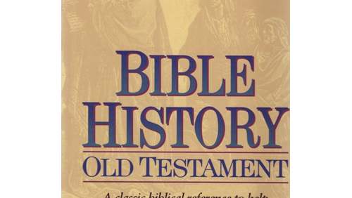
1000 Years as “God’s Chosen People”
God promised to bless all nations through Abraham
God miraculously rescued them out of Egypt
They refused to enter the Promised Land
They forgot God one generation after Joshua
They didn’t finish taking the Promised Land
For 400 years under the judges they struggled with idolatry, sin, brokenness, civil war and external enemies
They rejected God as their king – needed a human king
Their first king failed to follow God and protect them from their enemies
God’s Chosen People? Really???

Slide 9
2 Samuel 7 – The Story
David decides he wants to build a temple for God… But God declines the offer (vss 1-7)
God’s Promise, “You won’t build me a house, but I’ll build you a house!” (vss 8-17)
David’s prayer of response (vss 18-29)

Slide 10
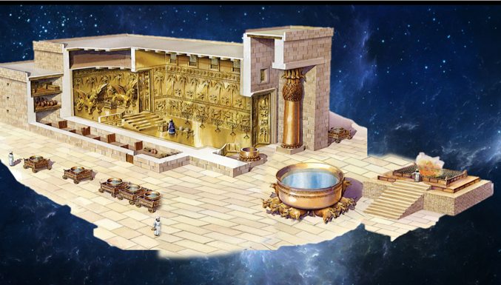
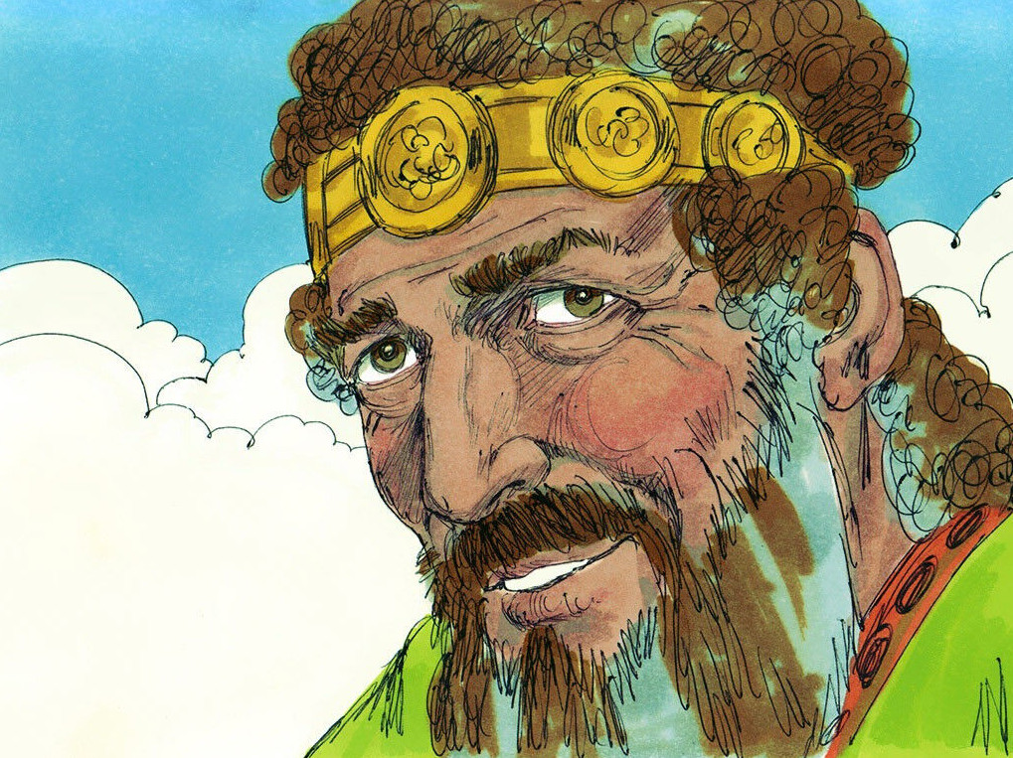
2 Samuel 7:1-7
A Good Idea

Slide 11
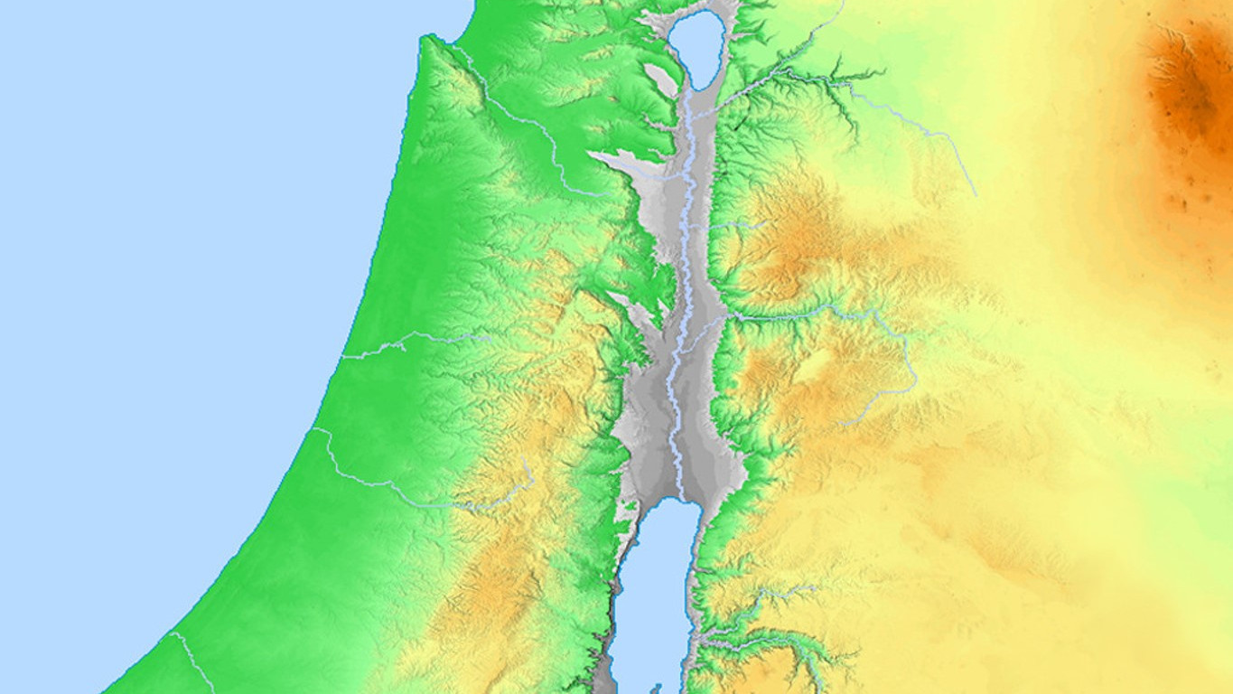
Context of
2 Samuel 7
“After the king was settled in his palace and the LORD had given him rest from all his enemies…”
2 Samuel 7:1

Slide 12
Context of
2 Samuel 7
David had spent 13 years
On the run from Saul
Death of Saul
Ish-Bosheth in Mahanaim
(Other Tribes)
Two Kingdoms:
Civil War
Between the Kingdoms
David in Hebron
(Judah)

Slide 13
Context of
2 Samuel 7
Ish-Bosheth Murdered
Two Kingdoms:
Murderers bring his
head to David
David orders
them killed
David in Hebron
(Judah)

Slide 14
Context of
2 Samuel 7
United Kingdom
All Tribes Ask David
To Be Their King
David in Hebron

Slide 15
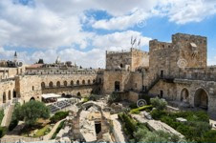
Context of
2 Samuel 7
United Kingdom
David Builds
His Palace
David Attacks
Jerusalem

Slide 16
Context of
2 Samuel 7
United Kingdom
Philistines attack, but David defeats them

Slide 17
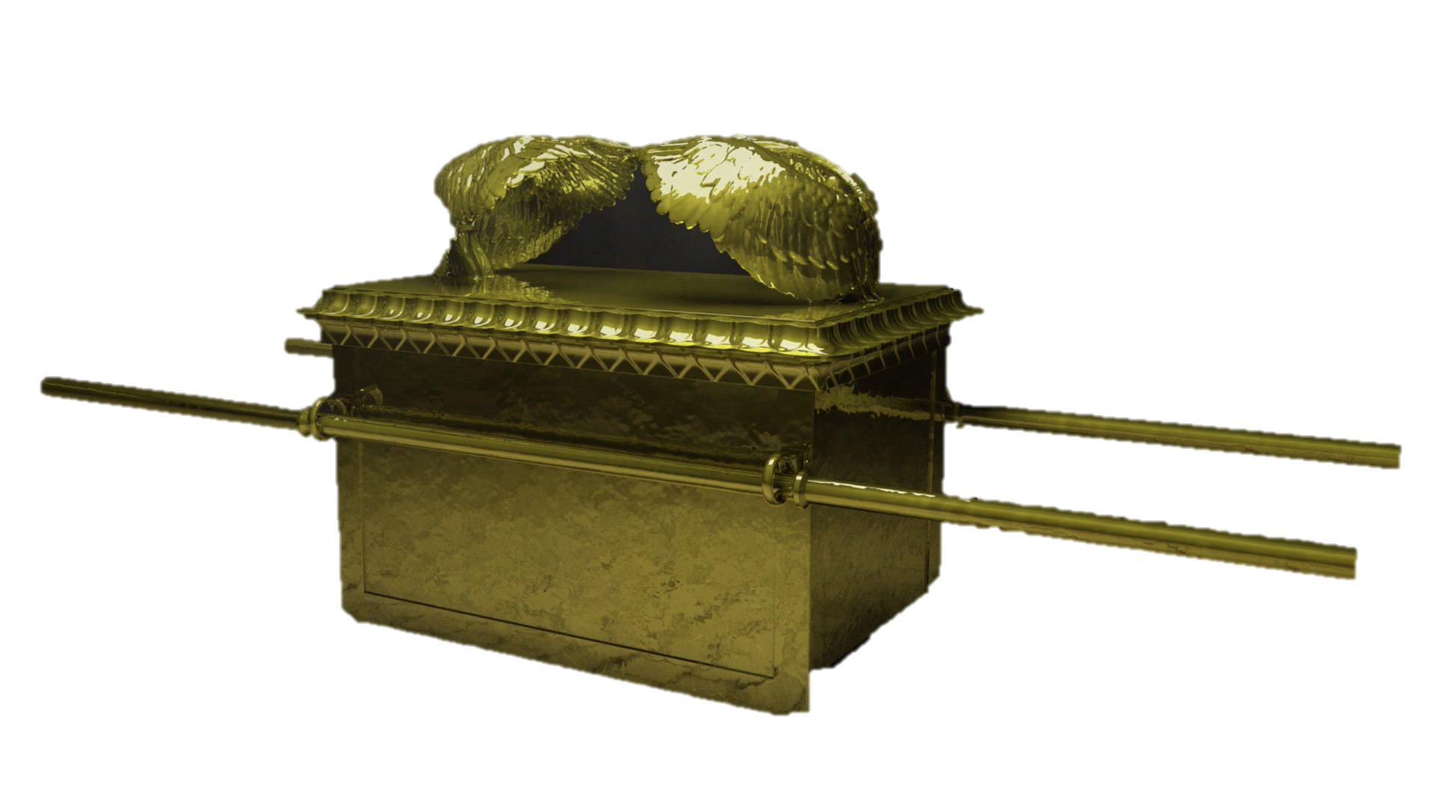
Context of
2 Samuel 7
United Kingdom
David brings the
Ark to Jerusalem

Slide 18
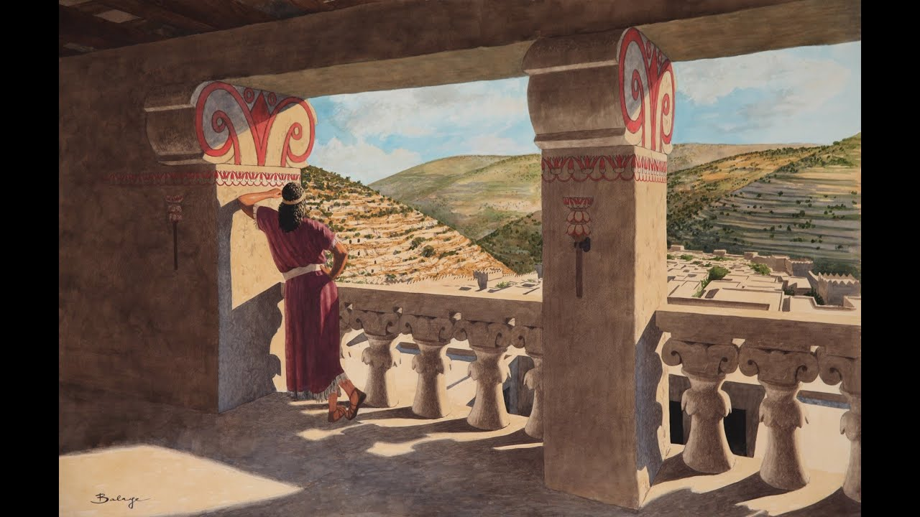
Context of
2 Samuel 7
Rest… At Last!

Slide 19
A good idea but…
No Thanks!
Time to Build a House for God!

Slide 20
David wanted to honor God with a house! Why wasn’t it a priority to God?
“I have been moving about in a tent… wherever I have gone with all the sons of Israel did I speak a word… ‘Why have you not built me a house of cedar?’”

Slide 21
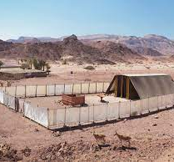
Why did God “live” in a tent?
So he could be with his people!

Slide 22
So what can we learn about what God is like?
Being with his people is important to him!

Slide 23
How does this relate to us?
God wants to be with you!!!

Slide 24
2 Samuel 7:8-17
A Pile of Promises!

Slide 25
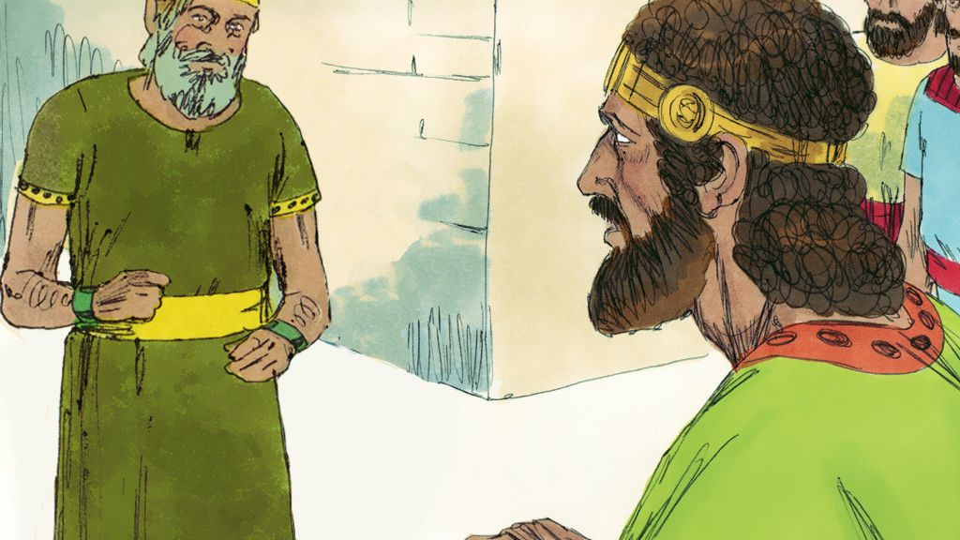
You won’t build a house for me…
But I will build you a house!!!
(vs 11)

Slide 26
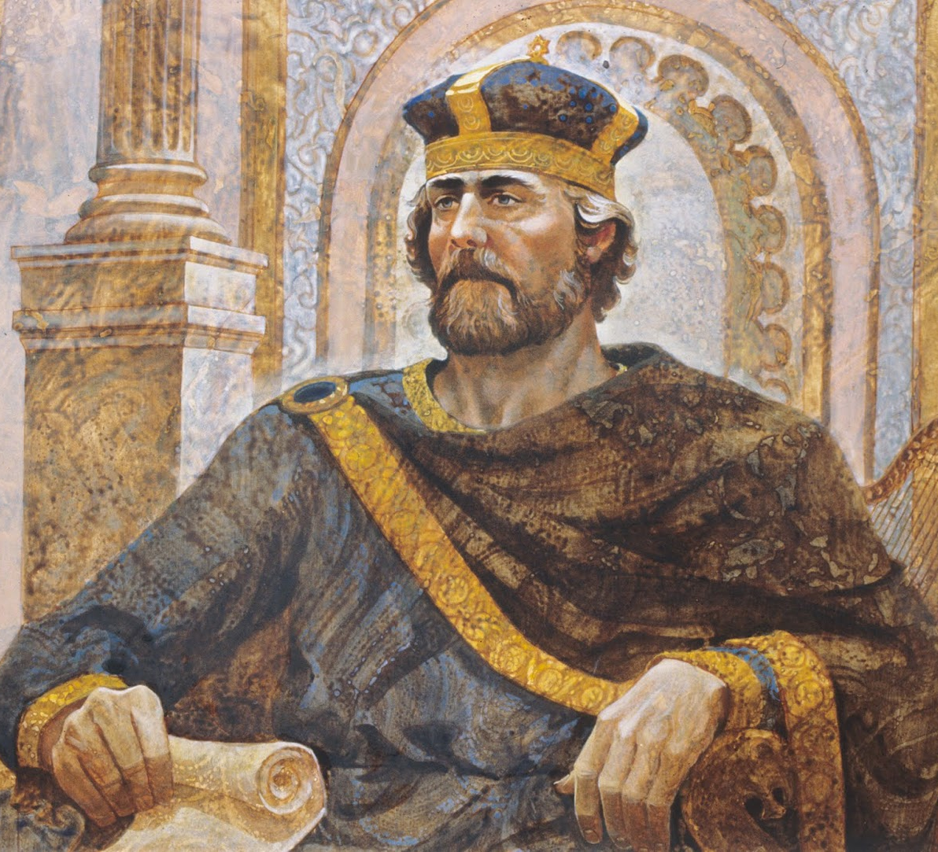
The Davidic
Covenant:
What God Promised to David

Slide 27
God’s Promises to David:
I will…
Make your name great
Appoint a place for my people Israel
Give rest from your enemies
Build a house for you
Establish the kingdom of your son
Enable David’s son to build God’s house
Establish his throne forever
Establish David’s house & kingdom forever
Applies to…
David
Applies to…
Solomon
Applies to…
Jesus!

Slide 28
So what can we learn about what God is like?
Through David’s line, God has committed to building a kingdom for his people!
Why?
God glorifies his name by delighting in his people and blessing them!

Slide 29
How does this relate to us?
As a child of God, He delights in blessing you!

Slide 30
Aside:
Why all of these promises???

Slide 31
Remember God’s promise to Abraham – that he would bless all nations through him?
2 Samuel 7
David:
A Dynasty
Jesus:
An Eternal
Kingdom for
All Nations
Jacob:
A family
Abraham:
A person
Israelites:
A Nation
Genesis 12

Slide 32
Matthew 1
2 Samuel 7
Genesis 12
“This is the genealogy of Jesus the Messiah the son of David, the son of Abraham:
…David was the father of Solomon…
and Jacob the father of Joseph, the husband of Mary, and Mary was the mother of Jesus who is called the Messiah.”

Slide 33
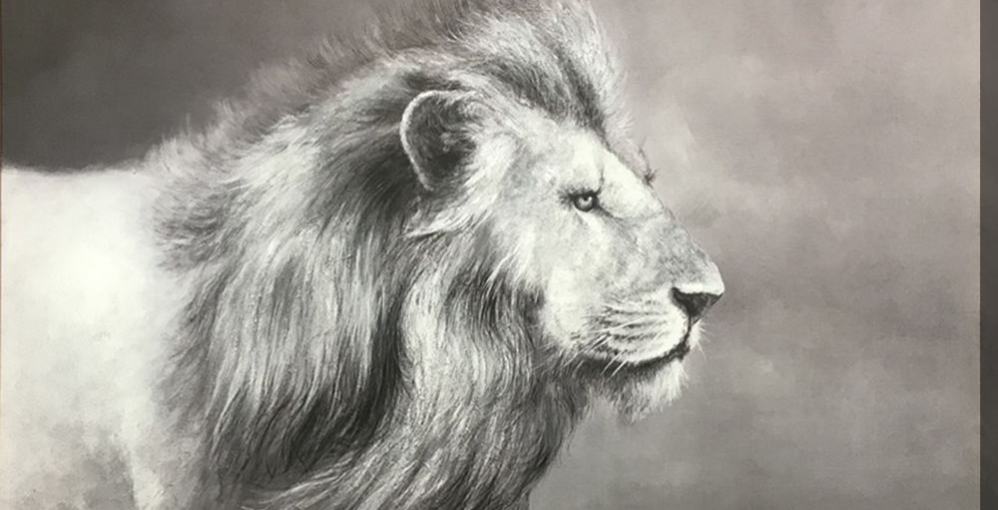
From here on out, the Bible uses Kingdom language!

Slide 34
⁶ For to us a child is born, to us a son is given, and the government will be on his shoulders.
And he will be called Wonderful Counselor, Mighty God, Everlasting Father, Prince of Peace.
⁷ Of the greatness of his government and peace there will be no end. He will reign on David’s throne and over his kingdom, establishing and upholding it with justice and righteousness from that time on and forever.
Isaiah 9:6-7

Slide 35
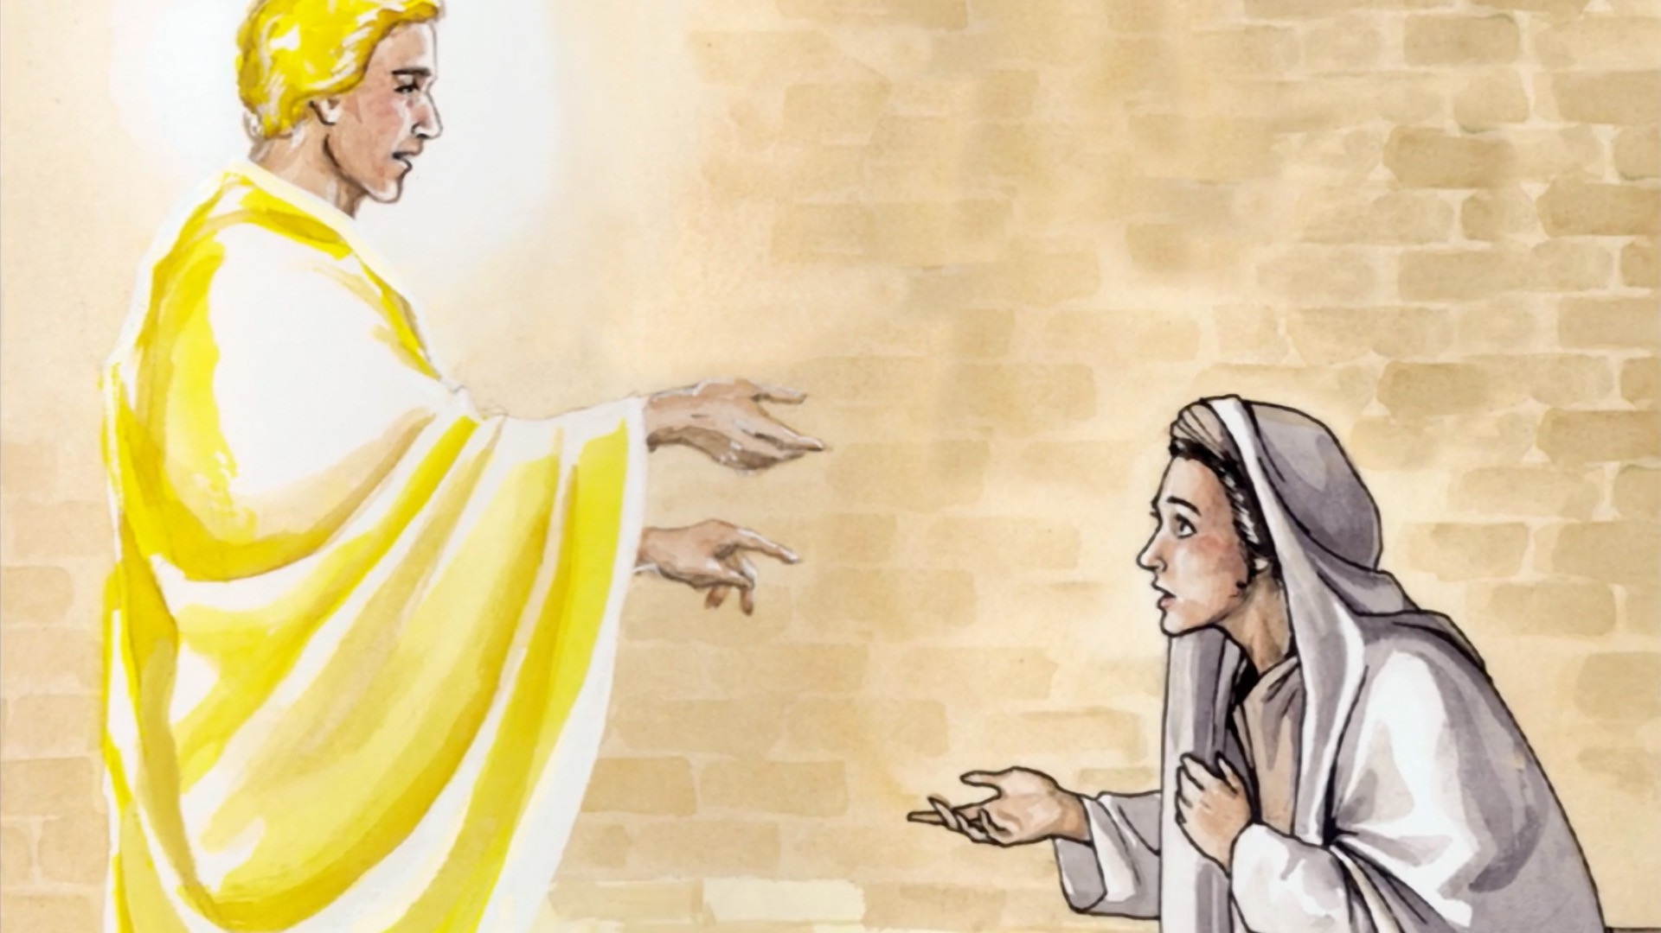
³² He will be great and will be called the Son of the Most High. The Lord God will give him the throne of his father David, ³³ and he will reign over Jacob’s descendants forever; his kingdom will never end.
Luke 1:32-33

Slide 36
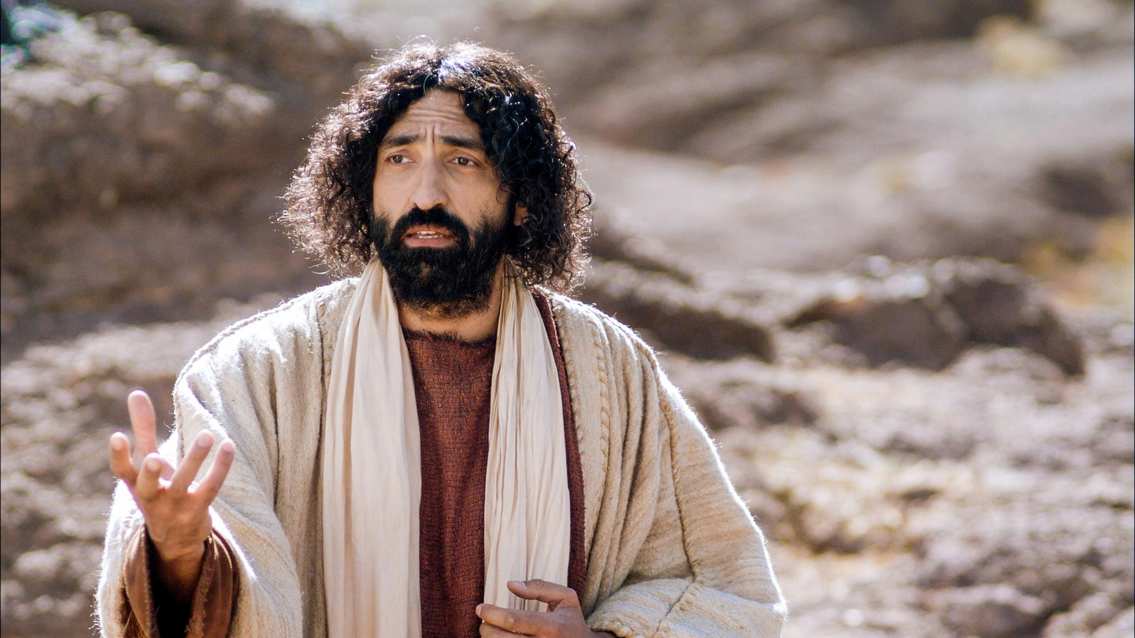
Repent, for the kingdom of heaven is near!
Matthew 4:17

Slide 37
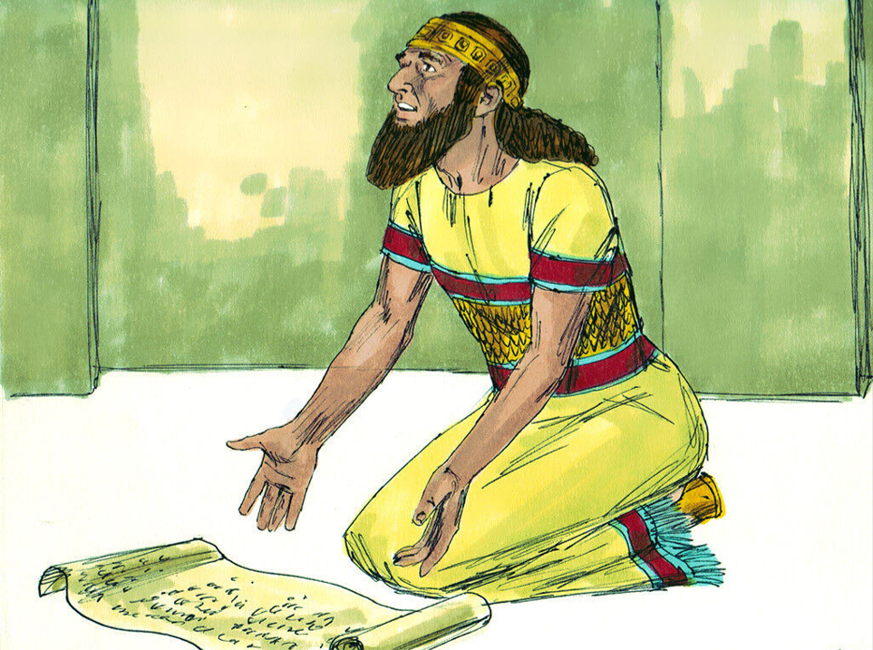
Now… Back to our Story!
2 Sam 7:18-29
David’s Response

Slide 38
David’s Response…
Humility… “Who am I and what is my house that you have brought me this far?”
Thankfulness… David reviews God’s faithfulness to his people

Slide 39
²² For this reason You are great, O Lord God; for there is none like You, and there is no God besides You, according to all that we have heard with our ears. ²³ And what one nation on the earth is like Your people Israel, whom God went to redeem for Himself as a people and to make a name for Himself, and to do a great thing for You and awesome things for Your land, before Your people whom You have redeemed for Yourself from Egypt, from nations and their gods? ²⁴ For You have established for Yourself Your people Israel as Your own people forever, and You, O Lord, have become their God.

Slide 40
David’s Response…
Humility… “Who am I and what is my house that you have brought me this far?”
Thankfulness… David reviews God’s faithfulness to his people
Faith in the promises…

Slide 41
Lord Almighty, God of Israel, you have revealed this to your servant, saying, ‘I will build a house for you.’ So your servant has found courage to pray this prayer to you.
2 Samuel 7:27

Slide 42
You are God
Your Words are Truth
You have promised this good thing
Please do it!
2 Samuel 7:28-29

Slide 43
So what can we learn about God?
God was faithful to his promises to his people!

Slide 44
How does this relate to us?
God will be faithful to his promises to us!

Slide 45
Do you believe that God is on your side – that God is truly for you?
Do you believe that God wants to be with you?
Do you believe that God delights in blessing you?
Do you believe that God will be faithful to his promises to you?
Notes:
If God were in the bleachers of your life, would he be cheering for you?

Slide 46
Small Group Time…

Slide 47
Small Group Discussion Guide – 2 Samuel 7
Theme: God is for his people!
Key Thought: A key aspect of living lives of faith is believing that God is for us – that he wants to be with us, that he delights in blessing us and that he is faithful to his promises to us.
Starter Questions:
What is something big that someone has promised you or that you’ve promised someone?
Why do we make promises?
Transition: Promises are an important part of how God relates to his people. What he promises us, and his faithfulness to those promises, prove that he is on our side!
Discussion Questions:
God Wants to be With Us:
Why was having a fancy temple not a high priority to God? From verses 6-7, what was more important to him than that?
What do you think it looks like for God to be “with you”?
God Delights in Blessing Us:
Read 2 Samuel 7:8-16. List all the promises that God gave to David.
What do all the promises in verses 8-16 show us about God’s attitude towards his people? (Big idea: God delights in blessing his people!)
If we too are God’s people, what can we learn about his attitude towards us?
God is Faithful to His Promises to Us:
Read 2 Samuel 7:22-25. How would you summarize God’s work on behalf of his people and his attitude toward them? How is this surprising based on the previous 1000 years of history?
Read 2 Samuel 7:27-29. Why do you think David asked God for what God had just promised to give him? (Answer: Praying in faith is praying for what God has already promised to do!)
Based on God’s faithfulness to his promises to his people, what can we conclude about his faithfulness to his promises toward us?
Drawing it All Together:
Of the three big truths about God – that he wants to be with us, that he delights in blessing us and that he is faithful to his promises to us – which one means the most to you personally?

