Slide 1
2 SAMUEL 9
Grace
Dr Scott Wooddell Eastridge Park Christian Church, Mesquite, Texas Uploaded by Dr. Rick Griffith • Jordan Evangelical Theological Seminary Files in many languages for free download at BibleStudyDownloads.org

Slide 2
2 SAMUEL 9
What is grace?
What does grace look like?

Slide 3
1. MAN’S FALLEN AND BROKEN CONDITION
“The king asked, ‘Is there no one still left of the house of Saul to whom I can show God’s kindness?’ Ziba answered the king, ‘There is still a son of Jonathan; he is crippled in both feet.’”
Crippled in both feet
Living in Lo Debar

Slide 4
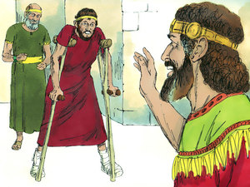
2. GOD’S GRACE AND PROVISION
David said, “Mephibosheth!”
“your servant” he replied.
“Don’t be afraid.”
“I will surely show you kindness.”
“I will give you the inheritance of your grandfather.”
“You will sit at my table for the rest of your life.”

Slide 5
3. GOD’S PROVISION AND OUR NEW POSITION
FROM RAGS TO RICHES
Delivered from sin (Gal. 1:4)
Enriched with inheritance (1 Pet. 1:4)
Made children of God (John 1:12)
Given living hope (1 Pet. 1:3)
Promised an eternal home (John 14:2)

Slide 6
TAKE HOME TRUTH
Grace is God’s immeasurable riches freely given to undeserving sinners

Slide 7
Black

Slide 8
OT Preaching link at BibleStudyDownloads.org
Get this presentation for free!
Notes:
OT Preaching (op)

