Slide 1
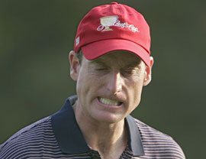
2 SAMUEL 6
Resolving Anger
Dr Scott Wooddell Eastridge Park Christian Church, Mesquite, Texas Uploaded by Dr. Rick Griffith • Jordan Evangelical Theological Seminary Files in many languages for free download at BibleStudyDownloads.org

Slide 2
2 SAMUEL 6
How do we work through our anger and restore peace to our heart?

Slide 3
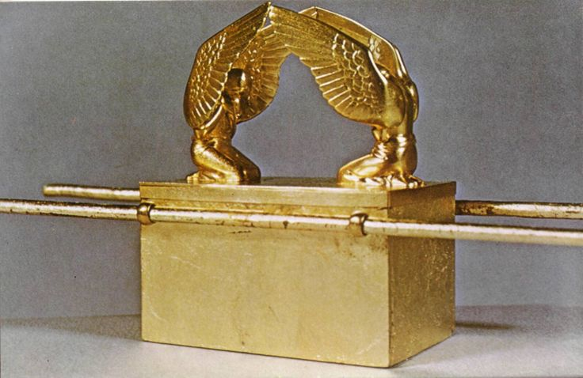
2 SAMUEL 6
“Let us bring the Ark of our God back to us for we did not inquire of it during the reign of Saul“
“The whole assembly agreed to do this, because it seemed right to all the people.” (1 Chronicles 13:3-4)

Slide 4
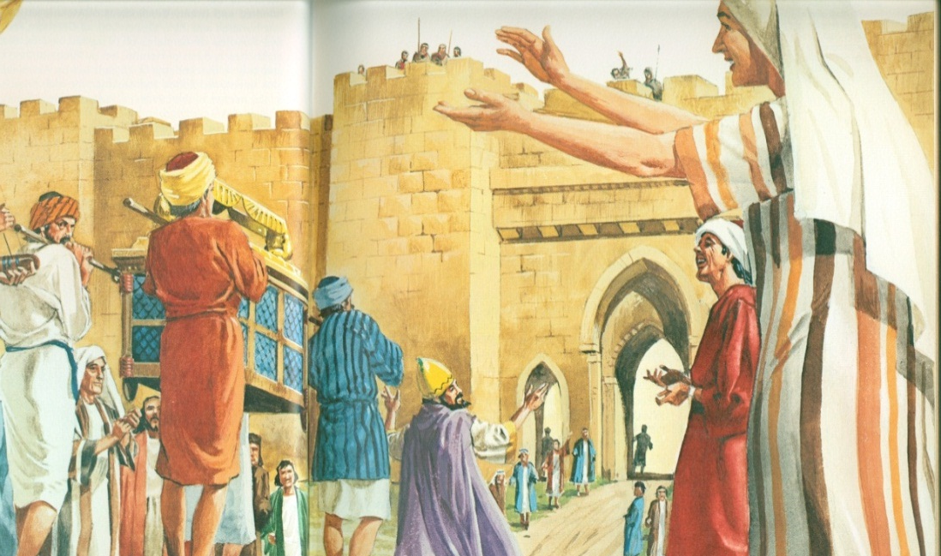
2 SAMUEL 6
WE TRUST IN GOD’S SOVEREIGN WILL.
WE SUBMIT TO GOD’S HOLY WAYS.
“…and when the camp is ready to move, the Kohathites are to come to do the carrying (on their shoulders). But they must not touch the holy things or they will die.”

Slide 5
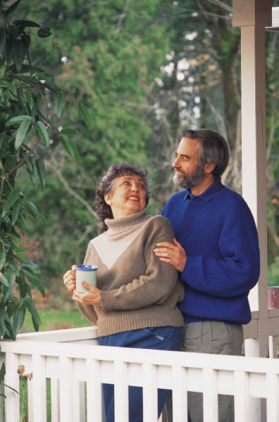
TAKE HOME TRUTH
When we feel angry with God, we trust in His sovereign will and submit to His holy ways.

Slide 6
Black

Slide 7
OT Preaching link at BibleStudyDownloads.org
Get this presentation for free!
Notes:
OT Preaching (op)

