Slide 1

Be Warned
ALERT
2 Kings
Dr. Rick Griffith • Crossroads International Church Singapore
CICFamily.com • BibleStudyDownloads.org

Slide 2

Warnings Help Us
Notes:
What do you think of when you see a warning sign? When you think about it…

Slide 3
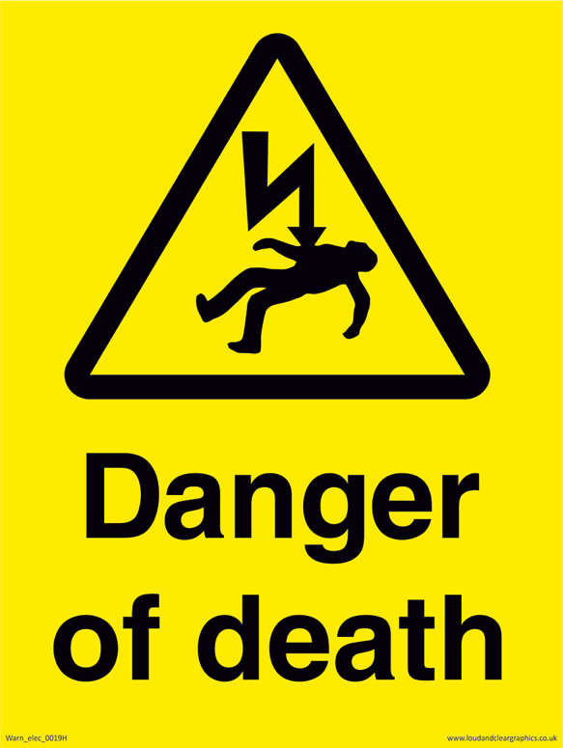


Warnings Help Us
POISON
Danger
of death
SLIPPERY SURFACE
Notes:
—warning us of potential death, poisoning, falling, or…

Slide 4

Warnings Help Us
Notes:
…or heart attacks.

Slide 5

Do you appreciate warnings? Many people don’t.
Notes:
Text

Slide 6
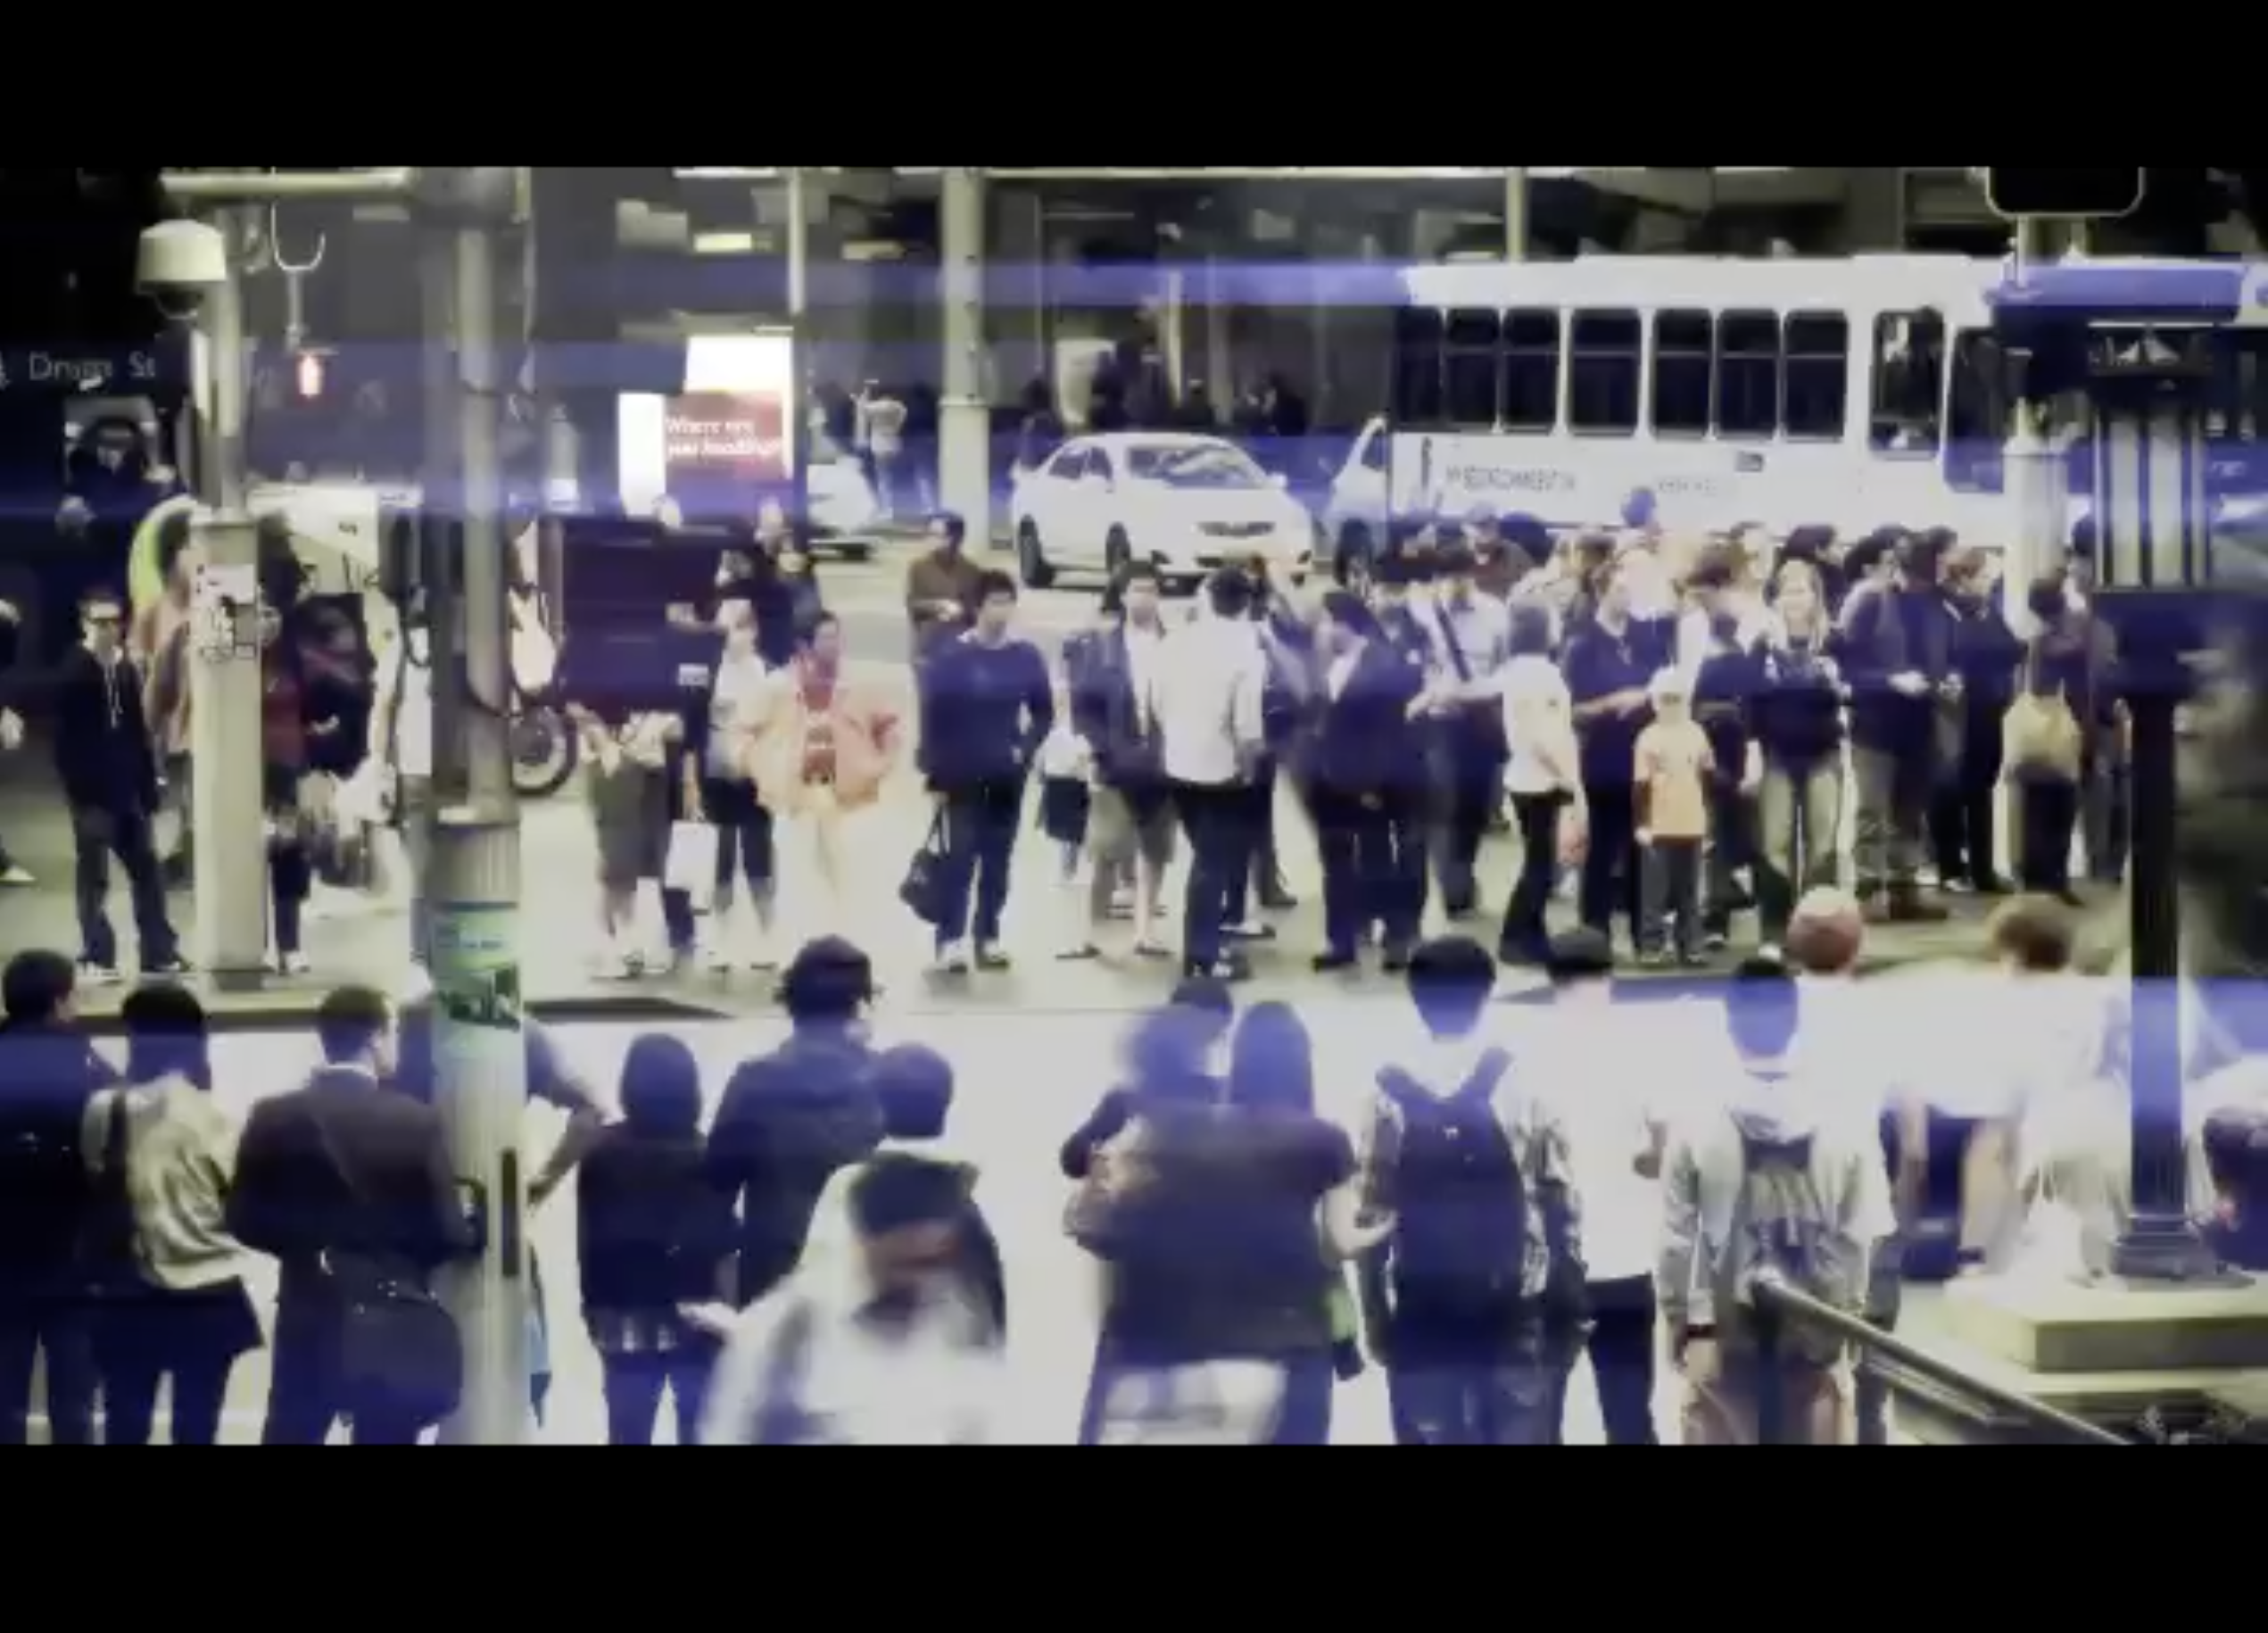
Everyone Worships
Notes:
Everyone worships something—that’s God’s warning.

Slide 7

Everyone Worships
Notes:
Most people don’t worship God even though he warns of the dire results of worshipping other things.

Slide 8
What is the best
WARNING we can heed?
Notes:
If there is one warning that is more important than any other, what might that be? What do you think?
Tell the person next to you.

Slide 9
Background to 2 Kings
Notes:
God had warned Israel of the results of idolatry for centuries.

Slide 10
Deut. 28: Blessings & Curses
Your towns and your fields
will be blessed (3)
Your towns and your fields
will be cursed (16)
Your children and your crops
will be blessed (4)
Your children and your crops
will be cursed (17)
Your fruit baskets and bread-boards will be blessed (5)
Your fruit baskets and bread-boards will be cursed (18)
Wherever you go and whatever you do, you will be blessed (6)
Wherever you go and whatever you do, you will be cursed (19)
Your enemies will attack you from one direction, but they will scatter from you in seven! (7)
You will attack your enemies from one direction, but you will scatter from them in seven! (25)
You will lend to many nations, but you will never need to borrow from them (12)
They will lend to money to you, but you will not lend to them
(44)
Notes:
Around 750 BC, which was over 800 years before we will begin today, God warning in Deut 28 not to have any other gods….

Slide 11
Occasion
220
Why?
Exile
Deut 28
Notes:
Today we'll see the account of Babylon's siege and destruction of Samaria and Jerusalem for the nation's sin, but what was the justification for God's judgment upon these two nations? The leaders and the people sinned through ungodliness and idolatry, and true to the curses of Deut. 28, God gave the people the consequences of their obedience.

Slide 12
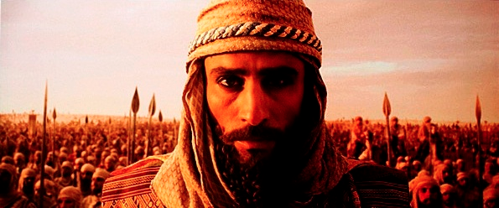
Not heeding God's warnings would raise up enemies.

Slide 13


1 Kings 12 through 2 Kings 24
7
ROYALTY
ca. 1000 B.C.
S - D - S
DC
<<<< SPLIT >>>>
NORTH SOUTH
2 Sam 7:4-16
1 Chron 17:3-15
A R C
ISRAEL JUDAH
10 2
NC
ROYALTY
THE PROPHETS
S - D - S
••• SPLIT •••
North South
20-J 20-R
Israel
Judah
10 2
South: Rehoboam
THE PROPHETS
North: Jeroboam
20-J 20-R
NO GOOD KINGS
SOME GOOD KINGS
Handbook pg. 32-37
46
2
Notes:
In each of the two kingdoms,
//// …20 kings reigned in the Northern Kingdom and 20 kings in the Southern…beginning with JEROBOAM in the NORTH…remember it by 20-J….and REHOBOAM in the SOUTH…20-R. You can remember that order this way: North above South; J before R.
//// The NORTHERN KINGDOM OF ISRAEL is, by far, the more wicked, rebellious and idolatrous of the two. There were NO GOOD KINGS IN THE NORTHERN KINGDOM. However, in the South, there were some, though very few, good kings.

Slide 14

Let's Study Through Scripture
The Bible: Book by Book
Notes:
We are in a study through the whole Bible right now, book by book. The goal is to give us a basic understanding of each book of the Bible.

Slide 15

Date
250
264
First Kings covers 120-years: from 971 BC with the crowning of Solomon to 852 BC during Ahaziah's reign. The year 931 marks the most significant date when Solomon's kingdom split into the northern nation of Israel and the southern kingdom of Judah after his death.
Jerome
1
Kingdoms
2
Kingdoms
3
Kingdoms
4
Kingdoms
Books
1
Samuel
2
Samuel
1
Kings
2
Kings
Kings
Saul
David
Solomon-Ahaziah
Ahaziah-Zedekiah
Dates
1043
1011
971 931 852
852 722 586 560
538
Kingdom
---------United-------
------------------- ---------Divided------------
Surviving
-Returned-

Slide 16
1 Kings Key Word
219
Divi sion

Slide 17
2 Kings Key Word
219
Divi sion
Israel
Judah
Downfalls

Slide 18
What is the best
WARNING we can heed?
We will see:
1. What God warns against and
2. What we should do about it.
Notes:
Restatement

Slide 19
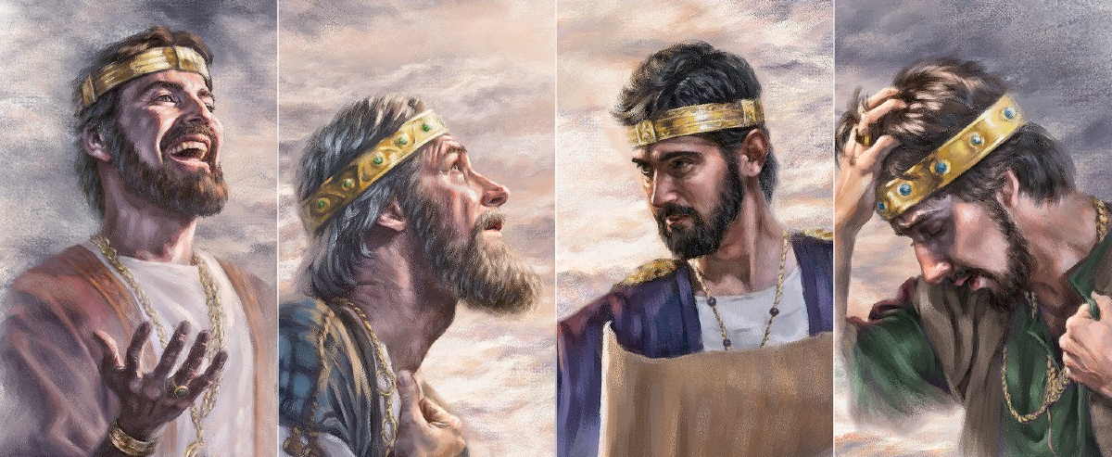
Second Kings
Downfalls of the Kingdoms
Dr. Rick Griffith • Singapore Bible College • BibleStudyDownloads.org
Notes:
So what does God warn against?

Slide 20
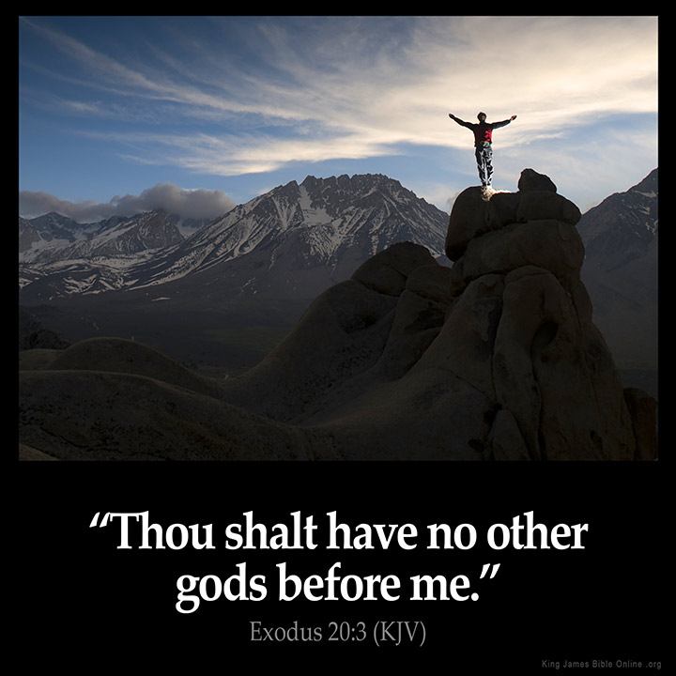
I. God warns against worshipping other gods.
Notes:
2 Kings depicts the downfalls that came from idolatry.

Slide 21
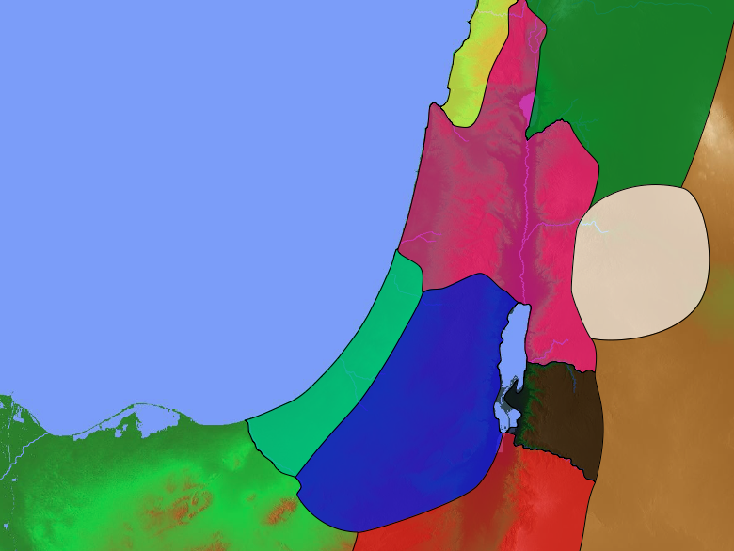
Downfalls in 2 Kings
140
Israel to Assyria
Israel
God judged idolatry by destroying Israel
(2 Kings 1–17).
Judah

Slide 22
Slides on
2 Kings 1

Slide 23
Downfalls of the Kingdoms
Late Divided Kingdom |  |  | Surviving Kingdom
Israel & Judah |  |  | Judah
Chaps. 1–17 |  |  | Chaps. 18–25
Israel Exiled to Assyria |  |  | Judah Exiled to Babylon
Ahaziah to Hoshea |  |  | Hezekiah to Zedekiah
130 Years (852-722 BC) |  |  | 163 Years (722-560 BC)
2 Bad Israel Kings & Elisha's Ministry 1:1–8:15
249

Slide 24
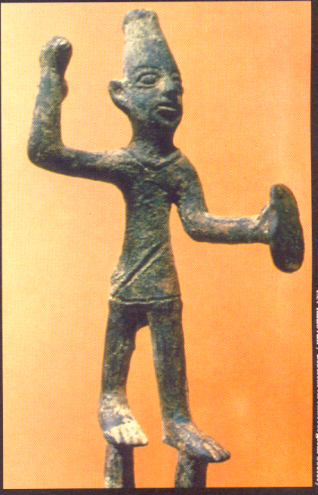
1 Kings 22:51–2 Kings 8:15
252
2 Bad Israel Kings & Elisha's Ministry
Ahaziah of Israel (853-852)
"Is it because there is no God in Israel for you to consult that you have sent messengers to consult Baal-Zebub, the god of Ekron?"
"You will certainly die!"
(1:16)
Ch 1

Slide 25
Slides on
2 Kings 2

Slide 26

Elijah (1 Kings) & Elisha (2 Kings)

Slide 27
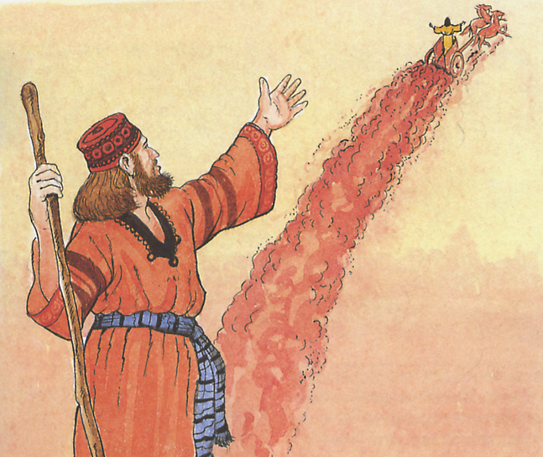
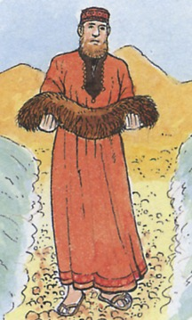
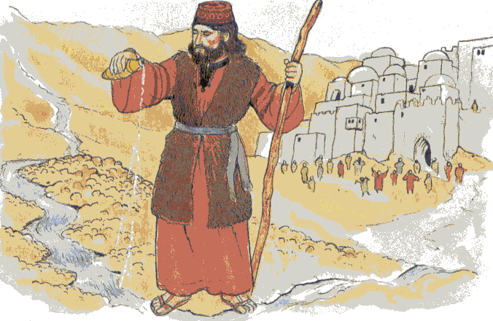
Elijah passes the mantle to Elisha
252
Elisha picks up Elijah's cloak and performs the 1st miracle
(divided water of Jordan River)
Healing of the water
Elijah into heaven on a chariot of fire
Chaps. 1–2

Slide 28
Slides on
2 Kings 3

Slide 29
Elijah & Elisha
Elijah means "The LORD is my God," as he confronted a king & priests of Baal. He lived apart & preached judgment & repentance.
Elisha means "God is salvation," as he lived among people, preferring the poor & outcast, and stressed hope & God's grace.

Slide 30
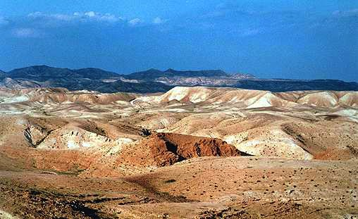
Defeat of Moab
The Desert of Edom was where Elisha provided water for Joram & Jehoshaphat to defeat Moab
Ch 3

Slide 31
Slides on
2 Kings 4

Slide 32
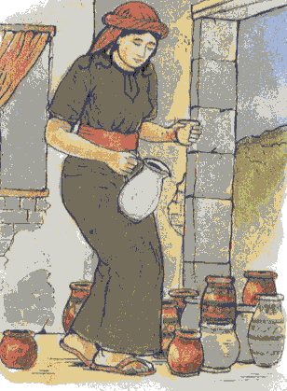
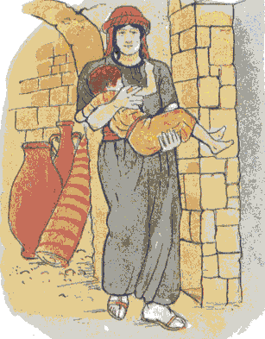
Helping Women
Oil for widow
  Son for Shunammite woman & restoration for son
Ch 4

Slide 33
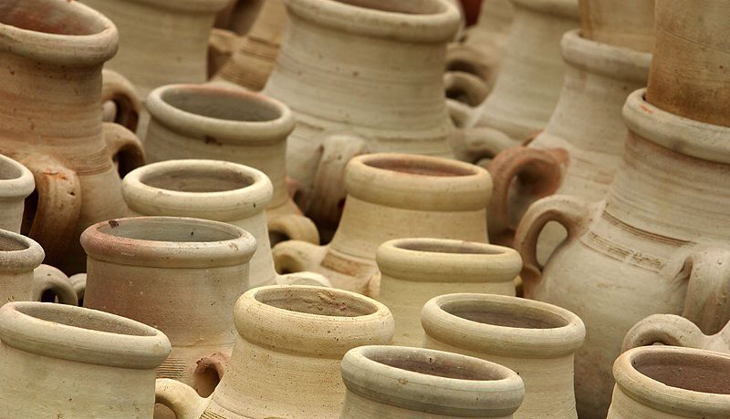
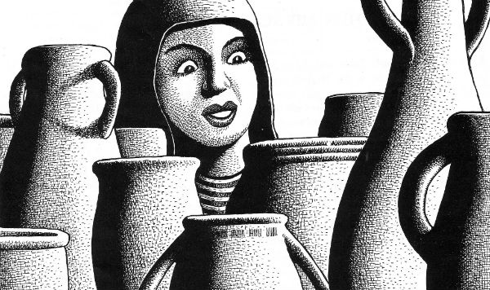
Elisha miraculously provided oil for a prophet's widow to pay her debts to show God's care for those who trust him despite the apostasy around them (4:1-7).

Slide 34
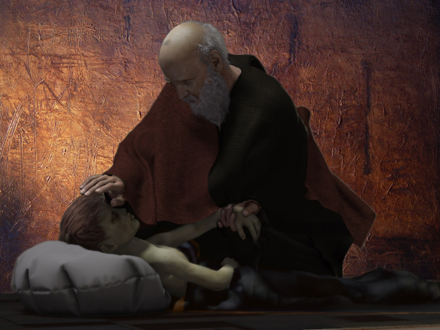
Elisha miraculously restored the Shunammite's boy to life years later to show God's sovereignty over Baal, to whom child sacrifice was offered in Israel (4:18-37).

Slide 35
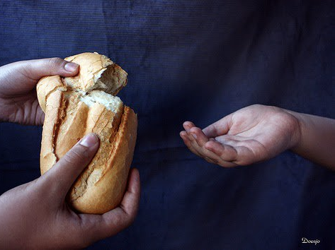
Elisha miraculously multiplied 20 bread loaves to feed 100 men during a famine to show God's sovereignty over the powerless Baal, god of fertility and "lord of the earth"
(4:42-44).

Slide 36
Slides on
2 Kings 5

Slide 37
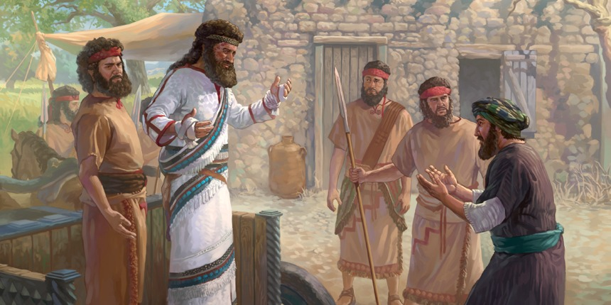
Naaman was a mighty Syrian commander and a leper (2 Kings 5)

Slide 38
A Captive's Compassion (2 Kings 5:3)
She had been captured in a raid, taken to a foreign country, and made a slave. Yet instead of bitterness, she showed compassion toward her master. She wanted him healed, and she believed her God would do it. God used this girl's tragedy to heal and convert her enemy—a wonderful example of love reaching out.

Slide 39
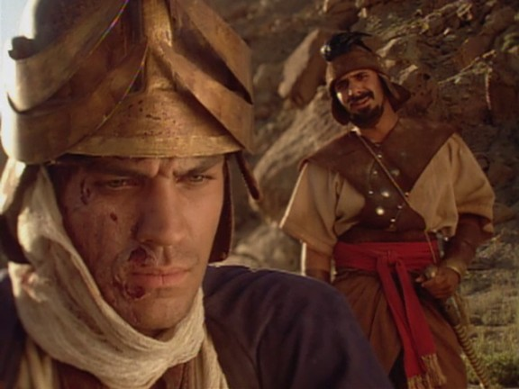
Miracles for Gentiles
Curing the Syrian general, Naaman, of leprosy
shows God's concern wasn't limited to Israel
2 Kings 5

Slide 40
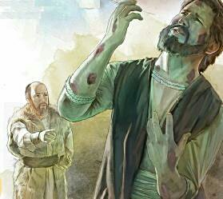
Warning for Believers
The leprosy of Naaman transferred to Elisha's servant Gehazi for thinking he was only God's hireling
2 Kings 5:26-27

Slide 41
Slides on
2 Kings 6

Slide 42
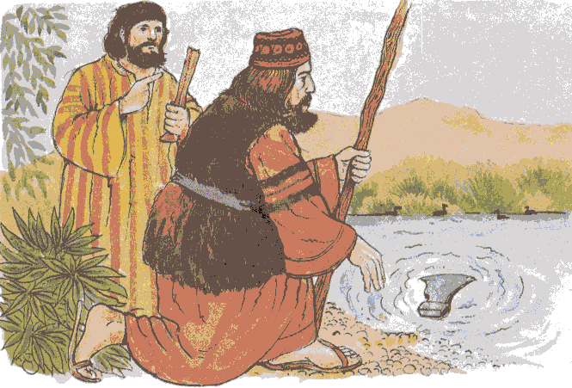
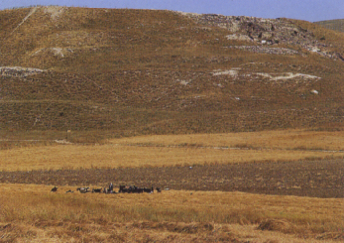
More Miracles
The floating axe-head
Blinding of Syrians (right: Dothan, where Elisha & his servant saw the angel army)

Slide 43
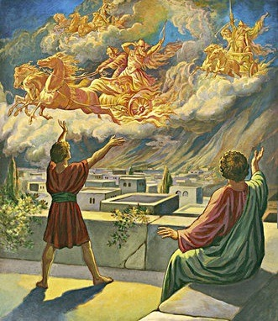
Chariots of Fire (2 Kings 6:17)
Surrounded by an army, Elisha's servant cried, "What shall we do?" But when Elisha prayed, the servant could suddenly see that God's forces, invisible to everyone else, far outnumbered the enemy. The story offers a rare glimpse of the "invisible world" of supernatural forces. God has resources to help that we cannot see.

Slide 44
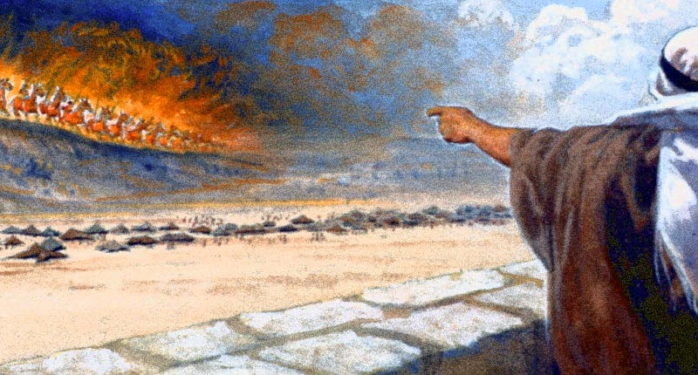
The Chariots of God
God's forces always outnumber Satan's
6:17

Slide 45
Slides on
2 Kings 7

Slide 46
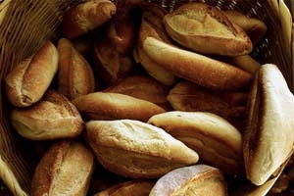
Elisha miraculously prophesied Samaria’s rescue from a Syrian famine siege and God replied with food from the enemy camp to show that God provides food and protection, not Baal (6:24–7:20)

Slide 47
Slides on
2 Kings 8

Slide 48
Downfalls of the Kingdoms
Late Divided Kingdom |  |  | Surviving Kingdom
Israel & Judah |  |  | Judah
Chaps. 1–17 |  |  | Chaps. 18–25
Israel Exiled to Assyria |  |  | Judah Exiled to Babylon
Ahaziah to Hoshea |  |  | Hezekiah to Zedekiah
130 Years (852-722 BC) |  |  | 163 Years (722-560 BC)
2 Bad Israel Kings & Elisha's Ministry 1:1–8:15 | 10 Bad Israel Kings & 4 Bad / 4 Good Judah Kings 8:16–16:20
249

Slide 49
Family Wickedness (2 Kings 8:25–9:29)
238
253
Ethbaal
King of Sidonians
Omri
King of Israel
Asa
Line of David
Jezebel
Ahab
Jehoshaphat
Ahaziah
Jehoram (Joram)
Athaliah
Jehoram
Good kings in white; queen in gray italics
Notes:
It may sound confusing, but there were two kings who lived at the same time in the northern and southern kingdoms who were named Jehoram and also Ahaziah—Ahaziah of Israel on the left and Ahaziah of Judah on the right. In 2 Kings 11:2 (cf. 2 Chron. 22:11), we read how the Davidic line was all wiped out by the mother of Ahaziah of Judah—all except one of her grandsons named Joash. God's promise of an eternal king through David (2 Sam. 7:14) would have been unfulfilled had it not been through the courage of Jehoshebah, Ahaziah's sister, who saved the life of the infant nephew, Joash.

Slide 50
Slides on
2 Kings 9

Slide 51
Family Wickedness (2 Kings 8:25–9:29)
238
253
Ethbaal
King of Sidonians
Omri
King of Israel
Asa
Line of David
Jezebel
Ahab
Jehoshaphat
Ahaziah
Jehoram (Joram)
Athaliah
Jehoram
All brothers killed
(2 Ch 21:4)
All brothers killed
(2 Ch 22:1)
Killed by Jehu
Ahaziah
All brothers killed
(2 Ch 22:11)
Joash
Good kings in white; queen in gray italics
Notes:
It may sound confusing, but there were two kings who lived at the same time in the northern and southern kingdoms who were named Jehoram and also Ahaziah—Ahaziah of Israel on the left and Ahaziah of Judah on the right. In 2 Kings 11:2 (cf. 2 Chron. 22:11), we read how the Davidic line was all wiped out by the mother of Ahaziah of Judah—all except one of her grandsons named Joash. God's promise of an eternal king through David (2 Sam. 7:14) would have been unfulfilled had it not been through the courage of Jehoshebah, Ahaziah's sister, who saved the life of the infant nephew, Joash.

Slide 52
Slides on
2 Kings 10

Slide 53

Middle Divided Kingdom
253
-254
2 Kings 1–14
JUDAH
Jehoram (8) Ahaziah (1) Athaliah (6) Joash (40) Amaziah (29)
ISRAEL
Ahaziah (2)
Joram (12)
Jehu (28)
Jehoahaz (17)
Jehoash (16)
Jeroboam II (41)
X
Influenced history
X
Founders of a dynasty

Slide 54
Late Divided Kingdom
2 Kings 15–17
JUDAH Azariah/Uzziah (52)
Jotham (16) Ahaz (16)
ISRAEL Zechariah (6 mths) Shallum (1 mth) Menahem (10) Pekahiah (2) Pekah (20) Hoshea (10)
X
X
X
X
Influenced history
X
Founders of a dynasty

Slide 55
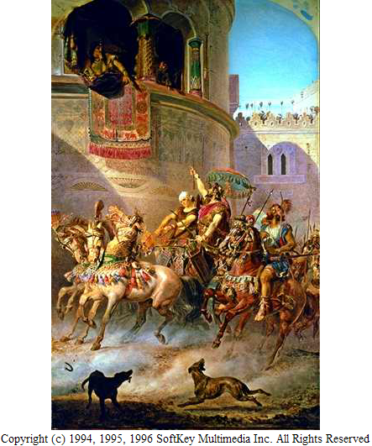
Jehu of Israel
(841-814)
This is what the LORD says:
"I anoint you king over Israel."
Ch. 9:3

Slide 56
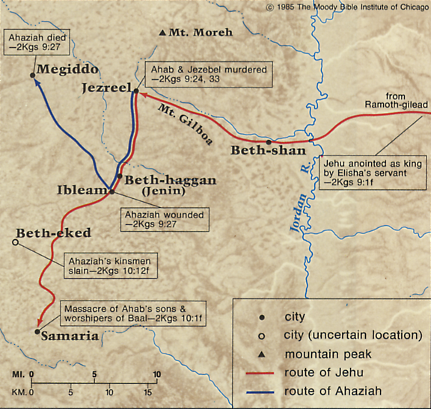
Jehu - King by a coup
Joram
Murdered Joram & Joram's mother, Jezebel
Murdered Ahaziah & relatives
Purged the entire family of Ahab (70 sons, close friends, etc.)
Demolished Baal worship
Allowed golden calf worship to continue
Ch. 9-10

Slide 57
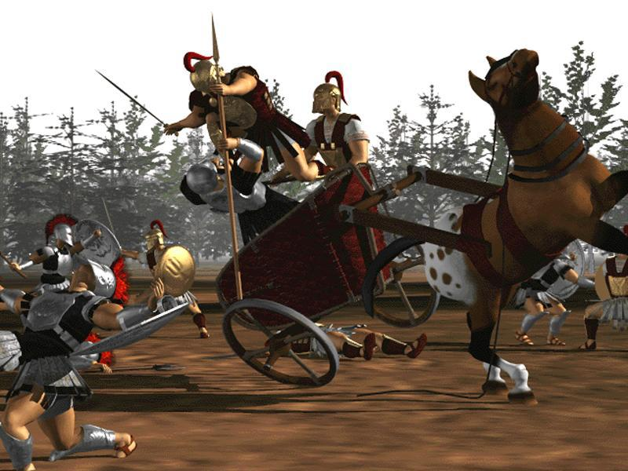
Jehu's Slaughters (2 Kings 10:14)
God chose Jehu to purge Israel, but his violence went far beyond his original task. God condemned Jehu in Hosea 1:4.

Slide 58
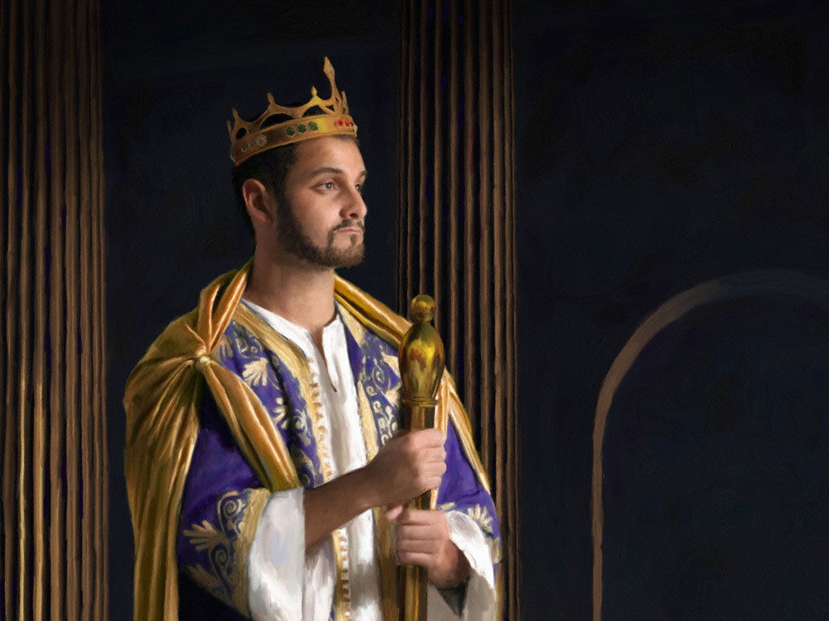
KEY VERSE:
2 Samuel 7:12-13
209
"For when you (David) die, I will raise up one of your descendants, and I will make his kingdom strong. He is the one who will build a house—a temple—for my name. And I will establish the throne of his kingdom forever."

Slide 59

The Kingdom in Matthew 1
218b
Fall of the Kingdom
Establishing the Eternal Kingdom
ABRAHAM
Solomon
Shealtiel
Isaac
Rehoboam
Zerubbabel
Jacob
Abijah
Abiud
Judah
Asa
Eliakim
Perez
Jehoshaphat
Azor
"Thus there were fourteen generations in all from Abraham to David, fourteen from David to the exile to Babylon, and fourteen from the exile to Christ."
Matthew 1:17
Hezron
Jehoram
Zadok
Ram
Uzziah
Akim
Amminadab
Jotham
Eliud
Nahshon
Ahaz
Eleazar
Salmon
Hezekiah
Matthan
Boaz
Manasseh
Jacob
Obed
Amon
Joseph +
Mary
Rise of the Kingdom
Jesse
Josiah
KING DAVID
JECONIAH (EXILE)
JESUS CHRIST

Slide 60
Family Wickedness (2 Chron. 21–22)
238
Ethbaal
King of Sidonians
Omri
King of Israel
Asa
King of Judah
(Line of David)
Jezebel
Ahab
Jehoshaphat
Athaliah
Jehoram
All brothers killed
(2 Ch 21:4)
Good kings in white; queen in gray italics
Notes:
It may sound confusing, but there were two kings who lived at the same time in the northern and southern kingdoms who were named Jehoram and two named also Ahaziah—Ahaziah of Israel on the left and Ahaziah of Judah on the right. In 2 Kings 11:2 (cf. 2 Chron. 22:11), we read how the Davidic line was all wiped out by the mother of Ahaziah of Judah—all except one of her grandsons named Joash. God's promise of an eternal king through David (2 Sam. 7:14) would have been unfulfilled had it not been through the courage of Jehoshebah, Ahaziah's sister, who saved the life of the infant nephew, Joash. In fact, the line dwindled to only one living descendant of David the preceding two generations also!

Slide 61
Family Wickedness (2 Chron. 21–22)
238
Ethbaal
King of Sidonians
Omri
King of Israel
Asa
King of Judah
(Line of David)
Jezebel
Ahab
Jehoshaphat
Ahaziah
Jehoram (Joram)
Athaliah
Jehoram
All brothers killed
(2 Chron. 21:4)
All brothers killed
(2 Kings 9;
2 Chron. 22:1)
Killed by Jehu
Ahaziah
All brothers killed
(2 Kings 11;
2 Chron. 22:11)
Joash
Good kings in white; queen in gray italics
Notes:
It may sound confusing, but there were two kings who lived at the same time in the northern and southern kingdoms who were named Jehoram and two named also Ahaziah—Ahaziah of Israel on the left and Ahaziah of Judah on the right. In 2 Kings 11:2 (cf. 2 Chron. 22:11), we read how the Davidic line was all wiped out by the mother of Ahaziah of Judah—all except one of her grandsons named Joash. God's promise of an eternal king through David (2 Sam. 7:14) would have been unfulfilled had it not been through the courage of Jehoshebah, Ahaziah's sister, who saved the life of the infant nephew, Joash. In fact, the line dwindled to only one living descendant of David the preceding two generations also!

Slide 62
Slides on
2 Kings 11

Slide 63

Family Righteousness (2 Kings 11)
253
Aaron
Priest of Israel
Asa
King of Judah
(Line of David)
Jehoshaphat
Athaliah
Jehoram
Ahaziah
Unnamed Nurse
Jehoiada
Jehoshebah
Joash
Righteous in white; queen in gray italics
Notes:
In 2 Kings 11:2 (cf. 2 Chron. 22:11), we read how the Davidic line was all wiped out by the mother of Ahaziah of Judah—all except one of her grandsons named Joash. God's promise of an eternal king through David (2 Sam. 7:14) would have been unfulfilled had it not been through the courage of Jehoshebah, Ahaziah's sister and husband of Jehoiada the priest. Jehoshebah saved the life of her infant nephew, Joash, with the courageous help of his unnamed nurse who raised him for 6 years in the temple out of the murderous eye of Athaliah.

Slide 64
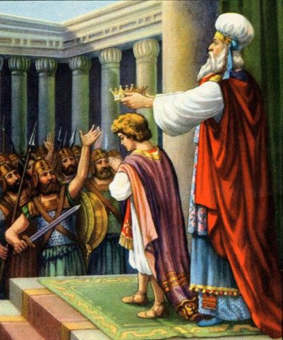
Jehoiada Crowns Joash
(2 Kings 11:12;
2 Chron. 23:11)

Slide 65
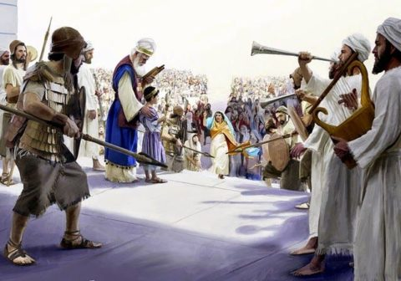
Jehoiada Crowns Joash
(2 Kings 11:12;
2 Chron. 23:11)

Slide 66
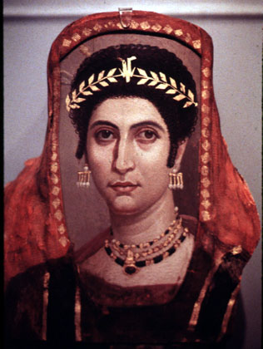
Athaliah Killed
(2 Kings 11:15-16;
2 Chron. 23:14-15)

Slide 67

Faithful By A Thread
The Davidic rulers came down to only one man (three times!)

Slide 68
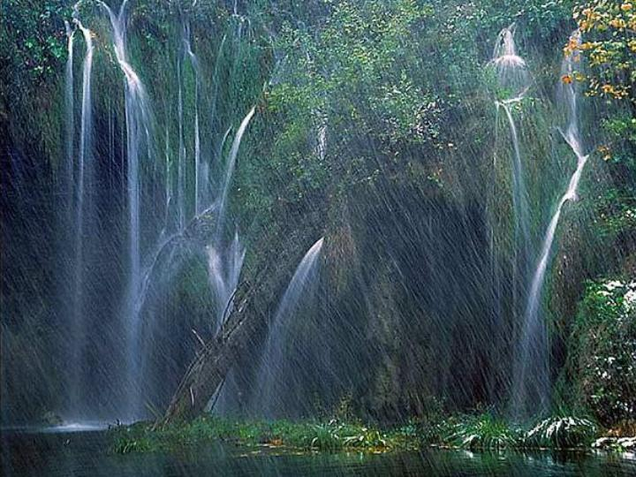
God still keeps His promises to those who worship Him today

Slide 69
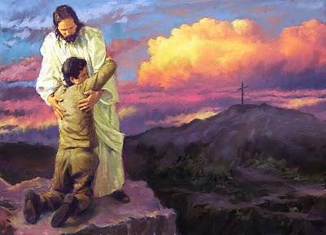
God still keeps His promises to those who worship Him today

Slide 70
Slides on
2 Kings 12

Slide 71
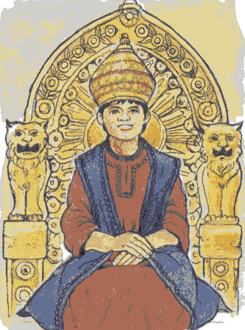
Joash of Judah
Became king at 7 years old
"Did what was right in the eyes of the LORD all the years Jehoiada the priest instructed him"
High places not removed, people continued to offer sacrifices and burn incense there
Temple repaired
Attacked by Hazael king of Aram; sent sacred objects, gifts and gold from the temple to Hazael in exchange for his withdrawal
Ch. 12

Slide 72
Slides on
2 Kings 13

Slide 73
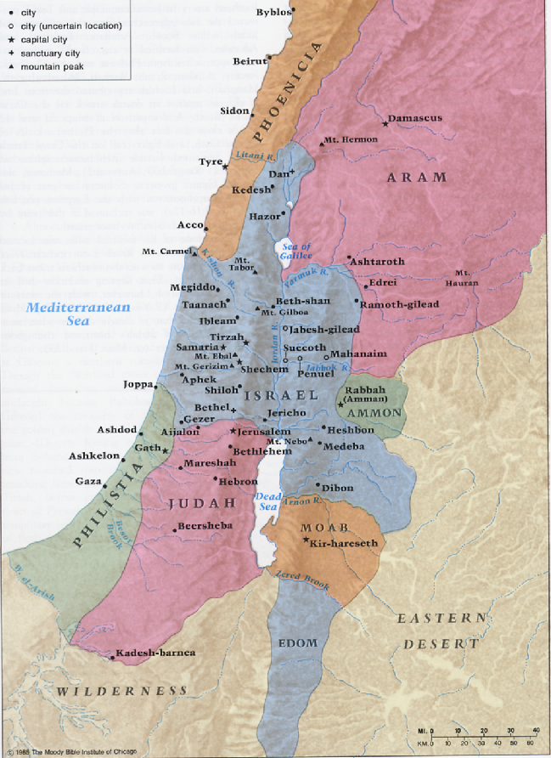
Troublesome Neighbors
(2 Kings 13:20)
Moab and Aram (Syria) were small kingdoms like Judah and Israel. Sometimes they fought against Israel or Judah, and sometimes they joined together to oppose a larger threat.

Slide 74
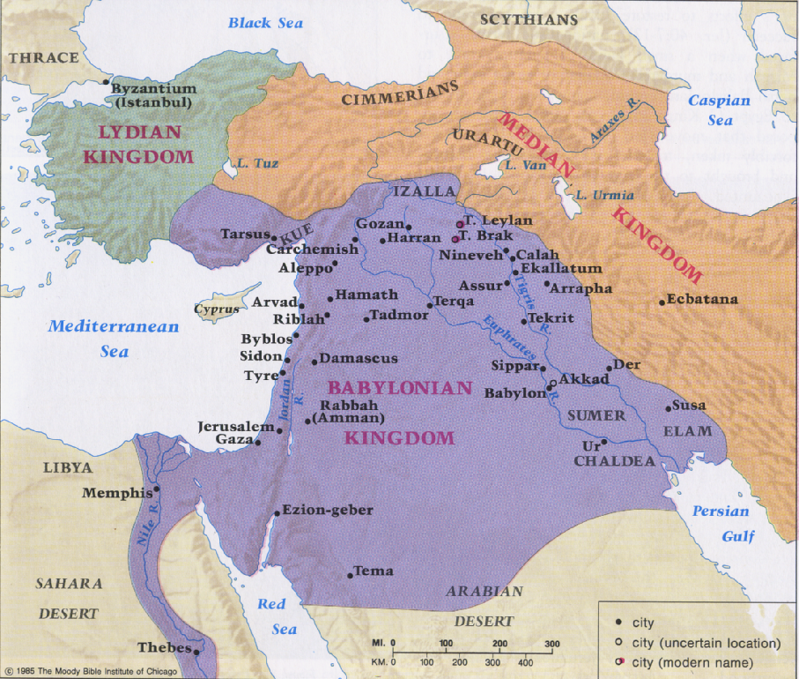
Troublesome Neighbors
(2 Kings 13:20)
On the world scene, constant threats came from Egypt and Assyria. Assyria was the superpower before its empire declined. Later, Babylon became the superpower of the region.

Slide 75
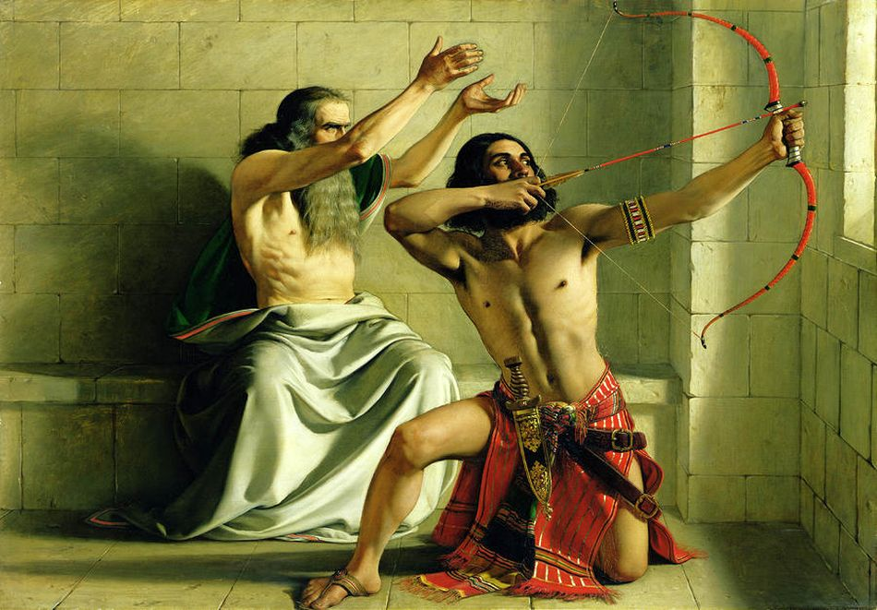
Elisha's Last Prediction
Jehoash of Israel (798-782)
Experienced 3 victories over Aram (as Elisha predicted before his death)
2 Kings 13:10-25

Slide 76
Slides on
2 Kings 14

Slide 77
Prophets of Israel
(2 Kings 14:23)
Amos and Hosea prophesied in the beautiful city of Samaria. (Jonah also prophesied in Nineveh, the capital city of Assyria.)
Israel scoffed at these prophets' words of doom, but within 30 years all their predictions came true.

Slide 78
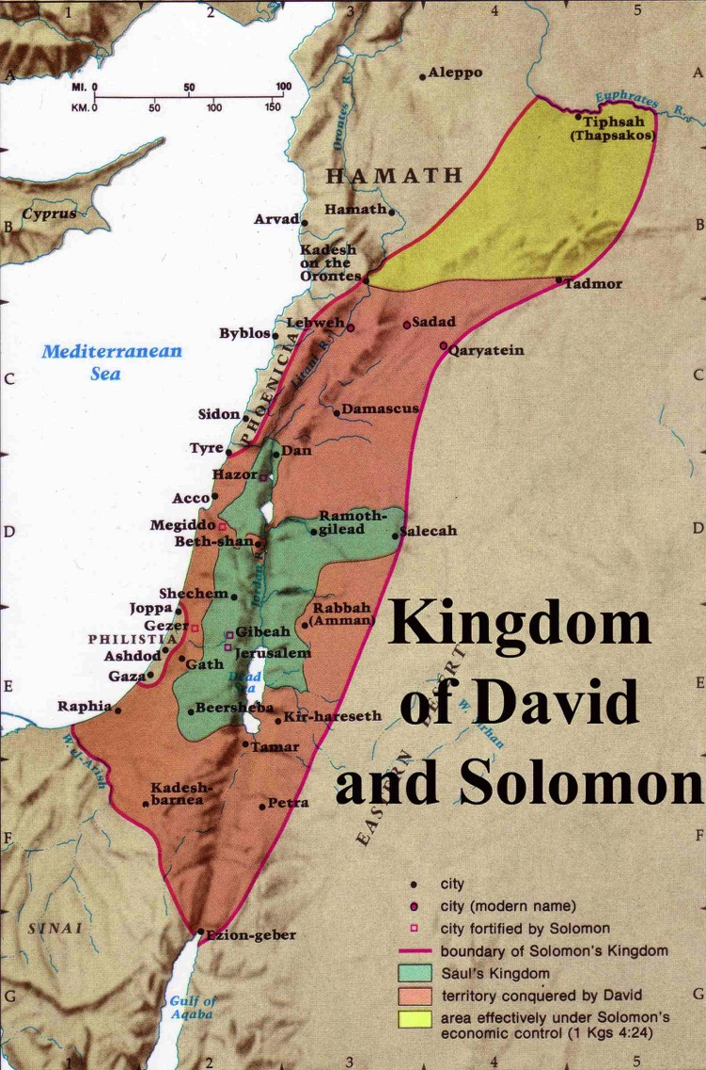
Expansion under Jeroboam II
446
Jeroboam II
"Jeroboam II recovered the territories of Israel between Lebo-hamath and the Dead Sea,* just as the Lord, the God of Israel, had promised through Jonah son of Amittai, the prophet from Gath-hepher."
(2 Kings 14:25 NLT).
* Hebrew the sea of the Arabah
Jeroboam I (930 BC)
Notes:
The boundaries under Jeroboam II went even farther than David and Solomon, who only had tribute sent from Hamath.

Slide 79
Middle Divided Kingdom Kings
2 Kings 1–14
JUDAH
Jehoram (8) Ahaziah (1) Athaliah (6) Joash (40) Amaziah (29)
ISRAEL
Ahaziah (2)
Joram (12)
Jehu (28)
Jehoahaz (17)
Jehoash (16)
Jeroboam II (41)
X
Influenced history
X
Founders of a dynasty

Slide 80
Slides on
2 Kings 15

Slide 81
Late Divided Kingdom
2 Kings 15–17
JUDAH Azariah (Uzziah) (52)
Jotham (16) Ahaz (16)
ISRAEL Zechariah (6 mths) Shallum (1 mth) Menahem (10)
Pekahiah (2) Pekah (20) Hoshea (10)
X
X
X
X
Influenced history
X
Founders of a dynasty

Slide 82
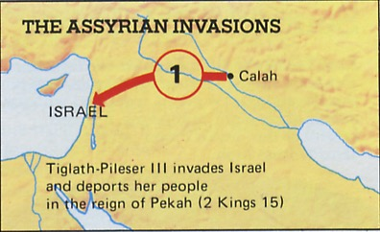
Invasion
Assyria invaded in the reign of PEKAH of Israel (745-727)
2 Kings 15
Ch. 17

Slide 83
Slides on
2 Kings 16

Slide 84

Assyrian Campaigns Against Israel & Judah
The Assyrian invasions of the 8th century BC were the most traumatic political events in Israel's entire history.
Assyria ruthlessly impaled corpses on stakes, severed heads, and skinned captives alive.

Slide 85
2 Kings 17:6
7
ROYALTY
ca. 1000 B.C.
S - D - S
DC
<<<< SPLIT >>>>
NORTH SOUTH
2 Sam 7: 4-16
1 Chron 17:3-15
A R C
ISRAEL JUDAH
10 2
NC
ROYALTY
THE PROPHETS
S - D - S
••• SPLIT •••
North South
20-J 20-R
Israel
Judah
Jer 31: 31-33
10 2
200
THE PROPHETS
20-J 20-R
200
ASSYRIA
Assyria
Handbook pg. 32-37
47
Notes:
Israel, the NORTHERN KINGDOM, existed for about 200 years. Then from out of the far northeast, God sends his judgment in the
form of the dreaded ASSYRIANS who…

Slide 86
Slides on
2 Kings 17

Slide 87
Downfalls of the Kingdoms
Late Divided Kingdom |  |  | Surviving Kingdom
Israel & Judah |  |  | Judah
Chaps. 1–17 |  |  | Chaps. 18–25
Israel Exiled to Assyria |  |  | Judah Exiled to Babylon
Ahaziah to Hoshea |  |  | Hezekiah to Zedekiah
130 Years (852-722 BC) |  |  | 163 Years (722-560 BC)
2 Bad Israel Kings & Elisha's Ministry 1:1–8:15 | 10 Bad Israel Kings & 4 Bad / 4 Good Judah Kings 8:16–16:20 | Bad Hoshea culminating in Fall of Israel 17
249

Slide 88
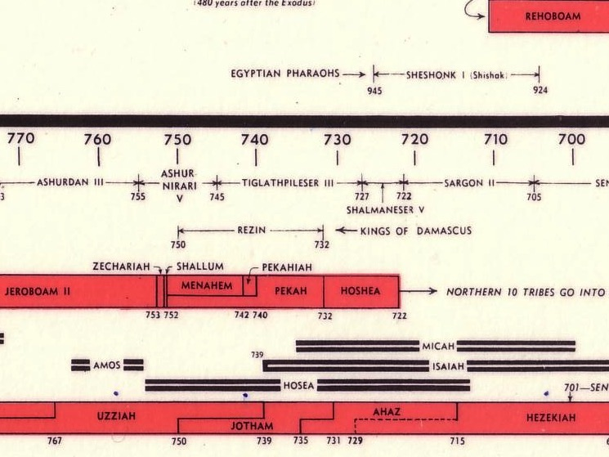

Chart of OT Kings & Prophets
232 & 342

Slide 89
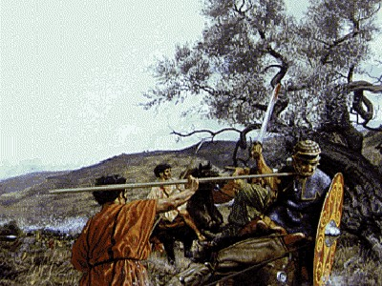
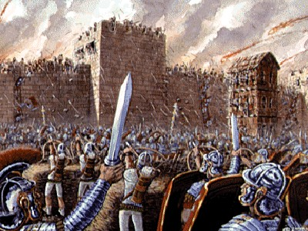
Assyrian Campaigns Against Israel & Judah
The bloody military sieges on both Israel and Judah was profound. The prophets screamed out against their horror, while at the same time pled with the people to see God's hand in history, to recognize spiritual causes in the present punishment.

Slide 90
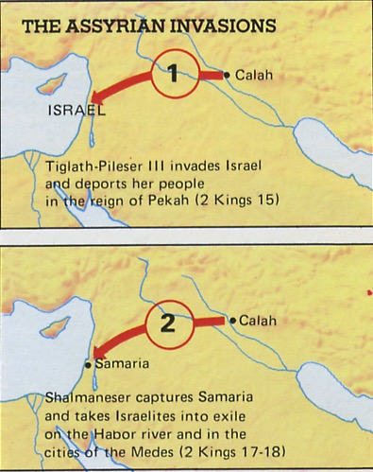
Invasions
Assyria invaded in the reign of PEKAH of Israel (745-727)
HOSHEA appealed to So of Egypt rather than pay tribute to Shalmaneser resulting in the FALL OF SAMARIA
Ch. 17

Slide 91
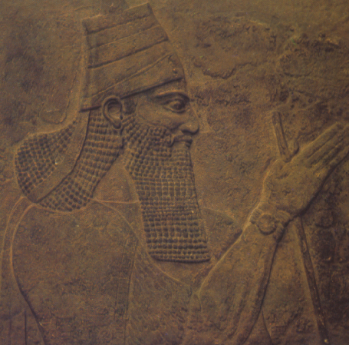
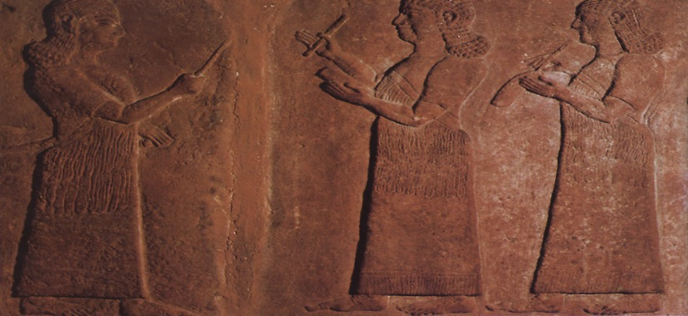

Downfall of Samaria

Slide 92
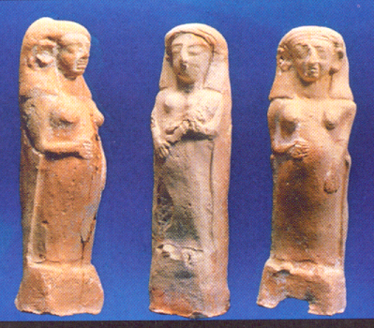
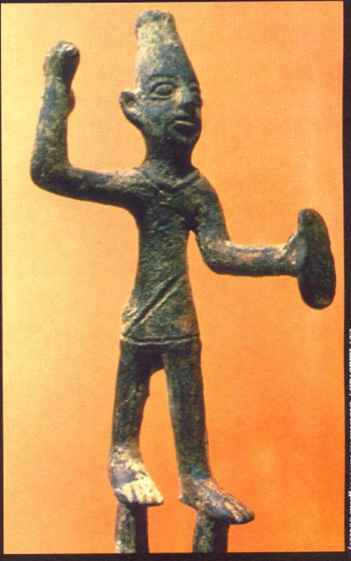
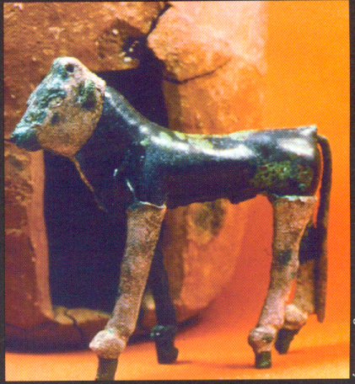
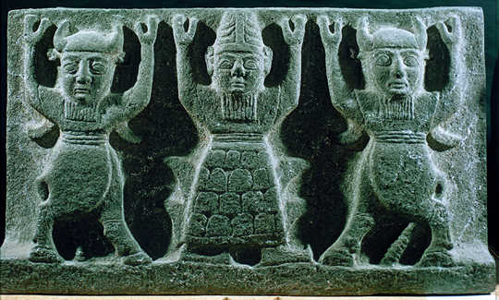
Is God's Judgment Justified?
Israel's exile to Assyria came for rejecting the Law of God for idols, sacred stones, high places, Asherah poles, astrology, divination, sorcery and other practices of the nations
(2 Kings 17)

Slide 93
2 Kings 17:6
DRESSING
THE
STAGE
MS
N(A)
H
SG
C
ER
B
J
MN
ROYALTY
DS
S - D - S
••• SPLIT •••
E
North South
THE NORTHERN KINGDOM:
ISRAEL (722 B.C.)
THE GREAT JEWISH DIASPORA
Israel
Judah
KB
U
10 2
THE PROPHETS
20-J 20-R
200
Assyria
MS
PG
RS
Handbook pg. 32-37
48
1
Notes:
…sweep down to take the NORTHERN KINGDOM away.
The people are dispersed -- absorbed by the Assyrians and other cultures of that day. This becomes known as the great Diaspora, or Dispersion, of the Jews.
//// The year is 722 BC. In all of our study, there are only two specific dates that are helpful to remember. The capture of the NORTHERN KINGDOM, 722 BC, is one of them. Never again do we hear of the NORTHERN KINGDOM as a united people. Through the following centuries they are gradually dispersed throughout the world.

Slide 94
Downfalls in 2 Kings
140
Israel to Assyria
Israel
God judged idolatry by destroying Judah
(2 Kings 18–25).
Judah to Babylon
Judah

Slide 95
Slides on
2 Kings 18

Slide 96
Downfalls of the Kingdoms
249
Late Divided Kingdom |  |  | Surviving Kingdom
Israel & Judah |  |  | Judah
Chaps. 1–17 |  |  | Chaps. 18–25
Israel Exiled to Assyria |  |  | Judah Exiled to Babylon
Ahaziah to Hoshea |  |  | Hezekiah to Zedekiah
130 Years (852-722 BC) |  |  | 163 Years (722-560 BC)
2 Bad Israel Kings & Elisha's Ministry 1:1–8:15 | 10 Bad Israel Kings & 4 Bad / 4 Good Judah Kings 8:16–16:20 | Bad Hoshea culminating in Fall of Israel 17 | Good Hezekiah & 2 Bad Judah Kings 18–21

Slide 97

Hezekiah
He became king at age 25 and ruled well for 29 years
2 Kings 18:2

Slide 98

Hezekiah destroyed idols (18:4)

Slide 99



Good Hezekiah &
2 Bad Judah Kings
X
Most righteous king
Removed idolatry
Obeyed, trusted & served God
X
2 Kings 18–20

Slide 100
Slides on
2 Kings 19

Slide 101


Hezekiah's Greatest Test
The Assyrian army besieged Jerusalem in 701 BC
Hezekiah pled with the LORD for deliverance that:
"all kingdoms on earth may know that you alone are God"
Chaps. 18–20

Slide 102
Slides on
2 Kings 20

Slide 103
Surviving Kingdom
2 Kings 18–25
JUDAH Hezekiah (29) Manasseh (55) Amon (2) Josiah (31) Jehoahaz (3 months) Jehoiakim (11) Jehoiachin (3 months) Zedekiah (11)
Influenced history

Slide 104
Slides on
2 Kings 21

Slide 105

Evil Manasseh
Manasseh's evil reign of 55 years reinstituted all the pagan practices destroyed by Hezekiah his father which vindicated God's soon punishment of exile in Babylon for Judah
Chap. 21

Slide 106

Zephaniah preached just after Manasseh filled both courts with idols

Slide 107

Manasseh
Manasseh was taken to Babylon in chains
2 Chron 33:11-17
Notes:
Not noted in 2 Kings is what we find in Chronicles: "The chronicler reported that Manasseh for his sins was taken captive to Babylon (2 Chron. 33:11) by the king of Assyria, probably Ashurbanipal (669-626 b.c.). There Manasseh repented of his sins and God in His grace allowed Manasseh to return to Jerusalem after a period of captivity (2 Chron. 33:12-13; cf. 2 Chron. 33:18-19). After his restoration the king cleaned up much of the idolatry in Judah (2 Chron. 33:15-17). Manasseh’s sins had stained Judah deeply, however, and even later reforms under Josiah could not avert God’s judgment (2 Kings 23:26)" (Bible Knowledge Commentary, 1:580-81).

Slide 108

The Prayer of Manasseh
Manasseh
2 Chron 33:11-17
Notes:
One short Apocryphal writing actually records the prayer of Manasseh where he repents.

Slide 109
Downfalls of the Kingdoms
249
Downfalls of the Kingdoms
Late Divided Kingdom |  |  | Surviving Kingdom
Israel & Judah |  |  | Judah
Chaps. 1–17 |  |  | Chaps. 18–25
Israel Exiled to Assyria |  |  | Judah Exiled to Babylon
Ahaziah to Hoshea |  |  | Hezekiah to Zedekiah
130 Years (852-722 BC) |  |  | 163 Years (722-560 BC)
2 Bad Israel Kings & Elisha's Ministry 1:1–8:15 | 10 Bad Israel Kings & 4 Bad / 4 Good Judah Kings 8:16–16:20 | Bad Hoshea culminating in Fall of Israel 17 | Good Hezekiah & 2 Bad Judah Kings 18–21 | Good Josiah & 4 Bad Judah Kings 22:1–24:16
249

Slide 110
Slides on
2 Kings 22

Slide 111

Josiah
At age 8, Josiah became the last of the good kings of Judah
2 Kings 22

Slide 112

Josiah
At age 26, Josiah initiated temple repairs that made a remarkable discovery
2 Kings 22:8

Slide 113


The "Book of the Law" motivated Josiah (2 Kings 22)
"Then Shaphan the scribe told the king, saying, 'Hilkiah the priest has given me a book.' And Shaphan read it before the king… when the king heard the words of the Law, that he tore his clothes" (2 Chron. 34:18-19).
Notes:
"After becoming king at age 8, King Josiah was said to have "begun to seek God" on his own when he was 16. After seeking God for 4 years, King Josiah was led by God to purge his kingdom of all its false gods. Then at the age of 26, having cleaned out his kingdom, he concentrated his efforts on repairing the house of the Lord. It was while the priests were clearing out the treasury in the house of the Lord that they found the Book of the Law" (http://sheddinglightonthepath.blogspot.sg/2012/02/complete-revelation.html). This book was probably the scroll of Deuteronomy.

Slide 114
Slides on
2 Kings 23

Slide 115

Josiah
2 Kings 22–23
Reading the scroll led Josiah to action.
He renewed the Mosaic Covenant and removed all pagan altars built by his grandfather Manasseh

Slide 116
BABYLON CONQUERS ASSYRIA!
DRESSING
THE
STAGE
MS
However… the SOUTHERN Kingdom?
N(A)
H
SG
C
ER
B
J
MN
ROYALTY
DS
S - D - S
••• SPLIT •••
E
North South
Israel
Judah
KB
U
10 2
THE PROPHETS
20-J 20-R
200
Assyria
MS
PG
RS
Handbook pg. 32-37
49
2
Notes:
However…The SOUTHERN KINGDOM OF JUDAH experiences quite a different kind of judgment.
//// By this time, the Babylonians defeat the Assyrians. Then…
//// The Babylonian King Nebuchadnezzar now turns his attention toward Judah, that remaining Southern kingdom.

Slide 117

2 Kings 25:1-21
DRESSING
THE
STAGE
MS
N(A)
H
SG
C
ER
B
J
MN
ROYALTY
DS
S - D - S
••• SPLIT •••
E
North South
Israel
Judah
KB
U
10 2
THE SOUTHERN KINGDOM:
JUDAH (586 B.C.)
THE BABYLONIAN EXILE
THE PROPHETS
20-J 20-R
200
350
Assyria
Babylon
MS
PG
RS
Handbook pg. 32-37
51
2
Notes:
Then, in the terrible onslaught of 586 BC, JUDAH, herself,
//// faces the invasion of the BABYLONIANS under King Nebuchadnezzar. All of Jerusalem -- including SOLOMON's great Temple -- is completely destroyed by the Babylonians. This is that second and important specific date to remember…586 B.C.
//// The SOUTHERN KINGDOM OF JUDAH is carried away into the famous Babylonian CAPTIVITY, sometimes called the EXILE.

Slide 118
Slides on
2 Kings 24

Slide 119

Deportation of Jehoiachin to Babylon
During Jehoiakim's reign, Nebuchadnezzar invaded Judah and Jehoiakim became his vassal for 3 years. But he changed his mind and rebelled against Babylon.
During his son Jehoiachin's reign, Nebuchadnezzar laid siege to Jerusalem and removed all the treasures from the temple and palace. He carried into exile 10,000 people, including Jehoiachin.
10,000 carried into exile
in Babylonia
Moody Atlas, 144
Ch. 24

Slide 120
An Evil End to Judah
256
1
Josiah
640-609
(31 yrs.)
Good king in white
Evil kings in yellow
3
5
2
Johanan
(no rule)
Jehoiakim (Eliakim)
609-597
(11 yrs.)
Zedekiah
(Mattaniah)
597-586
(11 yrs.)
Jehoahaz
(Shallum)
609
(3 mos.)
4
Jehoiachin
(Jeconiah/Coniah)
597
(3 mos.)
Babylon
Exiled

Slide 121
Slides on
2 Kings 25

Slide 122
Downfalls of the Kingdoms
249
Downfalls of the Kingdoms
Late Divided Kingdom |  |  | Surviving Kingdom
Israel & Judah |  |  | Judah
Chaps. 1–17 |  |  | Chaps. 18–25
Israel Exiled to Assyria |  |  | Judah Exiled to Babylon
Ahaziah to Hoshea |  |  | Hezekiah to Zedekiah
130 Years (852-722 BC) |  |  | 163 Years (722-560 BC)
2 Bad Israel Kings & Elisha's Ministry 1:1–8:15 | 10 Bad Israel Kings & 4 Bad / 4 Good Judah Kings 8:16–16:20 | Bad Hoshea culminating in Fall of Israel 17 | Good Hezekiah & 2 Bad Judah Kings 18–21 | Good Josiah & 4 Bad Judah Kings 22:1–24:16 | Bad Zedekiah culmination in Fall of Judah & Jerusalem 24:17–25:30
249

Slide 123
A Kingdom Disappears
(2 Kings 25:22)
Judah's final rebellion (under Zedekiah) against Babylon failed, resulting in an 18-month siege and the destruction of Jerusalem.
Survivors were taken away in the "Babylonian captivity," a tragic moment in Jewish history.
God spelled out the reasons for this disaster in 2 Kings 21:10-16 (read).

Slide 124



Downfall of Jerusalem

Slide 125
2 Kings 25
7
ROYALTY
ca. 1000 B.C.
S - D - S
DC
<<<< SPLIT >>>>
NORTH SOUTH
2 Sam 7:4-16
1 Chron 17:3-15
A R C
ISRAEL JUDAH
10 2
NC
ROYALTY
THE PROPHETS
S - D - S
••• SPLIT •••
North South
20-J 20-R
Israel
Judah
Jer 31: 31-33
10 2
200
350
THE PROPHETS
20-J 20-R
200
350
ASSYRIA
BABYLON
Assyria
Babylon
Handbook pg. 32-37
50
Notes:
IN JUDAH…where there were a few good kings…that kingdom lasts for about 150 years longer -- or for a total of 350 years after the national split.

Slide 126

II. Worship God alone so he doesn’t discipline your idolatry.
Notes:
Give the Lord first place so he won’t have to get your attention—let him wear the crown!

Slide 127

Crowns we wear today
Don't worship family
Notes:
Don’t worship family. Make him your first relationship. Singles, find someone who worships Jesus more than you.

Slide 128
Decline of Judah
278
ASA
HEZEKIAH
REHOBOAM
JOSIAH
ATHALIAH
MANASSEH
ZEDEKIAH
Huang Sabin, Singapore Bible College
Notes:
Judah had some times when they worshipped right, so they lasted longer with some upswings.

Slide 129
Crowns we wear today
Don't worship family
Don't worship time
Don't worship health
Don't worship teachers
Notes:
Don’t worship family. Make him your first relationship. Singles, find someone who worships Jesus more than you.
Don’t worship time. Give him the time he is due. Show up on time for the King of kings.
Don’t worship health. Trust your body to him instead. Be fit enough without exercise becoming your god.
Don’t worship teachers. Test all things by his Word. Read it! Don't believe everything you see on YouTube!

Slide 130
Patterns of Kingly Rule
279
Good with a Bad End (8)
Solomon* (1:1), Asa (14:2), Jehoshaphat (17:3; 20:37), Joash (24:22), Amaziah (25:19, 27), Uzziah (26:16), Hezekiah (32:25), Josiah (34:1–36:1)
Bad with a Good End (3)
Rehoboam (12:6-7, 12), Abijah** (=Abijam; 13:10; 1 Kings 15:3), Manasseh (33:12, 19)
Good to Better (2)
David (1 Kings 3:6),
Jotham (27:6)
Bad to Worse (9)
Jehoram (21:6, 11-12), Ahaziah (20:35; 22:3), Athaliah (22:10), Ahaz (28:22), Amon (33:20-25), Jehoahaz (36:1; cf. 2 Kings 13:2), Jehoiakim (36:5), Jehoiachin (36:9), Zedekiah (36:12)
Adapted from Huang Sabin, Singapore Bible College

Slide 131
What is the best
WARNING we can heed?
Notes:
Restatement

Slide 132

Main Idea of 2 Kings
God warns against idolatry by showing us its horrible results.
Notes:
Restatement

Slide 133

2 Kings
Summary Statement
249
41
The covenant disobedience and resultant downfalls of the kingdoms of Israel and Judah are contrasted with God's loyalty to the Davidic Covenant to remind Israel of the need to obey the Law–not repeat past mistakes.

Slide 134

What are you most tempted to worship instead of God?

Slide 135
Black

Slide 136


OT Preaching link at BibleStudyDownloads.org
Get this presentation and script for free!

