Slide 1


Template Suite 1-Title 01359
22
Dr. Terry Mortenson
Adapted and expanded by Dr. Rick Griffith
Noah's Flood: Washing Away Millions of Years
Dr. Rick Griffith, Crossroads International Church
cicfamily.com & biblestudydownloads.com

Slide 2

AiG web site #1

Slide 3
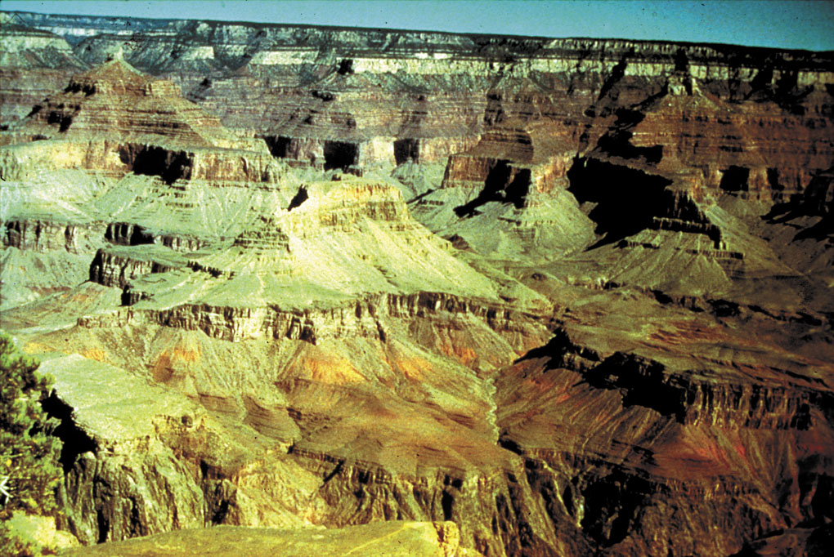
The Grand Canyon
When & how was this all formed?

Slide 4
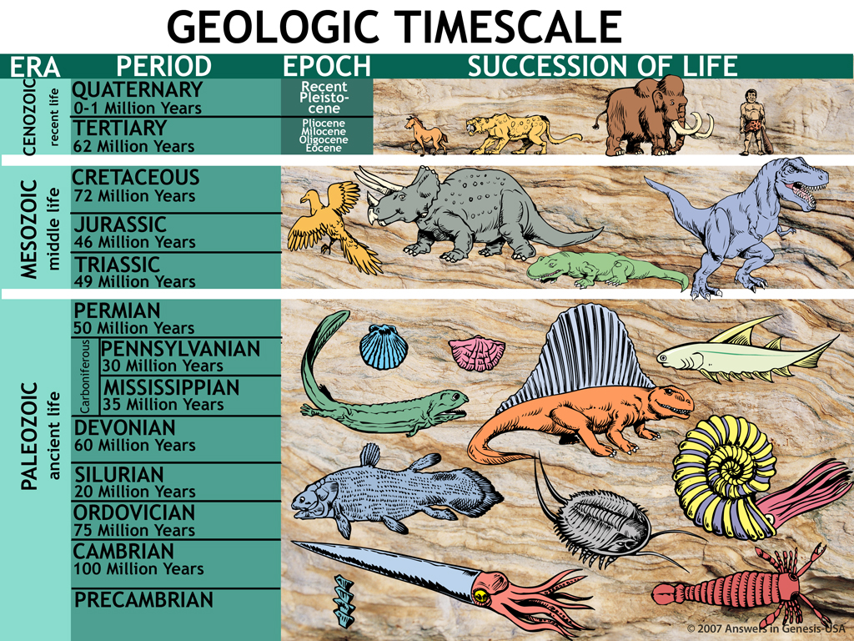
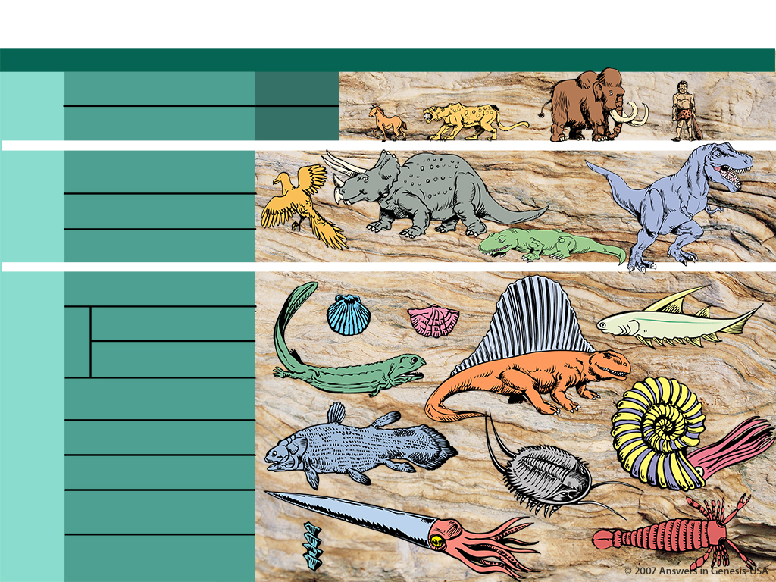
Geologic Timescale 00089
GEOLOGIC TIMESCALE
ERA
PERIOD
EPOCH
SUCCESSION OF LIFE
1.9—3.8 Billion Years: single cell to man
CENOZOIC
(recent life)
QUATERNARY
0-1 Million Years
Recent Pleistocene
TERTIARY
62 Million Years
Pliocene
Milosene
Oligocene
Eocene
MESOZOIC
(middle life)
CRETACEOUS
72 Million Years
JURASSIC
46 Million Years
TRIASSIC
49 Million Years
PALEOZOIC
(ancient life)
PERMIAN
50 Million Years
PENNSYLVANIAN
30 Million Years
Carboniferous
MISSISSIPPIAN
35 Million Years
DEVONIAN
60 Million Years
SILURIAN
20 Million Years
According to Evolution
ORDOVICIAN
75 Million Years
CAMBRIAN
100 Million Years
PRECAMBRIAN
Notes:
The age of the earth is a huge debate today—how did we get this low in such a short time? By accident?!
_____________
Same slide at:
02-Noah’s Flood-slide 4
06-Millions of Years-slide 4
10-Seven Cs-slide 79

Slide 5
Four Views of Flood
22
1. Historical global catastrophe
2. Historical local catastrophe
3. Historical global tranquil flood
4. Myth

Slide 6
Purpose of the Flood
22

Slide 7

Gen. 6:7, 13 NAS
22
Genesis 6:7, 13
7. The LORD said, "I will blot out man whom I have created from the face of the land, from man to animals to creeping things and to birds of the sky; for I am sorry that I have made them."
13. Then God said to Noah, "The end of all flesh has come before Me; for the earth is filled with violence because of them; and behold, I am about to destroy them with the earth."
Notes:
The underlined word is eretz, the same word translated earth in Gen. 1:1 and 2:1 and 2:4. Eretz is used 45 times in the Flood account in Gen. 6:5-9:17. The circled word is adamah, which in modern translations is rendered more accurately as "ground" or "land." It is used only 9 times in the Flood account. In his rejection of the global Flood, OT scholar Dr. Walter Kaiser said in the Feb. 2006 John Ankerberg debates on creation that eretz is never used in the flood account, but that only adamah is used. He was seriously in error.

Slide 8
Purpose of the Ark
22

Slide 9
Gen. 7:1-3 NAS
Genesis 7:1-3
1. Then the LORD said to Noah, "Enter the ark, you and all your household, for you alone I have seen to be righteous before Me in this time.
2. You shall take with you of every clean animal by sevens, a male and his female; and of the animals that are not clean two, a male and his female;
3. also of the birds of the sky, by sevens, male and female, to keep off-spring alive on the face of all the earth.

Slide 10

Noah's Ark (kids) & wave
X

Slide 11

Noah's Ark w/football field & city block

Slide 12
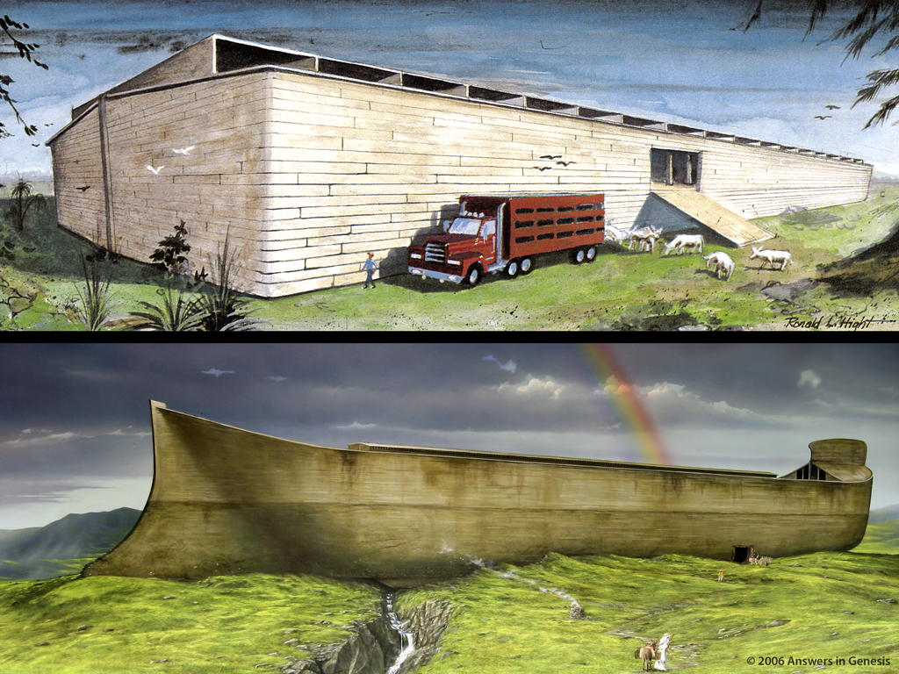
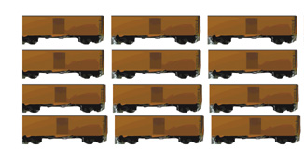
Two Arks Comparison 1 01810
560

Slide 13

Ark & people perishing
Notes:
The Flood was a real event that can help us understand how God is working in the world today

Slide 14
Character of the Flood
22

Slide 15
Gen. 7:11 NAS
Genesis 7:11
In the six hundredth year of Noah's life, in the second month, on the seventeenth day of the month, on the same day all the fountains of the great deep burst open, and the floodgates of the sky were opened.
Notes:
Tsunamis caused by seaquakes can travel at speeds up to 500 mph for thousands of miles.

Slide 16
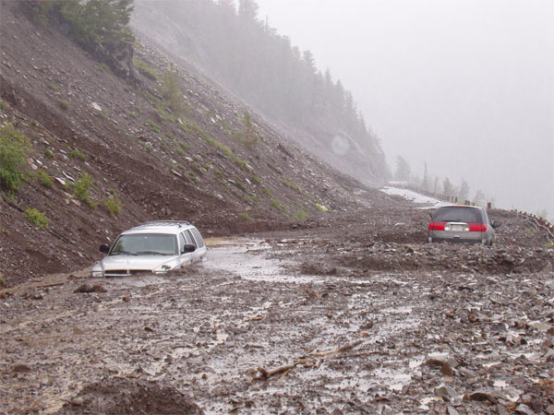
Notes:
Mudslide in southern California, 2008: http://edstacy.blogspot.com/, accessed 22 Sept 2008

Slide 17
Gen. 7:11 NAS
Genesis 7:11
In the six hundredth year of Noah's life, in the second month, on the seventeenth day of the month, on the same day all the fountains of the great deep burst open, and the floodgates of the sky were opened.
Notes:
Tsunamis caused by seaquakes can travel at speeds up to 500 mph for thousands of miles.

Slide 18
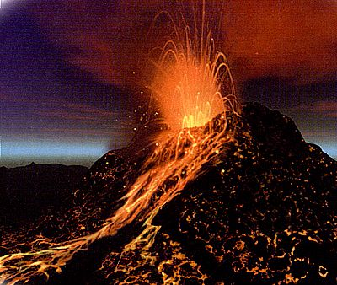
Earthquake—Turkey 2000
Notes:
Volcano from http://images.google.com/imgres?imgurl=http://www.rocks-and-minerals.com/more-about-rocks/images/volcano.jpg&imgrefurl=http://www.rocks-and-minerals.com/more-about-rocks/rocks-that-erupt.htm&h=338&w=400&sz=43&tbnid=Ny5TIZJt3b0J:&tbnh=101&tbnw=119&start=18&prev=/images%3Fq%3Dvolcano%26hl%3Den%26lr%3D%26sa%3DN, downloaded 12 Oct. 2004
Nicaragua flood, National Geographic 196:5 (Sept. 1999), p. 110

Slide 19
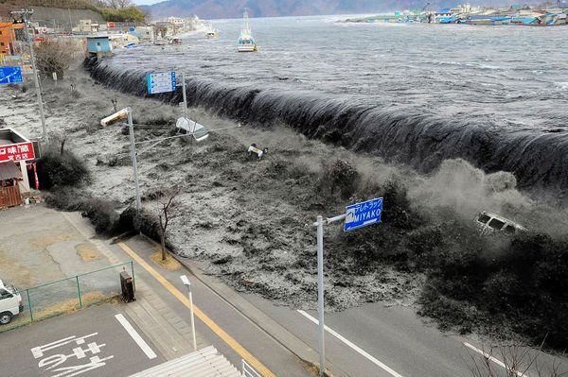
blank
Tsunami in Japan March 2011
Notes:
http://news.nationalgeographic.com/news/2011/03/pictures/110315-nuclear-reactor-japan-tsunami-earthquake-world-photos-meltdown/#/japan-earthquake-tsunami-nuclear-unforgettable-pictures-wave_33291_600x450.jpg, accessed 2011 Mar 26

Slide 20

Tsunami in Japan March 2011
Notes:
http://news.nationalgeographic.com/news/2011/03/pictures/110315-nuclear-reactor-japan-tsunami-earthquake-world-photos-meltdown/#/japan-earthquake-tsunami-nuclear-unforgettable-pictures-wave_33291_600x450.jpg, accessed 2011 Mar 26

Slide 21

Dinosaurs in Flood

Slide 22
Depth of the Flood
22

Slide 23
Gen. 7:19-20 NAS
Genesis 7:19-20
19. The water prevailed more and more upon the earth, so that all the high mountains everywhere under the heavens were covered.
20. The water prevailed fifteen cubits higher, and the mountains were covered.
Notes:
Where did the water come from? Fountains of the deep==under the ground and ocean floor. Lou Bergeron, "Deep waters," New Scientist, 2097 (30 Aug. 1997), p. 22, reports that studies suggest that there is at least 10 times as much water in the mantle of the earth (400 km deep) as in all the oceans. Some of this water is brought to the surface in volcanic eruptions today.
Where did all water go? Into late-flood ocean basins and underground reservoirs, as we have today. Present mountains were raised in the latter part of the flood (Ps. 104:6-9 is describing the flood, not the creation of dry land on Day 3, if you study the text carefully). There are marine fossils on the tops of all the high mountains which is part of the evidence that shows that they were once horizontal sediments under the sea that were hardened into stone and later broke and tilted in the process of mountain-building.

Slide 24

Local flood miracle wall
X

Slide 25


Rainbow promise
  Noah and your descendants
  The animals and the livestock
  The birds and all the wild animals
  And the living creatures.
  Only a global Flood makes sense of the promise.
  Otherwise God lied.
Rainbow Promise
Notes:
25
Then God told Noah and his sons, ⁹ "I hereby confirm my covenant with you and your descendants, ¹⁰ and with all the animals that were on the boat with you—the birds, the livestock, and all the wild animals—every living creature on earth. ¹¹ Yes, I am confirming my covenant with you. Never again will floodwaters kill all living creatures; never again will a flood destroy the earth."
Gen. 9:12 Then God said, "I am giving you a sign of my covenant with you and with all living creatures, for all generations to come. ¹³ I have placed my rainbow in the clouds. It is the sign of my covenant with you and with all the earth. ¹⁴ When I send clouds over the earth, the rainbow will appear in the clouds, ¹⁵ and I will remember my covenant with you and with all living creatures. Never again will the floodwaters destroy all life. ¹⁶ When I see the rainbow in the clouds, I will remember the eternal covenant between God and every living creature on earth." ¹⁷ Then God said to Noah, "Yes, this rainbow is the sign of the covenant I am confirming with all the creatures on earth."

Slide 26

CW-Local Flood 1 01129
77j
LOOK AT THAT BEAUTIFUL RAINBOW! IT'S A PROMISE FROM GOD THAT HE'LL NEVER* AGAIN FLOOD THE ENTIRE EARTH AS HE DID IN NOAH'S DAY!
HE TOLD YOU IT WAS JUST A "LOCALIZED" FLOOD?
THAT'S WHAT HE SAID!
MY CHRISTIAN COLLEGE PROFESSOR SAID THAT NOAH'S FLOOD DIDN'T COVER THE ENTIRE EARTH.

Slide 27

CW-Local Flood 2 01130
SO HE BELIEVES THAT GOD PROMISED TO NEVER AGAIN SEND A "LOCALIZED" FLOOD?

Slide 28

Billions of Dead Things 00058
Billions of dead things
Buried in rock layers
Laid down by water
All over the earth

Slide 29


FOSSIL
RECORD
PAIN
X
DEATH
KILLING
MILLIONS OF YEARS
=
DISEASE
STRUGGLE
SUFFERING
EXTINCTION

Slide 30
Early 19th Century Views of Earth History
Biblical view (Scriptural geologists)
X
SCW
F
P
(ca. 6000 years)
Catastrophist view (e.g., Cuvier, Smith)
X
SB
C
C
C
C
P
(millions of years)
Uniformitarian view (e.g., Hutton, Lyell)
SB?
P
(millions of years)
Notes:
SCW = Supernatural Creation Week (of 6 literal days)
SB = Supernatural beginning (belief of theists who didn't believe Genesis literally)

Slide 31

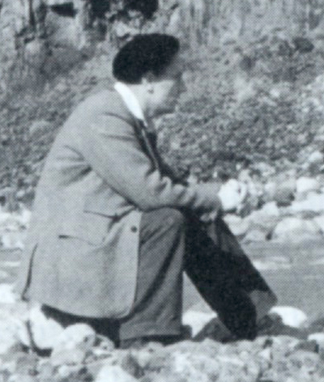
Ager 1981—brainwashing pt. 1
22
"My excuse for this lengthy and amateur digression into history is that I have been trying to show how I think geology got into
the hands of the theoreticians who were conditioned by the social and political history of their day more than by observations in the field."
Notes:
Derek Ager (1923-1993), Professor and Head of the Geology Dept. at University College of Swansea (Wales) from 1969-1988 and president of the British Geological Association 1988-1990, continued in "retirement" as Emeritus Professor till his death in 1993. In his life he visited over 57 countries to look at rocks and wrote 200 papers and four books, as well as many short articles for New Scientist.
Warning to YEC not to use information from his book: Derek Ager, The New Catastrophism (Cambridge, UK: Cambridge Univ. Press, 1993), p. xi. Ager says (bold in the original): "On that side too were the obviously untenable views of bible-oriented fanatics, obsessed with myths such as Noah's flood, and of classicists thinking of Nemesis. That is why I think it necessary to include the following 'disclaimer': in view of the misuse that my words have been put to in the past, I wish to say that nothing in this book should be taken out of context and thought in any way to support the views of the 'creationists' (who I refuse to call 'scientific')."
In The Nature of the Stratigraphic Record, p. 20, he says:
"This is heady wine and has intoxicated palaeontologists since the days when they could blame it all on Noah's flood. In fact, books are still being published by the lunatic fringe with the same explanation. In case this book should be read by some fundamentalist searching for straws to prop up his prejudices, let me state categorically that all my experience (such as it is) has led me to an unqualified acceptance of evolution by natural selection as a sufficient explanation for what I have seen in the fossil record. I find divine creation, or several such creations, a completely unnecessary hypothesis. Nevertheless this is not to deny that there are some very curious features about the fossil record."

Slide 32
Ager 1981—brainwashing pt. 1
22
"In other words, we
have allowed
ourselves to be
brain-washed into
avoiding any
interpretation of the
past that involves extreme and what might be termed 'catastrophic' processes."
Derek Ager, The Nature of the Stratigraphical Record (London: Macmillan, 1981), pp. 46-47.
Notes:
Derek Ager (1923-1993), Professor and Head of the Geology Dept. at University College of Swansea (Wales) from 1969-1988 and president of the British Geological Association 1988-1990, continued in "retirement" as Emeritus Professor till his death in 1993.

Slide 33
What's missing?
What was it originally?

Slide 34
What's missing? answers
A
B
C
D

Slide 35
Nothing is missing!
It was drawn that way.
Notes:
I brainwashed you into thinking something was missing!

Slide 36
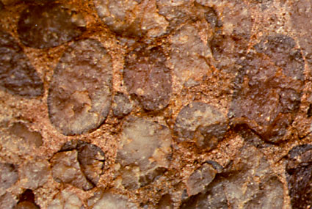
Ager 1993—rapid deposition, Sutton Stone
Regarding "Sutton Stone," a conglomerate labeled as "Early Jurassic" near Ager's home in Swansea, Wales:
"This has usually been interpreted as the basal conglomerate of a diachronous transgressive sea. It has been suggested, with very little fossil evidence, that this conglomerate spans three to five ammonite zones and therefore up to five million years in time. I think it was deposited in a matter of hours or minutes."
Derek Ager, The New Catastrophism (Cambridge: Cambridge Univ. Press, 1993), p. 120.
Notes:
He then gives his reasons for this conclusion, attributing the deposit to a hurricane or tsunami.
This is near his home, so he was well acquainted with it.
Ager was Emeritus Professor of Geology, University College of Swansea.
Conglomerate is a clastic sedimentary rock that forms from the cementing of rounded cobble and pebble sized rock fragments. Conglomerate is formed by river movement or ocean wave action. The cementing agents that fill the spaces to form the solid rock conglomerate are silica, calcite, or iron oxides.
Notice in the photo above the rounded rock particles in the conglomerate. These rounded particles make conglomerate different from breccia.
Photo: http://www.indiana.edu/~geol105/1425chap5.htm, accessed 22 April 2008
Definition of conglomerate: http://volcano.und.edu/vwdocs/vwlessons/lessons/Slideshow/Serocks/Sedrock2.html, accessed 22 April 2008

Slide 37
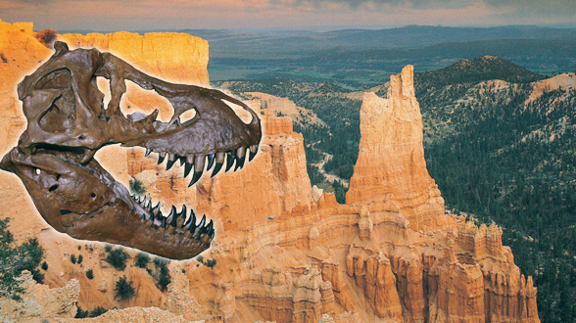
Assumptions Facts-Interpretations Geology
ANTI-BIBLICAL
ASSUMPTIONS
BIBLICAL ASSUMPTIONS
OLD EARTH
NO GLOBAL FLOOD
YOUNG EARTH
GLOBAL FLOOD

Slide 38


Template Suite 1-Content 01360
23
How long does it take to make fossils?

Slide 39

No tag!
23
Fossils don't come with tags saying how old they are
65
Million
Years
old
Notes:
Revised: July 2005.

Slide 40
Q655 on fossilization rapid
"Fossilization is a process that can take anything from a few hours to millions of years. …
The amount of time that it takes for a bone to become completely permineralized is highly variable. If the groundwater is heavily laden with minerals in solution, the process can happen rapidly. Modern bones that fall into mineral springs can become permineralized within a matter of weeks."
Philip J. Currie & Eva B. Koppelhus, 101 Questions about Dinosaurs (Mineola, NY: Dover Publications, 1996), p. 11.

Slide 41
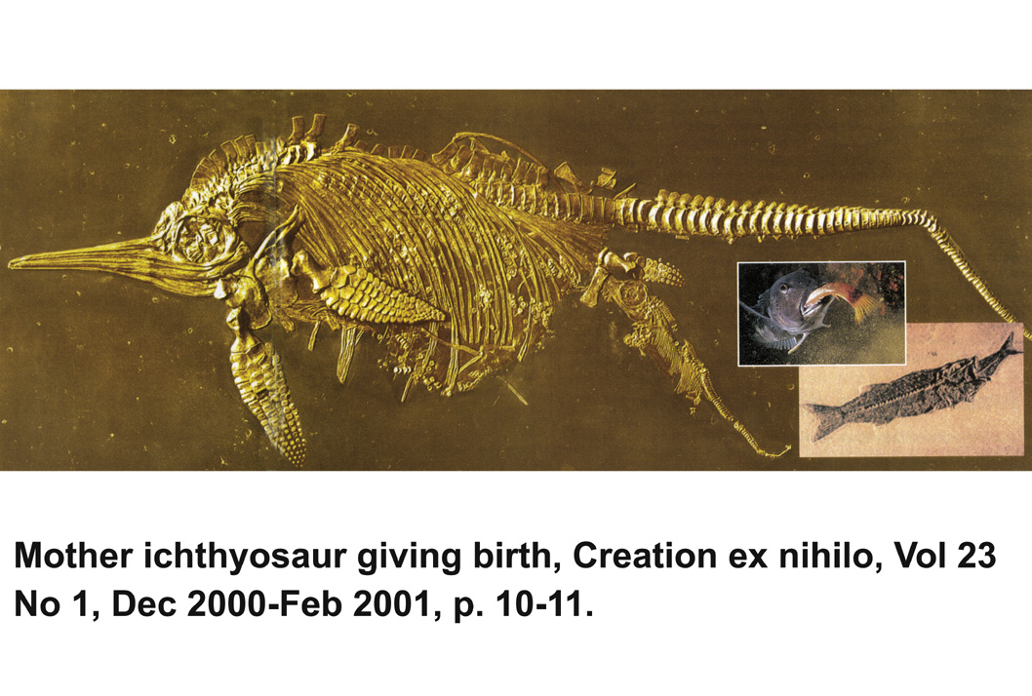
Ichthyosaur giving birth
Notes:
41
Creation, Vol. 23, No. 1 (Dec. 2000-Feb 2001), pp. 10-11.

Slide 42
Fish eating lunch
Notes:
42
Creation, Vol. 23, No. 1 (Dec. 2000-Feb 2001), pp. 10-11.

Slide 43

Darwin—soft creature preservation
"No organism wholly soft can be preserved" [in the fossil record].
Charles Darwin, On the Origin of Species (London: Penguin Books, 1968 reprint of 1859 first edition), p. 298.
Notes:
Even Darwin said that soft organisms can’t be fossilized—but that assumes that the animal body lays on top of the soil while millions of years of erosion takes place. Obviously, that can’t happen.

Slide 44

The nature of the fossils shows rapid burial and rapid fossilization
Fossilized Worm, found in China
Notes:
Fossils form from RAPID burial and RAPID fossilization.
http://www.abc.net.au/science/articles/2004/10/27/1228791.htm, accessed 12 April 2008. The article stated that the worm was fossilized before bacteria could eat the worm.

Slide 45
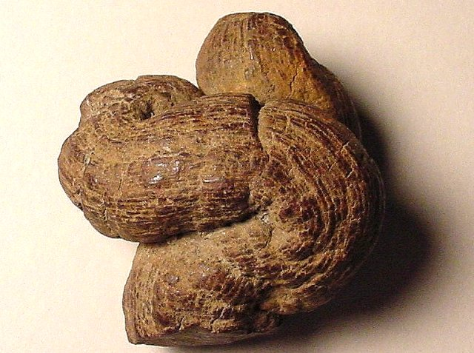
Fossilized Animal Manure
(coprolite)
Notes:
"A Coprolite is the fossil that results when human or animal dung is fossilized. They are classified as trace fossils as opposed to body fossils, as they give evidence for the animal's behaviour (in this case, diet) rather than morphology. The name is derived from the Greek words κοπρος (kopros) meaning 'dung' and λιθος (lithos) meaning 'stone'. They were first described by William Buckland in 1829. … Coprolites may range in size from a few millimetres to over 60 centimetres."
A layman might just call this “rock poop.”
Info from: http://en.wikipedia.org/wiki/Coprolite, accessed 12 April 2008
Photo: http://skywalker.cochise.edu/wellerr/fossil/coprolite/coprolite02.htm, accessed 12 April 2008. Site says that the picture is copyright free for non-commercial educational purposes.

Slide 46
Template Suite 1-Content 01360
23
How long does it take to form & erode rocks?
    Sea creatures high above sea level
    Sand carried across continents
    Thick layers of mud and sand often bent
    Layers across entire continents.
    Deep, wide erosion

Slide 47
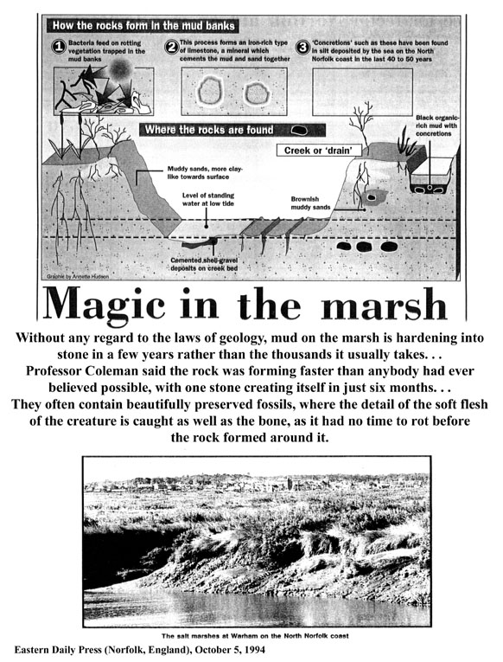
Magic in the Marsh #1
"Without any regard to the laws of geology, mud on the marsh is hardening into stone in a few years rather than the thousands it usually takes....
Eastern Daily Press (Norfolk, UK), 5 Oct. 1994, p. 7

Slide 48
Magic in the Marsh #2
Professor Coleman said the rock was forming faster than anybody had ever believed possible, with one stone creating itself in just six months.... They often contain beautifully preserved fossils, where the detail of the soft flesh of the creature is caught as well as the bone, as it had no time to rot before the rock formed around it."

Slide 49
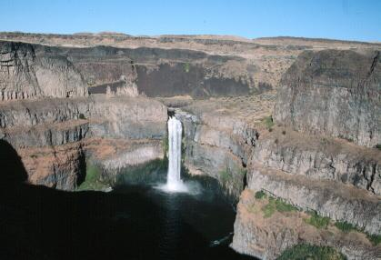
Scablands scene
Scablands, Eastern Washington
15,000 mi² (39,000 km²)
Palouse Falls
Carved by flood waters in 1-2 DAYS, not millions of years
Notes:
These were originally thought by evolutionary geologists to have formed by stream erosion over millions of years.
Now many evolutionists believe the erosion was the result of 40-100 floods over the course of 1500-3000 years from glacial Lake Missoula to the east.
But other geologists who have carefully investigated the evidence believe most of it was eroded in 1-2 DAYS. It is estimated that 500 cubic miles of water rampaged westward at 60 mph in a torrent flowing with ten times the volume of all the rivers on earth and carrying boulders the size of houses from Montana to Oregon.
See http://www.smithsonianmag.com/smithsonian/issues95/apr95/missoula.html and this report from a NOVA (PBS-TV) report in Mar. 2007: http://www.pbs.org/wgbh/nova/megaflood/scablands.html
Mike Oard (The Missoula Flood Controversy, Creation Research Society, 2004) believes the evidence points to 1 big flood and maybe a few smaller ones, but most of the erosional damage was done by the big one in the post-Flood glacial period.
See also this 2005 report by a YEC geologist teaching in Oregon: http://www.answersingenesis.org/docs2005/0928megaflood.asp, which argues for one major flood and that the basalt layers were deposited under water during the Genesis Flood.
Picture source--http://www.ndsu.nodak.edu/instruct/schwert/geosci/g496_columbia_plateau/g495link.htm

Slide 50
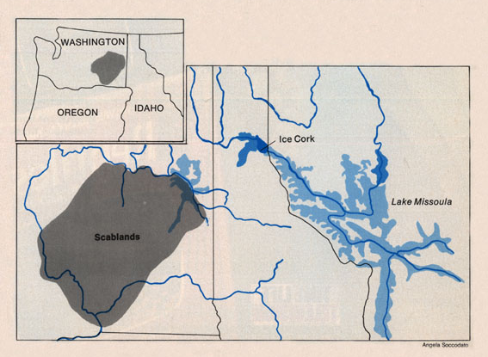
Scablands map
"The 'establishment,' as represented by the United States Geological Society, closed ranks in opposition. … Instead of testing Bretz's flood on its own merits, they rejected it on general principles …"
Notes:
Bretz's first geological paper was in 1923. His "Spokane Flood" flowed from the north at 400 ft deep. His fellow uniformitarian opponents called it an "outrageous hypothesis" and assaulted him verbally. But he continued to amass evidence of the flood and published another paper in 1932, but now attributing the flood to the bursting of glacial Lake Missoula to the east in Montana.
Bretz's catastrophist theory was accepted finally by the geological establishment in 1965.
The evidence for Lake Missoula had been known since the late 1800s, but the uniformitarian geologist, Joseph Pardee, said in his published papers that it had drained slowly. Evidence suggests that he privately believed (even in 1922 before Bretz's first paper) that the lake had burst producing a catastrophic flood, but the peer pressure of the establishment prevented him from saying so publicly.
Bretz believed that he saw evidence for 7 floods.
Glacial Lake Missoula was perched at 4,200 feet above sea level. When an ice dam failed, water hundreds of meters (yards) deep swept across an area twice the size of New Jersey at freeway speed, carving giant channels through the basalt that are now dry "coulees"), depositing gravel-boulder bars over 100 meters (300 feet) high and leaving dried waterfalls that make Niagara Falls look small.

Slide 51
Scablands--Gould quote
"Bretz stood against a firm, highly restrictive dogma that never had made any sense: the emperor had been naked for a century. Charles Lyell, the godfather of geologic gradualism, had pulled a fast one in establishing the doctrine of imperceptible change."
Stephen Jay Gould, "The Great Scablands Debate," Natural History, Vol. 87:7 (Aug./Sept. 1978), pp. 12, 14.
Notes:
Bretz's catastrophist theory was proposed in 1923. It was accepted finally by the geological establishment in 1965.

Slide 52

God's Word
is TRUTH
BIBLICAL GLASSES
MAN DECIDES "TRUTH"
MILLIONS
OF
YEARS
MILLIONS
OF
YEARS
EVOLUTIONIZED GLASSES
Notes:
We all have a philosophy about how evidence should be interpreted. "Oh no, not me!"
Neutrality is a non-neutral position – because it makes a positive assertion.

Slide 53
Template Suite 1-Content 01360
Wide-spread Evidence of Rapid Successive Deposition

Slide 54
Rapid Deposition
Lack of erosional features

Slide 55
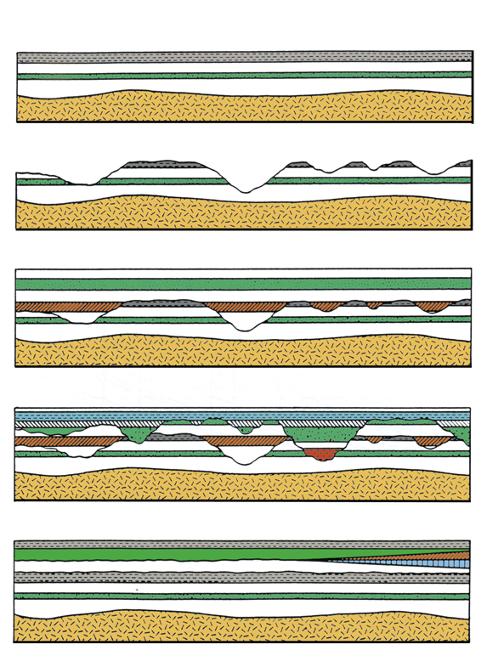
Multiple catastrophism--animated
Notes:
For layers to form over millions of years, erosion would be expected.
• However, most layers are cut away through catastrophic events over a short period of time…
• Then new layers are formed over them through a series of deposits
• These new deposits then shift even further quite quickly, leaving a complicated formation of layers
• If deposition happened over millions of years, we would expect very even layers due to erosion
From CENTJ 9(2):1995, p. 226

Slide 56
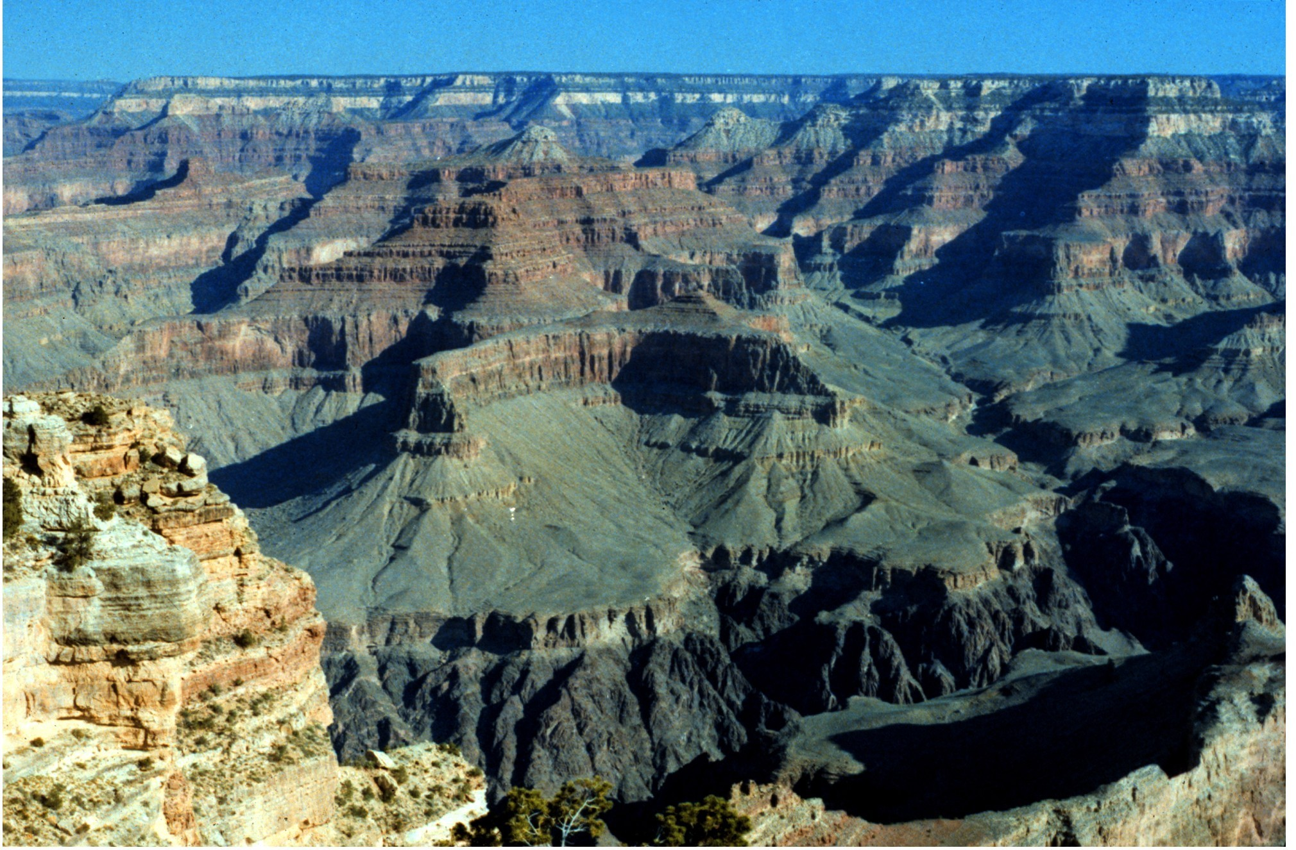
Grand Canyon—dating layers and canyon
Sedimentation: 300 MILLION YEARS
Erosion: ONE MILE in less than 5 MILLION YEARS
Notes:
Evolutionary geologists say the Grand Canyon layers of sediment were deposited over about 300 million years.
(Conventional reasoning based on current erosion rates say about 15 million.)
Then they say that erosion of one mile was carved in about 5 million years. Really?
—Tapeats Sandstone at Great Unconformity (550 mya) to Kaibab Limestone at the top (250 mya).

Slide 57
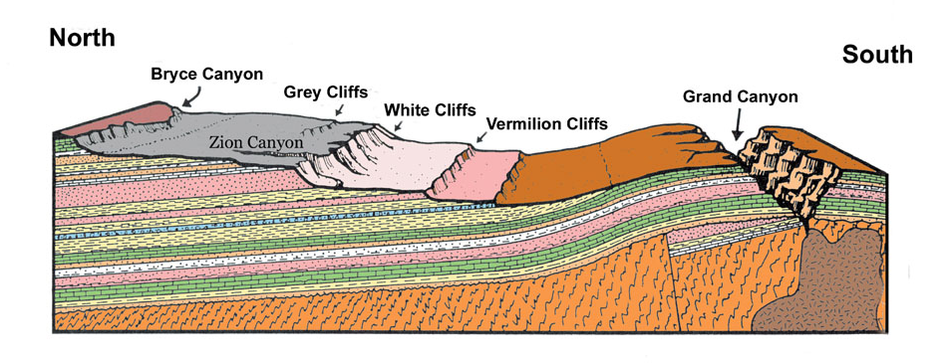
Grand Canyon cutaway
Massive Erosional Features
300 Million years?
North
South
Bryce Canyon
Grey Cliffs
White Cliffs
Grand Canyon
Vermilion Cliffs
Zion Canyon
Virtually No Erosional Features
Between the Layers
Notes:
Here is an actual cutaway of the Grand Canyon.
• We obviously see erosion in this area—massively!—yet this is all on the top of the layers we see today—NOT WITHIN these layers.
• Yet we are lead by evolutionists to believe that the layers took millions of years when no erosion is seen within the layers?
• No, the Grand Canyon was formed by a huge water channel that cut through soft layers
Picture: Steven A. Austin, ed., Grand Canyon: Monument to Catastrophe (Santee, CA: Institute for Creation Research, 1994), p. 58.

Slide 58
Rapid Deposition
Lack of erosional features
Soft-sediment deformation
Notes:
Another proof for quickly formed layers is that the sediment had to be altered (or deformed) when it was soft—not in the course of millions of years when it would have hardened!

Slide 59
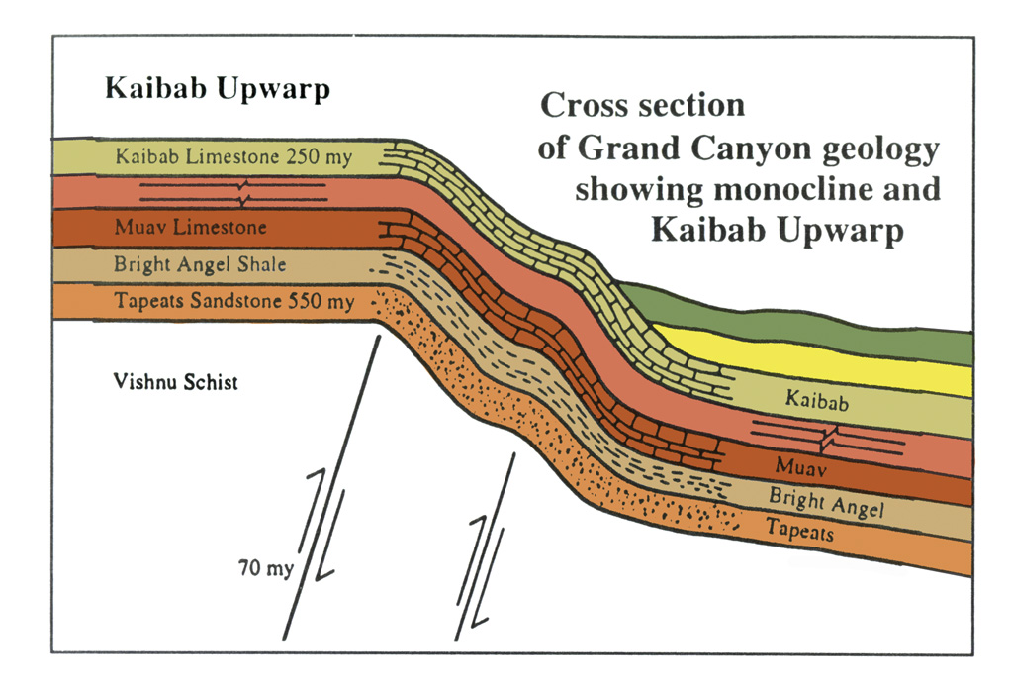
Grand Canyon—strata deformation
Kaibab Upwarp
Cross section
of Grand Canyon geology
showing monocline and
Kaibab Upwarp
Notes:
Another Grand Canyon cross section shows the various layers bent upwards by 1000 feet (.3 km).
Does it not seem obvious that these layers were soft when they were bent?
Yet evolution would have us to believe that they laid down over millions of years, hardened, then were bent!
North rim (highest point is 8500 ft) is on average 1000 ft higher in elevation than the south rim.
70 million years ago is when evolutionists say the upwarp occurred, 480 million years after the Tapeats Sandstone formed!
Source: John Morris, The Young Earth (Master Books, 1994), pp. 107-8.

Slide 60
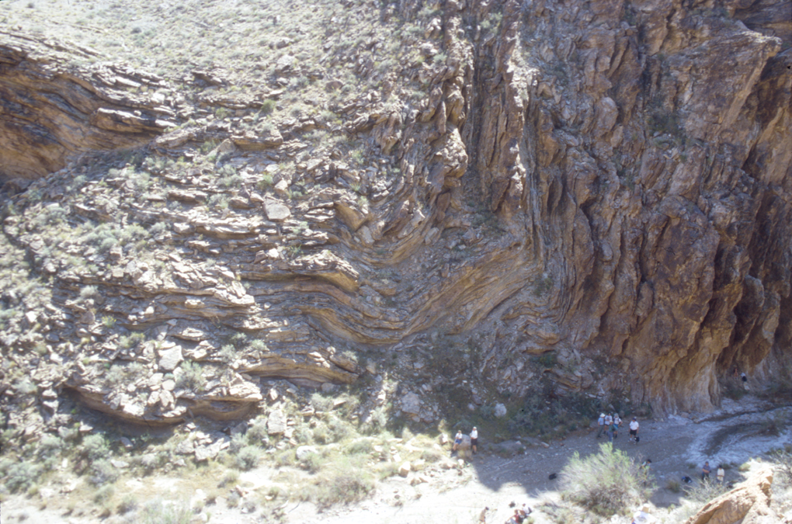
Grand Canyon—90 degree bend
Notes:
Here is a clear Grand Canyon deformation where the horizontal layer was bent 90 degrees vertically. How could these rocks be bent slowly under pressure after they had hardened? No, they were deformed quickly while still relatively soft. Otherwise there would be elongation of the sand grains. Why do they show no cracking of the crystals? Because they formed quickly!

Slide 61
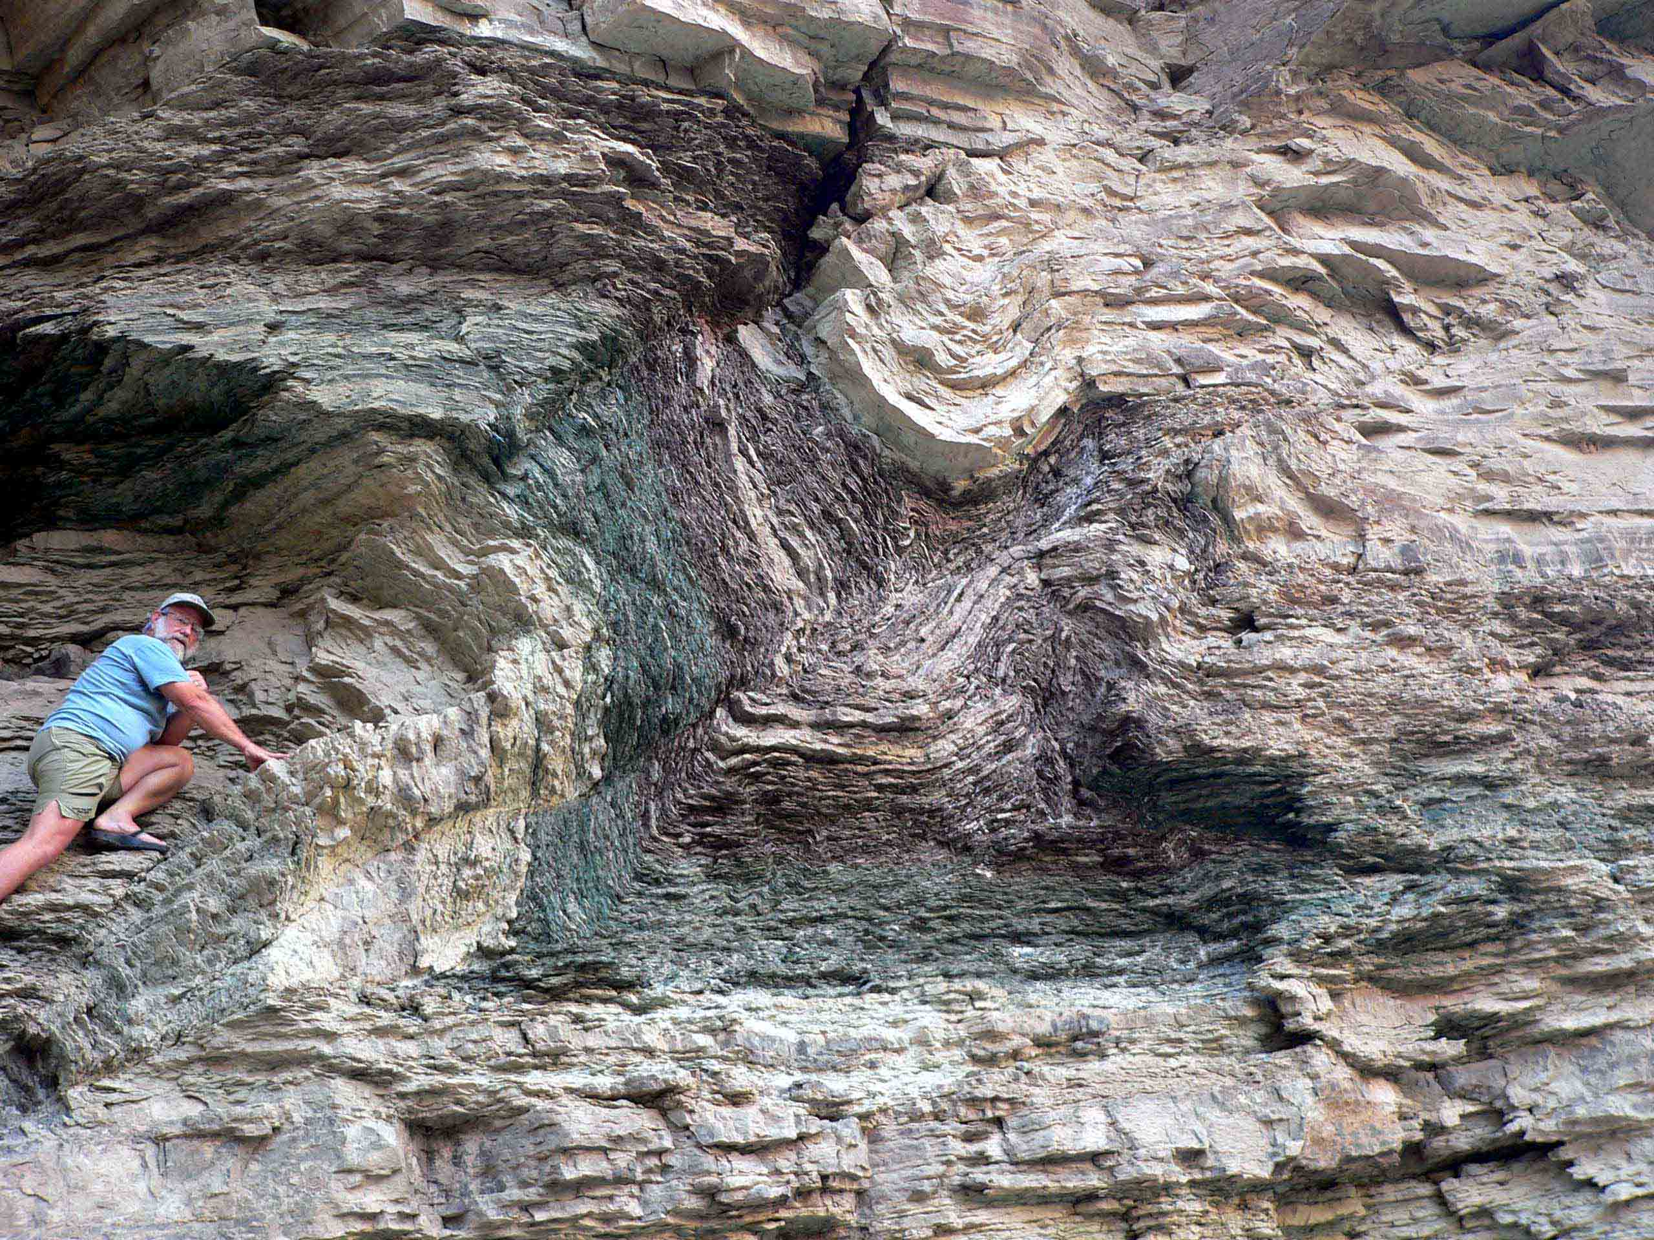
Notes:
This folding is in the Bright Angel Shale (dated at 530 MYA by conventional geology) that is right at the Whitmore helicopter pad where visitors fly out of Grand Canyon. Evolutionists tell us that under heat and pressure solid rocks will bend. But in this case the rock gets metamorphosed, which this shale is not. The evidence says this was wet and relatively soft and plastic when it was bent.

Slide 62
Rapid deposition #6—fossil graveyards
Rapid Deposition
Lack of erosional features
Soft-sediment deformation
Lack of bioturbation at interface
Notes:
Another key evidence for a young earth is the lack of bioturbation at interface.
In other words, the layers do not show any movement of life within them (and between them) that one would expect over millions of years.

Slide 63

Bioturbation illustrated
growing plants
clams
worms
Living Ocean Bottom Ecology
John Morris, The Young Earth, 99
Notes:
Here is what we would expect to find in each layer, as we have today on the ocean bottom.
However, this kind of disturbance in a layer is very rarely seen. Even where it IS seen, it is reasonable to imagine that the evidence in the particular rock formation could have been caused by animal life in a matter or hours, days or weeks during the alternating periods of calm and violence at this location, rather than being evidence of thousands or millions of years.

Slide 64
Rapid Deposition
Lack of erosional features
Soft-sediment deformation
Lack of bioturbation at interface
Ripple marks, animal tracks & raindrop marks
Notes:
Would one expect ripple marks or animal tracks or raindrop marks on a soil that has had millions of years of erosion? Hardly!

Slide 65
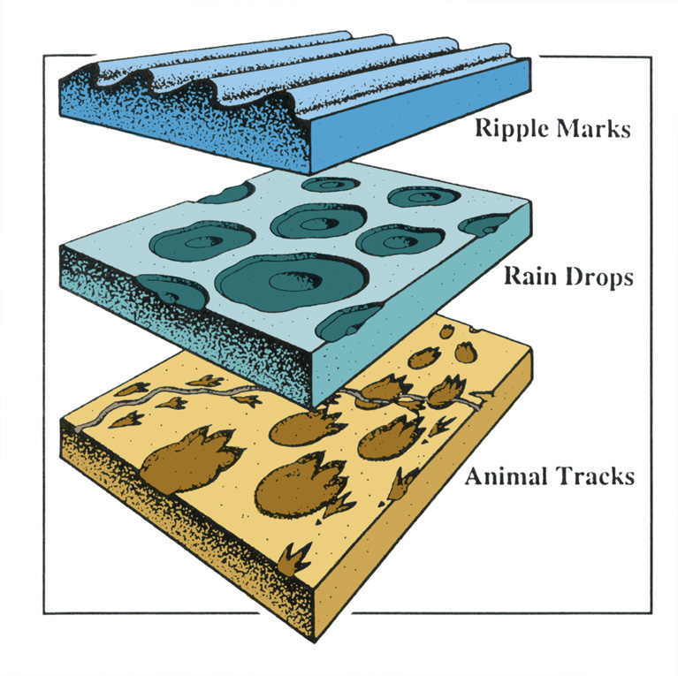
Marks and tracks illustrated
Ripple marks
Rain drops
Animal tracks
Notes:
Notice this Grand Canyon deformation. It shows evidence that animal tracks were made under water, not air (as previously thought), in the Grand Canyon, Coconino Sandstone.
Do we really think that this layer would take thousands or millions of years? Certainly erosion would wipe all these features away. No, these layers were formed very quickly—within hours or days or weeks.
http://www.answersingenesis.org/home/area/magazines/docs/v15n1_grandcanyon.asp

Slide 66
Rapid Deposition
Lack of erosional features
Soft-sediment deformation
Lack of bioturbation at interface
Ripple marks, animal tracks & raindrop marks
Polystrate fossils
Notes:
Polystrate fossils refers to fossils that cover various strata instead of the entire fossil being in the same strata. This would obviously mean that the deposits were formed quickly. For example…

Slide 67
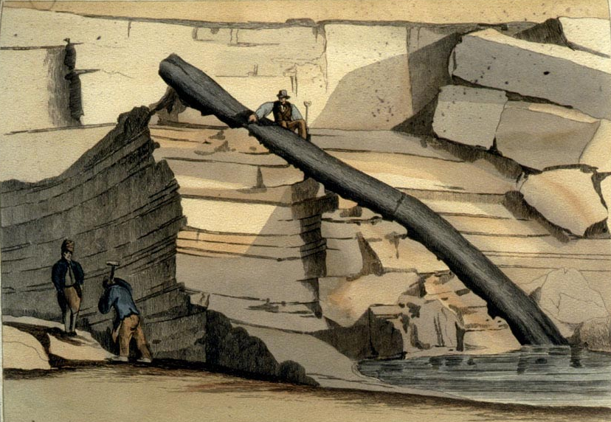
Craigleith polystrate tree
Notes:
This tree was found in 1826 in Craigleith quarry near Edinburgh, Scotland, in a 200-ft thick mass of alternating sandstone and shale.
As the workers in the quarry took away the sandstone and shale layers, they uncovered this tree and an artist painted the unusual find.
Do you think that this tree remained here through millions of years of sediment build-up?
The in-situ (autochthonous) and transport (allochthonous) theories were much debated from the 1820s to the early 1840s, though even Buckland said in 1840 that he only knew of a few trees that looked in-situ.

Slide 68
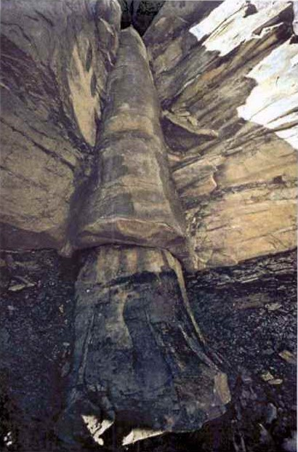
Coal layer
Limestone
KETTLES COAL MINES
Cooksville, TN
Coal layer
Photo: D.Patton
Notes:
In Tennessee we even have a tree whose trunk is in a coal layer, middle in limestone, and top in another coal layer.

Slide 69
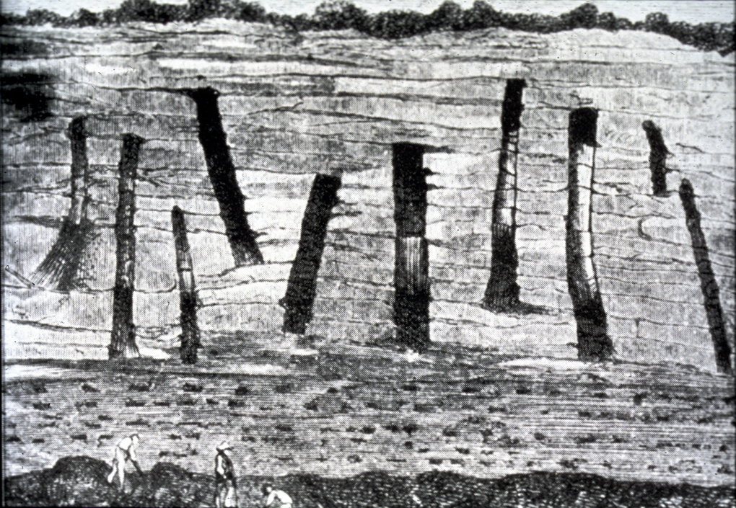
French cliff polystrates
Notes:
This Tennessee tree was found in a 200 ft thick mass of alternating sandstone and shale

Slide 70
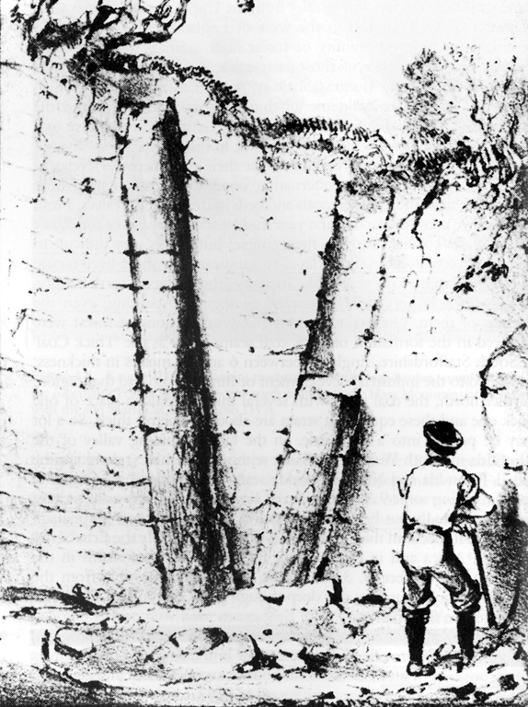
Polystrate tree--Ager
"Obviously sedimentation had to be very rapid to bury a tree in a standing position before it rotted and fell down.
… we cannot escape the con-clusion that sedimenta-tion was at times very rapid indeed and that at other times there were long breaks in sediment-ation, though it looks both uniform and continuous."
"in position of growth"
Derek Ager, The New Catastrophism (Cambridge: Cambridge U Press, 1993), 48-49.
Notes:
Dr. Ager proves catastrophes did occur, but he refuses to believe that they happened worldwide such as in Noah’s Flood. He notes…(read quote).
• He then says that these trees are “in position of growth.” But those trees are not in position of growth for they were not buried gradually as they grew and a catastrophe that laid down that much sediment would not leave the trees standing. Furthermore such polystrate trees never have any branches or roots. What kind of trees grow like that?

Slide 71
What about radiometric dating methods
What about radiometric dating methods?
Notes:
But you say, how about these reliable radiometric dating methods that PROVE the earth to be millions of years old?

Slide 72
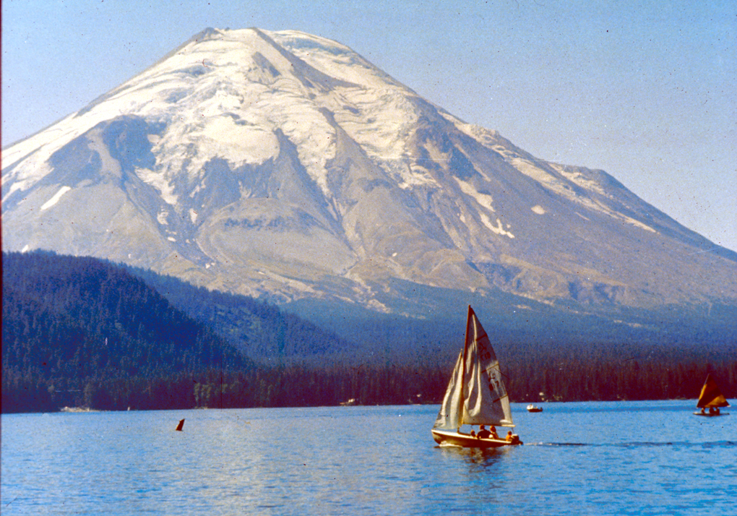
Mt. St. Helens before eruption

Slide 73
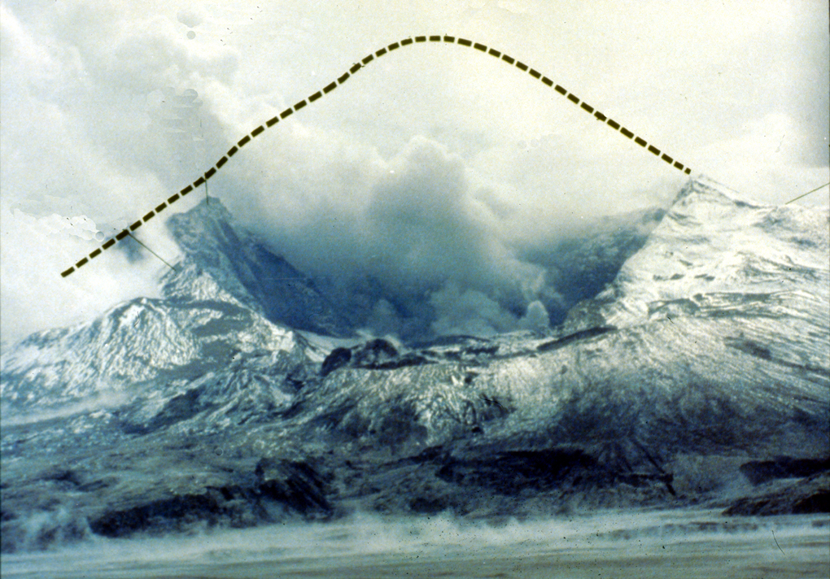
Mt. St. Helens top blown off
Lava dome
Notes:
A lava dome started forming soon after the eruption. The first two domes were blown away by subsequent smaller eruptions in 1980. The present dome started forming in late October 1980 and continues growing to this day, though at faster rate than in the first 6 years (see below).
During 17 so-called dome-building eruptions, from 18 October 1980 to 26 October 1986, thick pasty lava oozed out of the volcanic vent like toothpaste from a tube. Dacite lava is too thick to flow very far, so it simply piled up around the vent, forming the mountain-like dome, which now plugs the volcanic orifice.
Mountain rapidly rebuilding in 2005!
Sept 25, 2005 article: http://www.billingsgazette.com/index.php?tl=1&display=rednews/2005/09/25/build/nation/52-st-helens.inc
"Although things could change at any time, scientists are not expecting any big changes at Mount St. Helens in the near future. The new lava dome is growing about six times faster than it did during the six years of dome building between 1980 and 1986. The extrusion rate is about 1.3 to 9.2 cubic yards per second, averaging 3 cubic yards - enough to fill up the back of a pickup truck every second.
The new Mount St. Helens dome was about 10 feet below the rim of the crater in July, although it has crumbled a little since then. The growth has been in a series of six big upward thrusts or "whalebacks" as the scientists like to call them because of their shape. At the rate it is growing, Mount St. Helens could regain its conical top within decades."

Slide 74
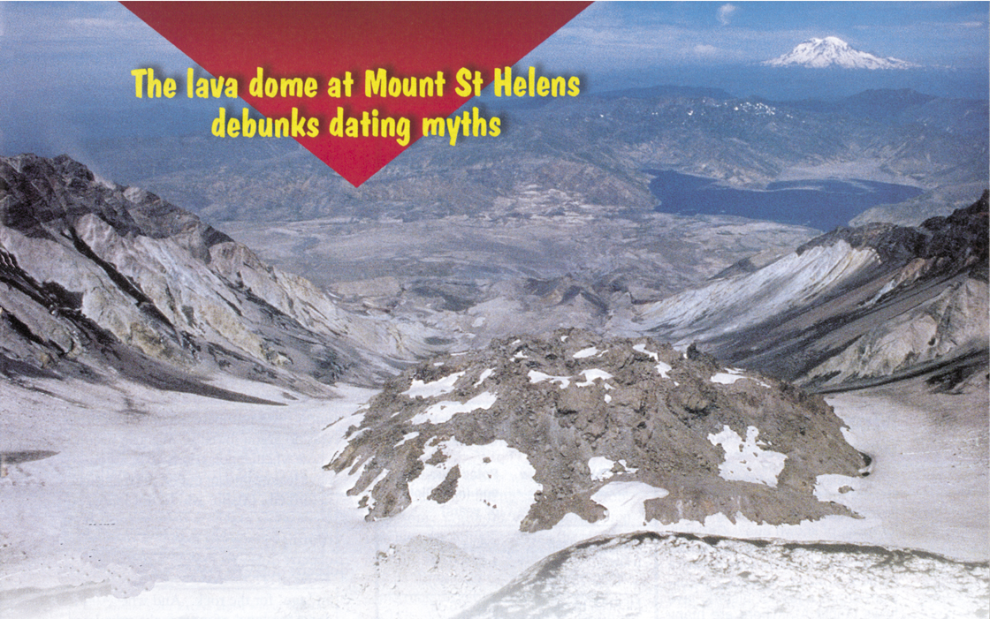
Mt. St. Helens—dome dating
The lava dome at Mount St. Helens debunks dating myths
Radiometric age: 340,000 – 2.8 million years
Actual age: less than 12 years!!
Notes:
• Samples were collected and dated in 1992 from the dome that started forming in late Oct. 1980.
• The highly respected lab (Geochron Laboratories of Cambridge, MA) was not told where the samples were collected, only that they were from dacite rock and low levels of argon were expected. The lab dated a "whole rock" sample and 4 different mineral samples.
• Well, we know that they were formed in 1980 so they were only 12 years old.
• the lava dome at Mt. St. Helens debunks dating myths.
Photo: Creation Magazine 23:3 (June-Aug. 2001), pp. 23-25. Other examples of erroneous dating from various places in the world are in this article.

Slide 75
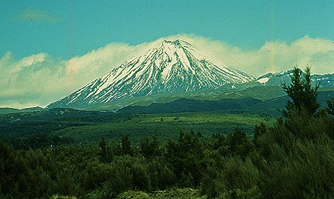
Dating Mt. Ngauruhoe
Mt. Ngauruhoe, New Zealand
5 eruptions from 1949 to 1975
K-Ar dates: 270,000 – 3.5 million yrs
Rocks really <50 yrs old when dated!!!
Notes:
Source of picture and text below: http://volcano.und.edu/vwdocs/volc_images/img_ngauruhoe.html
Mt. Ngauruhoe is a beautifully shaped volcano on the edge of the Tongariro massif. Ngauruhoe is New Zealand's most active volcano with 61 eruptions since 1839 (most recent eruption in 1977). Photograph of Ngauruhue by W.B. Hamilton, U.S. Geological Survey, November 1965.
My statement summarizes the research by Andrew Snelling, "The cause of anomalous Potassium-Argon 'ages' for recent andesite flows at Mt. Ngauruhoe, New Zealand, and the implications for Potassium-Argon 'dating'," Proceedings of the Fourth International Conference on Creationism (Pittsburgh: Creation Science Fellowship, 1998), pp. 503-525. Andrew collected the samples and sent them to a top US lab for dating. He did not tell the lab where the samples were collected but suggested that they could be "young," so as to ensure that the lab took extra care in their analysis. Andrew reports in this paper 24 other published examples of similarly erroneous dates (by millions of years) for rocks that are only a few decades or centuries old. The implication is that the lavas already had the argon in them from the mantle and there is no way to distinguish primordial AR-40 from the AR-40 that results from decay of K-40 after the lava crystalizes.

Slide 76
Rocks: known or unknown age?
Rocks of
Known Age
Rocks of
Unknown Age
Radiometric dating clearly does not work.
Radiometric dating is assumed to work.

Slide 77
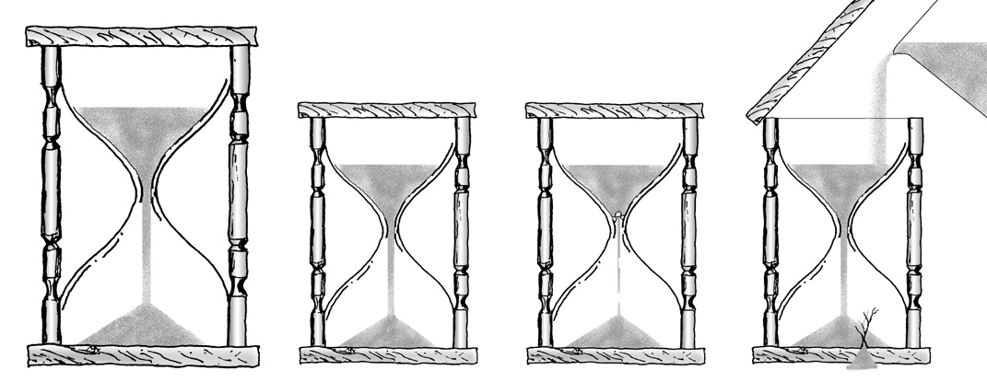
Radiometric dating--hourglasses
Radiometric Dating Assumptions
Parent
?
?
?
?
Daughter
?
Daughter
Original ratios?
Rate of decay?
Added or removed?
Notes:
From The Answers Book, p. 81.
Article summarizing the 2003 RATE research on helium in zircons and C-14 both showing accelerated decay rates in the past and pointing an earth of only a few thousands of years: Carl Wieland, "RATE group reveals exciting breakthroughs!", <www.answersingenesis.org/docs2003/0821rate.asp>, 21 Aug. 2003.
Why are these decay processes believed to date with the lava crystallized? Andrew Snelling explains:
The minerals in the volcanic rocks which contain the radioisotopes don't form until the lava cools and crystallizes. This means that the radioisotopes aren't locked into those minerals until the lavas crystallize. And until the radioisotopes are locked into the minerals the clock hasn't been set to age zero. While the lava is still molten the radioisotopes are free to move around. That's why the ages obtained on the volcanic rocks are said to date when the lavas crystallized. However, this doesn't take into account the possibility that the radioisotopes locked into the minerals could have been inherited from the lavas formed as magmas deep inside the earth. But their assumption of dating when the lava crystallized is also based on knowledge that some minerals only preferentially lock in parent radioisotopes and reject the daughter isotopes because the latter are chemically different. This is presumed then to set the clocks at zero, so that all the daughter isotopes measured today have resulted from radioactive decay of the parent isotopes locked in when the minerals and the lavas crystallized.

Slide 78
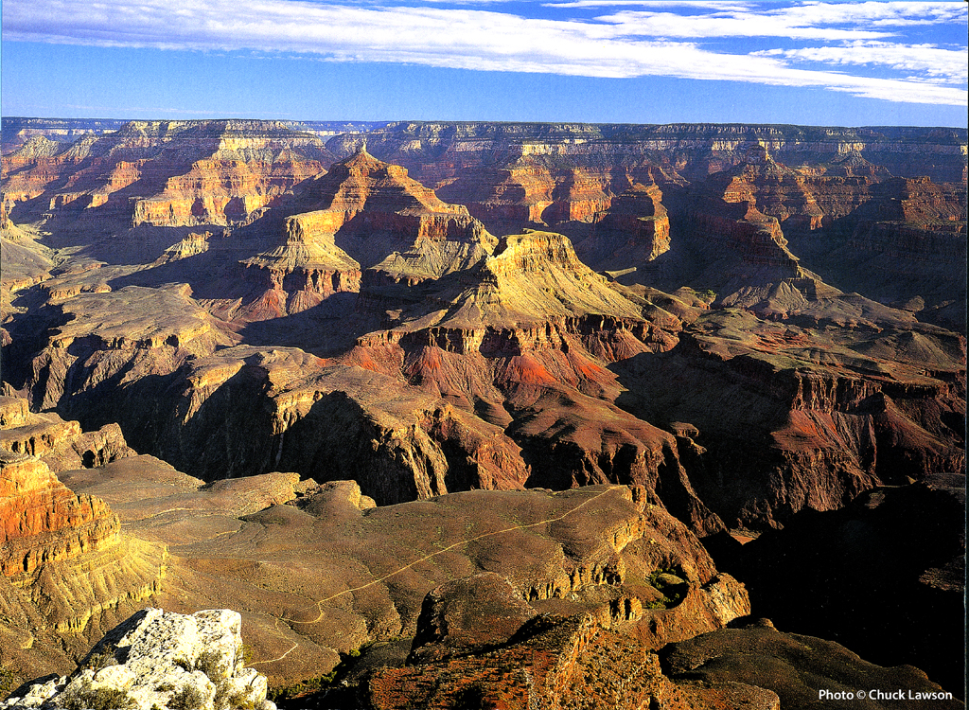
Grand Canyon – calendar 2004 Aug.
Millions
of years?
Noah's
Flood!
Notes:
Photo from "Grand Canyon 2004 Engagement Calendar" (August) produced by Smith-Southwestern, Inc., P.O. box 20100, Mesa, AZ 85277-100.

Slide 79


A&E on bones
PAIN
DEATH
KILLING
DISEASE
STRUGGLE
SUFFERING
EXTINCTION
X
Noah's
Flood
MILLIONS
OF YEARS
PAIN
DEATH
KILLING
DISEASE
STRUGGLE
SUFFERING
EXTINCTION
Notes:
79

Slide 80
Geologic Timescale 00089
地质时间尺度
时代 时期 时代 一连串的生活
新生代
最近的生活
第四纪
0-1百万年
洪水后存款
Post-Flood deposits
第三纪
62百万年
早白垩世
72百万年
中生代
中年生活
侏罗纪
46百万年
三叠纪
49百万年
二叠纪
50百万年
Flood deposits
宾夕法尼亚纪
30百万年
洪水存款
石炭系
密西西比纪
35百万年
泥盆世
60百万年
古生代
古代生活
志留纪
20百万年
奥陶世
20百万年
寒武世
100百万年
前寒武纪
洪水前的存款
Pre-Flood deposits
Notes:
Translate overlays at the right and then drag them over the above image

Slide 81
Flood on Mars Q501
"A flood of biblical proportions—enough to fill the Mediterranean Sea—gushed down from the highlands of Mars a billion or so years ago, the latest pictures from the Pathfinder confirmed Monday."
Robert S. Boyd, "Ancient gullies suggest 'key ingredient for life'," Cincinnati Enquirer, July 8, 1997.

Slide 82
Noachian Epoch on Mars Q853
"The total release of gases from Tharsis magma may have produced the equivalent of a global layer of water nearly 400 feet deep ... At the very end of the Noachian epoch, volcanic activity dissipated..."
Roger Phillips (Dir., Washington U.'s McDonnell Center for Space Sciences), "Mars Calamity May Have Created Conditions for Life," New York Times, Mar. 16, 2001.
Notes:
There are other possible explanations for the geological features on Mars that are interpreted as flood deposits, for similar features appear on the Moon, where noone believes there ever was water and on lava flows on dry land on earth. They could be the result of repeated volcanic eruptions or even surges in one eruption. See Creation, 26:1 (Dec. 2003-Feb. 2004), pp. 10-13.

Slide 83

Noah's Flood on Mars 00342
Noah's Flood on MARS?

Slide 84

Mars + Water 01428
Mars
Ice exists at the polar caps.
NO
WATER!
No liquid water has ever been observed.

Slide 85
Rom. 1:21-22 NAS
Romans 1:21-22
21. For even though they knew God, they did not ﻿﻿honor Him as God or give thanks, but they became ﻿﻿futile in their speculations, and their foolish heart was darkened.
22. Professing to be wise, they became fools.

Slide 86
Ager: We've been brainwashed
Derek Ager:
"We have allowed ourselves to be brainwashed …"

Slide 87

Q 706 Archer
"From a superficial reading of Genesis 1, the impression would seem to be that the entire creative process took place in six twenty-four-hour days. If this was the true intent of the Hebrew author ...
this seems to run counter to modern scientific research, which indicates that the planet Earth was created several billion years ago..."
Gleason Archer, A Survey Of Old Testament Introduction (Chicago: Moody, 1985), 187.

Slide 88
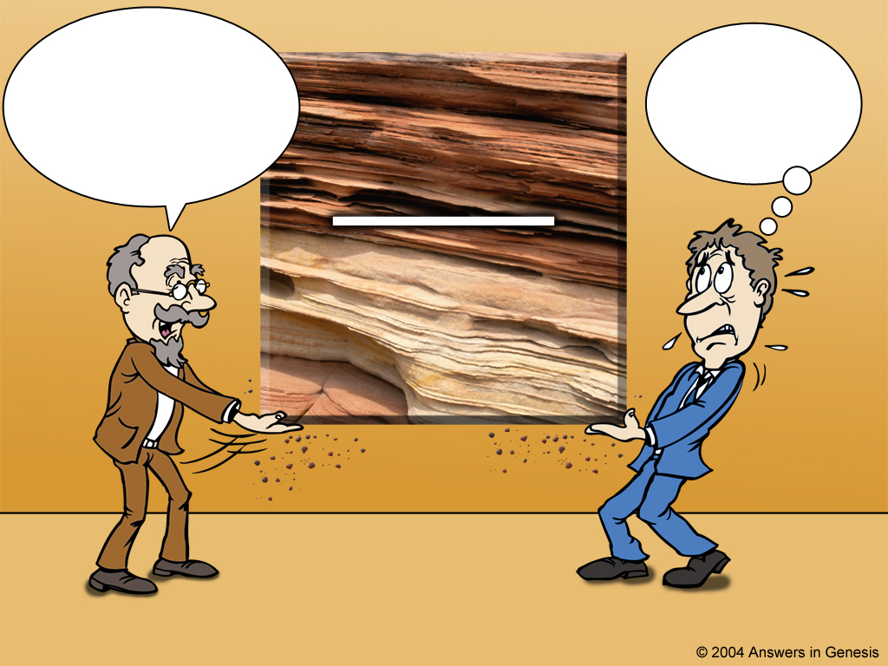
Scientist and theologian
The Bible is not true! These rocks are millions of years old. You have to believe me because I'm a scientist.
I'll just accept the millions of years and add them to the Bible!
ROCK LAYERS
MILLIONS OF YEARS
Scientist
Theologian
Notes:
However, instead of accepting the history of God's Word, theologians have compromised with the ideas of fallible men. You say:
But, wait a minute! Hasn't science PROVED the earth is millions of years old? And what about the Gap Theory, and Theistic Evolution, and the Day Age Theory and Progressive Creation and didn't dinosaurs die out 65 million years ago? However, all of these questions start with ideas OUTSIDE the Bible

Slide 89

Science is not the issue
The issue really is NOT
science!

Slide 90

Notes:
We all have a philosophy about how evidence should be interpreted. "Oh no, not me!"
Neutrality is a non-neutral position – because it makes a positive assertion.

Slide 91

Which authority?
Which authority?
Infallible WORD OF GOD
Holy Bible
Scientific Theories
fallible opinions of sinful men

Slide 92





Scientist & Bible—layered new
The
earth is billions of years old & Noah's Flood never happened. Take my word for it!
I created 6000 years ago and sent a global Flood. Take My Word for it!
Dr. Gleason Archer & other OT scholars, who have trusted the secular geologists
HOLY BIBLE

Slide 93
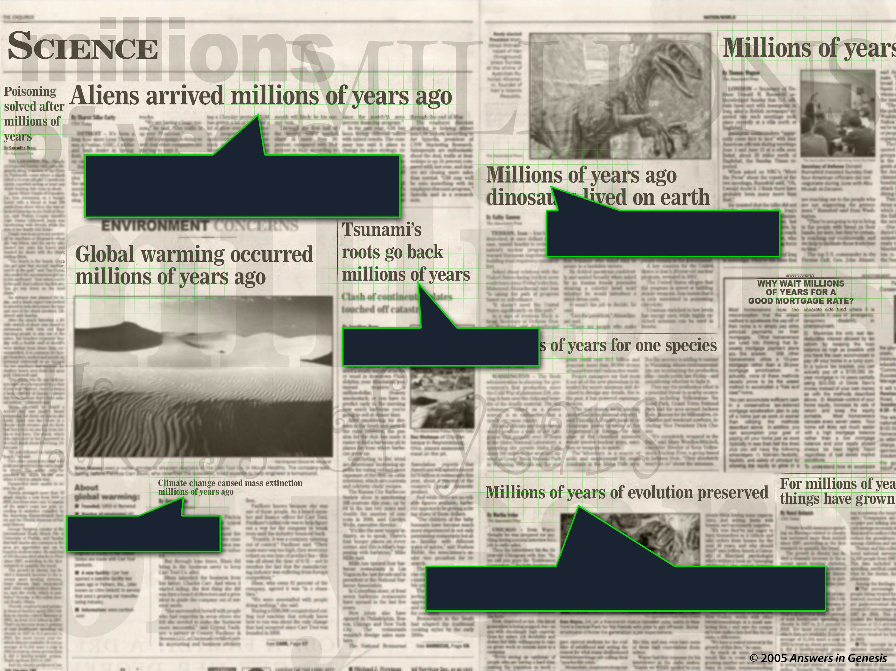
Mil of Yrs Headlines 02011
Millions of years
Millions of years
Millions of years
Millions of years
Millions of years of evolution

Slide 94
I Peter 3:15 NAS
1 Peter 3:15
But sanctify Christ as Lord in your hearts, always being ready to make a defense to everyone who asks you to give an account for the hope that is in you, yet with gentleness and reverence.

Slide 95
AiG web site #1

Slide 96
Matt. 24:37-39 NAS
Matthew 24:37-39
37. For the coming of the Son of Man will be just like the days of Noah.
38. For as in those days before the flood they were eating and drinking, marrying and giving in marriage, until the day that Noah entered the ark,
39. and they did not understand until the flood came and took them all away; so will the coming of the Son of Man be.
Notes:
Also Lk 17:26-29—Jesus mentions Noah and judgment of Flood (from Gen. 1-11) and Lot and judgment of Sodom and Gomorrah and Lot's wife (Gen. 12-50)—Jesus took both accounts as literal history. In fact, all the accounts that modern man finds so unbelievable (Noah, Lot, Jonah, serpents in the wilderness, etc.) Jesus took as historical fact.

Slide 97

Noah's Ark - Invitation

Slide 98

060 N'sA Door-John10.9
"I am the gate; whoever enters through me will be saved.
He will come in and go out, and find pasture"
(John 10:9 NIV).

Slide 99
Blank
END

Slide 100
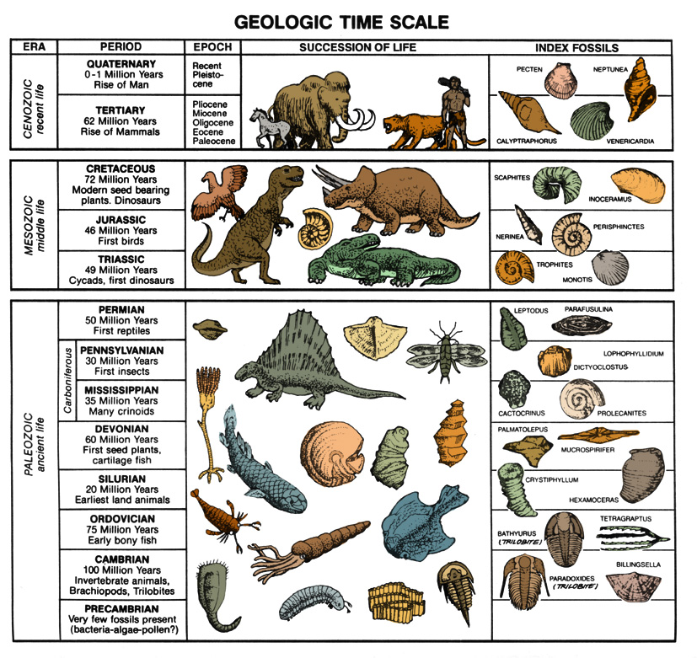
Coal dated by C-14
Eocene
36-57 mya
Cretaceous
66-144 mya
Pennsylvan.
286-320 mya
All the samples are essentially the same ¹⁴C age—less than 70,000 years old!
Notes:
C-14 is found in organic samples throughout the phanerozoic (Cambrian to Quarternary)—all but the youngest organic material shows C-14 evidence of being buried contemporaneously, much less that 250,000 years ago. There is also evidence that some C-14 is primordial—that is, it was not produced by cosmic ray bombardment of nitrogen in the upper atmosphere, but was part of the original creation.

Slide 101
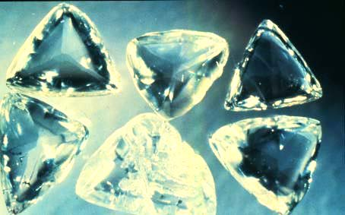
Carbon-14 in diamonds!
"Age" based on long half-life isotope dating (e.g., K/Ar) of the rocks containing diamonds:
1–2 billion years
¹⁴C-dating of 12 diamonds (crystal structure of diamonds prevents recent contamination with ¹⁴C): "age" of 58,000 years.
www.icr.org/research/AGUC-14_Poster_Baumgardner.pdf (American Geophysical Union Conference, Dec 2003 poster session)
Notes:
Photo of Macles diamonds from the Argyle pipe, Western Australia (these are not the ones dated) from: http://volcano.und.nodak.edu/vwdocs/minerals/diamonds.html 'courtesy of Grand Boxer'.
While the poster presentation at the AGU conference documents five diamonds dated by 14C, seven more have since been C-dated, according to March 2005 personal communication between Dr. Don Batten (AiG) and Dr. Russ Humphreys (an ICR co-researcher with Dr. Baumgardner).

Slide 102
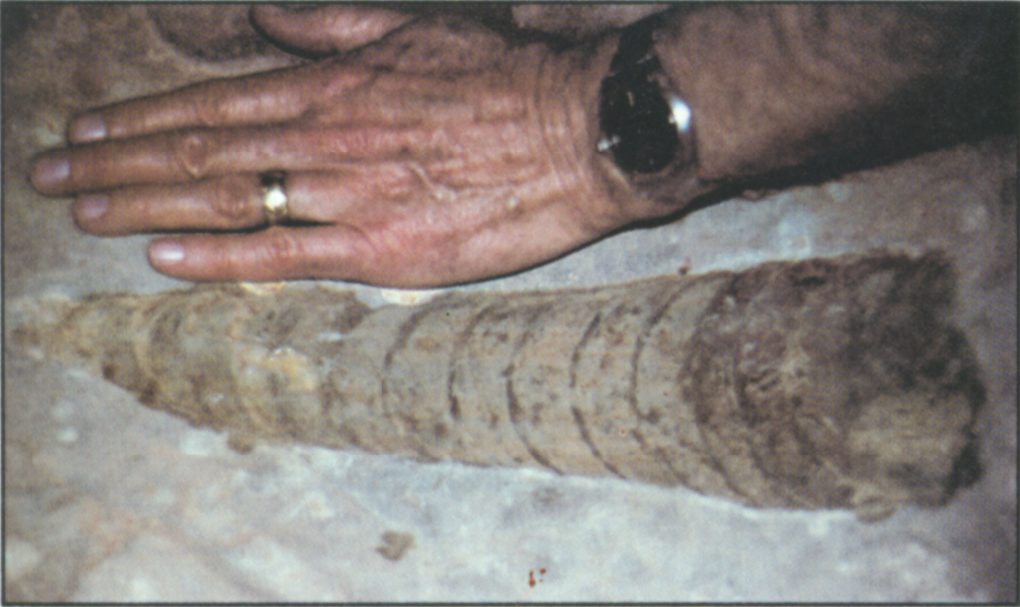
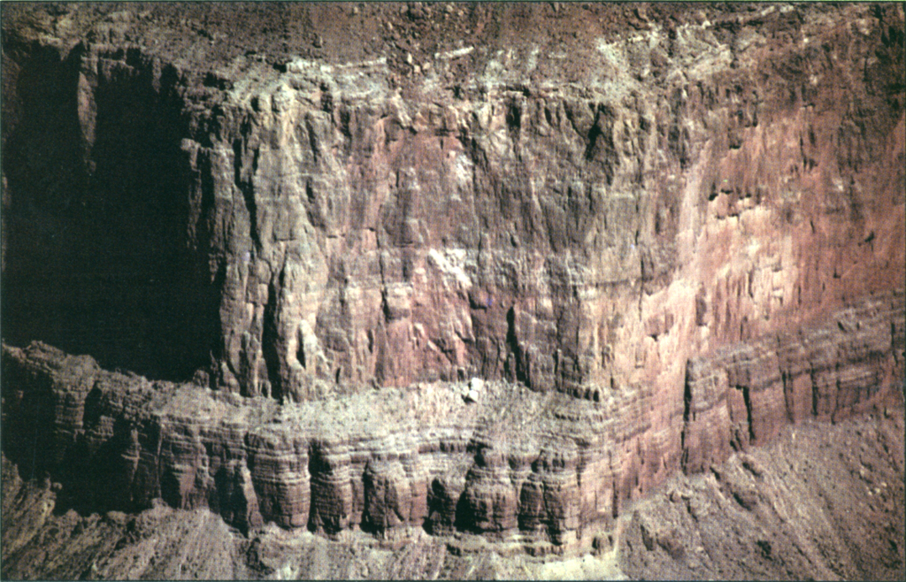

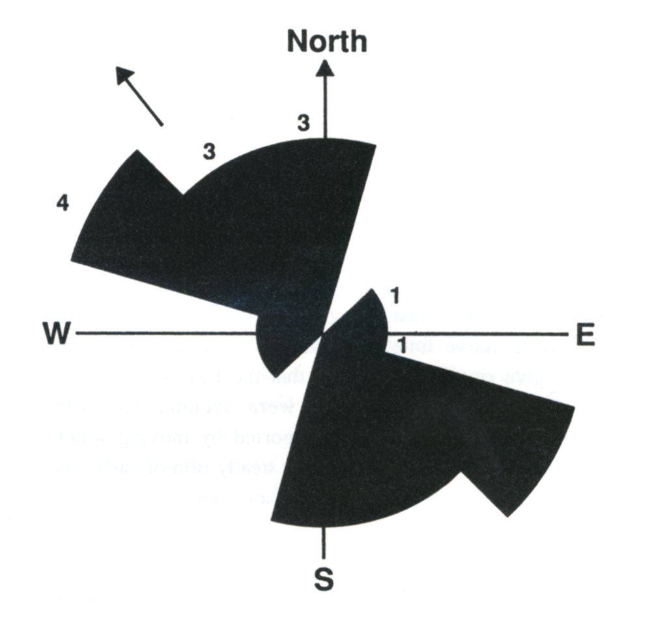
Nautiloid mass kill
Mass Kill Event
400 ft
11,500 mi.²
Nautiloid fossil
Redwall Limestone
15% buried upright
orthocone nautiloid
flow orientation
Notes:
Redwall Limestone (fine-grained lime mud deposit, red from iron oxide impurities):
400 ft thick covering 30,000 km2 (11,538 miles2) in N. Arizona and Nevada from Marble Canyon to Las Vegas.
Some of the lime (calcium carbonate) was precipitated from sea water, but Dr. Austin believes most of it was transported from a NW source(s)
Billions of nautiloids (similar to living spiral nautilus shell creatures in Indian Ocean) in 2 meter (7ft) thick bed (120 mi E/W x 30 mi N/S area) in Redwall (first found in 1966—Nautiloid Canyon)
nautiloid size range 2-7 ft (0.6-2.0 meters)
25% buried upright (point down), indicates rapid burial
A continental-wide sheet of water moving on a relatively level surface at an estimated speed of 5 m/s (18 km/hr or 11 mi/hr) did this (which is faster than any river rapids and is like water at the end of a water fall)!
Similar fossil beds have been found in other parts of the world, all pointing to a large body of rapidly moving water.
See Steve Austin's research in his ICC 2003 paper, "Nautiloid mass kill and burial event…" Artist rendition of living nautiloid is from my.erinet.com/ ~jwoolf/nautiloi.gif, downloaded 4 Nov 2004. Other three pictures are from Steve Austin, ed., Grand Canyon: Monument to Catastrophe (Santee, CA: ICR, 1994), p. 25 & 27.

Slide 103
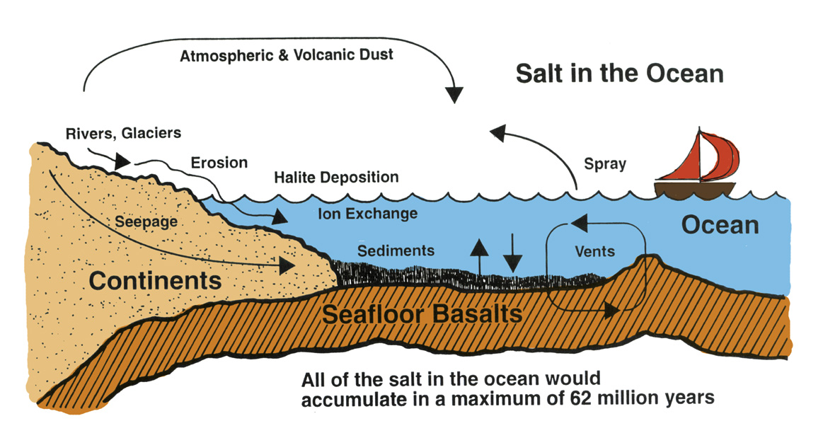
Age of ocean--salt
Salt in the Oceans
Age of ocean--salt
海洋中的盐
大气和火山尘埃
河流，冰川
侵蚀
喷雾
岩盐沉积
渗漏
离子交换
海洋
沉积物
发行
大洲
海底玄武岩
All the salt in the oceans would accumulate in a maximum of 62 million years.
在海洋中积累的盐
最多在6200万年。.
Notes:
Translate overlays at the right and then drag them over the above image
Only 27% of the 45 million tons of salt going into the oceans each year is being removed. So 3-4 times as much is going in as is going out. (ICR Impact article #384, June 2005, p. iii.)
Diagram: John Morris, The Young Earth (Master Books, 1994), 87.
Technical study: Steven A. Austin & D. Russell Humphreys, "The Sea's Missing Salt: A Dilemma for Evolutionists," in Robert Walsh, ed., Proceedings of the Second International Conference on Creationism (Pittsburgh: Creation Science Fellowship, 1990), II:17-33.

Slide 104



A&E on bones
X
Noah's
Flood
X

Slide 105

Noah and Family in Ark 02987

Slide 106

Evolutionized Worldview 00826
进化论的世界观
EVOLUTIONIZED WORLDVIEW
死亡流血苦难
疾病
数百万年
人的存在
世界
Notes:
Translate overlays at the right and then drag them over the above image

Slide 107

Partially Biblical
WORLDVIEW
完善
创造
灾难
十字架
败坏
混乱
基督
世界
X
X
X
X
X
X
X
X
Notes:
When Christians don't have the first four lenses (either denying them or ignoring some of the truths of Gen. 1-11), they too don't see (understand) things in the world clearly. They can see some things reasonably clearly (e.g., Jesus died for the sin problem caused by Adam, men are to be the loving heads of their homes and in the church, man is distinct from the animals and made in the image of God), but some things are distorted (e.g. age of the earth, death before the fall) and so they only have a partially biblical worldview, not a truly Christian worldview.

Slide 108
Black blank------------extras
END

Slide 109

OT Sermons link at biblestudydownloads.com
Get this presentation for free!

