Slide 1

Be
Changed
1 Samuel
Dr. Rick Griffith • Crossroads International Church Singapore
CICFamily.com • BibleStudyDownloads.org

Slide 2

Change
Do you like it?
Notes:
Do you like change?

Slide 3
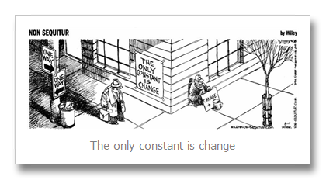
The only constant is change.
Notes:
Whether you like change or not, change is inevitable.

Slide 4
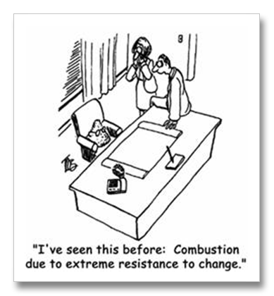
I've seen this before: Combustion due to extreme resistance to change.
Notes:
Some like it while others hate it, so some of us are early adopters while others are laggards. The majority tolerates it.

Slide 5

What changes are you experiencing right now?
Why?
Notes:
Job?
Body?
Relationships?
Something else?
• Why are you experiencing these changes right now?
If we are honest, we really don’t understand why change happens.
Is God causing it—or are you causing the change? I can comprehend why some of us initiate change, but…

Slide 6
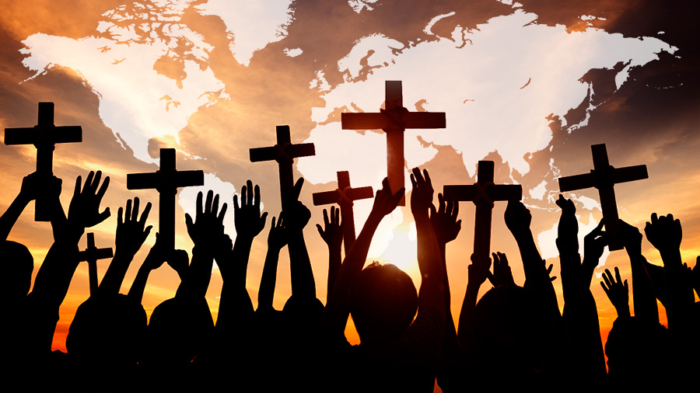
Why does God cause change?
Notes:
What reasons would the LORD have to make us have to adjust to new environments over and over?

Slide 7

Let's Study Through Scripture
The Bible: Book by Book
Notes:
We are in a study through the whole Bible right now, book by book. The goal is to give us a basic understanding of each book of the Bible.

Slide 8
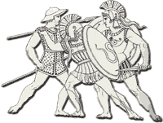
Morality & Politics
195
Poor moral values during Judges era
Weak & vulnerable to enemy attacks
Notes:
Judges had led Israel for 350 years with the only constant being change itself. Judge after judge came and left the scene, some good and some bad. Few agreed that the situation was sustainable. Change needed to happen because each person did what was right in his own eyes with enemies at the door.

Slide 9
Key Word
194
39
Transition
1 Samuel
Notes:
Too often we think of the period of the judges as limited only to the book of Judges. Yet it also includes Ruth and 1 Samuel, where Samuel himself was the final judge.

Slide 10
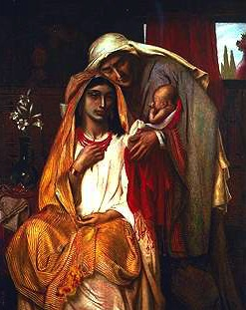
Genealogy of Perez
1. 2. 3. 4. 5. 6. 7. 8. 9. 10.
Perez Hezron Ram Amminadab Nahshon Salmon Boaz Obed Jesse David
Simeon Solomon's The Book of Ruth
Ruth 4:18-22
Notes:
If we keep reading right from the end of Ruth, we see Ruth concluding with its final word, “David.” We are left with the amazing realization that the whole story of Ruth was about David’s great-grandmother!

Slide 11
Theme
194
Degenerate Theocracy
to Davidic Monarchy
1 Samuel
Notes:
In 1 Samuel we will see why David was the climax of Ruth. All along, God’s plan was to delegate his authority to David and his descendants.

Slide 12

Purpose of this Book
196
Purpose of this Book
Theocracy
Monarchy
GOD AS
Man as
Notes:
The book of 1 Samuel gives the transitions necessary for that change to come about from a theocracy to a monarchy focused on David.

Slide 13
Change
FOR ISRAEL
FOR
US
1 Samuel
Notes:
Today we will see what God was doing in changing Israel’s situation
• and then see why change occurs for us today.

Slide 14
Why does God cause change?
Notes:
What reasons would the LORD have to make us have to adjust to new environments over and over?

Slide 15
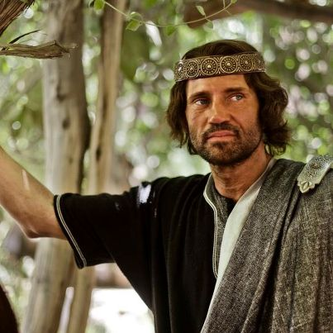
I. God had always planned to rule through Davidic kings.
Exegetical Idea of 1 Samuel
Notes:
The LORD even used Israel’s sin to bring in the monarchy under David.

Slide 16
Theology of Judges-Ruth-Samuel
193
Judges
Ruth
Samuel
Bethlehem
David
Boaz
Bethlehemites
Idolatry (17–18)
Concubine (19)
Gibeah
Murder (19–20)
Saul
Monarchy
Needed
Monarchy
Prepared
Monarchy
Established
Adapted from Thomas L. Constable, "A Theology of Joshua, Ruth, and Judges,"
in A Biblical Theology of the OT, ed. Roy B. Zuck, 95-96, 117

Slide 17
Slides on
1 Samuel 1
Notes:
Israel’s first national leadership transition from Eli to Samuel came by Samuel's birth, call, and acceptance over Eli's wicked house to prepare for the prophesied monarchy (1 Sam 1–3).

Slide 18
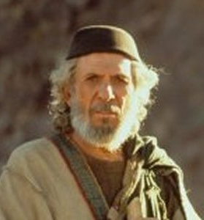
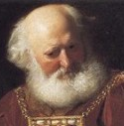
Transition #1
196
1 Samuel
1 Samuel
Eli
Samuel
Notes:
The first transition of national leadership from Eli to Samuel marked the end of judges with Samuel as the last judge (1 Sam 1–7).

Slide 19
Book Chart
Degenerate Theocracy to Davidic Monarchy
Theocracy Ended |  | Monarchy Established
Decline of Judges |  | Rise of Kings
Chapters 1–7 |  | Chapters 8–31
Samuel: "Heavenly King" |  | Saul: "Earthly King"
Eli | Samuel | Saul |  | David
Man After Man's Heart | Man After God's Heart | Man After Man's Heart |  | Man After God's Heart
Paralysis | Prayer | Panic |  | Patience
Transition #1 Eli to Samuel (1–3) | Samuel & Ark’s Wanderings (4–7) | Transition #2 Samuel to Saul (8–12) | Saul Rejected (13–15) | Transition #3 Saul to David (16–31)
c. 94 Years
Birth of Samul (1105 BC) to Death of Saul (1011 BC)
203
1 Samuel:
194

Slide 20
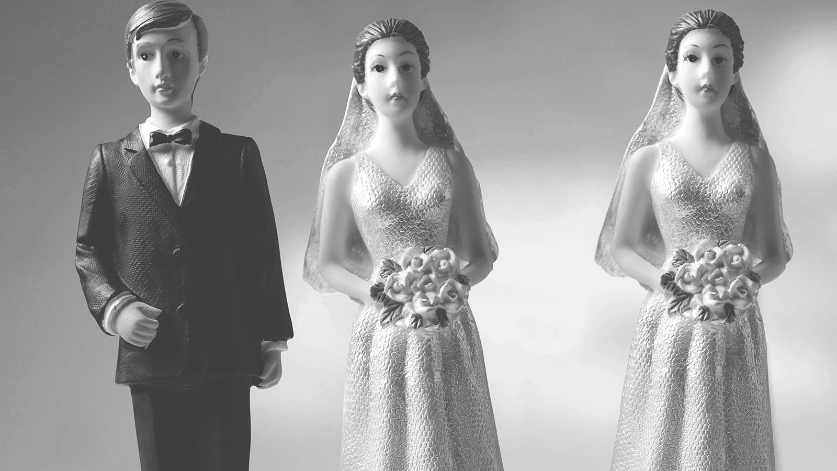
One wife is enough!
197

Slide 21

Barrenness in a Mother’s World
197

Slide 22
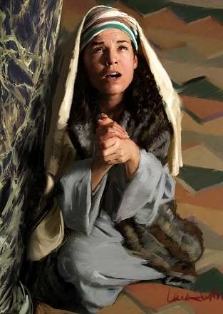
Hannah Prays for a Son
197

Slide 23
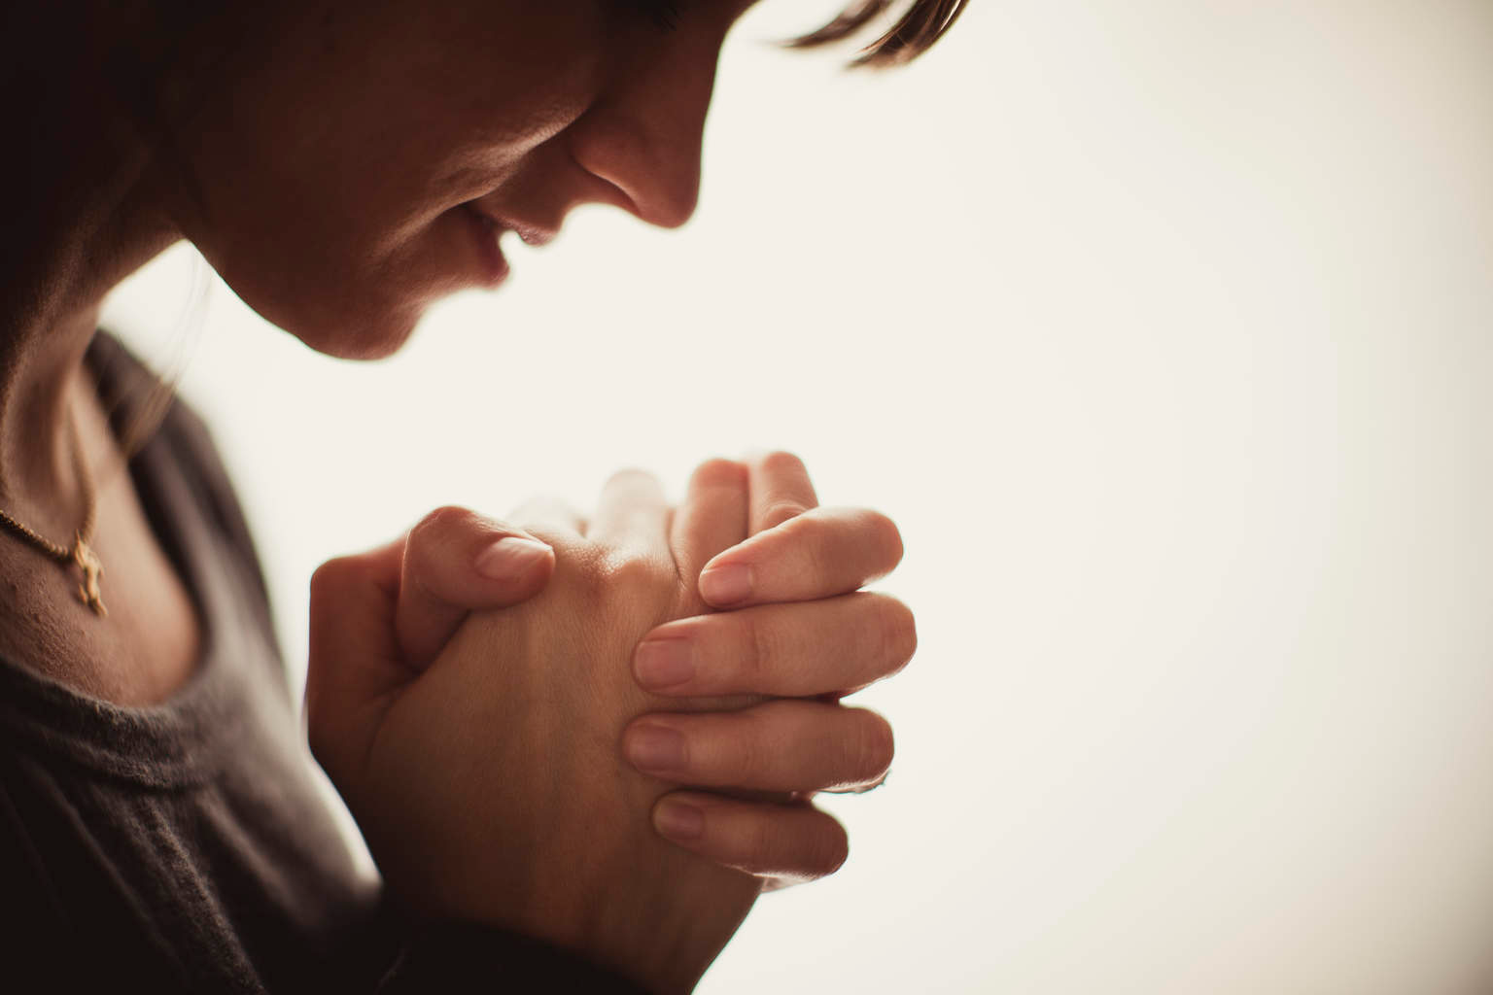
God knows our heart's prayers
197

Slide 24
Slides on
1 Samuel 2
Notes:
Hannah's prophetic prayer praised God's attributes and his future provision of kings (2:1-11).

Slide 25
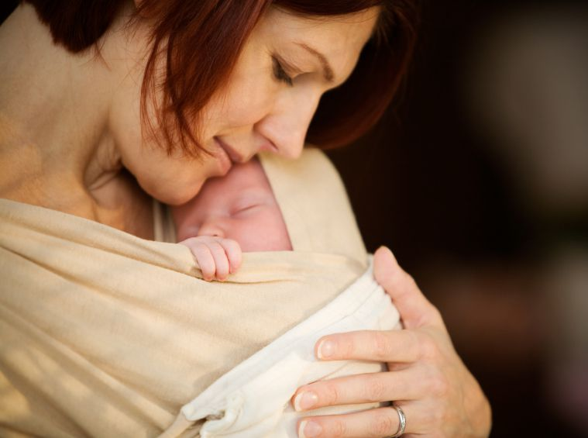
God Answers
197

Slide 26
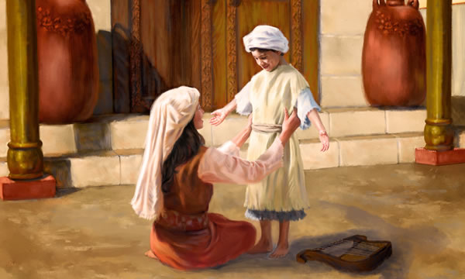
Hannah Cares for Samuel
197

Slide 27
Biographical Contrast by Interchange (1 Sam 1–12)
201
1:1–2:11
2:18-21
2:26
3:1-4:1a
7:3–12:25
Samuel
But Samuel
Samuel
Samuel
Samuel
Eli's Sons
Eli & Sons
Eli & Sons
Eli & Sons (Plus Results)
2:12-17
2:22-25
2:27-36
4:1b–7:2
Donald K. Campbell, Dallas Seminary handout

Slide 28
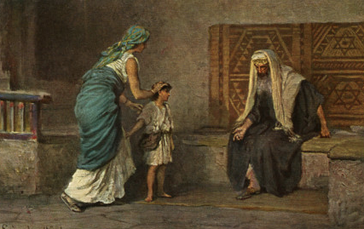
Hannah brings Samuel to Eli
197

Slide 29
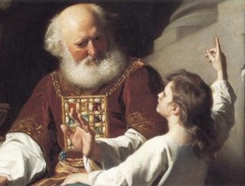
Eli & Samuel
197

Slide 30
Slides on
1 Samuel 3
Notes:
Samuel's call by the LORD and acceptance by the people verified the leadership transition from Eli to Samuel (1 Sam 3).

Slide 31

The Boy Samuel
197

Slide 32
Slides on
1 Samuel 4
Notes:
Israel showed its need for Samuel's leadership in their ignorance of the character of God evident in their superstitious use of the ark to fight the Philistines (1 Sam 4–7).

Slide 33
Book Chart
Degenerate Theocracy to Davidic Monarchy
Theocracy Ended |  | Monarchy Established
Decline of Judges |  | Rise of Kings
Chapters 1–7 |  | Chapters 8–31
Samuel: "Heavenly King" |  | Saul: "Earthly King"
Eli | Samuel | Saul |  | David
Man After Man's Heart | Man After God's Heart | Man After Man's Heart |  | Man After God's Heart
Paralysis | Prayer | Panic |  | Patience
Transition #1 Eli to Samuel (1–3) | Samuel & Ark’s Wanderings (4–7) | Transition #2 Samuel to Saul (8–12) | Saul Rejected (13–15) | Transition #3 Saul to David (16–31)
c. 94 Years
Birth of Samul (1105 BC) to Death of Saul (1011 BC)
203
1 Samuel:
194

Slide 34
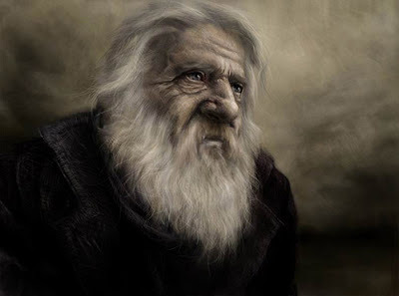
"And Samuel's word came to all Israel"
(1 Samuel 4:1 NIV)
197
Notes:
The Philistine capture of the ark and deaths of Eli and his sons fulfilled the LORD's prophecy against Eli and showed their need for a new leader due to confusion over God's omnipresence (1 Sam 4).

Slide 35
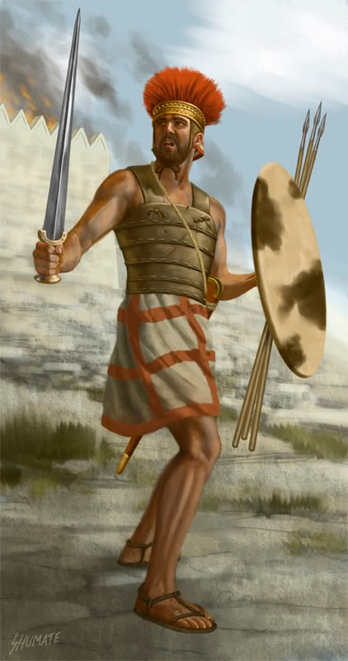
A Rough Start as Judge
197
The Philistines defeat Israel
They capture the Ark of the Covenant too
1 Sam 4

Slide 36
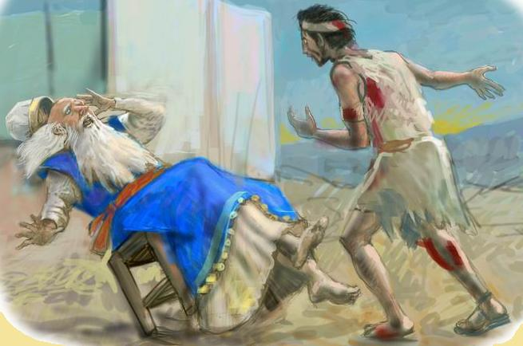
News Brought to Eli (1 Sam 4:18)
197

Slide 37
Slides on
1 Samuel 5
Notes:
The ark’s superiority over Dagan in the Philistine camp showed God's omnipotence over all gods and grace even in Israel’s disobedience (1 Sam 5).

Slide 38
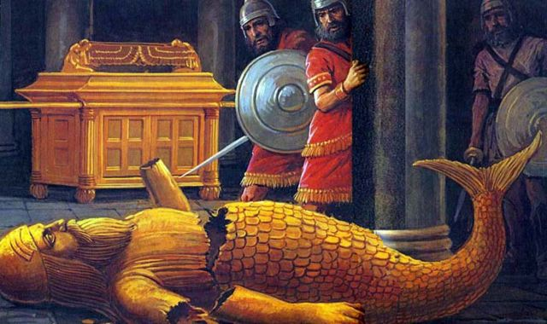
Dagan Shamed at Ashdod
(1 Samuel 5:4)
197

Slide 39
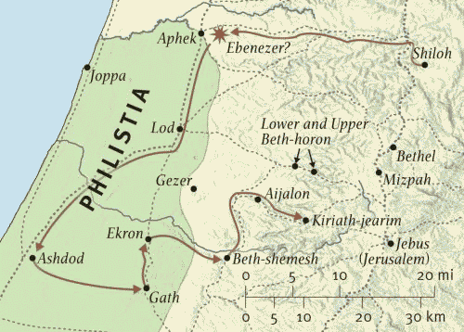
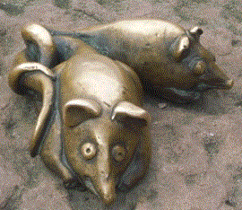
Route of the Ark (1 Samuel 5)
197

Slide 40
Slides on
1 Samuel 6

Slide 41

What should Israel's next move be to protect the Ark of God?
197

Slide 42
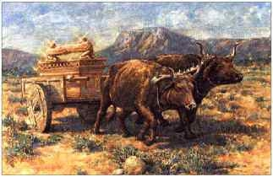
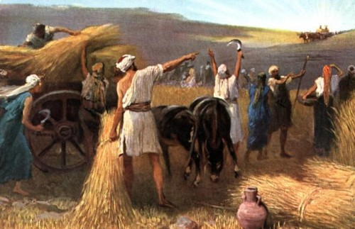
The Ark Returned
197
The Ark was returned to the Israelites at Beth Shemesh.
The Ark was restored to Kiriath Jearim
1 Sam 6

Slide 43
Slides on
1 Samuel 7

Slide 44
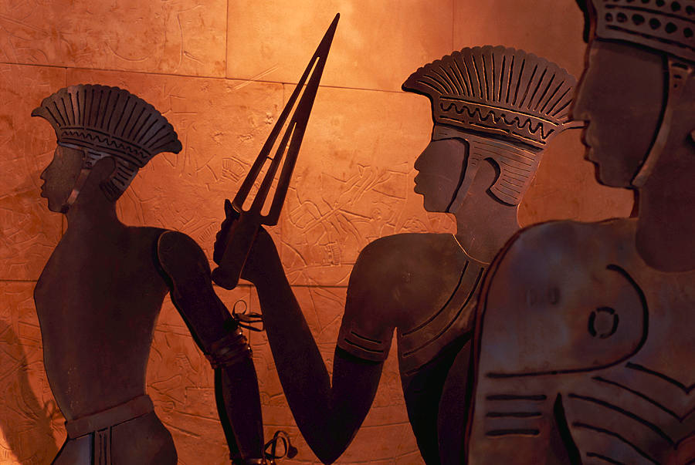
Samuel Subdues the Philistines at Mizpah (1 Samuel 7:2-17)
197

Slide 45
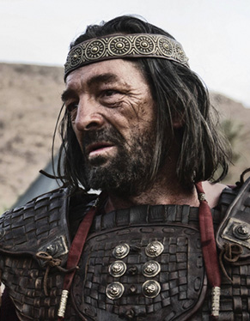
Transition #2
196
1 Samuel
1 Samuel
Samuel
Saul
Notes:
The second transition of national leadership from Samuel to Saul marked the start of the monarchy due to Israel's evil motives (1 Sam 8–12).

Slide 46
Slides on
1 Samuel 8

Slide 47

Key Verse
Key Verse
194
1 Sam. 8:5
Let's read it
Was it a good idea for Israel to ask for a king?
Why or why not?
  Premature
  Wrong motive

Slide 48
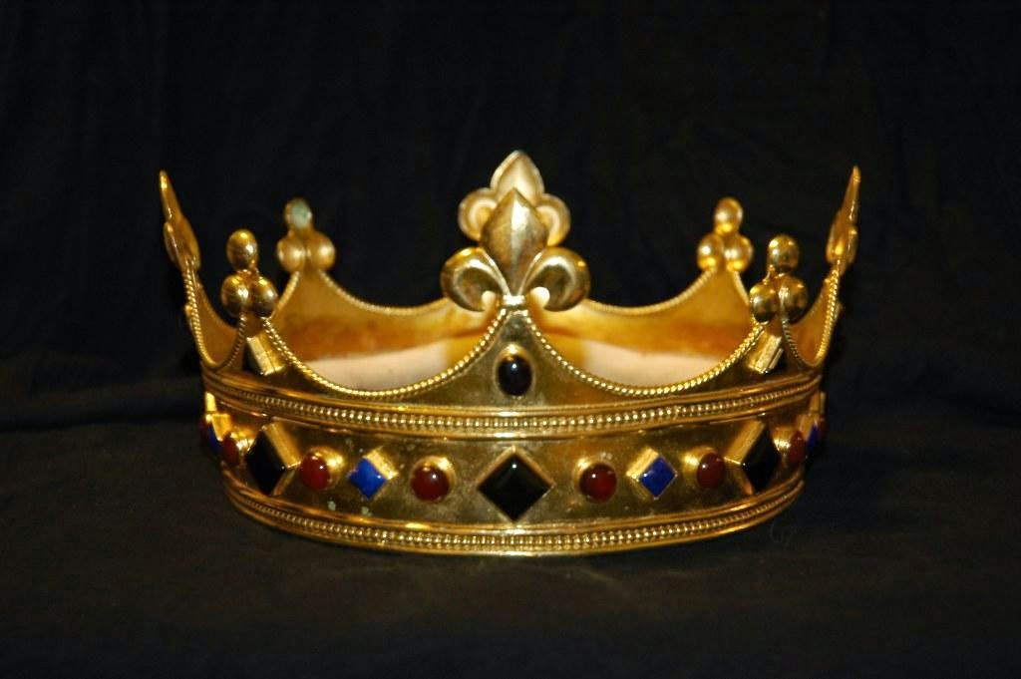
Who deserved the crown?
197

Slide 49

Matthew: Christ as King
"Judah, my son, is a young lion that has finished eating its prey. Like a lion he crouches and lies down; like a lioness—who dares to rouse him?
¹⁰The scepter will not depart from Judah, nor the ruler's staff from his descendants, until the coming of the one to whom it belongs, the one whom all nations will honor" (NLT).
Since Jacob's blessing in Genesis 49:9-10, the lion has depicted a king…

Slide 50
Book Chart
Degenerate Theocracy to Davidic Monarchy
Theocracy Ended |  | Monarchy Established
Decline of Judges |  | Rise of Kings
Chapters 1–7 |  | Chapters 8–31
Samuel: "Heavenly King" |  | Saul: "Earthly King"
Eli | Samuel | Saul |  | David
Man After Man's Heart | Man After God's Heart | Man After Man's Heart |  | Man After God's Heart
Paralysis | Prayer | Panic |  | Patience
Transition #1 Eli to Samuel (1–3) | Samuel & Ark’s Wanderings (4–7) | Transition #2 Samuel to Saul (8–12) | Saul Rejected (13–15) | Transition #3 Saul to David (16–31)
c. 94 Years
Birth of Samul (1105 BC) to Death of Saul (1011 BC)
203
1 Samuel:
194

Slide 51
Slides on
1 Samuel 9
Notes:
Samuel privately anointed Saul as king to prepare him for public coronation (9:1–10:16).

Slide 52
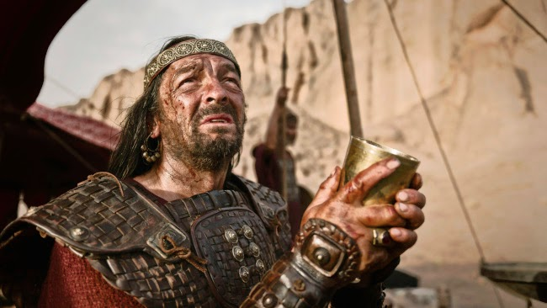
What kind of man was Saul?
198

Slide 53
Slides on
1 Samuel 10
Notes:
Samuel publicly made Saul king as an official declaration of God's displeasure with the nation's decision (10:17-27).

Slide 54

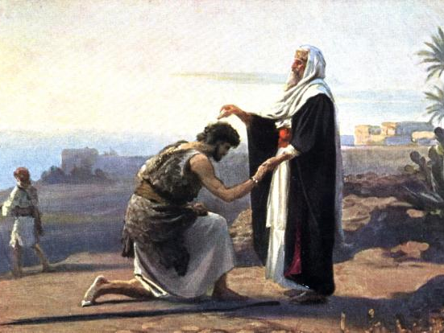
Saul Anointed King
198
1 Samuel 10:1
Notes:
The anointing started very private but then ended up before the entire nation!

Slide 55
Slides on
1 Samuel 11
Notes:
Saul's rescue of Jabesh Gilead and confirmation at Gilgal confirmed him as king in Israel’s eyes (1 Sam 11).

Slide 56
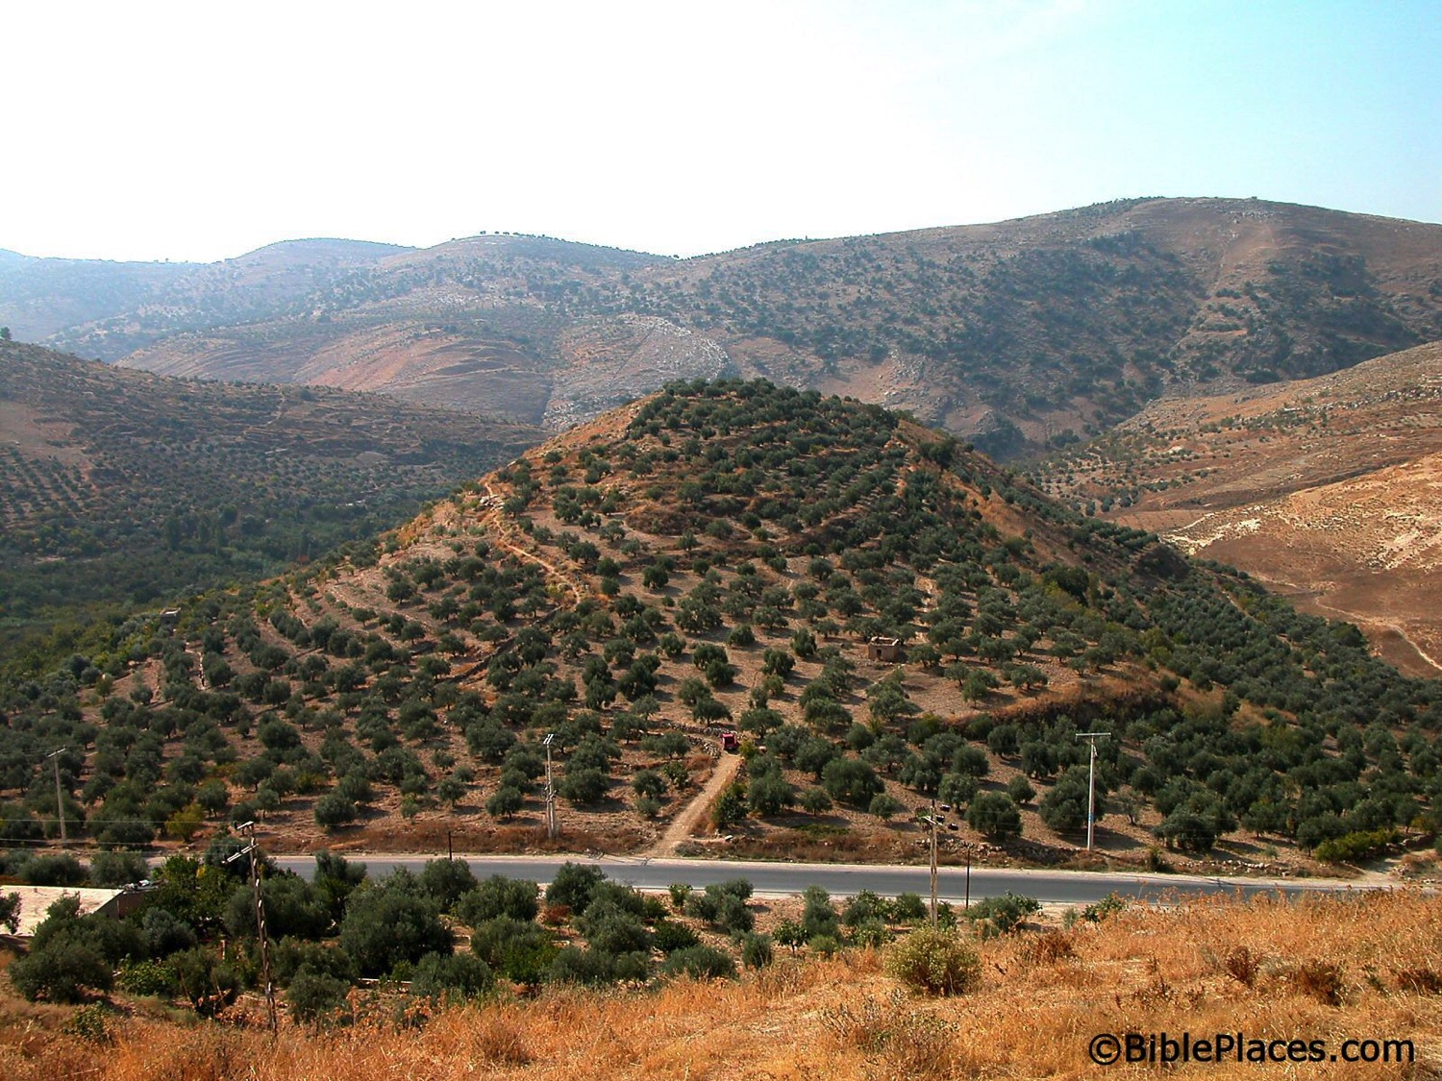
A Great Start as King
198
Tell of Jabesh Gilead (now an olive orchard, never excavated)
Saul led Israelites to victory at Jabesh Gilead (1 Sam 11)

Slide 57
Slides on
1 Samuel 12
Notes:
In Samuel’s retirement speech as judge (but not prophet), he reminded Israel of their sin of asking for a king to motivate them to live based on the Mosaic covenant (1 Sam 12).

Slide 58
The Beginning of…
198
1 Sam 12

Slide 59
Slides on
1 Samuel 13
Notes:
Saul's impatience and fear of the Philistines by having priests offer sacrifices before the required seven days results in Samuel hinting at the LORD had already appointed a godly king (13:1-22).

Slide 60
Book Chart
Degenerate Theocracy to Davidic Monarchy
Theocracy Ended |  | Monarchy Established
Decline of Judges |  | Rise of Kings
Chapters 1–7 |  | Chapters 8–31
Samuel: "Heavenly King" |  | Saul: "Earthly King"
Eli | Samuel | Saul |  | David
Man After Man's Heart | Man After God's Heart | Man After Man's Heart |  | Man After God's Heart
Paralysis | Prayer | Panic |  | Patience
Transition #1 Eli to Samuel (1–3) | Samuel & Ark’s Wanderings (4–7) | Transition #2 Samuel to Saul (8–12) | Saul Rejected (13–15) | Transition #3 Saul to David (16–31)
c. 94 Years
Birth of Samul (1105 BC) to Death of Saul (1011 BC)
203
1 Samuel:
194

Slide 61
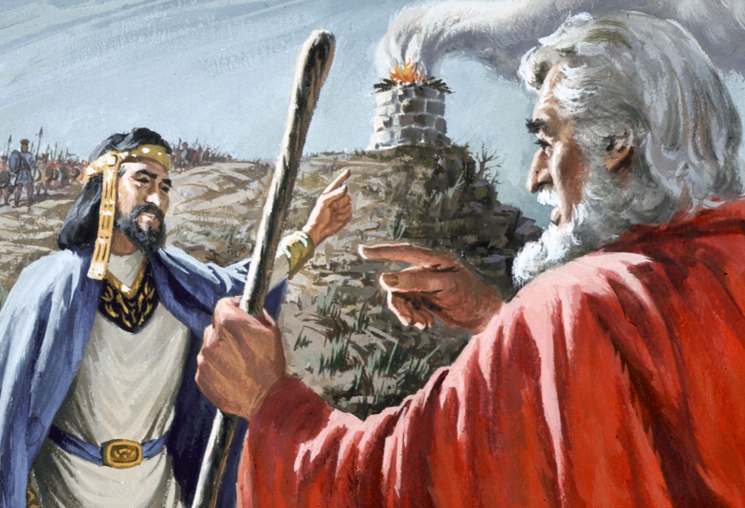
Saul's excuses (1 Samuel 13)
198

Slide 62
Slides on
1 Samuel 14
Notes:
Saul's rashness by preventing his men from food and leading them to eat blood unlawfully shamed him in his vow to kill the "disobedient" Jonathan and showed his godless rule (13:23–14:52).

Slide 63
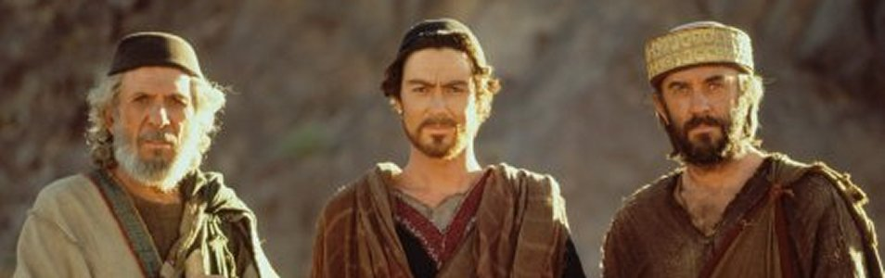
Samuel, David & Saul
198
Notes:
Saul's rashness by preventing his men from food and leading them to eat blood unlawfully shamed him in his vow to kill the "disobedient" Jonathan and showed his godless rule (13:23–14:52).

Slide 64
Slides on
1 Samuel 15
Notes:
Saul's disobedience by not completely destroying the Amalekites was his last act of disobedience before the LORD rejected him as king to show Israel's need for a righteous king (1 Sam 15).

Slide 65

Saul's Refusal to Destroy the Amalekites (1 Sam. 15)
198
1 Sam 15

Slide 66

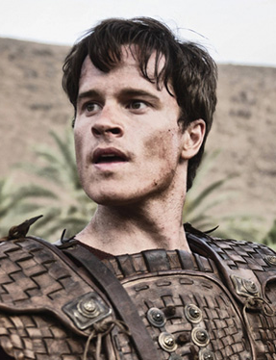
Transition #3 from Saul to David
Transition #3
198
1 Samuel
1 Samuel
Saul
David
Notes:
The third transition moved the kingship from the tribe of Benjamin (in Saul) to the tribe of Judah (David). In fact, Saul dies a tragic death in the final chapter of 1 Samuel.

Slide 67
Slides on
1 Samuel 16
Notes:
Saul and David were friends while David rose as his musician and warrior (1 Sam 16–17).

Slide 68
Book Chart
Degenerate Theocracy to Davidic Monarchy
Theocracy Ended |  | Monarchy Established
Decline of Judges |  | Rise of Kings
Chapters 1–7 |  | Chapters 8–31
Samuel: "Heavenly King" |  | Saul: "Earthly King"
Eli | Samuel | Saul |  | David
Man After Man's Heart | Man After God's Heart | Man After Man's Heart |  | Man After God's Heart
Paralysis | Prayer | Panic |  | Patience
Transition #1 Eli to Samuel (1–3) | Samuel & Ark’s Wanderings (4–7) | Transition #2 Samuel to Saul (8–12) | Saul Rejected (13–15) | Transition #3 Saul to David (16–31)
c. 94 Years
Birth of Samul (1105 BC) to Death of Saul (1011 BC)
203
1 Samuel:
194

Slide 69
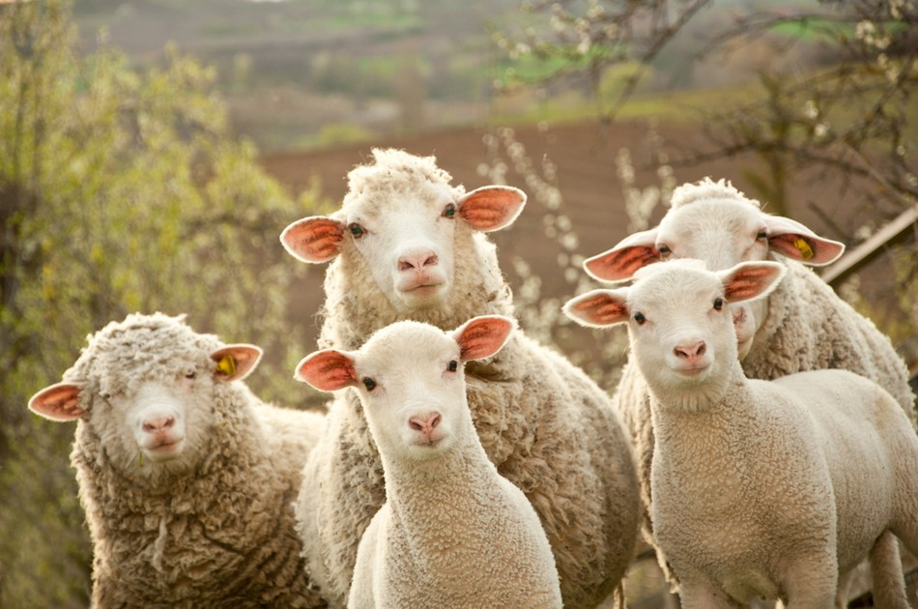
David's Sheep
198
Notes:
Hidden valleys are where shepherds are turned into kings.
What you do in secret is the most important things about you.
David cared for sheep when no one but God was looking.

Slide 70
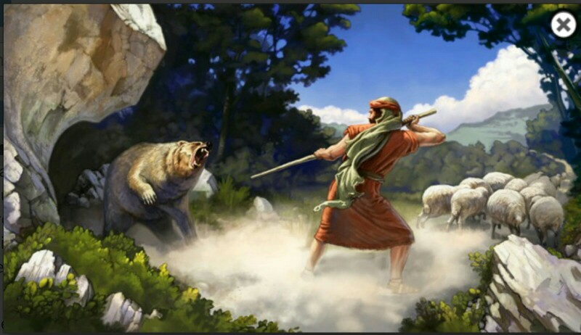
David's Courage
198
Notes:
David's care for the sheep was tested by a lion and a bear and who-knows what else?

Slide 71
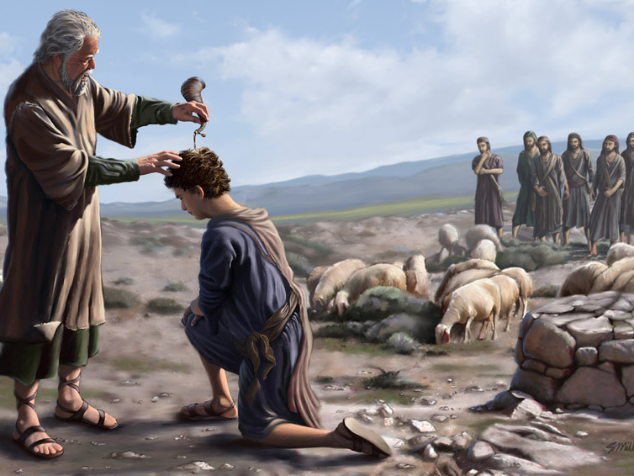
Samuel Anointed David
198
1 Sam 16
Notes:
In a rather humorous account where David wasn't even invited to his family feast, God passed by his handsome brothers because God doesn't look at the outside. Even Samuel was initially fooled by David's ruddy appearance.

Slide 72
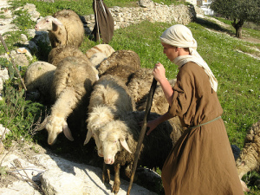
Who was David?
198
David
Youngest son of Jesse
Handsome, strong, courageous
Shepherd tending his father's sheep
Strong arms, excellent harpist
1 Sam 16

Slide 73
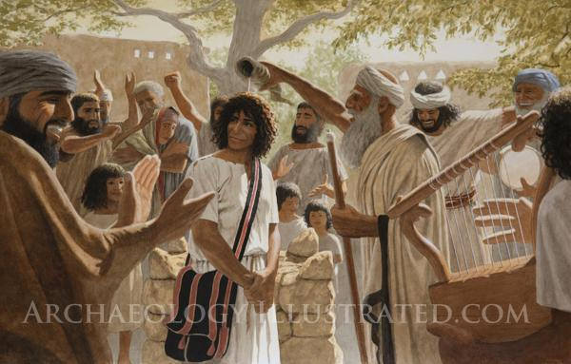
God's Work in David
1 Sam 16
198
David
Chosen by the LORD
Anointed as Israel's 2nd king
Spirit of God came upon Him with power

Slide 74
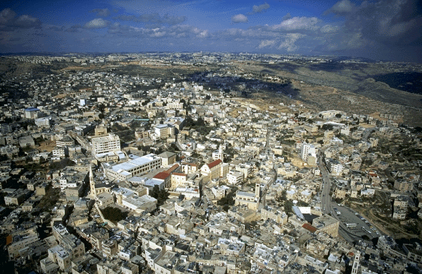
Bethlehem
Bethlehem: David was anointed king by Samuel here (1 Sam 16:13,15)
Zondervan Atlas

Slide 75
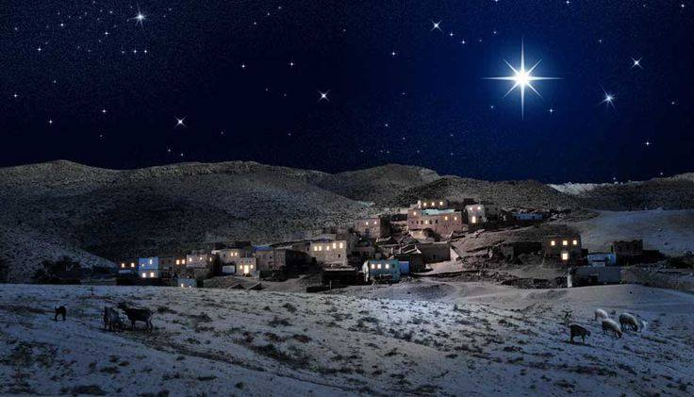
Bethlehem
Bethlehem plays a much larger role in ther New Testament as the birthplace of Jesus
Zondervan Atlas

Slide 76
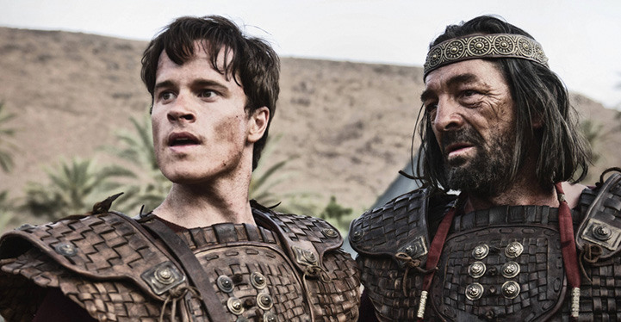
David & Saul
198

Slide 77

David in the King's Court
198
The Spirit of God left King Saul
An evil spirit tormented him
David rescued him by playing harp to relieve the king
1 Sam 16

Slide 78
Slides on
1 Samuel 17
Notes:
David's victory over Goliath won Saul's approval as one of his warriors (1 Sam 17).

Slide 79
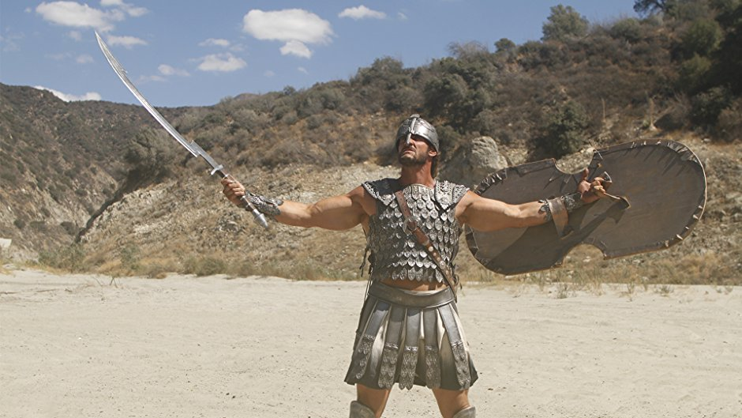
David's Enemy

Slide 80
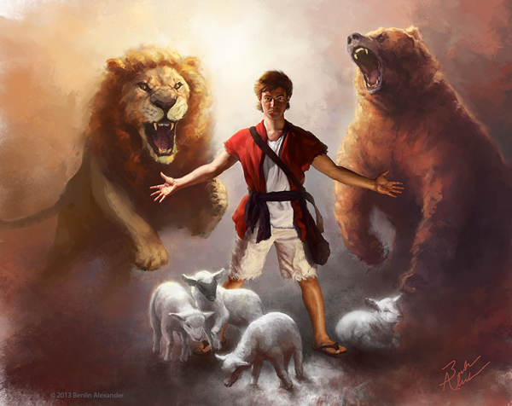
David's Courage

Slide 81
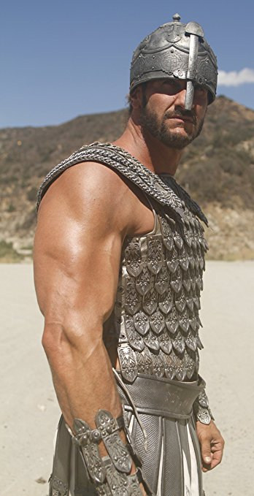
First Victory!
198
David Over Goliath
David won with only a sling & stone
Read: 1 Sam. 17:45-47
The LORD was with David
1 Sam. 17

Slide 82
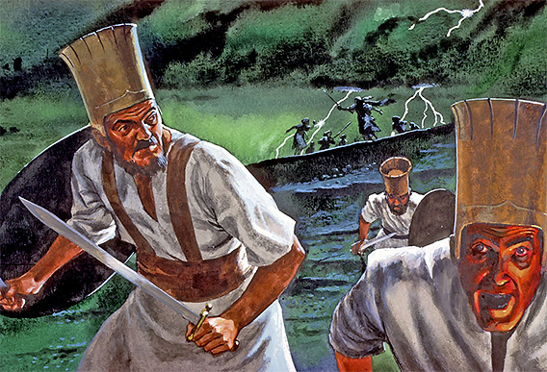
Result: Philistines Flee
198
1 Sam 17

Slide 83
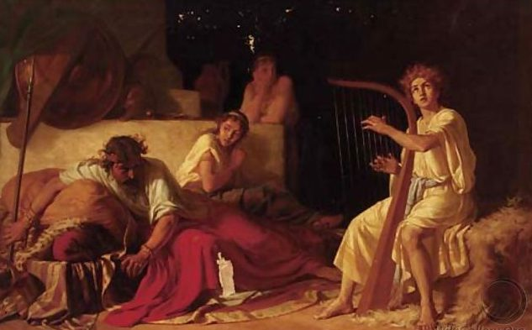
Saul initially trusted David
198

Slide 84
Slides on
1 Samuel 18
Notes:
Saul and David were enemies when Saul exiled him and attempted to kill him, thus teaching him valuable lessons that would enable him to rule righteously (1 Sam 18–27).
Saul attempted to kill David out of jealousy over God's blessing on his life as a carnal response to God’s revealed will (18:10–20:42).

Slide 85
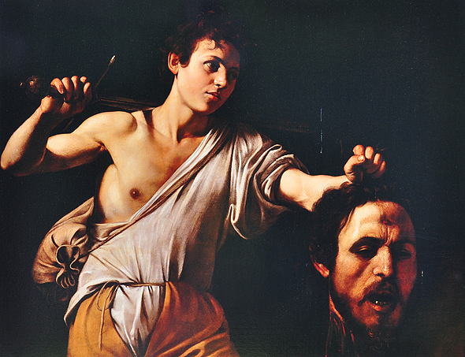
David Beheads Goliath
(1 Sam 17:57)

Slide 86
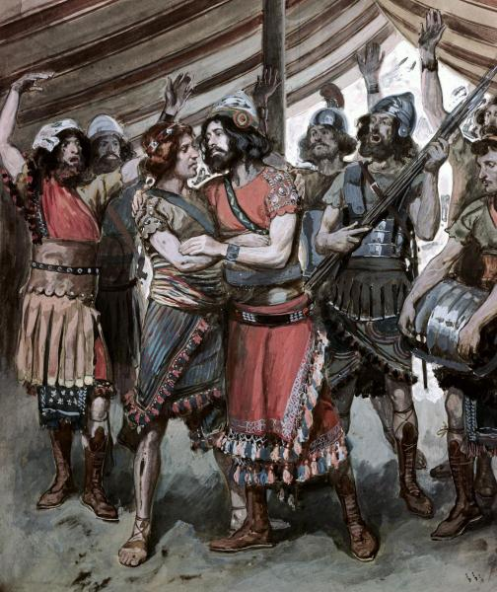
Jonathan & David
(1 Sam 18:1)
198
Notes:
"While still holding the dripping head of Goliath, David appears before Saul, who asks about his family. In the king's tent at that time is Saul's son and heir, Jonathan. He is probably a decade older than David, but there is an instant bond between the two.
David's Bond with Jonathan (18:1)
"After David had finished talking with Saul, Jonathan became one in spirit with David, and he loved him as himself." (18:1)
3. Jonathan's Friendship, Saul's Jealousy (1 Samuel 18-20)
by Dr. Ralph F. Wilson
Audio (29:42)
http://www.jesuswalk.com/david/03_david_jonathan.htm
Accessed 11 Nov 2017
_________
Picture by James J. Tissot, detail of 'Friendship of David and Jonathan' (1896-1902) gouache on board, Jewish Museum, New York. David is on the left, Jonathan on the right.

Slide 87
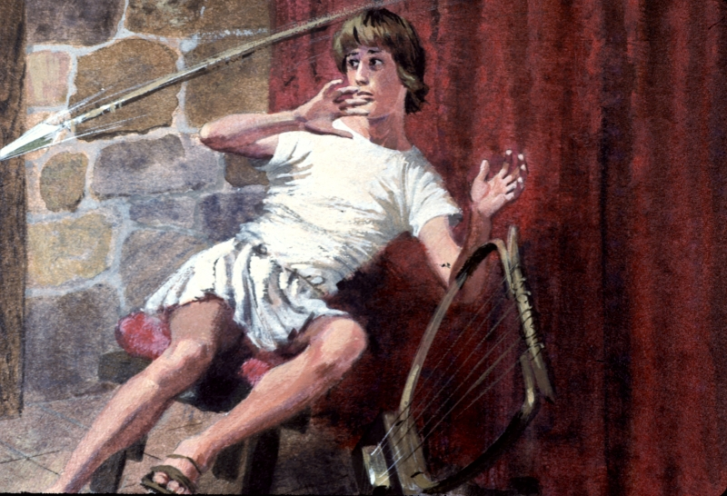
Saul's Jealousy of David
David's prestige
Saul's jealousy
So Saul tried to kill David
The LORD was with David but had left Saul
1 Sam. 18–19

Slide 88
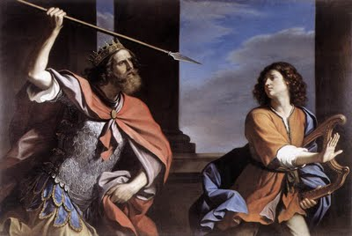
Saul distrusts David
198

Slide 89

Paranoia
198

Slide 90
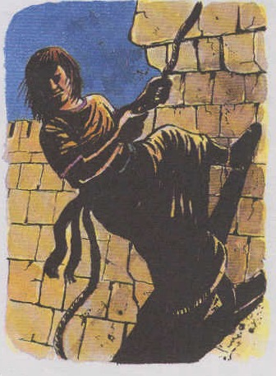
David the Refugee
198
Was loved by his wife Michal
She deceived her father (Saul) to help David flee and escape from being killed by her father
1 Sam. 18–19

Slide 91
Slides on
1 Samuel 19
Notes:
Saul attempted to kill David out of jealousy over God's blessing on his life as a carnal response to God’s revealed will (18:10–20:42).

Slide 92


David the fugitive
198
Notes:
Saul tried to kill David by throwing a spear at him (18:10-16).
Saul tried to kill David by tricking him to fight the Philistines (18:17-30).
Saul tried to kill David by commanding his servants to kill David (19:1-7). Saul tried to kill David by throwing a spear at him again (19:8-10).
Saul tried to kill David by sending messengers to kill him (19:11-17).
Saul tried to kill David by seeking his life at Samuel's house (19:18-24).

Slide 93
Slides on
1 Samuel 27
Notes:
At Gath and Ziklag, David developed his leadership and combat skills by carrying out raids against peoples south of the Philistines (1 Sam 27).

Slide 94


A Tale of Three Kings
198
The Three Kings:
Saul
David
Absalom
Notes:
Application: When an oppressive superior mistreats you (like Saul mistreated David), how do you respond? If you do not learn submission and brokenness, eventually when you get into a position of authority, you too could become a “Saul” who grasps for power! Learn the lesson of David. As we will see in 2 Samuel, David eventually had plenty of opportunities to imitate Saul—especially when his son Absalom claimed to be the rightful “third king” after Saul and David. This decision of David not to become a Saul is well said in this modern classic for those in ministry transition: Gene Edwards, A Tale of Three Kings: A Study in Brokenness (Wheaton, IL: Tyndale, 1980, 1982). It’s a fast-moving, stirring, and biblical account of only 98 pages.

Slide 95

David exults in God alone
198

Slide 96
Slides on
1 Samuel 28

Slide 97

Saul's Final Decline!
199
Philistines set up camp and Saul was afraid
Inquired of the LORD how to deal with the Philistine army
- What did the LORD say?
Reply
1 Sam. 28

Slide 98

Saul Consulted a Medium
199
Succumbed to
idol worship
Disobeyed the LORD!
1 Sam. 28

Slide 99

The witch of Endor was a fake
198

Slide 100
Slides on
1 Samuel 29

Slide 101

David Enlisted by Achish & Rejected
140
Phoenicia
Aram
1 Samuel 29
Gilboa
Israel
Ammon
Philistia
Moab
Egypt
Edom

Slide 102

David Pretended to Befriend Philistines
200
What about David?
Found strength in the LORD and continued to pursue and obey the LORD in his undertaking
1 Sam. 29

Slide 103
Slides on
1 Samuel 30

Slide 104
David Pursues the Amalekites
140
Phoenicia
Aram
1 Samuel 30
Gilboa
Israel
Ammon
Philistia
Moab
Ziklag
Egypt
Amalekites
Edom

Slide 105
Slides on
1 Samuel 31

Slide 106

Saul died with his sons Jonathan, Abinadab, and Malkishua (1 Sam. 31:2)
200

Slide 107

Saul killed himself
(1 Sam. 31:4) but an Amalekite lied by saying he did it instead (2 Sam. 1:10)
200

Slide 108
Saul's Body
After Saul's death men from Jabesh Gilead courageously took his body off the wall of Beth Shan
200
Tell of Jabesh Gilead (now an olive orchard, never excavated)

Slide 109
I. God had always planned to rule through Davidic kings.
Exegetical Idea of 1 Samuel
Notes:
The LORD even used Israel’s sin to bring in the monarchy under David.

Slide 110

II. God initiates change to fulfill his plans for us.
Main Idea of 1 Samuel
Notes:
The LORD alters our lives to focus on his purposes.

Slide 111

Sometimes change comes though our desire to be like the world
Notes:
I don’t see the world trying to be like the church much, but I do see the church trying to be like the world in many ways—dress, authority, morality, technology, etc.
Our “been there, done that” types of regrets in our lives cause us to change.
We can learn from the mistakes of others since none of us will live long enough to make all the mistakes ourselves.

Slide 112

The better way to change is for us to let God lead us
Text

Slide 113
"The world has yet to see what God can do through one man who is totally yielded to him"
—Dwight L. Moody—
Notes:
If you gave complete control of your life to God, what would change?
Would you still have the same habits?
Would you still have the same job?
Where would you live?
What would you be doing?

Slide 114
Why does God cause change?
Notes:
Restatement

Slide 115
I. God had always planned to rule through Davidic kings.
Exegetical Idea of 1 Samuel
Notes:
The LORD even used Israel’s sin to bring in the monarchy under David.

Slide 116
II. God initiates change to fulfill his plans for us.
Main Idea of 1 Samuel
Notes:
The LORD alters our lives to focus on his purposes.

Slide 117
Be
Changed
1 Samuel
Dr. Rick Griffith • Crossroads International Church Singapore
CICFamily.com • BibleStudyDownloads.org
Notes:
So what should we do (Exhortation)?
Be changed! (Notice the title of this sermon.)

Slide 118

Change
Notes:
Do you fear change? Then change your view of change! Max Lucado said, “The circumstances we ask God to change are often the circumstances God is using to change us.”

Slide 119

If nothing ever changed, there'd be no butterflies.
—Unknown
Notes:
Be open to God initiating any change he wants in your life. As someone said, “If nothing ever changed, there’d be no butterflies.” Be that butterfly.

Slide 120

Change
Notes:
Are you willing for God to make whatever change in your life that he wants? Then tell him. Tell him that you want “The Power of Your Love” as the song says.

Slide 121
Black

Slide 122


OT Preaching link at BibleStudyDownloads.org
Get this presentation and script for free!

