Slide 1
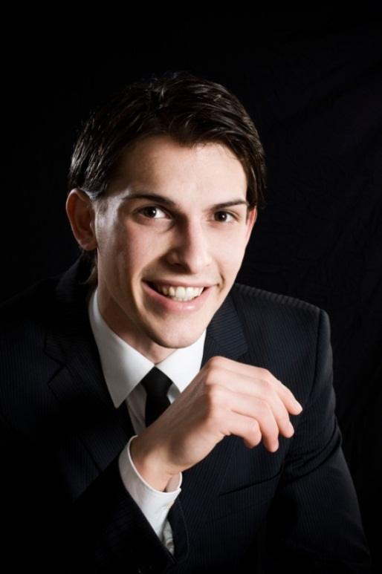
1 SAMUEL 18
Enjoying God's Blessings
Dr Scott Wooddell Eastridge Park Christian Church, Mesquite, Texas Uploaded by Dr. Rick Griffith • Jordan Evangelical Theological Seminary Files in many languages for free download at BibleStudyDownloads.org

Slide 2
1 SAMUEL 18
How can I enjoy the blessings of the Lord?

Slide 3
1. DAVID IS BLESSED OF THE LORD
“In everything he did he had great success because the Lord was with him.” (v. 14)
David
Jonathan pledges his allegiance to David
The people pledge their allegiance to David
Michal pledges her allegiance to David

Slide 4
1. DAVID IS BLESSED OF THE LORD
“The next day an evil spirit from God came forcefully upon Saul. He was prophesying in his house, while David was playing the harp, as he usually did.”
“Saul had a spear in his hand and he hurled it saying to himself, ‘I’ll pin David to the wall.’” (v. 10)

Slide 5
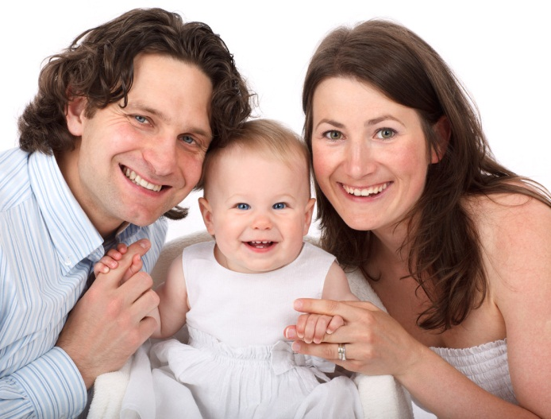
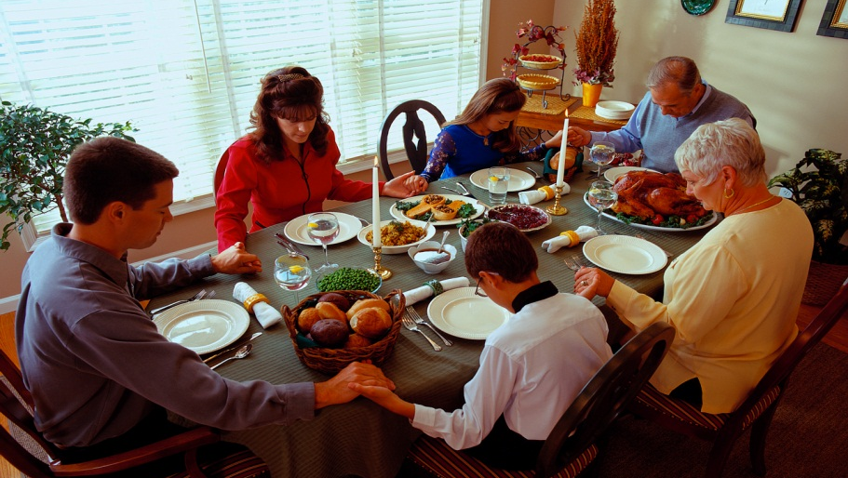
2. WE CAN BE BLESSED OF THE LORD
The Lord bless you and keep you.
The Lord make His face to shine upon you and be gracious to you.
The Lord lift up His countenance upon you and give you peace.

Slide 6
TAKE HOME TRUTH
Those who walk in the presence of the
Lord enjoy the blessings of the Lord.

Slide 7
Black

Slide 8
OT Preaching link at BibleStudyDownloads.org
Get this presentation for free!
Notes:
OT Preaching (op)

