Slide 1
1 SAMUEL 17
Winning Your Battle
Dr Scott Wooddell Eastridge Park Christian Church, Mesquite, Texas Uploaded by Dr. Rick Griffith • Jordan Evangelical Theological Seminary Files in many languages for free download at BibleStudyDownloads.org

Slide 2
1 SAMUEL 17
How can I win this battle?

Slide 3
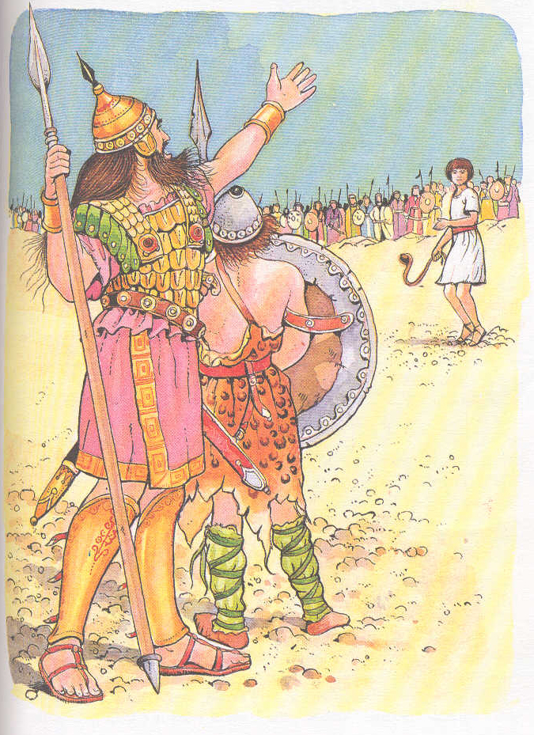
1. THE BATTLE INTIMIDATES THOSE WHO LACK FAITH IN THE LORD
“Then the Philistine said, ‘This day I defy the ranks of Israel! Give me a man and let us fight each other.’”
“On hearing the Philistine’s words, Saul and all the Israelites were dismayed and terrified.” (vs. 10-11)

Slide 4
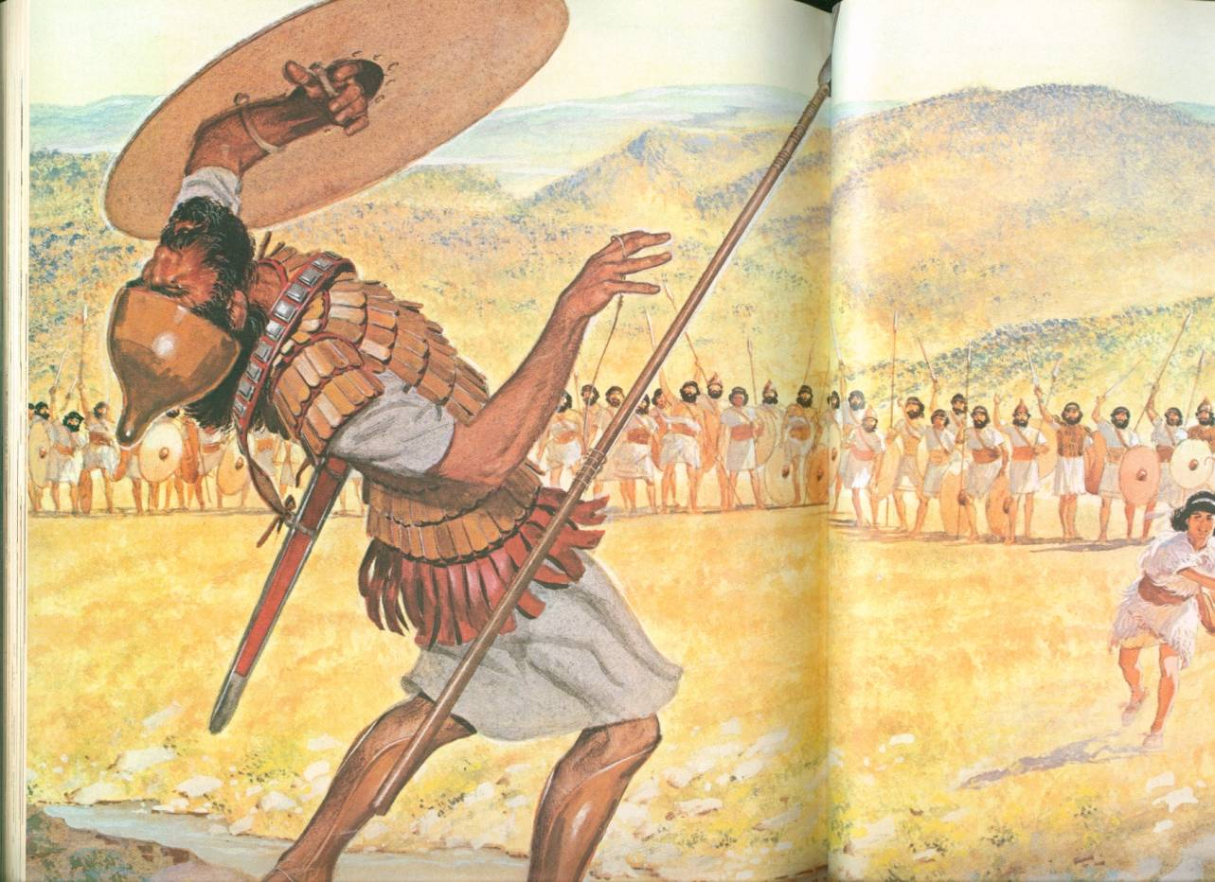
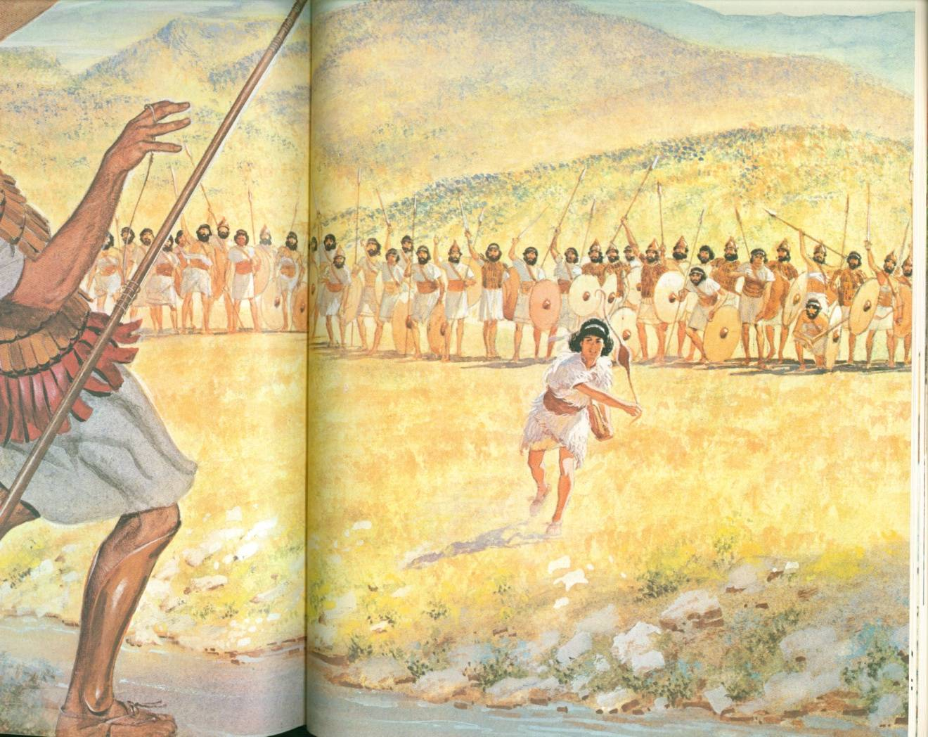
2. THE BATTLE IGNITES THOSE WHO HAVE FAITH IN THE LORD
“You come against me with sword and spear and javelin, but I come against you in the Name of the Lord Almighty, the God of the armies of Israel, whom you have defied. This day the Lord will hand you over to me, and I’ll strike you down and cut off your head.” (vs. 45-46)
“So David triumphed over the Philistine with a sling and a stone.” (v. 30a)

Slide 5
TAKE HOME TRUTH
When we put faith in the Lord, we get victory in the battle

Slide 6
Black

Slide 7
OT Preaching link at BibleStudyDownloads.org
Get this presentation for free!
Notes:
OT Preaching (op)

