Slide 1
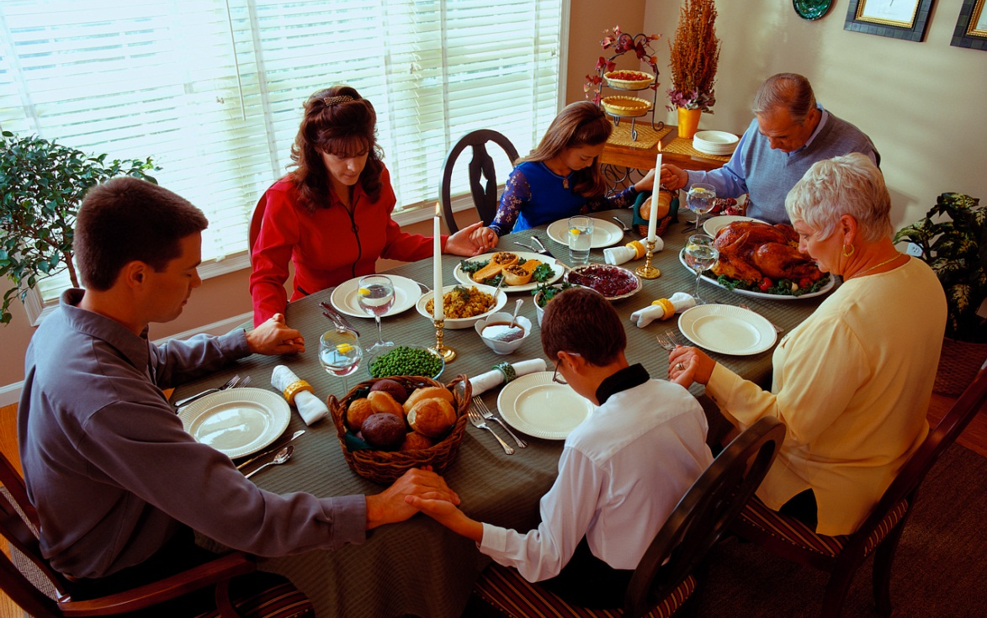
1 SAMUEL 16
Finding God's Blessing
Dr Scott Wooddell Eastridge Park Christian Church, Mesquite, Texas Uploaded by Dr. Rick Griffith • Jordan Evangelical Theological Seminary Files in many languages for free download at BibleStudyDownloads.org

Slide 2
1 SAMUEL 16
What can we do to put ourselves in a position to be blessed by God?

Slide 3
1. A HEART THAT LOVES GOD
“The Lord does not look at the things man looks at. Man looks at the outward appearance, but the Lord looks at the heart.” (v. 7b)
“Then the Lord said, ‘Rise and anoint him; he is the one.’” (v. 12b)

Slide 4
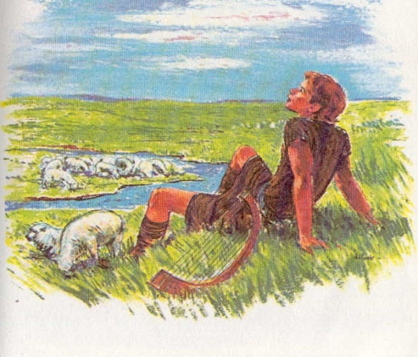
2. HANDS THAT SERVE GOD
“Then Saul sent messengers to Jesse and said, ‘Send me your son David, who is with the sheep.’” (v. 19)
“David came to Saul and entered his service. Saul liked him very much and David became one of his armor-bearers.” (v. 21)

Slide 5
TAKE HOME TRUTH
God blesses those who have a heart that loves Him and hands that serve Him.

Slide 6
Black

Slide 7
OT Preaching link at BibleStudyDownloads.org
Get this presentation for free!
Notes:
OT Preaching (op)

