Slide 1
1 Chronicles 17
Unanswered Prayer
Dr Scott Wooddell Eastridge Park Christian Church, Mesquite, Texas Uploaded by Dr. Rick Griffith • Jordan Evangelical Theological Seminary Files in many languages for free download at BibleStudyDownloads.org

Slide 2
1 Chronicles 17
How can I stay encouraged when my prayers go unanswered?

Slide 3
1. WE PRAY AND TRUST THE LORD TO ANSWER
The Lord says, “Yes.” (Acts 12)
The Lord says, “Not yet.” (1 Samuel 1)
The Lord says, “No.” (2 Corinthians 12)
“…my grace is sufficient for you…”
(2 Corinthians 12:9)

Slide 4
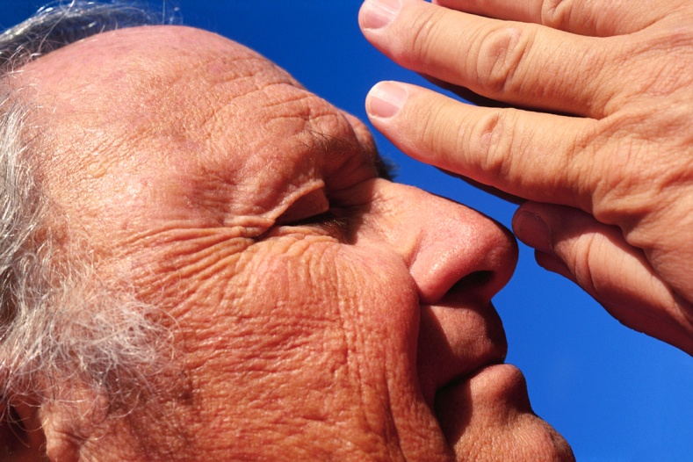
2. THE LORD ANSWERS AND MEETS OUR DEEPEST NEEDS
David’s prayerful desire is to do something wonderful for God, but God does something wonderful for David.
An unconditional promise
A deeper intimacy
A new direction
“…my grace is sufficient for you…”

Slide 5
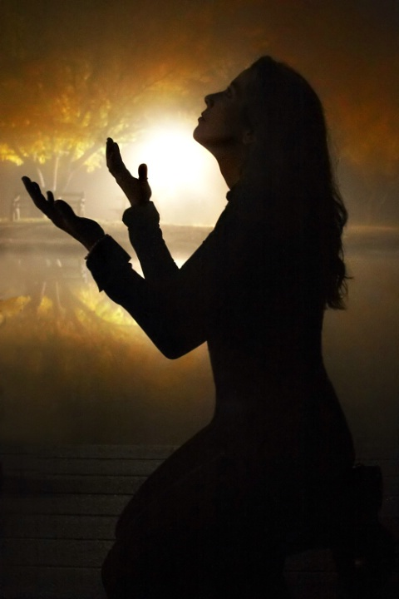
TAKE HOME TRUTH
When we don’t receive the answer we prayed for, we look for God’s grace in abundant measure.

Slide 6
Black

Slide 7
OT Preaching link at BibleStudyDownloads.org
Get this presentation for free!
Notes:
OT Preaching (op)

