Slide 1


Title slide
15
Dr. Terry Mortenson
Adapted and expanded by Dr. Rick Griffith
Creation or Evolution:
Why It Matters
Dr. Rick Griffith, Crossroads International Church
cicfamily.com & biblestudydownloads.com
Notes:
This template is intended for talk titles. Although it can be used for significant section titles, its "cover page" feel makes it best used once at the beginning of a presentation. Subtitle can be as its name suggests or the speaker's name. Presentation Team recommends title text size as 50–72 and subtitle size as 30–48 with optimal sizes already used in this example. This also contains a floating AiG logo that can be repositioned or removed as appropriate for the overhead's content.

Slide 2

What in the world did we do this past summer?
Rick & Susan Griffith
Notes:
Rather than us talking about us today…

Slide 3

America—largest number of…
• John (22) Seattle (World Vision)
• Stephen & Katie (25) Boise (Pilot/MS)
• Kurt & Cara (28) Chicago (Accenture/BS)
• Mom & Three Churches (N. CA)
• Three S. CA churches
• Dad & One Church (Hawaii)
Our Ministry in July 2015

Slide 4

Our Three Sons

Slide 5

Our Three Sons

Slide 6



Kurt works in IT
9g

Slide 7
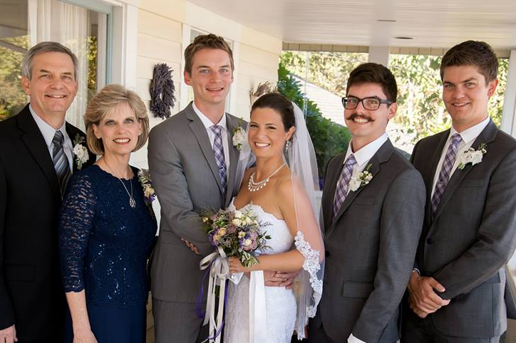
The Griffith Family
Sept 2014
2014
Rick
Stephen
25
Susan
John
22
Kurt & Cara
28

Slide 8
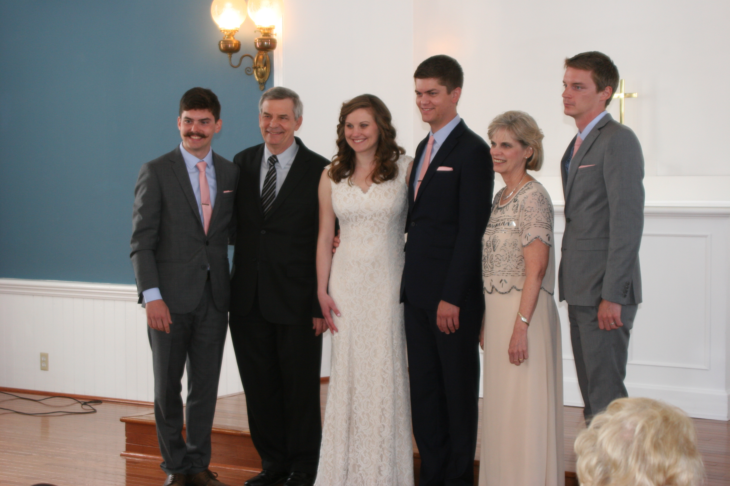
The Griffith Family
May 2015
2015
John
22
Kurt
28
Rick
Susan
Stephen & Katie 25

Slide 9


Stephen is a pilot with Horizon Air, Seattle
6

Slide 10

Above Seattle
9g

Slide 11

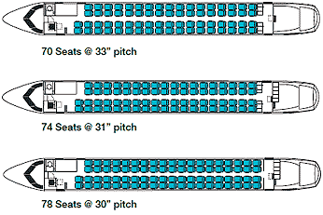
Stephen flies with Horizon Air
6

Slide 12

Cara & Kurt • Katie & Stephen

Slide 13

John at Biola University

Slide 14

John at Biola University

Slide 15

Caleb • Brennen • Holly • John • Kelsey
Taiwan • Slovania • Turkey • Singapore • Indonesia
WorldVenture Interns June- August 2013

Slide 16


John at World Vision

Slide 17
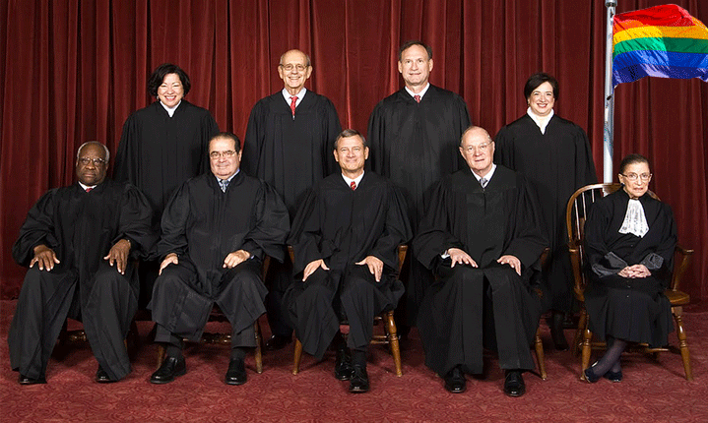
Supreme Court Redefinition of Marriage 26 June 2015

Slide 18
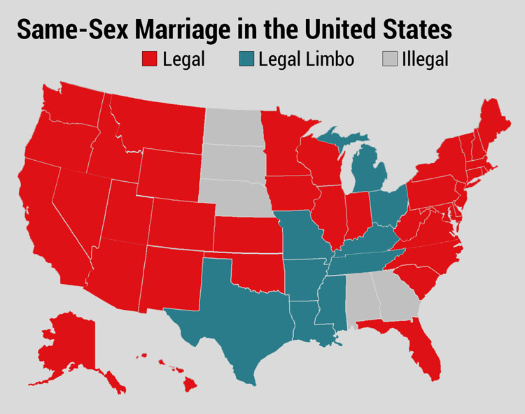
Supreme Court Redefinition of Marriage 26 June 2015

Slide 19

Supreme Court Redefinition of Marriage 26 June 2015

Slide 20

Supreme Court Redefinition of Marriage 26 June 2015

Slide 21

Supreme Court Redefinition of Marriage 26 June 2015

Slide 22
The Fallout

Slide 23
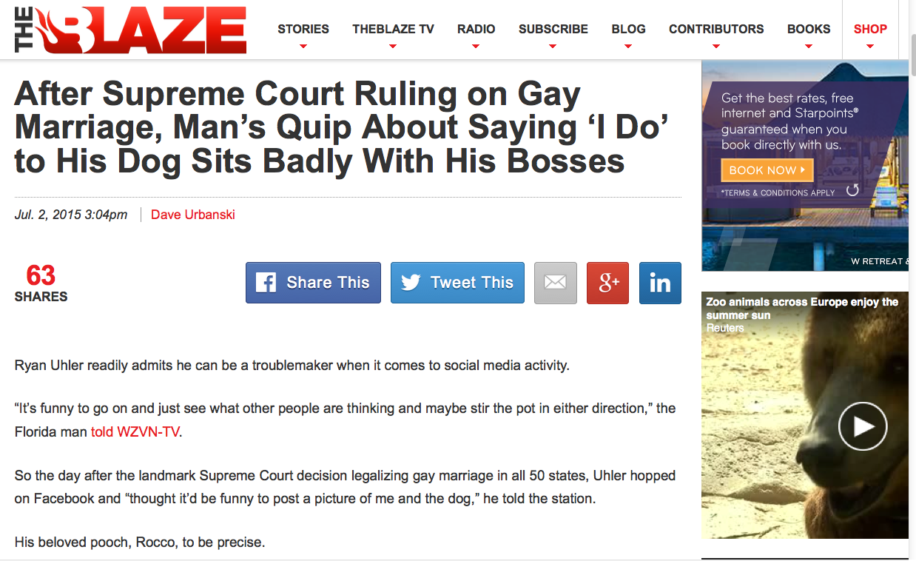
How far will the redefinition go?
Notes:
Dave Urbanski, "After Supreme Court Ruling on Gay Marriage, Man's Quip About Saying 'I Do' to His Dog Sits Badly With His Bosses"
His tech computer fired him for this facebook quote.
"Uhler said the company where he'd worked as a digital marketing specialist for the last two years — Grace Tax Advisory Group in Fort Myers — fired him because of his post.
"What happened was, they took it out of context," he told WZVN.
Trial lawyer Scot Goldberg told the station that while the company's actions are "a little bit over the line," Uhler's former bosses have legal recourse since Florida is an "at will" state — meaning no reason is needed for firing without notice.
Now relegated to hoofing it for a new job — you might call it "Ryan Uhler's Day Off" and then some — his affection for Rocco remains steadfast.
"God, I love my dog," he told the station, "just as much as I love my wife and my kid."
No word yet on how that's going over with the family."
July 2, 2015 (accessed 3 July 2015) at http://www.theblaze.com/stories/2015/07/02/after-supreme-court-ruling-on-gay-marriage-mans-quip-about-saying-i-do-to-his-dog-sits-badly-with-his-bosses/

Slide 24
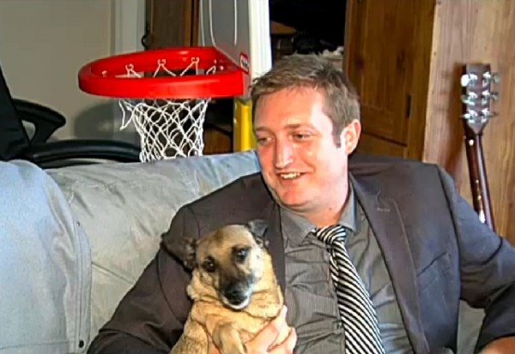
"How is marrying a dog different if you love them? Today I hope we can focus on doggy-style love. I love my dog Rocco, and he loves me. Hopefully one day we can be married."
Notes:
Dave Urbanski, "After Supreme Court Ruling on Gay Marriage, Man's Quip About Saying 'I Do' to His Dog Sits Badly With His Bosses"
His tech computer fired him for this facebook quote.
"[Ryan] Uhler said the company where he'd worked as a digital marketing specialist for the last two years — Grace Tax Advisory Group in Fort Myers — fired him because of his post.
"What happened was, they took it out of context," he told WZVN.
Trial lawyer Scot Goldberg told the station that while the company's actions are "a little bit over the line," Uhler's former bosses have legal recourse since Florida is an "at will" state — meaning no reason is needed for firing without notice.
Now relegated to hoofing it for a new job — you might call it "Ryan Uhler's Day Off" and then some — his affection for Rocco remains steadfast.
"God, I love my dog," he told the station, "just as much as I love my wife and my kid."
No word yet on how that's going over with the family."
July 2, 2015 (accessed 3 July 2015) at http://www.theblaze.com/stories/2015/07/02/after-supreme-court-ruling-on-gay-marriage-mans-quip-about-saying-i-do-to-his-dog-sits-badly-with-his-bosses/

Slide 25
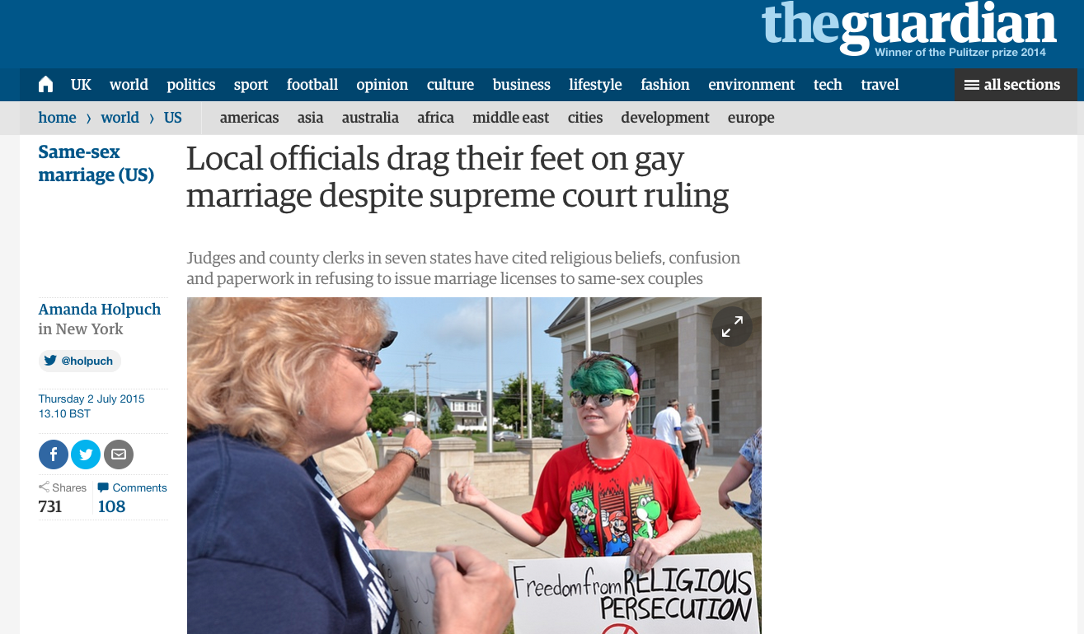
Supreme Court Redefinition of Marriage 26 June 2015
Notes:
Tony Perkins (President of Family Research Council) wrote on 1 July 2015 at http://www.frc.org/updatearticle/20150701/keep-calm-clerk-on
The five justices of the Supreme Court weren't the only ones with a strong opinion on marriage. And dozens of county clerks are risking everything to prove it. Five days after five justices bulldozed the votes of 50 million people, the Left was wrong to assume everyone would just fall in line. They didn't count on an army of local officials standing in the wreckage of judicial activism, refusing to budge.
For most of them, it wasn't a question of if their beliefs would come under attack, but when. Like Jennifer Schoenrock, the wife of a disabled veteran and family breadwinner, they knew the day was coming when they'd have to choose between their convictions and their career. "I want to do the right thing," Jennifer explained. And that means obeying God's law -- not man's. After last week, these clerks take seriously the reality that their offices are the new front lines in the battle for religious liberty -- and many of them have no intention of going quietly. As far as they're concerned, a lot of things have changed since Friday, but their First Amendment rights weren't one of them.
From small counties in Arkansas to busy towns in Texas, there are hundreds of people ready to defend the ground five unelected justices took from voters. The Court may have changed their definition of marriage, Kentucky clerk Chris Cockrell explained, but he isn't prepared to change his. If that means going to jail, so be it. And according to the state's ACLU, that's no empty threat. "Two things can happen if a Kentucky clerk won't issue a marriage license to a same-sex couple," warned one law professor. "They can resign or go to jail."
And don't think the Left won't send them. This week, the Kentucky County Clerks Association says it's been swamped with cries for help from local officials after Governor Steve Beshear (D) ordered government workers to abide by the ruling. Resistance comes with a heavy price: a year in prison for "first-degree official misconduct." That doesn't scare Rowan County clerk (and Democrat) Kim Davis. Like a lot of offices, hers shut down the marriage license window altogether -- in part because so many of her co-workers object. "What has happened is that five lawyers have imposed their personal view of what the definition of marriage should be on the rest of us. And I, as a Christian, have strong views too. And I know I don't stand alone."
Gay activists have started picketing Davis's office, but she refuses to resign. If the government won't force her, the ACLU vows to. Which may be why the only people busier than state officials are U.S. attorneys. On both sides, offices have been inundated with requests for legal help. In Texas, Attorney General Ken Paxton has promised to find legal representation for any government official whose beliefs are under attack.
That could be several. Of the 254 counties in Texas, less than half (114) told the AP they were "ready and willing" to issue same-sex marriage licenses. Nationally, nonprofit groups like Alliance Defending Freedom and Liberty Institute are already responding to the marriage whirlwind, flying to the aid of clerks and other officials everywhere.
In some states, the turmoil is even splitting the executive and legislative branches. After Governor Asa Hutchinson (R) insisted that Arkansas comply with the Court, state representatives swore to stand by clerks who refuse. "We affirm our support for Amendment 83 of the Arkansas Constitution as overwhelmingly passed by the people in 2004. We refuse to simply shrug our shoulders and abandon basic principles that have guided our country successfully the past 239 years. We will work with other conservative leaders in our state and across the nation... [to] explore all available options."
Down in Mississippi, the handful of clerks handing in their resignation letters includes Linda Barnette. After 24 years, the Grenada County Baptist said that when it came to her job or her faith, there was never any real debate. "My final authority is the Bible," she told Fox News's Todd Starnes. In her mind, the battle is finally at the church's door. "Christians are being put to the test," she said. 'We're going to see the true Christians who stand. It's going to be time to stop talking the talk. It's going to come down to that."
One man who knows about walking the walk is Governor Bobby Jindal (R-La.). Fortunately, the Louisiana governor was as prepared for this as he would be for any local disaster and had the foresight to protect religious liberty in law. People in Indiana and Arizona weren't so lucky. Their governors either watered down their legislation -- or refused to pass it altogether -- leaving officials without the legal firewall they need to keep the Left at bay. If the ACLU wants to sue Governor Jindal, let them. "The Left likes to pick and choose which liberties they support at any given time," he jabbed.
The reality is, the First Amendment has been around a lot longer than whatever "rights" the Court invented June 26. And with a growing chorus of conservative leaders, Bobby Jindal is willing to go to the mat to defend them. Your state officials should too. Contact your leaders and ask them to follow in the footsteps of courageous conservatives like Governor Jindal and Ken Paxton. Also, don't miss the Governor in his own words from yesterday's radio interview on "Washington Watch."

Slide 26

How Should We Respond to This 5-4 Ruling?
Notes:
Tony Perkins (President of Family Research Council) wrote on his Action Alert on 30 June 2015:
"Last week, the Supreme Court ruled in Obergefell v. Hodges that all states must license and recognize marriages between same-sex couples. This decision could have devastating implications for institutions and individuals that hold the belief that marriage is between one man and one woman. We have seen state discrimination, and we need you to urge Congress to prevent federal discrimination against those who support natural marriage!"

Slide 27


Can we just say "No"?
US$135,000 fine
Notes:
Tony Perkins (President of Family Research Council) wrote on his Action Alert on 30 June 2015:
"Businesses and organizations continue to be threatened because of their owners' faith. An Oregon bakery owned by Aaron and Melissa Klein was fined $135,000 simply for declining to make a wedding cake for a same-sex wedding. Barronelle Stutzman, a grandmother in Washington state, had to close her floral business because of the crippling fees imposed on her for not providing flower arrangements for a same-sex wedding.
Child welfare organizations, such as Lutheran Community Services and Catholic Charities, are being threatened by this decision to recognize same-sex marriage or face losing their ability to participate in federal programs or apply for federal grants.
Our Founders envisioned a nation where the moral and religious beliefs of individuals, faith-based organizations, and business owners would be protected, not a nation where one's convictions about marriage could be used as a disqualifying factor for interaction with the federal government.
To stop the federal government from discriminating against people because of their beliefs in marriage, Senator Mike Lee (R-UT) has introduced the First Amendment Defense Act, S.1598, in the Senate, and Representative Raúl Labrador (R-UT) has introduced the companion bill, H.R. 2802, in the House. Simply put, FADA would prohibit the federal government from penalizing persons for their personal moral or religious beliefs in natural marriage in areas such as federal employment, grants, contracts, tax treatment, and other programs.

Slide 28


Can we help?

Slide 29


Other Cases

Slide 30

"You better be ready and you better be prepared because it's coming. There will be persecution of Christians for our stand."
Rev. Franklin Graham

Slide 31
Isaiah 5:20 NLT
"What sorrow for those who say
that evil is good and good is evil,
that dark is light and light is dark,
that bitter is sweet
and sweet is bitter."

Slide 32

Why is common sense not so common anymore?
We lack a foundation in Scripture.

Slide 33

AiG web site #1

Slide 34
America—largest number of…
America has the largest number of:
• Churches/Seminaries
• Christian Colleges
• Christian Bookshops/Resources
• Christian Radio/TV

Slide 35

America—less Christian
America has the largest number of:
• Churches/Seminaries
• Christian Colleges
• Christian Bookshops/Resources
• Christian Radio/TV
But is becoming LESS Christian EVERY day!

Slide 36

ISSUES TODAY
ABORTION
SCHOOL VIOLENCE
PORN-OGRAPHY
HOMOSEXUAL BEHAVIOR
RACISM
FAMILY BREAK-UP

Slide 37

Q 899 Barna
"A minority of born-again adults (44%) and an even smaller proportion of born-again teenagers (9%) are certain of the existence of absolute moral truth."
Barna Research Online, 'The Year's Most Intriguing Findings, From Barna Research Studies,' December 12, 2000, www.barna.org.
Notes:
www.barna.org/cgi-bin/PagePressRelease.asp?PressReleaseID=77&Reference=E&Key=moral%20truth

Slide 38
Foster Letter 2002
"The 'American Family In Crises Research' by the Southern Baptist Council on Family Life uncovered some disturbing facts. Of the children raised in evangelical homes, 88% leave the church at age 18 and never return."
Pastor's Weekly Briefing, Focus on the Family, 26 July 2002, quoted in Gary Foster, The Foster Letter, 10 Aug. 2002, p. 1.
Notes:
From Carl Kerby
Following is the entire quote that was in my newsletter. My source was the 7/26/02 issue of Pastor's Weekly Briefing published by the Pastoral Ministries department of Focus on the Family.
American Family In Crises Research by the Southern Baptist Council on Family Life has uncovered some disturbing facts that are leading the group to emphasize the need to rebuild the American family.
§ 88% of the children raised in evangelical homes leave church at the age of 18, never to return.
§ The divorce ratio among members of evangelical churches is virtually the same as non-church members.
§ One million children in the U.S. see their parents divorce.
§ Personal bankruptcies are at an all-time high in America.
The majority of children in America have less than 10 minutes of significant and meaningful conversation with their parents each week. If you remove the mother, you can measure this statistic in seconds. The council recommends that families set aside one evening a week as a family night, on which no local church activities would be scheduled to interfere. It also urged an increased emphasis on biblically based premarital counseling. (PWB 7/26)
Gary D. Foster
Gary D. Foster Consulting
334 Sutherland Place
Manitou Springs, CO 80829
Phone: 719-685-1138 E-mail: GFosterCns@rmi.net Website: http://www.garydfoster.com/
"Helping Christian ministries & product companies discover new revenue streams and to better leverage existing ones."

Slide 39

Already Gone 04802
Already Gone
  by Ken Ham and Britt Beemer,
  with Todd Hillard
© Answers in Genesis-USA

Slide 40

High school attended
Catholic school
0.6%
Charter school
3.2%
Home school
3.4%
Christian school
6.9%
Public school
85.9%
Notes:
Survey done by American Research Group (similar to Barna and Gallup)—professional statistically valid study paid for by AiG supporters
Survey 20-29 year olds who grew up in church but don't go to church any more, to find out why.

Slide 41

If you don't believe, when did you first have doubts?
Don't know
1.61%
Elementary school
4.37%
College
10.57%
Middle school
39.77%
High school
43.68%

Slide 42

Which of these makes you question the Bible the most?
45.2%
Miracles not true
4.3%
Bible not make sense
10.7%
Creation account
11.2%
Too many rules
14.4%
Earth not 10K yrs
29.7%
None
25.6%
Those Who Often Attended Sunday School

Slide 43

Which of these makes you question the Bible the most?
32.1%
Miracles not true
0.8%
Bible not make sense
11.7%
Creation account
13.5%
Too many rules
10.7%
Earth not 10K yrs
17.8%
None
43.4%
Those Who Rarely Attended Sunday School
Notes:
We are not saying that we should get rid of Sunday school. But we are suggesting that we need to change the curriculum and the training.
Most Sunday school teachers, like most Christian adults don't know how to defend the faith against the skeptical challenges that are coming through the schools, media, science programs on TV, etc. We need apologetics training for the teachers and then they need to give it to the kids.

Slide 44

Psalm 11:3 NAS
Genesis is foundational to all other biblical doctrines
Psalm 11:3
"If the foundations are destroyed, what can the righteous do?"

Slide 45

Typical House

Slide 46

House 2 00419
Notes:
Suppose many huge trucks rumbled around the house without ever touching it.

Slide 47

Typical House collapsed

Slide 48

Blocks-Genesis + Doctrine 00874
X
DOCTRINE
X
GENESIS

Slide 49

Blocks – Genesis/doctrine/sin grey
DOCTRINE
SIN
GENESIS
GENESIS
Genesis is foundational to all other biblical doctrines

Slide 50
Blocks – Genesis/doctrine/clothing grey
DOCTRINE
CLOTHING
GENESIS
GENESIS
Notes:
talk again about modesty—wedding pictures we get from committed Christians with very immodest wedding dresses, in most churches where I speak including our own, teens and older women are immodestly dressed—just reflective of the influence of nudity in our culture and our ignorance of the Genesis foundation of the Bible's teaching on clothes. Men, teach your wives and daughters. Wives and daughters, ask your husbands and dads about specific clothing.

Slide 51

Blks-Gen Doc + Doc
15
7-DAY WEEK
DOMINION
WORK
CURSE
NATIONS
1st COMING
2nd COMING
DOCTRINE
GENESIS
GENESIS

Slide 52
Blocks – Genesis/doctrine/marriage grey
DOCTRINE
MARRIAGE
GENESIS
GENESIS
Notes:
Mal. 2:16—God hates divorce

Slide 53


Marriage silhouettes
The two parts don't make one
Notes:
So as Christians, when we are confronted with this issue of homosexual marriage, which picture is consistent with the Christian foundation found in the book of Genesis? God ordained marriage as one man for one woman for life in the book of Genesis.

Slide 54
Blocks-Genesis + Gospel 00872
DEATH
GENESIS
Genesis is foundational to the doctrine of death

Slide 55

WHY?
55
Notes:
55
55
See 124

Slide 56

Why would a loving God allow earthquakes?
Notes:
56

Slide 57


FOSSIL
RECORD
PAIN
DEATH
X
KILLING
MILLIONS OF YEARS
=
DISEASE
STRUGGLE
SUFFERING
EXTINCTION

Slide 58
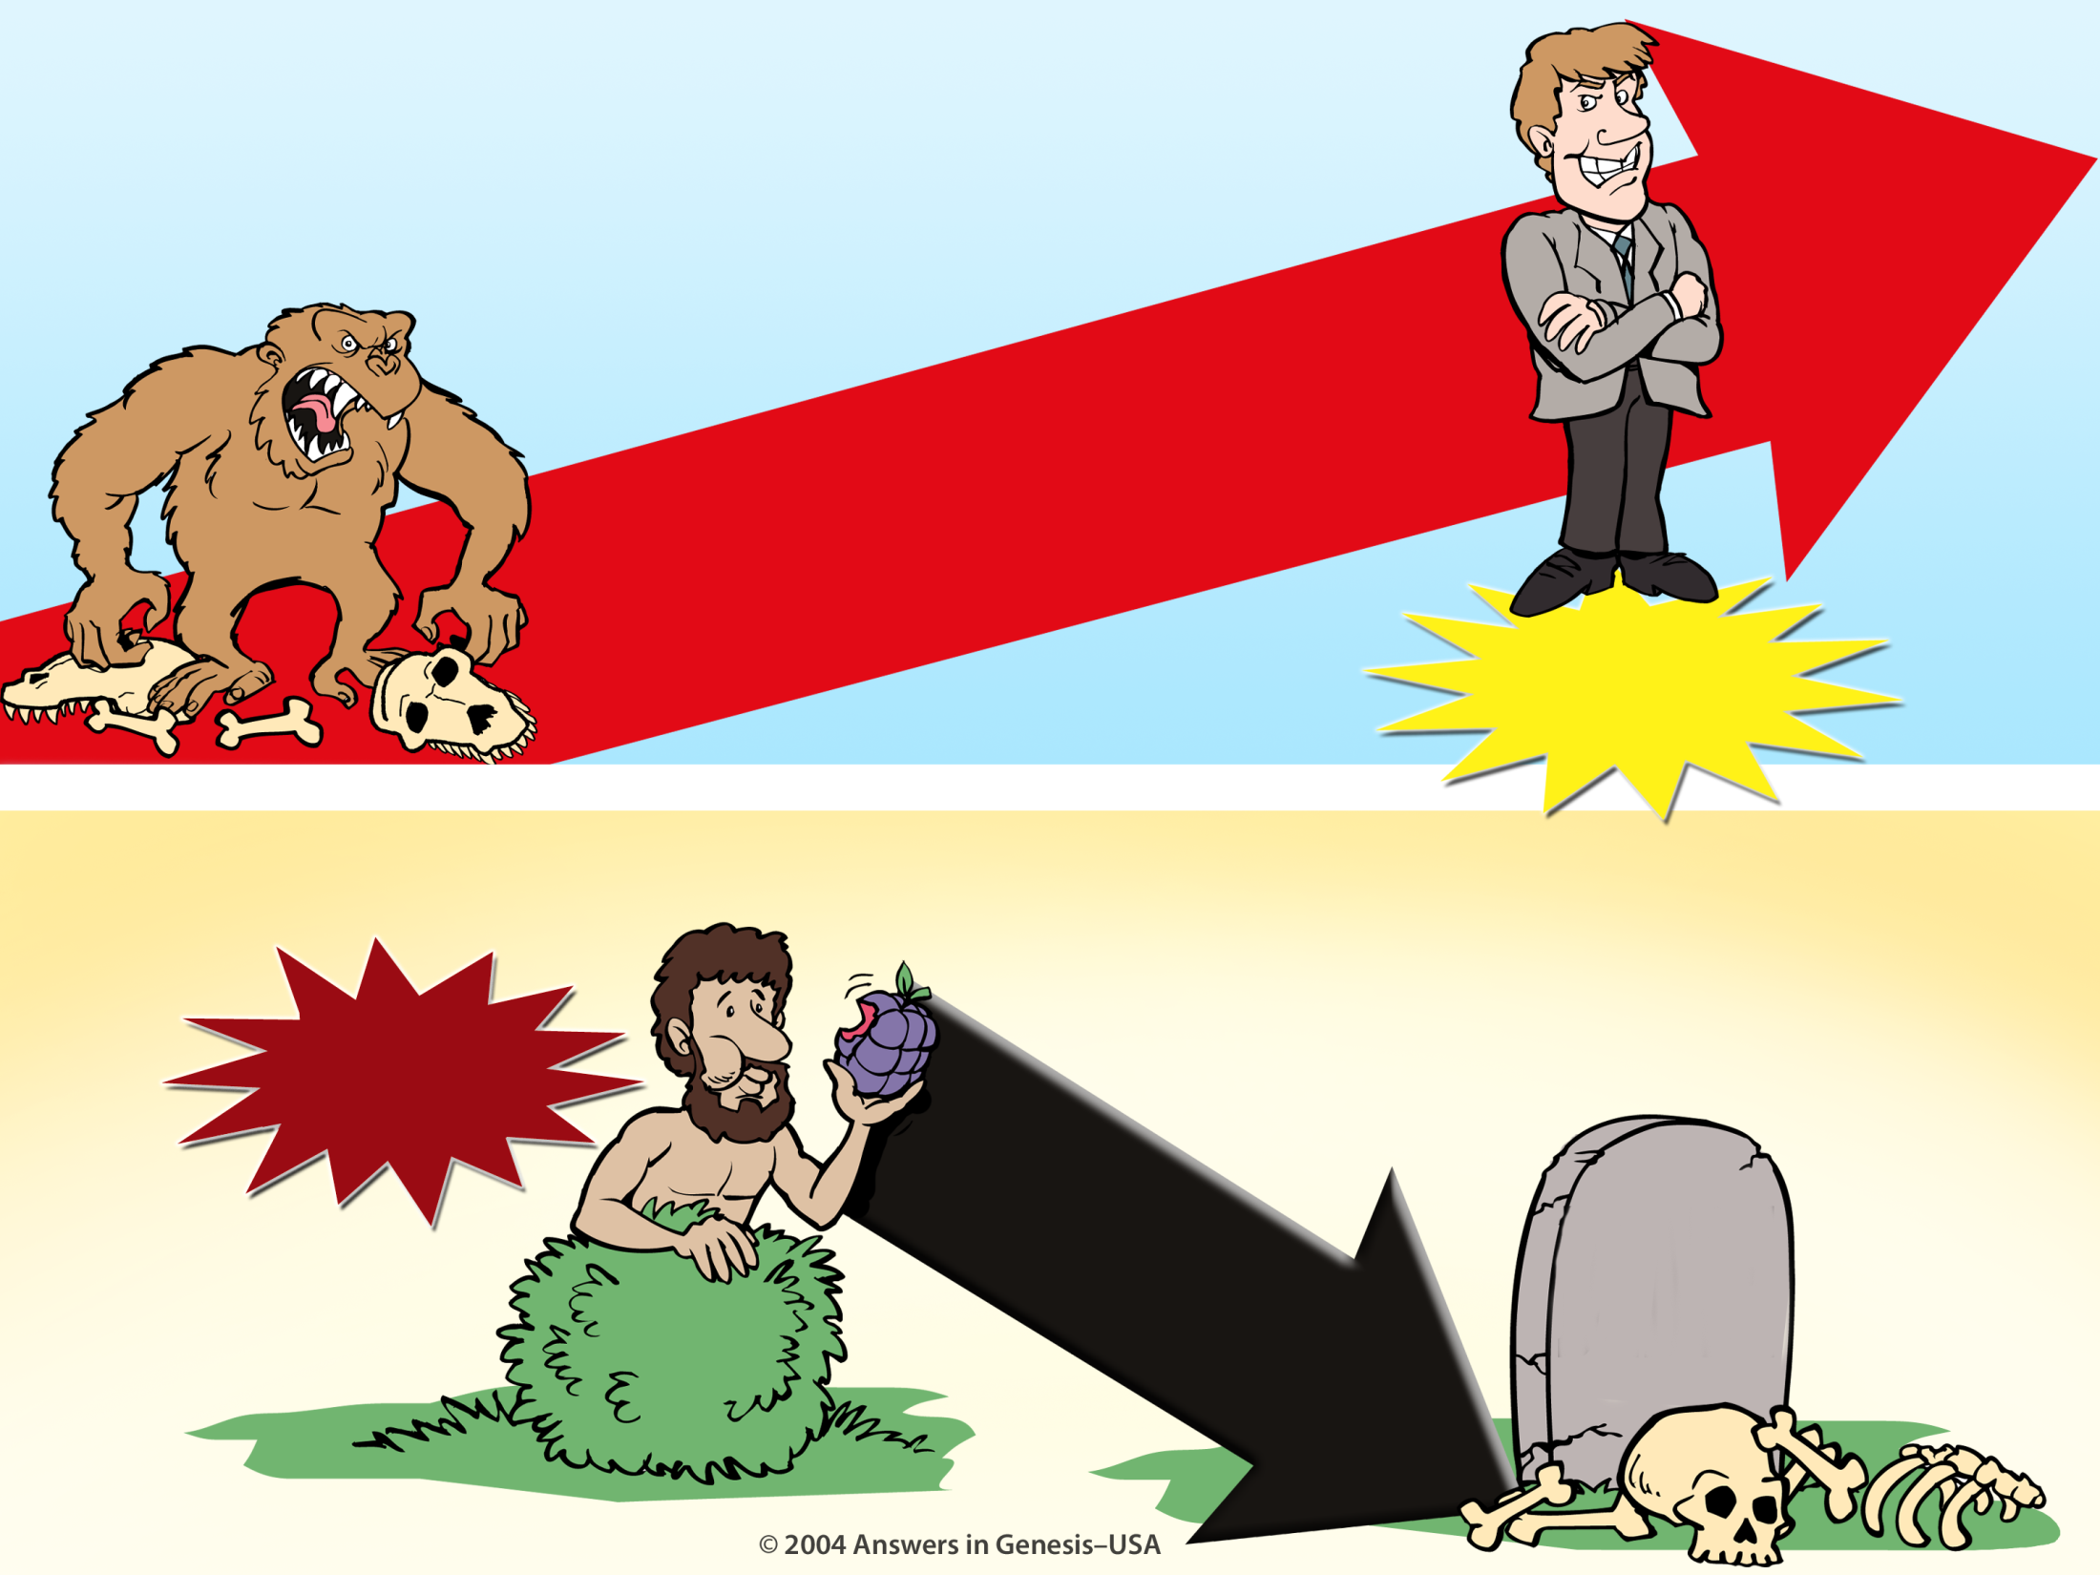
Evolution Millions of Years + Creation 01133
EVOLUTION
MILLIONS OF YEARS
DEATH
Suffering Disease Bloodshed
MAN'S
EXISTENCE
CREATION
MAN'S
ACTIONS
SIN
DEATH
Notes:
58
Do these two views agree?
No, of course not. They are diametrically opposed to each other.

Slide 59
Gen. 1:29-30 NAS
Genesis 1:29-30
"Then God said, 'Behold, I have given you every plant yielding seed that is on the surface of all the earth, and every tree which has fruit yielding seed; it shall be food for you; ³⁰and to every beast of the earth and to every bird of the sky and to every thing that moves on the earth which has life, I have given every green plant for food'; and it was so."
Pre-Fall world:
Man and animals were vegetarians.
In the Bible, plants were not living souls.

Slide 60

Convincing Dialogue
You will NOT surely die. When you eat of the fruit, your eyes will be open and you will be like GOD, knowing good and evil.

Slide 61
Convincing Dialogue
Your transparent appeal to our pride and naïveté is no match for the security and joy we have here in God's presence.

Slide 62
Convincing Dialogue
It's organic, rich in antioxidants, and now available in convenient GO-PACKS.
We'll take two.

Slide 63

The Sad Results
The Fall brought many consequences

Slide 64

Serpent judged physically
(Gen. 3:14)
"Then the LORD God said to the serpent, 'Because you have done this, you are cursed… You will crawl on your belly, groveling in the dust as long as you live."

Slide 65

"…you are cursed more than all animals, domestic and wild…"
Animals cursed (Gen. 3:14 NLT)
Notes:
65

Slide 66

Eve judged physically: increased pain in childbirth (Gen. 3:16)

Slide 67
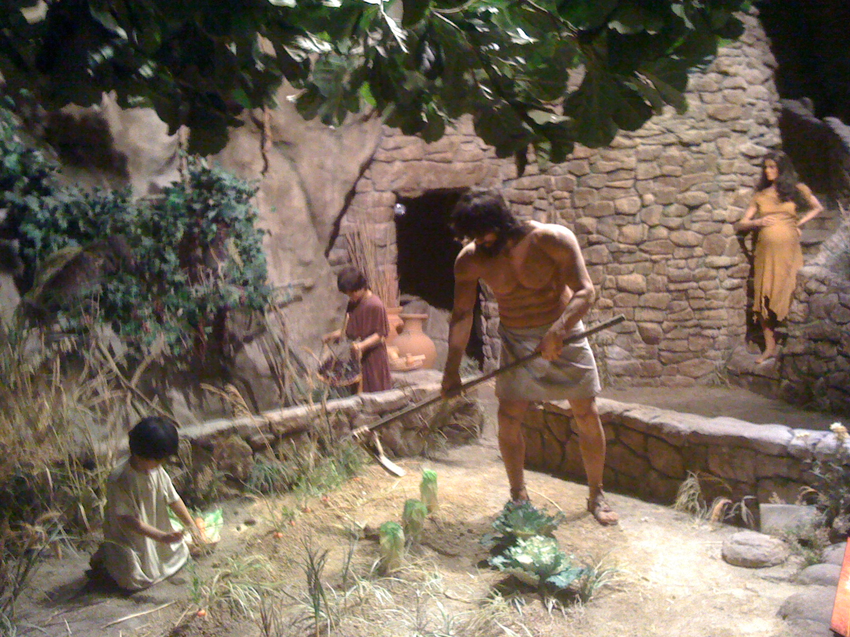
"And to the man he said, 'Since you listened to your wife and ate from the tree whose fruit I commanded you not to eat, the ground is cursed because of you. All your life you will struggle to scratch a living from it. ¹⁸It will grow thorns and thistles for you, though you will eat of its grains'" (3:17-18 NLT).
Ground was cursed (Gen. 3:17-18)

Slide 68
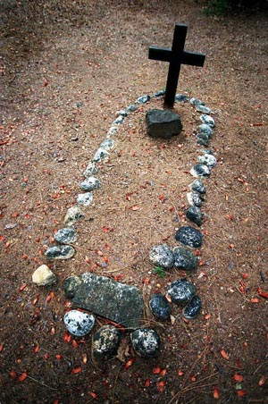
"By the sweat of your brow will you have food to eat until you return to the ground from which you were made. For you were made from dust, and to dust you will return" (3:19 NLT).
Adam & Eve began to die physically
Notes:
Adam's physical death did not come for another 930 years (Gen. 5:5), but his spiritual separation (death) came immediately upon sinning against God.

Slide 69
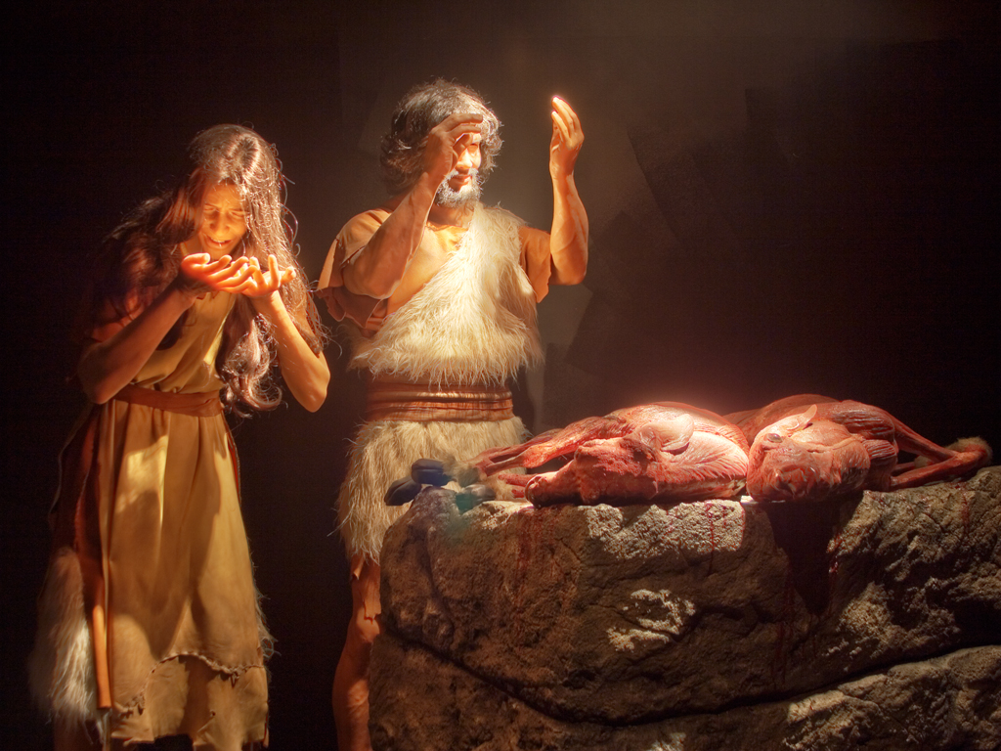
Implied Death
Redemption through a sacrifice gave them animal skin coverings
Genesis 3:21
Notes:
69
God killed animals to clothe Adam and Eve with reminders of redemption (3:21).
Here we see the first experience of death in the Bible—for without the shedding of blood, there is no forgiveness.

Slide 70

"For all creation is waiting eagerly for that future day when God will reveal who his children really are. ²⁰Against its will, all creation was subjected to God's curse. But with eager hope, ²¹the creation looks forward to the day when it will join God's children in glorious freedom from death and decay'"
(Rom. 8:19-21 NLT).
Creation in bondage to corruption (Rom. 8:19-23)

Slide 71
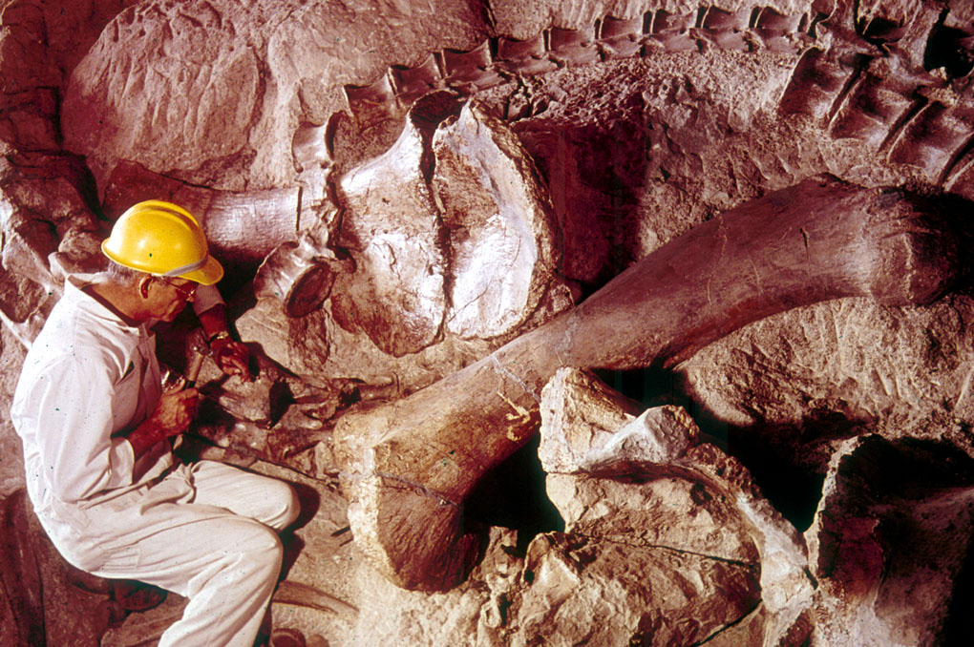
Problems with the fossil record
Notes:
Picture from Dinosaur National Monument (national park) in Utah & Colorado
Show my fossil shells

Slide 72

Which will you believe?
If God cursed the earth with thorns AFTER Adam sinned…
Genesis 3:18
"Both thorns and thistles it shall grow for you"
Psilophyton crenulatum
WHY
do we find FOSSIL THORNS from "millions of years ago"?
Lower Devonian 360-408 million years

Slide 73

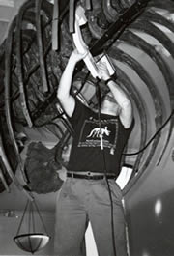
Whitehead 2003—dino cancer
"Many dinosaurs had cancer, researchers have discovered. Their tumours were like those of human patients, showing that cancer has been around, essentially unchanged, for a very long time. 'Diseases look the same independent of what critter is affected,' says Bruce Rothschild ..."
One of 10,000 dinosaur bones X-rayed in the USA
Disease in human fossils are "dated" to be much older than any acceptable date for Adam
John Whitehead, "Dinosaurs got cancer," Discover, 21 Oct. 2003, <www.nature.com>.
Notes:
Picture and quote from http://www.nature.com/nsu/031020/031020-2.html

Slide 74

Evolution vs Bible timeline
Evolution
The Bible

Slide 75

Bible Modified 00814b
When people TRY to make them agree, guess which one gets "MODIFIED"?
HOLY BIBLE
EVOLUTION THEORY
God's
PERFECT
Word
Man's
FALLIBLE
Opinion
EVOLUTION THEORY
GENESIS

Slide 76

A&E on bones animated
OH ADAM, THIS IS SUCH A PERFECT WORLD!
X
YES EVE! IT'S "VERY GOOD" JUST LIKE GOD SAID!
GARDEN OF EDEN
PAIN
MILLIONS OF YEARS
DEATH
FOSSIL
RECORD
KILLING
DISEASE
STRUGGLE
SUFFERING
EXTINCTION

Slide 77
Fossils on Garden of Eden
X
PAIN
FOSSIL
RECORD
DEATH
Noah's
Flood
KILLING
DISEASE
STRUGGLE
SUFFERING
EXTINCTION

Slide 78
Fossils on Garden of Eden
Mass
Extinctions
GARDEN OF EDEN
PAIN
FOSSIL
RECORD
DEATH
Noah's
Flood
KILLING
DISEASE
STRUGGLE
SUFFERING
EXTINCTION
Fossil Graveyards

Slide 79
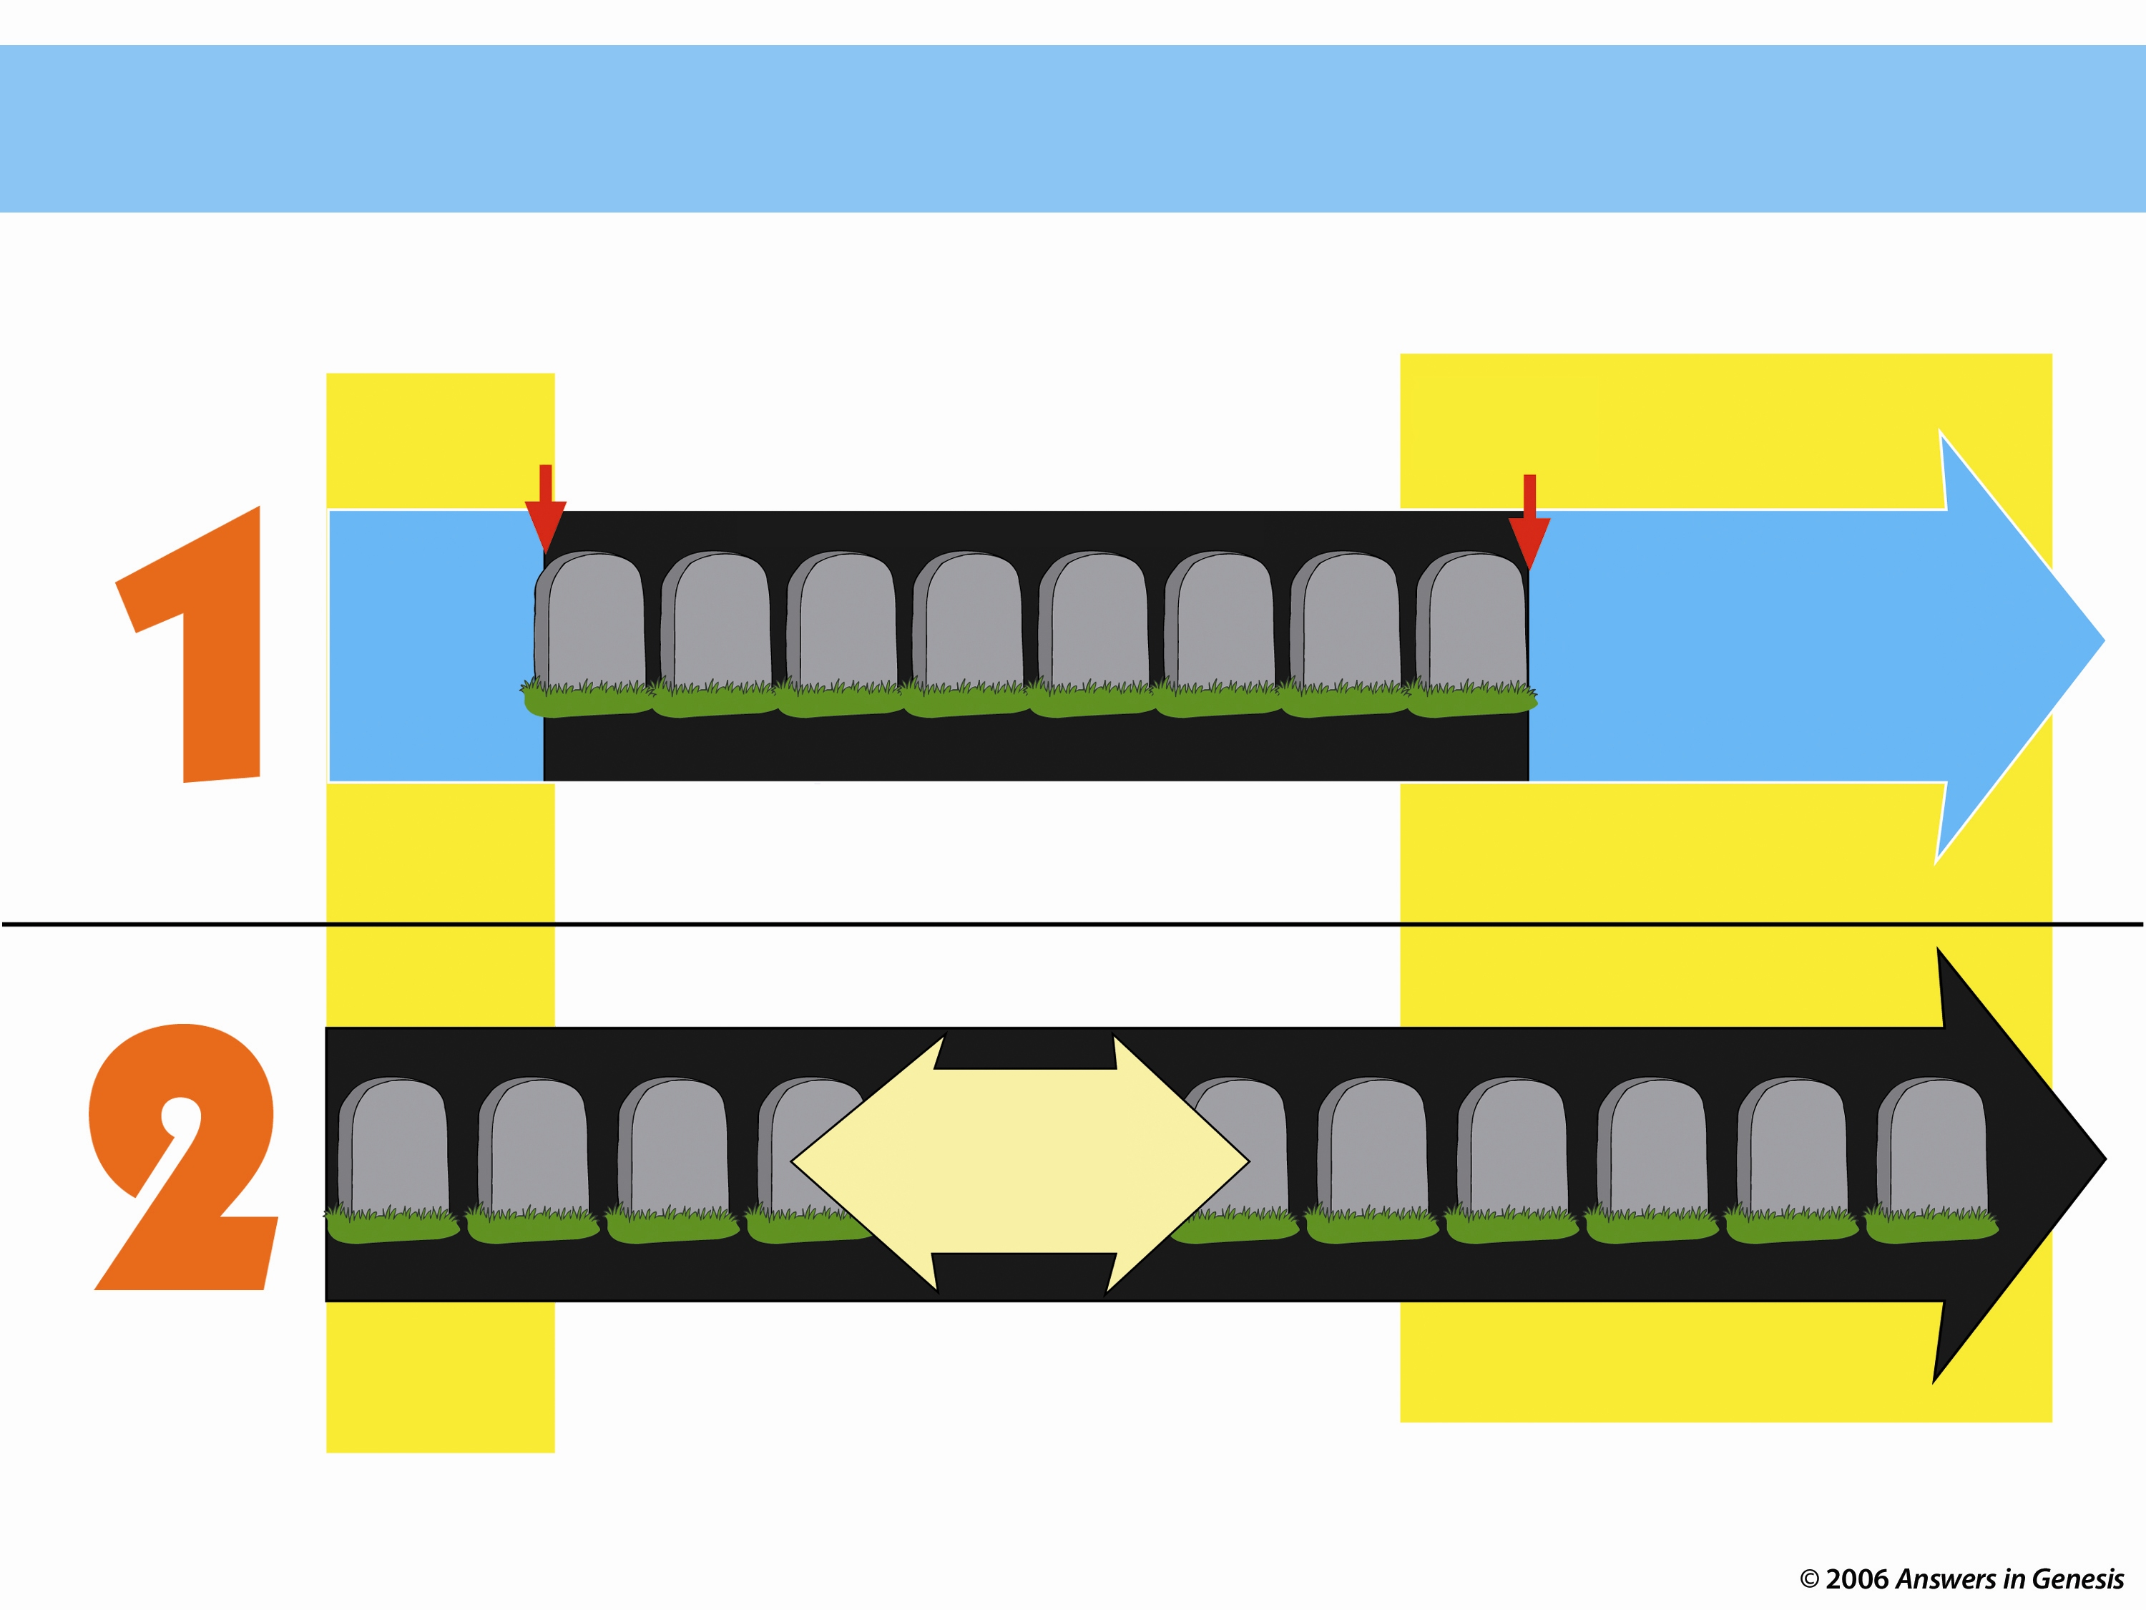
Two Histories of Death
Beginning
Death is an enemy
Future
Man's sin brought Death
DEATH will be done away with
ONLY THOUSANDS OF YEARS
God's Word
NO DEATH
NO DEATH
Death is temporary
Man's Opinion
MILLIONS AND MILLIONS OF YEARS
Life and death have always been together
Death is a permanent part of history
As long as there is life, there will be death

Slide 80

Which View of Death Matches Romans 5:12?
VERY GOOD!
PAST
Millions of Years
PRESENT
FUTURE
Adam
Death
Death
Death
Death
Genesis is foundational to the doctrine of God
VERY GOOD!
PRESENT
FUTURE
PAST
Adam
No Death
Death
Death
No Death

Slide 81










Gap Where Fit Mil of Yrs 00845
WHERE DO YOU "FIT" MILLIONS OF YEARS?
Somewhere?
Between Genesis 1:1 and 1:2
(gap theorists)
Spread the millions of years out in the six "days"
(progressive creationists and theistic evolutionists)
DAY
DAY
DAY
DAY
DAY
DAY
EARTH, SPACE, TIME & LIGHT
ATMOSPHERE
DRY LAND & PLANTS
SUN, MOON & STARS
SEA & FLYING CREATURES
LAND ANIMALS & MAN

Slide 82
Ex. 20:11 NAS
Exodus 20:11
"For in six days the Lord made the heavens and earth, the sea, and all that is in them, and rested on the seventh day; therefore the Lord blessed the Sabbath day and made it holy."

Slide 83
Blocks-Genesis + Gospel 00872
X
DEATH
X
GENESIS

Slide 84
Blocks-Genesis + Gospel 00872
Genesis is foundational to the gospel
GOSPEL
GENESIS

Slide 85
Gen. 3:15 NAS
Genesis 3:15
"And I will put enmity between you and the woman, and between your seed and her seed; he shall bruise you on the head, and you shall bruise him on the heel."

Slide 86
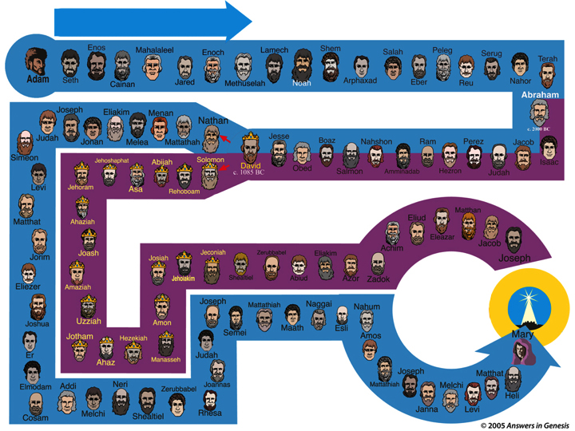
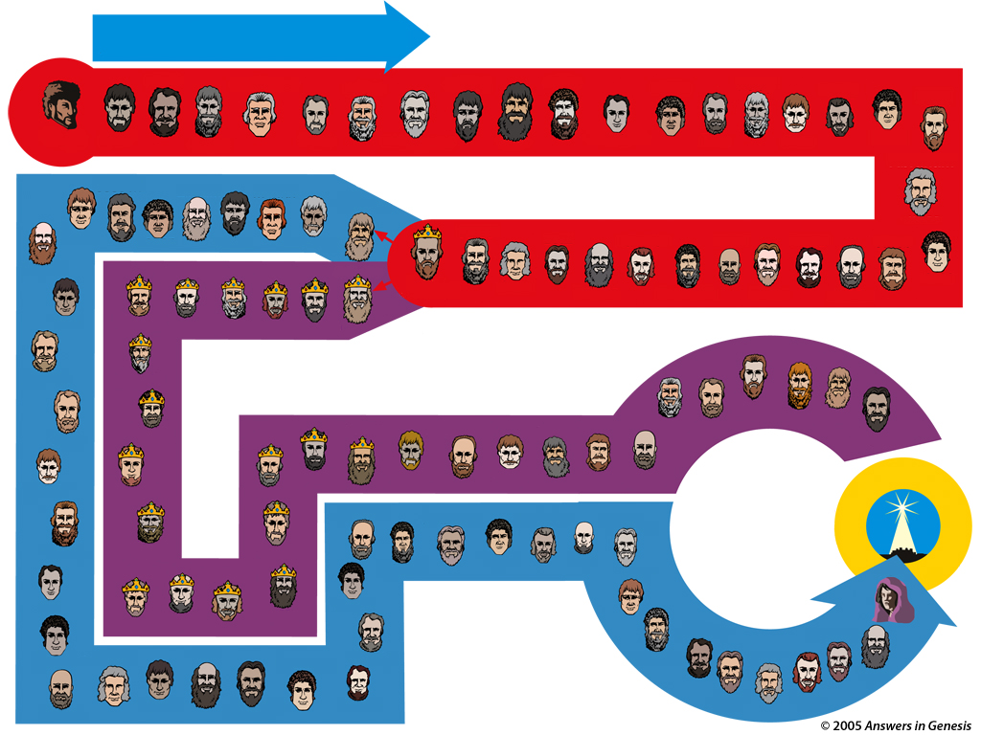
Adam to Christ
From Adam to Christ!
Enos
Mahalaleel
Enoch
Lamech
Shem
Salah
Peleg
Serug
Terah
Adam
Seth
Cainan
Jared
Methuselah
Noah
Arphaxed
Eber
Reu
Nahor
Abraham
Abraham
Joseph
Eliakim
Menan
David
Abraham
Nathan
David
Judah
Jonan
Melea
Mattathah
Jesse
Boaz
Nahshon
Ram
Perez
Jacob
Simeon
Jehoshaphat
Abijah
Solomon
Isaac
David
c. 1085 BC
Obed
Salmon
Amminadab
Hezron
Judah
Levi
Jehoram
Asa
Rehoboam
Eliud
Matthan
Matthat
Ahaziah
Line of Joseph
Line of Joseph
Eleazar
Jacob
Jorim
Joash
Josiah
Jeconiah
Zerubbabel
Eliakim
Achim
Joseph
Eliezer
Amaziah
Jehoiakim
Shealtiel
Abiud
Azor
Zadok
Joseph
Mattathiah
Nahum
CHRIST
Naggai
Joshua
Uzziah
Amon
Esli
Jotham
Hezekiah
Semei
Maath
Amos
Mary
Line of Mary
Er
Judah
Line of Mary
Ahaz
Manasseh
Joseph
Matthat
Elmodam
Addi
Neri
Zerubbabel
Joannas
Mattathiah
Melchi
Heli
Cosam
Melchi
Shealtiel
Rhesa
Janna
Levi
Notes:
86

Slide 87
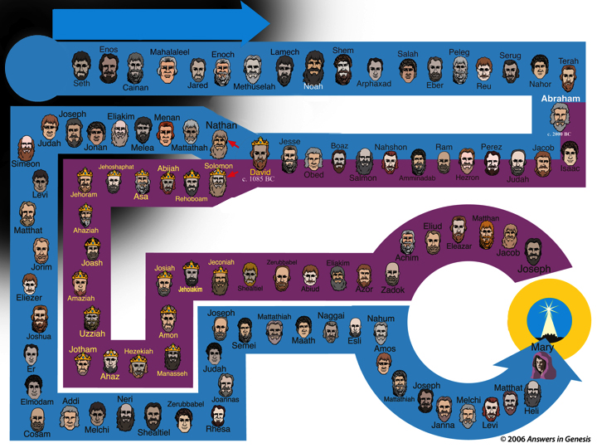

Adam to Christ
From Metaphor to Christ?
From Metaphor to Christ?
Enos
Mahalaleel
Enoch
Lamech
Shem
Salah
Peleg
Serug
Terah
Adam
Nahor
Metaphor
Seth
Cainan
Jared
Methuselah
Noah
Arphaxed
Eber
Reu
Abraham
Line of Mary
Abraham
Joseph
Eliakim
Menan
David
Abraham
Nathan
David
Judah
Jonan
Melea
Mattathah
Jesse
Boaz
Nahshon
Ram
Perez
Jacob
Simeon
Jehoshaphat
Abijah
Solomon
Isaac
David
c. 1085 BC
Obed
Salmon
Amminadab
Hezron
Judah
Levi
Jehoram
Asa
Rehoboam
Line of Joseph
Matthan
Ahaziah
Eliud
Matthat
Line of Joseph
Line of Joseph
Eleazar
Jacob
Jorim
Joash
Josiah
Jeconiah
Zerubbabel
Eliakim
Achim
Joseph
Eliezer
Amaziah
Jehoiakim
Shealtiel
Abiud
Azor
Zadok
CHRIST
Joseph
Mattathiah
Nahum
CHRIST
Naggai
Joshua
Uzziah
Amon
Esli
Jotham
Hezekiah
Semei
Maath
Amos
Mary
Line of Mary
Er
Judah
Line of Mary
Ahaz
Manasseh
Joseph
Matthat
Elmodam
Addi
Neri
Zerubbabel
Joannas
Mattathiah
Melchi
Heli
Cosam
Melchi
Shealtiel
Rhesa
Janna
Levi
Notes:
87

Slide 88

First/last Adam
He is Risen!!
Jesus Christ
"The Last Adam"
1 Cor. 15:45
X
For as in Adam all die,
Even so in Christ shall all be made alive.
1 Cor. 15:22
X
"The First Adam"
1 Cor. 15:45

Slide 89
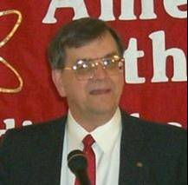
Frank Zindler
"The most devastating
thing though that
biology did to
Christianity was the
discovery of biological
evolution. Now that we
know that Adam and Eve
never were real people the central myth of Christianity is destroyed. If there never was an Adam and Eve, there never was an original sin…"
Notes:
Mr. Zindler is editor of American Atheist. He spent 17 years as a teacher and professor of biology, psychobiology, and geology at a branch of St. Univ of NY (SUNY). He is a member of several learned societies including the American Association for the Advancement of Science, New York Academy of Science, Society of Biblical Literature and the American Schools of Oriental Research. Mr. Zindler is also a member of the Jesus Seminar, and an expert in a number of esoteric, biblical-era languages. Neither the American Atheists web site nor the one below say where he taught and both refer to him as "Mr." and neither say that he has a PhD (so he must not, and so what is he doing in the AAAS and the NYAS and the SBL? His statements at the web site below show his gross ignorance of science, archeology and the Bible.
Picture: http://www.secularstudents.org/files/frank.jpg

Slide 90
I think that evolution is absolutely the death knell of Christianity."
"If there was never an
original sin, there is no
need of salvation. If there
is no need of salvation,
there is no need of a
savior. And I submit that
puts Jesus, historical or otherwise, into the ranks of the unemployed.
Frank Zindler (American atheist, in a debate with Dr. William Lane Craig), Atheism vs Christianity (video), Zondervan, 1996.
Notes:
90
Sadly, at the time (and as of 2007) Dr. Craig was compromised with the Big Bang and millions of years.

Slide 91
Blocks-Genesis + Gospel 00872
X
GOSPEL
X
GENESIS

Slide 92
Blocks-Genesis + Gospel 00872
Genesis is foundational to morality
X
MORALITY
X
GENESIS

Slide 93
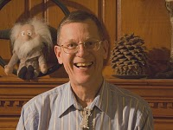
Evolution and Atheism, Provine
EVOLUTION & ATHEISM
"Let me summarize my
views on what modern
evolutionary biology
tells us loud and clear.
… There are no gods,
no purposes, no goal-
directed forces of any kind. There is no life after death."
William B. Provine (Prof. of Biology, Cornell
Univ.), Origins Research, 16:1/2 (1994), p. 9.
Notes:
Will Provine has been a professor at Cornell since 1969. His graduates have included Evolutionary Biology, History, Science and Technology Studies, Zoology, and Education, spanning three colleges. He earned a Ph.D. in the History of Science at the University of Chicago in 1970. He is a member of the American Academy of Arts and Sciences and the American Association for the Advancement of Science. He is the author of The Origins of Theoretical Population Genetics (1970) and Sewall Wright and Evolutionary Biology (1986), both published by The University of Chicago Press. He is currently (in Feb 2010) writing a book on the implications of evolution and another book on random genetic drift in evolution. His huge library on evolution and genetics is being moved gradually to the Cornell Library.
Photo and bio from http://debatesummit2010.blogspot.com/, accessed 2010 Feb 10.

Slide 94
Evolution and Atheism, Provine
EVOLUTION & ATHEISM
"When I die, I am
absolutely certain that
I am going to be dead.
That's the end for me.
There is no ultimate
foundation for ethics, no ultimate meaning to life and no free will for humans, either."
William B. Provine (Prof. of Biology, Cornell
Univ.), Origins Research, 16:1/2 (1994), p. 9.

Slide 95



6 Days or Millions of Years in Your Past 00087—layered.
My thinking in every area
GOD IS
AUTHORITY
IN YOUR PAST
GOD
SETS
THE
RULES
6 CREATION DAYS
OR
MILLIONS OF YEARS
IN YOUR PAST
MAN IS AUTHORITY
RELATIVE MORALITY
Man's Fallible Knowledge
My thinking
in every area

Slide 96

Balloons problem—evol vs creat
Gay
Marriage
PROBLEM
THE
Abortion
PSALM 11:3
Moral
Relativism
Euthanasia
CHRISTIANITY
HUMANISM
EVOLUTION
CREATION
Notes:
96
The humanistic philosophies all are undermining the very foundation of what Christians believe by focusing their attacks at creation.
Meanwhile, Christians accept their evolutionary theory and then focus our attacks at the results of humanism instead of attacking the foundation in evolution.
Some Christians shoot their own foundation and others are asleep or shooting other Christians.

Slide 97

Results of Humanism
REMOVE
THE CROSS
FROM
PUBLIC
PLACES
PRAYER OUT
OF PUBLIC
SCHOOLS
NO CHRIST IN
CHRISTMAS
REMOVE
GOD FROM
PLEDGE OF
ALLEGIANCE
GAY
MARRIAGE
NO PUBLIC
NATIVITY
SCENES
SCHOOL
VIOLENCE
NO
LOVING GOD
IN TRAGEDY
CREATION
OUT OF
PUBLIC
SCHOOLS
FAMILY
BREAK-UP
HOMOSEXUAL
BEHAVIOR
RACISM
PORNOGRAPHY
EUTHANASIA
ABORTION
REMOVAL OF 10 COMMAND-MENTS
HUMANISM
Notes:
97

Slide 98







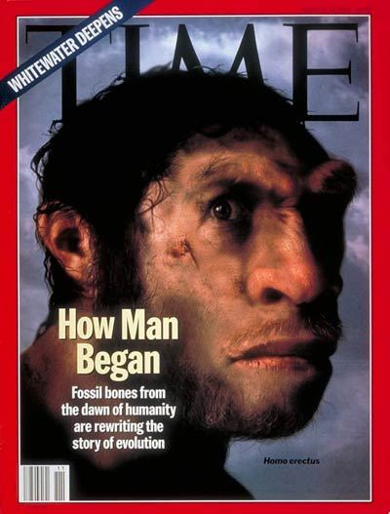
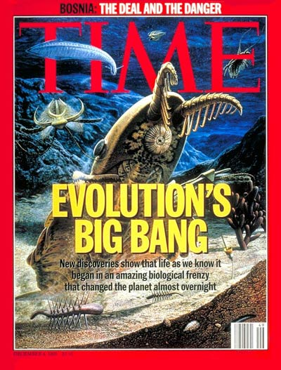

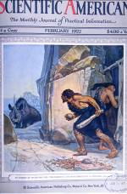



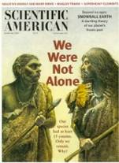
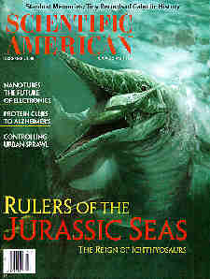

The Media assumes evolution is true

Slide 99

Dinosaurs & Kids - 3

Slide 100
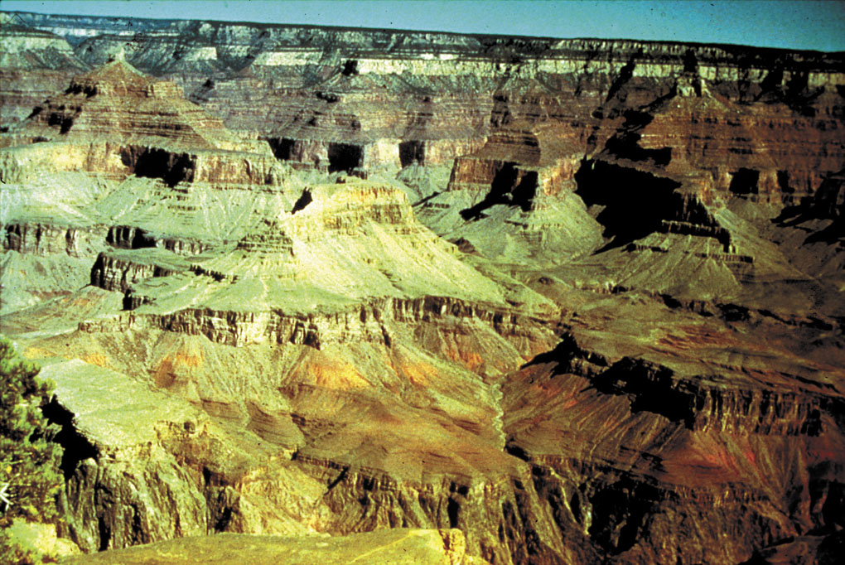
Grand Canyon--yellowish
Grand Canyon National Park
Notes:
Evolutionists basically dominate all the signs and brochures at the Grand Canyon, leading us to believe that it was carved gradually by the small Colorado River at the bottom.

Slide 101

UK – British Museum on Natural History
Natural History Museum, London
Notes:
Evolutionists also control the museums of natural history throughout the USA and London.

Slide 102





High School biology textbooks 2006
Glencoe
Holt
Evolution
EXPOSED
Miller-
Levine
Prentice Hall
Notes:
The basic texts all support evolution, but it is refuted by Roger Patterson, Evolution Exposed (2006)

Slide 103
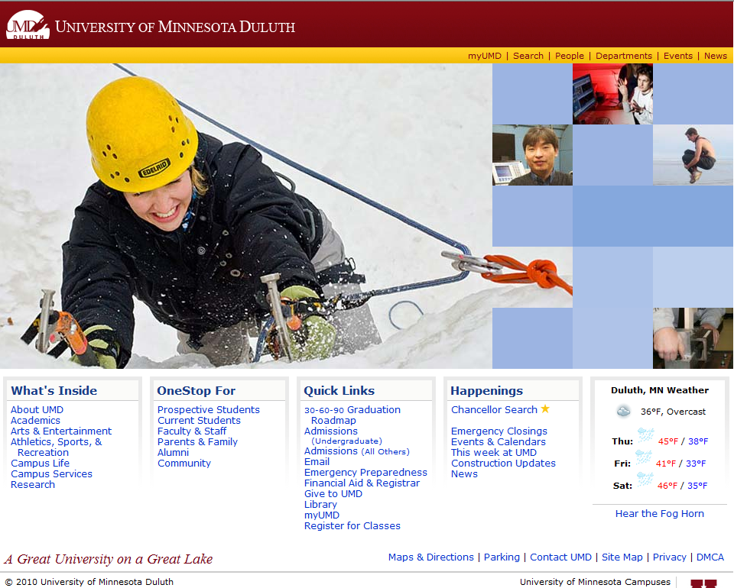
University of Minnesota Duluth
Notes:
Evolution also is the founding philosophy of every public university---and these universities are filled with many from Christian homes!

Slide 104
I Peter 3:15 NAS
1 Peter 3:15
"But sanctify Christ as Lord in your hearts, always being ready to make a defense to everyone who asks you to give an account for the hope that is in you, yet with gentleness and reverence."
Genesis is foundational to the reliability and authority of the Bible

Slide 105







Turning "Jews" into "Greeks" 02027
Turning Church Kids into Skeptics
Secular
Media &
Education
Notes:
105
After book sales and before final statements:
"Parents and grandparents, Your kids and grandkids are being indoctrinated with evolution and millions of years a whole lot more than you were when you were in school. Can they stand strong in their faith in the face of this relentless challenge? Do you care? If you walk out of here and say "That was a nice message, I believe Genesis" but don't get any resources for your kids and grandkids and make sure that they believe Genesis and know how to defend their faith, then you don't care enough. And when they crumble under the intellectual pressure, you will be partly responsible for not equipping them with answers.

Slide 106

Christian College 1
HERE I AM!
READY TO
LEARN ABOUT
GOD'S WORD.
WELCOME
TO CHRISTIAN
COLLEGE!
Intro
to the
Bible
1-11
Genesis
Notes:
Sadly, youth are not even protected when they attend many Christian colleges! The red carpet underneath them is Genesis 1-11…

Slide 107

Christian College 2
LESSON #1: DON'T BELIEVE THIS PART!
1-11
Intro
to the
Bible
Notes:
And even Christian professors tell our Christian youth they need not take Genesis at face value!

Slide 108

Balloons problem—man's vs God's word
THE
SOLUTION
ISAIAH 58:12
Gay
Marriage
Moral
Relativism
CHRISTIANITY
HUMANISM
MAN'S WORD
GOD'S WORD
Notes:
108

Slide 109
AiG web site #1

Slide 110
Evolution & Millions of Years: Do they really matter?
Destroy any basis for morality
Contradict the Bible's teaching on death
Make the gospel unbelievable
Undermine the reliability & authority of the Bible
Evolution & millions of years are destructive LIES!

Slide 111

Nailing Genesis 1-11 to church
GENESIS
1-11
MAN'S OPINIONS
MILLIONS OF YEARS
Notes:
111

Slide 112
Black blank------------extras
END

Slide 113

OT Sermons link at biblestudydownloads.com
Get this presentation for free!

