Slide 1
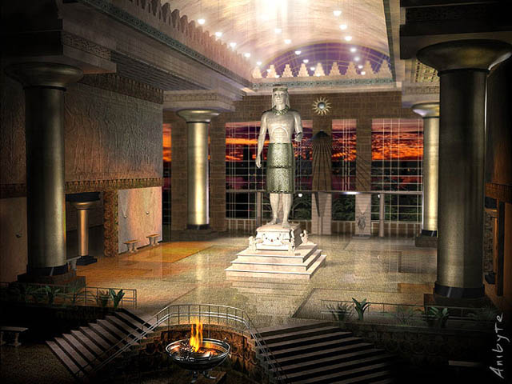
THE OLIVET DISCOURSE
The Temple Desecration
Matthew 24:15
Dr. Randall Price • World of the Bible Ministries International
Uploaded by Dr. Rick Griffith • Jordan Evangelical Theological Seminary
BibleStudyDownloads.org

Slide 2
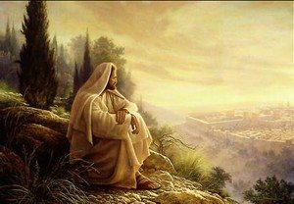
THE OLIVET DISCOURSE
Jesus’ Teaching on
the End Time
Lesson 5

Slide 3

“Therefore when you see the ABOMINATION OF DESOLATION which was spoken of through Daniel the prophet, standing in the holy place (let the reader understand)…” Matthew 24:15

Slide 4
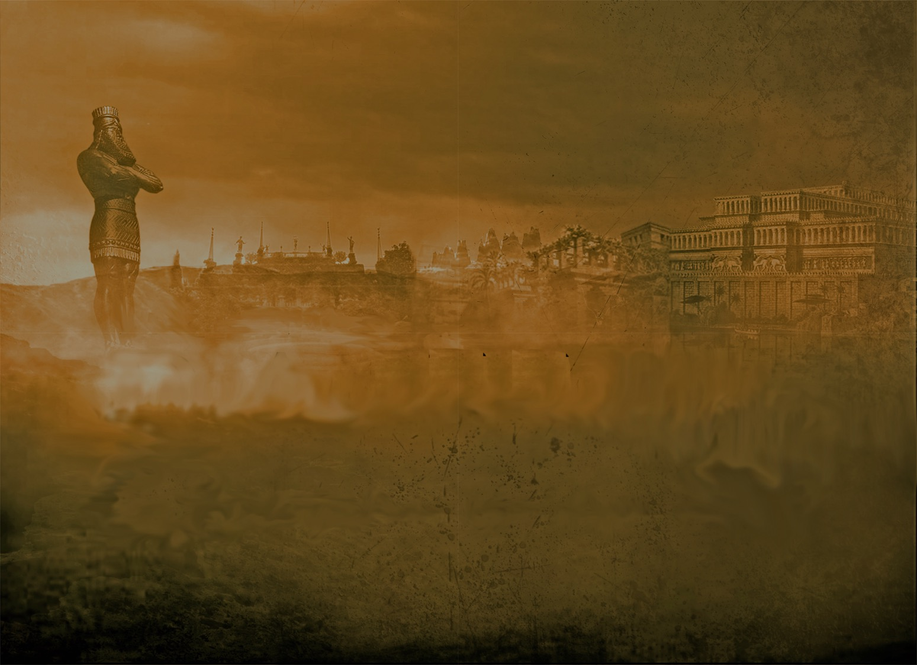
The Abomination of Desolation
When will it appear?
It was foreshadowed by Antiochus Epiphanes, but was not fulfilled in him because in Jesus’ day it was still future (Matthew 24:15-22).

Slide 5
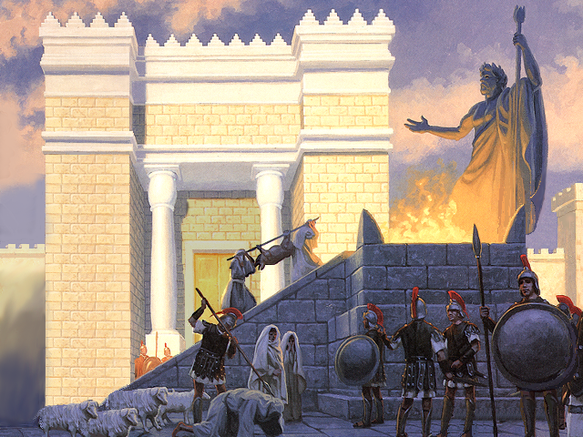
“And forces from him will arise, dese-crate the sanctuary fortress, and do away with the regular sacrifice. And they will set up the Abomination of Desolation.”
Daniel 11:31

Slide 6
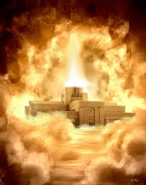
The Biblical Concept
of the Temple

Slide 7
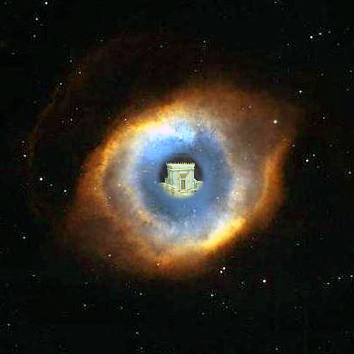
“The LORD is in His holy temple; the LORD’s throne is in heaven; His eyes behold, His eyelids test the sons of men.” Psalm 11:4
“then hear Thou in heaven Thy dwelling place”
1 Kings 8:39
“the throne of the Majesty in the heavens … in the sanctuary … the true tabernacle … For every high priest … on earth … serve a copy and shadow of the heavenly things, just as Moses was warned by God when he was about to erect the tabernacle; for, ‘See,’ He says, ‘that you make all things according to the pattern which was shown you on the mountain.’” Hebrews 8:1–5

Slide 8
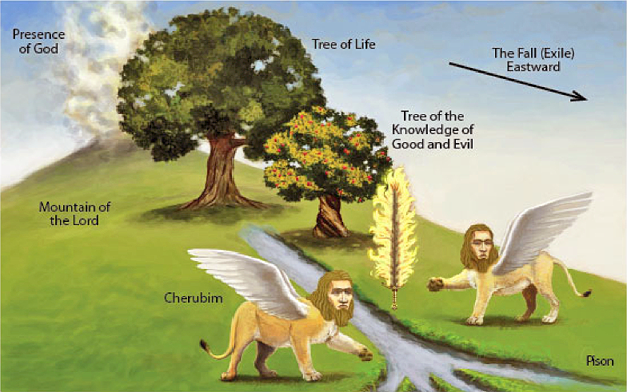

Slide 9
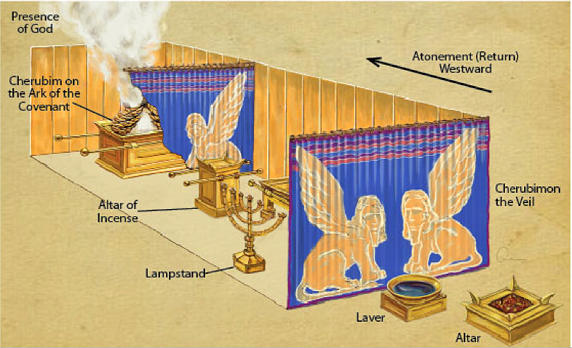

Slide 10
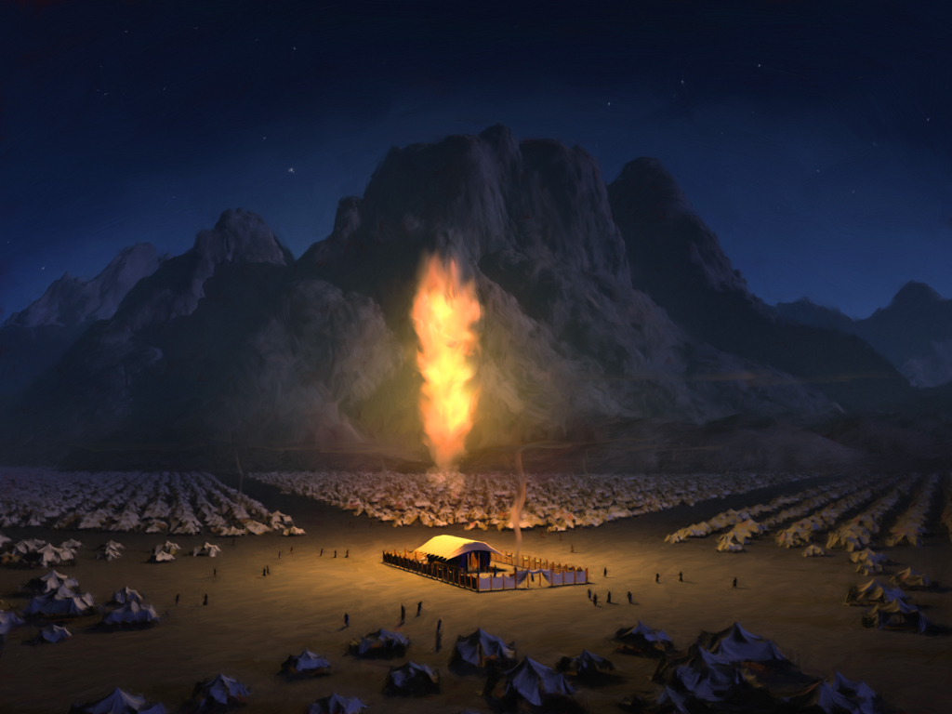
Let them make for Me a Sanctuary
[dwelling place] that I may
dwell in their midst.
Exodus 25:8

Slide 11
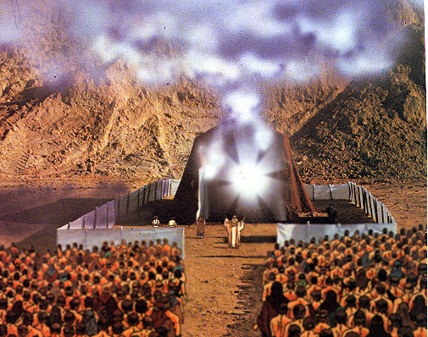
משכן
mishkan

Slide 12
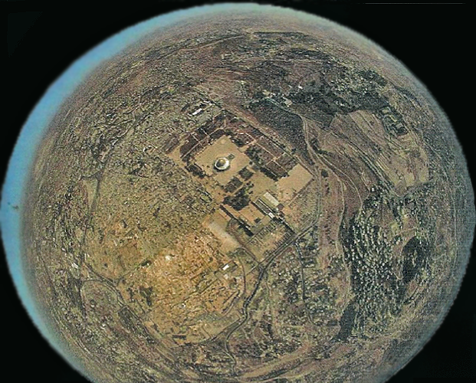
“For the LORD has chosen Zion (Jerusalem); He has desired it for His habitation. “This is My resting place forever; Here I will dwell, for I have desired it.”
Psalms 132:13–14

Slide 13
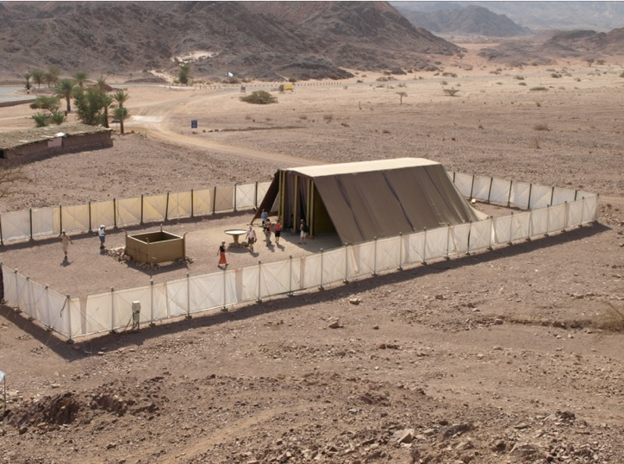
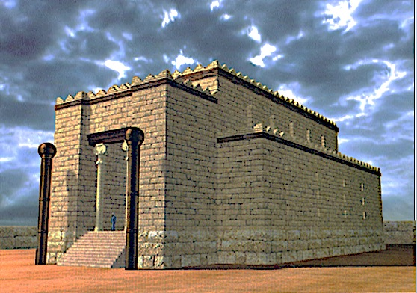
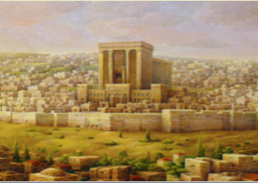
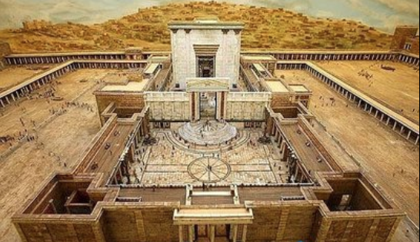
FOUR FORMS OF THE SANCTUARY

Slide 14
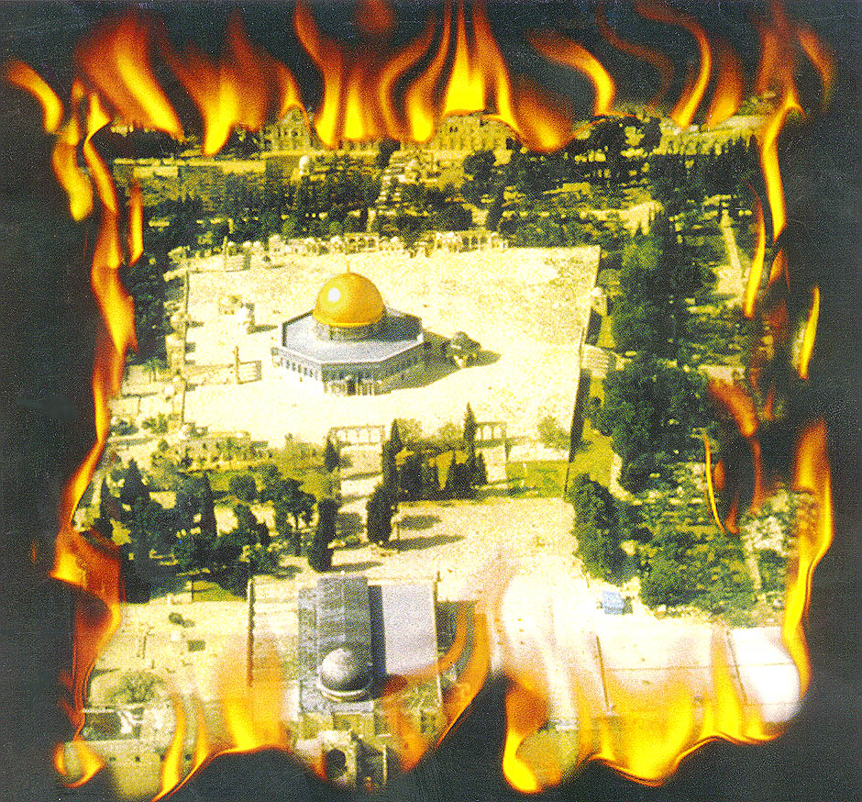
THE TEMPLE MOUNT
The Most Volatile 35 Acres on Earth

Slide 15
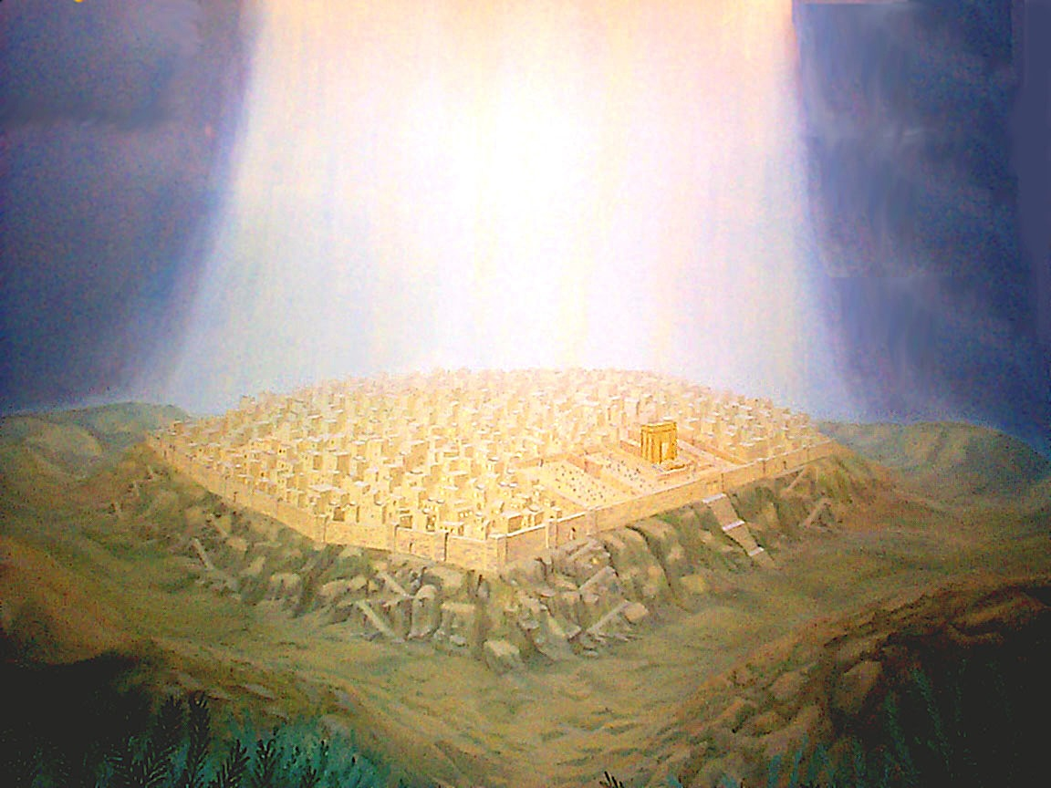
THE TEMPLE
IN PROPHECY

Slide 16


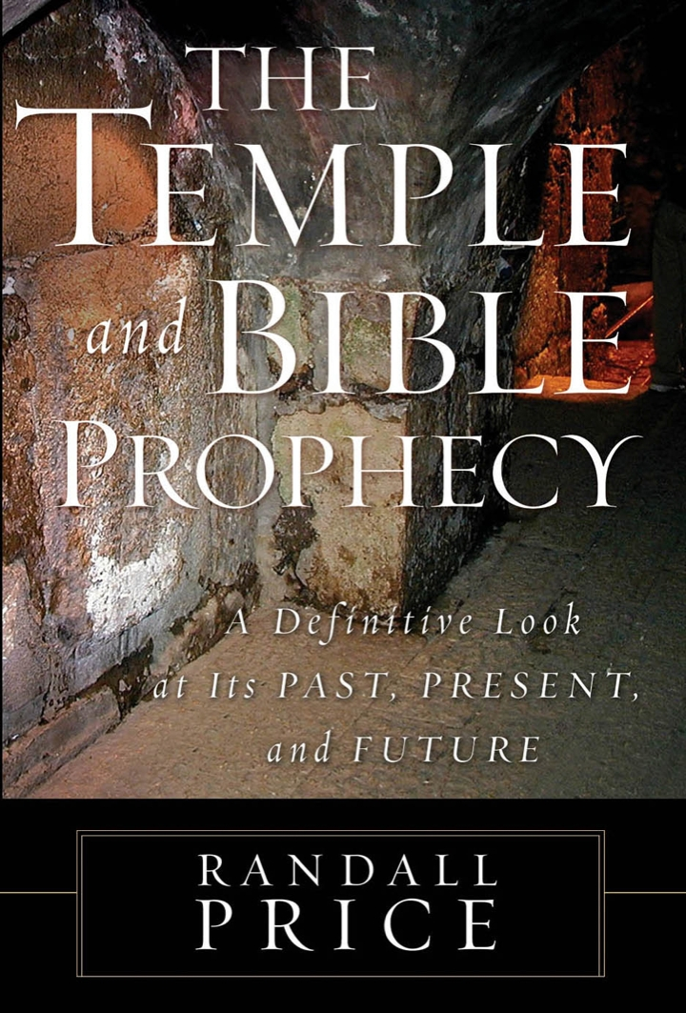
Text
Text

Slide 17
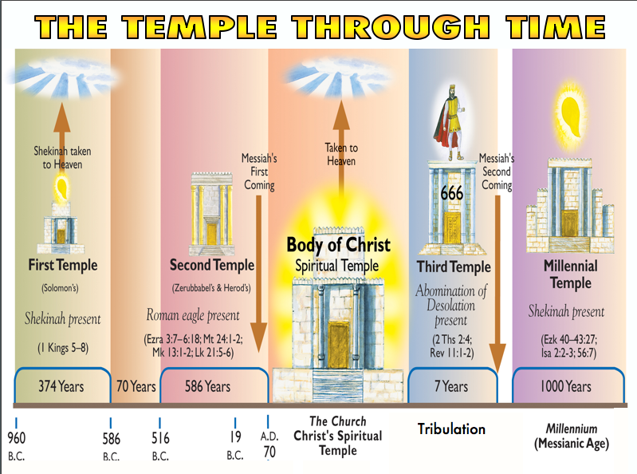

Slide 18
The Abomination of Desolation
When will it appear? It was foreshadowed by Antiochus Epiphanes, but was not fulfilled in him because in Jesus’ day it was still future (Matthew 24:15-22).
What is it? The only clue given is that it will be something standing (like an idol or image) in the holy place (Dan. 12:11; Matt. 24:15).
“wing” = refers to the pinnacle of the temple; it’s a Hebrew word that means “overspreading.” What begins there will spread to other places.
“abomination” = an image or idol that being placed in the Holy place produces desecration that results in desolation.

Slide 19
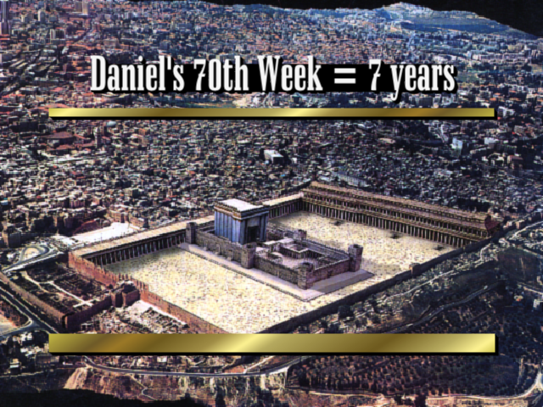

Slide 20
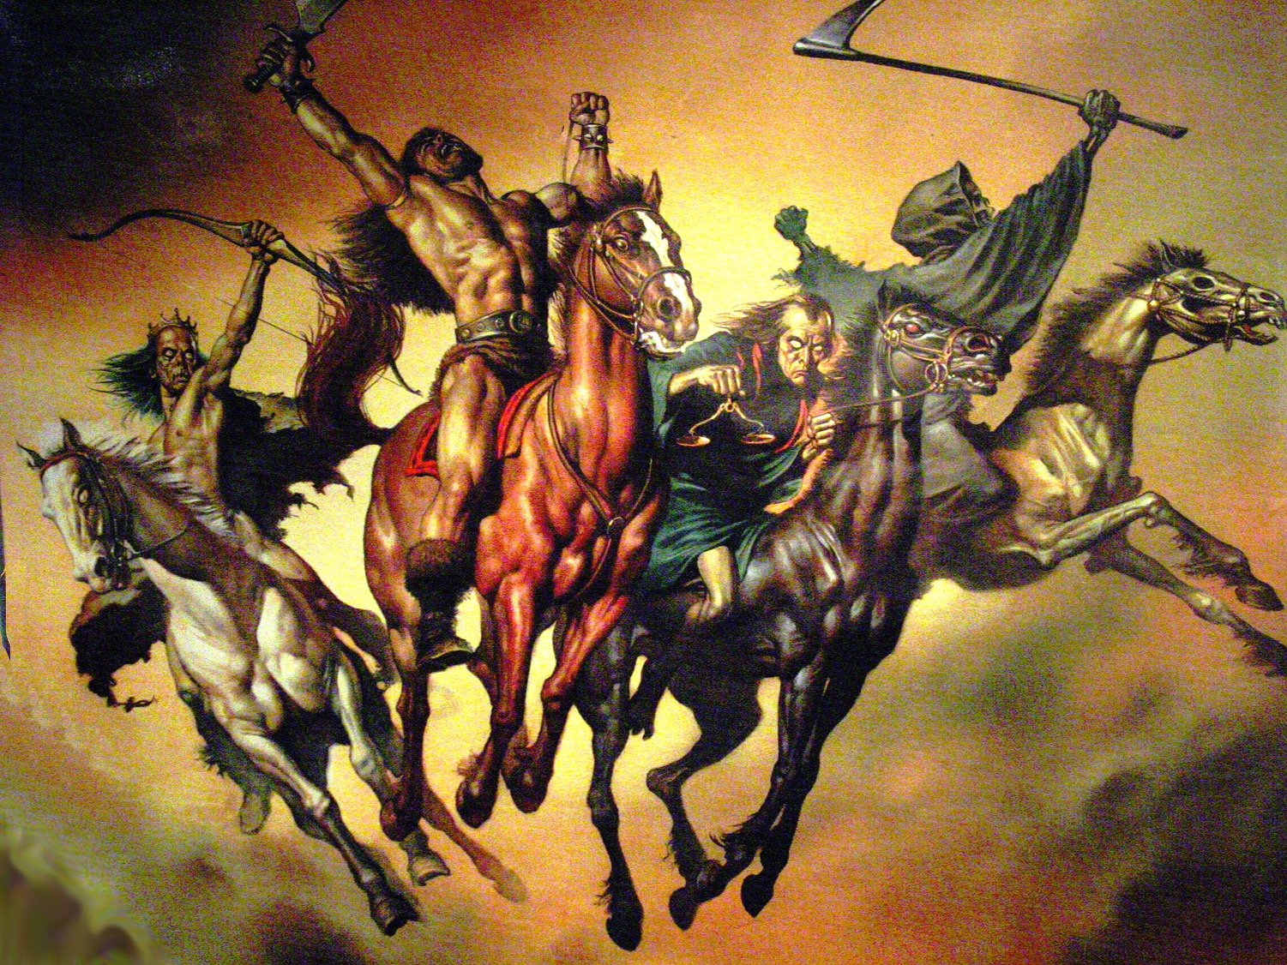
Events at the Start of the 70th Week
“The Lamb broke one of the seven seals … And I looked, and behold, a white horse, and he who sat on it had a bow; and a crown was given to him; and he went out conquering, and to conquer … the second seal … a red horse … to take peace from the earth, and that men should slay one another … the third seal … a black horse … (famine) … the fourth seal … an ashen horse … over a fourth of the earth, to kill with sword and with famine and with pestilence and by the wild beasts of the earth … the fifth seal … slain because of the word of God, and because of the testimony which they had maintained … the sixth seal … a great earthquake … sun became black … and the whole moon became like blood” Rev. 6:1–12

Slide 21
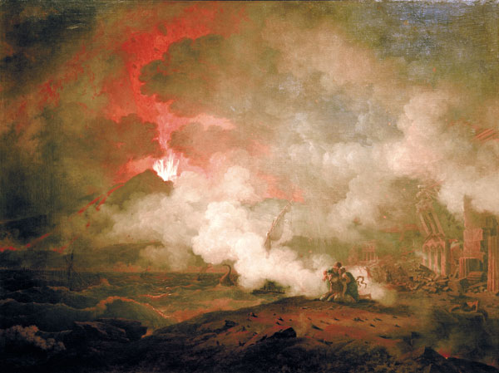
Parallels Between Daniel 9:27 and Revelation
Topic Daniel 9:27 Revelation
Beg. of Trib. Peace Treaty Rider on White Horse (6:1)
Temple Sacrifices Temple (11:1-2)
Time Half of 7 years 1260 days; 42 months
Antichrist One who Persecution (13:7) Persecutes makes desolate Jews
Antichrist’s Abomination of Image of Antichrist (13:11-15) Image Desolation
End of Trib. Destruction of the Antichrist Defeated (19:20) Desolator

Slide 22

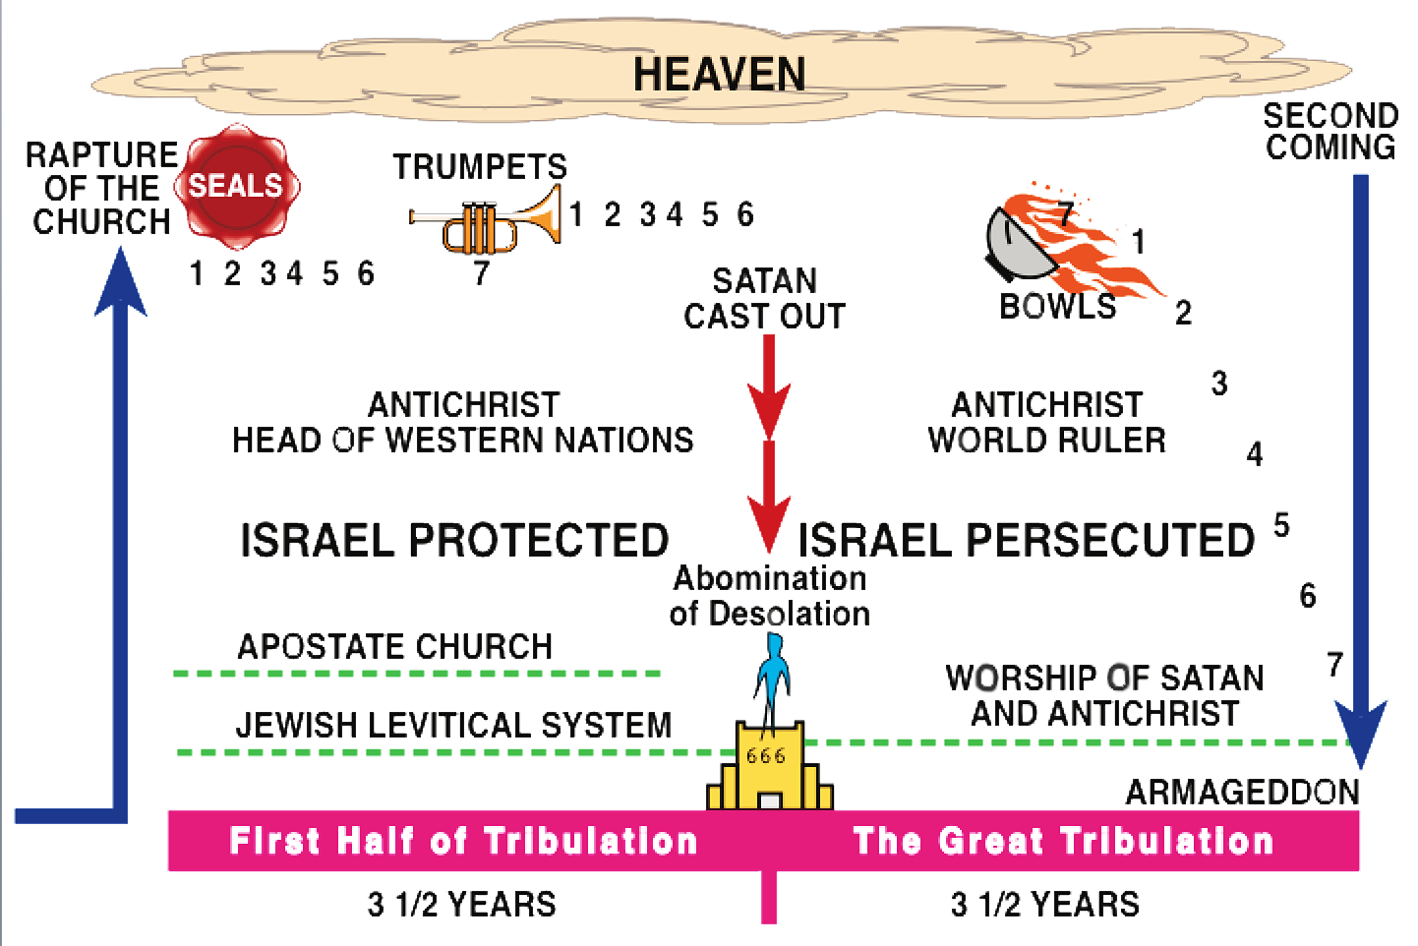
Overview of Tribulation Events
ISRA EL
PRESERVED
COVENANT WITH ANTICHRIST
CORRUPTION OF ANTICHRIST
CONDEMNATION OF
ANTICHRIST
TEMPLE DESIGNED
TEMPLE DELIVERED
TEMPLE DESECRATED

Slide 23
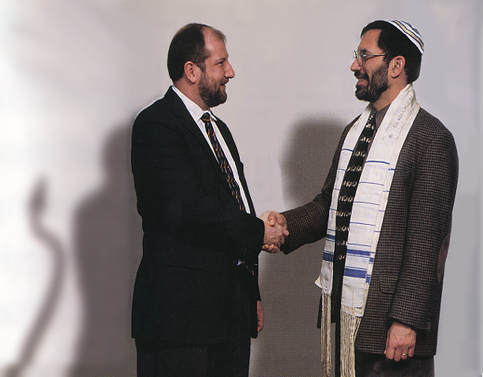
The Start of the 70th Week
Antichrist
Jewish Leader
““And he will make a firm covenant with the many for one week, but in the middle of the week he will put a stop to sacrifice and grain offering …” Daniel 9:27a

Slide 24
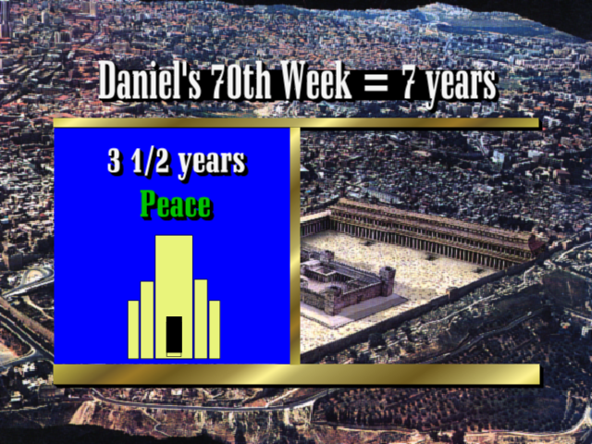

Slide 25
Temple rebuilt at the Beginning of 70th Week

Slide 26
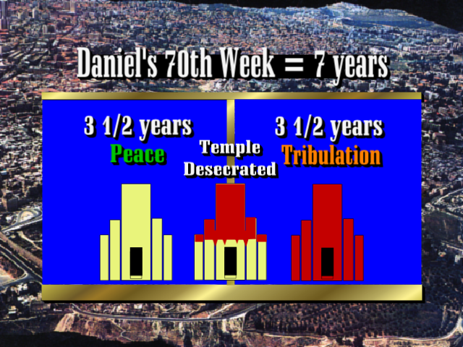

Slide 27
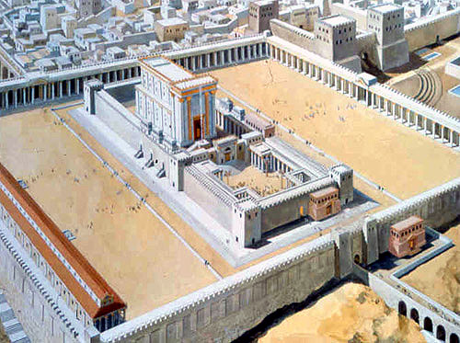
The Mid-Point of the 70th Week
And there was given me a measuring rod like a staff; and someone said, “Rise and measure the Temple of God, and the altar, and those who worship in it. And leave out the court which is out-side the temple, and do not measure it, for it has been given to the nations; and they will tread under foot the holy city for forty-two months.” Revelation 11:1-2

Slide 28
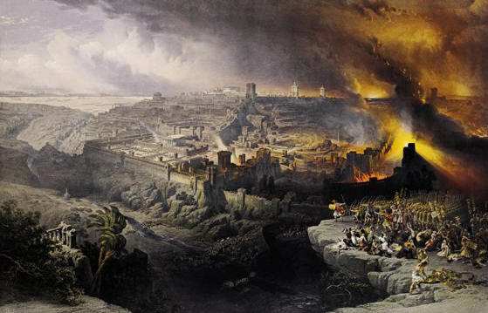
“and they will fall by the edge of the sword, and will be led captive into all the nations; and Jerusalem will be trampled under foot by the Gentiles until the times of the Gentiles be fulfilled.” Luke 21:24

Slide 29
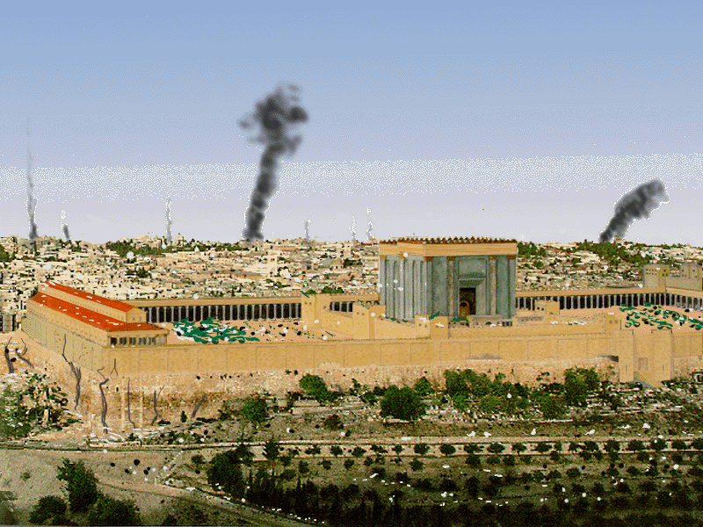
For I will gather all the nations against Jerusalem to battle, and the city will be captured, the houses plundered… and half the city exiled… Zechariah 14:2

Slide 30

Homepage at BibleStudyDownloads.org
Use this QR Code for Access
Notes:
Apologetics & Evangelism (ae)

Slide 31


Olivet Discourse link at BibleStudyDownloads.org
Get this presentation for free!
Notes:
Olivet Discourse (od)

