Slide 1
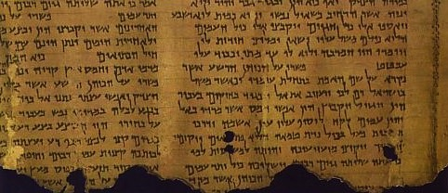
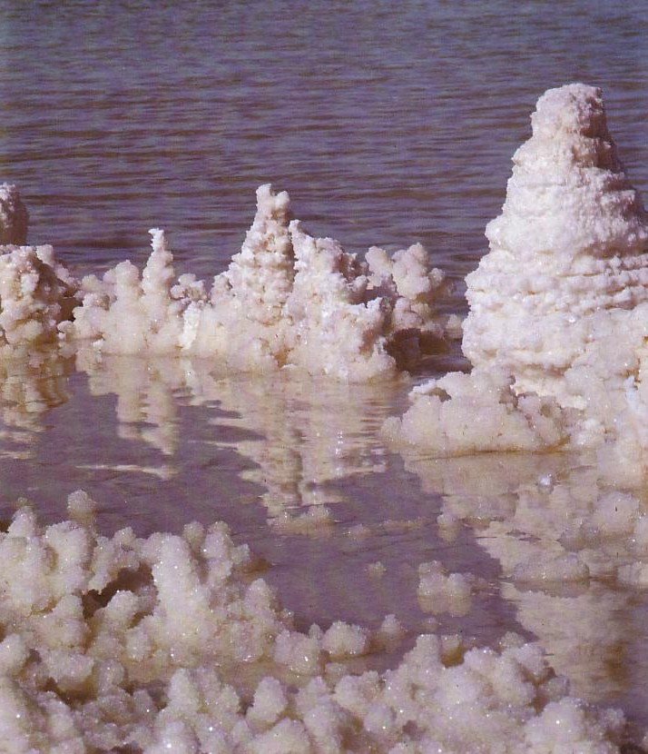
The Dead Sea Scrolls
The most significant literature found in the history of the Church
Dr. Rick Griffith • Jordan Evangelical Theological Seminary
BibleStudyDownloads.org

Slide 2

Location of the Dead Sea
Sea of Galilee
The Great Sea
215 km. (135 mi.)
Jordan River
Salt Sea

Slide 3

Elevations in North-South Divisions
Jordan Rift

Slide 4
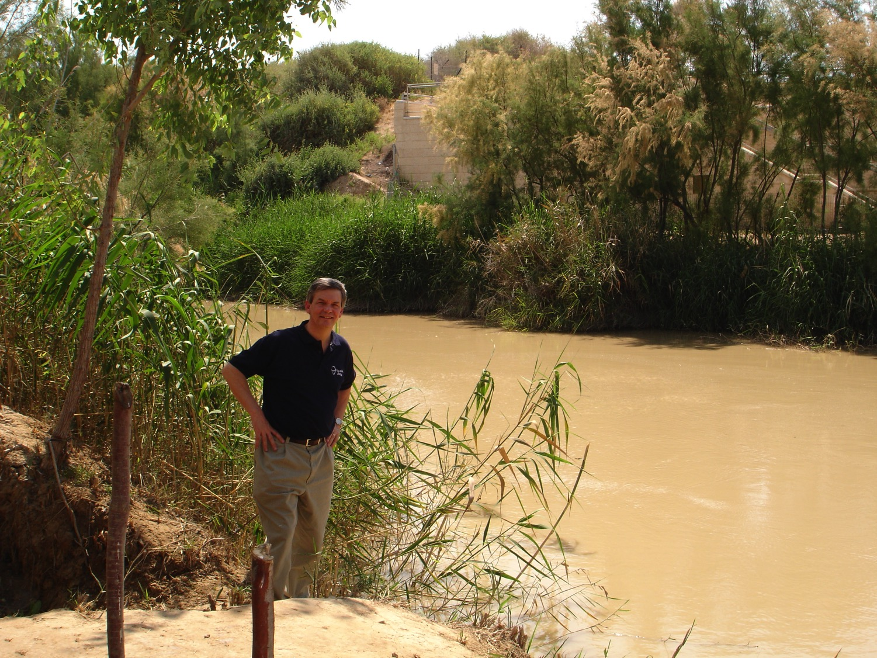
Baptismal Site of Jesus

Slide 5
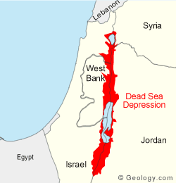

The Jordan Rift
Lebanon
Syria
West
Bank
Deep Depression
Dead Sea Depression
Israel
Jordan
From the Wilderness of Judea looking east to the Salt Sea below
Egypt
© Geology.com

Slide 6
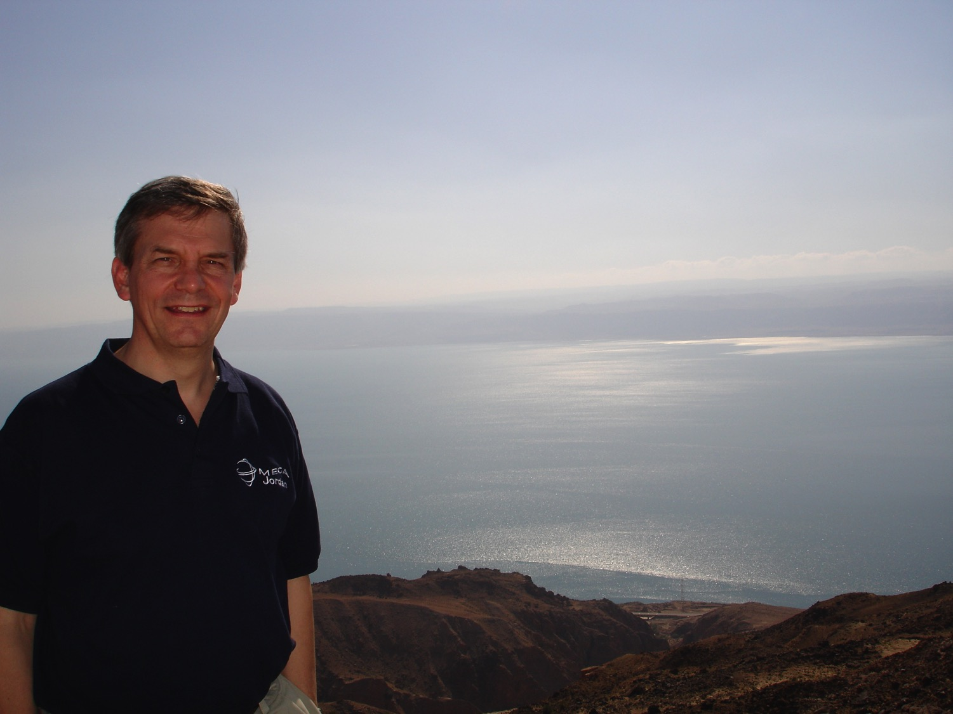
From the Heights

Slide 7
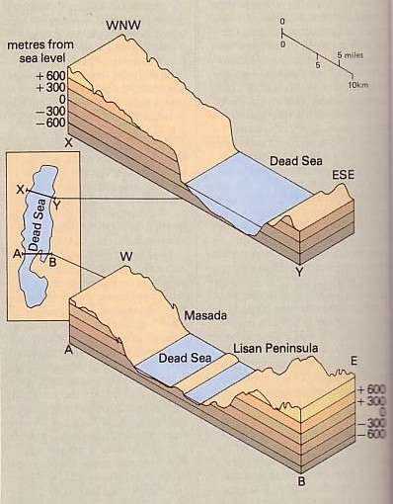
The lowest spot on earth
(-394 m.)
3-4 in. rain/year
3 sections now
Dropped 12 m. since 1975—was 20 m. higher in the 1st cent. AD
Israel makes US$1 billion/yr. from potassium for fertilizer

Slide 8
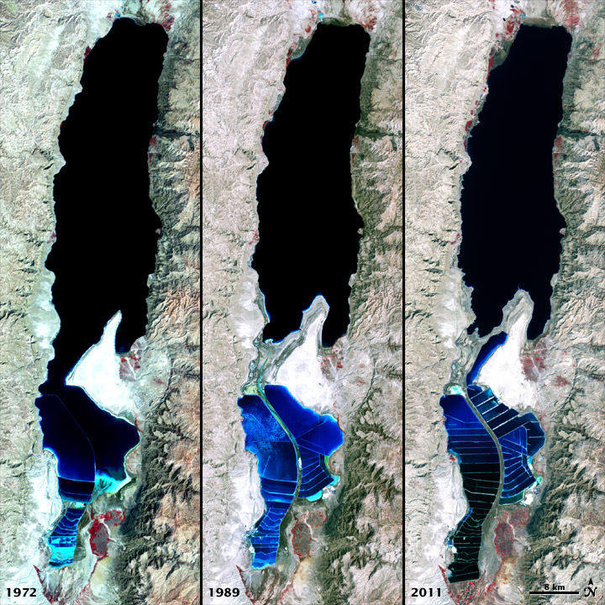
Black
1972
1989
2011

Slide 9
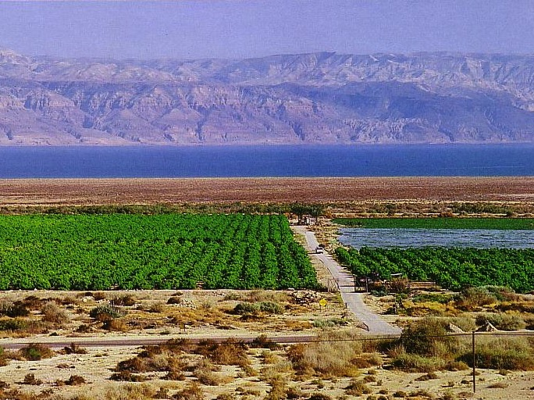
Crops from a Fresh Water Oasis

Slide 10
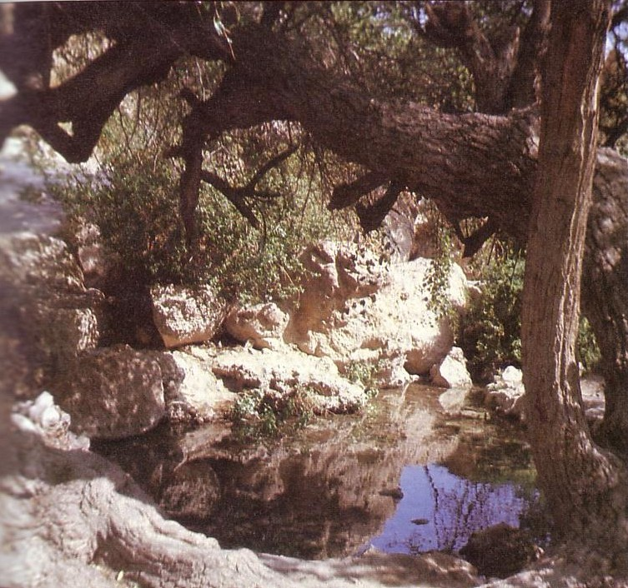
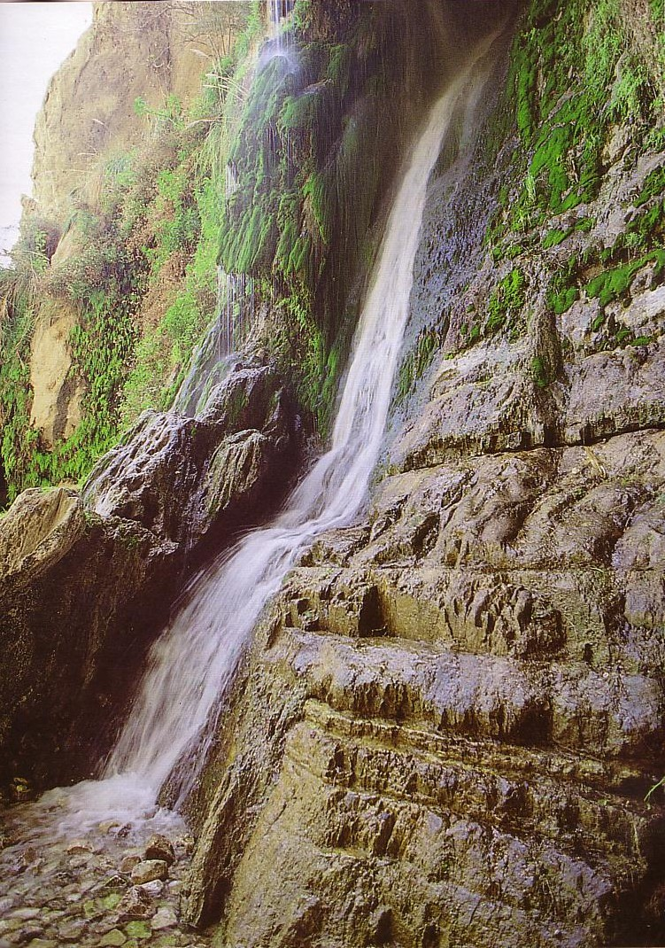
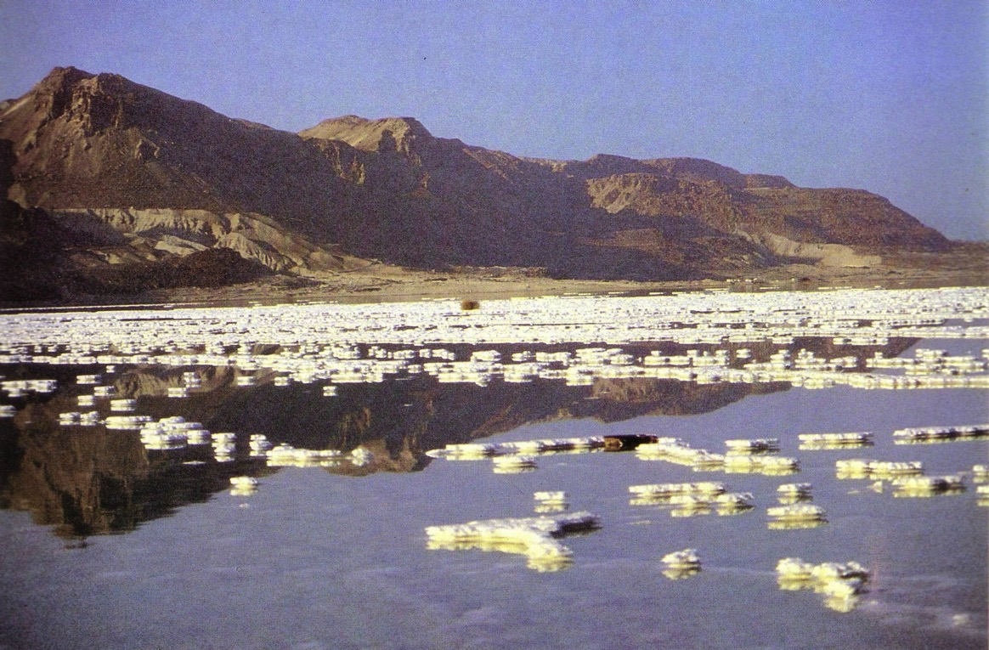
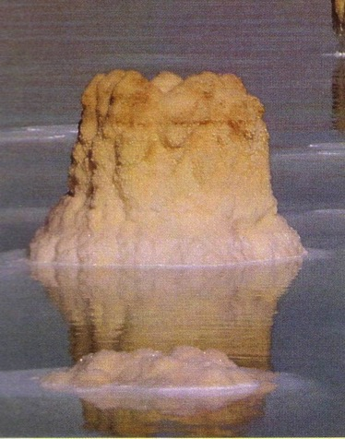
En Gedi
The Salt Sea

Slide 11
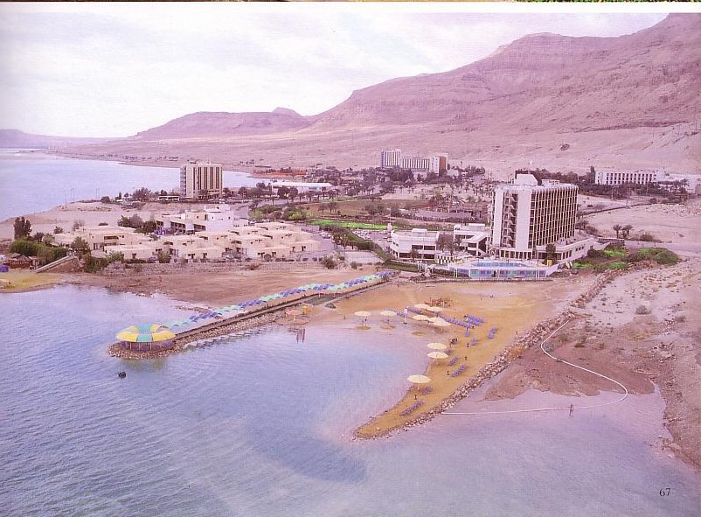

Resorts of Salt?

Slide 12
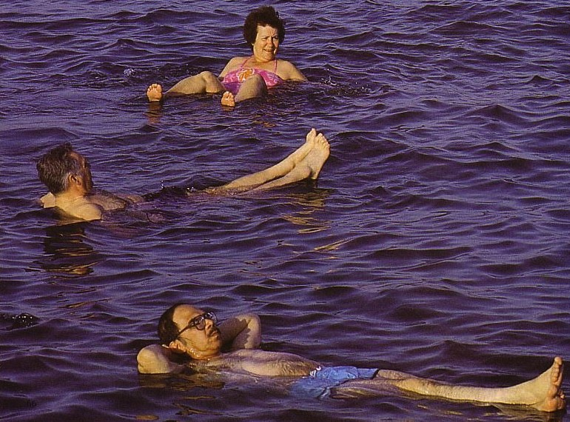
The Highest Salt Content on Earth
6 times the salt content of sea water
27% solids with 7% salt
Float effortlessly
No outlet

Slide 13
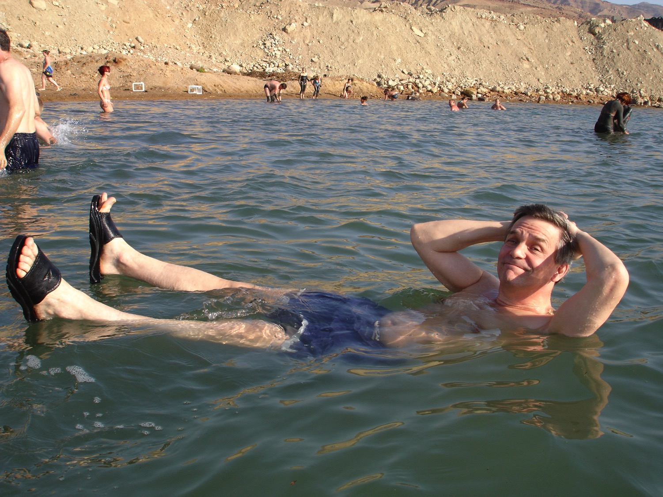
I enjoyed it too!

Slide 14
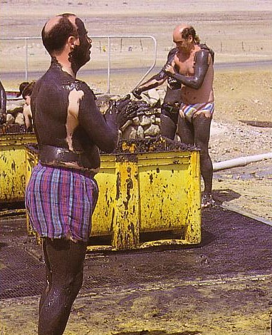
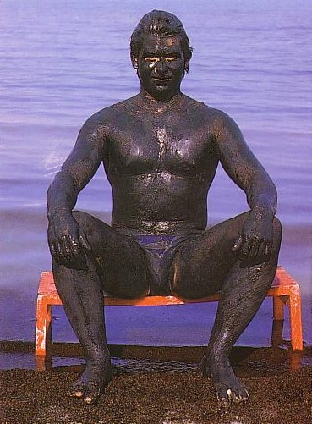
Dead Sea Mud
Great for the skin (they say)
You can't get too much

Slide 15

Rick, Randall, Tim

Slide 16

Stings the skin but feels great!

Slide 17

Pure Pleasure!?

Slide 18
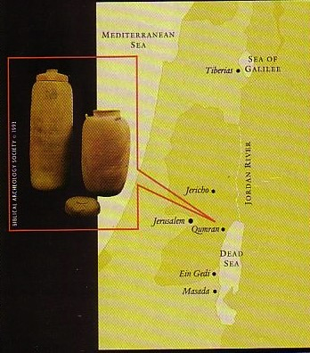
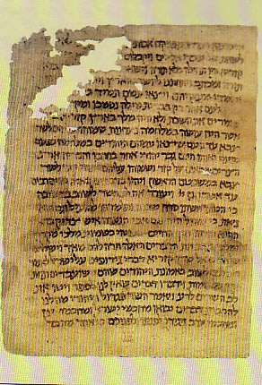
History of the Dead Sea Scrolls
OTB413 = NTB174
Seven scrolls were found (1947) and quickly published
Bar Kochba letters (1952, 1960-61)
Hundreds of scrolls and 18,000 fragments followed (1947-1956)

Slide 19
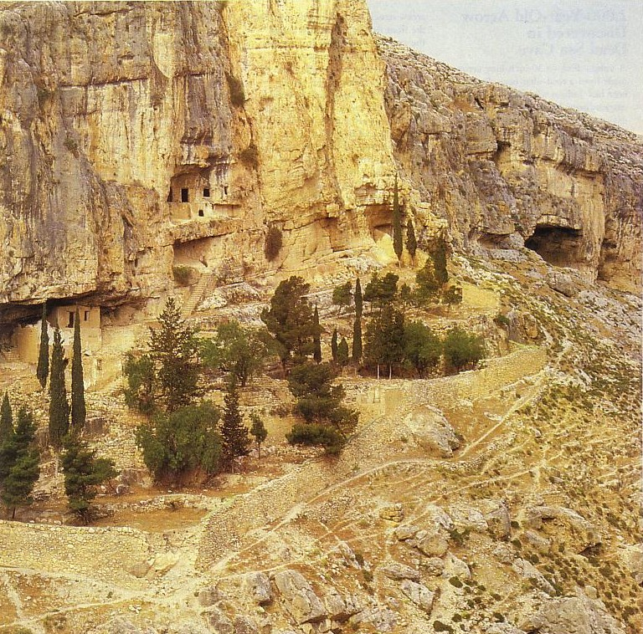
Tough Work!
Often gettingscrolls from the hills wasn't easy

Slide 20
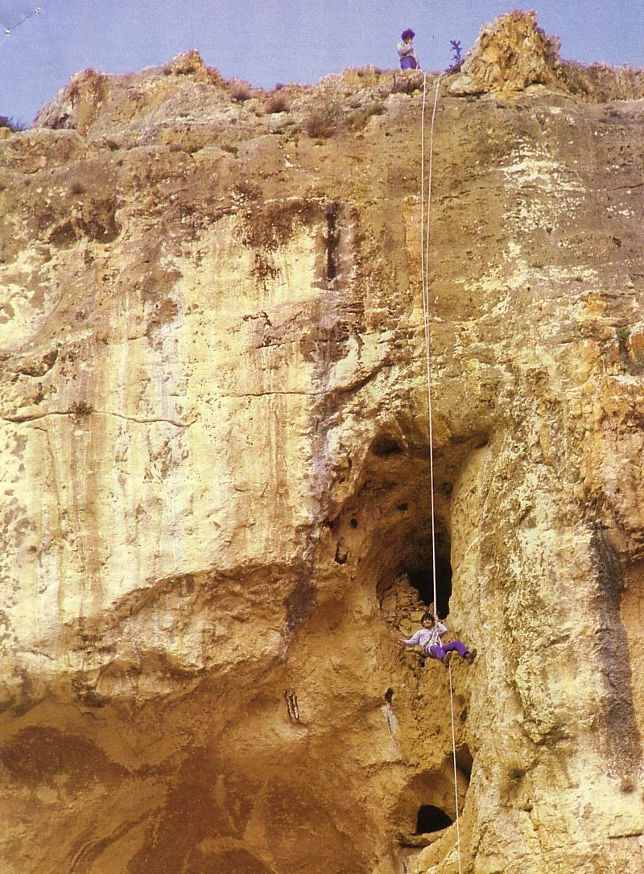
Near Impossible Work
Sometimes it was near impossible!

Slide 21
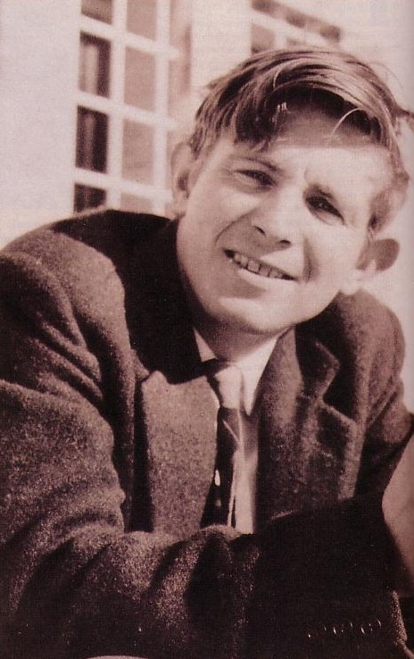
Evaluating the Scrolls
174
Fragments were assigned to John Strugnell and his small team of scholars

Slide 22
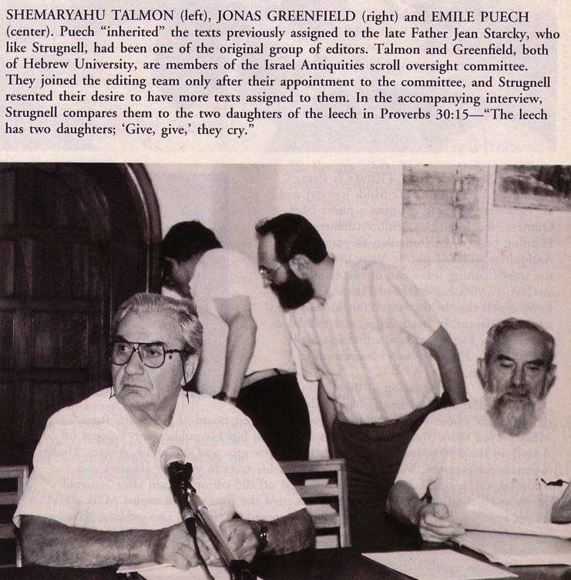
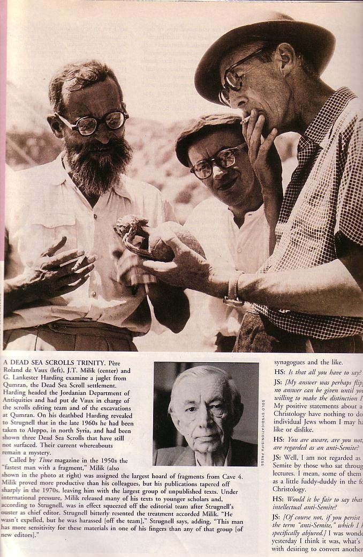
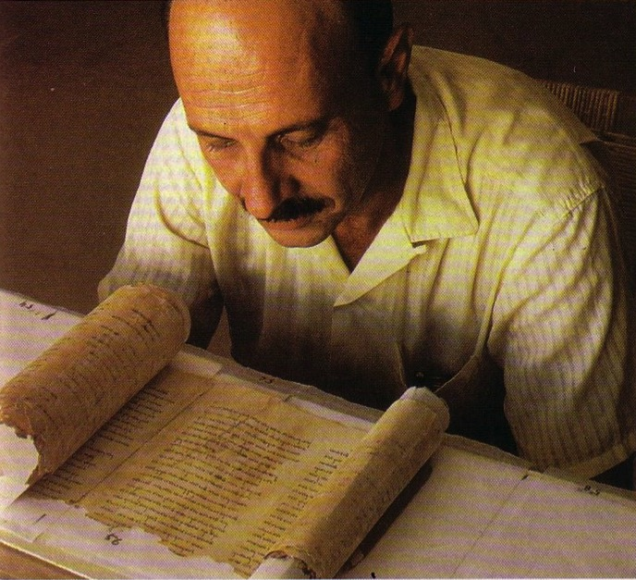
Strugnells' Team
They alone could see the fragments
Talmon, Puech, Greenfield
Yigal Yadin
De Vaux, Milik, Harding

Slide 23
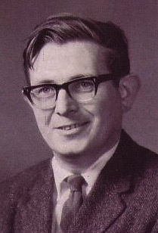
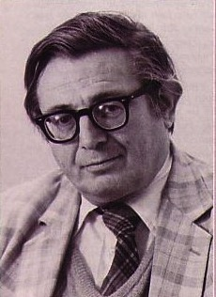
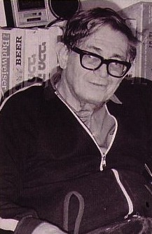
Ever-so-slow work…
174
Fragments were unpublished for almost 40 years by John Strugnell's small team of scholars
None of his scholars were Jewish
Meanwhile, Strugnell aged

Slide 24
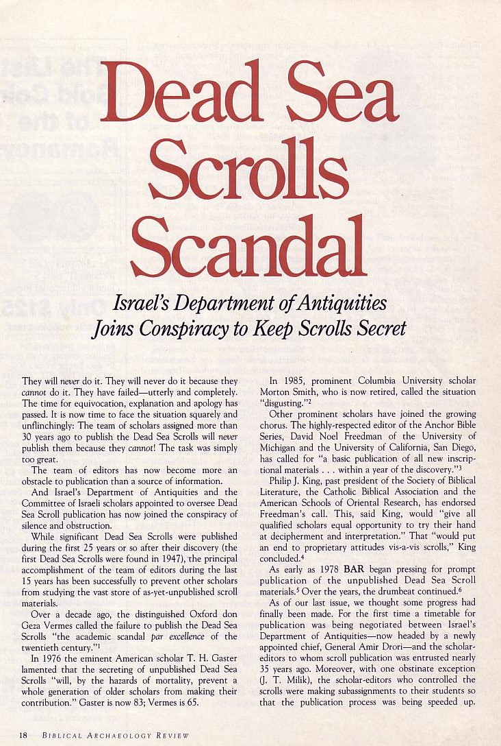
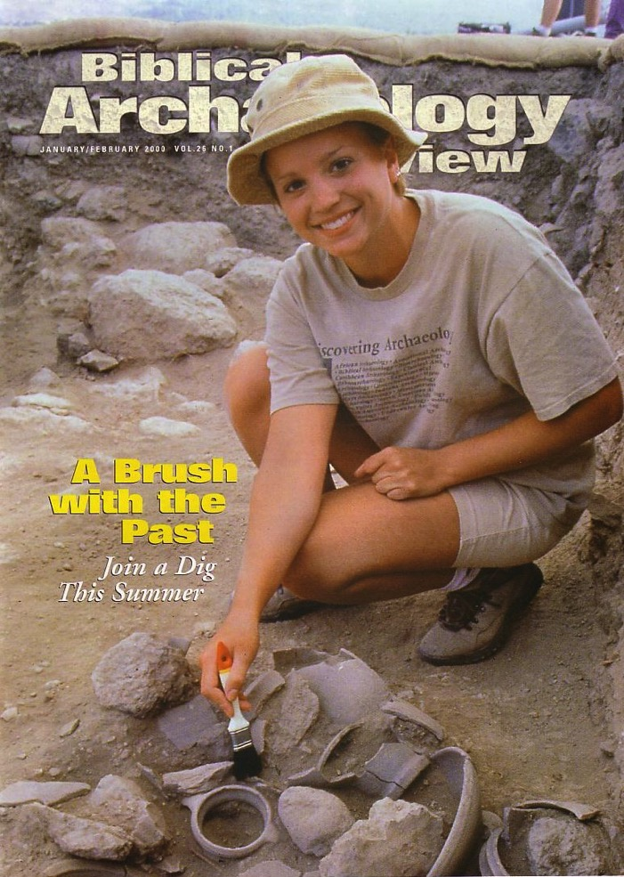
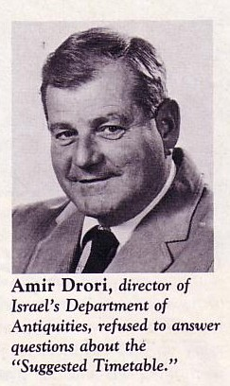
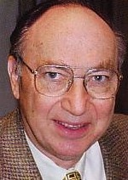

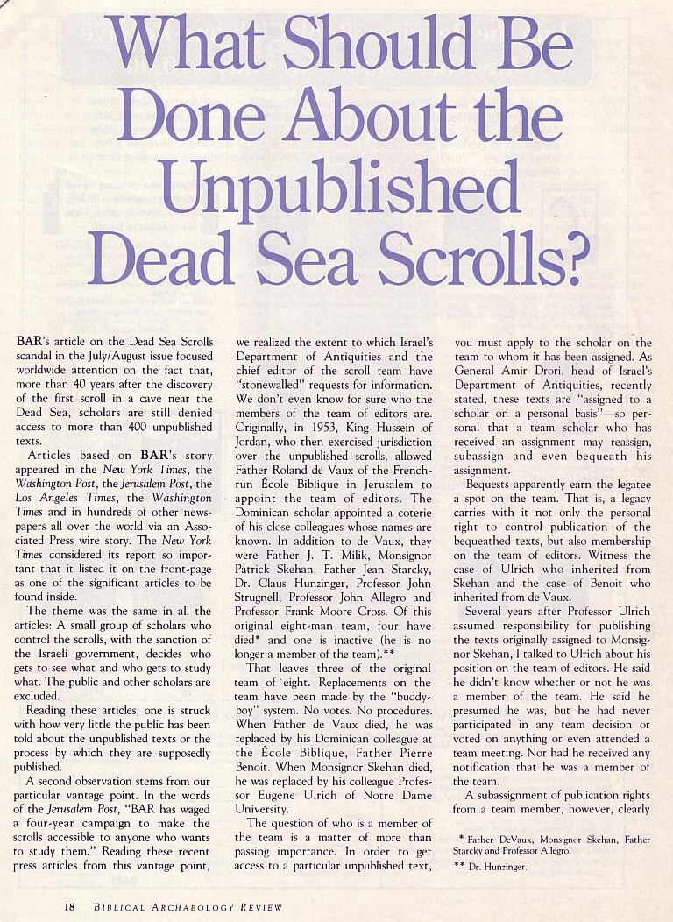
Hershel Shanks Complained in BAR
174

Slide 25
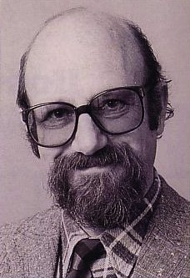
What happened to Strugnell?
174
Strugnell denounced Israel and was sacked (1990)
Strugnell was replaced by Emmanuel Tov, who expanded the translation team to 70 scholars from 8 countries, including 13 women

Slide 26

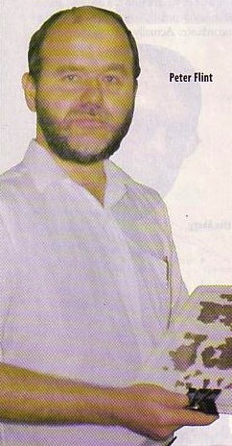
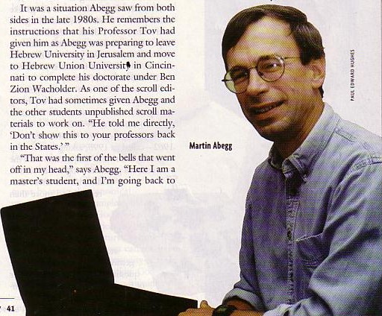
Evangelical DSS Scholars
175
Martin Abegg let the cat out of the bag

Slide 27
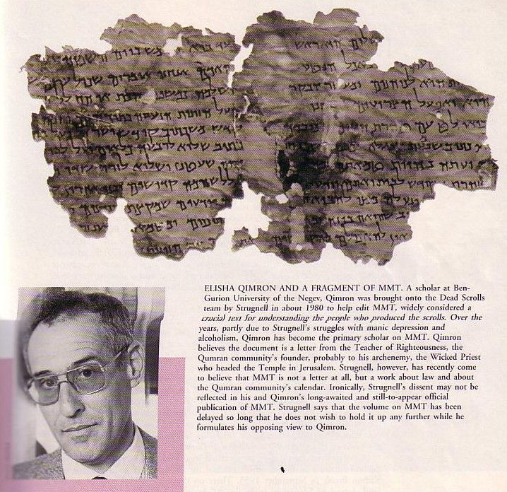
MMT
175
The only letter in Qumran
MIQSAT MA'ASE HA-TORAH
"some precepts of the Torah" (Qimron)?
"some legal rulings of the Torah"?
"works of the law" (Abegg's translation shows that this is evidence for rabbinic belief in salvation by works, which Paul argues against in Galatians.)
Elisha Qimron

Slide 28
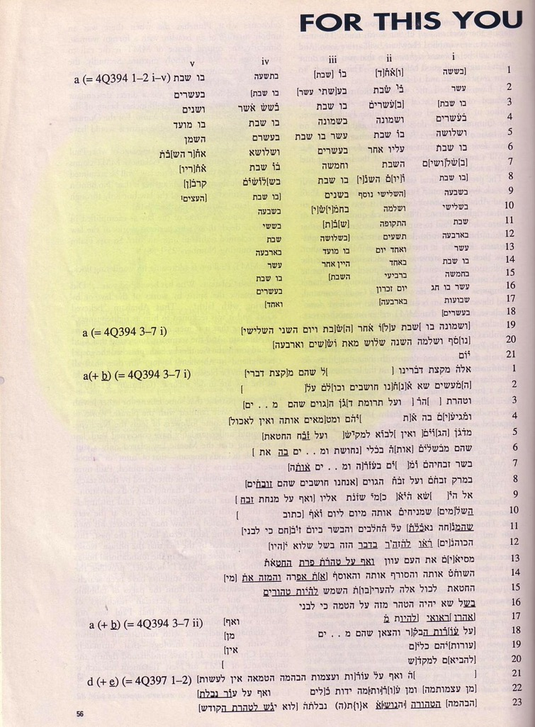
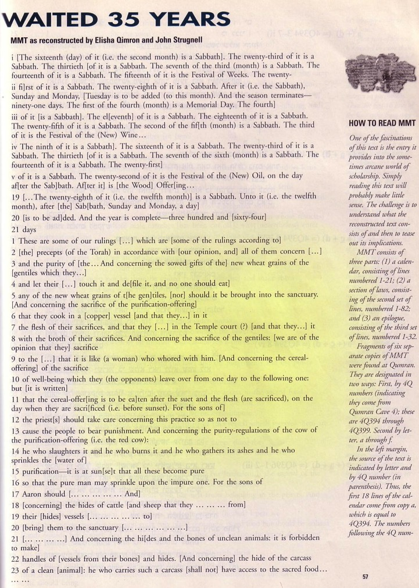
Shank's Controversial Reprint

Slide 29
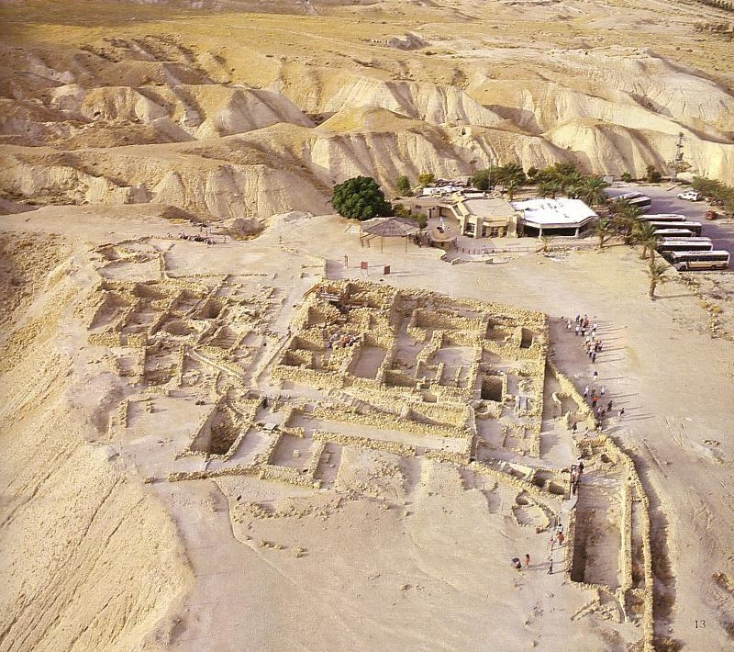

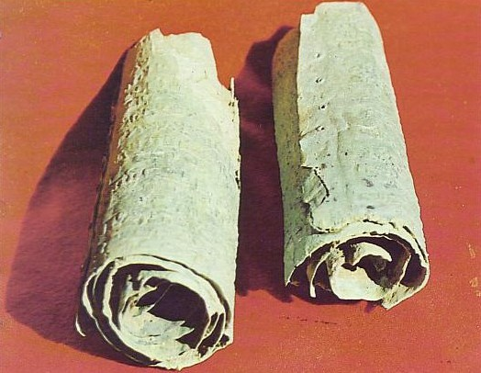
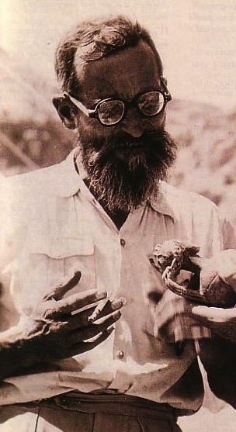
The Qumran Ruins
De Vaux

Slide 30
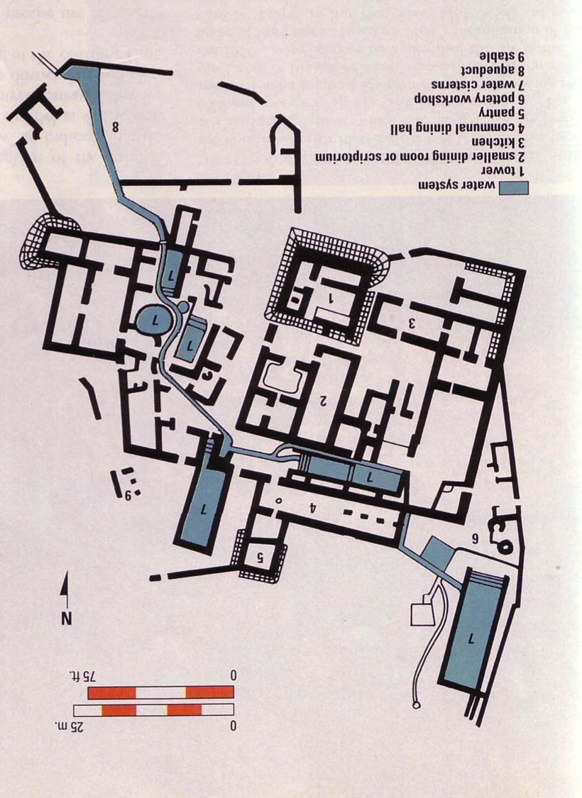
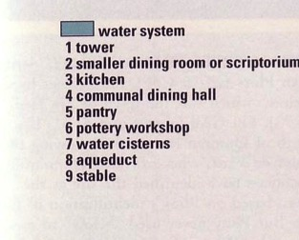

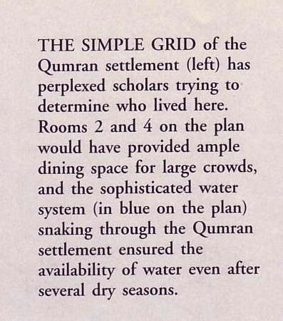
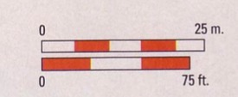
Map of the Qumran Community
179

Slide 31
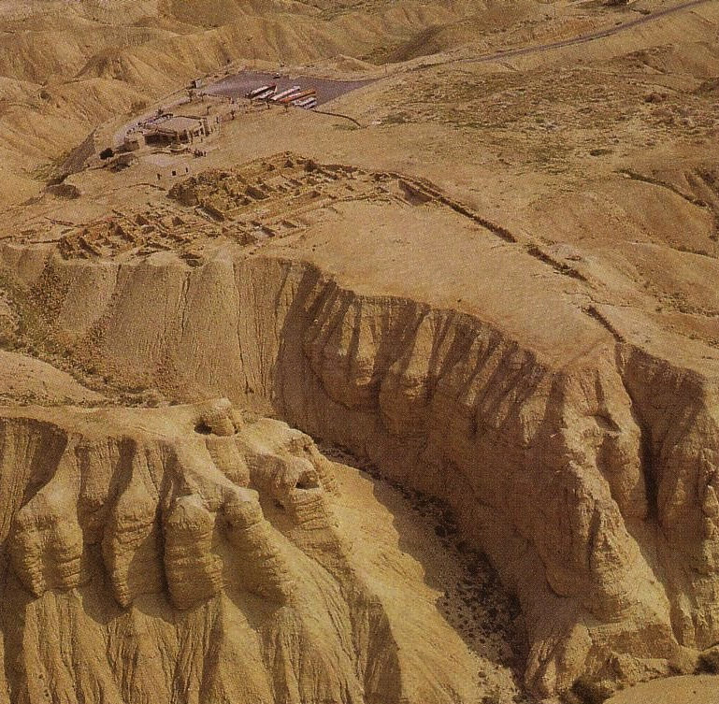
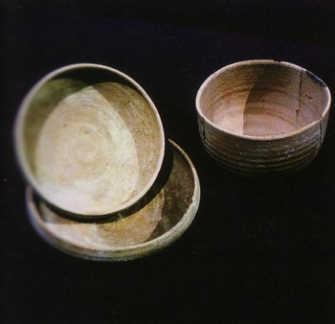
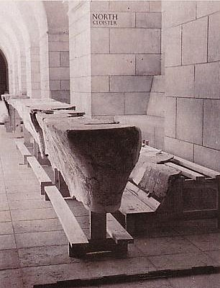
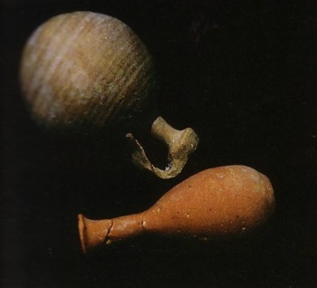


Finds at Qumran

Slide 32





The Qumran Community
179

Slide 33

Who were the Essenes?
180
North of En Gedi (Pliny the Elder)
“On the west side of the Dead Sea, but out of the range of the noxious exhalation of the coast, is the solitary tribe of the Essenes, which is remarkable beyond all the other tribes in the whole world, as it has no women and has renounced all sexual desire, has no money, and has only palm trees for company. Day by day the throng of refugees is recruited to an equal number by numerous [additions] of persons tired of life and driven thither by the waves of fortune to adopt their manners. Thus through thousands of ages (incredible to relate), a race in which no one is born lives on forever; so prolific for their advantage is other men's weariness of life! Lying below them [Essenes] was formerly the town of En Gedi”
(Pliny, Natural History 2)
Notes:
trans. H. Rackham, Loeb Classical Library [London: Heinemann/Cambridge, MA: Harvard Univ. Press, 1969], 5.15, 73

Slide 34

Who were the Essenes?
180
North of En Gedi (Pliny the Elder)
No marriage (Josephus)

Slide 35


Who were the Essenes?
180
North of En Gedi (Pliny the Elder)
No marriage (Josephus)
Scriptorium
Sectarian writings

Slide 36

Why did the Essenes form?
67, 180
The high priesthood was corrupt
Annas & Caiaphas of the NT era continued the corrupt practices of Jason and Menelaus (175 BC). So the Essenes withdrew to the desert during the reign of Simon (143-135 BC)

Slide 37


Peter fought against the corrupt priesthood, but the Essenes…

Slide 38

Essenes chose to withdraw…
67, 180
Jerusalem
Qumran
Simon the High Priest at the Temple:
"The Evil Priest"
Essene:
"Teacher of Righteousness"
versus

Slide 39

Why did the Essenes form?
67, 180
The high priesthood was corrupt
The temple was mostly a marketplace

Slide 40



Other views of who lived at Qumran
180
Sadducees?
Pharisees?
Roman fortress?
Zealots?
Christians?
Jerusalem theory (many sects)?
Wealthy man's estate?
Conclusion: The Essene view is still the most plausible

Slide 41

Others Doubt the Essene Theory
184a
Alan Crown, "Qumran: Was It An Essene Settlement?" BAR 20 (Sept/Oct 94): 30

Slide 42

What Scrolls were Found?
181
Every OT book but Esther (e.g., 11QPs)
Apocrypha and Pseudepigrapha
Commentaries (e.g., 1QpHab)
Collections of OT passages on a theme
Sectarian writings
  Manual of Discipline
  Temple Scroll
  War Scroll

Slide 43


The Copper Scrolls
182
Provide detailed plans for the third temple

Slide 44
What Scrolls were Found?
182
Every OT book but Esther (e.g., 11QPs)
Apocrypha and Pseudepigrapha
Commentaries (e.g., 1QpHab)
Collections of OT passages on a theme
Sectarian writings
  Manual of Discipline
  Temple Scroll
  War Scroll
No NT manuscripts

Slide 45

Many scrolls have missing parts

Slide 46

But many are clearly readable!

Slide 47
Contents of the Scrolls
Biblical Manuscripts e.g., Isaiah, Exodus, Leviticus, Numbers, Deuteronomy
Commentaries e.g., Genesis, Job, Isaiah, Hosea, Micah, Habakkuk, Psalm 37, 45
Apocrypha e.g. Epistle to Jeremiah, Tobit, Ecclesiasticus.
Nelson's New Illustrated Bible Dictionary.

Slide 48
Contents of the Scrolls
Pseudepigrapha e.g., Book of Jubilees, Book of Enoch, The Testaments of the Twelve Patriarchs (fragments).
Previously Unknown Pseudepigrapha e.g., Sayings of Moses, Vision of Amram, Psalms of Joshua, Daniel cycle (The Prayer of Nabonidus), Book of Mysteries.
Nelson's New Illustrated Bible Dictionary.

Slide 49
Contents of the Scrolls
Community Documents e.g., The Manual of Discipline, Damascus Document, Thanksgiving Psalm, War Scroll.
Nelson's New Illustrated Bible Dictionary.

Slide 50

Pseudepigrapha
I. The Palestinian group
Psalms of Solomon
Psalms of Joshua
Testaments of the Twelve Patriarchs
Book of Jubilees
Testament of Job
Life of Adam and Eve
New Bible Dictionary

Slide 51
Pseudepigrapha
I. The Palestinian group
Apocalypse of Moses
Martyrdom of Isaiah
Paralipomena of Jeremiah
Book of Enoch
Book of the Secrets of Enoch
Assumption of Moses
New Bible Dictionary

Slide 52
Pseudepigrapha
I. The Palestinian group
Apocalypse of Ezra
Apocalypse of Baruch
New Bible Dictionary

Slide 53
Pseudepigrapha
II. The Jewish-Hellenistic group
Letter of Aristeas
Sibylline Oracles
3 Maccabees
4 Maccabees
New Bible Dictionary

Slide 54

Is Jesus in the DSS?
182
What's the answer?

Slide 55


Cave 4 brought forth the most scrolls
182
Beliefs & Characteristics of Essenes
Study of Torah & devout life
Sovereignty of God
Eschatological themes
Communal
Legalism

Slide 56

Significance of the DSS
182
1. Qumran community study

Slide 57

Jesus versus Tradition
Qumran
Jesus (Matt. 5)
"[God] shall admit into the Covenant of Grace all… that love all the sons of light… and hate all the sons of darkness…"
Rule of the Community (1QS 1:4; cf. 9:21)
"You have heard that it was said, 'Love your neighbor and hate your enemy'" (5:43)
"But I tell you, 'Love your enemies and pray for those who persecute you'" (5:44)

Slide 58
Significance of the DSS
182
1. Qumran community study
2. Pseudepigrapha study

Slide 59

Significance of the DSS
182
3. Hebrew study greatly advanced
Cave 4 view of the Community across the wadi

Slide 60

Significance of the DSS
182
4. Masoretic study advanced

Slide 61


Shrine of the Book
Significance of the DSS
183
5. Proves conservative dating of OT books
When was Daniel written?
Conservatives
say 560 BC
Liberals
say 164 BC
DSS Daniel copy
200-100 BC
600
500
400
300
200
100
BC

Slide 62


Significance of the DSS
183
This Isaiah scroll matches the A.D. 1000 Masoretic Text upon which all modern translations are based 99% of the time.
6. Transmission of OT accurate
Masoretic Isaiah Scroll
Isaiah AD 1000
1200 years earlier!
Isaiah 200 BC
Dead Sea Isaiah Scroll

Slide 63

Significance of the DSS
183
7. MMT shows that Paul's opponents who taught salvation by the law were indeed real people.
MIQSAT MA'ASE HA-TORAH
"works of the law" (Abegg's translation gives evidence for rabbinic belief in salvation by works, which Paul argues against in Galatians.)

Slide 64
Paul versus Legalists
Legalists
Paul
"The one who does righteousness stores up life for himself with the Lord"
Psalms of Solomon
(about 50 BC)
"Miracles, however, will appear at their own time to those who are being saved by their works"
2 Baruch
(about AD 100)
"But now God has shown us a way to be made right with him without keeping the requirements of the law, as was promised in the writings of Moses and the prophets long ago. ²² We are made right with God by placing our faith in Jesus Christ. And this is true for everyone who believes, no matter who we are"
(Rom. 3:21-22 NLT)

Slide 65

Paul versus Legalists
154k
Legalists
Paul
"The one who does righteousness stores up life for himself with the Lord"
Psalms of Solomon
(about 50 BC)
"Miracles, however, will appear at their own time to those who are being saved by their works"
2 Baruch
(about AD 100)
"Let me ask you this one question: Did you receive the Holy Spirit by obeying the law of Moses? Of course not! You received the Spirit because you believed the message you heard about Christ."
(Gal. 3:2 NLT)

Slide 66

Where did John grow up?
184
^{NIV} Luke 1:80 And the child grew and became strong in spirit; and he lived in the desert until he appeared publicly to Israel.
The Wilderness of Zin

Slide 67

John the Baptist
184
Where did John get the concept of immersion and repentance?

Slide 68

Essenes loved the Word of God

Slide 69



John the Baptist
184
Where did John get the concept of immersion and repentance?

Slide 70

The Essenes vs. John & Jesus
184
Essenes & John
Essenes & Jesus
Appeal to Isaiah 40:3
Call to repentance & baptism
Anticipated imminent kingdom of God
Water, spirit, & fire
Strange diet
Criticized religious leaders
Criticized temple leaders
Forbade divorce & remarriage
Spiritual offerings
Saw God's people as spiritual temple

Slide 71
Black

Slide 72


OT Backgrounds link at BibleStudyDownloads.org
Get this presentation for free!
Notes:
Bible Study (bs)

