Slide 1

Kings & Chronicles Chronology
Solomon
Rehoboam
Abijah
Asa
Jehoshaphat
Jehoram
Uzziah
Jotham
Ahaz
Hezekiah
Manasseh
Amon
Josiah
Jeconiah (Exile)
Dr. Rick Griffith • Jordan Evangelical Theological Seminary BibleStudyDownloads.org

Slide 2

Making Sense of Samuel, Kings, and Chronicles
220
264
1
Chronicles
2
Chronicles
Books
1
Samuel
2
Samuel
1
Kings
2
Kings
Kings
Saul
David
Solomon-Ahaziah
Ahaziah-Zedekiah
Dates
1043
1011
971 931 852
852 722 586 560
538
Kingdom
---------United-------
------------------- ---------Divided------------
Surviving
-Returned-
Notes:
The books of Samuel and Kings follow a straight chronology. But 1 Chronicles overlaps 2 Samuel with the life of David and 2 Chronicles covers the time of 1-2 Kings and even beyond it with the return from the exile.
_____________
OS-09-1Sam-210
OS-11-1Kings-217
OS-12-2Kings-66
OS-13-1Chron-56
OS-14-2Chron-43

Slide 3
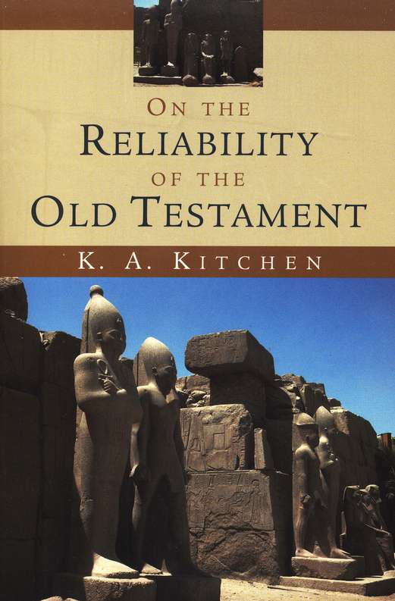
Why so few mentions of David & Solomon in ancient texts or inscriptions?
Kitchen has a two-fold answer…
The survival of artifacts in Israel is quite unlikely with so many destroyed cities
The policy of the state was not to mention rival kings (as they typically only talked about themselves)
Notes:
1. “﻿Outdated Solomonic stelae, for example, might have been reused in fresh masonry by later kings; the Babylonians thoroughly destroyed the temple and palace of the “City of David” area in 586; Zerubbabel’s “second temple” rebuilding, and even more, the massive rebuilding under Herod would have removed the last traces of prior Iron Age structures. Then, in turn, the Romans thoroughly destroyed Jerusalem; and the temple of Jupiter in Aelia Capitolina would not help survival of older work on the Temple Mount. Byzantine rebuildings, a damaging Persian incursion, and Muslim, Crusader, and later destructions and rebuilds all have taken their toll of earlier remains. It would be a miracle if anything like individual slabs such as inscribed stelae were to survive such a history of devastation and reuse.”
Kenneth Kitchen. On the Reliability of the Old Testament (Eerdmans). Kindle Edition.
2. “﻿This can be seen from the state of minimal survival in other, comparable Levantine kingdoms. Aram-Damascus has left us almost nothing from over two hundred years of its kingdom. Damascus has been repeatedly rebuilt during millennia, yielding (so far) no Iron Age inscriptions whatsoever. For all his power, Hazael of Aram-Damascus has left us only bits from elsewhere: the shattered Tel Dan stela, his name on ivories carried off to Assyria, and a couple of stray horse-blinker pieces. Just one stela of a Benhadad survives that may represent Aleppo. From all Moab’s kings, only Mesha’s stela and one other fragment have so far turned up.12 Sealings apart, only about three small pieces commemorate kings of Ammon, and none commemorate the kings of Edom. We have short epigraphs of about four of the earlier kings of Byblos, but none pre–sixth century from Tyre and Sidon. And so on. Thus, in such a context we can hardly grumble at the near-total failure so far of texts to surface mentioning or belonging to David and Solomon.”
Kenneth Kitchen. On the Reliability of the Old Testament (Eerdmans). Kindle Edition. Loc 2134 of 14432

Slide 4
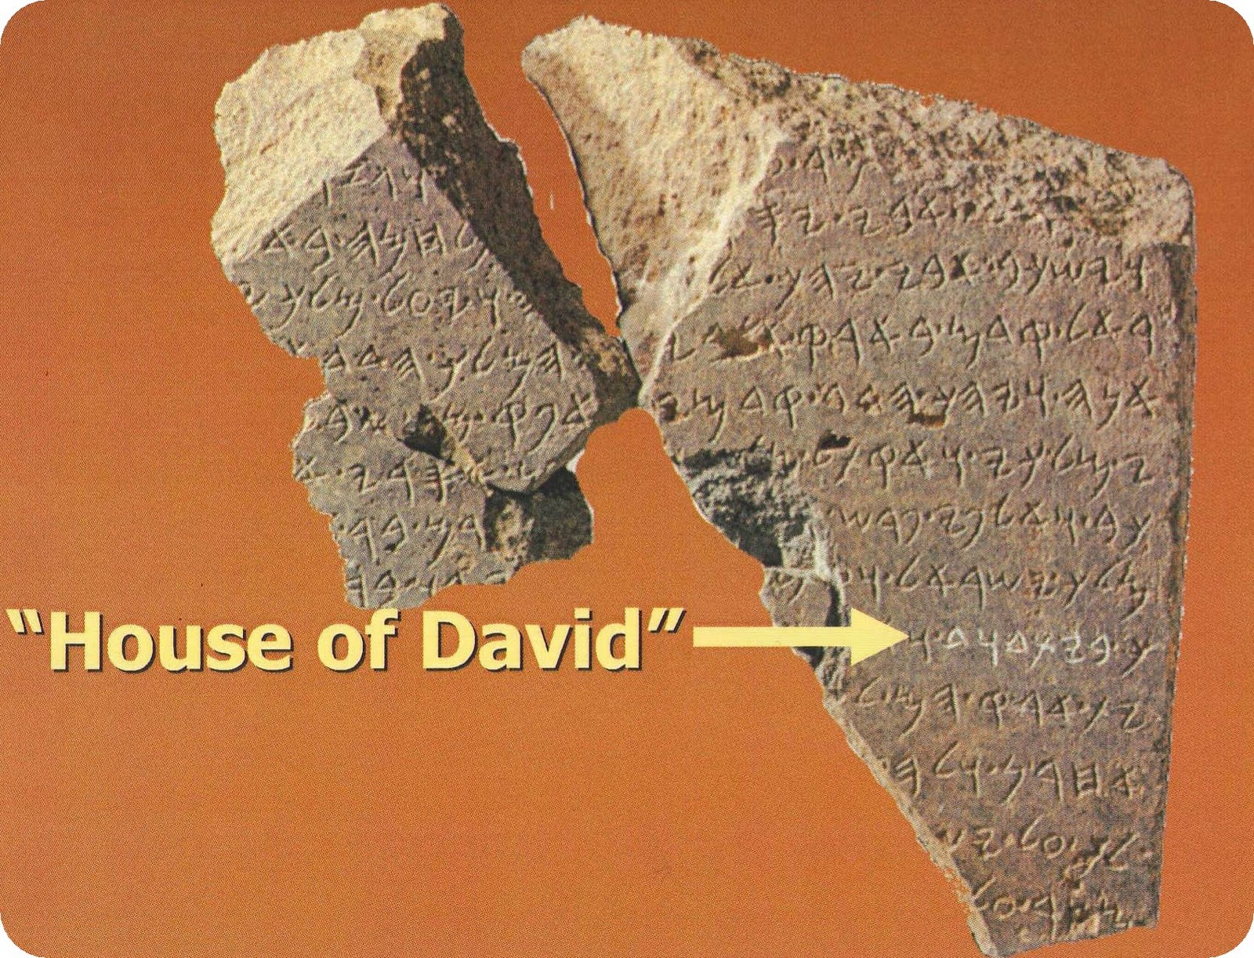
But David is noted three times…
1. ﻿The 841 BC Tell Dan Stele (“House of David”)
“House of David”
Notes:
“﻿The publication of fragments of an Old Aramaic stela from Tell Dan in 1993/1995 brought to light the first recognized nonbiblical mention of the tenth-century king David, in a text that reflected events of the year 841 and would have been set up at no great interval after that date.13 On the simplest interpretation (cf. pp. 36-37 above, with the footnotes) of the surviving middle lines (3-9) of this text, we have here the killing or defeating of “[…]ram, son of […], king of Israel,” and in parallel, the killing of “[…]iah son of […],” relating to Byt-Dwd, “the House of David” — a phrase which cannot seriously be interpreted in any other way, it being of a very well known type.”
Kenneth Kitchen. On the Reliability of the Old Testament (Eerdmans). Kindle Edition. Loc 2142 of 14432

Slide 5
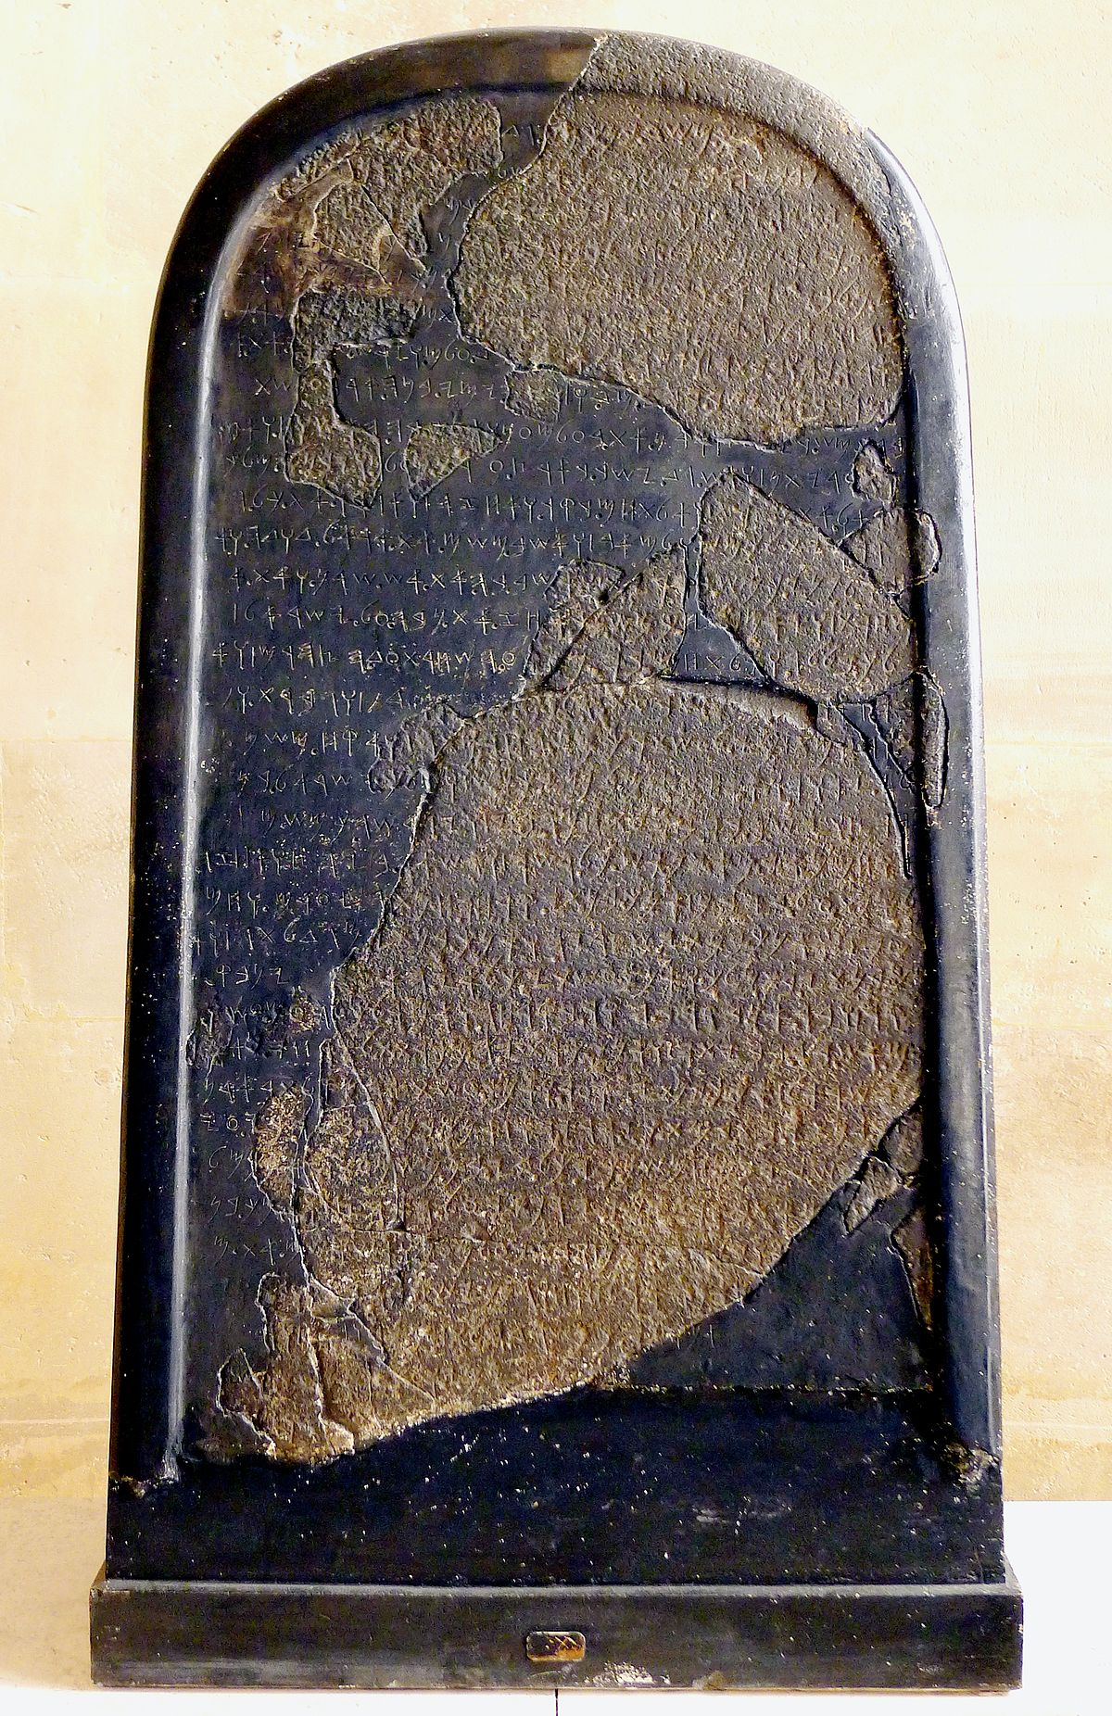
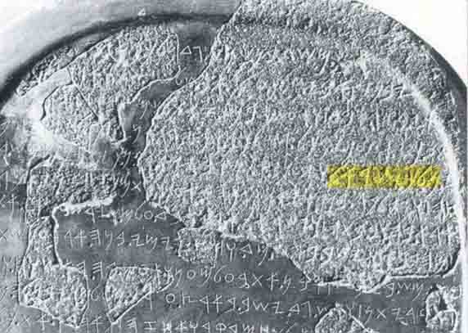
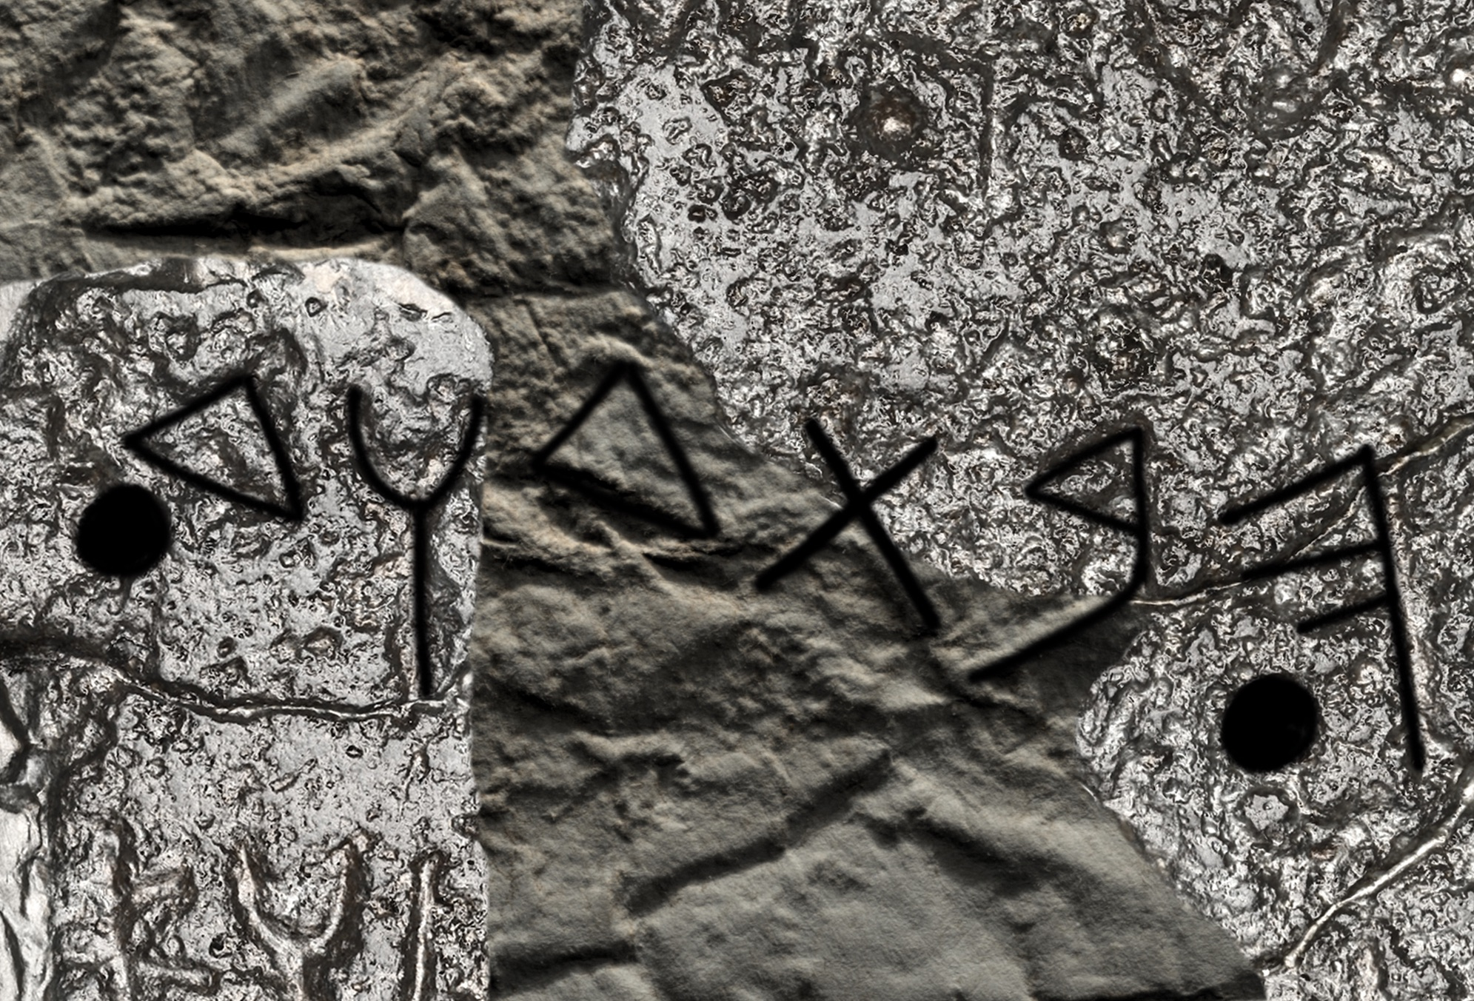
But David is noted three times…
2. ﻿The ca 840 BC Mesha Stela (“House of David”)
“House of David”
Notes:
“﻿(b) Second for David As often happens, one discovery can lead to others. Equally convincingly, Lemaire was subsequently able to show that bt-[d]wd is to be read in line 31 of the famous stela of Mesha king of Moab, dating to about the same period. Cf. fig. 13B. This links the “House of David” (= Judah) with an occupation of part of southern Moab (around Horonen), corresponding to Israel’s penetration in the north under Omri and his dynasty. So we have David mentioned twice in retrospect, some six generations after his death.”
Kenneth Kitchen. On the Reliability of the Old Testament (Eerdmans). Kindle Edition. Loc 2160 of 14432

Slide 6
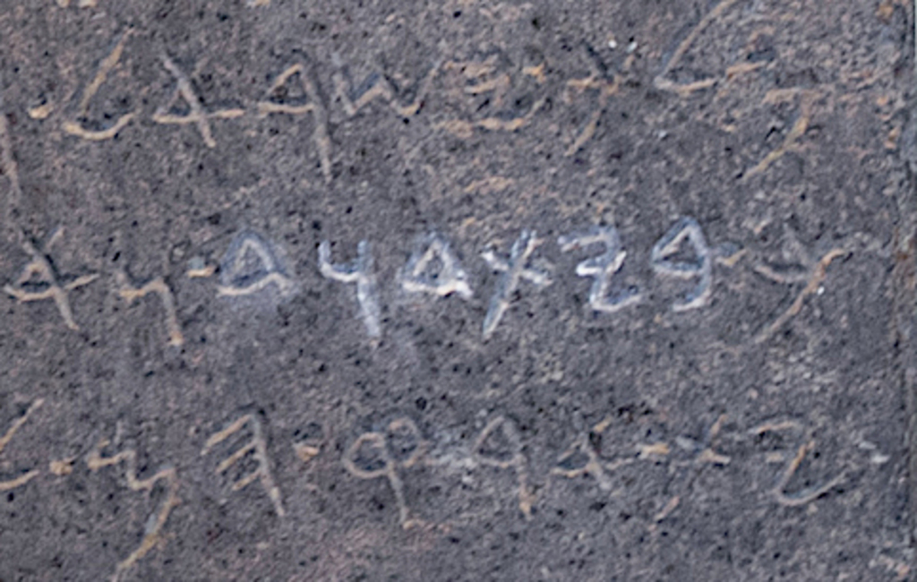
But David is noted three times…
3. ﻿The 926/925 BC Shoshenq I of Egypt Inscription of locations (“Heights of David” = Judah)
“the heights of Dwt”
= “the heights of Dawit”
= “the heights of David”
Notes:
“﻿Nor is this all, it seems. After his victory over Rehoboam and Jeroboam in 926/925, Shoshenq I of Egypt had engraved at Karnak a long list of Palestinian place-names. Some of these are now destroyed, and thus lost to us; many can be readily identified with known places in Israel, Judah, the Negev, and a few in western Transjordan. But quite a few have remained obscure. Among these, in a group of names clearly located by association in the Negev/south Judah area, is “the heights of Dwt.”15 It could not really be Dothan — no final n, and in entirely the wrong context for a north Palestinian settlement. However, in an Ethiopic victory inscription of the early sixth century A.D. in southwest Arabia, the emperor of Axum cited explicitly passages (Pss. 65; 19) from the “Psalms of Dawit,” exactly the consonants Dwt as found with Shoshenq. In Egyptian transcriptions of foreign names (both places and personal), a t could and sometimes did transcribe a Semitic d. This happens in the New Kingdom in such familiar place-names as Megiddo (Egyp. Mkt), Edreʿi (Egyp. ’itrʿ), Adummim (Egyp. itmm), Damascus (Egyp. Tmsq), ﻿﻿Dothaim/n (Egyp. Ttyn). Back in the Middle Kingdom the Execration Texts have a prince of Magdali (Egyp. Mktry). And just then, we have this use in personal names also, including a “David” — “the Asiatic, chief carpenter, Twti” is for a Dawid or Dodi on a stela; another is a probable Dodi-(H)uatu, Egyptian Tt-w’t, in a papyrus. Thus there is no reason to doubt a final -d becoming a voiceless t in both Egyptian and Ethiopic (both, Afro-Asiatic languages).16 And no better alternative seems forthcoming. This would give us a place-name that commemorated David in the Negev barely fifty years after his death, within living memory of the man. The Negev was an area where David had been prominent in Saul’s time (1 Sam. 24:1; 27; 30; p. 84 above). His name being in such a place-name is analogous with the “field of Abram,” also in Shoshenq’s list. So, historically, we would be within fifty years of David’s own lifetime. Cf. fig. 13C.”
Kenneth Kitchen, On the Reliability of the Old Testament (Grand Rapids, MI: Eerdmans, 2003). Kindle Edition. Loc 2178-2169 of 14432

Slide 7

Critical scholars point out many places where the chronologies of Kings and Chronicles do not match—and the reigns of the kings of Israel and Judah seem contradictory.
So what should we do?
Oh, well… The Bible just has those contradictions?
Notes:
OS-11-1Kings-47
OS-13-1Chron-43

Slide 8
The Mystery of the Kings
70i
The total number of years of the reigns of Israel and Judah in a fixed time span were not the same
If chronology is worked according to lengths of reign, synchronisms won't fit (and vice versa)
Seeming lack of harmony between OT chronology and that of ANE
Why does it matter?
  It concerns the historicity and reliability of the Bible and the accuracy of its transmission

Slide 9
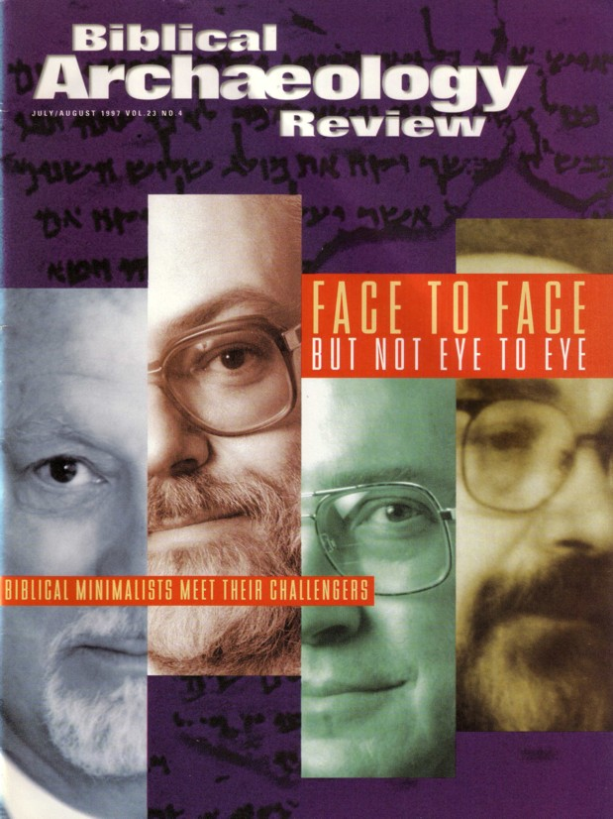
Is the Chronology of Israel's Kings Necessary?
Whether David and Solomon ever even lived was doubted by “Biblical Minimalists” in the July/Aug 1997 issue of BAR

Slide 10
Years Kings of Judah Ruled
65c
Rehoboam 17
Abijam 3
Asa 41
Jehoshaphat 25
Jehoram 8
Ahaziah 1
Athaliah 6
Joash 40
Amaziah 29
Azariah (Uzziah) 52
Jotham 18
Ahaz 19
Hezekiah 29
Manasseh 55
Amon 2
Josiah 31
Jehoahaz 3 months
Jehoiakim 11
Jehoiachin 3 months
Zedekiah 11
Total 398
Rehoboam began 931 BC
Zedekiah ended 586 BC
Total Years 345 years
Why the difference?
How can we explain this?

Slide 11
Proposed Reasons for Discrepancies
70i
Inaccurate systems used by biblical historians
Accidental errors of transmission
Largely schematic and artificial
chronology
Intentional mutilation of text to cover up various facts

Slide 12
Proposed Solutions
70i
Editorial changes to the chronological data (3rd century B.C. Septuagint)
Include periods of political chaos in which no king sat on the throne
Disregard the data in the Masoretic Text and determine dates with synchronisms with ANE history
Discover original method of dating

Slide 13
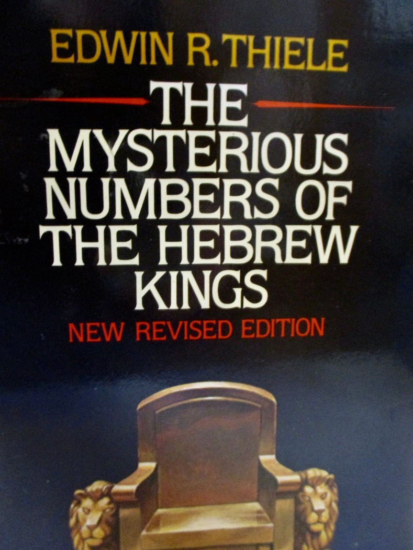
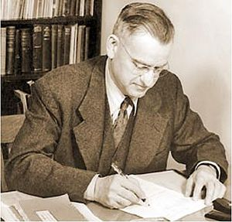
Enter stage…
Seventh-Day Adventist OT scholar
Edwin R. Thiele (pronounced TEE-lee)
1924-2006
Notes:
OS-11-1Kings-48
OS-13-1Chron-44

Slide 14
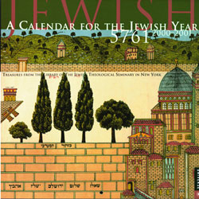

Jewish Calendars
134
Civil
Sacred
Numbered

Slide 15
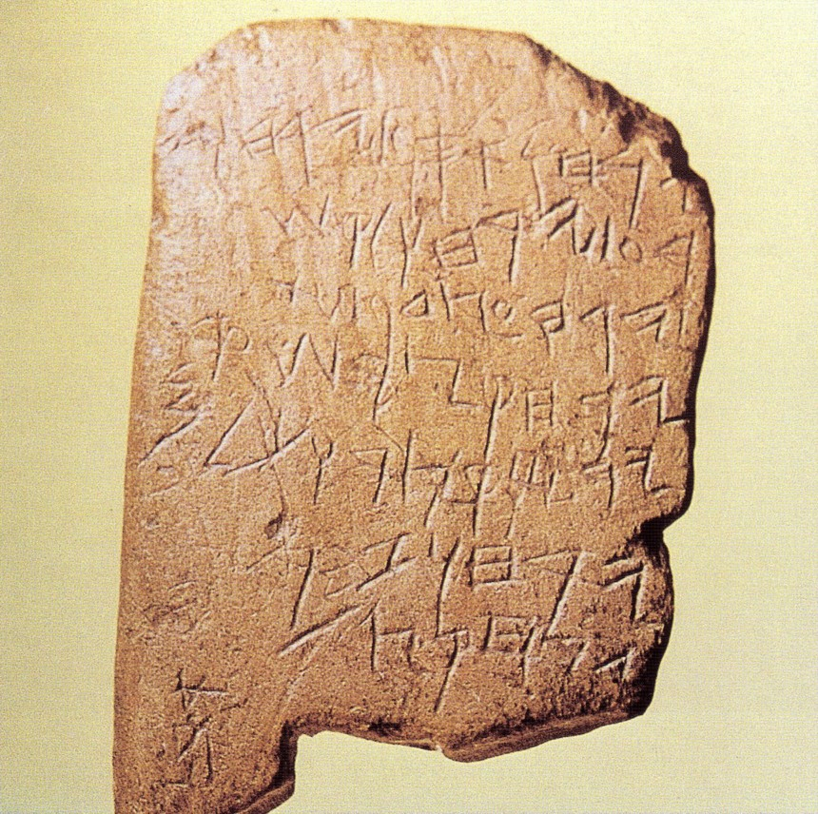
The Gezer Calendar
Elul/Tishri
Bul/Kislev
Tebeth/Shebat
Adar
Abib
Ziv
Sivan/Tammuz
Ab
Months of vintage & oil harvest;
Months of sowing;
Months of spring pasture;
Month of flax pulling;
Month of barley harvest;
Month of wheat harvest/measuring;
Months of pruning;
Month of summer fruit.
10th century Old Hebrew school tablet
Notes:
This limestone tablet found by archaeologists in 1908 has seven lines of archaic script. It was revealed to be in Old Phoenician script used in 1000 BC (time of Solomon). It contains the annual farming cycle with the plural (“months”) designating two months. The fact that it has erasures shows that it is a schoolboy's exercise tablet where he wrote this poem which may have been a popular memory device similar to “Thirty days has September…” This may be the oldest Hebrew inscription we have today.

Slide 16
The Gezer Calendar
Aug-Sept
Oct-Nov
Dec-Jan
February
March
April
May-June
July
Months of vintage & oil harvest;
Months of sowing;
Months of spring pasture;
Month of flax pulling;
Month of barley harvest;
Month of wheat harvest & measuring;
Months of pruning;
Month of summer fruit.
10th century Old Hebrew school tablet
Notes:
This limestone tablet found by archaeologists in 1908 has seven lines of archaic script. It was revealed to be in Old Phoenician script used in 1000 BC (time of Solomon). It contains the annual farming cycle with the plural (“months”) designating two months. The fact that it has erasures shows that it is a schoolboy's exercise tablet where he wrote this poem which may have been a popular memory device similar to “Thirty days has September…” This may be the oldest Hebrew inscription we have today. Image: Wilson, The Stones Still Shout, 89; Text: Arnold, 171

Slide 17

Hebrew Calendars
The Exodus Night:
While the Israelites were still in the land of Egypt, the LORD gave the following instructions to Moses and Aaron: ²"From now on, this month will be the first month of the year for you" (Exod. 12:1-2)
180,
290
1 Nisan
2 Iyar
3 Sivan
4 Tammuz
5 Av
6 Elul
7 Tishri
8 Cheshvan
9 Kislev
10 Tevet
11 Shevat
12 Adar
Mar-Apr
Sacred Calendar Begins
Civil Calendar Begins
Sep-Oct

Slide 18
Hebrew Calendars
Which system did they use to determine the king's reign?
Israel began
with Nisan
& didn't count
accession year
180,
290
1 Nisan
2 Iyar
3 Sivan
4 Tammuz
5 Av
6 Elul
7 Tishri
8 Cheshvan
9 Kislev
10 Tevet
11 Shevat
12 Adar
Mar-Apr
Did they count the accession year?
Sacred Calendar Begins
Two Key Issues:
Civil Calendar Begins
Judah began
with Tishri
& counted
accession year
What if the
king's reign
began here?
Sep-Oct

Slide 19
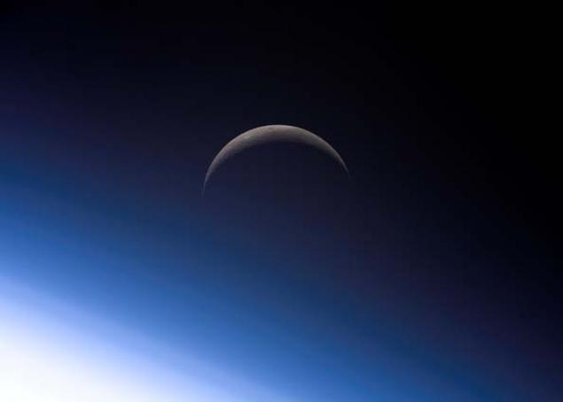
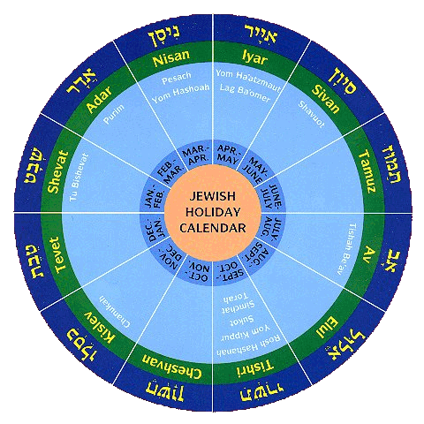
Characteristics
221
Calendar Differences Between Judah and Israel
When a king's reign began
When the year began

Slide 20
Thiele's Solution
70j
Different Dating Systems used by Judah and Israel
Judah | Israel
Accession-year system, beginning with Tishri (931-848) | Non-Accession year system, beginning with Nisan (931-848)
Time of alliance and intermarriage with Israel Non-Accession year system, beginning with Tishri for Judah and Nisan for Israel (848-796)
Accession-year system, beginning with Tishri for Judah and Nisan for Israel (796-586)

Slide 21
Thiele's Solution
70j
Some co-regencies in Israel and Judah
Two instances of rival reigns in Israel
Certain synchronisms in 2 Kings 17 and 18 inserted by a late hand out of harmony with original pattern of reigns

Slide 22
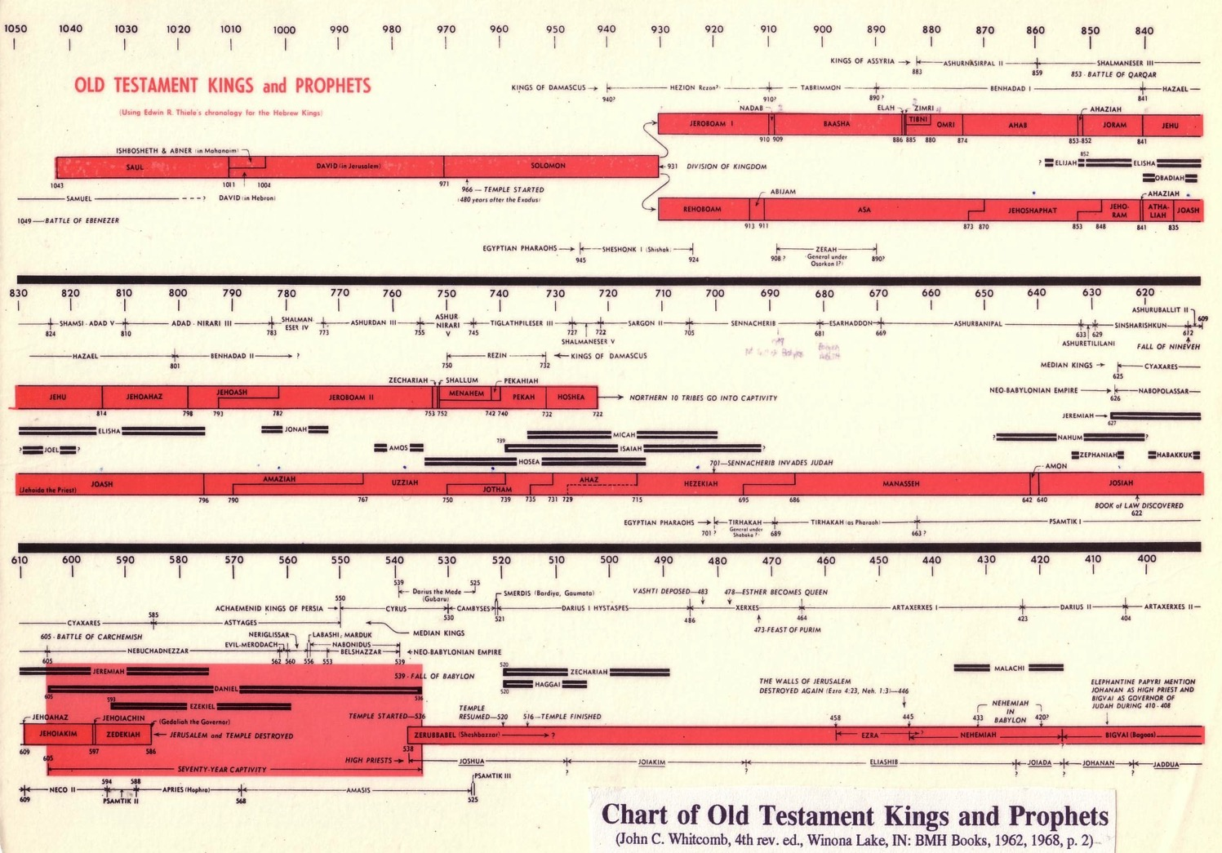
Chart of OT Kings & Prophets
232 & 342
Chart of Old Testament Kings & Prophets
John C. Whitcomb, 4th ed. (Winona Lake, IN: BMH Books, 1968), 2
Notes:
For many centuries no one was able to decipher the chronology of the kings of Israel and Judah, as it was so complicated in many ways:
System: Israel had two calendars: a civil calendar that begins with the Feast of Trumpets in Sept (in Tishri, ironically called the 7th month!) and the sacred calendar that began in Nisan at the Exodus in March-April. But which calendar did God’s people use?
Accession: Did the author of Kings count as a full year that portion of the year left when a king was crowned? This accession year would change the dates significantly, considering that we are talking about 39 rules in both Israel and Judah.
Finally, in the late 20th century, Seventh-day OT scholar Edwin Thiele (pronounced TEE-lee) figured out the chronology.
a) Judah and Israel had two dating systems of accession years based on different calendars (civil v. secular). Further, this switched twice in terms of whether the accession or non-accession system was used.
b) Added to the above, several times a king continued to rule after his son had already been crowned, leading to a co-regency—both in Israel and in Judah.
c) Twice in Israel, two kings were vying for rule at the same time, and
d) A scholar misunderstood the above factors along the way and tried to correct the chronology in 2 Kings 17–18, but this only complicated matters. Instead, we should just accept the original text as it stands.

Slide 23
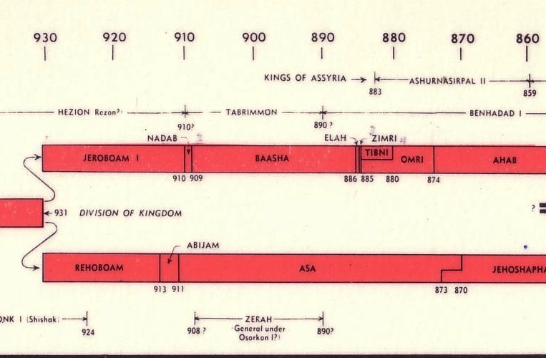

Chart of OT Kings & Prophets
232 & 342
Chart of Old Testament Kings & Prophets
John C. Whitcomb, 4th ed. (Winona Lake, IN: BMH Books, 1968), 2
Notes:
Here is the beginning of the divided kingdom where Jeroboam received the 10 northern tribes called Israel while Rehoboam continued the dynasty of David and Solomon in the southern kingdom of Judah.

Slide 24
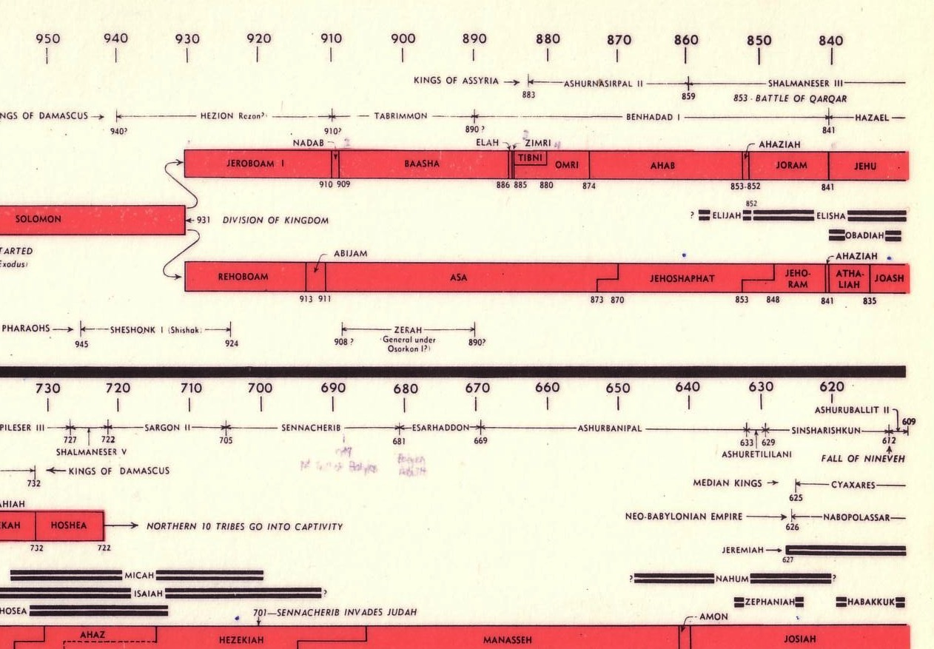
Chart of OT Kings & Prophets
65c
Chart of Old Testament Kings & Prophets
John C. Whitcomb, 4th ed. (Winona Lake, IN: BMH Books, 1968), 2
Rival Kings
Co-Regency

Slide 25
OT Kings (No Animation)
232 & 342
Jeroboam
Nadab
Baasha
Zimri
Ahab
Joram
JNBEZOAAJJ
Elah
Omri
Ahaziah
Jehu
Jehoram
Jehoshaphat
Rehoboam
Asa
Abijam
Ahaziah
Athaliah
Joash
RAAJJAAJ
U Has Ash 2
ZS MPPH
Jeroboam II
Jehu
Zechariah
Jehoahaz
Jehoash
Shallum
Menahem
Pekahiah
Pekah
Hoshea
Ahaz
Joash
Amaziah
Uzziah
Jotham
Hezekiah
Manasseh
Amon
Josiah
JAU JAH MAJ
19 Kings of Israel (all bad)
Black/Blue = 9 dynasties in Israel
Has Kim's Chin Zed
12 Bad Kings of Judah
One Dynasty
Jehoiachin
Jehoiakim
Zedekiah
Jehoahaz
8 Good Kings of Judah
Chart of Old Testament Kings & Prophets
John C. Whitcomb, 4th ed. (Winona Lake, IN: BMH Books, 1968), 2
Notes:
Here you see all 20 kings of Israel and all 20 kings of Judah—laid out without animation and with the memory devices to help you recall their names.
Think of the first letter of each king and note the memory device JNBEZOAAJJ. The shift between black and blue names show when the dynasty changed in Israel.
RAAJJAAJ does the same for Judah but here all are in the same dynasty of David, so the colors indicate bad and good kings.
UHasAsh2 are not all capitals but indicate only a new kings at the capital letter. The difficulty here is 4 kings whose names all begin with "J" so the memory device shows the end of their names.
ZS MPPH give us the final 6 kings of Israel. The rest of the chart thus indicates only Judah.
JAU JAH MAJ provides another silly pneumonic ending in the last of the good kings of Judah called Josiah.
Has Kim's Chin Zed is another strange clue that we are looking at the end of three kings whose names once again all begin with "J" (not unusual since each was named after Jehovah).
Of course, the final king must have a name ending with "Z" so we can wrap this up alphabetically :-) !

Slide 26
OT Kings (Animated)
232 & 342
Jeroboam
Nadab
Baasha
Zimri
Ahab
Joram
JNBEZOAAJJ
Elah
Omri
Ahaziah
Jehu
Jehoram
Jehoshaphat
Rehoboam
Asa
Abijam
Ahaziah
Athaliah
Joash
RAAJJAAJ
U Has Ash 2
ZS MPPH
Jeroboam II
Jehu
Zechariah
Jehoahaz
Jehoash
Shallum
Menahem
Pekahiah
Pekah
Hoshea
Ahaz
Joash
Amaziah
Uzziah
Jotham
Hezekiah
Manasseh
Amon
Josiah
JAU JAH MAJ
19 Kings of Israel (all bad)
Black/Blue = 9 dynasties in Israel
Has Kim's Chin Zed
12 Bad Kings of Judah
One Dynasty
Jehoiachin
Jehoiakim
Zedekiah
Jehoahaz
8 Good Kings of Judah
Chart of Old Testament Kings & Prophets
John C. Whitcomb, 4th ed. (Winona Lake, IN: BMH Books, 1968), 2
Notes:
Here you see all 20 kings of Israel and all 20 kings of Judah—laid out with animation and with the memory devices to help you recall their names. Try to guess their names before you advance the animation.
Think of the first letter of each king and note the memory device JNBEZOAAJJ. The shift between black and blue names show when the dynasty changed in Israel.
RAAJJAAJ does the same for Judah but here all are in the same dynasty of David, so the colors indicate bad and good kings.
UHasAsh2 are not all capitals but indicate only a new kings at the capital letter. The difficulty here is 4 kings whose names all begin with "J" so the memory device shows the end of their names.
ZS MPPH give us the final 6 kings of Israel. The rest of the chart thus indicates only Judah.
JAU JAH MAJ provides another silly pneumonic ending in the last of the good kings of Judah called Josiah.
Has Kim's Chin Zed is another strange clue that we are looking at the end of three kings whose names once again all begin with "J" (not unusual since each was named after Jehovah).
Of course, the final king must have a name ending with "Z" so we can wrap this up alphabetically :-) !

Slide 27
Northern Early Kings
232 & 342
Jeroboam
Nadab
Baasha
Zimri
Ahab
Joram
Elah
Omri
Ahaziah
Jehu
JNBEZOAAJJ
Jehoram
Jehoshaphat
Rehoboam
Asa
Abijam
Ahaziah
Athaliah
Joash
RAAJJAAJ
Jeroboam II
Jehu
Zechariah
Jehoahaz
Jehoash
Shallum
Menahem
Pekahiah
Pekah
Hoshea
U Has Ash 2
ZS MPPH
Ahaz
Joash
Amaziah
Uzziah
Jotham
Hezekiah
Manasseh
Amon
Josiah
JAU JAH MAJ
Kings of Israel (all bad)
Line between 9 dynasties in Israel
Bad Kings of Judah
Jehoiachin
One Dynasty
Jehoiakim
Zedekiah
Jehoahaz
Good Kings of Judah
Has Kim's Chin Zed

Slide 28
Southern Early Kings
232 & 342
Jeroboam
Nadab
Baasha
Zimri
Ahab
Joram
Elah
Omri
Ahaziah
Jehu
JNBEZOAAJJ
Jehoram
Jehoshaphat
Rehoboam
Asa
Abijam
Ahaziah
Athaliah
Joash
RAAJJAAJ
Jeroboam II
Jehu
Zechariah
Jehoahaz
Jehoash
Shallum
Menahem
Pekahiah
Pekah
Hoshea
U Has Ash 2
ZS MPPH
Ahaz
Joash
Amaziah
Uzziah
Jotham
Hezekiah
Manasseh
Amon
Josiah
JAU JAH MAJ
Kings of Israel (all bad)
Line between 9 dynasties in Israel
Bad Kings of Judah
Jehoiachin
One Dynasty
Jehoiakim
Zedekiah
Jehoahaz
Good Kings of Judah
Has Kim's Chin Zed

Slide 29
Northern Later Kings
232 & 342
Jeroboam
Nadab
Baasha
Zimri
Ahab
Joram
Elah
Omri
Ahaziah
Jehu
JNBEZOAAJJ
Jehoram
Jehoshaphat
Rehoboam
Asa
Abijam
Ahaziah
Athaliah
Joash
RAAJJAAJ
Jeroboam II
Jehu
Zechariah
Jehoahaz
Jehoash
Shallum
Menahem
Pekahiah
Pekah
Hoshea
U Has Ash 2
ZS MPPH
Ahaz
Joash
Amaziah
Uzziah
Jotham
Hezekiah
Manasseh
Amon
Josiah
JAU JAH MAJ
Kings of Israel (all bad)
Line between 9 dynasties in Israel
Bad Kings of Judah
Jehoiachin
One Dynasty
Jehoiakim
Zedekiah
Jehoahaz
Good Kings of Judah
Has Kim's Chin Zed

Slide 30
Placing the Prophets
342
Placing the Prophets
Key Dates
931
Obadiah
722
Jonah
Amos
Hosea
Isaiah
Micah
Nahum
Zephaniah
Jeremiah
Lamentations
Joel
Daniel
Haggai
Habakkuk
Ezekiel
Zechariah
Malachi
586

Slide 31
Black

Slide 32


OT Criticism link at BibleStudyDownloads.org
Get this presentation for free!
Notes:
OC Criticism (oc)

