Slide 1

Pagan Literature
Ancient Near East Backgrounds
to the Old Testament
Dr. Rick Griffith • Jordan Evangelical Theological Seminary
BibleStudyDownloads.org

Slide 2
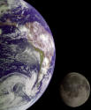
Narratives Parallel to Genesis
188
Memphite Theology
Enuma Elish
Atrahasis Epic
Gilgamesh Epic
Creation
Creation
Creation & Flood
Flood

Slide 3
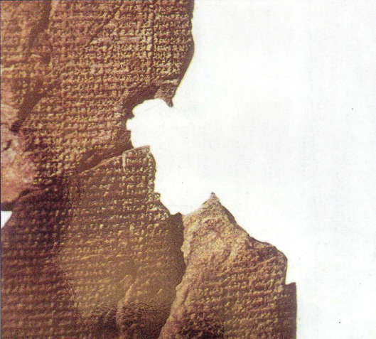
Atrahasis Epic
"Let the birth-goddess create offspring, and let man bear the toil of the gods… create humanity that he may bear the yoke… let Nintu mix clay, that god and man may be thoroughly mixed in the clay, let there be a spirit from the god's flesh"
(Arnold/Beyer, 24)
Akkadian 1650 BC
Creation & flood stories
Man created to help overworked gods
Man made from clay

Slide 4
Genesis
Atrahasis Epic
Anu, the high god
Man too noisy
Atrahasis built boat
Pitch used
Animals caught
Rained 7 days
Regretted Flood
(Arnold/Beyer, 21-31)
Yahweh, the only God
Man too sinful
Noah built boat
Pitch used
God brought animals
Rained 40 days
Rainbow promise
(Genesis 6–9)

Slide 5

Questions We All Must Answer
Genesis = "Beginnings"
Origin: Where did we come from?
Purpose: Why am I here? Is there meaning?
Morality: Why is there evil in the world?
Destiny: Where am I going? Is there hope?

Slide 6

Noah's Character
"And the LORD said, 'I will wipe this human race I have created from the face of the earth. Yes, and I will destroy every living thing—all the people, the large animals, the small animals that scurry along the ground, and even the birds of the sky. I am sorry I ever made them. ⁸But Noah found favor with the LORD" (6:7-8 NLT).

Slide 7
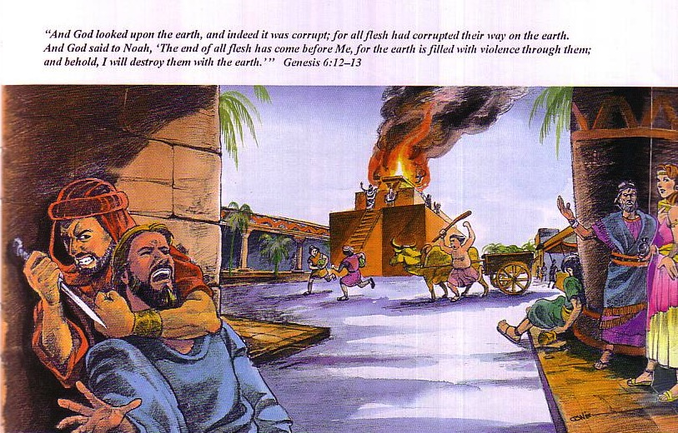
Need for a new start…
65
God saw how corrupt the earth had become, for all the people on earth had corrupted their ways. ¹³So God said to Noah, "I am going to put an end to all people, for the earth is filled with violence because of them. I am surely going to destroy both them and the earth" (Gen. 6:12-13).

Slide 8
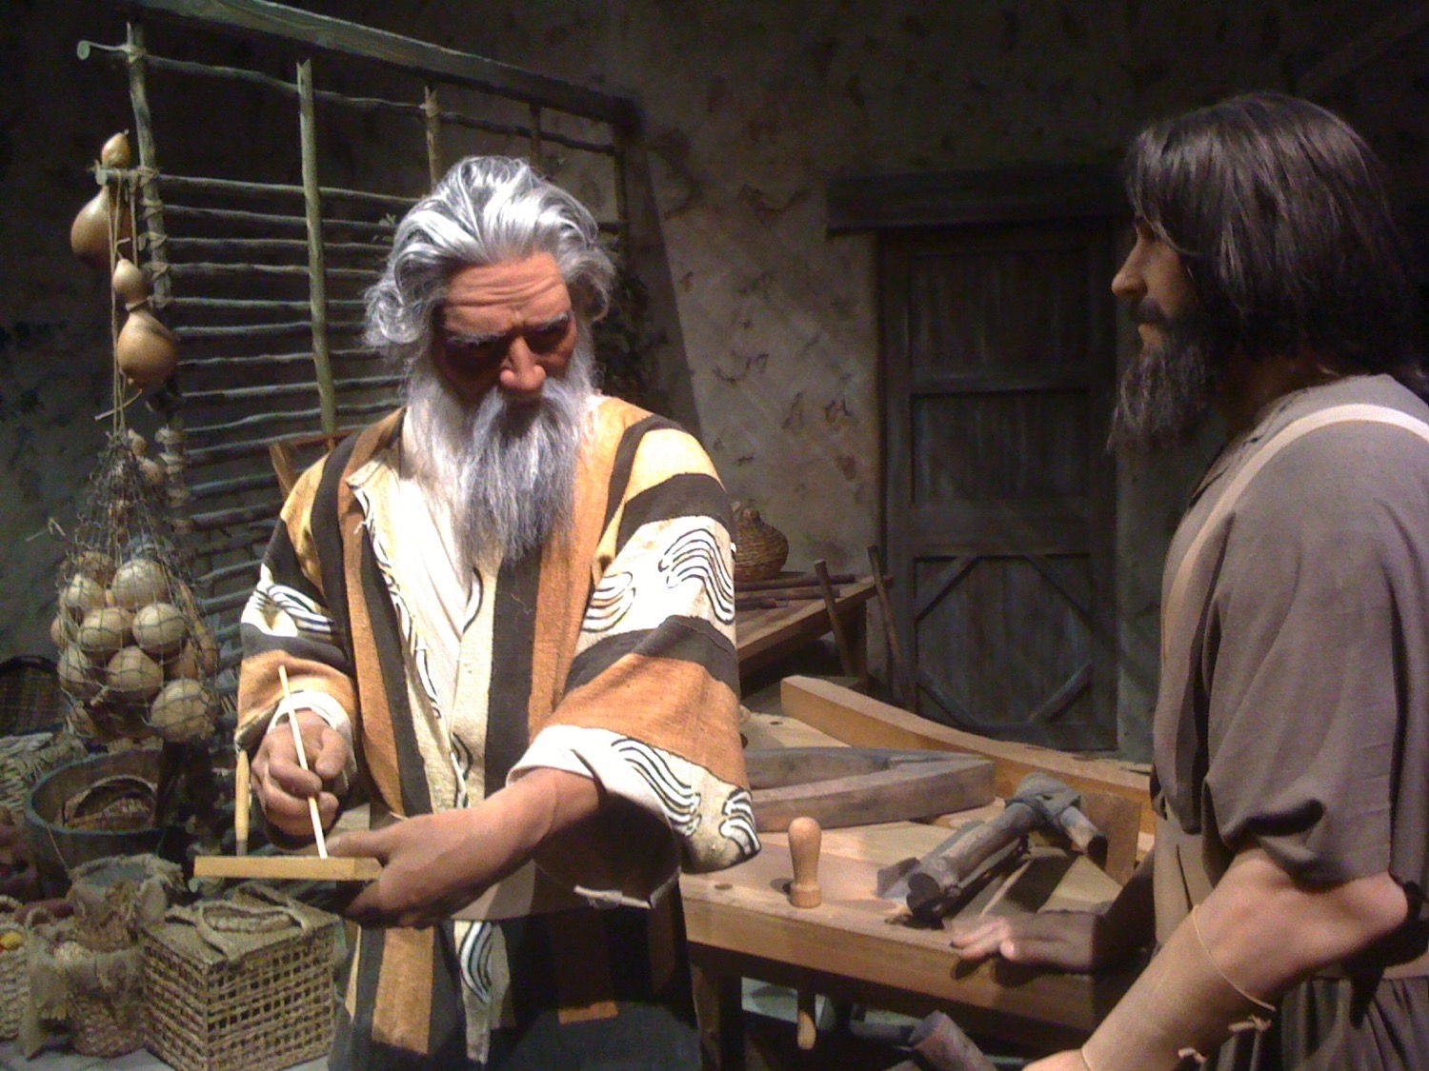
Noah & His Son

Slide 9
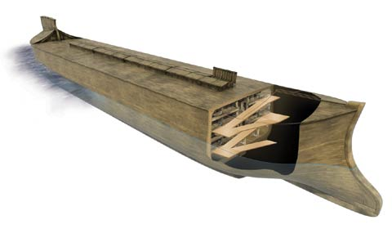
"By Faith…" (Hebrews 11)
"It was by faith that Noah built a large boat to save his family from the flood. He obeyed God, who warned him about things that had never happened before. By his faith Noah condemned the rest of the world, and he received the righteousness that comes by faith" (Heb. 11:5 NLT)

Slide 10
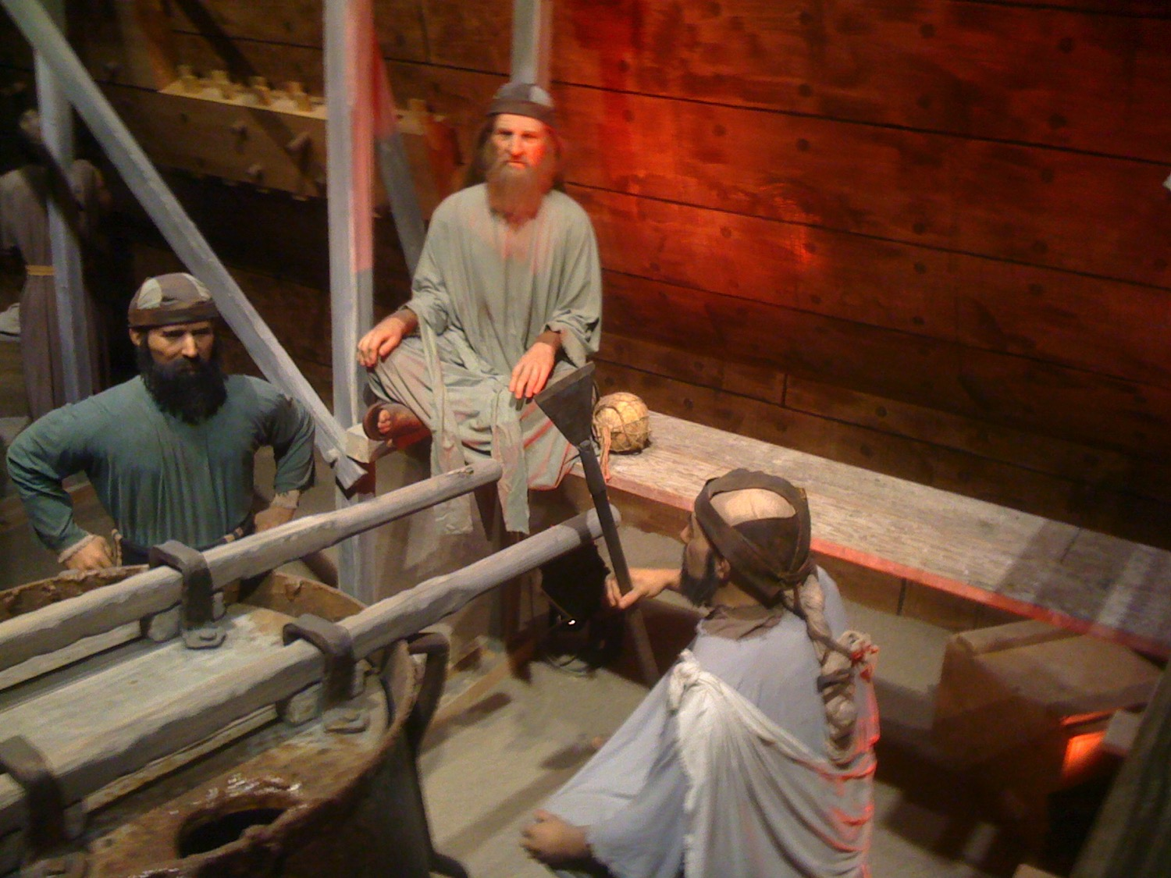
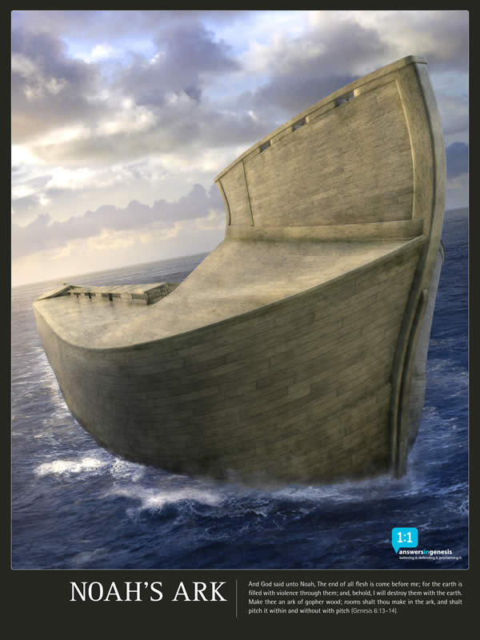
Noah & His Son

Slide 11
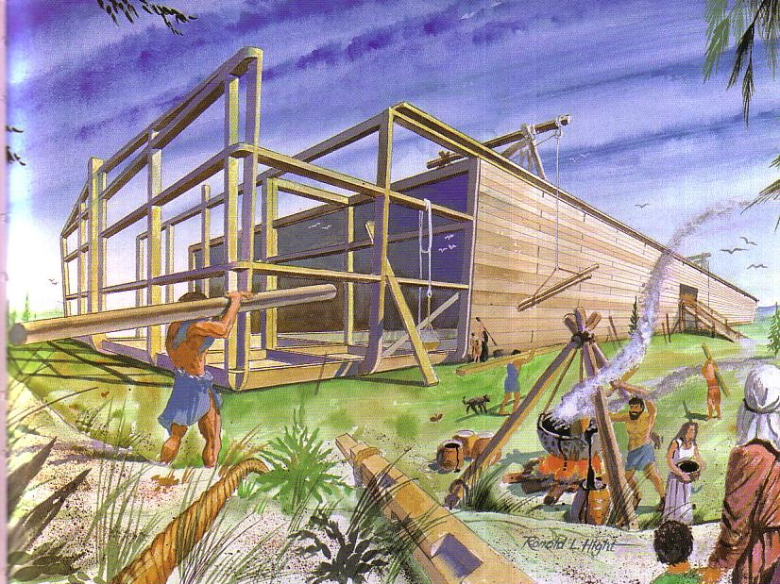
Building the Ark
65

Slide 12
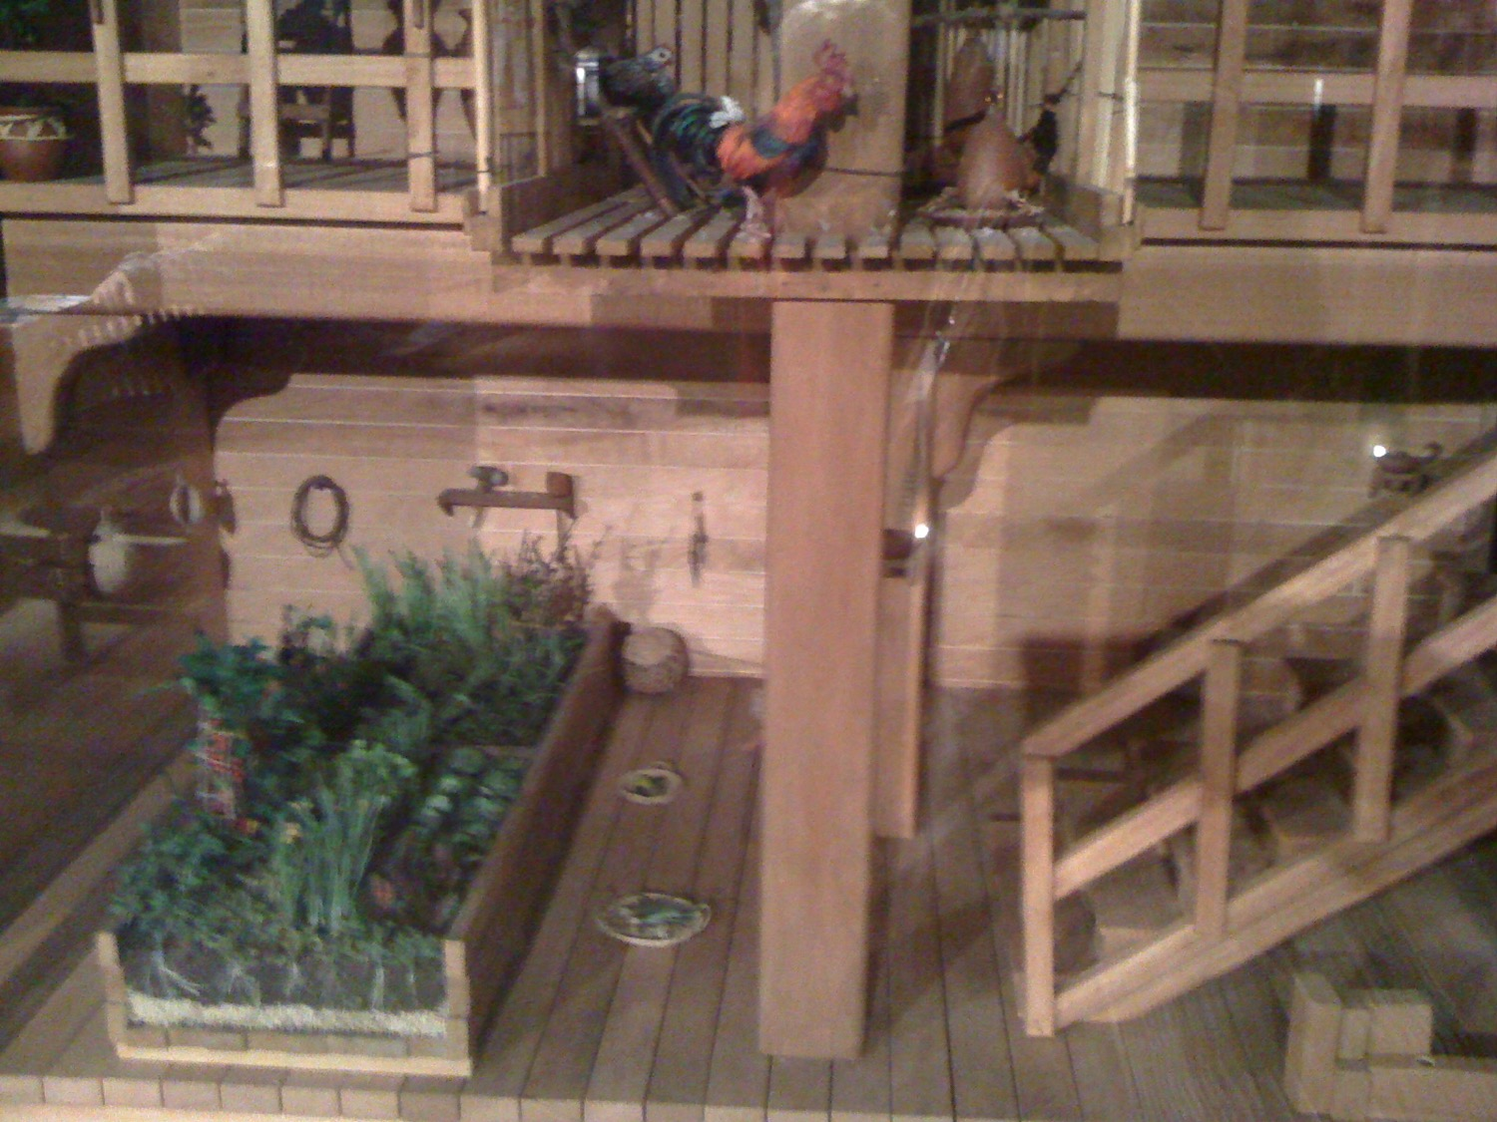
Food in the Ark

Slide 13
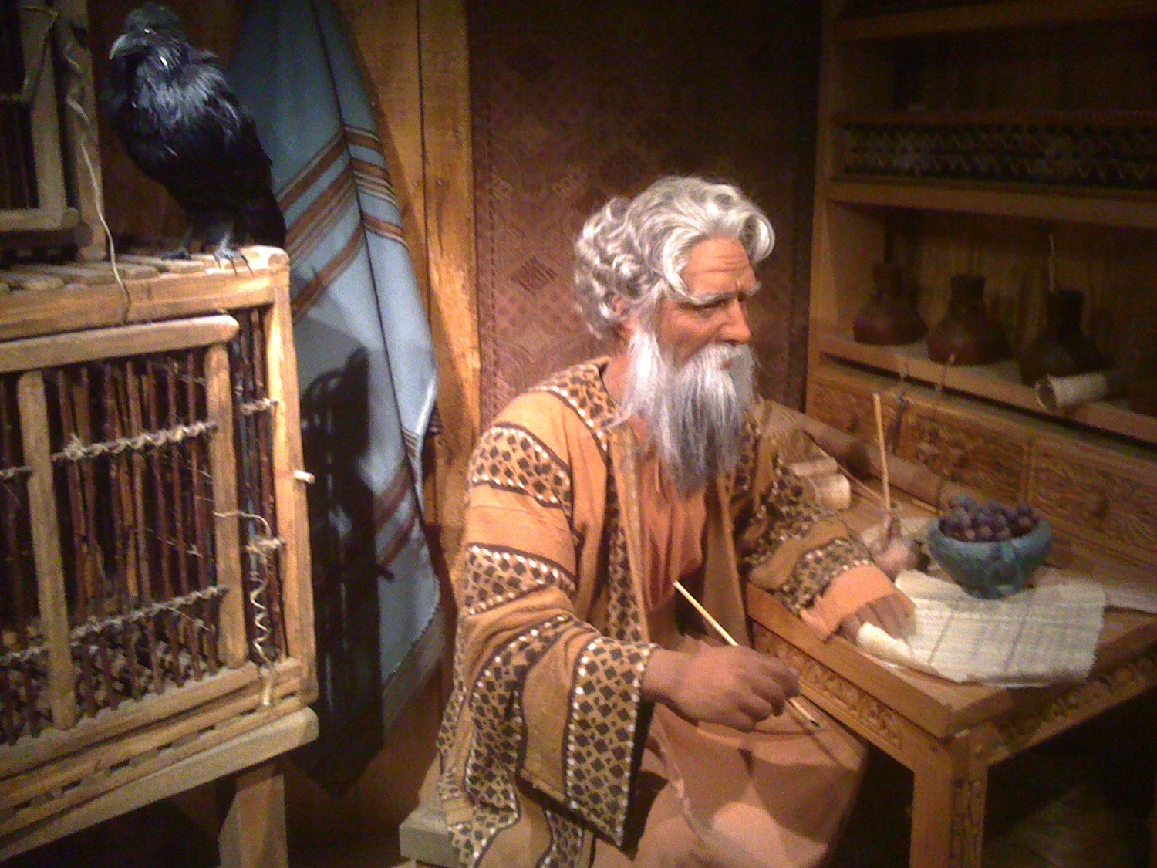
Noah & His Study

Slide 14


Cubit Diagram Sample
This is a sample page from "The World of the Bible" a PowerPoint Sunday School Series from eBibleteacher.com
B
I
B
L
E
Finger
18 Inches
= 1 Cubit
Span
Handbreadth
Length Measurement
© EBibleTeacher.com
INDEX
Notes:
The new "World of the Bible" series has over 450 slides and covers Bible lands, people, time, measurements and culture.
The ancient Bible people used measurements that could be easily reproduced. The cubit was simply the measurement from your elbow to the end of your fingers. Cubits are known to have varied from 16 to 19 inches. In the case of dispute, the king's arm was used to determine the standard cubit.
Like the cubit, spans, handbreadth and fingers were also easily determined. Even today, some people still use these measurements such as in measuring horses.

Slide 15
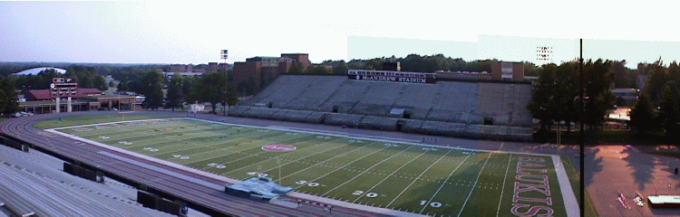
Noah's Ark Size
The ark was 300 cubits long (450 feet), 50 cubits wide (75 feet) and 30 cubits tall (45 feet) Gen 6:15
INDEX

Slide 16
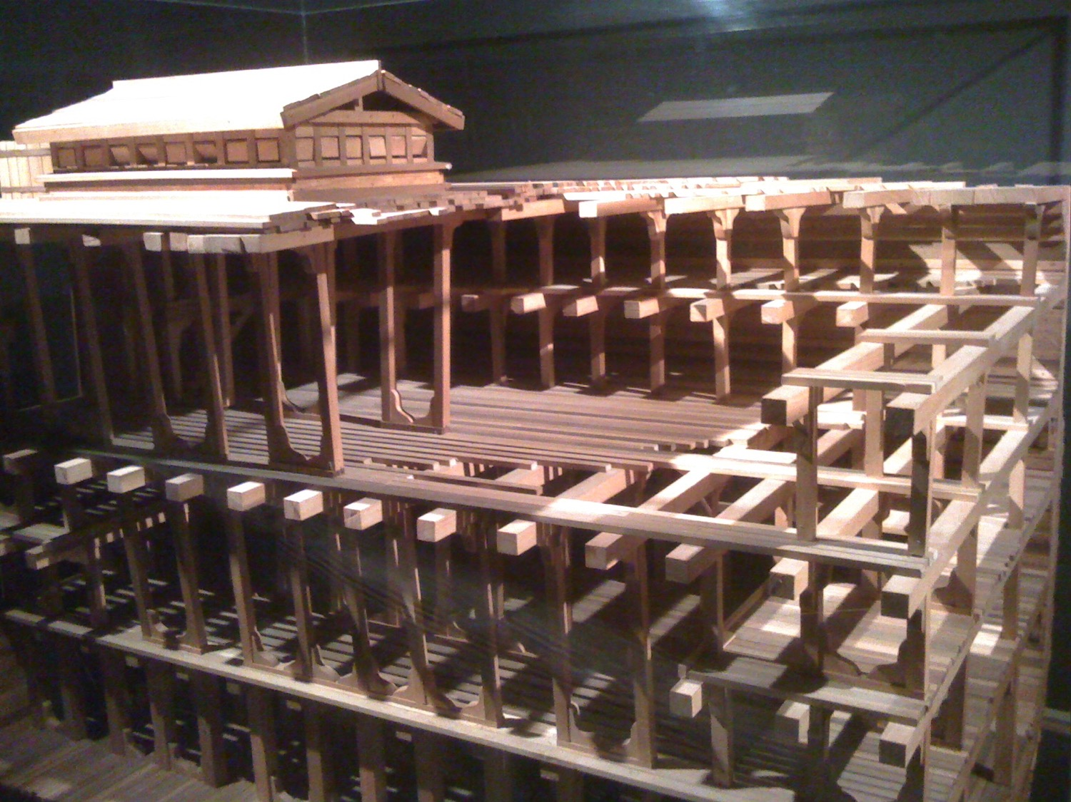
The Ark

Slide 17
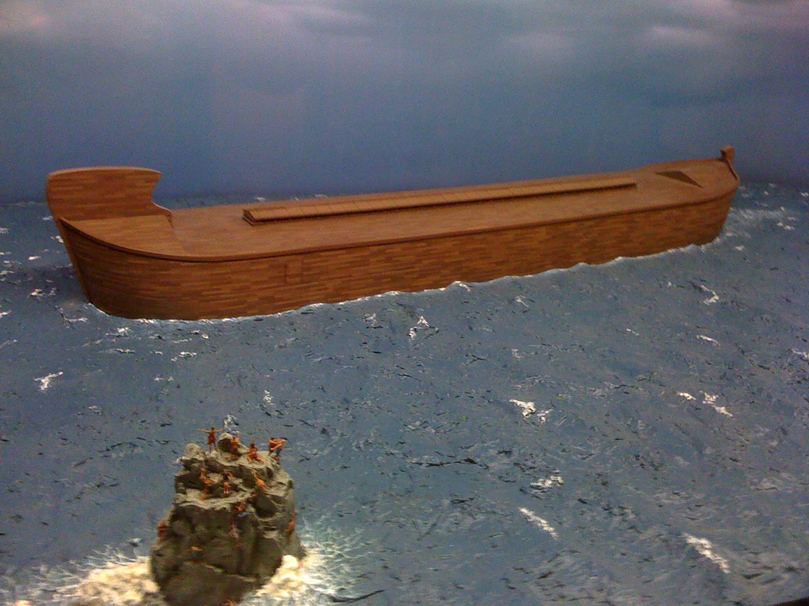
The Ark

Slide 18
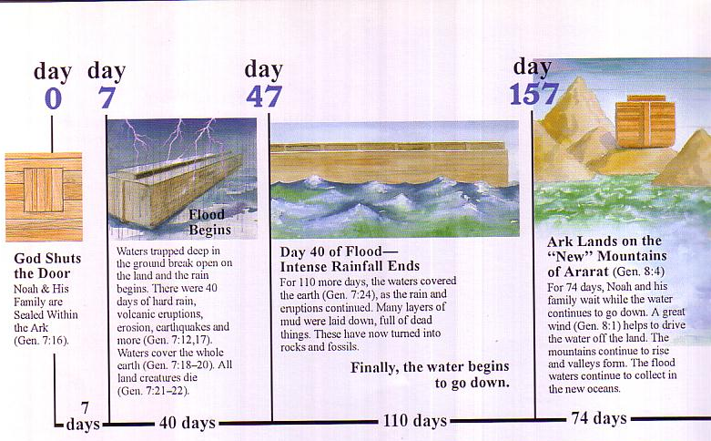
Flood Chronology
Day
0
Day
7
Day
47
Day
157
Flood Begins
Waters trapped deep in the ground break open on the land in 40 days of hard rain with volcanic eruptions, erosion, earthquakes, and more （Gen 7：12，17）. Waters cover the whole earth (Gen 7:18-20). All land creatures die （Gen 7:21-22）.
Day 47 of Flood—Intense Rainfall Ends
For 110 more days, the waters cover the earth （Gen 7：24）, as the rain and eruptions continue. Many layers of mud laid down, full of dead things. They have now turned into rocks and fossils.
Finally, the water begins to go down.
Ark Lands on New Ararat Mountains （Gen 8：4）
For 74 days, Noah and his family wait while the water continues to go down. A great wind（Gen 8：1） helps to drive the water off the land. The mountains continue to rise and valleys form. The flood waters continue to collect in the new oceans.
God Shuts the Door
Noah and his family sealed within the ark（Gen 7：16）.
7
Days
40
Days
110
Days
74
Days

Slide 19
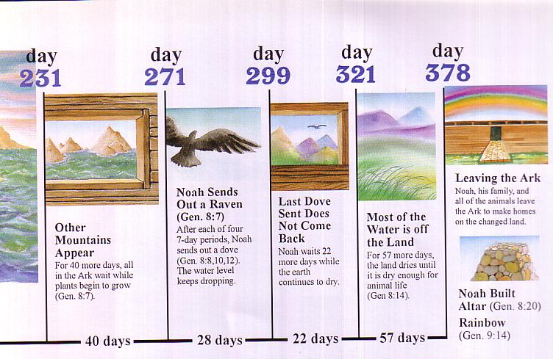
Flood Chronology
Day
231
Day
271
Day
299
Day
321
Day
378
Leaving the Ark
Noah, his family and the animals leave the ark to make homes on the changed land.
Noah Sends Out a Raven （Gen 8：7）
After each of four
7-day periods, Noah sends out a dove (Gen 8：8，10，12). The water level keeps dropping.
Most of the Water is Off the Land（Gen 8:14）.
For 57 more days, the land dries until it is dry enough for animal life
(Gen 8:14).
Last Dove Sent Does Not Come Back
Noah waits 22 more days while the earth continues to dry.
Other Mountains Appear
For 40 more days, all in the ark wait while plants begin to grow （Gen 8:7）.
Noah Builds Altar （Gen 8：20）
Rainbow
（Gen 9：14）
40
Days
28
Days
22
Days
57
Days

Slide 20
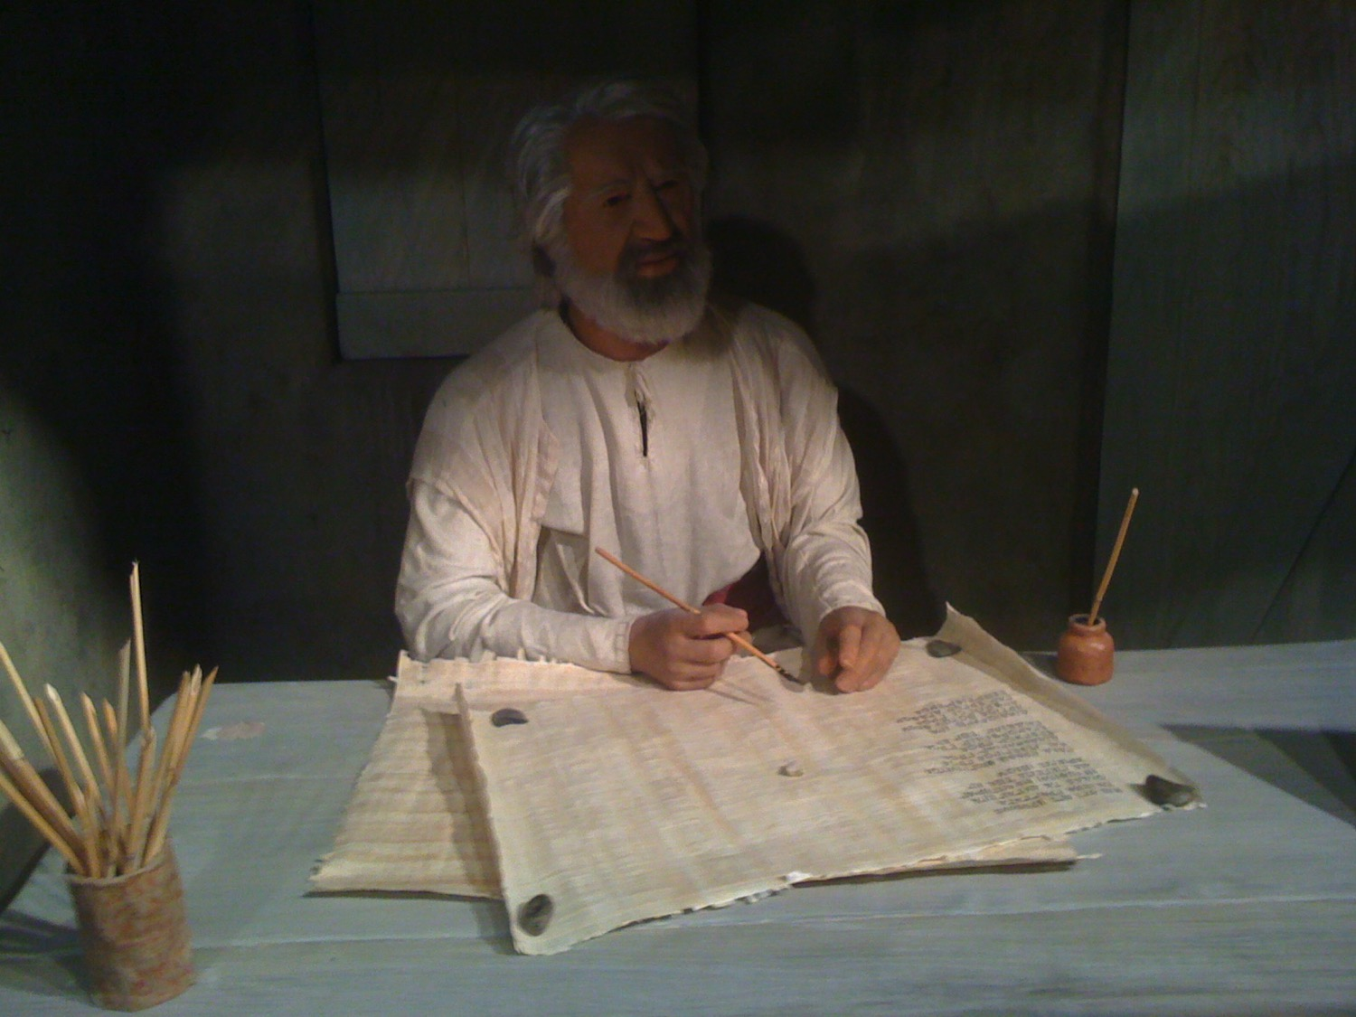
Flood Chiasm
7 days of waiting for flood (7:4)
7 days of waiting for flood (7:10)
40 days of flood (7:17a)
150 days of water triumphing (7:24)
God remembered Noah (8:1)
150 days of water waning (8:3)
40 days of waiting (8:6)
7 days of waiting (8:10)
7 days of waiting (8:12)
– Gordon Wenham, Genesis 1–15, Word Biblical Commentary (Dallas: Word Books, 1994)

Slide 21



Patriarch's long lives
90
Ages of people when they died
Adam
930 Years
Methuselah
969 Years
Noah
950 Years
Shem
600 Years
The Flood explains why life spans shortened
Abraham
175 Years
Moses
120 Years
David
70 Years
Notes:
From John Morris, Noah's Ark and the Ararat Adventure, p. 10.

Slide 22
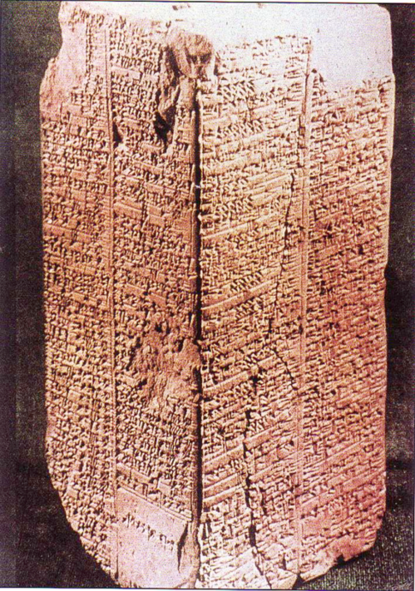
Sumerian King List
64a
Inscribed about 1800 BC (about 600 years after the Flood)
Ten of these kings before the Flood are said to have lived between 21,000 to 43,200 years each
(cf. Gen. 5)
Arnold & Beyer, Readings from the ANE, 150
Notes:
See Clifford Wilson, The Stones Sill Shout, 25 and Arnold/Beyer, Readings from the ANE, 150.

Slide 23
Sumerian King List
"When kingship came down from heaven. . .
Alulim became king and reigned for 28,800 years…
Eight kings reigned for 241,000 years. Then the flood waters streamed over the earth."
64a
King & Years of Reign
Alulim 28,800
Alalgar 36,000
Enmenluanna 43,200
Enmengalanna 28,800
Dumuzi 36,000
Ensipazianna 28,800
Enmeduranna 21,000
Urbatutu 18,600
Total 241,000
Arnold & Beyer, Readings from the ANE, 150
Notes:
See Clifford Wilson, "The Stones Sill Shout p. 25 and Arnold/Beyer, "Readings from the ANE," 150

Slide 24
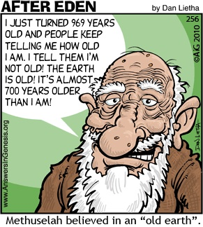
Methuselah
90
I JUST TURNED 969 YEARS OLD AND PEOPLE KEEP TELLING ME HOW OLD I AM. I TELL THEM I'M NOT OLD! THE
EARTH IS OLD! IT'S ALMOST 700 YEARS OLDER THAN
I AM!
Methuselah believed in an "Old Earth."

Slide 25
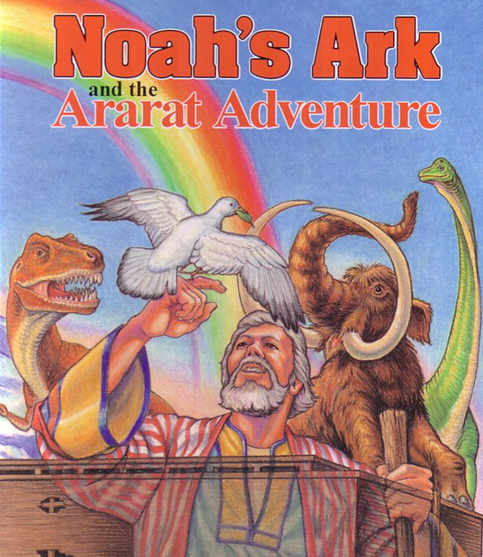
Why Not Dinosaurs on Noah's Ark?

Slide 26
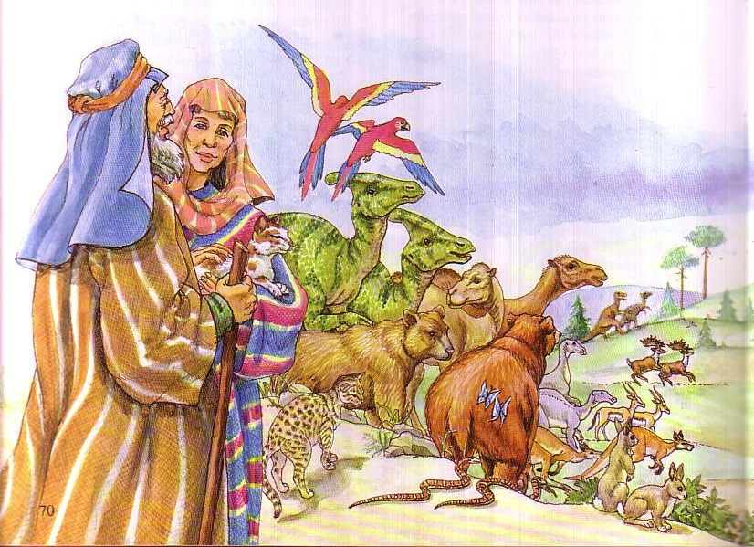
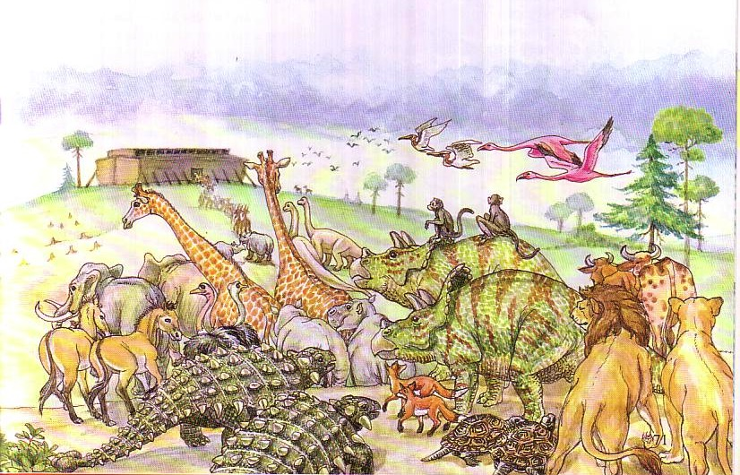
Genesis 6:19 NIV
"You are to bring into the ark two of all living creatures, male and female, to keep them alive with you."

Slide 27
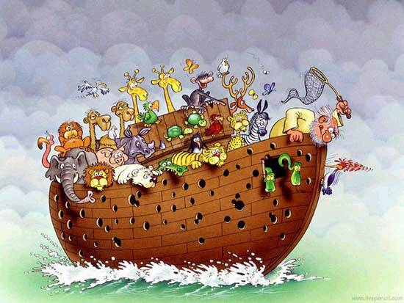

The ark even had woodpeckers
"two animals of every kind…"

Slide 28
Slides on
Genesis 7

Slide 29

Does it really matter if there really was a universal Flood?
77j
Genesis 7–8

Slide 30

Dr. Hugh Ross: A Mid-East Flood Advocate
77i
http://www.reasons.org/exploring-extent-flood-what-bible-says-part-two
"The Genesis Flood may well have extended beyond Mesopotamia. Most of the place names recorded in Genesis 2–8 are associated with locations within Mesopotamia, but some are not. The notable exceptions are the Pishon and Gihon rivers, which flowed from the southern part of the Arabian Peninsula. It seems possible that the Genesis Flood inundated not only all of Mesopotamia but also the entire Persian Gulf region and much of southern Arabia as well."
Notes:
http://www.reasons.org/interpreting-genesis/noahs-flood/exploring-extent-flood-part-one

Slide 31
Dr. Hugh Ross: A Mid-East Flood Advocate
77i
http://www.reasons.org/exploring-extent-flood-what-bible-says-part-two
Why does Ross advocate a limited flood?
Presupposition of old earth
Meaning of "world" in other OT passages
Notes:
http://www.reasons.org/interpreting-genesis/noahs-flood/exploring-extent-flood-part-one

Slide 32

But why not a local flood?
77j
If the Flood was local, why did Noah have to build an ark? He could have walked to the other side of the mountains and missed it.
If the Flood was local, why did God send the animals to the ark so they could escape death? There would have been other animals to reproduce that kind if these particular ones had died.
Ken Ham & Terry Mortenson, "What's Wrong with Progressive Creationism?"
in The New Answers Book 2 [http://www.answersingenesis.org/articles/nab2/whats-wrong-with-progressive-creation]

Slide 33

But why not a local flood?
77j
If the Flood was local, why was the ark big enough to hold all the different kinds of vertebrate land animals? If only Mesopotamian animals were aboard, the ark could have been much smaller.
If the Flood was local, why would birds have been sent on board? These could simply have winged across to a nearby mountain range.
Ken Ham & Terry Mortenson, "What's Wrong with Progressive Creationism?"
in The New Answers Book 2 [http://www.answersingenesis.org/articles/nab2/whats-wrong-with-progressive-creation]

Slide 34
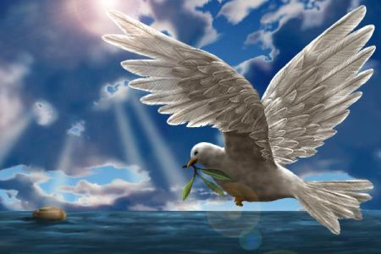
But why not a local flood?
77j
If the Flood was local, how could the waters rise to 15 cubits (8 meters) above the mountains (Genesis 7:20)? Water seeks its own level. It couldn't rise to cover the local mountains while leaving the rest of the world untouched.
Ken Ham & Terry Mortenson, "What's Wrong with Progressive Creationism?"
in The New Answers Book 2 [http://www.answersingenesis.org/articles/nab2/whats-wrong-with-progressive-creation]

Slide 35
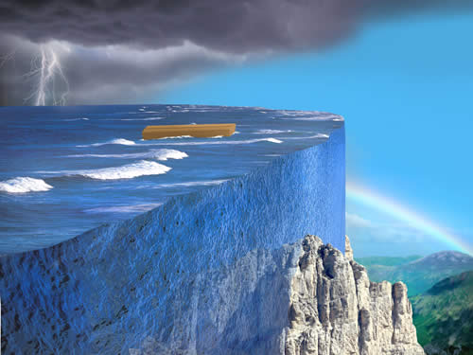
How high was the water?
77j
"The waters rose and increased greatly on the earth, and the ark floated on the surface of the water. ¹⁹ They rose greatly on the earth, and all the high mountains under the entire heavens were covered. ²⁰ The waters rose and covered the mountains to a depth of more than twenty feet" (Gen. 7:18-20).

Slide 36
But why not a local flood?
77j
If the Flood was local, people who did not happen to be living in the vicinity would not be affected by it. They would have escaped God's judgment on sin. If this had happened, what did Christ mean when He likened the coming judgment of all men to the judgment of "all" men in the days of Noah (Matthew 24:37–39)? A partial judgment in Noah's day means a partial judgment to come.
Ken Ham & Terry Mortenson, "What's Wrong with Progressive Creationism?"
in The New Answers Book 2 [http://www.answersingenesis.org/articles/nab2/whats-wrong-with-progressive-creation]

Slide 37
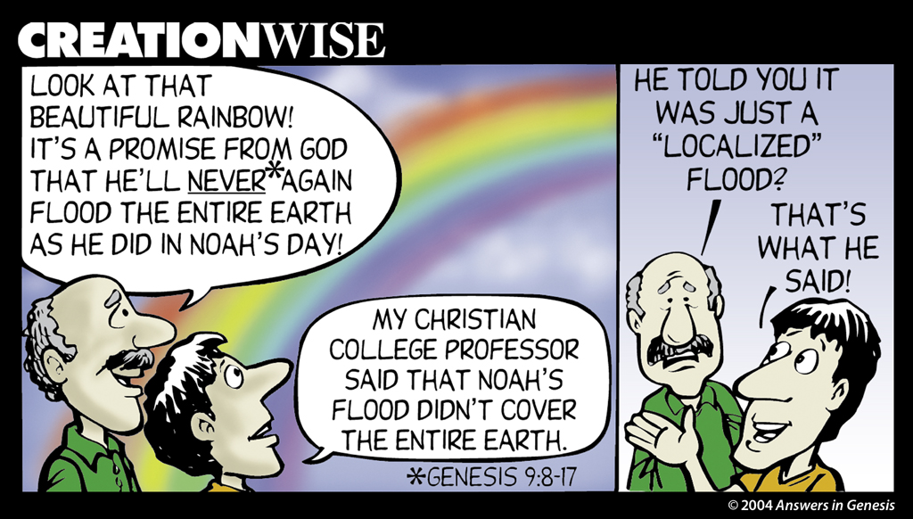
CW-Local Flood 1 01129
77j
LOOK AT THAT BEAUTIFUL RAINBOW! IT'S A PROMISE FROM GOD THAT HE'LL NEVER* AGAIN FLOOD THE ENTIRE EARTH AS HE DID IN NOAH'S DAY!
HE TOLD YOU IT WAS JUST A "LOCALIZED" FLOOD?
THAT'S WHAT HE SAID!
MY CHRISTIAN COLLEGE PROFESSOR SAID THAT NOAH'S FLOOD DIDN'T COVER THE ENTIRE EARTH.

Slide 38
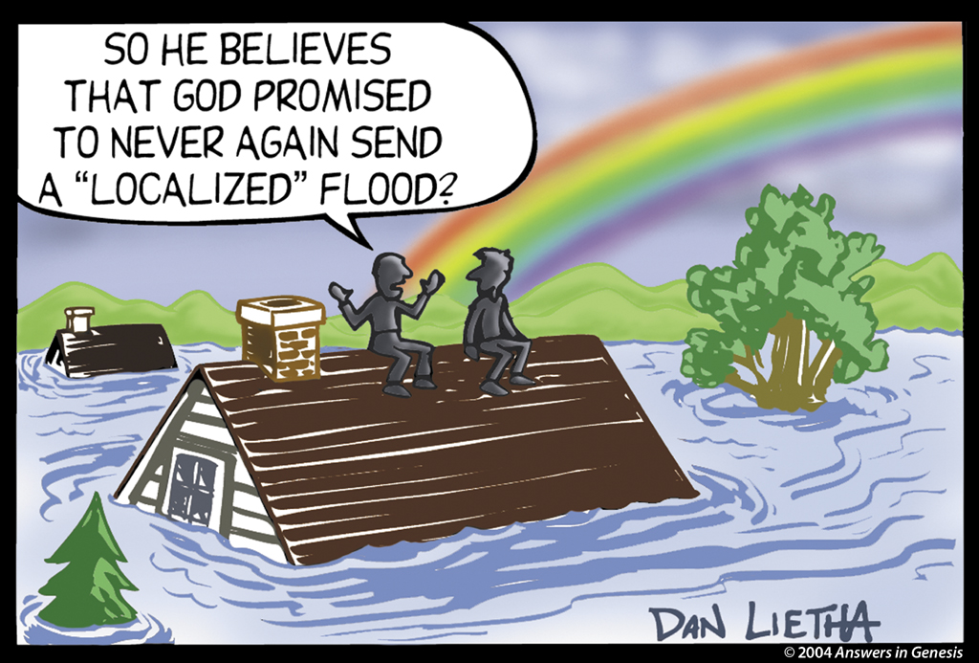
CW-Local Flood 2 01130
SO HE BELIEVES THAT GOD PROMISED TO NEVER AGAIN SEND A "LOCALIZED" FLOOD?

Slide 39
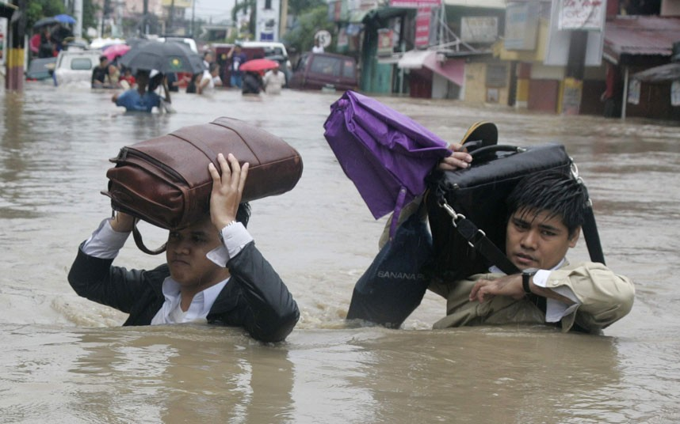
A local flood?
If Noah's Flood was local, God HAS repeatedly broken His promise never to send such a flood again!
77j
Notes:
http://www.answersingenesis.org/Home/Area/overheads/archive/oh20030829_191_scrn.jpg

Slide 40
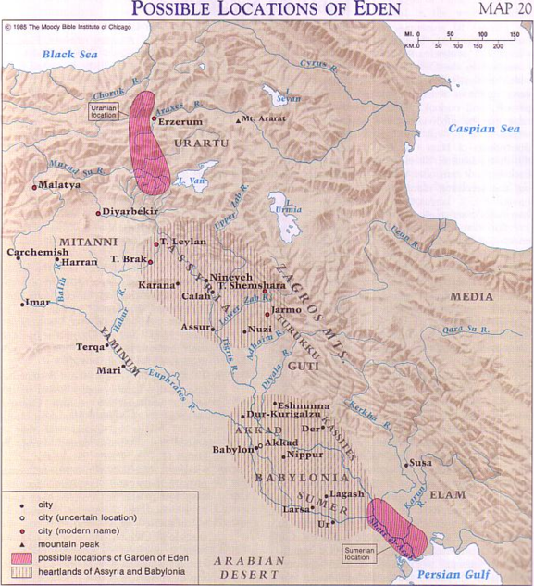
Barry Beitzel, Moody Atlas, 75
Ararat
Tigris
Euphrates
Genesis 6–8

Slide 41

Rodinia––The World That Perished
The transformation of Adam's world into today's world

Slide 42

THE WORLD THAT PERISHED
The transformation of Adam's world into today's world

Slide 43
Slides on
Genesis 8

Slide 44

Flood Significance
God's righteous judgment
God's gracious redemption
Water baptism (1 Pet. 3:20-21)
^{NLT} 1 Peter 3:20 those who disobeyed God long ago when God waited patiently while Noah was building his boat. Only eight people were saved from drowning in that terrible flood. ²¹And this is a picture of baptism. . .

Slide 45
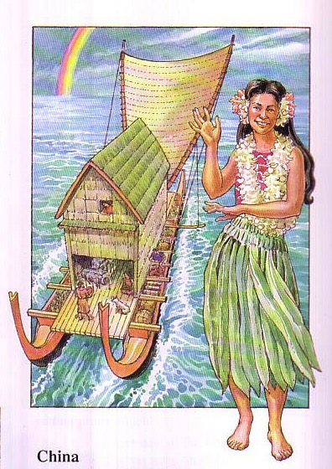
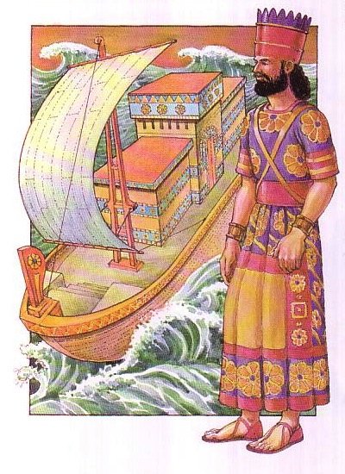
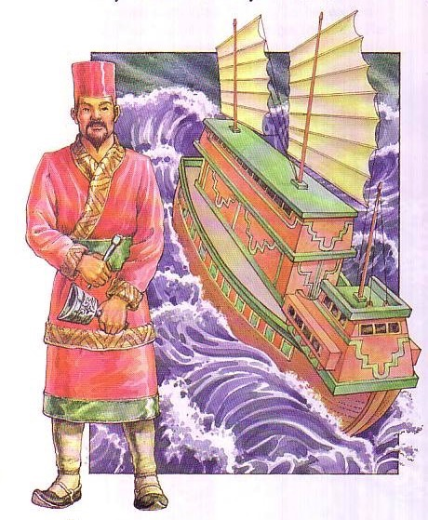
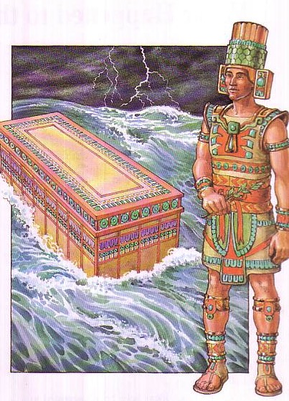
Flood Legends
83c
270 Flood Legends
Hawaii
Babylonia
Mexico
Common Elements:
universal flood
boat saved
family passengers
China

Slide 46
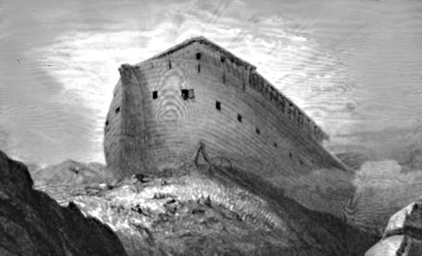
Scoffers Believe in Uniformitarianism
"First of all, you must understand that in the last days scoffers will come, scoffing and following their own evil desires. They will say, 'Where is this "coming" he promised? Ever since our fathers died, everything goes on as it has since the beginning of creation.'
2 Peter 3:3-4 (NIV)

Slide 47
Scoffers Doubt the Flood
"But they deliberately forget that long ago by God's word the heavens existed and the earth was formed out of water and by water. By these waters also the world of that time was deluged and destroyed. By the same word the present heavens and earth are reserved for fire, being kept for the day of judgment and destruction of ungodly men."
2 Peter 3:5-7 (NIV)

Slide 48
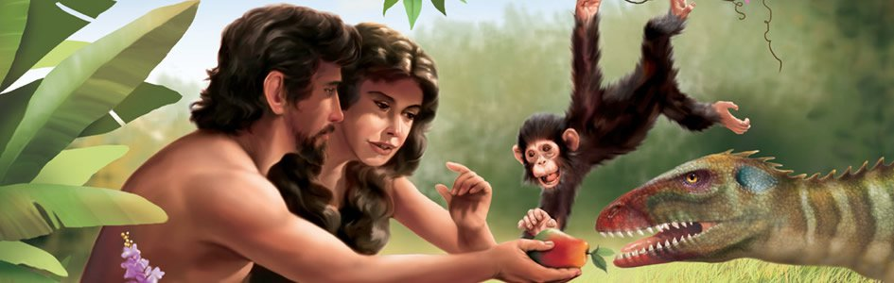
Adam and Eve lived with dinosaurs centuries earlier, so why would we think that dinosaurs died out by the Flood?

Slide 49
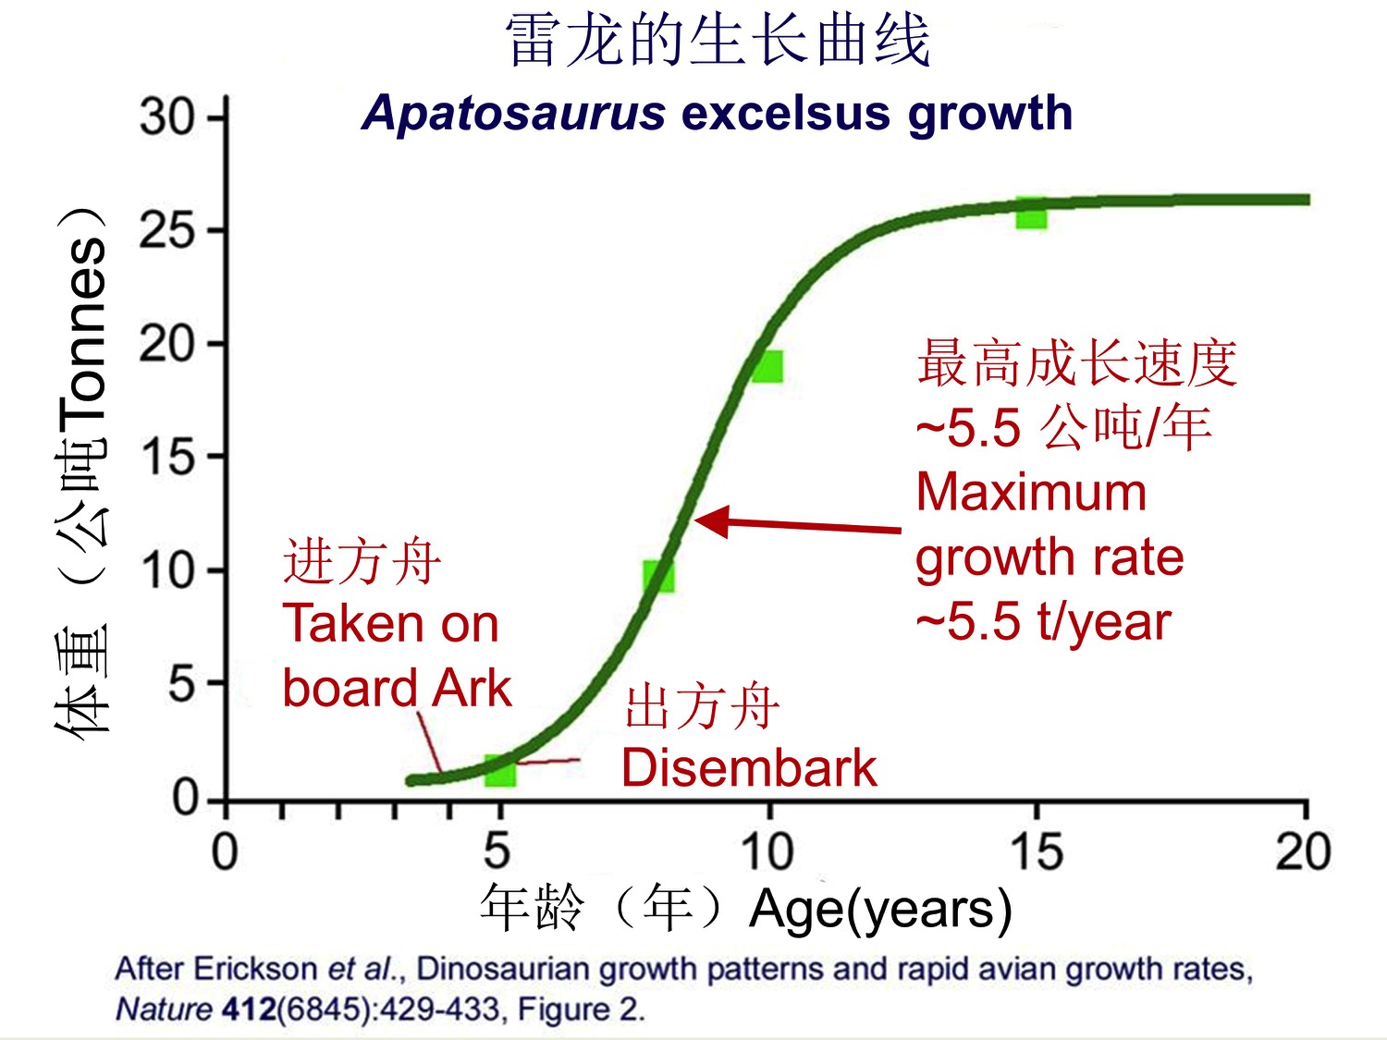
Small dinosaurs easily fit on the ark.
Apatosaurus excelsus growth
Maximum growth rate about 5.5 tons/year
Tons
Taken on board Ark
Disembark
Age (years)
Notes:
OB-29-Literature-49
OS-01-Gen4-20-Slide 130

Slide 50
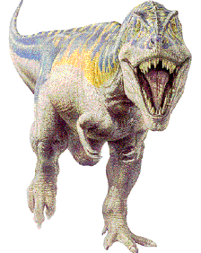
Dinosaurs Lived Recently
Behemoth--giant vegetarian
(Job 40:15-24)
Leviathan--ferocious meat eater (Job 41)
British King Morvidus was killed by a monster by being "gulped down… as a big fish swallows a little one" (336 BC)
A monster was killed in 1693 in Bedd-yr-Afanc, England
Monsters have been reported in nearly 200 places in England alone
Notes:
Bill Cooper, After the Flood (Chicester, England: New Wine, 1995), 131.

Slide 51

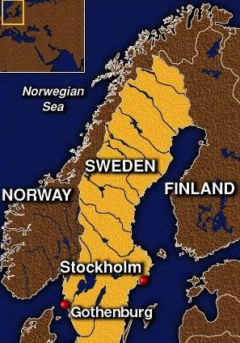
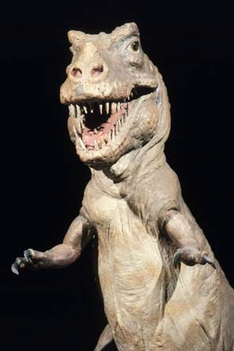
Beowulf & the Creatures of Denmark
Danish poem extols Beowulf (AD 495-583)--later king for 50 years
The monster Grendel ("grinder, destroyer") preyed on Danes 12 years (AD 503-515)
This hero cleared monstrous animals from the sea lanes
between Denmark and Sweden
He then pulled out Grendel's small arm, who retreated to his cave and bled to death
DENMARK

Slide 52
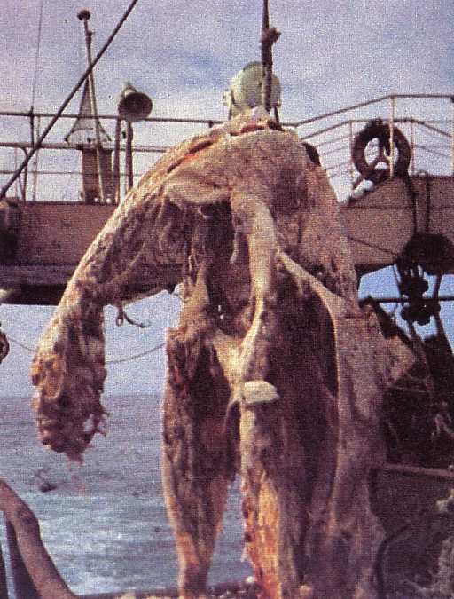
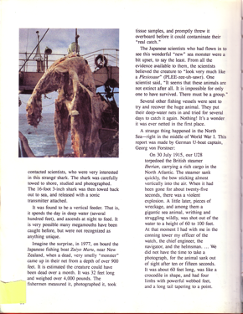
Japanese Fisherman's Dead Monster
(The Times 21 July 1977)
Two tons & ten meters long
Caught at 330 meters deep ocean near Christchurch
Plesiosaurus: huge, small-headed reptiles with long neck and four fins
Photographed and sketched by marine biologist Michihiko Yano
Captain threw it back into sea for fear of contaminating his fish.
Soon after BBC reported it to be a shark (30 July 1977)!
Enlarge and read this!
Duane T. Gish, Dinosaurs by Design (4730 Barnes Road, Colorado Springs, CO: Master Books and Creation-Life Publishers, 1992), 86
Notes:
Duane T. Gish, Dinosaurs by Design, 4730 Barnes Road, Colorado Springs, CO: Master Books and Creation-Life Publishers, 1992, 86

Slide 53
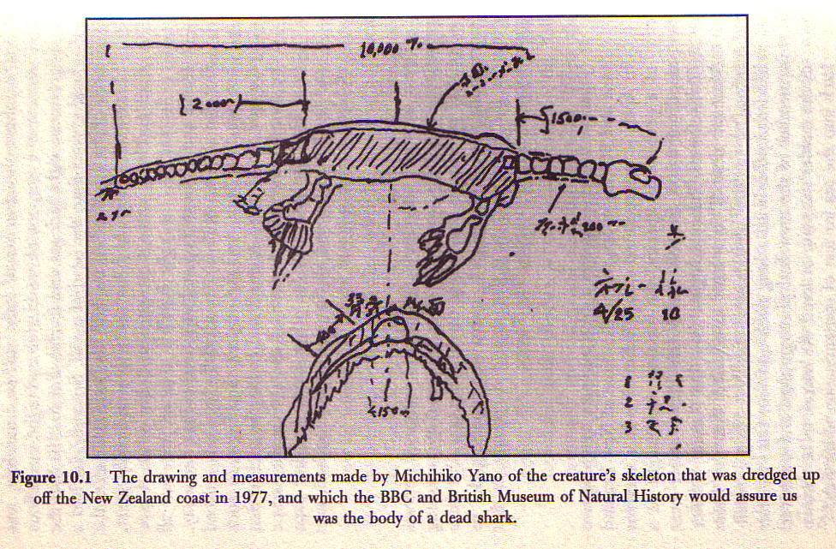
Is This a Shark?!
Bill Cooper, After the Flood, 140

Slide 54
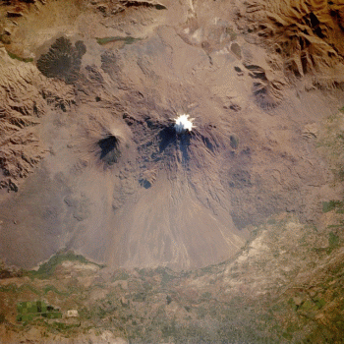
Noah's Ark Mt. Ararat
A view from space of snow-covered Mt. Ararat and Little Ararat--inactive volcanoes located in eastern Turkey. Mount Ararat rises over 3 miles above sea level. This mountain is the traditional resting place of Noah's ark.
Mt. Ararat
NASA Photo
© EBibleTeacher.com
INDEX
Notes:
The picture shows a satellite view of snow covered Mt. Ararat and Little Ararat. These mountains are inactive volcanoes located in eastern Turkey. Mt. Ararat rises over 3 miles above sea level. This mountain is the traditional resting place of the Ark. You can see the lava flow fields to the south part of the mountain peak. Below the lava field you can see green fields.

Slide 55
Slides on
Genesis 9

Slide 56
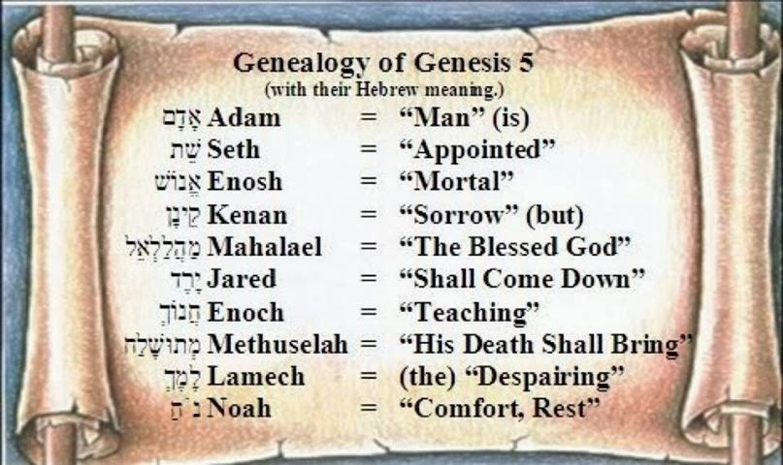
The Meaning of Each Patriarch's Name in the 10 Generations
Notes:
Reading downward with the meanings above, we see that death reigned on the earth. However, their names teach us that at the time of the death of Methuselah in the year of the Flood, through Noah (“comfort, rest”) the world that was renewed through the Flood.

Slide 57
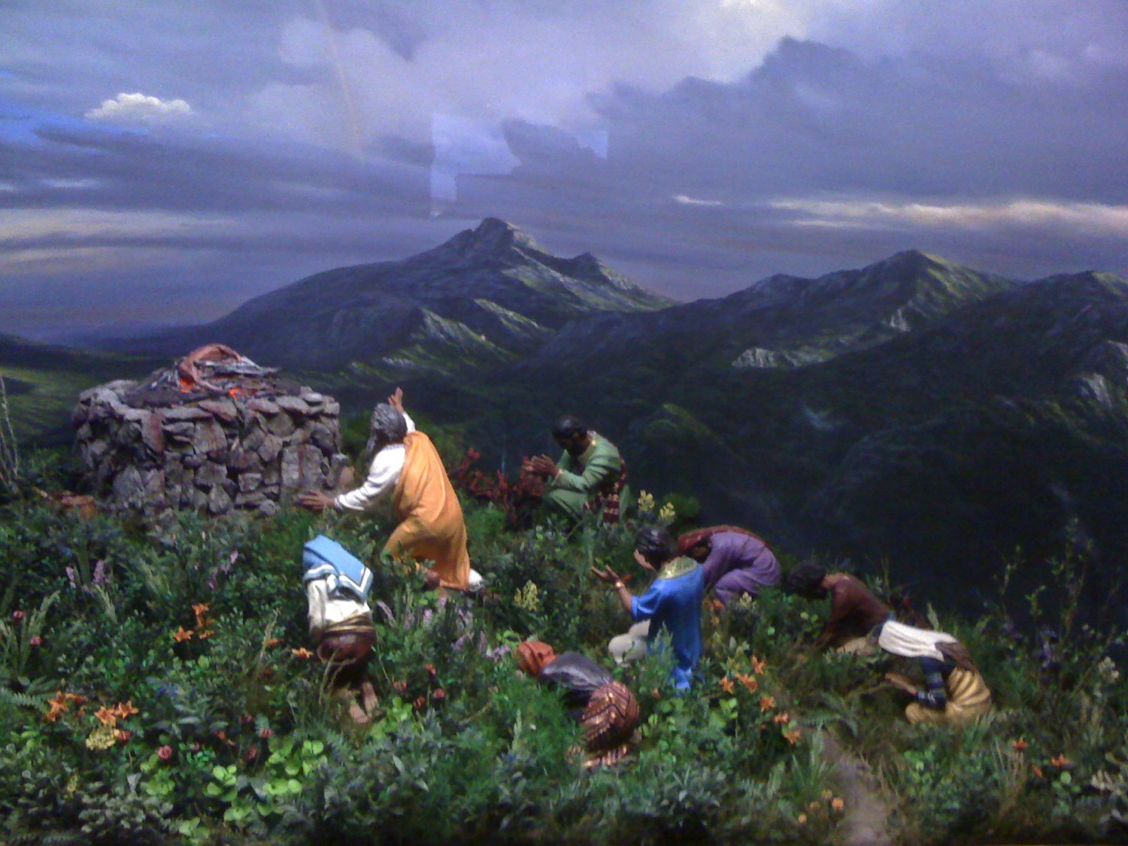
Worship & the Rainbow

Slide 58
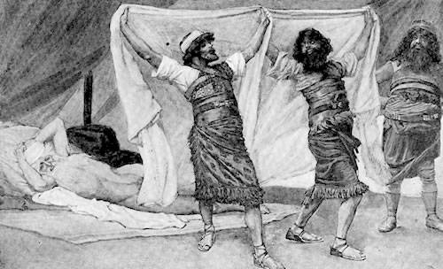
Noah Wasn't Perfect
"Ham, the father of Canaan, saw that his father was naked and went outside and told his brothers. ²³Then Shem and Japheth took a robe, held it over their shoulders, and backed into the tent to cover their father. As they did this, they looked the other way so they would not see him naked" (9:22-23 NLT).

Slide 59
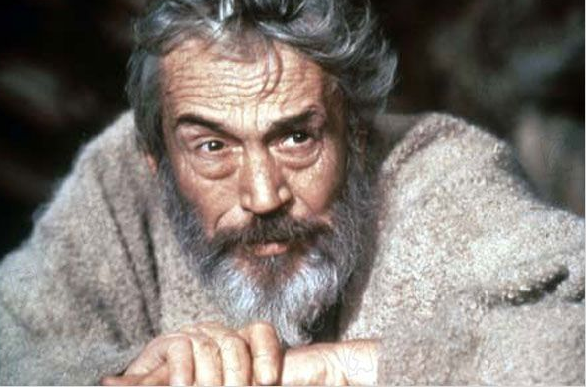
Noah Wasn't Perfect
"When Noah woke up from his stupor, he learned what Ham, his youngest son, had done. ²⁵Then he cursed Canaan, the son of Ham:
'May Canaan be cursed!
May he be the lowest of servants to his relatives'" (9:24-25 NLT).

Slide 60
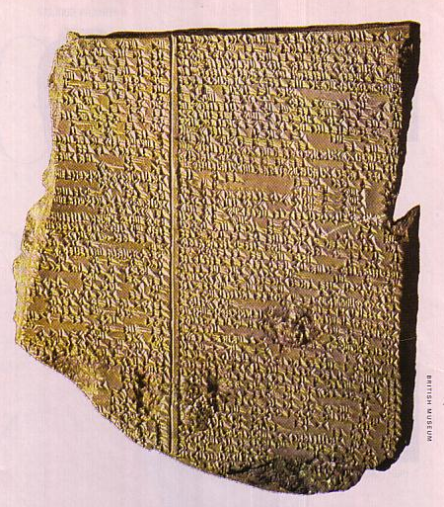
Gilgamesh Epic
Tablet XI
218
Nineveh, Iraq
650 BC
Flood story similar to Gen. 6–9

Slide 61
LITERATURE TYPES
140
Gilgamesh Epic
BABYLONIAN VERSION OF THE FLOOD (2000 BC)
Babylonian Mythology
Many gods (Polytheism)
Gods quarrel /disagree
Confusion as to why the Flood came
Adad - thunder
Ninurta- winds
Annunaki - lightning
Biblical Account
One God (Monotheism)
A Holy God
God punished the corrupt people
Creator / Sustainer of all - executes judgment

Slide 62
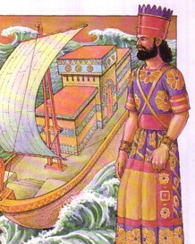
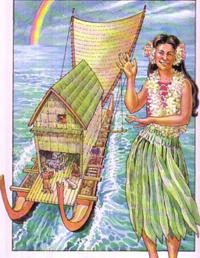
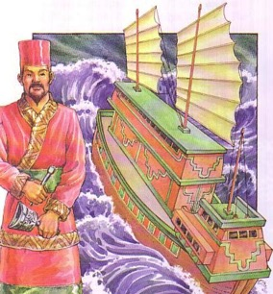

Flood Legends
188g
83c
270 Flood Legends
Hawaii
Babylonia
Mexico
Common Elements:
universal flood
boat saved
family passengers
China

Slide 63


Chinese Character for Boat
188g
Vessel
Ship
Eight
Person
Eight
Ship
Mouth of Person
China

Slide 64



Types of Pagan Literature
189
Historical
  Assyrian (e.g., Tiglath-Pileser)
  Egyptian (histories of pharaohs)
  Babylonian Chronicles
  Persian (e.g., Cyrus Cylinder)
Wisdom
  Instruction of Amenemope

Slide 65

Wisdom Literature Parallels
188b
Amen-em-opet
Proverbs 22:17–24:22
"Give thine ear, and hear what I say, And apply thine heart to apprehend; It is good for thee to place them in thine heart, let them rest in the casket of thy belly; That they may act as a peg upon thy tongue" (chap. 1)
"Incline thine ear, and hear the words of the wise, And apply thine heart to my doctrine; For it is pleasant if thou keep them in thy belly, that they may be established together upon thy lips" (Proverbs 22:17-18)
Notes:
"The Legacy of Egypt", S. R. K. Glanville, contributor W. O. E Oesterley, p. 246-248, Oxford, 1942 (http://en.wikipedia.org/wiki/Instruction_of_Amenemope accessed 9 July 2014)

Slide 66
Wisdom Literature Parallels
188b
Amen-em-opet
Proverbs 22:17–24:22
"Beware of robbing the poor, and oppressing the afflicted" (chap. 2)
"Rob not the poor, for he is poor, neither oppress (or crush) the lowly in the gate" (Proverbs 22:22)
Notes:
"The Legacy of Egypt", S. R. K. Glanville, contributor W. O. E Oesterley, p. 246-248, Oxford, 1942 (http://en.wikipedia.org/wiki/Instruction_of_Amenemope accessed 9 July 2014)

Slide 67

Types of Pagan Literature
189
Historical
  Assyrian (e.g., Tiglath-Pileser)
  Egyptian (histories of pharaohs)
  Babylonian Chronicles
  Persian (e.g., Cyrus Cylinder)
Wisdom
  Instruction of Amenemope
  Egyptian Love Songs

Slide 68

Wisdom Literature Parallels
188b
Amen-em-opet
Egyptian Love Poems
Proverbs 22:17–24:22
Song of
Solomon
"If only I were a laundryman of my sister's garment even for one month! I would be strengthened by grasping [the clothes] that touch her body (Arnold, 192)
"Your clothes are scented like the cedars of Lebanon" (4:11)

Slide 69
Types of Pagan Literature
189
Historical
  Assyrian (e.g., Tiglath-Pileser)
  Egyptian (histories of pharaohs)
  Babylonian Chronicles
  Persian (e.g., Cyrus Cylinder)
Wisdom
  Instruction of Amenemope
  Egyptian Love Songs
  Hymns & Prayers

Slide 70
Wisdom Literature Parallels
188
Amen-em-opet
Egyptian Love Poems (Arnold, 192)
Mari Letters
Babylonian
Theogony
Babylonian Theodicy
Proverbs 22:17–24:22
Song of
Solomon
Akkadian Prophecies
Murders for Sovereignty
Dialogue on the Suffering of "Job"

Slide 71

Types of Pagan Literature
(Continued)
Prophetic
  Mari Prophecy Texts (1800-1760 BC)
Mari

Slide 72
Types of Pagan Literature
189
190
(Continued)
Prophetic
  Mari Prophecy Texts (1800-1760 BC)
  Marduk Prophecy (Readings from the ANE, 215)
Letters
  Amarna Letters
  Lachish Ostraca
Legal (pp. 190-191)
  Similarities
    Hittite Treaties (suzerain-vassal covenants)
    Exodus-Leviticus, Deuteronomy, Josh. 24
Hittite Treaty Format
(15th Century BC, p. 190)
Preamble (speaker intro)
Historical Prologue
Stipulations (terms)
Deposit of Document
Call for Divine Witnesses
Cursings & Blessings

Slide 73


Laws Before Sinai
192
Hammurapi
Moses
1800 BC
1400 BC
Babylon
Mount Sinai

Slide 74
Law Codes Parallel to Exodus
191
Sumerian
Reform of Uruinimgina
Laws of Ur-Nammu
Laws of Lipit-Ishtar
Akkadian
Laws of Eshnunna
Laws of Hammurapi
Middle Assyrian Laws
Hittite
Hittite laws of Murshilish I or Khattushilish I

Slide 75


Jewish Laws Were Fairer
192
Offense
Hammurapi
Moses
Stealing
Death (§ 4)
Restore 2x (Exod 22:9)
Burglary
Death (§ 21)
Restore 2x (Exod 22:7)
Harboring Slave
Death (§ 16)
No offense (Deut 23:15)
Injuring Slave
Master paid
(§ 199)
Slave freed
(Exod 21:26-27)

Slide 76
Jewish Laws Were Fairer
192
Offense
Hammurapi
Moses
Injure rich man
Same as OT
(§§ 196-197)
Injurer gets same injury
Injure poor man
Fined one mina of silver (§ 198)
Injurer gets same injury
Kill rich's daughter
Kill injurer's daughter (§ 209)
No class distinctions
Injuring Slave
5 silver shekels fine (§§ 211, 213)
No class distinctions

Slide 77
Hammurapi's Laws in Genesis
192a
  The adoption law made Eliezer Abram's heir (Gen. 15). § 191.
  The giving of Hagar to Abraham (Gen. 16) and of Bilhah (Gen. 30:4) and Zilpah (Gen.30:9) to Jacob, accorded with this code. § 146.
  The purchase of Machpelah by Abraham (Gen. 23) was conducted in strict conformity with its commercial enactments. § 7.
  The penalty of death for stealing, proposed by Jacob to Laban (Gen. 31:32), came from this code that punished sacrilege with death. § 6.

Slide 78
Hammurapi's Laws in Genesis
192a
  The taking of life by burning, with which Judah
  threatened his daughter-in-law Tamar (Gen. 38:24), is also according to the Babylonian code. § 110.
  The proposal of Joseph's steward, that the one with whom the cup was found should die (Gen. 44:9), harmonized with the law punishing with death for any theft from a palace. § 6.

Slide 79
Hammurapi's Laws in Genesis
192a
  The giving of a special portion by Jacob to his favourite son Joseph (Gen. 48:22) was provided for by this code. § 165.
  The cutting off of Reuben from his birthright (Gen. 49:4) was the prescribed way of punishing his offence according to Hammurabi's law. § 158.
  The inability of Abram to sell Hagar (Gen. 16:6) accords with Hammurabi, as she was a maidservant who bore Abram children. § 119.

Slide 80

General Law-Code Differences of the Babylonians vs. the OT
192b
Issue | Hammurapi | Moses
Law-Code Basis | The king's word | The character of Yahweh
Motive not to sin | Offense to a god's whims | God's holiness: "Be holy as I am holy" (Lev. 19:2) and love for Him (Deut. 6:4-5)
Government | Civil | Theocratic
Social distinctions | Many | None
Punishment | Harsh (death penalty common) | Reasonable (capital punishment used sparingly)
Deities | Polytheistic | Monotheistic
Women | Abuse allowed | Respected
Slaves | No rights (no rest, permanent status) | Rights (Sabbath rest, freed after 6 years)
Human life | Cheap & Expendable | Highly valued

Slide 81

Table of Nations
17
JAPHETHITES
Ararat
SEMITES
Sumerians
HAMITES
Canaanites
Egyptians

Slide 82


Is the Table of Nations Accurate (Gen. 10–11)?
MS
"Having constructed the Table of Nations into a simple genealogy, I wanted to see how many of its names were attested in the records of other nations in the Middle East… [I saw that] the Table of Nations had listed all the families and tribes of mankind in their correct groupings, whether those groupings were ethnological, linguistic or geographical. All the names, without exception, were accurate, and in more than twenty-five years of searching and analyzing, I uncovered not one mistake or false statement of fact in the Table of Nations."
Bill Cooper, After the Flood (Chichester: New Wine, 1995), 38-39
SG
ER
DS
PG
RS
25

Slide 83

"The earth is the LORD's"

Slide 84
Black

Slide 85


Critical Studies of the OT link at BibleStudyDownloads.org
Get this presentation and script for free!
Notes:
OC Critical Studies in the OT

