Slide 1
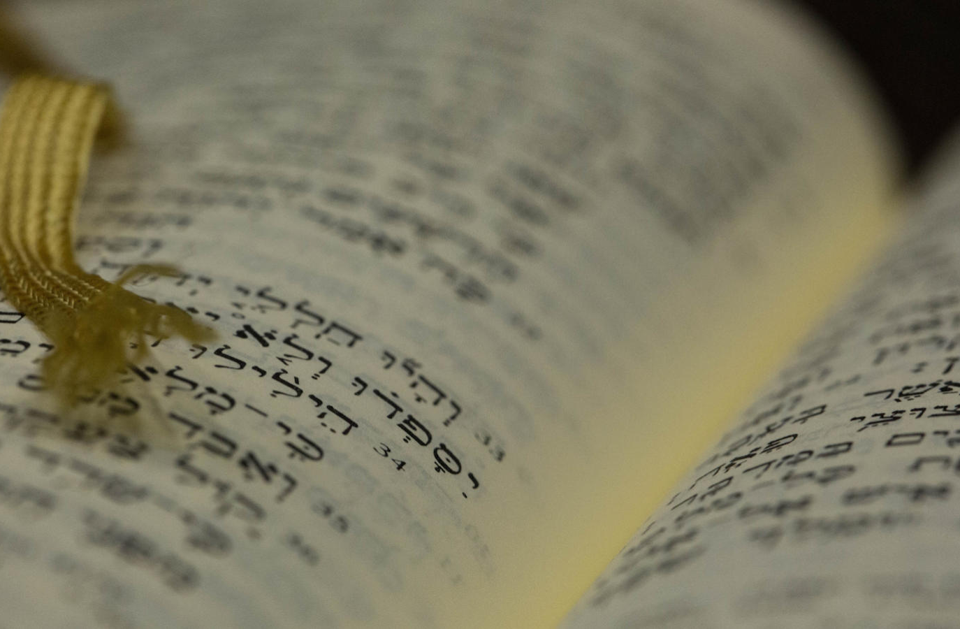
Introduction
to Critical Studies in the Old Testament
Dr. Rick Griffith • Jordan Evangelical Theological Seminary
BibleStudyDownloads.org

Slide 2
Distinguishing Terms (Merrill, “Intro”)
Introduction
Criticism
Traditional Meaning:
Preliminary study
Survey
Content
Assessing nature
Negative, destructive
Evaluation
Biblical Scholarship Meaning:
Leads into content
Focus on familiarity
Focus on understanding
Origin, text, history
Merrill avoids the term
Legitimate (not source)
Essential/sacred: form, redaction, rhetorical, “new literary” criticism

Slide 3
Types of Criticism
Higher
= Literary
(e.g., JEDP)
Lower
= Textual
(e.g., Apparatus)

Slide 4
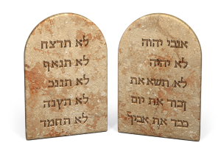
Did God really give the Ten Commandments?

Slide 5
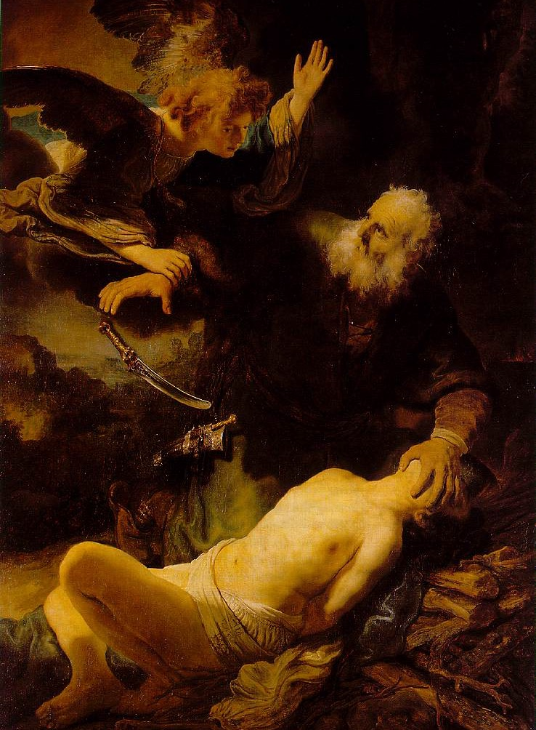
Is the OT Reliable?
Many say “no”:
Secularists
Muslims
OT Scholars

Slide 6
Chart of OT Kings & Prophets
65c

Slide 7
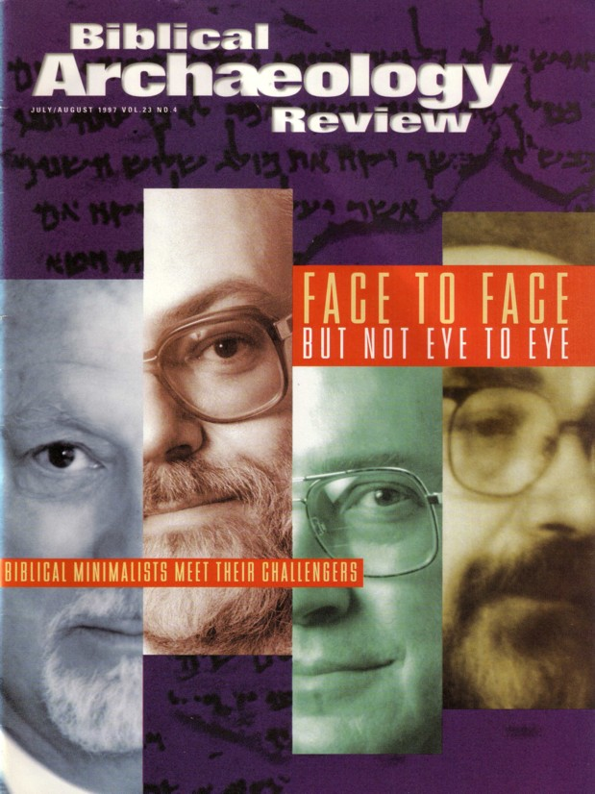
Is the Chronology of Israel's Kings Necessary?
Whether David and Solomon even lived was doubted by “Biblical Minimalists” in the July/Aug 1997 issue of BAR

Slide 8
Two Questions on Righteous Suffering (Answer based on 1 Peter 3:13-17)
280l
What does a selfless lifestyle look like for the believer undergoing injustice?
What specific rewards do we receive when we respond to unjust treatment selflessly?

Slide 9
Righteous Suffering (1 Peter 3:13-17)
280l
Selflessness is shown in:
Being eager to do good for others (3:13)
Suffering for doing what is right (3:14a, 17)
Submitting to the Lordship of Christ (3:15a)
Defending the faith (3:15b)
Being gentle and respectful (3:15c)
Rewards for the selfless sufferers:
Blessed (3:14a)
Freedom from the fear that afflicts persecutors (3:14b)
Hope to share with others (3:15)
Clear conscience (3:16)

Slide 10
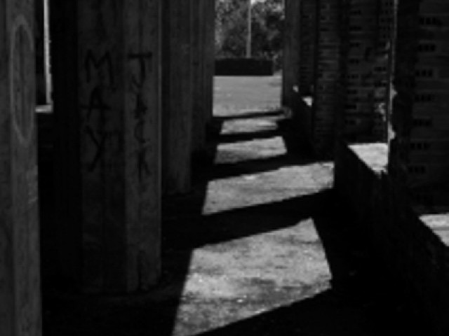
Who fears more?
Persecutors?
Persecutees?
"Do not fear what they [persecutors] fear…" (1 Peter 3:14b)

Slide 11
1 Peter 3:15-16 (NIV)
"But in your hearts set apart Christ as Lord. Always be prepared to give an answer to everyone who asks you to give the reason for the hope that you have. But do this with gentleness and respect, ¹⁶ keeping a clear conscience, so that those who speak maliciously against your good behavior in Christ may be ashamed of their slander."

Slide 12
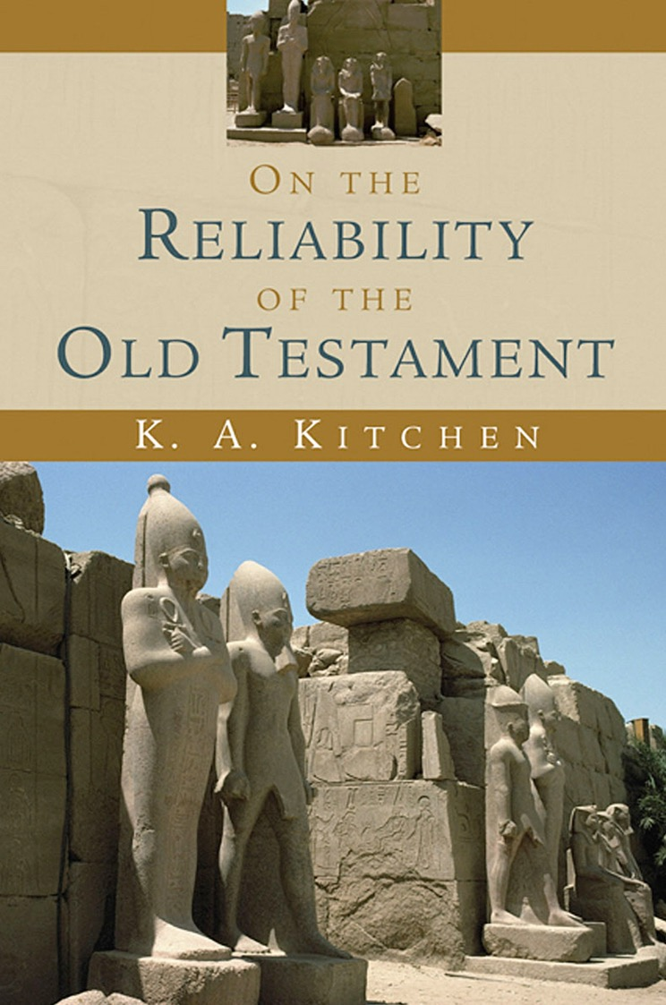
Kitchen is a British Evangelical
Chapter 1: What’s in Question?
Notes:
Kitchen, K. A.. On the Reliability of the Old Testament . Grand Rapids: Eerdmans, 2003. Kindle Edition.

Slide 13
How Do Scholars Doubt the OT?
They say the OT was written just before the Dead Sea Scrolls:
"Those who most decidedly dismiss this whole story point to the date of our earliest discovered MSS of its texts, namely, the Dead Sea Scrolls of the second century B.C. onward. They would take the most minimal view, that the biblical books were originally composed just before the time of the Dead Sea Scrolls, i.e., in the fourth/third centuries B.C. (end of Persian, into Hellenistic, times)."
Notes:
Kitchen, K. A.. On the Reliability of the Old Testament . Grand Rapids: Eerdmans, 2003. Kindle Edition.

Slide 14
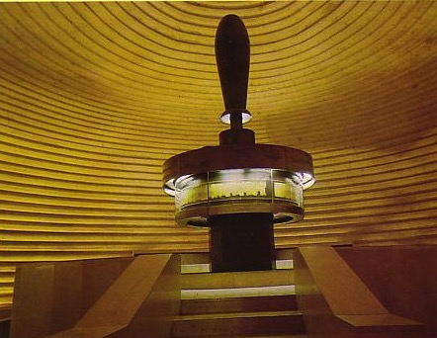
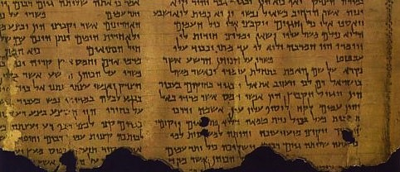
Shrine of the Book
Significance of the DSS
183
When was the OT written?
Conservatives
say 1400-400 BC
Minimalists
Say whole OT in 3rd-4th Century BC
Dead Sea Scrolls
200-100 BC
600
500
400
300
200
100
BC

Slide 15
How Do Scholars Doubt the OT?
They say the OT was written just before the Dead Sea Scrolls:
"﻿With that late date they would couple an ultralow view of the reality of that history, dismissing virtually the whole of it as pure fiction, as an attempt by the puny Jewish community in Palestine to write themselves an imaginary past large, as a form of national propaganda."
Notes:
Kitchen, K. A.. On the Reliability of the Old Testament . Grand Rapids: Eerdmans, 2003. Kindle Edition.

Slide 16
Why Do Scholars Doubt the OT?
Other societies were inventing history at the time:
Manetho, Aegyptiaka (History of Egypt) under Ptolemy II
Berossus, Chaldaika, Babylon, under Antiochus I
So why not Hellenistic Jews from 400-200 BC?
Notes:
“﻿After all, others were doing this then. In the third century B.C. the Egyptian priest Manetho produced his Aegyptiaka, or history of Egypt, probably under Ptolemy II,
1 and by then so also did Berossus, priest of Marduk at Babylon, his Chaldaika, for his master, the Seleucid king Antiochus I.
2 Comparison with firsthand sources shows that these two writers could draw upon authentic local records and traditions in each case. So it is in principle possible to suggest that a group of early Hellenistic Jews tried to perform a similar service for their community by composing the books we now know as the Old Testament or Hebrew Bible.”
Kitchen, K. A.. On the Reliability of the Old Testament . Grand Rapids: Eerdmans, 2003. Kindle Edition.

Slide 17
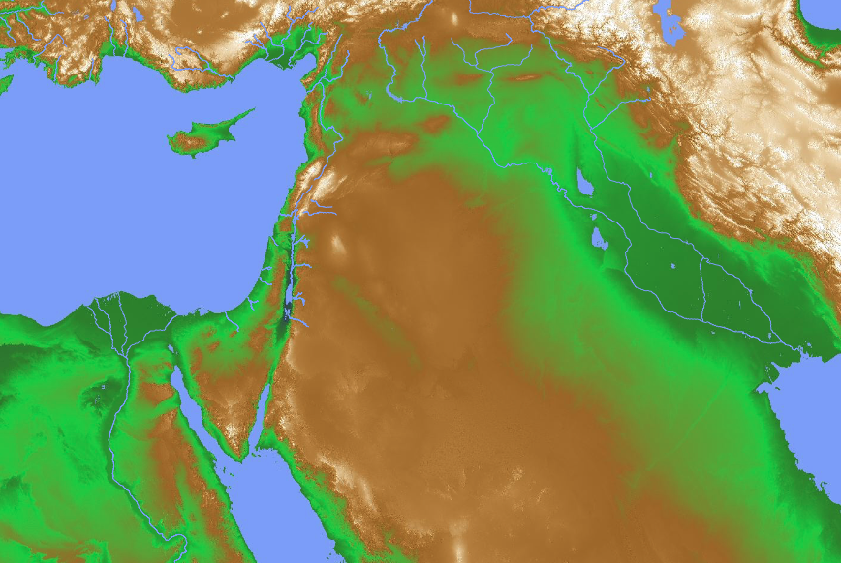
Inventing “History”
Babylon (Berossus)
Palestine (OT?)
Egypt (Manetho)
Notes:
“﻿After all, others were doing this then. In the third century B.C. the Egyptian priest Manetho produced his Aegyptiaka, or history of Egypt, probably under Ptolemy II,1 and by then so also did Berossus, priest of Marduk at Babylon, his Chaldaika, for his master, the Seleucid king Antiochus I.2 Comparison with firsthand sources shows that these two writers could draw upon authentic local records and traditions in each case. So it is in principle possible to suggest that a group of early Hellenistic Jews tried to perform a similar service for their community by composing the books we now know as the Old Testament or Hebrew Bible.”
Kitchen, K. A.. On the Reliability of the Old Testament . Grand Rapids: Eerdmans, 2003. Kindle Edition.

Slide 18
Shrine of the Book
Significance of the DSS
183
DSS prove conservative dating of OT books
When was Daniel written?
Conservatives
say 560 BC
Minimalists
say whole OT from 400-200 BC
Liberals
say 164 BC
DSS Daniel copy
200-100 BC
600
500
400
300
200
100
BC

Slide 19
Problems Doubting the OT
Were Jews inventing history like other societies at the time?
Jews wrote in Hebrew for their own community (Greek translation came later)
Jews could not draw upon authentic history and sources like Manetho & Berossus
Notes:
“﻿﻿The difference is, however, twofold. Factually, the Old Testament books were written in Hebrew — for their own community — right from the start, and were only translated into Greek (the Septuagint) afterward, and again primarily for their own community more than for Greek kings. Also, while Manetho and Berossus drew upon authentic history and sources, this activity is denied to the Jewish writers of the Old Testament. So, two questions here arise. (1) Were the Old Testament books all composed within circa 400-200 B.C.? And (2) are they virtually pure fiction of that time, with few or no roots in the real history of the Near East during circa 2000-400 B.C.?”
Kitchen, K. A.. On the Reliability of the Old Testament . Grand Rapids: Eerdmans, 2003. Kindle Edition.

Slide 20
Our Quest
What evidence supports genuine OT information from 2000 (Abraham) to 400 (Malachi) BC?
—Not speculations
—Not convictions
—But evidence by going back to 2000–400 BC
Notes:
“﻿﻿﻿So our study on reliability of the Old Testament writings will deal with them in this light. Have they any claim whatsoever to present to us genuine information from within 2000-400? And were they originated (as we have them) entirely within, say, 400-200? In this little book we are dealing with matters of history, literature, culture, not with theology, doctrine, or dogma. My readers must go elsewhere if that is their sole interest. So “reliability” here is a quest into finding out what may be authentic (or otherwise) in the content and formats of the books of the Hebrew Bible. Are they purely fiction, containing nothing of historical value, or of major historical content and value, or a fictional matrix with a few historical nuggets embedded? Merely sitting back in a comfy armchair just wondering or speculating about the matter will achieve us nothing. Merely proclaiming one’s personal convictions for any of the three options just mentioned (all, nothing, or something historical) simply out of personal belief or agenda, and not from firm evidence on the question, is also a total waste of time. So, what kind of test or touchstone may we apply to indicate clearly the reliability or otherwise of Old Testament writers? The answer is in principle very simple, but in practice clumsy and cumbrous. We need to go back to antiquity itself, to go back to 400 B.C., to fly back through the long centuries… ”
Kitchen, K. A.. On the Reliability of the Old Testament. Grand Rapids: Eerdmans, 2003. Kindle Edition.

Slide 21
Our Evidence
Tells
Literature
Inscriptions
Old Testament
Types:
Implicit (disciplines of Egyptology, archaeology, etc.)
Explicit (Hezekiah noted in Sennacherib annuals or state seal impression—bulla, covenant styles)
Notes:
“﻿﻿﻿So our study on reliability of the Old Testament writings will deal with them in this light. Have they any claim whatsoever to present to us genuine information from within 2000-400? And were they originated (as we have them) entirely within, say, 400-200? In this little book we are dealing with matters of history, literature, culture, not with theology, doctrine, or dogma. My readers must go elsewhere if that is their sole interest. So “reliability” here is a quest into finding out what may be authentic (or otherwise) in the content and formats of the books of the Hebrew Bible. Are they purely fiction, containing nothing of historical value, or of major historical content and value, or a fictional matrix with a few historical nuggets embedded? Merely sitting back in a comfy armchair just wondering or speculating about the matter will achieve us nothing. Merely proclaiming one’s personal convictions for any of the three options just mentioned (all, nothing, or something historical) simply out of personal belief or agenda, and not from firm evidence on the question, is also a total waste of time. So, what kind of test or touchstone may we apply to indicate clearly the reliability or otherwise of Old Testament writers? The answer is in principle very simple, but in practice clumsy and cumbrous. We need to go back to antiquity itself, to go back to 400 B.C., to fly back through the long centuries… ”
Kitchen, K. A.. On the Reliability of the Old Testament. Grand Rapids: Eerdmans, 2003. Kindle Edition.

Slide 22
﻿Table 1. The Seven Segments of Traditional Biblical “History”
1
2
3
4
5
6
7
Primeval Proto- History
The Patriarchs
Egyptian Sojourn and Exodus
Settlement in Canaan
United Monarchy
Divided Monarchy
Exile and Return
7
6
5
4
3
1
2
Notes:
“﻿For the purpose of our inquest, the basic Old Testament “story” can be divided conveniently into seven segments, representing its traditional sequence, without prejudice as to its historicity or otherwise. Table 1. The Seven Segments of Traditional Biblical “History” But we shall not follow this sequence in numerical order. Instead we shall go to the two most recent “periods” (6 and 7), first to 6, the divided monarchy, which is the period during which the Old Testament accounts are the most exposed, so to speak, to the maximum glare of publicity from external, non-biblical sources, during a period (ca. 930–580 B.C.) of the maximum availability of such evidence to set against the Old Testament data. Then, after tidying up the “tail end,” period 7, we can go back through those long corridors of time (5 back to 1) to consider the case for ever more remote periods in the record, both ancient Near Eastern and biblical, and eventually sum up the inquest.
Kitchen, K. A.. On the Reliability of the Old Testament . Wm. B. Eerdmans Publishing Co.. Kindle Edition.

Slide 23
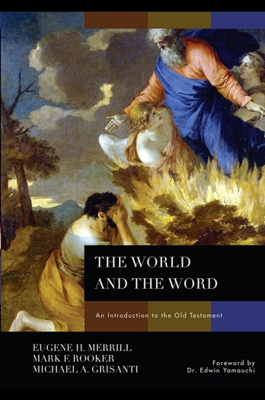
Updating Evangelical Introductions
TWO GOALS:
• Distinguish data & interpretations
• Integrate theology
Kitchen 2003
Merrill et al 2011

Slide 24
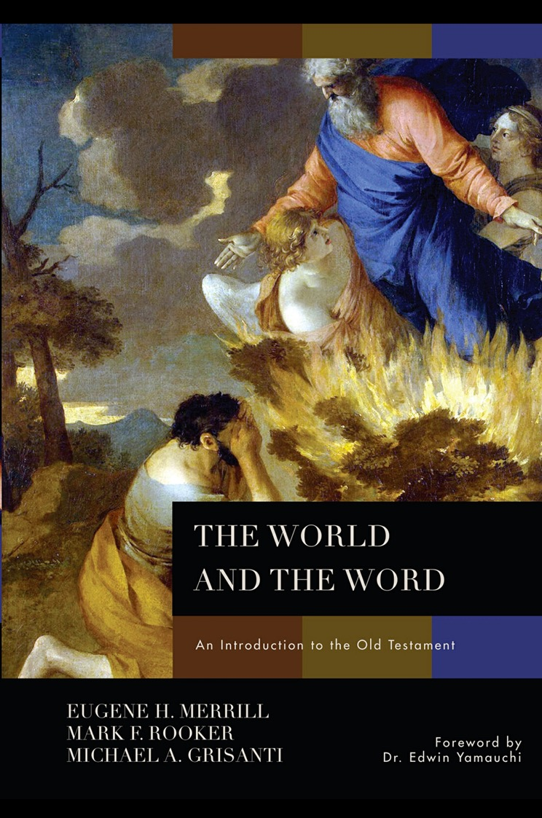
CONTENTS
Introduction
World of OT
Text of OT
Approaches to Study the OT
Pentateuch
Historical Books
Prophetic Books
Poetic Books
Epilogue

Slide 25
Our Study in This Course
INTRODUCTION
CREATION
CHRONOLOGY
AUTHORSHIP
ARCHAEOLOGY
RELIGION

Slide 26
Black

Slide 27
Critical Studies of the OT link at BibleStudyDownloads.org
Get this presentation and script for free!
Notes:
OC Critical Studies in the OT

