Slide 1
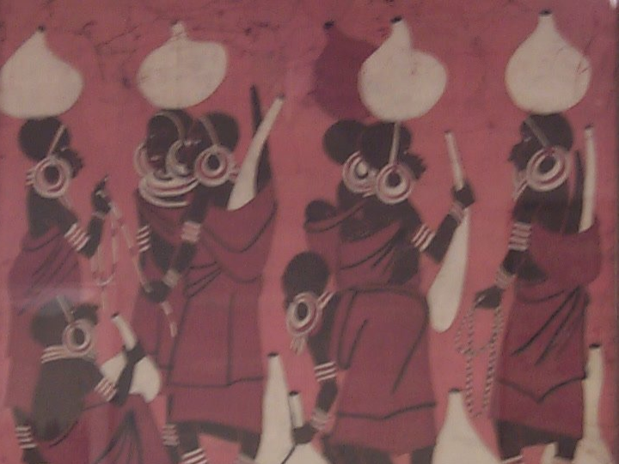
What's a Woman to Do?
The Role of Women in
Pagan and Godly Societies,
Ancient and Modern
Dr. Rick Griffith • Jordan Evangelical Theological Seminary • BibleStudyDownloads.org

Slide 2
Small Group Discussion
153
What key differences would you expect to see between pagan and Israelite men?
What views on men would you expect to find the same in both Israel and the pagan nations?
What were the key differences between of pagan and Israelite women in the Ancient Near East?
What do these differences tell us about God?
The Role of Men
The Role of Women

Slide 3
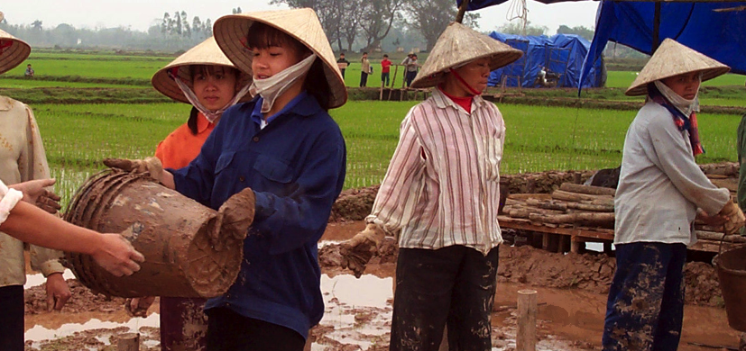
Common Laborers
Women are often common laborers
in many societies today

Slide 4
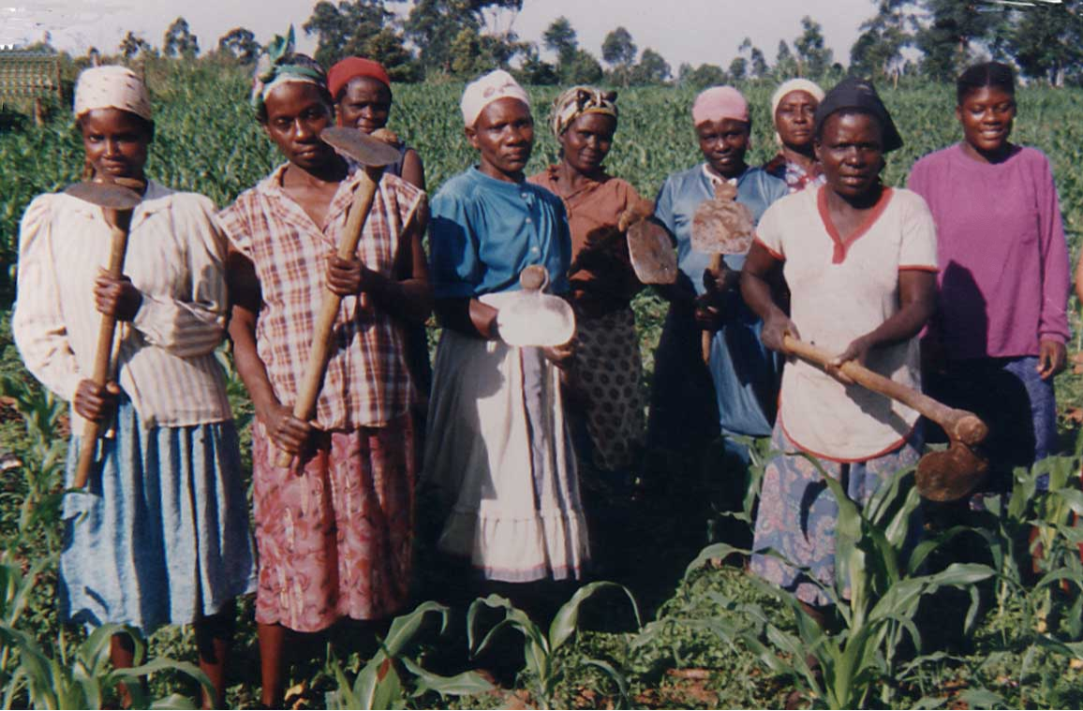
Hoe Ladies

Slide 5
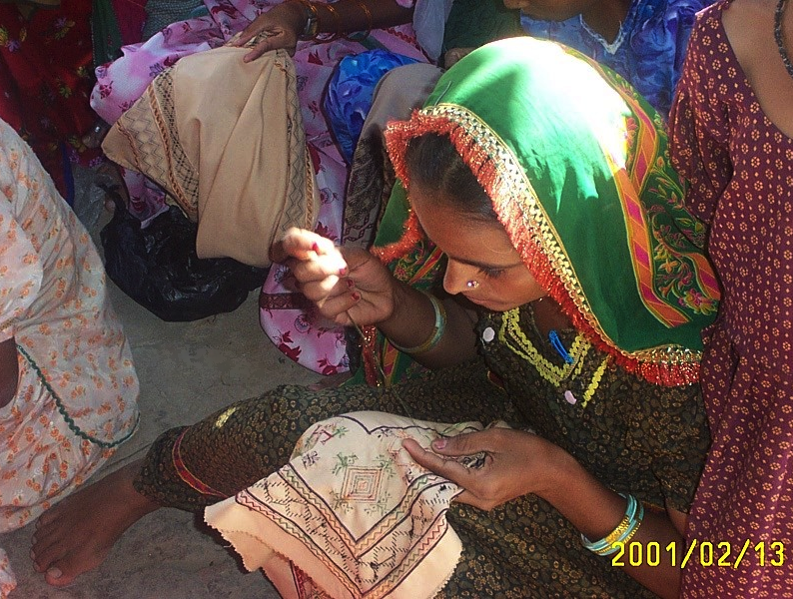
Women in Training
Traditional roles

Slide 6
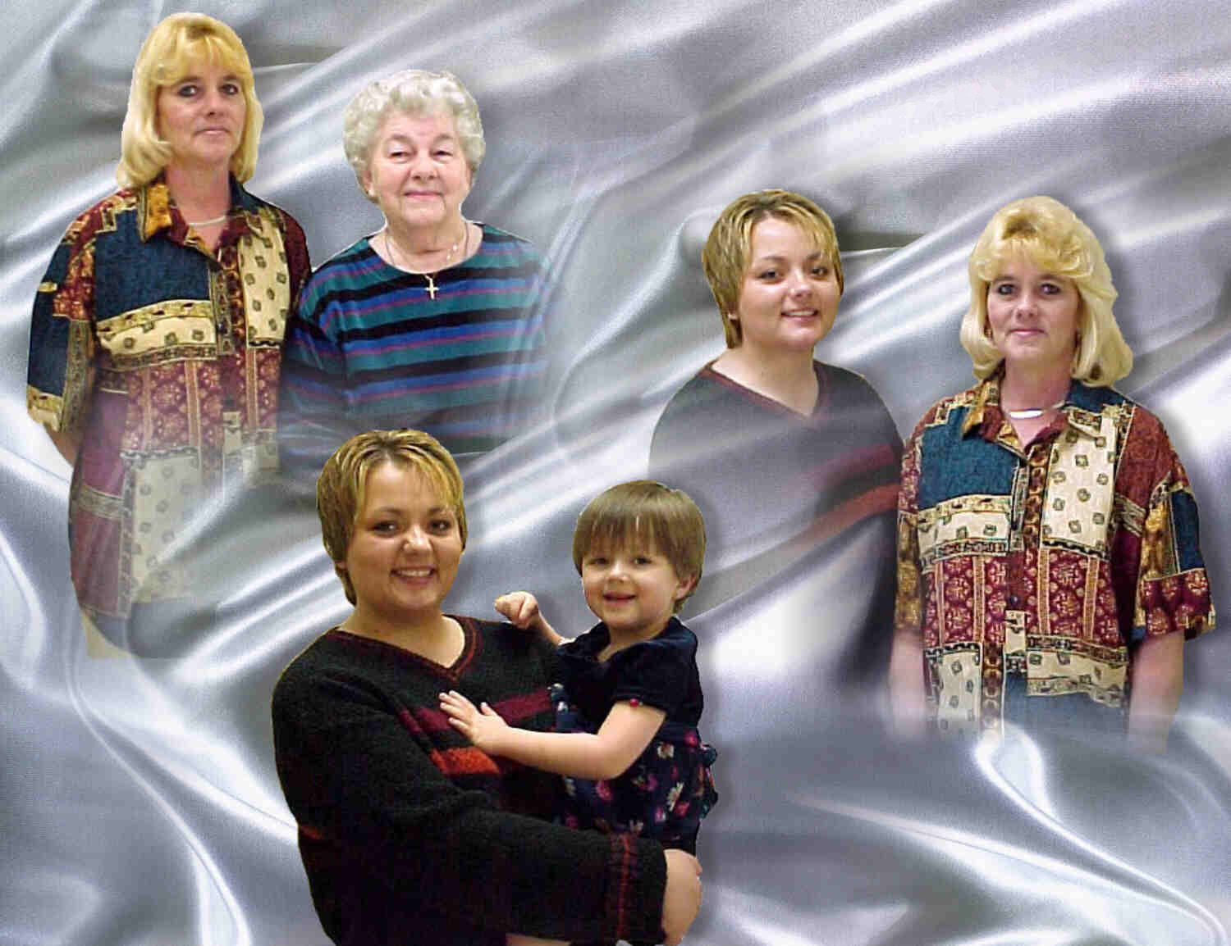
A Woman's Many Roles

Slide 7

What About Woman in the West and Urbanized World?

Slide 8
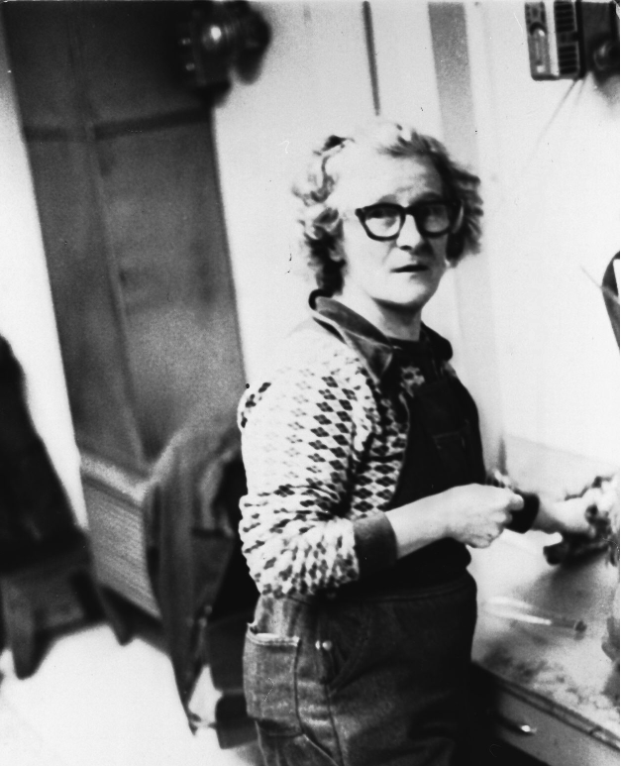

Woman Miner
Notes:
http://www.google.com.sg/imgres?imgurl=www.ironrangeresearchcenter.org/RC5/women_miner_10.jpg&imgrefurl=http://www.ironrangeresearchcenter.org/RC5/ironworld_women.htm&h=1840&w=1255&sz=211&tbnid=g3ok6tiCyysJ:&tbnh=149&tbnw=102&start=77&prev=/images%3Fq%3Dwomen%2Bat%2Bwork%26start%3D60%26imgsz%3Dxxlarge%26svnum%3D10%26hl%3Den%26lr%3D%26ie%3DUTF-8%26sa%3DN

Slide 9
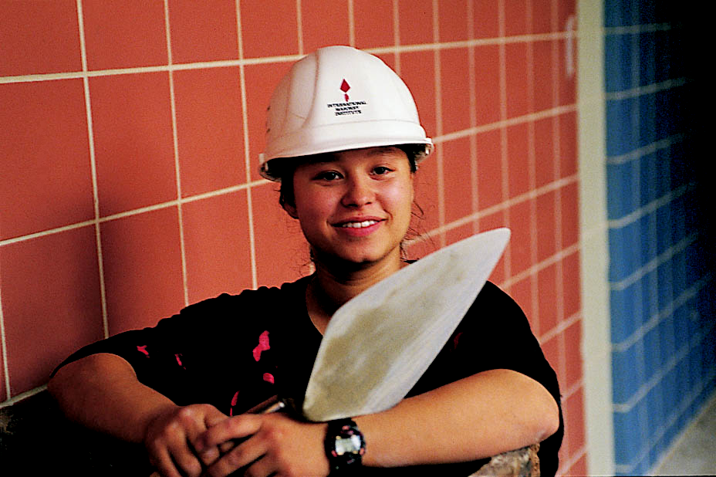
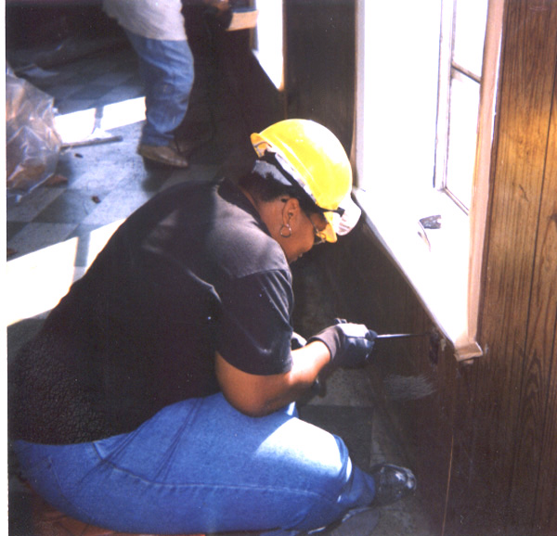
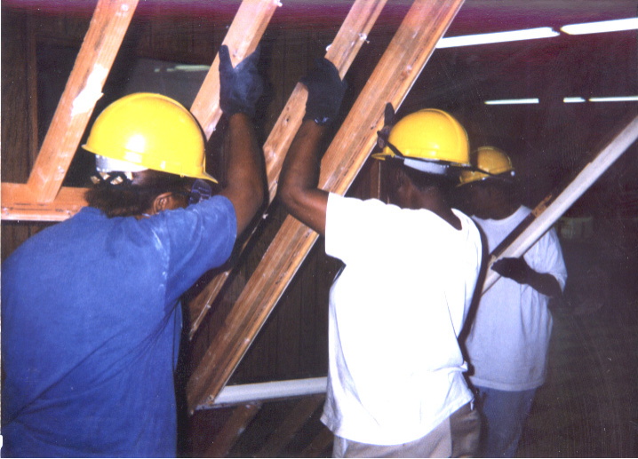
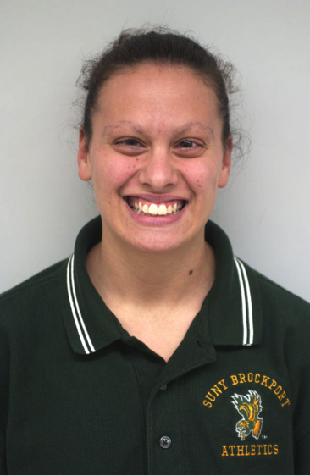

WOW
Bricklayer
(Wider Opportunities for Women)
Electrician
Carpenter
Coach
Notes:
www.work4women.org/multimedia/ photos.cfm

Slide 10
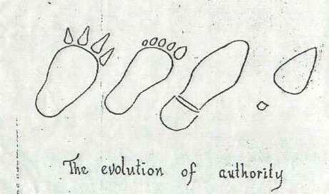
Women Have Increasing Influence in Society
The evolution of authority

Slide 11

NOW Website

Slide 12
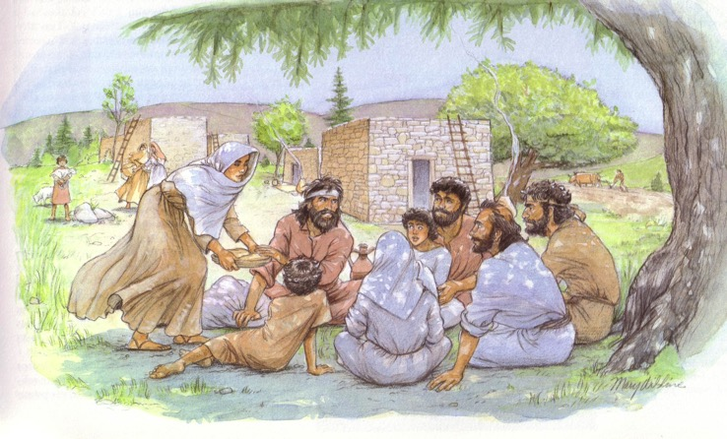
Men in Israel and the Nations
153
What key differences would you expect to see between pagan and Israelite men?
What perspectives on men would you expect to find the same in both Israel and the pagan nations?

Slide 13
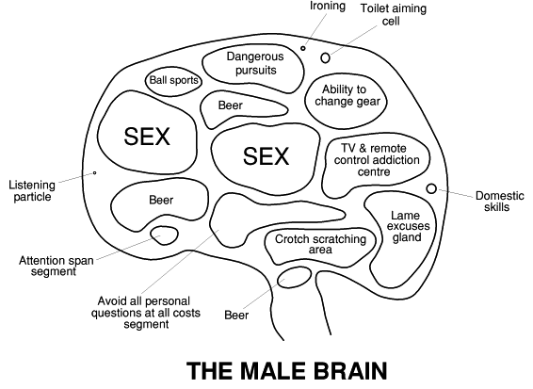
The Male Brain
Ironing
Toilet aiming cell
Dangerous pursuits
Ball Sports
Ability to change gear
Beer
SEX
SEX
TV remote addiction centre
Listening particle
Beer
Domestic skills
Lame excuses gland
Crotch scratching area
Attention span segment
Avoid all personal questions at all costs segment
Beer
The Male Brain
Notes:
http://www.jwolfe.clara.net/Humour/MedPicts/BrainMaleFemale.gif

Slide 14
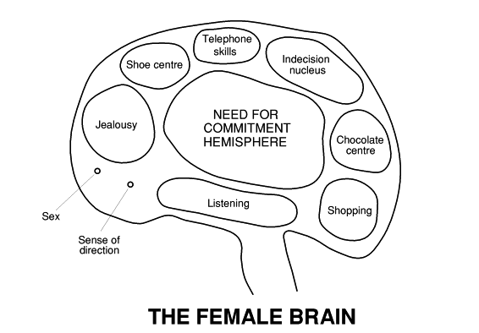
The Female Brain
Telephone Skills
Shoe Centre
Indecision Nucleus
Need for Commitment Hemisphere
Jealousy
Chocolate Centre
Listening
Shopping
Sex
Sense of Direction
The Female Brain
Notes:
http://www.jwolfe.clara.net/Humour/MedPicts/BrainMaleFemale.gif

Slide 15
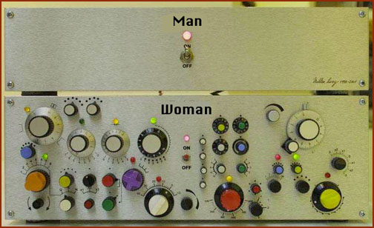
Life Explained
Man

Slide 16
Life Explained
Man
Woman

Slide 17
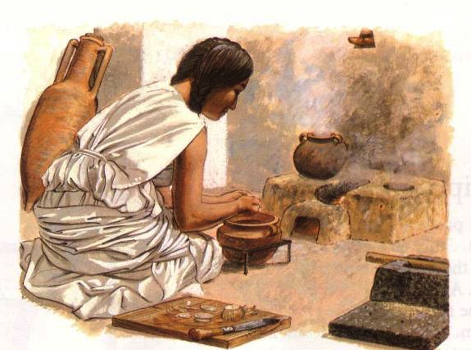
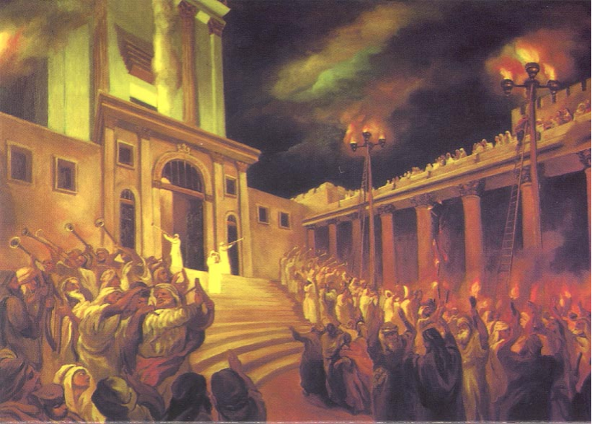

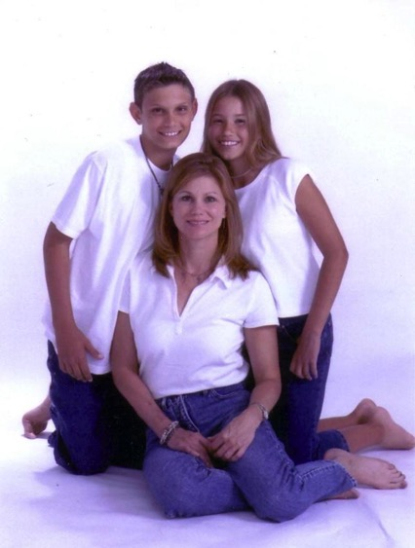
In which society do you think women were happiest?
Ancient Pagan
Ancient Israel
Modern Urban

Slide 18
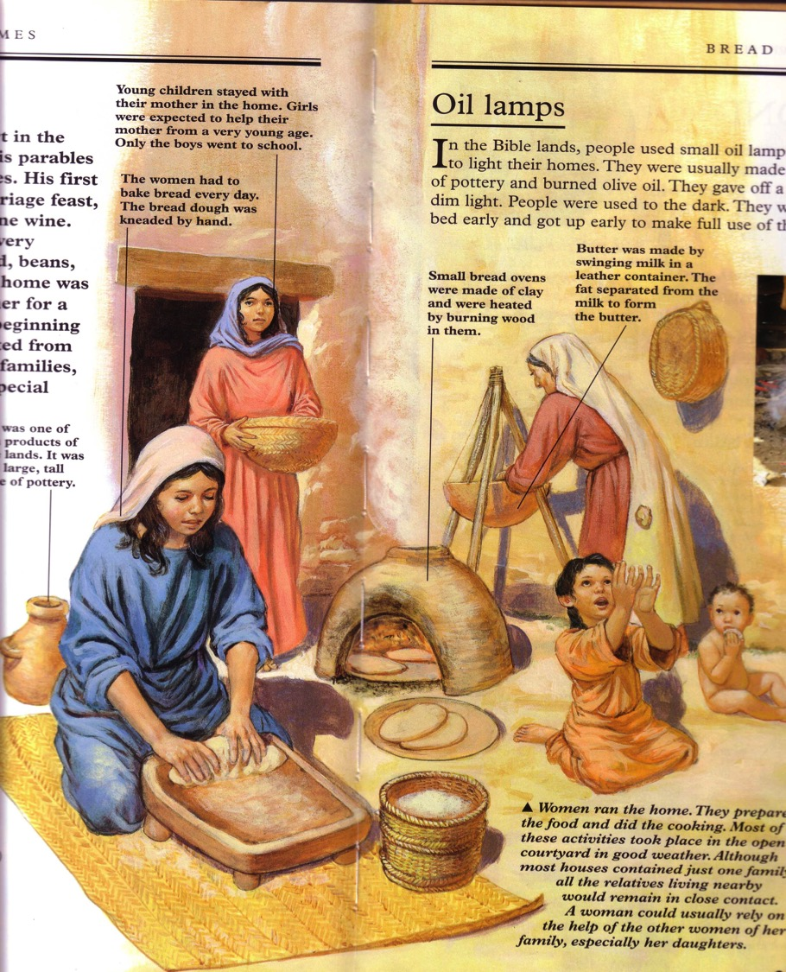
Common Traits of All Ancient Near East Women
154

Slide 19
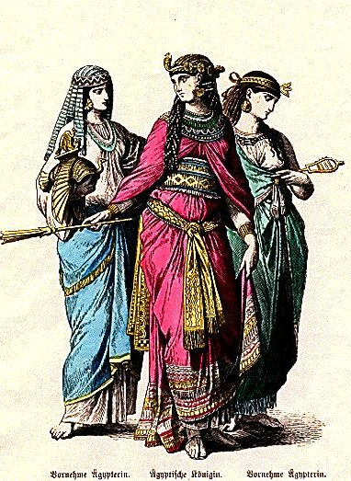
Common Traits of all ANE Women:
154
Motherhood ideal
Served men
Prophetesses
Concubines/polygamy
Arranged marriages
Divorce favored men
Protected by law
Religious leadership

Slide 20
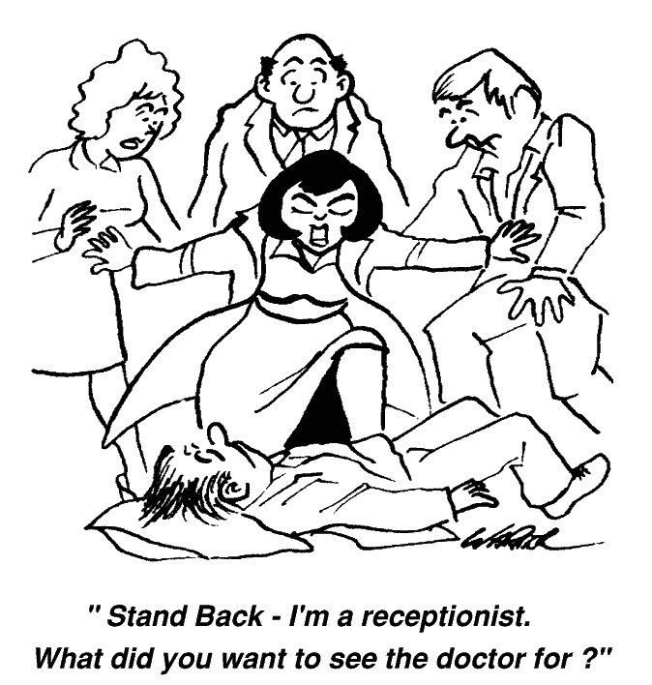
Women Who Take Control
"Stand back–– I'm a receptionist. What did you want to see a doctor for?"

Slide 21
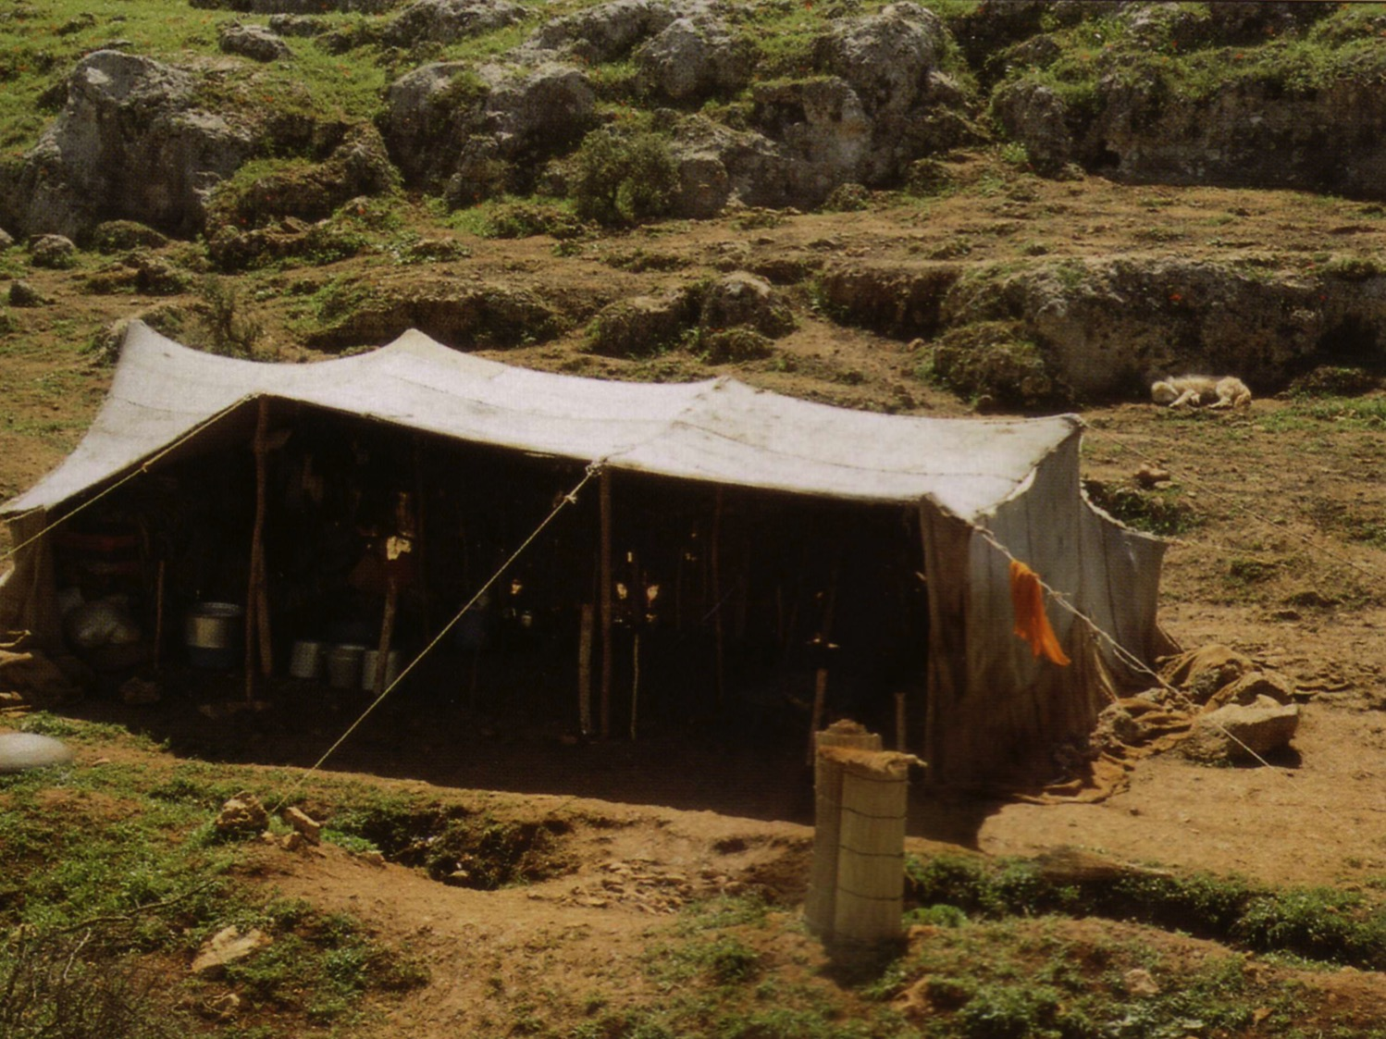
Ancient Near East Women
154a
Pagan
Israelite
Many laws
Few laws
Property
Persons
Inferior to men
Equal to men
Abuse allowed
Honeymoon
Few educated
All educated

Slide 22
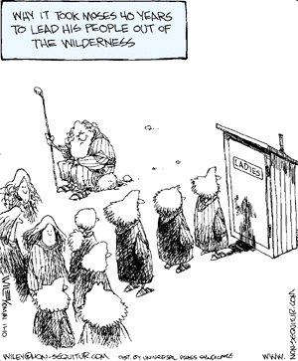
Why it took Moses 40 years to lead his people out of the wilderness

Slide 23
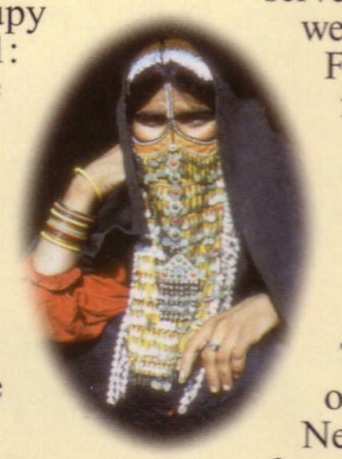
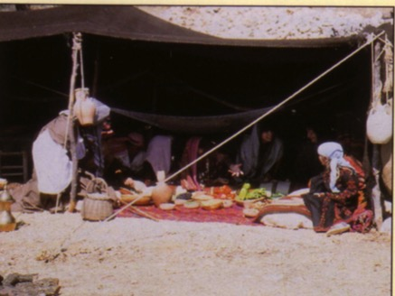
Ancient Near East Women
154a
Pagan
Israelite
Veils required
Wedding only
Prostitutes
Prostitution Illegal
Polygamy rare
Polygamy OK
Widow abuse
Widows cared for

Slide 24


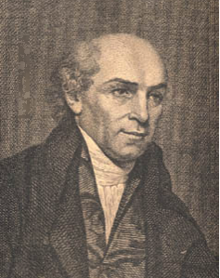
Sati (Widow Burning) in India killed thousands until William Carey led to its abolishment in 1829
Widow
Notes:
In addition to sharing the gospel and meeting the physical needs of people throughout India, Dr William Carey made it a life goal to end the practice of sati, or widow burning.
http://www.wholesomewords.org/missions/giants/biocarey2.html

Slide 25
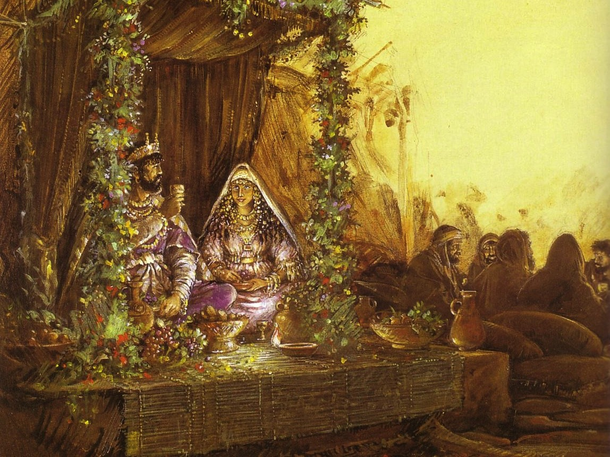
Ancient Near East Women
154b
Pagan
Israelite
Adultery guilt
Adultery innocent
Offends property
Offends people
Offends hubby
Offends God too
Varied penalties
Death penalty
Incest banishes
Incest kills

Slide 26

Blurring the Sexes
Male or female?

Slide 27
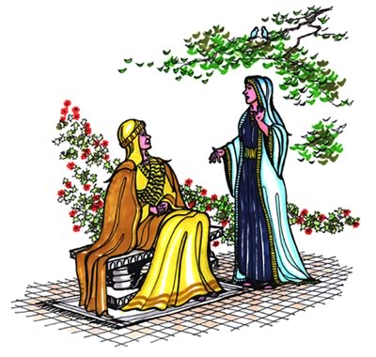
Ancient Near East Women
154b-c
Pagan
Israelite
Right to divorce
No right to divorce
Divorce abuse
Divorce protection
Rape victim
Rape immunity
Sometimes heir
Always heir
Outside work varied
Outside work varied

Slide 28
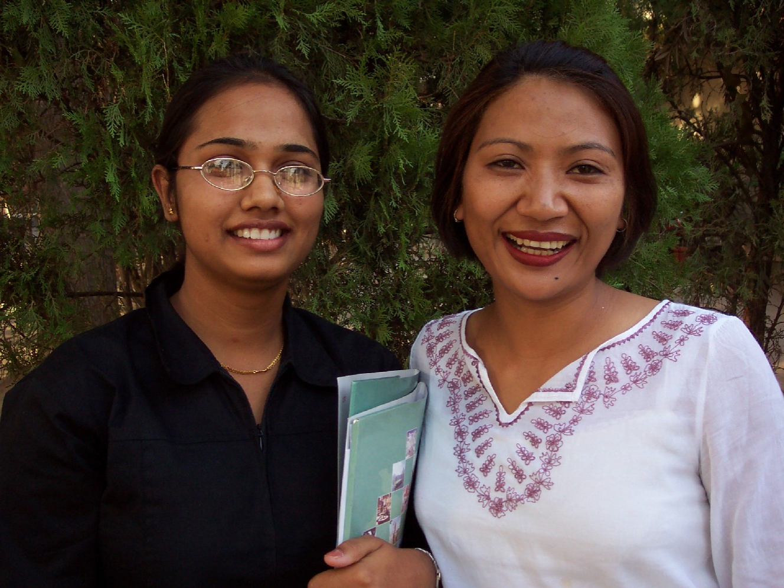
CCC India Staff Women

Slide 29
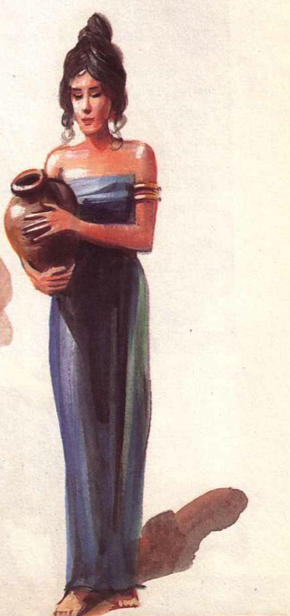
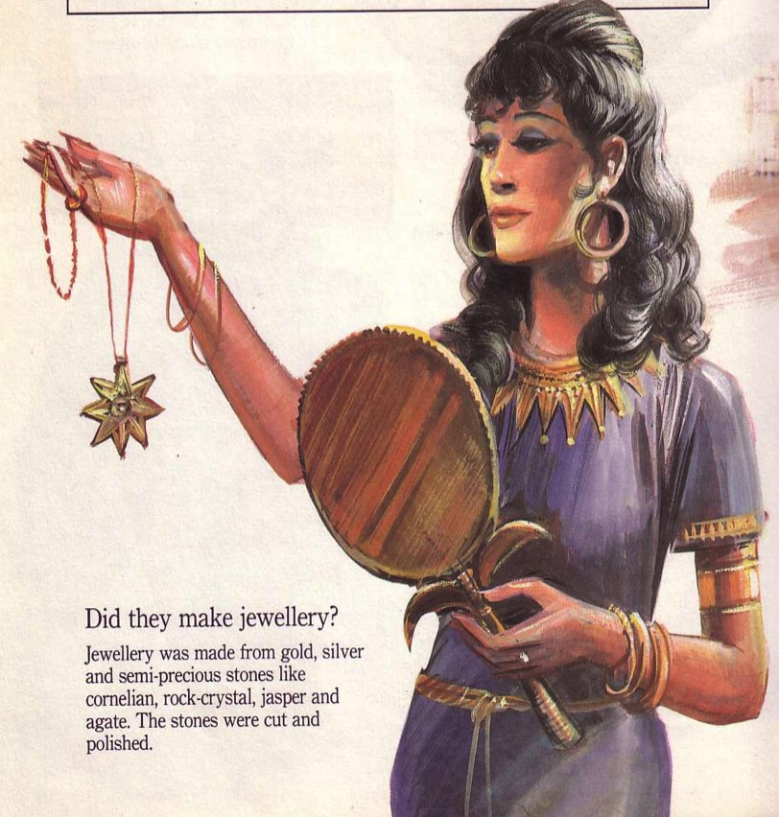
Ancient Near East Women
154c
Pagan
Israelite
Priestesses
Prohibited
Prophetesses
Rare
Leadership rare
More common
Higher social & legal position
Lower but protected in home

Slide 30

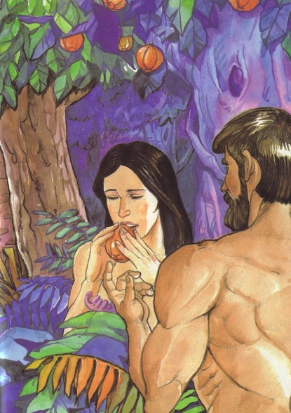
1 Timothy 2:11-15
154d
¹¹A woman should learn in quietness and full submission. ¹²I do not permit a woman to teach or to have authority over a man; she must be silent.
¹³For Adam was formed first, then Eve. ¹⁴And Adam was not the one deceived; it was the woman who was deceived and became a sinner. ¹⁵But women {Gr. she} will be saved {or restored} through childbearing— if they continue in faith, love and holiness with propriety.

Slide 31
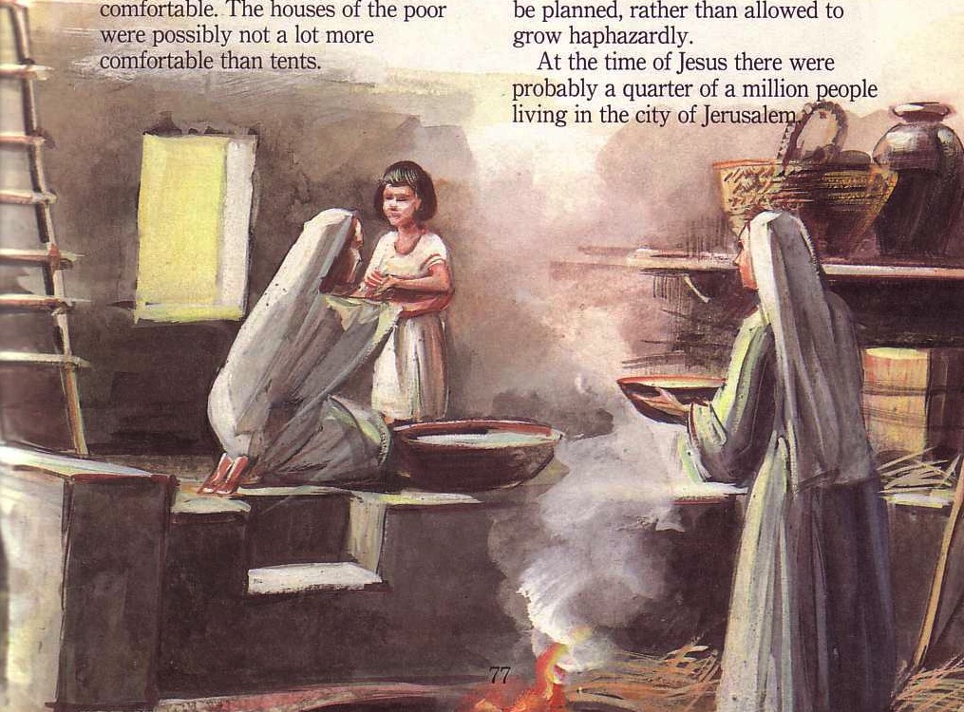
So What's Today's Moral?

Slide 32
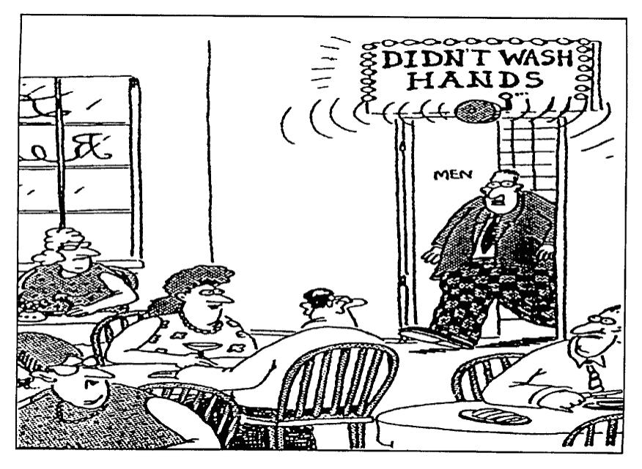
Women have to look after men
Didn't wash hands!

Slide 33

Men aren't perfect either
Waiting…
for the perfect man.

Slide 34
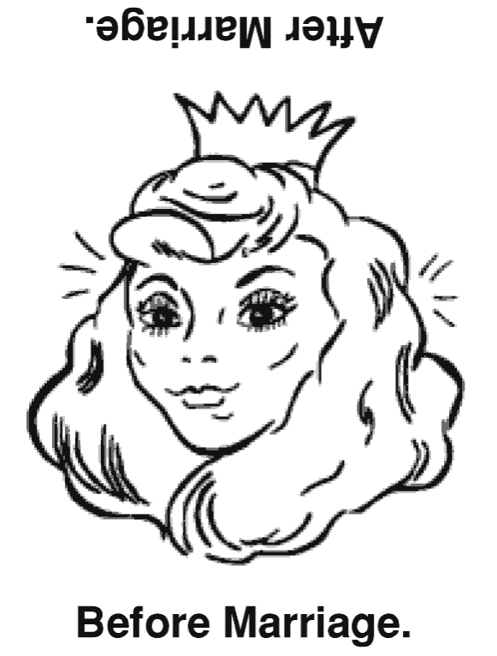
Marriage Turns Some of Us Upside Down
Before Marriage.
After Marriage.

Slide 35
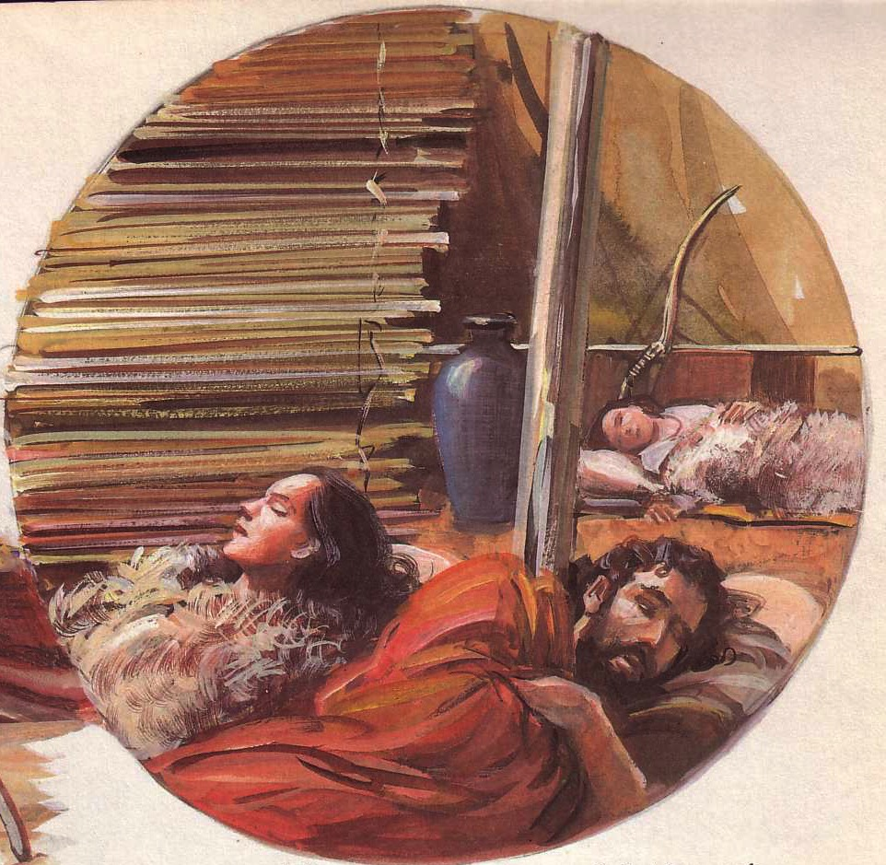
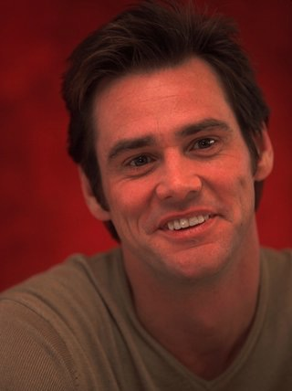
Discussion Groups
154e
"So many people expect that fairy tale where everyone is going to be together forever, but I don't subscribe to that. I'd love for it to happen, but I think 10 years with someone is enough."
––Twice divorced actor Jim Carrey
The Internet Movie Database
(www.imdb.com/news/wenn/2004-04-02)

Slide 36
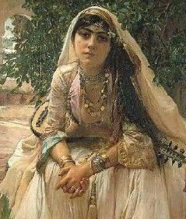
Discussion Groups
154e
What key differences between pagan and Israelite women are the most striking or significant to you? What do these differences tell us about God?

Slide 37
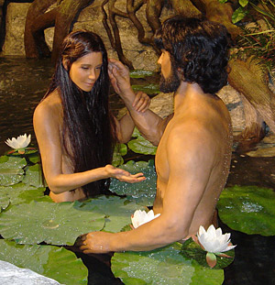
Discussion Groups
154e
Does the biblical account of Eve’s creation as Adam’s “helper” mean that woman was created to serve man? Why or why not?

Slide 38

Discussion Groups
154e
Do you think God’s basic perspective of women changed from the OT to NT times? Think in terms of their nature, role, and temperament.
GENDER ROLES in the church

Slide 39

Discussion Groups
154e
Does the fact that women are equal to men by being made in God’s image (Gen. 1:26) and by being saved by grace (Gal. 3:28) imply equality in their opportunities for service? Why or why not?

Slide 40

Discussion Groups
154e
What did Paul mean when he prohibited women from teaching men or exercising authority over them (1 Tim. 2:10-11)? How does this reconcile with his approval of Priscilla teaching Apollos (Acts 18:26)?

Slide 41

Discussion Groups
154e
Should the same standard for women at their home church apply overseas where fewer qualified men are available?
(Some churches prohibit women from preaching at home but allow this on the mission field.)

Slide 42
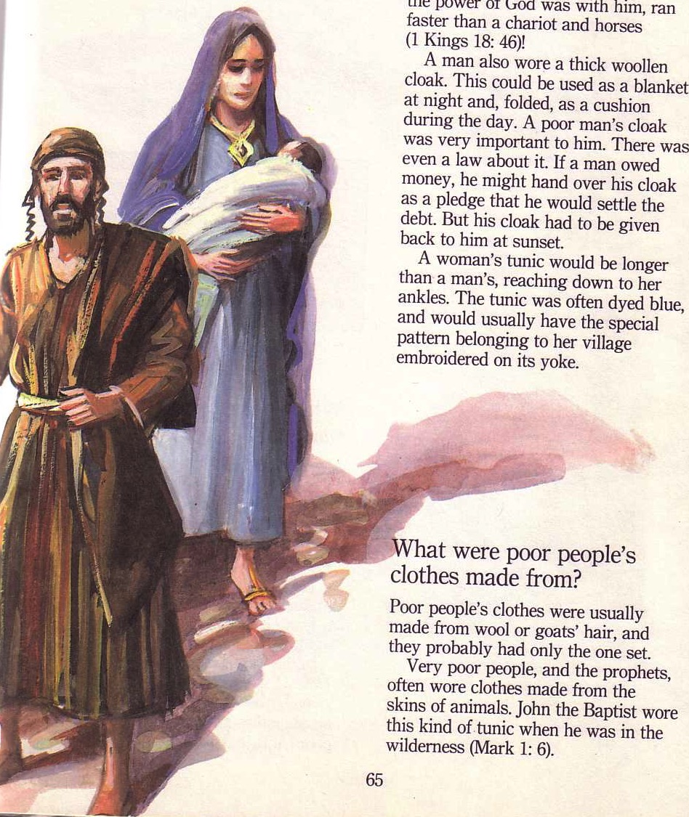
Summary
154e
Jewish women had far greater freedoms than Gentile women
Jewish freedoms gave Christian women the same
Some confuse equality in person as an equality of roles
Freedom for Christian women has given non-Christian women the same in the world

Slide 43


So What?
154f
Do you men treat women with dignity as equally created in God's image?
Do you women thank God for the true liberation you have received in the gospel?

Slide 44
Black

Slide 45


OT Backgrounds link at BibleStudyDownloads.org
Get this presentation for free!
Notes:
OT Survey (os)

