Slide 1
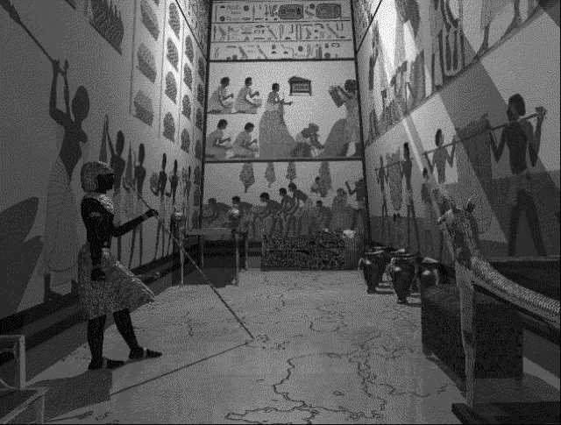
Temples of the Ancient Near East
Dr. Rick Griffith • Jordan Evangelical Theological Seminary • BibleStudyDownloads.org

Slide 2
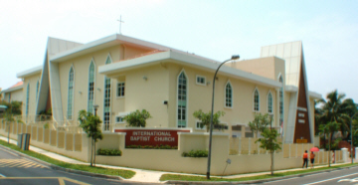
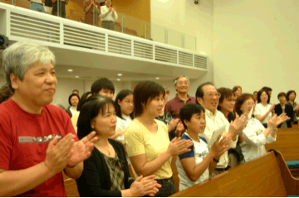
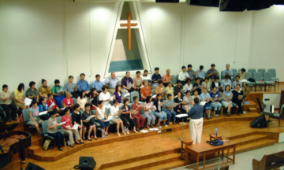
How do the elements of our church service reflect our theological understanding?
164

Slide 3
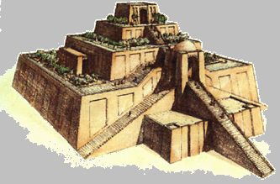
The Influence of Temples
166
604 occurrences in the OT

Slide 4
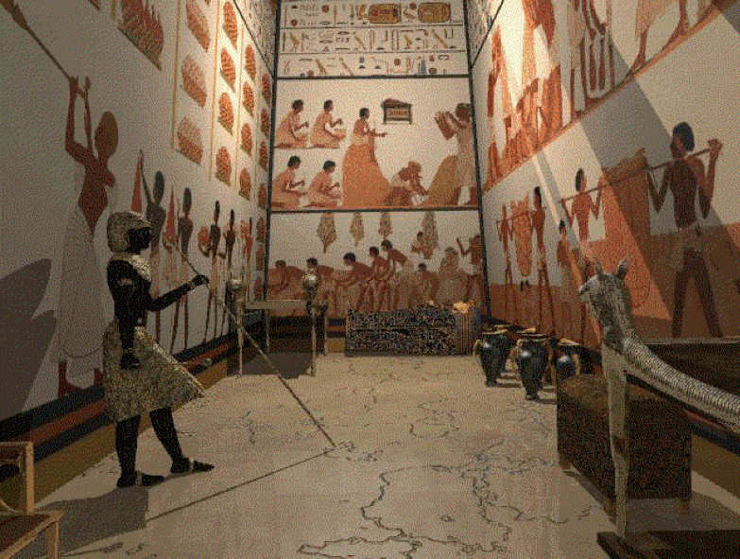
LETS TAKE A VIRTUAL TOUR, SHALL WE?

Slide 5
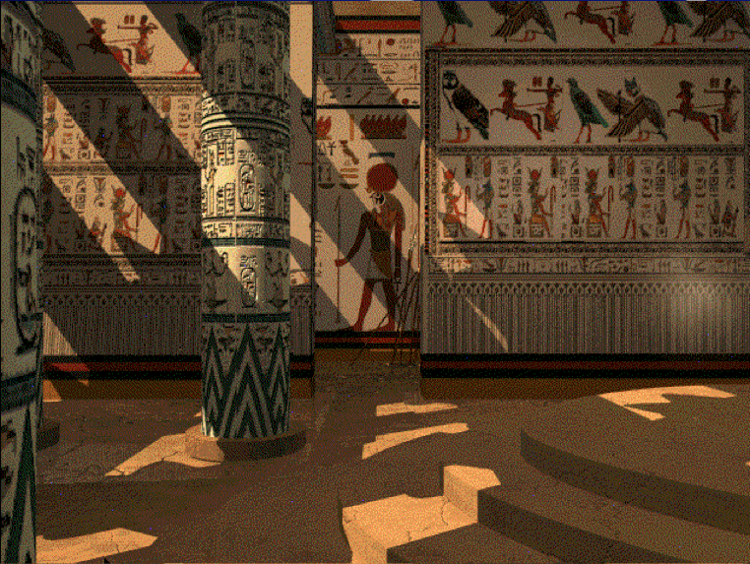
LETS TAKE A VIRTUAL TOUR, SHALL WE?

Slide 6
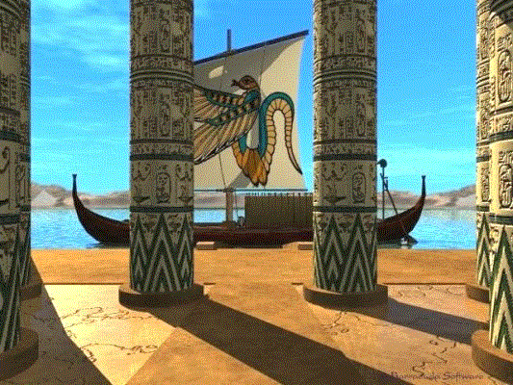
LETS TAKE A VIRTUAL TOUR, SHALL WE?

Slide 7
Courtyard
The courtyard was a large open room without a roof. The outer walls showed scenes of the pharaoh in battle. The inner walls showed the pharaoh making offerings to the gods and goddesses. People were only allowed to enter the temple courtyard on festival days.

Slide 8
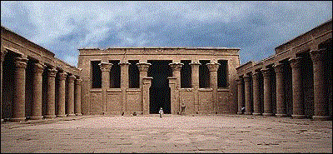
Outer Hall
The hypostyle hall was a large room with columns. Most of the room was dark except that the centre aisle was lit by small windows cut into the roof.
Only the important priests and the pharaoh were allowed to enter the hypostyle hall. This room would have been used for performing religious rituals.

Slide 9
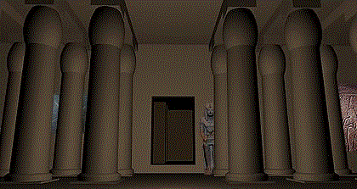
Inner Hall
The second hall was filled with columns and was very dark. Only the high priests and the pharaoh could ever enter this part of the temple.

Slide 10
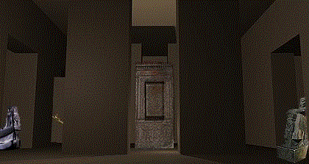
Sanctuary
The sanctuary was the most special and important part of the temple. It was a very dark and mysterious place. Only the high priests and the pharaoh could ever enter the sanctuary. In the middle of the sanctuary stood the shrine where the statue of the god or goddess was kept.

Slide 11
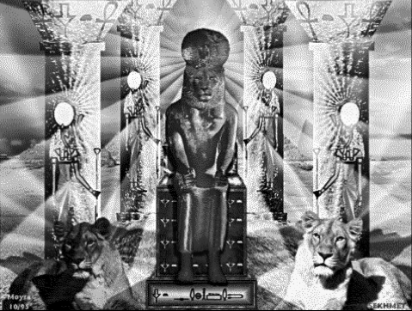
Statue
The ancient Egyptians believed that sometimes during rituals the god or goddess would enter the statue.

Slide 12
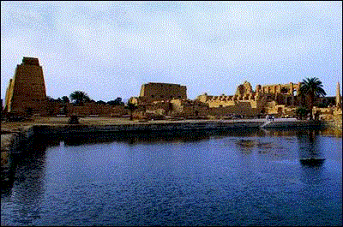
Sacred Lake
The sacred lake was a pool of water next to the temple. It represented the world before time began. The priests used water from the sacred lake to perform rituals in the temple.

Slide 13
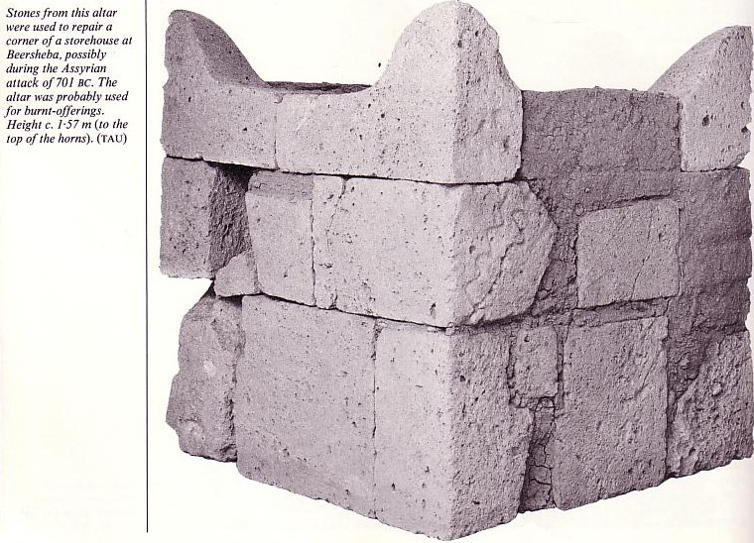
Similarities Between
Pagan Temples
& the Jewish Temple
166

Slide 14
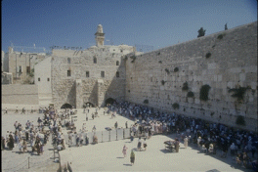
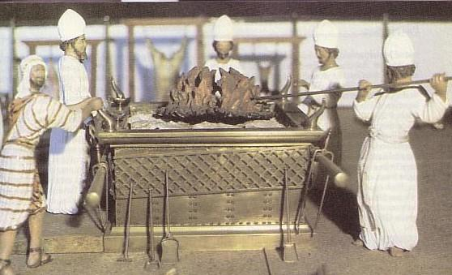
Similarities Between
Pagan Temples
& the Jewish Temple
166
Purpose
  Single deity worship
  Sacrifices and offerings

Slide 15
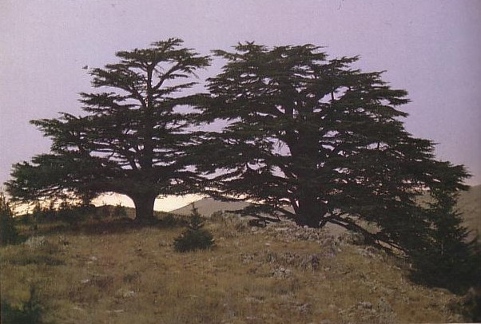
Similarities Between
Pagan Temples
& the Jewish Temple
166
Purpose
  Single deity worship
  Sacrifices and offerings
  Palace of the deity
  Entrance for priests only
  Treasury
  Primary gathering place

Slide 16
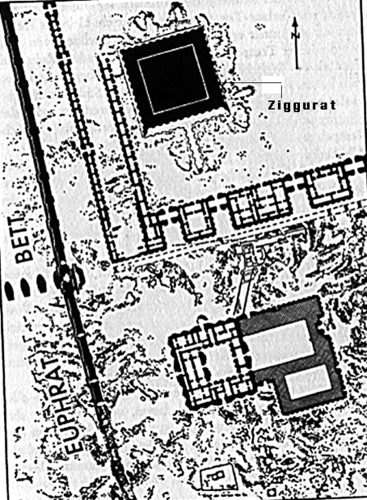
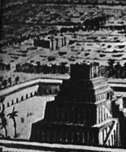
Similarities Continued
167
Location
  High elevation
  Near king's palace
Architecture
  Portable shrines
  Tripartite (3 sections)
  Twin pillars
  Decorations
  Cosmological significance

Slide 17
We Have Come into His House
We have come into His house,
and gathered in His name to worship Him (2x).
We have come into His house,
and gathered in His name
to worship Christ the Lord,
Worship Him,
Jesus Christ Our Lord.

Slide 18

Our God is An Awesome God!

Slide 19
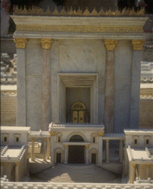
Differences Between the Temples
168-169
Pagan
Multiple
To appease the god
No covenant
“Better” place to pray
Bad worship motive
Many animal types
Human sacrifice OK
Jewish
Single
To hear from Yahweh
Covenant with Yahweh
Prayer for all nations
Worship to glorify God
Only unblemished ones
Animals alone sacrificed

Slide 20
What is the “temple” today?
171
Church building?
Church priests?

Slide 21
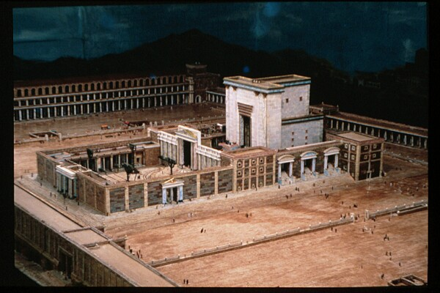
1 Peter 2:5 (NIV)
171
“You also, like living stones, are being built into a spiritual house to be a holy priesthood, offering spiritual sacrifices acceptable to God through Jesus Christ.”

Slide 22
What is the “temple” today?
171
Church building?
Church priests?
Bodies of individual believers

Slide 23
1 Corinthians 3:16-17 (NIV)
171
“Don't you know that you yourselves are God's temple and that God's Spirit lives in you? If anyone destroys God's temple, God will destroy him; for God's temple is sacred, and you are that temple.”

Slide 24
What is the “temple” today?
171
Church building?
Church priests?
Bodies of individual believers
Universal church

Slide 25
Ephesians 2:21-22 (NIV)
171
“In him the whole building is joined together and rises to become a holy temple in the Lord. And in him you too are being built together to become a dwelling in which God lives by his Spirit.”

Slide 26
What is the “temple” today?
171
Church building?
Church priests?
Bodies of individual believers
Universal church
Tribulation & millennial temples
Heavenly temple

Slide 27
“Now the earth formless and empty, darkness was over the the surface of the deep…”
“…and the Spirit of God was hovering over the waters.”
Genesis 1:2 NIV

Slide 28
“Earth was a soup of nothingness, a bottomless emptiness, an inky blackness…”
“…God's Spirit brooded like a bird above the watery abyss.”
Genesis 1:2 The Message

Slide 29
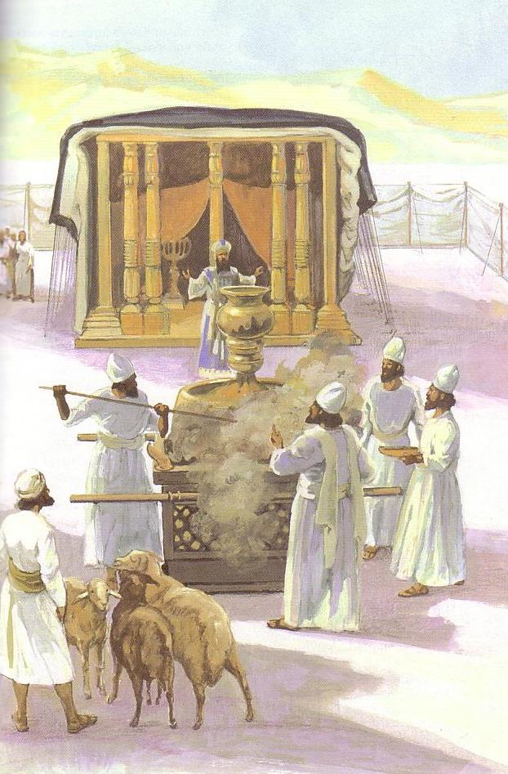
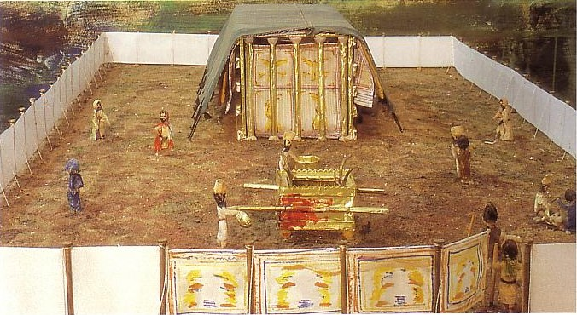
The Tabernacle

Slide 30
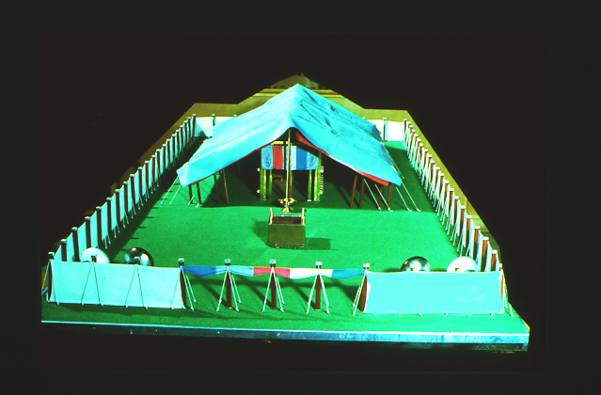
The Tabernacle
7
God sets up a place for Him to dwell as King
MOSES
Exodus
Sinai
M - C - C
Kadesh Barnea
40
The Tabernacle in the Wilderness
Handbook pg. 26-29
2
16

Slide 31
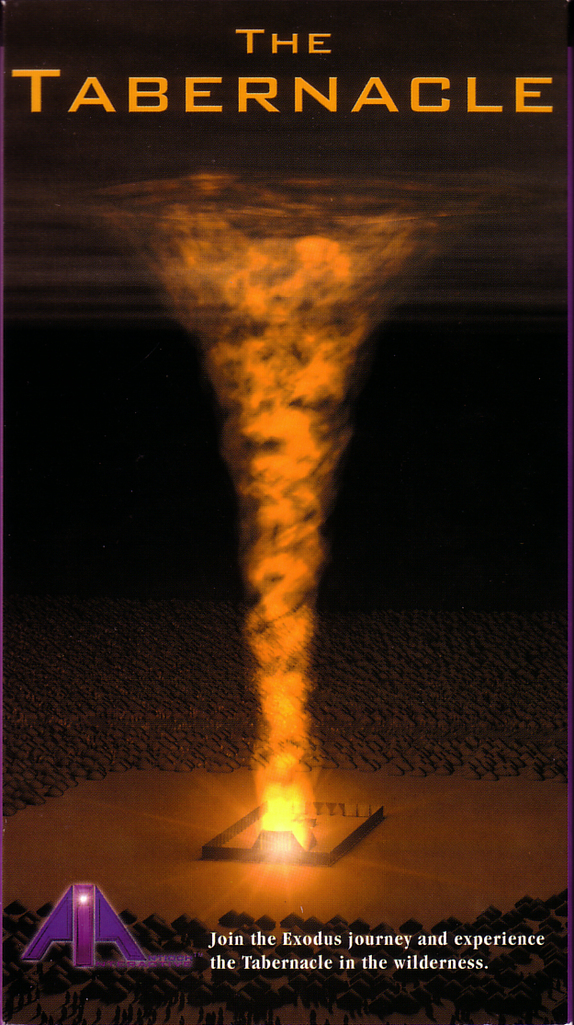

God's presence filled his new palace!
Then the cloud covered the tent of meeting, and the glory of the LORD filled the tabernacle.
Exodus 40:34 ESV

Slide 32
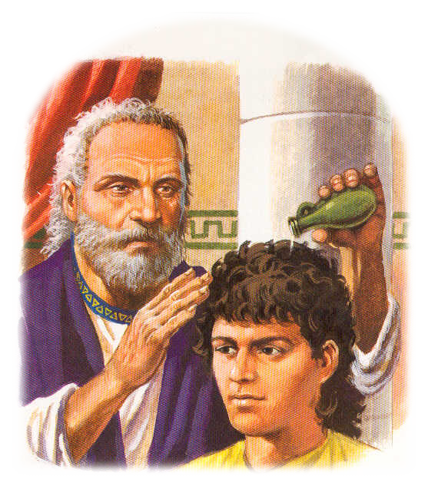
The Spirit also came upon judges, prophets, and kings in the Old Testament

Slide 33
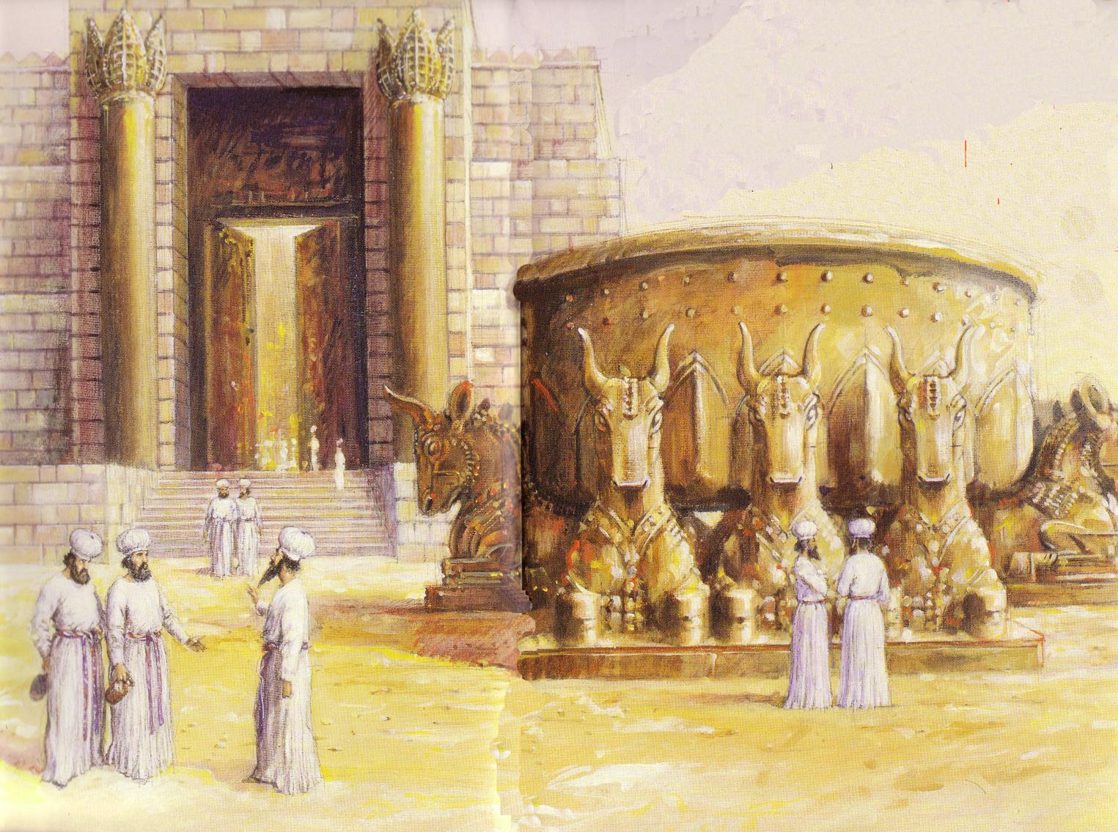
God's Presence Indwelt Solomon's Temple

Slide 34
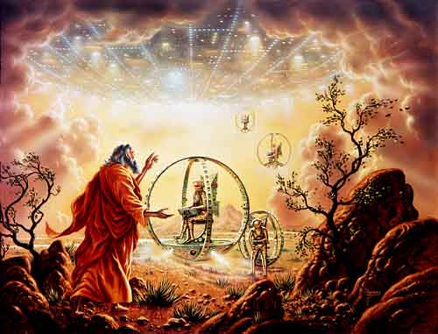
Ezekiel 1

Slide 35
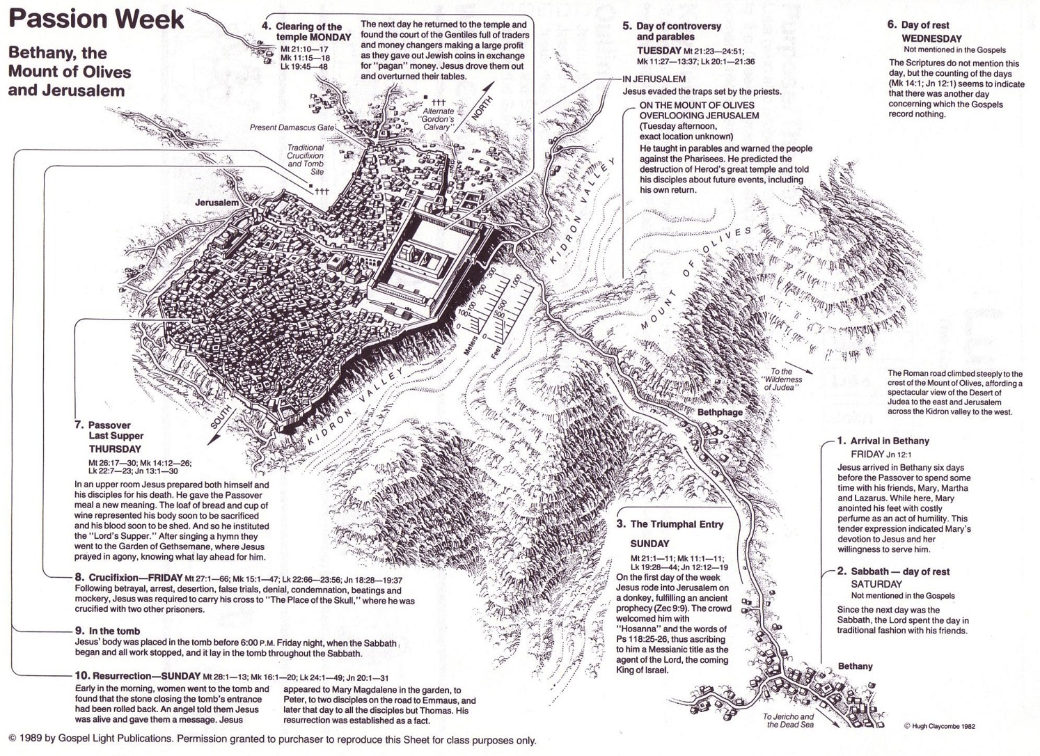
The Spirit Leaves & Returns
Mt. of Olives
656
Ezek. 8:4; 9:3; 10:4; 10:18-19; 11:23
Notes:
The Mount of Olives repeatedly plays a vital role in biblical prophecy. Ezekiel last saw the glory of God leave the temple and land on this mount. More than 500 years later, some Galilean Jews last proclaimed Jesus as Messiah on the Mount of Olives at the Triumphal Entry (Luke 19:37) days before Jerusalem's leaders had him crucified, but Christ rose and returned to the Mount of Olives and ascended from there (Acts 1:10). The next time Jesus will be seen on earth is at this same Mount of Olives (Acts 1:11)!
The Kidron Valley below the mount is likely the Valley of Jehoshaphat, where Jesus will judge the nations (Joel 3).
_____________
Common-400
BE-38-Zechariah-126
ES-13-Tribulation-19
ES-26-Restoration of Israel-299
OB-40-Temples-35-Expanded in Separate Slides
OS-26-Ezek1-39-slide 178
OS-26-Ezek40-43-slide 86
OS-38-Zechariah-179
LC-06-Official Presentation-49
NS-01-Matt15-28-slide 112
NS-03-Luke13-24-slide 111
NS-Acts1-2-slide 215

Slide 36
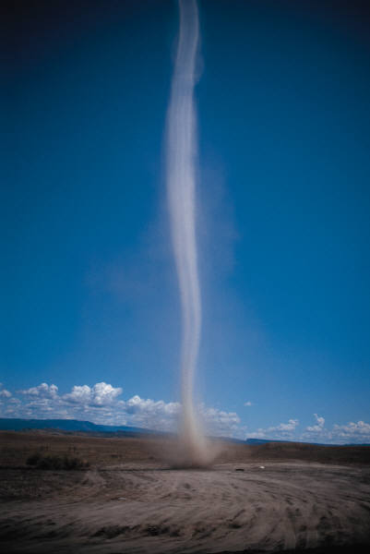
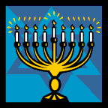
The Spirit Leaves & Returns
Mt. of Olives
656
Ezek. 8:4; 9:3; 10:4; 10:18-19; 11:23
Notes:
The Mount of Olives repeatedly plays a vital role in biblical prophecy. Ezekiel last saw the glory of God leave the temple and land on this mount. More than 500 years later, some Galilean Jews last proclaimed Jesus as Messiah on the Mount of Olives at the Triumphal Entry (Luke 19:37) days before Jerusalem's leaders had him crucified, but Christ rose and returned to the Mount of Olives and ascended from there (Acts 1:10). The next time Jesus will be seen on earth is at this same Mount of Olives (Acts 1:11)!
The Kidron Valley below the mount is likely the Valley of Jehoshaphat, where Jesus will judge the nations (Joel 3).
_____________
Common-400
BE-38-Zechariah-126
ES-13-Tribulation-19
ES-26-Restoration of Israel-299
OB-40-Temples-35-Expanded in Separate Slides
OS-26-Ezek1-39-slide 178
OS-26-Ezek40-43-slide 86
OS-38-Zechariah-179
LC-06-Official Presentation-49
NS-01-Matt15-28-slide 112
NS-03-Luke13-24-slide 111
NS-Acts1-2-slide 215

Slide 37
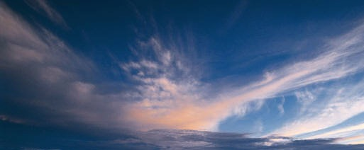
The Spirit Leaves & Returns
Mt. of Olives
656
Ezek. 8:4; 9:3; 10:4; 10:18-19; 11:23
Notes:
The Mount of Olives repeatedly plays a vital role in biblical prophecy. Ezekiel last saw the glory of God leave the temple and land on this mount. More than 500 years later, some Galilean Jews last proclaimed Jesus as Messiah on the Mount of Olives at the Triumphal Entry (Luke 19:37) days before Jerusalem's leaders had him crucified, but Christ rose and returned to the Mount of Olives and ascended from there (Acts 1:10). The next time Jesus will be seen on earth is at this same Mount of Olives (Acts 1:11)!
The Kidron Valley below the mount is likely the Valley of Jehoshaphat, where Jesus will judge the nations (Joel 3).
_____________
Common-400
BE-38-Zechariah-126
ES-13-Tribulation-19
ES-26-Restoration of Israel-299
OB-40-Temples-35-Expanded in Separate Slides
OS-26-Ezek1-39-slide 178
OS-26-Ezek40-43-slide 86
OS-38-Zechariah-179
LC-06-Official Presentation-49
NS-01-Matt15-28-slide 112
NS-03-Luke13-24-slide 111
NS-Acts1-2-slide 215

Slide 38
The Spirit Leaves & Returns
Mt. of Olives
656
Ezek. 8:4; 9:3; 10:4; 10:18-19; 11:23
Luke 19:37; 24:50; Acts 1:10
Notes:
The Mount of Olives repeatedly plays a vital role in biblical prophecy. Ezekiel last saw the glory of God leave the temple and land on this mount. More than 500 years later, some Galilean Jews last proclaimed Jesus as Messiah on the Mount of Olives at the Triumphal Entry (Luke 19:37) days before Jerusalem's leaders had him crucified, but Christ rose and returned to the Mount of Olives and ascended from there (Acts 1:10). The next time Jesus will be seen on earth is at this same Mount of Olives (Acts 1:11)!
The Kidron Valley below the mount is likely the Valley of Jehoshaphat, where Jesus will judge the nations (Joel 3).
_____________
Common-400
BE-38-Zechariah-126
ES-13-Tribulation-19
ES-26-Restoration of Israel-299
OB-40-Temples-35-Expanded in Separate Slides
OS-26-Ezek1-39-slide 178
OS-26-Ezek40-43-slide 86
OS-38-Zechariah-179
LC-06-Official Presentation-49
NS-01-Matt15-28-slide 112
NS-03-Luke13-24-slide 111
NS-Acts1-2-slide 215

Slide 39
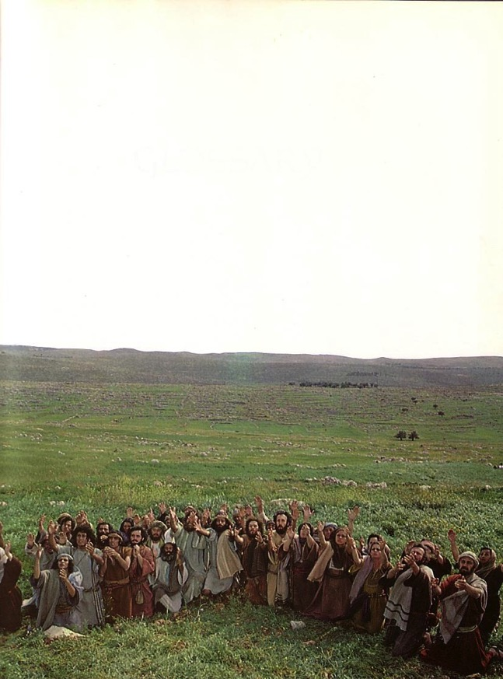
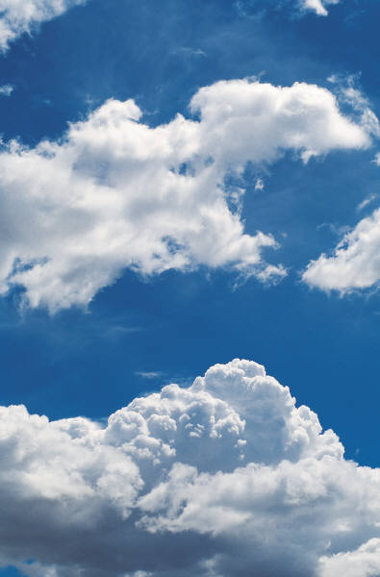
The Spirit Leaves & Returns
Mt. of Olives
656
Ezek. 8:4; 9:3; 10:4; 10:18-19; 11:23
Luke 19:37; 24:50; Acts 1:10
Notes:
The Mount of Olives repeatedly plays a vital role in biblical prophecy. Ezekiel last saw the glory of God leave the temple and land on this mount. More than 500 years later, some Galilean Jews last proclaimed Jesus as Messiah on the Mount of Olives at the Triumphal Entry (Luke 19:37) days before Jerusalem's leaders had him crucified, but Christ rose and returned to the Mount of Olives and ascended from there (Acts 1:10). The next time Jesus will be seen on earth is at this same Mount of Olives (Acts 1:11)!
The Kidron Valley below the mount is likely the Valley of Jehoshaphat, where Jesus will judge the nations (Joel 3).
_____________
Common-400
BE-38-Zechariah-126
ES-13-Tribulation-19
ES-26-Restoration of Israel-299
OB-40-Temples-35-Expanded in Separate Slides
OS-26-Ezek1-39-slide 178
OS-26-Ezek40-43-slide 86
OS-38-Zechariah-179
LC-06-Official Presentation-49
NS-01-Matt15-28-slide 112
NS-03-Luke13-24-slide 111
NS-Acts1-2-slide 215

Slide 40
The Spirit Leaves & Returns
Mt. of Olives
656
Ezek. 8:4; 9:3; 10:4; 10:18-19; 11:23
Luke 19:37; 24:50; Acts 1:10
Acts 1:11; Zech. 14:4; Ezek. 43:1-5
Notes:
The Mount of Olives repeatedly plays a vital role in biblical prophecy. Ezekiel last saw the glory of God leave the temple and land on this mount. More than 500 years later, some Galilean Jews last proclaimed Jesus as Messiah on the Mount of Olives at the Triumphal Entry (Luke 19:37) days before Jerusalem's leaders had him crucified, but Christ rose and returned to the Mount of Olives and ascended from there (Acts 1:10). The next time Jesus will be seen on earth is at this same Mount of Olives (Acts 1:11)!
The Kidron Valley below the mount is likely the Valley of Jehoshaphat, where Jesus will judge the nations (Joel 3).
_____________
Common-400
BE-38-Zechariah-126
ES-13-Tribulation-19
ES-26-Restoration of Israel-299
OB-40-Temples-35-Expanded in Separate Slides
OS-26-Ezek1-39-slide 178
OS-26-Ezek40-43-slide 86
OS-38-Zechariah-179
LC-06-Official Presentation-49
NS-01-Matt15-28-slide 112
NS-03-Luke13-24-slide 111
NS-Acts1-2-slide 215

Slide 41
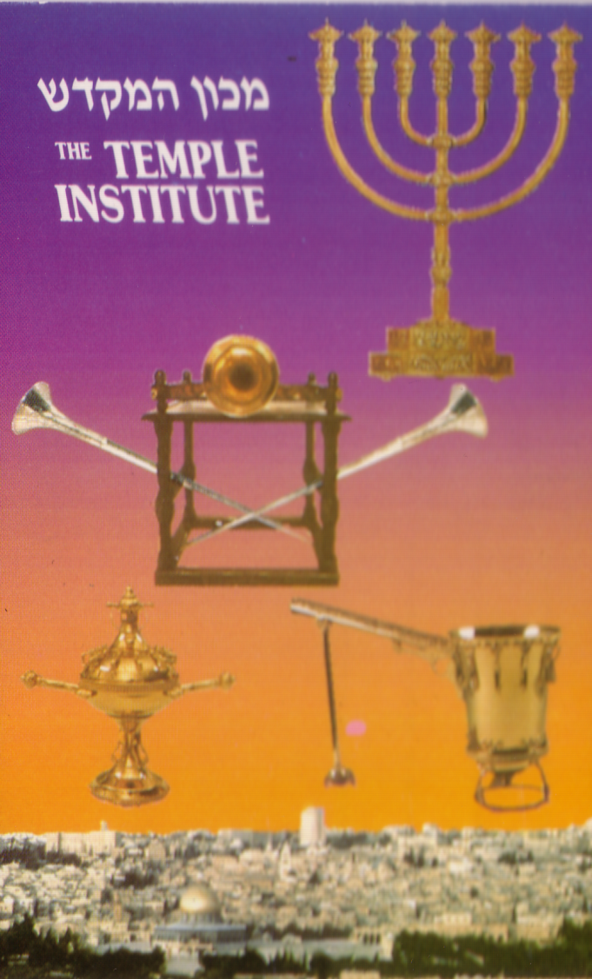
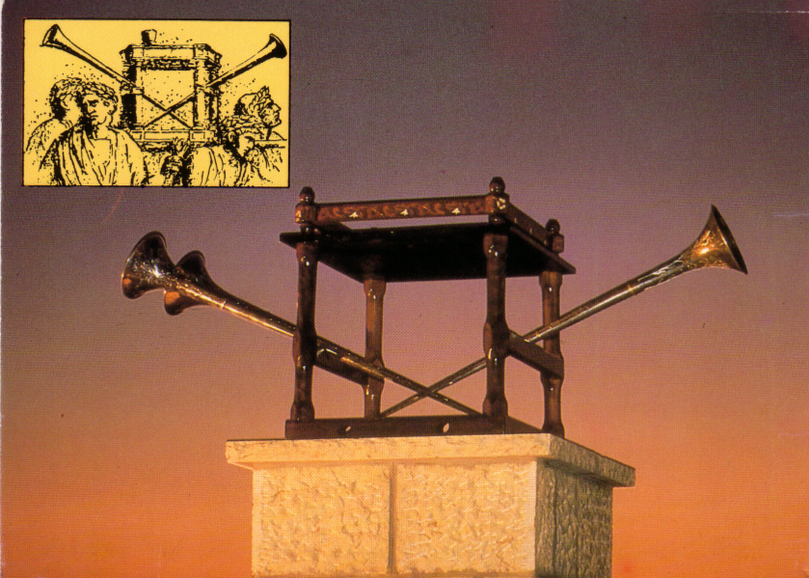
Preparations for the Third Temple

Slide 42
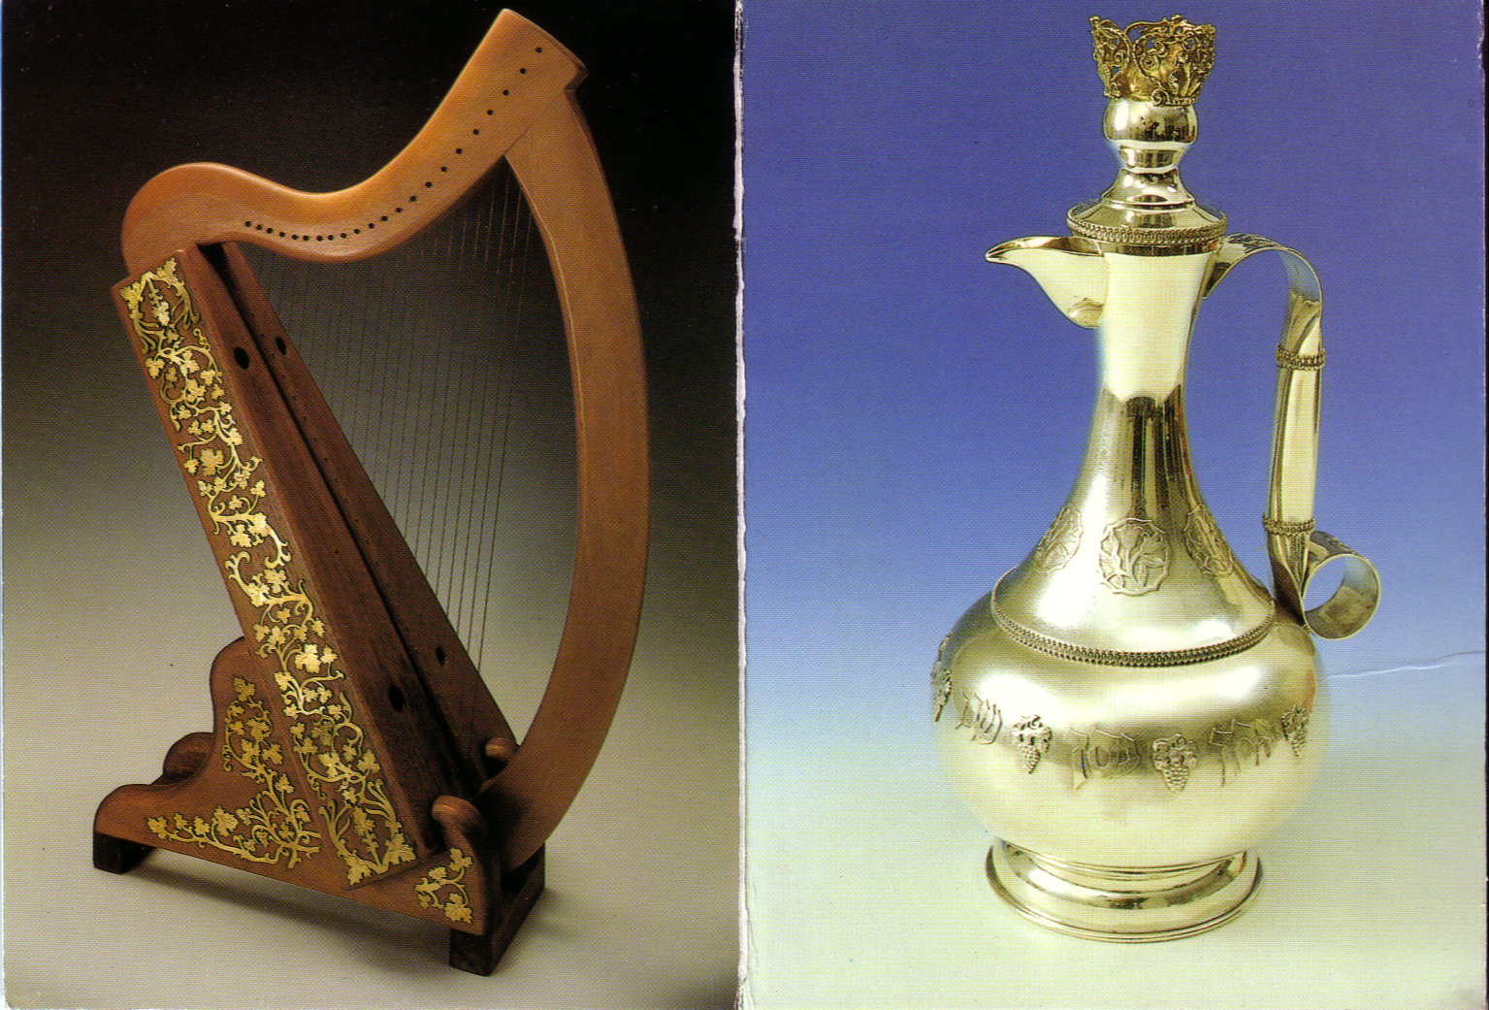
The harp and silver decanter

Slide 43
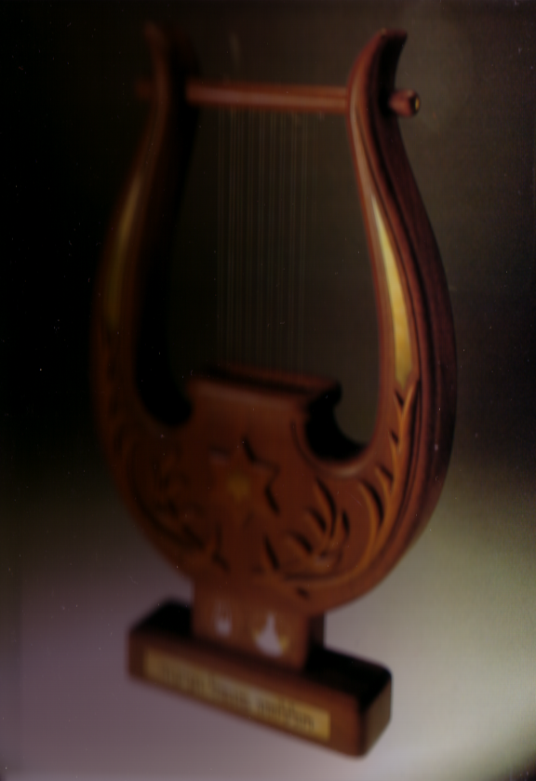
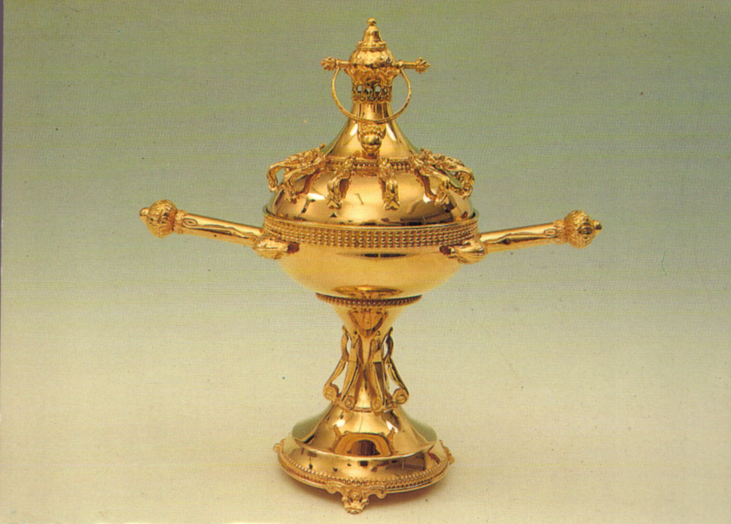
A harp and incense chalise

Slide 44
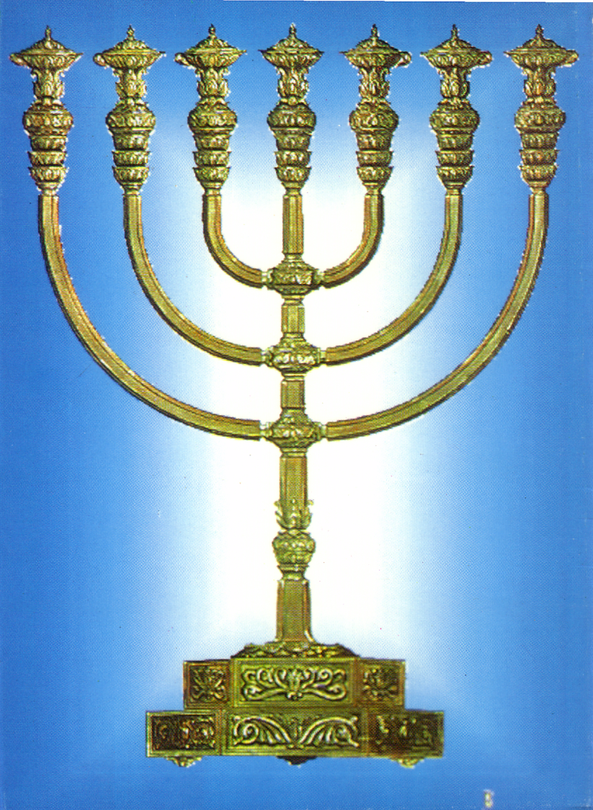
Menorah (Lampstand)

Slide 45
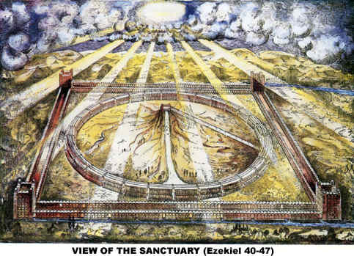
Ezekiel's Temple
www.antipas.org/.../ezekiels_temple/ ezekiels_temple.html

Slide 46
We Have Come into His House
172
We have come into His house,
and gathered in His name to worship Him (2x).
We have come into His house,
and gathered in His name
to worship Christ the Lord,
Worship Him,
Jesus Christ Our Lord.

Slide 47
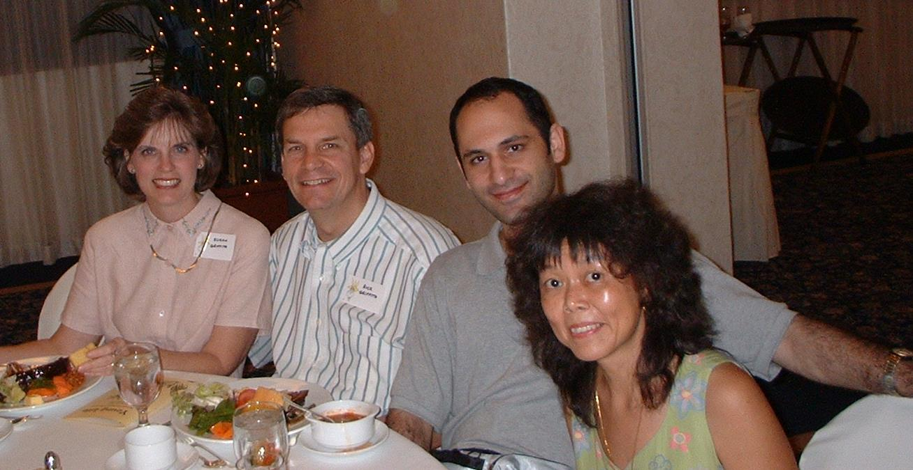
That's Where God Is
When His people come together,
that's where God is;
When our spirits join in worship,
that's where God is;
For the Lord doesn't dwell in houses of stone
but in the hearts of the ones He calls His own.
When His people come together,
that's where God is
Words & Music by Steve Jones, 1996

Slide 48
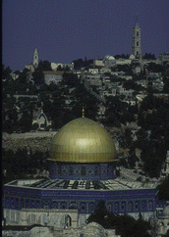
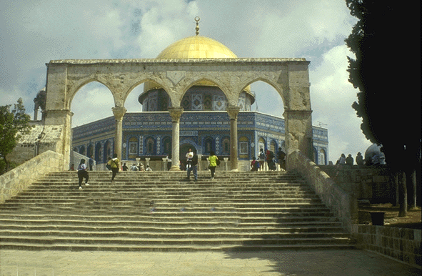
What about places of worship today?

Slide 49

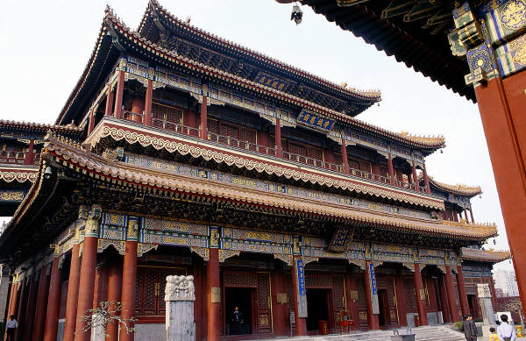
What is a biblical view of pagan temples, mosques, and synagogues today?
Tourist attractions?
Alternate places of worship?
Houses of demons?

Slide 50
Practical Issues for Small Groups
Is Paul's synagogue ministry a model
for our temple ministry today? Why?
Should you worship at temples? Why?
Should you even visit temples? Why?

Slide 51
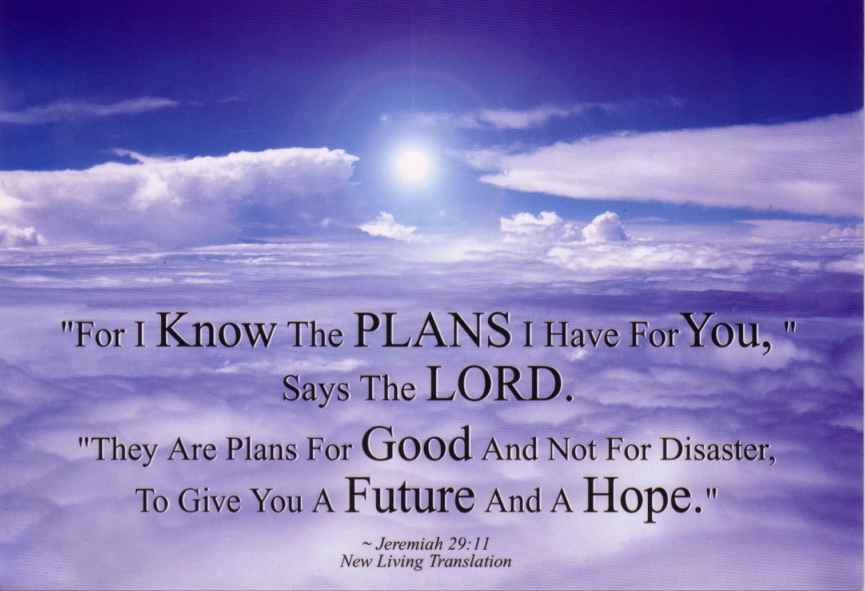
Jeremiah 29:11
“For I KNOW the PLANS I have for YOU,”
says the LORD.
“They are plans for GOOD and not for disaster,
To give you a FUTURE and a HOPE.”
— Jeremiah 29:11 NLT

Slide 52
Black

Slide 53


OT Backgrounds link at BibleStudyDownloads.org
Get this presentation for free!
Notes:
OT Backgrounds (ob)

