Slide 1

Salvation in the Old Testament
175c
Dr. Rick Griffith • Jordan Evangelical Theological Seminary • BibleStudyDownloads.org

Slide 2

Which is the Most Accurate?
121a
Salvation by…
Faith + Works
Faith Alone
Faith + Works
OT
Works
Faith Alone
Faith Alone
Faith + Works
NT
Faith
• Which verses in the Bible support your answer?
cf. OTS 119e
Notes:
Did God change the means of salvation from the OT to the NT?
We are NOT talking about whether people should do good works—we all agree on that. But are works needed for salvation?
Paul answers this question in Romans 4 with the example of Abraham who was saved by faith alone—see Gen 15:6.
________
BE-03-Lev-27
OB-37-Sacrifices-72_eng_ob_1667_v5—slide 17
OB-39-Salvation-2
OS-03-Leviticus-13
OP-03-Lev-27
OP-Lev_6v24-7v10 Why All That Blood Sin & Guilt Offerings-49_eng_op_v4.0—slide 34
OS-04-Num-27
NP-Acts_15v1-35_Dont_Be_Law_Abiding_(Rick_Griffith)-61_eng_pr_v4—slide 5
NS-05-Acts15-16-slide 26
NS-Rom3-4-slide 77
NS-09-Galatians-48
NS-20-James-30
NS-23-1Jn-58
SA-03-Biblical Terms-6
SA-15-Inheritance-26

Slide 3
Salvation & Sanctification
121a
Man's Role
God's Response
Life of Faith
Restored Fellowship
Faith in God as offered Passover Lamb
Journey to Canaan
Sacrifices (Sin, Guilt)
OT
Exodus
Type
|
Antitype
Type
|
Antitype
Type
|
Antitype
Type
|
Antitype
Faith in Christ as Lamb of God (1 Cor. 5:7)
Salvation (1 Cor. 10:1-4)
Growth (1 Cor. 10:5)
Confession (1 John 1:9)
NT
Positional Sanctification
Progressive Sanctification
Notes:
The OT plan of salvation is mirrored in the NT—both by simple faith in the Lamb pictured in the Passover.
Exodus from Egypt is a type of the believer who leaves his slavery to sin—all believers in the Lamb are saved, including all Israelites who left Egypt as they demonstrated that faith by putting the blood on the doorposts of their homes (=positional sanctification).
But both OT and NT believers must live a life of faith in God, pictured in Israel’s journey to Canaan and mirrored in the Christian’s growth or progressive sanctification.
Finally, as OT believers confessed their ongoing sins in the sin and guilt sacrifices (for restoring fellowship with God—NOT for salvation!), so NT believers confess sins even after they are saved to restore their fellowship (NOT relationship!) with God.
_________
Common English-78
OB-37-Sacrifices-18
OS-00-Book Overviews-73
OS-04-Numbers-13
NS-09-Galatians-49
NS-20-James-31
SA-03-Biblical Terms-7
SA-15-Inheritance-26

Slide 4
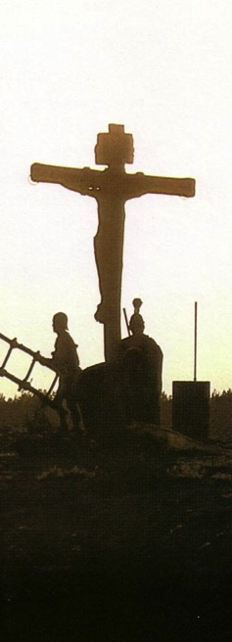
Salvation in All Ages:
The Centrality of the Cross
B.C.
Looked forward to the Cross of Christ
A.D.
Look back at the Cross of Christ
Notes:
We must see the centrality of the cross—how people before Jesus believed by looking toward the cross while those of us after Jesus look back at the cross. In other words, the foundation of salvation has always been the death of Christ—for believers before and after the cross.
____________________
Common-198
BE-03-Leviticus-73
OB-37-Sacrifices-18
OB-38-Salvation-4
OS-03-Leviticus-193
NS-09-Galatians-16, 49, 118
NS-20-James-32
SA-03-Biblical Terminology-10
SA-15-Inheritance-26
TP-01-Our Inheritance OT Summary-29

Slide 5
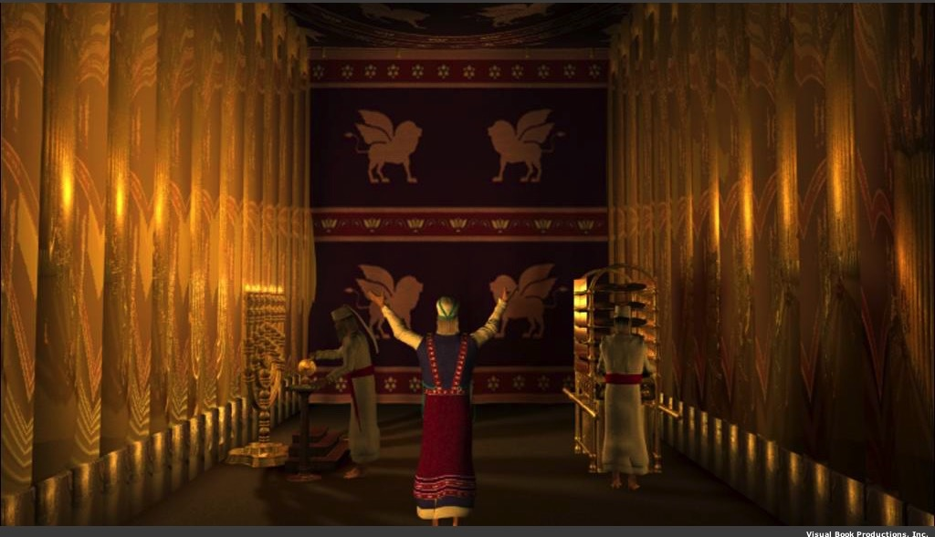
Why did God prescribe offerings for Israel's weaknesses and sins?

Slide 6
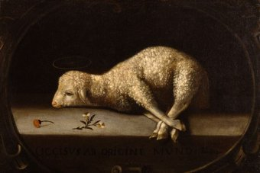
God forgave Israelites through the blood of offerings (Lev 4:1–5:13; 6:24-30).
Notes:
Jews restored their fellowship with the Lord through sin and guilt sacrifices.

Slide 7
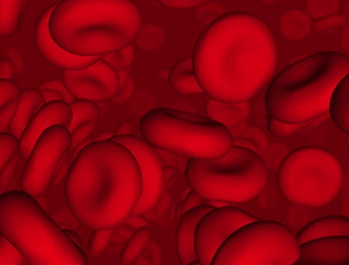
Why did God institute the sacrificial system?
Did the blood actually forgive sin?

Slide 8
Did blood sacrifices save Israelites under the Law?
BLOOD

Slide 9
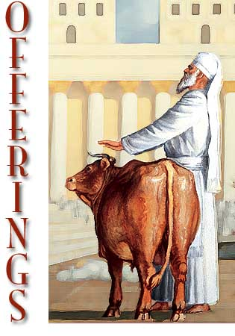
Sacrifices forgave sin
"Through this process, the priest will purify the people, making them right with the LORD, and they will be forgiven" (4:20 NLT; cf. 4:26, 31, 35).

Slide 10

OT Forgiveness of Sin
OB 175p
OS 121b
Pipe = Relationship with God (never changing)
Sin
Clog = Fellowship with God (hindered by sin)
Sacrifices = Confession of Sin (sin forgiven to restore fellowship but relationship was never threatened)
Notes:
Do we still have a relationship with God when we sin? Yes!
Sin does not hinder our relationship with God but our fellowship with Him.
OT sacrifices did not establish a relationship with God but rather they restored their fellowship with God
OB-38-Salvation-10
OS-03-Leviticus-14

Slide 11

NT Forgiveness of Sin
121b
Pipe = Relationship with God (never changing)
Sin
Clog = Fellowship with God (hindered by sin)
Christ's Sacrifice = The Basis for Confession of Sin (sin is forgiven to restore fellowship but relationship has never been never threatened)
Notes:
Our relationship with God can be compared to a pipe.
Occasionally the pipe gets a clog—like sin—that hinders our fellowship with God.
Do we still have a relationship with God when we sin? Yes!
Sin does not hinder our relationship with God but our fellowship with Him.
_________
OB-38-Salvation-11
OS-03-Leviticus-56, 72, 130
OS-04-Numbers-30
NS-23-1Jn-59
SA-03-Biblical Terms-9
SA-15-Inheritance-28

Slide 12
NT Forgiveness of Sin
121b
"If we confess our sins, He is faithful and righteous to forgive us our sins and to cleanse us from all unrighteousness" (1 John 1:9 NAU)
Pipe = Relationship with God (never changing)
Sin
Clog = Fellowship with God (hindered by sin)
Christ's Sacrifice = The Basis for Confession of Sin (sin is forgiven to restore fellowship but relationship has never been never threatened)
Notes:
Our relationship with God can be compared to a pipe.
Occasionally the pipe gets a clog—like sin—that hinders our fellowship with God.
Do we still have a relationship with God when we sin? Yes!
Sin does not hinder our relationship with God but our fellowship with Him.
_________
OB-38-Salvation-11
OS-03-Leviticus-56, 72, 130
OS-04-Numbers-30
NS-23-1Jn-59
SA-03-Biblical Terms-9
SA-15-Inheritance-28

Slide 13
Salvation in the Old Testament
176
OT Times
(Moses to Christ's Death)
NT Times
(Christ's Death to Today)
Basis
of Salvation
God's gracious provision of the death of Christ ("it is the blood that makes atonement for one's life,"
Lev. 17:11b)
God's gracious provision of the death of Christ ("without the shedding of blood there is no forgiveness," Heb. 9:22)
Requirement
of Salvation
Faith in the provision that God has revealed—as a gift (Ps. 51:16-17)
Faith in the provision that God has revealed—as a gift (Gal. 2:16)
Ultimate Content
of Salvation
Object of faith is God Himself—prophets exhorted repentance, not sacrifices (Jer. 3:12)
Object of faith is God Himself—heroes of faith are cited to exhort faith in God (Heb. 11)
Specific
Revealed Content
of Salvation
Cumulative content of faith involved sacrifices & promises: animals (Gen. 3:21), Abel's sacrifice (4:4), Abrahamic covenant (15:15-19), etc.
New content of faith is the shed blood of Jesus Christ (1 Pet. 1:18-21) which removes sin (cp. OT sacrifices merely covered sin)
Believer's Expression
of Salvation
Obey moral law, offer animal sacrifices, obey Mosaic law (civil
and ceremonial aspects)
Obey moral law, observe Lord's Supper and baptism, etc. through the Spirit's enabling (Rom. 8:9)

Slide 14
Salvation in the Old Testament
176
OT Times
(Moses to Christ's Death)
NT Times
(Christ's Death to Today)
Basis
of Salvation
God's gracious provision of the death of Christ ("it is the blood that makes atonement for one's life,"
Lev. 17:11b)
God's gracious provision of the death of Christ ("without the shedding of blood there is no forgiveness," Heb. 9:22)
Requirement
of Salvation
Faith in the provision that God has revealed—as a gift (Ps. 51:16-17)
Faith in the provision that God has revealed—as a gift (Gal. 2:16)
Ultimate Content
of Salvation
Object of faith is God Himself—prophets exhorted repentance, not sacrifices (Jer. 3:12)
Object of faith is God Himself—heroes of faith are cited to exhort faith in God (Heb. 11)
Specific
Revealed Content
of Salvation
Cumulative content of faith involved sacrifices & promises: animals (Gen. 3:21), Abel's sacrifice (4:4), Abrahamic covenant (15:15-19), etc.
New content of faith is the shed blood of Jesus Christ (1 Pet. 1:18-21) which removes sin (cp. OT sacrifices merely covered sin)
Believer's Expression
of Salvation
Obey moral law, offer animal sacrifices, obey Mosaic law (civil
and ceremonial aspects)
Obey moral law, observe Lord's Supper and baptism, etc. through the Spirit's enabling (Rom. 8:9)

Slide 15
Salvation in the Old Testament
176
OT Times
(Moses to Christ's Death)
NT Times
(Christ's Death to Today)
Basis
of Salvation
God's gracious provision of the death of Christ ("it is the blood that makes atonement for one's life,"
Lev. 17:11b)
God's gracious provision of the death of Christ ("without the shedding of blood there is no forgiveness," Heb. 9:22)
Requirement
of Salvation
Faith in the provision that God has revealed—as a gift (Ps. 51:16-17)
Faith in the provision that God has revealed—as a gift (Gal. 2:16)
Ultimate Content
of Salvation
Object of faith is God Himself—prophets exhorted repentance, not sacrifices (Jer. 3:12)
Object of faith is God Himself—heroes of faith are cited to exhort faith in God (Heb. 11)
Specific
Revealed Content
of Salvation
Cumulative content of faith involved sacrifices & promises: animals (Gen. 3:21), Abel's sacrifice (4:4), Abrahamic covenant (15:15-19), etc.
New content of faith is the shed blood of Jesus Christ (1 Pet. 1:18-21) which removes sin (cp. OT sacrifices merely covered sin)
Believer's Expression
of Salvation
Obey moral law, offer animal sacrifices, obey Mosaic law (civil
and ceremonial aspects)
Obey moral law, observe Lord's Supper and baptism, etc. through the Spirit's enabling (Rom. 8:9)

Slide 16
Salvation in the Old Testament
176
OT Times
(Moses to Christ's Death)
NT Times
(Christ's Death to Today)
Basis
of Salvation
God's gracious provision of the death of Christ ("it is the blood that makes atonement for one's life,"
Lev. 17:11b)
God's gracious provision of the death of Christ ("without the shedding of blood there is no forgiveness," Heb. 9:22)
Requirement
of Salvation
Faith in the provision that God has revealed—as a gift (Ps. 51:16-17)
Faith in the provision that God has revealed—as a gift (Gal. 2:16)
Ultimate Content
of Salvation
Object of faith is God Himself—prophets exhorted repentance, not sacrifices (Jer. 3:12)
Object of faith is God Himself—heroes of faith are cited to exhort faith in God (Heb. 11)
Specific
Revealed Content
of Salvation
Cumulative content of faith involved sacrifices & promises: animals (Gen. 3:21), Abel's sacrifice (4:4), Abrahamic covenant (15:15-19), etc.
New content of faith is the shed blood of Jesus Christ (1 Pet. 1:18-21) which removes sin (cp. OT sacrifices merely covered sin)
Believer's Expression
of Salvation
Obey moral law, offer animal sacrifices, obey Mosaic law (civil
and ceremonial aspects)
Obey moral law, observe Lord's Supper and baptism, etc. through the Spirit's enabling (Rom. 8:9)

Slide 17
Salvation in the Old Testament
176
OT Times
(Moses to Christ's Death)
NT Times
(Christ's Death to Today)
Basis
of Salvation
God's gracious provision of the death of Christ ("it is the blood that makes atonement for one's life,"
Lev. 17:11b)
God's gracious provision of the death of Christ ("without the shedding of blood there is no forgiveness," Heb. 9:22)
Requirement
of Salvation
Faith in the provision that God has revealed—as a gift (Ps. 51:16-17)
Faith in the provision that God has revealed—as a gift (Gal. 2:16)
Ultimate Content
of Salvation
Object of faith is God Himself—prophets exhorted repentance, not sacrifices (Jer. 3:12)
Object of faith is God Himself—heroes of faith are cited to exhort faith in God (Heb. 11)
Specific
Revealed Content
of Salvation
Cumulative content of faith involved sacrifices & promises: animals (Gen. 3:21), Abel's sacrifice (4:4), Abrahamic covenant (15:15-19), etc.
New content of faith is the shed blood of Jesus Christ (1 Pet. 1:18-21) which removes sin (cp. OT sacrifices merely covered sin)
Believer's Expression
of Salvation
Obey moral law, offer animal sacrifices, obey Mosaic law (civil
and ceremonial aspects)
Obey moral law, observe Lord's Supper and baptism, etc. through the Spirit's enabling (Rom. 8:9)

Slide 18
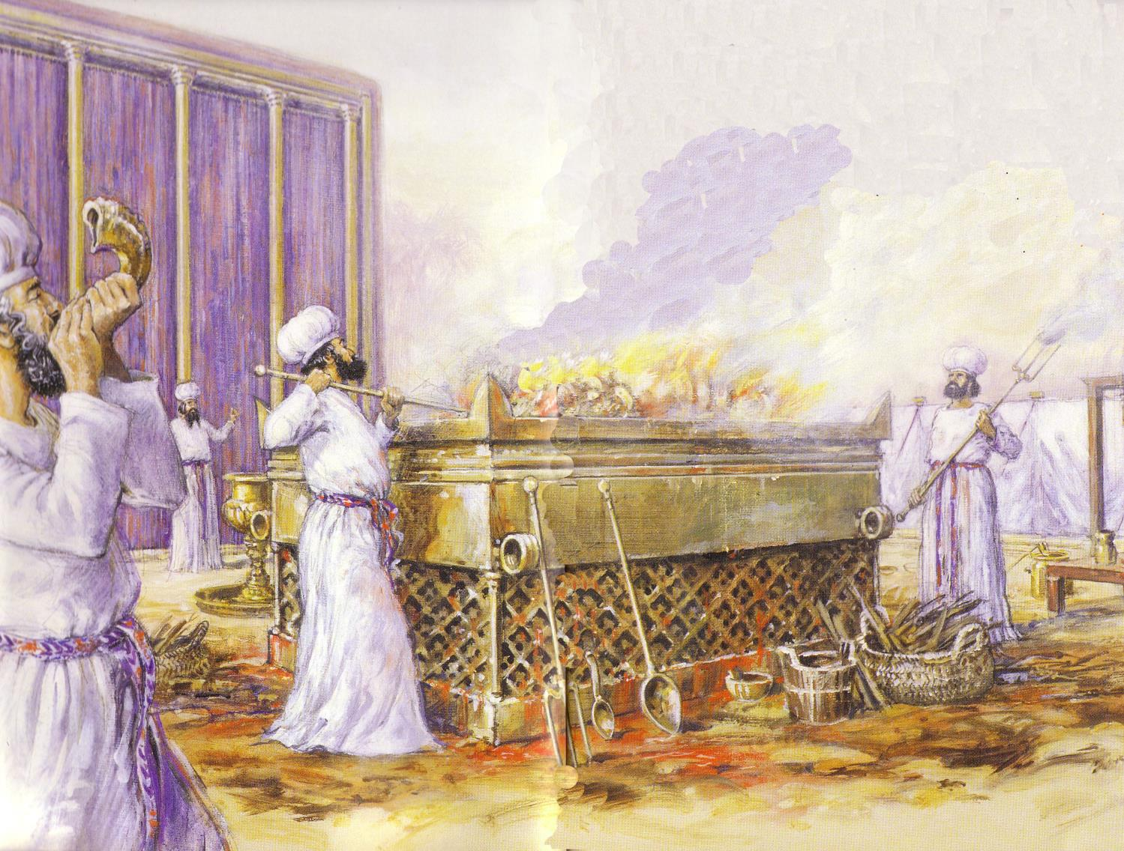
Leviticus
176
Sanctification through sacrifice and separation
1–10 Sacrifice
(worshipping God)
11–27 Separation
(walking with God)

Slide 19
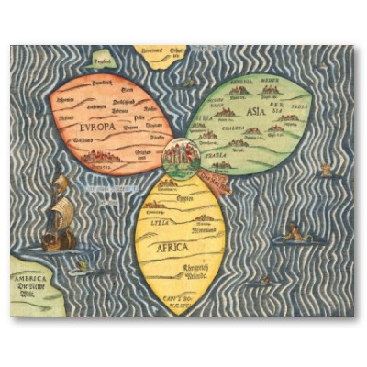
Overview
175d
What did Ancient Israel believe about salvation?
What about their neighbors?
What do Christians believe today?

Slide 20

Salvation
175e 163a
Israelite View
Holy God
Sinful Man
Need for atonement
To restore fellowship
To avoid wrath
Pagan View
God-like-man
Man Not Sinful
Need to appease god
For prosperity
To avoid calamity
OT View
OT Sacrifice
NT View
Christ's Sacrifice
So what do you think?

Slide 21

Religions of Ancient Near East Sumerians, Assyrians, Babylonians, Egyptians, Canaanites, Moabites
175e
Was there a concept of "salvation" among the nations surrounding Israel?
What were their worldviews and how were these shaped by their religions?
Their views on life and hereafter
The kind of gods they worshiped

Slide 22
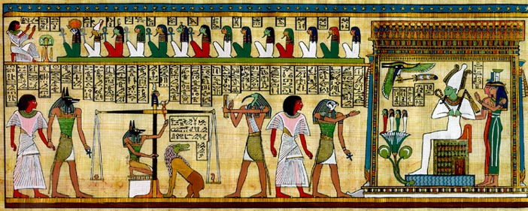
Egyptians
175f
Views on life and thereafter:
The believed in some form of next life based on works.
Death was simply a temporary interruption.
Eternal life could be ensured by piety to the gods, preservation of the physical form and the provision of statuary and other funerary equipment.
Their belief in the rebirth after death became the driving force behind their funeral practices.

Slide 23
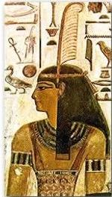
Egyptian Worldview
175f
Views on life and thereafter:
Each human consisted of the physical body, the 'ka', the 'ba', and the 'akh'.
To enjoy the afterlife, all these elements had to be sustained and protected from harm.
Man must live according to ma'at, the Egyptian concept of justice and righteousness.
All of Ancient Egypt was based on religion as their beliefs were vitally important to them.

Slide 24
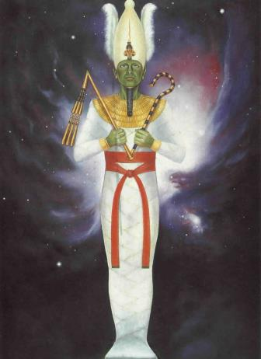
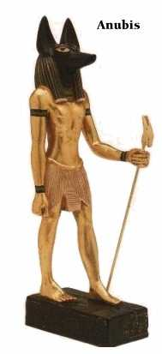
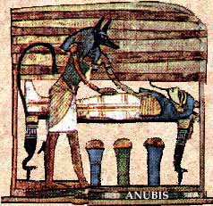
Egyptian Gods
175f
Like the Sumerians, they had a pantheon of gods – Hapi, Re, Osiris, Seth…
They believed that Osiris presides over the netherworld and judges everyone there according to ma'at.
Man was commanded to reflect divine harmony by assuming a spirit of quietude, reasonable behavior, cooperation, and a recognition of the eternal qualities of existence.

Slide 25
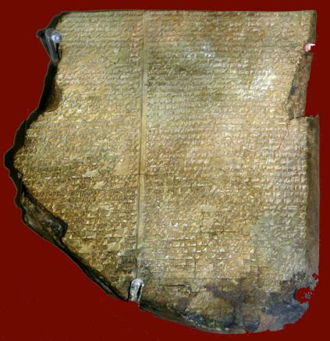
Sumerians, Assyrians, Babylonians
175g
Views on life and thereafter:
Believed in a sacred land or paradise called Dilmun reserved only for the gods
Thought humans are not destined for it but will end up in the Netherworld after death
Blamed the existence of evil on demonizing powers and forces that manipulate men as pawns on a chessboard so that man is a victim.

Slide 26
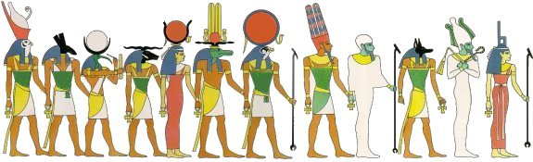
Sumerians, Assyrians, Babylonians
175g
The gods they worshiped:
Chief among the pantheon of gods – An, Enlil, Inanna, Enki, Nanna and Utu.
Incest, fighting, lazy, manipulative
The gods created humans to be their slaves

Slide 27
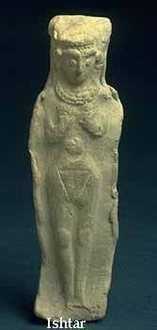
Canaanites
175g
The gods they worshiped:
Pantheon of gods – El, Hadad (Baal), Dagan, Ashtart (Ishtar), Anat…
Views on life and thereafter:
Canaanites were polytheistic in their cultic practices – "Ba-al Cycle"
Their religious practices were more concerned about the here and now rather than the here-after.

Slide 28
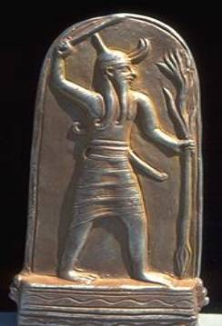
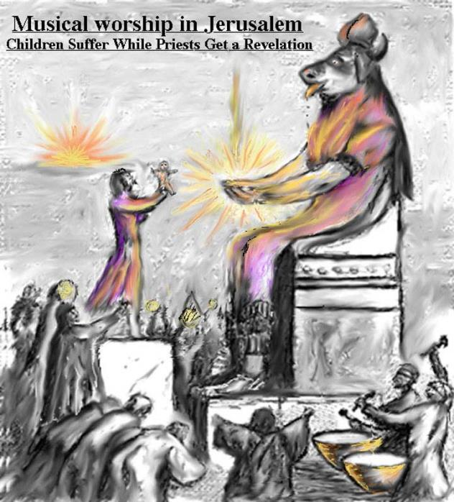
Moabites
175h
Chemosh was the most prominent of Moabite gods.
Child and human sacrifice to show devotion to Chemosh (even the king's son was probably sacrificed to Chemosh)
Nothing indicates that the Moabites had any understanding of salvation

Slide 29
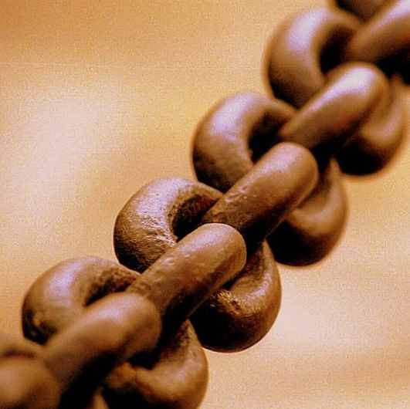
Israel's Unique Understanding of Salvation
175h

Slide 30

Israel's Understanding of Salvation
175h-i
The Holiness of God
The Cost of Sin

Slide 31

The Holiness of God
175h
The search for salvation is based on the realization of a need for salvation.
The realization of that need comes from a conviction of sin.
There can only be a conviction of sin, if there is a standard of holiness to begin with.

Slide 32
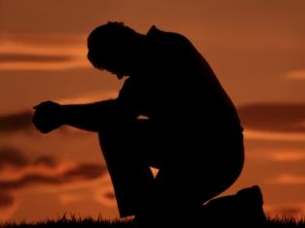
The Holiness of God
175h
The primary reason for Israel's unique understanding of salvation was because God had revealed Himself to Israel as holy.
He said, "Be holy because I, the LORD your God, am holy" (Lev. 19:2).

Slide 33

The gods of Pagan cultures
175h
None of the gods of the pagan nations had revealed themselves to be holy in the way that the God of Israel had done.
In fact, the gods of the pagan nations were immoral themselves.

Slide 34
The gods of Pagan cultures
175h
Without a standard of holiness to begin with, there was no real conviction of sin among the pagan cultures.
Therefore, there was no concrete search for salvation.

Slide 35
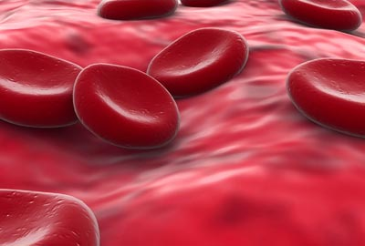
The Cost of Sin
175i
God gave Israel the sacrificial system to help them understand that the cost of sin was heavy.
Sin demanded atonement and life must be given for life, for the atonement of sin.
"For the life of the creature is in the blood, and I have given it to you to make atonement for yourselves on the altar; it is the blood that makes atonement for one's life" (Lev. 17:11).

Slide 36

The Cost of Sin
175i
In the Old Testament, animal life was used as a sacrifice for sin.
But this was only a temporary solution until Christ Himself came and became the final and complete sacrifice for sin.
In view of God's holiness, Israel clearly understood that the cost of sin was heavy and looked to God for salvation from sin.

Slide 37
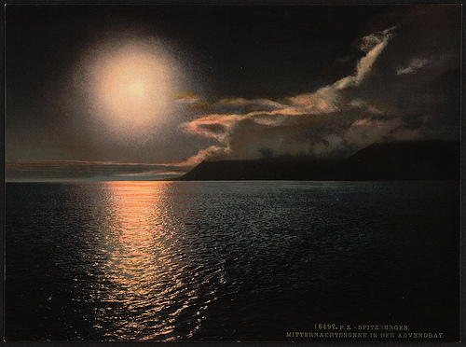
Sin in Pagan Cultures
175i
Pagan cultures did not feel the weight of their misdeeds as much as Israel because there was no one to convict them of sin.
Since there was no conviction, there was no search for salvation from their sin.

Slide 38
Pagan Cultures and Their Gods
175i
Pagan cultures were primarily concerned with success and power.
Note how their gods were gods of power:
Chemosh – god of war, Moabites
Dagon – god of Grain, Philistines
Enlil – god of Storm, Mesopotamians

Slide 39

Pagan Cultures and Their Gods
175i
They sought their gods to gain their favor or to appease them when they were angry, so that they would bless them with success in war, agriculture and wealth.
The search for salvation, as the Jews understood it, was pitifully, if not entirely absent.

Slide 40

Salvation in the Old Testament
175i

Slide 41

Social–individual–YAHWEH
175i
The concept suggests more social than individual salvation
Individuals were raised up for the benefit of the community
(Noah, Abraham, Joseph in Egypt, Moses, Judges and even Esther)
Despite the importance attributed to these human agents, salvation is eventually attributed to God

Slide 42
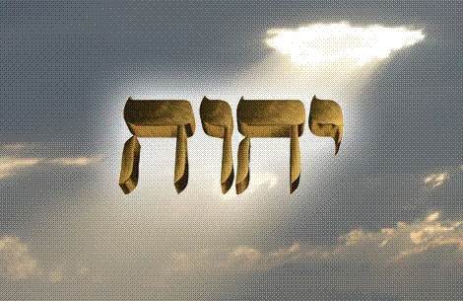
God
175j
God's revelation of Himself
God is Creator of the universe (Gen. 1:1; 2:1)
God is the only God (Deut. 6:4; Exod. 15: 11)
God is Almighty (Exod. 14:13)
God is Holy (Lev. 11:44)
God is Love (Deut. 33:3)
God is Eternal (Exod. 3:14)
God alone can save (Isa. 43: 14)

Slide 43
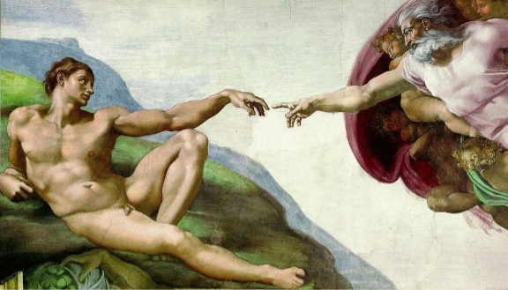
Mankind
175j
Created by God in his image (Gen. 1:27)
Man is unique among all the creatures (Gen. 2:7)
Man was created to rule over all living creatures (Gen. 1:28)

Slide 44

The Fall of Man & Spread of Sin
175j
Sin is acting independent of God's counsel (Gen. 3)
Sin doubts the trustworthiness of God's character (Gen. 3:4-5)
The Pervasiveness of Sin:
Cain and Abel (Gen. 4:1-6)
The Generation of the flood (Gen. 6:5–9:28)
The Tower of Babel (Gen. 11:1-9)

Slide 45

God's Plan for Redemption
175j
God the Seeker (Gen. 3:9)
God's Promise (Gen. 3:15)
God's Providence (Gen. 3:21)

Slide 46
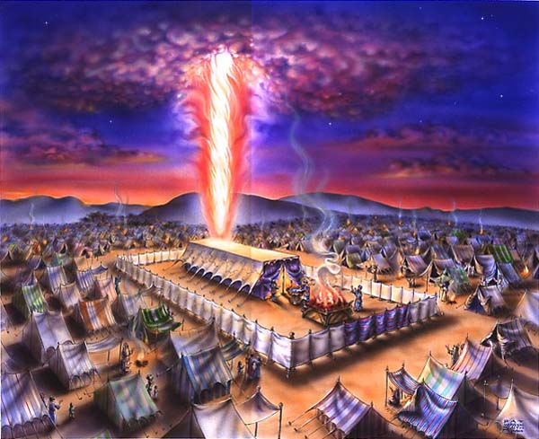
Plan Progressively Revealed
175l
Creation
Sin
Promise
Covenant
Law
Tabernacle

Slide 47
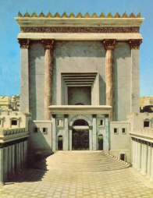

Plan Progressively Revealed
175l
Temple Built
Destruction of the Temple
Exile
Redemption
Preparation for
the coming of the Messiah

Slide 48

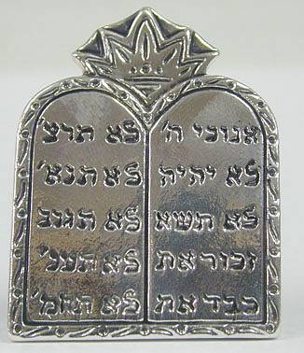
Sacrifices?
175l
In the Old Testament, the sacrifices performed:
By faith in the God who saves,
Not for salvation
Personal righteousness was insufficient
Whoever trusted the words of God and responded in faith was saved (Gen. 15:6).

Slide 49
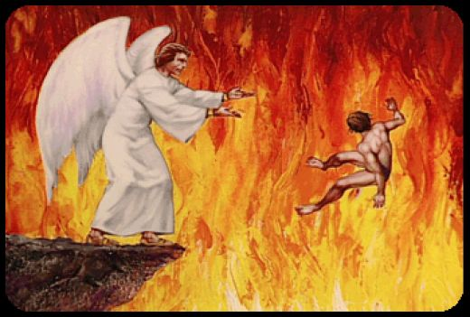
"And anyone whose name was not found recorded in the Book of Life was thrown into the lake of fire" (20:15)
NTS 438

Slide 50
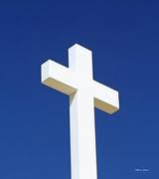
The Transfer to Paradise
14 & 16
NLT
S H E O L
Bliss
HADES
Luke 16:26
"…there is a great chasm separating us. No one can cross over to you from here, and no one can cross over to us from there."
Notes:
Before Christ's death, all the dead went to OT Sheol or the underworld of the dead—both saved and unsaved—whether to bliss (Abraham's bosom) or suffering in Hades (Luke 16:26). But Jesus brought believers to Paradise after his resurrection. Also, Hades differs from Hell in that Hades is now a temporary place of punishment, while Hell is the future, eternal place of torment.
___________________
Common-472
ES-03-Reincarnation&SpiritsInPrison-45
LC-06-Preparation of the Disciples by the King-104
LC-09-Rejection-138
OB-38-Salvation-50 (extended into several slides)
OP-Eccles9:1-18—slide 28
NS-08-2Cor-268
NS-10-Ephesians-270
NS-21-1Peter-235
NS-22-Rev20-22-slide 155

Slide 51
The Transfer to Paradise
14 & 16
NLT
S H E O L
"Christ suffered for our sins once for all time. He never sinned, but he died for sinners to bring you safely home to God. He suffered physical death, but he was raised to life in the Spirit.
¹⁹So he went and preached to the spirits in prison— ²⁰those who disobeyed God long ago when God waited patiently while Noah was building his boat. Only eight people were saved from drowning in that terrible flood."
Bliss
HADES
1 Pet. 3:18-20
Notes:
Before Christ's death, all the dead went to OT Sheol or the underworld of the dead—both saved and unsaved—whether to bliss (Abraham's bosom) or suffering in Hades (Luke 16:26). But Jesus brought believers to Paradise after his resurrection. Also, Hades differs from Hell in that Hades is now a temporary place of punishment, while Hell is the future, eternal place of torment.
___________________
Common-472
ES-03-Reincarnation&SpiritsInPrison-45
LC-06-Preparation of the Disciples by the King-104
LC-09-Rejection-138
OB-38-Salvation-50 (extended into several slides)
OP-Eccles9:1-18—slide 28
NS-08-2Cor-268
NS-10-Ephesians-270
NS-21-1Peter-235
NS-22-Rev20-22-slide 155

Slide 52
The Transfer to Paradise
14 & 16
NLT
"…today you will be with me in paradise."
Luke 23:43
S H E O L
Bliss
HADES
Notes:
Before Christ's death, all the dead went to OT Sheol or the underworld of the dead—both saved and unsaved—whether to bliss (Abraham's bosom) or suffering in Hades (Luke 16:26). But Jesus brought believers to Paradise after his resurrection. Also, Hades differs from Hell in that Hades is now a temporary place of punishment, while Hell is the future, eternal place of torment.
___________________
Common-472
ES-03-Reincarnation&SpiritsInPrison-45
LC-06-Preparation of the Disciples by the King-104
LC-09-Rejection-138
OB-38-Salvation-50 (extended into several slides)
OP-Eccles9:1-18—slide 28
NS-08-2Cor-268
NS-10-Ephesians-270
NS-21-1Peter-235
NS-22-Rev20-22-slide 155

Slide 53
The Transfer to Paradise
14 & 16
NLT
HEAVEN
S H E O L
Bliss
HADES
Notes:
Before Christ's death, all the dead went to OT Sheol or the underworld of the dead—both saved and unsaved—whether to bliss (Abraham's bosom) or suffering in Hades (Luke 16:26). But Jesus brought believers to Paradise after his resurrection. Also, Hades differs from Hell in that Hades is now a temporary place of punishment, while Hell is the future, eternal place of torment.
___________________
Common-472
ES-03-Reincarnation&SpiritsInPrison-45
LC-06-Preparation of the Disciples by the King-104
LC-09-Rejection-138
OB-38-Salvation-50 (extended into several slides)
OP-Eccles9:1-18—slide 28
NS-08-2Cor-268
NS-10-Ephesians-270
NS-21-1Peter-235
NS-22-Rev20-22-slide 155

Slide 54
The Transfer to Paradise
"That is why the Scriptures say, 'When he ascended to the heights, he led a crowd of captives and gave gifts to his people.' ⁹Notice that it says 'he ascended.' This clearly means that Christ also descended to our lowly world. ¹⁰And the same one who descended is the one who ascended higher than all the heavens, so that he might fill the entire universe with himself."
14 & 16
NLT
HEAVEN
Eph. 4:8-10
S H E O L
Bliss
HADES
Notes:
Before Christ's death, all the dead went to OT Sheol or the underworld of the dead—both saved and unsaved—whether to bliss (Abraham's bosom) or suffering in Hades (Luke 16:26). But Jesus brought believers to Paradise after his resurrection. Also, Hades differs from Hell in that Hades is now a temporary place of punishment, while Hell is the future, eternal place of torment.
___________________
Common-472
ES-03-Reincarnation&SpiritsInPrison-45
LC-06-Preparation of the Disciples by the King-104
LC-09-Rejection-138
OB-38-Salvation-50 (extended into several slides)
OP-Eccles9:1-18—slide 28
NS-08-2Cor-268
NS-10-Ephesians-270
NS-21-1Peter-235
NS-22-Rev20-22-slide 155

Slide 55
The Transfer to Paradise
14 & 16
NLT
HEAVEN
"I was caught up to the third heaven…I was caught up to paradise"
2 Cor. 12:2-4
S H E O L
Bliss
HADES
Notes:
Before Christ's death, all the dead went to OT Sheol or the underworld of the dead—both saved and unsaved—whether to bliss (Abraham's bosom) or suffering in Hades (Luke 16:26). But Jesus brought believers to Paradise after his resurrection. Also, Hades differs from Hell in that Hades is now a temporary place of punishment, while Hell is the future, eternal place of torment.
___________________
Common-472
ES-03-Reincarnation&SpiritsInPrison-45
LC-06-Preparation of the Disciples by the King-104
LC-09-Rejection-138
OB-38-Salvation-50 (extended into several slides)
OP-Eccles9:1-18—slide 28
NS-08-2Cor-268
NS-10-Ephesians-270
NS-21-1Peter-235
NS-22-Rev20-22-slide 155

Slide 56
The Transfer to Paradise
14 & 16
NLT
HEAVEN
S H E O L
Bliss
HADES
HADES
Notes:
Before Christ's death, all the dead went to OT Sheol or the underworld of the dead—both saved and unsaved—whether to bliss (Abraham's bosom) or suffering in Hades (Luke 16:26). But Jesus brought believers to Paradise after his resurrection. Also, Hades differs from Hell in that Hades is now a temporary place of punishment, while Hell is the future, eternal place of torment.
___________________
Common-472
ES-03-Reincarnation&SpiritsInPrison-45
LC-06-Preparation of the Disciples by the King-104
LC-09-Rejection-138
OB-38-Salvation-50 (extended into several slides)
OP-Eccles9:1-18—slide 28
NS-08-2Cor-268
NS-10-Ephesians-270
NS-21-1Peter-235
NS-22-Rev20-22-slide 155

Slide 57
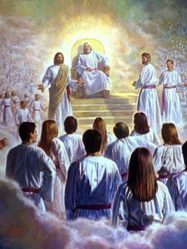
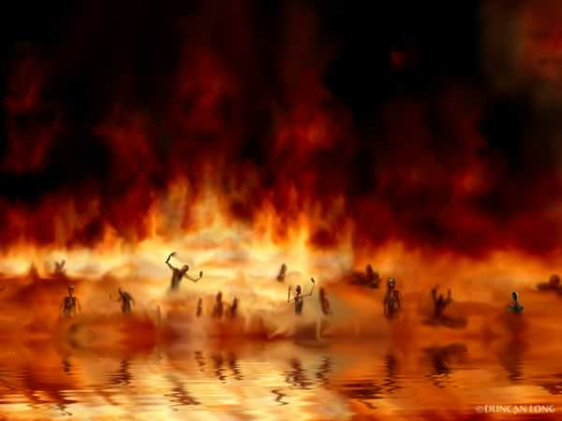
The Transfer to Paradise
14 & 16
NLT
HEAVEN
Eph. 4:8-10
Luke 23:43
2 Cor. 12:2-4
S H E O L
Bliss
HADES
1 Pet. 3:18-20
HADES
Rev. 20:14-15
Luke 16:26
Hell
Gehenna
Lake of Fire
Lake of Burning Sulfur
Second Death
"Then death and [Hades] were thrown into the lake of fire... ¹⁵And anyone whose name was not found recorded in the Book of Life was thrown into the lake of fire."
Notes:
Before Christ's death, all the dead went to OT Sheol or the underworld of the dead—both saved and unsaved—whether to bliss (Abraham's bosom) or suffering in Hades (Luke 16:26). But Jesus brought believers to Paradise after his resurrection. Also, Hades differs from Hell in that Hades is now a temporary place of punishment, while Hell is the future, eternal place of torment.
___________________
Common-472
ES-03-Reincarnation&SpiritsInPrison-45
LC-06-Preparation of the Disciples by the King-104
LC-09-Rejection-138
OB-38-Salvation-50 (extended into several slides)
OP-Eccles9:1-18—slide 28
NS-08-2Cor-268
NS-10-Ephesians-270
NS-21-1Peter-235
NS-22-Rev20-22-slide 155

Slide 58
The Lake of Fire (20:14-15)
NTS 438

Slide 59
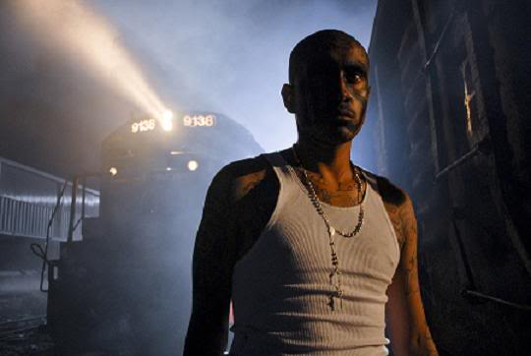
Salvation in the New Testament
175l

Slide 60
What about the New Testament?
175l
Consistent Plan, Unchanging Method:
the same promise of deliverance
the same Redeemer
the same condition required for participation in the blessing of redemption (faith)
the same complete salvation for all who embrace the offer of divine mercy
The New Testament continues the Old Testament affirmation that salvation belonged to God alone

Slide 61
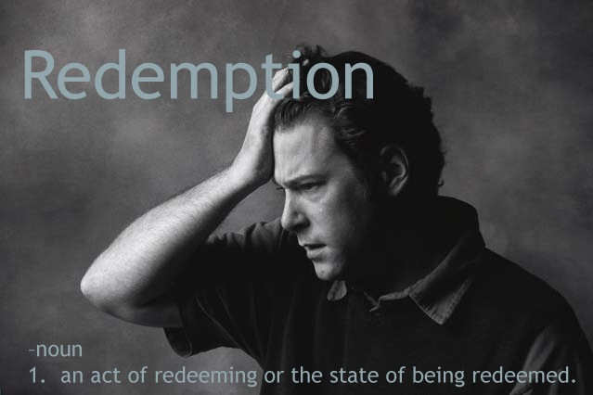
The Elements
175l
Firstly, God's Promise to man is that He will act on his behalf
Secondly, God's Provision is the basis for salvation
Thirdly, Man's Acceptable Response is to accept God's provision for salvation by faith

Slide 62

The Objective & The Subjective
175l
PROMISE?
PROVISION?
RESPONSE?
"Salvation is not a reward for the good we have done but by faith in Christ" (Eph. 2:8-9)
Paul Feinberg, "Salvation in the OT," in Tradition & Testament

Slide 63

Subjective & Objective Salvation
175l
Objective
Removal of Sin
Payment for Sin
Christ's death as basis or ground of salvation
Subjective
Forgiveness of Sin
Cleansing from Sin
Covering (down payment)
Hebrews 10:4
Paul Feinberg, "Salvation in the OT," in Tradition & Testament

Slide 64
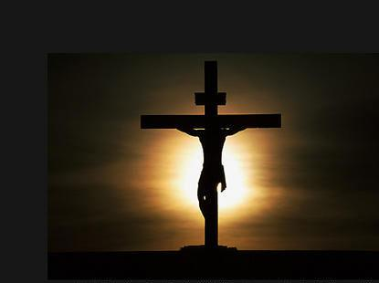
The Objective Aspect of Salvation
175l
Mystery of one body in Christ composed of Jews and Gentiles uncovered (Eph. 3:9; 6:19)
God's Plan
Conceived before the foundation of the world (Eph. 1:3-14)
For all the nations (Gen. 12)
Completed in Jesus (Heb. 10)
His death was for all (John 11:51-52)
Forgiveness of sins for all nations (Luke 24: 47)
The promised blessing through Abraham for all people (Gal. 3:8)

Slide 65

The Objective Basis - Christ
175m
God's sovereign choice was Christ “…the lamb of God who takes away the sin of the world” (John 1:29).
This is the Christ who is described in the book of Hebrews as both the author and mediator of salvation (Heb. 2:10; 7:25).
"In Him we have redemption through His blood, the forgiveness of the sins in accordance in the riches of God's grace that He lavished on us with all wisdom and understanding" (Eph. 1:7-8).

Slide 66

The Subjective Aspect of Salvation
175m
Essence Vs Expression
OT – Sacrifices
NT – Baptism, Lord's Supper

Slide 67
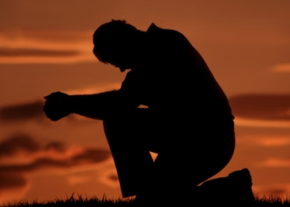
Implications for Today
175m-n
Immutable Holiness of God
Life has more to it than the here and now!
Our attitude to Christ's sacrifice will impact the 'not yet Christian's' view of the gospel (we give them perspective)

Slide 68
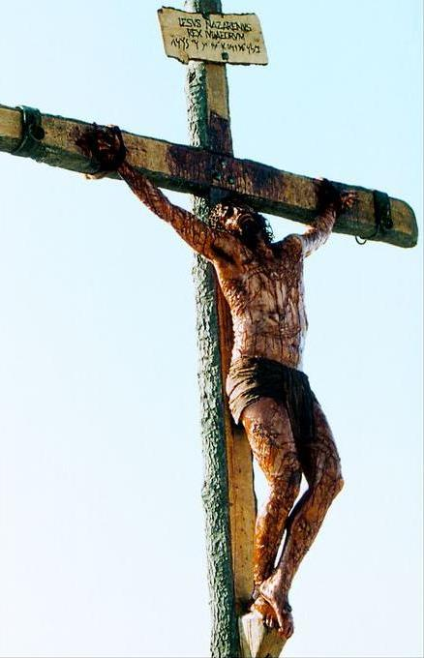
What language shall I borrow to thank Thee, dearest friend, for this Thy dying sorrow, Thy pity without end?
O make me Thine forever, and should I fainting be, Lord, let me never, never outlive my love to Thee.

Slide 69
Now, how then shall we be saved?
Presenters:
Wendy Yiu, John Wong, Akshay Rajkumar, Jose Philip
October 2005

Slide 70
Black

Slide 71


OT Backgrounds link at BibleStudyDownloads.org
Get this presentation for free!
Notes:
NT Survey (ns)

