Slide 1
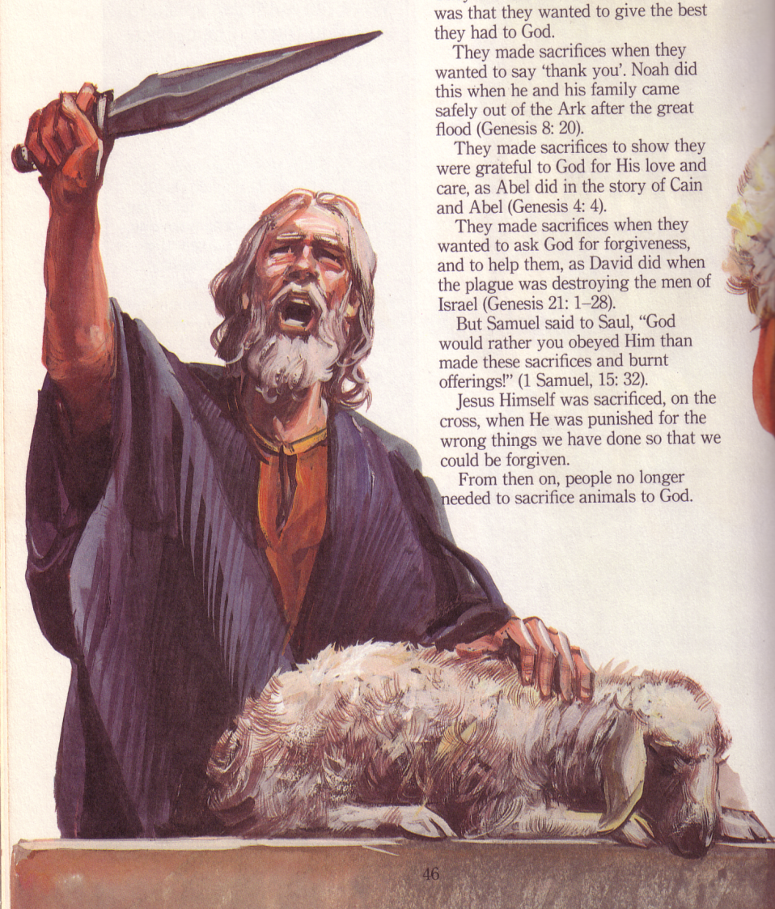
Sacrifices in the Ancient Near East
Sacrifices
in the Ancient Near East
Dr. Rick Griffith • Jordan Evangelical Theological Seminary • BibleStudyDownloads.org

Slide 2
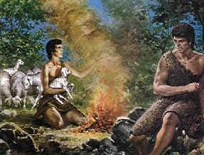
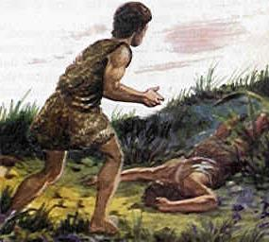
Why do you think both Israel and the pagans had animal sacrifices?
Did Cain and Abel know that God required blood sacrifices?
Cain killed his brother Abel because God did not like Cain's sacrifice

Slide 3
One's View of God Affects His View of Sacrifices, Morality & Mission
163a
Pagan
Israel
Horrible god
Holy God
Man seen as OK in comparison
Man seen as sinful
Seeks pleasure & material needs
Seeks spiritual needs
Sacrifices appease deity for sex, food & money
Sacrifices atone for sin to reconcile God & man
Local deity makes them rich
God forgives sin
Massacre others for wealth
Mission to others for their good

Slide 4
One's View of God Affects His View of Sacrifices, Morality & Mission
163a
Pagan
Israel
Horrible god
Holy God
Man seen as OK in comparison
Man seen as sinful
Seeks pleasure & material needs
Seeks spiritual needs
We become like the God we worship!
Sacrifices appease deity for sex, food & money
Sacrifices atone for sin to reconcile God & man
Local deity makes them rich
God forgives sin
Massacre others for wealth
Mission to others for their good

Slide 5
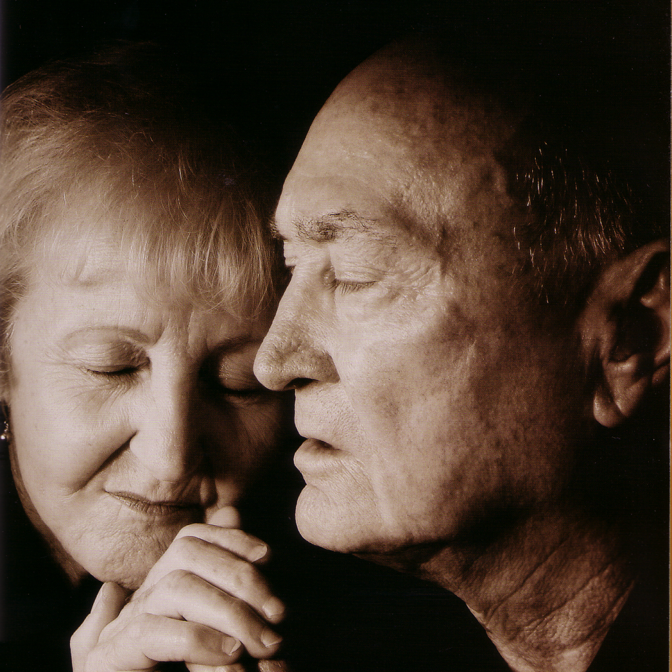
Pagan "Salvation"
164
Appeasement
Salvation by works
Here and now concern

Slide 6
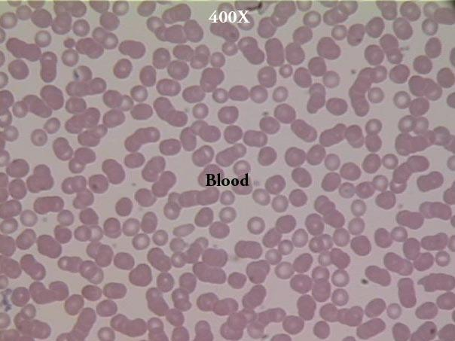
What's the Significance of
Blood?
"In fact, the law requires that nearly everything be cleansed with blood, and without the shedding of blood there is no forgiveness"
(Heb. 9:22 NIV)

Slide 7
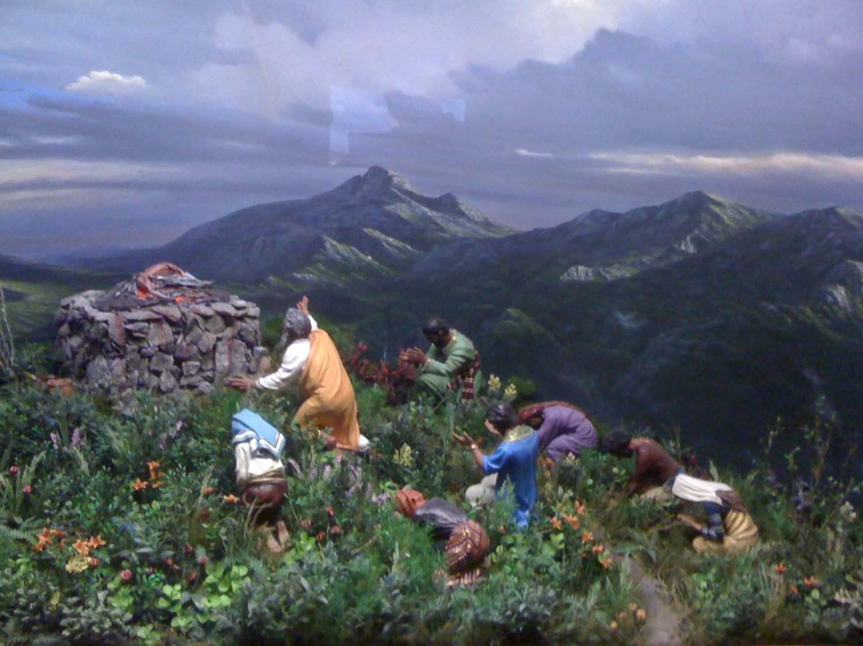
Capital Punishment Begins
Gen. 9:5 “And I will require the blood of anyone who takes another person’s life. If a wild animal kills a person, it must die. And anyone who murders a fellow human must die. ⁶If anyone takes a human life, that person’s life will also be taken by human hands. For God made human beings in his own image. ⁷Now be fruitful and multiply, and repopulate the earth.”

Slide 8
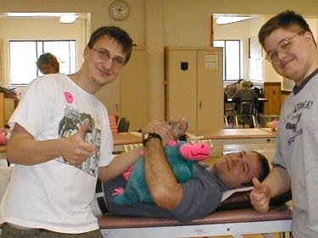
"The life is in the blood"
  "For the life of a creature is in the blood, and I have given it to you to make atonement for yourselves on the altar; it is the blood that makes atonement for one's life" (Lev. 17:11)

Slide 9
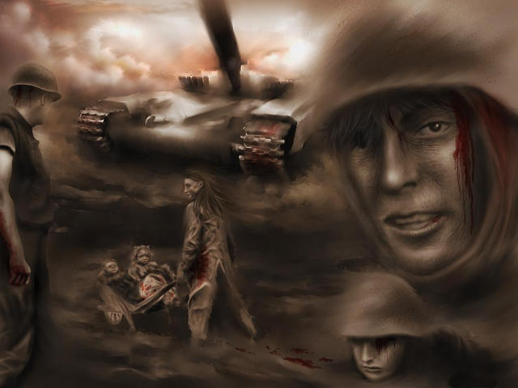

Blood of Appeasement?
ap· pease tr.v. ap· peased, ap· peas· ing,
ap· peas· es
To bring peace, quiet, or calm to; soothe.
To satisfy or relieve: appease one's thirst.
To pacify or attempt to pacify (an enemy) by granting concessions, often at the expense of principle.
www.dictionary.com

Slide 10
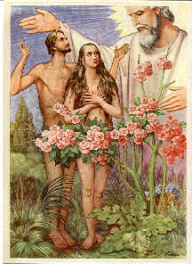

Adam & Eve
They were naked and unashamed

Slide 11
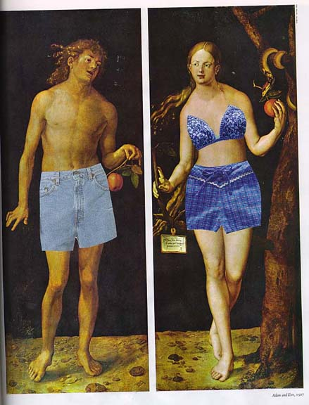
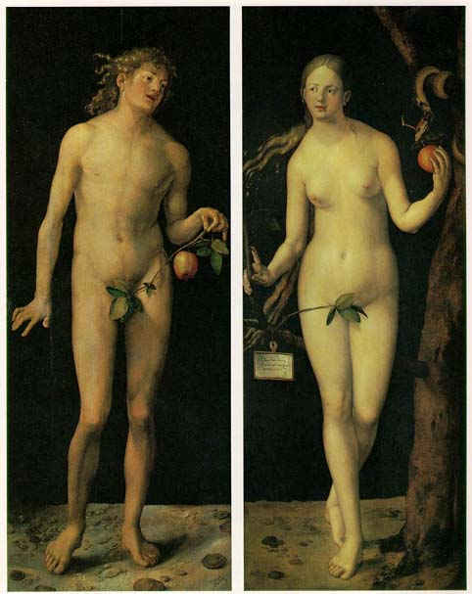
Man's Attempts to Cover Shame
Ok, ok, so they actually used fig leaves. . .

Slide 12
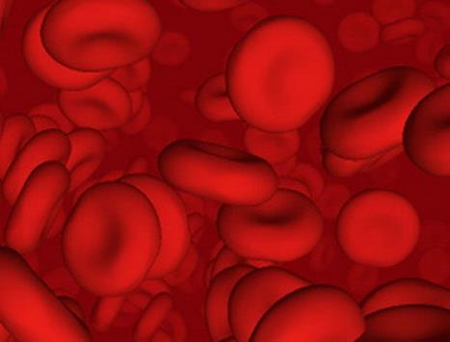
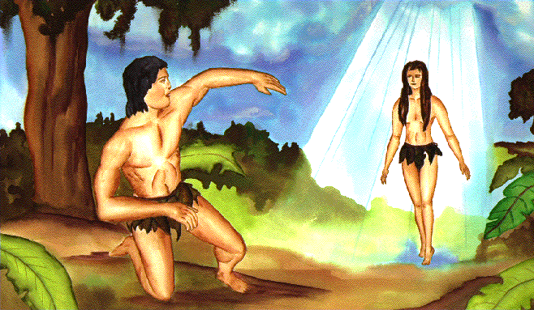
Origin of Blood Sacrifice
"The LORD God made garments of skin for Adam and his wife and clothed them" (Gen. 3:21)

Slide 13
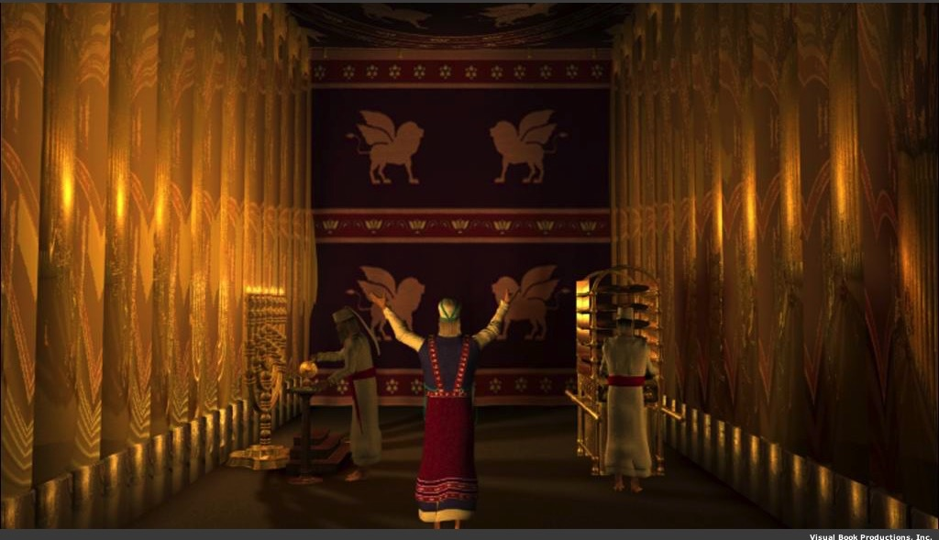
Why did God prescribe offerings for Israel's weaknesses and sins?

Slide 14
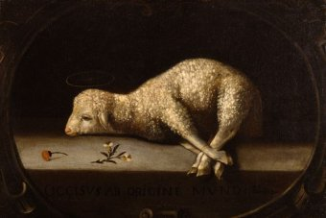
God forgave Israelites through the blood of offerings
(Lev 4:1–5:13; 6:24-30).
Notes:
Jews restored their fellowship with the Lord through sin and guilt sacrifices.

Slide 15
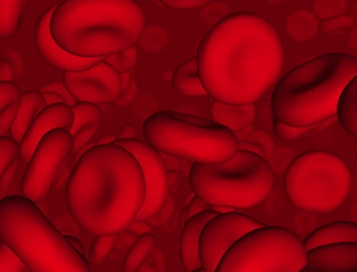
Why did God institute the sacrificial system?
Did the blood actually forgive sin?

Slide 16
Did blood sacrifices save Israelites under the Law?
BLOOD

Slide 17
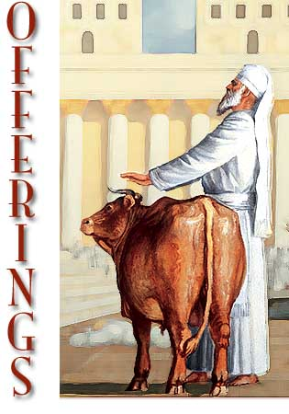
Sacrifices forgave sin
"Through this process, the priest will purify the people, making them right with the LORD, and
they will be forgiven"
(Lev 4:20 NLT;
cf. 4:26, 31, 35).

Slide 18

Which is the Most Accurate?
121a
Salvation by…
Faith + Works
Faith Alone
Faith + Works
OT
Works
Faith Alone
Faith Alone
Faith + Works
NT
Faith
• Which verses in the Bible support your answer?
cf. OTS 119e
Notes:
Did God change the means of salvation from the OT to the NT?
We are NOT talking about whether people should do good works—we all agree on that. But are works needed for salvation?
Paul answers this question in Romans 4 with the example of Abraham who was saved by faith alone—see Gen 15:6.
________
BE-03-Lev-27
OB-37-Sacrifices-72_eng_ob_1667_v5—slide 17
OB-39-Salvation-2
OS-03-Leviticus-13
OP-03-Lev-27
OP-Lev_6v24-7v10 Why All That Blood Sin & Guilt Offerings-49_eng_op_v4.0—slide 34
OS-04-Num-27
NP-Acts_15v1-35_Dont_Be_Law_Abiding_(Rick_Griffith)-61_eng_pr_v4—slide 5
NS-05-Acts15-16-slide 26
NS-Rom3-4-slide 77
NS-09-Galatians-48
NS-20-James-30
NS-23-1Jn-58
SA-03-Biblical Terms-6
SA-15-Inheritance-26

Slide 19
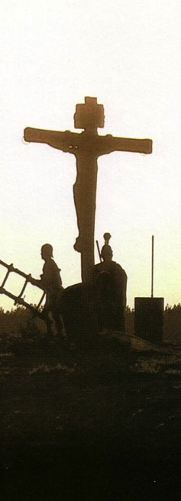
Salvation in All Ages:
The Centrality of the Cross
B.C.
Looked forward to the
Cross of Christ
A.D.
Look
back at the
Cross of Christ
Notes:
We must see the centrality of the cross—how people before Jesus believed by looking toward the cross while those of us after Jesus look back at the cross. In other words, the foundation of salvation has always been the death of Christ—for believers before and after the cross.
____________________
Common-198
BE-03-Leviticus-73
OB-37-Sacrifices-18
OB-38-Salvation-4
OS-03-Leviticus-193
NS-09-Galatians-16, 49, 118
NS-20-James-32
SA-03-Biblical Terminology-10
SA-15-Inheritance-26
TP-01-Our Inheritance OT Summary-29

Slide 20
Salvation & Sanctification
121a
Man's Role
God's Response
Life of Faith
Restored Fellowship
Faith in God as offered Passover Lamb
Journey to Canaan
Sacrifices
(Sin, Guilt)
OT
Exodus
Type
|
Antitype
Type
|
Antitype
Type
|
Antitype
Type
|
Antitype
Faith in Christ as Lamb of God (1 Cor. 5:7)
Salvation
(1 Cor. 10:1-4)
Growth
(1 Cor. 10:5)
Confession
(1 John 1:9)
NT
Positional Sanctification
Progressive Sanctification
Notes:
The OT plan of salvation is mirrored in the NT—both by simple faith in the Lamb pictured in the Passover.
Exodus from Egypt is a type of the believer who leaves his slavery to sin—all believers in the Lamb are saved, including all Israelites who left Egypt as they demonstrated that faith by putting the blood on the doorposts of their homes (=positional sanctification).
But both OT and NT believers must live a life of faith in God, pictured in Israel’s journey to Canaan and mirrored in the Christian’s growth or progressive sanctification.
Finally, as OT believers confessed their ongoing sins in the sin and guilt sacrifices (for restoring fellowship with God—NOT for salvation!), so NT believers confess sins even after they are saved to restore their fellowship (NOT relationship!) with God.
_________
Common English-78
OB-37-Sacrifices-18
OS-00-Book Overviews-73
OS-04-Numbers-13
NS-09-Galatians-49
NS-20-James-31
SA-03-Biblical Terms-7
SA-15-Inheritance-26

Slide 21

OT Forgiveness of Sin
121b
Pipe = Relationship with God (never changing)
Sin
Clog = Fellowship with God (hindered by sin)
Sacrifices = Confession of Sin (sin forgiven to restore fellowship but relationship was never threatened)
Notes:
Do we still have a relationship with God when we sin? Yes!
Sin does not hinder our relationship with God but our fellowship with Him.
OT sacrifices did not establish a relationship with God but rather they restored their fellowship with God
________
OS-03-Leviticus-14
OS-04-Num-29
OP-02-Lev-28
NS-23-1Jn-58
SA-03-Biblical Terms-9
SA-15-Inheritance-27

Slide 22
NT Forgiveness of Sin
121b
Pipe = Relationship with God (never changing)
Sin
Clog = Fellowship with God (hindered by sin)
Christ's Sacrifice = The Basis for Confession of Sin (sin is forgiven to restore fellowship but relationship has never been never threatened)
Notes:
Our relationship with God can be compared to a pipe.
Occasionally the pipe gets a clog—like sin—that hinders our fellowship with God.
Do we still have a relationship with God when we sin? Yes!
Sin does not hinder our relationship with God but our fellowship with Him.
_________
OB-38-Salvation-11
OS-03-Leviticus-56, 72, 130
OS-04-Numbers-30
NS-23-1Jn-59
SA-03-Biblical Terms-9
SA-15-Inheritance-28

Slide 23
NT Forgiveness of Sin
121b
"If we confess our sins,
He is faithful and righteous to forgive us our sins and to cleanse us from all unrighteousness"
(1 John 1:9 NAU)
Pipe = Relationship with God (never changing)
Sin
Clog = Fellowship with God (hindered by sin)
Christ's Sacrifice = The Basis for Confession of Sin (sin is forgiven to restore fellowship but relationship has never been never threatened)
Notes:
Our relationship with God can be compared to a pipe.
Occasionally the pipe gets a clog—like sin—that hinders our fellowship with God.
Do we still have a relationship with God when we sin? Yes!
Sin does not hinder our relationship with God but our fellowship with Him.
_________
OB-38-Salvation-11
OS-03-Leviticus-56, 72, 130
OS-04-Numbers-30
NS-23-1Jn-59
SA-03-Biblical Terms-9
SA-15-Inheritance-28

Slide 24
Salvation in the Old Testament
176
OT Times
(Moses to Christ's Death)
NT Times
(Christ's Death to Today)
Basis
of Salvation
God's gracious provision of the death of Christ ("it is the blood that makes atonement for one's life,"
Lev. 17:11b)
God's gracious provision of the death of Christ ("without the shedding of blood there is no forgiveness," Heb. 9:22)
Requirement
of Salvation
Faith in the provision that God has revealed—as a gift (Ps. 51:16-17)
Faith in the provision that God has revealed—as a gift (Gal. 2:16)
Ultimate Content
of Salvation
Object of faith is God Himself—prophets exhorted repentance, not sacrifices (Jer. 3:12)
Object of faith is God Himself—heroes of faith are cited to exhort faith in God (Heb. 11)
Specific
Revealed Content
of Salvation
Cumulative content of faith involved sacrifices & promises: animals (Gen. 3:21), Abel's sacrifice (4:4), Abrahamic covenant (15:15-19), etc.
New content of faith is the shed blood of Jesus Christ (1 Pet. 1:18-21) which removes sin (cp. OT sacrifices merely covered sin)
Believer's Expression
of Salvation
Obey moral law, offer animal sacrifices, obey Mosaic law (civil
and ceremonial aspects)
Obey moral law, observe Lord's Supper and baptism, etc. through the Spirit's enabling (Rom. 8:9)

Slide 25
Salvation in the Old Testament
176
OT Times
(Moses to Christ's Death)
NT Times
(Christ's Death to Today)
Basis
of Salvation
God's gracious provision of the death of Christ ("it is the blood that makes atonement for one's life,"
Lev. 17:11b)
God's gracious provision of the death of Christ ("without the shedding of blood there is no forgiveness," Heb. 9:22)
Requirement
of Salvation
Faith in the provision that God has revealed—as a gift (Ps. 51:16-17)
Faith in the provision that God has revealed—as a gift (Gal. 2:16)
Ultimate Content
of Salvation
Object of faith is God Himself—prophets exhorted repentance, not sacrifices (Jer. 3:12)
Object of faith is God Himself—heroes of faith are cited to exhort faith in God (Heb. 11)
Specific
Revealed Content
of Salvation
Cumulative content of faith involved sacrifices & promises: animals (Gen. 3:21), Abel's sacrifice (4:4), Abrahamic covenant (15:15-19), etc.
New content of faith is the shed blood of Jesus Christ (1 Pet. 1:18-21) which removes sin (cp. OT sacrifices merely covered sin)
Believer's Expression
of Salvation
Obey moral law, offer animal sacrifices, obey Mosaic law (civil
and ceremonial aspects)
Obey moral law, observe Lord's Supper and baptism, etc. through the Spirit's enabling (Rom. 8:9)

Slide 26
Salvation in the Old Testament
176
OT Times
(Moses to Christ's Death)
NT Times
(Christ's Death to Today)
Basis
of Salvation
God's gracious provision of the death of Christ ("it is the blood that makes atonement for one's life,"
Lev. 17:11b)
God's gracious provision of the death of Christ ("without the shedding of blood there is no forgiveness," Heb. 9:22)
Requirement
of Salvation
Faith in the provision that God has revealed—as a gift (Ps. 51:16-17)
Faith in the provision that God has revealed—as a gift (Gal. 2:16)
Ultimate Content
of Salvation
Object of faith is God Himself—prophets exhorted repentance, not sacrifices (Jer. 3:12)
Object of faith is God Himself—heroes of faith are cited to exhort faith in God (Heb. 11)
Specific
Revealed Content
of Salvation
Cumulative content of faith involved sacrifices & promises: animals (Gen. 3:21), Abel's sacrifice (4:4), Abrahamic covenant (15:15-19), etc.
New content of faith is the shed blood of Jesus Christ (1 Pet. 1:18-21) which removes sin (cp. OT sacrifices merely covered sin)
Believer's Expression
of Salvation
Obey moral law, offer animal sacrifices, obey Mosaic law (civil
and ceremonial aspects)
Obey moral law, observe Lord's Supper and baptism, etc. through the Spirit's enabling (Rom. 8:9)

Slide 27
Salvation in the Old Testament
176
OT Times
(Moses to Christ's Death)
NT Times
(Christ's Death to Today)
Basis
of Salvation
God's gracious provision of the death of Christ ("it is the blood that makes atonement for one's life,"
Lev. 17:11b)
God's gracious provision of the death of Christ ("without the shedding of blood there is no forgiveness," Heb. 9:22)
Requirement
of Salvation
Faith in the provision that God has revealed—as a gift (Ps. 51:16-17)
Faith in the provision that God has revealed—as a gift (Gal. 2:16)
Ultimate Content
of Salvation
Object of faith is God Himself—prophets exhorted repentance, not sacrifices (Jer. 3:12)
Object of faith is God Himself—heroes of faith are cited to exhort faith in God (Heb. 11)
Specific
Revealed Content
of Salvation
Cumulative content of faith involved sacrifices & promises: animals (Gen. 3:21), Abel's sacrifice (4:4), Abrahamic covenant (15:15-19), etc.
New content of faith is the shed blood of Jesus Christ (1 Pet. 1:18-21) which removes sin (cp. OT sacrifices merely covered sin)
Believer's Expression
of Salvation
Obey moral law, offer animal sacrifices, obey Mosaic law (civil
and ceremonial aspects)
Obey moral law, observe Lord's Supper and baptism, etc. through the Spirit's enabling (Rom. 8:9)

Slide 28
Salvation in the Old Testament
176
OT Times
(Moses to Christ's Death)
NT Times
(Christ's Death to Today)
Basis
of Salvation
God's gracious provision of the death of Christ ("it is the blood that makes atonement for one's life,"
Lev. 17:11b)
God's gracious provision of the death of Christ ("without the shedding of blood there is no forgiveness," Heb. 9:22)
Requirement
of Salvation
Faith in the provision that God has revealed—as a gift (Ps. 51:16-17)
Faith in the provision that God has revealed—as a gift (Gal. 2:16)
Ultimate Content
of Salvation
Object of faith is God Himself—prophets exhorted repentance, not sacrifices (Jer. 3:12)
Object of faith is God Himself—heroes of faith are cited to exhort faith in God (Heb. 11)
Specific
Revealed Content
of Salvation
Cumulative content of faith involved sacrifices & promises: animals (Gen. 3:21), Abel's sacrifice (4:4), Abrahamic covenant (15:15-19), etc.
New content of faith is the shed blood of Jesus Christ (1 Pet. 1:18-21) which removes sin (cp. OT sacrifices merely covered sin)
Believer's Expression
of Salvation
Obey moral law, offer animal sacrifices, obey Mosaic law (civil
and ceremonial aspects)
Obey moral law, observe Lord's Supper and baptism, etc. through the Spirit's enabling (Rom. 8:9)

Slide 29
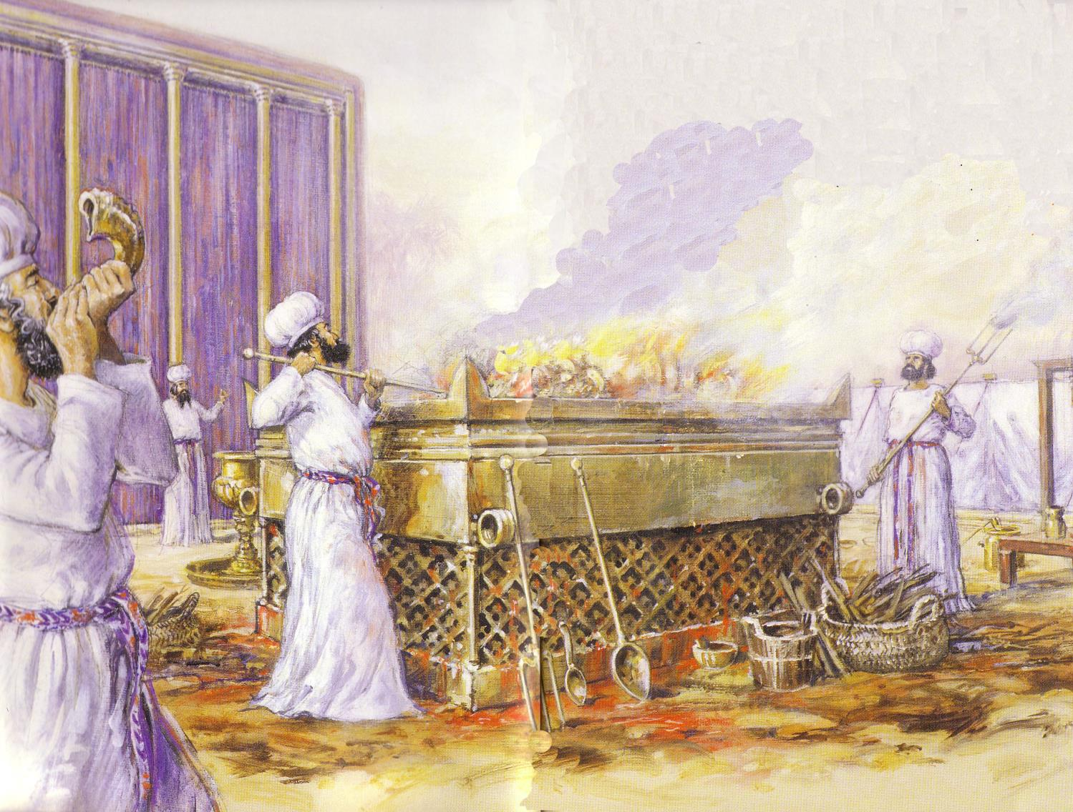
Leviticus
176
Sanctification through sacrifice and separation
1–10 Sacrifice
(worshipping God)
11–27 Separation
(walking with God)

Slide 30
Subjective & Objective Salvation
Objective
Removal of Sin
Payment for Sin
Christ's death as basis or ground of salvation
Subjective
Forgiveness of Sin
Cleansing from Sin
Covering (down payment)
Hebrews 10:4

Slide 31

Extra Biblical Feast #1
180
1 Nisan
2 Iyar
3 Sivan
4 Tammuz
5 Av
6 Elul
7 Tishri
8 Cheshvan
9 Kislev
10 Tevet
11 Shevat
12 Adar
Passover
Redemption
Unleavened Bread
Separation
Firstfruits
Resurrection
Pentecost
Spirit
Kingdom
Tabernacles/Booths
9th of Av
Repentance
Day of Atonement
Rapture
Trumpets
3 Pilgrimage Feasts

Slide 32
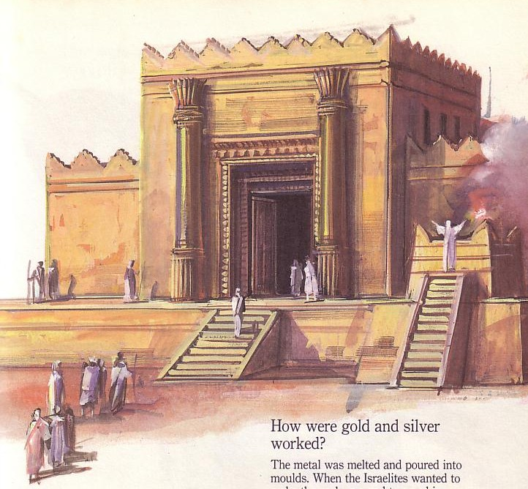
Jewish life revolved around Solomon's temple for 400 years (959-586 BC)
Judaism in Israel and the Diaspora (continued)
184
Notes:
The temple was Israel's spiritual focus, the financial center (the national bank), and the social heart of the nation.

Slide 33
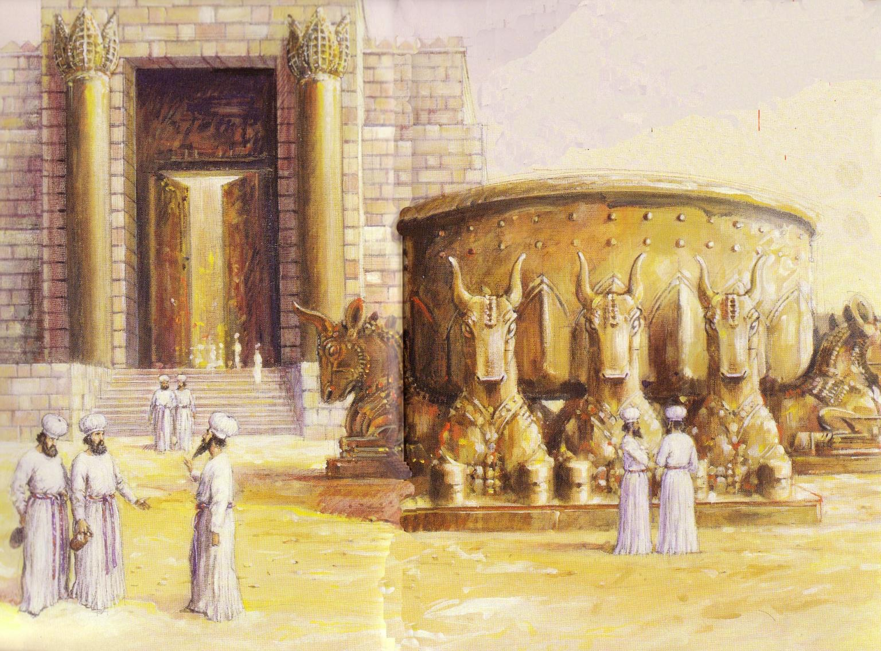
Jews Maintained Holiness at the Basin
Notes:
The basin cleansed the hands and feet of the priests who brought the people before the Lord inside the temple.

Slide 34
Jews Maintained Holiness at the Basin
Temple Destroyed!
The 9th of Ab
• 586 BC
• AD 70
Notes:
God disciplined the nation for its sins twice—ON THE SAME DAY!
—He used the Babylonians to destroy the temple and the city in 586 BC
—He used the Romans to destroy the temple and the city in AD 70

Slide 35
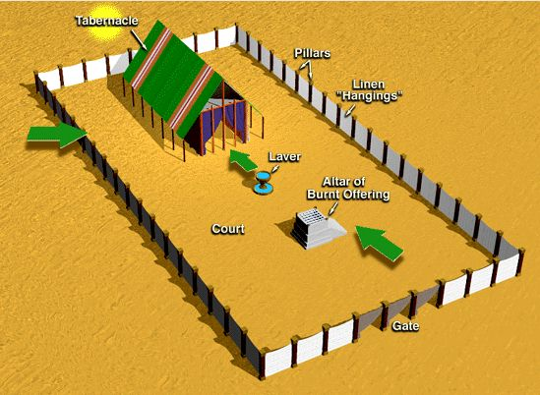
Offerings in Leviticus 1-7
177
Whole burnt offering
Grain offering
Fellowship offering
Sin offering
Guilt offering
Consecration
Voluntary
Cleansing
Obligatory

Slide 36
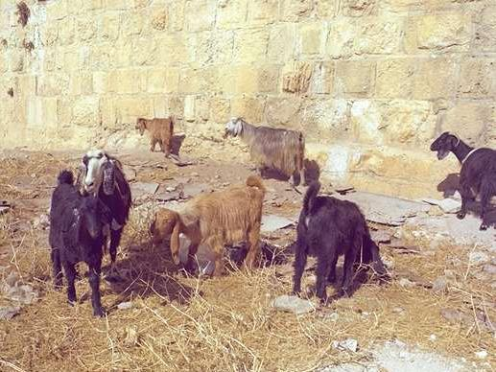
Clean and Unclean
176
Clean = life, health, holiness
Unclean = death, illness, profane
Separation and special status

Slide 37
Offerings in Leviticus 1-7
177
Whole burnt offering 1
Grain/Drink offering 2
Fellowship offering 3
Sin offering 4:1-5:13
Guilt offering 5:14-6:7
6:8-13
6:14-23
6:24-30
7:1-10
7:11-38
People
Priests

Slide 38
Offerings in Leviticus 1-7
177
Whole burnt offering
Grain offering
Fellowship offering
Sin offering
Guilt offering
Consecration
Voluntary
Cleansing
Obligatory

Slide 39
Offering Rituals in Lev. 1–5
177
The worshipper presents his offering
He lays his hand(s) upon the victim, and possibly confesses his sin.
3. The worshipper slaughters the offering.
R. T. Beckwith, New Bible Dictionary, 1962

Slide 40
Offering Rituals in Lev. 1–5
177
4. The priest collects the blood in a basin and dashes it against the NE and SW corners of the altar in such a way that all four sides are spattered. The remainder of the blood is then poured out at the base of the altar.
R. T. Beckwith, New Bible Dictionary, 1962

Slide 41
Offering Rituals in Lev. 1–5
177
5. A portion of the sacrifice is burned.
6. Any remaining portions of the sacrifice were eaten in a sacrificial meal, either by the priests and worshippers (fellowship-offering), or by the priests and their families, or by the priests alone.
R. T. Beckwith, New Bible Dictionary, 1962

Slide 42
The Tabernacle & Courtyard
Tabernacle
Pillars
Linen "Hangings"
Laver
Altar of Burnt Offering
Court
Gate
Notes:
#35 in original file

Slide 43
Rituals for Levitical Offerings
175c
Worshipper's Actions |  | DEDICATORY
 |  | BURNT | GRAIN | DRINK
 | References | Lev. 1:3-17; 6:8-13 | Lev. 2; 6:14-23 | Num. 15:1-10; Lev. 23
 | Presentation: Selection of Offering | Bull (1:3), male sheep (1:10) | Grain or barley prepared in one of 5 ways: Basic flour with oil; incense mixed with the part burned on the altar Oven-baked cakes/wafers mixed or served with oil Griddle-baked cakes, with oil Pan-fried cakes If firstfruits: crushed heads of new grain | With a bull–– ½ hin With a ram–– ½ hin With a lamb–– ½ hin (Note: one hin = about 1 quart)
 | Laying on of Hands | 1:4 (except for bird) (see under "Sin offering")
 | Slaying of Animal | Done by worshiper except that a bird was killed by the priest (cf. 1:15)
 | Preparation of Offering | Skinning, dismembering, washing (cf. 1:6, 12, 16-17) | Worshiper normally prepared it in advance. Priest separated a memorial portion for burning on the altar
F. Duane Lindsey, "Leviticus," The Bible Knowledge Commentary, 1:168-69
Notes:
#45 in original file

Slide 44
Rituals for Levitical Offerings
175c
129
Priest's Actions |  |  |  | DEDICATORY
 |  |  |  | BURNT | GRAIN | DRINK
 | Manipulation of Blood |  |  | Blood caught in a bowl and splashed against sides of the altar (1:5, 11) Bird's blood drained out on side of the altar (1:15)
 | Incineration on Altar |  |  | All the animal burned on the altar (1:8-9, 12-13, 15, 17) | Memorial portion burned on the altar by the priest (all was burnt if it was the priest's own offering) | Entire libation poured out to the Lord at the sanctuary (Num. 28:7)
 | Distribution or Disposal of Carcass | Distribution of Disposal of Carcass |  | Skin (7:8) | Accompanying burnt offering: the priest ate unburned portion
 |  | Worshiper's portion |  | None | Accompanying fellowship offering: the worshiper ate unburned portion, but a small portion went to the priest
 |  | Remainder |  | Bird's crop to ash pit (1:16)
F. Duane Lindsey, "Leviticus," The Bible Knowledge Commentary, 1:168-69
Notes:
#45 in original file

Slide 45
Rituals for Levitical Offerings
175c
129
Worshipper's Actions |  | COMMUNAL | EXPIATORY
 |  | FELLOWSHIP | SIN | GUILT
 | References | Lev. 3; 7:11-36 | Lev. 4:1–5:13; 6:24-30 | Lev. 5:14–6:7; 7:1-10
 | Presentation: Selection of Offering | Bull, lamb, or goat, male or female (3:1, 6, 12; In a freewill offering, minor imperfections were permitted in animals, 22:23) | Young bull (for priest or nation) Male goat (for tribal leader) Female goat or lamb (for layperson) Dove, young pigeon (for poor person) Flour (1/10 ephah; for very poor) | Usually a ram (a male lamb in the case of a cleansed leper or defiled Nazarite)
 | Laying on of Hands | 3:2, 8, 13 (see "Burnt offering") | Sinner's identification with animal or subsequent symbolic transfer of sin and legal transfer of guilt | Confession (Num. 5:7) apparently accompanied by laying on of hands
 | Slaying of Animal | At sanctuary entrance (see "Burnt offering") | At sanctuary entrance for priest/nation North of altar for others (see "Burnt offering") | North of altar (Lev. 7:2)
 | Preparation of Offering
F. Duane Lindsey, "Leviticus," The Bible Knowledge Commentary, 1:168-69
Notes:
#45 in original file

Slide 46
Rituals for Levitical Offerings
175c
129
Priest's Actions |  |  |  | COMMUNAL | EXPIATORY
 |  |  |  | FELLOWSHIP | SIN | GUILT
 | Manipulation of Blood |  |  | Blood caught in a bowl and splashed against sides of the altar (3:2, 8, 13) | Ritual varied according to the position of the worshiper (but involved "sprinkling" rather than "splashing" of blood), the occasion of sacrifice, or the type of animal (e.g., different if a bird) | Blood caught in a bowl and splashed against the sides of the altar (7:2)
 | Incineration on Altar |  |  | Choice viscera (including "fat tail" of sheep) burned on altar | Choice viscera burned on altar | Choice viscera burned on altar
 | Distribution or Disposal of Carcass | Distribution of Disposal of Carcass |  | Breast of animal was to be a "wave offering" and eaten by priests | Priest received carcass of offering by leader or layperson | Priest received carcass
 |  | Worshiper's portion |  | Communal meal for the worshiper's family at proper time and place
 |  | Remainder |  | Remainder burned | Carcass burned outside the camp for priest or nation
F. Duane Lindsey, "Leviticus," The Bible Knowledge Commentary, 1:168-69
Notes:
#45 in original file

Slide 47
Special Sacrificial Rituals
175d
130
Special Rituals |  |  |  | DEDICATORY
 |  |  |  | BURNT | GRAIN | DRINK
 | Consecration | 1. Of priests (Ex. 29; Lev. 8) |  | Ram
 |  | 2. Of temple (2 Chron. 29) |  | 70 bulls, 100 rams, 200 male lambs
 | Decon-secration | Fulfillment of Nazirite vow (Num. 6:14-17) |  | Year-old male lamb | Regular grain offering, special bread offering
 | Purification rituals | 1. Broken vow (Num. 6:9-12) |  | Dove and young pigeon
 |  | 2. Cleansing of leper (Lev. 14:12-20) |  | Year-old male lamb (dove or pigeon for poor) | Grain offering
 |  | 3. Man (15:14-15) or woman with hemorrhage (15:29-30) |  | Dove or young pigeon
 |  | 4. Woman after childbirth (12:6-8) |  | Year-old lamb (or dove or pigeon)
F. Duane Lindsey, "Leviticus," The Bible Knowledge Commentary, 1:168-69
Notes:
#45 in original file

Slide 48
Special Sacrificial Rituals
175d
130
Special Rituals |  |  |  | COMMUNAL | EXPIATORY
 |  |  |  | FELLOWSHIP | SIN | GUILT
 | Consecration | 1. Of priests (Ex. 29; Lev. 8) |  | Ram for the ordination | Bull (special ritual)
 |  | 2. Of temple (2 Chron. 29) |  | Numerous bulls, sheep, and goats | Seven bulls, seven rams, seven male lambs, seven male goats
 | Decon-secration | Fulfillment of Nazirite vow (Num. 6:14-17) |  | Ram | Year-old ewe lamb
 | Purification rituals | 1. Broken vow (Num. 6:9-12) |  |  | Dove and young pigeon | Year-old male lamb
 |  | 2. Cleansing of leper (Lev. 14:12-20) |  |  | Year-old ewe lamb | Year-old male lamb (plus log of oil)
 |  | 3. Man (15:14-15) or woman with hemorrhage (15:29-30) |  |  | Dove or young pigeon
 |  | 4. Woman after childbirth (12:6-8) |  |  | Dove or young pigeon
F. Duane Lindsey, "Leviticus," The Bible Knowledge Commentary, 1:168-69
Notes:
#45 in original file

Slide 49
Special Sacrificial Rituals
175d
130
Special Rituals |  |  |  | DEDICATORY |  |  | COMMUNAL | EXPIATORY
 |  |  |  | BURNT | GRAIN | DRINK | FELLOWSHIP | SIN | GUILT
 | Other | 1. Jealousy ritual (Num. 5:15-26) |  |  | 1/10 ephah barley meal, no oil or incense (Note: one ephah = ½ bushel, ca. 8 quarts)
 |  | 2. Priest's daily grain offering (Lev. 6:19-23) |  |  | 1/10 ephah fine flour
 |  | 3. Sin offering of very poor (5:11-13) |  |  |  |  |  | 1/10 ephah fine flour
F. Duane Lindsey, "Leviticus," The Bible Knowledge Commentary, 1:168-69
Notes:
#45 in original file

Slide 50
Special Sacrificial Rituals
175d
130
 | DEDICATORY
 | BURNT | GRAIN | DRINK
OCCASION | Voluntary worship: certain prescribed rituals and calendrical offerings | An auxiliary offering accompanying burnt and always accompanying fellowship offerings; could be sin offering for the very poor | An auxiliary offering normally accompanying burnt or fellowship offerings, but never with sin or guilt offering alone
DISTINCTIVENESS | Wholly burned on the altar (Lev. 1:9) | As a nonbloody offering, it accompanied bloody offerings | Wine was probably a deliberate substitute for blood of pagan libations
OLD TESTAMENT THEOLOGICAL SIGNIFANCE | Signified the worshipper's act of total dedication to God | Signified dedication of everyday life to God in recognition of His covenant mercies
TYPOLOGY | Christ died as the Lamb of God in complete dedication to the accomplishment of God's will | Christ's perfect person is associated with His sacrificial death
F. Duane Lindsey, "Leviticus," The Bible Knowledge Commentary, 1:168-69
Notes:
#45 in original file

Slide 51
Special Sacrificial Rituals
175d
130
 | COMMUNAL | EXPIATORY
 | FELLOWSHIP | SIN | GUILT
OCCASION | THANK OFFERING: for unexpected deliverance or blessing already granted | Unintentional sin against divine command by an individual or the entire nation | Misappropriation or denial of rightful due to God or man, normally assessable in monetary compensation
 | VOTIVE OFFERING: for blessing or deliverance granted in answer to prayer which had accompanying vow
 | FREEWILL OFFERING: to express thankful devotion without regard to specific blessing
DISTINCTIVE-NESS | Most parts eaten before the Lord by the worshiper (and his family) | (See "Occasion" above) | Sacrifice (see "Occasion" above) was usually accompanied by compensation plus fine to wronged party
OLD TESTAMENT THEOLOGICAL SIGNIFANCE | The worshiper recognized the meat eaten as a token of God's covenant faithfulness | Provided atonement and forgiveness for specific unintentional sins where no restitution was involved | The ram was for expiation, accompanied by payment of restitution to the wronged party
TYPOLOGY | Christ's death is the basis of fellowship with God and other believers | Christ died as a satis-factory substitutionary sacrifice to provide the forgiveness of sins | Christ's death atones for the damage or injury caused by sin
F. Duane Lindsey, "Leviticus," The Bible Knowledge Commentary, 1:168-69
Notes:
#45 in original file

Slide 52
Old Testament Sacrifices
175b
NAME
OT TEXTS
ELEMENTS
PURPOSE
BURNT OFFERING
Lev 1; 6:8-13; 8:18-21; 16:24
Bull, ram or male bird (dove or young pigeon for poor); wholly consumed; no defect
Voluntary act of worship; atone for unintentional sin in general; expressed surrender to God
GRAIN OFFERING
Lev 2; 6:14-23
Grain, flour, olive oil, incense, bread, or salt with burnt or fellowship offering
Voluntary act of worship; recognition of God's goodness and provisions; devotion to God
The Bible Visual Resource Book, 29

Slide 53
Old Testament Sacrifices
175b
NAME
OT TEXTS
ELEMENTS
PURPOSE
FELLOWSHIP OFFERING
Lev 3; 7:11-34
Goat or sheep (no defect); variety of breads
Voluntary; thanksgiving with group meal
SIN OFFERING
Lev 4:1-5:13; 6:24-30; 8:14-17; 16:3-22
Perfect bull, goat, or lamb; dove/pigeon (poor); 1/10 ephah fine flour for very poor
Mandatory; atones for unintentional sin; confession, forgiveness & cleansing
GUILT OFFERING
Lev 5:14-6:7;
7:1-6
Perfect ram or lamb
Mandatory to atoned for unintentional sin pay 20% fine
The Bible Visual Resource Book, 29

Slide 54
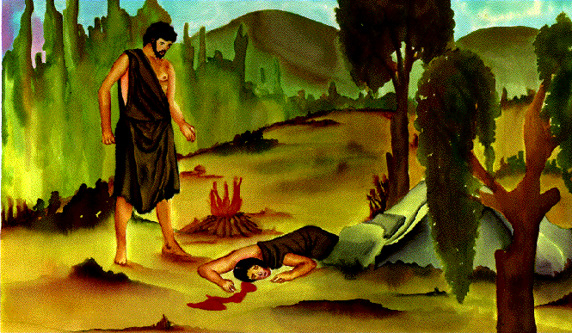
Cain Kills Abel

Slide 55
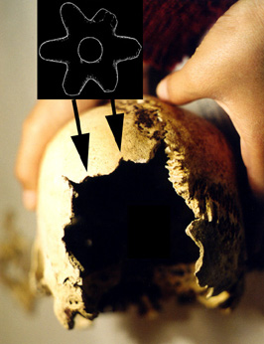
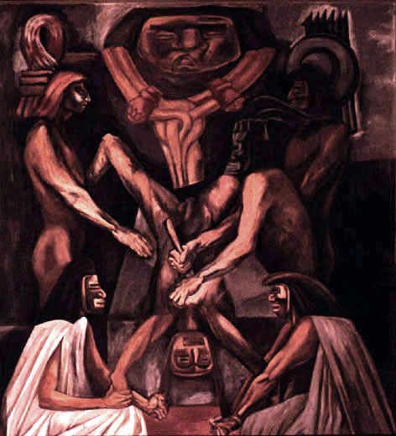
Human Sacrifice
Ancient Aztecs of South America also practiced this horrible ANE custom

Slide 56

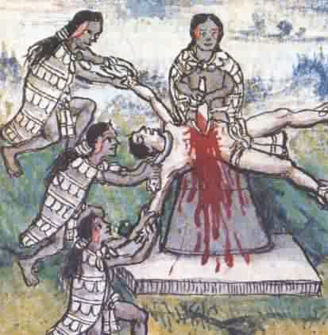
Human Sacrifice
Aztecs offered an estimated 20,000 people a year to their gods.

Slide 57

Ahaz of Judah
"He burned sacrifices in the Valley of Ben Hinnom and sacrificed his sons in the fire, following the detestable ways of the nations the LORD had driven out before the Israelites"
( 2 Chron. 28:3)

Slide 58
Oholah & Oholibah of Judah
"…They committed adultery with their idols; they even sacrificed their children, whom they bore to me, as food for them . . . On the very day they sacrificed their children to their idols, they entered my sanctuary and desecrated it. That is what they did in my house"
(Ezek. 23:37, 39).

Slide 59
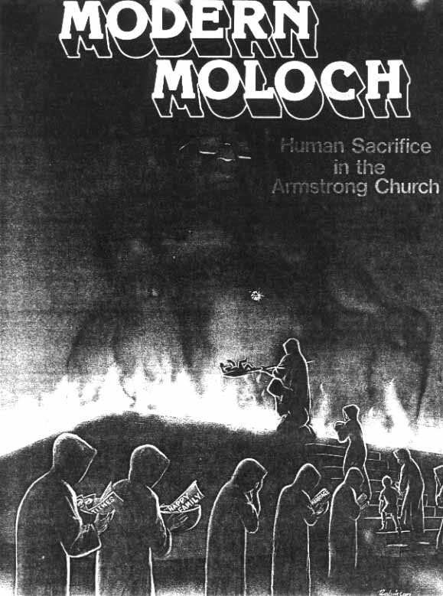
"Divine Healing Only"
Countless people have died needlessly as religious leaders refuse to take them to doctors!

Slide 60

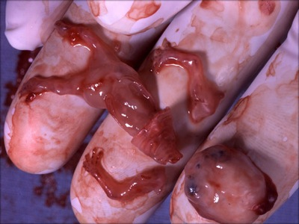
Human Sacrifice Today

Slide 61
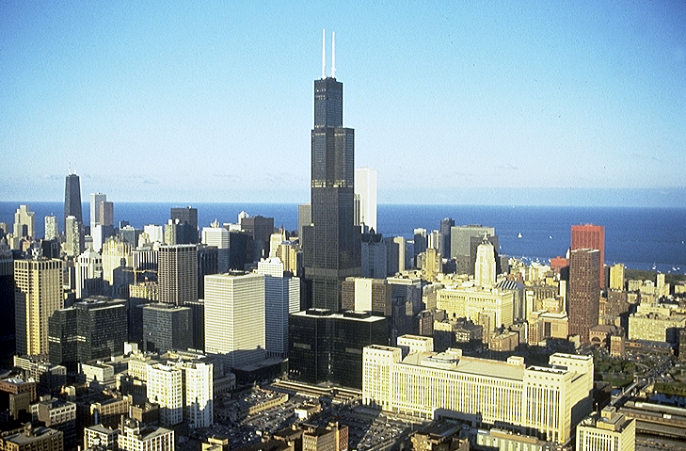


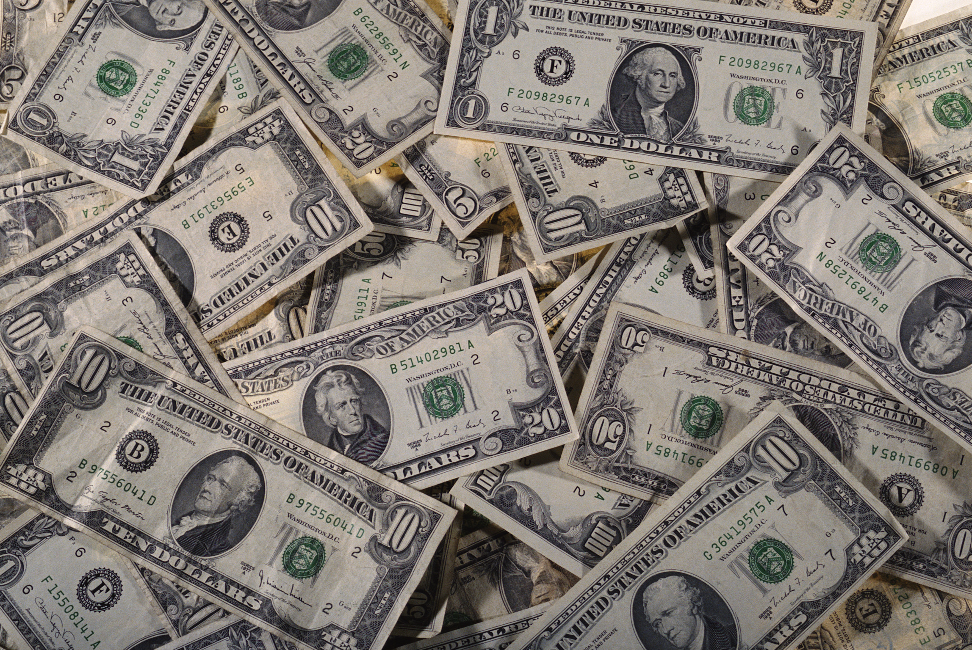


TBB
QUESTION: IN A HIGH TECH WORLD, WHAT ABOUT JESUS' BLOOD SACRIFICE?
58

Slide 62
Hebrews 9:15-22
On the Meaning of the "BLOOD"…
¹⁵For this reason Christ is the mediator of a new covenant, that those who are called may receive the promised eternal inheritance — now that he has died as a ransom to set them free from the sins committed under the first covenant.
59
2

Slide 63
Hebrews 9:15-22
¹⁶In the case of a will, it is necessary to prove the death of the one who made it,
On the Meaning of the "BLOOD"…
¹⁷because a will is in force only when somebody has died; it never takes effect while the one who made it is living.
60
1

Slide 64
Hebrews 9:15-22
On the Meaning of the "BLOOD"…
¹⁸This is why even the first covenant was not put into effect without blood.
61

Slide 65
Hebrews 9:15-22
¹⁹When Moses had proclaimed every commandment of the law to all the people, he took the blood of calves, together with water, scarlet wool and branches of hyssop, and sprinkled the scroll and all the people.
On the Meaning of the "BLOOD"…
62

Slide 66
Hebrews 9:15-22
On the Meaning of the "BLOOD"…
²⁰ He said, "This is the blood of the covenant, which God has commanded you to keep."
²⁰ He said, "This is the blood of the covenant, which God has commanded you to keep."
63
1

Slide 67
Hebrews 9:15-22
On the Meaning of the "BLOOD"…
²¹In the same way, he sprinkled with the blood both the tabernacle and everything used in its ceremonies.
64

Slide 68
Hebrews 9:15-22
On the Meaning of the "BLOOD"...
²²In fact, the law requires that nearly everything be cleansed with blood, and without the shedding of blood there is no forgiveness.
65

Slide 69
Hebrews 9: 15-22
On the Meaning of the "BLOOD"…
²²In fact, the law requires that nearly everything be cleansed with blood, and without the shedding of blood there is no forgiveness.
shedding of blood
66
1

Slide 70
Hebrews 9:15-22
On the Meaning of the "BLOOD"…
Without that sacrifice, there is no forgiveness. Our Lord provided that ultimate sacrifice when he went to Calvary and became victorious over death itself in our behalf!
67

Slide 71
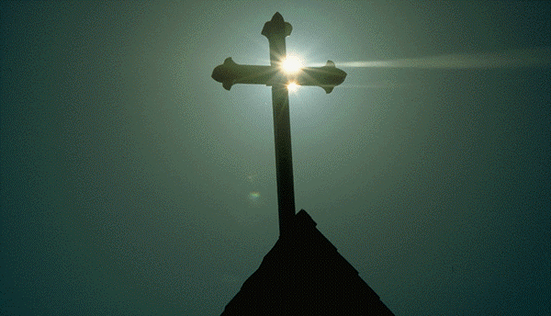
What's So Good About Good Friday?

Slide 72
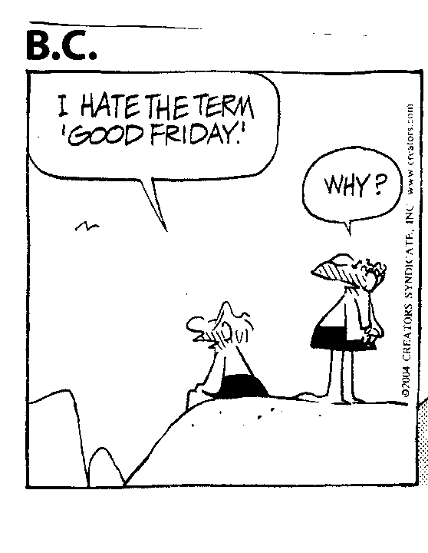
BC 1 of 3
What does all this mean?
I hate the term “Good Friday.”
Why?

Slide 73
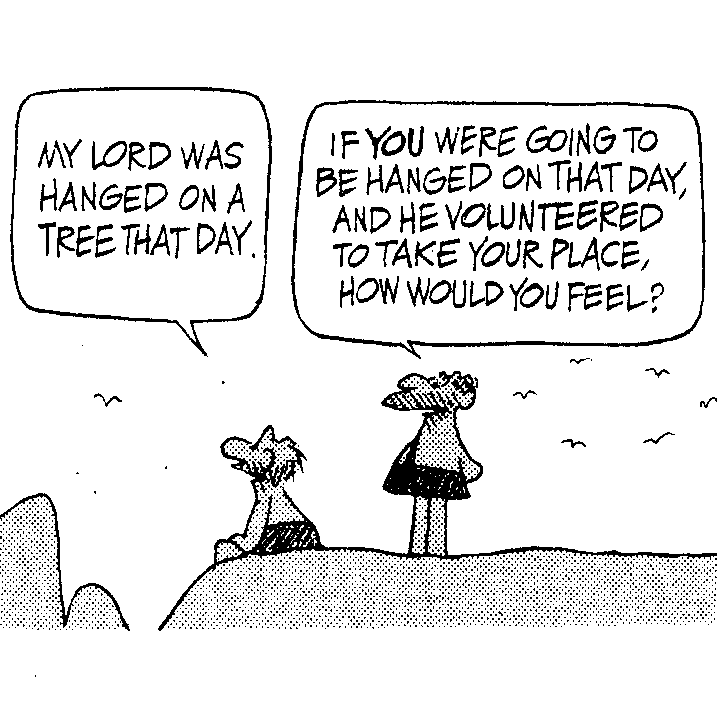
BC 2 of 3
What does all this mean?
My Lord was hanged on a tree that day.
If YOU were going to be hanged on that day, and he volunteered to take your place, how would you feel?

Slide 74
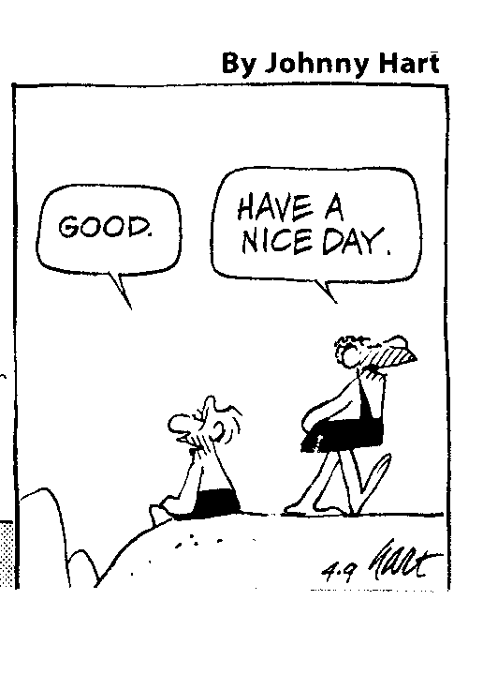
BC 3 of 3
What does all this mean?
Have a nice day.
Good.

Slide 75
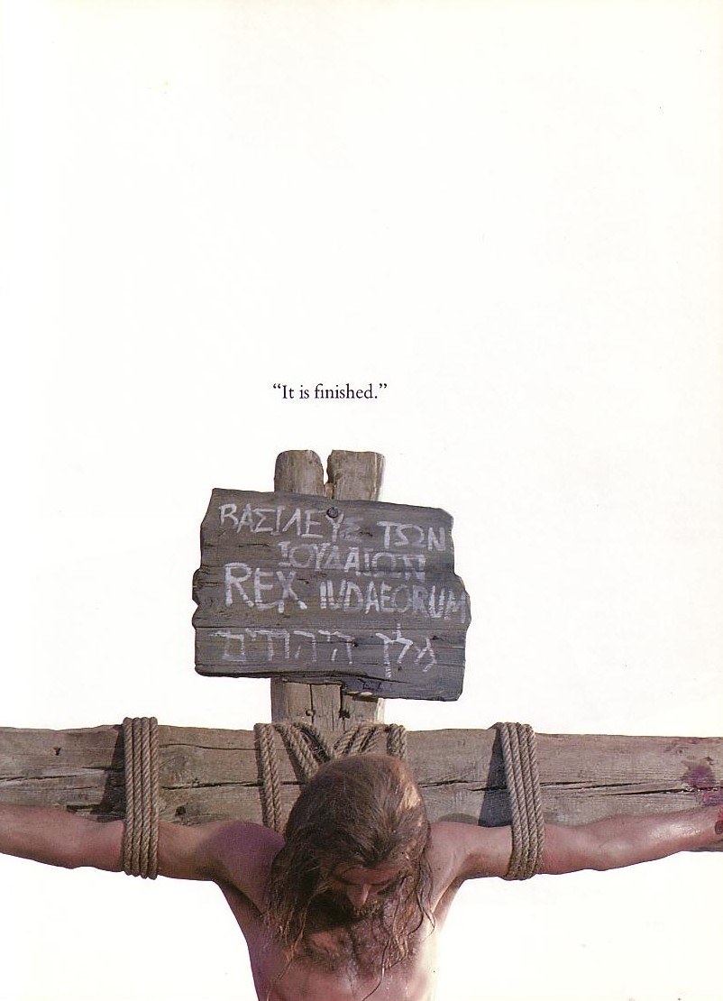

"It is finished"
Legal
Paid
in Full

Slide 76
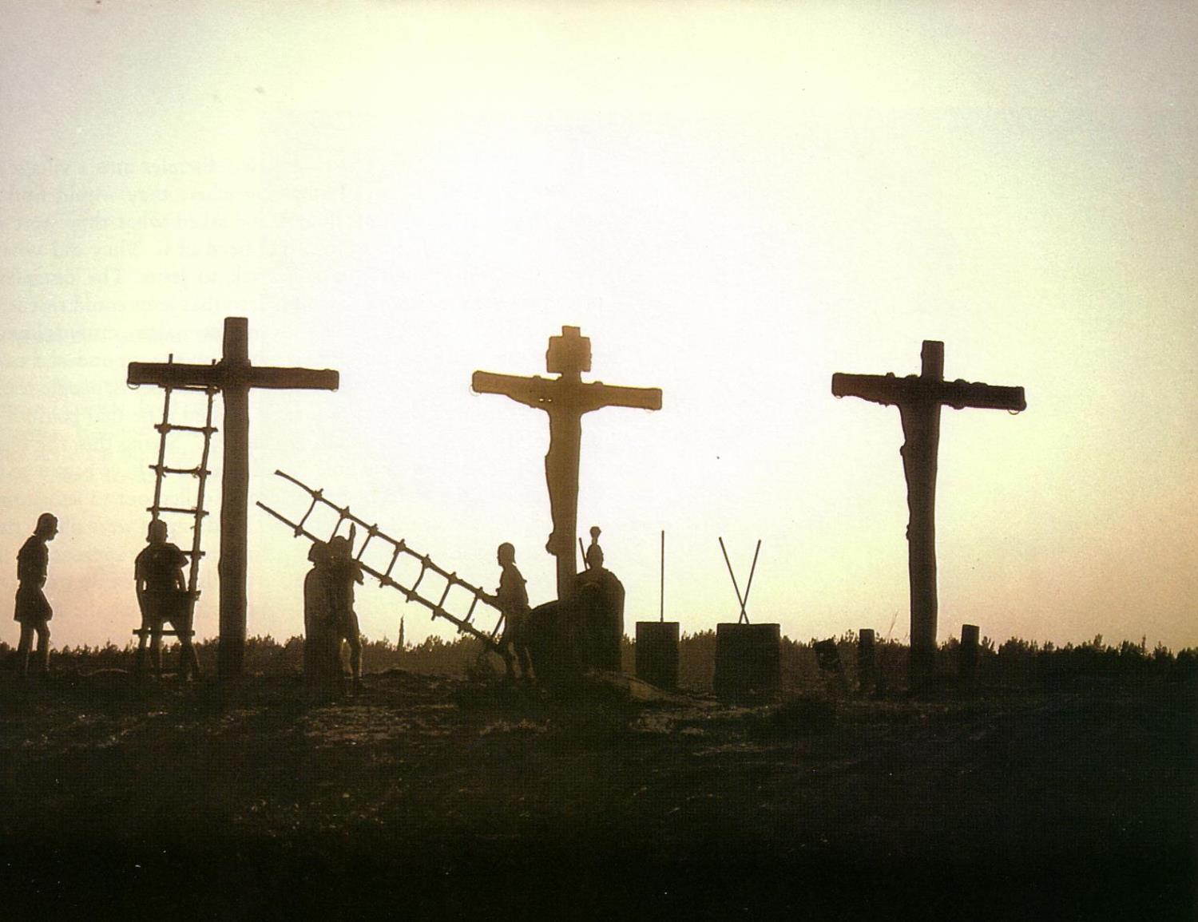
How was Jesus' death unique?
Illegal
He died for our sin
He died of a broken heart

Slide 77
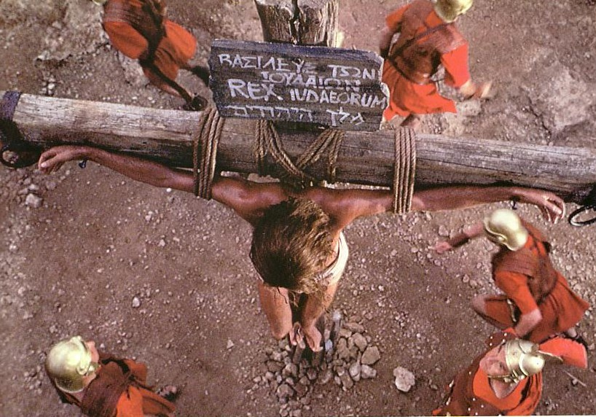
How do you now better appreciate Christ's death for you?

Slide 78
Black

Slide 79


OT Backgrounds link at BibleStudyDownloads.org
Get this presentation for free!
Notes:
NT Survey (ns)

