Slide 1
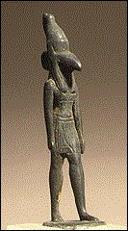
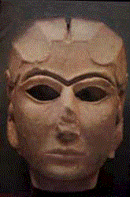
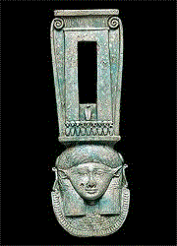
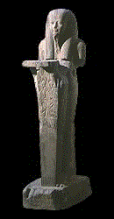
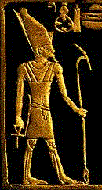

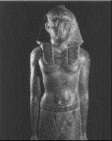

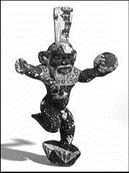



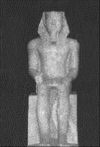

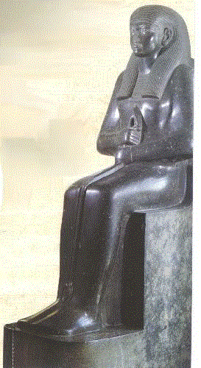



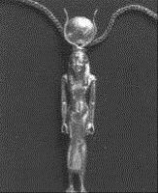

Pagan Religions
160a
PAGAN RELIGIONS
Dr. Rick Griffith • Jordan Evangelical Theological Seminary • BibleStudyDownloads.org

Slide 2
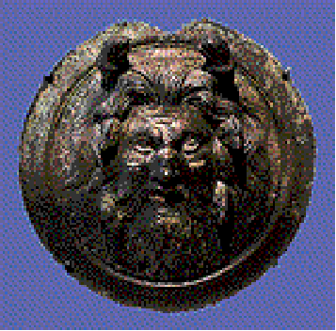
What is the key reason we see so many religions in the world?
Answer in your small groups
Why are there such divergent beliefs since we all had the same biological source in Adam and Eve?

Slide 3

Romans 1:20
Person who is Limitless
Person who is Supernatural
For since the creation of the world God's invisible qualities—his eternal power and divine nature—have been clearly seen, being understood from what has been made, so that men are without excuse (NIV).

Slide 4
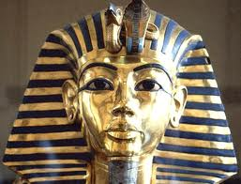
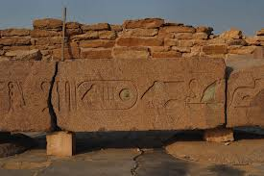
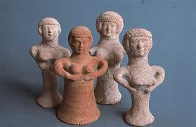
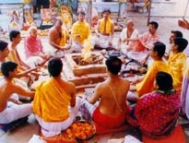
Scope
160b
Scope:
Let's compare and contrast the major pagan religions of antiquity. How did their worship differ from one another?

Slide 5
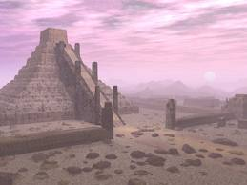
Methodology
160b
Gather information on pagan religions of the main people groups (Sumerians, Babylonians, Assyrians, Canaanites, Egyptians, etc.)
Compare the religions under 3 main categories: characteristics of gods, temple worship, general beliefs and practices.
Consider what we can learn from these counterfeit religions.

Slide 6
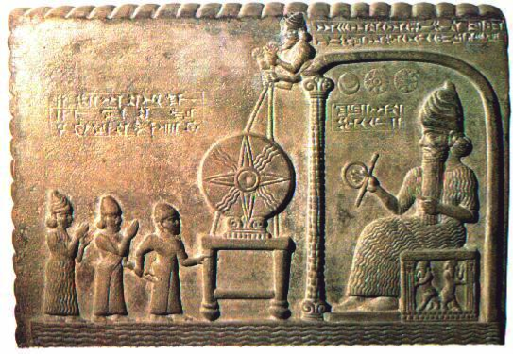
Sumerian-Babylonian gods
160b

Slide 7
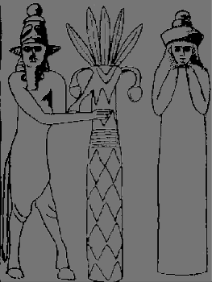
ENLIL
160c
SUMERIAN HIGH GOD
Lord of the airspace
God of heaven and earth
Responsible for the Flood
Creator of mankind
Banished to 'hell' for raping Ninlil

Slide 8
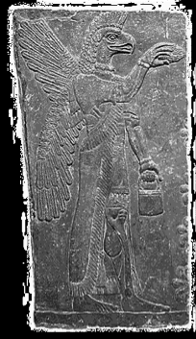
MARDUK
160c
BABYLONIAN HIGH GOD
'King of the Igigi'
four eyes, four ears,
emits fire from his mouth
Anu installed to lead pantheon
Given more than 50 names:
1. Asarluhi, 2. Marduk, 3. The Son, The Majesty of the Gods, 4. Marukka, 5. Mershakushu, 6. Lugal-dimmer-ankia (King of heaven and earth), 7. Bel, 8. Nari-lugal-dimmer-ankia, 9. Asarluhi, 10. Namtila, 11. Namru, 12. 'Asare, 13. Asar-alim, 14. Asar-alim-nuna, 15. Tutu, 16. Zi-ukkina, 17. Ziku, 18. Agaku, 19. Shazu, 20. Zisi, 21. Suhrim, 22. Suhgurim, 23. Zahrim, 24. Zahgurim, 25. Enbilulu, 26. Epadun, 27. Gugal, 28. Hegal, 29. Sirsir, 30. Malah, 31. Gil, 32. Gilima, 33. Agilima, 34. Zulum, 35. Mummu, 36. Zulum-ummu, 37. Gizh- numun-ab, 38. Lugal-ab-dubur, 39. Pagal-guena, 40. Lugal-Durmah, 41. Aranuna, 42. Dumu-duku, 43. Lugal-duku, 44. Lugal-shuanna, 45. Iruga, 46. Irqingu, 47. Kinma, 48. Kinma, 49. E-sizkur, 50. Addu, 51. Asharu, 52. Neberu, 53. Enkukur

Slide 9
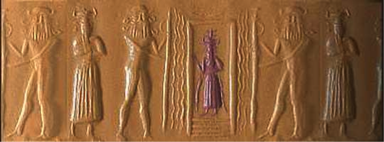
Canaanite gods
160c

Slide 10

BAAL
160d
CANAANITE HIGH GOD
Prince of the earth, god of fertility, lord of sky and earth, god of thunder and lightning etc
Lord, master, owner
Chief male deity of the Phoenicians and Canaanites
Slain by Mot & revived by Anath
Worshipped in the high places of Moab (Num. 22:41)

Slide 11

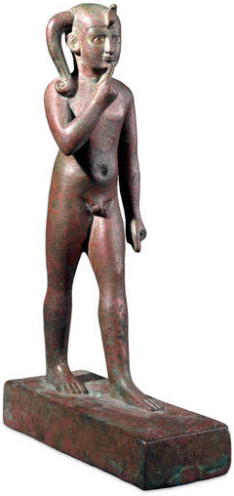

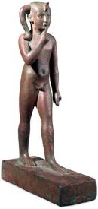
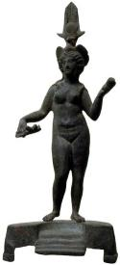

The Baal Cycle
Baal Rises
Baal Rises
Mot kills Baal
Mot kills Baal
Winter
Spring
Summer
Fall
Winter
Spring

Slide 12
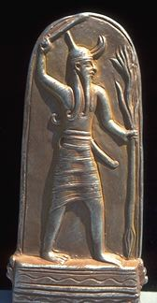


Religion
90
Baal fertility cycle (Baal Epic)
Mot (death) in winter defeated by Baal (life) in spring
Temple prostitution and sexual fertility rites in religious worship helped Baal resurrect in spring

Slide 13

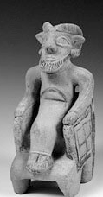
Child Sacrifice to Baal
91
During worship live babies were placed on the burning hot hands of the statue of Baal.
After dying they were then pushed into a hole underneath.

Slide 14
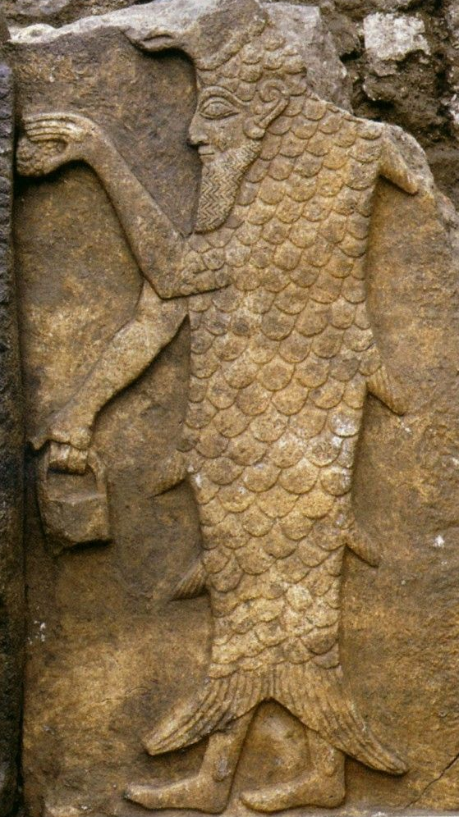
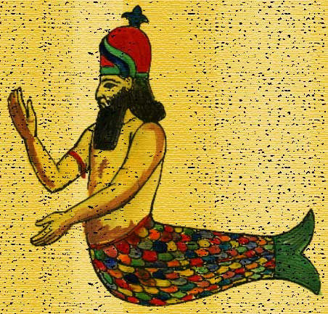
DAGON
160d
PHILISTINE HIGH GOD
Hebrew word dag (fish): Human with back half as fish
Hebrew/Akkadian word dagan (grain): a grain god
Upper torso: man
Back half: fish
Temples at Gaza, etc.
(Judges 21, 23)

Slide 15


Egyptian gods
160d

Slide 16
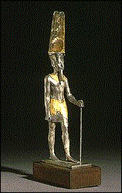
AMUN
160e
EGYPTIAN HIGH GOD
'King of the Gods'
Man with a ram-head
Wore ostrich plumed hat
Later called Amun-Ra

Slide 17
Similar gods
Similar gods
160e

Slide 18
Pagan gods were like humans
160e
Had families and could procreate
Ate and feasted - even got drunk!
Experienced human feelings of jealousy, anger, lust, etc.
Fought amongst themselves
Had varying powers but none omnipotent
Could die and re-live again

Slide 19
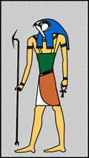
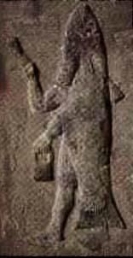
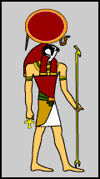
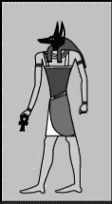
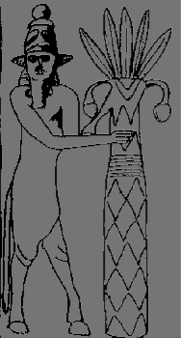
Portrayed as Human-Animal
160f
Dagon (fish tail)
Horus (hawk head)
Enlil (horse legs)
Ra (eagle head)
Anubis (jackal head)

Slide 20



WHO DOES NOT BELONG HERE? ? ?

Slide 21
Pagan Beliefs on Creation
160f
    The Sumer-Babylonian myths depict creation with war and violence (a classic case of the "fittest survive" mentality).
    Egypt's creator was powerful but when he became Pharaoh and lived with men, his power dissipated into the air.

Slide 22
Pagan Beliefs on the Great Flood
160f
Assyrian
Humanity overpopulated
The gods, led by Enlil, agreed to cleanse the earth
Utnapishtim was warned of a flood by the god Ea in a dream
He built a seven-level ship with all living creatures aboard
It stormed for six days
He released dove, sparrow & raven, then knew water had receded
Sacrificed to the gods and he & his wife given immortality

Slide 23
Pagan Beliefs on the Great Flood
160f
1. Babylonian flood - result of a disagreement among the gods vs Assyrian - earth was overpopulated
Assyrian
2. Both Ziusudra (Babylonian) and Utnapishtim (Assyrian) were given immortality
Humanity overpopulated
The gods, led by Enlil, agreed to cleanse the earth
Utnapishtim was warned of a flood by the god Ea in a dream
He built a seven-level ship with all living creatures aboard
It stormed for six days
He released dove, sparrow & raven, then knew water had receded
Sacrificed to the gods and he & his wife given immortality

Slide 24
Pagan Beliefs on Life after Death
160g
1. Besides Egyptians who believed in some form of hope in next life based on works, the other cultures did not have favorable views of the after-life

Slide 25
Pagan Beliefs on Relationship with Gods
160g
1. Consideration for morality was not so distinct in Sumer-Babylonian and Canaanite/ Phoenician cultures
2. Egyptians' motivation for morals was based on fear and entry to heaven on good works

Slide 26
Pagan Worship by Priests
160g
Sumer-Babylonian
Egyptian
Assyrian
    King = official representative of deity, insuring fertility of land by careful observance of the New Year ritual
    Elaborate priestly bureaucracy to maintain temple and its deity
    Queen might manage affairs of temple goddess
    Pharaoh = divine, ultimate high priest who built temples and oversaw their maintenance.
    Lay priests operated small chapels with patron deities not worshipped anywhere else.
Epic of Ugarit
King represented human community before gods.
12 priestly families with a high priest among them
Others: consecrated persons (possibly cultic prostitutes), singers, makers of vestments and sculptors. Priests functioned as scribes as well.
1. Political rulers assumed to have close contact with gods
2. Women functioned with special roles in the temple

Slide 27
Pagan Worship in Temples
160h
Sumer-Babylonian
Egyptian
Assyrian
    Temple = 1/3 of city, may lease land for income
    Ziggurat, a stepped tower of 3-7 stages
    divine statue at foot of temple carved from wood, adorned with precious stones
    Temples built on ruins , eventually becoming man-made mountains
    Hypostyle hall for religious rituals - priests and pharaoh only
    Second hall - high priest and pharaoh only
    Sanctuary -> shrine where the statue of the god or goddess was kept - god or goddess may enter statue.
    Sacred lake next to the temple
    Temples = dwelling place of deity
    courts = festive assemblies
    statue to depict deity
    Tophet (child cemeteries) contain some 20,000 cinerary urns with the remains of infant children and animals.
1. Grand architecture depicting central importance of religion
2. Existence of statues to represent gods

Slide 28
Pagan Worship - Rites & Rituals
160h
Both sexes went to temples not to worship
but to be worshipped!

Slide 29
Pagan Worship - Rites & Rituals
160h
Their immorality was so depraved that they killed people just for their material prosperity!
Moabites
Philistines
    National god Chemosh, worshipped primarily by offering the first-born son (2 Kings 3:26-27)
    Baal, Lord of Heaven
    worshipped by both ritual immorality and child sacrifice (2 Kings 16:7, 21:6).

Slide 30
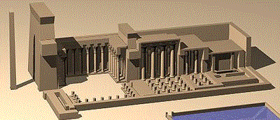
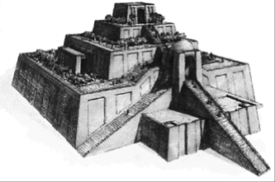
Babylonian & Assyrian Temples
160h

Slide 31
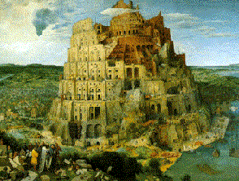
THE TOWER OF BABEL (Gen. 11:1-5)
In this classic story, people were building a colossal staged temple-tower or multi-storeyed ziggurat that would reach heaven. But did they really believe they could reach their gods? Most likely the tower would be used as a place of worship.
Actually, their purpose for the tower was to provide a common religious rallying point, lest the people be scattered. The builders were in open defiance of God's command (Gen. 9:1) .

Slide 32
What common characteristics were true of most, if not all, Ancient Near East pagan religions?
Give at least two traits.
In other words...

Slide 33
Uniqueness of Pagan Religion
Polytheistic
Gods sinful
Blemished sacrifices
Offerings
Priestesses
Local deities
Religions of the plains (left-stage)
Worship motivated by fear or finances
Visual images of gods (idols)
Temple prostitutes
Had to care for their gods
Mythology acceptable
Political leaders

Slide 34
How was Israel's religion distinct from these other religions of the OT era?
Give at least two contrasts.

Slide 35
Israel's Distinct Worship
Monotheistic (worshipped the true God)
Holy God without sin
Priesthood by genealogy
YHWH not a local deity
Salvation by faith (?)
Attested by genuine miracles
Religion of the desert (right-stage)
No physical depiction of God
Moral standards of worshipers & leaders
Covenant relationship with God
God initiated
Can't manipulate God
Male priests only

Slide 36

But what does this all have to do with me?
Let's now see the Discovery Channel movie on superstitions of the Hungry Ghost…

Slide 37
How did reading these pagan writings for today's class help you appreciate Judaism?
How did this possibly aid your own walk with God?

Slide 38
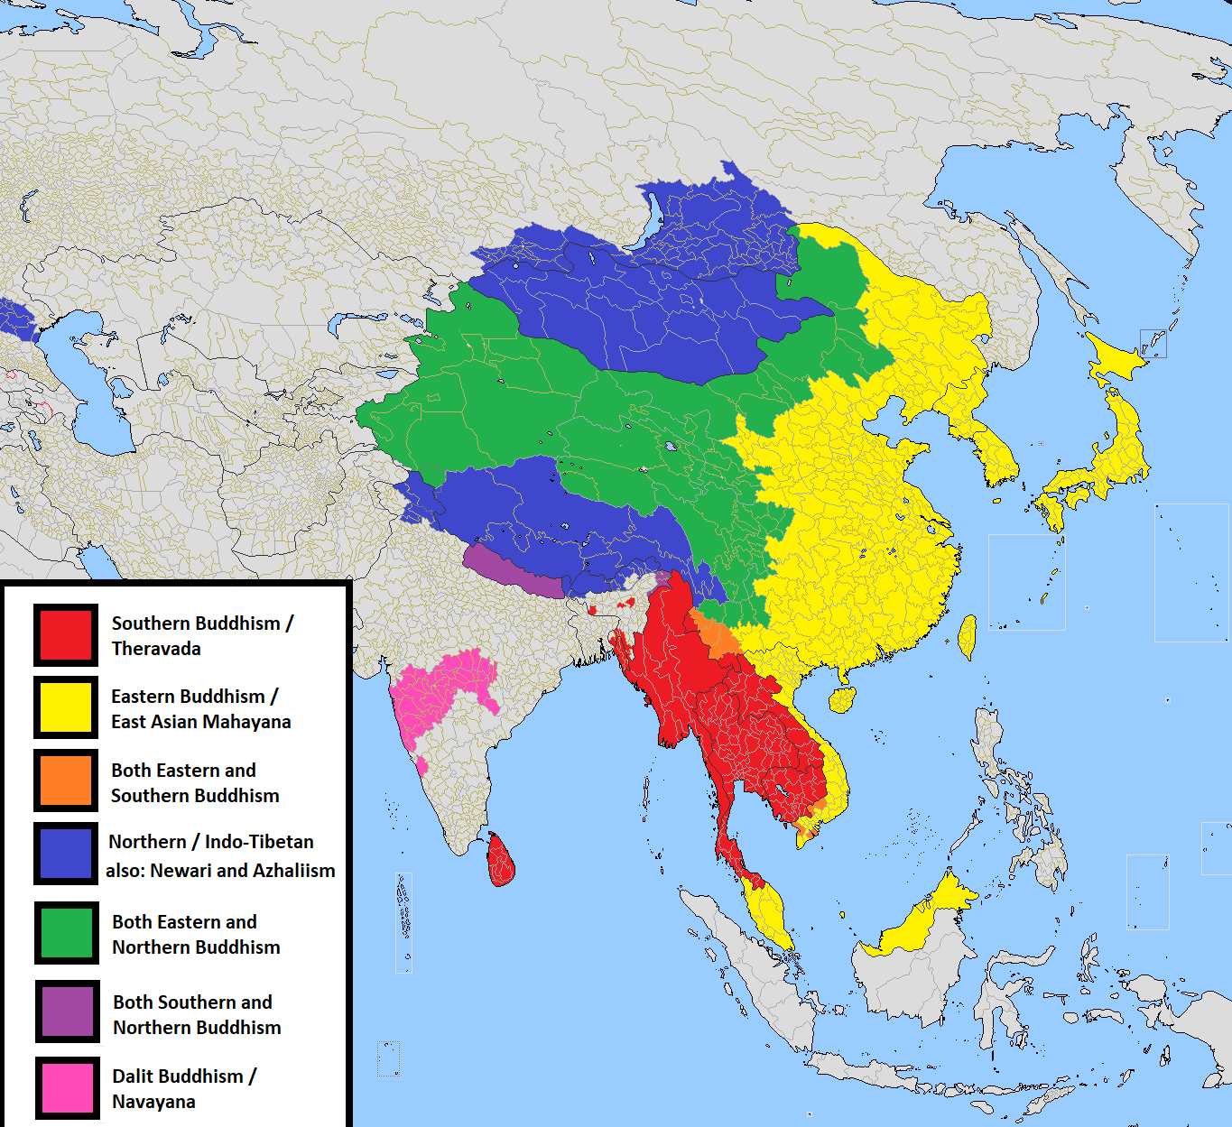
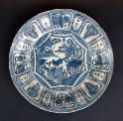


Buddhism

Slide 39




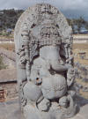

Hinduism

Slide 40




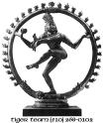
Hinduism

Slide 41
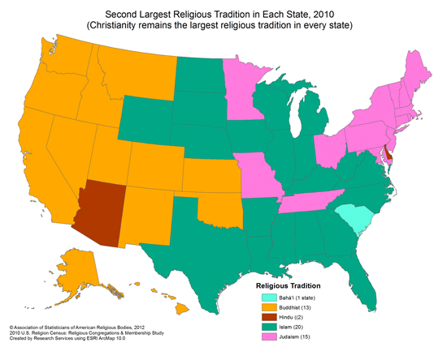
Second Largest Religious Tradition in Each State, 2010
(Christianity remains the largest religious tradition in every state)
Religious Tradition
Baha’i (1 state)
Buddhism (13)
Hinduism (2)
Islam (20)
Judaism (15)
Notes:
https://tricycle.org/trikedaily/painting-west-saffron/
Painting the West Saffron
A new map published by the Washington Post misrepresents Buddhist populations in Western states.
By Jeff WilsonJun 10, 2014
Scholars have known for some time that Buddhism is the largest religion in Hawaii after Christianity, the majority religion in all US states. Now—according to an article in last week’s Washington Post—Buddhism has also attained second-place status in a dozen Western states.
The Washington Post makes its case with a colorful map that indicates the number of adherents to the second-largest religion in each state. It shows Buddhism taking second-place honors in Hawaii, Alaska, Washington, Oregon, California, Idaho, Montana, Nevada, Utah, Colorado, New Mexico, Kansas, and Oklahoma.
When you look at the map by county, however, the data isn’t as clear as the first state-by-state map suggests. The solid swath of Buddhist saffron that covers nearly the entire western side of America in the state map becomes a fractured mess of color in the county map. It reveals that Buddhism is sometimes only popular in a handful of the Western states’ small counties, with many other surrounding counties colored to indicate that Muslims, Jews, Hindus, or Baha’i are the dominant minority. Buddhists dominate only a single county in both Nevada and Oklahoma, for example, but because those counties are so populous, the whole state gets awarded to the Buddhists. The opposite also happens: there are places where Buddhists are clearly numerous, yet the state is claimed for some other religion. (The informative value of these kinds of maps in general was recently critiqued in an article in Jacobin titled “Infotainment Journalism.”)
My reaction to these maps, especially the primary state-by-state one, is conflicted. The data on Buddhism may be broadly correct, but a closer look reveals many flaws. The Religious Congregations and Membership Study, which provides the data for these maps, pulls its statistics on Buddhism from a significant but problematic study conducted in 2009. I was present when the results of that study were announced at the American Academy of Religion, and like many other experts, I came away troubled by the conceptual flaws in the data collection. My own understanding of the numbers, based on field site visits to many hundreds of Buddhist groups in every tradition and every part of America, differed significantly from theirs. Some groups I knew to be much smaller than they were being represented, while others were certainly larger than the study claimed. And there were some key groups that seemed to be flat out missing. I happened to be seated next to a high-ranking insider for one of the (allegedly) biggest groups included in the study, and as the number of adherents in his organization was rattled off by the presenter, he sharply drew in his breath, shook his head, and turned to whisper to me that the study’s number was way off: his group had at best a third of the number of members that the study was claiming.
Why is it so hard to get the numbers right on Buddhists in America, despite the best efforts of highly trained and experienced social scientists? To save space (and the reader’s patience), I’ll just focus on the largest factors that cause under- and overestimation of Buddhist populations in the US. The data for the maps is based on a study that counted affiliations with organized religious groups—a method, like nearly all studies of American religion, derived from a Protestant Christian model. This model fundamentally assumes that all religious persons gather together into exclusive public bodies with which they maintain a unique personal identification. But that just isn’t true of most religions, and it certainly isn’t true for most people who practice Buddhism, in Asia or in the United States.
For the average Buddhist practitioner, there has never been an expectation of regular visitation to a site like Sunday morning church service. Nor has there been an expectation of formal membership in a specific group, such as belonging to a congregation. The average person in Buddhist Asia hasn’t claimed personal identification with a particular sect—indeed, in many cultures historically influenced by Buddhism, regular participants in Buddhist activities won’t even admit to belonging to any religion, let alone claiming identity as a Buddhist.
The Buddhist pattern of non-attendance and non-affiliation holds fairly well in the United States, too. Here, religious incorporation laws based on Protestant congregationalism and dominant cultural expectations have led some Buddhists to create formal institutions that hold weekly meetings and maintain membership lists (or at least mailing lists). But the simple fact is that great masses of people practicing Buddhism—including self-identified Buddhists— don’t profess affiliation with any particular institution. This means that even generally reliable data collection methods, such as large-scale phone surveys that ask individuals to list their religious identifications, do not capture a fully accurate picture of Buddhist numbers.
When you collect data by contacting Buddhist groups in the phonebook (so to speak—the study’s attempts to identify formal Buddhist groups were actually more wide-ranging and sophisticated), you miss crucial pieces of the puzzle. Not only do you neglect the sizable numbers of people who rarely or never attend a public group; you also overlook the many grassroots gatherings and loose networks that aren’t registered as formal tax-exempt organizations. These missing Buddhists almost certainly comprise the majority of people practicing Buddhism in America. So at the very best, these maps represent the relative sizes of minority religious institutions in each state rather than the actual relative number of Buddhists, Muslims, and so forth.
On the other hand, approaching the groups you can find and asking them how many adherents they have is also a recipe for problems. Religious groups often have little incentive to report accurate numbers. Many lack the ability—or interest—to collect reliable data. Minority religious groups have even less incentive: when you’re heavily outnumbered in a historically racist and at times religiously intolerant society, you’ve got compelling reasons to exaggerate your size and strength. Projecting a larger image of small organizations can help dissuade those who might be inclined to harass those groups they think can’t fight back.
Among other things, projecting a larger image of your organization can make it seem less marginal. The issue is compounded by the sense of competition that many religious groups—including some Buddhists—feel with outside groups. Numbers come to be seen as a measure of the effectiveness, even the correctness, of one’s doctrines and practices. It can be embarrassing or humiliating to report the low number of people who agree with your conviction of how the universe operates. Many misrepresent their groups’ sizes as much to avoid their own anxieties as to brag to outsiders.
The numbers that the Washington Post maps utilize thus cannot be accurate in any strict sense of the word, since they’ve missed many Buddhists on the one hand and received dubious information from some of the groups on the other. But does this mean that the study, and the maps derived from it, are useless to us? Not necessarily so.
Although not completely accurate, the study is suggestive and intriguing. Leaving aside the specific numbers, we can focus on overall patterns. Regardless of whether or not Buddhism is indeed the second-largest religion in all 13 listed states—and none of the other 37—we can be relatively confident that Buddhism tends to represent a higher percentage of adherents compared to other non-Christian groups in the West than in other parts of the country.
In my book Dixie Dharma, I argue that we need to take a regional view in examining Buddhism in America, and the West is one of the most important of America’s Buddhist regions. Western states have received the highest share of Buddhist immigrants since the 1840s, and the region’s spirit of religious experimentation has encouraged many others to explore Buddhism. Buddhism on the Left Coast has had a long time to establish an institutional presence, and has also had a great mass of likely adherents from which to draw. It thus makes a good showing in a study based on a survey of religious institutions.
These differences between places, such as that between the West and the rest of America, give reason to take a regional lens rather than blithely talking about “American Buddhism” as a whole. To practice Buddhism in California may be a different thing than to practice it in South Carolina. Beyond the obvious differences of climate and terrain, the Buddhist experience is impacted by whether one has access to local institutions and a variety of traditions—something most Americans can’t take for granted. It matters if Buddhism is acknowledged as a relatively large presence in one’s area or exists among a variety of different minority religions and a significant population of non-religious (or at least non-committed) people. It’s quite a different Buddhist experience to practice in a place where religious diversity is low and not necessarily celebrated than in much of California.
Even if some survey one day suggests more reliably that Buddhism is the second-largest religion in every state, we’ll still need to keep these sorts of maps in perspective. The truth is that Christians outnumber members of non-Christian religions 15 to 1. And Christianity’s massive dominance is unlikely to change within our lifetimes or those of our grandchildren, no matter how multicultural the country becomes in the meantime. As sociologist Mark Silk points out in his own reaction to the Washington Post article, even the religiously unaffiliated outnumber all minority religions put together by a factor of 4 to 1. In light of this, being the second largest religion just doesn’t amount to much.

Slide 42
Application
160i
Application
Israel was influenced by paganism (Ps. 106:34-42), so today, we should beware of syncretism.
- Children's coloring book ("The many faces of the Great Mother" - Ashteroth)
- Girl Scouts oath (reduced emphasis on God)
- World Council of Churches (prayers to goddess Sophia)
Do not let God-centeredness in you reduce to self-indulgence (2 Cor. 10:4-5)

Slide 43
Application
160i
Application
"Pay attention to all that I have said to you, and make no mention of the names of other gods, nor let it be heard on your lips"
(Exodus 23:13 ESV).
Israel was influenced by paganism (Ps. 106:34-42), so today, we should beware of syncretism.
- Children's coloring book ("The many faces of the Great Mother" - Ashteroth)
- Girl Scouts oath (reduced emphasis on God)
- World Council of Churches (prayers to goddess Sophia)
Do not let God-centeredness in you reduce to self-indulgence (2 Cor. 10:4-5)

Slide 44
Application
160i
Application
"Pay attention to all that I have said to you, and make no mention of the names of other gods, nor let it be heard on your lips"
(Exodus 23:13 ESV).
"We are human, but we don’t wage war as humans do. ⁴ We use God’s mighty weapons, not worldly weapons, to knock down the strongholds of human reasoning and to destroy false arguments. ⁵ We destroy every proud obstacle that keeps people from knowing God. We capture their rebellious thoughts and teach them to obey Christ."
(2 Cor 10:3-5 NLT).
Israel was influenced by paganism (Ps. 106:34-42), so today, we should beware of syncretism.
- Children's coloring book ("The many faces of the Great Mother" - Ashteroth)
- Girl Scouts oath (reduced emphasis on God)
- World Council of Churches (prayers to goddess Sophia)
Do not let God-centeredness in you reduce to self-indulgence (2 Cor. 10:4-5)

Slide 45
Bibliography
Hoerth, Alfred J.; Mattingly, Gerald L.; and Yamauchi, Edwin M., eds. Peoples of the Old Testament World. Grand Rapids, Michigan: Baker Books 1994.
Gower, Ralph. The New Manners and Customs of Bible Times. Chicago: Moody, 1987.
Hindson, Edward E. The Philistines and the Old Testaments. Grand Rapids, Michigan: Baker, 1983.
Websites

Slide 46
ORIGINALLY PRESENTED BY:
PAGAN RELIGIONS
ALVIN
AI CHENG
MAGNAI

Slide 47
Black

Slide 48


OT Backgrounds link at BibleStudyDownloads.org
Get this presentation and script for free!

