Slide 1
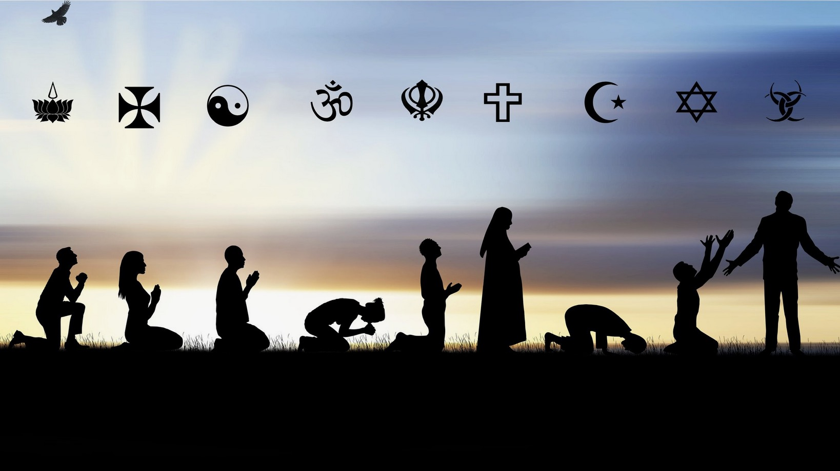
Present Religions
Present
Religions
Dr. Rick Griffith • Jordan Evangelical Theological Seminary • BibleStudyDownloads.org

Slide 2
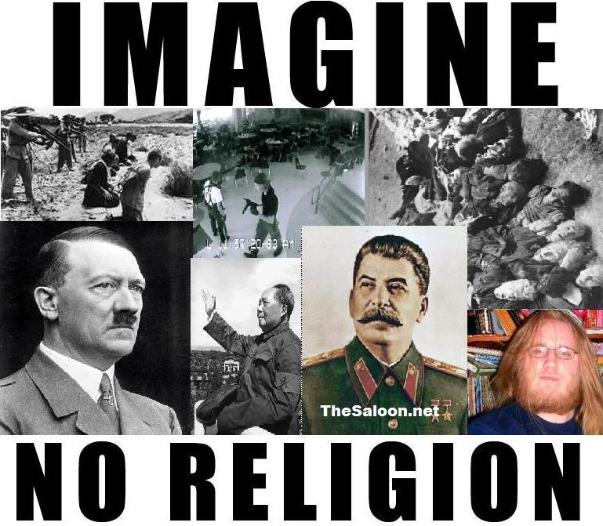
Imagine no religion
IMAGINE
NO RELIGION

Slide 3
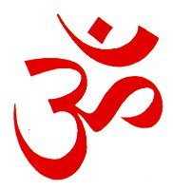
Hinduism
Symbol | Supreme Being | Book
 | One Supreme Reality - Brahman is everywhere but has no form. It can be represented by male, female or animal. Trimurti - 3 gods in one image. Brahma - the Creator Vishnu - the Preserver of life. Shiva - the Destroyer and Regenerator. The images are an aid to worship and are not worshipped themselves. | The Vedas - these existed in oral form for centuries before they were written down. The Puranas - long verse stories of Hindu myths, gods, goddess and heroes. Dharma-Shastra (ancient law and customs) Upanishads and Bhagavad-Gita (philosophical writings)

Slide 4
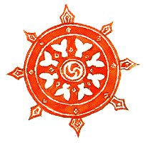
Buddhism
Symbols
Symbol | Supreme Being | Book
 | Buddha (the Enlightened One) Born a Hindu Prince as Siddhartha Gautama c. 560 BC in Nepal. (He is not actually worshipped as a God, but Buddhists follow his teachings) | Tripataka (three Baskets) Written in ancient Pali or in Sanskrit Like baskets of food, the three baskets of wisdom should be passed from one person to another.

Slide 5
Islam
Symbol | Supreme Being | Book
 | Allah | Qur'an (Koran) Comprised of writings of Mohammed (born AD 571).

Slide 6
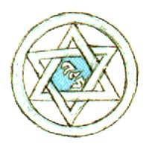
Judaism
Symbol | Supreme Being | Book
 | The Lord God | Tenakh - the Scriptures of 24 books divided into three sections: Torah lists all the Laws given to Moses by God and all the rules for the conduct of everyday living. Nevi'im comprise the prophetic books of Judaism. Ketubim contains the psalms and writings.

Slide 7
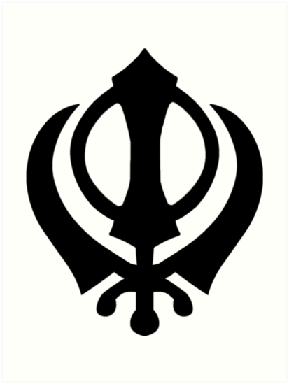
Sikhism
Symbol | Supreme Being | Book
 | Nam (God) | Guru Granth Sahib (Revered Book) Adi Granth (First Book) Includes some writings from Muslims and Hindus

Slide 8
Christianity
Symbol | Supreme Being | Book
 | God The Holy Trinity: God the Father, God the Son, and God the Holy Spirit. | The Bible: Old Testament New Testament

Slide 9
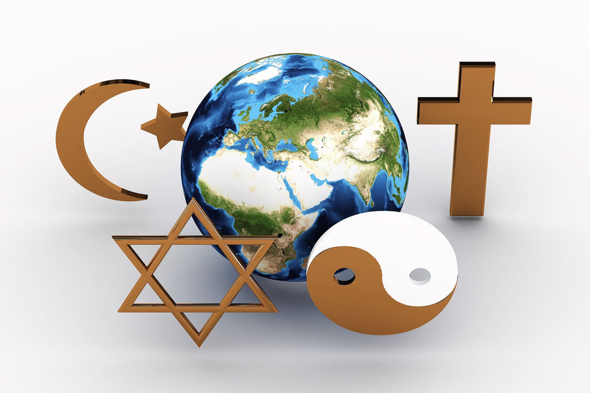

Slide 11
OT Backgrounds link at BibleStudyDownloads.org
Get this presentation for free!
Notes:
NT Survey (ns)

