Slide 1
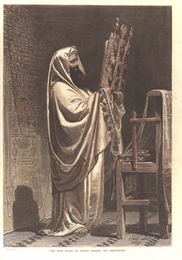
The Priesthood of Judaism
Leadership in the Old Testament
Dr. Rick Griffith • Jordan Evangelical Theological Seminary • BibleStudyDownloads.org

Slide 2
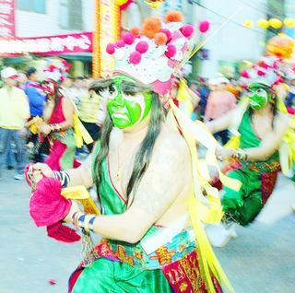
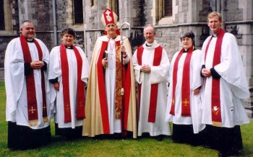
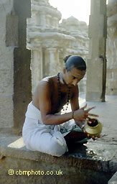
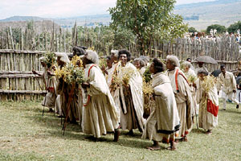
Introduction
one authorized to perform the sacred rites of a religion, especially as a mediatory agent between humans and God

Slide 3
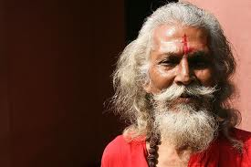
A Hindu Priest's Day
6am: Rise and prayer
7am: 1st bath followed by morning duties (washing and cleaning)
8am: Breakfast (lower ranks to feed gods and bathe them)
9am: Teaching and meeting of people's or other matters on hand
11am: 2nd bath and prayers
12pm: Lunch followed by rest and feeding of gods
1pm: Other duties (funerals, prayers, advice)
3pm: 3rd bath plus washing and dressing of gods
4pm: Priestly rites (sacrifice)
6pm: Dinner and further meditation (feeding of gods)
7pm: Closing and cleaning of temple

Slide 4
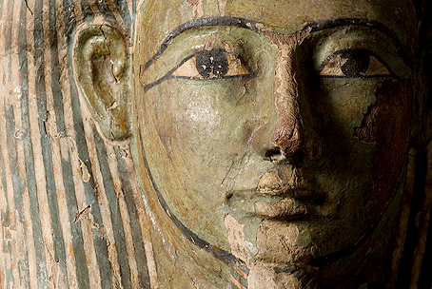
Egyptian

Slide 5
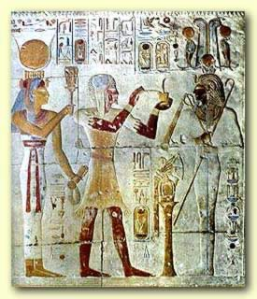
Egyptian Priesthood
Election and types of priests
Purification laws
Duties

Slide 6
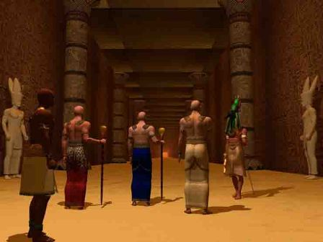
Election & Types
Egyptian belief:
World created, ordered and governed by gods through pharaoh
A god for every aspect of life, even in putting on make-up
The gods must be honoured and attended to every day or life is threatened

Slide 7
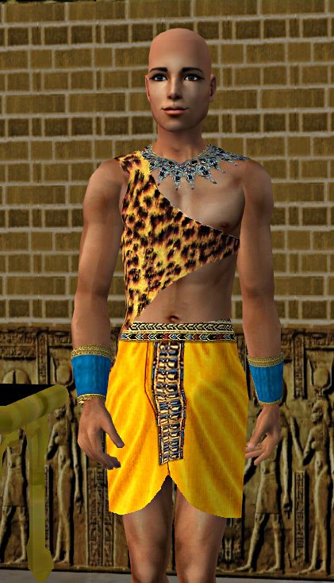
Election & Types
Priesthood may be:
Conferred by the pharaoh
Inherited from father by son, grandson or other family member
Purchased
Priesthood coveted for its privileges & prestige

Slide 8
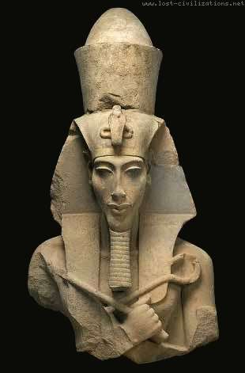
Election & Types
Chief priest – Pharaoh
High priest – Pharaoh's political advisor; oversees magical rites and ceremonies
Lector priest (kher heb) – recites sacred ritual and religious texts
"Specialist" priests – in charge of horology, astrology and healing

Slide 9
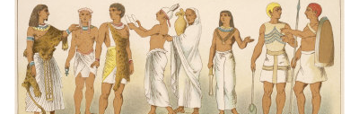
Lay magicians – community service providers (e.g. counseling, magical arts, healing)
Scribes – writing magical texts, issuing royal decrees, maintaining records
Priestesses – singing, music and dance

Slide 10
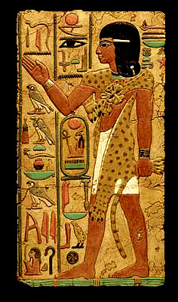
Election & Types
Priests had secular careers
May marry and have children
Called to duty one month in three
Organised in four phyles

Slide 11
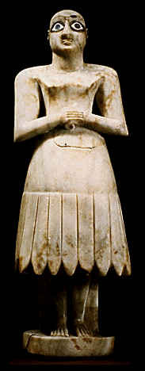
Purification Laws
Purification Laws
Before temple service:
Must wash
Must shave
Must abstain from sexual activity
Must avoid certain food (e.g., fish)
Must avoid wearing wool or leather

Slide 12
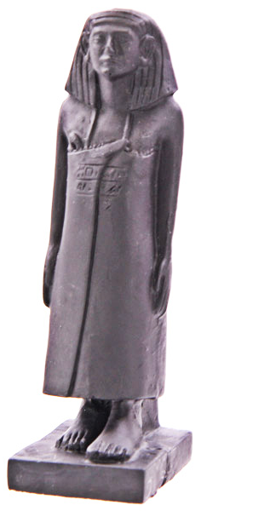
Duties
Not to proselytise
Not to spread teaching about god's superiority
Not to oversee people's spiritual or moral welfare
Not to perform acts of appeasement or sacrifice for the benefit of people

Slide 13
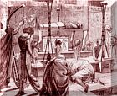
Embalming of Priests

Slide 14
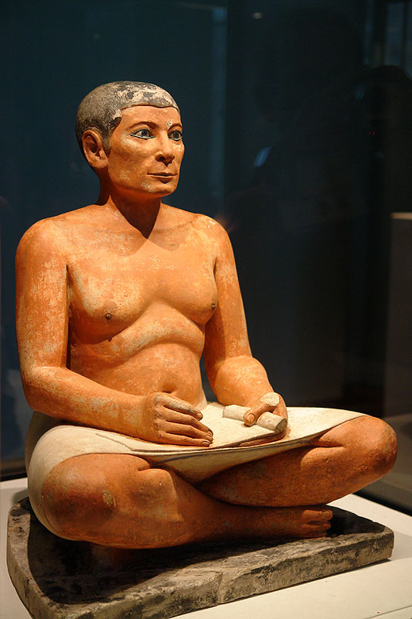
Duties
To honour and attend to gods every day
Festivals and feast days ceremonies
Non-religious duties

Slide 15

Zoroastrianism

Slide 16

Singapore

Slide 17
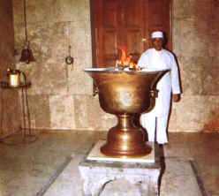
■ Atharvans (Fire priests)
■ Magi
Priestly Hierarchy

Slide 18
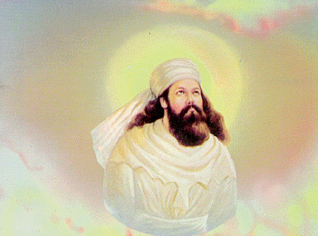
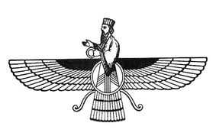
Initiation
Acquired occupation and not a hereditary profession.
Aspirant (young/old, male/female) could train for the priesthood.
Rigorous training required.

Slide 19
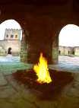
Religious Duties
■ Priestly training began at the age of 7.
■ Learning to recite the Avesta and other texts of the Yasna Liturgy.
■ Feeding the Avesta fire in temple perpetually with sandalwood whilst reciting the Avesta from heart.

Slide 20
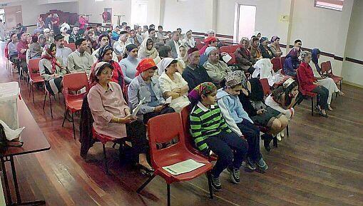
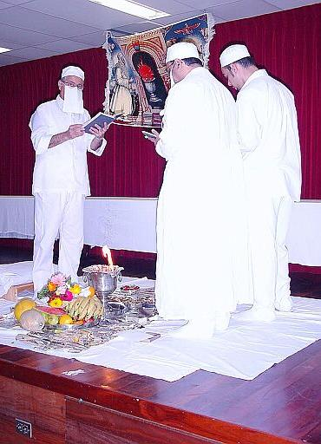
Conducting of Ceremonies:
■ Navzote (new initation ceremony)
■ Burial
■ Sacrifices

Slide 21
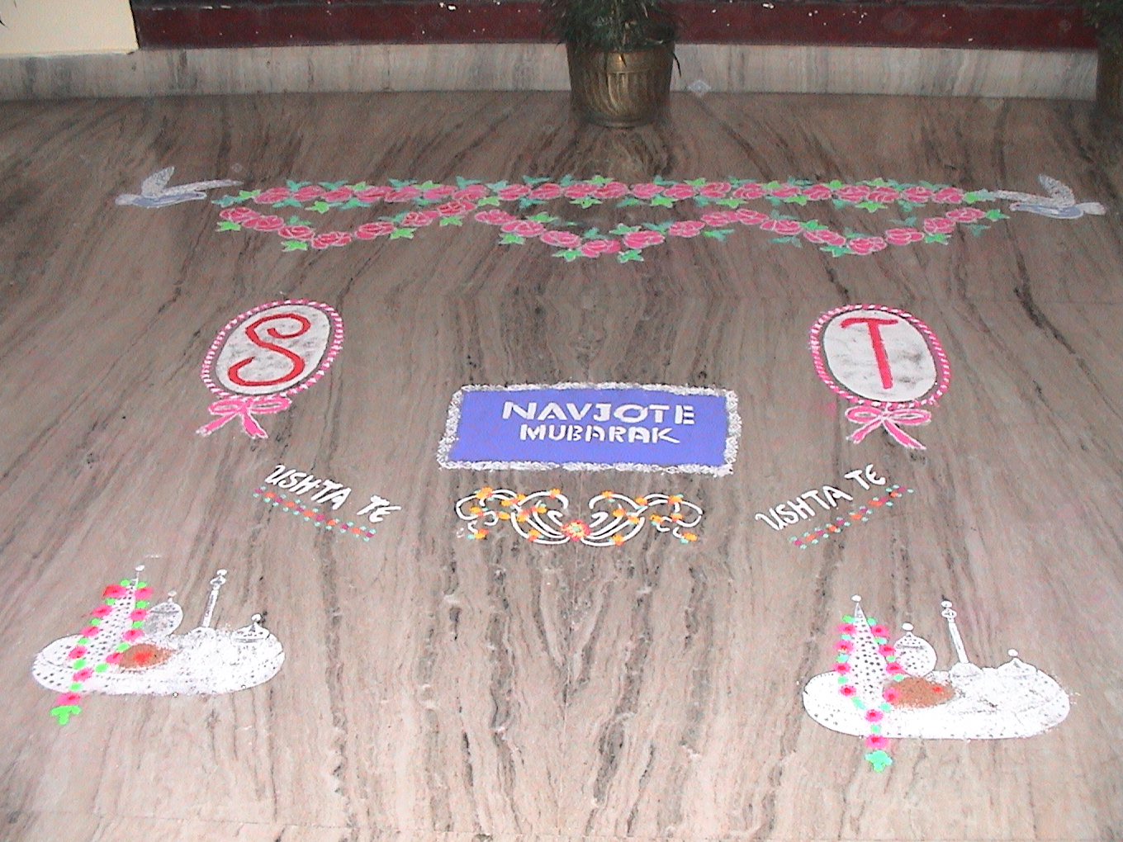
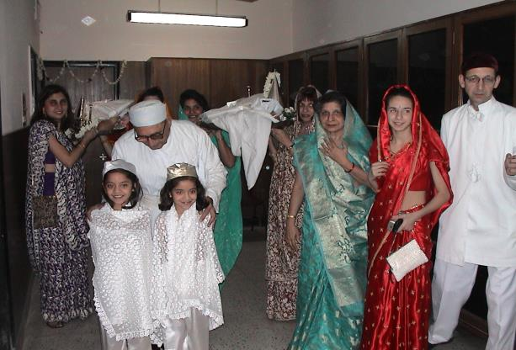
Navzote
1.Nahn
2.Prayers of Repentance
3.Investiture of Sedreh and Kusti
4.Blessings

Slide 22
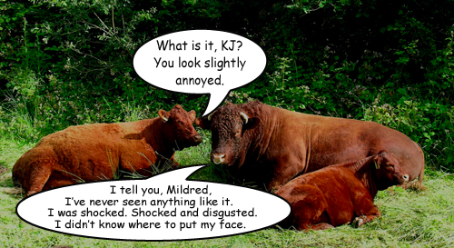
Laws
Great focus on purity and cleanliness:
→ Food, clothes and bathing
→ Drinking of "consecrated bull" urine
→ No unclean animals

Slide 23
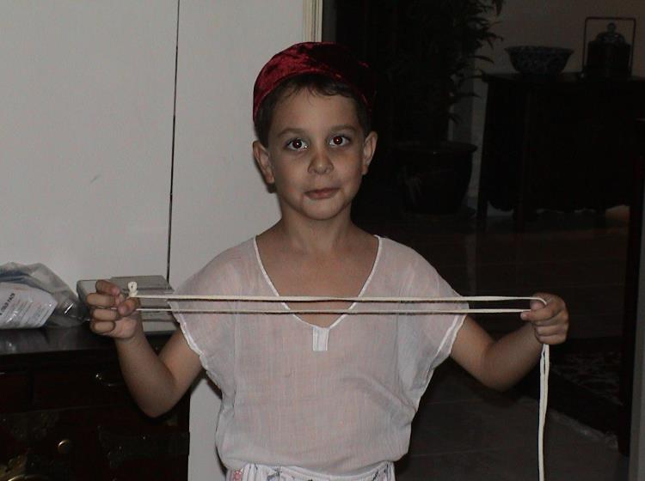
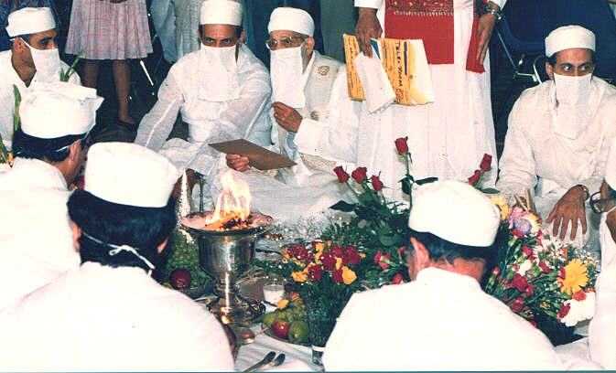
→ Wearing of the white Sudreh to indicate purity
→ Kusti made of lamb wool to remind us to respect the animal Kingdom
→ Like a barrier which protects because of spiritual energy in them
→ Whilst tending the fire, one has to wear a veil to prevent the spittle from polluting the fire.

Slide 24
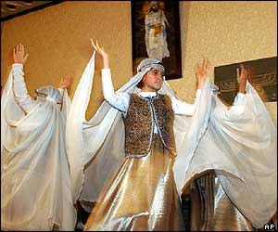
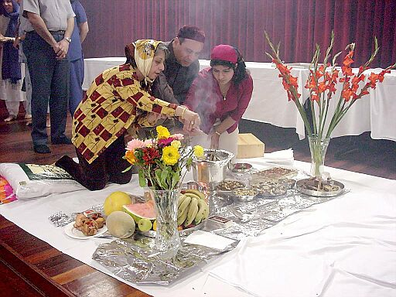
→ Marriage is a must due to the high regards of marriage to the religion
→ Must be kept away from the dead.

Slide 25
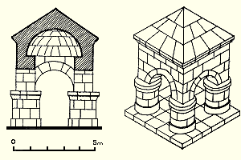
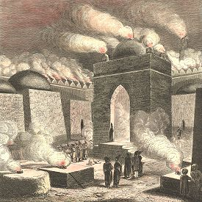
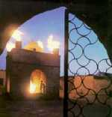
Dwelling

Slide 26
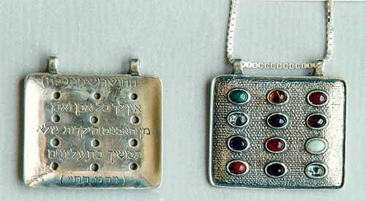
The Levitical Priesthood
Nature
Requirements
Uniqueness

Slide 27
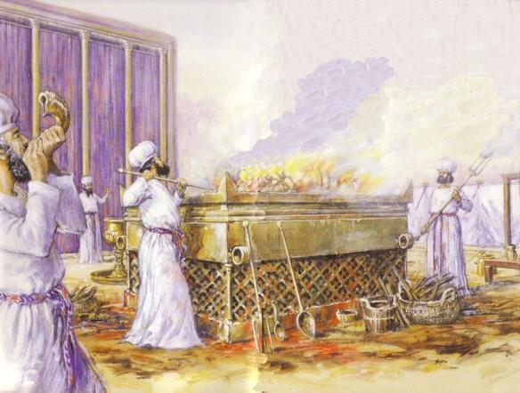
Nature:
Who were the Priests?
Men who represented God to His people

Slide 28
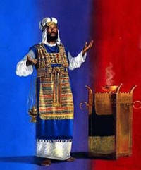
Contrasting Levites and Priests
166d
Who were the Priests?
Abraham
Men who represented God to His people
Descendents of Levi through Aaron
Isaac
Jacob
Reuben—Simeon—Levi—Judah— etc.
(12 sons of Jacob)
All other lines Aaron
Levites Priests
see OTS, 171a see OTS, 202

Slide 29
166d
The Priestly Line
LEVI
Gershon
Kohath
Merari
Levites
Amram
Priests
High Priest
Miriam
Aaron
Moses
Offered
Unauthorised Fire;
Killed by God
Nadab
Abihu
Eleazar
Ithamar

Slide 30
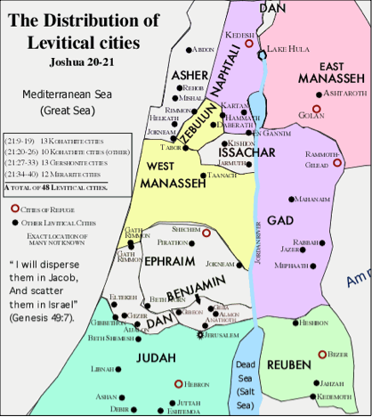
Levites
Privileges
  No land inheritance
  Resided in 48 cities (6 also cities of refuge)
  Received tithes
  Sometimes received spoils of battles

Slide 31
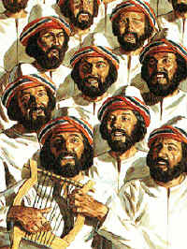
Levites
Election
Age of Service
  25-50
  After 50 years old:
  semi-retired,
  serving limited duties
  20-50
    After David established permanent site for the ark

Slide 32
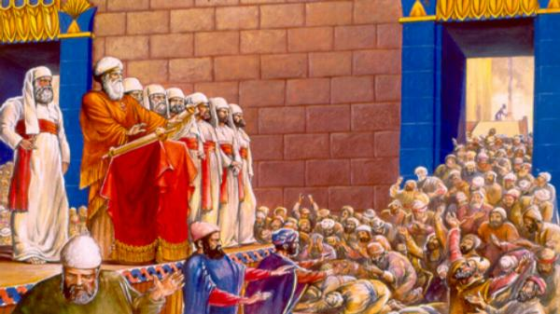
Levites
Duties
  Set apart from other Israelites
  Death if tried to serve as priests

Slide 33
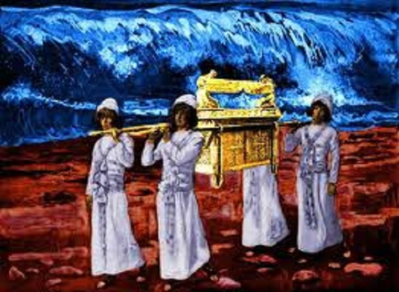
Levites
Service of the Tabernacle:
  Sons of Kohath carry furniture of the tabernacle
  Sons of Gershon care for the covering, screen, and hangings
  Sons of Merari carry and erect the frame of the court and tabernacle

Slide 34
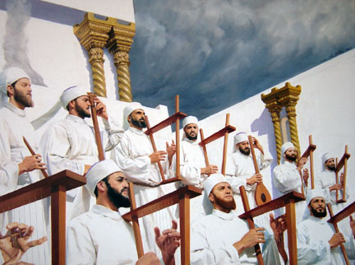
Levites
In David's reign:
  Musicians/Singers
  Gatekeepers - ministering in the temple of the LORD
  Treasurers and Other Officials

Slide 35
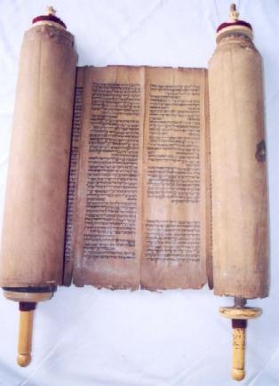
Priests
Introduction/Background
  From days between conquest of Canaan and establishment of Monarchy
  general laxness of worship
      e.g., Samuel was an Ephraimite
        Micah's priest (Judges 17, 18)

Slide 36

Leviticus 21 Requirements:
What Did it Take to Be a Priest?
179
Ritually clean (1-4)
No shaven heads, beards, or bodies (5)
Marriage to a divorcee or former harlot prohibited (7, 14)
Not physically disabled (17-21)

Slide 37
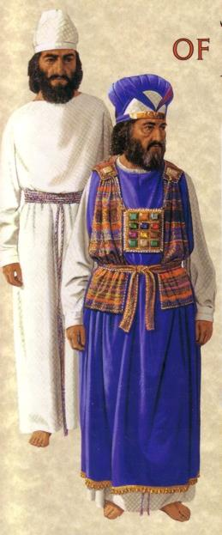
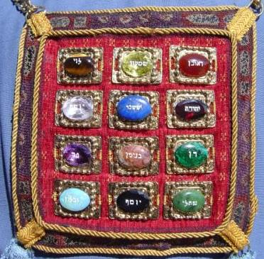
Garments of the High Priest
Turban (gold plate over forehead)
Tunic (white fine linen shirt)
Undergarments (linen from waist to thigh)
Robe (blue with bells & pomegranates)
Ephod (gold, blue, and purple with onyx stones)
Sash (belt to hold the garments together)
Breastpiece
Urim & Thummin
Exodus 28

Slide 38
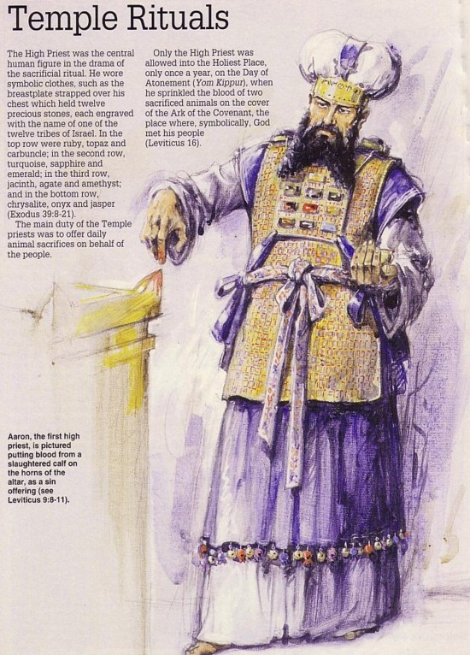
The Jewish High Priest
Atoned for sins of the people on the Day of Atonement
Type of Christ

Slide 39
Contrasting Levites and Priests
166d
Levites
Priests
Descendants of…
Levi
Aaron (also a descendant of Levi)
Population
Many (the larger group)
Few (a subset of the Levites, Josh. 21:4)
Role
Assisted priests and supervised religious activities permitted outside of the sanctuary: teaching, singing, leading worship, officials, administration, judges & gatekeepers
Mediators between God and Israel
Sacrificial Role
Couldn’t offer sacrifices nor incense (Num. 16:2-7, 38)
Offered sacrifices and incense (Deut. 33:10b)
Location of Homes
Extensive—in 35 cities throughout the tribes in the central, northern, and eastern parts of Israel (Josh. 21:5-7)
Limited to 13 cities in Judah, Simeon, & Benjamin that were near the temple (Josh. 21:4, 9-13)

Slide 40
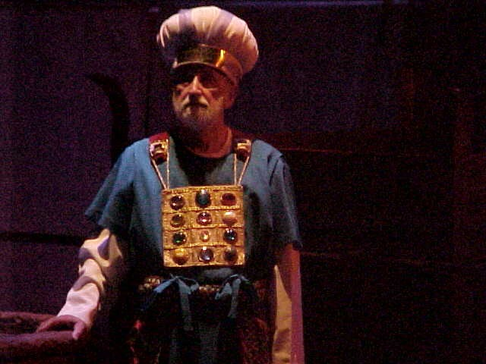
Uniqueness: How did Israel’s Priests Differ from Pagan Priesthoods?
179
Genealogically determined
Appointed by God
Salary paid by worshippers
No tribal allotment
High standards
Sacrificed two weeks annually

Slide 41
Uniqueness: How did Israel’s Priests Differ from Pagan Priesthoods?
179
Genealogically determined
Appointed by God
Salary paid by worshippers
No tribal allotment
High standards
Sacrificed two weeks annually
The point:
Israel’s priesthood did not follow the patterns of the pagan nations

Slide 42
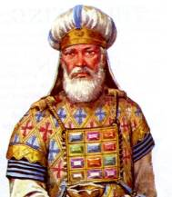
Priests
Introduction/Background
  In Numbers
    Known as "the sons of Aaron"
  In Deuteronomy
    Known as "the priests, who are the Levites" (NIV) or "the priest the Levites" (KJV).
    In view that different portions are ascribed to the priests and Levites
      Priests and Levites were still distinct
  In Joshua
    Distinction between the priests and Levites is clearly maintained

Slide 43
Priests
Introduction/Background
  In Numbers
    Known as "the sons of Aaron"
  In Deuteronomy
    Known as "the priests, who are the Levites" (NIV) or "the priest the Levites" (KJV).
    In view that different portions are ascribed to the priests and Levites
      Priests and Levites were still distinct
  In Joshua
    Distinction between the priests and Levites is clearly maintained
Male descendants of Levi & Aaron

Slide 44
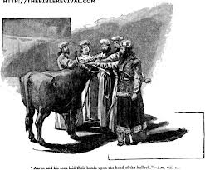
Priests
Ordination of Aaron and sons
  whole process took seven days
  Aaron and his sons were not to leave the sanctuary
  Includes
  preparation,
  anointing
  the priests and
  offering of
  sacrifices

Slide 45
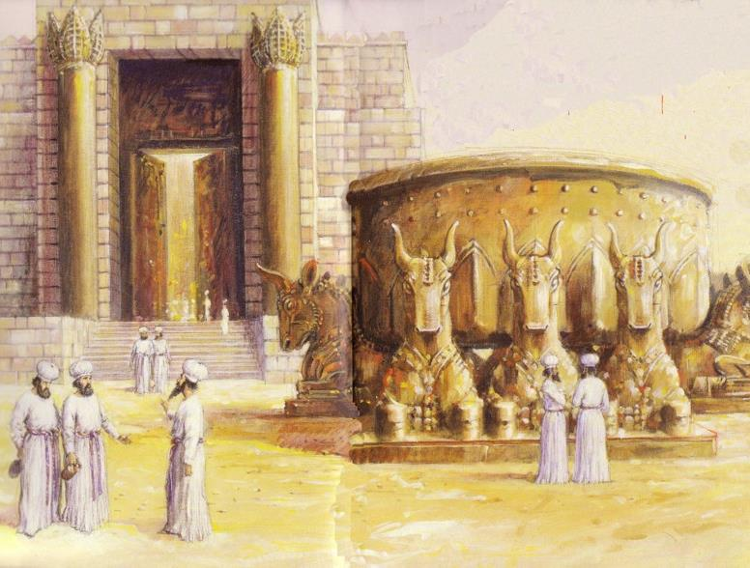
Priests
Priests' Responsibilities
  To maintain ceremonial cleanliness
  To teach God's law to the Israelites

Slide 46
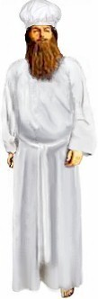
Priests
Duties in addition to care of sanctuary:
  function as judges in difficult decisions
  regulate the control of lepers
  guard the book of law
  assist Moses with the ceremony of covenant renewal

Slide 47

Priests
  receive restitution for wrong if the victim has no next of kin
  conduct test for an unfaithful wife
  teach God's law to Israelites
In Joshua's time, the priests carried the ark of the Lord.

Slide 48
Priests
Consecration rules:
  Must be holy because they present the offering made to the LORD
  Must not shave their heads or edges of their beards or cut their bodies
  Must not marry divorcees or prostitutes
  Must be without any defects
  Must refrain from alcohol before duty in the sanctuary

Slide 49

Priests
Privileges
  had no land inheritance but had 13 towns from the tribes of Judah, Simeon and Benjamin
  received parts of the offering not consumed by sacrifice, firstlings of flocks and herds, and a tenth of Levitical tithes
  sometimes received the spoil of battles

Slide 50

Priests
Aaron
Ordination:
  anointing oil poured on his head
  wore priestly garments
Rules:
  must not uncover his head or tear clothes
  the woman he marries
    must be a virgin of his own people
    must not be a widow or divorced or defiled by prostitution
Duties:
  routine duties like other priests
  on the Day of Atonement
    Represented people of Israel, sprinkling the blood of sacrificial goat on the mercy seat
Eleazar
Eldest Rep.

Slide 51

The Priesthood of Jesus Christ

Slide 52

Election
Appointed by God yet is God (Heb. 5:5)
Appointed by God's oath (Heb. 7:21)

Slide 53

Duties
1) Atoned for sin to reconcile man and God
2) Intercedes for God's people (Heb. 7:25)

Slide 54
 | Aaronic priests | Jesus Christ
Heredity | Must descend from Aaron from the tribe of Levi | Descendant of Judah
Priestly order | Aaron | Melchizedek
Appointed | by God without oath | by God on oath
Personality | Sinful man | Sinless Son of Man
Tenure | Life | Eternity
Duties | Offered animal sacrifices for atonement of sins | Offered himself for atonement of sins
Place of service | Itinerant tabernacle or temple in Jerusalem | Outside Jerusalem
Efficacy of sacrifice | Annual offering | Once for all
Effect of service | Obtained forgiveness for the sins of the Jews annually | Obtained forgiveness for the sins of the world forever Opened access for all believers to God
Current work | None | Intercession for believers at the right hand of God

Slide 55

The Priesthood of believers

Slide 56

Our Election
Heirs of the promise the unchangeableness of his purpose (Heb. 6:17)
Royal Priesthood and chosen (1 Pet. 2:9)

Slide 57

Our Duties
To offer spiritual sacrifices acceptable to God through Jesus Christ (1 Pet. 2:5)
To declare God's wonderful deeds (1 Pet. 2:9) and share his salvation to the world (Matt. 28:19-20).

Slide 58

Our Laws
1) Inward purification of the believer by indwelling of Holy Spirit.
2) Outward purification of the believer by Spirit-led living.
The believer is exhorted to:
(a) Live for righteousness (1 Pet. 2:24)
(b) Live for holiness (1 Pet. 1:14-16)

Slide 59

Our Dwelling
To be in the world but not of it (John 17:13-19)

Slide 60

Conclusion
1. Christians, male and female, are called believer priests today.
2. The NT priesthood functions are simpler than those of pagan and OT priesthoods.

Slide 61
Essentials of the NT priesthood:
No need for human mediator between man and God
Direct and personal relationship with God
Serve one supreme God, not a pantheon of gods
Moral standing from a moral God who justifies
No need for animal sacrifices to atone for sins; sacrifices are praise and prayer and godly living
A priesthood that celebrates life as a sacrifice, not death
The duty and privilege to keep in step with the Spirit

Slide 62


Christ’s yoke was heavy, but the yoke he gives to us is easy and the burden light. May we in our busy schedules and lifestyles find rest even as we serve God in our lives.

Slide 63

1 Peter 2:5 (NIV)
171
“You also, like living stones, are being built into a spiritual house to be a holy priesthood, offering spiritual sacrifices acceptable to God through Jesus Christ.”

Slide 64

Two Questions:
Who has the ultimate say in the church?
What is the biblical pattern for church leadership?

Slide 65

I. Ultimate authority in the local church rests with the congregation

Slide 66

Congregational Authority
In Church Discipline (Matt. 18:17)
  “Take it to the church…”
In Leader Selection (Acts 6:3)
  “Choose… from among you…”
In Maintaining True Doctrine:
“For I received from the Lord what I also passed on to you…” (1 Cor. 11:23)
“Friends… test the spirits” (1 John 4:1)
“Contend for the faith” (Jude 3)

Slide 67

Episcopal Church
Structure
(Simplified)
Bishop
Anglican
Lutheran
Methodist
Orthodox
Catholic
Vicar
Vicar
Vicar
Deacons
Deacons
Deacons
People
People
People

Slide 68

Lower Presbyterian Structure
Presbytery
Elders
(Session)
Elders
(Session)
Elders
(Session)
People
People
People

Slide 69

Middle Presbyterian Structure
Synod
Presbytery
Presbytery
Elders
(Session)
Elders
(Session)
Elders
(Session)
Elders
(Session)
Elders
(Session)
Elders
(Session)
People
People
People
People
People
People

Slide 70

Highest Presbyterian Structure
General Assembly
Synod
Synod
Presbytery
Presbytery
Presbytery
Presbytery
Elders
(Session)
Elders
(Session)
Elders
(Session)
Elders
(Session)
Elders
(Session)
Elders
(Session)
Elders
(Session)
Elders
(Session)
Elders
(Session)
Elders
(Session)
Elders
(Session)
Elders
(Session)
People
People
People
People
People
People
People
People
People
People
People
People

Slide 71

What About Baptists?
The Autonomy of the Local Church

Slide 72
Two Questions:
Who has the ultimate say in the church?
What is the biblical pattern for church leadership?

Slide 73

II. The biblical pattern is church leadership by elders.

Slide 74

Scriptural support for a plurality of elders:
plurality
plurality
  Not One Elder…
  But Many…

Slide 75

Elders led from the time of Moses
Elders
led with
Moses
1400 BC
“Go, assemble the elders of Israel and say to them…” (Exod. 3:16)

Slide 76

Who Led the Synagogue?
Elders
led with
Moses
1400 BC
Elders
led
Synagogues
600 BC

Slide 77

God has advocated group leadership through the ages
Elders
led with
Moses
1400 BC
Elders
led
Synagogues
600 BC
NT
Elders

Slide 78

Places Mentioning Elders
elders = overseers = bishops = pastors
Jerusalem (AD 47):
NIV Acts 11:30 This they did, sending their gift to the elders by Barnabas and Saul.
Ephesus (AD 57):
NIV Acts 20:17 From Miletus, Paul sent to Ephesus for the elders of the church.
Galatia (AD 48):
NIV Acts 14:23 Paul and Barnabas appointed elders {or Barnabas ordained elders; or Barnabas had elders elected} for them in each church
Crete (AD 66):
NIV Titus 1:5 The reason I left you in Crete was that you might straighten out what was left unfinished and appoint {or ordain} elders in every town, as I directed you.
Philippi (AD 62):
NIV Philippians 1:1 Paul and Timothy, servants of Christ Jesus, To all the saints in Christ Jesus at Philippi, together with the overseers and deacons:
Pontus, Galatia, Cappadocia, Asia & Bithynia (AD 64)
NIV 1 Peter 5:1 To the elders among you, I appeal as a fellow elder… (cf. 1:1)

Slide 79
Three Major Tasks of Elders
Administration
Teaching
1 Tim. 3:1, 4-5; 5:17
1 Tim. 3:2; 5:17
Lead
Pastor
Episkopos =
Epi “over” +
skopos “look” =
“watch over”
Pastoring
1 Pet. 5:1-4
Acts 20:29, 35
1 Thess. 5:12
Eph. 4:11

Slide 80
How Elders Relate to Deacons
60
Model 1: Senior Pastor over Deacons
Senior Pastor
Deacons
Unbiblical

Slide 81
How Elders Relate to Deacons
60
Model 2: Senior Pastor alongside Deacons
Senior Pastor
Deacons
Unbiblical

Slide 82
How Elders Relate to Deacons
60
Model 3: Deacons lead elders/pastors
Deacons
Unbiblical
Pastors

Slide 83
How Elders Relate to Deacons
60
Model 4: Elder Board leads Deacon Board
Elders
Deacons

Slide 84
How Elders Relate to Deacons
60
Apostles over "The Seven"
Apostles
DDDDDDD
DDDD
DDDDD
"The Seven"
Acts 21:8

Slide 85
How Elders Relate to Deacons
60
Model 5: Elders with Deacon Committees
Elders
DDDDDDD
DDDD
DDDDD

Slide 86




Can’t we just call current deacons “elders”?
Deacon
Deacon
Elder
Elder

Slide 87

No. There are many differences between them…
Deacon
Elder
Qualifications
Character
Character + Teaching
Role (Gifting)
Administration
Pastoral
Time Involved
Much
Even more extensive
Age
Younger
Older

Slide 88


OK, lah… But…

Slide 89

Leadership by elders and congregational authority are not contradictory

Slide 90

Balancing leadership with congregational involvement

Slide 91
Balancing leadership with congregational involvement

Slide 92
Balancing leadership with congregational involvement

Slide 93
Balancing leadership with congregational involvement

Slide 94
Balancing leadership with congregational involvement

Slide 95
Balancing leadership with congregational involvement

Slide 96
Balancing leadership with congregational involvement

Slide 97

—Main Idea—
Ultimate authority in the local church rests with the congregation but these people should be led by elders

Slide 98

So What?
So what?

Slide 99
Action Points:
Congregational Authority means…
  This is my church…
  So what is your unique role in your church?
Elder Leadership means…
  I must have realistic expectations of who will pastor me…
  My greatest need is for a shepherd--not an organizer

Slide 100

WHAT ABOUT LEADERS TODAY?
MR DEACON
A GOOD MAN FOR A TOUGH JOB

Slide 101
GOD'S DEACON CHECKLIST:
1 TIMOTHY 3:8-13

Slide 102
1 TIMOTHY 3:1-13 OVERVIEW
Elder Qualifications
1-7
Deacon Qualifications
8-13
Deacons 8-10
Wives 11
Deacons 12-13

Slide 103
WORTHY OF RESPECT
1 Timothy 3:8

Slide 104
SINCERE
“NOT DOUBLE-TONGUED”

Slide 105
NOT GIVEN TO DRUNKENNESS
“ONE WHO SITS LONG AT WINE”
FERMENTED GRAPE JUICE
NOT INTOXICATED
IN SCRIPTURE STRONG DRINK AND DRUNKENNESS ARE FORBIDDEN

Slide 106
NOT PURSUING DISHONEST GAIN
“NOT FOND OF SILVER”
NOT GREEDY - THE DESIRE FOR MORE
1 PETER 5:2
MATERIALISM IS NOT HIS PRIORITY
NOT A MERCENARY - SERVES FOR MONEY

Slide 107

HOLDS TO DEEP TRUTHS
KNOWLEDGE OF WORD OR GOD
BECOMING MORE LIKE CHRIST
HEBREWS 7:26
EPHESIANS 4:15 - 5:12

Slide 108

TESTED (AS BLAMELESS)
ONE AGAINST WHOM THERE IS NO LEGITIMATE CHARGE OF WRONG DOING IN SPEECH AND ACTONS.
ABOVE REPROACH
GOOD REPUTATION

Slide 109
BLAMELESS

Slide 110
WHAT ABOUT DEACON WIVES?

Slide 111
A DEACON WIFE MUST BE…
WORTHY OF RESPECT
NOT MALCIOUS TALKERS
TEMPERATE
TRUSTWORTHY
These four traits parallel those of deacons in v. 8

Slide 112

… TO BE REVERENT IN THE WAY THEY LIVE
REVERENT - CONDUCT IN EVERY AREA OF LIFE THAT IS FITTING FOR A PERSON WHO PROFESSES TO WORSHIP GOD

Slide 113
… NOT TO BE SLANDERERS
SLANDER - FALSELY ACCUSE, BACKBITING
MALICIOUS GOSSIP - SPREADING STORIES ABOUT OTHERS WHETHER TRUE OR FALSE

Slide 114
… NOT TO BE ADDICTED
TO MUCH WINE
CONTROLLED BY, INTOXICATED, A SLAVE TO
WOMEN LIVING IN A PAGAN CULTURE WHERE DRUNKENNESS WAS COMMON

Slide 115
… TO TEACH WHAT IS GOOD
A TEACHER OF WHAT IS GOOD
GOOD - BEAUTIFUL, ATTRACTIVE
ETHICALY GOOD, IN THE SENSE OF WHAT IS RIGHT, FAIR.

Slide 116
HUSBAND OF ONE WIFE
LIT. “ONE WOMAN KIND OF MAN”
CULTURE: - SEXUAL IMPURITY - DIVORCE
BELIEVERS WERE “CALLED OUT OF”
CONTEXT: MORAL CHARACTER

Slide 117

Look at the right woman

Slide 118
HIS CHILDREN
CHILDREN = CHILD IN HIS HOME
BELIEVERS
UNDER HIS CONTROL
1 TIMOTHY 3:12 “He must manage his children and his household well” (cf. elders in v. 4)

Slide 119
The Frog in the Pan

Slide 120
DEACON REWARDS
“THOSE WHO HAVE SERVED WELL GAIN AN EXCELLENT STANDING AND GREAT ASSURANCE IN THEIR FAITH IN CHRIST JESUS” (V. 13)
GOD
MEN

Slide 121
Original Group Presentation Members
Priests
By: Grace Eu Soo Hwa
Melvin Koh
Lim Lay Kwan
Wong Shin Hoe

Slide 122
Black

Slide 123


OT Backgrounds link at BibleStudyDownloads.org
Get this presentation for free!
Notes:
NT Survey (ns)

