Slide 1
Monotheism
161
A Basic Jewish Belief that Went Against the Flow of the Ancient Near East
Dr. Rick Griffith • Jordan Evangelical Theological Seminary • BibleStudyDownloads.org

Slide 2
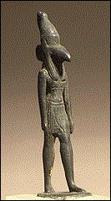
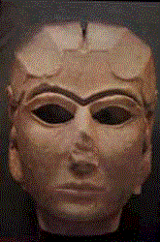
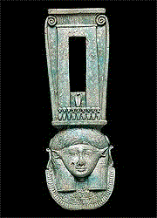
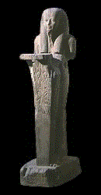
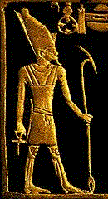

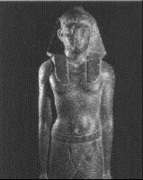

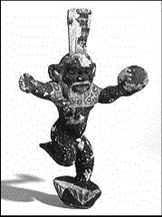



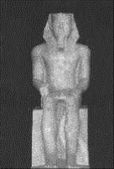
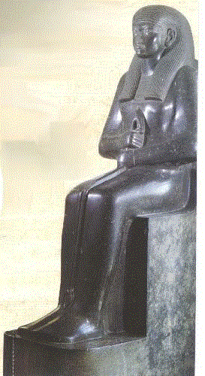



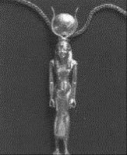

POLYTHEISM
161

Slide 3
POLYTHEISM:
161
What kind of impact did the pagan high gods have upon Israel?

Slide 4


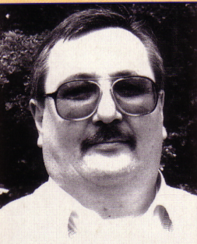
Creation by One God Universal
161
"Indeed, in every major culture throughout the ancient world of which we have any record, the overwhelming consensus was that the universe had been created by often a single and usually supreme divine being (even in notoriously polytheistic cultures)."
Bill Cooper, After the Flood (Chichester, UK: New Wine Press, 1995), 18

Slide 5

Romans 1:20 (NIV)
161
Person who is Limitless
Person who is Supernatural
For since the creation of the world, God's invisible qualities– his eternal power and divine nature-- have been clearly seen, being understood from what has been made, so that men are without excuse.

Slide 6
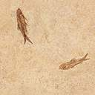
Knowledge of God is innate (before missions)
161
"Before time, and throughout time, there has been a self-existing being, eternal, infinite, complete, omnipresent . . . Outside this being, before the beginning, there was nothing."
Taoist philosopher
Lao-Tzu of China,
6th century BC
He obviously didn't get this concept from Genesis as the Bible reached China centuries later!
Notes:
Lao-Tzu, Tao-te-ching. Tr. Léon Wieger. English version by Derek Bryce (Lampeter, UK: Llanerch Pub., 1991), 13; cited by Bill Cooper, After the Flood (Chichester, England: New Wine Press, 1995), 16.

Slide 7
Greek Monotheism
161
"First of all the Void came into being . . . next Earth . . . Out of the Void came darkness . . . and out of the Night came Light and Day . . ."
Hesiod (8th century BC)
Notes:
Hesiod. Theogony, tr. Norman Brown (New York: Bobbs-Merrill, 1953), 15; cited by Bill Cooper, After the Flood (Chichester, England: New Wine Press, 1995), 19.

Slide 8
A Step Higher…
161
"Homer and Hesiod attributed to the gods all the things which among men are shameful and blameworthy—theft and adultery and mutual deception . . . [But] there is one God, greatest among gods and men, similar to mortals neither in shape nor in thought . . . he sees as a whole, he thinks as a whole, he hears as a whole . . . Always he remains in the same state, changing not at all . . . But far from toil he governs everything with his mind." —Xenophanes, 6th Century BC
Notes:
Jonathan Barnes, Early Greek Philosophy (Harmondsworth, England: Penguin Classics, 1987), 95-97; cited by Cooper, 19.

Slide 9
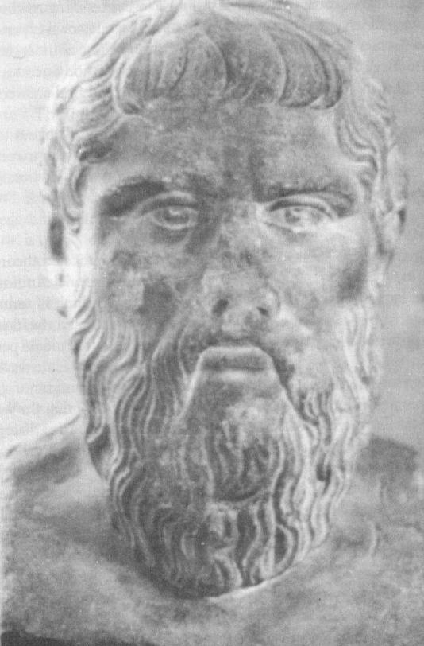
Creation Was by a Good God
162
"Let us therefore state the reason why the framer of this universe of change framed it at all. He was good, and what is good has no particle of envy in it; being therefore without envy, he wished all things to be as like himself as possible. This is as valid a principle for the origin of the world of change as we shall discover from the wisdom of men. . ."
Plato (429-380 BC)
Notes:
Plato, Timaeus and Criteas, tr. Desmond Lee (Harmondsworth, England: Penguin Classics, 1965), 42; cited by Cooper, 20.

Slide 10
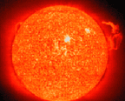
Atheism Exists Only for Fools
162
"The fool says in his heart, 'There is no God.' They are corrupt, their deeds are vile; there is no one who does good"
(Psalm 14:1 NIV)

Slide 11

The First Evolutionist Writer
162
Anaximander (ca. 610-540 BC) studied under Thales and provides the first recorded challenge to creationism.
He probably was the first written evolutionist. Plutarch said Anaximander: ". . . originally, humans were born from animals of a different kind . . ."
His theory is so developed that he had probably built on others' teaching.
Notes:
Jonathan Barnes, Early Greek Philosophy (Harmondsworth, England: Penguin Classics, 1987), 73; cited by Bill Cooper, After the Flood (Chichester, England: New Wine Press, 1995), 21.

Slide 12
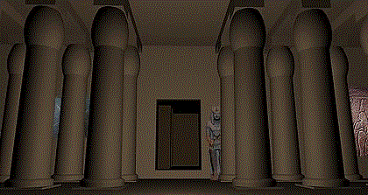
Influential High Gods
160
Religion | High God | Characteristics | Influence on Israel
Sumerian | Nannar (Sin) |  | Worshipped originally by Abraham (Josh. 24:2)
Assyrian | Anu |  | None
Babylonian | Marduk | Marduk promoted to supreme god | Moderate
Egyptian | Amon | Most polytheistic ANE people | None

Slide 13
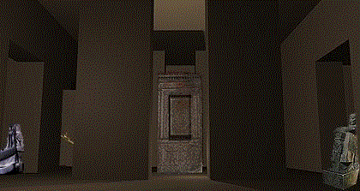
Influential High Gods
160
Religion | High God | Characteristics | Influence on Israel
Canaanite | Baal or El | Depraved practices | High
Sidonian | Ashtoreth |  | 1 Kings 11:5, 33
Philistine | Dagon |  | None
Ammonite | Molech |  | 1 Kings 11:5, 33
Moabite | Chemosh |  | 1 Kings 11:5

Slide 14
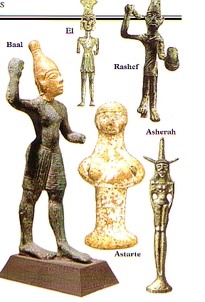
Pagan Deities
162-163
Nature
Worship
Priesthood
High Places
Detestable Elements

Slide 15
How Different They Are!
163
 | Monotheism | Polytheism
Truth | Absolute | Relative
Writings | Book | Books
Idols | Prohibited | Accepted
Religions | Judaism Christianity Islam | Buddhism Hinduism Mormonism

Slide 16
One's View of God Affects His View of Sacrifices, Morality & Mission
163a
Pagan
Israel
Horrible god
Holy God
Man seen as OK in comparison
Man seen as sinful
Seeks pleasure & material needs
Seeks spiritual needs
We become like the God we worship!
Sacrifices appease deity for sex, food & money
Sacrifices atone for sin to reconcile God & man
Local deity makes them rich
God forgives sin
Massacre others for wealth
Mission to others for their good

Slide 17
The Jewish Shema
"Hear, O Israel:
The LORD our God,
the LORD is one"
(Deut. 6:4)

Slide 18
Islam's Daily Proclamation
"I attest that there is no God if not God Himself, and I attest that Muhammad is the Messenger of God"

Slide 19
A Summation of Christianity
“Now to the King eternal, immortal, invisible, the only God, be honor and glory for ever and ever. Amen.” (1 Tim. 1:17 NIV)

Slide 20

Let's contrast the Bible with writings sacred to other religions…
This penetrating work in 2003 "tells it like it is" concerning the Koran and Islam

Slide 21

The Qur'an According to Edward Gibbon
"[The Qur'an is an] incoherent rhapsody of fable and precept and declaration which seldom excites a sentiment or an idea, which sometimes crawls in the dust and is sometimes lost in the clouds. . . . The use of fraud and perfidy, of cruelty and injustice, were often subservient to the propagation of the faith, . . . Mohammed commanded or approved the assassination of Jews and idolaters, . . .

Slide 22

The Qur'an According to Edward Gibbon
"Mohammed indulged the appetites of a man and abused the claims of a prophet. A special revelation dispensed him from the laws which he had imposed upon his nation. The female sex, without reserve, was abandoned to his desires."
--Edward Gibbon, Decline and Fall of the Roman Empire, vol. 5 (cited in Richardson, Secrets of the Koran, 65-66)

Slide 23
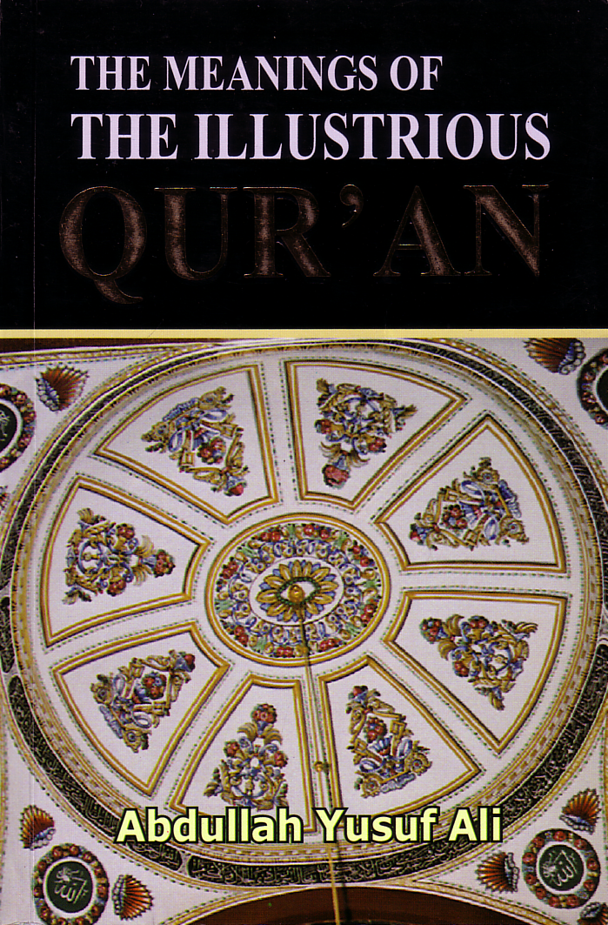
How Qur'an begins
"In the name of Allah, Most Gracious, Most Merciful. Praise be to Allah, the Cherisher and Sustainer of the worlds; Most Gracious, Most Merciful; Master of the Day of Judgment. You (alone) do we worship, and Your aid we seek.
Show us the straight way, The way of those on whom You have bestowed Your Grace, those whose (portion) is not wrath, and who go not astray."

Slide 24
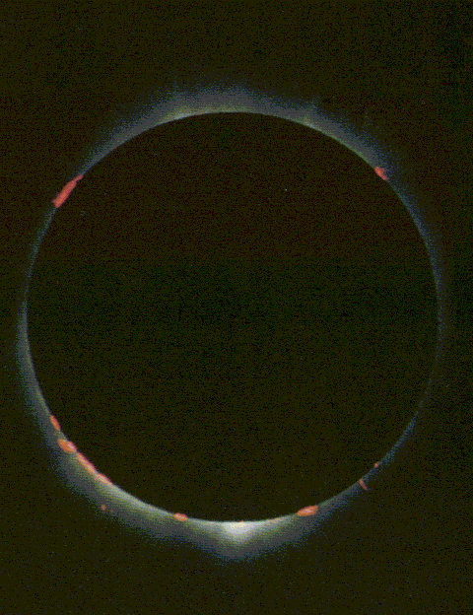

But Not All Monotheism is the Same…
Islamic
Biblical
Non-Trinitarian
Trinitarian
No Relationship within Himself
In Relationship within Himself
Attributes Stem from His Will
Attributes Stem from Holy Nature
Essentially Arbitrary
Inherently Consistent
Can't Be Known or Trusted
Can Be Both Known and Trusted
Imad Shehadeh, "The Predicament of Islamic Monotheism," Bibliotheca Sacra 161 (April-June 2004): 162.
Notes:
Imad Shehadeh, "The Predicament of Islamic Monotheism," Bibliotheca Sacra 161 (April-June 2004): 162.

Slide 25
The Trinity
Father
is
is not
is not
GOD
is
is
Son
Spirit
is not
H. Wayne House, Charts of Christian Theology and Doctrine, p. 45

Slide 26
Matthew 3:16-17 (NIV)
As soon as Jesus was baptized,
he went up out of the water.
At that moment heaven was opened,
and he saw the Spirit of God descending like a dove and lighting on him.
And a voice from heaven said,
"This is my Son, whom I love;
with him I am well pleased."

Slide 27
Matthew 28:19 (NIV)
Therefore go and make disciples of all nations, baptizing them in the name
of the Father
and of the Son
and of the Holy Spirit

Slide 28
1 Corinthians 12:4-6 (NIV)
There are different kinds of gifts,
but the same Spirit.
There are different kinds of service,
but the same Lord.
There are different kinds of working,
but the same God
works all of them in all men.

Slide 29
2 Corinthians 13:14 (NIV)
May the grace
of the Lord Jesus Christ,
and the love
of God,
and the fellowship
of the Holy Spirit
be with you all.

Slide 30
1 Peter 1:2 (NIV)
who have been chosen
according to the foreknowledge
of God the Father,
through the sanctifying work
of the Spirit,
for obedience
to Jesus Christ
and sprinkling by his blood

Slide 31
Jude 20-21 (NIV)
But you, dear friends,
build yourselves up
in your most holy faith
and pray in the Holy Spirit.
Keep yourselves in God's love
as you wait for the mercy
of our Lord Jesus Christ
to bring you to eternal life.

Slide 32
Ephesians 4:4-6
one God and Father
above all
through all
in all
v. 6
one body
one Spirit
one Lord
one
faith
v. 4
v. 5
one hope
one baptism
Marva Dawn, The Unnecessary Pastor, p. 237

Slide 33
The Trinity
Father
is
is not
is not
GOD
is
is
Son
Spirit
is not
H. Wayne House, Charts of Christian Theology and Doctrine, 45

Slide 34

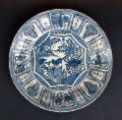
How should we apply Israel's uniqueness to the Church?
159
What principles regarding how Israel dealt with Ancient Near East pagan religions should the church today also follow in respect to other religions?
Principle for Israel | Modern Parallel

Slide 35
Black

Slide 36


OT Backgrounds link at BibleStudyDownloads.org
Get this presentation for free!
Notes:
OT Backgrounds (ob)

