Slide 1
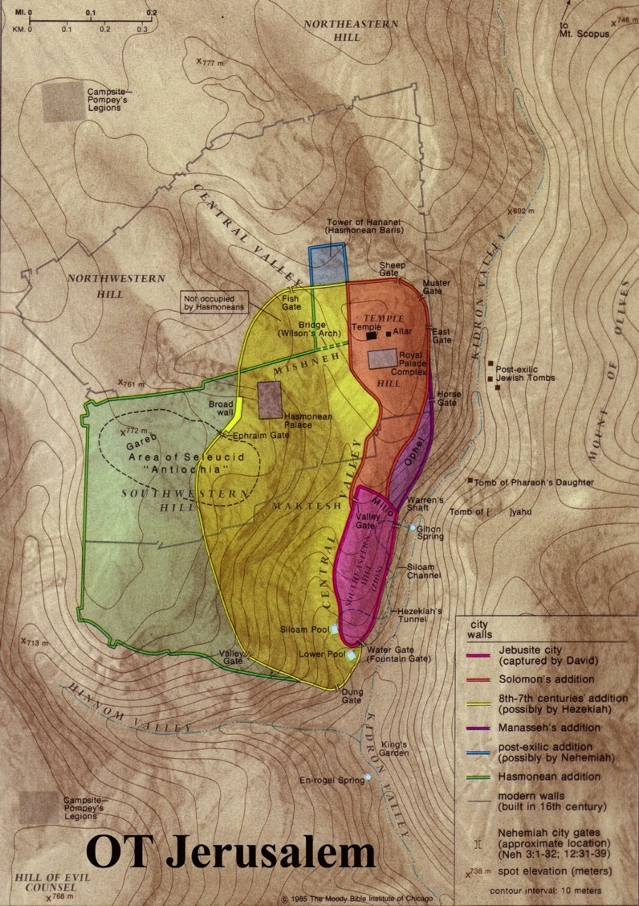
The Geography of Jerusalem
The Holy City
Dr. Rick Griffith • Jordan Evangelical Theological Seminary • BibleStudyDownloads.org

Slide 2
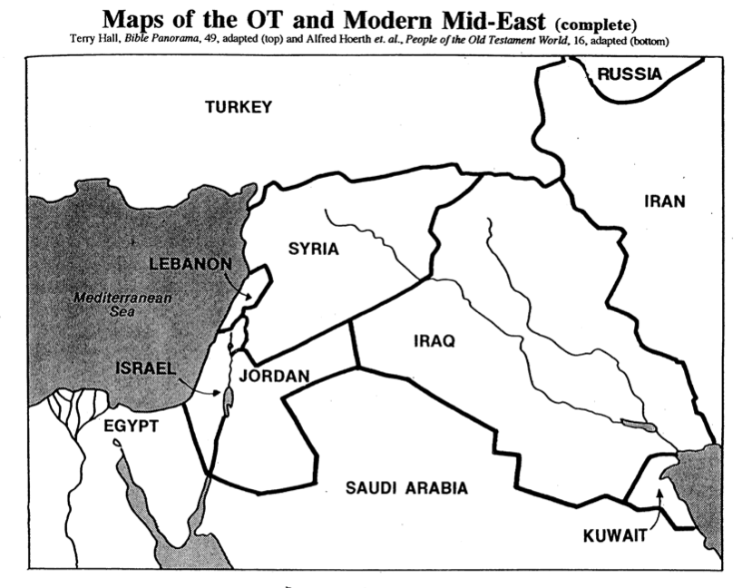
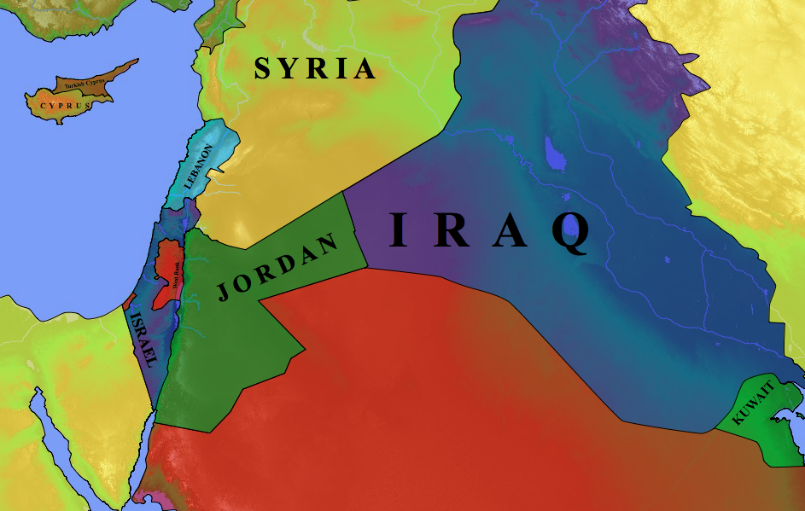
Modern Middle East Nations
27
Terry Hall, Bible Panorama, 49
Turkey
Russia
Syria
Cyprus
Iran
Lebanon
Iraq
Mediterranean Sea
Jordan
Israel
Saudi Arabia
Kuwait
Egypt

Slide 3
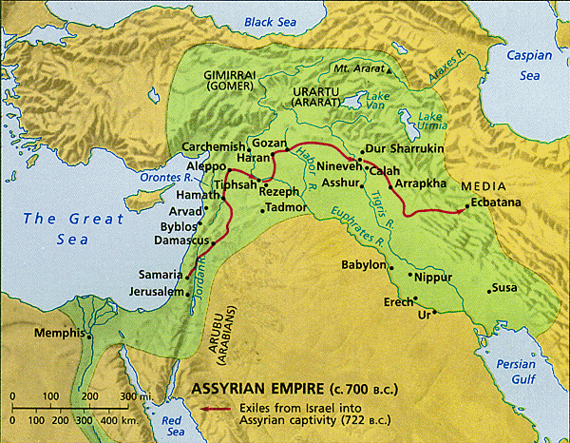
The Ancient Near East
28
Fertile Crescent
Iraq
Israel
Egypt

Slide 4
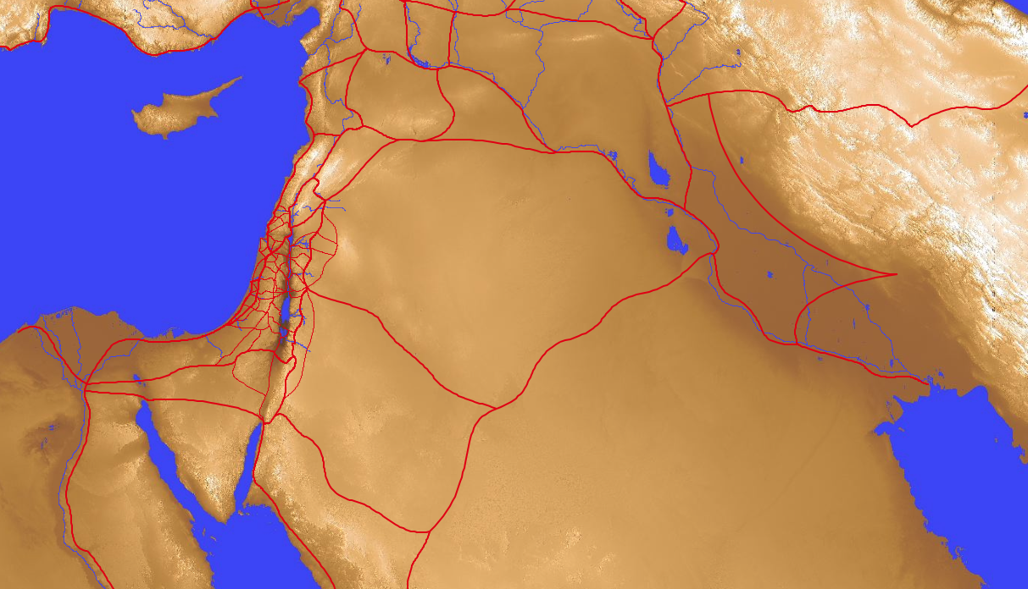
Old Testament Trade Routes & Bodies of Water
28
8
Tigris
7
1
Euphrates
Mediterranean
Sea
4
Sea of Chinnereth
5
Jordan River
6
Salt Sea
2
Nile River
9
Persian
Gulf
3
Red Sea
In your small group…
Name each of the 9 bodies of water
Tell how each got its name
Notes:
Mediterranean: "In the middle" (medi) + "lands" (terrain) = "between two lands" (Europe and Africa)
Nile River: "The name Nile comes from the Greek “neilos”, which means valley. The Ancient Egyptians called the river Ar or Aur (black) because of the colour of the sediment left after the river's annual flood (http://www.primaryhomeworkhelp.co.uk/egypt/nile.htm)
Red Sea: "Like the Yellow Sea, the Red Sea may also be named after a natural process. Seasonal blooms of a bacteria commonly called “sea sawdust” turn the water red. These bacteria, Trichodesmium erythraeum, help process nutrients in the ocean that certain small marine creatures depend upon. But there are other thoughts regarding how the Red Sea, which is an inlet of the Indian Ocean, got its name. Among them is the idea that it borders the “red land,” the name ancient Egyptians used to refer to the Egyptian Desert. Another theory states that the color red signifies “south.” Some Asiatic languages use colors to refer to directions" (http://www.dictionary.com/e/yellow-sea/)
Sea of Chinnereth: harp sea as it is shaped like the ancient harp
Jordan River: "The river's name in Hebrew is יַרְדֵן (Yarden), and it is derived from יָרַד (yarad) meaning "descend" or "flow down" (https://www.behindthename.com/name/jordan).
Salt Sea: sea with highest salt content on earth as it is the lowest spot where water stops and evaporates to make it continnually saltier
Euphrates River: "A river named Perath (Hebrew for Euphrates) is one of the four rivers that flow from the Garden of Eden according to Genesis 2:14. This Hebrew word, derived from either the word "stream" or "to break forth," has been translated as Euphrates" (http://www.newworldencyclopedia.org/entry/Euphrates_River)
Tigris River: "From Latin Tigris, from Ancient Greek Τίγρις (Tígris), an alternative form of Τίγρης (Tígrēs), from Old Persian 𐎫𐎡𐎥𐎼𐎠 (Tigrā), from Elamite 𒋾𒅅𒊏 (ti-ig-ra), from Sumerian 𒀀𒇉𒈦𒄘𒃼 (^{ÍD}Idigna, ^{ÍD}Idigina, literally “fast as an arrow”).} (https://en.wiktionary.org/wiki/Tigris#Etymology)
Persian Gulf: named after the land just to the north

Slide 5
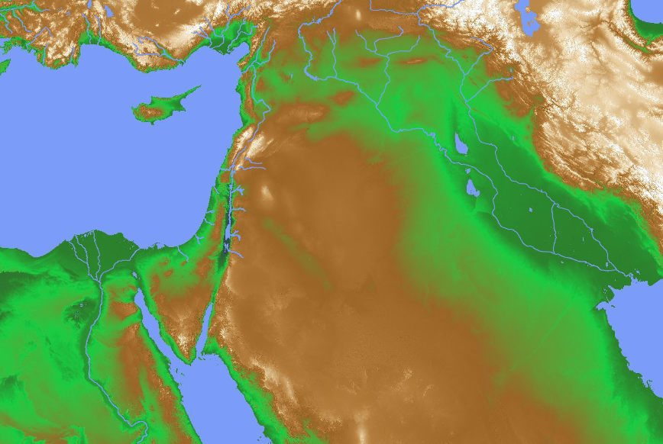
Mesopotamia
28
T
Tigris
Mesopotamia
N
Nineveh
E
Euphrates
B
Babylon

Slide 6
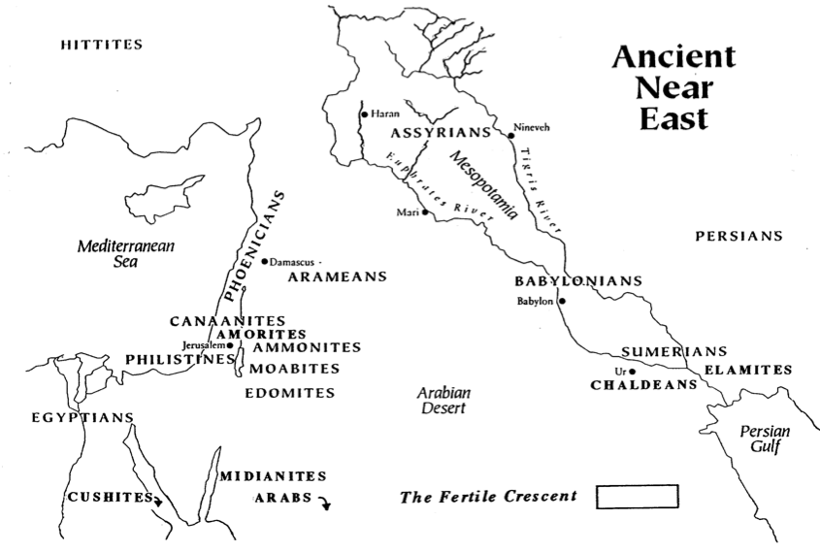
The Ancient Near East
Small Group:
Name the 7 cities
15
HITTITES
3
ASSYRIANS
Tigris
Haran
5
Euphrates
Nineveh
PHOENICIANS
Mesopotamia
2
Damascus
4
Mediterranean
Sea
Mari
PERSIANS
ARAMEANS
CANAANITES
BABYLONIANS
AMORITES
Babylon
6
Jerusalem
1
GILEADITES
SUMERIANS
PHILISTINES
AMMONITES
7
ELAMITES
MOABITES
Ur
EDOMITES
Arabian
Desert
CHALDEANS
EGYPTIANS
MIDIANITES
Persian
Gulf
Fertile Crescent in Green
CUSHITES
ARABS
Alfred Hoerth et. al., Peoples of the Old Testament World, 16

Slide 7

Jerusalem is called the
“holy city” 11 times in the Bible
OT
Neh. 11:1
Neh. 11:18
Isa. 48:2
Isa. 52:1
Dan. 9:24
NT
Matt. 4:5
Matt. 27:53
Rev. 11:2
Rev. 21:2*
Rev. 21:10*
Rev. 22:19*
* Refers to the New Jerusalem after the present is destroyed

Slide 8
A Question to Consider…
Are there “holy things” today?
Said differently…
Is any object actually holy to Christians and to God?
Is it proper to refer to something as a “sacred” object?
If so, which object is sacred?

Slide 9
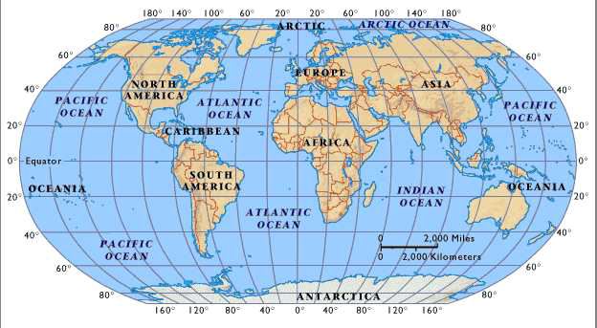
The World Today
Arctic Ocean
Europe
Asia
North America
Atlantic Ocean
Pacific Ocean
Pacific Ocean
Caribbean
Africa
South America
Oceania
Oceania
Indian Ocean
Atlantic Ocena
Pacific Ocean
Antarctica
Notes:
Despite our global news, the center of the action is typically the Middle East. Why it that?

Slide 10
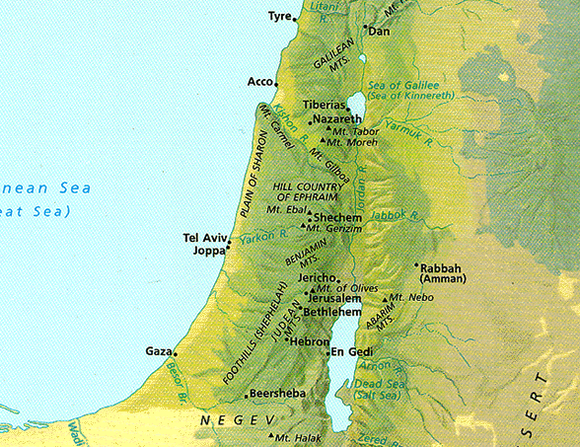
Elevations in North-South Divisions
18
Notes:
Israel's topography divides into five sections, each going north to south.

Slide 11
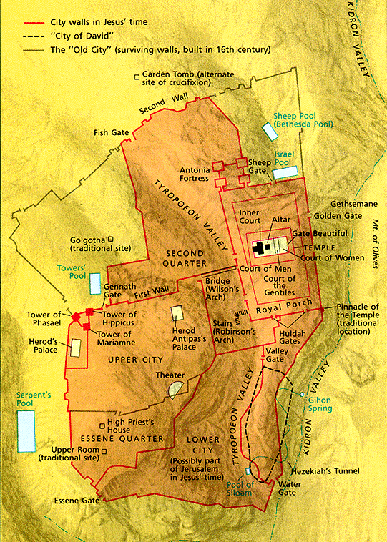
Jerusalem
27
Disadvantages
Advantages
Stages
Significance

Slide 12
Jerusalem
27
Disadvantages

Slide 13
Left Stage
20
Travel in Ancient Israel
Right Stage

Slide 14
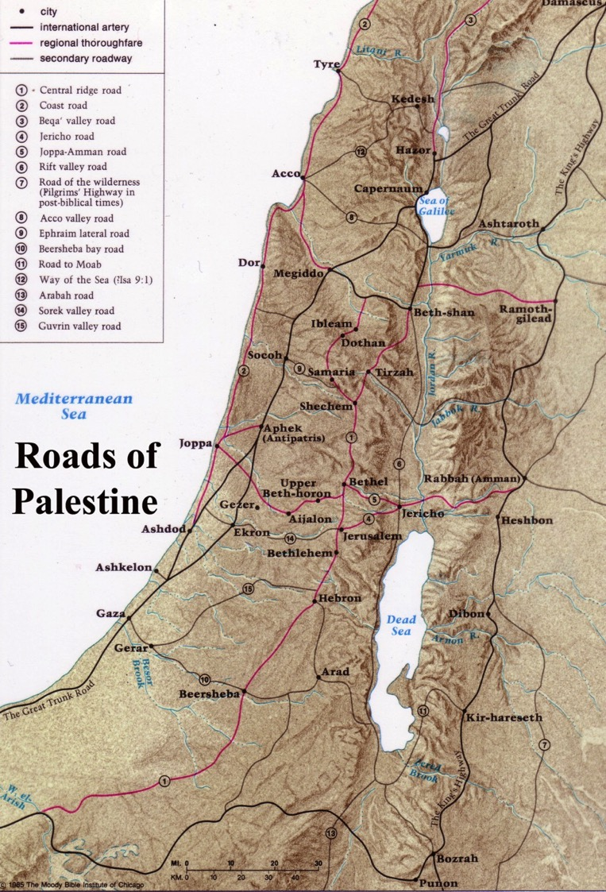
Jerusalem was off the main highways
20
Great Trunk Road
Central Ridge Road
Kings Highway

Slide 15
Jerusalem
20
Disadvantages
Advantages

Slide 16
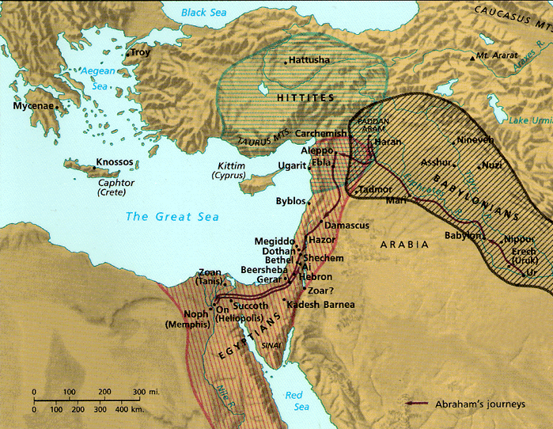
Israel's Strategic Location
26
Thought Question:
How has God placed you in a strategic place for His purposes?
“Thus says the Lord GOD: This is Jerusalem; I have set her in the center of the nations, with countries round about her”
Ezekiel 5:5
Notes:
Note that "Lord" is adonai in Ezekiel 5:5

Slide 17
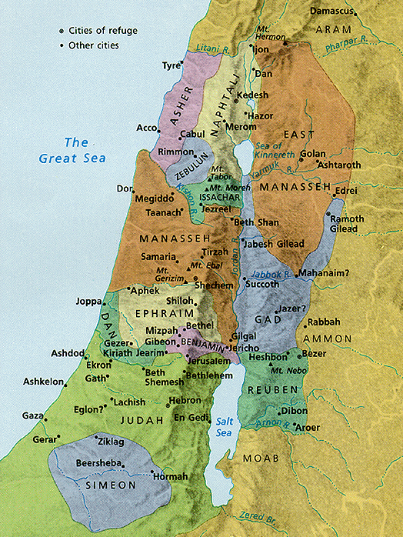
Division of Canaan
23
Jerusalem was between Judah and Benjamin but close to the northern tribes
Jerusalem

Slide 18
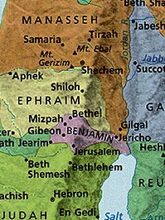
Central Location
23
OT Jerusalem was in Benjamin north of Judah but close to the northern tribes
Jerusalem
Notes:
18
Some say Jerusalem was in the “navel” of Israel, meaning the center!

Slide 19
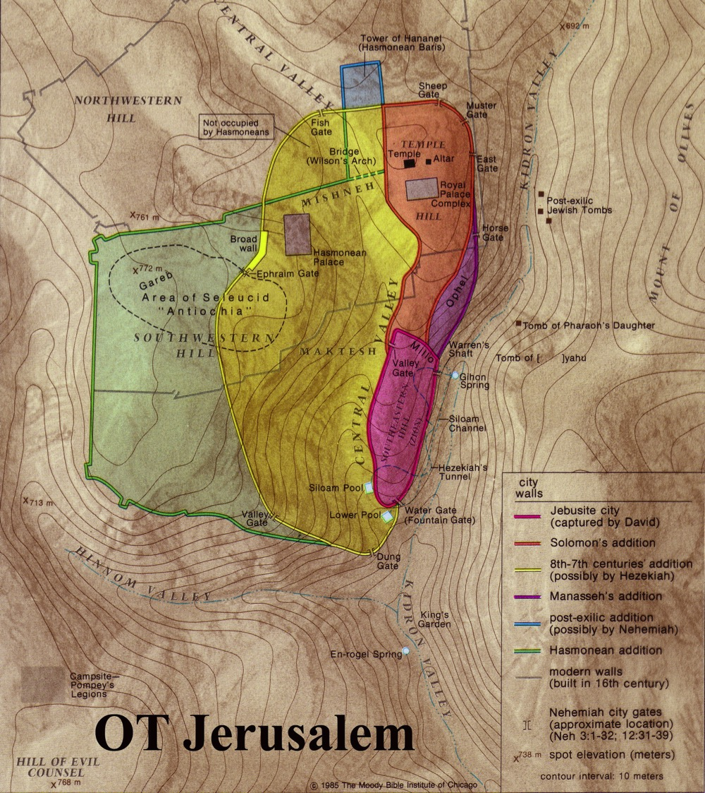
Jerusalem was a Border City
21
The OT border between Benjamin and Judah ran just south of the city
Benjamin
Judah

Slide 20
Jerusalem
23
Disadvantages
Advantages
Protective valleys
Tyropoeon Valley
Tyropoeon
Hinnom
Kidron
Kidron Valley
Hinnom Valley

Slide 21
Jerusalem
28
30-31
Disadvantages
Advantages
Protective hills
Water source

Slide 22
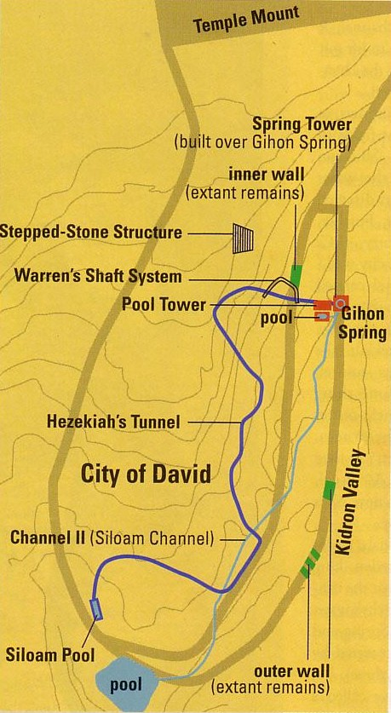
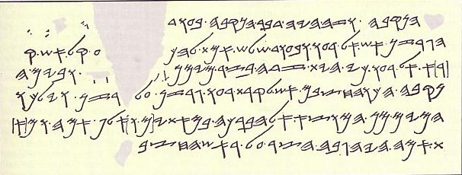
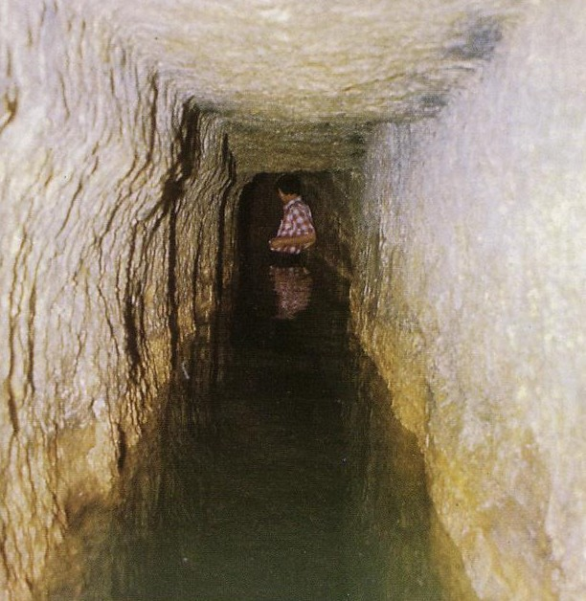
Hezekiah's Tunnel
31
Siloam Inscription

Slide 23
Siloam Inscription
30
“[...when] (the tunnel) was driven through. And this was the way in which it was cut through: While [...] (were) still [...] axe(s), each man toward his fellow, and while there were still three cubits to be cut through, [there was heard] the voice of a man calling to his fellow, for there was an overlap in the rock on the right [and on the left]. And when the tunnel was driven through, the quarrymen hewed (the rock), each man toward his fellow, axe against axe; and the water flowed from the spring toward the reservoir for 1,200 cubits, and the height of the rock above the head(s) of the quarrymen was 100 cubits.”

Slide 24
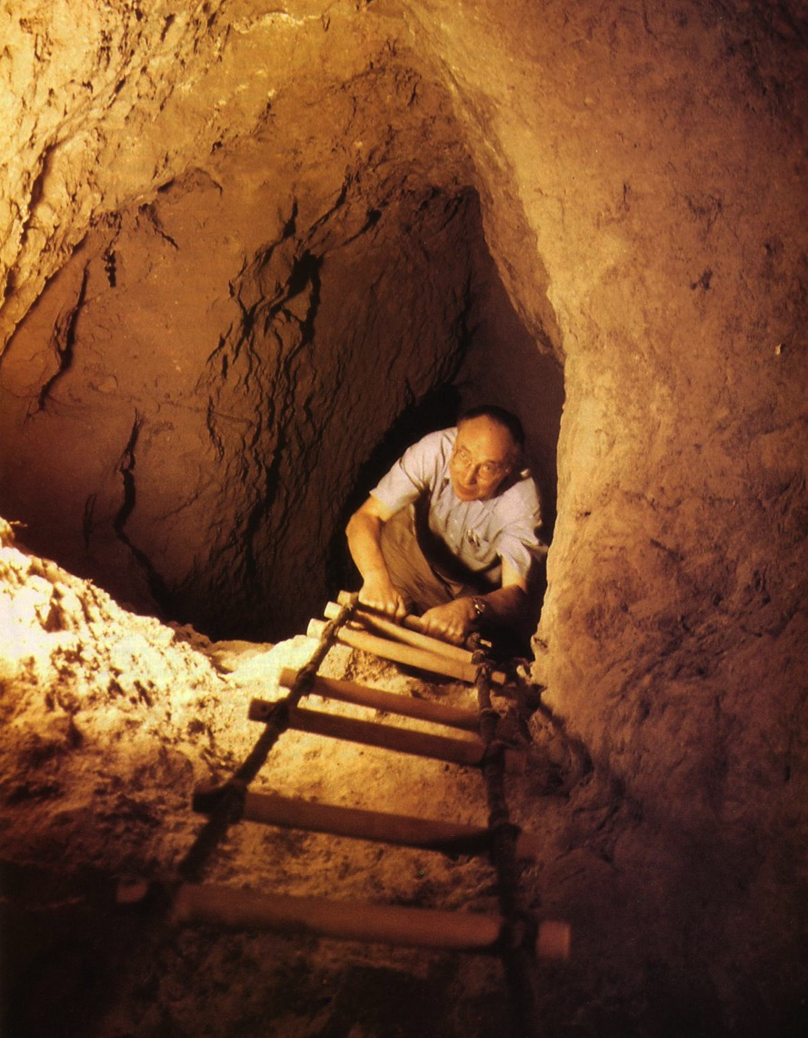
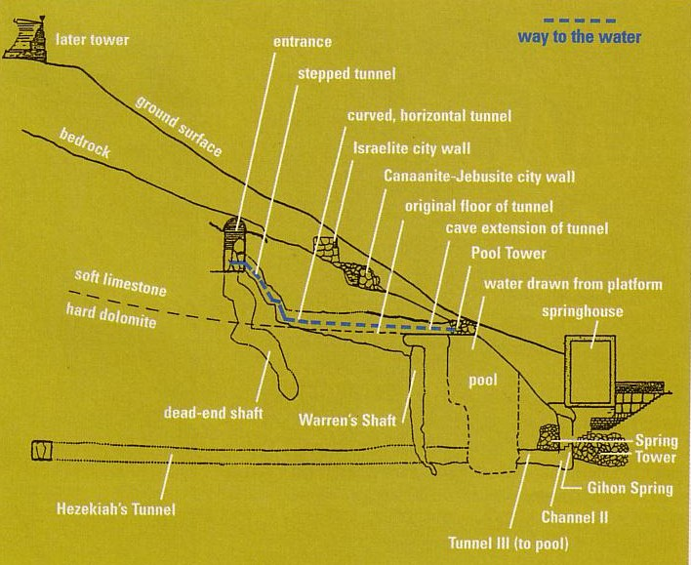
Warren's Shaft
31, 34
Notes:
BAR Nov/Dec 1999

Slide 25
Jerusalem
27
Disadvantages
Advantages
Stages
Jebusite (1500 BC)

Slide 26
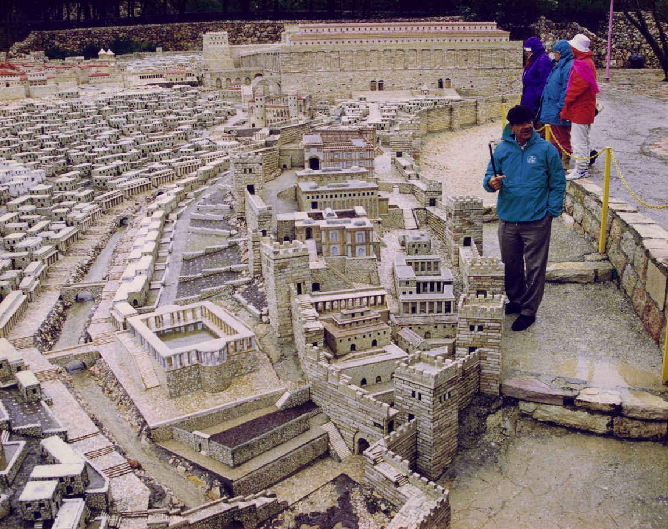
Model of the City of David (AD 66)
(Rebuilt Old Jebusite City)

Slide 27
Jerusalem
23
Disadvantages
Advantages
Stages
Jebusite (1500 BC)
Solomon (971 BC)
Hezekiah (700 BC)
Hezekiah (700 BC)
586 BC
Nehemiah (444 BC)
Hasmonean (100 BC)
Herod the Great (20 BC)
Modern Walls
AD 70
Notes:
Jerusalem grew in stages from the Jebusite period until its destruction in 586/587 BC. Nehemiah then began the reconstruction, and the city once again grew until its second destruction in AD 70. Then, various reconstructions followed in the centuries after Christ, culminating in the present walls established in the 1500s. Yet these walls encompass only the Old City, which is about 1% of Jerusalem's current area.
_________________
NB-03-Geography of NT Jerusalem-26
OB-27-Geography of Jerusalem_OTB-26
OS-19-Psalms-186

Slide 28
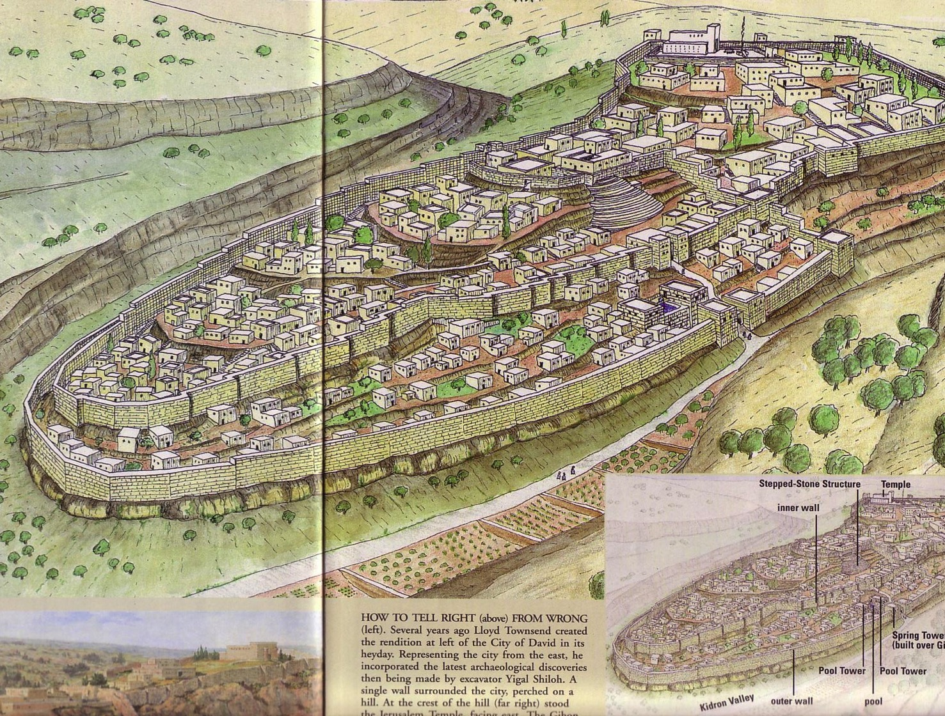
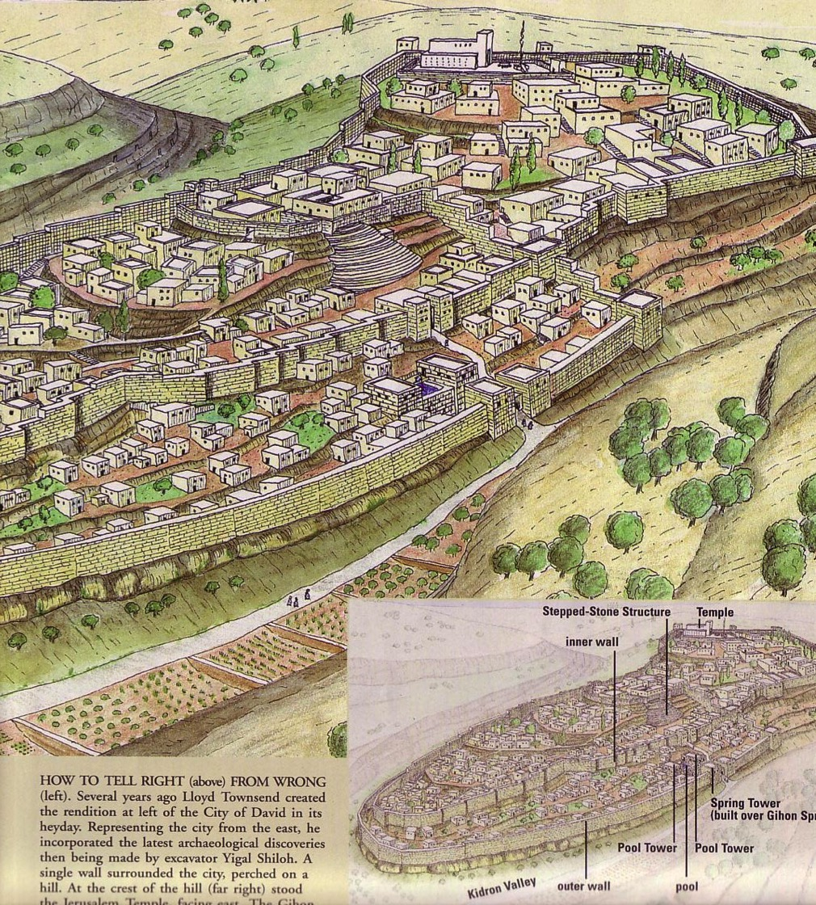
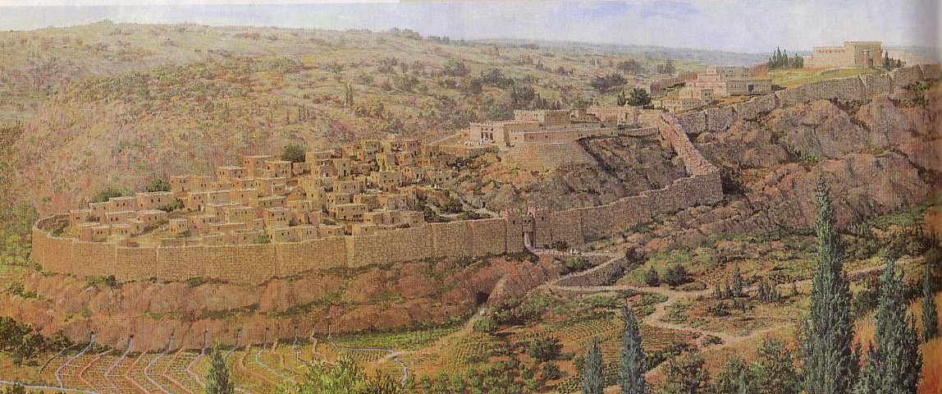
Eastern City of David
“Then [Hezekiah] worked hard repairing all the broken sections of the wall and building towers on it. He built another wall outside that one and reinforced the supporting terraces of the City of David.
(2 Chron. 32:5)
34
“Afterward [Manasseh] rebuilt the outer wall of the City of David, west of the Gihon spring in the valley, as far as the entrance to the Fish Gate and encircling the Ophel; he also made it much higher…
(2 Chron. 33:14)

Slide 29
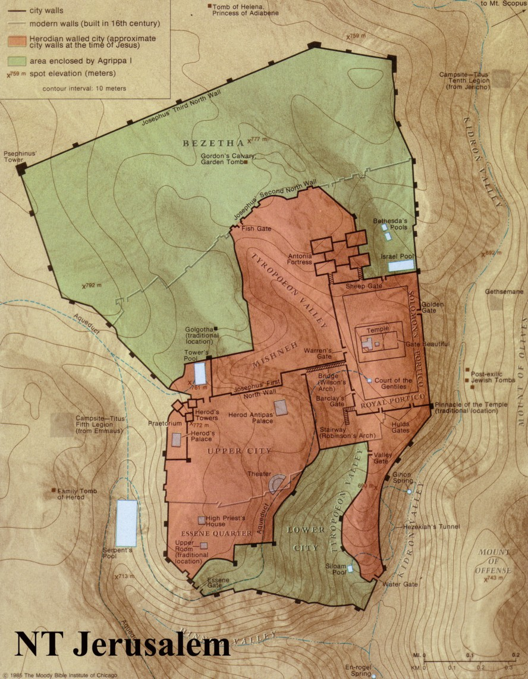
How many hills?
Northeast
Temple
Ophal
Upper City
Lower City

Slide 30
Jerusalem
23-24
Disadvantages
Advantages
Stages
Significance
Jewish
Christian
Muslim
All Nations

Slide 31
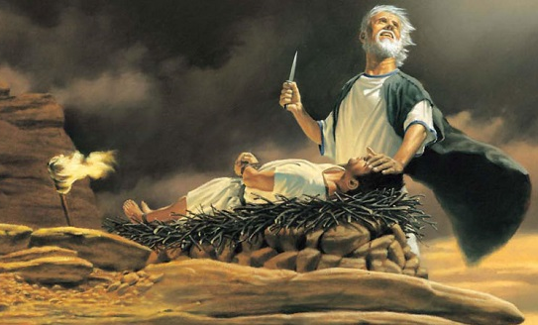
Genesis 22

Slide 32
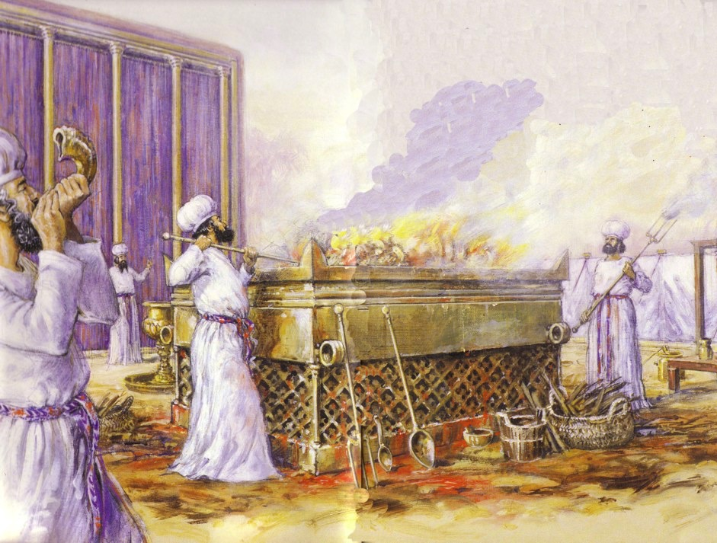
Whole Burnt Offerings Were First at the Mobile Tabernacle

Slide 33
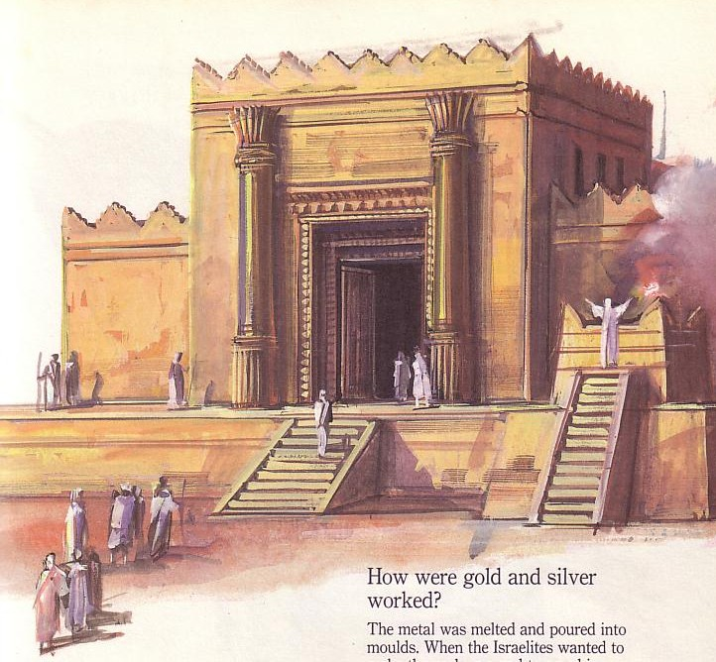
Jewish life then revolved around Solomon's temple for 400 years (959-586 BC)

Slide 34
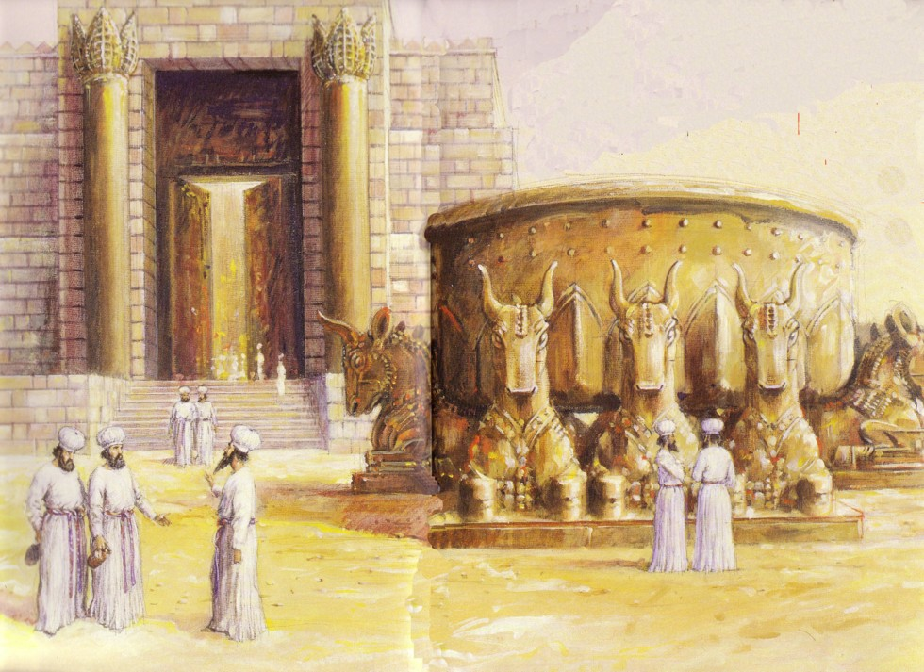
Jews Maintained Holiness at the Basin
586 BC: Temple Destroyed!

Slide 35
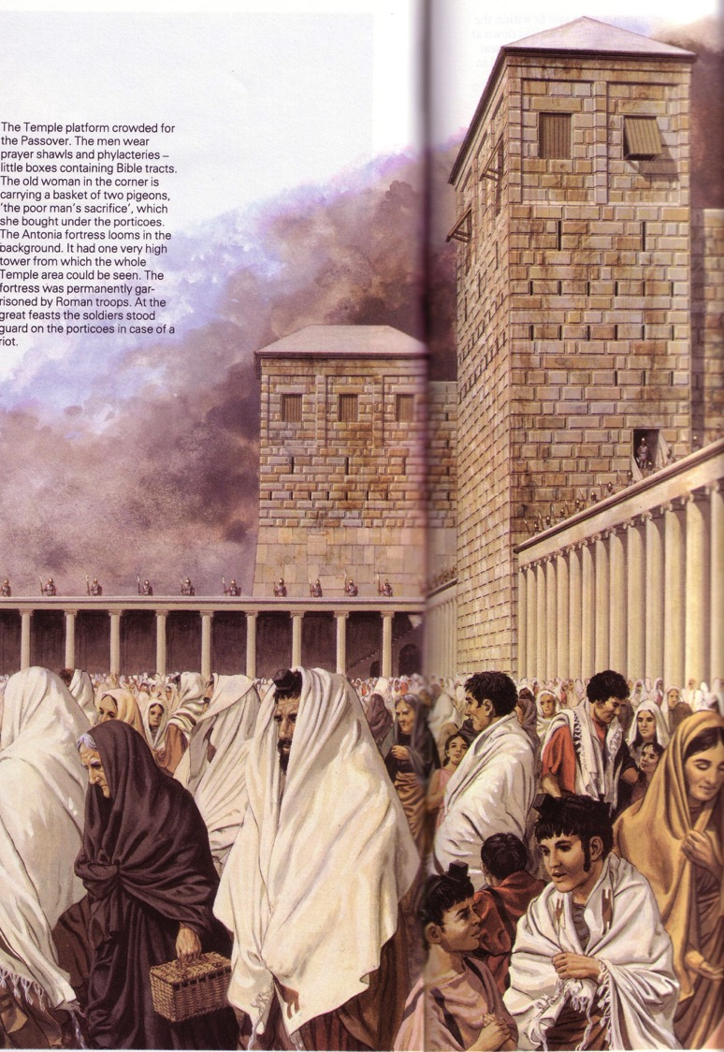
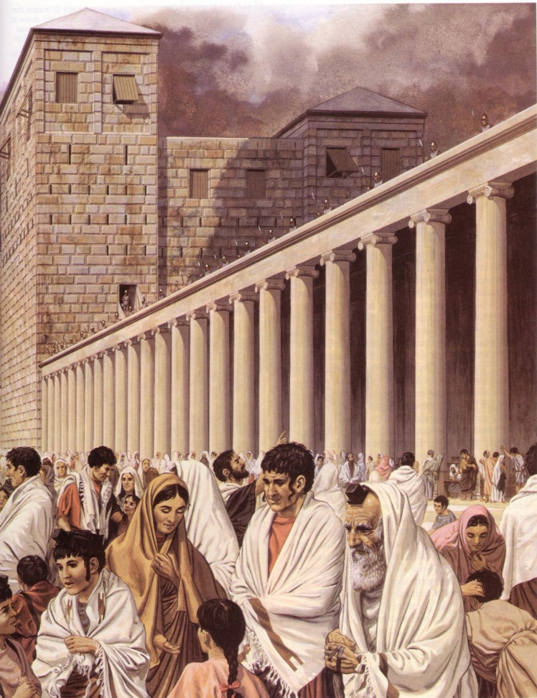
After temple rebuilding, in NT Passovers 100,000 Jews visited the Temple!
AD 70: Temple Destroyed Again!

Slide 36
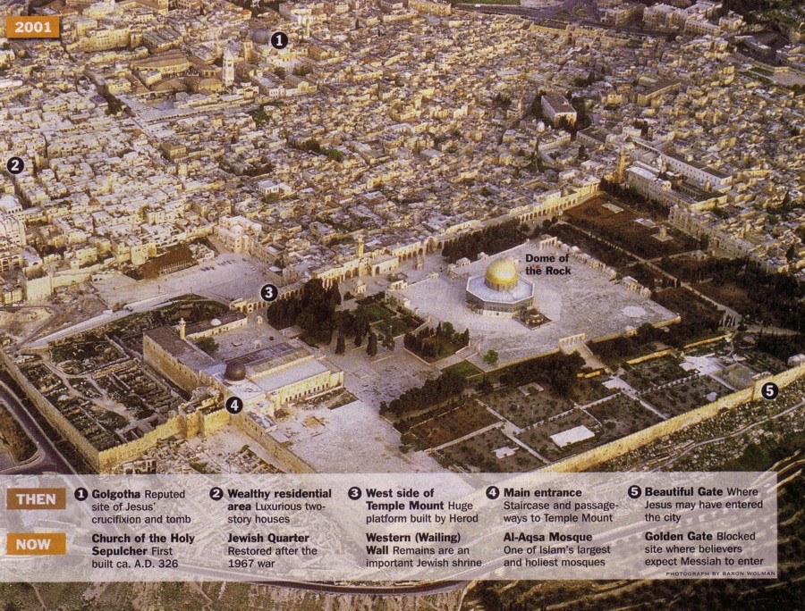

Jerusalem Today
35

Slide 37
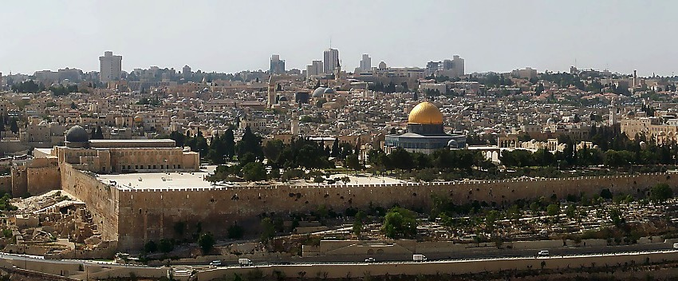
Jerusalem's Temple Mount Today
1 Kings 6:14-38
Site of Abraham's Near-Sacrifice of Isaac…Mt. Moriah…Mt. Zion
Handbook pg. 32-37
32
6

Slide 38
Jerusalem's Temple Mount Today
1 Kings 6:14-38
Site of Abraham's Near-Sacrifice of Isaac…Mt. Moriah…Mt. Zion
Building those amazing structures!
Handbook pg. 32-37
32
6
Notes:
This could be an outline of Mt. Zion...the biblical name for today's Temple Mount.

Slide 39
Jerusalem's Temple Mount Today
1 Kings 6:14-38
Site of Abraham's Near-Sacrifice of Isaac…Mt. Moriah…Mt. Zion
Building those amazing structures!
Handbook pg. 32-37
32
6
Notes:
This could be an outline of Mt. Zion...the biblical name for today's Temple Mount.
//// To build these expensive structures, the first step was to clear off and level the top of the mountain ...

Slide 40
Jerusalem's Temple Mount Today
1 Kings 6:14-38
Site of Abraham's Near-Sacrifice of Isaac…Mt. Moriah…Mt. Zion
Building those amazing structures!
Handbook pg. 32-37
32
6
Notes:
This could be an outline of Mt. Zion...the biblical name for today's Temple Mount.
//// To build these expensive structures, the first step was to clear off and level the top of the mountain ...
//// followed by the construction of a massive pavement with retaining walls of stone and gravel fill.

Slide 41
Jerusalem's Temple Mount Today
1 Kings 6:14-38
Site of Abraham's Near-Sacrifice of Isaac…Mt. Moriah…Mt. Zion
Building those amazing structures!
The Western or "Wailing Wall"
Handbook pg. 32-37
32
6
Notes:
This could be an outline of Mt. Zion...the biblical name for today's Temple Mount.
//// To build these expensive structures, the first step was to clear off and level the top of the mountain ...
//// followed by the construction of a massive pavement with retaining walls of stone and gravel fill.
//// On the left, today, you can see a portion of the retaining wall known today as the Western Wall, or to some, the Wailing Wall.

Slide 42
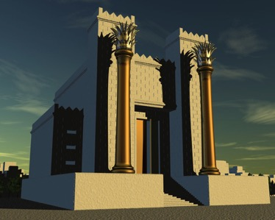
Jerusalem's Temple Mount Today
1 Kings 6:14-38
Site of Abraham's Near-Sacrifice of Isaac…Mt. Moriah…Mt. Zion
Building those amazing structures!
The Western or "Wailing Wall"
The "First" Temple Built by Solomon
Handbook pg. 32-37
32
6
Notes:
This could be an outline of Mt. Zion...the biblical name for today's Temple Mount.
//// To build these expensive structures, the first step was to clear off and level the top of the mountain ...
//// followed by the construction of a massive pavement with retaining walls of stone and gravel fill.
//// On the left, today, you can see a portion of the retaining wall known today as the Western Wall, or to some, the Wailing Wall.
//// At that site, King Solomon built the First Temple to the Lord.

Slide 43
Jerusalem's Temple Mount Today
1 Kings 6:14-38
Site of Abraham's Near-Sacrifice of Isaac…Mt. Moriah…Mt. Zion
Building those amazing structures!
The Western or "Wailing Wall"
Herod's "Second" Temple of Jesus' Time
Handbook pg. 32-37
32
6
Notes:
This could be an outline of Mt. Zion...the biblical name for today's Temple Mount.
//// To build these expensive structures, the first step was to clear off and level the top of the mountain ...
//// followed by the construction of a massive pavement with retaining walls of stone and gravel fill.
//// On the left, today, you can see a portion of the retaining wall known today as the Western Wall, or to some, the Wailing Wall.
//// At that site, King Solomon built the First Temple to the Lord.
//// It was followed hundreds of years later by the Second Temple, familiar in Jesus' time. Today, though, and for the past 1,400 years….

Slide 44
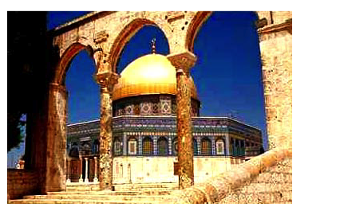
Jerusalem's Temple Mount Today
1 Kings 6:14-38
Site of Abraham's Near-Sacrifice of Isaac…Mt. Moriah…Mt. Zion
Building those amazing structures!
The Western or "Wailing Wall"
Today's Islamic Dome of the Rock
Handbook pg. 32-37
32
6
Notes:
This could be an outline of Mt. Zion...the biblical name for today's Temple Mount.
//// To build these expensive structures, the first step was to clear off and level the top of the mountain ...
//// followed by the construction of a massive pavement with retaining walls of stone and gravel fill.
//// On the left, today, you can see a portion of the retaining wall known today as the Western Wall, or to some, the Wailing Wall.
//// At that site, King Solomon built the First Temple to the Lord.
//// It was followed hundreds of years later by the Second Temple, familiar in Jesus' time. Today, though, and for the past 1,400 years….
//// the Moslem Dome of the Rock has occupied that same great pavement…since A.D. 685.

Slide 45
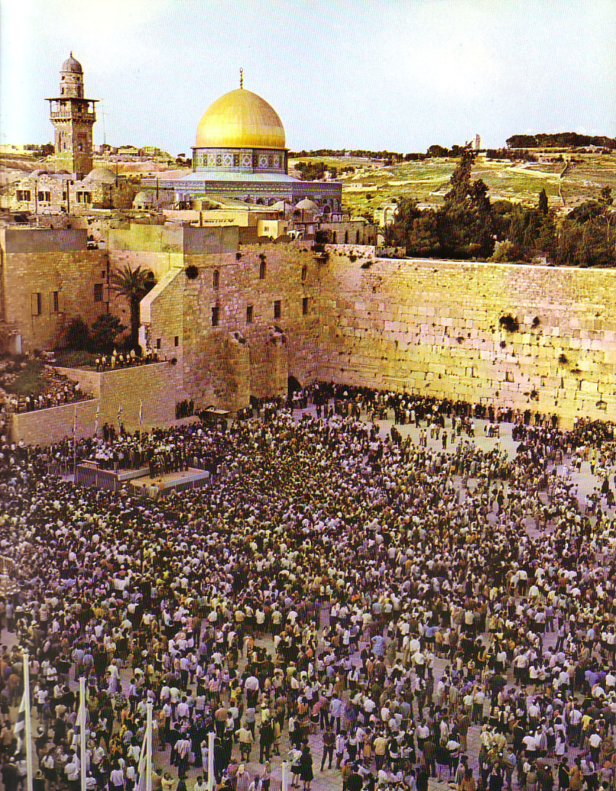
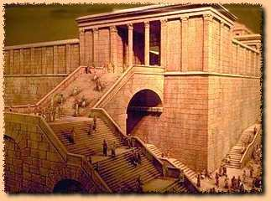
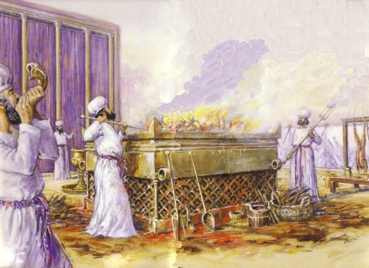
Jewish Western Wall
35

Slide 46
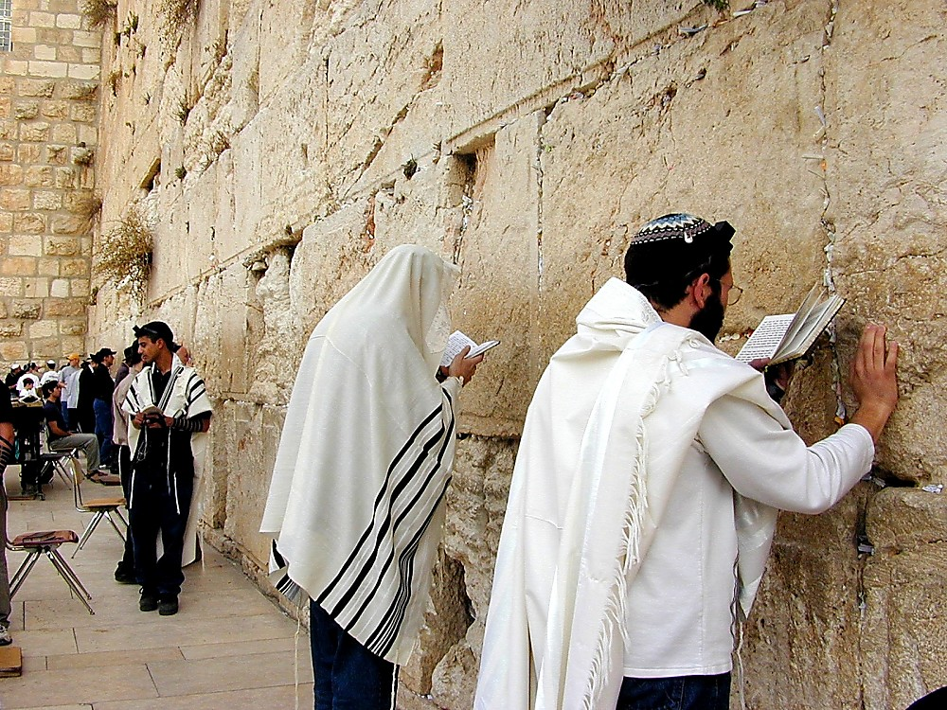
Jewish Western Wall
35

Slide 47
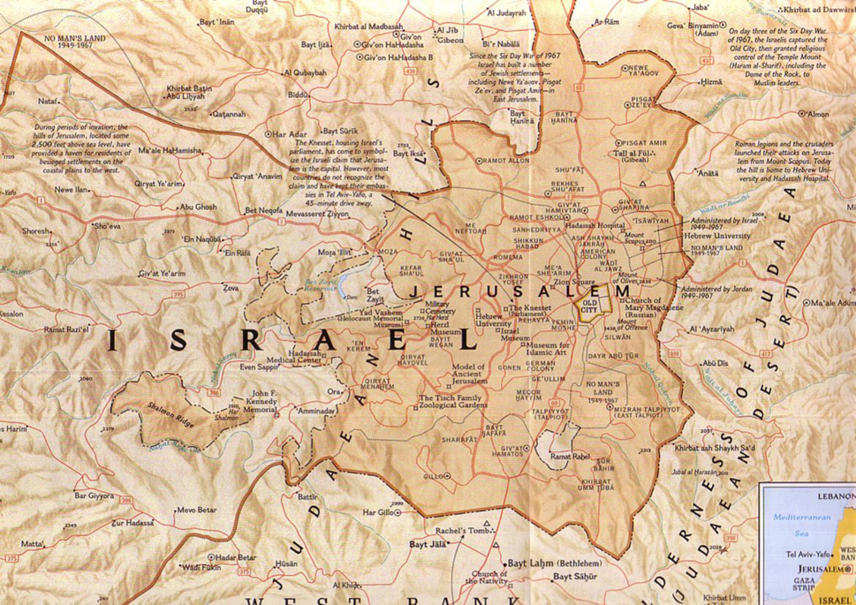
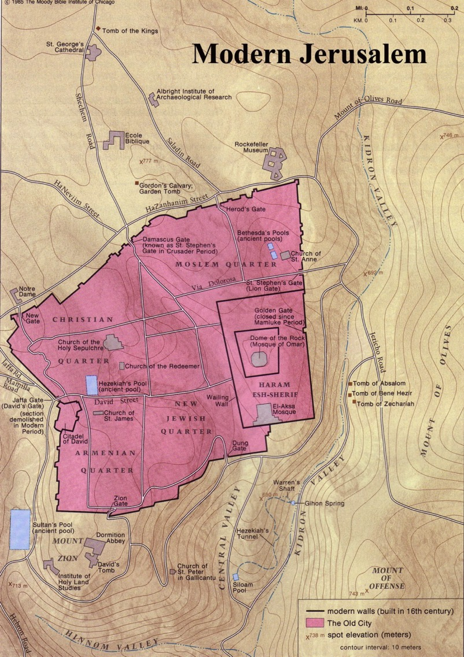

Wider Jerusalem
Notes:
The size of the Old City comprises about 1% of the present city of Jerusalem.

Slide 48
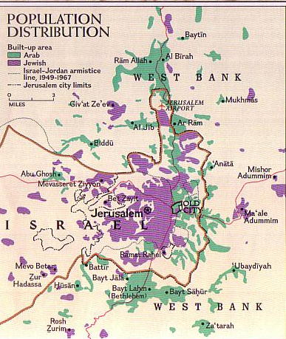
Present Jerusalem Population
West = Jews
East = Arabs
Notes:
The Jewish population started in the western side of Jerusalem, but it has steadily moved east into what used to be primarily Arabs.

Slide 49
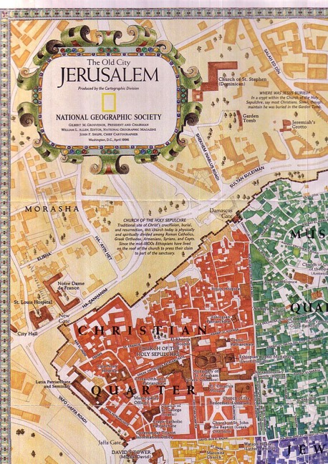
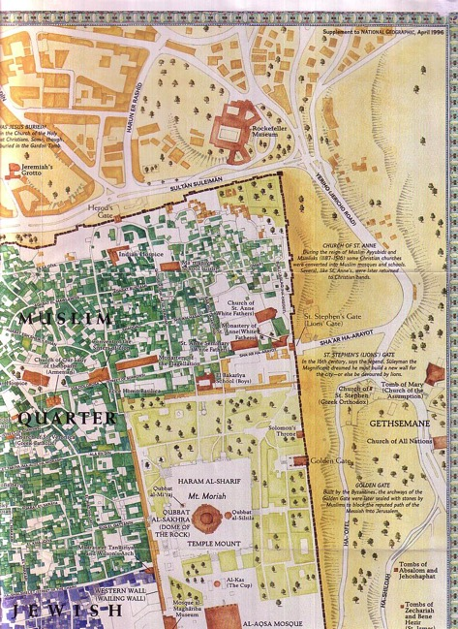
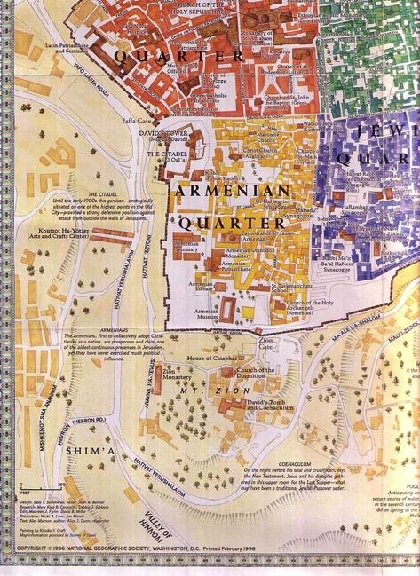
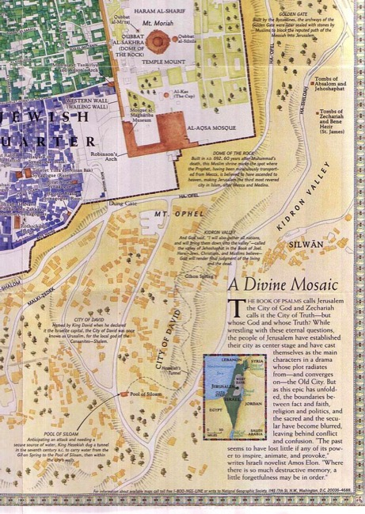
The Old City
36
Each of the four quarters represents an era
Notes:
Now, the Old City of Jerusalem has four main quarters, almost divided like a square pizza. But Muslims control the largest section, by far, in the Muslim Quarter in green. Add to that the Temple Mount, also under Islamic control.

Slide 50
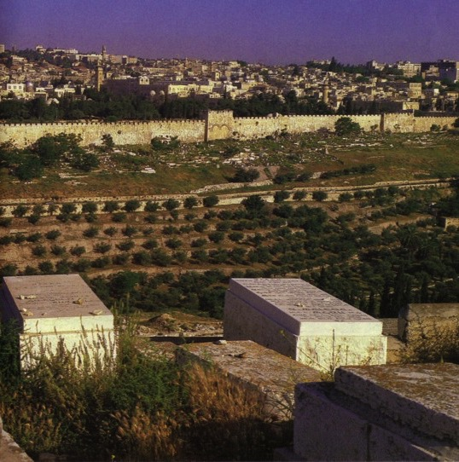
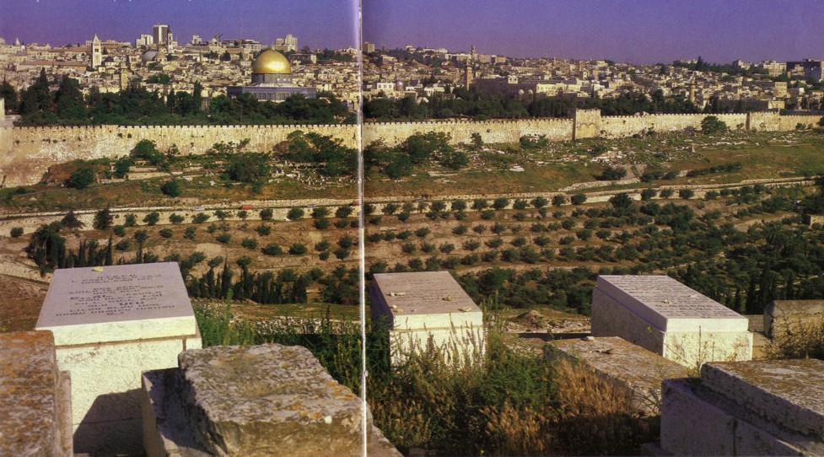
Jewish Hope of Resurrection
36
Jews buried on the Mt. of Olives hope to be the first to enter the Eastern Gate with the Messiah when He comes
Notes:
Here is the most expensive cemetery in the world!

Slide 51
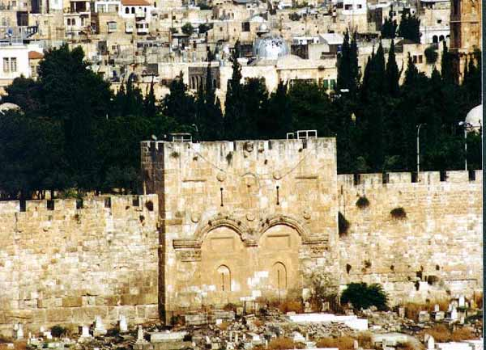
Muslims Sealed the Eastern Gate
Notes:
This gate was blocked after the Turkish conquest of Jerusalem in AD 1517.

Slide 52
Significance to Christians:
28
Christ's Death
Resurrection
Church Born
Mother Church
Christ's Return
NT Jerusalem

Slide 53

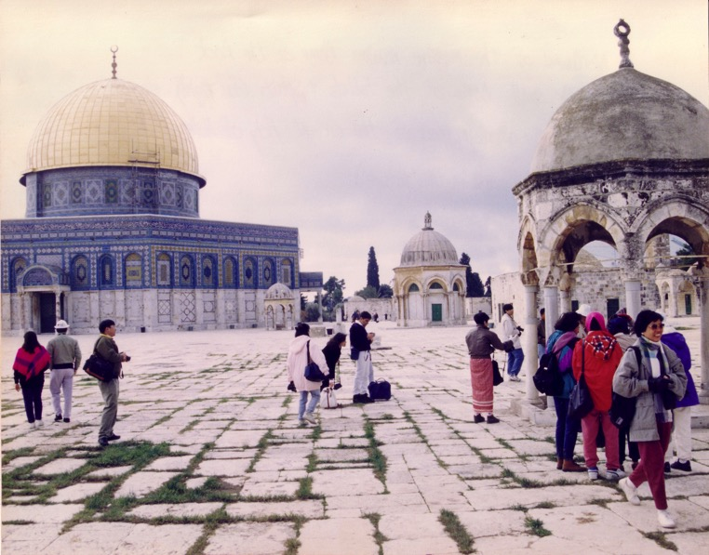

Muslim Control
Mosque of Omar
(Dome of the Rock)
Al-Aksa Mosque
Notes:
Muslims control Temple Mount, but do not call it Temple Mount, for this would give away the fact that Jewish temples stood on it for nearly 1000 years. Instead, Islam emphasizes their two mosques atop the man-made platform built by Solomon.

Slide 54

A Dome to Outshine the Dome
Notes:
In the 1990s, King Hussein of Jordan sought to make the Dome of the Rock more dazzling than the dome of the Church of the Holy Sepulcher, so he covered the Dome of the Rock's dome with 14-carat gold!

Slide 55

The Rock Inside
SACRED STONE:
The Dome of the Rock celebrates a union with God
Notes:
The Dome encircles the bedrock at the top of the mountain where Abraham nearly sacrificed Isaac, and etchings in the stone perfectly match the size of the ark of the covenant, marking the exact spot where the ark stood from 966-586 BC.

Slide 56


Muslim Prayers at the Dome
Notes:
Yet Muslims acknowledge none of this history, even though the word "Jerusalem" does not appear in the Koran!

Slide 57
Muslim Control
36
Mosque of Omar
(Dome of the Rock)
Al-Aksa Mosque

Slide 58

What's the Future for the Dome?
24

Slide 59


Chronology of the 70th "Week"
556
Adapted from J. Dwight Pentecost, Dallas Theological Seminary, 1988
Middle of the Week
Sign of
Son of Man
Matt. 24:30
Christ's Return Complete
3½ YEARS
1290 DAYS
Dan. 12:11
30 DAYS
30 DAYS
1260 DAYS
45 DAYS
Rev. 12:6
Dan. 12:12
3½ YEARS
3½ YEARS
Election
of Beast
Rev. 17:13
Covenant Made
Dan. 9:27a
Covenant Broken
Dan. 9:27b
The Great Tribulation
2nd ADVENT
The Tribulation
"He will confirm a covenant with many for one 'seven.' In the middle of the 'seven' he will put an end to sacrifice and offering. And on a wing [of the temple] he will set up an abomination that causes desolation, until the end that is decreed is poured out on him" (Daniel 9:27 NIV).
Notes:
The final of the 70 "weeks" also will last seven years and is the focus of Daniel's prophecies more than any other period. Revelation later builds on the foundation that Daniel established.
______________
Common-404
BE-27-Daniel-117
LC-09-Preparation-30
OB-27-Geography of Jerusalem-59
OS-27-Daniel-407, 499
NS-14-2Thess-184
NS-27-Rev1-slide 170
NS-22-Rev7-12-slide 99

Slide 60

Antichrist will make a 7-year treaty with Israel
This will likely enable the rebuilding of the Jerusalem temple
Artwork by Sunny Chandra
Notes:
The 70th week of Daniel 9:27 is believed by nearly all scholars to depict a seven-year period. Since this “ruler to come” will set up a desecration in the temple and this event is still future, it must mean that the present temple rebuilding preparations in Jerusalem right now will be successful in building the temple on its original spot.

Slide 61

Antichrist will make a 7-year treaty with Israel
This will likely enable the rebuilding of the Jerusalem temple
Artwork by Sunny Chandra
Notes:
The traditional spot for the temple is the exact spot where the Dome of the Rock was constructed by Muslims in the late AD 690s. But will this be easily demolished by one who the world will accept as a peaceful negotiator? That seems unlikely.

Slide 62

Antichrist will make a 7-year treaty with Israel
This will likely enable the rebuilding of the Jerusalem temple
Artwork by Sunny Chandra
Notes:
Some propose that this deceitful ruler will negotiate a deal to have the temple built right next to the Dome. Rabbis like Asher Kaufman have proposed the northern site as the original site of Solomon’s temple, partly because it gives a straight shot towards the Eastern Gate.

Slide 63

Antichrist will make a 7-year treaty with Israel
This will likely enable the rebuilding of the Jerusalem temple
Artwork by Sunny Chandra
Notes:
Building these adjacent would certainly be the result of a master negotiator!

Slide 64

Antichrist will make a 7-year treaty with Israel
This will likely enable the rebuilding of the Jerusalem temple
Artwork by Sunny Chandra
Notes:
Perhaps such a feat would underscore the unity of all religions—a major tenant of the one-world religion that will lead to global worship of the Antichrist as the messianic figure at the focus of that one-world government.

Slide 65
24
Millennial Jerusalem
"The law will go out from Zion,
the word of the LORD from Jerusalem"
—Isaiah 2:3
Notes:
65
Isaiah predicted a one-world government with Jerusalem as its capital. This city of God’s presence will be the focus of worldwide worship of God though his son Jesus on the throne in Jerusalem. The Antichrist will seek to pre-empt this by declaring himself to be this leader, but he will be defeated so that Jesus can take his rightful place as the world’s political King and religious Saviour.

Slide 66

And I saw the holy city, the new Jerusalem, coming down from God out of heaven like a bride beautifully dressed for her husband
(21:2 NLT).
453

Slide 67

The New Jerusalem
455

Slide 68

Figurative or Literal?
455

Slide 69



The New Jerusalem
460
Size of New Jerusalem
2,250,000 sq. miles

Slide 70

The New Jerusalem & SE Asia
2200 km
460
2200 km
2200 km
2200 km

Slide 71

The New Jerusalem over present Jerusalem
460

Slide 72
Now how would you answer the question I asked earlier?
Are there “holy things” today?
God called Jerusalem the Holy City because it was where He put His name.
God's presence is no longer in a city but in the hearts of believers (1 Cor. 6:19).
How do people see you as holy?

Slide 73
Black

Slide 74


OT Backgrounds link at BibleStudyDownloads.org
Get this presentation for free!
Notes:
NT Survey (ns)

