Slide 1
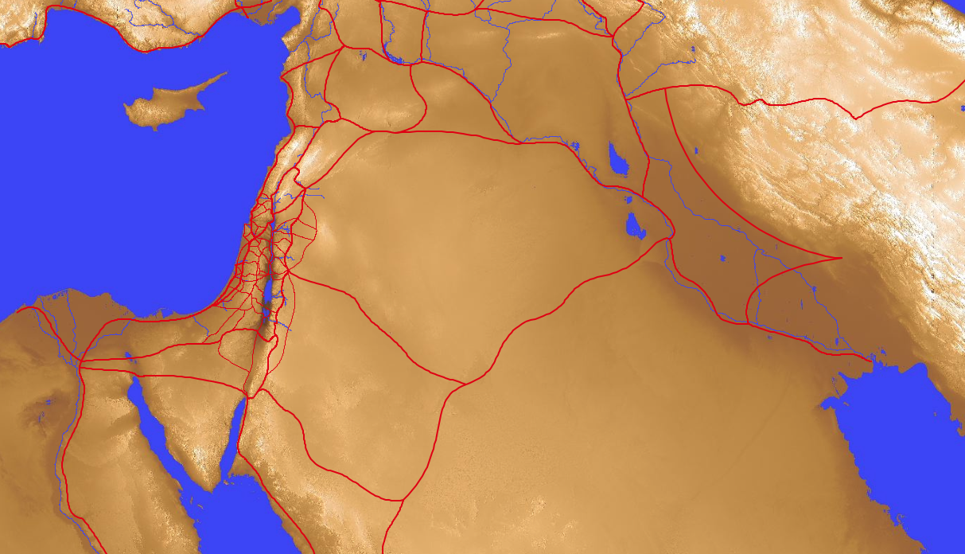
Geography of Israel & the Ancient Near East
14-15
Dr. Rick Griffith • Jordan Evangelical Theological Seminary • BibleStudyDownloads.org

Slide 2
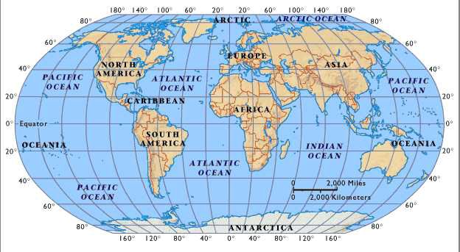
The World Today

Slide 3
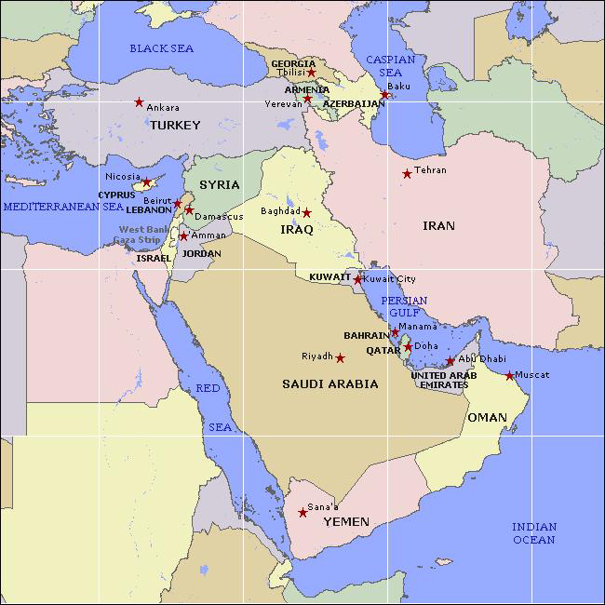
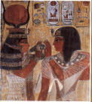
Modern Middle East

Slide 4
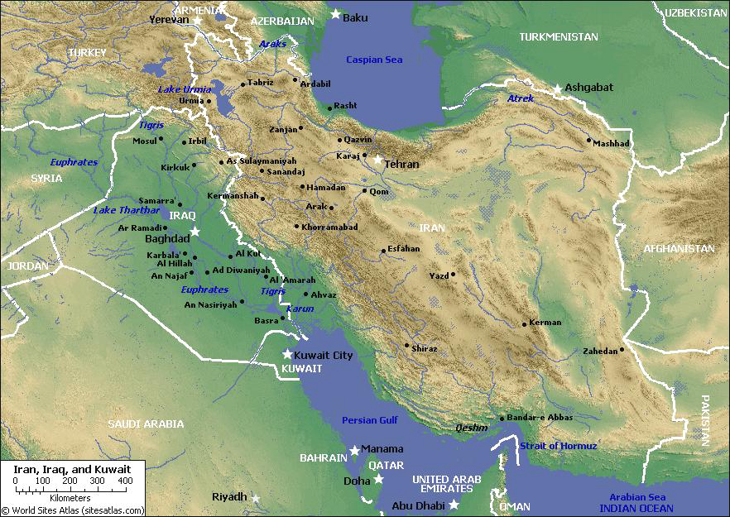
Mesopotamia
15
Tigris
Assyria
Euphrates
Babylon
Persia
Chaldea
Persian Gulf

Slide 5
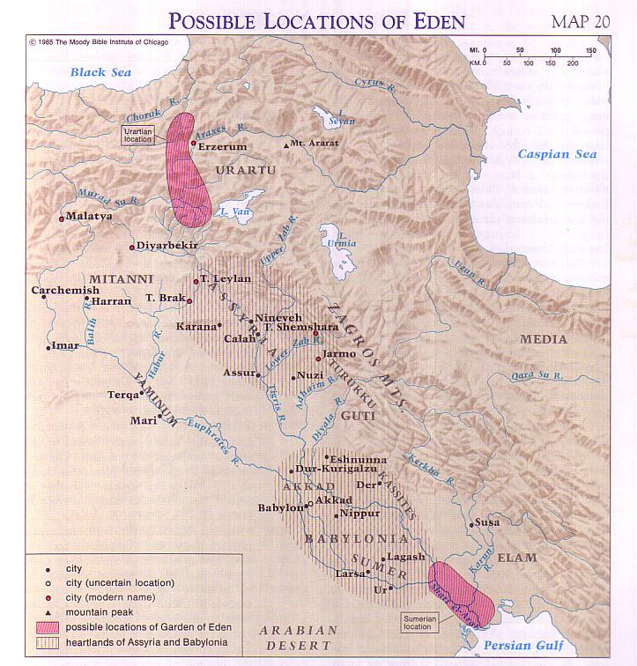
Possible Locations of Eden
Barry Beitzel, Moody Atlas of Bible Lands, 75
Eden
Tigris
Euphrates
Pishon? (Saudi Arabia)
Genesis 1-2
Gihon? (Ethiopia)

Slide 6
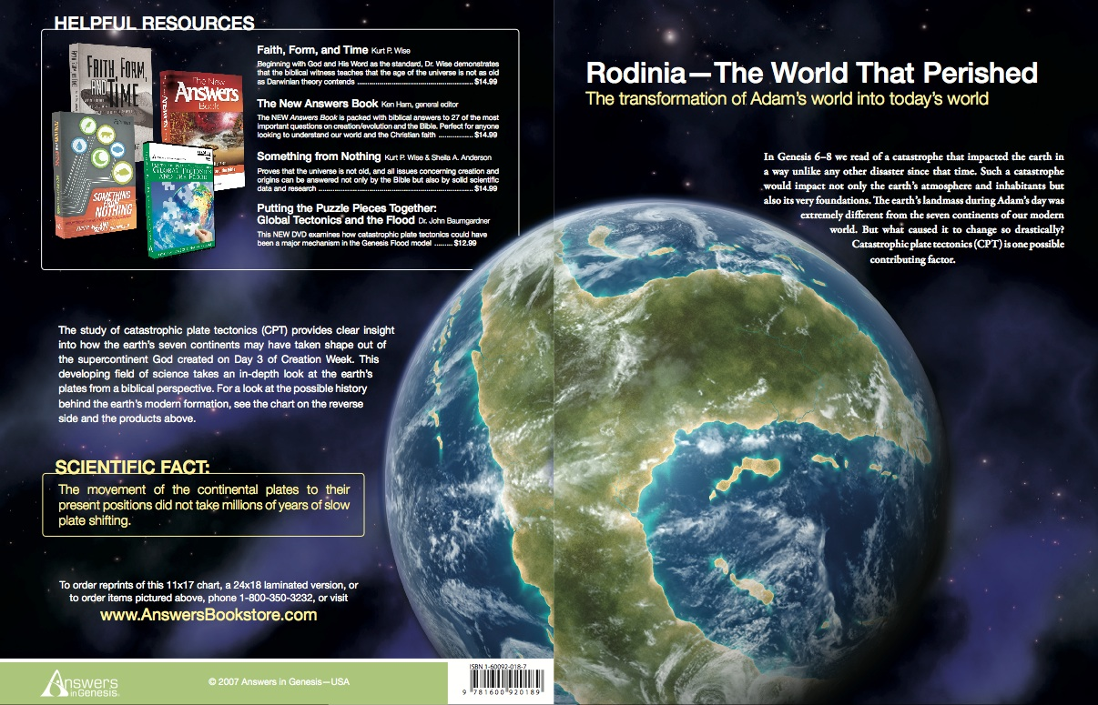
Rodinia––The World That Perished
The transformation of Adam's world into today's world

Slide 7
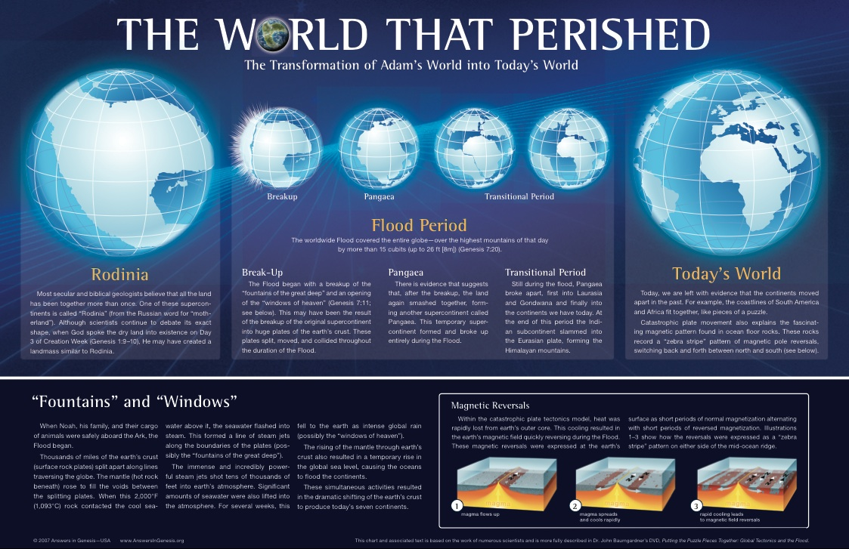
THE WORLD THAT PERISHED
The transformation of Adam's world into today's world

Slide 8
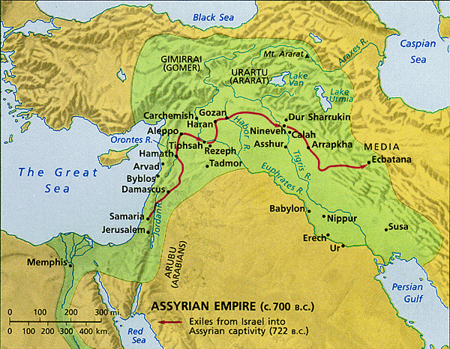
The Ancient Near East
15
Fertile Crescent
Iraq
Israel
Egypt

Slide 9
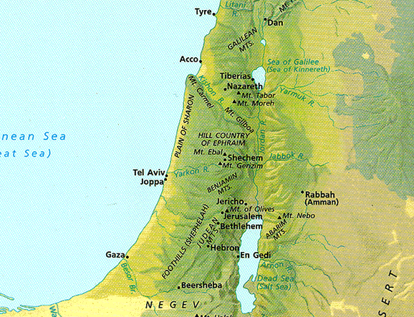



Bodies of Water in Israel
n.m. lyre -- lyre, stringed instrument used for popular as well as sacred music (B4604)
20
OT: Sea of Chinnereth
105 km. (65 mi.)
The Great Sea
215 km. (135 mi.)
Jordan River
Salt Sea
Notes:
The OT name for the northern sea (actually, a lake) is the Sea of Chinnereth.
• This is the Hebrew word for harp, given the harp-shape of this body of water.
• Its distance to the Salt Sea is 105 km.
• However, the Jordan River winds so much that the real length is more than twice that distance at 215 km!

Slide 10
Bodies of Water in Israel
20
NT: Sea of Galilee
OT: Sea of Chinnereth
105 km. (65 mi.)
The Great Sea
215 km. (135 mi.)
Jordan River
Salt Sea
Notes:
• The Salt Sea has been called the Dead Sea since the early centuries of the church, so named because it only has water flowing into it and none out of it, increasing its salinity and making everything in it dead. It is the lowest spot on Earth.

Slide 11
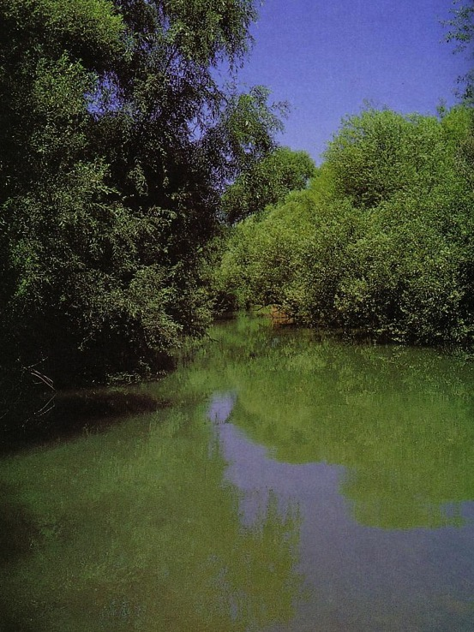
Bodies of Water in Israel
20
NT: Sea of Galilee
OT: Sea of Chinnereth
105 km. (65 mi.)
The Great Sea
215 km. (135 mi.)
Jordan River
Salt Sea
Nahal Senir, one of the sources of the Jordan River
Notes:
The Jordan River actually begins north of the Sea of Galilee.

Slide 12
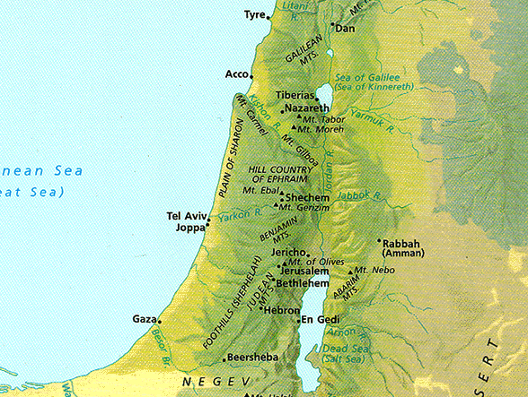
Regions of Israel (OT)
18
Bashan
Galilee
Israel
G
Gilead
Ammon
A
Judah
M
Moab
E
Edom

Slide 13
Regions of Israel (NT)
18
Batanea
Galilee
Decapolis
Perea
Judea
Idumea
Arabia

Slide 14
Regions of Israel (NT)
18
Batanea
Galilee
Some Area
Decapolis
Perea
Judea
Idumea
Arabia

Slide 15
Regions of Israel (NT)
18
Batanea
Galilee
Samaria
Decapolis
Perea
Judea
Idumea
Arabia

Slide 16
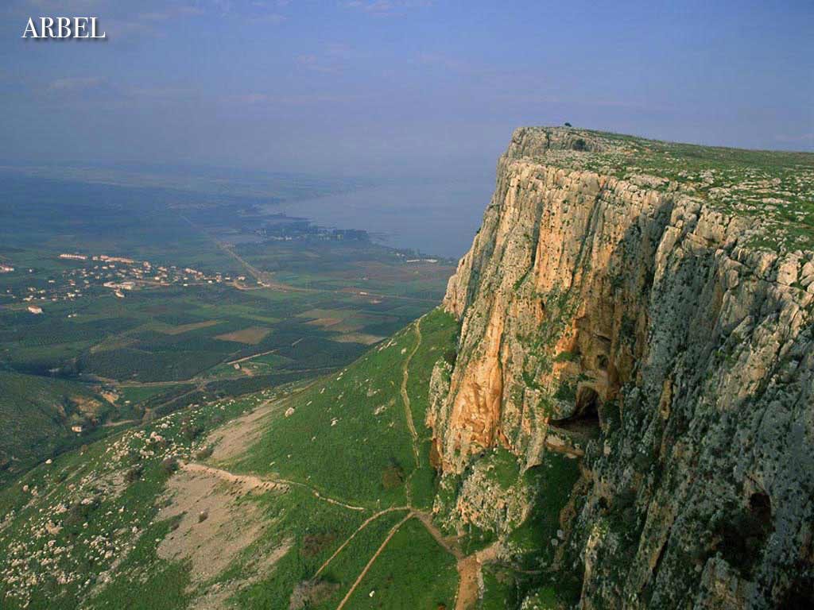
The Sea of Galilee
Arbel
(North shore looking east))

Slide 17
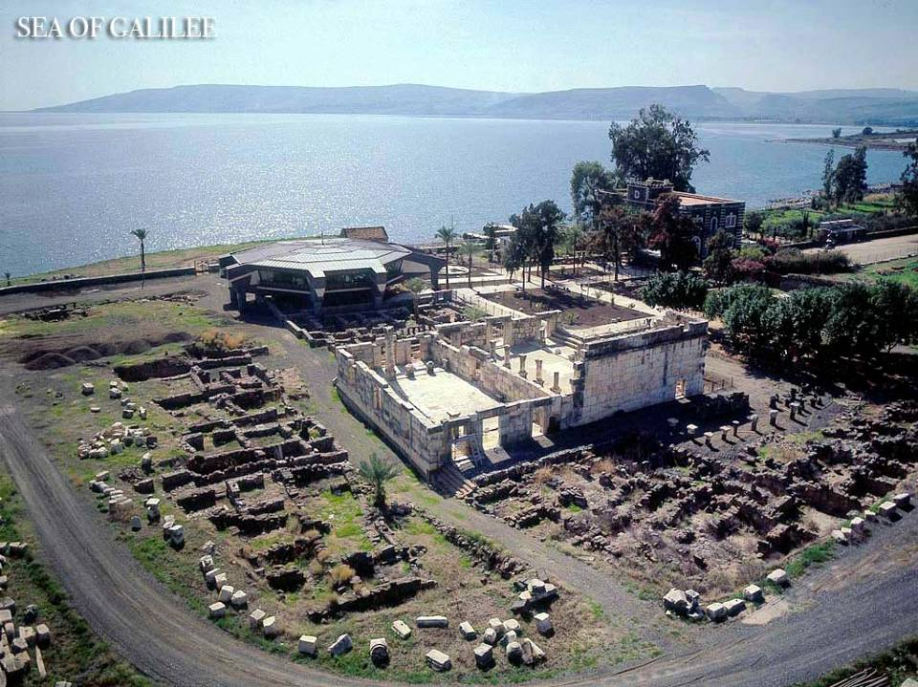
Sea of Galilee

Slide 18
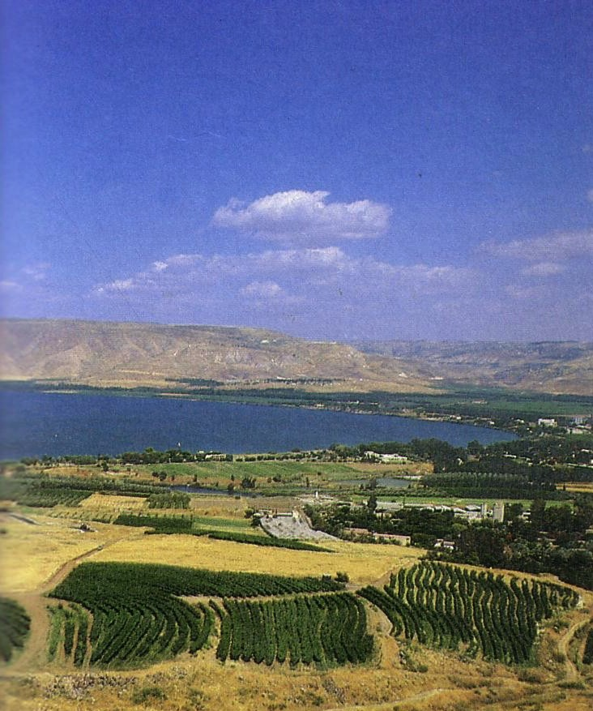
The Sea of Galilee
(South shore looking east)

Slide 19
Mountains in Israel
20
Hermon
Carmel
Tabor
Gilboa
Zion
Olives
Nebo
Hor

Slide 20
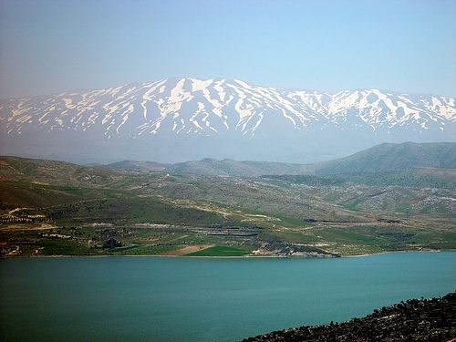
Mount Hermon

Slide 21
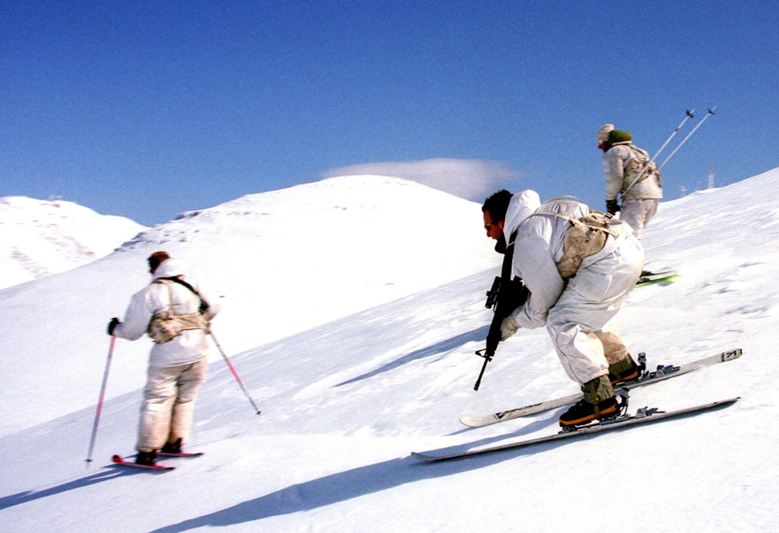
Mount Hermon

Slide 22
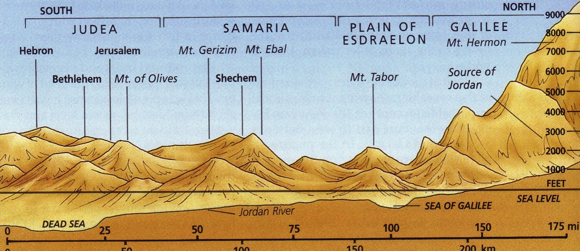
Elevations
18

Slide 23
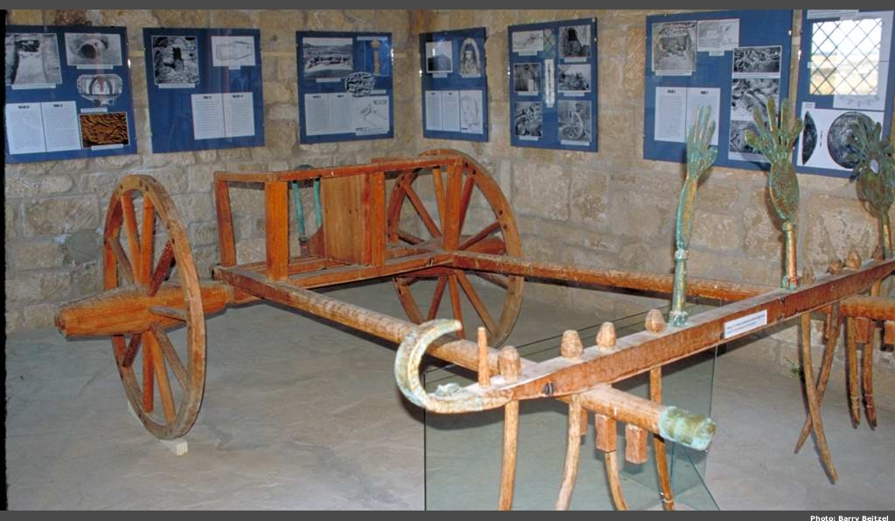
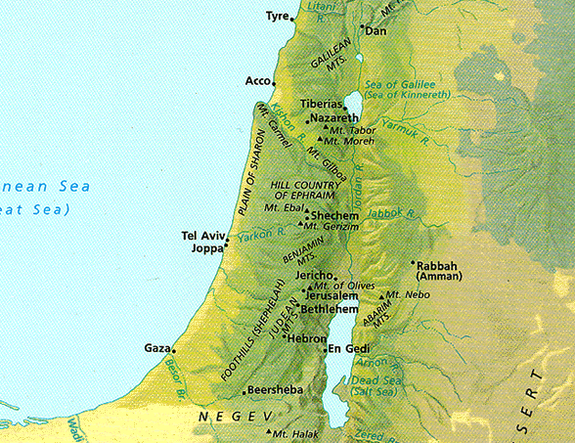
Elevations in North-South Divisions
18
Coastal Plain

Slide 24
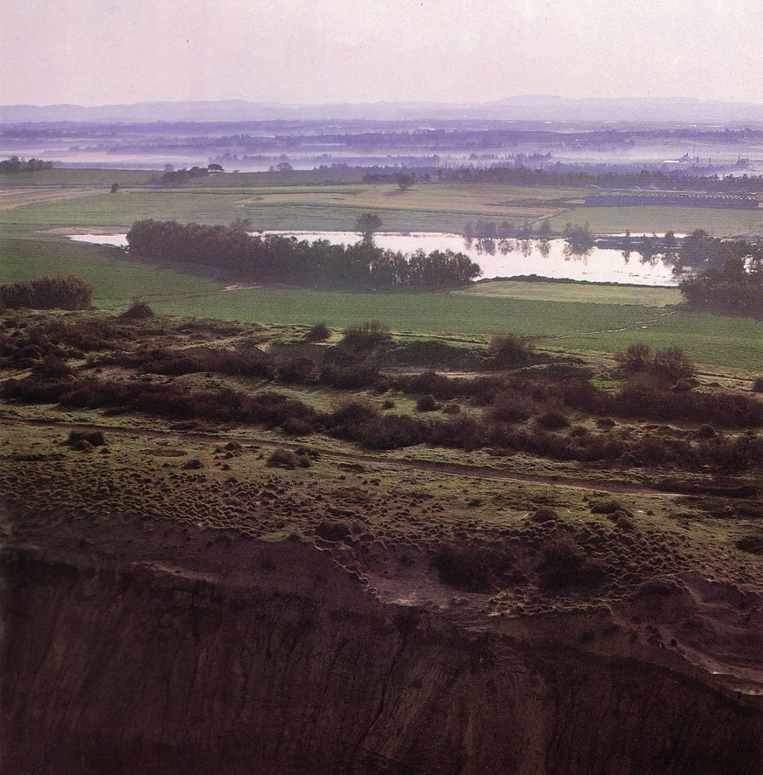
Coastal Plain
18
Kurkar (sandstone) ridges in the foreground while looking east to the foothills
Notes:
These ridges provide a natural barrier from water running westward to the Great Sea.

Slide 25
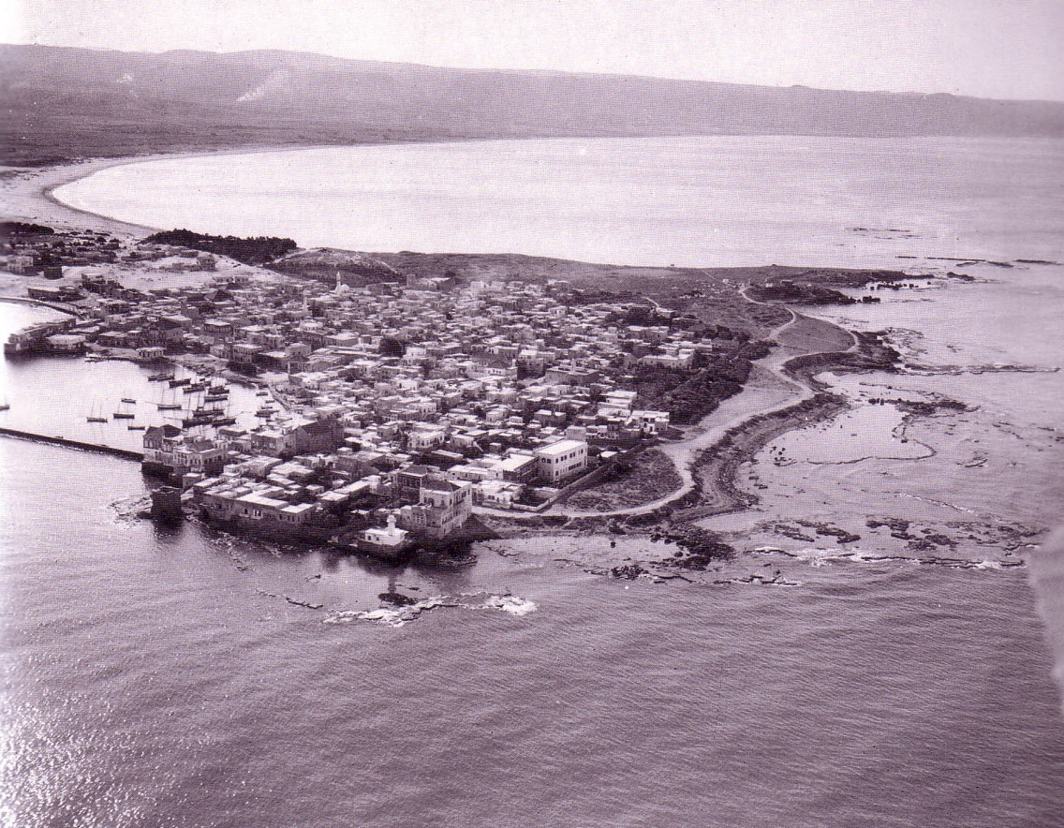
Coastal Plain
18
Tyre

Slide 26
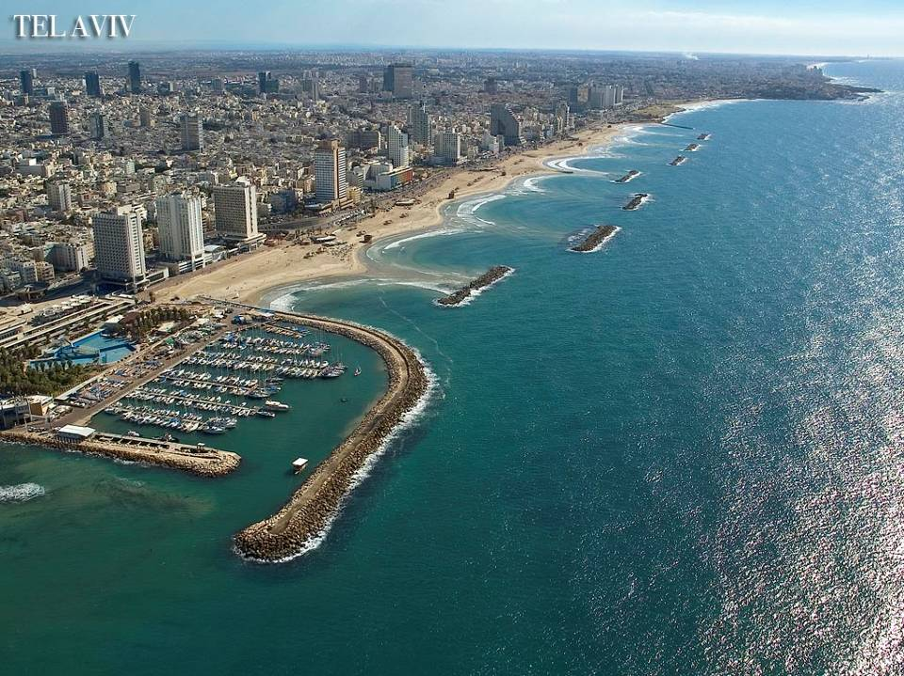
Tel Aviv

Slide 27
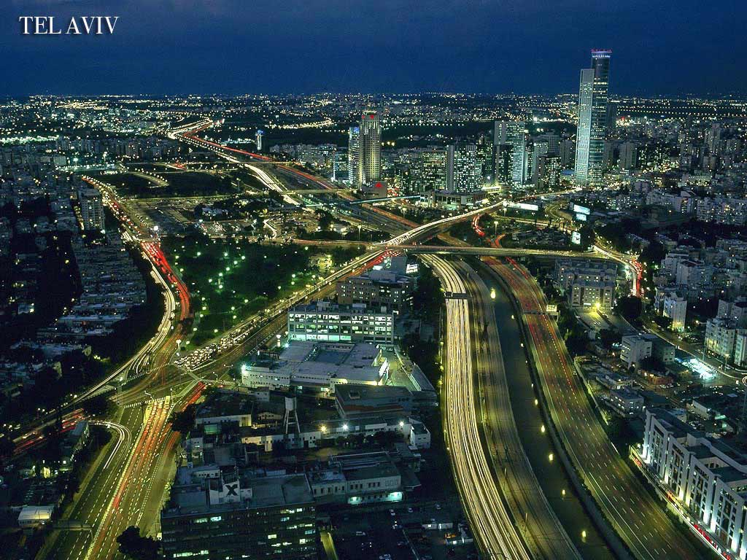
Tel Aviv

Slide 28
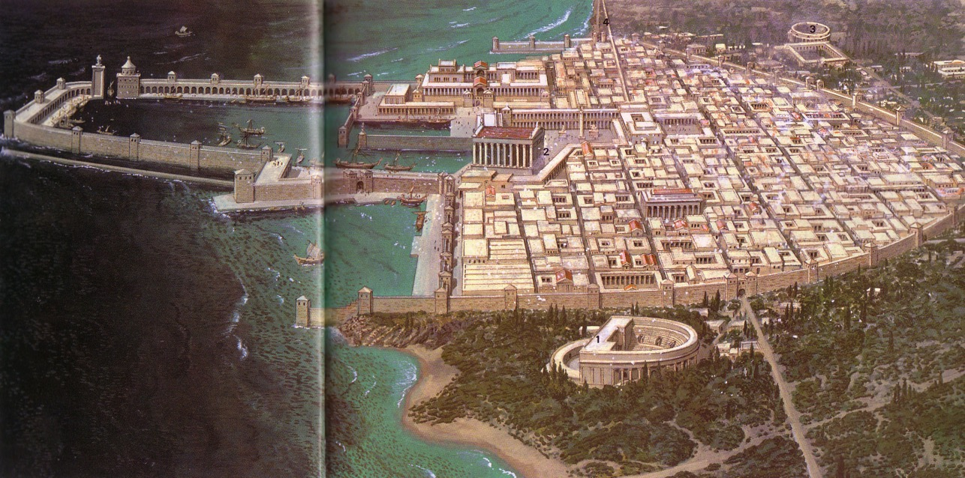
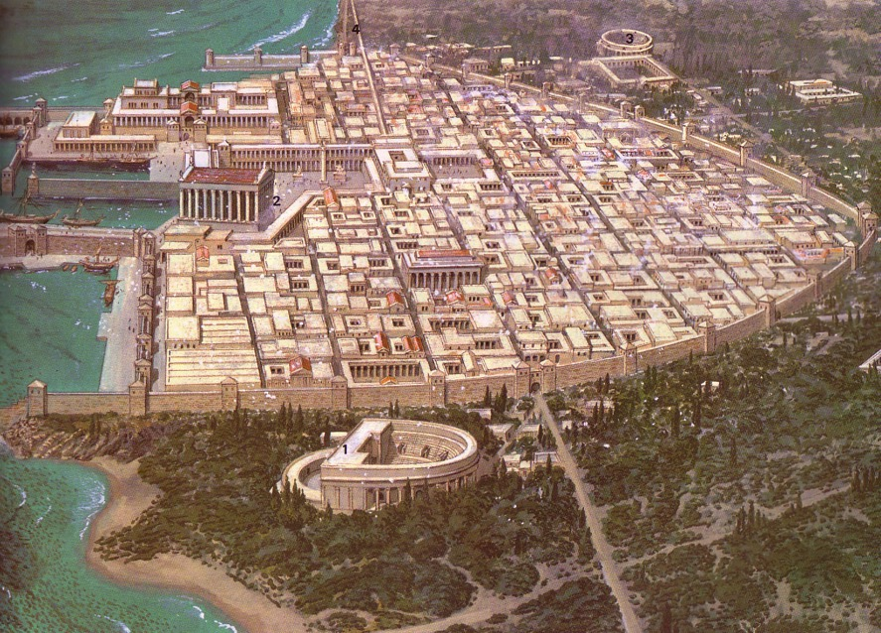
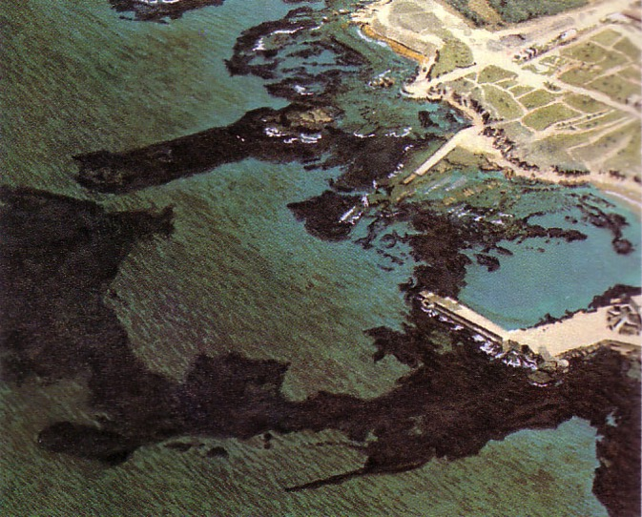
Coastal Plain
18
Caesarea

Slide 29
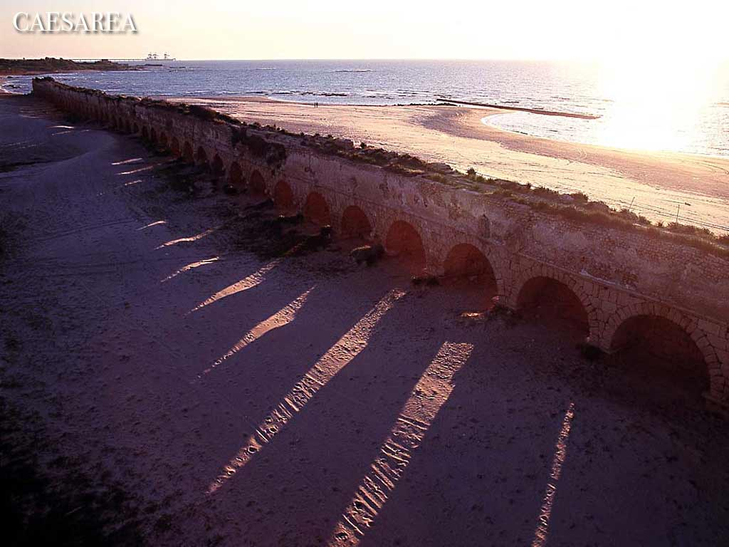
Caesarea

Slide 30
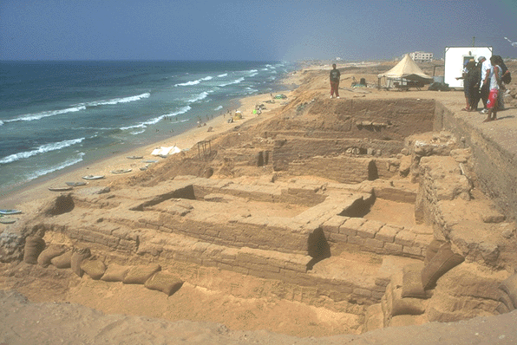
Coastal Plain
18
Gaza

Slide 31
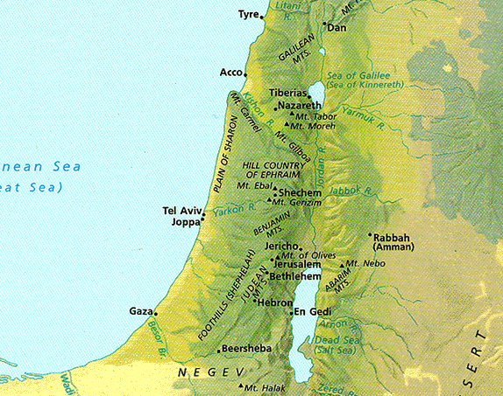
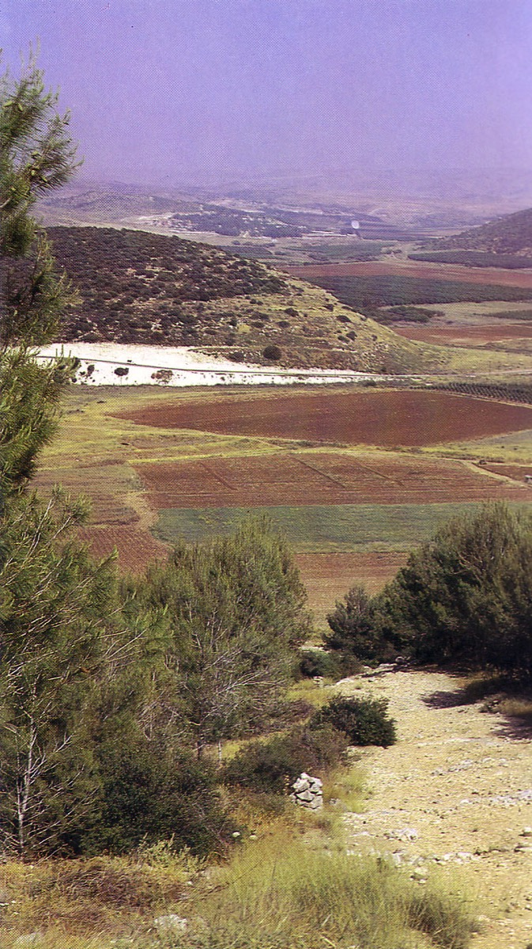
Elevations in North-South Divisions
18
Shephelah
Valleys and Hills

Slide 32
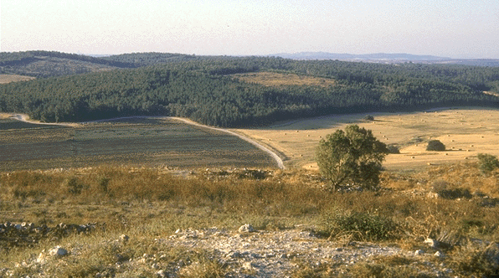
Shephelah
18
Farmland

Slide 33
Elevations in North-South Divisions
18
Central Mountain Range

Slide 34
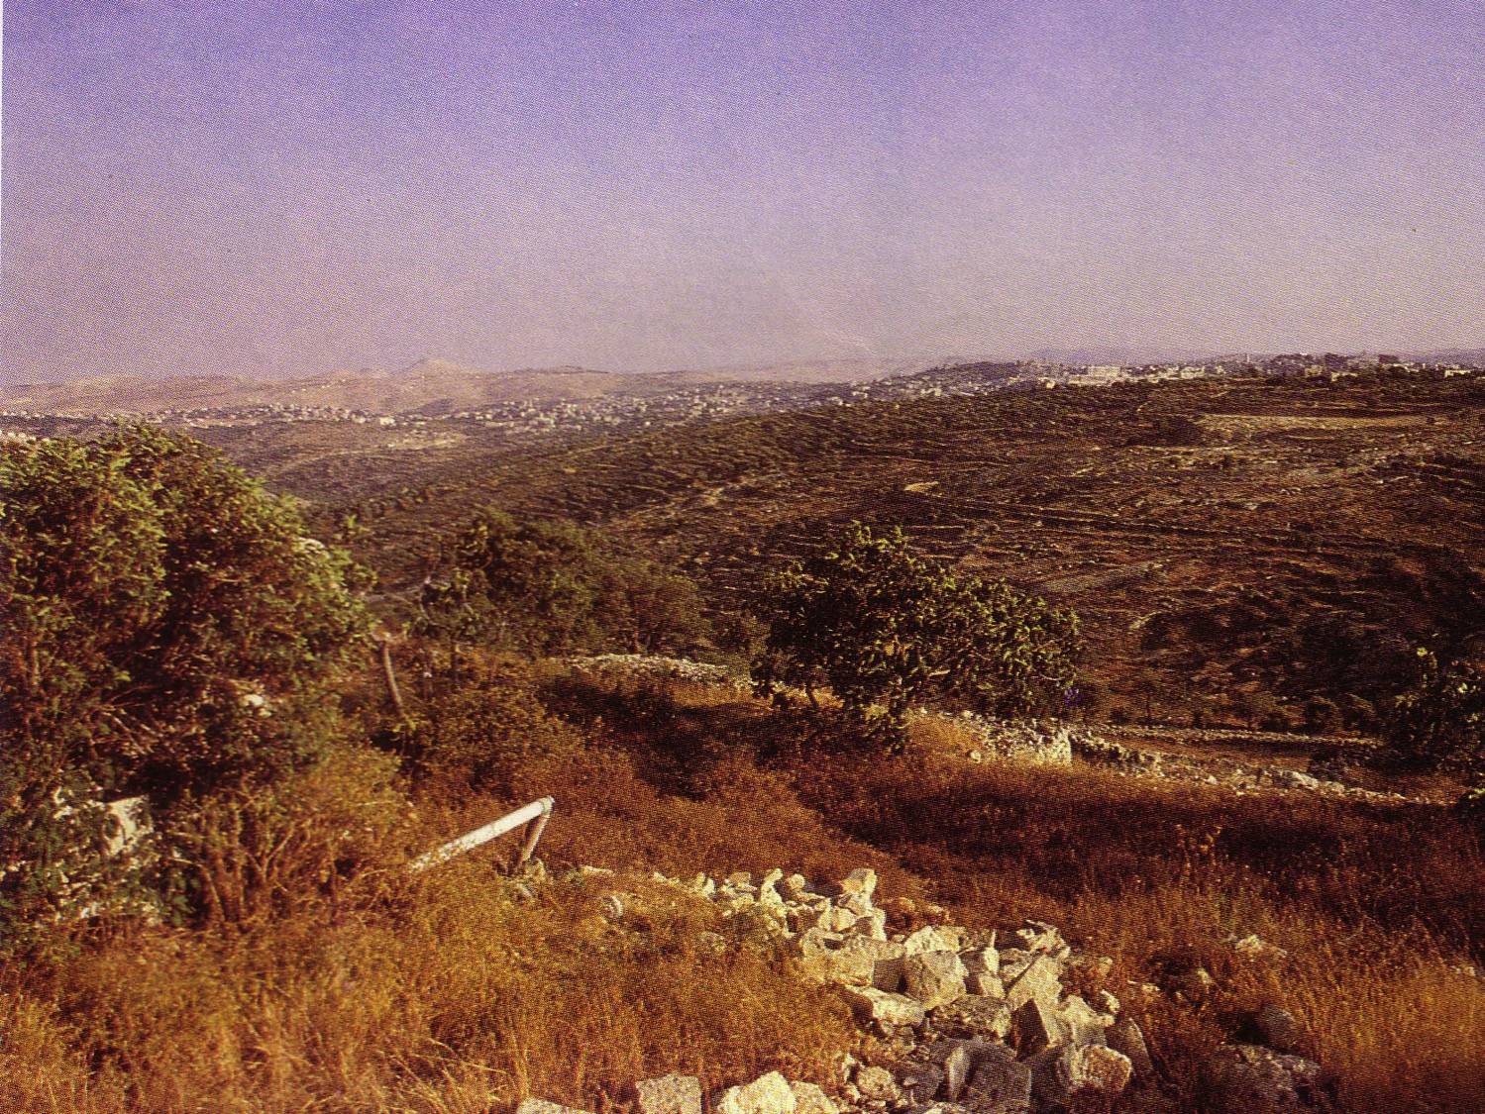
Judean Hills
18

Slide 35
Elevations in North-South Divisions
18
Also Called:
Plain of Megiddo
Jezreel Valley
Central Mountain Range

Slide 36
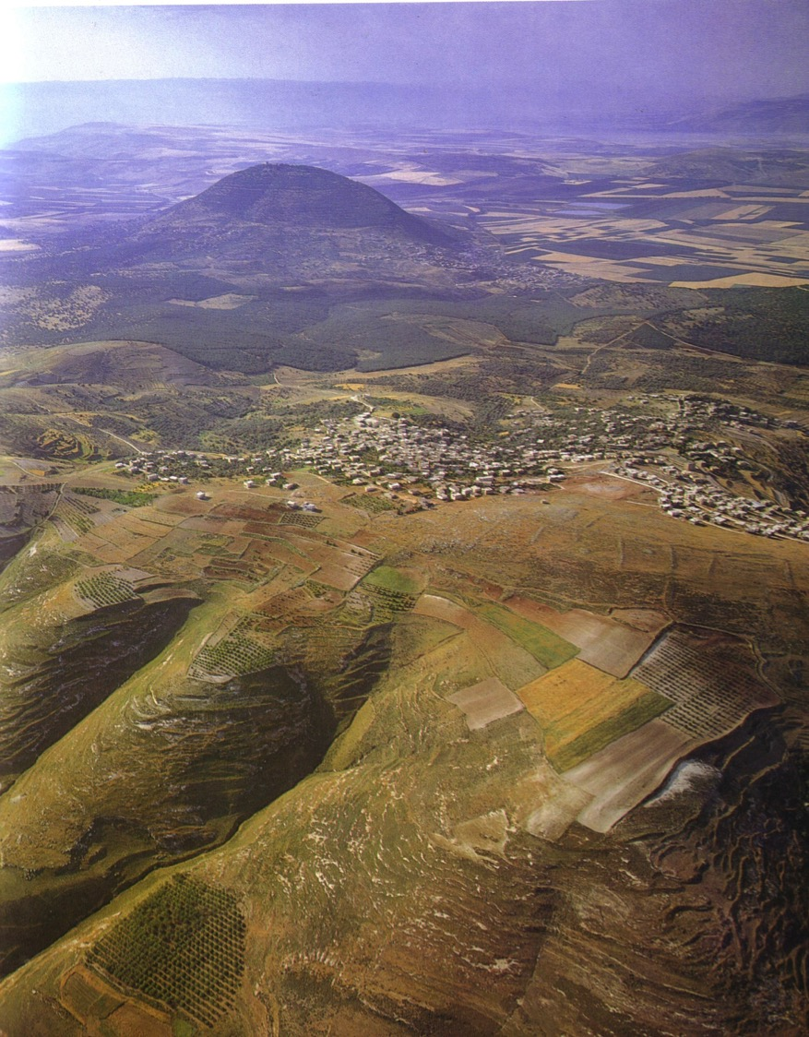
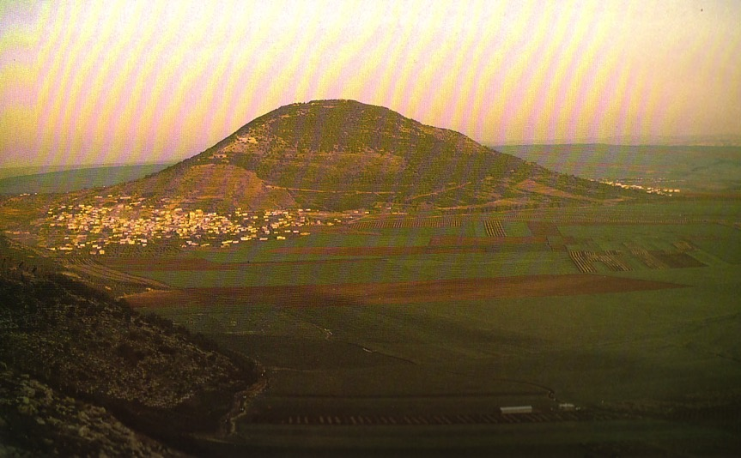
Mount Tabor in the Jezreel Valley
18

Slide 37
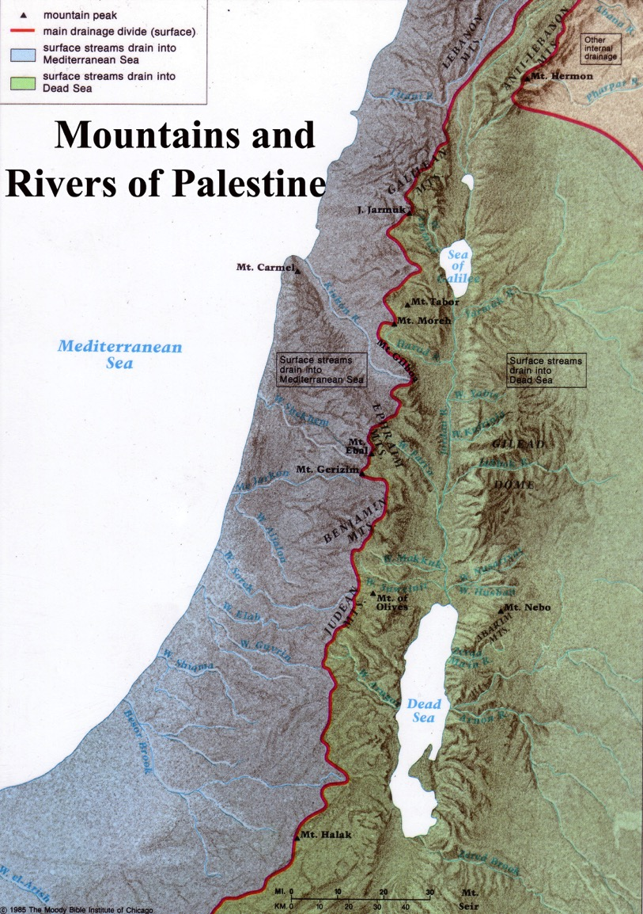
Central Mountain Range
18
A ridge causes water to flow east or west
The higher elevation is in the south

Slide 38
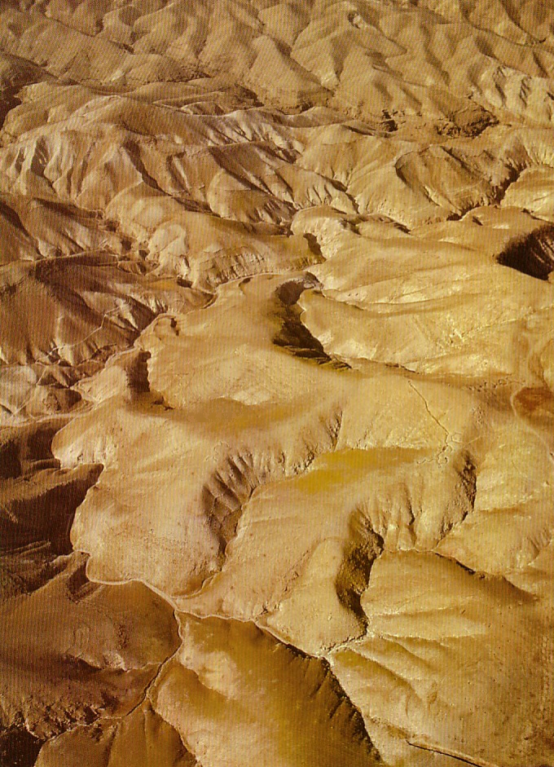
The Wilderness of Judea
18

Slide 39
Elevations in North-South Divisions
18
Jordan Rift

Slide 40
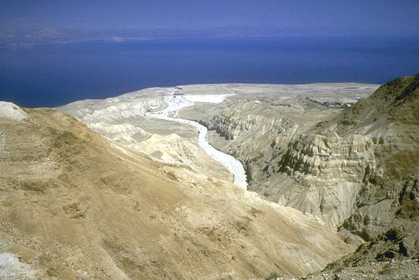
Jordan Rift
18
Deep Depression
From the Wilderness of Judea looking east to the Salt Sea below

Slide 41
Elevations in North-South Divisions
18
Transjordan Plateau

Slide 42
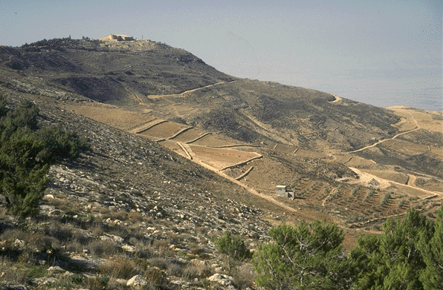
Transjordan Plateau
18
Mt. Nebo

Slide 43
Elevations in North-South Divisions
18

Slide 44
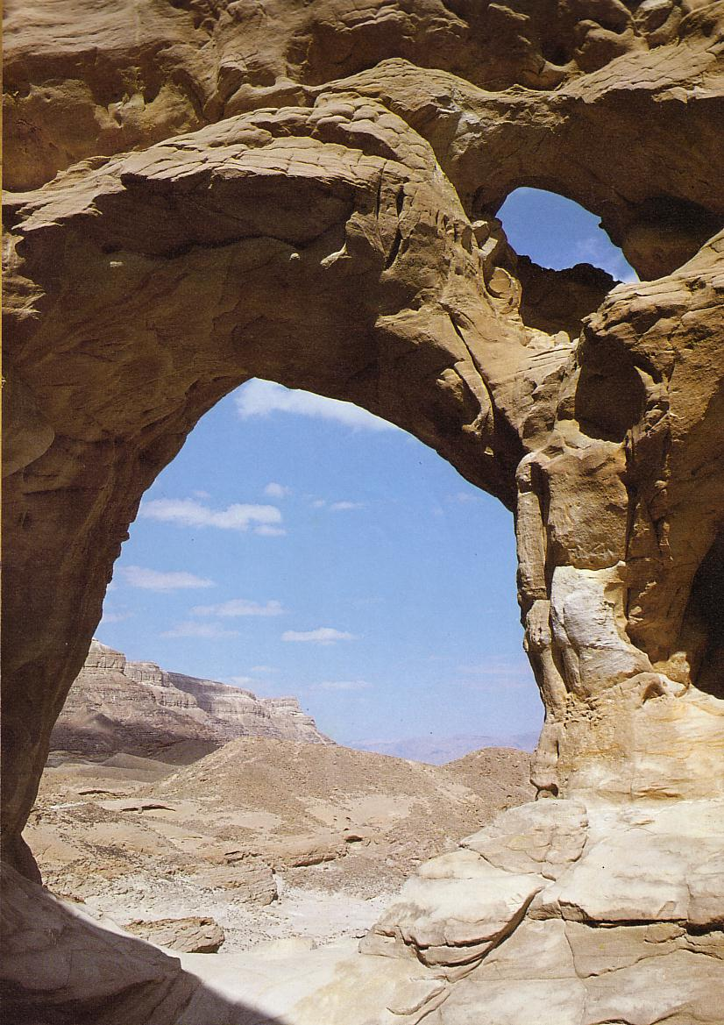
The Negev
18

Slide 45
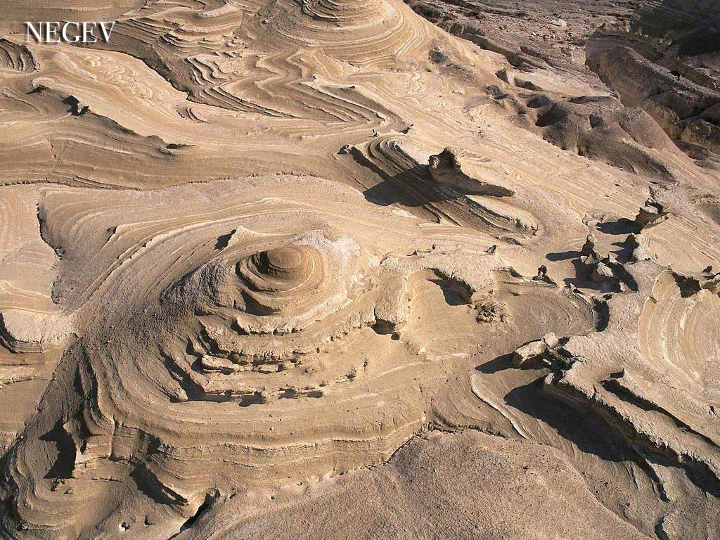
The Negev
Herodion

Slide 46
Left Stage
20
Travel in Ancient Israel
Right Stage
West & North
East & South

Slide 47

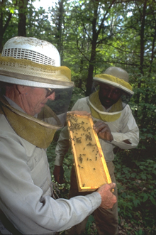
Left Stage
20
Life in
Ancient Israel
Right Stage
Farmers
Land of Honey
Herdsmen
Land of Milk

Slide 48
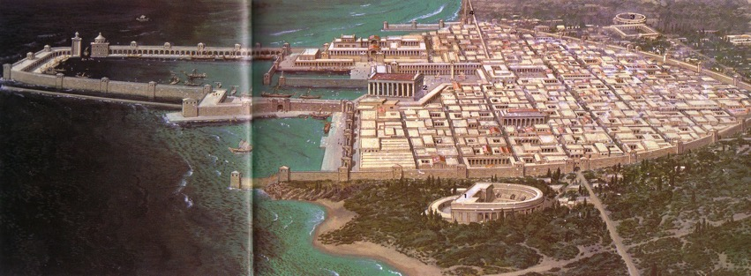
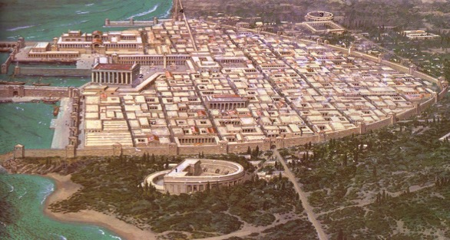
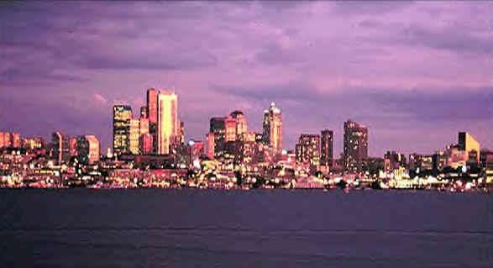
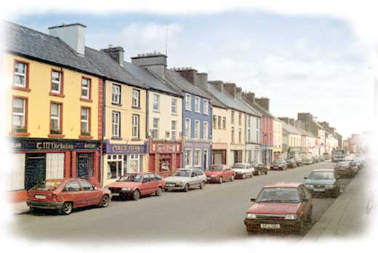
Left Stage
20
Life in
Ancient Israel
Right Stage
40 Large Cities
310 Small Towns

Slide 49

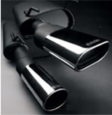
Left Stage
20
Life in
Ancient Israel
Right Stage
Easy,
Predictable
Exhausting,
Unpredictable

Slide 50

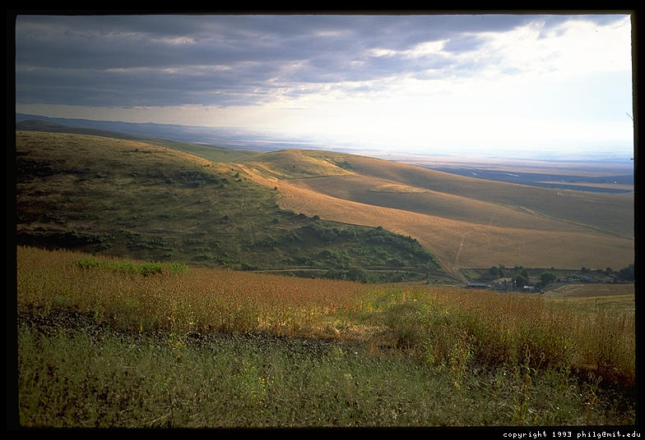
Left Stage
20
Life in
Ancient Israel
Right Stage
Trade, Noisy,
International
Isolation, Quiet,
Nationalism

Slide 51

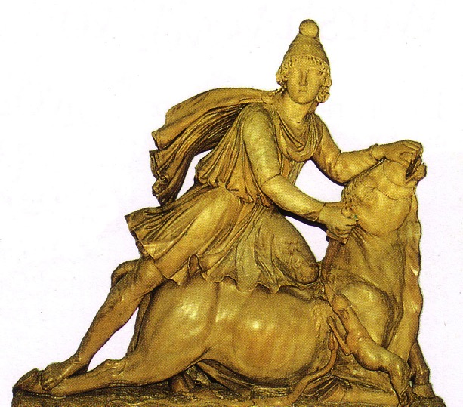
Left Stage
20
Life in
Ancient Israel
Right Stage
Syncretism,
Paganism
Religious Purity,
Monotheism

Slide 52
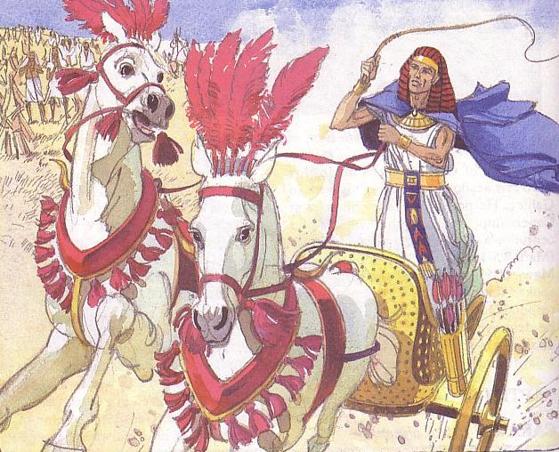

Left Stage
20
Life in
Ancient Israel
Right Stage
Controlled
By Israel only
150 years
Controlled
By Israel
1650 years

Slide 53
Left Stage
Phoenicians
Syrians
20
Life in
Ancient Israel
Right Stage
Romans
Sea Peoples,
The “ians” (mostly)
Desert Peoples,
The “ites”
Ammonites
Babylonians
Assyrians
Israelites
Philistines
Moabites
Edomites
Egyptians

Slide 54
Left Stage
20
Travel in Ancient Israel
Right Stage
West & North
East & South

Slide 55

Left Stage
Real Life
Right Stage
In what ways is this city left stage for you personally?
What are the most effective ways you have found to live right stage?

Slide 56
Topography of Israel
http://www.studylight.org/se/maps/browse.cgi?st=51&pn=11

Slide 57


Israel of 1400 BC is today's West Bank!

Slide 58

Israel Today
Foundation for Middle East Peace
(March 2002)

Slide 59


The West Bank (2002)
Foundation for Middle East Peace
(March 2002)

Slide 60

The Gaza Strip (2002)
All Jews left Gaza in 2005
Foundation for Middle East Peace
(March 2002)
Notes:
On August 17, 2005, Israel began to evacuate all the Jews from Gaza. It was expected to take several weeks, but took less than one. Israel and the Palestinians agreed the buildings would be razed and the army began that process after the residents left.
A total of 1,700 families were uprooted at a cost of nearly $900 million. This includes 166 Israeli farmers who produce $120 million in flowers and produce. Approximately 15 percent of Israel's agricultural exports originate in Gaza, including 60 percent of its cherry tomato and herb exports. Israel will also lose 70 percent of all its organic produce, which also is grown in Gaza.
The Israeli Supreme Court was to decide on the fate of the 38 synagogues, but most, if not all, will be dismantled. In addition, 48 bodies, including some victims of terror attacks, are being relocated from the cemetery outside Neve Dekalim to Israel. A total of 42 daycare centers, 36 kindergartens, seven elementary schools, and three high schools will be closed. It will cost approximately $500 million to relocate military bases outside Gaza and build new crossing facilities.
When the disengagement process is complete, no Jews will be present in the Gaza Strip. (from http://www.jewishvirtuallibrary.org/jsource/Peace/gaza_settlements.html)

Slide 61

The Golan Heights (2002)
Foundation for Middle East Peace
(March 2002)

Slide 62

Jerusalem (2002)
Foundation for Middle East Peace
(March 2002)

Slide 63


Jacob's Blessing His 12 Sons Was Prophetic
(Gen. 49–50)

Slide 64


Blessing Judah & the Lesser Tribes
Jacob's Blessing His 12 Sons Was Prophetic
(Gen. 49–50)
Zebulun
Issachar
Levi
Judah
Reuben
Simeon

Slide 65

Blessing All the Tribes
Naphtali
Asher
Manasseh
Zebulun
Issachar
Manasseh
Ephraim
Gad
Dan
Benjamin
Levi
Judah
Reuben
Simeon

Slide 66
Black

Slide 67


OT Backgrounds link at BibleStudyDownloads.org
Get this presentation for free!
Notes:
NT Survey (ns)

