Slide 1
The Jewish Feasts
Key Festivals to Understand
Israel & Us Today
Note that page numbers for NT Backgrounds are different as they cover NTB pages 136-137
Dr. Rick Griffith • Jordan Evangelical Theological Seminary • BibleStudyDownloads.org

Slide 2
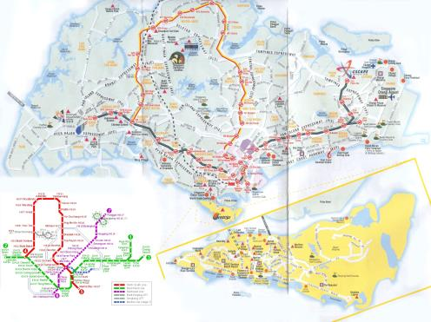
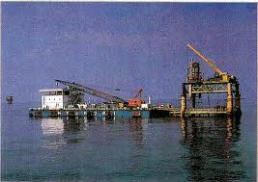
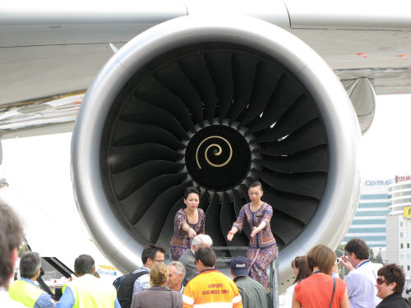

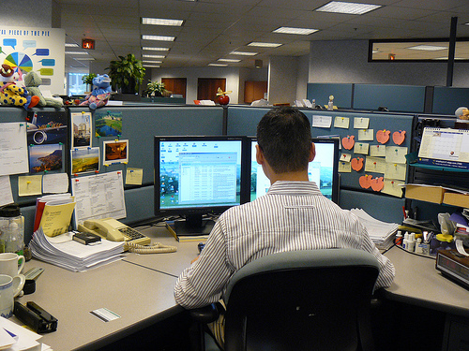




The Modern Work Ethic

Slide 3
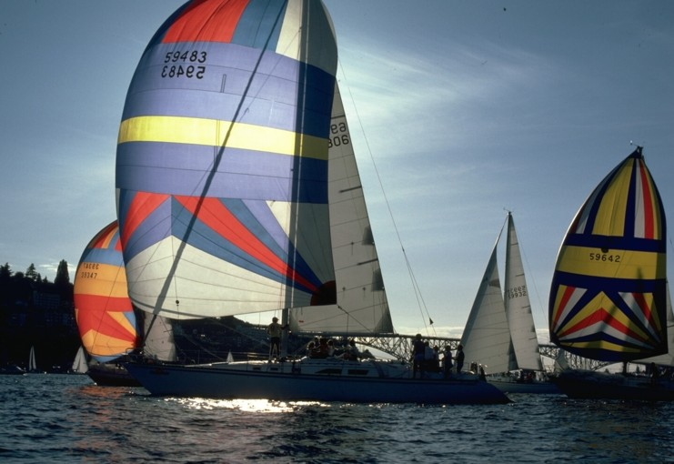
Why take a break?
179

Slide 4
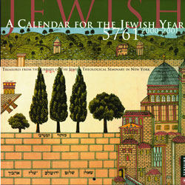

Jewish Calendars
180
Civil
Sacred
Numbered

Slide 5
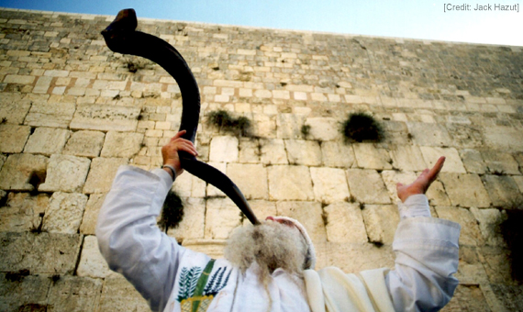
The Feast of Trumpets
Starts the Civil Year on Tishri 1

Slide 6

Hebrew Calendars
The Exodus Night:
While the Israelites were still in the land of Egypt, the LORD gave the following instructions to Moses and Aaron: ²"From now on, this month will be the first month of the year for you" (Exod. 12:1-2)
180
1 Nisan
2 Iyar
3 Sivan
4 Tammuz
5 Av
6 Elul
7 Tishri
8 Cheshvan
9 Kislev
10 Tevet
11 Shevat
12 Adar
Mar-Apr
Sacred Calendar Begins
Civil Calendar Begins
Sep-Oct

Slide 7
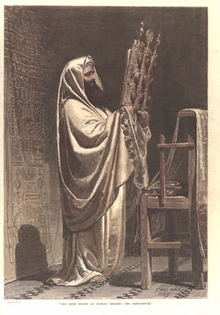
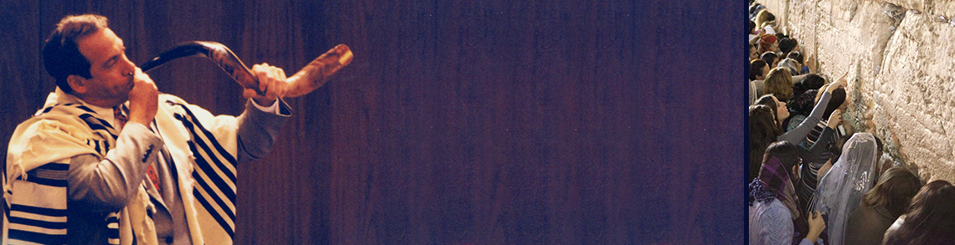
Bible Feasts
134
Holy Day Celebrations in the Old Testament
Lev 23; Deut 16

Slide 8
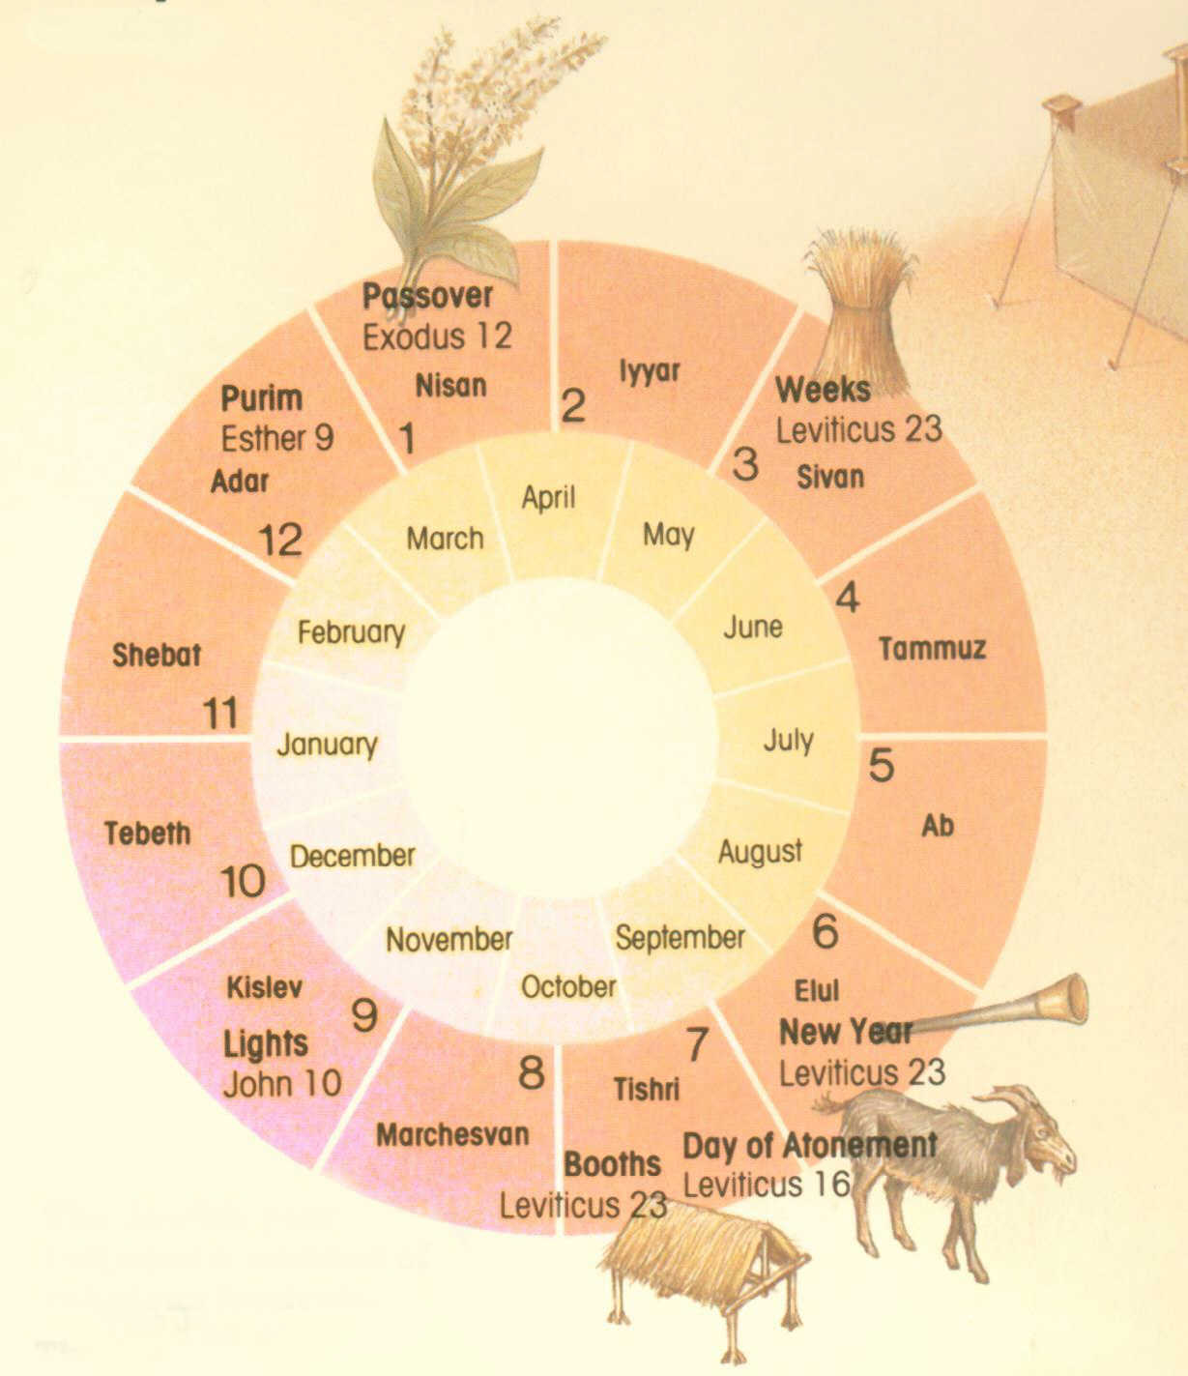
The Seven Feasts
Leviticus 23; Deuteronomy 16
Passover
Unleavened Bread
Firstfruits
Pentecost
Trumpets
Atonement
Tabernacles
1 Nisan
2 Iyar
3 Sivan
4 Tammuz
5 Av
6 Ellul
7 Tishri
8 Cheshvan
9 Kislev
10 Tevet
11 Shevat
12 Adar
Notes:
#80 in original file

Slide 9
Weekly Sabbath
Feasts
Leviticus 23; Deuteronomy 16
Leviticus 23
1 Nisan
2 Iyar
3 Sivan
4 Tammuz
5 Av
6 Ellul
7 Tishri
8 Cheshvan
9 Kislev
10 Tevet
11 Shevat
12 Adar
Rest and remember covenant
Christ our Rest-giver in the kingdom
Notes:
#81 in original file

Slide 10
Passover
Feasts
Leviticus 23; Deuteronomy 16
1 Nisan
2 Iyar
3 Sivan
4 Tammuz
5 Av
6 Ellul
7 Tishri
8 Cheshvan
9 Kislev
10 Tevet
11 Shevat
12 Adar
Recalls Exodus
Christ our redeemer
Notes:
#82 in original file

Slide 11
Unleavened Bread
Feasts
Leviticus 23; Deuteronomy 16
1 Nisan
2 Iyar
3 Sivan
4 Tammuz
5 Av
6 Ellul
7 Tishri
8 Cheshvan
9 Kislev
10 Tevet
11 Shevat
12 Adar
Dependence on Egypt broken
Christ our sanctifier
Notes:
#82 in original file

Slide 12
Firstfruits
Feasts
Leviticus 23; Deuteronomy 16
1 Nisan
2 Iyar
3 Sivan
4 Tammuz
5 Av
6 Ellul
7 Tishri
8 Cheshvan
9 Kislev
10 Tevet
11 Shevat
12 Adar
Dedicate harvest
Christ's resurrection
Notes:
#83 in original file

Slide 13
Pentecost
Feasts
Leviticus 23; Deuteronomy 16
1 Nisan
2 Iyar
3 Sivan
4 Tammuz
5 Av
6 Ellul
7 Tishri
8 Cheshvan
9 Kislev
10 Tevet
11 Shevat
12 Adar
Thanksgiving
Birth of Church
Notes:
#84 in original file

Slide 14
Trumpets
Feasts
Leviticus 23; Deuteronomy 16
1 Nisan
2 Iyar
3 Sivan
4 Tammuz
5 Av
6 Ellul
7 Tishri
8 Cheshvan
9 Kislev
10 Tevet
11 Shevat
12 Adar
New Year Repentance
Rapture
Notes:
#85 in original file

Slide 15
Atonement
Feasts
Leviticus 23; Deuteronomy 16
1 Nisan
2 Iyar
3 Sivan
4 Tammuz
5 Av
6 Ellul
7 Tishri
8 Cheshvan
9 Kislev
10 Tevet
11 Shevat
12 Adar
Atone for sins
Christ our atonement
Notes:
#86 in original file

Slide 16
Tabernacles
Feasts
Leviticus 23; Deuteronomy 16
1 Nisan
2 Iyar
3 Sivan
4 Tammuz
5 Av
6 Ellul
7 Tishri
8 Cheshvan
9 Kislev
10 Tevet
11 Shevat
12 Adar
Celebrate harvest & remember wilderness blessings
Millennial rest
Notes:
#87 in original file

Slide 17
Eschatology of Israel's Feasts (Lev. 23)
184
Date
Length
Feast
Significance (Past)
Typology (Future)
* Feasts celebrated in the Millennium (Isa. 66:23; Ezek. 45:21; 46:1; Zech. 14:16-19; Luke 22:16)
† Feasts celebrated in three annual Jerusalem pilgrimages by all male Israelites (Exod. 23:14-17)
Weekly
1 day
Sabbath*
(Shabbat)
Reminder of:
• Creation rest of God
• Deliverance from Egypt
Sign of Mosaic Covenant
(Exod. 20, 31; Deut 5)
Millennial rest
(Heb. 4:1-11)
1-14
(Nisan)
1 day
(Read Song
of Songs)
Passover*†
(Pesach)
Redemption from Egypt by blood of the sacrificial lamb (Exod. 12)
Redemption from sin by Christ's death as Lamb
(1 Cor. 5:7b)
1-15
to 1-21
(Nisan)
7 days
Unleavened
Bread*†
Separation/break from dependence upon Egypt to dependence upon God
Separated life of the redeemed for God
(1 Cor. 5:7a, 8)
1-16 (Day after Harvest Sabbath)
1 day
Firstfruits
(barley sheaf ceremony)
Anticipation of God's future material provisions
-begins grain harvest
Resurrection of Christ
(1 Cor. 15:20)
3-6
(Sivan)
1 day
(Read Ruth)
Pentecost†
(Shavuoth)
(Weeks)
(Harvest)
Thanksgiving for God's past material provisions - ends grain harvest (Deut. 16:9-12)
Coming of the Holy Spirit to complete Christ's resurrection (Acts 2)
Notes:
Each annual "appointed time" (Heb.) had both commemorative (historical) and anticipatory (eschatological) meaning. In other words, the seven celebrations each year not only look at God's past work, but they look forward to God's prophetic future for the nation. It fits that Jesus would die on the very day of Passover that looks back at Israel's redemption from Egypt and looks forward to Israel's redemption realized when the nation trusts in their Messiah and are saved (Rom 11:26-27). In fact, each typological element looks to Jesus. Every year when Jews follow the seven feasts, they prophetically instruct themselves in how they fit into Yahweh's plan for the ages! Sadly, most of them cannot see this. Pray that they will.
____________
Common-531
AP-03-Fulfilled Prophecies-21
BS-13-Types-19
ES-26-Restoration of Israel-5
NB-11-Religion-Feasts-7
OB-25-Feasts-17
OS-03-Leviticus-275
OS-05-Deuteronomy-221

Slide 18
Eschatology of Israel's Feasts (Lev. 23)
184
Date
Length
Feast
Significance (Past)
Typology (Future)
Spring-Summer
no feasts
—
Enjoyment of the harvest
Church Age
7-1
(Tishri)
1 day
Trumpets
(New Year)
(Rosh Hashanah)
Preparation for national redemption and cleansing on Day of Atonement
Rapture (1 Thess. 4:13f.) Revelation (Matt. 24:31)
—Kingdom preparation
7-10
(Tishri)
1 day
Day of Atonement (Yom Kippur)
National repentance and cleansing from sins of the people (Lev. 16)
National repentance of Israel in the Tribulation (Rom. 11:26-27)
7-15
to 7-21
(Tishri)
7 days
(Read
Eccles.)
Tabernacles*†
(Booths/Tents)
(Succot)
(the Lord)
(Ingathering)
Anticipated fulfillment of the Abrahamic Covenant (Neh. 8)
Actual fulfillment of the Abrahamic Covenant
—Kingdom (Matt. 17:4)
* Feasts celebrated in the Millennium (Isa. 66:23; Ezek. 45:21; 46:1; Zech. 14:16-19; Luke 22:16)
† Feasts celebrated in three annual Jerusalem pilgrimages by all male Israelites (Exod. 23:14-17)
7-22
(Tishri)
1 day
Shemini Atzeret
(Simchat Torah)
"8th Day of Assembly" "Rejoicing in the Torah"
Notes:
God commanded the seven feasts in two seasons so that no feasts would be celebrated in the spring and summer. This four-month gap commemorated each year by Israel points to our present age when God is building his mostly Gentile Church. It will be interrupted with the Festival of Trumpets at the coming of Messiah to resume Israel's prophetic calendar, leading to the nation's salvation (Rom 11:26-27) and the earthly kingdom to follow, typified in Tabernacles.
____________
Common-532
AP-03-Fulfilled Prophecies-22
BS-13-Types-20
ES-26-Restoration of Israel-6
NB-11-Religion-Feasts-8
OB-25-Feasts-18
OS-03-Leviticus-276
OS-05-Deuteronomy-222

Slide 19
Eschatology of Israel's Feasts (Lev. 23)
184
Date
Length
Feast
Significance (Past)
Typology (Future)
The following days are not commanded in Scripture and probably have no eschatological significance:
This Typology column shows that the order of Israel's annual feasts prophetically parallels her experience as a nation throughout history!
5-9
(Ab)
1 day
(Read Lam.)
9th of Ab
(Tish'ah be'ab)
Destructions of Jerusalem:
586 BC & AD 70
9-25
(Kislev)
1 day
+ 7 more days of candle lighting
Hanukkah
(Dedication)
(Lights)
(Illumination)
(Maccabees)
Saving of the nation
under Judas Maccabeus
in 164 BC
(cf. John 10:22)
* Feasts celebrated in the Millennium (Isa. 66:23; Ezek. 45:21; 46:1; Zech. 14:16-19; Luke 22:16)
† Feasts celebrated in three annual Jerusalem pilgrimages by all male Israelites (Exod. 23:14-17)
12-14/15
(Adar)
2 days
(Read Esther)
Purim
(Lots)
Saving of the nation
under Esther (9:21)
Notes:
Jews added these three feasts beyond the seven noted in Lev 23.
Note also the two footnotes appearing in the preceding two slides:
* Three feasts will be celebrated in the Millennium (Isa. 66:23; Ezek. 45:21; 46:1; Zech. 14:16-19; Luke 22:16)
† Three feasts were commanded in three annual Jerusalem pilgrimages by all male Israelites (Exod. 23:14-17)
There exists overlap in these millennial and pilgrimage feasts, as expected, for the most significant feasts of the past will unite the nation in the future.
____________
Common-533
AP-03-Fulfilled Prophecies-23
BS-13-Types-21
ES-26-Restoration of Israel-7
NB-11-Religion-Feasts-9
OB-25-Feasts-19
OS-03-Leviticus-277
OS-05-Deuteronomy-223

Slide 20
Feasts Historically Looked Backward to Israel's Past
180
1 Nisan
2 Iyar
3 Sivan
4 Tammuz
5 Av
6 Elul
7 Tishri
8 Cheshvan
9 Kislev
10 Tevet
11 Shevat
12 Adar
Passover
Unleavened Bread
Firstfruits
Pentecost
Tabernacles/Booths
Day of Atonement
Trumpets
3 Pilgrimage Feasts

Slide 21
Feasts Also Prophetically Look Forward to Israel's Future
180
1 Nisan
2 Iyar
3 Sivan
4 Tammuz
5 Av
6 Elul
7 Tishri
8 Cheshvan
9 Kislev
10 Tevet
11 Shevat
12 Adar
Passover
Redemption
Unleavened Bread
Separation
Firstfruits
Resurrection
Pentecost
Spirit
Kingdom
Tabernacles/Booths
Repentance
Day of Atonement
Rapture
Trumpets
3 Pilgrimage Feasts

Slide 22
I. Israel rested to maintain a holy walk with God.
180
All Jewish men attended the three annual feasts to remind them of God's blessings in their lives (Exod. 23:14-19).

Slide 23
Passover: Pilgrimage Feast #1
180
1 Nisan
2 Iyar
3 Sivan
4 Tammuz
5 Av
6 Elul
7 Tishri
8 Cheshvan
9 Kislev
10 Tevet
11 Shevat
12 Adar
Passover
Redemption
Unleavened Bread
Separation
Firstfruits
Resurrection
3 Pilgrimage Feasts

Slide 24
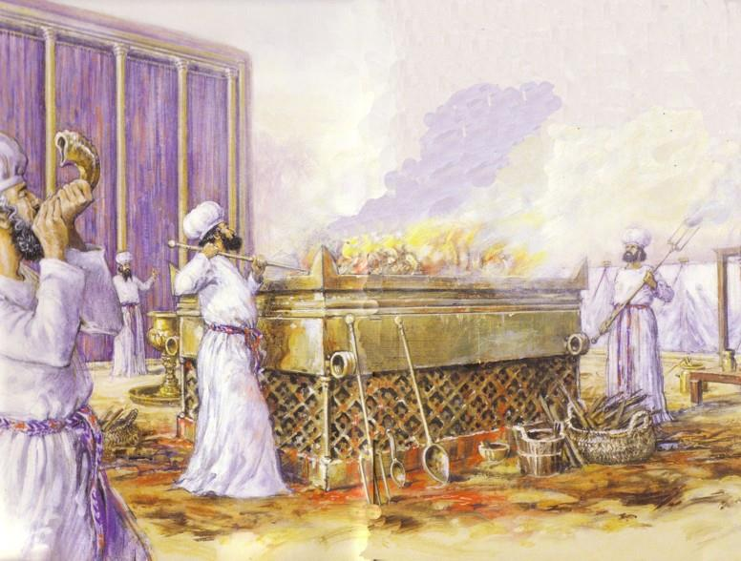
Jews Often Gave Whole Burnt Offerings

Slide 25

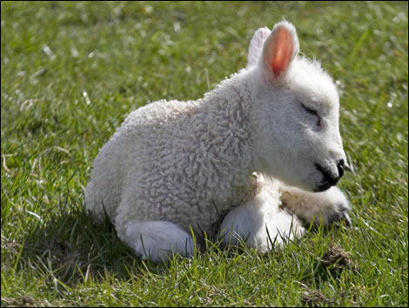
The Passover Lamb
"… on the tenth day of this [first] month each family must choose a lamb or a young goat for a sacrifice, one animal for each household" (Exod. 12:3)

Slide 26
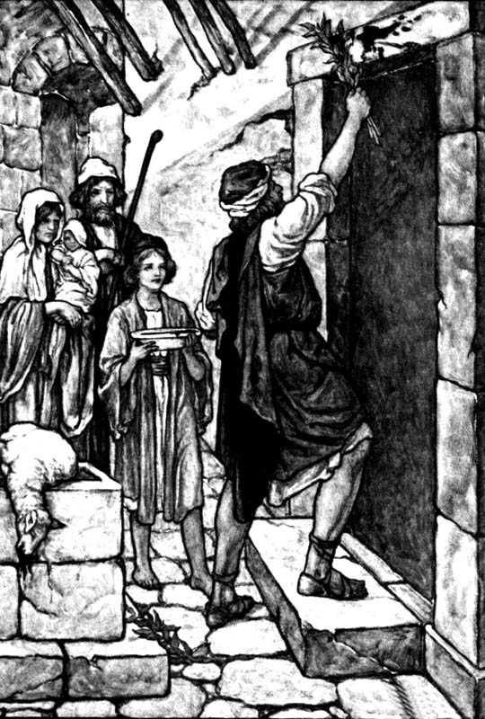
Passover Protection
The blood will be a sign for you on the houses where you are; and when I see the blood, I will pass over you. No destructive plague will touch you when I strike Egypt.
Exodus 12:13 (NIV)

Slide 27
Faith Pictured
By faith he kept the Passover and the sprinkling of blood, so that the destroyer of the firstborn would not touch the firstborn of Israel.
Hebrews 11:28 (NIV)

Slide 28
The Lamb Pictured
The next day John saw Jesus coming toward him and said, "Look, the Lamb of God, who takes away the sin of the world!"
John 1:29 (NIV)

Slide 29
The Cross Pictured
For Christ, our Passover lamb, has been sacrificed.
1 Corinthians 5:7 (NIV)

Slide 30
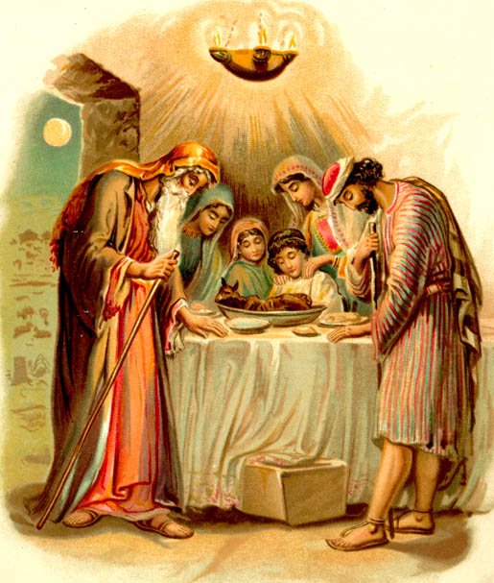
Faith in a Lamb

Slide 31
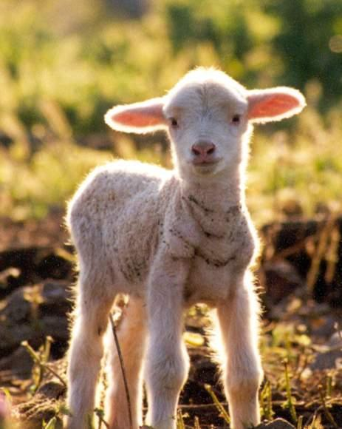
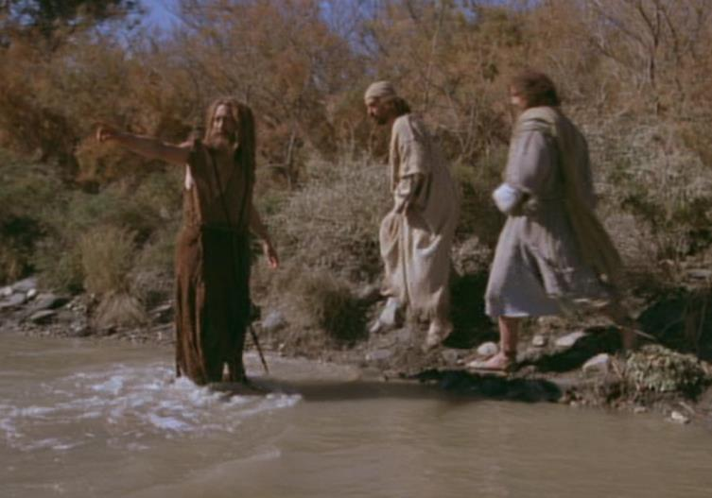
The Passover Lamb
"Look, the Lamb of God, who takes away the sin of the world" (John 1:29)

Slide 32
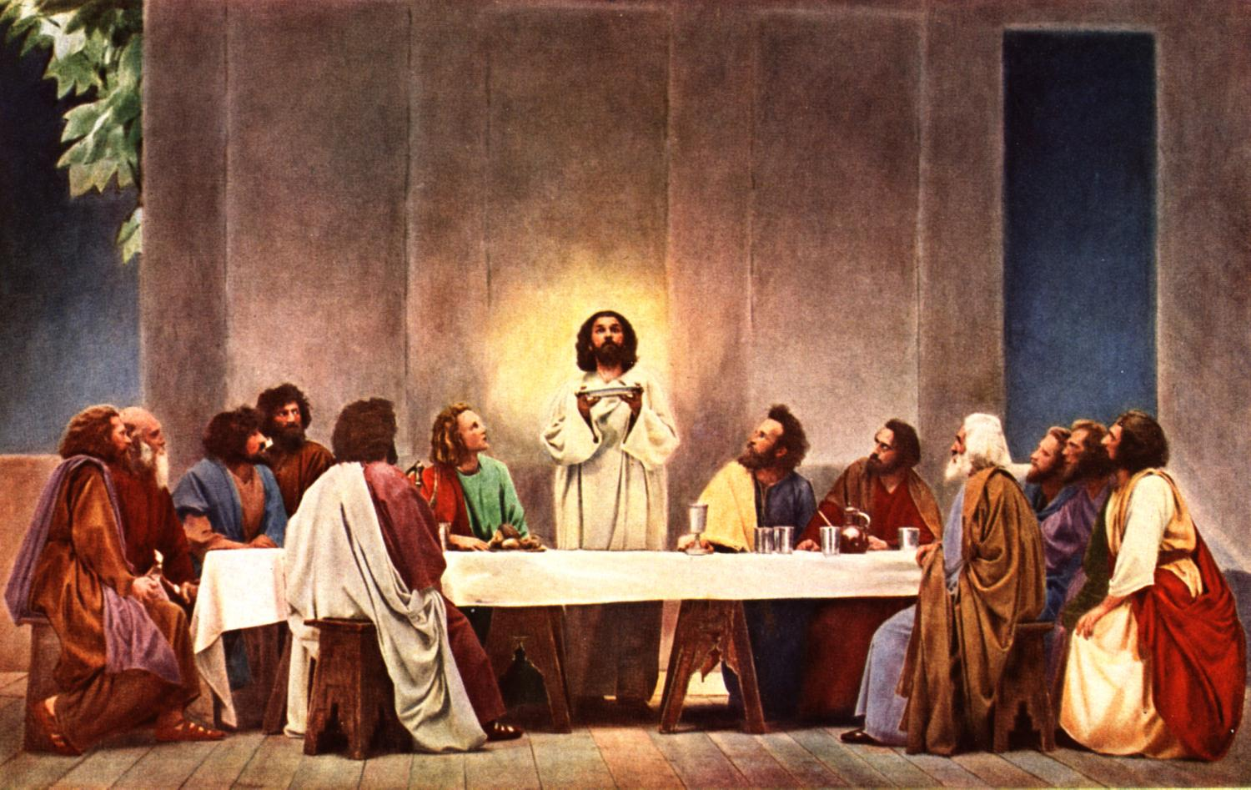
"This is my body…"

Slide 33
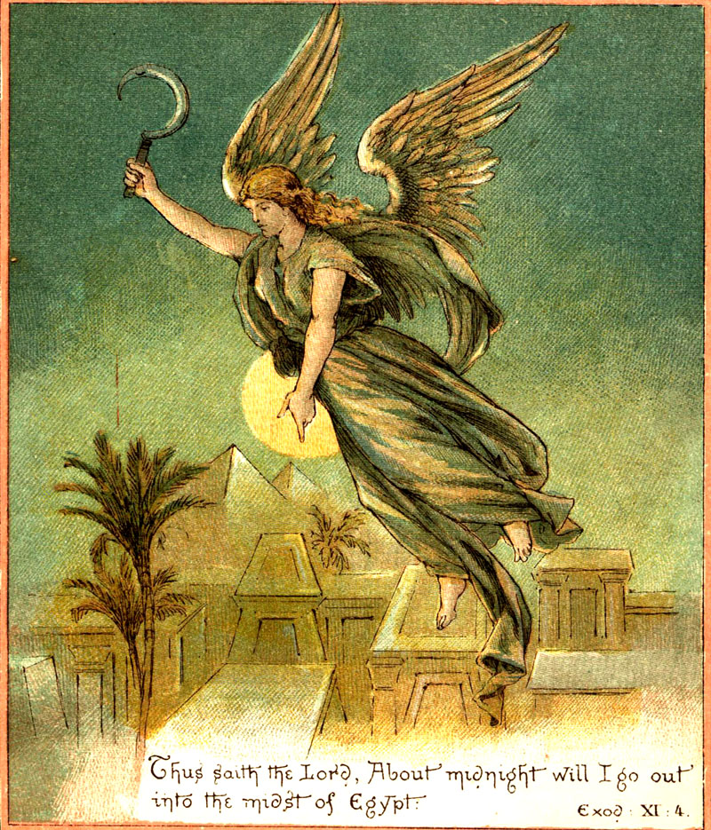
The Angel of Death Passed Over Houses with Blood on the Doors

Slide 34
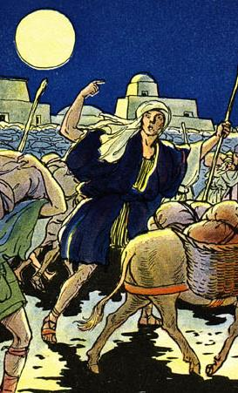
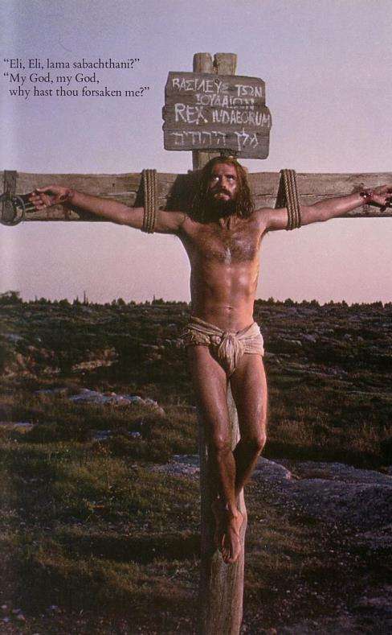
The Common Thread
What the Exodus is to the Old Testament…
the cross is to the New Testament
Deliverance!

Slide 35
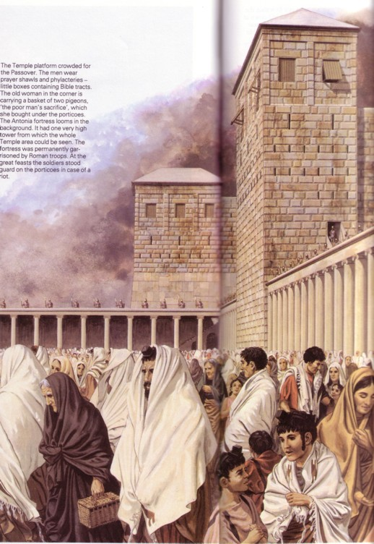
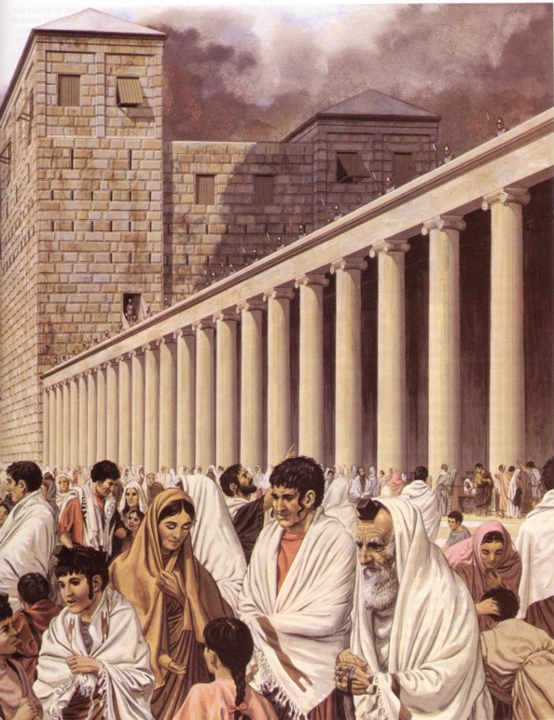
During NT Passovers 100,000 Jews visited the Temple!

Slide 36
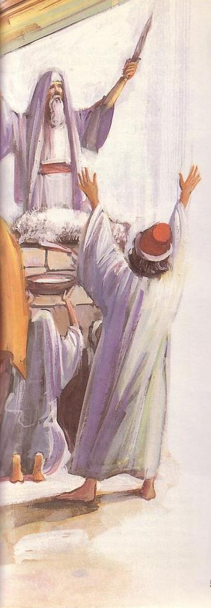
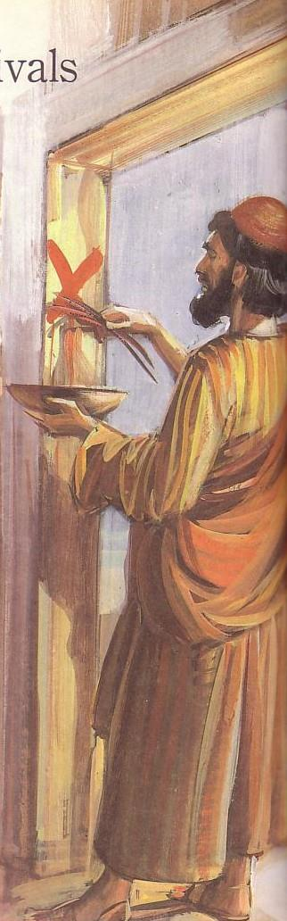
Passover's Past Significance
184

Slide 37
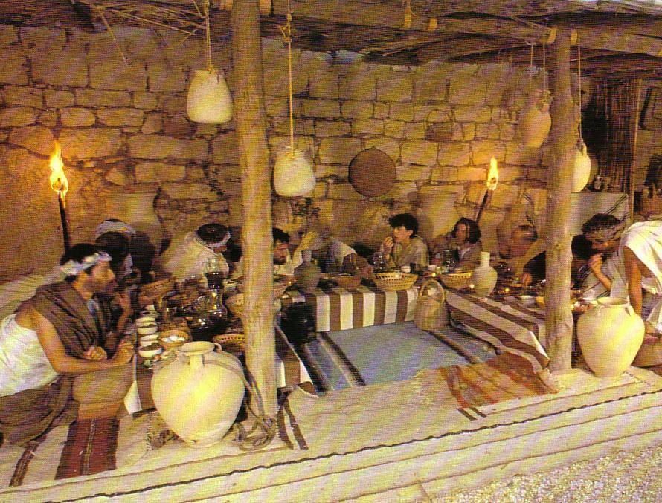
Seating at Jesus' Passover

Slide 38
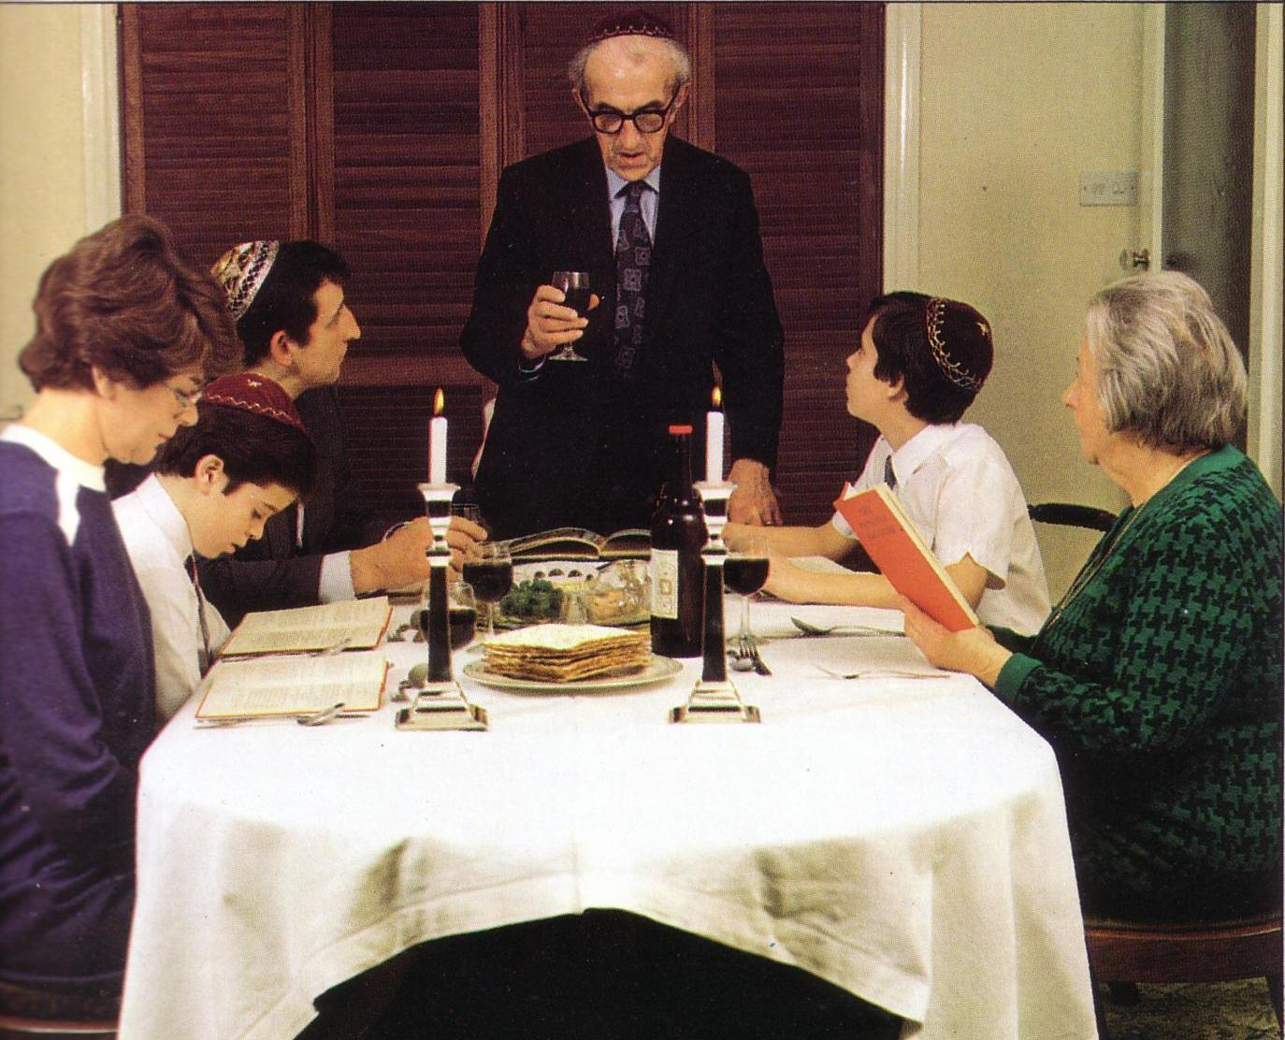
Modern Passover

Slide 39
Passover: Pilgrimage Feast #1
180
1 Nisan
2 Iyar
3 Sivan
4 Tammuz
5 Av
6 Elul
7 Tishri
8 Cheshvan
9 Kislev
10 Tevet
11 Shevat
12 Adar
Passover
Redemption
Unleavened Bread
Separation
3 Pilgrimage Feasts

Slide 40
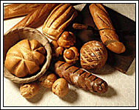

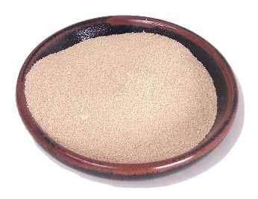
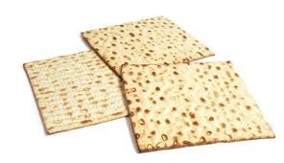
Feast of Unleavened Bread
184
Yeast symbolizes sin, so bread without yeast signifies separation from sin since Jesus died to free us from sin.
Notes:
www.stephenwilliamson.com/ Hobbies/bakin.htm (Yeast bloom)

Slide 41
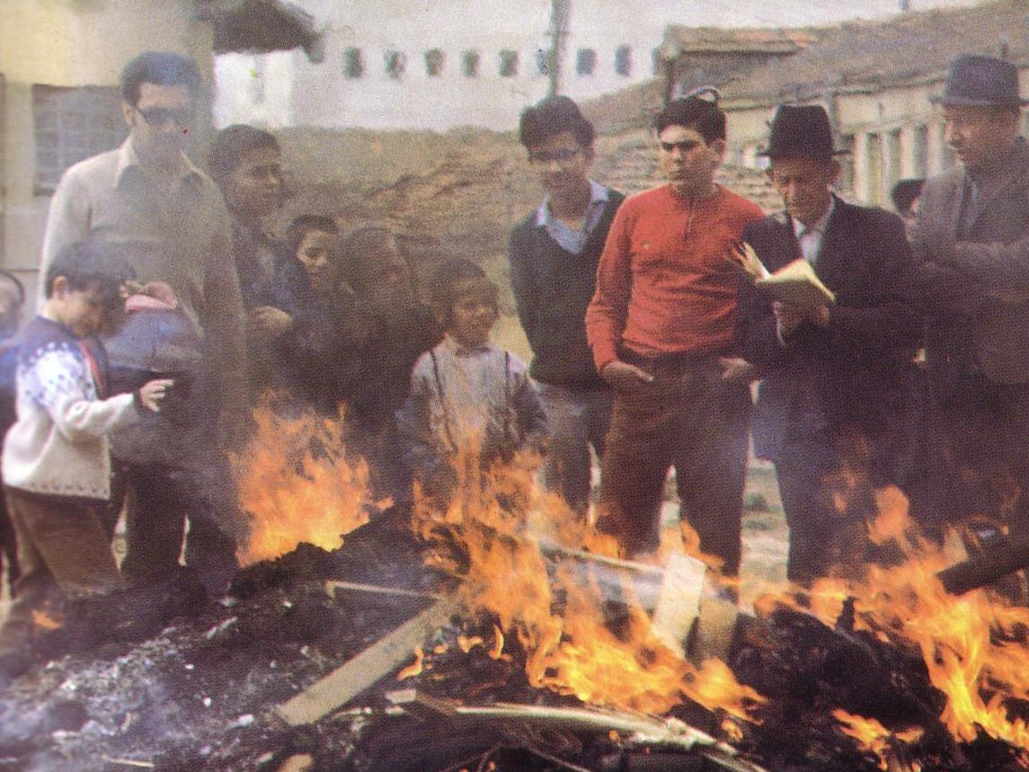
"Burn All the Yeast!"

Slide 42
Passover: Pilgrimage Feast #1
180
1 Nisan
2 Iyar
3 Sivan
4 Tammuz
5 Av
6 Elul
7 Tishri
8 Cheshvan
9 Kislev
10 Tevet
11 Shevat
12 Adar
Passover
Redemption
Unleavened Bread
Separation
Firstfruits
Resurrection
3 Pilgrimage Feasts

Slide 43
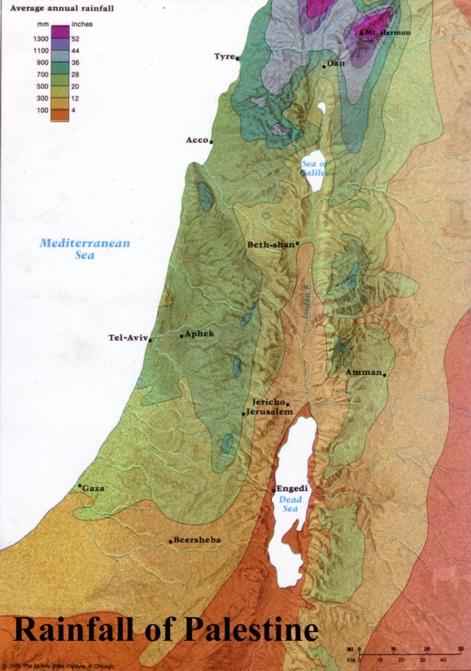
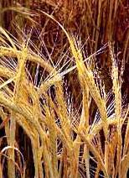
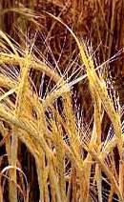
Firstfruits: Wave Sheaf Offering
184
Harvested in the far north of Israel
Brought down to Jerusalem

Slide 44
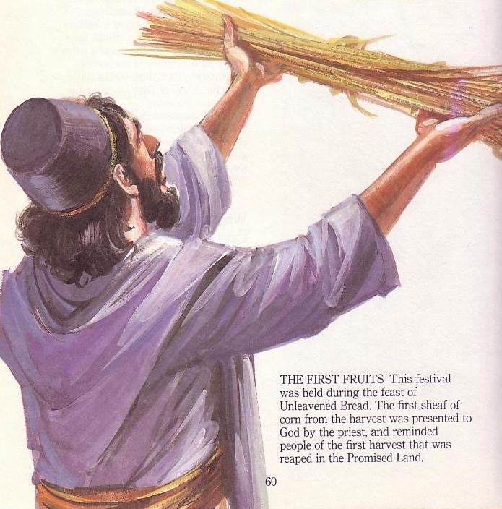
Firstfruits Temple Offering
184
Harvested far north in Israel
Brought down
to Jerusalem
Waved before
the LORD

Slide 45

A Prophetic Weekend
Thursday
Friday
Saturday
Sunday
Galilean
Passover
Unleavened Bread
Firstfruits
Judean
Passover
Unleavened Bread
Firstfruits
Last Supper
Crucifixion
Resurrection
2 April 33
3 April 33
5 April 33
“But now Christ has been raised from the dead, the first fruits of those who are asleep” (1 Cor 15:20 NAU).
Christ is the only one ever resurrected, but as such, he is also the first among many who will join a resurrected body.
Notes:
Leviticus 23 gives the order of three key feasts of Israel: • Passover, • Unleavened Bread, and • Firstfruits.
• But how could Jesus have Passover Thursday night but then die at 3 PM the next day on Friday when the Passover lambs were being slaughtered? And why did the Jewish leaders want the bodies off the cross quickly as Passover was approaching when Jesus had already celebrated Passover the night before?
• The answer is that Galilean Jews celebrated Passover the day before • Judean Jews. Since his disciples were Galileans, Jesus naturally celebrated on their timetable.
• The Feast of Unleavened Bread always began the day after Passover (Lev 23:5-6).
• Then Firstfruits followed sometime later on the first Sabbath after the first crops began to ripen (Lev 23:11). It indicated that millions of additional sheaves would follow until the entire harvest came in at Pentecost. In AD 33, these three celebrations occurred one after another on three consecutive days!
The significance is astonishing. • Christ predicted his death at the Last Supper Thursday night. • Then Jesus died on the Judean Passover • so that believers can live a life without yeast (Unleavened Bread), • which immediately followed with his resurrection on Firstfruits as he is the first and only human ever to obtain a glorified body as an installment for millions more to follow (1 Cor 15:20)!
We know these dates to be • 2 April 33 for the Thursday night Passover, • 3 April 33 was the day of his crucifixion, and • Jesus rose from the dead on the Feast of Firstfruits on 5 April 33.
Another view by Mark Moore:
"§ 143 Preparation for the Passover Meal (Mt 26:17–19; Mk 14:12–16; Lk 22:7–13)
The Synoptics indicate that Jesus ate the actual Passover meal on Nisan 14 before he was crucified on Nisan 15 (roughly equivalent to our April). Some, however, have interpreted John 18:28 and 19:14 to say that Jesus died at the very time the Passover lambs were being slain on Nisan 14. If that is true then we have an obvious contradiction between John and the Synoptics.
Though some are always eager to charge the Evangelists with theological editing or outright error, a better solution seems to be the suggestion that two separate calendars were followed. For example, Jaubert argues that Jesus followed the Essene solar calendar,²¹ or that the Passover sacrifices and meals were spread over two days because of the flood of visitors to Jerusalem.²² This would put the Passover on Thursday for the disciples but on Friday for the Sadducees. Hoehner argues that there was a difference in how the Galileans and Judeans reckoned their days (from sunrise or sunset).²³ Hence Jesus and the other Galileans ate the Passover a day before the Judeans did. Others have suggested that the discrepancy stemmed from an argument between the Pharisees and Sadducees. However, none of these arguments based on a calendar have strong documentary support.
There is a third solution that is better still and much simpler. Jesus and his disciples celebrated the actual Passover. John knew that. After all, he was familiar with synoptic chronology. In fact, John 13 also describes the Passover Jesus celebrated. (1) It was in Jerusalem rather than Bethany, which had been their haunt the entire week. (2) They are pictured as reclining at the table at night, which is indicative of a festival meal. And (3) when the disciples saw Judas exit urgently they believed he was going out to get last minute supplies for the Passover meal or to give alms to the poor. These are indications of a Passover meal. Consequently, what John calls the Passover (18:28), is actually the chagigah (Num 28:18–19), which opened the Feast of Unleavened Bread. Was John confused about what it was actually called? No. In John’s day, there was little distinction between the Passover (Nisan 14) and the Feast of Unleavened Bread (Nisan 15–21). Both terms were used interchangeably (Mt 26:17; Mk 14:1, 12; Lk 2:41; 22:1; Josephus, Ant 2.317; JW 5.98). So it was perfectly acceptable for John to identify this special meal as the Passover. Besides, every other time John uses the term “Passover” he refers to the entire feast, not the single meal (Jn 2:13, 23; 6:4; 11:55; 12:1; 13:1). Therefore, we suggest that Jesus and the disciples ate the actual Passover meal, celebrated on Nisan 14. Furthermore, the Jews of John 18:12 refused to enter Pilate’s praetorium so they would not be disqualified from the rest of the seven day Feast of Unleavened Bread, not the actual Passover meal.²⁴
²¹ Annie Jaubert, The Date of the Last Supper (New York: Alba House, 1965). One great weakness of her view is that her evidence for the Essene solar calendar comes from a third century document.
²² Cf. Maurice Casey, “The Date of the Passover Sacrifices and Mark 14:12,” TB 48/2 (1997): 245–247.
²³ H.W. Hoehner, Chronological Aspects of the Life of Christ (Grand Rapids: Zondervan, 1977).
Ant Antiquities of the Jews
JW Jewish Wars
²⁴ Cf. Carson, pp. 528–532; and B. Smith, “The Chronology of the Last Supper,” WTJ 53 (1991): 29–45. F. Chenderlin, “Distributed Observance of the Passover: A Preliminary Test of the Hypothesis,” Biblica 57 (1976): 1–24, adds a couple of additional keen points. First, there were probably too many Passover participants to have all the lambs killed and eaten in a single day. Hence, he argues for a “distributed observance” in which the Passover would be celebrated on successive days. Second, if that were the case, the Jewish leaders may have preferred to eat the Passover on the holy high Sabbath during Passover week rather than strictly on Nisan 14."
— Mark E. Moore, The Chronological Life of Christ (Joplin, MO: College Press Publishing Company, 2011), 557–558.
————————————
Common-435
OB-25-Feasts-35
OS-03-Leviticus-303
OS-26-Ezek40-43-Slide105
LC-00-Chronology of Christ-8
LC-08-Preparation-98
LC-09-Rejection-226
LC-10-Resurrection-35
NB-11-Feasts-35
NC-10-Reliability of Acts-13
NS-00-NTS Chronology-slide 40
NS-00-Chronology of Christ-8
NS-01-Matt15-28-slide 315
NS-02-Mark9-16-slide 262
NS-03-Luke13-24-slide 292
NS-04-John12-21-slide 390

Slide 46
Pentecost: Pilgrimage Feast #2
180
1 Nisan
2 Iyar
3 Sivan
4 Tammuz
5 Av
6 Elul
7 Tishri
8 Cheshvan
9 Kislev
10 Tevet
11 Shevat
12 Adar
Passover
Redemption
Unleavened Bread
Separation
Firstfruits
Resurrection
Pentecost
Spirit
3 Pilgrimage Feasts
Notes:
Pentecost depicts the coming of the Holy Spirit to complete Christ's resurrection (Acts 2).

Slide 47
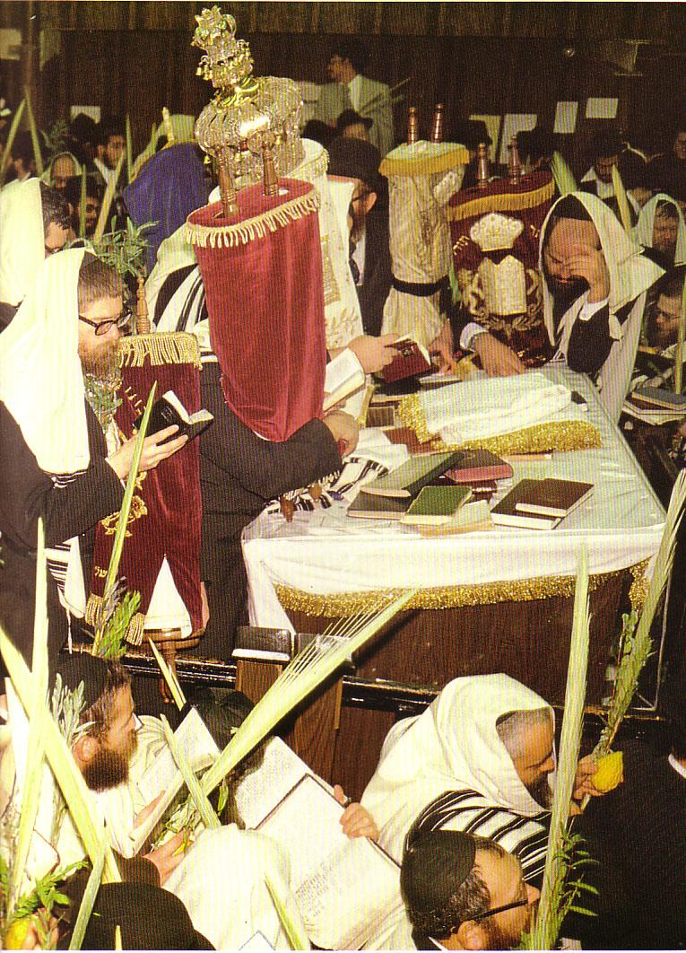

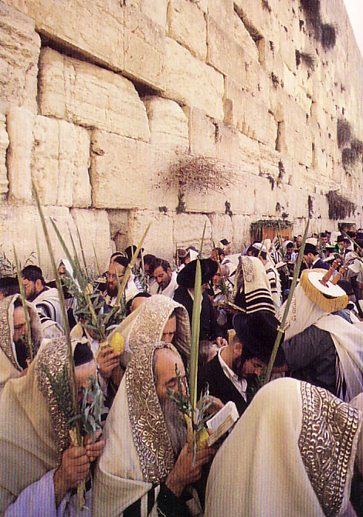
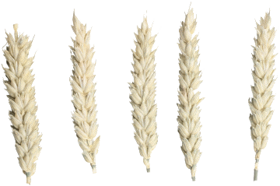
Celebrating the Wheat Harvest

Slide 48
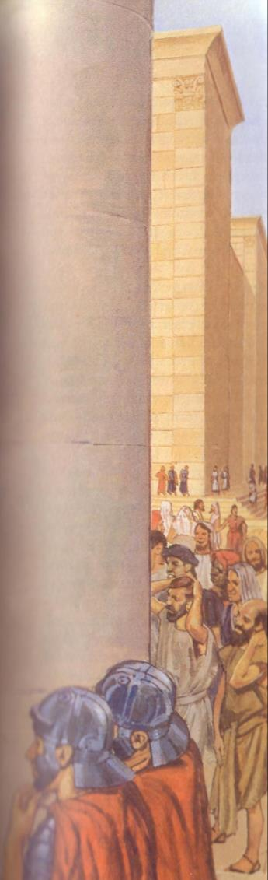
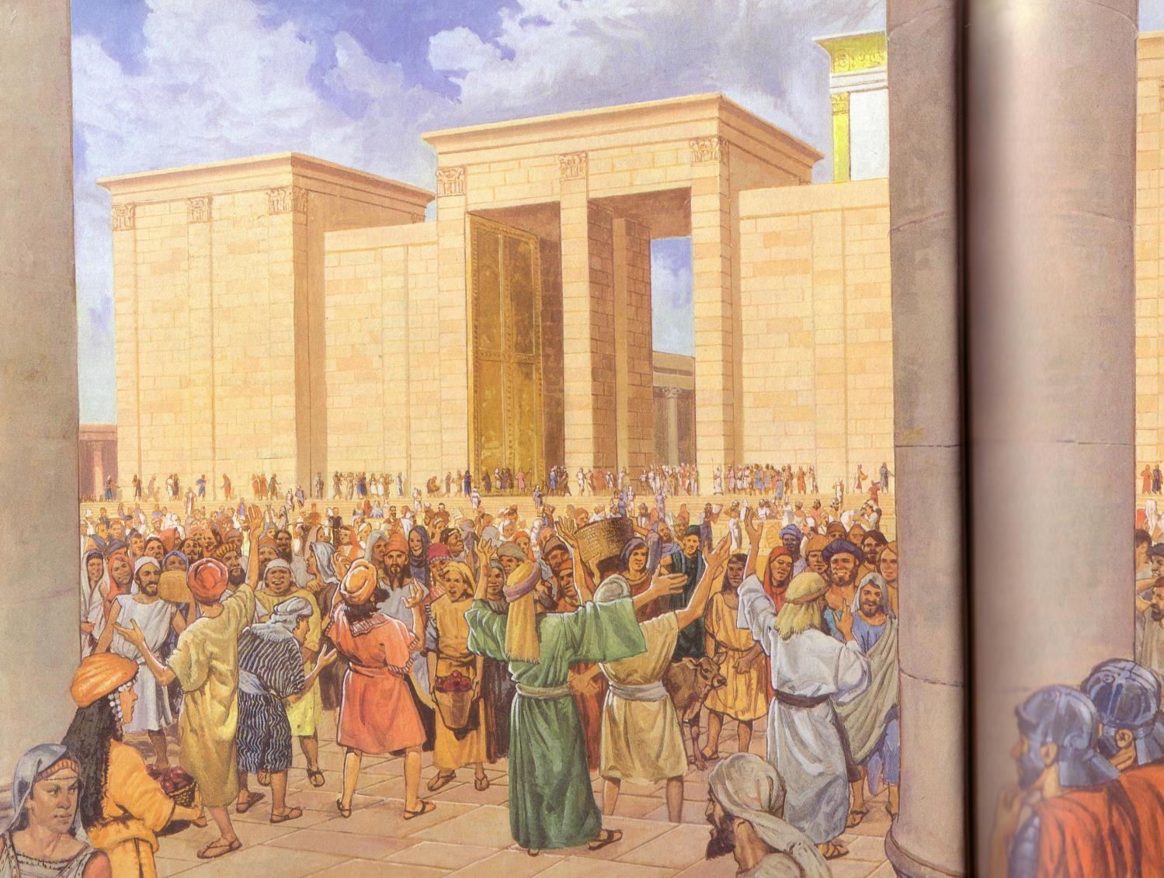
Apostles praised God in languages they had never learned (Acts 2)

Slide 49
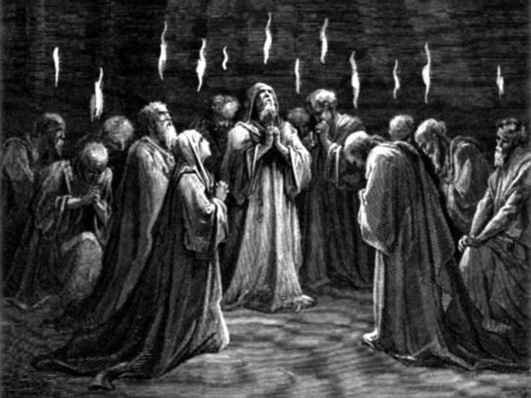
The Spirit Came at Pentecost (Acts 2)

Slide 50
Leviticus 23 Feasts
180
1 Nisan
2 Iyar
3 Sivan
4 Tammuz
5 Av
6 Elul
7 Tishri
8 Cheshvan
9 Kislev
10 Tevet
11 Shevat
12 Adar
Passover
Redemption
Unleavened Bread
Separation
Firstfruits
Resurrection
Pentecost
Spirit
Rapture
Trumpets
3 Pilgrimage Feasts

Slide 51
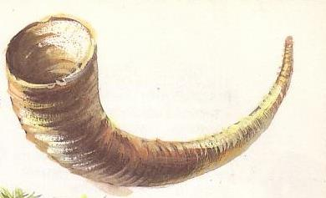
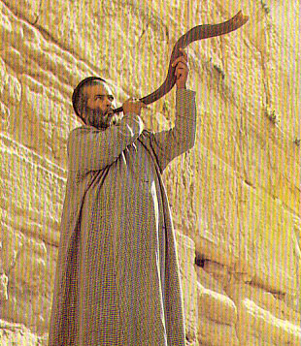
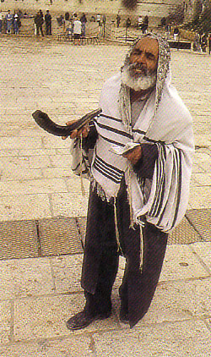
Rosh Hashanah (New Year)
184
Notes:
http://images.google.com/imgres?imgurl=www.rigal.freeserve.co.uk/jewish/calendar/calenda2a.gif&imgrefurl=http://www.rigal.freeserve.co.uk/jewish/calendar/jcalendar2.htm&h=398&w=477&prev=/images%3Fq%3DJewish%2BCalendar%2BDiagram%26svnum%3D10%26hl%3Den%26lr%3D%26ie%3DUTF-8%26oe%3DUTF-8

Slide 52
Leviticus 23 Feasts
180
1 Nisan
2 Iyar
3 Sivan
4 Tammuz
5 Av
6 Elul
7 Tishri
8 Cheshvan
9 Kislev
10 Tevet
11 Shevat
12 Adar
Passover
Redemption
Unleavened Bread
Separation
Firstfruits
Resurrection
Pentecost
Spirit
Repentance
Day of Atonement
Rapture
Trumpets
3 Pilgrimage Feasts

Slide 53
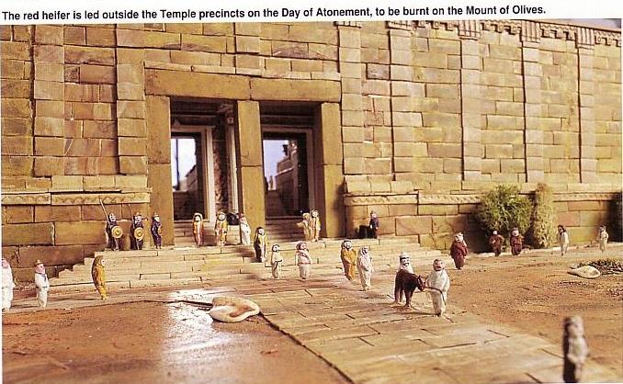
Yom Kippur: Day of Atonement
184
The red heifer is led out of Temple Mount on the Day of Atonement to be burnt on the Mount of Olives

Slide 54
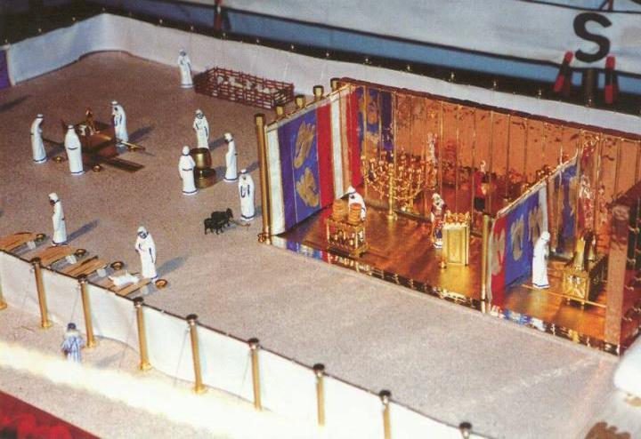
Day of Atonement (Lev. 16:29-34)
Courtyard
Holy Place
Holy of Holies

Slide 55
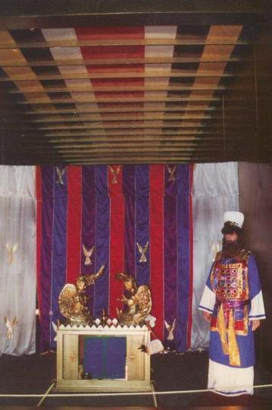
Day of Atonement
Priest's preparation
Priest's sin offering
People's sin offering
Scapegoat
Cleansing
Leviticus 16:29-34

Slide 56
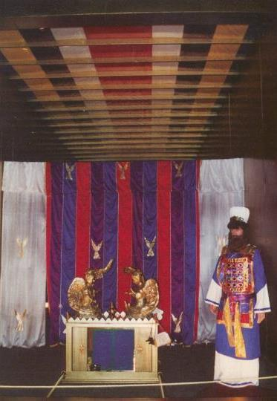
Day of Atonement Symbolism
When Christ came as high priest of the good things that are already here, he went through the greater and more perfect tabernacle that is not man-made, that is to say, not a part of this creation.
Hebrews 9:11 (NIV)

Slide 57
Once with His Own Blood for All!
He did not enter by means of the blood of goats and calves; but he entered the Most Holy Place once for all by his own blood, having obtained eternal redemption.
Hebrews 9:12 (NIV)

Slide 58
No More Atonement Needed
Nor did he enter heaven to offer himself again and again, the way the high priest enters the Most Holy Place every year with blood that is not his own.
Hebrews 9:25 (NIV)

Slide 59
Sin Done Away With (Not Just Covered)
Then Christ would have had to suffer many times since the creation of the world. But now he has appeared once for all at the end of the ages to do away with sin by the sacrifice of himself.
Hebrews 9:26 (NIV)

Slide 60
A Seat in the Holy of Holies?
But when this priest had offered for all time one sacrifice for sins, he sat down at the right hand of God.
Hebrews 10:12 (NIV)

Slide 61
Tabernacle: Pilgrimage Feast #3
180
1 Nisan
2 Iyar
3 Sivan
4 Tammuz
5 Av
6 Elul
7 Tishri
8 Cheshvan
9 Kislev
10 Tevet
11 Shevat
12 Adar
Passover
Redemption
Unleavened Bread
Separation
Firstfruits
Resurrection
Pentecost
Spirit
Tabernacles/Booths
Repentance
Day of Atonement
Rapture
Trumpets
3 Pilgrimage Feasts
Notes:
The Day of Atonement prophetically looks forward to the national repentance of Israel in the Tribulation (Rom. 11:26-27).
This will be followed by the prophetic significance of Israel living in the land instead of in tabernacles.

Slide 62
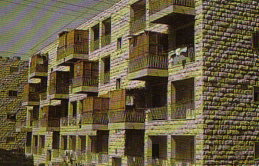




Feast of Booths
184
Leviticus 23:42-43 "Live in booths for seven days: All native-born Israelites are to live in booths so your descendants will know that I had the Israelites live in booths when I brought them out of Egypt. I am the LORD your God."
Tabernacles (Shelters)

Slide 63
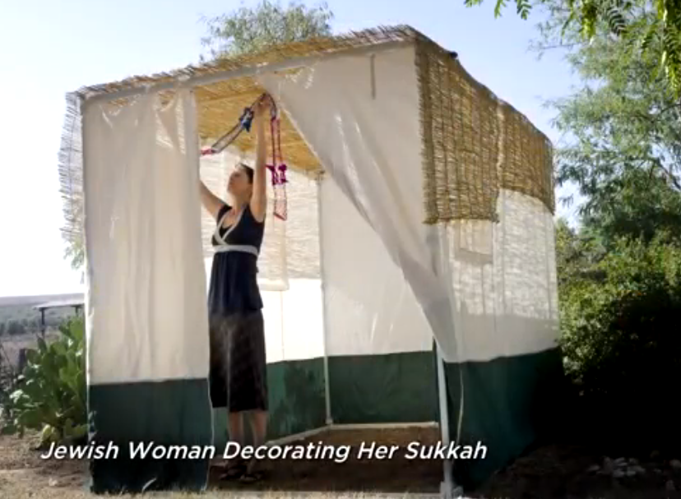
Jewish Woman Decorating Her Sukkah

Slide 64
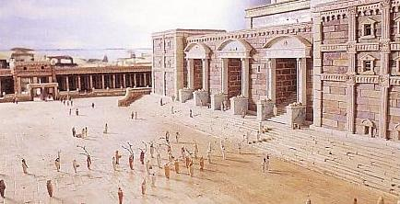

Feast of Tabernacles
184
Deuteronomy 16:13 "Celebrate the Feast of Tabernacles for seven days after you have gathered the produce of your threshing floor and your winepress."

Slide 65

Harvests Lasted Apr-Nov
183
Harvesting & Ingathering Based on Modern Agricultural Practices in Israel
 | Mar | Apr | May | June | July | Aug | Sep | Oct | Nov
Barley |  | X
Wheat |  |  | X
Oats |  |  | X
Peas |  | X | X
Chickpeas |  |  |  | X
Lentils |  | X | X
Vetch |  | X | X
Sesame |  |  |  |  | X
Flax |  |  |  |  | X
Millet |  |  |  |  | X | X
Grapes |  |  |  | X | X | X | X
Figs |  |  |  |  |  | X | X
Pomegranates |  |  |  |  |  | X | X
Olives |  |  |  |  |  |  | X | X | X
The olive harvest was the final harvest. No wonder why the olive tree represents Israel being restored and fruitful in last days (Jeremiah 11:16; Hosea 14:6; Romans 11:16-21)
http://www.wcg.org/lit/law/festivals/harvest.htm
Notes:
The three Pilgrimage Feasts brought all Jewish men to Jerusalem three times annually, strengthening the unity of Israel. These took place amidst the three ovals here in conjunction with
• the barley harvest,
• the wheat harvest, and
• the olive harvest.
• This final harvest depicted the end of the age.
Hebrew Roots/The restoration process/Israel
< Hebrew Roots‎ | The restoration process
https://en.wikibooks.org/wiki/Hebrew_Roots/The_restoration_process/Israel
Accessed 23 Feb 2019
THE OLIVE TREE - ISRAEL
The Olive tree is one of the five specie that grow in the land of Israel which are, the Pomegranate, the Fig, the Date Palm, Grape Vines and the Olive (Deut.8:8; Haggai 2:19; Joel 1:12).
By divine decree, the Olive tree has been chosen by Yahweh God as the national emblem of Israel as it characterises their qualities.
The trees grow plentifully around the countryside and are known for their tenacity, as they grow in almost any condition upon the hills or in valleys, in rocky or fertile soil. They are able to thrive in great temperature extremes of cold and heat with a minimum of water, and are virtually indestructible. There are some trees in the land which have survived being destroyed by invading armies, that are over 2,000 years old. Even when cut down or burned, new shoots will emerge from its roots. No matter what the conditions, the evergreen olive tree will live and produce fruit which is a source of food, light, hygiene and healing. Their habit of growth gives them a form of gracefulness and character which sets them apart from other trees.
The first reference in the Bible to the olive is in the Ark. It was an olive leaf that a dove from Noah's ark brought to Noah, “Then the dove came to him in the evening, and behold, a freshly plucked olive leaf was in her mouth; and Noah knew that the waters had receded from the earth” (Gen. 8:11).
From the beginning of civilization, Olives have been eaten as a Mediterranean staple food and olive oil has been used for cooking, in lamps for light (Ex. 27:20, Lev. 24:2), for medicine, and for anointing oil in religious ceremonies (Ex. 30:24-25).
Olive oil was so plentiful in Israel that it was one of the products regularly exported. Solomon sent the King of Tyre 100,000 gallons (378,533 liters) of olive oil (I Kings. 5:11).
It was in the Garden of Gethsemane (Gat Shemen, literally, the place of the “olive press”), where Yeshua spent much of His time in Jerusalem with His disciples. “Coming out, He went to the Mount of Olives, as He was accustomed, and His disciples also followed Him” (Luke 22:39).
The primary characteristics symbolized by the Olive tree is fruitfulness, faithfulness and steadfastness.
Psalms 52:8 says, “But I am like a green olive tree in the house of God; I trust in the mercies of God forever and ever.” By means of His grace, we are sustained by His Presence to remain fruitful, faithful and steadfast.
Psalms 128:3 says, “Your wife shall be like a fruitful vine in the very heart of your house; Your children like olive plants all around your table.” Again, a prophecy of fruitfulness like the olive tree, sending up many shoots from the parent tree to grace their personal altar to the Lord. Coming from their base or root, it symbolizes the blessing of them reproducing their faith and works in their children.
It is in Jeremiah 11:16, that Yahweh identifies the Olive Tree as the symbol of Israel. "The Lord called your name Green Olive Tree, lovely and of good fruit."
Hosea prophesies that in the end-time Israel shall once again be restored and its "branches shall spread; his beauty shall be like an olive tree" (Hosea 14:6).
Paul also in the new covenant uses this same analogy for Israel (Romans 11:16-21).
Rom.11:16 "For if the Firstfruit is holy, the lump also is holy, and if the root is holy, so are the branches. 7 But if some of the branches (of Israel, the Olive tree) were broken off, and you, being a wild olive, were grafted in among them, and became partaker with them of the root of the richness of the olive tree; 18 don't boast over the branches. But if you boast, it is not you who bear the root, but the root you.19 You will say then, "Branches were broken off, that I might be grafted in." 20 True; by their unbelief they were broken off, and you stand by your faith. Don't be conceited, but fear; 21 for if God didn't spare the natural branches, neither will he spare you."
• “The State of Israel chose the olive leaves around the Menorah as its emblem. The olive leaves symbolize peace, as this is the wish of our state. The olive also symbolizes light, as the oil produced from the olive lightened the Menorah in the Temple.”
The Olive in the Jewish and Israeli culture - Jerusalem Post https://www.jpost.com/.../The-Olive-in-the-Jewish-and-Israeli-culture-193416
Oct 31, 2010

Slide 66



Tabernacles = Final Harvest
184
Winnowing = Events at Christ's return to earth:
Nations judged (Matt. 13:30, 39; Rev. 14:15)
Transfiguration = Kingdom to follow (Matt. 17:4)

Slide 67

Transfiguration = Booths = Kingdom (Matt. 17:4)
Notes:
The Day of Atonement prophetically looks forward to the national repentance of Israel in the Tribulation (Rom. 11:26-27).
This will be followed by the prophetic significance of Israel living in the land in the kingdom instead of in tabernacles/booths.

Slide 68
Tabernacle: Pilgrimage Feast #3
180
1 Nisan
2 Iyar
3 Sivan
4 Tammuz
5 Av
6 Elul
7 Tishri
8 Cheshvan
9 Kislev
10 Tevet
11 Shevat
12 Adar
Passover
Redemption
Unleavened Bread
Separation
Firstfruits
Resurrection
Pentecost
Spirit
Kingdom
Tabernacles/Booths
Repentance
Day of Atonement
Rapture
Trumpets
3 Pilgrimage Feasts
Notes:
The Day of Atonement prophetically looks forward to the national repentance of Israel in the Tribulation (Rom. 11:26-27).
This will be followed by the prophetic significance of Israel living in the land in the kingdom instead of in tabernacles/booths.

Slide 69


Summary on Feasts of Israel
183
Clustered mostly in two months
Joyful and somber
At Jerusalem and home
Designed around agriculture
United the nation
Provided rest
Pointed to the past and future

Slide 70
Three Other Feasts Not Commanded in Scripture…

Slide 71
Extra Biblical Feast #1
180
1 Nisan
2 Iyar
3 Sivan
4 Tammuz
5 Av
6 Elul
7 Tishri
8 Cheshvan
9 Kislev
10 Tevet
11 Shevat
12 Adar
Passover
Redemption
Unleavened Bread
Separation
Firstfruits
Resurrection
Pentecost
Spirit
Kingdom
Tabernacles/Booths
9th of Av
Repentance
Day of Atonement
Rapture
Trumpets
3 Pilgrimage Feasts

Slide 72

Jewish life revolved around Solomon's temple for 400 years (959-586 BC)
Judaism in Israel and the Diaspora (continued)
184
Notes:
The temple was Israel's spiritual focus, the financial center (the national bank), and the social heart of the nation.

Slide 73

Jews Maintained Holiness at the Basin
Notes:
The basin cleansed the hands and feet of the priests who brought the people before the Lord inside the temple.

Slide 74
Jews Maintained Holiness at the Basin
Temple Destroyed!
The 9th of Ab • 586 BC • AD 70
Notes:
God disciplined the nation for its sins twice—ON THE SAME DAY!
—He used the Babylonians to destroy the temple and the city in 586 BC
—He used the Romans to destroy the temple and the city in AD 70

Slide 75
Extra Biblical Feast #2
180
1 Nisan
2 Iyar
3 Sivan
4 Tammuz
5 Av
6 Elul
7 Tishri
8 Cheshvan
9 Kislev
10 Tevet
11 Shevat
12 Adar
Passover
Redemption
Unleavened Bread
Separation
Firstfruits
Resurrection
Pentecost
Spirit
Hanukkah
Kingdom
Tabernacles/Booths
9th of Av
Repentance
Day of Atonement
Rapture
Trumpets
3 Pilgrimage Feasts

Slide 76




Hanukkah (Feast of Lights) commemorates the victory of Judas Maccabeus over the Seleucids in 164 BC
184
7-Branch Menorah (Regular)
9-Branch Lampstand (Hanukkiah)

Slide 77
Extra Biblical Feast #3
Purim
180
1 Nisan
2 Iyar
3 Sivan
4 Tammuz
5 Av
6 Elul
7 Tishri
8 Cheshvan
9 Kislev
10 Tevet
11 Shevat
12 Adar
Passover
Redemption
Unleavened Bread
Separation
Firstfruits
Resurrection
Pentecost
Spirit
Hanukkah
Kingdom
Tabernacles/Booths
9th of Av
Repentance
Day of Atonement
Rapture
Trumpets
3 Pilgrimage Feasts

Slide 78

Purim: Lots of Victory
184

Slide 79
I. Israel rested to maintain a holy walk with God.
182
All Jewish men attended the three annual feasts to remind them of God's blessings in their lives (Exod. 23:14-19).
Keeping the Sabbath was God's key command because it signified Israel's covenant with the holy LORD (31:12-17).

Slide 80

Sabbath
182

Slide 81
The Eschatological Significance of the Sabbath
23
529
NS 266k
A visual summary of the ThD dissertation by Richard James Griffith, Dallas Theological Seminary, 1990
Christ’s Second Coming in 2 Phases
Pre-Fall
Pre-Mosaic
Mosaic
Church
Tribulation
Millennial Kingdom
Eternity
Creation
Fall of Man
Mount Sinai
Death of Christ
Rapture
Revelation
Rev 20:1-6
Eternity
6 Days
(Work)
Gen 1
7th Day
(Rest)
Gen 2:1-3
Law Instituted
Exod 20
Law Abolished
Rom 7:1-6
Gal 3:19, 23-29
1 Cor 9:20
2 Cor 3:6-11
Daniel’s 70th Week of 70-Week Prophecy
Dan 9:27
Some Aspects of Law Reinstituted
Ezek 40–48
God’s Work
Work of Creation
Gen 1
Work of Sustaining
John 5:17
Work of Recreation
Rev 21–22
Israel Repeatedly Rejected God’s Offer of the Promised Land Rest…
God’s Rest
Not Resting
Rests from Creative Activity
Gen 2:2-3
Rest Stops by Sin
Rest Linked to Canaan
Gen 12:1-3; 15:18;
Deut 30:1-10
Rejected in Wilderness
Gen 14:23;
Heb 3:9
Rejected in David’s Time
Ps 95:7b-11
Rejected in Messiah
Matt 23:37-39
Rejected in Peter’s Sermon
Acts 3:19-20
Rest Accepted & Reinstituted
Heb 3:7–4:11
Israel’s Sabbath
No Sabbath for Mankind
Israel’s Sabbath Anticipated
Gen 2:3
Sabbath Instituted
Exod 16
Neh 9:13-14
Sign of Mosaic Covenant
Exod 31:13, 17;
Ezek 20:12, 20
Sabbath Abolished
Col 2:16-17
Gal 4:9-10
Rom 14:5
Hos 2:11
Lord’s Day Instituted
Acts 20:7
1 Cor 16:1-2
Rev 1:10
Sabbath Reinstituted
Matt 24:20
Sabbath Reinstituted
Ezek 46:1
Isa 66:23
Transition Begins
Transition Completed
Israel’s National History
Nation Established at Mt Sinai
Exod 19
69 Weeks
（483 years）
444 BC-AD 33
Dan 9:25
Nation Set Aside in
Church Age Gap: “Times of the Gentiles”
Dan 9:26
Luke 21:24
1 Week
(7 Years)
AD ??
Dan 9:27
Nation Repents, Believes in Messiah, Re-established
Ezek 36–39
Kingdom Typology
Kingdom Language
Gen 1
Abrahamic & Land Covenants
Gen 12:1-3; 15:18
Deut 30:1-10
Sabbath Looks Back at Creation & Redemption
Exod 20:8-11
Deut 5:12-15
Sabbath Looks Forward & Typifies Kingdom
Heb 4:9
Lev 23:1-3
Sabbath Typifies in a Dual Sense
Notes:
OB-25-Feasts-80
OS-00-Intro-26
OS-02-Exodus-320
OS-26-Ezek 40-48-slide 23
NS-19-Hebrews-175

Slide 82

182
I. Israel rested to maintain a holy walk with God.
All Jewish men attended the three annual feasts to remind them of God's blessings in their lives (Exod. 23:14-19).
Keeping the Sabbath was God's key command because it signified Israel's covenant with the holy LORD (31:12-17).
One violation of holy rest was to start a fire on the Sabbath (35:1-3).

Slide 83

II. We also need holy times to rest and reflect on God's work in our lives.
Holy time?
Like Israel, we need annual celebrations of holy rest.
Like Israel, we need weekly celebrations of holy rest.

Slide 84

Main Idea: Take a holy break!

Slide 85
What are Parallel Repeated Christian Feasts Today?
Lent
Easter
Christmas
Lord's Supper
Baptism? (But this occurs only once for each person)

Slide 86

Discussion Questions
What are we really saying when we complain that we don't have time to rest?
How can your next Christian "feast" be more restful and spiritual?
In what way is God telling you to make time holy?

Slide 87
The Sacred Calendar of Israel
Purim
180
1 Nisan
2 Iyar
3 Sivan
4 Tammuz
5 Av
6 Elul
7 Tishri
8 Cheshvan
9 Kislev
10 Tevet
11 Shevat
12 Adar
Winter
Passover
Redemption
Unleavened Bread
Separation
Firstfruits
Resurrection
Pentecost
Spirit
Hanukkah
Summer
Kingdom
Tabernacles/Booths
9th of Av
Repentance
Day of Atonement
Rapture
Trumpets
3 Pilgrimage Feasts

Slide 88
Black

Slide 89


OT Backgrounds link at BibleStudyDownloads.org
Get this presentation for free!
Notes:
NT Survey (ns)

