Slide 1
How Did the Universe Get Here?
Contrasting Various Views on Origins
Dr. Rick Griffith • Jordan Evangelical Theological Seminary
BibleStudyDownloads.org

Slide 2
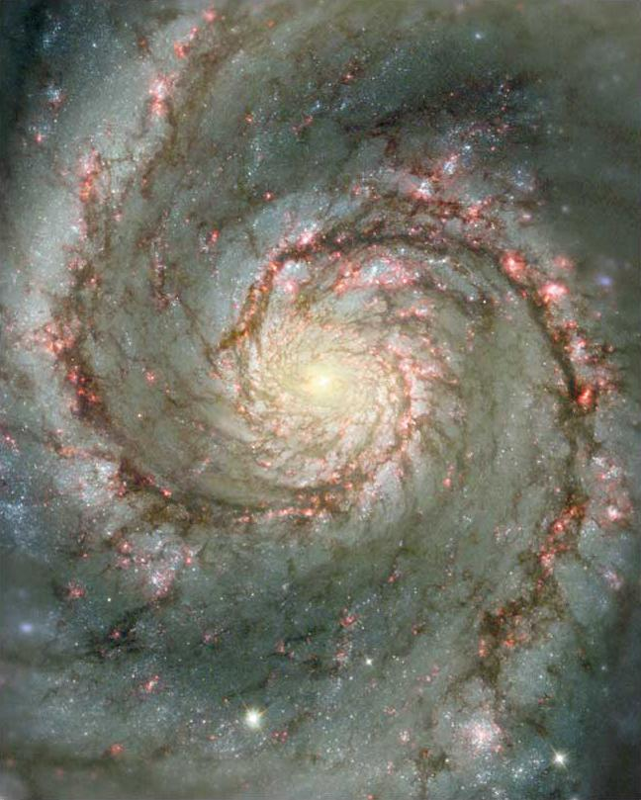
Questions We All Must Answer
Genesis = "Beginnings"
Origin: Where did we come from?
Purpose: Why am I here? Is there meaning?
Morality: Why is there evil in the world?
Destiny: Where am I going? Is there hope?

Slide 3
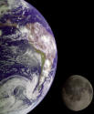
Narrative Parallels to Genesis
188
Memphite Theology
Enuma Elish
Atrahasis Epic
Gilgamesh Epic
Creation
Creation
Creation & Flood
Flood

Slide 4
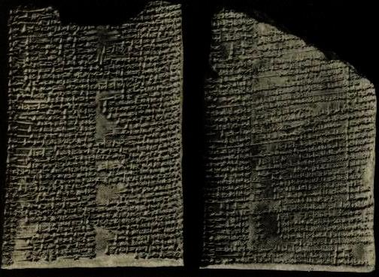
Enuma Elish ("When on High")
188d
Babylonian account of creation
Written in Akkadian
On seven tablets, composed during 11th century BC
Tiamat the mother goddess
Marduk the son kills Tiamat, creating the universe from splitting her corpse into water and sky
Humankind made to do hard physical labour from blood of Tiamat's co-conspirator, Kingu

Slide 5
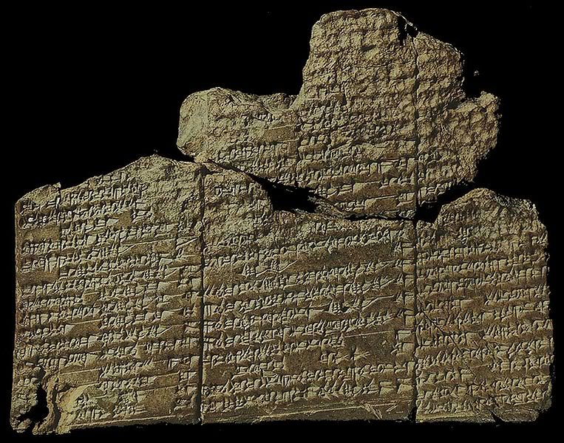
Two Other Sumerian Accounts
Eridu Genesis
Enki, Ninmakh and Creation of Humankind
Origin: 1600 BC
Order parallels Genesis account
Narrates creation of mankind, cities, and great flood; hero named Ziusudra
Enki created by fathering clay of Apsu
Enki, Ninmakh and Namma fashioned humans from clay to farm food and labour

Slide 6
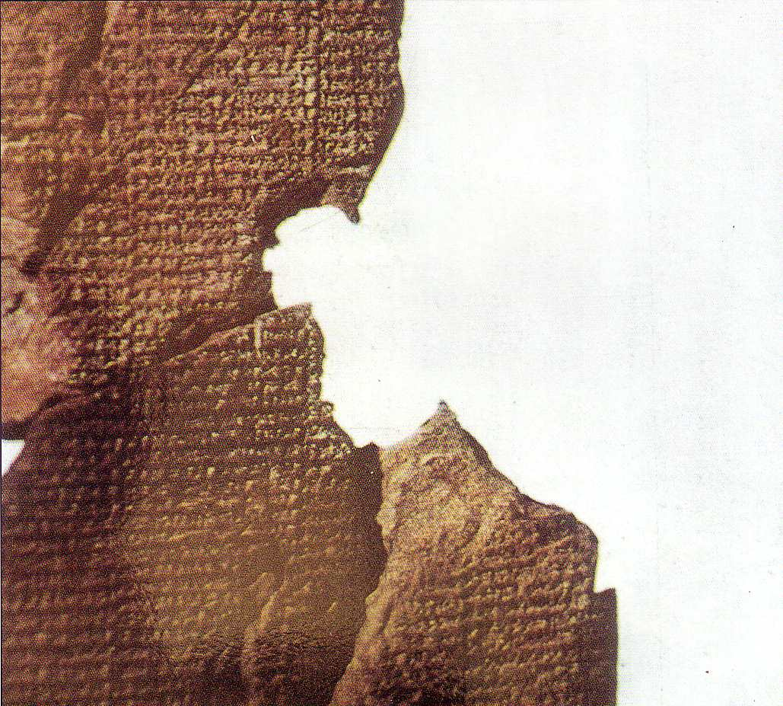
Atrahasis Epic
188i
"Let the birth-goddess create offspring, and let man bear the toil of the gods… create humanity that he may bear the yoke… let Nintu mix clay, that god and man may be thoroughly mixed in the clay, let there be a spirit from the god's flesh" (Arnold/Beyer, 24)
Akkadian 1650 BC
Creation & flood stories
Man created to help overworked gods
Man made from clay

Slide 7
Views of Creation
187l
Pagan | Biblical (Genesis)
Polytheistic | Monotheistic (Gen 1:1)
Myth | History
Written to satisfy man's curiosity on origins | Written to glorify God & extend his rule
The gods created themselves and other gods | The Word existed before creation (John 1:1-3)
The gods struggled for sovereignty | Yahweh sovereign by nature (Gen 1:3)
Man mostly not in divine image (low status) | Man created in God's image (high status)
People made to be slaves of the gods | Man rules over creation (Gen 1:26-27)
Life came from death | Life came from life

Slide 8
Views of Creation
187l
Pagan | Biblical (Genesis)
The most powerful god used magic to create | Yahweh did not need to use magic
Male and female gods had sexual activity | Yahweh had no female consort
Creation resulted from conflict between gods | Creation by orderly means
Creative activity not separated into days | Six days of creation model the work week
These are gods in and of themselves | Creation of light, sun, sky, moon, etc.
No corresponding rest day is taught | A Sabbath rest completes creation
Material assumed to be eternal in the past | No pre-existent material (Hebrews 11:3)

Slide 9

Relevance of Genesis Title 00513
The
Relevance
of Genesis

Slide 10

IN THE BEGINNING
God
created
the heavens and the earth
Genesis 1:1

Slide 11

Psalm 11:3 KJV 00422
Psalm 11:3
If the foundations be destroyed, what can the righteous do?

Slide 12
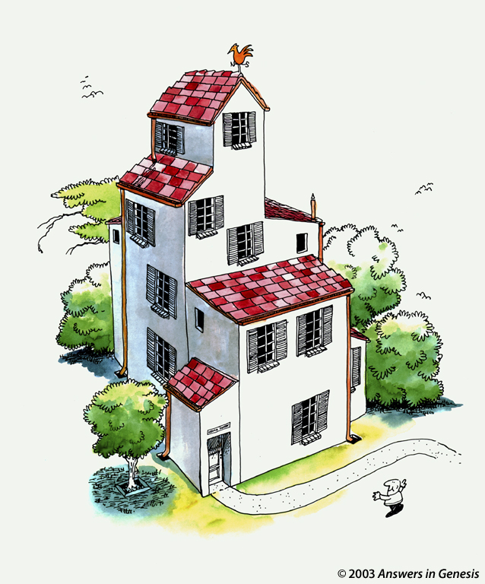
House 1 00418

Slide 13

House 2 00419
Notes:
Suppose many huge trucks rumbled around the house without ever touching it.

Slide 14
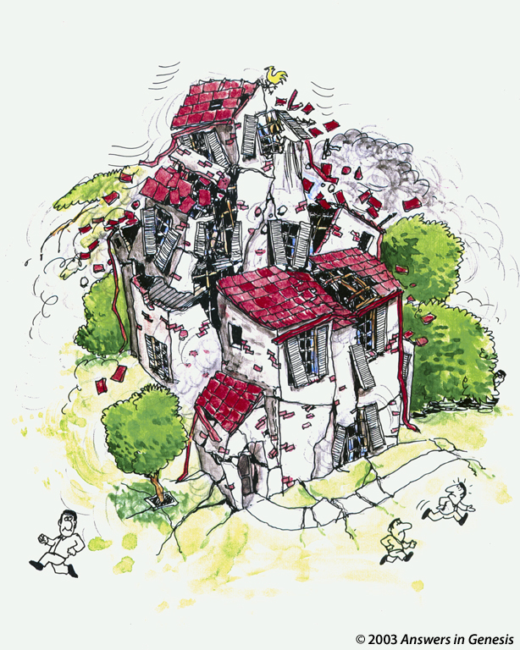
House 3 00420
Notes:
Trucks like that would cause such a stir that they would destroy the very foundation of the house, causing it to collapse.

Slide 15
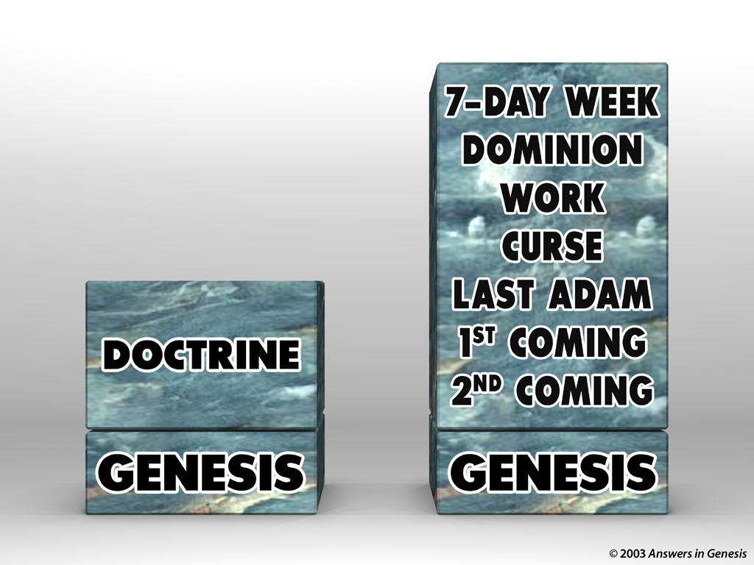

Blocks-Genesis Doctrine & Doctrines 00405
2ND COMING
1ST COMING
LAST ADAM
CURSE
DOMINION
DOCTRINE
WORK
7-DAY WEEK
GENESIS
GENESIS

Slide 16
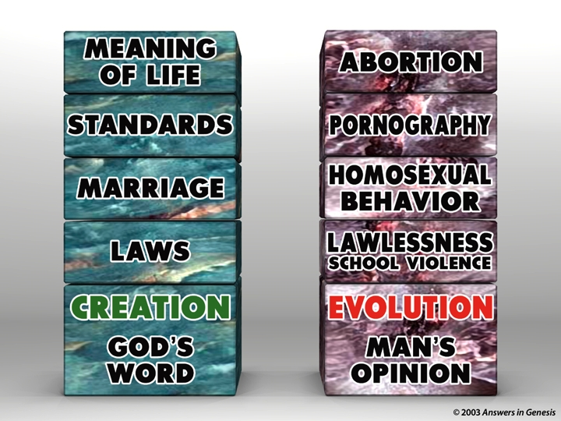
Blocks-God's Word & Man's Opinion 00403
MEANING
OF LIFE
ABORTION
STANDARDS
PORNOGRAPHY
MARRIAGE
HOMOSEXUALITY
LAWS
LAWLESSNESS
CREATION
GOD'S
WORD
EVOLUTION
MAN'S
OPINION

Slide 17
Q335-Sagan 00434
The secrets of evolution are time and death. Time for the slow accumulations of favorable mutations, and death to make room for new species.
Carl Sagan, program entitled "One Voice in the Cosmic Fugue."
© 2003 Answers in Genesis

Slide 18


FOSSIL
RECORD
PAIN
DEATH
KILLING
MILLIONS OF YEARS
=
DISEASE
STRUGGLE
SUFFERING
EXTINCTION

Slide 19
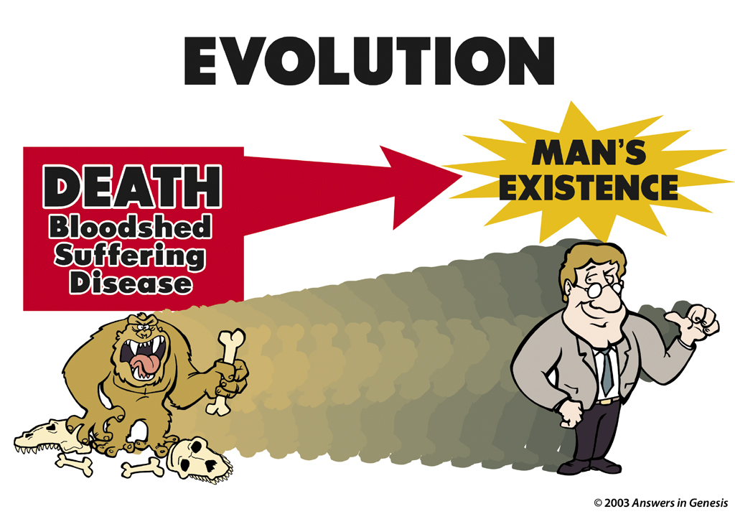
Evolution: Death-Man 00413
EVOLUTION
MAN'S EXISTENCE
DEATH
Bloodshed
Suffering
Disease

Slide 20
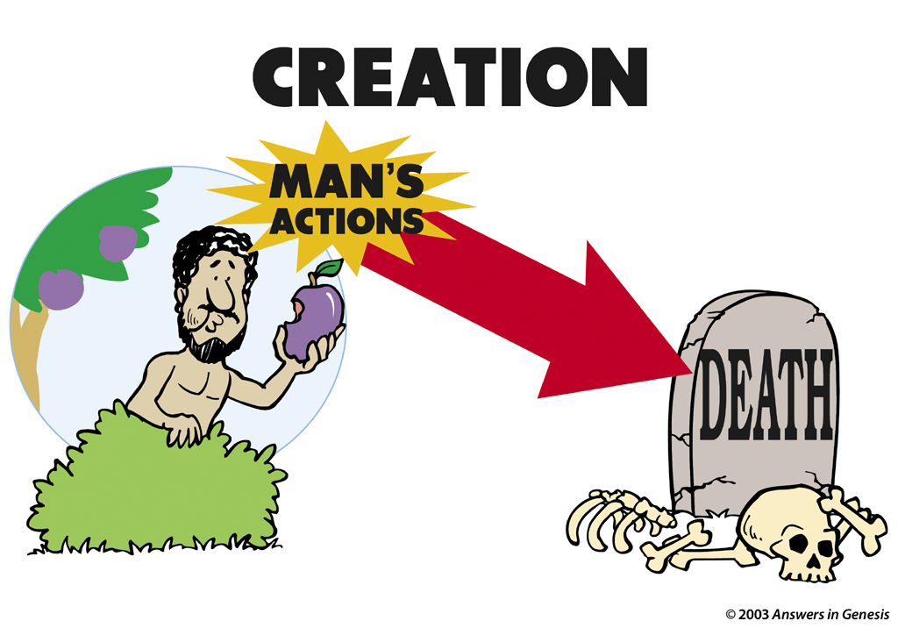
Creation: Actions-Death 00412
CREATION
MAN'S ACTIONS
DEATH

Slide 21
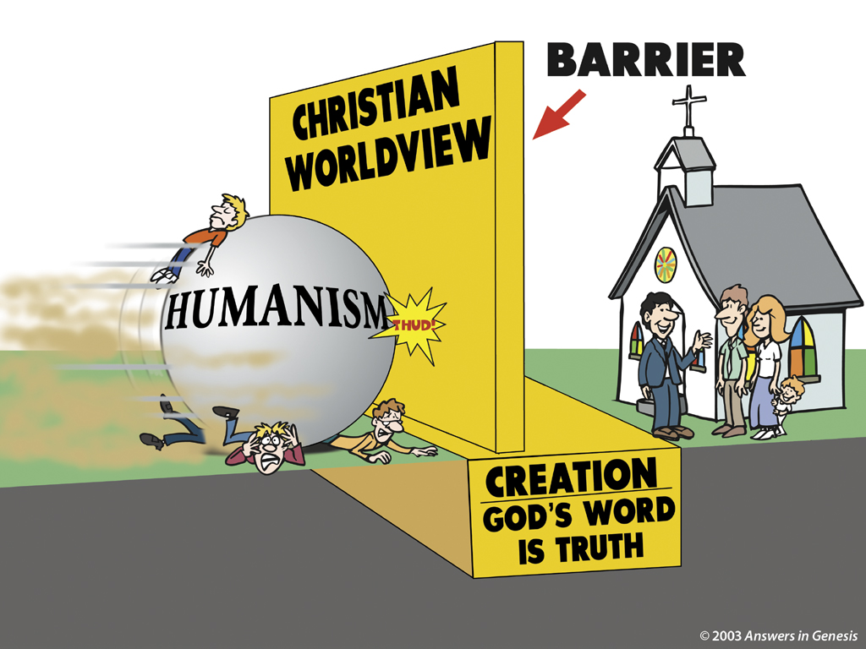
Christian Barrier 1 00410
BARRIER
CHRISTIAN WORLDVIEW
HUMANISM
CREATION: GOD'S WORD IS TRUTH

Slide 22
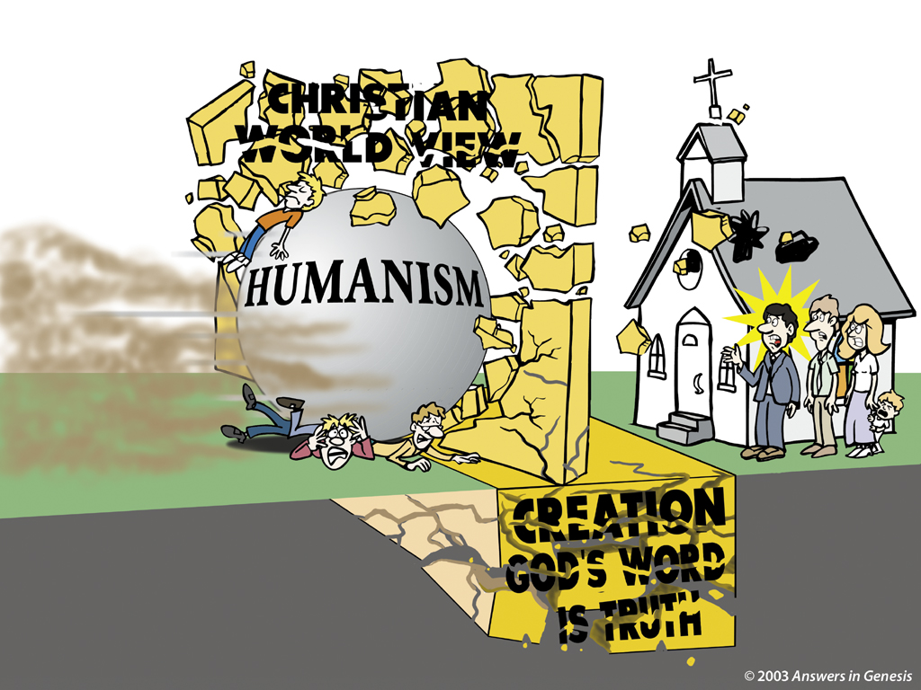
Christian Barrier 2 00411

Slide 23
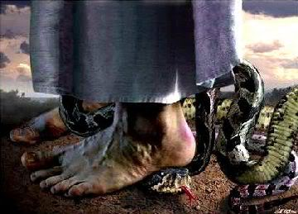
Genesis 3:15
Genesis 3:15
And I will cause hostility between you [serpent] and the woman [Eve], and between your offspring and her offspring. He will strike your head, and you will strike his heel" (NLT).

Slide 24
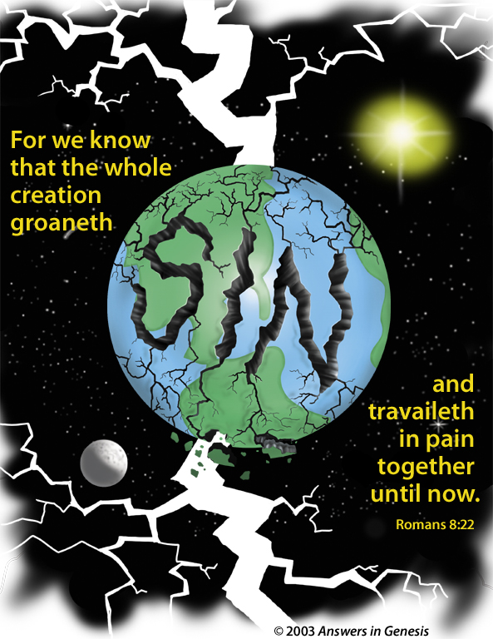
Sin-Romans 8:22 00074
For we know that all creation has been groaning
as in the pains of childbirth right up to the present time.
(Rom. 8：39 NLT)

Slide 25
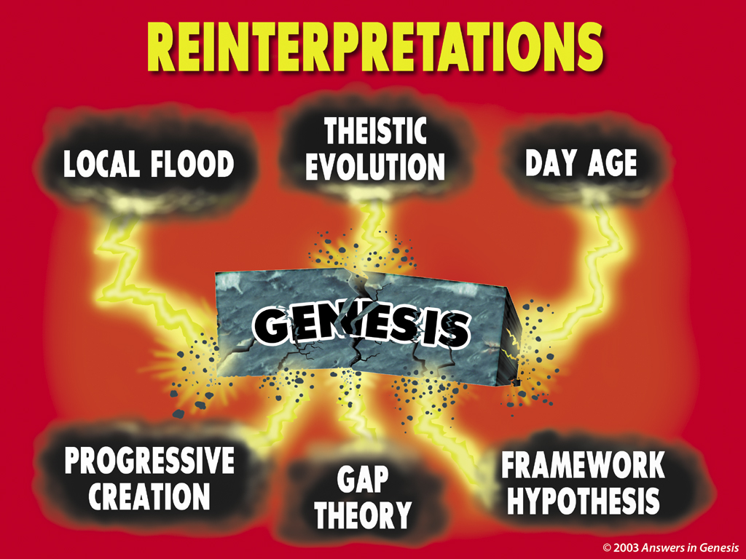
Reinterpretations 00363
REINTERPRETATIONS
REINTERPRETATIONS
THEISTIC
EVOLUTION
LOCAL FLOOD
DAY AGE
GENESIS
PROGRESSIVE
CREATION
FRAMEWORK
HYPOTHESIS
GAP
THEORY

Slide 26

Creation Theories
187c
24-Hour Day
1 day = literal 24 hours
Day-Age
1 day = indefinite era
Literary
7 days = symbolic
Prior Creation
Creation | Gap | Re-Creation
1:1 1:2-2:3
Two-Phase
Creation | Gap | Creation
1:1-2:3 2:4-25
Genesis 1

Slide 27
Q335-Sagan 00434
9. How did sin arise?
(a) The Garden of Eden is a "myth," i.e. a historical tale embodying spiritual truth. From the viewpoint of anthropology it is exceedingly unlikely that there was a First Man and Woman. Yet the "myth" contains many great truths…
continued…
Hugh Montefiore, bishop of the Anglican (Episcopal) church, Confirmation Notebook, p. 20
© 2003 Answers in Genesis

Slide 28
Q335-Sagan 00434
9. How did sin arise?
(b) Human beings are the results of evolution, and shaped by natural selection. Self-centeredness and aggression were essential at every stage of evolution.
(c) Human beings naturally inherit this self-centeredness ("original sin") and without it babies could not survive.
Hugh Montefiore, bishop of the Anglican (Episcopal) church, Confirmation Notebook, p. 20
© 2003 Answers in Genesis

Slide 29
Q335-Sagan 00434
What the cross is not:
(b) The Son standing in my place to take the punishment that I ought to have. Such a view is immoral. In any case, no one person could suffer the whole world's punishments.
Hugh Montefiore, bishop of the Anglican (Episcopal) church, Confirmation Notebook, p. 22
© 2003 Answers in Genesis

Slide 30



Who believes what?
Creationists (55%)
Theistic Evolutionists (32%)
Darwinists (13%)
(the view that leading scientists and educators accept)
2005 CBS News/New York Times Poll
Notes:
"In a recent survey of beliefs about origins, a 2005 CBS News/New York Times Poll of 885 persons found 55 percent of the general public were creationists, 32 percent were theistic evolutionists, and only 13 percent were orthodox Darwinists (the view that leading scientists and educators accept)." (Theistic Evolution and the Creation-Evolution Controversy (#393) by Jerry Bergman, PhD at http://www.icr.org/article/2701/). Jerry Bergman is on the Biology faculty at Northwest State College in Ohio

Slide 31

Did life originate as an accident?
"There are only two possible explanations as to how life arose: Spontaneous generation arising to evolution or a supernatural creative act of God…. There is no other possibility. Spontaneous generation was scientifically disproved 120 years ago by Louis Pasteur and others, but that just leaves us with only one other possibility… that life came as an act of supernatural creation by God, but I can't accept that philosophy because I do not want to believe in God. Therefore, I choose to believe that which I know is scientifically impossible, spontaneous generation leading to evolution."
Dr. George Wald
Professor Emeritus of Biology, Harvard
Nobel Prize winner in Biology, 1971
Notes:
George Wald, "Origin, Lie and Evolution," Scientific American 1978); cited by Joe White and Nicholas Comninellis, Darwin's Demise (Green Forest, AR: Master Books, 2001), 46.

Slide 32
Q335-Sagan 00434
"The day will come when the evidence constantly accumulating around the evolutionary theory becomes so massively persuasive that even the last and most fundamental Christian warriors will lay down their arms and surrender unconditionally. I believe that day will be the end of Christianity."
Richard Bozath, "The Meaning of Evolution,"
American Atheist, September 20, 1979, p. 30
© 2003 Answers in Genesis

Slide 33
Q335-Sagan 00434
"As were many persons from Alabama, I was a born again Christian. When I was 15, I entered the Southern Baptist Church with great fervor and interest in the fundamentalist religion. I left at 17 when I got to the University of Alabama and heard about evolutionary theory."
E. O. Wilson, Professor of Sociobiology at Harvard University, The Humanist (September 1982), 40
© 2003 Answers in Genesis

Slide 34
Q335-Sagan 00434
… raised a Methodist in Indianapolis and went to church regularly as a child and teenager, "I believed all this God stuff," he said. "I was a good little boy and all that… In school, we opened with the Lord's prayer. That was big stuff." That changed when he attended Purdue University in Indiana. After taking physics and chemistry, he began to question the veracity of the Bible. In particular, he doubted how the entire world could have flooded in the days of Noah's Ark.
Richard Suhre, suit to the remove Ten Commandments from Haywood County Courthouse, North Carolina
© 2003 Answers in Genesis

Slide 35
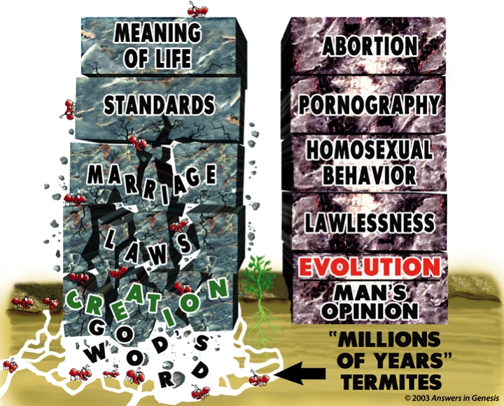
Blocks-God's Word & Man's Opinion-Termites 00884

Slide 36

Balloons problem—evol vs creat
Gay
Marriage
THE
PROBLEM
Abortion
PSALM 11:3
Moral
Relativism
Euthanasia
CHRISTIANITY
HUMANISM
EVOLUTION
CREATION
Notes:
36
The humanistic philosophies all are undermining the very foundation of what Christians believe by focusing their attacks at creation.
Meanwhile, Christians accept their evolutionary theory and then focus their attacks at the results of humanism instead of attacking the foundation in evolution.
Some Christians shoot their own foundation and others are asleep or shooting other Christians.

Slide 37
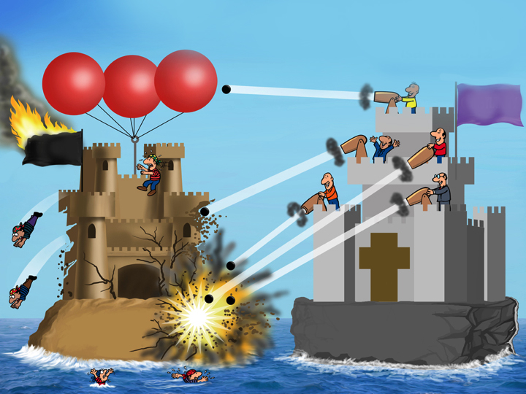
Balloons problem—man's vs God's word
THE
SOLUTION
ISAIAH 58:12
Gay
Marriage
Moral
Relativism
CHRISTIANITY
HUMANISM
MAN'S WORD
GOD'S WORD
Notes:
37

Slide 38

Product-The Lie 00417

Slide 39
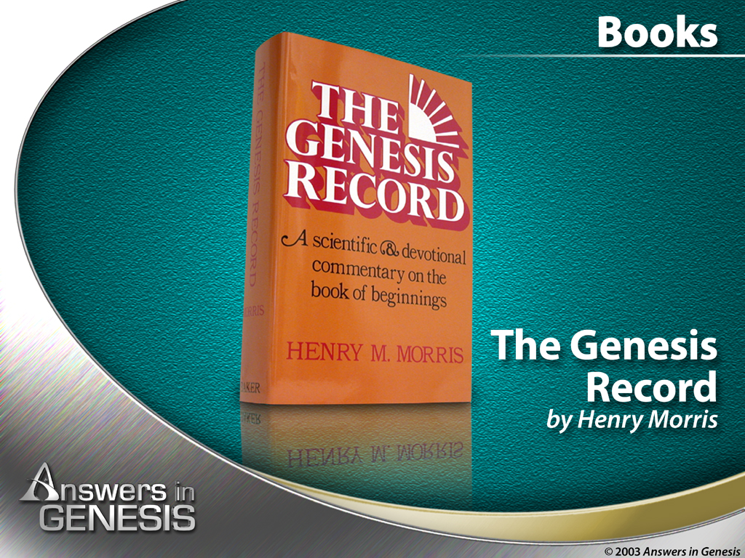
Product-The Genesis Record 00416

Slide 40

Questions & Answers 00441

Slide 41

AiG Web Address 00439

Slide 42
Days of Creation
OTS 33
Void
Formless
Forming
Filling
Day 4: Sun, moon & stars arranged
Day 1: Light
Day 2: Water & air separated
Day 5: Fish & fowl
Day 3: Land & sea separated
Day 6: Animals & man
Genesis 1:3-31

Slide 43
How Does 1:1 Relate to 1:2-3?
34
Original Creation (Traditional View)
Leupold, Keil, Cassuto, Griffith
1- Creation out of nothing of the original mass on Day 1
"In the beginning God created the heavens and the earth" (1:1)
2- Three disjunctive, parallel clauses describe the condition of the earth immediately after the creation of the universe.
"Now the earth was formless and empty, darkness was over the surface of the deep, and the Spirit of God was hovering over the waters" (1:2 NIV)
3- An independent, narrative sentence shows the manner in which God worked—by His Word.
"And God said, 'Let there be light,' and there was light" (1:3)
Allen Ross, Creation & Blessing, 718
Notes:
This view sees verse 3 as continuing Day 1 rather than starting it. Exodus 20:11 supports this, as it puts 1:1-2 with Day 1: “For in six days the Lord made the heavens, the earth, the sea, and everything in them; but on the seventh day he rested. That is why the Lord blessed the Sabbath day and set it apart as holy” (NLT).
Exodus 31:17 supports this as well: “[The Sabbath] is a permanent sign of my covenant with the people of Israel. For in six days the Lord made heaven and earth, but on the seventh day he stopped working and was refreshed.’”
The Qumran practice of leaving space after each day supports 1:1-3 as part of Day 1 since 4QGenesisB has 1:1-5 all as one unit. Thus, these five verses were to be read as one unit.
The Book of Jubilees 2:1-24 reworks Genesis 1 by retelling the story in seven works of creation: water, abysses, light, etc. where
Haggadah Talmud also includes 1:1-3 as part of Day 1.
Was “formless and void” a negative statement indicating chaos? Some Egyptians used it in this manner, and the Babylonian Tiamat saw demons in the desert where it was “formless.” However, Jer. 4:23 “I looked at the earth, and it was empty and formless. I looked at the heavens, and there was no light” seems to indicate the negative sense.
Separation of the heaven and earth was a common motif in the ANE. See Gilgamesh and Enuma Anu Enlil and the Egyptian Memphite Theology.
But wouldn’t this make God create the heavens twice—here and on day 2? No, as it is used in a different sense in these places. Nathan Chambers (ETS presentation, 21 Nov 2019) sees this as referring theologically to God’s dwelling place, which also was created, so he says that it means that God created his own throne room on Day 1. This is a minor view, though.
A bipartite cosmology (heaven and earth) seems to be taught here, but later it shows that he actually created a tripartite universe: heaven, earth, and sea (cf. Exodus 20:11). This shows that 1:1 is not simply a heading for the narrative, as it is bipartite rather than tripartite.
The "earth" is 1:1 referred to the present sky, earth, and sea but all messed up. Verse 10 is the dry earth and verse 28 refers to rule over the dry earth also. This makes 1:2 include everything in the realm for humanity. God's dwelling place (1:1a) was finished but man's dwelling place was inhabitable.
This view is consistent with Greg Beale's heavenly temple view as the Holy of Holies (=God's dwelling place) is complete but man lives in a world that needed forming.
Why does Genesis start like this with a simple declaration?
1. Genesis 1 starts the biblical narrative with original creation that God made from nothing rather than a drama within existing matter. God did not have to fight any other gods to create.
2. This shows the initial act of creation, showing the story in historically relevant terms. If God created everything instantaneously, there would be no story to tell as it would be as if he snapped his fingers rather than over six days. It implies a wildness to creation, though, as God must overcome it.
3. God is transcendent over creation, but he is not opposed to creaturely agency. Instead, he makes use of means. He does not work through mediation, though the earth responds by making plants appear.
_______________________
OS-01-Gen1-3-Slide124
OB-22-Creation-43

Slide 44
Gap Theory (or Ruin/Reconstruction)
34
How Does 1:1 Relate to 1:2-3?
Pember, Hengstenburg, Scofield Reference Bible (1st ed.)
1- An independent narrative of the original, perfect creation
"In the beginning God created the heavens and the earth" (1:1)
Satan's fall
2- Satan fell between 1:1 and 1:2, followed by God's judgment which put the earth into a chaotic state
"Now the earth became formless and empty, darkness was over the surface of the deep, and the Spirit of God was hovering over the waters" (1:2 NIV margin)
3- An independent, narrative sentence describes the first step to reconstruct & reform the judged earth
"And God said, 'Let there be light,' and there was light" (1:3)
Allen Ross, Creation & Blessing, 718-19, 721
Notes:
OS-01-Gen1-3-Slide125
OB-22-Creation-44

Slide 45
Gap Theory (or Ruin/Reconstruction)
34
How Does 1:1 Relate to 1:2-3?
Pember, Hengstenburg, Scofield Reference Bible (1st ed.)
1- An independent narrative of the original, perfect creation
"In the beginning God created the heavens and the earth" (1:1)
Satan's fall
2- Satan fell between 1:1 and 1:2, followed by God's judgment which put the earth into a chaotic state
"Now the earth became formless and empty, darkness was over the surface of the deep, and the Spirit of God was hovering over the waters" (1:2 NIV margin)
—an improbable translation of the Hebrew disjunctive
3- An independent, narrative sentence describes the first step to reconstruct & reform the judged earth
"And God said, 'Let there be light,' and there was light" (1:3)
Allen Ross, Creation & Blessing, 718-19, 721
Notes:
OS-01-Gen1-3-Slide125
OB-22-Creation-44

Slide 46
Relative Beginning (5 variations)
How Does 1:1 Relate to 1:2-3?
34
Rashi/NEB, Speiser, Unger, Young, von Rad/Waltke/Ross
Satan's fall
1- Relative clause (dependent or temporal to 1:2) or title
"When God began to create the heavens and the earth" (1:1)
2- Three circumstantial clauses with negative, disjunctive sense describe the condition of the earth when God spoke.
"Now the earth was formless and empty, darkness was over the surface of the deep, and the Spirit of God was hovering over the waters" (1:2)
3- An independent, narrative sentence shows the manner in which God recreated/refashioned the earth into its present state (not creation out of nothing) after divine judgment.
"And God said, 'Let there be light,' and there was light" (1:3)
Allen Ross, Creation & Blessing, 719-20
Notes:
Prov 8:22-31 sees the creation as ex nihilo as it is a commentary on Genesis 1.
________________
OS-01-Gen1-3-Slide126
OB-22-Creation-45

Slide 47
Relative Beginning (5 variations)
How Does 1:1 Relate to 1:2-3?
34
Rashi/NEB, Speiser, Unger, Young, von Rad/Waltke/Ross
Satan's fall
1- Relative clause (dependent or temporal to 1:2) or title
"When God began to create the heavens and the earth" (1:1)
Implications:
"For the initial creation, or original creation, one has to look elsewhere in the Bible"
"This view in no wise teaches evolution or allows for it… It simply recognizes that 'beginnings' with God are not necessarily absolute beginnings" (Ross, 723)
2- Three circumstantial clauses with negative, disjunctive sense describe the condition of the earth when God spoke.
"Now the earth was formless and empty, darkness was over the surface of the deep, and the Spirit of God was hovering over the waters" (1:2)
3- An independent, narrative sentence shows the manner in which God recreated/refashioned the earth into its present state (not creation out of nothing) after divine judgment.
"And God said, 'Let there be light,' and there was light" (1:3)
Allen Ross, Creation & Blessing, 719-20
Notes:
Prov 8:22-31 sees the creation as ex nihilo as it is a commentary on Genesis 1.
________________
OS-01-Gen1-3-Slide126
OB-22-Creation-45

Slide 48

Water Vapor Canopy Theory
OTS 34
First proposed by Isaac Newton Vail in 1874
Support sought in "Let there be an expanse between the waters to separate water from water" (Gen. 1:6)
Provided enough water for universal flood (Gen. 7:11)
Enabled long pre-flood life spans (reduced radiation)
Held by young earth advocates
Hotly contested!

Slide 49
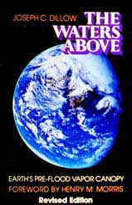
Evangelicals Differ
OTS 34
Reasons to Believe
Hugh Ross
Walt Brown
Old Earth
Progressive Creation
Mid-East Flood
Rain waters
reasons.org
godandscience.org
creationscience.com
Institute for Creation Research
Henry/John Morris, Duane Gish
Joseph Dillow, Ken Ham
Young Earth
24-hour Creation Days
Universal Flood
Vapor canopy
answersingenesis.org
genesispark.org
icr.org critiques Ross at:
icr.org/pubs/imp/imp-217.htm

Slide 50
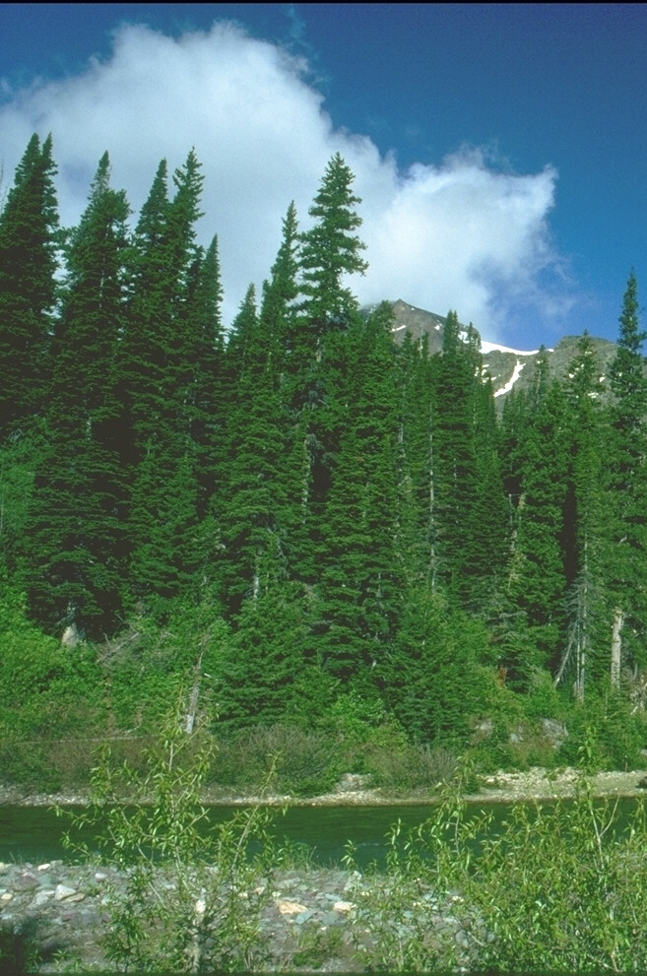
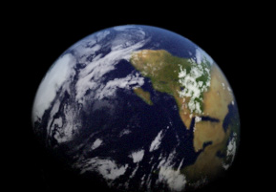
Two Accounts of Creation
Genesis 1
Genesis 2
Use of "God" (Elohim)
Days 1-6
Creation of Everything
"In the beginning…"
Use of "LORD" (Yahweh)
Day 6 alone
Creation of Adam & Eve
"These are the (toledot) generations…" (11x)
Notes:
But the Bible has a much greater view of man. Last week we saw Genesis 1 showed God creating everything in the beginning.
The next chapter zeros in on day 6 where Adam and Eve were created.

Slide 51
Black

Slide 52


OT Backgrounds link at BibleStudyDownloads.org
Get this presentation for free!
Notes:
NT Survey (ns)

