Slide 1
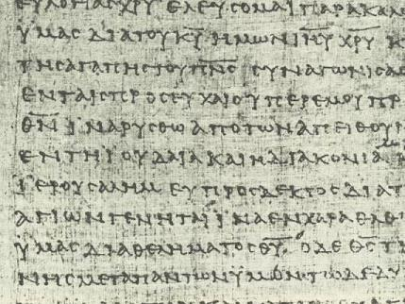
Covenants
Ancient & Modern
Dr. Rick Griffith • Jordan Evangelical Theological Seminary • BibleStudyDownloads.org

Slide 2
Types of Covenants
37
Covenants
Conditional
Unconditional
Thought Question for Small Groups:
Does God consider marriage a conditional or unconditional covenant?

Slide 3
Types of Covenants
37
Covenants
Conditional
Unconditional
Suzerain-Vassal | Royal Land Grant

Slide 4
Types of Conditional Covenants
38
Conditional
Verbal
Handshake
Sandal
Written
Parity (equals)
Suzerain-Vassal

Slide 5
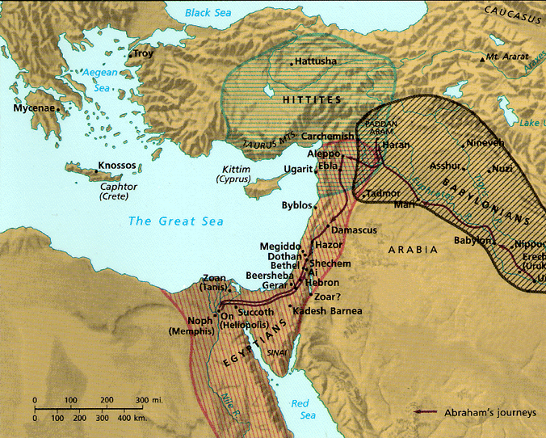
Ancient Covenants
38
Suzerain-Vassal
Parity
Hiram of Lebanon covenanted with Israel to build the temple (1 Kings 5:1)
Hittites were fierce “lords” (suzerains) who forced servant (vassal) nations to submit to their rule

Slide 6
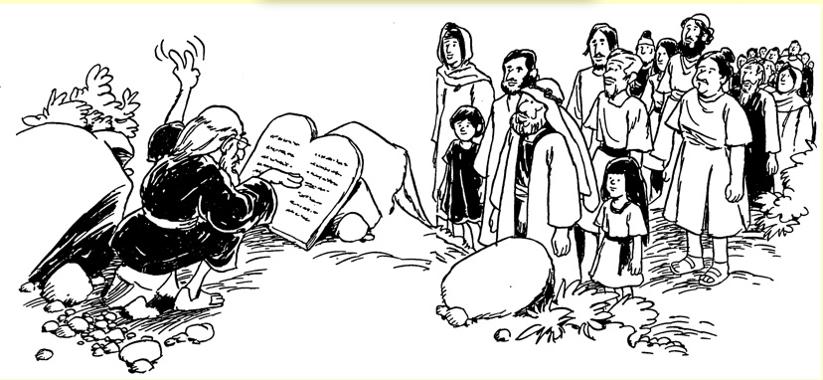
Deuteronomy
39
The language and structure of Deuteronomy is too advanced for Moses to have written it in the 15th century BC, so it must have been written much later by others in the 8th century BC under King Josiah
--claim of critical scholars in the 1800s
Renewal of the Mosaic Covenant

Slide 7
Suzerain-Vassal Format
40
Element
Explanation
Parallel in Deuteronomy
1. Preamble
Introduction to the treaty
Introduction: Historical Setting / Moses as Covenant Mediator (1:1-4)
2. Historical Prologue
History of the king's dealings with the vassal
Sermon #1: Historical Prologue
(1:5—4:43)
3. General Stipulation
Call for wholehearted allegiance to the king
Sermon #2: Covenant Obligations
(4:44—11:32)
4. Specific Stipulations
Detailed laws required of vassal to show allegiance
Sermon #2 cont'd: Specific Laws
(Chs. 12—26)

Slide 8
Suzerain-Vassal Format
40
Element
Explanation
Parallel in Deuteronomy
5. Divine Witnesses
Deities called to witness the treaty
Heaven & earth witness since no deities exist (4:26; 30:19; 31:28; 32:1)
6. Blessings & Curses
Results for obeying or disobeying the treaty
Sermon #3: Blessings & Curses
(Chs. 27—28)
Sermon #4: Covenant Summary
(Chs. 29—30)
Narrative / Sermons: Transition of the Covenant Mediator from Moses to Joshua
(Chs. 31—34)

Slide 9
Types of Covenants
41
Covenants
Conditional
Unconditional
Suzerain-Vassal | Royal Land Grant

Slide 10
Genesis 12:1-3
7
Genesis 12
The Lord had said to Abram,
“Leave your country, your people and your father's household, and go to the land I will show you.
1
“I will make you into a great nation
and I will bless you;
I will make your name great,
and you will be a blessing.
2
ABRAHAM
The CALL
I will bless those who bless you,
and whoever curses you I will curse;
and all peoples on earth
will be blessed through you.”
L - S - B
3
Handbook pg. 19-24
13
2

Slide 11
Three Promises
7
Genesis 12
The Lord had said to Abram,
“Leave your country, your people and your father's household, and go to the land I will show you.
1
A LAND
“I will make you into a great nation
and I will bless you;
I will make your name great,
and you will be a blessing.
2
A SEED
ABRAHAM
The CALL
I will bless those who bless you,
and whoever curses you I will curse;
and all peoples on earth
will be blessed through you.”
L - S - B
3
A BLESSING
Handbook pg. 19-24
14
2

Slide 12

Unconditional Nature
7
ABRAHAM
ABRAHAM
ca. 2000 B.C.
The CALL
AC
L - S - B
AJMJ
Gen. 12:1-3
A LAND
A SEED
ABRAHAM
The CALL
L - S - B
A BLESSING
AN UNCONDITIONAL PROMISE LATER TO BECOME A LEGAL COVENANT!
Handbook pg. 19-24
13
Notes:
Now…on ABRAHAM'S file folder, add the letters...L...S...B...standing for the words: LAND...SEED...AND BLESSING. Here is the significance of those words. Right there in the book of Genesis, 12th Chapter, verses 1-3, God makes THAT UNCONDITIONAL COVENANT PROMISE to Abraham…later to become an actual legal contract in the culture of that day!

Slide 13

Abrahamic Covenant
41
I will make you a great nation
and I will bless you.
I will make your name great,
and you will be a blessing.
I will bless those who bless you,
and whoever curses you I will curse;
and all peoples on earth
will be blessed in you" (Gen. 12:2-3)

Slide 14
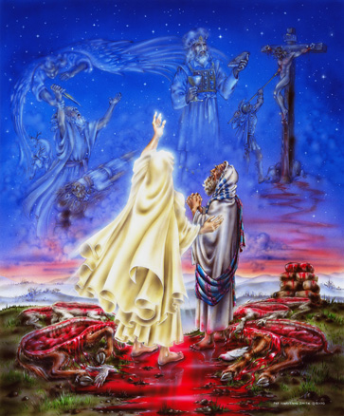
ROYAL LAND GRANT FORM OF THE ABRAHAMIC COVENANT
42
This painting inaccurately depicts Abram walking through the pieces

Slide 15
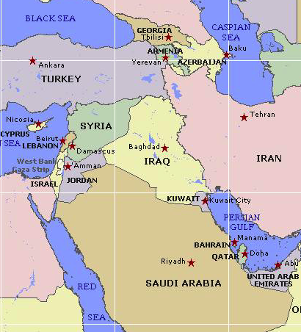

Borders of the Land Promised to Abraham
44
Genesis 15:18
"On that day the LORD made a covenant with Abram, saying, 'To your offspring I give this land, from the river of Egypt to the great river, the river Euphrates'" (ESV)

Slide 16
Abrahamic Covenant Promises
7
Abrahamic Covenant
Gen. 12:1-3
LAND SEED BLESSING
ABRAHAM
The CALL
L - S - B
12:1
12:2
12:3
“L-S-B”
Handbook pg. 19-24
15

Slide 17

Types of Unconditional Covenants
43
Abrahamic
Land
Davidic
New
Land | Seed | Blessing
Physical | Political | Spiritual
Deut. 30:1-10 | 2 Sam. 7:12-16 | Jer. 31:31-34

Slide 18

Literal * Eternal * Unconditional
Gen. 13:15; Gen. 15
7
Abrahamic Covenant
Gen. 12:1-3
LAND SEED BLESSING
ABRAHAM
The CALL
L - S - B
• LITERAL
• ETERNAL
• UNCONDITIONAL
Handbook pg. 19-24
16
3

Slide 19
Deuteronomy 30:1-4
44
7
EXILE & RETURN PROMISED
¹ When all these blessings and curses I have set before you come upon you and you take them to heart wherever the Lord your God disperses you among the nations, ²and when you and your children return to the Lord your God and obey him with all your heart and with all your soul according to everything I command you today, ³then the Lord your God will restore your fortunes and have compassion on you and gather you again from all the nations where he scattered you. ⁴Even if you have been banished to the most distant land under the heavens, from there the Lord your God will gather you and bring you back (NIV).
27

Slide 20
Deuteronomy 30:5-6
44
7
THE LAND PROMISES
⁵ He will bring you to the land that belonged to your fathers, and you will take possession of it. He will make you more prosperous and numerous than your fathers.
⁶ The Lord your God will circumcise your hearts and the hearts of your descendants so that you may love him with all your heart and with all your soul, and live. (NIV)
MOSES
Exodus
Sinai
M - C - C
Kadesh Barnea
40
40
5 Sermons
Handbook pg. 26-29
27

Slide 21
Palestinian Covenant
7
43
Abrahamic Covenant
Gen. 12:1-3
LAND SEED BLESSING
MOSES
Exodus
Sinai
Israel
M - C - C
Kadesh Barnea
40
40
5 Sermons
Deut. 30:1-10
Handbook pg. 26-29
28

Slide 22
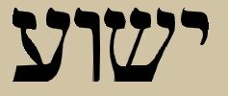
Yeshua: The Hebrew Word for Jesus
Jesus Christ is the focal point of the covenant with Abraham

Slide 23
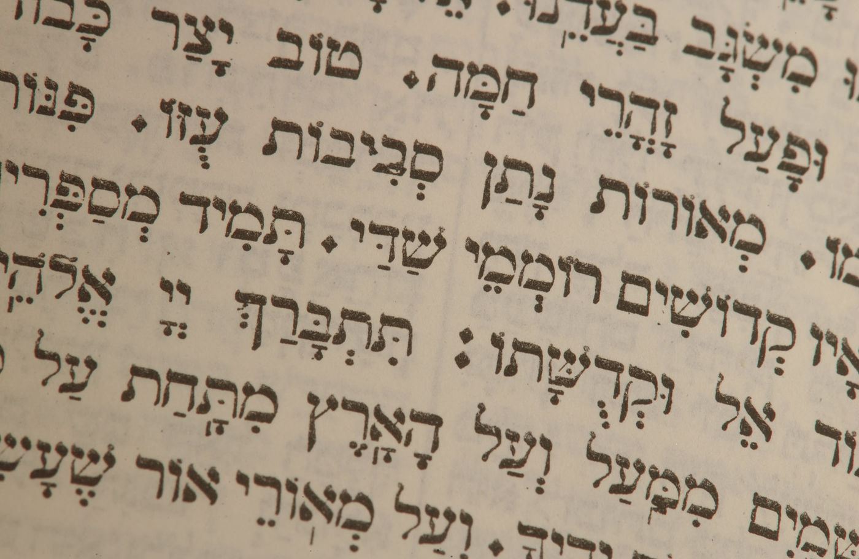
Promised Seed
David met the lineage requirements of
the Judah's line (Genesis 49:10;
Number 24:17)

Slide 24

The Lineage of
David
ABRAHAM
Isaac
Jacob
Judah
Perez
Hezron
Ram
Amminadab
Nahshon
Salmon
Boaz
Obed
Jesse
DAVID

Slide 25

Promises of the Davidic Covenant
45
What did God promise David in 2 Samuel 7:12-16?
New Dynasty
(2 Sam 7)

Slide 26
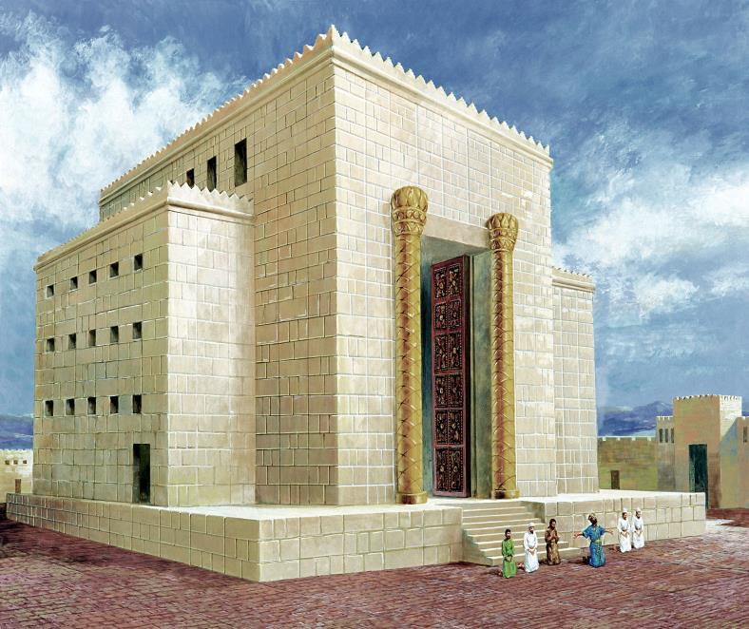


David's Temple
D
A
V
I
D

Slide 27
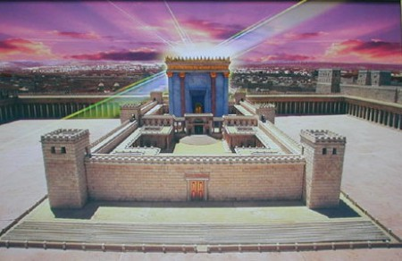
But who would build the Temple ?

Slide 28
Davidic Covenant
2 Samuel 7:12-16
And when your days are fulfilled and you sleep with your fathers, I will set up after you YOUR OFFSPRING who shall be born to you, and I will establish HIS KINGDOM.
He shall build a house for My Name [and My Presence], and I will establish the THRONE of HIS KINGDOM FOREVER.
I will be his Father, and he shall be My son. When he commits iniquity, I will chasten him with the rod of men and with the stripes of the sons of men.
But My mercy and loving-kindness SHALL NOT DEPART from him, as I took [them] from Saul, whom I took away from before you.
And your house and your kingdom shall be made sure forever before you; YOUR THRONE shall be ESTABLISHED FOREVER.

Slide 29
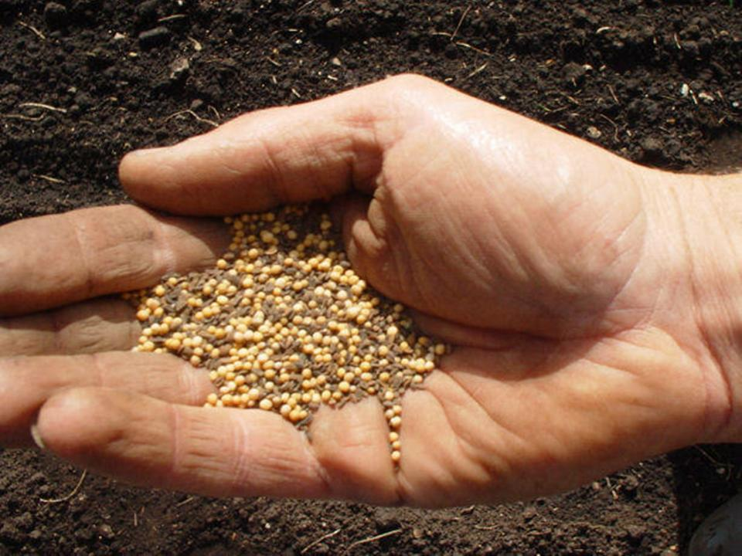
The Davidic Covenant is…
a continuation of the Seed aspect of the
Abrahamic Covenant and the promise
that Kings would come from Abraham
(Genesis 17:6-7)

Slide 30

How does the Davidic Covenant relate to Jesus?

Slide 31

Jesus is the Promised
Son Of David
46
Nine times Jesus is called "son of David" in Matthew (compared to twice in Mark and Luke and none in John). David is referred to 59 times in the New Testament (NIV) but none of them connect the present session of Christ with the Davidic throne.
Jesus' birthplace, Bethlehem, is called "the city of David" (Matthew 2:1; 1 Samuel 20:6)

Slide 32
Kingdom & Covenants Timeline
50
9g
Dr. Rick Griffith • Singapore Bible College • BibleStudyDownloads.org
Kingdom Teaching...
Adam rules with God (Gen. 1:26, 28; 2:19)
Satan begins rule as god of this world (Gen. 3:15;
2 Cor. 4:4)
God covenants with Abraham to reestablish man's rule via Israel as a "kingdom of priests" (Gen. 12:1-3; Exod. 19:6)
Israel's failure to witness to nations as a kingdom of priests is judged via exile under foreign rule
Israel rejects Messiah's offer of kingdom (Matt. 12:41-42; 23:37-39)
Jesus extends His kingdom in mystery form to the Church (Matt. 13)
Christ subdues Israel's enemies and nation believes (Rom. 11:26-27)
Christ rules over everything with saints (Eph. 1:9-10; Rev. 20:1-6; 22:5b)
Fall of Man (Gen. 3)
Noahic Covenant
Genesis 6:18; 9:8-17
Land Covenant
ISRAEL
CHURCH
MESSIANIC KINGDOM
(National Focus)
The "New Man" (Eph. 2:15)
Millennial Eternal
land
Genesis 15:18 (cf. Deut. 30:1-10) promises:
Land from Wadi of Egypt to Euphrates River (Isa. 27:12)
Eternal possession of land (Gen. 17:8) after exile/restoration
Whole world blessed via the land (Isa. 14:1-2)
Israel judged for rejecting Messiah by dispersion away from land for 19 centuries
(AD 70–AD 1948) but now partially restored (Ezek. 37:1-7)
Full restoration (Ezek. 37:8-28) Jerusalem world capital
(Isa. 2:1-5)
New Jerusalem
(Rev. 21–22)
Davidic Covenant
Christ is Head over His Church, which is a spiritual temple (Eph. 2:19-22; 2 Cor. 6:16)
Christ reigns over the world
(Isa. 11)
with saints (Rev. 5:10; 20:4-6)
Christ hands kingdom over to Father (1
Cor. 15:24)
Genesis 12:1-3
2 Samuel 7:12-16 promises:
Sons ("house" never wiped out)
Kingdom (political dynasty)
Throne (right to rule by descendants)
Temple (son to build it)
seed
Abrahamic Covenant
New Covenant
All
things made new!
(Rev. 21:5)
All 5 elements fulfilled in national restoration (Zech. 8)
Jeremiah 31:31-34 promises:
Forgiveness
Indwelling Spirit
New heart, nature, mind
Reunification of Israel and Judah
No need for evangelism
Mosaic Law replaced with first three elements of the New Covenant (Luke 22:20; 2 Cor. 3:6)
blessing
Mosaic Covenant
Law abolished, fulfilled, and replaced at the cross (Rom. 7:1-6;1 Cor. 9:19-21; Heb. 8:13)
Eighth Edition
29 Aug 2016
Temporary (Gal. 3:19) and conditional (Deut. 28) to reveal sin (Rom. 7:7) and regulate Israel (Gal. 3:23-25)
Scripture has a dual kingdom-covenant theme. Israel's role from Abraham to Christ expands to include the Church (continuity) yet the Church never replaces the nation as the "new Israel" (discontinuity). Israel will again enjoy world prominence after trusting Christ at His second coming.
Notes:
Slides 13 and 127 repeated

Slide 33
Promises of the Davidic Covenant
45
What did God promise David in 2 Samuel 7:12-16?
Sons: "house" never wiped out
Kingdom: political dynasty (each Jerusalem king will be one of his direct descendants)
Throne: As an eternal covenant (v. 16), the right to rule will remain with his family forever
Temple: Solomon will build it
Discipline: God will punish disobedient kings but still unconditionally keep these promises
New Dynasty
(2 Sam 7)

Slide 34

The New Covenant
47
Jeremiah 31:31-34
³¹“The time is coming,” declares the LORD, “when I will make a new covenant with the house of Israel and with the house of Judah.
³²It will not be like the covenant I made with their forefathers when I took them by the hand to lead them out of Egypt, because they broke my covenant, though I was a husband to them,” declares the LORD.
³³“This is the covenant I will make with the house of Israel after that time,” declares the LORD.

Slide 35
The New Covenant
47
Jeremiah 31:31-34
^{33b} “I will put my law within them, and I will write it on their hearts. And I will be their God, and they shall be my people. And no longer shall each one teach his neighbor and each his brother, saying, 'Know the LORD,' for they shall all know me, from the least of them to the greatest, declares the LORD. For I will forgive their iniquity, and I will remember their sin no more.”

Slide 36
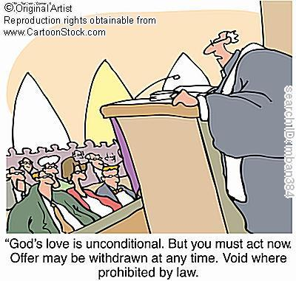
Unconditional Nature
47
Eternal (Jer. 31:36, 40; 32:40; 50:5; Isa 61:2. 8-9; 24:5; Ezek. 37:26)
Amplification of the Abrahamic Covenant, which is unconditional
Unqualified “I will” statements of God
Notes:
How did we know that it was unconditional?

Slide 37

Provisions
47
FULFILLED
Indwelling of the Holy Spirit
(Jer. 31:33 with Ezek. 36:27)
New nature, heart & mind
(Jer. 31:33; Isa. 59:21)
Forgiveness of sins
(Jer. 31:34b)
NOT YET FULFILLED
Everyone will know the Lord
(Jer. 31:34a)
Israel and Judah will be reunited (Jer. 31:31)
Notes:
There are debates that exist about the how far or when or to whom the covenant refers to. This is because Jeremiah 31 declares the covenant is for Israel and Judah but in the new testament. (Luke 22:20; 1 Cor 11:25; 2 Cor.3:6; Heb 8:8;9:15 ) it is declared for the church.
.
So questions arise if is there a new covenant? Is it especially for the church? Or is it only for Israel? Or was there two covenants? Or are these promises built upon each other?

Slide 38
How to Reconcile?
Jeremiah 31:31-34 (for Israel)
'everlasting covenant'
'a new heart'
'a new spirit'
'a covenant of peace'
'a covenant'
Luke 22:20 (for church)

Slide 39

Views on the Time of Fulfillment
47
Amillennialists often say all of the provisions of the New Covenant are being realized now in the church which they consider the “new Israel.” But are they?
1. Partial Fulfillment in the present church age
Only one New Covenant for Israel (Darby)
Two New Covenants: one for Israel and one for the church (Chafer)
One New Covenant with a two fold- application: primarily to Israel, secondarily to the Church
2. Complete fulfillment after the return of Christ
Notes:
Ignores NT, Christ's words, Paul's teachings
Ignore present work of the Holy Spirit cue cards
1)Cannot reconcile same terminology for OT and NT covenants.
2) The distinctions are too sharp.
View most modern pre-mils take. Deals with both OT/NT data, forgiveness and the holy spirit are blessings that we experience now.
Ignoring OT data between the distinctions between church and Israel

Slide 40
Views on New Covenant Fulfillment
View | Explanation | School & Scholars | Problems
Restated Mosaic | No New Covenant | Critical: –Couturier –Duhm –Schmidt –Potter | 1. OC/NC distinctions in text ignored 2. OC=conditional, NC=unconditional 3. OC=temporal, NC=eternal 4. OC=external, NC=internal 5. OC=no enablement, NC=enablement 6. NC=peace, prosperity, sanctuary, Spirit (parallel passages)
Church Alone | No Israel Participation | Amillennial/ Postmillennial: –Allis –Cox –Smick –Boettner | 1. Ignores OT data by equating Israel & the Church 2. NC introduced ≠ fulfilled to Israel 3. Present need to know YHWH (we still need to obey the Great Commission) 4. AD 70 Jerusalem vs. Jer. 31:40
48

Slide 41
Views on New Covenant Fulfillment
View | Explanation | School & Scholars | Problems
Israel Alone | No Church Participation | Misc/Classical Dispensational: –Darby – Thompson –von Rad | 1. Ignores NT data –Christ's Last Supper words –Paul's statements –Hebrews application to Church 2. Ignores present work of Spirit
Two New Covenants | NC for Israel + NC for Church | Early 1900s Dispensational: –Chafer –Walvoord (old) –Ryrie (old) | 1. Same terminology for OT & NT NCs 2. Israel/Church distinction too sharp 3. Basis of forgiveness the same 4. If 2 NCs then no OC for Church 5. Church doesn't possess Israel's promises
48

Slide 42
My View on New Covenant Fulfillment
View | Explanation | School & Scholars | Problems
Church Participa-tion | Primarily for Israel Secondarily for the Church | Misc/Present Dispensational: –Keil –Lemke –Bright –Scofield –Walvoord (DTS) –Ryrie (DTS) –Archer (TEDS) –Kaiser (TEDS) | Support: 1. Primary fulfillment is future–Rom 11 2. Deals with both OT & NT data 3. Forgiveness & the Spirit are blessings experienced now 4. NC has new law 5. Rebuttals to above views
48

Slide 43
Kingdom & Covenants Timeline
50
9g
Dr. Rick Griffith • Singapore Bible College • BibleStudyDownloads.org
Kingdom Teaching...
Adam rules with God (Gen. 1:26, 28; 2:19)
Satan begins rule as god of this world (Gen. 3:15;
2 Cor. 4:4)
God covenants with Abraham to reestablish man's rule via Israel as a "kingdom of priests" (Gen. 12:1-3; Exod. 19:6)
Israel's failure to witness to nations as a kingdom of priests is judged via exile under foreign rule
Israel rejects Messiah's offer of kingdom (Matt. 12:41-42; 23:37-39)
Jesus extends His kingdom in mystery form to the Church (Matt. 13)
Christ subdues Israel's enemies and nation believes (Rom. 11:26-27)
Christ rules over everything with saints (Eph. 1:9-10; Rev. 20:1-6; 22:5b)
Fall of Man (Gen. 3)
Noahic Covenant
Genesis 6:18; 9:8-17
Land Covenant
ISRAEL
CHURCH
MESSIANIC KINGDOM
(National Focus)
The "New Man" (Eph. 2:15)
Millennial Eternal
land
Genesis 15:18 (cf. Deut. 30:1-10) promises:
Land from Wadi of Egypt to Euphrates River (Isa. 27:12)
Eternal possession of land (Gen. 17:8) after exile/restoration
Whole world blessed via the land (Isa. 14:1-2)
Israel judged for rejecting Messiah by dispersion away from land for 19 centuries
(AD 70–AD 1948) but now partially restored (Ezek. 37:1-7)
Full restoration (Ezek. 37:8-28) Jerusalem world capital
(Isa. 2:1-5)
New Jerusalem
(Rev. 21–22)
Davidic Covenant
Christ is Head over His Church, which is a spiritual temple (Eph. 2:19-22; 2 Cor. 6:16)
Christ reigns over the world
(Isa. 11)
with saints (Rev. 5:10; 20:4-6)
Christ hands kingdom over to Father (1
Cor. 15:24)
Genesis 12:1-3
2 Samuel 7:12-16 promises:
Sons ("house" never wiped out)
Kingdom (political dynasty)
Throne (right to rule by descendants)
Temple (son to build it)
seed
Abrahamic Covenant
New Covenant
All
things made new!
(Rev. 21:5)
All 5 elements fulfilled in national restoration (Zech. 8)
Jeremiah 31:31-34 promises:
Forgiveness
Indwelling Spirit
New heart, nature, mind
Reunification of Israel and Judah
No need for evangelism
Mosaic Law replaced with first three elements of the New Covenant (Luke 22:20; 2 Cor. 3:6)
blessing
Mosaic Covenant
Law abolished, fulfilled, and replaced at the cross (Rom. 7:1-6;1 Cor. 9:19-21; Heb. 8:13)
Eighth Edition
29 Aug 2016
Temporary (Gal. 3:19) and conditional (Deut. 28) to reveal sin (Rom. 7:7) and regulate Israel (Gal. 3:23-25)
Scripture has a dual kingdom-covenant theme. Israel's role from Abraham to Christ expands to include the Church (continuity) yet the Church never replaces the nation as the "new Israel" (discontinuity). Israel will again enjoy world prominence after trusting Christ at His second coming.
Notes:
Slides 13 and 127 repeated

Slide 44
Contrasting the Covenants (2 Cor. 3–4)
166c
Old Covenant | New Covenant
initiated by Moses (3:8) | initiated by Christ (3:4)
of the letter (3:6a) | of the Spirit (3:6a, 18b)
kills (3:6b, 7a) | gives life (3:6b)
engraved on stone (3:3b, 7a) | engraved on hearts (3:3b; Jer. 31:33
glorious (3:7a) | more glorious (3:8, 10)
glory faded (3:7b, 11a, 13b) | glory ever-increases (3:11b, 18)
condemns men (3:9a) | brings righteousness (3:9b)
deception (3:13) | boldness (3:12)
veiled face of Moses (3:13b) | unveiled faces (3:13a, 18a)
veiled minds (3:14a) | unveiled minds (3:14b; 4:3-6)
veiled hearts (3:15) | unveiled hearts (3:16)
dullness (3:14a) | freedom (3:17)
Moses reflected God's glory | all believers reflect Christ's glory (3:17)
non-transforming (3:7) | transforming (3:18)
lack of zeal (3:13) | confidence, steadfastness (3:4-5; 4:1)
deception (3:13) | sincerity (4:2)

Slide 45


Contrasting Two Key Covenants
51
Abrahamic
Mosaic
Gen. 12:1-3
Exod. 20–31
“I will”
“If you will”
Unconditional
Conditional

Slide 46
Contrasting Two Key Covenants
51
 | Abrahamic | Mosaic
Recipient (Date & Place) | Abraham as mediator for all nations in 2060 BC at Ur of the Chaldees | Moses as mediator for Israel in 1445 BC at Mount Sinai
Scripture | Genesis 12:1-3 (but formalized into a covenant in Genesis 15) | Exodus 20–31 is the heart of the covenant
Between God & | A person (for a future nation) | A nation
Scope | Universal (“all peoples will be blessed through you”) | Only Israel received the Law (Deut. 4:8; Ps. 147:20)

Slide 47
Contrasting Two Key Covenants
51
 | Abrahamic | Mosaic
Promises | Land, seed, and blessing (without indication of time of fulfillment) | Blessing for obedience and cursing for disobedience (Lev. 26; Deut. 28)
Conditions | Unconditional: “I will…” | Conditional: “If you will…then I will…”
Partici-pation | Abraham asleep (Gen. 15:17) | Israel agreed to obey (Exod. 19:8)
Analogy | Father to son (royal grant) | Suzerain (superior king) to vassal (servant nation)

Slide 48
Contrasting Two Key Covenants
51
 | Abrahamic | Mosaic
Form | Oral (no written stipulations) | Written on tablets of stone & Pentateuch
Emphasis | Blessing over discipline/judgment (five “blessings” in Gen. 12:1-3) | Judgment/discipline over blessing (contrast Deut. 28:1-14 & 28:15-68)
Christology | Ultimate seed (Gen. 12:3) | Typified in tabernacle (Heb. 8–10)
Sign | Circumcision (Gen. 17:11) | Sabbath (Exod. 31:13, 17)

Slide 49
Covenant Comparisons
52
There are only 4 key eschatological covenants in Scripture. They share these traits in common:
1. Unconditional
2. Eternal
3. Partially & spiritually fulfilled at present
4. Fully & literally fulfilled in the future
5. Universal in scope

Slide 50
Covenant Contrasts
52
Abrahamic
Land
Davidic
New
Definition:
God's promise to give Israel…
land, rule, and blessing to benefit the world
physical land from the Wadi of Egypt to the Euphrates River (Gen. 15:18)
political rule
of a descendant of David forever from Zion
spiritual blessings of national cleansing and restoration
Relationship
Umbrella
Land
Seed
Blessing
Key Text
Gen. 12:1-3
Deut. 30:1-10
2 Sam. 7:12-16
Jer. 31:31-34
Recipient
Date
Place
Abraham
2060 BC
Ur of Chaldees
Moses
1445 BC
Mt. Sinai
David
1004 BC
Jerusalem
Jeremiah
595 BC
Jerusalem
Personal Blessings
to First
Recipient
Possessions & name blessed, son, opposers disciplined
Privilege of seeing Canaan from afar
Sons (“house”) never wiped out (Matt. 1:1-17)
—

Slide 51
Covenant Contrasts
52
Abrahamic
Land
Davidic
New
National
Blessings
A great nation would come from Abraham
Reproof (exile)
Regathering
Reunited
(Isa. 11:11-16)
Repentance
Restored land
prosperity
Temple (via son)
Righteous king to rule (a Davidic descendant) over a kingdom where Israel prominent (Isa. 11:1-5)
Reuniting of Israel
and Judah
Forgiveness
Indwelling Spirit
New heart
100% Christian
(Ezek. 36:25-38)
Universal
Blessings
All nations blessed through Christ
World blessed via visiting Jerusalem (Zech. 14:16-19)
Kingdom (political rule over entire world)
All the world evangelised
Present (Partial) Fulfillment
Church as spiritual seed of Abraham (Gal. 3:5)
Regathering & rebirth of modern Israel (Ezek. 37:7-8)
Church as spiritual temple & Christ awaits rule
Law abolished, forgiveness, new nature and Spirit indwelling
Future
(Full)
Fulfillment
All 4 covenants fulfilled in the millennial kingdom
Israel given full borders (Ezek. 37:8-28; 47–48)
Christ rules world (Isa. 2, 11) with saints (Rev. 5:10)
World 100%
Christian and Israel/Judah reunited

Slide 52
Signs of the Covenants
53
Covenant | Definition | Promise | Fulfillment | Sign
Noahic | Unconditional promise not to flood earth again | Gen. 9:12-17 | No more sea (Rev. 21:1) | Rainbow (Gen. 9:12-17)
Abrahamic | Promise to provide Israel a land, rule, and spiritual blessing | Gen. 12:1-3; 15:13-18 | Continues at present (Gal. 3:17) but Israel still has a future (Rom. 11:25-27) | Circumcision (Gen. 17:11)
Mosaic | Conditional stipulations for blessing on Israel | Exod. 19-31; Deut. 28 | Death of Christ (Rom. 7:4-6) | Sabbath (Exod. 31:13)
Land | Promise of physical land from the Wadi of Egypt to the River Euphrates | Deut. 30:1-10 | Land blessed (Amos 9:13-15) | No sign (that I know of)
Davidic | Promise of eternal, political rule of a descendant of David | 2 Sam. 7:12-17 | Rule renewed (Amos 9:11-12) | Christ seated at the Father's right hand (Acts 2:34-36)
New | Promise of spiritual indwelling of the Spirit (“law written on hearts”), forgiveness, and total evangelization of Israel | Jer. 31:31-34 | Paul & the Apostles (2 Cor. 3–4) All Israel saved (Rom. 11:26-27) | Cup of the Lord's Supper (Luke 22:20; 1 Cor. 11:25)

Slide 53
Deuteronomy (previous outline)
39

Slide 54
Deuteronomy (previous outline)
39

Slide 55
Deuteronomy (previous outline)
39

Slide 56
Black

Slide 57


OT Backgrounds link at BibleStudyDownloads.org
Get this presentation for free!
Notes:
OT Backgrounds (ob)

