Slide 1
UNLOCKING THE MYSTERIES OF OLD TESTAMENT CHRONOLOGY
70d
“Chronology is the backbone of history.”
– Edwin Thiele
Dr. Rick Griffith • Jordan Evangelical Theological Seminary • BibleStudyDownloads.org

Slide 2
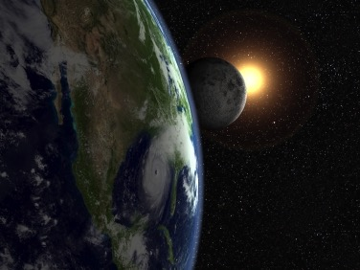

Genesis 5 Small Group Questions
How old was Adam when he died?
How old was the earth when Adam died?
On what basis did you answer the above?

Slide 3
Our Questions
70d
WHY ARE WE DOING THIS TOPIC???!
How do all the dates and genealogies in the Bible relate to us today?
Are all those numbers and genealogies we find in the Bible historically reliable?
Could mistakes have been made when the numbers were transmitted?
Can we reasonably say that the Bible is God's inerrant word with respect to chronology?

Slide 4
Our Method of Investigation
70d
Research key chronological problems of the genealogies, the patriarchs, the exodus, the judges and kings of Israel
Examine the issues, arguments and various solutions proposed
Come to our own conclusions based on biblical tenets and logical reasoning
Consider how our findings and conclusions apply to our lives

Slide 5

Genealogies & OT Chronology
Genesis 5 & 11
Dr. Rick Griffith • Jordan Evangelical Theological Seminary • BibleStudyDownloads.org
Notes:
CR-30-Gen_5_and_11_Genealogies-52_eng_cr_9230_v10-slide 1
OB-20-Chronology-124_eng_ob_7633_v7-Slide 5
OC-10-Gen_5_and_11_Genealogies-52_eng_oc_9230_v10-slide 1

Slide 6
What is OT Chronology?
38
The arrangement of OT events in time, including their dates and correlation with secular history
Purpose: To determine the correct dates of events and persons in the OT as precisely as possible

Slide 7
Why is the Chronology of the OT important?
It describes the building of the nation of Israel, a country with timeless significance
It fits OT events into the extra biblical records of the Near Eastern world
It helps give confidence in the historicity and reliability of the Bible
It builds faith in God and His message

Slide 8
How do Historians Determine the Chronology of the OT?
Sources
The Bible (genealogies, ages, lengths of reigns, time spans, synchronisms with events of other countries)
Historical records of the Ancient Near East (ANE)
Astronomical data
Material remains and archaeological findings
Records of contemporary historians

Slide 9
How do historians determine OT Chronology?
Methods
General: Examine the milieu of the time and compare with other known records to find compatibilities
Establish sequence and time according to Bible
Compare synchronic events in Bible and another reliable source
Verify with other sources
Work from established dates

Slide 10
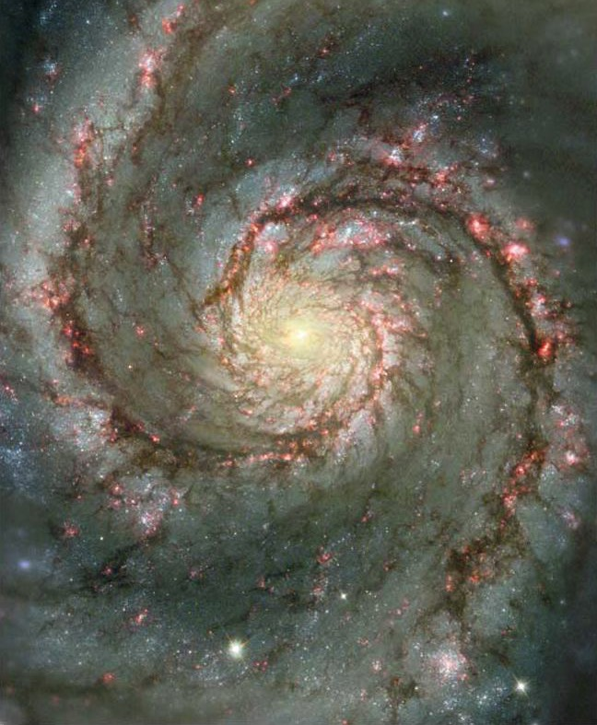
Genesis Questions
Beginnings
When did the creation occur?
Did the patriarchs really live that long?
©2003 TBBMI
7.5.03a.
18

Slide 11

Oh, no… I hit the geneaologies
in my read-through-the-Bible program again…

Slide 12

What’s the point?
GENEALOGY

Slide 13

What’s the point?
Genealogies can help you catch up on your sleep?

Slide 14

Can We Find the Date of Creation from Genesis 5 & 11?
Some Say "No"
Other genealogies in the Bible have gaps (e.g., Matt. 1:1-17)
Therefore there must be gaps in Genesis
A "no gap" view puts the Flood at 2487 BC but Egypt's history goes back before 3300 BC
Others Say "Yes"
The other genealogies do not give the father's ages when their sons were born
God wants us to "mark seasons and days and years" (Gen. 1:14)
Why else would God give us the ages of these men?

Slide 15
The Mystery of the Genesis 5 & 11 Genealogies
Genesis 5 carries the genealogy that stretches from Adam to the Flood. Genesis 11 carries the genealogy from Shem (son of Noah) to Terah (father of Abram)
Can information found in the genealogies of Genesis 5 and 11 be used to determine the dates of certain events in history?

Slide 16
Genesis Genealogy Mysteries
Adam
Genesis 5
Noah
Shem
Genesis 11
Terah
Can these genealogies help determine the dates of events in history?

Slide 17

Genesis 5 Genealogy
38
Adam
Seth
Enosh
Kenan
Mahalalel
Jared
Enoch
Methuselah
Lamech
Noah

Slide 18

Why Don't Genesis 5 & 11 Have Gaps?
38
Adam
State lengths of time
Seth
Enosh
Kenan
Mahalalel
Jared
Enoch
Methuselah
Lamech
Noah

Slide 19
Age at Son's Birth
38
Adam-130
Seth-105
Enosh-90
Kenan-70
Mahalalel-65
Jared-162
Enoch-65
Methuselah-187
Lamech-122
Noah-500

Slide 20
Genesis 5 Age at Death
38
Adam
930
Seth
912
Enosh
905
Kenan
910
Mahalalel
895
Jared
962
Enoch
365
God took him without death
Methuselah
969
Lamech
777
Noah
950

Slide 21
Why Don't Genesis 5 & 11 Have Gaps?
38
Adam
State lengths of time
Shorter lengths
Seth
Enosh
Kenan
Mahalalel
Jared
Enoch
Methuselah
Lamech
Noah

Slide 22
Genesis 5 Shorter Than Luke 3
38
Adam
Adam
2006
yrs
Noah
4138
yrs
Christ

Slide 23
Why Don't Genesis 5 & 11 Have Gaps?
Adam
State lengths of time
Shorter lengths
Most natural
Show father-son
Jude 14
Similar ANE chronologies
Seth
Enosh
7
Kenan
Mahalalel
Jared
Enoch
"Enoch, in the seventh generation from Adam, prophesied saying. . . "
(Jude 14a, NASB)
Methuselah
Lamech
Noah

Slide 24
Two Views
Straight chronology
The Bible has the necessary data to map out the basic historical timeline of the OT
Genealogical gaps
There are gaps not mentioned in the Bible
Genealogical information should not be used as the only source for dating events

Slide 25
Arguments Posed for Gaps
It is normal for Scripture to pass over very long periods of time with little or no remark
Omission of unimportant names is the rule rather than the exception
In the ancient world "begat" simply indicated “became the ancestor of,” however far removed that ancestor was
Lack of harmony exists between OT chronologies and neighboring states

Slide 26
Straight Chronology Support
The Bible is filled with much chronological information though scattered in many places
When this chronological information is fully systematized, a straight chronology may be proven

Slide 27
How can you tell the age of the earth?
Just ask the only Eyewitness!

Slide 28

"Just do the math."
"God, how old is the earth?"

Slide 29

Chronology of the Patriarchs (Gen. 5, 11)
38-44
Event
Reference
AH
BC
World created
"God finished"
-6 days
4143
Adam created
"God created man"
0
4143
Seth born
"Adam was 130…"
130
4013
Enosh born
"Seth was 105…"
235
3908
Jacob & family go to Egypt
"Jacob age 130 at 400 years before Exodus in 1445 BC"
2298
1845

Slide 30
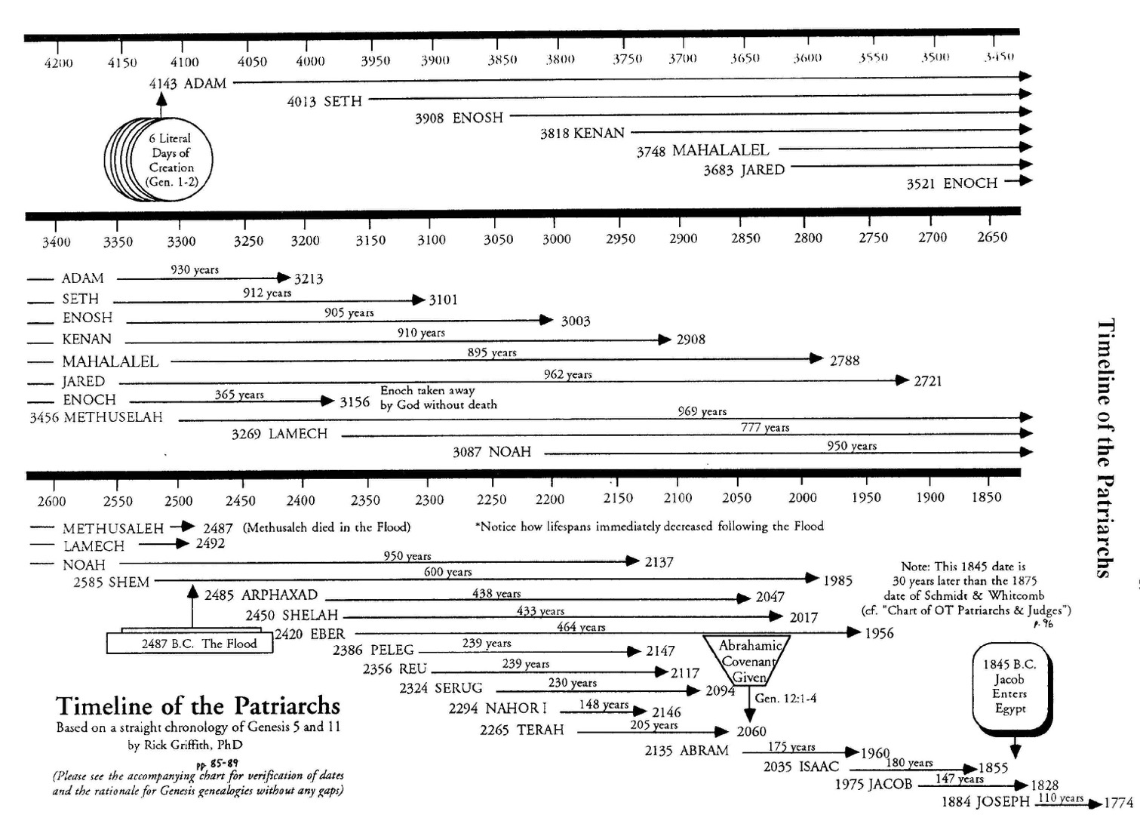
Methuselah's Death
44
Adam & Methuselah contemporaries
Adam probably told Methuselah the creation account, who told Shem, who told Abraham—only 3 retellings apart!
2487
A straight chronology works out exactly to show that Methuselah died in the year of the Great Flood!
2487
Methuselah & Shem contemporaries
Shem & Abraham contemporaries

Slide 31
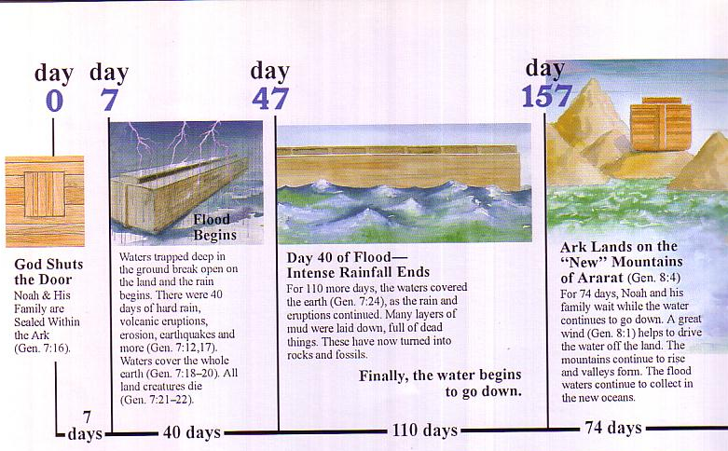
Flood Chronology
A “day” means a “day” in the Flood account.
Day
0
Day
7
Day
47
Day
157
Flood Begins
Waters trapped deep in the ground break open on the land in 40 days of hard rain with volcanic eruptions, erosion, earthquakes, and more （Gen 7：12，17）. Waters cover the whole earth (Gen 7:18-20). All land creatures die （Gen 7:21-22）.
Day 47 of Flood—Intense Rainfall Ends
For 110 more days, the waters cover the earth （Gen 7：24）, as the rain and eruptions continue. Many layers of mud laid down, full of dead things. They have now turned into rocks and fossils.
Finally, the water begins to go down.
Ark Lands on New Ararat Mountains （Gen 8：4）
For 74 days, Noah and his family wait while the water continues to go down. A great wind（Gen 8：1） helps to drive the water off the land. The mountains continue to rise and valleys form. The flood waters continue to collect in the new oceans.
God Shuts the Door
Noah and his family sealed within the ark（Gen 7：16）.
7
Days
40
Days
110
Days
74
Days

Slide 32
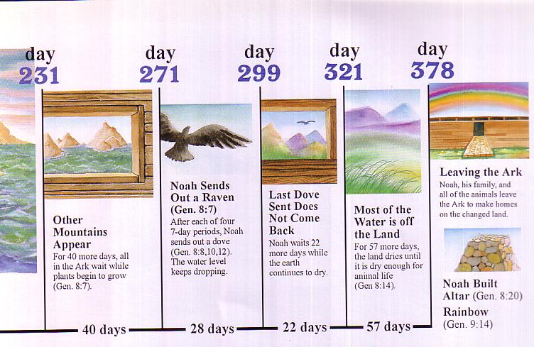
Flood Chronology
So why can’t a “year” mean a “year” in the genealogies?
Day
231
Day
271
Day
299
Day
321
Day
378
Leaving the Ark
Noah, his family and the animals leave the ark to make homes on the changed land.
Noah Sends Out a Raven （Gen 8：7） After each of four 7-day periods, Noah sends out a dove (Gen 8：8，10，12). The water level keeps dropping.
Most of the Water is Off the Land（Gen 8:14）.
For 57 more days, the land dries until it is dry enough for animal life (Gen 8:14).
Last Dove Sent Does Not Come Back
Noah waits 22 more days while the earth continues to dry.
Other Mountains Appear
For 40 more days, all in the ark wait while plants begin to grow （Gen 8:7）.
Noah Builds Altar （Gen 8：20）
Rainbow （Gen 9：14）
40
Days
28
Days
22
Days
57
Days

Slide 33
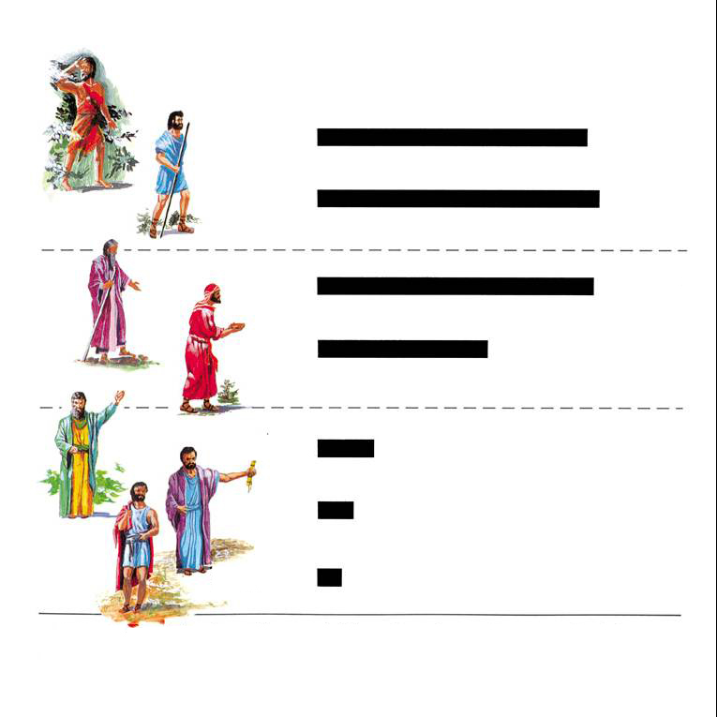
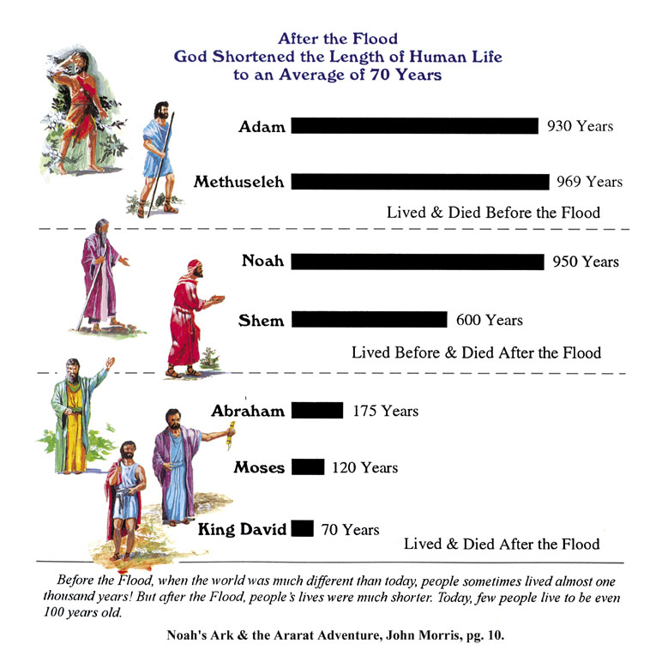

Patriarch's long lives
90
Ages of people when they died
Adam
930 Years
Methuselah
969 Years
Noah
950 Years
Shem
600 Years
The Flood explains why life spans shortened
Abraham
175 Years
Moses
120 Years
David
70 Years
Notes:
From John Morris, Noah's Ark and the Ararat Adventure, p. 10.

Slide 34
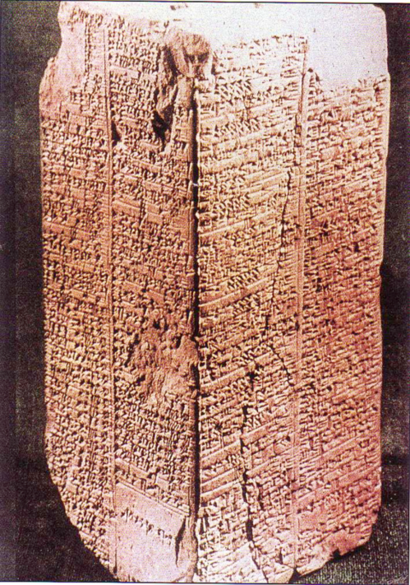
Sumerian King List
Inscribed about 1800 BC (about 600 years after the Flood)
Ten of these kings before the Flood are said to have lived between 21,000 to 43,200 years each
(cf. Gen. 5)
Arnold & Beyer, Readings from the ANE, 150
Notes:
See Clifford Wilson, The Stones Sill Shout, 25 and Arnold/Beyer, Readings from the ANE, 150.

Slide 35
Sumerian King List
OTB, 64a
“When kingship came down from heaven. . .
Alulim became king and reigned for 28,800 years…
Eight kings reigned for 241,000 years. Then the flood waters streamed over the earth.”
King & Years of Reign
Alulim 28,800
Alalgar 36,000
Enmenluanna 43,200
Enmengalanna 28,800
Dumuzi 36,000
Ensipazianna 28,800
Enmeduranna 21,000
Urbatutu 18,600
Total 241,000
Arnold & Beyer, Readings from the ANE, 150
Notes:
See Clifford Wilson, “The Stones Sill Shout p. 25 and Arnold/Beyer, “Readings from the ANE,” 150

Slide 36
Sumerian King List
None of us believe in kings who reigned 28,800 years, but it does show a belief in long ages and a worldwide flood.
Arnold & Beyer, Readings from the ANE, 150
Notes:
See Clifford Wilson, The Stones Sill Shout, 25 and Arnold/Beyer, Readings from the ANE, 150.

Slide 37
Sumerian King List
Kitchen, Reliability of the OT
How long did they really reign?
King & Years of Reign
Alulim 28,800
Alalgar 36,000
Enmenluanna 43,200
Enmengalanna 28,800
Dumuzi 36,000
Ensipazianna 28,800
Enmeduranna 21,000
Urbatutu 18,600
Total 241,000
The Math Kitchen
÷ 600 48
÷ 600 60
÷ 600 72
÷ 600 48
÷ 600 60
÷ 600 48
÷ 600 35
÷ 600 31
Total 402
Notes:
Kitchen proposes that each reign should actually be divided by 600 since the Sumerians invented the numbering system based on the number 6—as in our system of time that has the hour divided into 12 units, the 24-hour day, etc.”
““﻿That process can perhaps be reversed. Our scribes in 2000 B.C., faced with few kings and long periods, may have bumped up the numbers by using sexagesimal multipliers. So, at Hamazi and Uruk, reversing the process, we might take the 36,000 years of Alalgar or of Dumuzi and divide it by the factor 10 × 60 (600), which would give them each a reign of 60 years. Applied to Alulim’s (and others’) 28,800 years, he (and they) would have reigned 48 years; then Enmenduranna of Sippar at 21,000 years would have reigned 35 years. The mighty Enmenluanna at 43,200 years (the local Methuselah) would come out at 72 years — high but not impossible, even if it left Ramesses II (66 years) and Queen Victoria (64 years) just slightly jealous — but more modest than the 94 years of Pepi II, often granted. The more modest Ubartutu at 18,600 years comes out at 31 years, eminently reasonable. The principal works for all the preflood rulers, and no awkward fractions, etc., are left over. After the flood, reigns are still high, until suddenly Gilgamesh’s son Ur-nungal (no longer heroic?) reigns only 30 years, and all his successors are modest too, except in Kish (a special center of Sumerian kingship). Most of the “heroic” postflood kings may thus have been upped by only 60 years (not by 60 × 10). Thus Lugal-banda’s 1,200 years would then have been 20 years, and Enmebaragisi’s 900 years would have been 15 years. Those with 200 years down to 100 years may have had a factor of only 10 × years; but that is a baseless guess for now.”
—Kenneth A. Kitchen, On the Reliability of the OT (Grand Rapids, MI: Eerdmans, 2003), location 9647 of 14432 Kindle Ed.

Slide 38
Genesis 5 Age at Son's Birth
38
Adam-130
Seth-105
Enosh-90
Kenan-70
Mahalalel-65
Jared-162
Enoch-65
Methuselah-187
Lamech-122
Noah-500

Slide 39
Kitchen on Age at Son's Birth
Adam
130
÷ 5 =
26
Seth
105
÷ 5 =
21
Enosh
90
÷ 5 =
18
Kenan
70
÷ 5 =
14
Mahalalel
65
÷ 5 =
13
Jared
162
÷ 5 =
32
Enoch
65
÷ 5 =
13
Methuselah
187
÷ 5 =
37
Lamech
122
÷ 5 =
24
Noah
500
÷ 5 =
100
Notes:
“﻿So much for Sumer. What about Gen. 1–11? There was no sexagesimal system in Hebrew usage, and we are dealing with parents and children (direct or indirect), not reigns. The genealogies in Gen. 5 and 11 differ in the time of life at which children are born to the principal members: after long spans in the preflood one, and virtually normal after the flood. Therefore, as no single formula will apply to both lots, any more than to the preflood and postflood kings in Sumer, let us look at each group separately. Is there a “differential factor” as in Sumer? Overall, in Gen. 5, dividing the biblical number by five produces viable results for the age of the protopatriarchs at the birth of a firstborn from Adam to Lamech, running from 26 (for Adam) down to 16 for Kenan and 13 for Enoch; up to 37+ and 36+ for Methuselah and Lamech.”
—Kenneth A. Kitchen, On the Reliability of the OT (Grand Rapids, MI: Eerdmans, 2003), location 9647 of 14432 Kindle Ed.

Slide 40
Kitchen on Age at Death
Adam
930
÷ 5 =
186
Seth
912
÷ 5 =
182
Enosh
905
÷ 5 =
181
Kenan
910
÷ 5 =
182
Mahalalel
895
÷ 5 =
179
Jared
962
÷ 5 =
192
Enoch
365
÷ 5 =
73
Methuselah
969
÷ 5 =
193
Lamech
777
÷ 5 =
155
Noah
950
÷ 5 =
190
Notes:
“﻿﻿But it gives a consistently high average at death of 180/190 years (except Enoch, who was “translated” at 73), ﻿not unlike the later patriarchs from Abraham to Jacob.”
—Kenneth A. Kitchen, On the Reliability of the OT (Grand Rapids, MI: Eerdmans, 2003), location 9656 of 14432 Kindle Ed.

Slide 41
Alternate Kitchen View
Adam
930
Seth
912
Years Later When Clan Died Out
Enosh
905
Kenan
910
Mahalalel
895
Jared
962
Enoch
365
Methuselah
969
Lamech
777
Noah
950
Notes:
“﻿﻿The large postbirth figures might refer to the supposed life span of the clan, not just the men themselves, if one wished to pursue such paths. Only dear old Noah (having his firstborn at 500 = 100; living, even as “clan,” to 950 = 190 years) is the odd man out.”
—Kenneth A. Kitchen, On the Reliability of the OT (Grand Rapids, MI: Eerdmans, 2003), location 9656 of 14432 Kindle Ed.

Slide 42
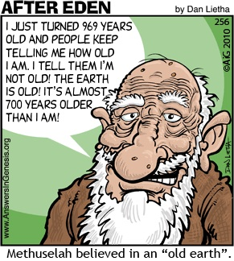
Methuselah
90
I JUST TURNED 969 YEARS OLD AND PEOPLE KEEP TELLING ME HOW OLD I AM. I TELL THEM I'M NOT OLD! THE EARTH IS OLD! IT'S ALMOST 700 YEARS OLDER THAN I AM!
Methuselah believed in an "Old Earth."
Notes:
How old is the earth? Let’s ask the oldest man!

Slide 43
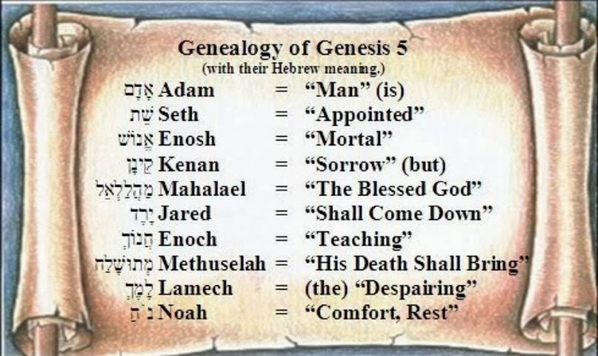
The Meaning of Each Patriarch's Name in the 10 Generations
Notes:
Reading downward with the meanings above, we see that death reigned on the earth. However, their names teach us that at the time of the death of Methuselah in the year of the Flood, through Noah (“comfort, rest”) the world that was renewed through the Flood.

Slide 44
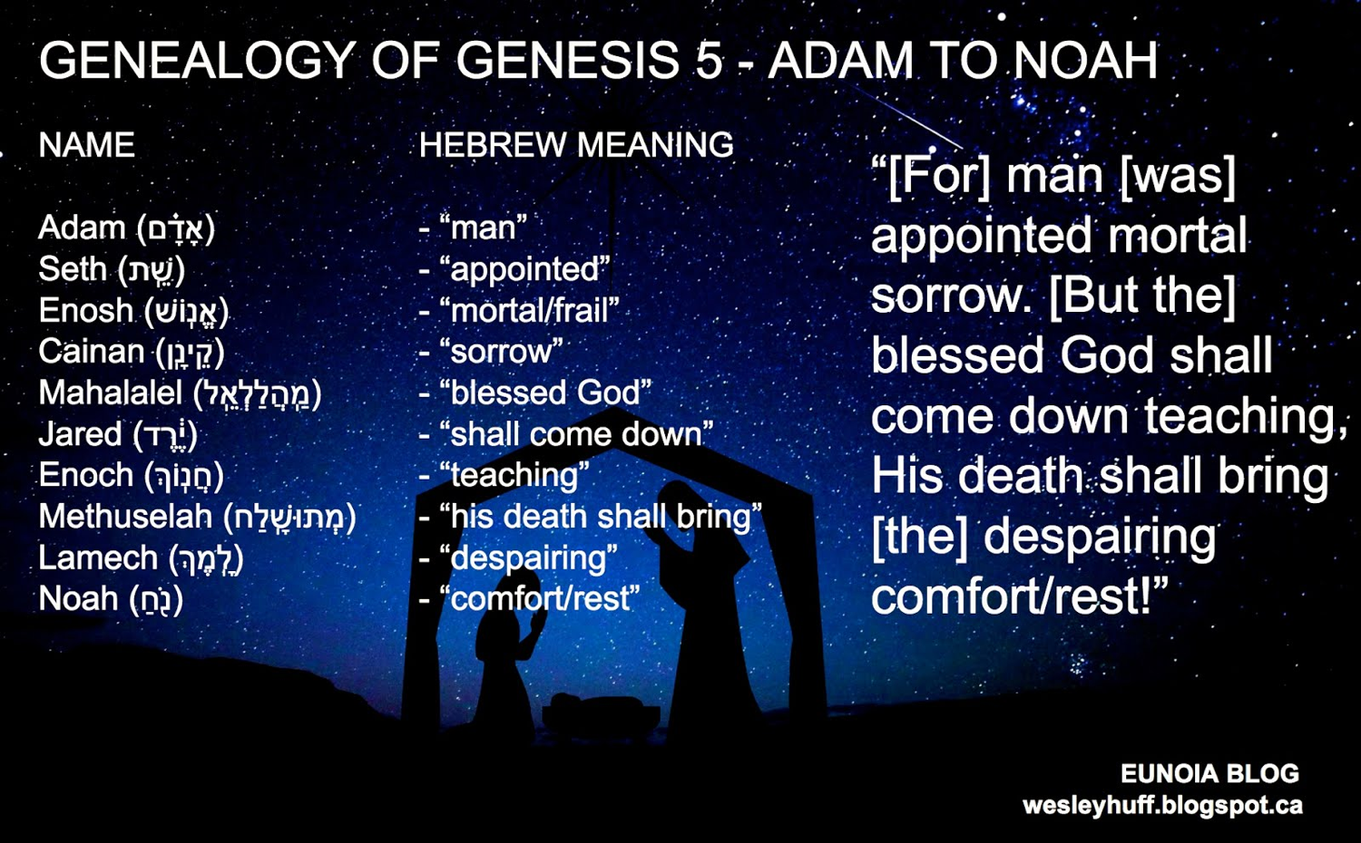
The Meaning of Each Patriarch's Name in the 10 Generations
Notes:
Reading downward with the meanings above, we see that death reigned on the earth. However, their names teach us that at the time of the death of Methuselah in the year of the Flood, through Noah (“comfort, rest”) the world that was renewed through the Flood.

Slide 45

OK, so what's the point?
Notes:
Restatement

Slide 46

Will you take God's Word at face value—even when it is uncomfortable?
Notes:
Restatement

Slide 47

How can you tell the age of the earth?
Trust the Book written by the Eyewitness

Slide 48
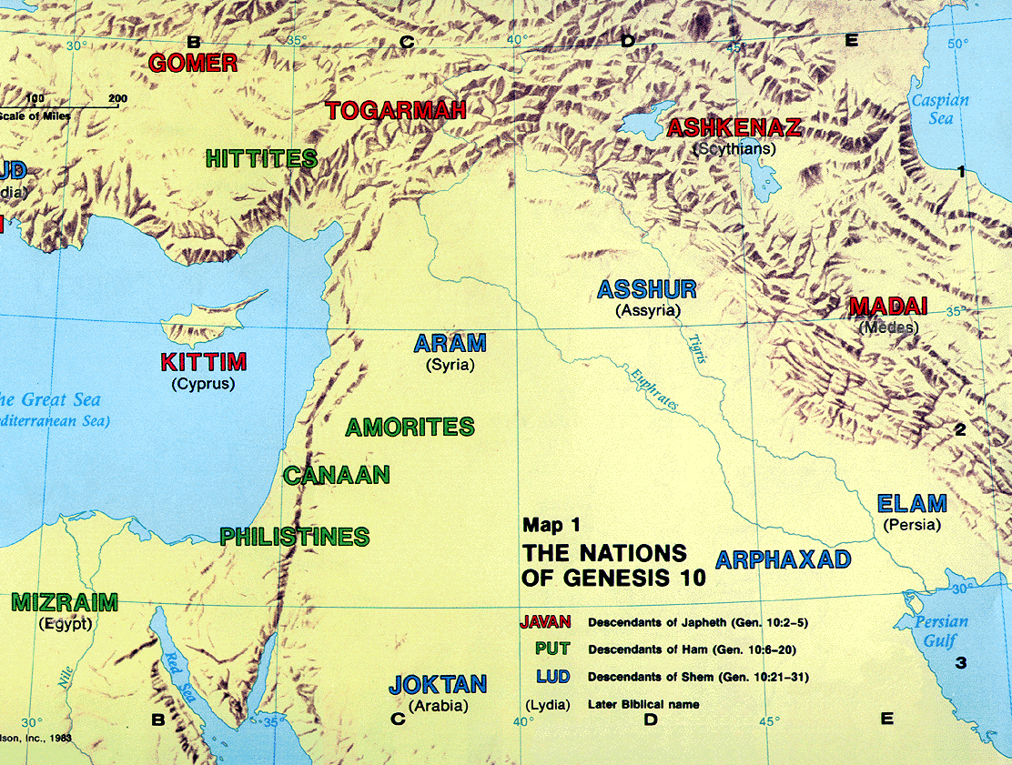
The Table of Nations
60
Pt. 6
NOAH
Japheth
HAM
SHEM
Caucasians
Canaanites
Semites
Europeans &
East Indians
Africans &
Asians
Jews &
Arabs
Genesis 10

Slide 49
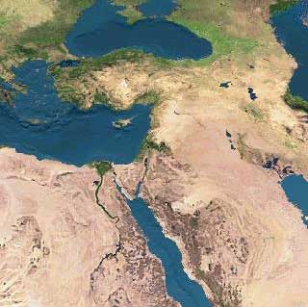

Is the Table of Nations Accurate (Gen. 10-11)?
60
Pt. 6
MS
“Having constructed the Table of Nations into a simple genealogy, I wanted to see how many of its names were attested in the records of other nations in the Middle East… [I saw that] the Table of Nations had listed all the families and tribes of mankind in their correct groupings, whether those groupings were ethnological, linguistic or geographical. All the names, without exception, were accurate, and in more than twenty-five years of searching and analyzing, I uncovered not one mistake or false statement of fact in the Table of Nations.”
Bill Cooper, After the Flood (Chichester: New Wine, 1995), 38-39
SG
ER
DS
PG
RS
Handbook pg. 15-16
25
1

Slide 50

Water Vapor Canopy Theory
64b
First proposed by Isaac Newton Vail in 1874
Support sought in "Let there be an expanse between the waters to separate water from water” (Gen. 1:6)
Provided enough water for universal flood (Gen. 7:11)
Enabled long pre-flood life spans (reduced radiation)
Held by young earth advocates
Hotly contested!

Slide 51

Evangelicals Differ
64b
Reasons to Believe
Hugh Ross
Walt Brown
Old Earth
Day-Age Theory
Local Flood
Rain waters
reasons.org
godandscience.org
creationscience.com
Institute for Creation Research, AiG
Henry/John Morris, Duane Gish
Joseph Dillow, Ken Ham
Young Earth
24-hour Creation Days
Universal Flood
Vapor canopy
answersingenesis.org
genesispark.org
icr.org critiques Ross at:
icr.org/pubs/imp/imp-217.htm

Slide 52
Conclusions from Findings
The purposes of the genealogies were:
Historical: to trace an exact outline of their history and establish their descent
Religious and theological: to show that God had protected this line as promised, and to show the connection with past godly people
The genealogies should not be read with modern meanings and inferences attached to the words

Slide 53
Black

Slide 54
The Mystery of the Patriarchs
70f
Who were they?
The ancestors of the people of Israel, Abraham, Isaac, Jacob & Joseph
Did they really exist?
Many OT scholars rejected the OT account of the patriarchs and their historical backgrounds, considering them fictional ancestors
New scholars believe they are historical as modern archaeologists and historians have corroborated many features of the patriarchal records in Gen. 12-50

Slide 55
The Mystery of the Patriarchs
70f
How can they be dated?
External events in their time
Evidence of period/social conditions in which they lived
Statements of time elapsed between their days

Slide 56
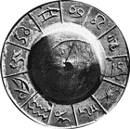
Egyptian Chronology
70f
Originally used a lunar calendar (but it could not predict the Nile's annual flooding)
First to develop solar calendar (earliest date claimed is 4236 BC)
Added an extra month when the solar and lunar calendars disagreed
Notes:
http://webexhibits.org/calendars/calendar-ancient.html

Slide 57
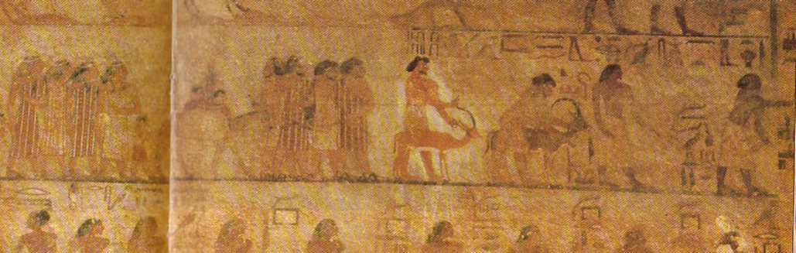
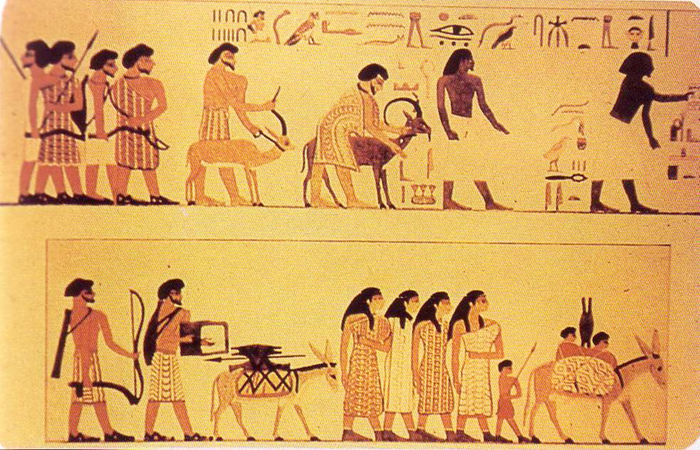
Beni Hasan Mural
219
Two Egyptians lead the procession (no beards)
Egypt
1850 BC
Attests to Israelites trading in Egypt
Joseph story (Gen. 37–50)
Solomon's wife (1 Kings 9:16), etc.
8 wealthy Asiatic men & 4 women follow
(note beards)
Notes:
Wilson, 47 and notes, 219

Slide 58
Conclusions from Findings
70f
Archaeological discoveries have shown that the patriarchs were historical figures and that the biblical record is accurate
Israel's existence now as a nation resulted from:
God keeping His covenant with Abraham
The patriarchs' faith and obedience
As Christians, we have the patriarchs as fathers of our faith and we are partakers of that same everlasting covenant

Slide 59
Black

Slide 60
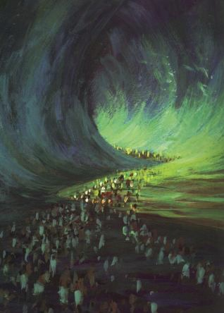
Crossing the Reed Sea
Amenophis II

Slide 61

The Exodus Took Faith!
I think you have some serious faith issues.

Slide 62
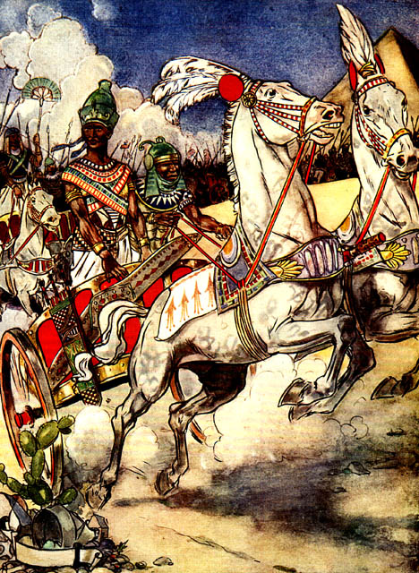
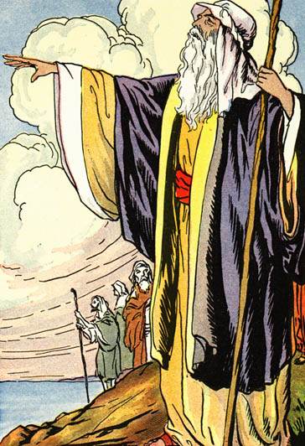
Was this Rameses II?

Slide 63
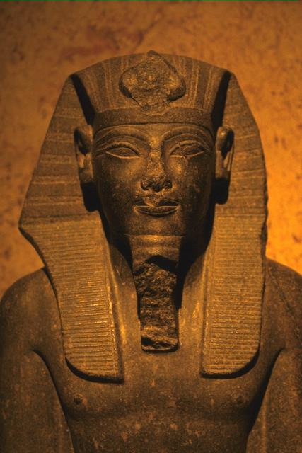
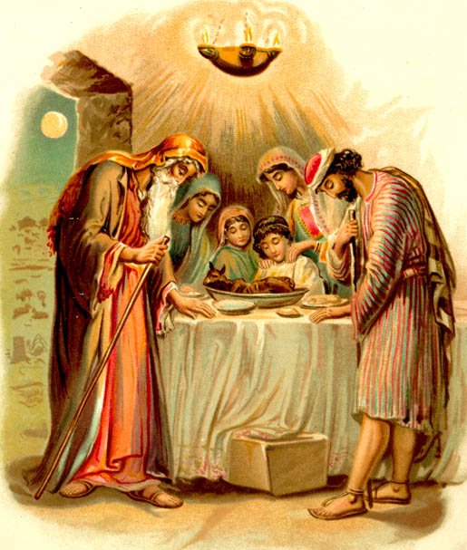
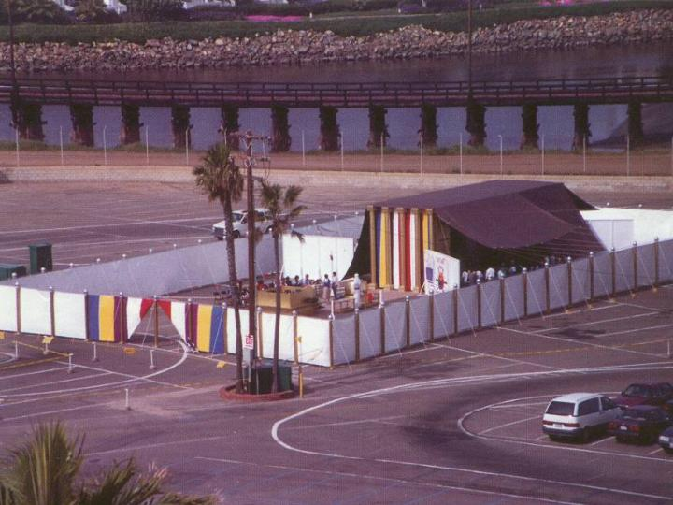
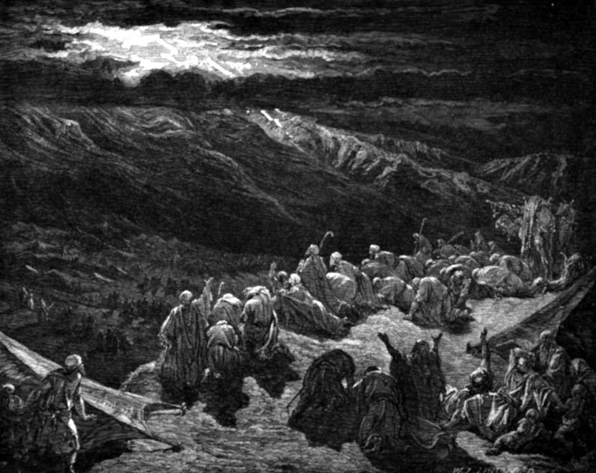
Traditional History of Egypt
OTB 73
3100-2686 Proto-Dynastic
2686-2181 Old Kingdom
2181-1991 First Intermediate
1991-1786 Middle Kingdom
1786-1558 Second Intermediate
1558-1085 New Kingdom
1098- 332 Late Dynastic
332- Alexander the Great
Pyramids
Abraham
Joseph
Moses
Notes:
https://portal.tiu.edu/uportal/teds/otdept/jhoffmeier

Slide 64

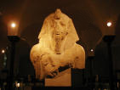
Traditional Dating of New Kingdom Pharaohs
87

Slide 65
Amenophis II

Slide 66

Traditional Dating of New Kingdom Pharaohs
87
* Other Egyptologists say Rameses began his reign in 1304 or 1292-1290. Absolute dates are difficult to ascertain.
Notes:
“Egyptian chronology is in a constant state of transition, with much of the terminology and dating in dispute. Professor E.J. Bickerman, Chronology of the ancient world (1980: 83-84 and 106), has properly called it "the rather fluid chronology of the Pharaohs and the Hittites," adding that Ramses II's accession is dated by various Egyptologists to 1304, 1290-92, or 1279 BCE. Reliable absolute dates, astronomical or other, are lacking, as Professor Heinrich Otten had noted. It is a "rubber chronology" that you can stretch or shrink anywhere, by arbitrarily established lengths of co-regencies between rulers and even overlapping dynasties. The possibility of a calendar reform called Menophres Era may radically modify the prevailing modern Egyptian chronology, so the previous "firm" dates cannot be supported astronomically.”
http://en.wikipedia.org/wiki/Egyptian_chronology

Slide 67
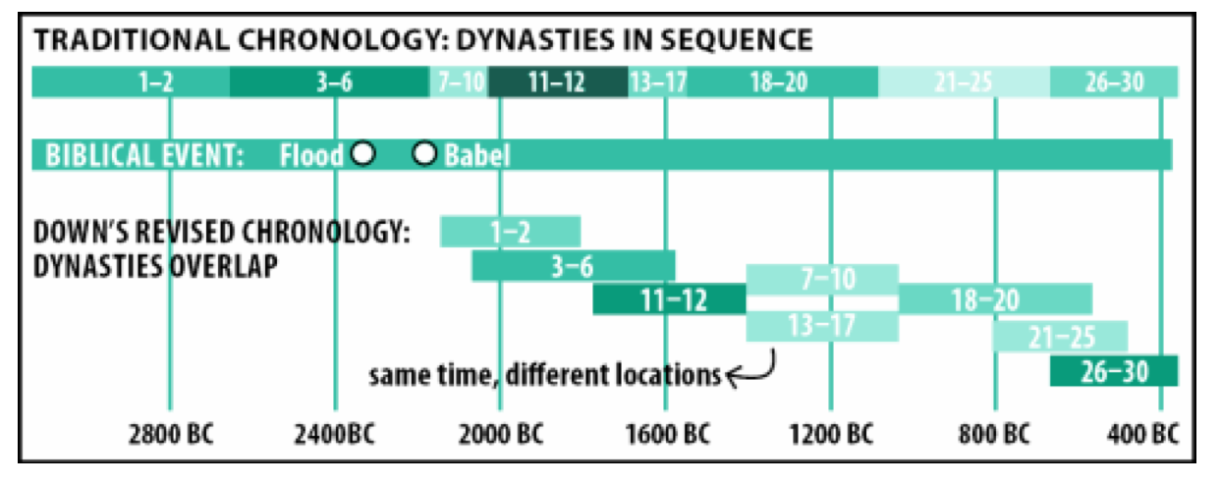
Contradicting Histories of Egypt
OTB 73
Notes:
https://answersingenesis.org/archaeology/ancient-egypt/doesnt-egyptian-chronology-prove-bible-unreliable/ for second column in The New Answers Book 2, Chapter 24
“Doesn’t Egyptian Chronology Prove That the Bible Is Unreliable?” by Dr. Elizabeth Mitchell on July 22, 2010

Slide 68
Histories of Egypt
OTB 73
Traditional
Biblical
3100-2686 Proto-Dynastic
2686-2181 Old Kingdom
2181-1991 First Intermediate
1991-1786 Middle Kingdom
1786-1558 Second Intermediate
1558-1085 New Kingdom
1098- 332 Late Dynastic
332- 323 Alexander the Great
2400-2200 Proto-Dynastic (no dynasty)
2200-1600 Old Kingdom (Dynasties 1-6)
1800-1000 First Intermediate (7-11)
1600-1000 Middle Kingdom (12-13)
1400-1000 Second Intermediate (14-17)
1000- 600 New Kingdom (18-20)
800- 332 Late Dynastic (21-31)
332- 323 Alexander the Great
Abraham
Pyramids
Pyramids
Abraham
Joseph
Joseph
Moses
Moses
Solomon
Jeremiah
Notes:
https://portal.tiu.edu/uportal/teds/otdept/jhoffmeier for first column
https://answersingenesis.org/archaeology/ancient-egypt/doesnt-egyptian-chronology-prove-bible-unreliable/ for second column in The New Answers Book 2, Chapter 24
“Doesn’t Egyptian Chronology Prove That the Bible Is Unreliable?” by Dr. Elizabeth Mitchell on July 22, 2010

Slide 69
What was the Date of the Exodus?
Abraham (2166-1991)
Joseph (1915-1805)
1446
1290
2000
1900
1800
1700
1600
1500
1400
1300
1200

Slide 70
When was the Exodus?
Abraham (2166-1991)
1446
1290
Joseph (1915-1805)
Moses (1525-1405)
2000
1900
1800
1700
1600
1500
1400
1300
1200

Slide 71
Egyptian Sojourn Chronologies Contrasted
400 YEAR SOJOURN
430 YEAR SOJOURN
215 YEAR SOJOURN
LATE
EXODUS
CRITICAL
66
The Patriarchs
2135-1774
Canaan Sojourn
1875-1845
Migration to Egypt
1845
The Patriarchs
2166-1805
Canaan Sojourn
2090-1876
Migration to Egypt
1876
2100
2000
The Patriarchs
1952-1589
Canaan Sojourn
1875-1660
Migration to Egypt
1660
The Patriarchs
1950-1650
Canaan Sojourn
?-1650
Migration to Egypt
1650
1900
Egyptian Sojourn
1875-1446
Slavery
1730 or 1580
Egyptian Sojourn
1845-1445
Slavery
1730?
1800
1700
Egyptian Sojourn
1660-1446
Slavery
1580
Egyptian Sojourn
1650-1230
Slavery
1580
1600
EXODUS
1500
The Patriarchs
1500-1300
Gradual Migration to Egypt
Adapted (column 1 added) from John H. Walton, Chronological and Background Charts of the OT, 2d ed., 99 (cf. OTS, 108a-b)
EXODUS
EXODUS
Wandering
1445-1405
Conquest and Judges
1405-1050
Wandering
1446-1405
Conquest and Judges
1406-1050
Wandering
1446-1405
Conquest and Judges
1406-1050
1400
1300
Egyptian Sojourn
1350-1230
EXODUS
1200
(No Wandering)
Conquest and Judges
1230-1025
(No Exodus or
40 Yr. Wandering)
Migration, Conquest and Judges
1230-1025
1100
United Kingdom
1050-931
United Kingdom
1050-931
United Kingdom
1050-931
United Kingdom
1025-931
United Kingdom
1025-931
1000
900

Slide 72
Egyptian Sojourn Chronologies Evaluated
View
400 YEAR SOJOURN
430 YEAR SOJOURN
215
YEAR SOJOURN
215 YEAR SOJOURN
LATE EXODUS
LATE
EXODUS
CRITICAL
CRITICAL
The following views are listed in order from the best to the worst perspective, in my opinion.
67
Exodus
Early
Early
Early
Late
Gradual Migration
Egyptian Sojourn
400
430
215
420
120
Years of Freedom
Unspecified
295 or 145
80
70
120
Years of Slavery
<400
135 or 285
135
350
none (a myth)
Exod. 12:40 Text
LXX &
Samaritan Pentateuch
MT
LXX & Samaritan Pentateuch
MT
Unimportant
Adapted (column 1 added) from John H. Walton, Chronological and Background Charts of the OT, 2d ed., 99 (cf. OTS, 108a-b)
Popularity
Few
Most common
Common
Few Evangelicals
Many Liberals
Many Liberals
Support:
• Gen. 15:13 (sojourn 400 yrs)
• Acts 13:19-20 "about 450 years" =
400 + 40 + 7
= 447 yrs.
• Exod. 12:40 "children of Israel" points to Gen. 35:10 (1875 BC) to begin 430 years as this is when nation called “Israel”
• Follows MT of Exod. 12:40
• Scripture sometimes uses round numbers
(See the next few pages for more early date arguments)
• Follows MT of Exod. 12:40
• The new king of Exod. 1 was a native Egyptian who followed the Hyksos
• Their later date for Abr. Cov. (1875 BC) to Jacob entering Egypt (1660 BC) is 215 yrs.
• Archaeology supports the destruction of some Canaanite cities in the 13th century
(See the next few pages for more late date arguments)
• The city of Rameses (Exod. 1:11) must have been built after Rameses II (1300 BC) since it was named after him

Slide 73
The Mystery of the Exodus
70g
When did it happen? 1446 or 1266?
Why does it matter?
It is the most important historical event in Israel's past, when it truly began to be a nation
It stands at the centre of Israel's faith
Many dates before and after depend on this date
The choice of date reflects our belief (or lack thereof) in the historicity and accuracy of the Bible and thus has an impact on our faith

Slide 74
Small Group Discussion
How does 1 Kings 6:1 help date the Exodus?
How does Judges 11:26 help date the Exodus?
(Solomon began to reign in 971 BC.)
(Jephthah lived around 1100 BC.)

Slide 75
An Early Exodus (1446)
70g
FOR
1 Kings 6:1
480 years from Exodus to the building of Solomon's Temple (966)
Judges 11:26 Jephthah assigns 300 years between his day (c.1100) and the Conquest
Exodus 1446 BC
+ 480 yrs
Temple = 966 BC
+ 4 yrs
Reign Began = 970/71

Slide 76
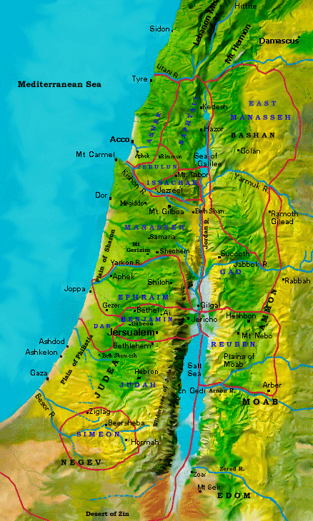
Jephthah versus Ammonites
70a, 70g
Manasseh
Gilead
Ammonites
Gad
Jephthah 1100 BC
Reuben
+ 300 yrs
Conquest =
1400 BC

Slide 77
An Early Exodus (1446)
70g
FOR
1 Kings 6:1
480 years from Exodus to the building of Solomon's Temple (966)
Judges 11:26 Jephthah assigns 300 years between his day (c.1100) and the Conquest
AGAINST
a) 480 means 12 generations. Actual no. of yrs is 12 x 25 = 300
b) The text is corrupt
c) Historian had inaccurate facts
This was a generalization or an inaccurate guess as he had no access to historical records

Slide 78
An Early Exodus (1446)
70g
FOR
The length of time assigned to the judges in the Bible cannot be squeezed into the 150 years required by a late Exodus, even with overlaps
Thutmose IV (Pharaoh after 1446 Exodus) was not the eldest son, who was possibly killed in the 10th plague
AGAINST
With overlaps and a symbolic understanding of time spans, it can be fitted in
There are many other possible explanations for his eldest son not ruling

Slide 79
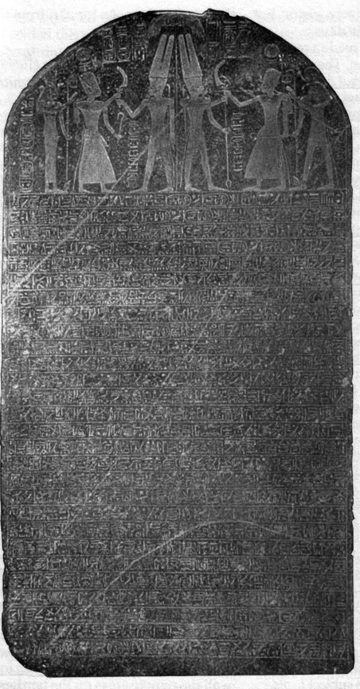
Merneptah Stela
70g
Lists Israel in Canaan as a people group in the 13th century
This is the first mention of the name “Israel” outside the Bible
Ancient Egypt, 1208 BC
Arnold/Beyer, 160

Slide 80

An Early Exodus (1446)
70g
FOR
The Merneptah Stela identifies Israel as a people group (not city state or foreign nation) c.1231. If Israel had left in 1266, they would still have been wandering in the wilderness at that time
AGAINST
This is not the same Israel of the Exodus
Israel might have left in 1300 and would have been a settled nation for 20 years
“Canaan is captive with all woe . . . Israel is wasted, bare of seed”
Merneptah Stela, Readings from the ANE, 160

Slide 81
A Late Exodus (1266-1299)
70h
FOR
Exod. 1:11 The Israelites built the city of Rameses. It must have been in honour of Rameses II (c.1290)
Thutmose III was not known as a great builder and therefore does not fit into the historical picture
AGAINST
The name 'Rameses' was used much earlier than 13th century. The city was being built before Moses' birth (before Rameses II)
He is known to have had some building projects in the delta region

Slide 82
A Late Exodus (1266-1299)
70h
FOR
Nelson Glueck argued that there is no archeological evidence that sedentary civilizations such as Edom and Moab existed before 1300. Since Israel had contact with them (Num. 20:14), the Exodus must be later
AGAINST
Later excavations showed that many areas were settled throughout 1500 to 1300
There were semi/nomadic tribes in existence in the 15th century

Slide 83
A Late Exodus (1266-1299)
70h
FOR
There is no evidence of widespread destruction in Canaan in the early 14th century. These cities of Canaan stood.
Archeological evidence shows that Bethel, Lachish and Debir in Palestine fell as a result of a violent attack between 1250 and 1200. It must have been the Israelite conquest.
AGAINST
Israelites did not cause material destruction during the Conquest, except Jericho, Ai and Hazor (Josh. 24:13)
The destruction might have been caused by Egyptian conquests (Pharaoh Merneptah)

Slide 84
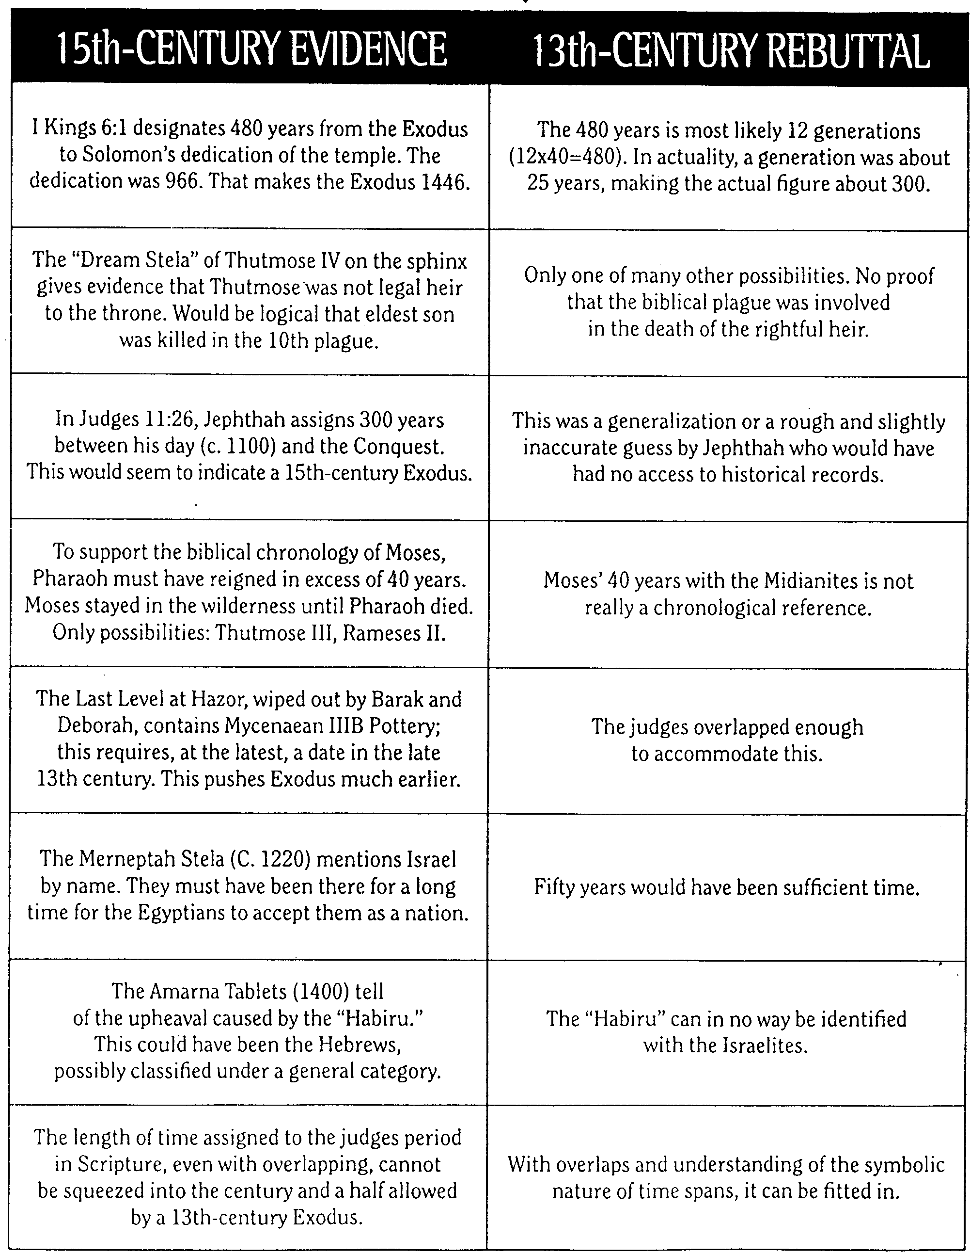
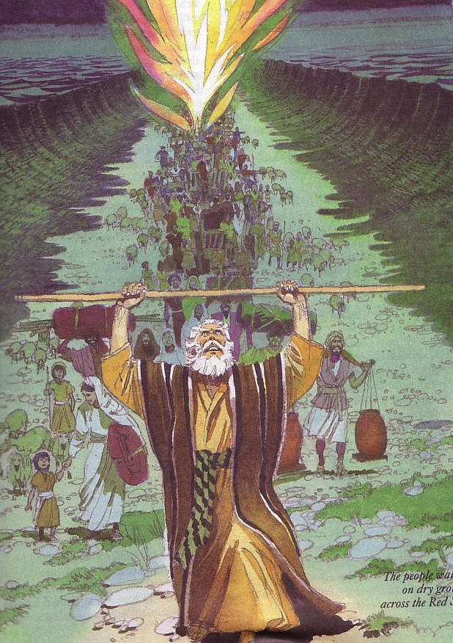
Early Date Evidence
70a
John H. Walton, Chronological and Background Charts of the OT, 2d ed., 102-3

Slide 85
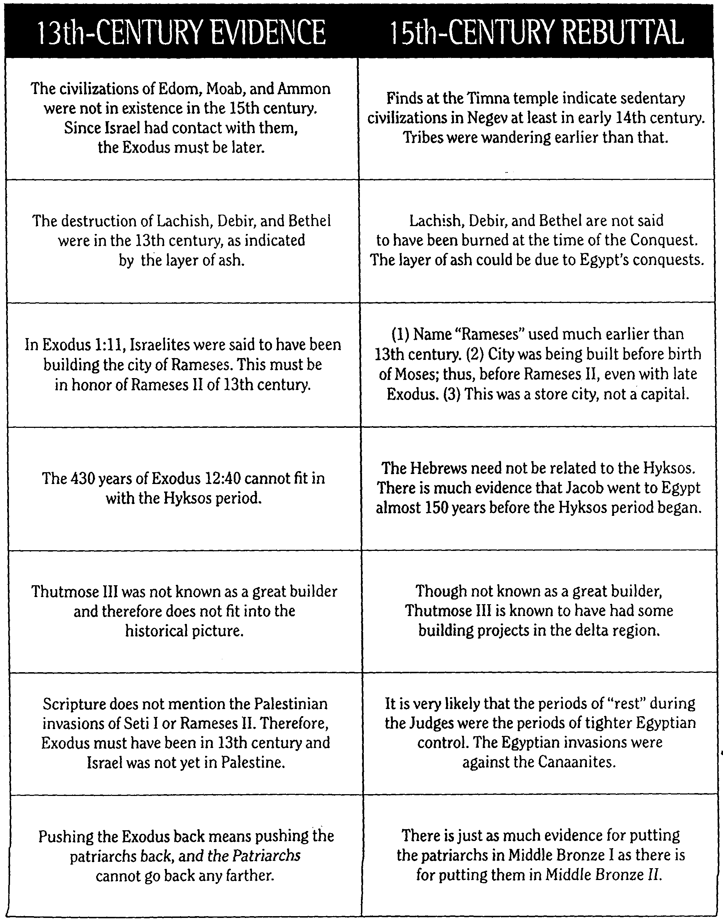
Early Date Responses
70b
十三世纪的证据 | 十五世纪证据
以东，莫阿布，和阿蒙的文明是在15世纪后。以色列与他们接触，所以外流必须在后。 | 以东，莫阿布，和阿蒙的文明是在15世纪后。以色列与他们接触，所以外流必须在后。
。销毁Lachish ， Debir和贝瑟尔是在13世纪，如一层灰。 | Lachish ， Debir和贝瑟尔不说，被烧毁的时候，征服。层灰的原因可能是埃及的征服。
在Exod.埃及记 1：11，犹太人被说已经建立了城市拉美西斯。这必须是13世纪为纪念拉美西斯二世建立的。 | 1 。名称“拉美西斯”使用更早超过13世纪。 2 。市正在建立Exod.生前摩西;从而在拉美西斯二世，即使后期外流。 3 。 这是一储蒇城市，而不是首都。
430多年的Exod.埃及记12:40不能配合Hyksos期 | 希伯来人不必与hyksos有关。有大量证据雅各前往埃及将近150年前开始的Hyksos时期。
图特摩斯三世不是一个伟大的建设者，因此不适合的历史图片。 | 虽然不知道是一个伟大的建设者，图特摩斯三世是众所周知的已经取得了一些建设项目中的三角洲地区。
圣经没有提到巴勒斯坦入侵塞蒂本人或拉美西斯二世。因此，Exod.埃及记必须是在13世纪和以色列还没有在巴勒斯坦。 | 士师时期“休息”期间同于埃及时期的严格控制。埃及入侵反对迦南人。
推进Exod.走回到手段推动始祖回来，始祖不能回去任何更远。 | 有一样的证据，把始祖青铜我中有把他们在中东铜牌二。
John H. Walton, Chronological and Background Charts of the OT, 2d ed., 102-3

Slide 86
What Do We Think?
70h
Disney's “Prince of Egypt” is historically inaccurate!
We support the early exodus theory

Slide 87
Conclusions from Findings
70h
Accept the biblical dates and references at face value unless there is real internal reason to reject them
The Bible's historical and chronological information is accurate and reliable

Slide 88
Black

Slide 89
The Mystery of the Judges
70h
We can define the era of the Judges by starting with the leadership of Moses and finishing with the crowning of Saul
480 (from Exodus to Solomon's temple; 1 Kings 6:1)
- 40 (Saul's rule Acts 13:11)
- 40 (David's rule 1 Kings 2:11) = 400 years
When the number of years that the Judges and Israel's enemies rule are added up, it exceeds the expected value of 400 years: 410+ yrs
But this doesn’t even include the 40-year wanderings, giving only 360 years

Slide 90
How Can We Fit in the Judges?
480 yrs
1446
360 yrs
966
Wanderings 40 yrs
410 yrs
David 40 yrs
Saul 40 yrs
?
1700
1600
1500
1400
1300
1200
1100
1000
900
Notes:
480 years exist from Solomon’s temple and the Exodus (1 Kings 6:1)
Subtracting three 40-year periods (120 years) gives 360 years from the entrance into the land (1406) to the monarchy of Saul (1043)
Yet the total period of the judges and oppressors is 410 years, so how do we fit these 410 years into the available 360 years?

Slide 91
Years the Judges Ruled
65b
1381 BC Mesopotamian rule began
Oppression
Peace
114
296
Total
Total
332
410
1049 BC Samson died

Slide 92
Possible Solutions
70i
Include the years of oppression by Israel's enemies within the periods of leadership of the Judges
Overlap the leaderships of the Judges

Slide 93
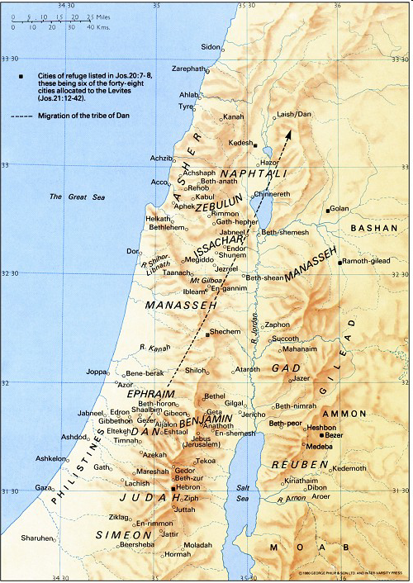
Locations of Judges
Shamgar
New Bible Atlas
Samson
Elon
Jair
Barak
Gideon
Jephthah
Tola
Abimelech
Ehud
Deborah
Izban
Othniel
Abdon
The Moody Atlas of Bible Lands, map 34

Slide 94
What Do We Think?
70i
It is clear from the Bible that the period of the Judges spans 410 yrs
Closer study reveals that there are some overlaps. For example, the judges Jephthah to Samson overlapped with the 40 years of Philistine oppression and the years of priestly service of Eli and Samuel

Slide 95
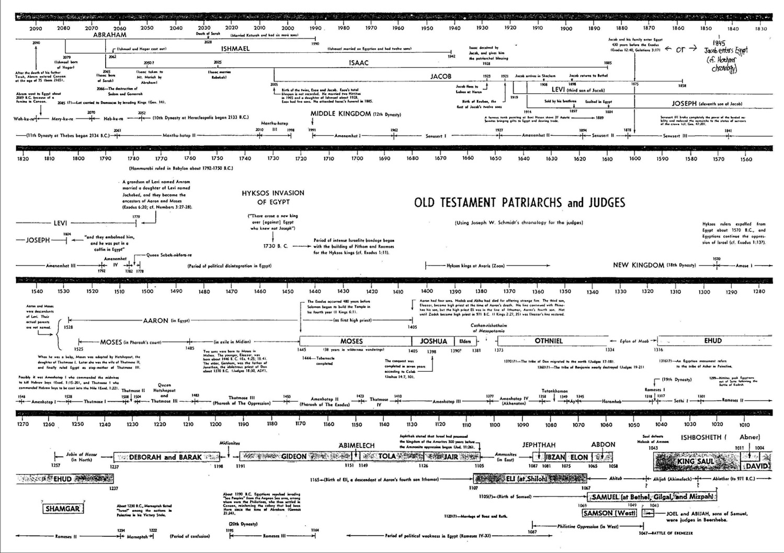
Old Testament Patriarchs & Judges
65a
Note the Overlaps!

Slide 96
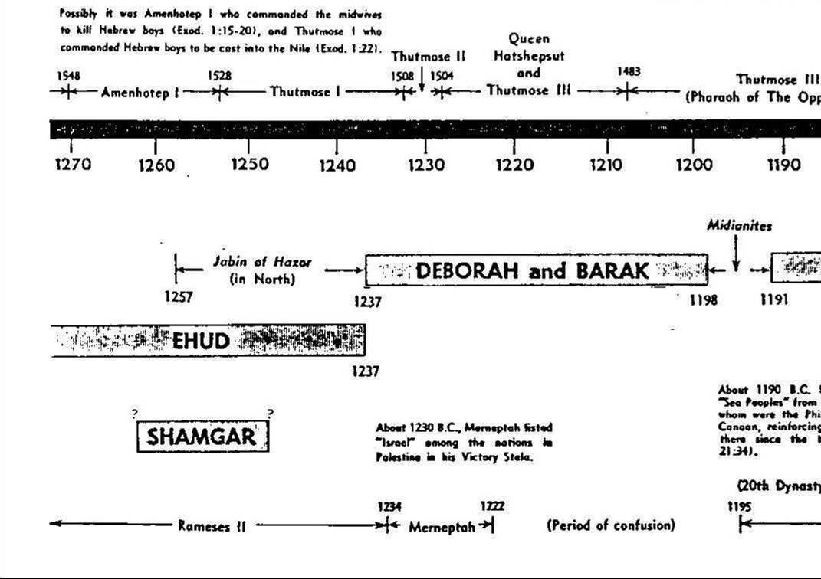
Old Testament Patriarchs & Judges
65a
Note the Overlaps!

Slide 97
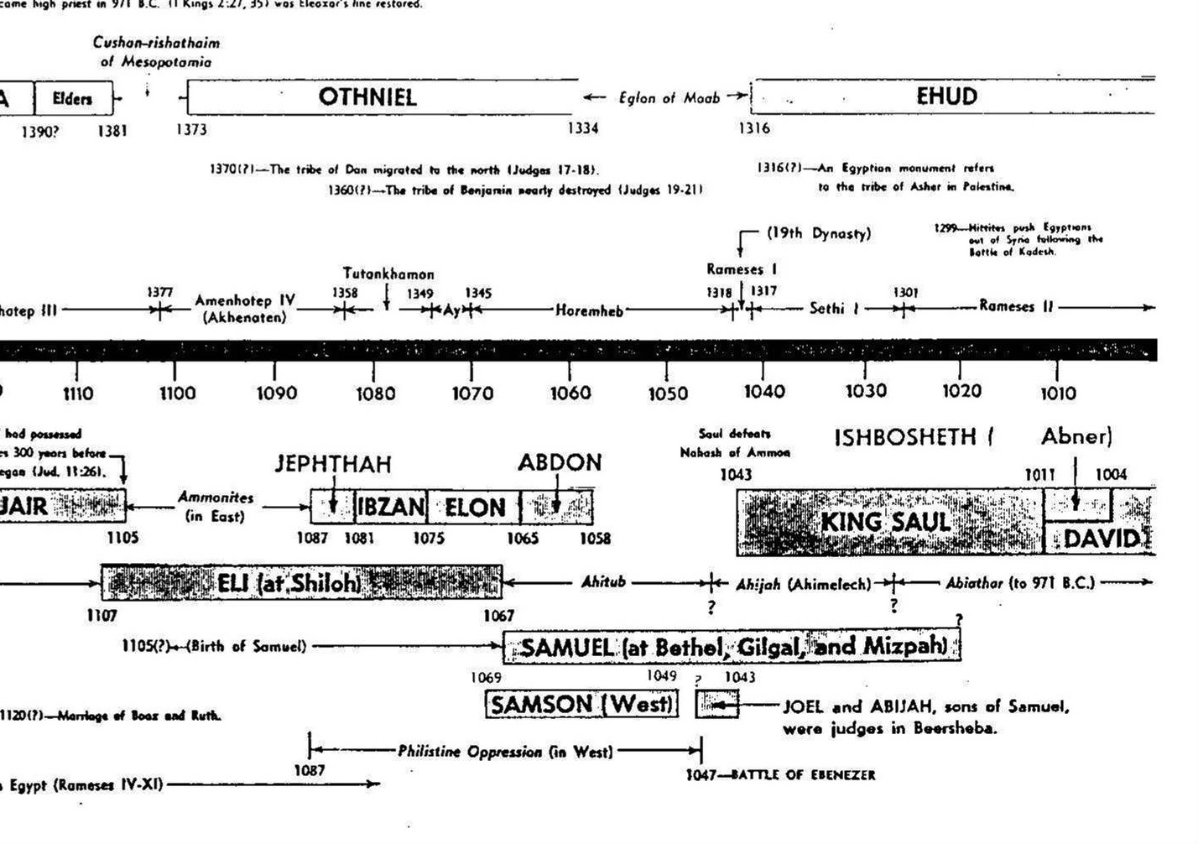
Old Testament Patriarchs & Judges
65a
Note the Overlaps!

Slide 98
Conclusions from Findings
70i
There is not enough biblical information to determine the exact number of years that each judge ruled alone
The years that Israel fell under enemy rule are not always mentioned
Nevertheless, the Bible is accurate in its historical information

Slide 99
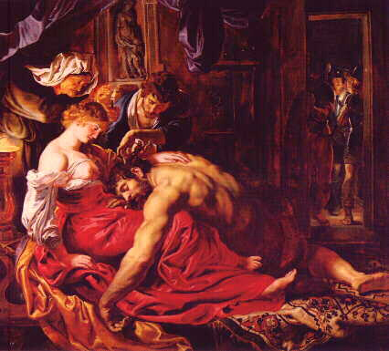
Samson's Weakness
The Story of Samson
What was his weakness?
Her?
Hair?
Heart?
“Samson… the he man with a she weakness”
-Chuck Swindoll

Slide 100
Black

Slide 101
The Mystery of the Kings
70i
The total number of years of the reigns of Israel and Judah in a fixed time span were not the same
If chronology is worked according to lengths of reign, synchronisms won't fit (and vice versa)
Seeming lack of harmony between OT chronology and that of ANE
Why does it matter?
It concerns the historicity and reliability of the Bible and the accuracy of its transmission

Slide 102
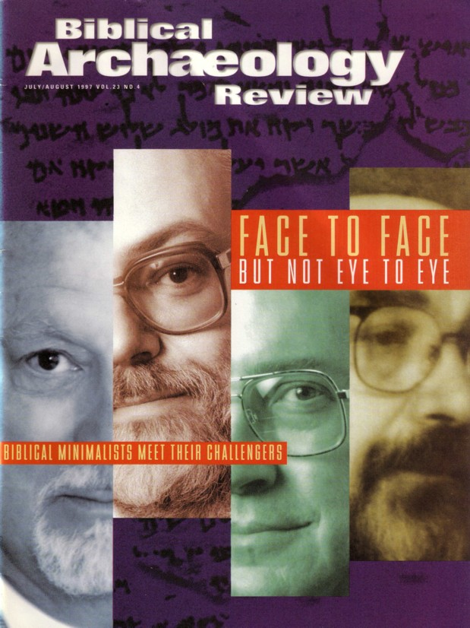
Is the Chronology of Israel's Kings Necessary?
Whether David and Solomon ever even lived was doubted by “Biblical Minimalists” in the July/Aug 1997 issue of BAR

Slide 103
Years Kings of Judah Ruled
65c
Rehoboam 17
Abijam 3
Asa 41
Jehoshaphat 25
Jehoram 8
Ahaziah 1
Athaliah 6
Joash 40
Amaziah 29
Azariah (Uzziah) 52
Jotham 18
Ahaz 19
Hezekiah 29
Manasseh 55
Amon 2
Josiah 31
Jehoahaz 3 months
Jehoiakim 11
Jehoiachin 3 months
Zedekiah 11
Total 398

Slide 104
Years Kings of Judah Ruled
65c
Rehoboam 17
Abijam 3
Asa 41
Jehoshaphat 25
Jehoram 8
Ahaziah 1
Athaliah 6
Joash 40
Amaziah 29
Azariah (Uzziah) 52
Jotham 18
Ahaz 19
Hezekiah 29
Manasseh 55
Amon 2
Josiah 31
Jehoahaz 3 months
Jehoiakim 11
Jehoiachin 3 months
Zedekiah 11
Total 398
Rehoboam began 931 BC
Zedekiah ended 586 BC
Total Years 345 years
Why the difference?
How can we explain this?

Slide 105
Proposed Reasons for Discrepancies
70i
Inaccurate systems used by biblical historians
Accidental errors of transmission
Largely schematic and artificial chronology
Intentional mutilation of text to cover up various facts

Slide 106
Proposed Solutions
70i
Editorial changes to the chronological data (3rd century B.C. Septuagint)
Include periods of political chaos in which no king sat on the throne
Disregard the data in the Masoretic Text and determine dates with synchronisms with ANE history
Discover original method of dating

Slide 107
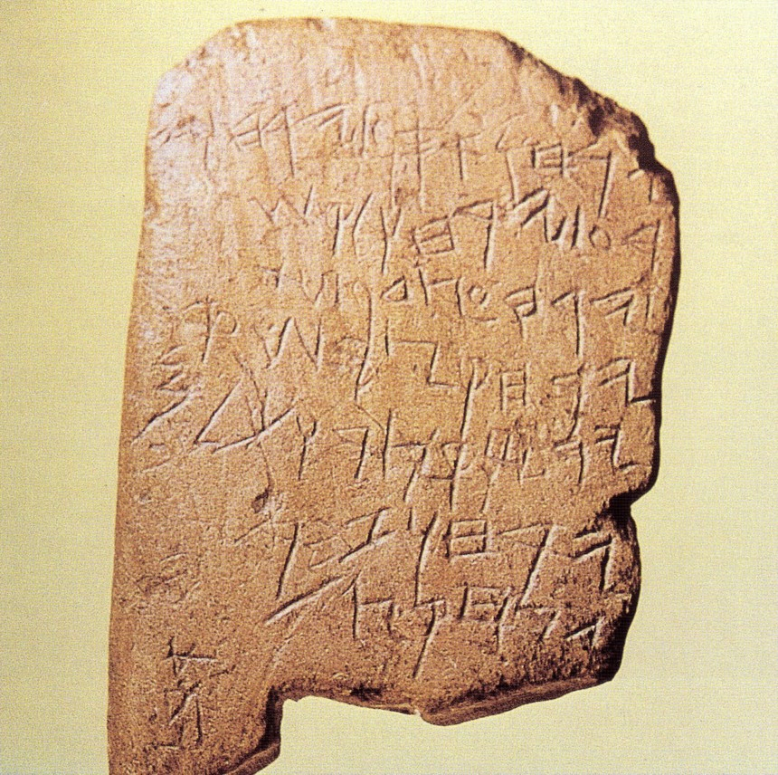
The Gezer Calendar
Elul/Tishri
Bul/Kislev
Tebeth/Shebat
Adar
Abib
Ziv
Sivan/Tammuz
Ab
Months of vintage & oil harvest;
Months of sowing;
Months of spring pasture;
Month of flax pulling;
Month of barley harvest;
Month of wheat harvest/measuring;
Months of pruning;
Month of summer fruit.
10th century Old Hebrew school tablet
Notes:
This limestone tablet found by archaeologists in 1908 has seven lines of archaic script. It was revealed to be in Old Phoenician script used in 1000 BC (time of Solomon). It contains the annual farming cycle with the plural (“months”) designating two months. The fact that it has erasures shows that it is a schoolboy's exercise tablet where he wrote this poem which may have been a popular memory device similar to “Thirty days has September…” This may be the oldest Hebrew inscription we have today.

Slide 108
The Gezer Calendar
Aug-Sept
Oct-Nov
Dec-Jan
February
March
April
May-June
July
Months of vintage & oil harvest;
Months of sowing;
Months of spring pasture;
Month of flax pulling;
Month of barley harvest;
Month of wheat harvest & measuring;
Months of pruning;
Month of summer fruit.
10th century Old Hebrew school tablet
Notes:
This limestone tablet found by archaeologists in 1908 has seven lines of archaic script. It was revealed to be in Old Phoenician script used in 1000 BC (time of Solomon). It contains the annual farming cycle with the plural (“months”) designating two months. The fact that it has erasures shows that it is a schoolboy's exercise tablet where he wrote this poem which may have been a popular memory device similar to “Thirty days has September…” This may be the oldest Hebrew inscription we have today. Image: Wilson, The Stones Still Shout, 89; Text: Arnold, 171

Slide 109
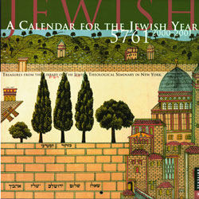

Jewish Calendars
134
Civil
Sacred
Numbered

Slide 110

Hebrew Calendars
The Exodus Night:
While the Israelites were still in the land of Egypt, the LORD gave the following instructions to Moses and Aaron: ²"From now on, this month will be the first month of the year for you" (Exod. 12:1-2)
180,
290
1 Nisan
2 Iyar
3 Sivan
4 Tammuz
5 Av
6 Elul
7 Tishri
8 Cheshvan
9 Kislev
10 Tevet
11 Shevat
12 Adar
Mar-Apr
Sacred Calendar Begins
Civil Calendar Begins
Sep-Oct

Slide 111
Hebrew Calendars
Which system did they use to determine the king's reign?
Israel began
with Nisan
& didn't count
accession year
180,
290
1 Nisan
2 Iyar
3 Sivan
4 Tammuz
5 Av
6 Elul
7 Tishri
8 Cheshvan
9 Kislev
10 Tevet
11 Shevat
12 Adar
Mar-Apr
Did they count the accession year?
Sacred Calendar Begins
Two Key Issues:
Civil Calendar Begins
Judah began
with Tishri
& counted
accession year
What if the
king's reign
began here?
Sep-Oct

Slide 112
Thiele's Solution
70j
Different Dating Systems used by Judah and Israel
Judah | Israel
Accession-year system, beginning with Tishri (931-848) | Non-Accession year system, beginning with Nisan (931-848)
Time of alliance and intermarriage with Israel Non-Accession year system, beginning with Tishri for Judah and Nisan for Israel (848-796)
Accession-year system, beginning with Tishri for Judah and Nisan for Israel (796-586)

Slide 113
Thiele's Solution
70j
Some co-regencies in Israel and Judah
Two instances of rival reigns in Israel
Certain synchronisms in 2 Kings 17 and 18 inserted by a late hand out of harmony with original pattern of reigns

Slide 114
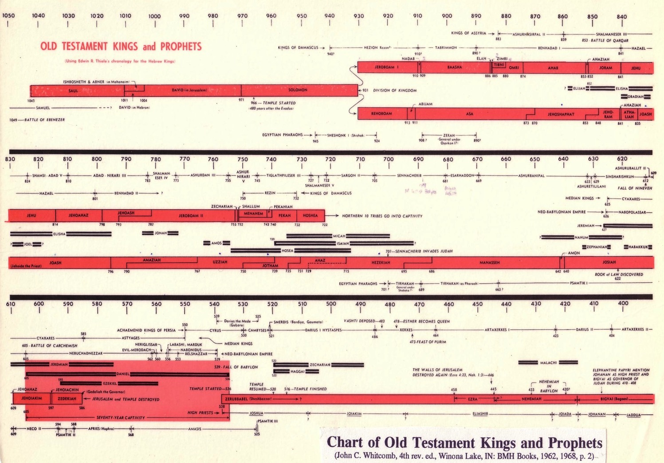
Chart of OT Kings & Prophets
65c

Slide 115
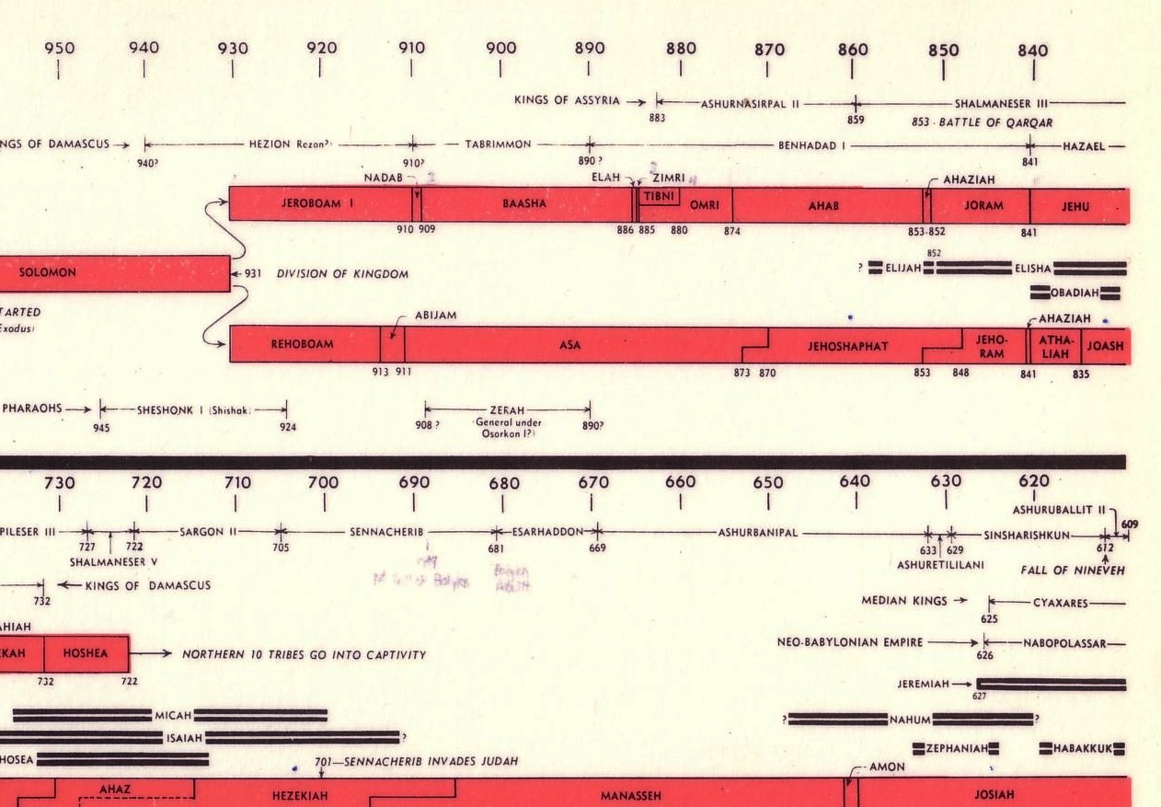
Chart of OT Kings & Prophets
65c
Rival Kings
Co-Regency

Slide 116
What Do We Think?
70j
Sound premise: Acceptance of biblical data as historical and accurate
Sound method: Began without any dates and subsequently checked worked-out dates with ANE records
Reliable results: Arrangement of reigns in harmony with biblical data and ANE history

Slide 117
Conclusions from Findings
70j
High regard for historical and chronological accuracy in recording events on the part of the scribes
Highly accurate transmission of the Bible
We have a reasonable and accurate basis for our faith

Slide 118
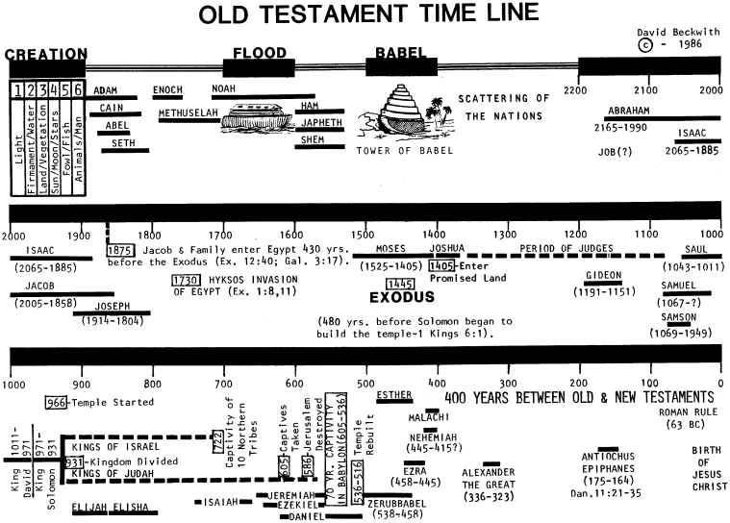
Old Testament Timeline
70m

Slide 119
OUR CONCLUSIONS
70j
Our God is a God who acts in history and deals with us from generation to generation
We have a rich heritage as we are part of the spiritual lineage of all who have walked in faith with God
The Bible is historically reliable
The Bible has a high degree of accuracy in transmission
Our faith has a reasonable and firm foundation in the inerrancy of God's Word

Slide 120
HOW CAN WE APPLY THIS?
70j
We should always begin with the assumption that historical information in the Bible is factual and accurate unless internal evidence points otherwise
We can chart our personal spiritual timelines
As we look back at the dates and sequence of events in our lives, let us reflect on how they relate to one another so that we recognize and begin to understand and appreciate the purposes and plans of God in our own histories

Slide 121
Bibliography
70l
Arnold, Bill T. and Bryan E. Beyer. Encountering the Old Testament. 3rd ed. Grand Rapids. Baker, 2015.
Bright, John. A History of Israel. Philadelphia: Westminster, 1981.
Merrill, Eugene H. An Historical Survey of the Old Testament. Grand Rapids, MI: Baker, 1991.
________. Kingdom of Priests. Grand Rapids, MI: Baker, 1987.
Pfeiffer, Charles F. Old Testament History. Washington: Canon Press, 1973.
Thiele, Edwin R. The Mysterious Numbers of the Hebrew Kings. Grand Rapids, MI: Zondervan, 1983.
Walton, John H. Chronological Charts of the Old Testament. Grand Rapids, MI: Zondervan, 1981.

Slide 122
Some Useful Websites
70l
http://www.biblicalhorizons.com/biblicalhorizons/ch/ Interesting evangelical articles on Chronology
http://www.bibarch.com
Excellent top-rated evangelical Biblical Archeology site
http://www.biblicalstudies.org.uk/chronology.html Many links to reputable and reliable sources

Slide 123
Why is Chronology Important?
70e
CONTEXT (Time and Sequence)
It indicates the social, political and economic contexts in which events took place
It tells us where events stand in a nation's history and how they relate to one another
It presents these events in relation to what was happening in neighbouring countries
It therefore helps us to understand and interpret events in the light of history

Slide 124


OT Backgrounds link at BibleStudyDownloads.org
Get this presentation for free!
Notes:
OT Survey (os)

Slide 125
Black

