Slide 1
The Legacy of the "SCROLL"
The Canon of the
Old Testament
Dr. Rick Griffith • Jordan Evangelical Theological Seminary
BibleStudyDownloads.org

Slide 2
Objectives of the Session
Christ be Glorified!
To have a brief but concise overview of the transmission of the OT Scriptures to what we have today
Acknowledge a lapse in historical records but confidence in faithfulness of men and women in the preservation of Scriptures

Slide 3
Road Map
CONSERVATION
CREATION
COMPILATION
CONCOCTIONS

Slide 4
Road Map
CREATION

Slide 5
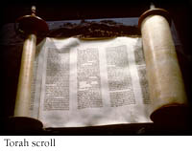
The Old Testament
How did we get from here…
To here?

Slide 6
What are the divisions of the OT?
195a
Torah (Law) also known as the Pentateuch
Nebi'im (Prophets)
Kethubim (Writings)
The first consonant in each of these three sections make up the TaNaK, the OT as we know it.
Canon is from Greek word kanon, meaning "rule" as in a "ruler."

Slide 7

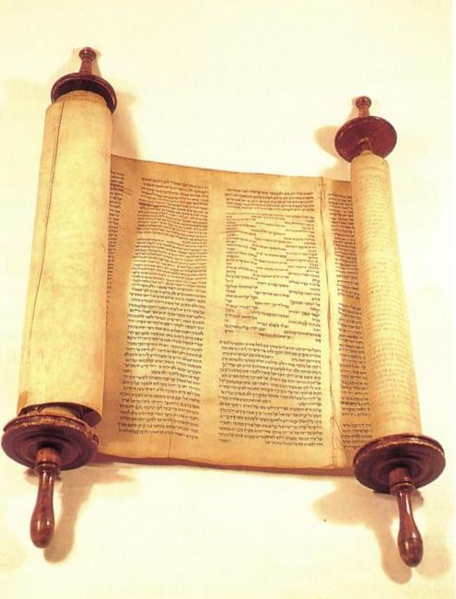
I. Inspired Writings
193
A. Old Testament
1. Hebrew: Masoretic Text (MT)
2. Greek: Septuagint (LXX)
3. OT Canonicity
B. New Testament
1. Dates
2. NT Canonicity

Slide 8
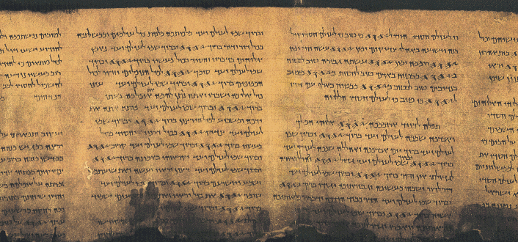
Jewish Writings
193
The Book of Psalms

Slide 9
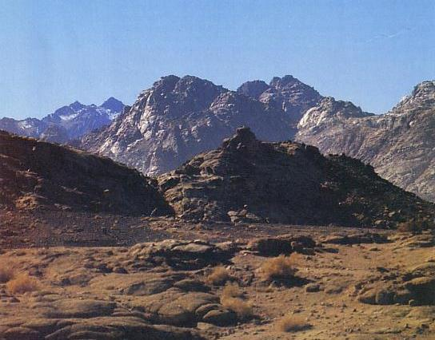
We have no Hebrew writings today that existed before Mt. Sinai (1445 BC)

Slide 10
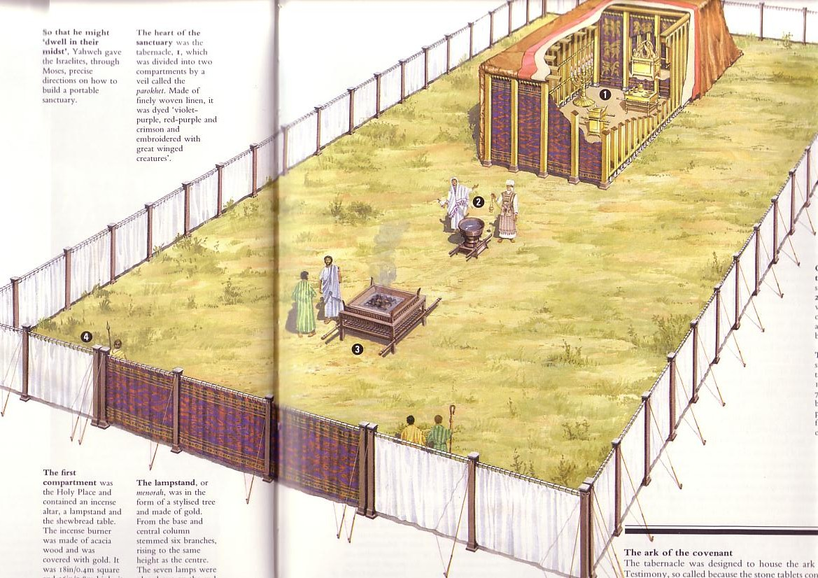
Jewish Primary Sources
Began at the Tabernacle

Slide 11
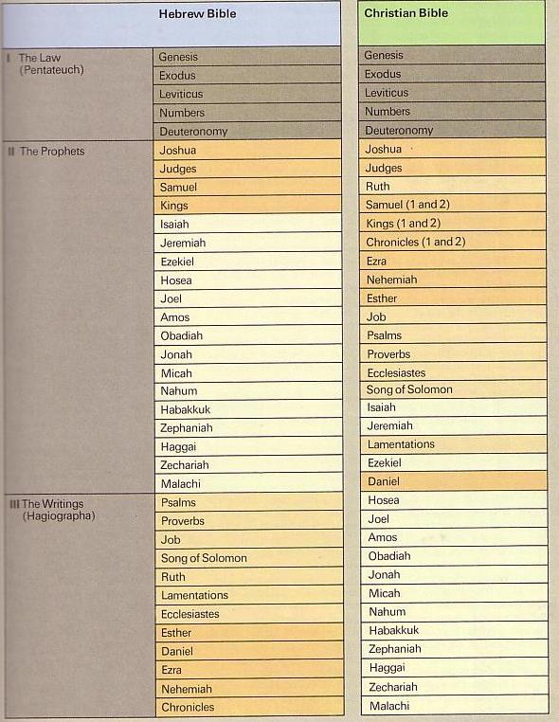
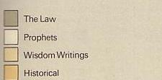
The Hebrew Canon
193
The Hebrew Canon
Jewish and Christian books are the same but in different order and classification
Notes:
"The Prophetic Books comprise the largest section of the Bible.¹ In Jewish tradition the Prophetic division includes the Former Prophets (Joshua–Kings) and the Latter Prophets (Isaiah, Jeremiah, Ezekiel, and the Twelve). The Former Prophets have much to say about individual prophets but seldom convey messages from them; the Latter Prophets contain much of the prophetic messages but say virtually nothing about them as persons.
Footnote:
¹ The OT was commonly divided into three sections by the Jews: the Law, the Prophets, and the Writings (see Luke 24:44). English Bibles following the Septuagint divide the Prophets into the Historical Books and the Prophetic Books, each of approximate equal length. The Historical and Prophetical Book sections are each of more length than any other segment of the Bible."
_______
Mark F. Rooker, “The Prophetic Books,” in The World and the Word: An Introduction to the Old Testament (Nashville, TN: B&H Academic, 2011), 361.

Slide 12
The Hebrew Canon
193
The Hebrew Canon
?
Matthew 5:17 "Do not think that I have come to abolish the Law or the Prophets;
I have not come to abolish them but to fulfill them."
Jewish and Christian books are the same but in different order and classification

Slide 13
The Hebrew Canon
193
The Hebrew Canon
Luke 24:44 "… everything written about me in the Law of Moses and the Prophets and the Psalms must be fulfilled."
Jewish and Christian books are the same but in different order and classification

Slide 14
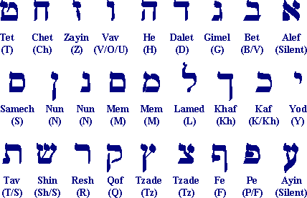
The Hebrew Consonants
The Hebrew Consonants
"tittle"
"yod"
Matt. 5:18 "… For verily I say unto you, Till heaven and earth pass, one jot or one tittle shall in no wise pass from the law, till all be fulfilled" (KJV).
Matt. 5:18 "… For truly I say to you, until heaven and earth pass away, not the smallest letter ["yod” or “jot”] or stroke ["tittle"] shall pass from the Law until all is accomplished" (NASB).
http://www.keyway.ca/htm2002/hebrewal.htm

Slide 15
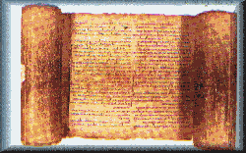

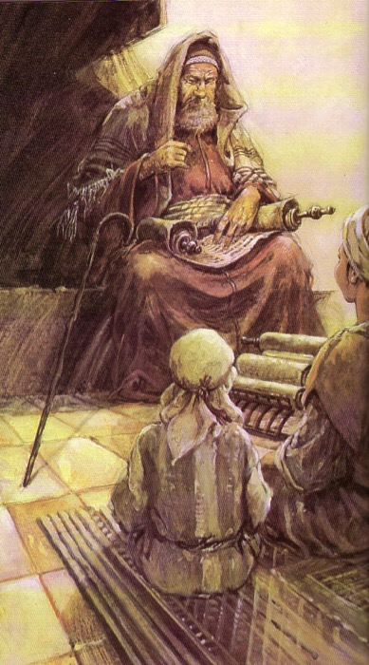
1. Hebrew: The Masoretic Text (MT)
155
Unpointed text
  (1500 BC – AD 800)
mhl rb hthsrb

Slide 16
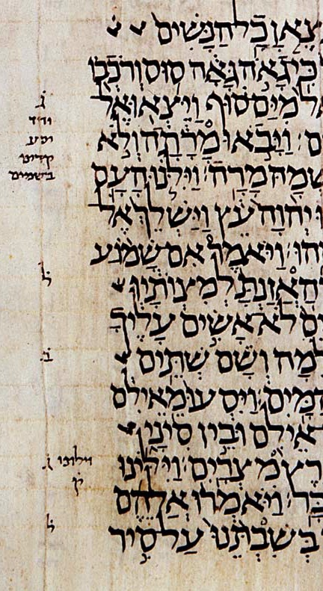
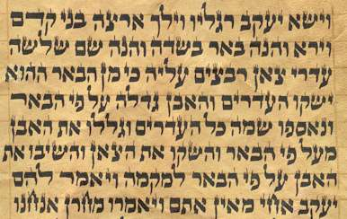
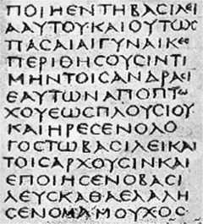
Most Hebrew manuscripts lack vowel pointing. Both Hebrew and Greek manuscripts often lack space between words too!

Slide 17
You can read without vowels too!
W rrly rd nglsh wtht vwls
bt t s pssbl wth prctc. t's vn fn!

Slide 18
You can read without vowels too!
W rrly rd nglsh wtht vwls
bt t s pssbl wth prctc. t's vn fn!
We rarely read English without vowels
but it is possible with practice. It's even fun!

Slide 19
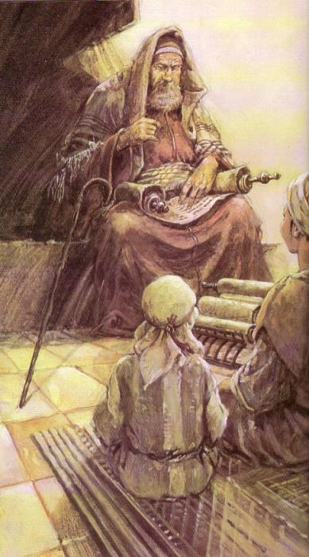
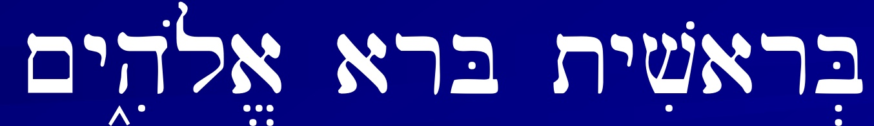
1. Hebrew: The Masoretic Text (MT)
193
The Hebrew Canon
Unpointed text
  (1500 BC – AD 800)
Pointed text by Masoretes
  (AD 800 - present)
mihole arab htihsereB
Bereshith bara elohim
In the beginning God created

Slide 20
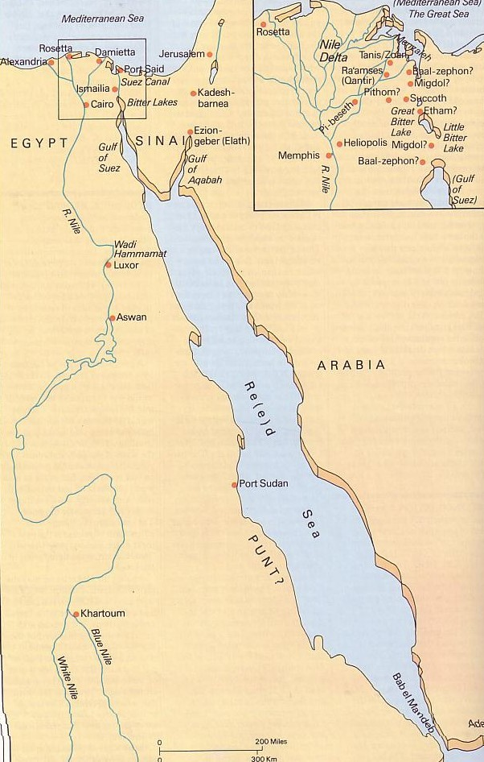
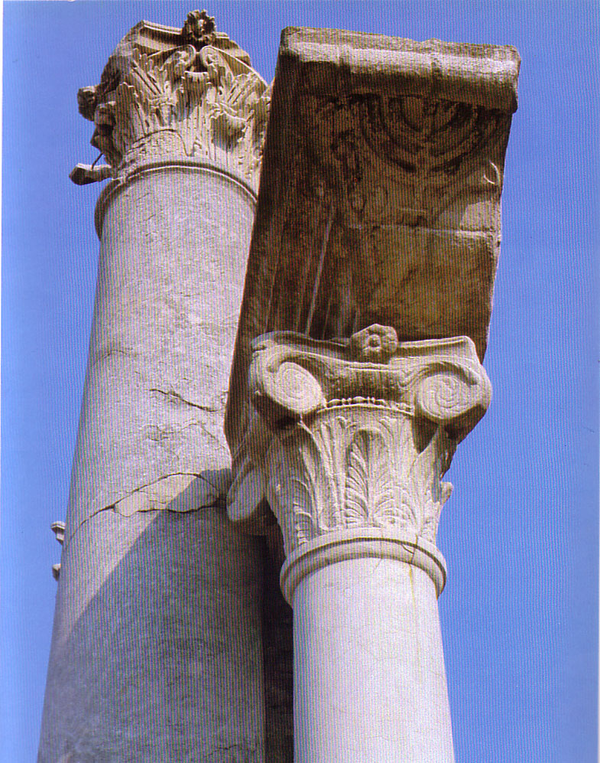
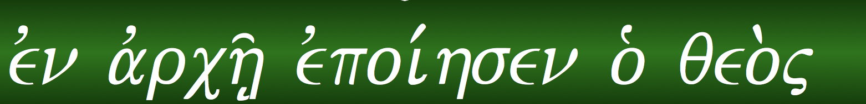
2. Greek: The Septuagint (LXX)
155
The OT Hebrew text was translated into Greek in Alexandria around 250 BC

Slide 21

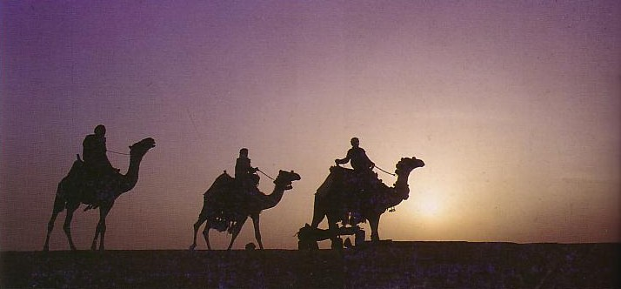
3. OT Canonicity
194
195
Why Adopted So Late?
Apocrypha
LXX
Antilegomena
Samaritans
Pharisaical Tradition
What Criteria was Used?
Authoritative & Enduring
Doctrinal Suitability
Prophetic Authorship
Claim to be God's Word
Dynamic Character
Canonicity is vital for those seeking God

Slide 22

In the beginning…
195a
From the time of Adam, commands given by God and traditions were probably passed down by oral tradition.

Slide 23

Discussion: Since stories passed by oral tradition for hundreds of years before Moses, what still gives you confidence that the Bible is God's Word, not just man's word?

Slide 24

The Beginning
Moses first received the 10 Commandments at Mount Sinai.
His five books are the first installment of the scriptural record.
Exodus 20:22–23:33

Slide 25
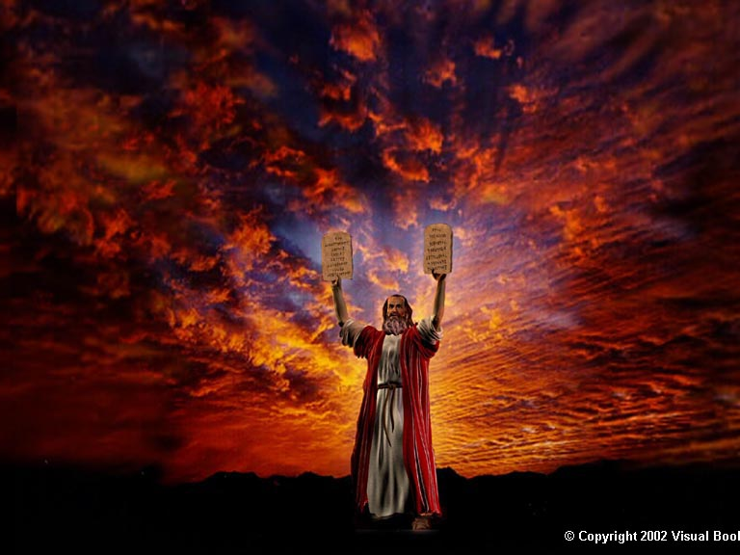
A Summation of God's Will

Slide 26



At the plains of Moab…
The book of Deuteronomy was added to the canon
By the time of Moses' death, Jews accepted the Pentateuch as from God himself

Slide 27
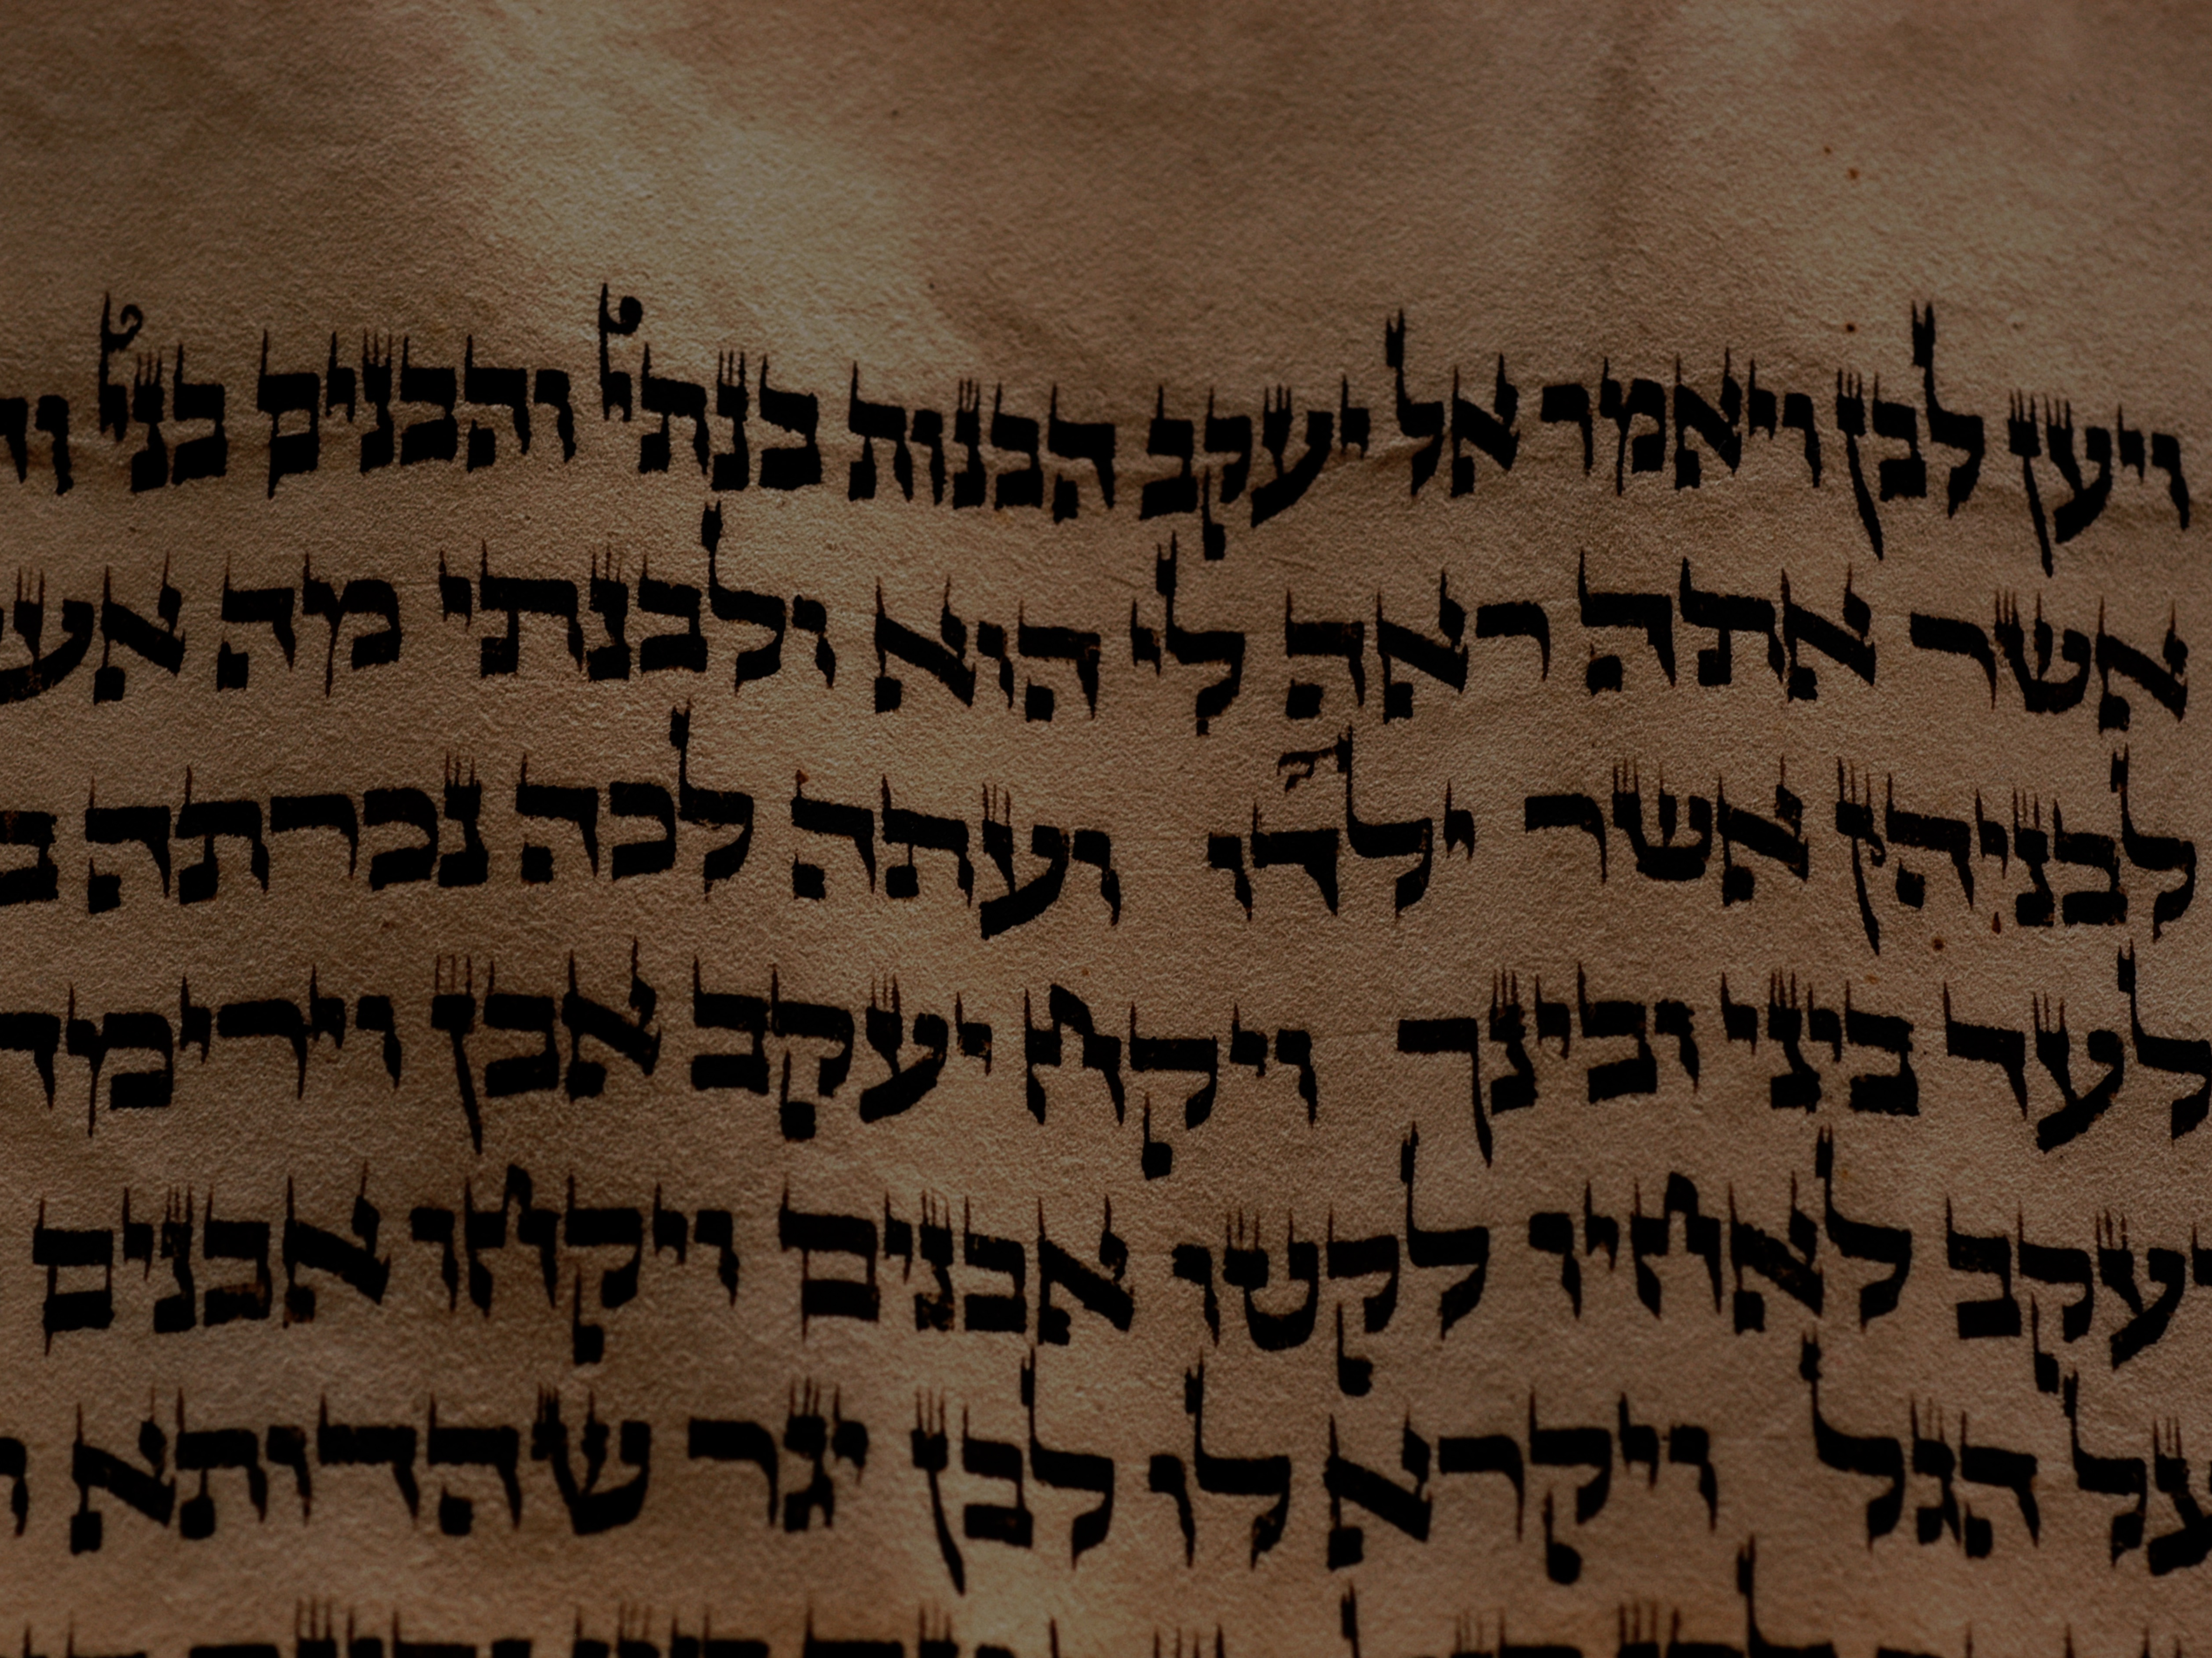
So!...The Command to Write
God explicitly commanded His servants to write down certain events and words:
Words of God at Sinai (Exod. 24⁴)
Tablets of Stone (Exod. 24¹² 34¹; Deut. 4¹³ 5²² 10^{2,4})
Moses to write the Words of God (Exod. 34²⁷⁻²⁹; Num. 33² Deut. 31⁹)
Joshua to write the Law (Deut. 27^{2-3,8} ; Josh. 8³²)
Josiah finds and reads the Law (2 Kings 22⁸⁻¹³)
Ezra preserves/edits the Books (Ezra 7¹⁰ ; Neh. 9³⁸ 13¹)

Slide 28
Preserve the Scrolls
Deuteronomy 31:26 "Take this Book of the Law and put it by the side of the ark of the covenant of the LORD your God, that it may be there for a witness against you."
Notice, the Torah (and subsequent writings) were not kept IN the Ark but beside it! …for ease of reference!

Slide 29
Adding to the Commands
The Jews Considered the Torah not to be messed with! We see the command given:
"You shall not add to the word that I command you, nor take from it, that you may keep the commandments of the LORD your God that I command you" (Deut. 4:2)
But as for the Writings and Prophets…

Slide 30
The Torah Only?
That's all well and good, but so far, you've only mentioned the Torah (Pentateuch)
What happened to the rest?
No one really knows for sure… but here's the generally believed account…

Slide 31
Writings & Prophets Limits
Joshua to write his own covenant (Josh 24²⁶)
Prophets unlike Moses to come after Moses (Exod 33¹¹; Deut 34¹⁰)
Samuel writes priestly ordinances (1 Sam 10²⁵)
Prophets commanded to write (Isa 8¹⁶ 30⁸ Jer 30² 36^{2,4,17,18} 45¹ 51⁶⁰ Ezek 43¹¹ Hab 2²)
Book read and explained to post exilic Jews (Neh 8¹⁻¹⁸) (Emendations made)

Slide 32
The Hebrew Canon
193
The Hebrew Canon
Jewish and Christian books are the same but in different order and classification

Slide 33
The Pentateuch (Torah)
Ca 722 BCE, by the time of the exile of the Northern Kingdom, the Pentateuch (hrt) was canonized.
And upon return from the exile, the Northern tribes already had the precursor of their current Samaritan Pentateuch (ca 110 BCE)

Slide 34

The Prophets and the Writings
The Prophets were probably canonized ca 400 BCE
The Writings were probably canonized ca 300 BCE

Slide 35
Road Map
CREATION
COMPILATION

Slide 36
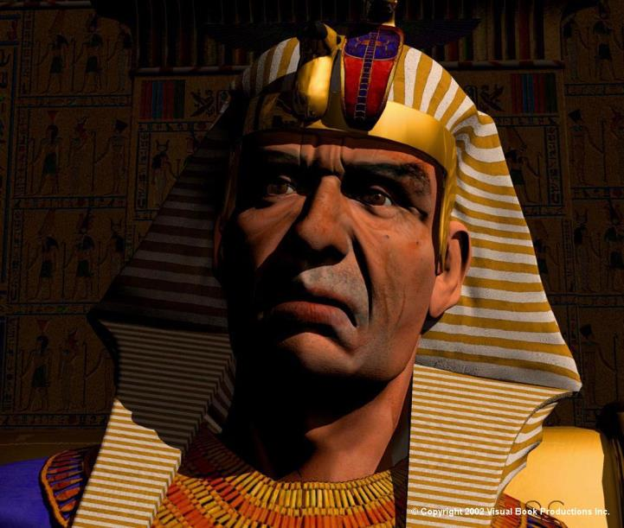
Evidences of the Canon before (the Assumed) Council of Jamnia
Letter of Aristeas (ca 130 BC) to his brother Philocrates about King Ptolemy II of 285 BC
The initial LXX contained only the Torah in ca 285 BC and the other books were added subsequently, finally bringing the completion of the Septuagint (LXX) ca 132 BC

Slide 37
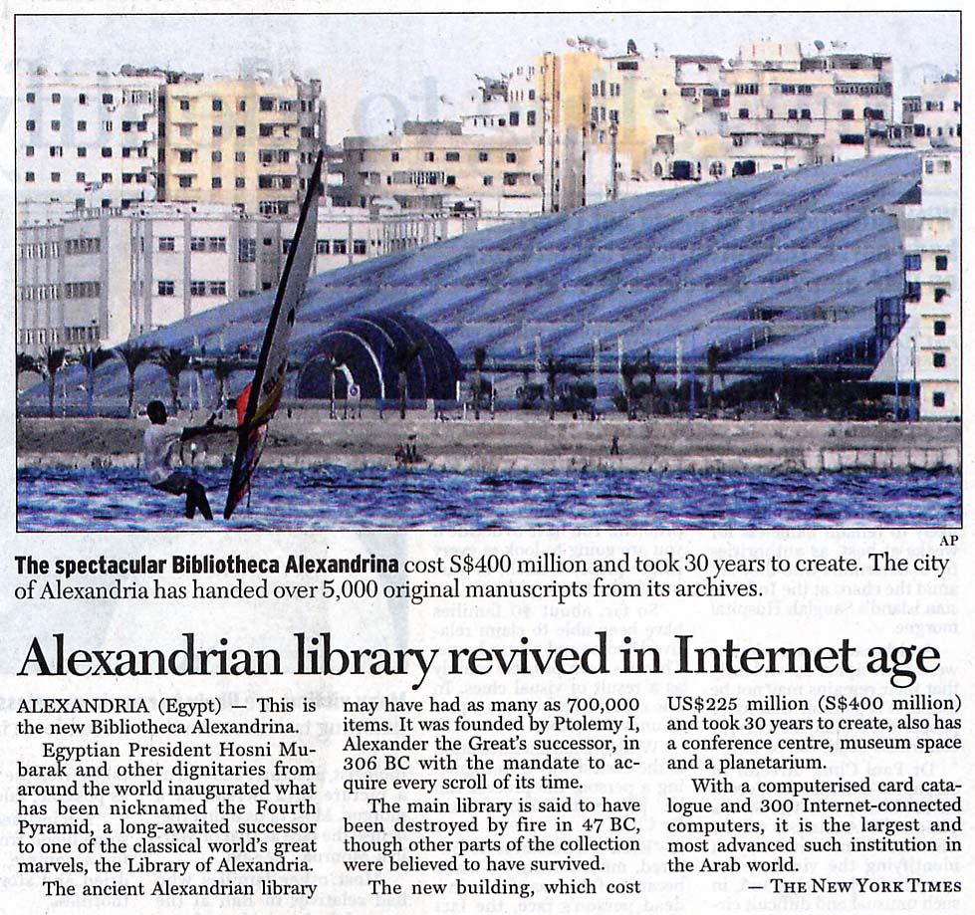
2002 News Paper Clip

Slide 38
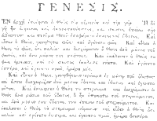
Septuagint (LXX)
194
This refers to the Greek translation of the Tanak. LXX means “seventy” in Latin.
It is useful as it helps us get closer to earlier manuscripts which were lost or destroyed.
Many versions of how they translated, such as…
6 representatives of each of the 12 tribes of Israel were sent to Alexandria with beautiful parchment of the Torah upon request of King Ptolemy to Eleazar the High Priest.
They completed it in 72 days.

Slide 39
Order of Books
195a
Judas Maccabeus, at the end of the war, was said to have collected the lost books:
2 Maccabees 2:14 "In like manner also Judas (Maccabeus) gathered together all those things that were lost by reason of the war we had, and they remain with us."
He probably then established the traditional order of the books in 164 BCE.
One traditional order is recorded in the Babylonian Talmud (Baba Bathra 14b-15a).

Slide 40
Council of Jamnia
195a
A council is believed to have convened at Jamnia in AD 90 (this is debated)
This was not so much to gather or decide the canon of the Tanak, but to confirm the places of the books already present
Books disputed but still placed in the canon became known as the Anti-Legomena ("spoken against")

Slide 41
The Divisions of "Scripture"
195a
Books that were undisputed are known as the Homolegomena
The books that were definitely thrown out are known as the Apocrypha
Disputed books are now called the Antilegomena, which include Ezekiel, Esther, Ecclesiastes, Proverbs and the Song of Songs
Books that were never considered part of the Scriptures are known as the Pseudepigrapha

Slide 42
Homolegomena
Undisputed for its content and doctrinal stability, accepted without reservation
Thirty-four (34) out of the 39 Old Testament books fall under the category of Homolegomena
Only five (5) fell under the category of Antilegomena

Slide 43
Disputed Books (Antilegomena)
195a
Song of Solomon – Considered too sensual
Ecclesiastes –Considered too skeptical. However, the conclusion is very much in line with the rest of Scripture: the fear of the Lord is the key to meaning in life.
Esther – The name of God is never mentioned in the book. However, it is clear that throughout the book, we see God preserving His people Israel.
Ezekiel –Thought to contradict the teaching of the Mosaic Law (e.g., no ark in the temple).
Proverbs – Thought to contain internal contradictions, this is and was not true of 26:4-5 and elsewhere.

Slide 44
Apocrypha
194a
Apocrypha is a Greek word meaning things hidden.
Traditionally in Bibles but not read or taught to the unlearned public
Considered by Protestants to be myth or uninspired due to content or doctrine

Slide 45
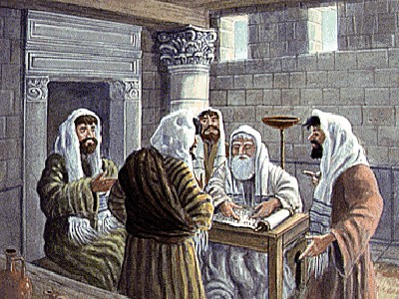
70 Scholars (LXX)

Slide 46

How Accepted are the 15 OT Apocryphal Books (250 BC-AD 100)?
165
Many
Most
Baruch
Letter of Jeremiah
Additions to Esther
Song of the Three Children
Susanna
Bel and the Dragon
1 Maccabees
2 Maccabees
Tobit
Judith
Wisdom of Solomon
Ecclesiasticus
A few...
1 Esdras
2 Esdras
Prayer of Manasseh
Psalm 151
3 Maccabees
4 Maccabees
Pseudepigraphal

Slide 47
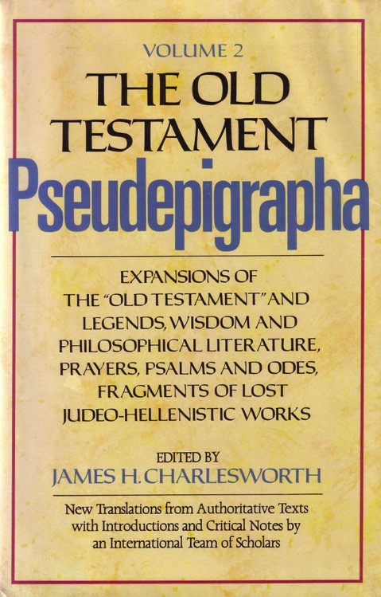
Selected Pseudepigrapha (200 BC-AD 200)
166
1 Enoch
Psalms of Solomon
Letter of Aristeas
Sibylline Oracles
Life of Adam & Eve
Testament of the 12 Patriarchs
Book of Jubilees
Lives of the Prophets
3 Maccabees
4 Maccabees
Assumption of Moses
2 Baruch
Ascension of Isaiah

Slide 48
Literary Categories
161-162
APOCALYPTIC
1 Enoch
2 Esdras
WISDOM
Ecclesiasticus
Wisdom of Solomon
FICTION
Tobit
Judith
Letter of Aristeas
Susanna
Bel and the Dragon
3 Maccabees
Sibylline Oracles
HISTORY
1 Esdras
1 Maccabees
2 Maccabees

Slide 49

No Gaps in Genesis 5
Jude quotes 1 Enoch
Adam
State lengths of time
Shorter lengths
Most natural
Show father-son
Jude 14
Seth
Enosh
7
Kenan
Mahalalel
Jared
Enoch
"Enoch, in the seventh generation from Adam, prophesied saying. . ."
(Jude 14a, NASB)
Methuselah
Lamech
Noah

Slide 50
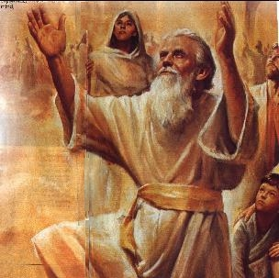
Enoch as a Prophet
Jude quotes 1 Enoch
"Enoch, who lived in the seventh generation after Adam, prophesied about these people"
(Jude 14a NLT).

Slide 51
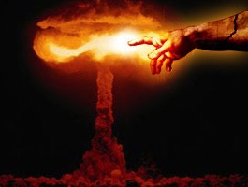
Quoting The Book of Enoch
Jude quotes 1 Enoch
[Enoch] said, “Listen! The Lord is coming with countless thousands of his holy ones ¹⁵to execute judgment on the people of the world. He will convict every person of all the ungodly things they have done and for all the insults that ungodly sinners have spoken against him” (Jude 14b-15 NLT).

Slide 52
Terminology of Authoritative Writings
194d
 | Jews | Protestants & Anglicans | Catholics | Eastern Orthodox
39 OT Books | Bible (inspired) | Old Testament (inspired) | Old Testament (inspired) | Old Testament (inspired)
27 NT Books | New Testament (uninspired) | New Testament (inspired) | New Testament (inspired) | New Testament (inspired)
4 Apocryphal Books (Tobit, Judith, etc.) | Apocrypha (uninspired; not in MT but in LXX) | Apocrypha (uninspired) | Deuterocanonical (canonical since 1546) | Apocrypha (canonical since 1673)
8 Apocryphal Books (1-2 Macc) | Apocrypha (uninspired) | Apocrypha (uninspired) | Deuterocanonical (since 1546) | Apocrypha (authoritative)
3 Apocryphal Books (Esdras, Manasseh) | Apocrypha (uninspired) | Apocrypha (uninspired) | Non-canonical (but in appendix) | Apocrypha (authoritative)
3 Pseudepigraphal Books: 3-4 Macc, Psalm 151 only | Pseudepigrapha | Pseudepigrapha (uninspired) | Apocrypha (but in appendix) | Apocrypha (authoritative)
60+ Pseud Books (esp. 1 Enoch) | Pseudepigrapha (uninspired) | Pseudepigrapha (uninspired) | Apocrypha (uninspired) | Pseudepigrapha (uninspired)

Slide 53


Why are these books doubted?
194c
Why are these books doubted?
Never recognized as authoritative
False theology
PURGATORY:
The result of sacrifices for pagan dead–"and thus he made atonement for the dead that they might be freed from their sin"
(2 Maccabees 12:46)
SALVATION BY WORKS:
"It is better to give to the poor than to store up gold. Such generosity will save you from death and will wash away all your sins."
(Tobit 12:8b-9a GNB)

Slide 54
Why are these books doubted?
194c
Why are these books doubted?
Never recognized as authoritative
False theology
No claim of inspiration
Lack of dynamic character
Suspicious history of RCC acceptance

Slide 55
So do these books have any value?
194c
So do these books have any value?
Yes!
Intertestamental history
Jewish sects and institutions
Theological beliefs (e.g., angels)

Slide 56
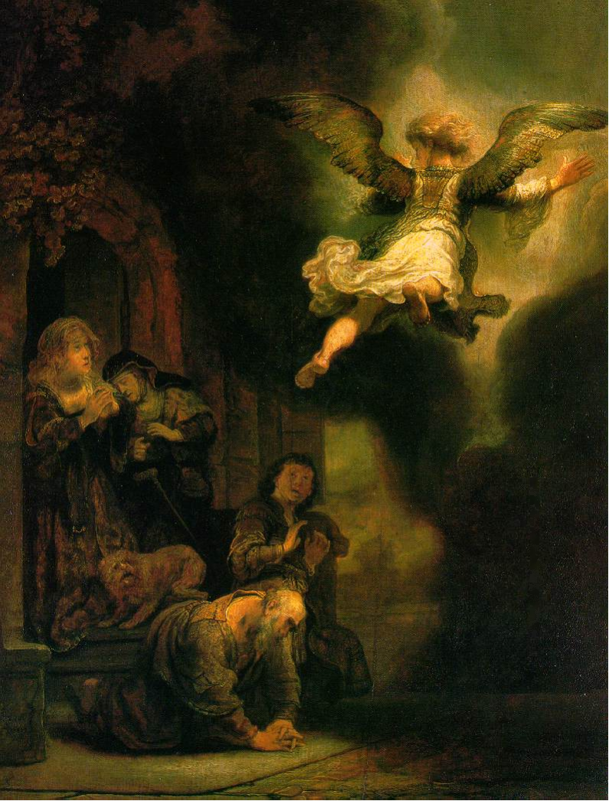
Archangel leaving the Family of Tobias
• Pictured on the front of the NT Backgrounds class notes
Rembrandt, 1637
Notes:
http://www.google.com.sg/imgres?imgurl=keptar.demasz.hu/arthp/art/r/rembran/painting/biblic1/tobias.jpg&imgrefurl=http://keptar.demasz.hu/arthp/html/r/rembran/painting/biblic1/&h=1045&w=795&sz=134&tbnid=s5jpeQ2vX3oJ:&tbnh=149&tbnw=113&start=6&prev=/images%3Fq%3DBiblical%2Bfamily%26imgsz%3Dxxlarge%26svnum%3D10%26hl%3Den%26lr%3D%26ie%3DUTF-8%26safe%3Dactive%26sa%3DG

Slide 57
So do these books have any value?
194c
So do these books have any value?
Yes!
Intertestament history
Jewish sects and institutions
Theological beliefs (e.g., angels)
Lexical backgrounds (e.g., "age to come")
Literary forms (e.g., letters)
Balance to rabbinic writings

Slide 58
Pseudepigrapha
194a
The Pseudepigrapha refers to the books that did not make it to the canons of either the Protestant and Catholic Bibles.
Books were taught to have “fake” authorship or authors with pseudonyms.
Content also appeared fictitious to say the least and contradictory to doctrine of the Torah.

Slide 59
Criteria for the Canon
195a
Doctrinal Stability (to Torah )
History of Authoritative use and usage
Claimed itself to be “Word of God”
Prophetic Authorship
Dynamic Character

Slide 60
Jesus' Testimony to the Canon
195a
Luke 24:27 And beginning with Moses and all the Prophets, He interpreted to them in all the Scriptures the things concerning himself.
Luke 24:44 Then he said to them, "These are my words that I spoke to you while I was still with you, that everything written about me in the Law of Moses and the Prophets and the Psalms must be fulfilled."
Luke 11:51 from the blood of Abel to the blood of Zechariah (2 Chron24:21), who perished between the altar and the sanctuary. Yes, I tell you, it will be required of this generation.
Matthew 23:35 so that on you may come all the righteous blood shed on earth, from the blood of innocent Abel to the blood of Zechariah the son of Barachiah (2 Chron. 24:21), whom you murdered between the sanctuary and the altar.
Law and Prophets (Matthew 5¹⁷ 7¹² 22⁴⁰)

Slide 61
New Testament Testimony to the OT Canon and Authority
195b
Jesus (Luke 18³¹⁻³³ 24²⁵⁻²⁷ John 10³⁵)
Peter (Acts 1¹⁶)
Stephen (Acts 7³⁸)
Paul (Romans 3²)
James (James 4⁵)

Slide 62
Close of the Canon
195b
The prophetic gift was said to have ceased
1 Maccabees 9:27 So was there a great affliction in Israel, the like whereof was not since the time that a prophet was not seen among them.

Slide 63
Road Map
CREATION
COMPILATION
CONCOCTIONS

Slide 64
Number of Books?
195b
Persons have come up with differing versions
22
There are 22 consonants in the Hebrew alphabet
Some authors say there are 22 books, like the 22 letters of the Hebrew alphabet (some say 24)
Josephus was the first to mention the number 22 around AD 96
The number 24 was 1st recorded in 2 Esdras 14⁴⁴⁻⁴⁸
The Qumran library had all OT books all but Esther
24
23

Slide 65
Which Books?
Books | Josephus AD 96 | Melito AD 170 | Origen AD 230 | Athanasius AD 367 | Our Bible Today
Torah | 5 | 5 | 5 | 5 | 5
Joshua |  |  | 1 | 1 | 1
Ruth & Judges | 1 | 2 | 1 | 2 | 2
Samuel and Kings |  | 2 | 2 | 4 | 4
Chronicles | 1 (Includes Samuel + Kings) | 2 | 1 | 2 | 2
Ezra & Nehemiah | 1 | 1 | 1 | 2 | 2
Psalms | 1 | 1 | 1 | 1 | 1
Proverbs | 1 | 1 | 1 | 1 | 1
Ecclesiastes | 1 | 1 | 1 | 1 | 1
Song of Songs | 1 | 1 | 1 | 1 | 1
Isaiah |  | 1 | 1 | 1 | 1
Jeremiah & Lamentations & Epistle of Jeremiah | 1 (Jeremiah & Lamentations) | 1 (Jeremiah & Lamentations) | 1 | 2 | 2
Daniel | 1 | 1 | 1 | 1 | 1
Ezekiel |  | 1 | 1 | 1 | 1
Job | 1 | 1 | 1 | 1 | 1
Esther | 1 |  | 1 | Epistle to Jeremiah | 1
Prophets | 6 | 1 (the 12) | 1 | 12 | 12
Jesus Naue |  | 1
Total | 22 | 23 | 22 | 39 | 39
195c
Now are you confused?

Slide 66
Road Map
CONSERVATION
CREATION
COMPILATION
CONCOCTIONS

Slide 67
The Chronology
195b
Ca 722 BCE Pentateuch
Ca 400 BCE Prophets canonized
Ca 300 BCE Writings canonized
Ca 285 BCE Septuagint (LXX Torah)
Ca 132 BCE Septuagint (LXX Full Version)
Ca 130 BCE letter of Aristeas
AD 90 Council of Jamnia 39 OT books affirmed
AD 96 Philo testifies to the OT Canon
AD 600 Masoretes added vowel points, accents and the Masora to lock in the Scriptures
Ca AD 918 full codex found from Ben Asher Family

Slide 68

What the text looked like…
#rahtaw~ymVhta~yhlaarBtyvarB
`#rah taw ~ymVh ta ~yhla arB tyvarB
`#r<a'(h' taeîw> ~yIm:ßV'h; taeî ~yhi_l{a/ ar"äB' tyvi arEB.
How the text was written, and how it was read
The kethiv – what was written
The qere – what was read

Slide 69
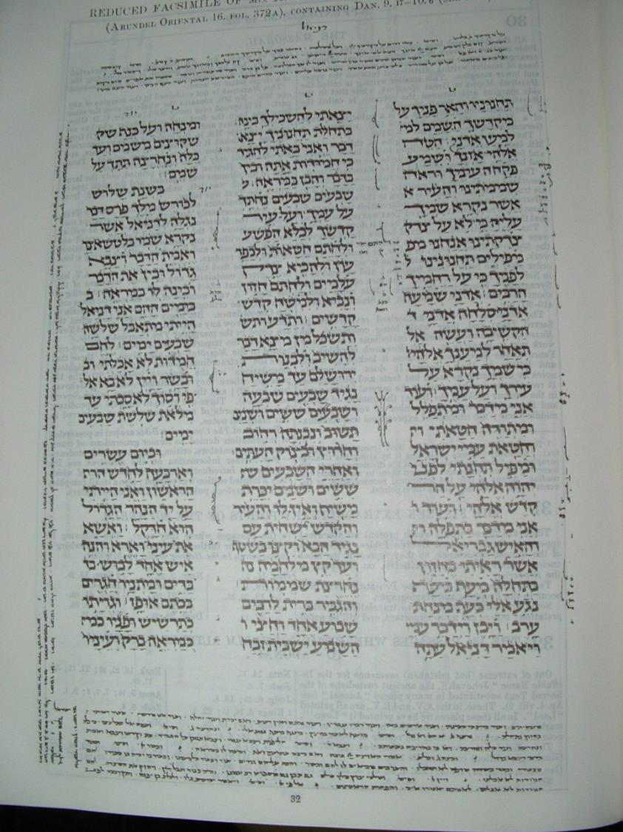
The Masora
The Masora is made up of two parts:
The Masora Magna is
the 4 top lines and the bottom 7 lines
The Masora Parva is the notes written on the side

Slide 70
A Fence to the Scriptures
The Masorah or Masoretic Text (MT) is written in 3 columns for ease of reading:
The Masora, was written like a fence around the three columns of the page to ensure no one adds to the letter of the book
Masora Magna basically give a word count of the number of times certain words appear in the Scriptures
Masora Parva indicates variant forms of the word (e.g. 'daud' vs 'dauid')

Slide 71
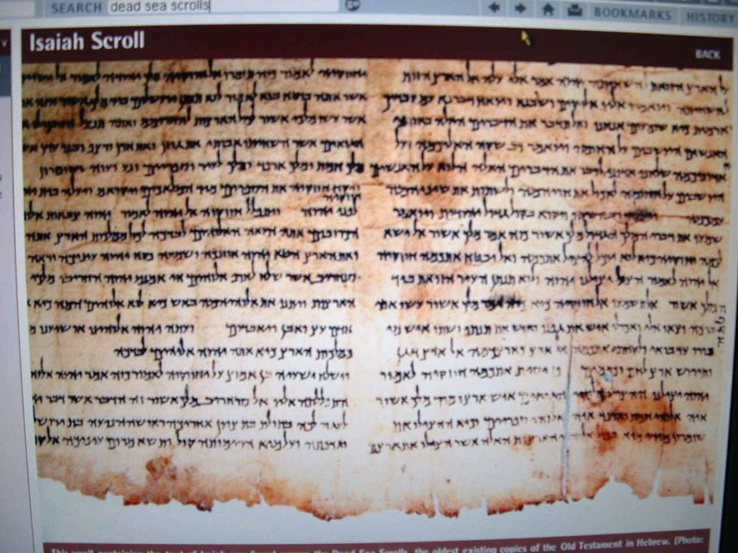
Sopherim
The Sopherim were believed to be the authorized revisers of the text of the Masorah
After the return from exile (Neh 8⁸), the Law was read and explained to the people
The Scribes or Sopherim were the official revisers of the text, amending the text before it was passed on to the Masoretes, who were the official custodians of the MT

Slide 72
Division of the Torah
The Babylonian Jews divided the Torah up into 54 parts that it may be read in a year [Parashiyyoth (parashah)].
The Palestinian Jews had the Torah paragraphed into 154 divisions to cover it in three years [Sedarim (seder)].

Slide 73
Ancient Texts We Have Today
AD 850 Codex of Pentateuch
AD 895 Cairo Codex – Prophets
AD 916 Leningrad Codex – Prophets
Ca AD 930 Aleppo Codex – Whole OT
Ca AD 918 Standard Division of OT by Masoretes of the Ben Asher Family
Ca AD 1000 Leningrad OT

Slide 74
Dead Sea Scrolls
In 11 mountain caves west of Khirbet Qumran, ancient manuscripts of all the canonical books except Esther were discovered in 1947-1956
Manuscripts found were dated from the middle of the 3rd Century BCE to AD 135. Prior to this, manuscripts used for the Hebrew Bible dated from AD 900-1000
Only minor discrepancies appeared compared to the MSS 1000 later—mostly of grammar!
The 7th edition of Kittel's BHS (Hebrew Bible) incorporates the textual variants

Slide 75
Division of Chapters
AD 1228 Stephen Langton divided the Latin Vulgate into chapters
AD 1518, the chapters were applied to the Hebrew Bible (Bomberg Edition)
AD 1571, chapters each received a number
Verses were subsequently added, first to the Bomberg's Great Bible

Slide 76
The Bible Today
1488 – Soncino – 1st Full Hebrew Bible
1937 – Kittel – Biblia Hebraica – 3rd Ed
1951 – Kittel – 7th Ed – Included readings from the Dead Sea Scrolls

Slide 77
What Does This Mean to Me?
Scripture has been transmitted us from the originals with great care
We can have confidence in the reliability of the Scriptures that we have now
The challenge of our predecessors to preserve, instruct and propagate the Scriptures still remains with us

Slide 78
Challenge
Are you convinced the Bible
comes from God
and is indeed the very word of God?
LIVE LIKE IT IS!

Slide 80


OT Backgrounds link at BibleStudyDownloads.org
Get this presentation for free!
Notes:
NT Survey (ns)

