Slide 1
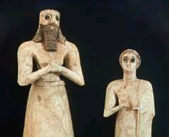
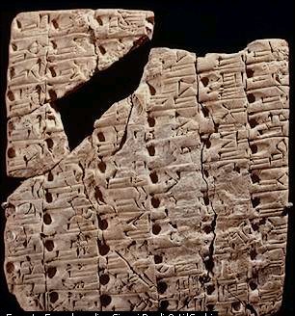
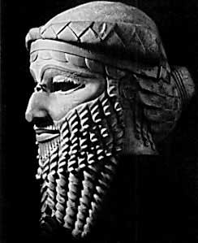
The Sumerians
75
AGENDA:
Origin
Geography
History
Government
Society
Language
Writing
Education
Literature
Religion
Relevance
Dr. Rick Griffith • Jordan Evangelical Theological Seminary • BibleStudyDownloads.org

Slide 2
Who Were the Sumerians?
75
They were the most significant people not noted in the Bible
Sumer
This map shows them coming from the desert, but they came from Ararat (Gen. 11)
Notes:
Sumerians were descendents of Shem (Semites) who around 4000 BC migrated to the point where the Tigris and Euphrates meet in southern Mesopotamia. This map interestingly show the Semitic peoples coming out of the desert (http://ancienthistory.about.com/gi/dynamic/offsite.htm?site=http://www.art%2Darena.com/iran1.html).

Slide 3
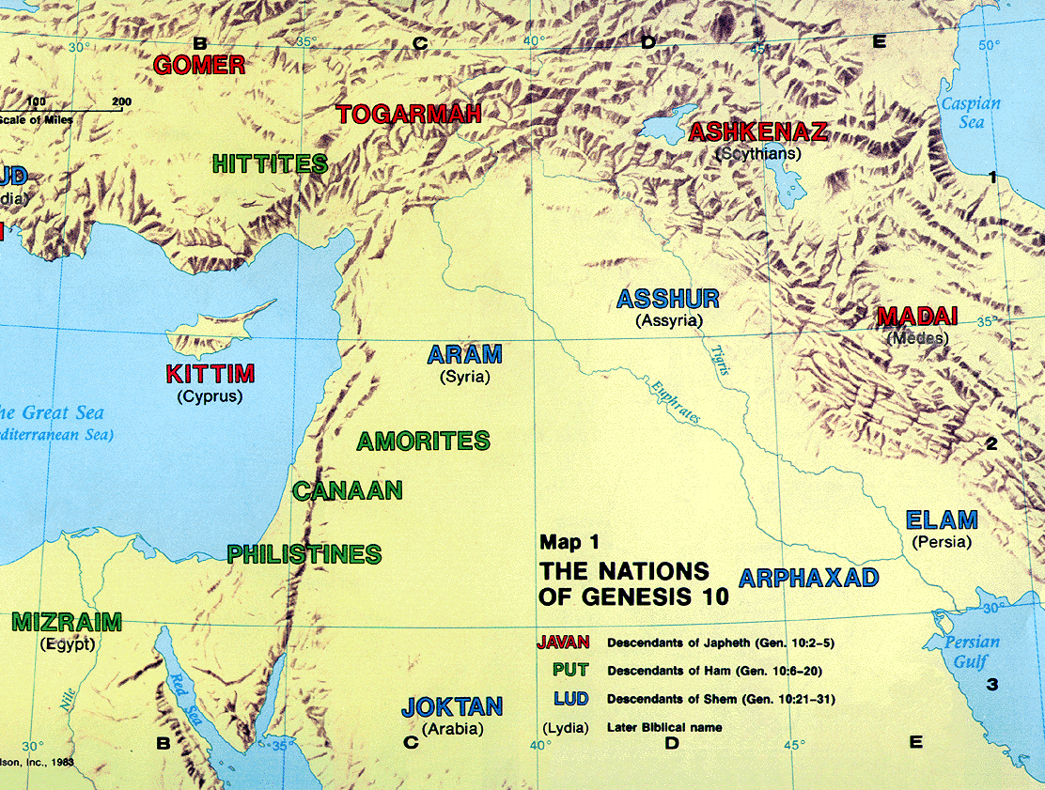
Identity: Who Were the Sumerians?
Sumerians

Slide 4
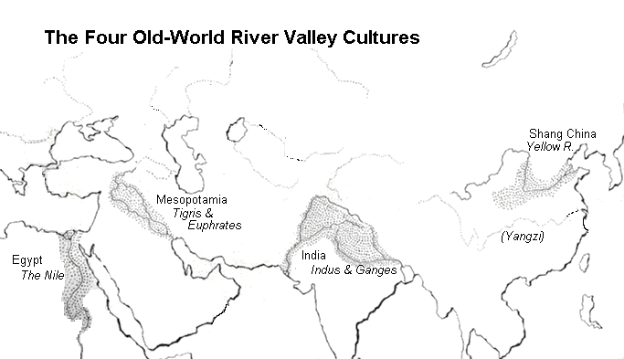
Man has always needed water
The Four Old-River Valley Cultures
Shang China
Yellow River
Mesopotamia
Tigris & Euphrates
Yangzi
Egypt
India
The Nile
Indus & Ganges
Notes:
Can you name the four key regions of ancient civilization and their rivers?
______________
http://www.google.com.sg/imgres?imgurl=web.syr.edu/~clmitche/Sumerian%2520God.jpg&imgrefurl=http://web.syr.edu/~clmitche/River.htm&hl=en&h=432&w=400&start=9&prev=/images%3Fq%3Dsumerian%2BAn%26imgsz%3Dsmall%7Cmedium%7Clarge%7Cxlarge%26svnum%3D10%26hl%3Den%26lr%3D%26ie%3DUTF-8

Slide 5
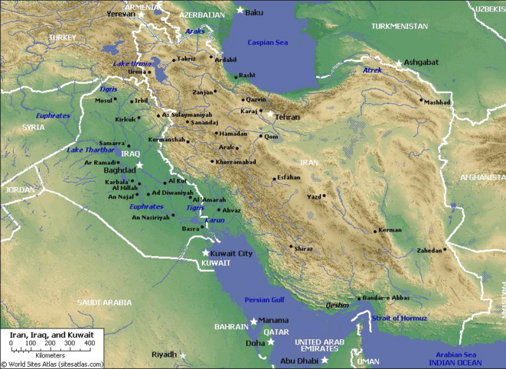
Geography of Sumer
Known as Babylonia, included South Iraq
(from Baghdad to the Persian Gulf)
Linked with Akkad
Possibly biblical“Shinar” (Gen. 10:10; 11:2; 14:1, 9)
Arable land

Slide 6
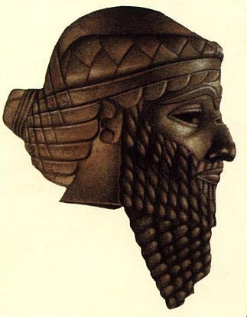
Origin
Entered Mesopotamia from mountains
city - Aratta
temple – Enlil
Arrived via Persian Gulf

Slide 7
Geography
Ur
Notes:
• The modern coastline of the Persian Gulf looks like this today.
• But the ancient coastline went significantly upstream northwest.
• Filled in, this dry area today was covered with water
• This, of course, made ancient Ur a coastal city!
• Also, the Euphrates River emptied into the Persian Gulf much sooner.
• Instead of joining the Euphrates as it does today, the Tigris River emptied into the Persian Gulf further east.

Slide 8
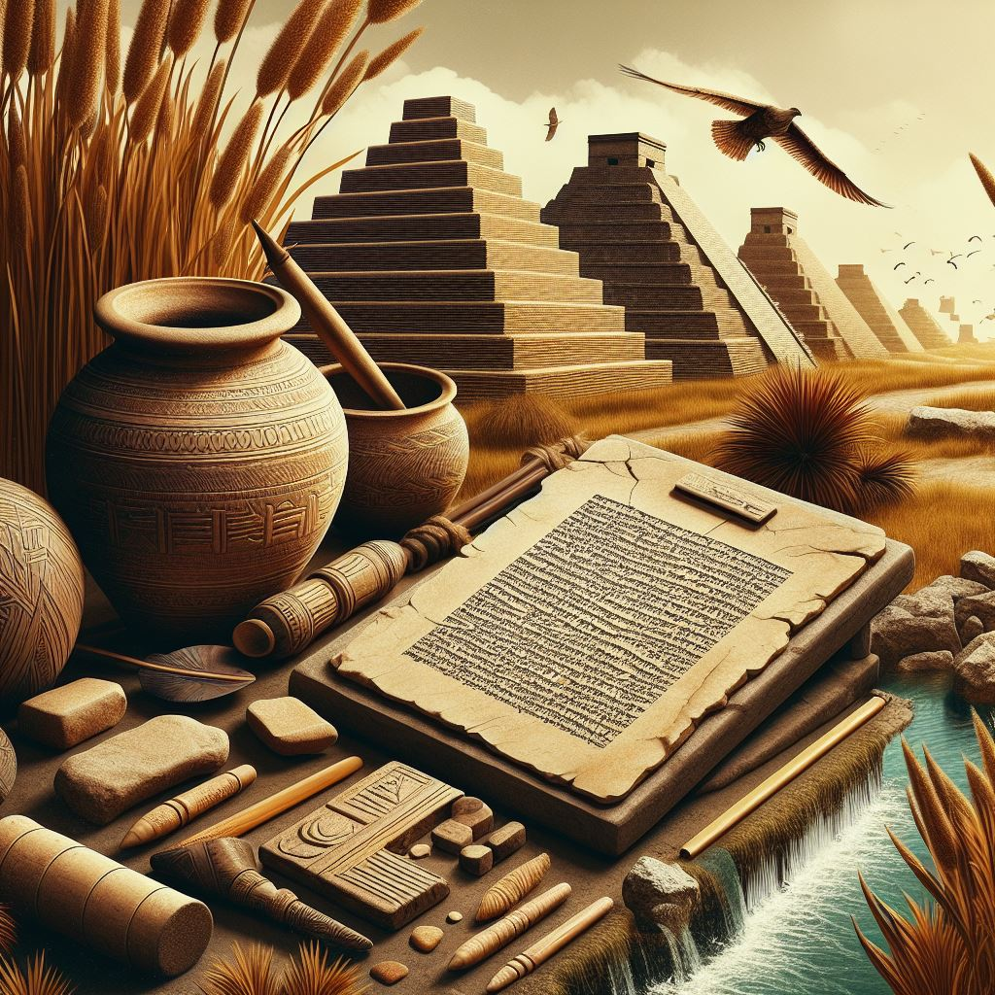
History
Three periods:
Early Sumerian: 3000 – 2700 B.C.
Classic Sumerian: 2700 – 2250 B.C.
Neo-Sumerian: 2100 – 1960 B.C.
Notes:
Let's look at these three periods in chronological order of 300 years, 450 years and

Slide 9
Early Sumerian 3000 – 2700 B.C.
Dominated by 3 major cities:
Uruk, Aratta and Kish
3 leading figures:
Enmerkar, Lugalbanda and Gilgamesh

Slide 10
Classic Sumerian 2700 – 2250 B.C.
Focused primarily on 4 cities:
Ur, Kish, Umma and Lagash

Slide 11
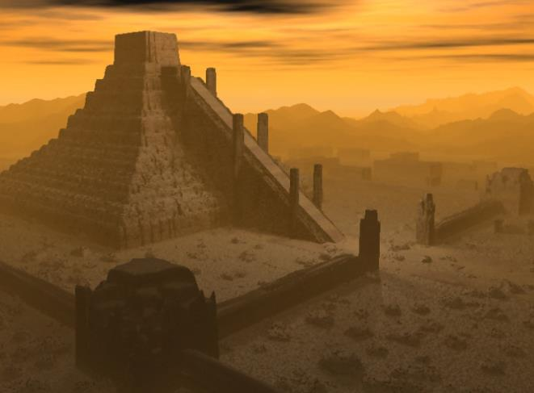
Classic Sumerian 2700 – 2250 B.C.
4 renowned figures :
Eannatum
Urukagina
Gudea of Lagash
Lugalzaggisi of Umma
The greatest treasure
The first true historic document

Slide 12
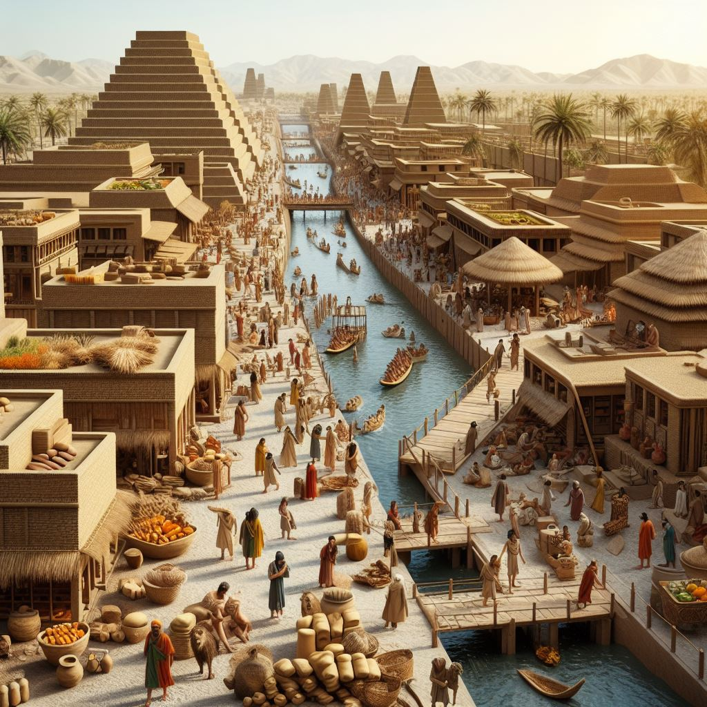
Neo-Sumerian 2100 – 1960 B.C.
The ruins of Akkadian dynasty, Ur arose
Widespread immigration of other people
Sumerians disappeared and the language no longer was used

Slide 13
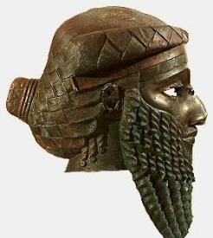
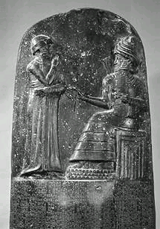
Sumerian Dynasties
3100-2700 Uruk IV-Early Dynastic I Periods
2600-2370 3rd Early Dynastic Period
2370-2228 Old Akkadian (Agade) Period
2306-2292 Manistusu
2254-2230 Sar-kali-sarri
2113-1991 3rd Dynasty of Ur
2113-2096 Ur-Nammu
2037-2029 Su-Sin
2028-2004 Ibbi-Sin
1991-1786 Isin-Larsa Dynasties
2017-1985 Isbi-Erra
1934-1924 Lipit-Istar
1894-1595 Old Babylonian Period (1st Dynasty of Babylon)
1792-1750 Hammurabi
– 1750 BC: The Sumerians at this point were absorbed by the Semites who inhabited the same area.

Slide 14
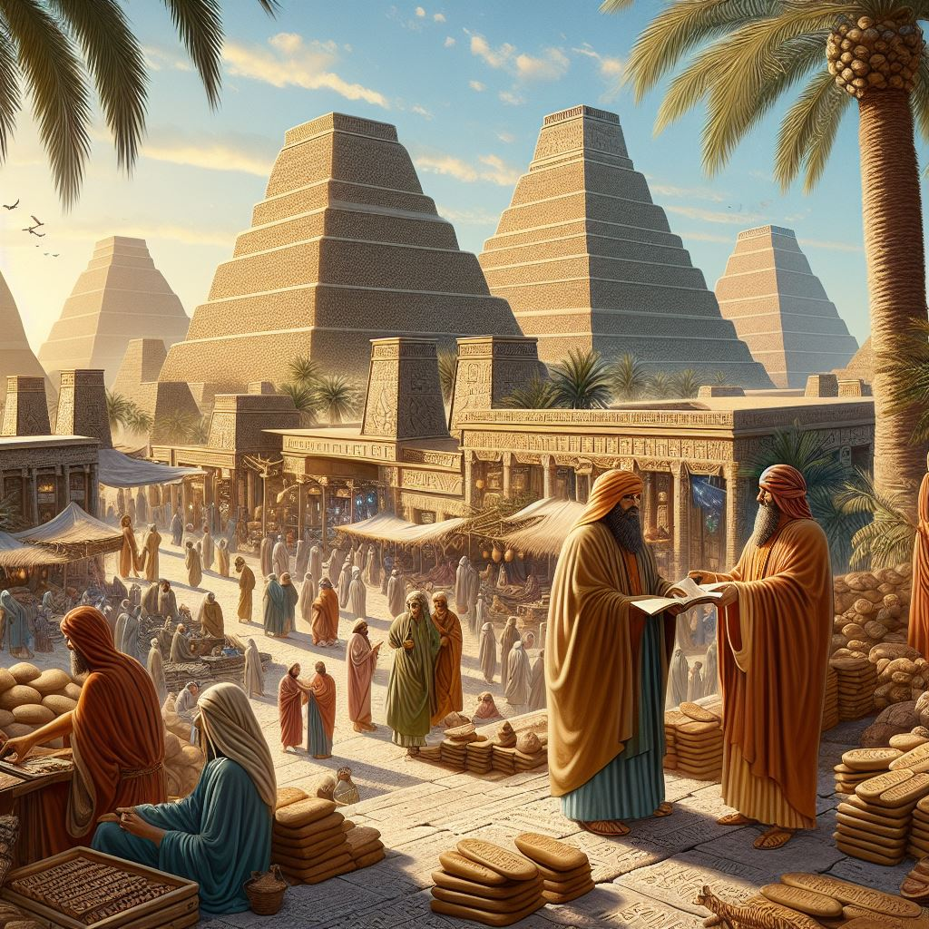
Government
Groups of agricultural villages
Temple with political power over society
Formation of a secular government
War leader (Lugal) grew in importance

Slide 15
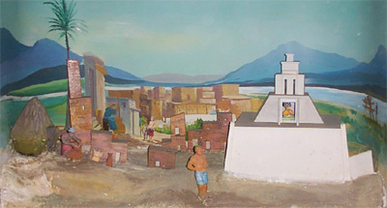
Society
Pantheistic worldview and social classes
The birth of the concept of laws
Divine authority of the law and government
Distinct laws for men and women

Slide 16
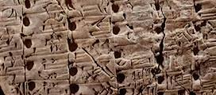
Language
77
An unknown language
Preservation of Sumerian written language

Slide 17
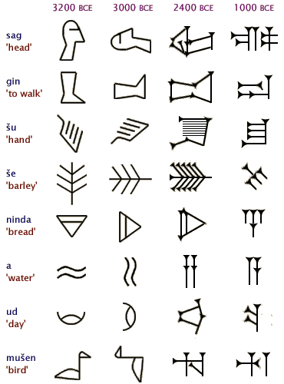
Writing
77, 79
Facts of Sumerian writing
Writing first appeared in Sumer
Syllabic pronunciation
Earliest inscriptions are in Sumerian
Different uses of picture-signs
Notes:
Pictures gradually gave way to simple strokes of the stylus on clay.

Slide 18
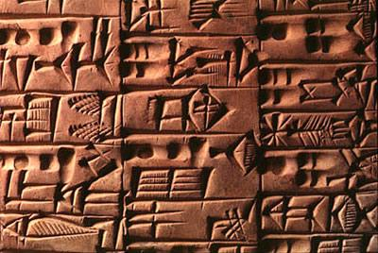
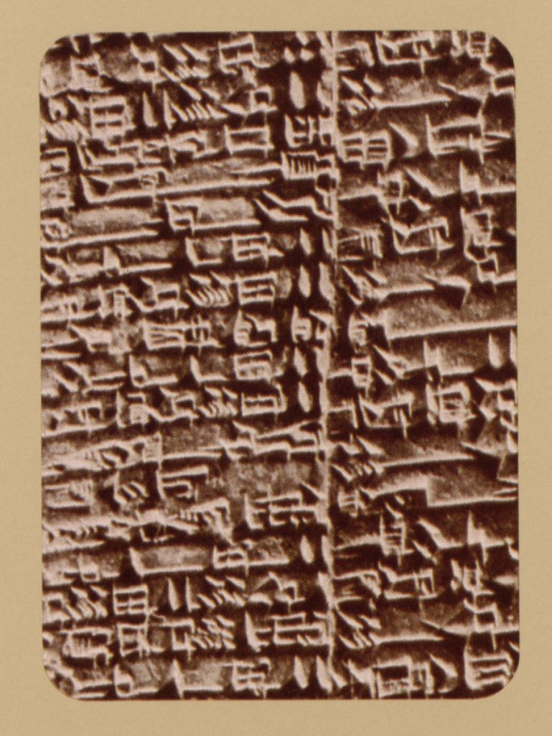
Writing
79
Stages of Cuneiform Development
Simple stylized pictures (pictographs)
Simplified picture signs into wedge-shaped script
Complex signs were reduced to uniform script
Notes:
Microsoft Copilot results on 25 May 2024 (searched for "Stages of Cuneiform Development that does not mention evolution"):
Certainly! Let’s delve into the stages of cuneiform development, focusing on its historical progression without invoking the concept of evolution:
Proto-Cuneiform (c. 3500 BCE):
The earliest cuneiform tablets were pictorial in nature. These depicted concrete and visible subjects such as kings, battles, and floods.
Their primary purpose was long-distance communication in trade. As a result, their compositions were straightforward, emphasizing information about goods, prices, and sellers.
Cuneiform Script Development (c. 3500 BCE):
The Sumerians pioneered the cuneiform script around this time.
The name “cuneiform” derives from the Latin word “cuneus,” meaning “wedge.” This reflects the wedge-shaped style of writing.
Using a stylus, they pressed into soft clay, creating wedge-like imprints representing word-signs (pictographs) and later, phonograms (word-concepts).
Advancements in Uruk (c. 3200 BCE):
The city of Uruk significantly contributed to the advancement of cuneiform writing.
Here, cuneiform evolved further, enabling the creation of literature beyond mere administrative records.
Uruk’s contributions elevated cuneiform to a powerful tool for expressing ideas and stories.
Refinement (3000 BCE):
Cuneiform continued to evolve, becoming more refined.
The consistent use of phonetic writing became apparent after 2600 BCE.
This marked the beginning of a true writing system, combining word-signs and phonograms.
Full Development (2900 BCE - 2334 BCE):
During the Early Dynastic Period in Mesopotamia, cuneiform reached its full development.
It became a sophisticated script, capable of expressing complex ideas, myths, and historical narratives.
Enheduanna: World’s First Author (2285 BCE - 2250 BCE):
Enheduanna, daughter of Sargon of Akkad, holds the distinction of being the world’s first author known by name.
She composed hymns and poems in cuneiform, leaving a lasting literary legacy.
Epic of Gilgamesh (c. 2150 BCE - c. 1400 BCE):
The tales of Gilgamesh were written in cuneiform during this period.
These stories later informed the epic known as The Epic of Gilgamesh.
Other Notable Works:
The Descent of Inanna (c. 1900 BCE - c. 1600 BCE) and the Atrahasis Myth of the Great Flood (c. 1640 BCE - c. 1700 BCE) were also composed in cuneiform.
The Ashurbanipal’s Library at Nineveh (c. 647 BCE - c. 629 BCE) contained an extensive collection of cuneiform clay tablets.
Transition to Alphabetic Script (c. 100 BCE):
Cuneiform was eventually abandoned in favor of the alphabetic script after approximately 100 BCE.
The decipherment of cuneiform tablets in the 19th century transformed our understanding of history, revealing the rich cultural heritage of ancient Mesopotamia.

Slide 19
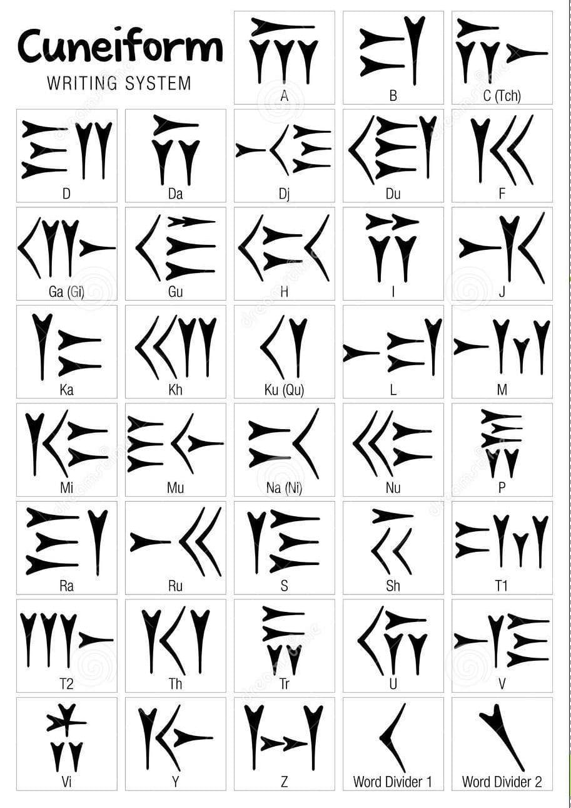
Writing
77, 79
Characteristics of Sumerian writing
Each sound was composed of 3-5 strokes of the stylus
Words had two types of dividers
Notes:
Pictures gradually gave way to simple strokes of the stylus on clay.

Slide 20
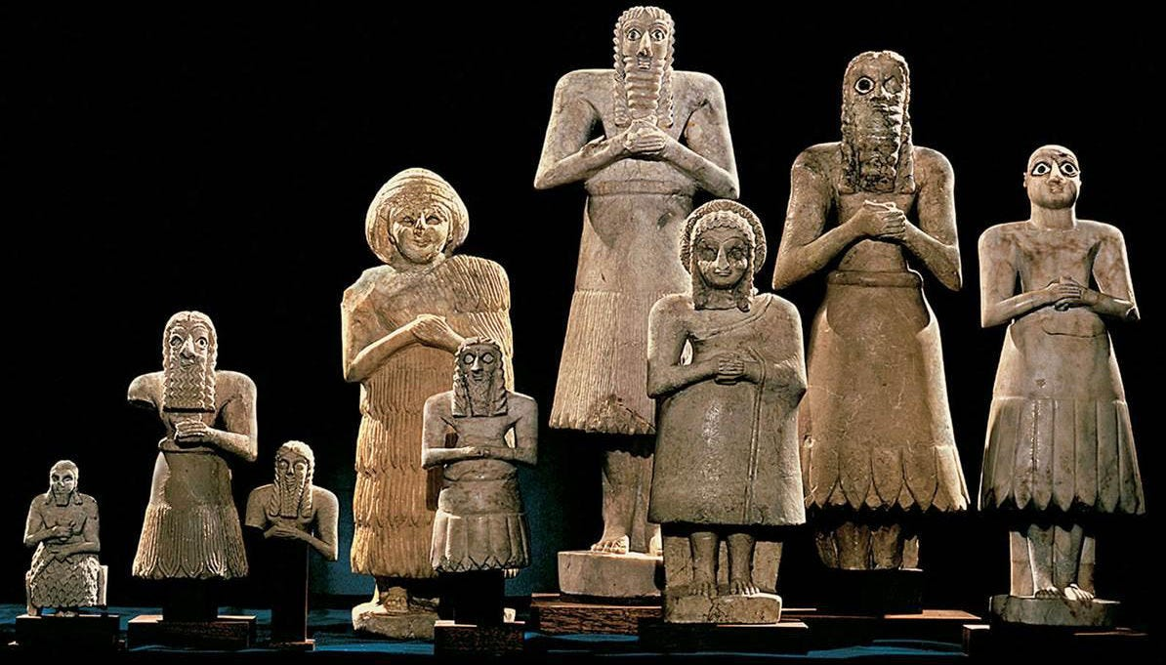
Education
77
Evidence of ancient Sumerian education
What was the purpose of the school (Edubba)?
Where did students learn?
Who went to school?

Slide 21
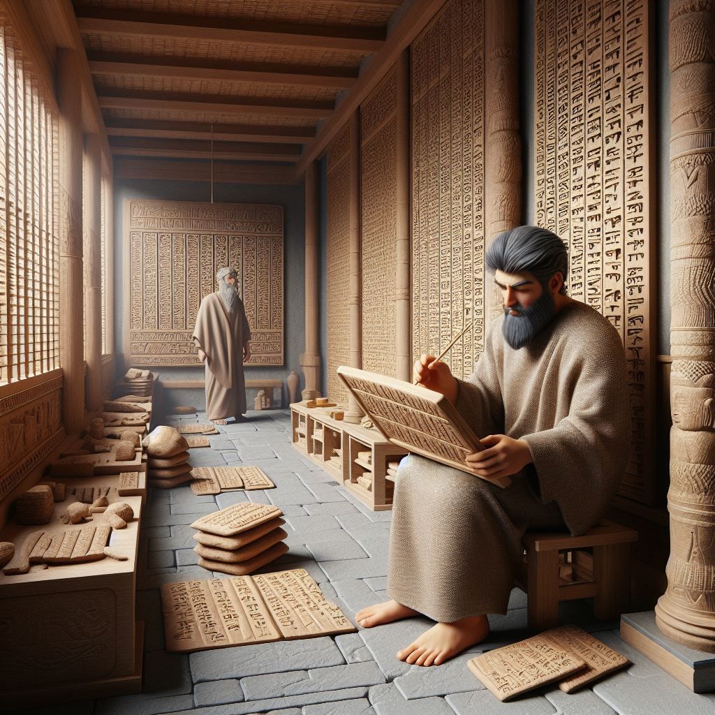
Edduba Organization
77
Ummia - principal
Adda edubba, “the father of the tablet house”
Ses edubba, “brother of the tablet house”
Dummui edudbba, “son of the tablet house”

Slide 22
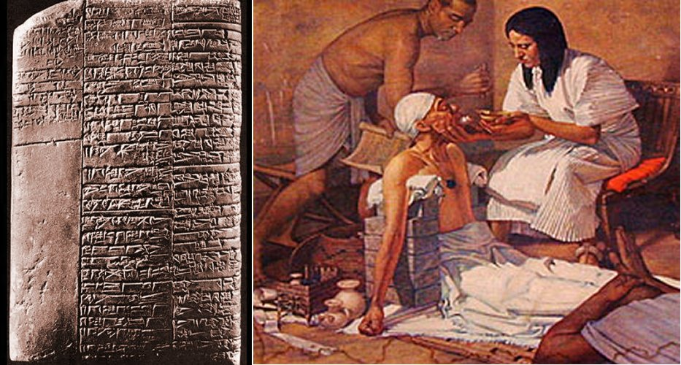
Literature
Two different types of tablets
Twelve-column tablets
Other type of tablets
Sumerian Medical Text

Slide 23
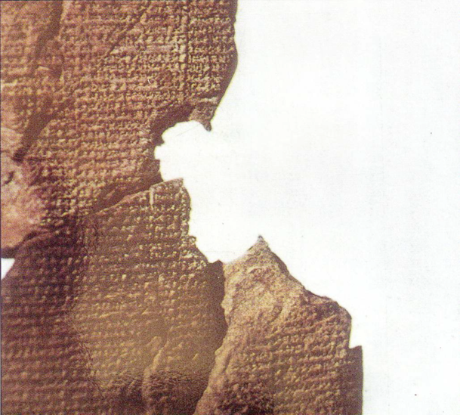
Atrahasis Epic
188i
“Let the birth-goddess create offspring, and let man bear the toil of the gods… create humanity that he may bear the yoke… let Nintu mix clay, that god and man may be thoroughly mixed in the clay, let there be a spirit from the god's flesh”
(Arnold/Beyer, 24)
Akkadian 1650 BC
Creation & flood stories
Man created to help overworked gods
Man made from clay

Slide 24
Genesis
Atrahasis Epic
188i
Anu, the high god
Man too noisy
Atrahasis built boat
Pitch used
Animals caught
Rained 7 days
Regretted Flood
(Arnold/Beyer, 21-31)
Yahweh, the only God
Man too sinful
Noah built boat
Pitch used
God brought animals
Rained 40 days
Rainbow promise
(Genesis 6-9)

Slide 25
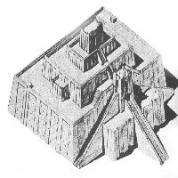
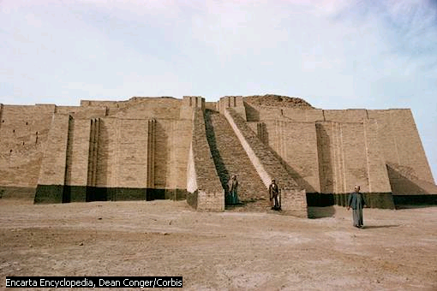
Religion
77-78
Ziggurat

Slide 26
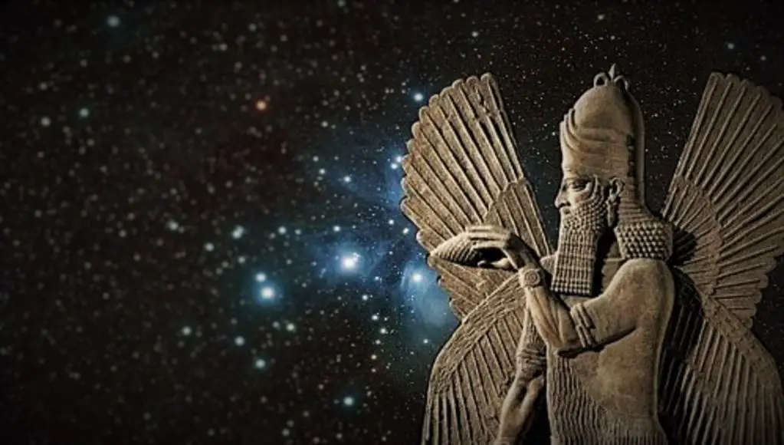
Sumer Cosmology
Heaven - an
Atmosphere/ air/ wind - lil
Earth - ki
Sea/ abyss - absu
En - lord

Slide 27
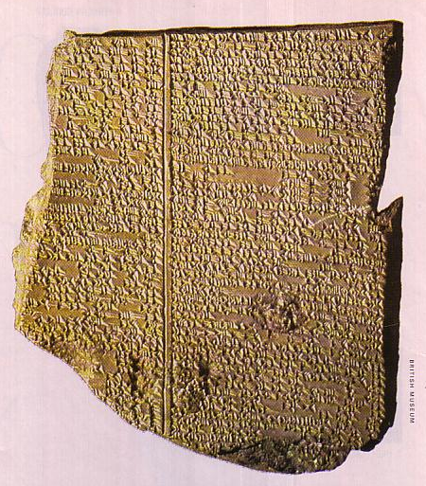
Gilgamesh Epic Tablet XI
218
Nineveh, Iraq
650 BC
Flood story similar to Gen. 6–9

Slide 28
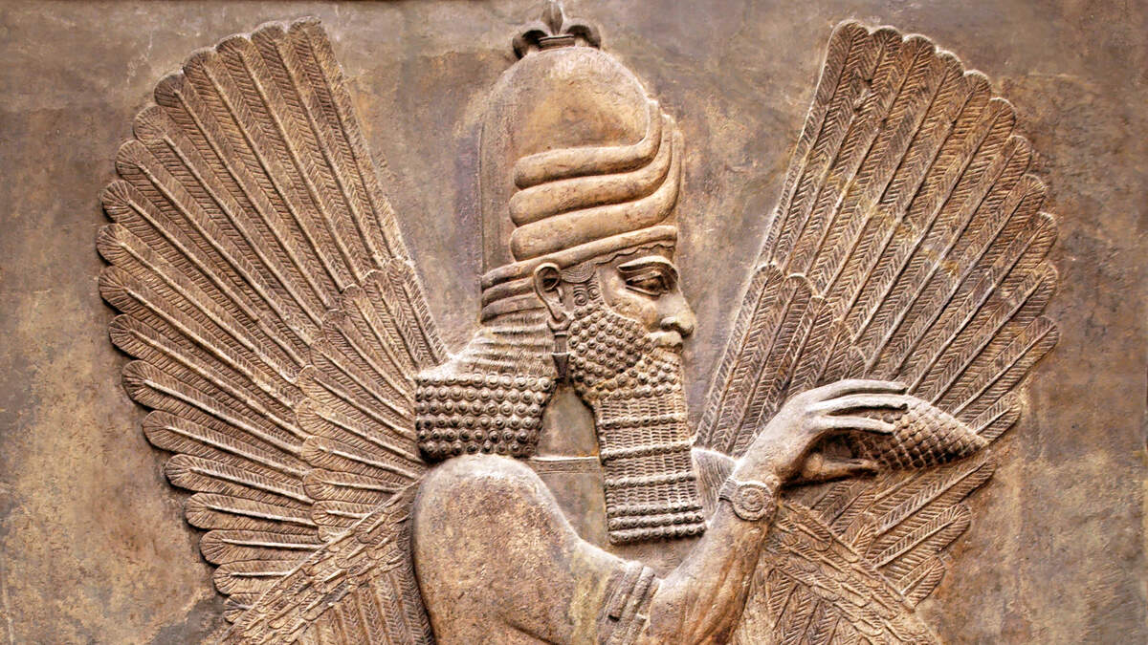
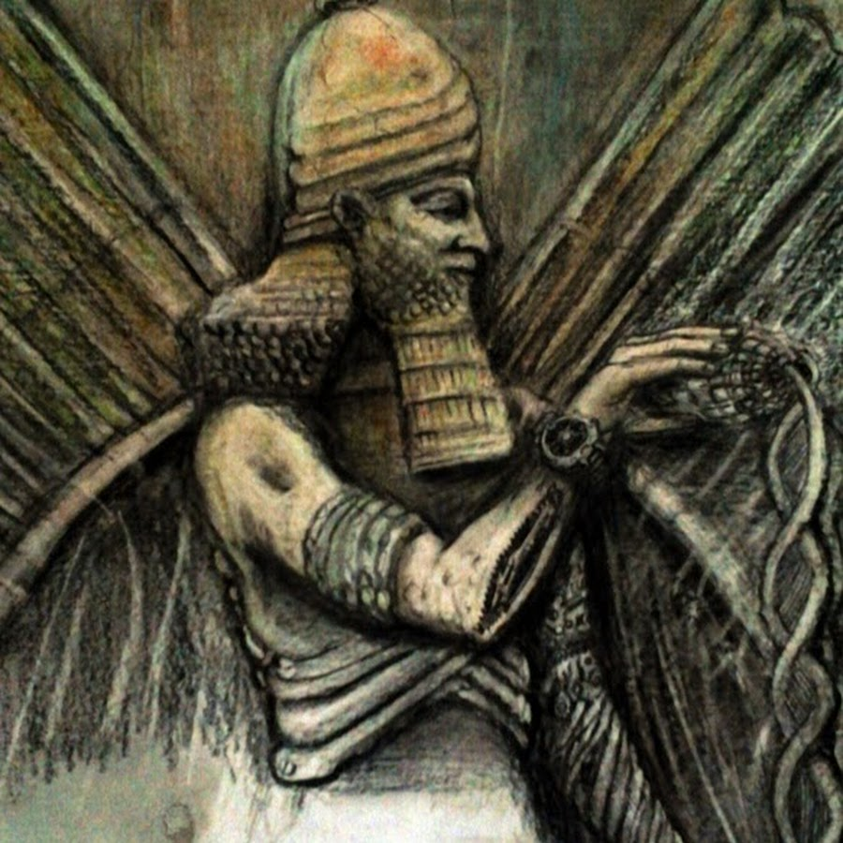
Four Leading Deities
An
sky god
male
Uruk
Enlil
air god
male
Nippur
Enki
god of abyss & wisdom
male
Eridu
Ninhursag
female
divine mother
Enlil's wife

Slide 29
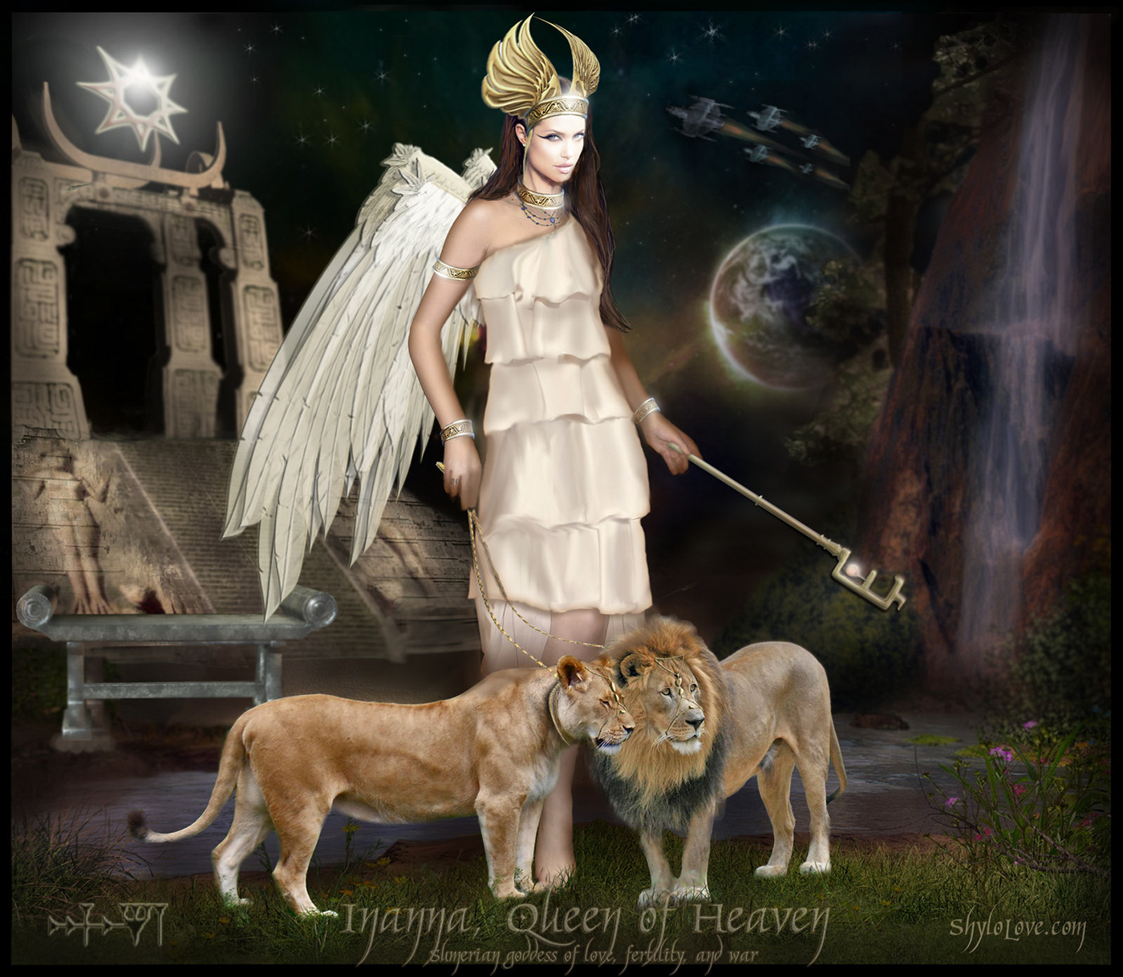
3 Astral Deities
Nanna (later called Sin)
the moon god
male
Ur
Utu
sun god
male
Sippar and Larsa
Inanna
goddess of love & war
female
Uruk

Slide 30
Religion
76
Enlil
Utu
An,
Inanna
Nanna
Enki

Slide 31
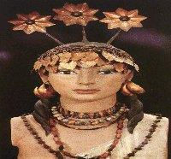
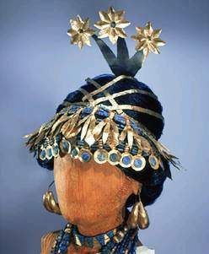
Religious Practices
Temple worship with sacrifices
Recitation of hymns and incantations
Feeding the gods
Appease offended spirits
Each deity is finely clothed

Slide 32
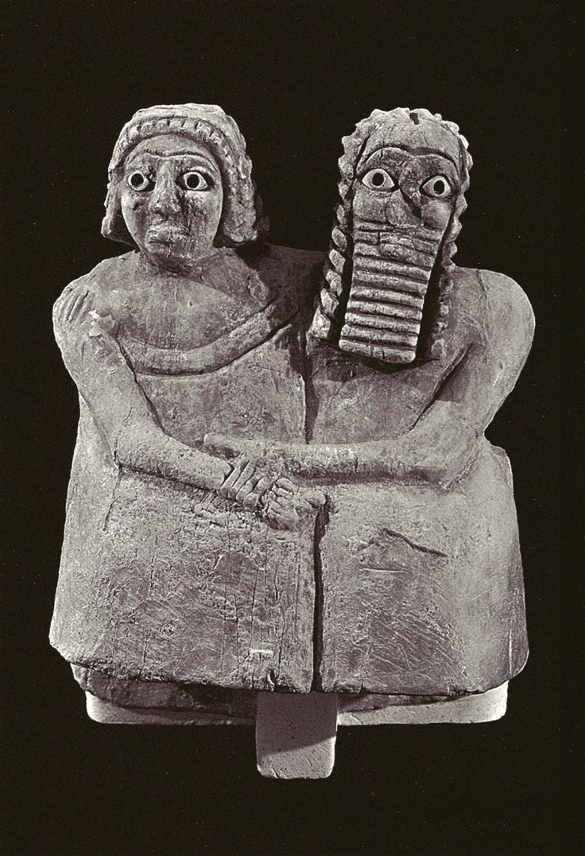
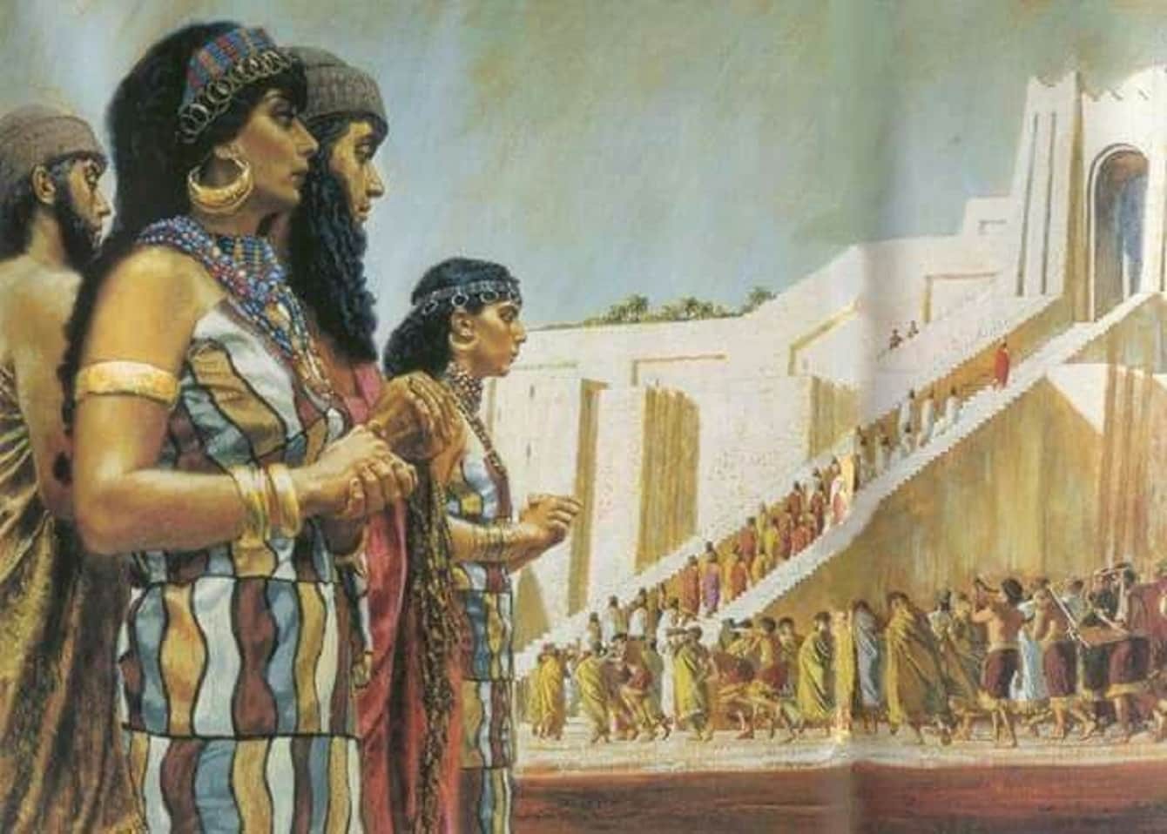
Religious Practices
Celebrating the festival of Ezen at the new moon
Sumerian New Year - Akiti
Sacred Marriage

Slide 33
Question...
So what's the point of knowing all this?
Sumerian Math Tables

Slide 34
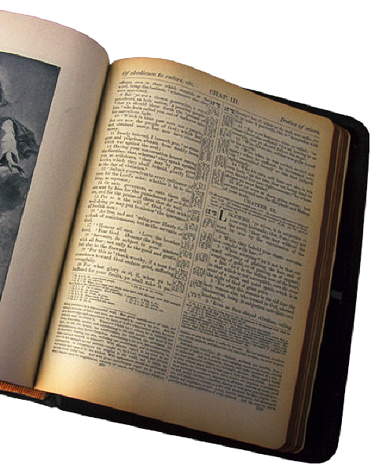
Understanding Sumerians and...
Their relation to the Old Testament

Slide 35
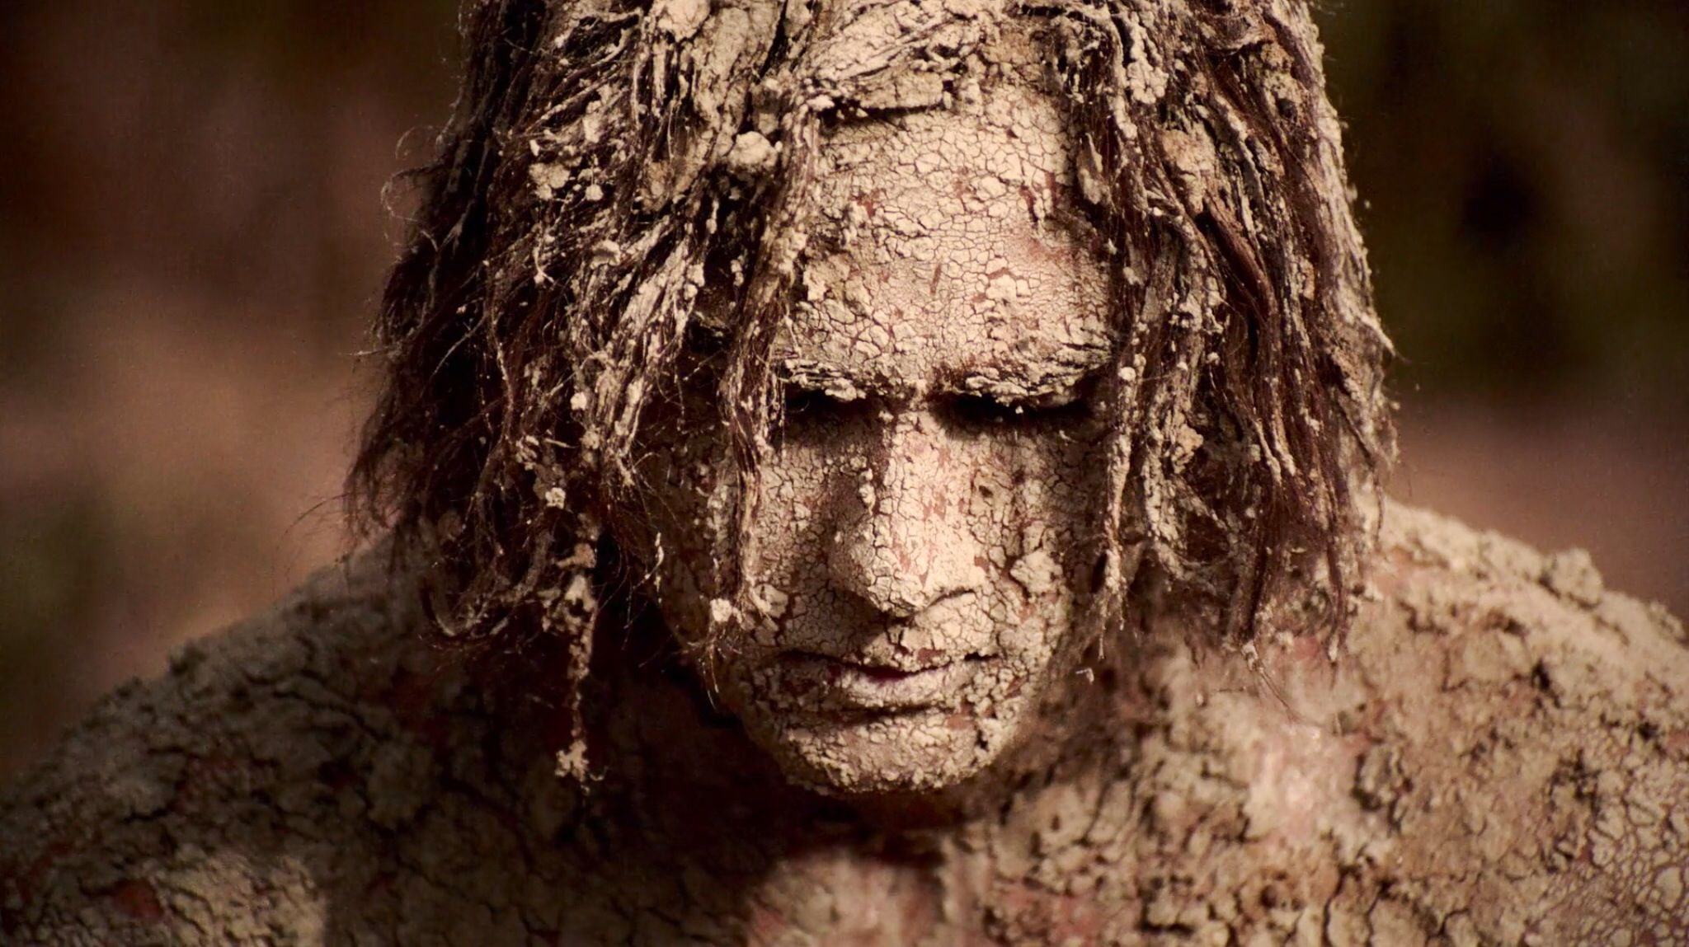
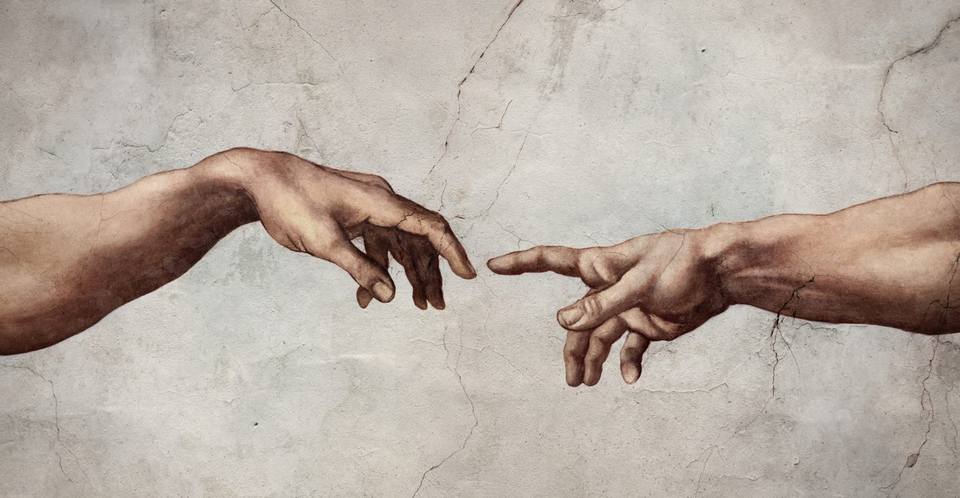
Sumer Theology vs Torah
#1
Mankind was created to provide food for the lazy gods
Vs
Yahweh created man to rule over the earth and enjoy companionship with Yahweh

Slide 36
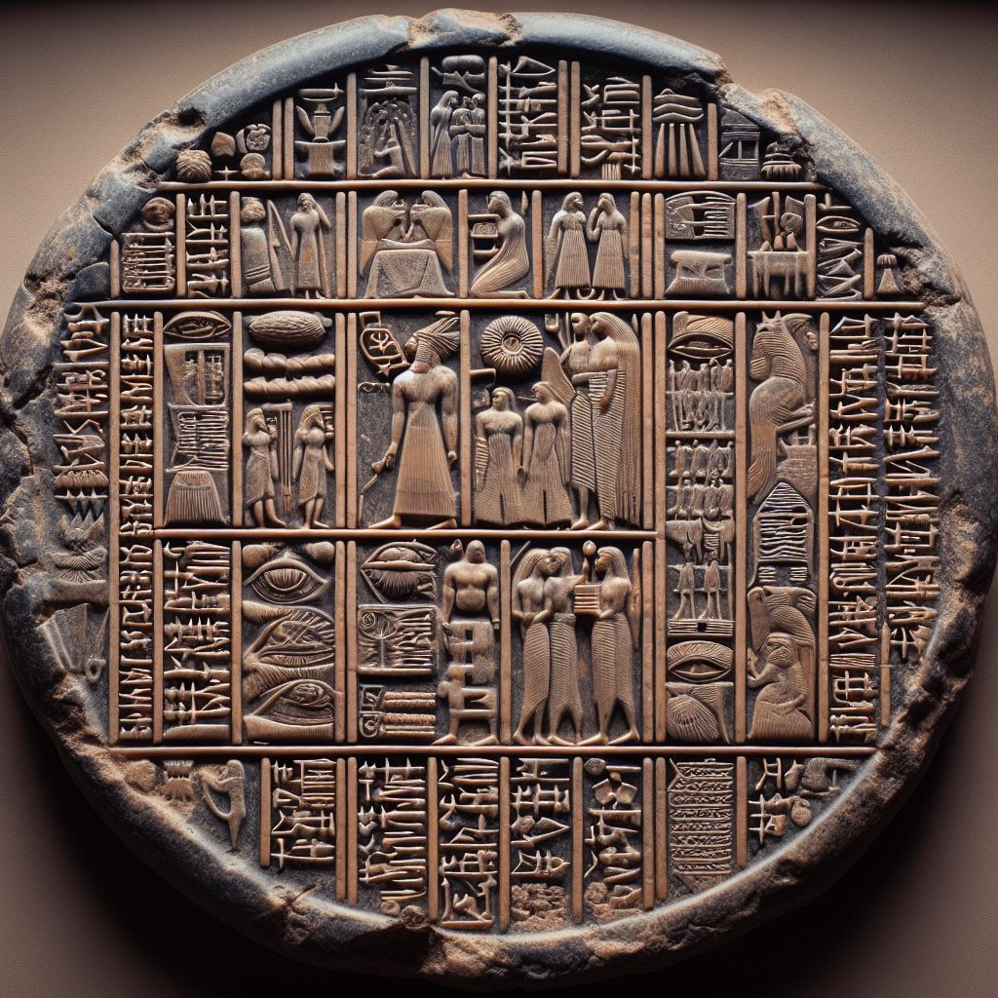
Sumer Theology vs Torah
#2 True worship is:
Polytheistic
Vs
Monotheistic

Slide 37
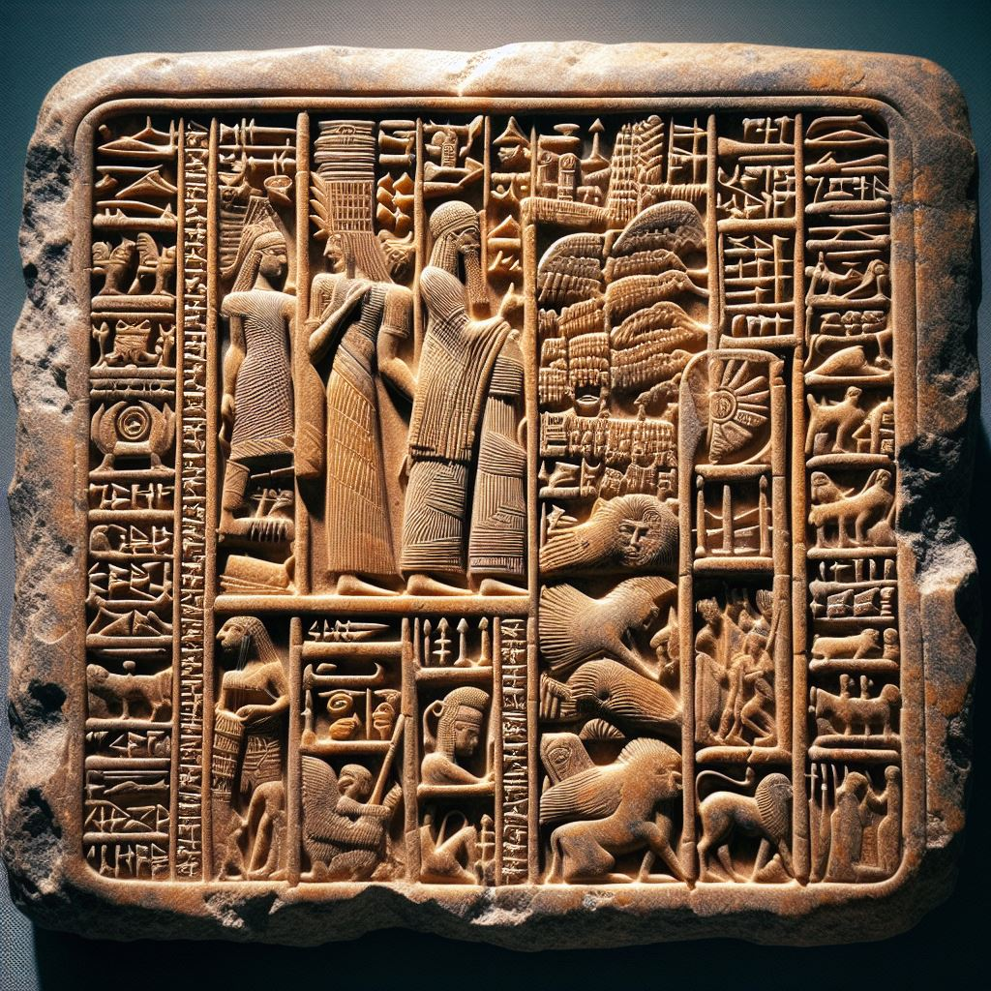
Sumer Theology vs Torah
#3
Sumerian gods had flawed character and personality
Vs
Yahweh is the perfect and infallible God incapable of sin and error

Slide 38
City gods
³¹ Terah took his son Abram, his daughter-in-law Sarai, and his grandson Lot (his son Haran's child) and left Ur of the Chaldeans to go to the land of Canaan. But they stopped instead at the village of Haran and settled there. ³² Terah lived for 205 years and died while still at Haran.
New Living Translation, Gen 11

Slide 39
Abram's understanding of Yahweh
¹⁹ Melchizedek blessed Abram with this blessing:
“Blessed be Abram by God Most High, (EL ELYON)
Creator of heaven and earth.
²⁰ And blessed be God Most High,
who has helped you conquer your enemies.”
Then Abram gave Melchizedek a tenth of all the goods he had recovered.
²¹ The king of Sodom told him, “Give back my people who were captured. But you may keep for yourself all the goods you have recovered.”
²² Abram replied, “I have solemnly promised the Lord, God Most High, Creator of heaven and earth, ²³ that I will not take so much as a single thread or sandal thong from you.
Gen. 14:19-23 NLT

Slide 40
The 3 Cs of Sumer
77
C
C
C
ivilization
uneiform
ity gods

Slide 41
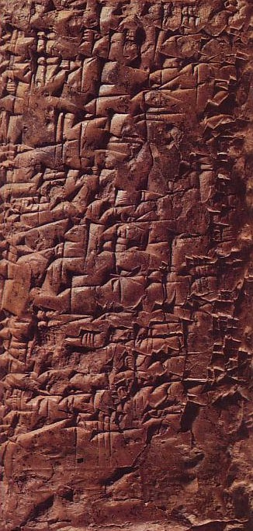
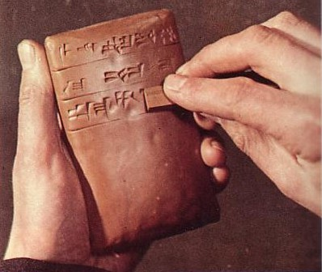
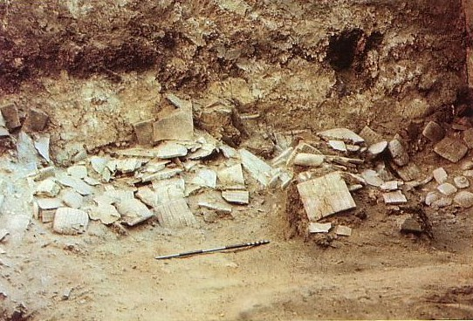
Writing was Sumer's greatest contribution
77

Slide 42
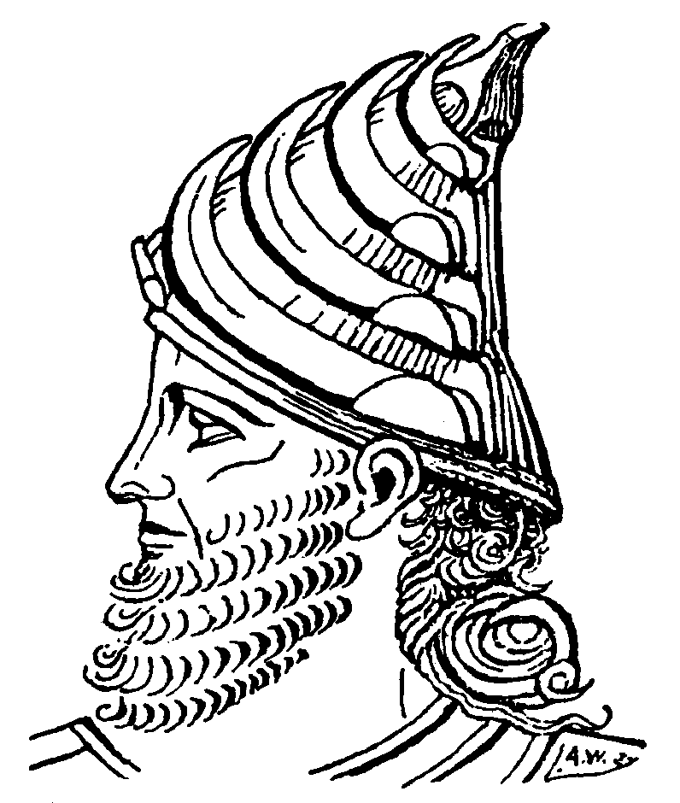
The First City State
77
Earliest Form of Government
Sumerian King Temple Boss
Council of Elders
Free Adult Males

Slide 43
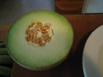
Invention of the Wheel
77
Notes:
We all have known about the circle since we were able to see fruit and the sun and moon. But how to harness its power?

Slide 44
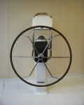
Invention of the Wheel
77
Notes:
But the Sumerians were the first to use the power of the circle to make a wheel.

Slide 45
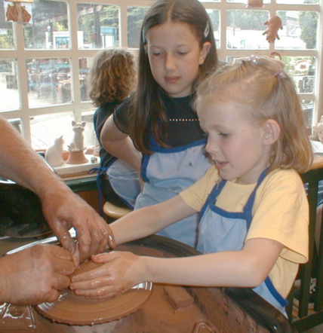
The Potter's Wheel
77
Notes:
The wheel then provided the means to make pottery to hold things.

Slide 46
Architecture
77
Ziggurat
Notes:
Sumerians also built the first temples as geometric ziggurats.

Slide 47
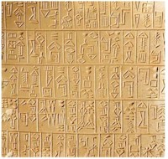
Lessons from Sumer
80
What principles can you discover regarding Sumer?
What does Abraham coming from this area say to us?

Slide 48
Lessons from Sumer
80
God brought Abraham out of his home in Sumer to give him a new start
Abraham' training for rural life in Canaan was in the most advanced civilization of his day (Sumer)
God often moves us physically to bring us into new avenues of His will
God trains us to do His will but this does not mean He ever “overeducates” us

Slide 49
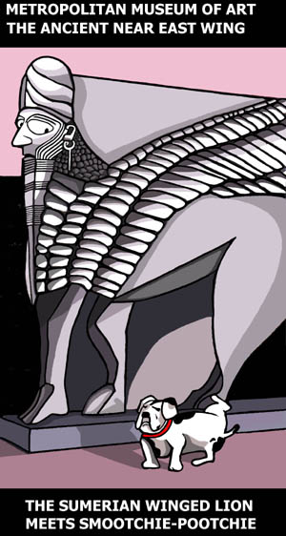
The Sumerians
METROPOLITAN MUSEUM OF ART THE ANCIENT NEAR EAST WING
THE SUMERIAN WINGED LION MEETS SMOOTCHIE-POOTCHIE

Slide 50
Black

Slide 51
OT Backgrounds link at BibleStudyDownloads.org
Get this presentation for free!
Notes:
NT Survey (ns)

