Slide 1
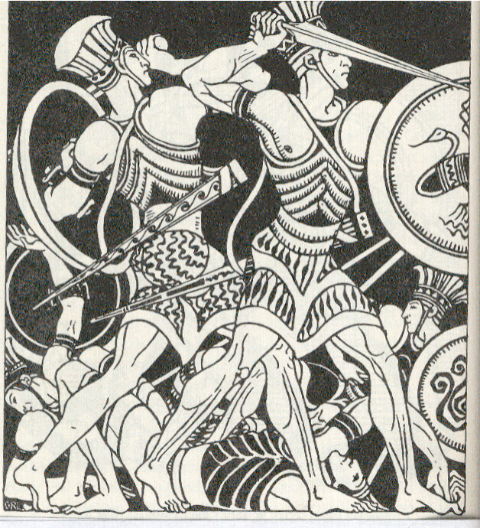
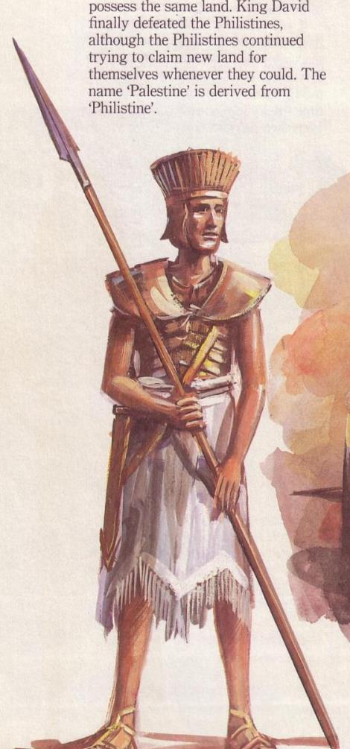
The Philistines
104
O
RIGINS
F
EATURES
CITIES
RELIGION
CULTURE
MILITARY
I
MPLICATIONS
Dr. Rick Griffith • Jordan Evangelical Theological Seminary • BibleStudyDownloads.org

Slide 2

The Ancient Near East
17
Mesopotamia
Syria-Palestine
Egypt
Notes:
We trace ANE history in these three broad geographical areas.

Slide 3
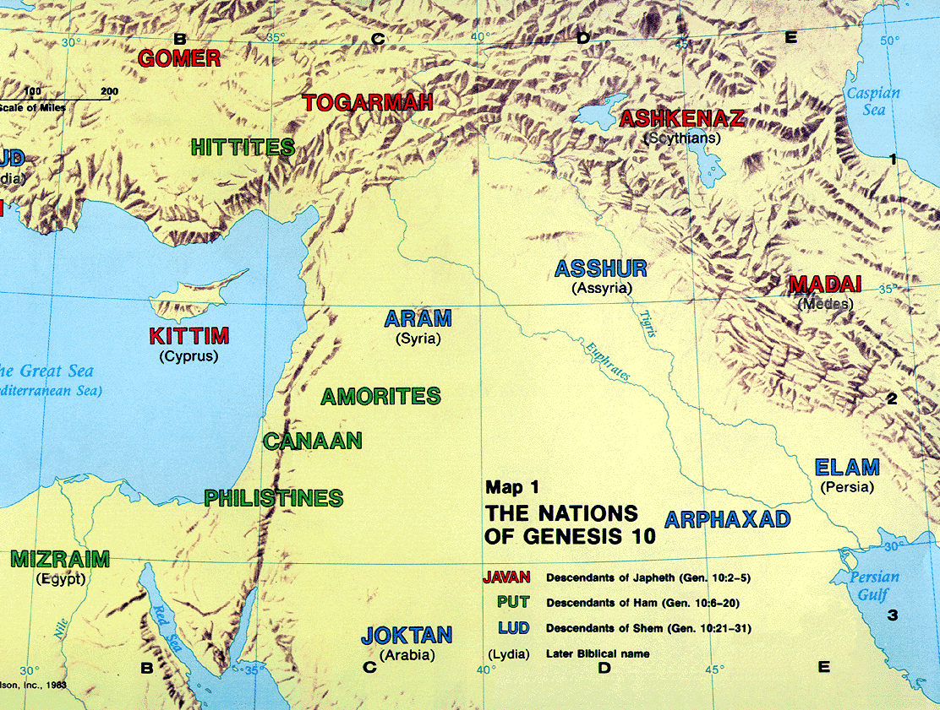
ANE Geography
17
CHERETHITES
Babel
Notes:
ANE history by culture begins with the dispersion of peoples from Babel in Genesis 11. Whereas the descendants of Japheth migrated north (red), the sons of Ham (green) and Seth (blue) remained within the Fertile Crescent and became three great regions: Egypt, Syria-Palestine, and Mesopotamia. Philistines descended from Japheth with some of them migrating from Cyprus. These were known as Cherethites.

Slide 4
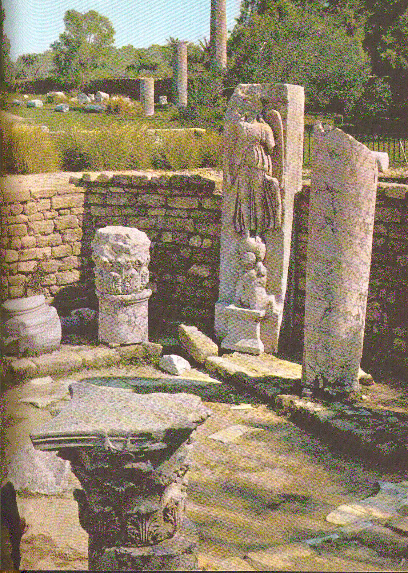
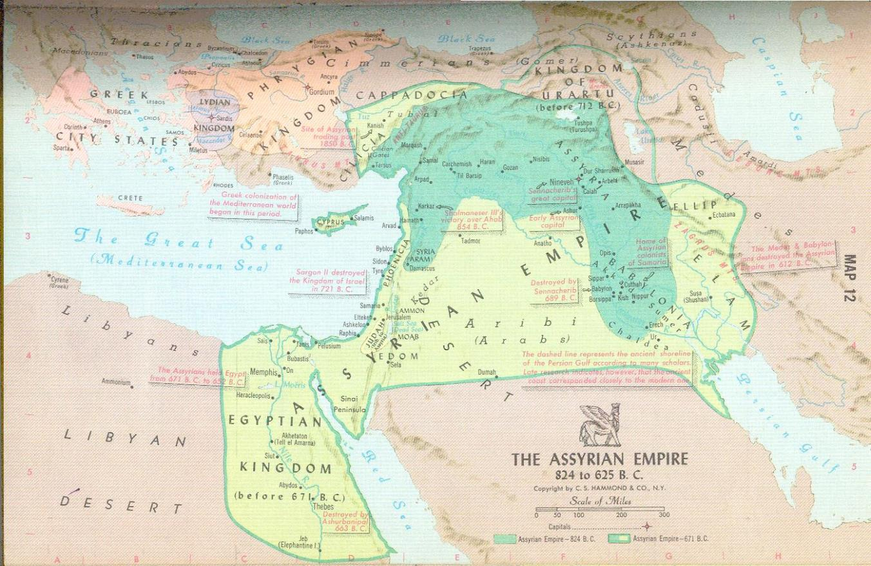
Origins
O
Jer. 47:4
Amos 9:7
104
RIGINS
For the LORD is going to destroy the Philistines,
The remnant of the coastland of Caphtor
(Jer. 47:4 NAU)
Aegean Sea
Cyprus
Crete
(Captor)
Philistines
Egypt
I brought Israel out of Egypt,
but I also brought the Philistines from Crete
(Amos 9:7 NLT)
Notes:
Jer 47:4 tells us that the Philistines were Sea People who migrated from Crete. Some went to Egypt and then later to Canaan's coast.

Slide 5
Origins
O
Jer. 47:4
Amos 9:7
114b
RIGINS
For the LORD is going to destroy the Philistines,
The remnant of the coastland of Caphtor
(Jer. 47:4 NAU)
I brought Israel out of Egypt,
but I also brought the Philistines from Crete
(Amos 9:7 NLT)
Notes:
Jer 47:4

Slide 6
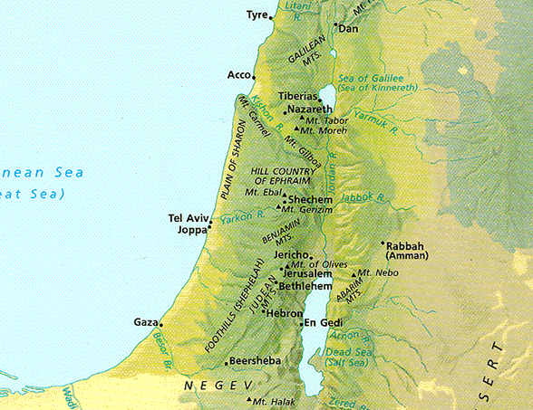
Elevations in North-South Divisions
18
Coastal Plain

Slide 7
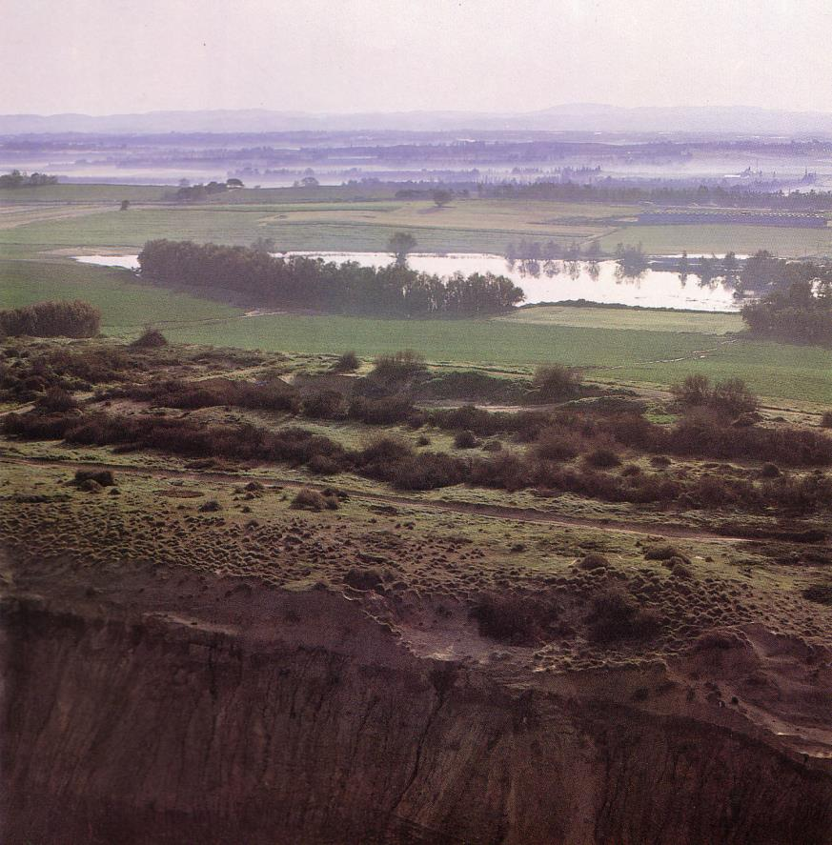
Coastal Plain
18
Kurkar (sandstone) ridges in the foreground while looking east to the foothills
Notes:
These ridges provide a natural barrier from water running westward to the Great Sea.

Slide 8
Left Stage
Phoenicians
Syrians
20
Life in
Ancient Israel
Right Stage
Sea Peoples,
The "ians" (mostly)
Desert Peoples,
The "ites"
Canaanites
Gileadites
Romans
Amorites
Ammonites
Israelites
Babylonians
Jebusites
Assyrians
Moabites
Philistines
Egyptians
Amalekites
Edomites

Slide 9
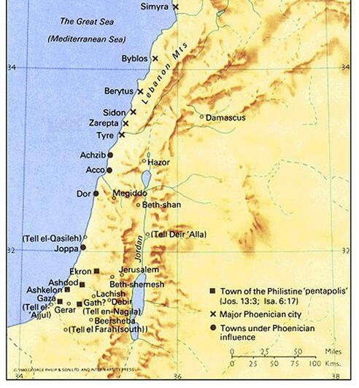
Features
20
F
EATURES
CITIES
The Philistines developed into 5 major cities.
These cities are called a Pentapolis.
Each was controlled by a seren (lord).
A
G
E
Ashkelon
Ashdod
Gaza Gath
Ekron

Slide 10
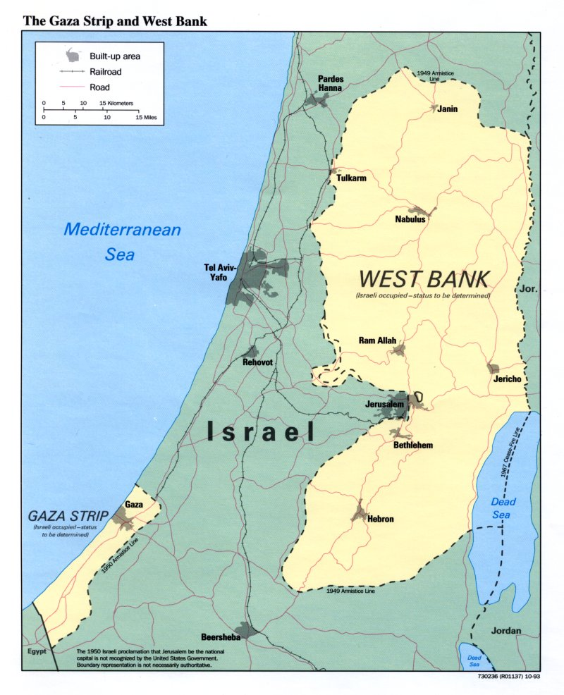
The Philistine Area Today

Slide 11
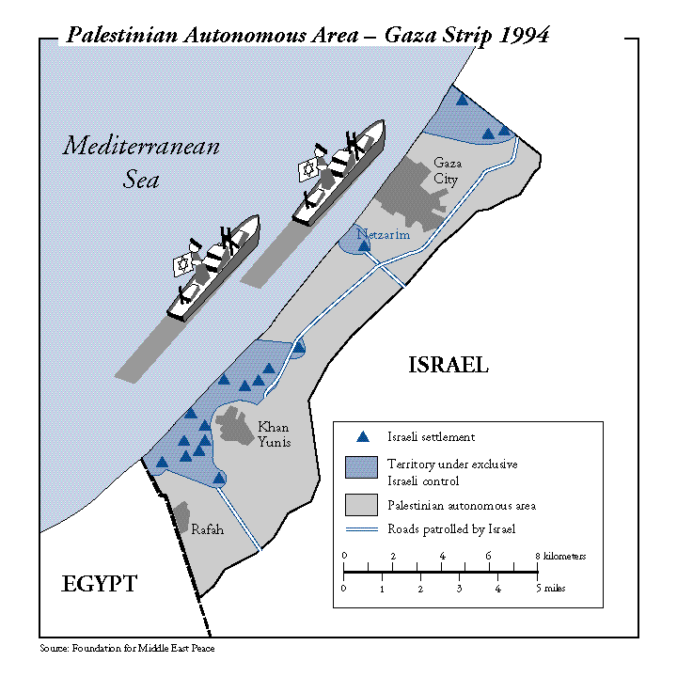
Israel later gave up the Gaza Strip

Slide 12
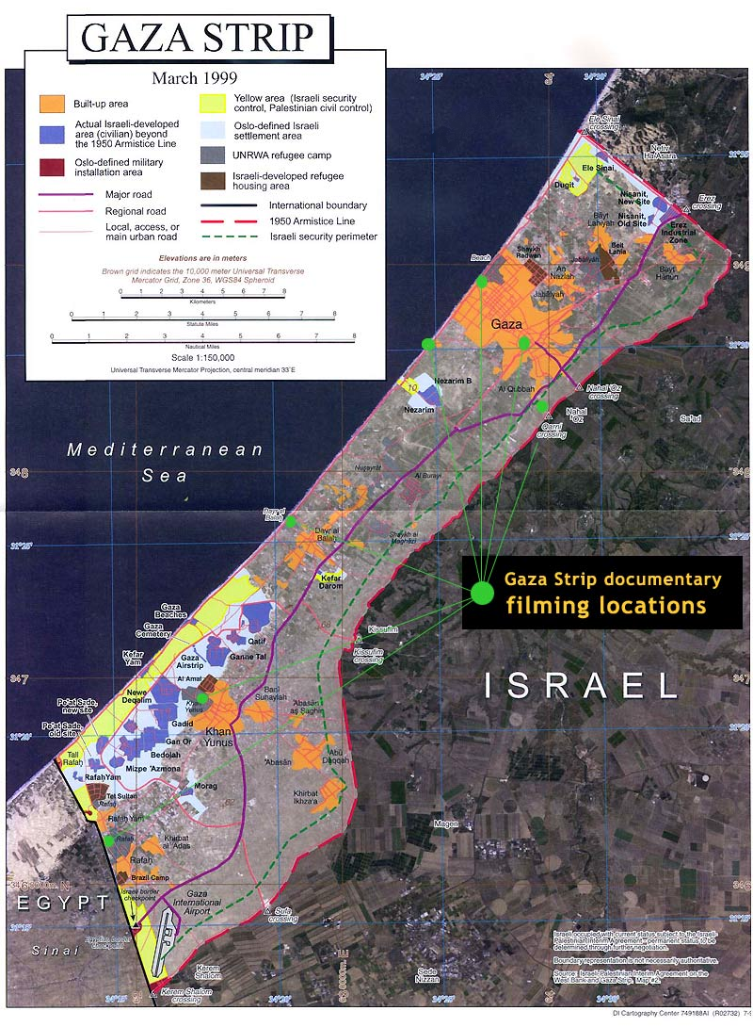
Gaza Up Close in 1999

Slide 13
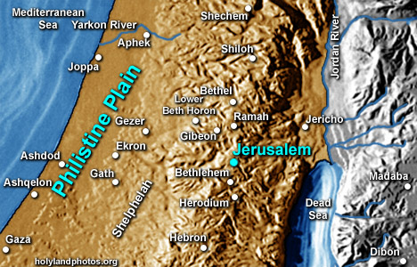
Geography of Philistia
105
The first three – Ashkelon, Ashdod, Gaza – were all situated on or beside the sea-coast, straddling the line of the Via Maris (Way of the Sea).
The other two – Gath and Ekron – were inland cities on the plain somewhere east of the three coastal cities; but archaeologists have not agreed on the original location of these two cities.

Slide 14
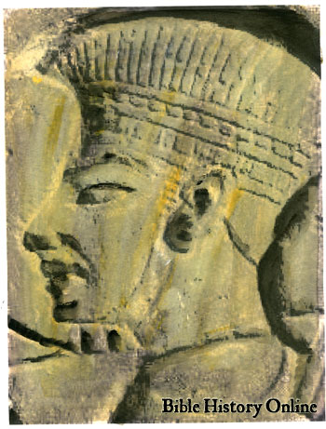
Major Archaeological Discoveries
105
Philistine pottery with its distinctive and elegantly stylized bird motif and statues
Many types of weapons
Philistine god/goddess temples

Slide 15
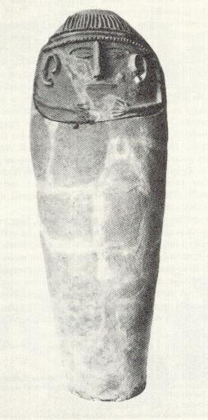
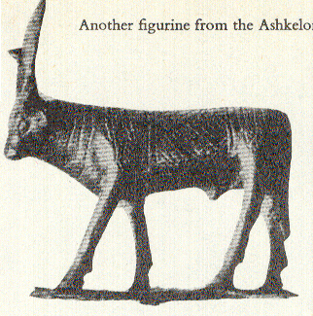
Ashkelon
105
A key city throughout the second millennium BC (middle and late Bronze Age).
Biblical records:
Once this city was occupied by Judah (Judg. 1:18)
In Samson's day it reverted to Philistine rule (Judg. 14:19)
Statue from Ashkelon (probably 4th century BC)

Slide 16

Nike
105
An interesting sculptured figure
The Winged Goddess of
Victory – Nike
She is standing upon a
globe of the world which rests upon the shoulders of Atlas

Slide 17
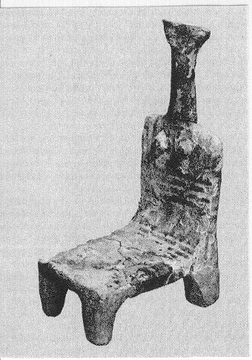
Ashdod
106
Ugarit texts noted Ashdod as an important trading city in the second half of the 2nd millennium BC: "traders from Ashdod" are specifically mentioned.
Biblical record:
In 1 Samuel 5, when Philistines captured the Ark of God,
the people of this city suffered a lot.
One of the Ashdod findings (a chair for a Philistine goddess)

Slide 18
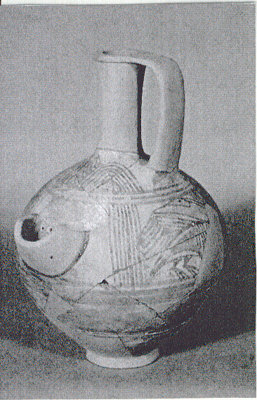
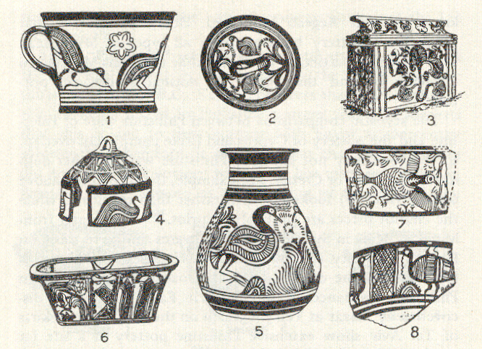
Philistines made beautiful pots!
106
P
O
T
T
E
R
Y

Slide 19
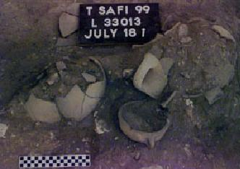
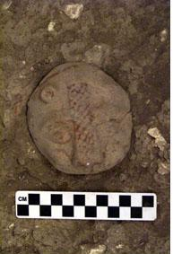
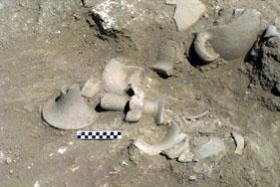
The Pottery
106
Distinctive type of Philistine pottery (influenced by Mycenaean, Cyprus, Egypt and Palestine)
Closely related to the Rhodes and Cyprus
Buff-colored beer jar (heavy drinkers), craters, cup, jar, etc
Typically painted in black and red

Slide 20
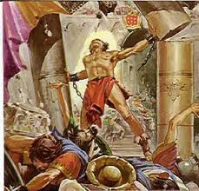
Gaza
107
Gaza was a centre of busy caravan routes which led to Egypt.
Gaza served as an administrative centre for protecting Egyptian interests in Canaan.
One of the most important stories about Gaza is Judges 16 where Samson died.

Slide 21
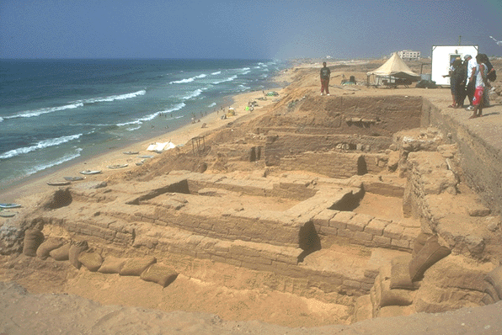
Coastal Plain
18
Gaza

Slide 22
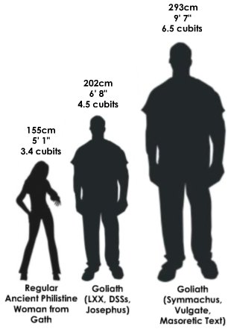
Gath
108
The ark of God moved to Gath from Ashdod; God gave them a plague of tumors (1 Sam. 5:6-10).
Gath was the city of Goliath (1 Sam. 18).
David ran away from Saul to Gath and he met Achish the King of Gath (1 Sam. 21:10-15).

Slide 23
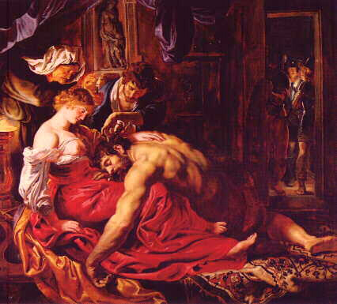
What was his weakness?
Samson in Gath
Her?
Hair?
Heart?
“Samson… the he man with a she weakness”
-Chuck Swindoll

Slide 24
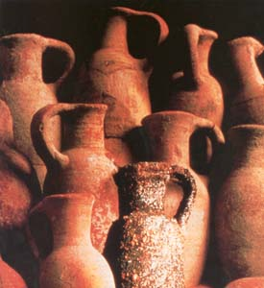
Ekron
108
It was between Judah and Dan and it remained unpossessed.
Joshua 15:14-46 indicates that Ekron was a fairly substantial city, having villages dependent upon it.
1 Samuel 5:10-6:12 record about the Ekronites who were afraid of the ark of God from Israel would kill them.

Slide 25
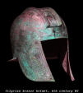

Language
111
Little is known about their language but there is no indication of language problems between Philistines and Israelites
They might have adapted the local Semitic language soon after they came
Their names are usually Semitic (Ahimelek, Mitinti, Dagon) but some are Asianic (Achish and Goliath)
Some Hebrew words are from Philistines
The Hebrew word for helmet (qoba) is a foreign word attributed to the Philistines

Slide 26
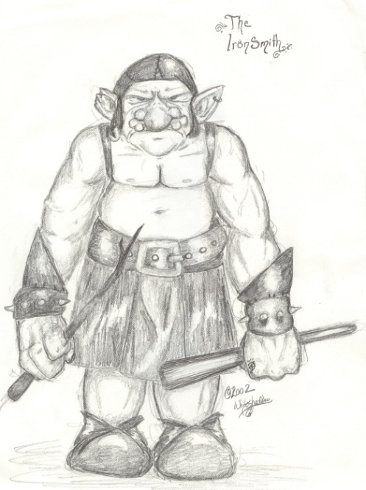
Iron Smiths
112
They controlled the smelting of iron (and kept Israel from having even one ironsmith – 1 Sam 13:19-22)
Their material culture was far superior to that of Israel
Philistines were actually the main civilizing influence on Palestine
Their superior culture & political organization gave them dominance over all of Palestine

Slide 27


Religion
109
Three famous Philistine gods in the Bible:
1. ASHTAROTH (1 Kings 11:5)
2. BAAL – ZEBUB (2 Kings 1:1-16)
3. DAGON (Judges 16:2; 1 Sam. 5:17)

Slide 28
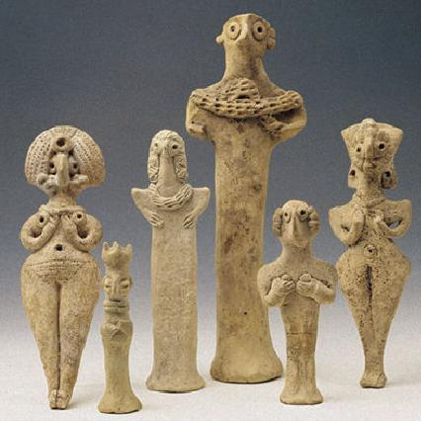
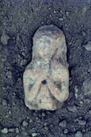
ASTAROTH / ASHTORETH
109
A common Semitic deity
Other names: Athtart, `Athtartu (Ugarit), Ashtart (Phoenicia), Astarte (Greek), Ishtar (Mesopotamia).
Meaning : shame
The mother goddess, the goddess of fertility, love and war (introduced to the Israelites by Canaanites)
Israel worshipped Ashtoreth soon after the people arrived in the Promised Land (Judg. 2:13)
Saul's body was placed in the Astaroth temple (1 Sam. 31:10)

Slide 29
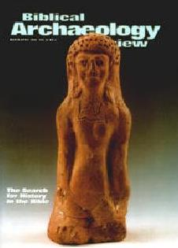
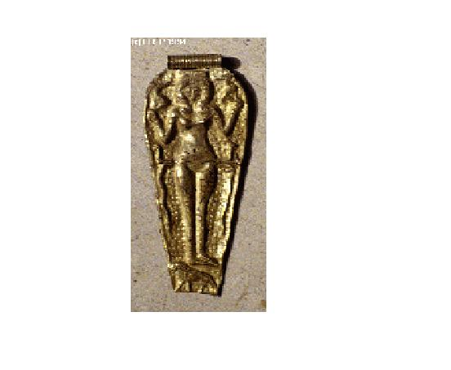
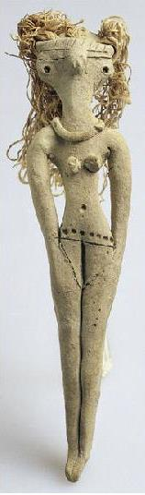
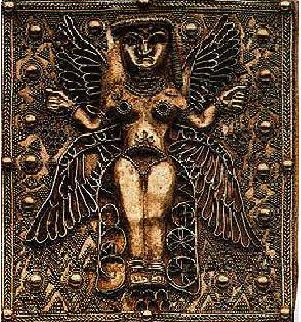
Other Goddess Forms
109
Ashera/ Astarte
(from Tel Rehov excavations in the Jordan Valley)
Qadash/Asherah
(goddess in fine gold foil pendant)
Ashtoreth
(golden plaque of 4 winged goddess)

Slide 30


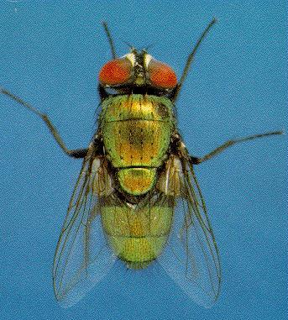
BAAL ZEBUB …BAAL WHAT?
109
Baal = Master, Lord Zebub = ???
Baal – Zebub :
The lord of the fly…?

Slide 31
Some suggestions:
109
The omnipresence of flies?
The god who guards them from flies?
A mockery from the Israelites?
NT (Jesus) : Beelzeboul – Lord Prince / Lord Baal / lord of the heavenly dwelling (Matt. 10:25; 12:24, 27, etc…)

Slide 32

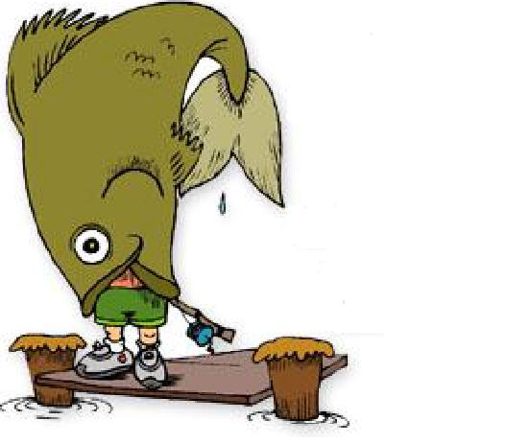

DAGON… guess?
110
Half fish and half human …
Hebrew
Dag = fish

Slide 33
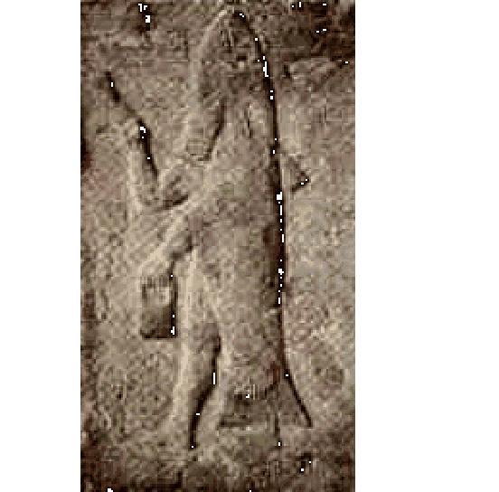
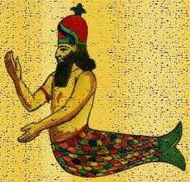
What some believe as the Philistine's DAGON
110

Slide 34
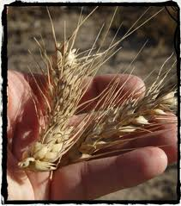
Grain God?
110
Another suggestion:
It might derived from the word:
dagan = grain, corn so he was a vegetation god
Dagon:
The principal deity of the Philistines during Samson's time at Gaza (Judg. 10:21-23) and during Saul & David's time (1 Sam. 5:2-3; 1 Chron. 10:10)
From at least 2500 BC onward, Dagon received worship throughout Mesopotamia

Slide 35
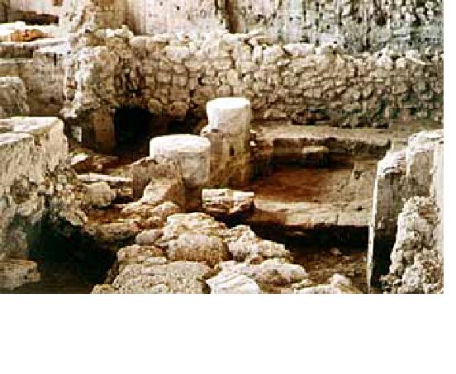
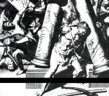
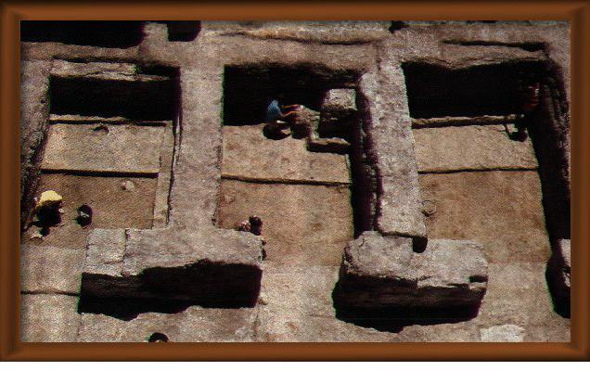
Dagon Temple Pillars
111
See the two pillars?
Remember Samson's last hours in the temple of Dagon?
What did he do?
(Judges 16:23-31)
Some ruins of the Philistine temple in Tell Qasile temple (above)
and Beth-Shean (right)

Slide 36
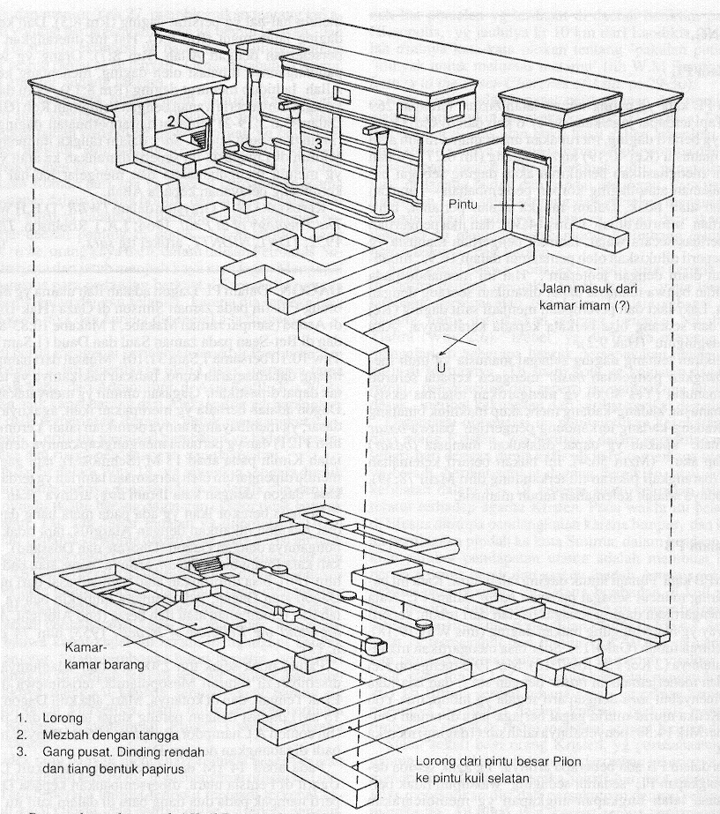
The Temple of Dagon
111
Dagon was the main Philistine
god

Slide 37

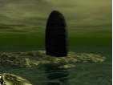





21st Century Dagon

Slide 38
Philistines were a fearsome people

Slide 39
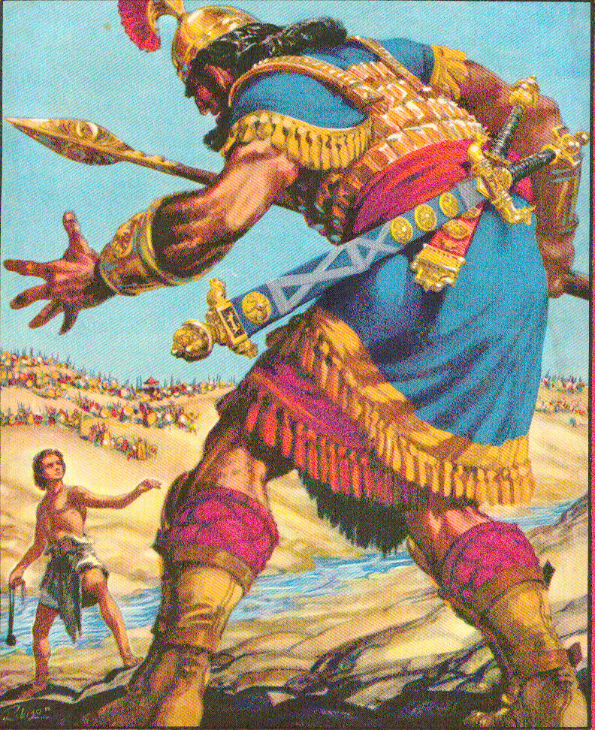
Goliath's Armor
112
Bronze Helmet
Iron point
[Wood] Spear Shaft
Bronze Armor
Bronze Javelin
Bronze
Greaves

Slide 40
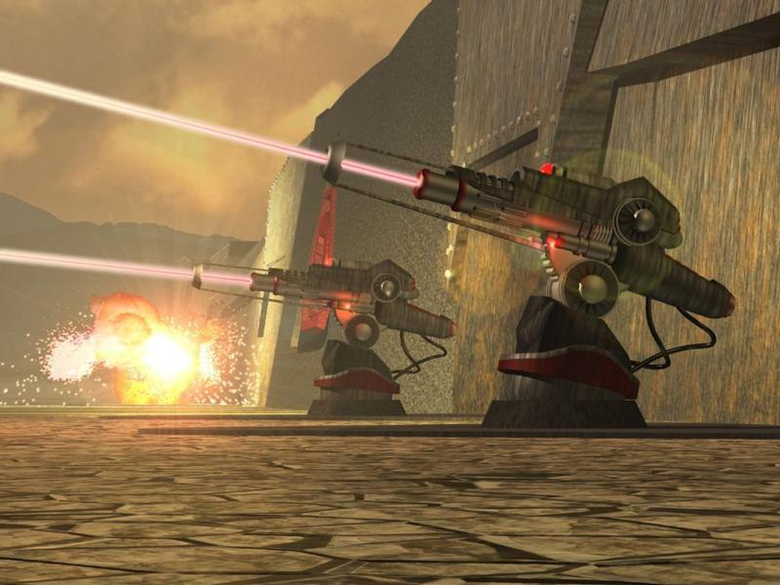
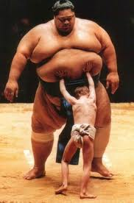
The Philistine Military Capacities (1 Sam 17:5-7)
112
Bronze helmet
Bronze coat of scale armor (5000 shekels = 57.5 kgs)
Bronze greaves (7 kgs)
Bronze javelin
Spear shaft with iron point (600 shekels = 11.5 kgs)
Shield

Slide 41
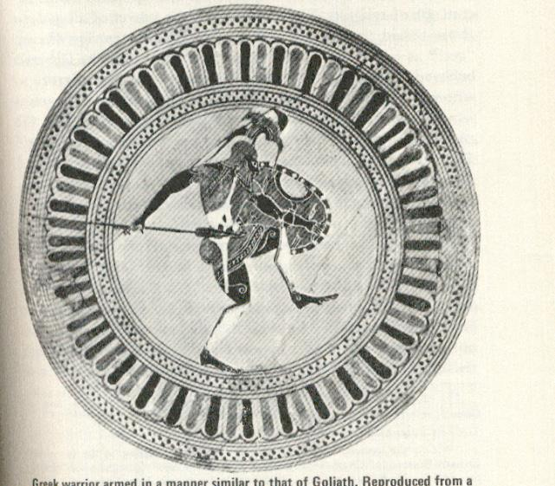
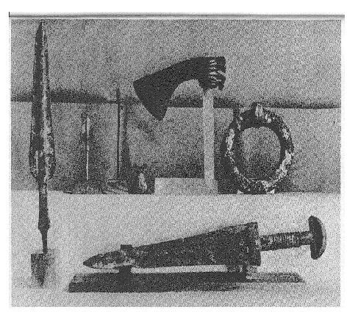
Weapons
112
Shield

Slide 42
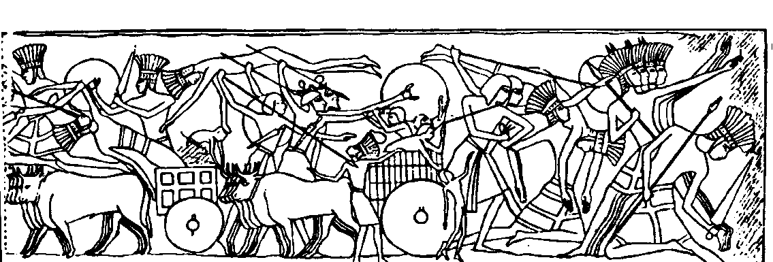

Philistine Military Organization
113
Chariotry
Cavalry
Infantry
Archers
(1 Sam. 13:5; 31:3)

Slide 43

Summary
P
113
entapolis: Ashkelon, Ashdod, Gaza, Gath, Ekron
H
am's descendant
I
srael's enemy
L
arge scale migration
I
Samuel 17 (David & Goliath)
S
ea People
T
echnology & temples
I
ron spear
N
Dago
was one of their deities
E
(2) AG
(Ashkelon, Ashdod, Gaza, Gath and Ekron)

Slide 44

The Importance of Technology
“But we just don’t have the technology to carry it out.”

Slide 45
Philistines Noted Very Early
Gen. 21:34 Abraham lived as a foreigner in Philistine country for a long time.
Ex. 13:17 When Pharaoh finally let the people go, God did not lead them along the main road that runs through Philistine territory, even though that was the shortest route to the Promised Land. God said, “If the people are faced with a battle, they might change their minds and return to Egypt.”
Josh. 13:3 and the larger territory of the Canaanites, extending from the stream of Shihor on the border of Egypt, northward to the boundary of Ekron. It includes the territory of the five Philistine rulers of Gaza, Ashdod, Ashkelon, Gath, and Ekron. The land of the Avvites
Judg. 3:3 These are the nations: the Philistines (those living under the five Philistine rulers), all the Canaanites, the Sidonians, and the Hivites living in the mountains of Lebanon from Mount Baal-hermon to Lebo-hamath.

Slide 46

"This is what the Sovereign LORD says: The people of Philistia have acted against Judah out of bitter revenge and long-standing contempt. ¹⁶ Therefore... ¹⁷ I will execute terrible vengeance against them to punish them for what they have done. And when I have inflicted my revenge, they will know that I am the LORD."
Philistia
(25:15-17)
Notes:
But God declared that Philistia fought not to protect themselves but out of revenge and contempt.
____________
OB-14-Philistines-46
OS-26-Ezek25-32—slide 45

Slide 47


1 Samuel 17 Thought Questions
114
How did David's view of the Philistines differ from that of the Israelites?
Why was his view different?
Why do non-Christians often have superior technology to Christians?
Or do they?

Slide 48
IMPLICATIONS
I
113
a) Philistines were more technologically advanced than Israel. God used them to teach warfare to Israel (Judg. 3:1-3) as well as farming.
b) The Israelites also adopted their gods and religions (Judges 10:6-7). This always made God angry and jealous.
c) God used the Philistines to chastise his people.
d) The continuing pressure from the Philistines triggered the Israelites to have a strong military leader (king).
e) Israel was privileged to be a chosen people. Whatever the Philistines did to Israel, God still controlled every event that happened between the two nations.

Slide 49
Israel's Early Western Neighbors
114a
John H. Walton, Chronological and Background Charts of the OT, 2d ed., 71
PHOENICIA
PHILISTIA
ORIGINS
Semitic Amorites
Aegean Sea people
c. 1500
Territory was divided between Hittite & Egyptian domination
Not yet in Palestine
PRE-JUDGES
1400–Began slow rebellion, first against Egypt
1380-1287–Mostly controlled by Hittites; control diminished until 1190
1190–Invasion by sea peoples. Independent city-states established
1100–Some control exercised by Tiglath-Pileser I
1190–Defeated Hittites, destroyed capital. Defeated by Rameses III, settled on coast of Palestine. 5 major cities: Ashkelon, Ashdod, Gath, Gaza, Ekron (A-A-G-G-E).
11th cent–Controlled parts of at least Dan & Judah (Jud. 14:4; 15:11). Samson held somewhat in control.
1060–Captured Israel's ark (1 Sam. 4)
1050–Israel subdued Philistia at Ebenezer (1 Sam. 7:7-14)
JUDGES
Notes:
Israel never developed a navy in antiquity. In fact, the word "navy" does not appear in the OT. This was simply because Israel's coastal "P" neighbors (both starting with "P") refused to be conquered.
__________
OB-14-Philistines-49
OB-15-Phoenicians-41
OS-04-Numbers-284

Slide 50
Israel's Early Western Neighbors
114a
John H. Walton, Chronological and Background Charts of the OT, 2d ed., 71
PHOENICIA
PHILISTIA
Political independence; cultural development
Philistines held in check through most of this period. They were defeated at Michmash by Jonathan & at Elah through David. Overran country at end after defeating and killing Saul at Mt. Gilboa
SAUL
Golden Age
981-942–Hiram I of Tyre; alliance with Israel.
Expansion of sea trade & exploration; colonies in N. Africa, Spain, Asia Minor, & Mediterranean
David defeated & subdued the Philistines (2 Sam. 5:17-25)
1000–900 BC
Notes:
Israel never developed a navy in antiquity. In fact, the word "navy" does not appear in the OT. This was simply because Israel's coastal "P" neighbors (both starting with "P") refused to be conquered.
__________
OB-14-Philistines-50
OB-15-Phoenicians-42
OS-04-Numbers-285

Slide 51
Israel's Early Western Neighbors
114a
John H. Walton, Chronological and Background Charts of the OT, 2d ed., 71
PHOENICIA
PHILISTIA
890–High Priest Ethbaal gains throne. Alliance with Israel continues with marriage of his daughter Jezebel to Ahab
865–Tribute to Assyria's Ashurnasirpal II
853–Joined 12-nation alliance against Shalmaneser III at Qarqar
841–Shalmaneser III takes some cities. Assyrian tributary through end of period
Paid tribute to Jehoshaphat (2 Chron. 17:11)
Raided Judah during the reign of Jehoram (2 Chron. 21:16-17)
805–Assyrian Adad-nirari III collected tribute; subjugated by Uzziah but invaded Judah during reign of Ahaz (2 Chron. 28:18); subdued by Tiglath-pileser III of Assyria
900–722 BC
725–During reign of Shalmaneser V, Luli of Sidon tried to unite Phoenicia in revolt
701–Sennacherib responded by invasion–many cities taken, deportation, puppet ruler
677–Revolt crushed by Esarhaddon–Sidon destroyed
665–Baalit of Tyre revolted–suppressed by Assurbanipal
584-571–Nebuchadnezzar siege--took Tyre
Country subjugated & Gaza captured by Hezekiah (2 Kings 18:8)
People captured & deported by Nebuchadnezzar
722–570 BC
Notes:
Israel never developed a navy in antiquity. In fact, the word "navy" does not appear in the OT. This was simply because Israel's coastal "P" neighbors (both starting with "P") refused to be conquered.
__________
OB-14-Philistines-51
OB-15-Phoenicians-43
OS-04-Numbers-286

Slide 52

Presenters
Adapted from Dany, Chandra, Budianto
Singapore Bible College 2001

Slide 53
Black

Slide 54


OT Backgrounds link at BibleStudyDownloads.org
Get this presentation for free!
Notes:
NT Survey (ns)

