Slide 1
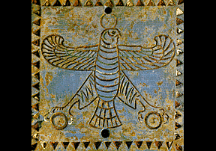
145
P E R S I A
Dr. Rick Griffith • Jordan Evangelical Theological Seminary • BibleStudyDownloads.org

Slide 2


What do you think of when you think of Persia?

Slide 3


Slide 4

北极
北极海洋
欧洲
亚洲
北美地区
太平洋
大西洋
太平洋
南极洲
非洲
赤道
南美洲
大洋洲
印度洋
大洋洲
大西洋
太平洋
加勒比

Slide 5

147

Slide 6


Slide 7
Time Warp
New Timeline: After the Flood

Slide 8
Beginning of Persia

Slide 9

17

Slide 10
145
ELAM
Son of Shem (Gen. 10:22). The name is Semitic. The Elamites gave their name to Elymais, the region on the left or E. bank of the Tigris, opposite Babylonia, between it on the W. and Persia proper on the E., and S.W. of Media. The region is also named Susiana or Susis from its capital Susa, called Shushah in Dan. 8:2, where Nehemiah (Neh. 1:1) waited on King Artaxerxes, and where Ahasuerus (Xerxes) held his court in Esther's (Est. 1:2; 2:5) time. Daniel mentions the river Ulai near, i.e. the Greek Euloeus. From Darius Hystaspes' time to Alexander the Great it was the Persian king's court residence.
* Fausset's Bible Dictionary, Electronic Database Copyright (c)1998 by Biblesoft

Slide 11
Genesis 10:21-32
²¹ Sons were also born to Shem, whose older brother was Japheth; Shem was the ancestor of all the sons of Eber.
²² The sons of Shem:
Elam, Asshur, Arphaxad, Lud and Aram. ²³ The sons of Aram: Uz, Hul, Gether and Meshech. ²⁴ Arphaxad was the father of Shelah, and Shelah the father of Eber. ²⁵ Two sons were born to Eber:
One was named Peleg, because in his time the earth was divided; his brother was named Joktan. ²⁶ Joktan was the father of Almodad, Sheleph, Hazarmaveth, Jerah, ²⁷ Hadoram, Uzal, Diklah, ²⁸ Obal, Abimael, Sheba, ²⁹ Ophir, Havilah and Jobab. All these were sons of Joktan.
³⁰ The region where they lived stretched from Mesha toward Sephar, in the eastern hill country.
³¹ These are the sons of Shem by their clans and languages, in their territories and nations.
145

Slide 12
History

Slide 13
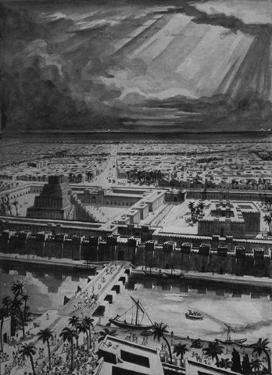
539 BC Babylon fell to the Medes and Persians so Darius the Mede ruled in Babylon

Slide 14
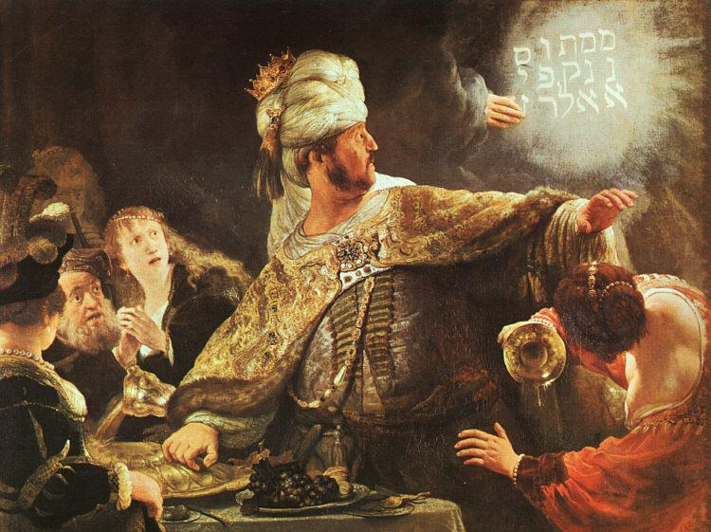
Belshazzar Humbled
Rembrandt

Slide 15



Fall of Babylon
144
BABYLON FELL (539 BC)
Cyrus entered under the water gates
Daniel 5
(Belshazzar's Feast)

Slide 16
Babylon's Fall (Herodotus)
144
"[Cyrus] placed a portion of his army at the point where the river enters the city, and another body at the back of the place where it issues forth, with orders to march into the town by the bed of the stream, as soon as the water became shallow enough: he then himself drew off with the unwarlike portion of his host, and made for the place where Nitocris dug the basin for the river, where he did exactly what she had done formerly: he turned the Euphrates by a canal into the basin, which was then a marsh, on which the river sank to such an extent that the natural bed of the stream became fordable.
"Hereupon the Persians who had been left for the purpose at Babylon by the river-side, entered the stream, which had now sunk so as to reach about midway up a man's thigh, and thus got into the town.
The History of the Persian Wars 1.191 (430 BC)

Slide 17
Babylon's Fall (Herodotus)
144
"Had the Babylonians been apprised of what Cyrus was about, or had they noticed their danger, they would never have allowed the Persians to enter the city, but would have destroyed them utterly; for they would have made fast all the street-gates which gave upon the river, and mounting upon the walls along both sides of the stream, would so have caught the enemy, as it were, in a trap. But, as it was, the Persians came upon them by surprise and so took the city. Owing to the vast size of the place, the inhabitants of the central parts (as the residents at Babylon declare) long after the outer portions of the town were taken, knew nothing of what had chanced, but as they were engaged in a festival, continued dancing and reveling until they learnt the capture but too certainly. Such, then, were the circumstances of the first taking of Babylon."
The History of the Persian Wars 1.191 (430 BC)

Slide 18
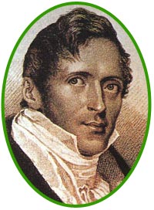
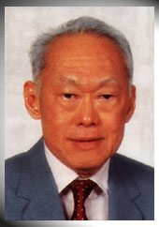
Amazing Prophecies
460
??
Stamford Raffles (1819)
Lee Kwan Yew (1959)
Did you hear that Raffles wrote 140 years before Lee Kwan Yew, "Behold, a man named Lee will arise to make Singapore its own country…"?
Notes:
Do you know why you did not hear of this prophecy? Because it never happened!
But what if it did? What if Raffles predicted the actual name of the founder of modern Singapore—and specified that he would rebuild the nation following World War II?
Wouldn’t that be amazing—perhaps even divinely inspired?

Slide 19
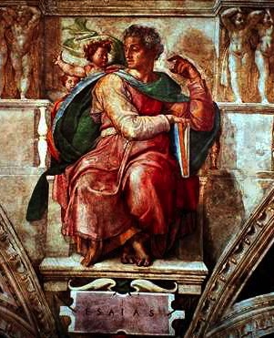
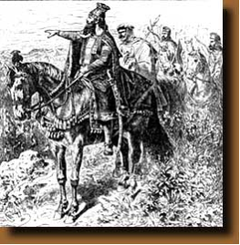
Amazing Prophecies
460
An Amazing Prophecy
41:2-3, 25
44:28
45:1-2
45:13-15
Isaiah (700 BC)
Cyrus (539 BC)
"When I say of Cyrus, 'He is my shepherd,' he will certainly do as I say.
He will command, 'Rebuild Jerusalem'; he will say, 'Restore the Temple' "
(Isa. 44:28 NLT)
Notes:
This is what God did with Isaiah’s prediction some 160 years before Cyrus the Persian sent the Jews back from Babylon and restored Jerusalem. Cyrus not only commanded the restoration of the temple in Ezra 1:2, but he funded the effort!
Isaiah notes the victories of Cyrus but not by name in 41:2, 25, but then specifically gives the name of Cyrus SIX times in his prophecy (NLT). Look these up in your Bible:
Is. 44:28 When I say of Cyrus, ‘He is my shepherd,’
he will certainly do as I say.
He will command, ‘Rebuild Jerusalem’;
he will say, ‘Restore the Temple.’”
Is. 45:1 This is what the LORD says to Cyrus, his anointed one,
whose right hand he will empower.
Before him, mighty kings will be paralyzed with fear.
Their fortress gates will be opened,
never to shut again.
2 This is what the LORD says:
“I will go before you, Cyrus,
and level the mountains.
I will smash down gates of bronze
and cut through bars of iron.
Is. 45:13 I will raise up Cyrus to fulfill my righteous purpose,
and I will guide his actions.
He will restore my city and free my captive people—
without seeking a reward!
I, the LORD of Heaven’s Armies, have spoken!”
Is. 48:14 Have any of your idols ever told you this?
Come, all of you, and listen:
The LORD has chosen Cyrus as his ally.
He will use him to put an end to the empire of Babylon
and to destroy the Babylonian armies.
Is. 48:15 “I have said it: I am calling Cyrus!
I will send him on this errand and will help him succeed.

Slide 20
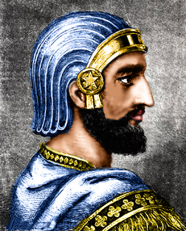
Cyrus Prophesied
“Who has stirred up this king from the east,
rightly calling him to God’s service?
Who gives this man victory over many nations
and permits him to trample their kings underfoot?
With his sword, he reduces armies to dust.
With his bow, he scatters them like chaff before the wind”
(Isaiah 41:2 NLT).

Slide 21
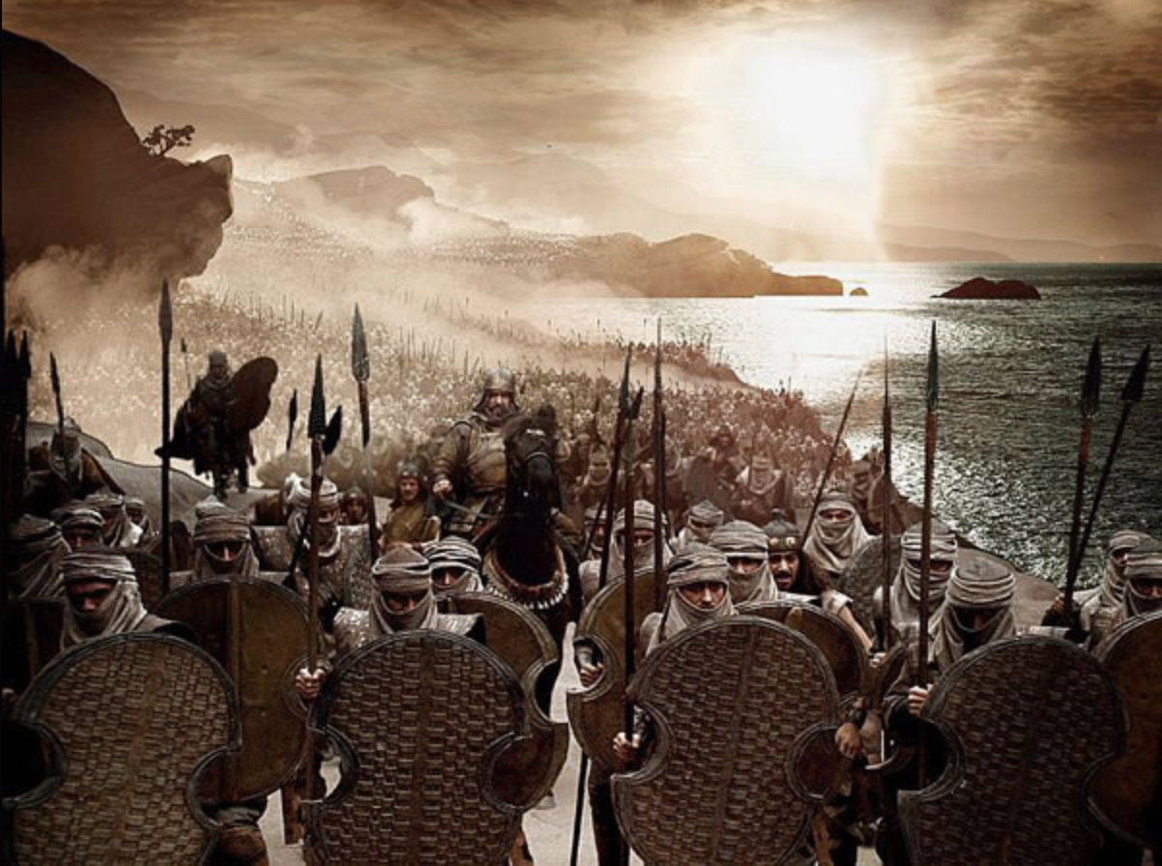
“He delivers up nations before him, and subdues kings. He makes them like dust with his sword, as the wind-driven chaff with his bow. He pursues them, passing on in safety, by a way he had not been traversing with his feet.” Isaiah 41:2b-3
Cyrus moved from country to country, conquering every king in his path. Around 550 BC he unified the Medes and Persians to defeat the powerful kingdom of Lydia (Asia Minor) in 546 BC. Turning south to Babylon, his army under the command of Darius conquered the city in 539 BC.

Slide 22
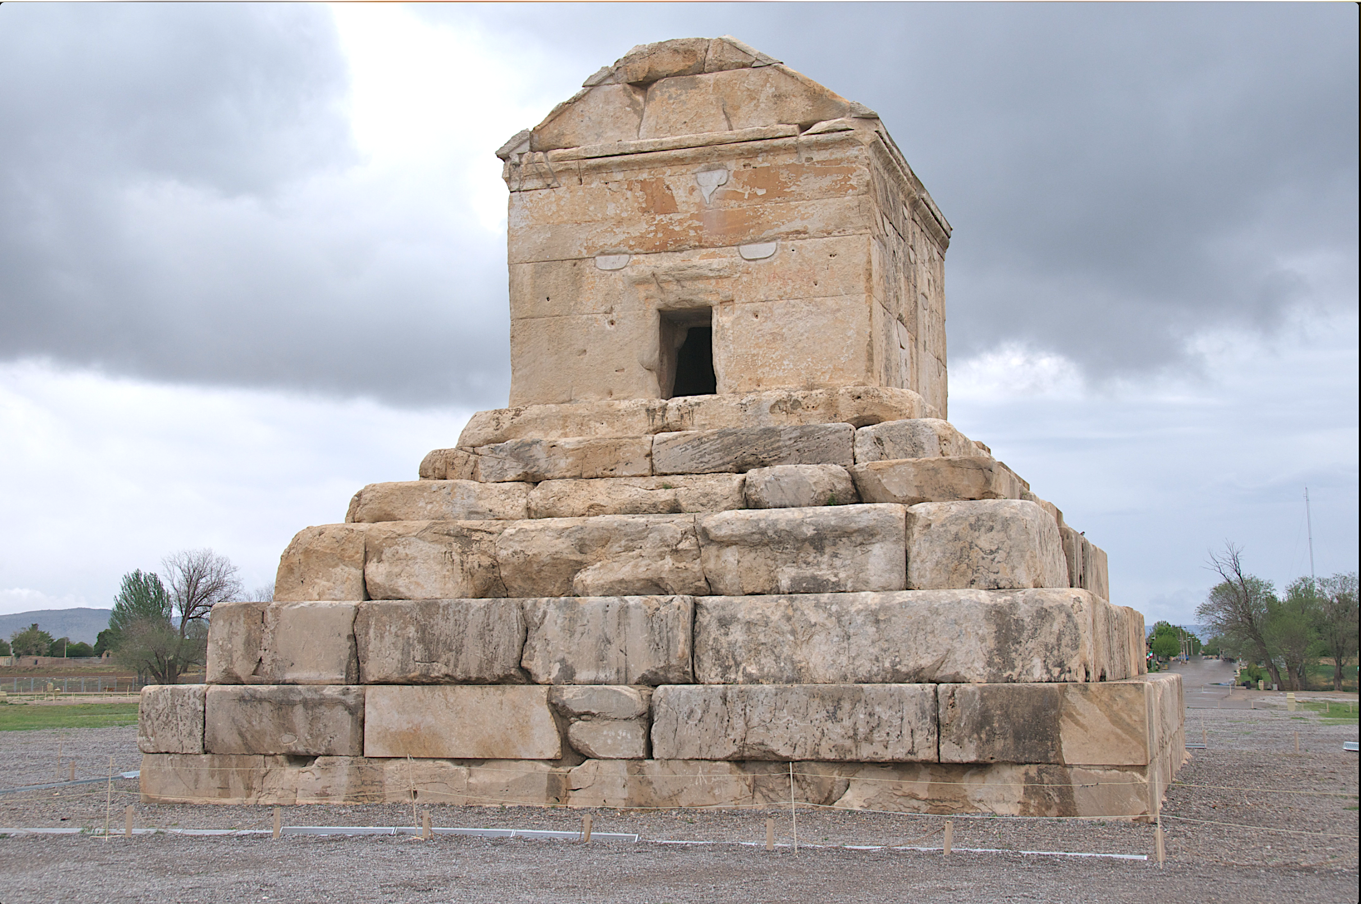
The emperor was killed in battle from a wound inflicted from a poisonous arrow during a campaign against the Massagetes of central Asia. Cyrus’ body was brought back to Pasargade in Persia; his tomb, which still exists, consists of a single chamber built on a foundation course of six steps.
The body was placed in a golden sarcophagus, and the tomb bore the inscription. He is considered as one of the most respected world leaders to date. He always fought side by side with his soldiers and never left them alone in the battlefield.
Tomb of Cyrus the Great

Slide 23
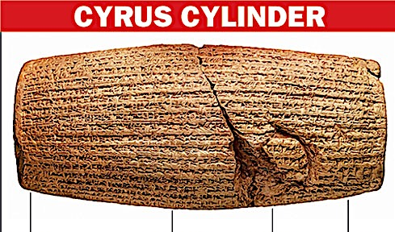
CYRUS CYLINDER
“I am Cyrus, king of the world, great king, legitimate king, king of Babylon, king of Sumer and Akkad, king of the four rims (of the earth), son of Cambyses, great king, king of Anshan, descendant of Teispes, great king, king of Anshan, family (which) always (exercised) kingship.”
What: Clay cylinder, 22.5 cm by 10 cm, inscribed with arguably the world’s first known human rights charter
Antiquity: 539 BC when Persian emperor Cyrus conquered Babylon
Contents: Freedom of worship for all, call for repatriation of deportees
Place: London Museum

Slide 24
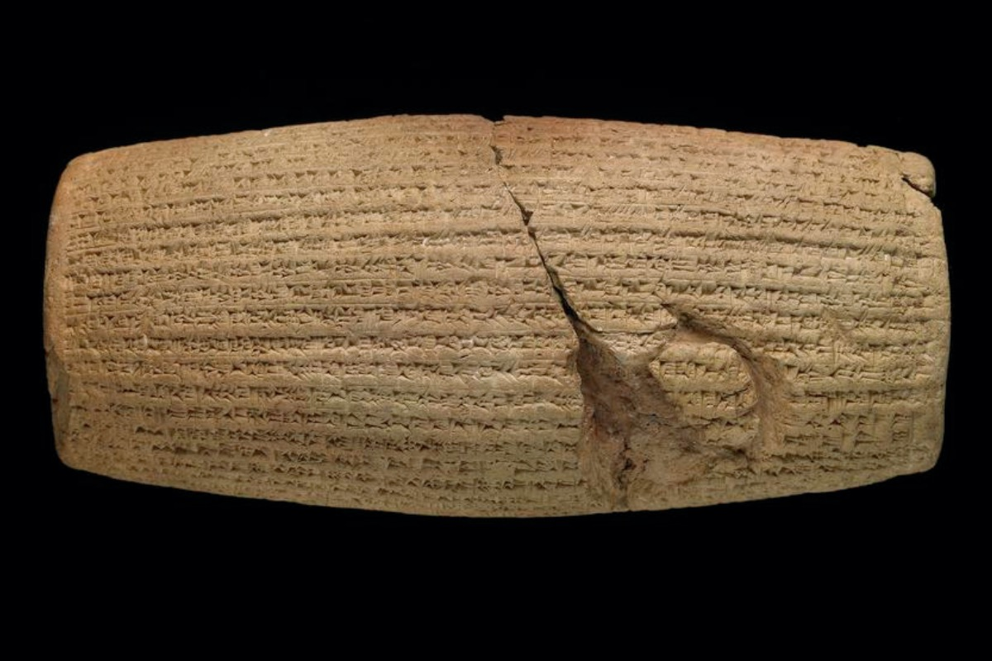

Policies of Cyrus the Great
Cyrus Cylinder
"I am Cyrus, king of the universe…"
"Nabonidus, the king who did not fear me…"
"Since the gods of foreign lands made permanent sanctuaries which are now dilapidated, I returned people to their lands and made provisions to rebuild"
Notes:
This small cylinder details the priorities of Cyrus the Great.

Slide 25
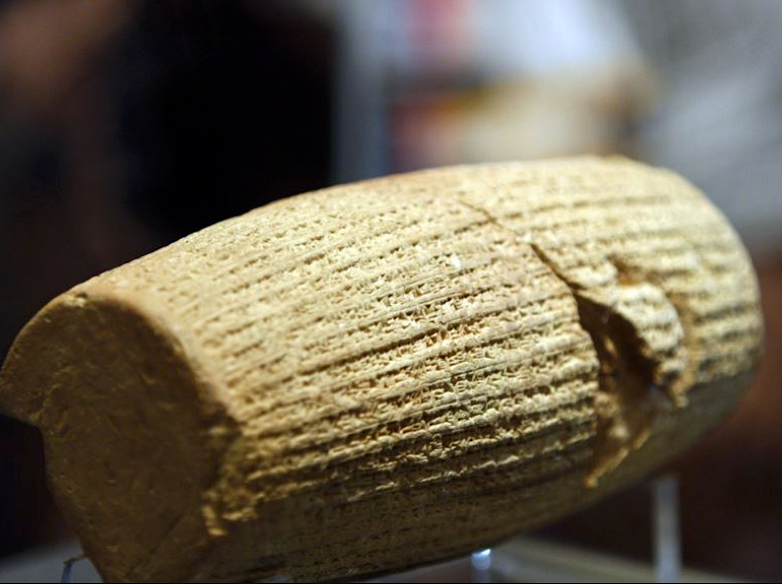
“Now that I put the crown of kingdom of Persia, Babylon, and the nations of the four directions on the head with the help of god I announce that I will respect the traditions, customs and religions of the nations of my empire and never let any of my governors and subordinates look down on or insult them until I am alive. From now on, till god grants me the kingdom favor, I will impose my monarchy on no nation. Each is free to accept it , and if any one of them rejects it, I never resolve on war to reign. Until I am the king of Persia, Babylon, and the nations of the four directions, I [will] never let anyone oppress any others, and if it occurs, I will take his or her right back and penalize the oppressor.”
“And until I am the monarch, I will never let anyone take possession of movable and landed properties of the others by force or without compensation. [While] I am alive, I [will] prevent unpaid, forced labor. Today, I announce that everyone is free to choose a religion. People are free to live in all regions and take up a job provided that they never violate other’s rights. No one [can] be penalized for his or her relatives’ faults. I prevent slavery and my governors and subordinates are obliged to prohibit exchanging men and women as slaves within their own ruling domains. Such traditions should be exterminated the world over. I implore to god to make me succeed in fulfilling my obligations to the nations of Persia, Babylon, and the ones of the four directions.”

Slide 26
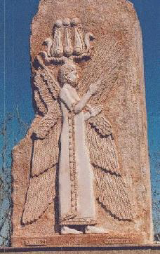
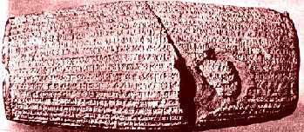
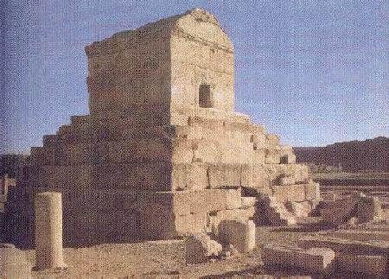
CYRUS II (559-530)

Slide 27

146
The boundaries of the empire that Cyrus II initiated
and Darius I consolidated stretched from Greece to India

Slide 28
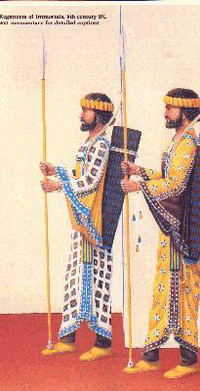

Slide 29
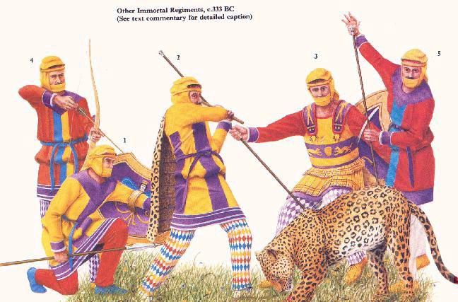
Immortal Regiments, c. 331 BC

Slide 30
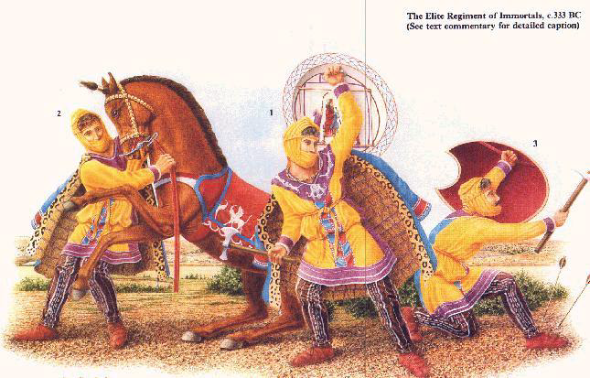
The Elite Regiment of Immortals, c. 333 BC

Slide 31
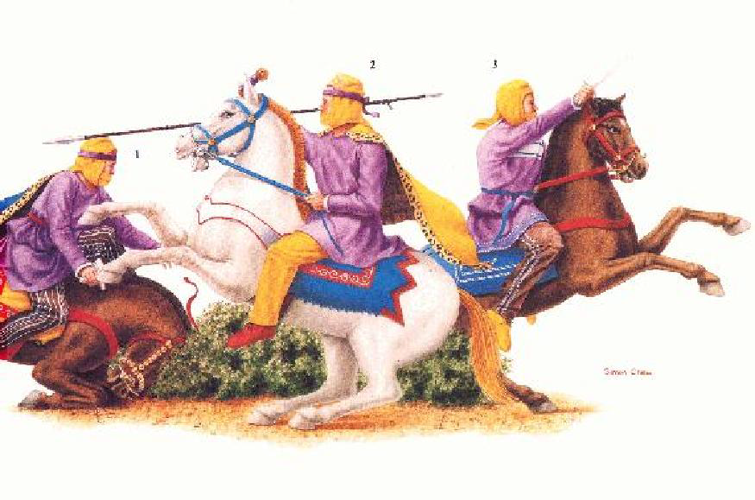
Persian National Cavalry at Issus c. 333 BC

Slide 32
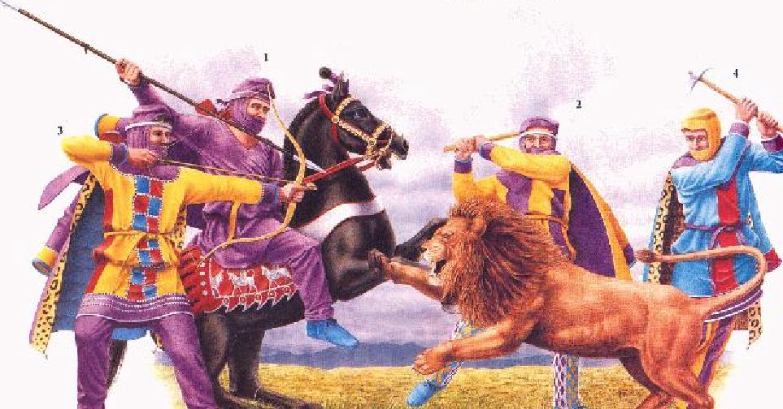
The Sidonian Army, c. 333 BC
1: King Abdalonymus
2: Sidonian Royal Spear Bearer
3: Sidonian Treasury Archer
4: Persian Commander
Notes:
Wikipediahttps://en.wikipedia.org › wiki › Abdalonymus
Abdalonymus was a Phoenician botanist and gardener of royal descent, who became King of Sidon under Alexander the Great in 332 BC. Abdalonymus.

Slide 33
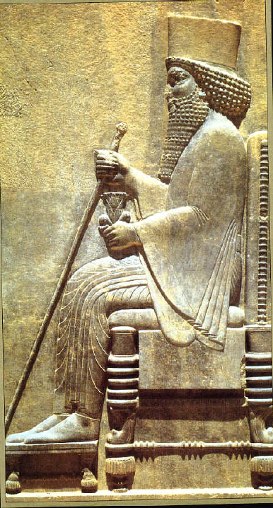
146
Darius
the Great
(521-486 BC)

Slide 34
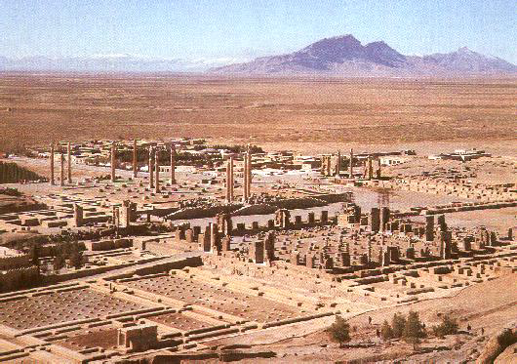
Remains of Persepolis

Slide 35
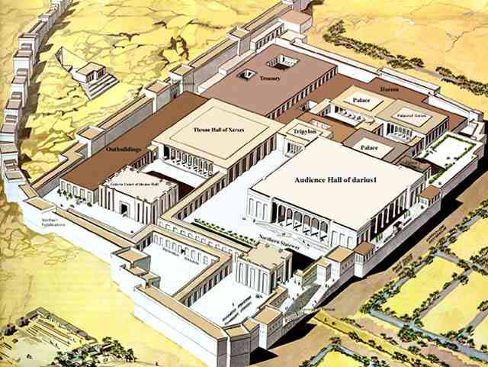

Slide 36
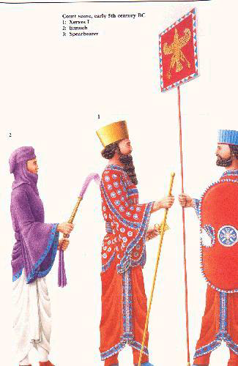
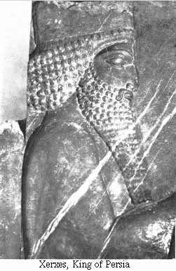
Xerxes of Persia

Slide 37
Language and Literature
148

Slide 38
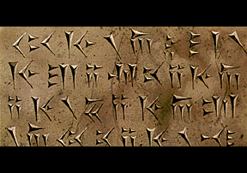
148
Cyrus Cylinder tells of two key events:
Victory over Babylon (Dan. 5:30-31)
Return Peoples to Homelands (Ezra 1:1-3)

Slide 39
Art and Architecture

Slide 40
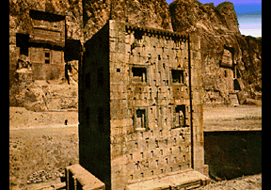
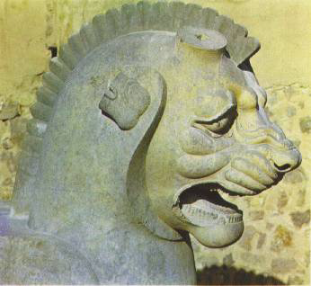
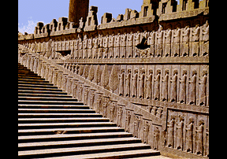
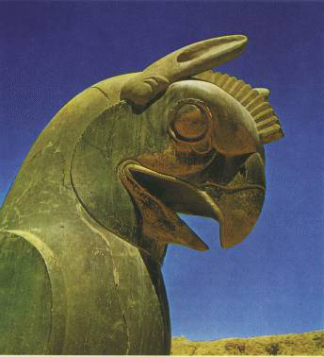

Slide 41
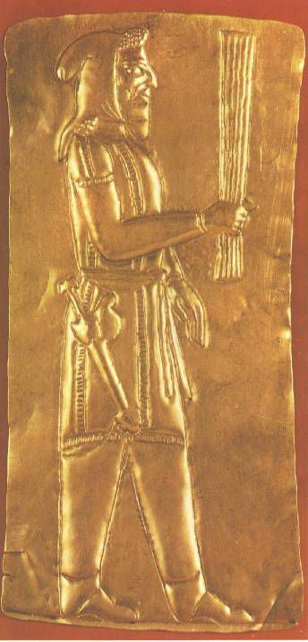
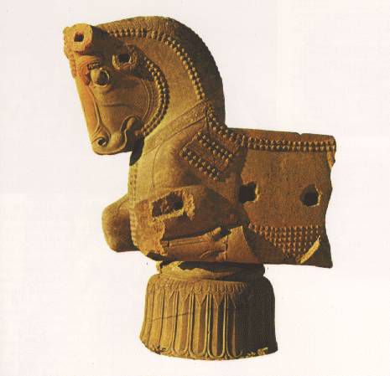
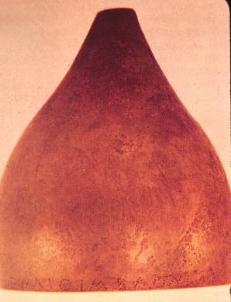
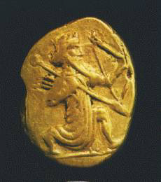

Slide 42
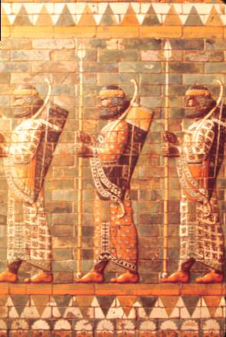
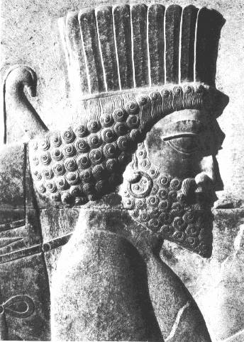
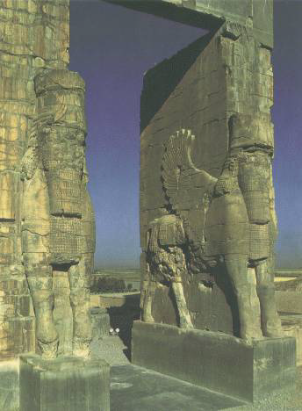
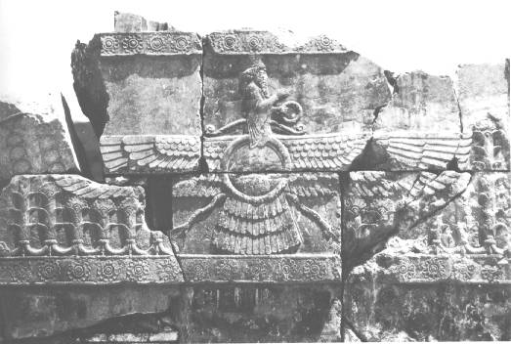

Slide 43
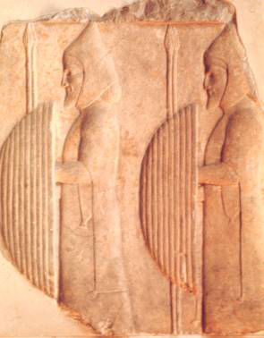
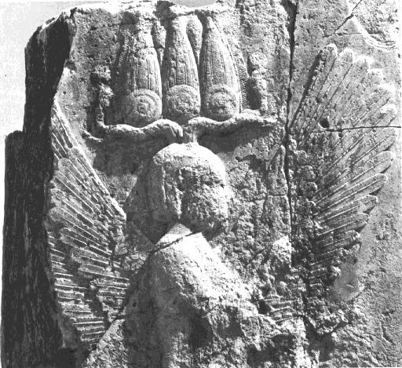
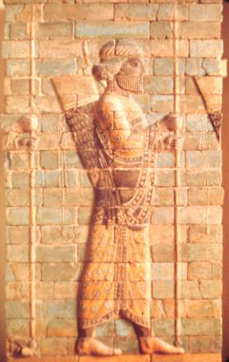
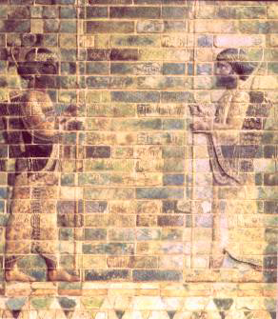
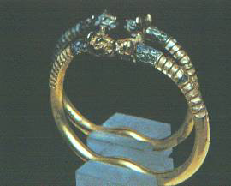

Slide 44
What the Bible Says About Persia

Slide 45
PERSIA. An empire which extended from India to Ethiopia, comprising one hundred and twenty-seven provinces, Esth. 1:1; Dan. 6:1. Government of, restricted by constitutional limitations, Esth. 8:8; Dan. 6:8-12. Municipal governments in, provided with dual governors, Neh. 3:9, 12, 16-18. The princes advisory in matters of administration, Dan. 6:1-7. Status of women in, queen sat on the throne with the king, Neh. 2:6. Vashti divorced for refusing to appear before the king's courtiers, Esth. 1:10-22; 2:4. Israel captive in, 2 Chr. 36:20; captivity foretold, Hos. 13:16. Men of, in the Tyrian army, Ezek. 27:10. Rulers of: Ahasuerus, Esth. 1:3. Darius, Dan. 5:31; 6; 9:1. Artaxerxes I, Ezra 4:7-24 . Artaxerxes II, Ezra 7; Neh. 2; 5:14. Cyrus, 2 Chr. 36:22, 23; Ezra 1; 3:7; 4:3; 5:13, 14, 17; 6:3; Isa. 41:2, 3; 44:28; 45:1-4, 13; 46:11; 48:14, 15. Princes of, Esth. 1:14. System of justice, Ezra 7:25. Prophecies concerning, Isa. 13: 17; 21:1-10; Jer. 49:34-39; 51:11-64; Ezek. 32:24, 25; 38:5; Dan. 2:31-45; 5:28; 7; 8; 11:1-4.

Slide 46
Persian Kings in Biblical History
149
Common Name
B.C. Date
Name In Persian
Name In Bible
Bible References
Cyrus
539-530
Koorush
Cyrus
Isaiah 45, Daniel, Ezra 1-3
Cambysses
530-521
Cambujieh
Ahasuerus
Ezra 4-6
Guamata
521
Berooyeh Doroughi
?
?
Darius the Great
521-486
Darryoosh
Darius
Ezra 5-6
Xerxes
486-465
Khashayarshah
Ahasuerus
Esther 1-10
Artaxerxes I
464-423
Ardeshier Deraz Dast
Artaxerxes
Nehemiah 1-13;
Ezra 4:7-23; 7-10

Slide 47
How Persians Affected Israel
150

Slide 48

Jewish life revolved around Solomon's temple for 400 years (959-586 BC)
How Persians Affected Israel
150

Slide 49
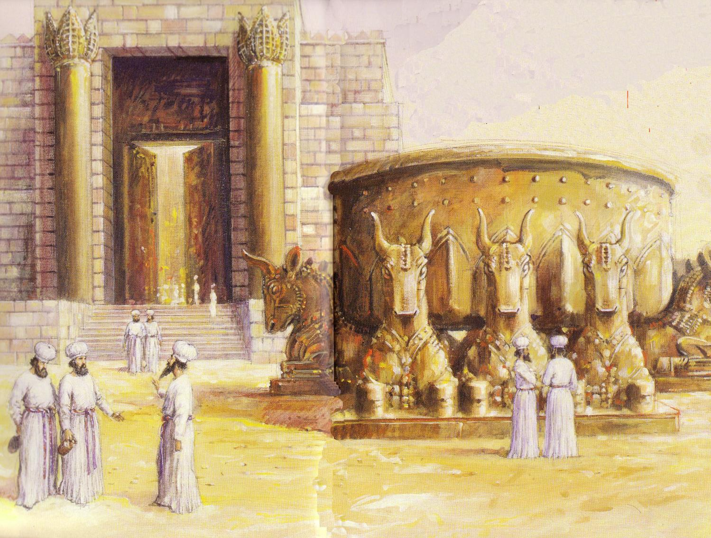
Jews Maintained Holiness at the Basin
How Persians Affected Israel
150
Temple Destroyed!

Slide 50
How Persians Affected Israel
150
In the first year of Cyrus king of Persia, in order to fulfill the word of the Lord spoken by Jeremiah, the Lord moved the heart of Cyrus king of Persia to make a proclamation throughout his realm and to put it in writing: "This is what Cyrus king of Persia says: 'The Lord, the God of heaven, has given me all the kingdoms of the earth and He has appointed me to build a Temple for Him at Jerusalem in Judah. Anyone of his people among you - may his God be with him, and let him go up to Jerusalem in Judah and build the Temple of the Lord, the God of Israel, the God who is in Jerusalem'" (Ezra 1:1-3).
Of all of the human empires that affected the people of Israel, the Persians did something rather unique - they permitted the return of the people of the southern kingdom of Judah, by God's command (see above verses), 70 years after their exile by the Babylonians under King Nebuchadnezzar.

Slide 51


The Postexilic Era
295
296
560
The Postexilic Era
Temple work
Prophets:
Haggai
Zechariah
Malachi
605
586
539
536
520
516
483-473
444-425
72 years
Others:
Zerubbabel
Esther
Ezra
Nehemiah
Persian Kings:
Cyrus
Darius
Xerxes
Artaxerxes
Notes:
The Post-Exilic Era involved three separate periods:
(1) Temple rebuilding led by Zerubbabel, Haggai, and Zechariah in two parts under Cyrus and Darius,
(2) The saving of the nation from destruction by Esther about 30 years later under Xerxes, and
(3) The restoration of Jerusalem’s walls and gates by Nehemiah another 72 years after that under Artaxerxes.
_________
Common-321
BE-37-Haggai-15
BE-39-Malachi-21
OB-13-Persians-45
OS-12-Kings & Prophets Charts-24
OS-15-Ezra-36
OS-16-Nehemiah-94, 156
OS-17-Esther-16, 75
OS-26-Ezek33-39—slide 85
OS-27-Daniel-340
OS-37-Haggai-25, 43
OS-38-Zechariah-46, 121
OS-39-Malachi-13, 56

Slide 52

سبيَيْن استغرق كلٌّ منهما ٧٠ سنة
560
سبي الشعب
605 ق.م.
586
539
536
516
سبي الهيكل
وَتَصِيرُ كُلُّ هَذِهِ ٱلْأَرْضِ خَرَابًا وَدَهَشًا، وَتَخْدِمُ هَذِهِ ٱلشُّعُوبُ مَلِكَ بَابِلَ سَبْعِينَ سَنَةً. وَيَكُونُ عِنْدَ تَمَامِ ٱلسَّبْعِينَ سَنَةً أَنِّي أُعَاقِبُ مَلِكَ بَابِلَ، وَتِلْكَ ٱلْأُمَّةَ، يَقُولُ ٱلرَّبُّ، عَلَى إِثْمِهِمْ وَأَرْضَ ٱلْكَلْدَانِيِّينَ، وَأَجْعَلُهَا خِرَبًا أَبَدِيَّةً.
(إرميا ٢٥: ١١-١٢)
Notes:
في عام 539 ق. م. في أثناء حُكْمِ داريوس، قرأ دانيال الكلام الوارد في إرميا 25: 11-12 الذي حدَّد فترة السبي بـِ 70 سنةً (605-536 ق.م.)، أو بكلماتٍ أُخرى، بعْدَ ثلاث سنواتٍ فقط (دانيال 9: 1-2). ولكن توجد طريقةٌ أُخرى للنظر إلى السبعين عامًا وهي أنَّ الهيكل كان في حالة خرابٍ من عام 586 ق. م. حتَّى 516 ق. م. وهي السنة التي اكتمل فيها بناءُ الهيكل الثاني.
لا يخبرنا إرميا بالتحديد عن السنة التي بدأ بها السبي (الذي دام 70 عامًا) والسنة التي انتهى بها.
ولكن يمكننا في الواقع تحديد ذلك بطريقتين- إمَّا أنَّه كان يقصد أنَّ سبي الشعب بدأ من سبي دانيال (605 ق. م.) إلى سنة عودة الشعب كلِّه (في عام 536 ق. م.)، وإمَّا أنَّ المقصود هو سبي الهيكل من سنة تدميره في 586 ق. م. إلى سنة إعادة بنائه في 516 ق. م.
In 539 BC under the rule of Darius, Daniel read Jeremiah 25:11-12 that limited the exile to 70 years (605-536 BC), or only three years away (9:1-2). But another way to see the 70 years is that the temple lay in ruins from 586 until 516 when the second temple was completed.
Jeremiah does not tell us the exact years that begin and end the 70-year exile.
But we can actually determine this in two ways—either the exile of the people beginning with Daniel’s deportation (605) to the people fully returning in 536, or the exile of the temple from its destruction in 586 to its rebuilding in 516.
_____________________
Common-320
BE-27-Daniel-89
ES-26-Restoration of Israel-186
OB-13-Persians-46
OS-00-OT Book Overviews-294, 755
OS-12-Kings & Prophets Charts-26
OS-12-2Kings-231
OS-14-2Chron-287
OS-15-Ezra-14
OS-Esther
OS-24-Jeremiah-53, 141
OS-27-Daniel-94, 284, 340, 361
OS-37-Haggai-9, 32
OS-Zechariah-15

Slide 53
How Persians Affected Israel
"I am Cyrus, who founded the Persian empire. Grudge me not therefore, this little earth that covers my body."

Slide 54
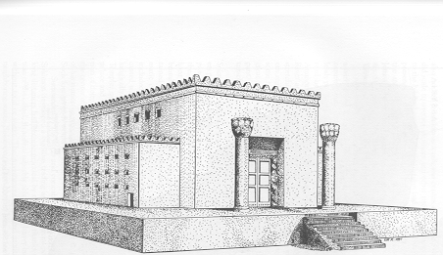
How Persians Affected Israel
150
Restoration of Temple Worship
Law of Moses Reestablished
Economic and Spiritual Life Revived
Rise of the Temple State
2nd Temple - Zerubbabel

Slide 55
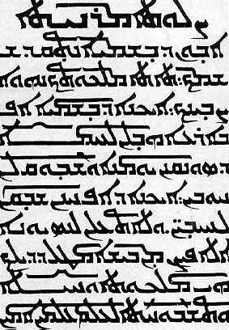
How Persians Affected Israel
151
Aramaic was the language of the Semitic culture, the language of the Hebrew Patriarchs, and under the Persians, the lingua franca of the Fertile Crescent.
The Lord's Prayer in Aramaic

Slide 56
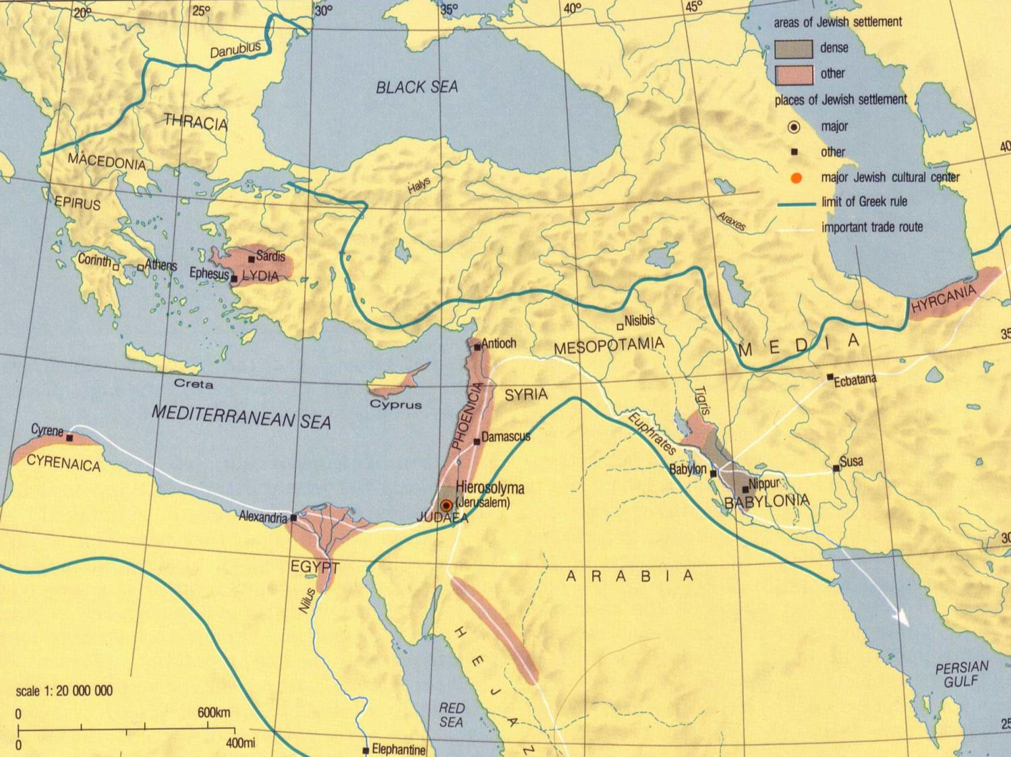
How Persians Affected Israel
151
Jewish Diaspora (300 BC)
Nicholas de Lange, Atlas of the Jewish World, 23

Slide 57
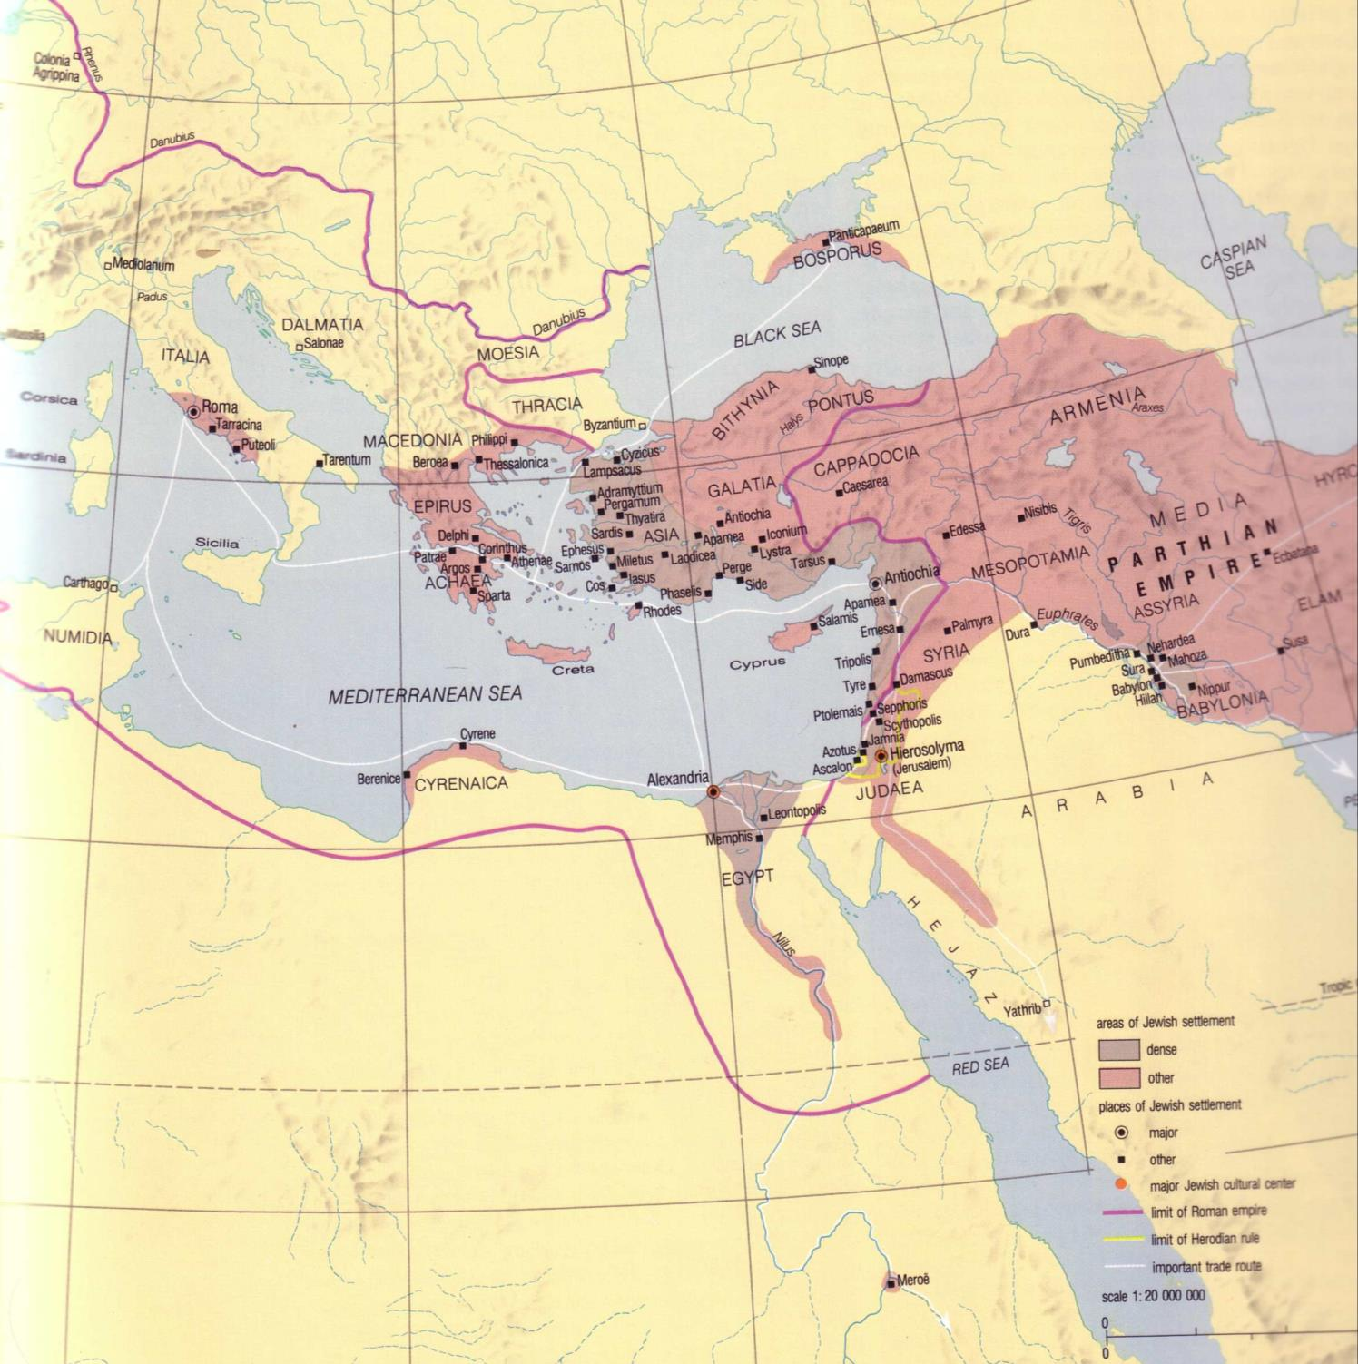
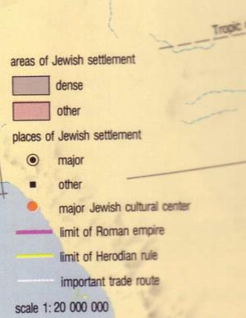
How Persians Affected Israel
151
World Population: 170 million
Jewish Population: 8 million
1
1
1
2
1
Jewish Diaspora (300 BC)
Nicholas de Lange, Atlas of the Jewish World, 25

Slide 58

How Persians Affected Israel
151

Slide 59

151
When orphaned at a young age, Esther was raised by her older cousin, Mordecai, who worked in the household of the Persian king (Esther 2:5-7). They apparently did not make use of the permission granted by Cyrus for the exiles to return to Jerusalem (approximate dates):
536 BC - the return from Babylon to Jerusalem
536-516 BC - the rebuilding of the Temple
478 BC - Esther became queen of Persia
473 BC - Esther saved the Jews from massacre
457 BC - Ezra went from Babylon to Jerusalem
444 BC - Nehemiah rebuilt the wall of Jerusalem

Slide 60
151
After the king divorced Vashti, Esther was chosen to be his wife. There has long been speculation why Queen Vashti refused to appear before the people at the great banquet (Esther 1:10-12), which triggered the divorce (Esther 1:19). While it may be that she simply had enough of a banquet that had turned into a 7-day binge (Esther 1:10), others believe that the correct translation of her refusal "to appear wearing her royal crown" is "to appear wearing only her royal crown." This theory would seem to be supported by the statements that the king was very drunk (Esther 1:10) when he made the demand to "display the queen's beauty to all the people" (Esther 1:11). If that is what happened, it would seem that the king was little more than a common fool - a condition that The Lord capitalized on to move Esther into position to fulfill her mission.

Slide 61
151
After the king divorced Vashti, Esther was chosen to be his wife. There has long been speculation why Queen Vashti refused to appear before the people at the great banquet (Esther 1:10-12), which triggered the divorce (Esther 1:19). While it may be that she simply had enough of a banquet that had turned into a 7-day binge (Esther 1:10), others believe that the correct translation of her refusal "to appear wearing her royal crown" is "to appear wearing only her royal crown.

Slide 62
151
After the king divorced Vashti, Esther was chosen to be his wife. There has long been speculation why Queen Vashti refused to appear before the people at the great banquet (Esther 1:10-12), which triggered the divorce (Esther 1:19). While it may be that she simply had enough of a banquet that had turned into a 7-day binge (Esther 1:10), others believe that the correct translation of her refusal "to appear wearing her royal crown" is "to appear wearing only her royal crown." This theory would seem to be supported by the statements that the king was very drunk (Esther 1:10) when he made the demand to "display the queen's beauty to all the people” (Esther 1:11). If that is what happened, it would seem that the king was little more than a common fool—a condition that the Lord capitalized on to move Esther into position to fulfill her mission.

Slide 63

Esther 5:1-2
Now it came about on the third day that Esther put on her royal robes and stood in the inner court of the king's palace in front of the king's rooms, and the king was sitting on his royal throne in the throne room, opposite the entrance to the palace.
² When the king saw Esther the queen standing in the court, she obtained favor in his sight; and the king extended to Esther the golden scepter which was in his hand. So Esther came near and touched the top of the scepter.

Slide 64

Esther and Mordecai
Esther and Mordecai 1685 Oil on canvas, 93 x 148.5 cm Museum of Fine Arts, Budapest
GELDER, Aert de
Dutch painter (1645-1727)
Notes:
http://gallery.euroweb.hu/art/g/gelder/esther.jpg

Slide 65

Esther Risked Her Life for the Jews

Slide 66

Key Verse
(Mordecai to Esther)
"For if you remain silent at this time, relief & deliverance for the Jews will arise from another place, but you & your father's family will perish. And who knows but that you have come to royal position for such a time as this?"
(Esther 4:14).

Slide 67

"..for such a time as this"

Slide 68

"..for such a time as this"

Slide 69

“That vile Haman…”

Slide 70

What Lessons Can We Learn from Studying Persia?
A Small Group Exercise…
152

Slide 71
A Review of Our Study of Ancient Peoples the Past Few Weeks…

Slide 72







What Empires and What Order?
Greek
Babylonian
Assyrian
Medo-Persian
Roman

Slide 73

Assyrian Developments
Fall of Samaria
Rise of Samaritans

Slide 74

Babylonian Rule over Israel
56
Deportations
Developments
Separation
Synagogue
No more idolatry

Slide 75



The Persian Era
57, 59
Returns
Developments
Temple
People
Walls

Slide 76






Intertestamental Empires
52

Slide 77
Black

Slide 78


OT Backgrounds link at BibleStudyDownloads.org
Get this presentation for free!
Notes:
NT Survey (ns)

